Slide 1


Automated Parts Counting Solutions
for Non- Serialized Parts
with 9 Customer Examples
© 2019, SPEDE Technologies. 440-808-8888 www.spede2020.com
Simplifying Processes... Standardizing Excellence.®

Slide 2
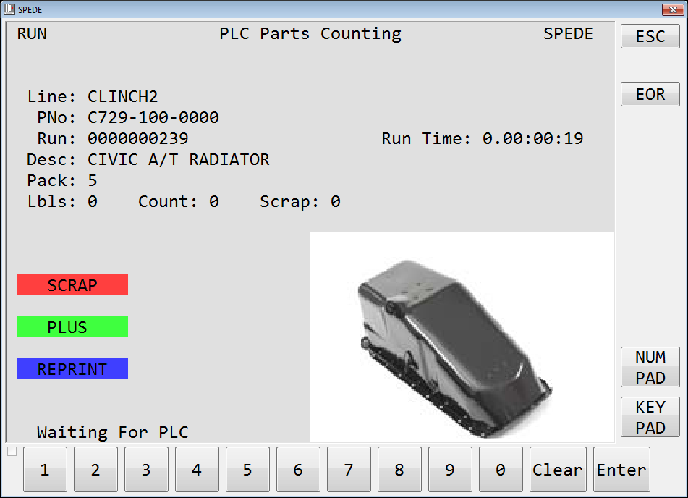
Automated Solutions for Counting Non-Serialized Parts
3 Reasons to Automate Parts Counting
  1. Accuracy
  Accurate Part counts
  Accurate Pack Counts and Container Labeling
  Accurate Production reporting
  2. Efficiency
  No labor and expense for manual counting
  No data entry or recordkeeping
  Real-time production run data displays at line-side
  Automatic updates to host systems
  3. Traceability
  Automatic traceability from Production back to Raw
  Automatic traceability forward to Customer
  Enables focused inquiries by part, run date, lot, etc.
© 2019, SPEDE Technologies. 440-808-8888 www.spede2020.com
Simplifying Processes... Standardizing Excellence.®
2

Slide 3

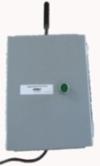

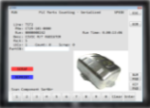


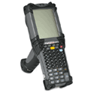

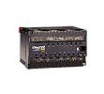
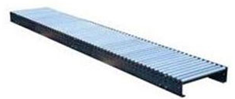
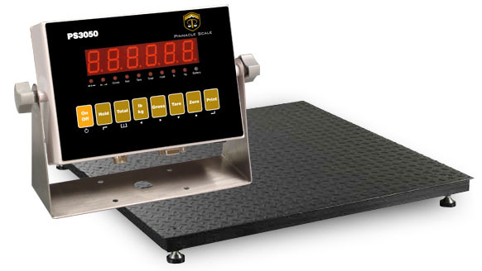

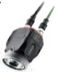
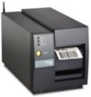


Overview of SPEDE and your Host Systems
Automated Solutions for Counting Non-Serialized Parts
Production Area
IT Area
Handheld
or fixed
Scanner
SPEDE Application Server
Host Computer
Production Machine PLC
SPEDE PLC
Part Nbr and EDI Data
TouchScreen PC
Part Nbr and EDI Data
Printed Label Data
Conveyor
Production, Part, Label data
Label DB
Your Shipping & Scanning
Apps
SQL
DB
Vision Sensor
Weigh Scale
Imaging Camera
Label Printer
SPEDE Apps Interface to and Control Production Area Devices
  PLC, Touchscreen PC, Handheld Scanner, Vision Sensor, Scale, Printer, Imaging Camera
  Prints Labels + Collects OEE Data
  Gets label data from host ERP, EDI, Release Accounting
  Time-stamps & logs printed label data, piece count, scrap & cycles data into SQL DB
  Printed Label Data is available to Host systems for Parts Traceability, OEE analysis, Shipping, etc.
© 2019, SPEDE Technologies. 440-808-8888 www.spede.com
Simplifying Processes... Standardizing Excellence.®
4

Slide 4
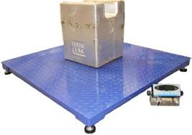
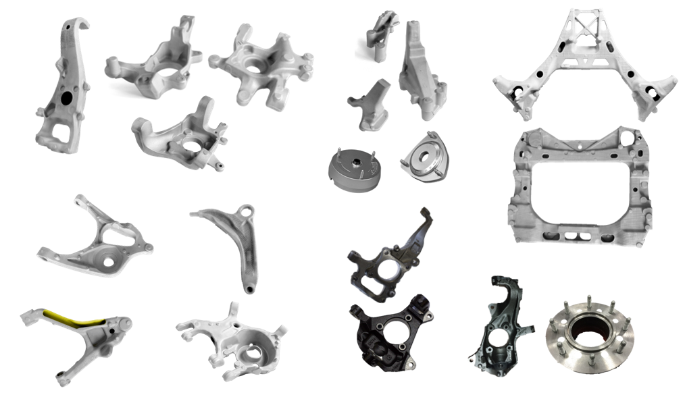

Non-Serialized Counting: Example 1
Automated Solutions for Counting Non-Serialized Parts
Parts Are Counted by Weigh Scale
Scale connected via RS-232 or TCP/IP
Part level piece weight, layer count, total pieces
SPEDE provided Tare Button on touch screen
Tare between layers if inter-layer dunnage
+/- percentage variance
Removing parts from scale decreases count
Weights recorded in SPEDE
Customers:
Nissin - brake pad
TGMO - map pocket
Busche – suspension knuckle
Interface to Weigh Scale ensures
Packed Quantity is correct
© 2019, SPEDE Technologies. 440-808-8888 www.spede.com
Simplifying Processes... Standardizing Excellence.®
5

Slide 5
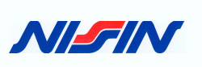
Automated Solutions for Counting Non-Serialized Parts
Non-Serialized Counting: Example 2
Parts Are Counted by Weigh Scale + Vision Verification
Scale connected via RS-232 or TCP/IP
Part level piece weight, layer count, total pieces
SPEDE provided Tare Button on touch screen
Tare between layers if inter layer dunnage
+/- percentage variance
Keyence Vision Sensor controlled by SPEDE
Part must pass vision then weight
Removing parts from scale decreases count
Customer:
Nissin Brake - engine mount bracket, aluminum castings
© 2019, SPEDE Technologies. 440-808-8888 www.spede.com
Simplifying Processes... Standardizing Excellence.®
6

Slide 6
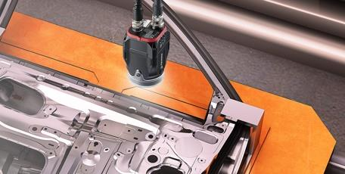
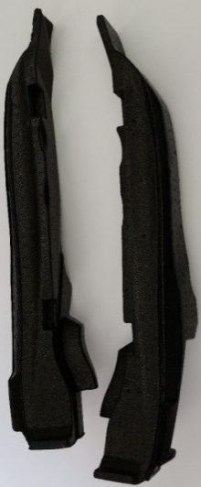

Automated Solutions for Counting Non-Serialized Parts
Non-Serialized Counting: Example 3
Parts Are Counted by Vision only
Keyence Vision Sensor controlled by SPEDE
1 to 4 Sensors per line
Sensors can be ganged together
Logical AND, all sensors must pass
Logical OR, any sensor can pass
Triggered by external object sensor
Only “good part” increments count
Onscreen minus, can be supervisor only
Customers:
Sonoco OH and TN – EPS/EPE bumper filler, door filler
TMD vision only – 4 vision sensors for Honda service
© 2019, SPEDE Technologies. 440-808-8888 www.spede.com
Simplifying Processes... Standardizing Excellence.®
7

Slide 7
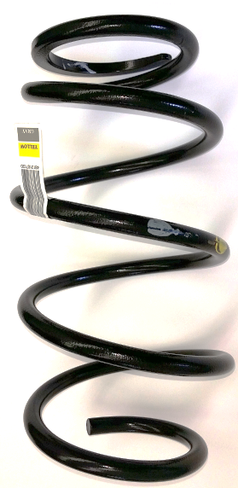

Automated Solutions for Counting Non-Serialized Parts
Non-Serialized Counting: Example 4
Parts Counting with Vision + Conveyor Controls
SPEDE provided PLC controls/panel box
Dry contact to start/stop/reset conveyor
SPEDE touchscreen conveyor controls for start/stop/reset
Keyence Vision Sensor (1 to 4)
Vision fail = bad part
Dry contact for pneumatic diverter for good/bad parts
Good parts diverted by pack count
Multiple pack out trays, printer per pack out tray
Customer:
NASCO Conveyor – Non Honda coil suspension springs
© 2019, SPEDE Technologies. 440-808-8888 www.spede.com
Simplifying Processes... Standardizing Excellence.®
8

Slide 8
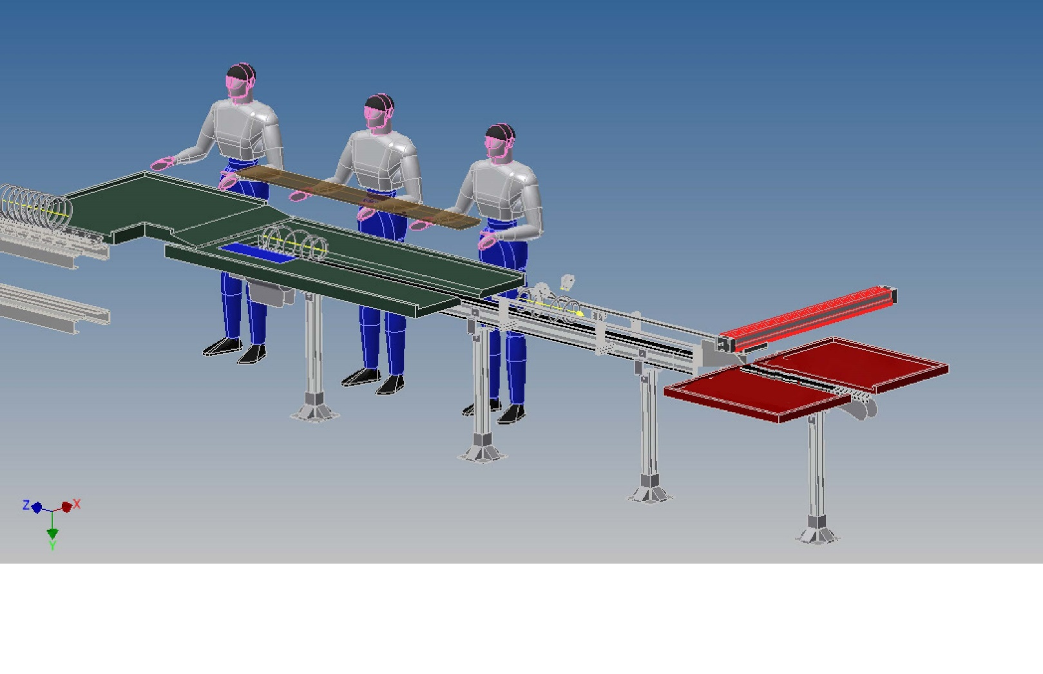



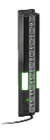

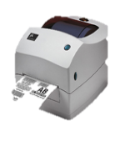



Vision Sensors on a conveyor
can validate, count, & route parts
WiFi
SPEDE Application
Server
SQL
DB
Updating SQL DB ----→
SPEDE
Vision App
SPEDE
Parts Counting
App
V2
V3
Parts Counting OK + 1
L3
L3
L1
Zebra
Printer
V1
L2
Controls L1, L2, L3
V1, V2, V3
Good
SPEDE PLC Control Panel
L1, L2, L3 = Light Curtain Sensors
V1, V2, V3 = Keyence Vision Sensors
Scrap
Click to start animation

Slide 9
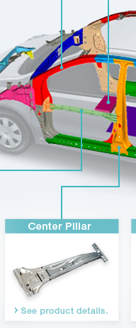

Automated Solutions for Counting Non-Serialized Parts
Non-Serialized Counting: Example 5
Parts Counting by discrete I/O from Production Machine PLC
to SPEDE PLC
SPEDE provided PLC controls/panel box
Dry contact input to SPEDE PLC
+/- contact for increment/decrement
Optional binary contacts for part number determination
Onscreen +/- count adjustments, can be supervisor only
Customer:
Topre - Center pillar and L/R threshold
© 2019, SPEDE Technologies. 440-808-8888 www.spede.com
Simplifying Processes... Standardizing Excellence.®
10

Slide 10
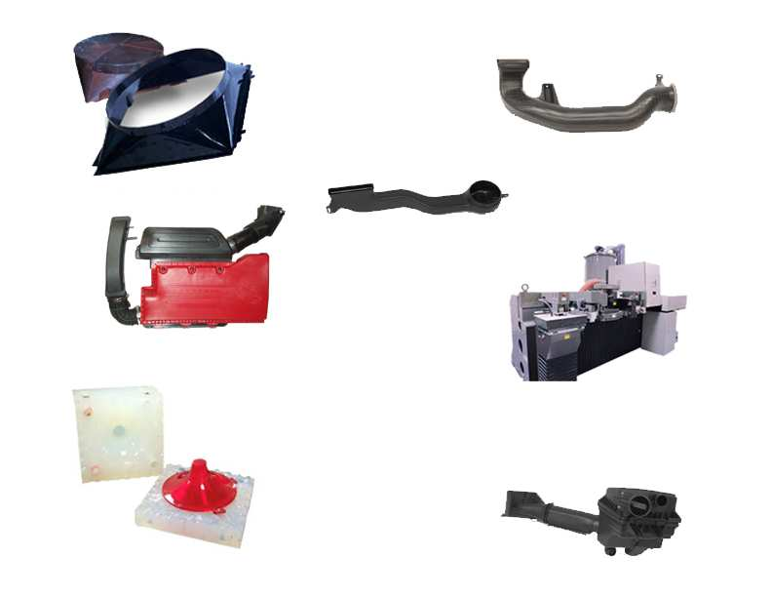

Automated Solutions for Counting Non-Serialized Parts
Non-Serialized Counting: Example 6
Simple PLC Count
Dedicated Poka Yoke per part number
SPEDE reads “COUNT”
Optional onscreen Plus/Minus/Scrap button
Customer:
TMD Fayetteville – HVAC duct, dedicated part poka yoke
© 2019, SPEDE Technologies. 440-808-8888 www.spede.com
Simplifying Processes... Standardizing Excellence.®
11

Slide 11
Automated Solutions for Counting Non-Serialized Parts
Non-Serialized Counting: Example 7
Simple PLC Count with Part Validation
SPEDE reads machine “cycle counter” address
Reads “PLC Part Number” address
Compares PLC part number to current, error if incorrect
On counter “change” piece count increment +1
Optional onscreen Plus/Minus/Scrap button
Customer:
TMD Jefferson - HVAC duct components
© 2019, SPEDE Technologies. 440-808-8888 www.spede.com
Simplifying Processes... Standardizing Excellence.®
12

Slide 12
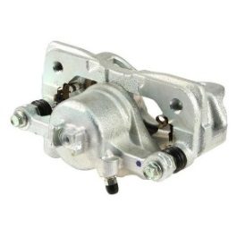
Automated Solutions for Counting Non-Serialized Parts
Non-Serialized Counting: Example 8
Simple PLC Count with Part Validation with Heart Beat
SPEDE writes to Heartbeat address every 500 msecs, PLC verifies and clears
Reads machine “cycle counter” address
Reads “PLC Part Number” address
Compares PLC part number to current, error if incorrect
On counter “change” piece count increment +1
Optional onscreen Plus/Minus/Scrap button
Customer:
Nissin Brake OH – Caliper Lines
© 2019, SPEDE Technologies. 440-808-8888 www.spede.com
Simplifying Processes... Standardizing Excellence.®
13

Slide 13
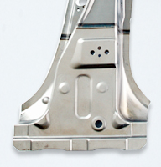
Automated Solutions for Counting Non-Serialized Parts
Non-Serialized Counting: Example 9
PLC-Generated Count with Part Validation
SPEDE reads machine “piece counter” address
Reads “PLC Part Number” address
Compares PLC part number to current, error if incorrect
Matches PLC piece counter
Optional onscreen Plus/Minus/Scrap button
Customer:
Topre 2500A Press
© 2019, SPEDE Technologies. 440-808-8888 www.spede.com
Simplifying Processes... Standardizing Excellence.®
14

Slide 14














Automated Solutions for Counting Non-Serialized Parts
Meet a Few SPEDE Customers...
© 2019, SPEDE Technologies. 440-808-8888 www.SPEDE.com
Simplifying Processes... Standardizing Excellence.®
15

Slide 15

To Discuss Your Line-side Project...
Call or Email ...
Bob Bunsey
440-808-8888 x22
info@spede.com
www.spede.com
About Us:
We are a software and systems integration company founded in 1980 as Computer Software Corporation, specializing in technology solutions for automotive suppliers and manufacturers . Our focus is automating production area processes to prevent errors, increase efficiency and provide real-time 20/20 visibility of shop floor operations.
The name SPEDE (pronounced speedy) is an acronym for Standard Platform for Electronic Data Entry. We assumed this d/b/a in 1994
to reflect the wide range of new and legacy technologies that we can integrate to form a single real-time communications platform on the
plant floor.
Our Customers are mid-size to Fortune 500 companies with multiple plant sites throughout the U.S. and in Mexico. They rely on SPEDE Automated Line-side Solutions to keep their mission-critical processes running smoothly, 24/7.
Active Member of AIAG for 20+ years
© 2019, SPEDE Technologies. 440-808-8888 www.spede.com
SPEDE Technologies 24930 Detroit Rd, Suites D & E Cleveland, OH 44145
Simplifying Processes... Standardizing Excellence.®
16

