Slide 1


Automated Parts Counting Solutions
for Serialized Parts
with 6 Customer Examples
© 2019 SPEDE Technologies. 440-808-8888 www.SPEDE.com
Simplifying Processes... Standardizing Excellence.®

Slide 2
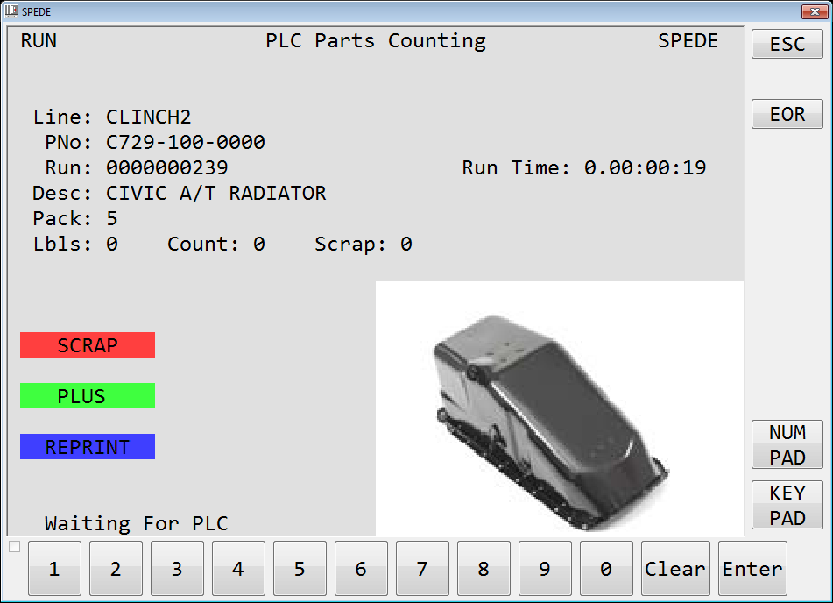
SPEDE Serialized Parts Counting Solutions
3 Reasons to Automate Parts Counting
  1. Accuracy
  Accurate Part counts
  Accurate Pack Counts and Container Labeling
  Accurate Production reporting
  2. Efficiency
  No labor and expense for manual counting
  No data entry or recordkeeping
  Real-time production run data displayed at lineside
  Automatic updates to host systems
  3. Traceability
  Automatic traceability of parts from Production back to Raw components
  Automatic traceability of finished parts forward to Customer shipment
  Enables focused inquiries, recalls, QC holds, by part, run date, lot, etc.
© 2019 SPEDE Technologies. 440-808-8888 www.SPEDE.com
Simplifying Processes... Standardizing Excellence.®
2

Slide 3

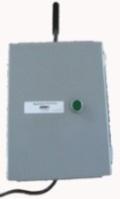


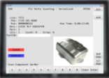
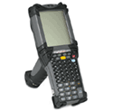


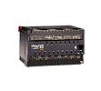

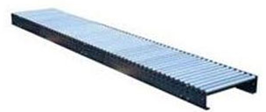
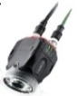
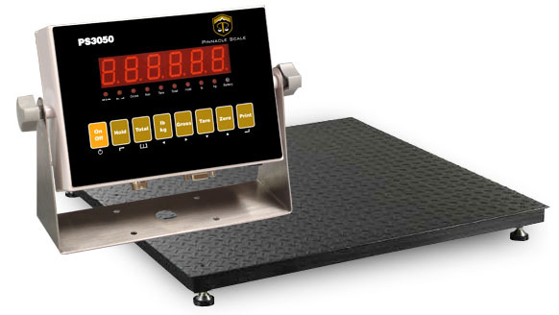


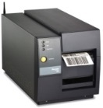

Overview of SPEDE Solution Interfaces
SPEDE Serialized Parts Counting Solutions
Production Area
b
IT Area
Handheld
or fixed
Scanner
Production Machine PLC
Host Computer
SPEDE PLC
TouchScreen PC
Part Nbr and EDI Data
Part Nbr and EDI Data
Printed Label Data
Production, Part, Label data
SPEDE Application Server
Conveyor
Label DB
Your Shipping & Scanning
Applications
SQL
DB
Vision Sensor
Weigh Scale
Imaging Camera
Label Printer
SPEDE Software resides on SQL Server, with access by Client PCs, Handhelds, PLCs, etc.
SPEDE Apps interface to and control networked devices
Collects / Displays Real-time PLC Production Data
    Time-stamps & Logs Piece Count, Scrap & Cycles data into MS/SQL DB for Traceability, OEE
4. Prints Labels; Logs Printed Label Data for Inventory, Shipping, Traceability
  Gets label data from host ERP, EDI, Release Accounting system
  Time-stamps and logs the printed label data into MS/SQL DB; updates to host systems
© 2019 SPEDE Technologies. 440-808-8888 www.SPEDE.com
Simplifying Processes... Standardizing Excellence.®
3

Slide 4
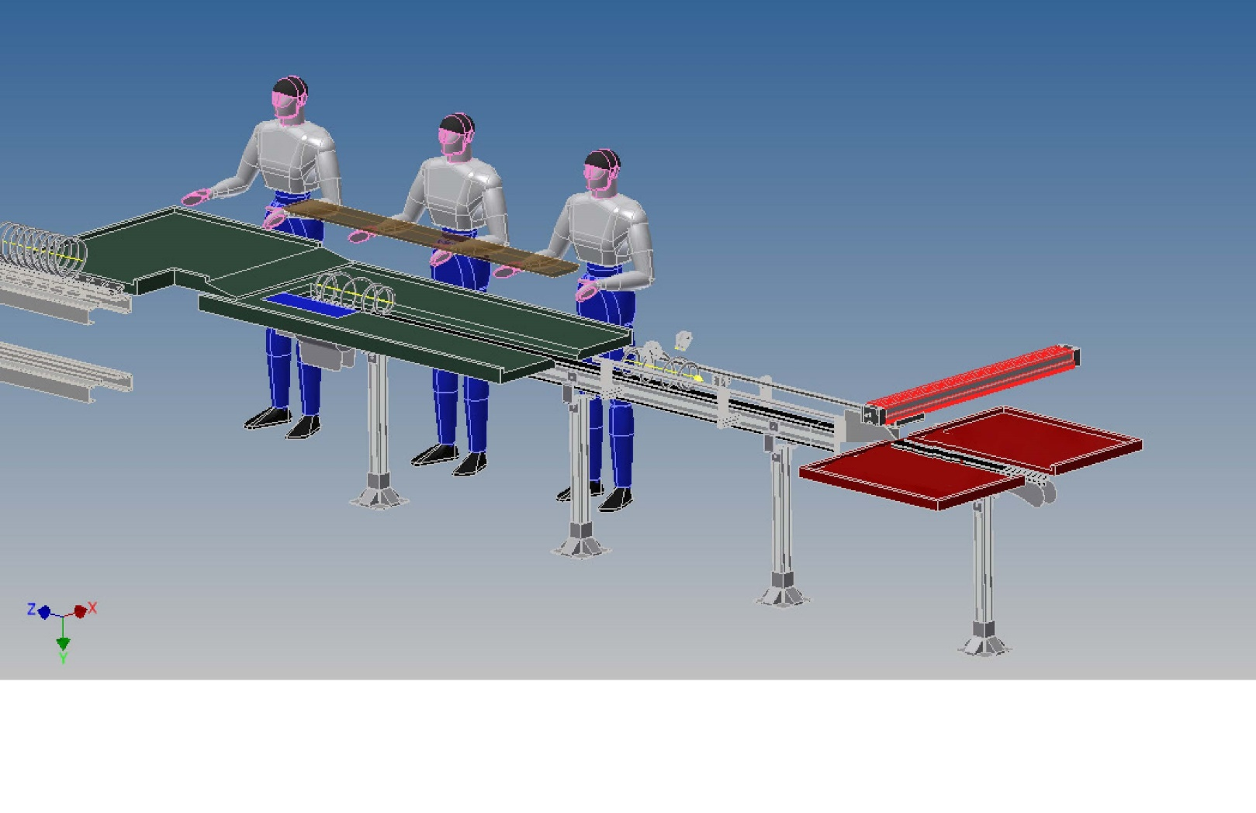



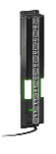

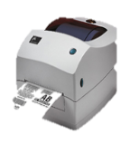



Vision Sensors on a conveyor
can validate, count, & route parts
WiFi
SPEDE Application
Server
SQL
DB
Updating SQL DB ----→
SPEDE
Vision App
SPEDE
Parts Counting
App
V2
V3
Parts Counting OK + 1
L3
L3
L1
Zebra
Printer
V1
L2
Controls L1, L2, L3
V1, V2, V3
Good
SPEDE PLC Control Panel
L1, L2, L3 = Light Curtain Sensors
V1, V2, V3 = Keyence Vision Sensors
Scrap
Click to start animation

Slide 5


Serialized Parts Counting: Customer Example 1
SPEDE Serialized Parts Counting Solutions
Serialized Part from PLC with Part Validation
SPEDE reads “Part Serial Number” address from PLC
SPEDE reads “PLC Part Number” address
SPEDE compares PLC Part Number to Current Part; “Error” if incorrect
SPEDE checks for duplicate and/or re-use of serial number with Reject
Increments Piece Count for each valid serial number
Customer:
Autoliv-Nissin
HVAC duct
Dedicated part poke yoke
© 2019 SPEDE Technologies. 440-808-8888 www.SPEDE.com
Simplifying Processes... Standardizing Excellence.®
5

Slide 6




SPEDE Serialized Parts Counting Solutions
Serialized Parts Counting: Customer Example 2
Serialized Part from Fixed/ Handheld Scanner
2D code contains Part Number / identifier, unique serial number
(YYMMDDHHMMSS)
Operator scans Piece barcode
SPEDE “finds” Part Number ; compares it to Current Part; “Error” if incorrect
SPEDE checks for duplicate and/or re-use of serial number with Reject
Increments Piece Count for each valid serial number
Scan twice to remove Part
Customers:
Nisco Door/ Trunk Seal
TMD, Tiffin Washer Bottle Assembly
Toyoda Gosei, MO Front Grill Components,
Center Console Assembly
© 2019 SPEDE Technologies. 440-808-8888 www.SPEDE.com
Simplifying Processes... Standardizing Excellence.®
6

Slide 7
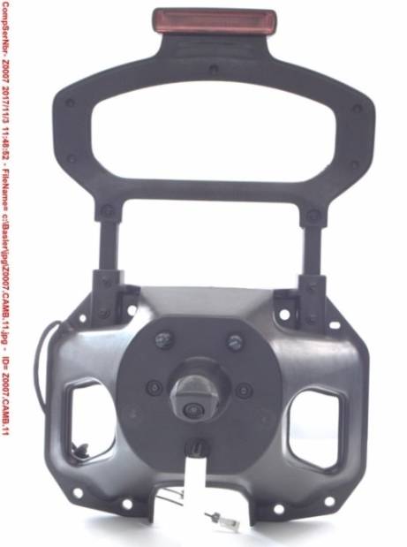
Serialized Parts Counting: Customer Example 3
SPEDE Serialized Parts Counting Solutions
Serialized Part plus Camera Snapshot
SPEDE gets Serial Number from handheld/inline/PLC input
Hi Res 4K Cameras do snapshot
SPEDE controls camera
Image stored in SQL and/or external JPEG by Part Serial Number
Serial number, date/time, file name watermark
SPEDE Web inquiry
Multiple cameras can be triggered simultaneously
Can be Full Container photo by Container Serial Number
with 1 or more layers
Tire Carrier image captured into SPEDE SQL Database
Customer:
TMD, Tiffin Tire Carriers
© 2019 SPEDE Technologies. 440-808-8888 www.SPEDE.com
Simplifying Processes... Standardizing Excellence.®
7

Slide 8
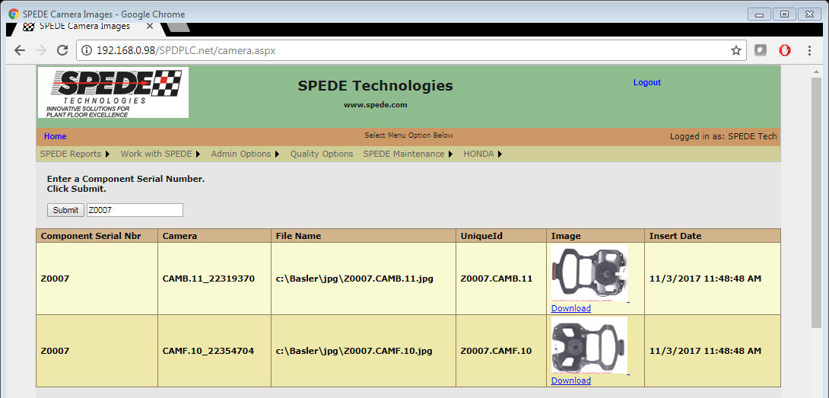
Serialized Parts Counting: Customer Example 3a
SPEDE Serialized Parts Counting Solutions
Serialized Part plus Camera Snapshot
TMD Tiffin Image of Tire Carrier captured into SPEDE SQL DB Website
© 2019 SPEDE Technologies. 440-808-8888 www.SPEDE.com
Simplifying Processes... Standardizing Excellence.®
8

Slide 9

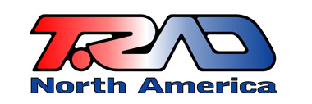
SPEDE Serialized Parts Counting Solutions
Serialized Parts Counting: Customer Example 4
SPEDE-generated Part Serial Number plus Part Label
PLC/ Onscreen Pushbutton input when new part
SPEDE generates Serial Number based upon requirements
SPEDE generates part label
Count is incremented after Label Print or Scan
Count is incremented by new Serial Number
Scan twice to Remove Part
Customer:
T-Rad - Radiators
© 2019 SPEDE Technologies. 440-808-8888 www.SPEDE.com
Simplifying Processes... Standardizing Excellence.®
9

Slide 10
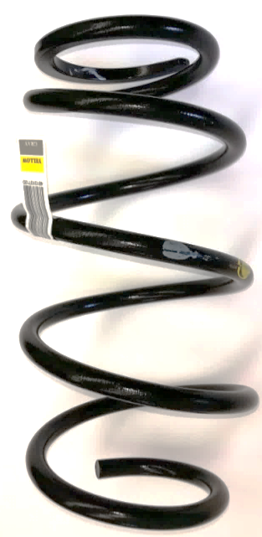

Serialized Parts Counting: Customer Example 5
SPEDE Serialized Parts Counting Solutions
Serialized Parts + Vision + Conveyor Control
A SPEDE-provided PLC controls panel box
Dry contact to start/stop/reset conveyor
SPEDE touchscreen conveyor controls for start/stop/reset
Keyence 2D barcode reader
Keyence Vision Sensor (up to 4 sensors to expand view field)
Bad part when Vision fail, no read on serial number, or
duplicate/re-used serial number
Dry contact for pneumatic diverter for good/bad parts
Good parts diverted by pack count
Multiple pack out trays, printer per pack out tray
Customer:
Nasco Conveyor – Coil Suspension Springs
© 2019 SPEDE Technologies. 440-808-8888 www.SPEDE.com
Simplifying Processes... Standardizing Excellence.®
10

Slide 11
SPEDE Serialized Parts Counting Solutions
Serialized Parts Counting: Customer Example 6
Serialized Parts for Honda Batch Orders
Serialized input from PLC/Inline/Handheld scanner
Honda Batch EDI imported into SPEDE
Batch Order quantities list on SPEDE touchscreen
Operator selects batch, SPEDE verifies part number/quantity
Honda container/batch/mixed master generated per EDI
Batches removed from list as completed
Management view of all batches/completion status
  Customers:
  Nasco Conveyor –Suspension Coils
  TGMO – Center Consoles
  TMD – Washer Bottle Assemblies
© 2019 SPEDE Technologies. 440-808-8888 www.SPEDE.com
Simplifying Processes... Standardizing Excellence.®
11

Slide 12
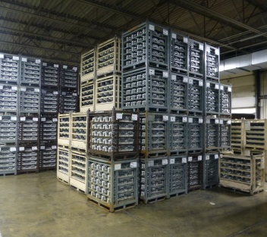
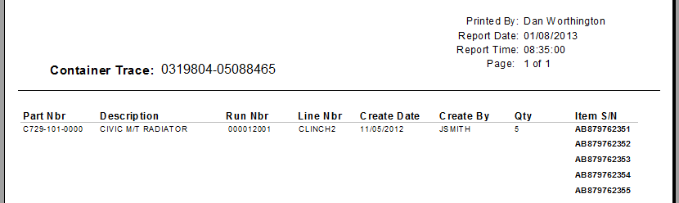
SPEDE Serialized Parts Counting Solutions
One More Reason... Serial Traceability
    Automatic Traceability by Part / Container
    A serial number is linked to each Part’s production data:
      Production Machine, Run Date, Shift, Operator, Lot, Location, etc.
      Container Serial Number(s) in which the Part was packed
      All other Serialized Parts in a generalized Container
    Provides Traceability by Part, Lot, Container, Line, Run Date, etc.
    Forward Traceability from Production out to Customer
    Backward Traceability from Production back to Receiving, Raw Components, Supplier
© 2019 SPEDE Technologies. 440-808-8888 www.SPEDE.com
Simplifying Processes... Standardizing Excellence.®
12

Slide 13













SPEDE Serialized Parts Counting Solutions
Meet a Few of our Customers...
13

Slide 14

To Discuss Your Line-side Project...
Contact:
Bob Bunsey
440-808-8888 x22
info@spede.com
www.spede.com
About Us:
SPEDE Technologies is a software and systems integration company with 40+ years of experience in the automotive and manufacturing industries.
We specialize in Automated Line-side Solutions that control and standardize production area processes to prevent errors, increase efficiency and provide 20/20 visibility into line-side operations.
The name SPEDE (pronounced speedy) is an acronym for Standard Platform for Electronic Data Entry. We assumed this d/b/a in 1994 to reflect the wide range of new and legacy technologies that we can integrate to form a single real-time communications platform on the plant floor.
Our Customers are mid-size to Fortune 500 companies with multiple plant sites throughout the U.S. and in Mexico. They rely on SPEDE Automated Line-side Solutions to keep their mission-critical processes running smoothly, 24/7.
© 2019, SPEDE Technologies. 440-808-8888 www.SPEDE.com
24930 Detroit Road, Suites D & E Cleveland OH 44145
Simplifying Processes.... Standardizing Excellence.®
Active Member of AIAG for 20+ years
14

