Slide 1

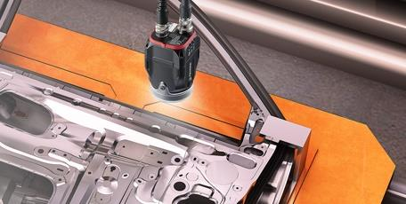
Comply with Honda MPRs by Automating Lineside Processes
A Vision Sensor Confirms a Part is Correct

Slide 2

Honda MPR Compliance Solutions
Functionality for Honda MPR Compliance
SPEDE Honda MPR* functionality includes:
Poka Yoke error-proofing methods
Component Traceability
Verification of Part / Component at Packing, Labeling
Automated Line-side Labeling
Pass thru Verification / Re-pack, Re-label Control
Rework Control
Small Lot / Partials Control
Honda Batch
Parts Traceability
Operator Accountability
* MPR = Minimum Process Requirements
© 2020, SPEDE Technologies. 440-808-8888 www.SPEDE.com
Simplifying Processes... Standardizing Excellence.®
2

Slide 3

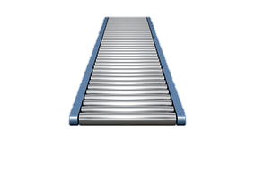

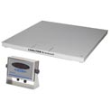


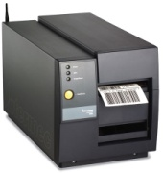

Diagram of SPEDE Automated Functionality
Serialize, Inspect, Count, Record, Label, Track and Trace Parts
  SPEDE reads the Part and ...
  Verifies the Part for correctness
  Diverts wrong or bad part
  Counts good parts toward pack count
  Weigh-counts the Parts Container
  Prints the Customer Container Label
  Collects OEE Data / Updates host apps
  Collects Track &Trace Data
Raw Material
& Data from your Suppliers
Raw Material
Warehouse
Integrates PLCs, Etchers, 2D Readers, Vision, Conveyors / Diverters, Weigh Scales ,
Cameras and OCR
RAW
Production
Run
Production
Machine
PLC
SPEDE
SQL
Server
Lineside Labeling & Control System
Phase-in Your Functionality
Read/Write PLC Data
Automate Container Labeling
Automate Piece Counts
Serialize Individual Parts
Validate Tools / Components
Validate Parts for correctness, defects
Control Partials at end of run /shift
Display real-time Piece Counts, Label Status, Machine Data, etc. on Touchscreen PC
Export Label Data to EDI / Shipping
Export Production Data to ERP / OEE
Trace Serialized Parts by Part Number, Lot, Container, Line, Run Date, etc.
Trace Parts Forward to Customer; Back to Production/ Suppliers
Create a History of Individual Parts including Rework
Confirm Processes / Accountability
Honda MPR Compliance
SERIALIZE
2D Serial Nbr
Vision Sensor
(count /inspect)
Host Computer
Conveyor
COUNT
INSPECT
Control Diverter
Divert
PLC
Image Capture
ERP/ ED/ RAS systems
Verify Pack Count
Scale Head
SQL DB
Bad
Parts
Good
Parts
Run
DB
Piece
DB
Label
DB
Weigh Scale
Rework or Scrap
WiFi Touchscreen PC
at packaging
Browser inquiries for QC, realtime inventory, traceability, etc.
FIN
Parts
Flow
Full Pack = Print a Label
Labeled Parts to warehouse,
ready to ship to Customers
Accurately Labeled Parts to Customers
+
Accurate Traceability Data to your ERP
© 2020 SPEDE Technologies. 440-808-8888 www.SPEDE.com
Simplifying Processes... Standardizing Excellence.®
3

Slide 4


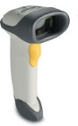
Honda MPR Compliance Solutions
Component Traceability
Track Vendor-supplied and Internally Produced Parts
Creates genealogy of End Item via scanning transactions at manufacturing processes
Trace serialized and non-serialized parts
Bill of Material by WIP/FG part number
Set up is done using SPEDE Web app
List of components / purchased items per part
Quantity per operation
Receive Raw / Purchased components
Use vendor supplied labels
Optionally print SPEDE labels by unit of measure issued
Issue components to line/operation
Scan component attributes -part number, vendor lot,
Component part validated to BOM/Line
Optional Return to Stock
Unused
To be reissued
Use prior serial or generate new
SPEDE Touchscreen PC
Tracability
Reports
Traceability Inquiries
© 2020, SPEDE Technologies. 440-808-8888 www.SPEDE.com
Simplifying Processes... Standardizing Excellence.®
4

Slide 5

Honda MPR Compliance Solutions
Automated Lineside Labeling
PLC, Vision Sensor, Scale or Camera Can Trigger a Label
Label-printing is triggered automatically by a line-side device
Host ERP / EDI supplies label data
Devices validate the correctness of a part or component
Count good parts only toward a pack count
Optional Conveyor interface can divert scrap or wrong parts
Container label automatically prints when count/dunnage is correct
Prevents packing errors: wrong or bad part / wrong quantity
Prevents mis-labeling of parts /containers
Collects data for part traceability
Prevents mis-identifying and mis-labeling of similar parts
© 2020, SPEDE Technologies. 440-808-8888 www.SPEDE.com
Simplifying Processes... Standardizing Excellence.®
5

Slide 6
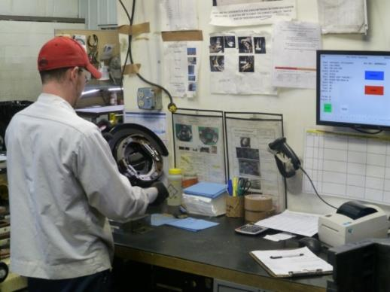
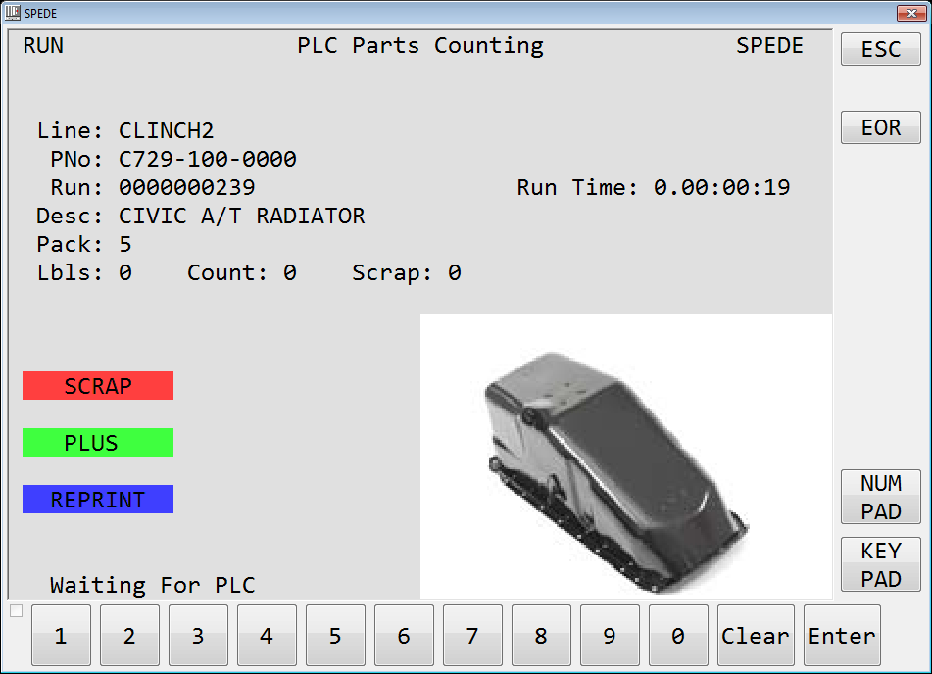
Honda MPR Compliance Solutions
Using PLCs to Automate Labeling
PLC Labeling
PLC supplies part number / run data / count
Counts good and scrap parts
Touchscreen PC at lineside displays production run data
including part, label status, pack count, etc.
Touchscreen allows operator to view piece count, adjust
for scrap
Serialized label prints when pack count is correct
Label data is supplied by Host ERP / EDI
Real-time Production Data
Production data can be sent to host OEE, ERP systems to
analyze efficiencies
© 2020, SPEDE Technologies. 440-808-8888 www.SPEDE.com
Simplifying Processes... Standardizing Excellence.®
6

Slide 7
Honda MPR Compliance Solutions
Vision Sensors for MPR Compliance
Vision Sensors for Part Verification and Labeling
Vision Sensor is “trained” to recognize a part number by its unique attribute
At Packing, the part is moved under the sensor
Sensor uses image capture & pixel analysis to identify the part
If part is correct, the running part count is incremented
If part is wrong, an audio/visual alert prevents packing error
When pack count is reached, SPEDE prints a container label
Part to be Identified
Keyence Vision Sensor
Vision Target Area
© 2020, SPEDE Technologies. 440-808-8888 www.SPEDE.com
Simplifying Processes... Standardizing Excellence.®
7

Slide 8
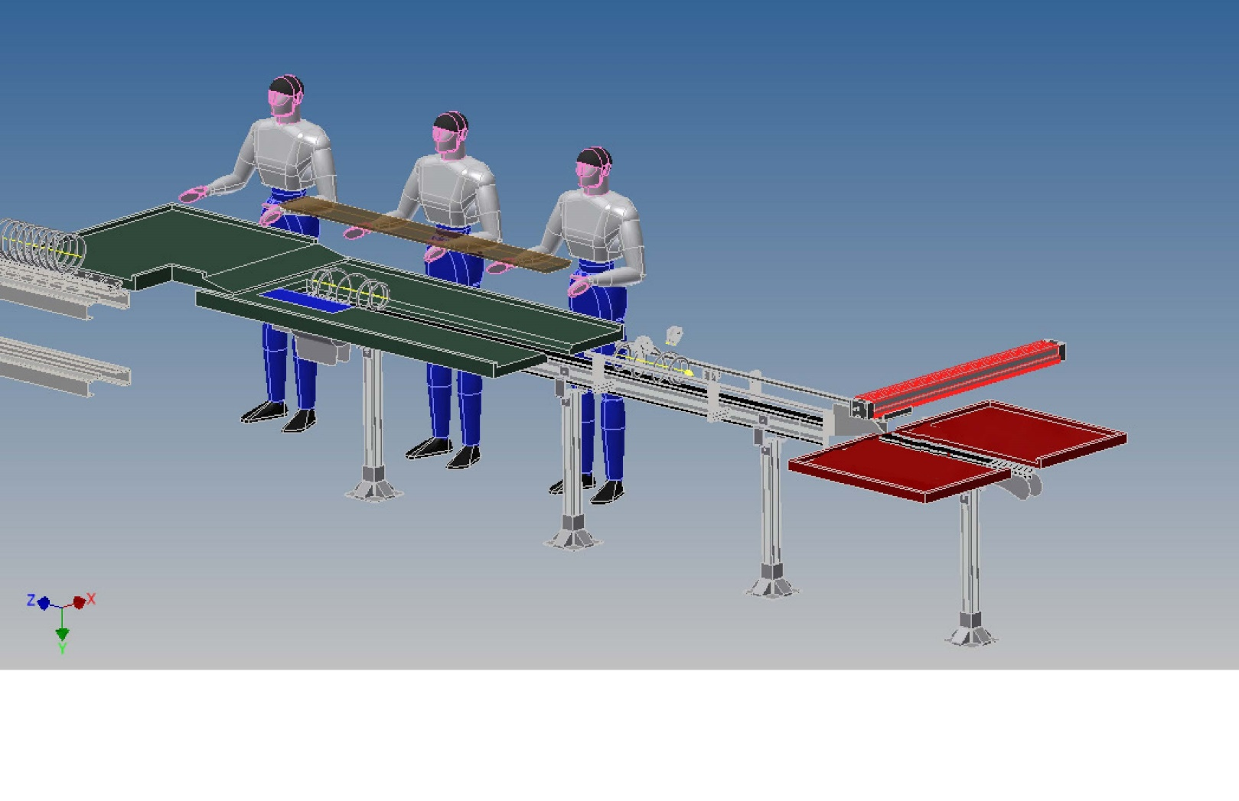
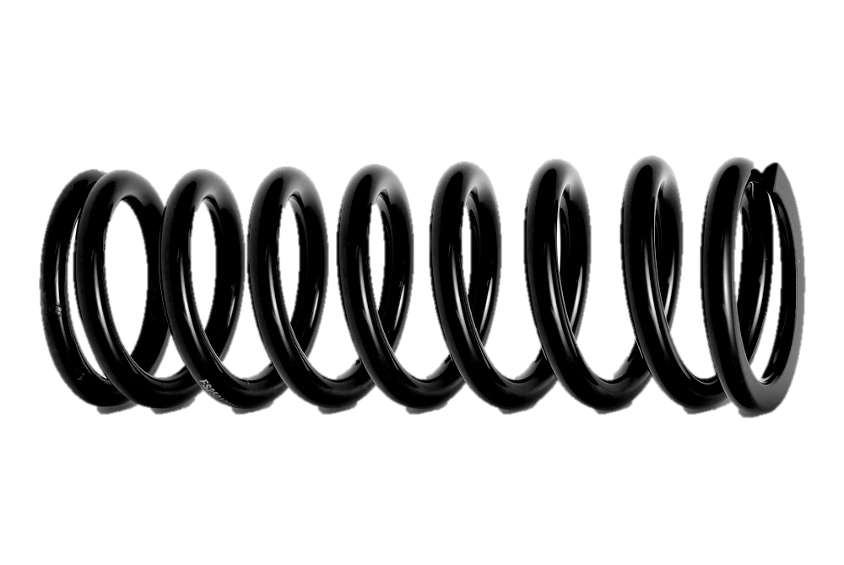
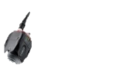


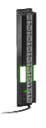
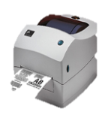



SPEDE Vision Sensors on Conveyor
can validate, count, & route parts
WiFi
SPEDE Application
Server
SQL
DB
Updating SQL DB ----→
SPEDE
Vision App
SPEDE
Parts Counting
App
V2
V3
Parts Counting OK + 1
L3
L3
L1
Zebra
Printer
V1
L2
Controls L1, L2, L3
V1, V2, V3
Good
SPEDE PLC Control Panel
L1, L2, L3 = Light Curtain Sensors
V1, V2, V3 = Keyence Vision Sensors
Scrap
Click to start animation

Slide 9
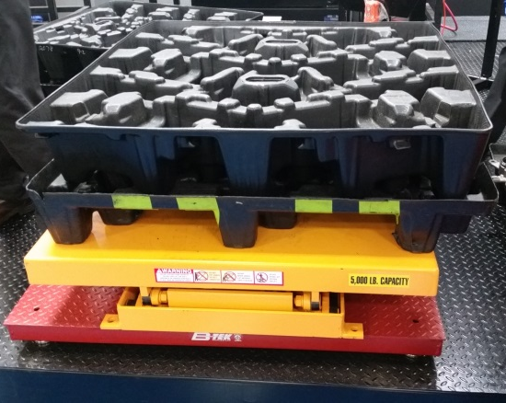
Honda MPR Compliance Solutions
Interfacing to Weigh Scales
Weigh Scales for Container Labeling
Weigh scale automatically triggers a label when count or weight is correct
Existing weigh scale provides piece weight
Weight can be used for piece counting / full pallet validation
Adjustable tolerances to accommodate piece weight variances
Actual weights are collected and stored with label data
Label database provides traceability
© 2020, SPEDE Technologies. 440-808-8888 www.SPEDE.com
Simplifying Processes... Standardizing Excellence.®
9

Slide 10
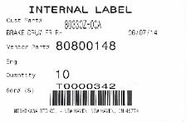
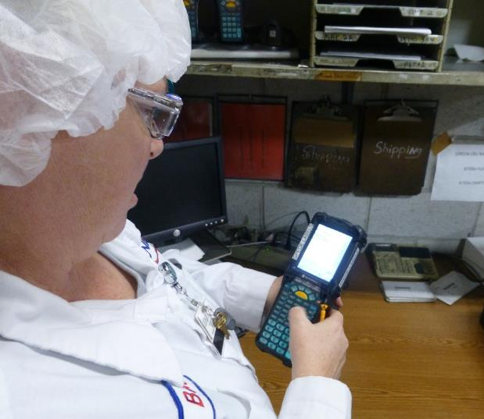
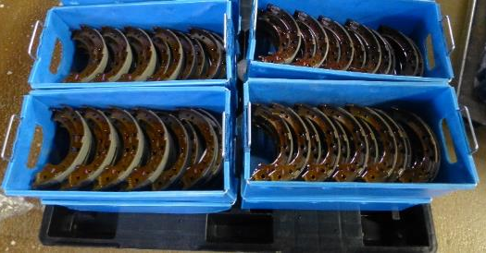
Honda MPR Compliance Solutions
WIP Labeling and Re-pack Control
Production / WIP Labeling
Prints serialized Internal (WIP) or Customer label
Scan serial number on WIP label to create new Honda label
Pass-thru Verification / Re-pack / Re-label
Scanning the serial number on container to be re-packed/re-labeled verifies part
is correct
Vision sensor can also be used to capture image of vendor’s part / component
SPEDE compares scanned image to stored image of correct part / component
Prevents errors due to incorrect vendor labeling of part/component
© 2020, SPEDE Technologies. 440-808-8888 www.SPEDE.com
Simplifying Processes... Standardizing Excellence.®
10

Slide 11
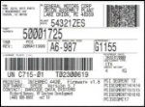
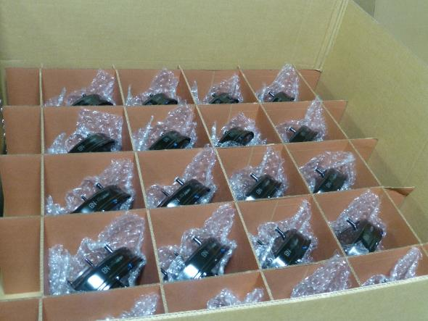
Honda MPR Compliance Solutions
Small Lots and Honda Batch
Small Lot Control
Controls non-standard pack counts at End of Run / Shift
Controls partial containers of Parts available for
Re-pack / Re-work
Honda Batch Orders - Serialized Parts
Serialized input from PLC/Inline/Handheld scanner
Honda Batch EDI imported into SPEDE
SPEDE displays Batch Order quantities list on touchscreen
Operator selects batch, SPEDE verifies part number/quantity
Prints Honda container/batch/mixed master label per EDI
Batches are removed from list as completed
Management view of all batches/completion status
© 2020, SPEDE Technologies. 440-808-8888 www.SPEDE.com
Simplifying Processes... Standardizing Excellence.®
11

Slide 12

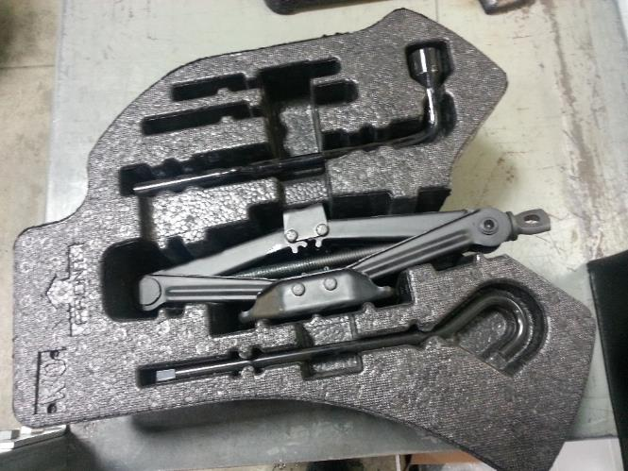
Honda MPR Compliance Solutions
Cameras for Packing Control
Packing Control - Using Cameras to verify packaging
Inexpensive USB camera(s) can be installed at Packing line
Camera captures image of part being packed to verify accuracy
SPEDE ensures that all slots in a segmented layer of package are filled before next
layer can begin
SPEDE ensures that all required components are in a Kit
When container or kit is correctly filled, SPEDE prints a container label
Video is preserved as proof of correct packaging in case of customer inquiry
Imaging Camera at Packing
A USB Camera can ensure all slots in a container or kit are correctly filled
© 2020, SPEDE Technologies. 440-808-8888 www.SPEDE.com
Simplifying Processes... Standardizing Excellence.®
12

Slide 13
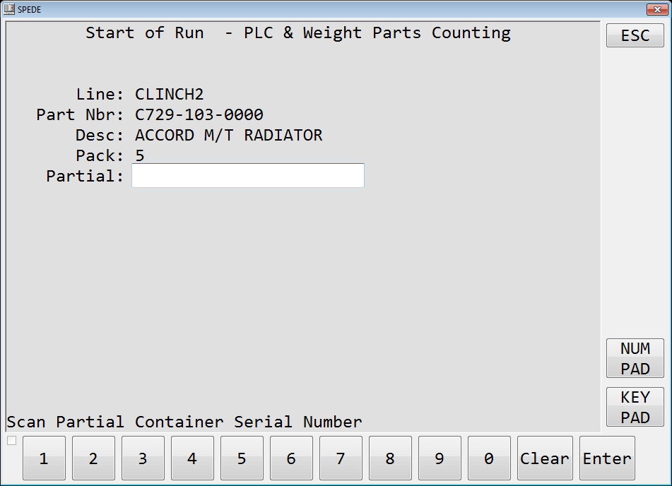
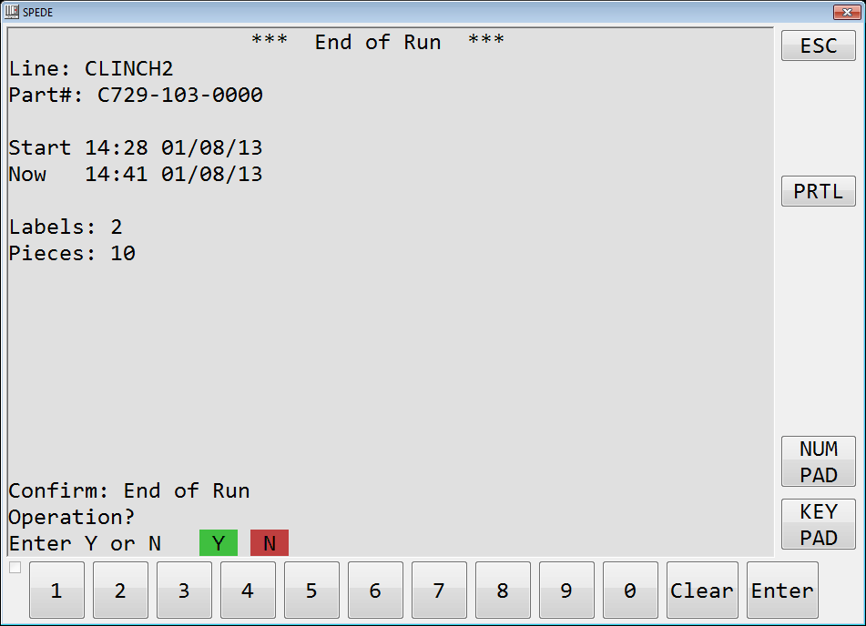
Honda MPR Compliance Solutions
Controls Partials and Rework
Controls Piece Counts at Start & End of Run:
Uses the Container Serial Number for control
Controls Partial Pack Counts at End of Run
and End of Shift
Pack Qty can be adjusted using a virtual
keypad on the TouchScreen
Validates aggregation of multiple
containers of Partials with same Part Number
Validates new Full Pack containers built
from multiple Partials
Provides for Re-work operations on Partials
© 2020, SPEDE Technologies. 440-808-8888 www.SPEDE.com
Simplifying Processes... Standardizing Excellence.®
13

Slide 14
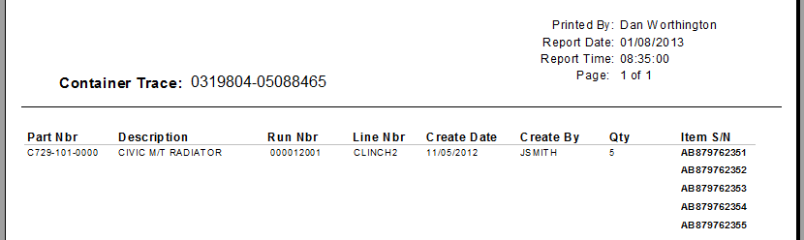
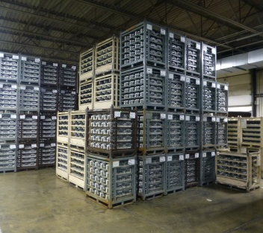
Honda MPR Compliance Solutions
Serial Traceability of Parts, Containers
Part / Container Traceability
    Serial number is linked to each part’s production data
    Traceability by part, lot, container, line, run date, associate, etc.
    Forward traceability from production to Customer
    Backward traceability from production to raw components to suppliers
© 2020, SPEDE Technologies. 440-808-8888 www.SPEDE.com
Simplifying Processes... Standardizing Excellence.®
14

Slide 15
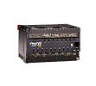
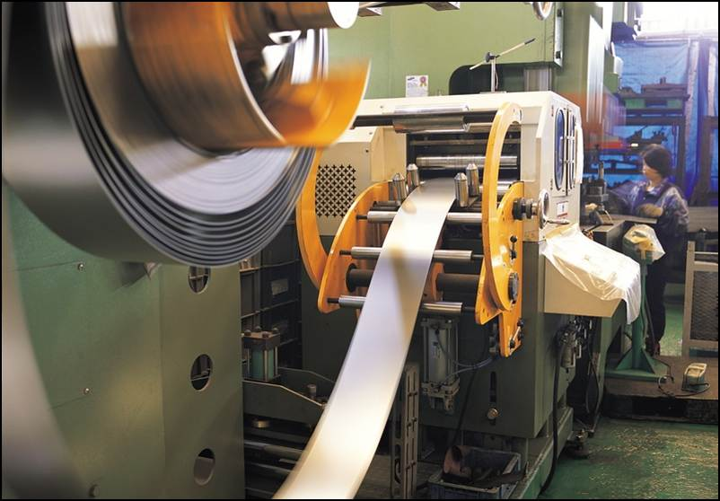
Honda MPR Compliance Solutions
Operator Accountability
Operator Accountability is Simplified
Associate must sign-in to perform all SPEDE operations
All scans, labels and events are linked to the current user
All transactions are retained in SQL Txn database
Tells you Who did What, Where, When
Confirms that each Operator is following your processes
PLC
Database
Typical Production Data stored in DB:
Part Number
Operator Nbr
Shift, Date, Time
WO Nbr
Lot Nbr
Machine Cycles, Cycle Timestamp
Part Count: Good, Scrap, Re-work
Machine Stats & Metrics, etc.
© 2020, SPEDE Technologies. 440-808-8888 www.SPEDE.com
Simplifying Processes... Standardizing Excellence.®
15

Slide 16

Meet Honda QC Objectives
... And Improve Your Operations too
Every container has the Correct Part
Every container has the Correct Quantity
Every container has the Correct Label
Every label has the Correct Data
Meets Honda MPRs for an Accurate Labeling and Traceability Process
Bottom Line: Your OEMs are happy!
© 2019, SPEDE TECHNOLOGIES. www.SPEDE.com 440.808.8888
Simplifying Processes ... Standardizing Excellence. ®
8

Slide 17
Complete PLC Labeling Solutions
Honda MPR Compliance Solutions
Our Solutions include Software, Hardware & Services:
SPEDE Software Platform and Labeling App - PC server-based
Connectivity of PLCs and printers to the SPEDE WiFi network
Interfaces to your ERP, EDI, Release Accounting, OEE Systems
Total System Support, 365 days/yr
Quick Installation with no impact on your Production or IT resources
Additional Options:
SPEDE–built PLCs for your production lines that need one
Interfaces to scales, vision, cameras, conveyors, OCR devices
WiFi TouchScreen PCs for line-sides
WiFi Label Printers
© 2019, SPEDE TECHNOLOGIES. www.SPEDE.com 440.808.8888
Simplifying Processes ... Standardizing Excellence. ®
16

Slide 18















Meet a Few of our Customers...
17

Slide 19

To Discuss Your Line-side Project...
Contact
Bob Bunsey
440-808-8888 x22
info@spede.com
www.spede.com
About Us:
SPEDE Technologies is a software and systems integration company with 41 years of experience in the automotive and manufacturing industries. We specialize in Automated Line-side Solutions that control and standardize production area processes to prevent errors, increase efficiency and provide 20/20 visibility into line-side operations.
Our Customers are mid-size to Fortune 500 auto suppliers with multiple plant sites throughout the U.S. and in Mexico. They rely on SPEDE Automated Line-side Solutions to keep their mission-critical processes running smoothly, 24/7.
© 2021, SPEDE Technologies. 440-808-8888 www.SPEDE.com
24930 Detroit Road, Suites D & E Cleveland OH 44145
Simplifying Processes.... Standardizing Excellence.®
Active Member of AIAG for 20+ Years
18

