Slide 1

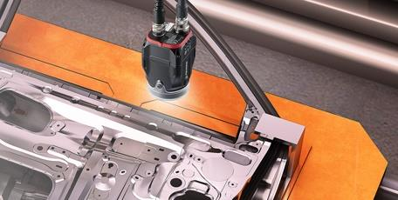
Poka Yoke Solutions
for Error-proof Packing & Labeling
© 2019, SPEDE Technologies. 440-808-8888 www.SPEDE.com
Simplifying Processes... Standardizing Excellence.®

Slide 2

SPEDE Poka Yoke Solutions for Manufacturing
What is Poka Yoke?
Poka Yoke is a Japanese term that means incorporating a mechanism (e.g. a technology) into a process, either to prevent errors from occurring, or to alert the operator if an error is being made so it can be immediately corrected.
SPEDE Poka Yoke Solutions:
Focus on error-prevention
Integrate new and legacy technologies into business processes
Automate and error-proof these processes:
Part identification
Part validation
Part counting
Scrap detection / diverting
Packaging / dunnage control
Container labeling
© 2019, SPEDE Technologies. 440-808-8888 www.SPEDE.com
Simplifying Processes... Standardizing Excellence.®
2

Slide 3
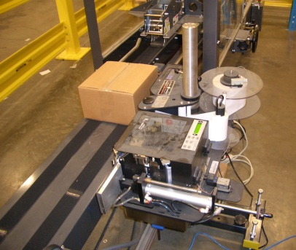
SPEDE Poka Yoke Solutions for Manufacturing
SPEDE Poka Yoke Solutions
SPEDE Solutions interface to a variety of technologies:
PLCs
Weigh Scales
Cameras
Vision Sensors
Touchscreen PCs
Conveyors / Diverters
OCR
Barcode and 2D scanners
Label Printers
Host ERP, EDI, OEE Systems
* Supports Poka Yoke Requirements for Honda MPR Compliance
PLC-controlled Print & Apply Labeling
© 2019, SPEDE Technologies. 440-808-8888 www.SPEDE.com
Simplifying Processes... Standardizing Excellence.®
3

Slide 4
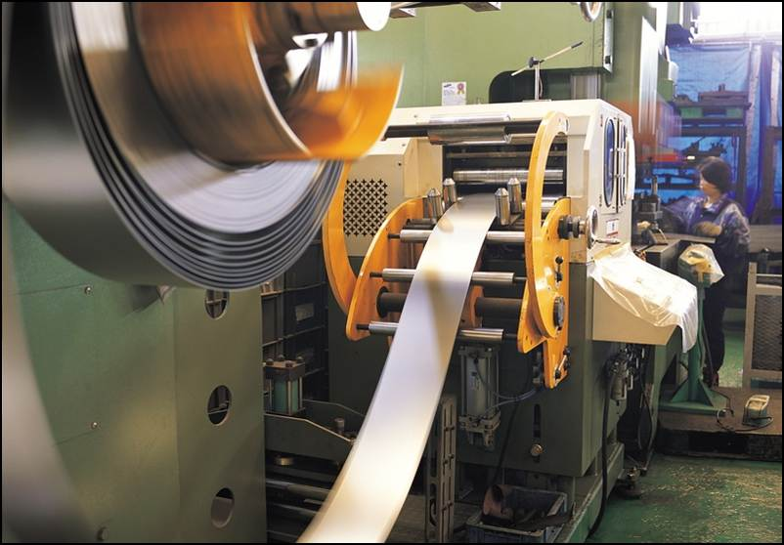
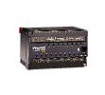
SPEDE Poka Yoke Solutions for Manufacturing
Use PLCs for Labeling Control
The PLC supplies the Part Nbr, Run Data, Piece Count
  Ensures the printed label matches the part being made
  Triggers a label when a pack count of “Good” Parts is reached
  Can interface to test jigs to identify Scrap
  Can use a SPEDE PLC if no production machine PLC is there
SPEDE controls piece counts at Start of Run, End of Run
SPEDE controls partial packs & counts at End of Run, End of Shift
SPEDE collects PLC data for Traceability, Accountability, OEE analysis
  Can display real-time production data at line-side on TouchScreen
SPEDE
Database
Displays Real-time Production Data:
Part Number
Operator Nbr
Shift, Date
WO Nbr
Lot Nbr
Machine Cycles, Cycle Timestamp
Part Counts : Good, Scrap, Re-work
Machine Stats & Metrics, etc.
PLC
© 2019, SPEDE Technologies. 440-808-8888 www.SPEDE.com
Simplifying Processes... Standardizing Excellence.®
4

Slide 5
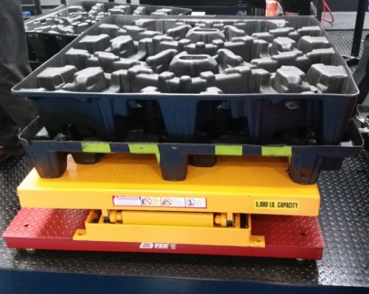
SPEDE Poka Yoke Solutions for Manufacturing
Use Weigh Scales to Trigger Labeling
Interfacing to weigh scales eliminates manual counts / guesstimates
SPEDE receives weight for piece counting or full pallet
validation
Adjustable tolerances accommodate piece weight variances
Automatically prints a label when weight/count is correct
  Option: displays “print button” on Touchscreen
  when weight/count is correct
  Operator touches “print button” to print the label
Actual weights are collected and stored with label data
in the Label Database
Optional integration with Vision can provide:
    Vision-check to ensure part is correct
    Weight verification to ensure part is placed in dunnage
Weigh Scale Can Trigger Labels to Print
© 2019, SPEDE Technologies. 440-808-8888 www.SPEDE.com
Simplifying Processes... Standardizing Excellence.®
5

Slide 6
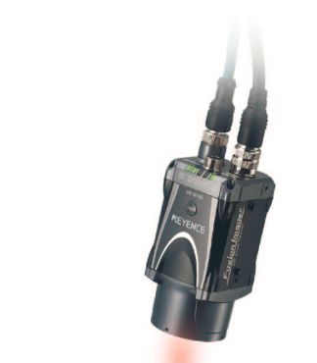
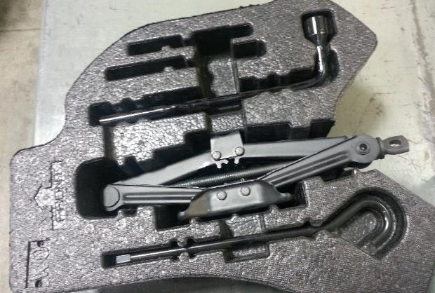
SPEDE Poka Yoke Solutions for Manufacturing
Use Vision Sensors for Labeling
Vision Sensors can prevent errors in identifying, counting, packing
SPEDE uses Vision Sensors for:
Pack and Re-pack control
Part Validation: Is this part good, scrap or rework?
Part Verification: Is this the correct part for this process?
Part Counting for accurate Pack Count
Kit Validation: Is this Kit complete and correct?
Dunnage layer validation: are all slots filled in this layer?
Can also read 2D serial on individual parts for accurate
counts and serial traceability
Keyence Vision Sensor
Vision can detect open slots in this Jack Kit
© 2019, SPEDE Technologies. 440-808-8888 www.SPEDE.com
Simplifying Processes... Standardizing Excellence.®
6

Slide 7
SPEDE Poka Yoke Solutions for Manufacturing
Use Vision Sensors for Error-proof Packing
How SPEDE Uses Vision:
Vision Sensor is “trained” to recognize a part number by its unique attribute
At Packing, the part is moved under the sensor
Sensor uses image capture & pixel analysis to identify the part
If part is correct, the running part count is incremented
If part is wrong, an audio/visual signal prevents a packing error
When pack count is reached, SPEDE prints a container label
Part to be Identified
Keyence Vision Sensor
Vision Target Area
© 2019, SPEDE Technologies. 440-808-8888 www.SPEDE.com
Simplifying Processes... Standardizing Excellence.®
7

Slide 8
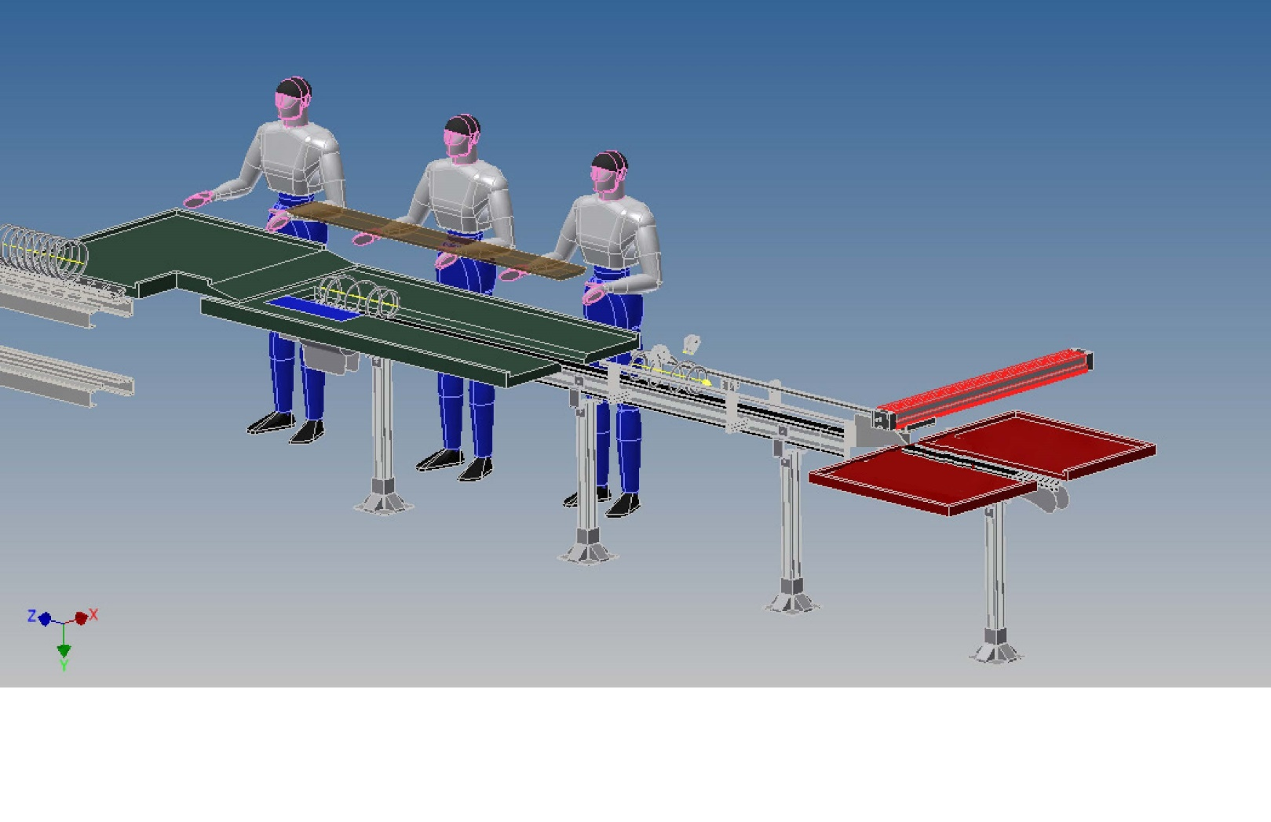



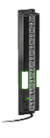

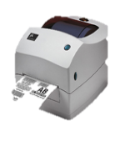



Vision Sensors on a conveyor
can validate, count, & route parts
WiFi
SPEDE Application
Server
SQL
DB
Updating SQL DB ----→
SPEDE
Vision App
SPEDE
Parts Counting
App
V2
V3
Parts Counting OK + 1
L3
L3
L1
Zebra
Printer
V1
L2
Controls L1, L2, L3
V1, V2, V3
Good
SPEDE PLC Control Panel
L1, L2, L3 = Light Curtain Sensors
V1, V2, V3 = Keyence Vision Sensors
Scrap
Click to start animation

Slide 9
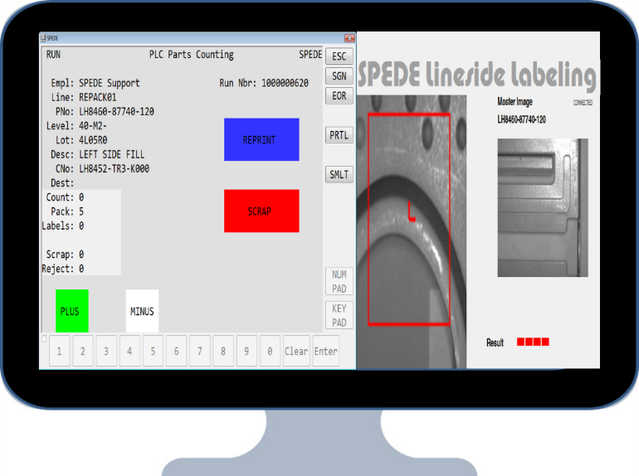
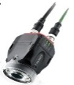

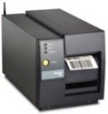

SPEDE Poka Yoke Solutions for Manufacturing
Use Vision for Error-proof Packing
Diagram of Vision-directed Packing / Labeling
  Use Vision when Parts are packed at the production machine
  Use Vision if no PLC is present to count the parts
  Vision sensor identifies and counts “good” parts
  Operator can press a Touchscreen to record scrap
  SPEDE prints the container label at pack count of good parts
Vision-directed
Line-side Labeling
Vision Sensor
Production
Machine
Finished Parts
Shipping Label
Pack
Station
If Part is Good
and Correct
Shipping Container
© 2019, SPEDE Technologies. 440-808-8888 www.SPEDE.com
Simplifying Processes... Standardizing Excellence.®
9

Slide 10

SPEDE Poka Yoke Solutions for Manufacturing
Use USB Cameras to Control Packing
SPEDE interfaces to USB Cameras at Packing
Camera captures image of the part being packed
Verifies the part is correct
Validates the part is “good” vs. scrap
Validates dunnage layer is filled before starting next layer
Takes a photo of the completed layer
Video can provide proof that packing requirements were
met for each layer in case of customer inquiry
Cameras can also be used for:
Color detection
OCR – reading a 1D or 2D barcode on the part
OCR – reading characters on the part
© 2019, SPEDE Technologies. 440-808-8888 www.SPEDE.com
Simplifying Processes... Standardizing Excellence.®
10

Slide 11


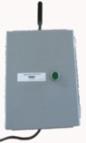
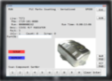

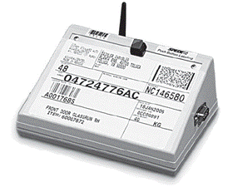





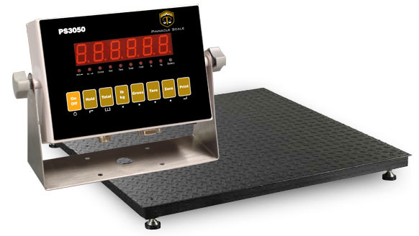
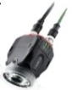

SPEDE Poka Yoke Solutions for Manufacturing
Interfacing to Devices and Host Systems
Production Area
b
IT Area
Host Computer
TouchScreen PC
Push-button
SPEDE PLC
Part Nbr and EDI Data
Production, Part, PLC, Label Data
Production & Label Data
Part Nbr and EDI Data
Your PLC
WiFi Bridge
SPEDE Application Server
SPEDE
Data
Label Printer
SPEDE
DB
User/ System Events,
Good/ Scrap Counts,
Data printed on Labels,
PLC Data/Metrics, etc.
Your Shipping and ERP Apps
Weigh Scale
Vision Scanner
SPEDE Server Hardware Requirements
  Local Windows server, MS SQL, 500GB Hard Drive, remote access
  Local Network Requirements
  TCP/IP to SPEDE Server
  TCP/IP to production PLC
  Prefer WiFi to SPEDE server, wired ethernet to PLC
© 2019, SPEDE Technologies. 440-808-8888 www.SPEDE.com
Simplifying Processes... Standardizing Excellence.®
11

Slide 12















Meet a Few of our Customers...
12

Slide 13

SPEDE Poka Yoke Solutions for Manufacturing
To Discuss Your Line-side Project...
Call or Email ...
Bob Bunsey
info@spede.com
440-808-8888 x22
www.spede.com
About Us:
We are a software and systems integration company founded in 1980 as Computer Software Corporation, specializing in technology solutions for automotive suppliers and manufacturers . Our focus is automating production area processes to prevent errors, increase efficiency and provide real-time 20/20 visibility of shop floor operations.
The name SPEDE (pronounced speedy) is an acronym for Standard Platform for Electronic Data Entry. We assumed this d/b/a in 1994
to reflect the wide range of new and legacy technologies that we can integrate to form a single real-time communications platform on the
plant floor.
Our Customers are mid-size to Fortune 500 companies with multiple plant sites throughout the U.S. and in Mexico. They rely on SPEDE Automated Line-side Solutions to keep their mission-critical processes running smoothly, 24/7.
© 2019, SPEDE Technologies. 440-808-8888 www.spede.com
SPEDE Technologies 24930 Detroit Rd, Suites D & E Cleveland, OH 44145
Simplifying Processes... Standardizing Excellence.®
Active Member of AIAG for 20+ years
13

