Slide 1


Welcome aboard
Introducing
FreeAgent
Month 2024
Notes:
We know that sharing your numbers with us regularly can feel like an extra task you could do without - but there’s a good reason why we ask you to do this.
Having access to your most up-to-date figures means we can give you the right advice at the right time, and ultimately help you make the best decisions for your business.
FreeAgent is a great tool for helping with accounting and bookkeeping tasks, securely storing financial data and automating recurring activities, such as invoicing, payroll, reporting and tax returns.

Slide 2
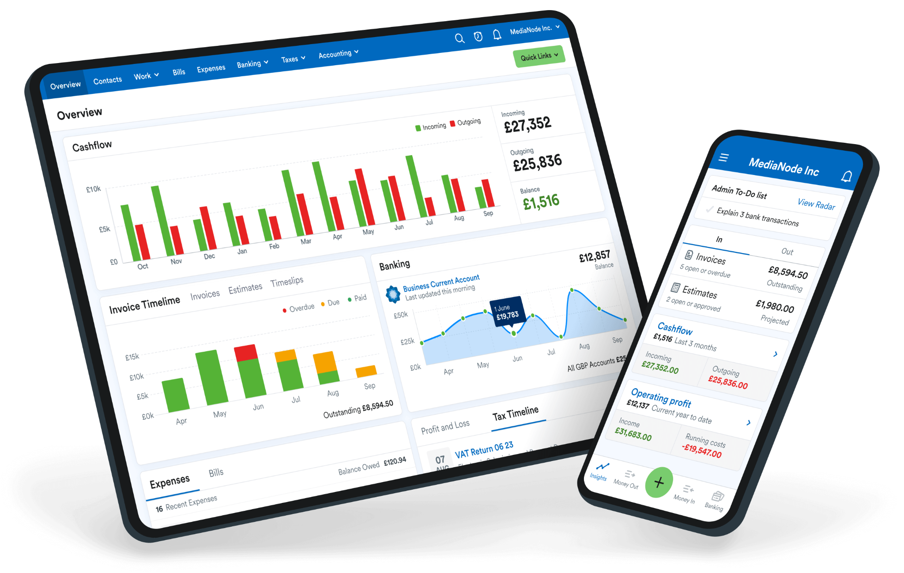
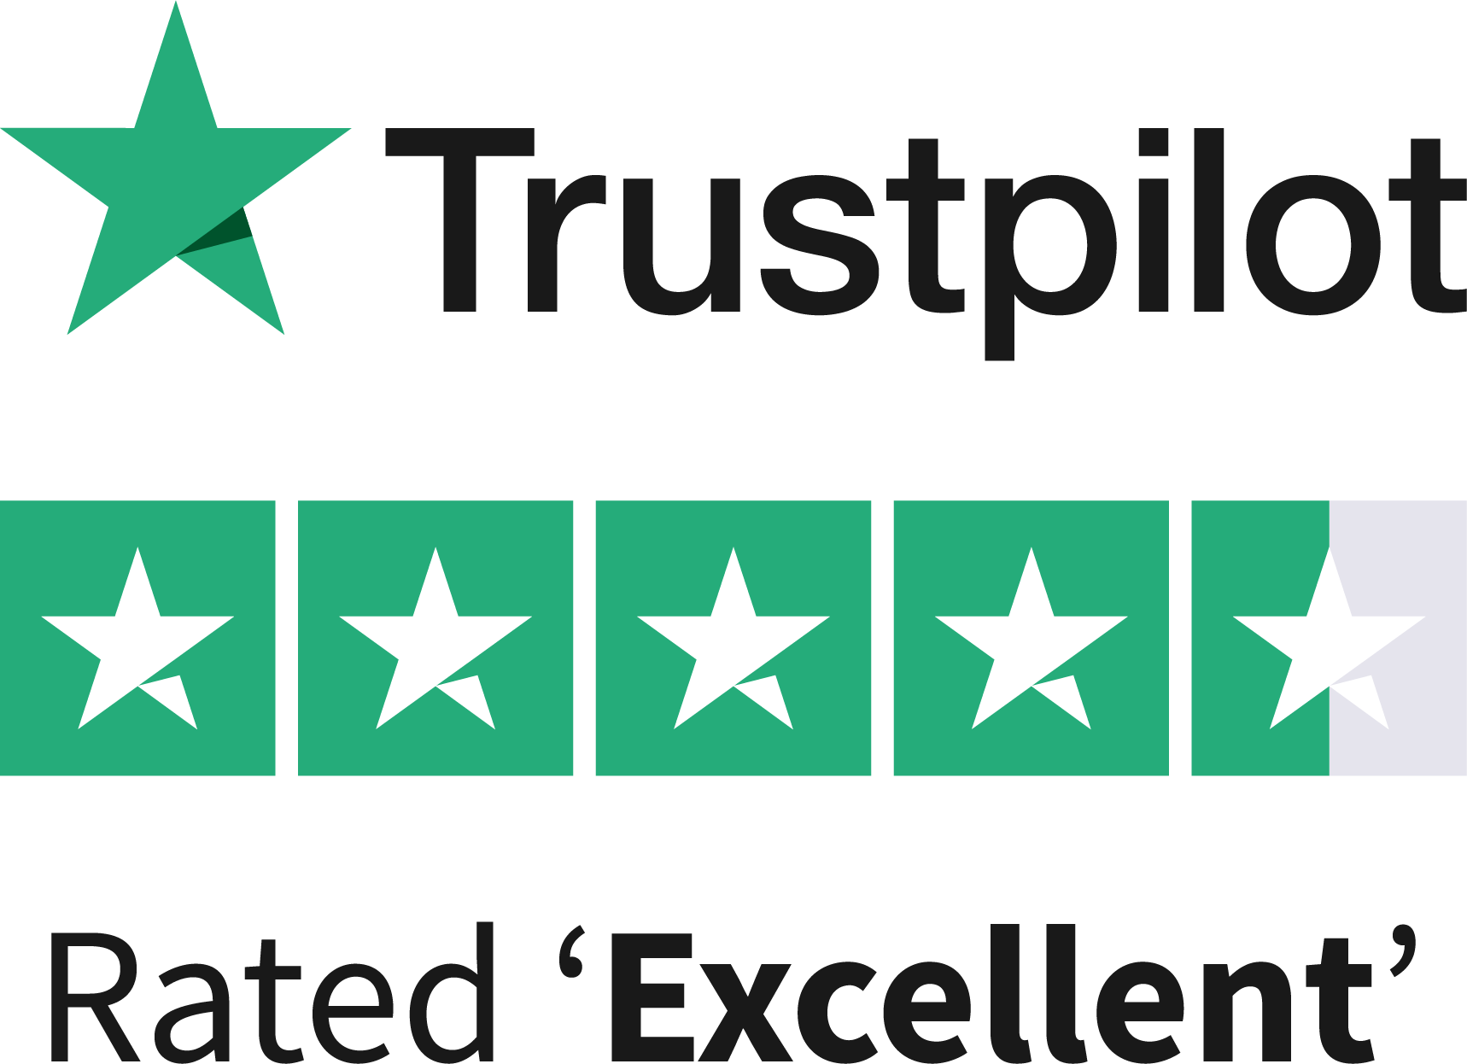
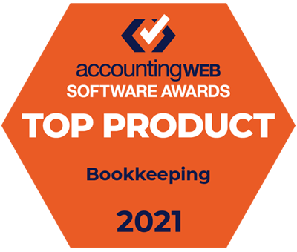
So, what is FreeAgent
FreeAgent is an award-winning, UK-based accounting application designed to help small businesses stay on top of their finances and work more productively with their accountants.
✅ Trusted by over 150,00 UK small businesses
✅ Voted the UK's #1 bookkeeping software for small businesses
Notes:
There are a number of great apps out there, so why are we recommending FreeAgent?
FreeAgent is an award-winning accounting app designed specifically to help small businesses. It helps you stay on top of your finances and work more productively with us. It is specifically designed to fit the needs of businesses like yours and is easier and friendlier to use than other accounting software available in the market which have overly complex features that might not be useful to you.
Over 150,000 UK small businesses already use FreeAgent, with many reviewers on Trustpilot mentioning how easy it is to set up. They also have great customer support if you ever get stuck. There are hundreds of reviews about FreeAgent on Trustpilot, so I encourage you to take a look and read about the experiences of others in a similar position.
On the slide, you can also see a couple of the recent awards FreeAgent has won over the years. Many of them are about the mobile app which, as we’ll explain more later, is a great asset.
Voted the UK's #1 bookkeeping software for small businesses
Top Product 2021 and 2020 AccountingWEB Software Awards: Data & Expense Management Software and SME Accounting / Bookkeeping Software

Slide 3

“
Simple to set up
FreeAgent is easy to use and my accountant can have access to the information they need. By having the mobile app too, I can add receipts on the go making this an easy process.
Trustpilot review by Andrew

Slide 4

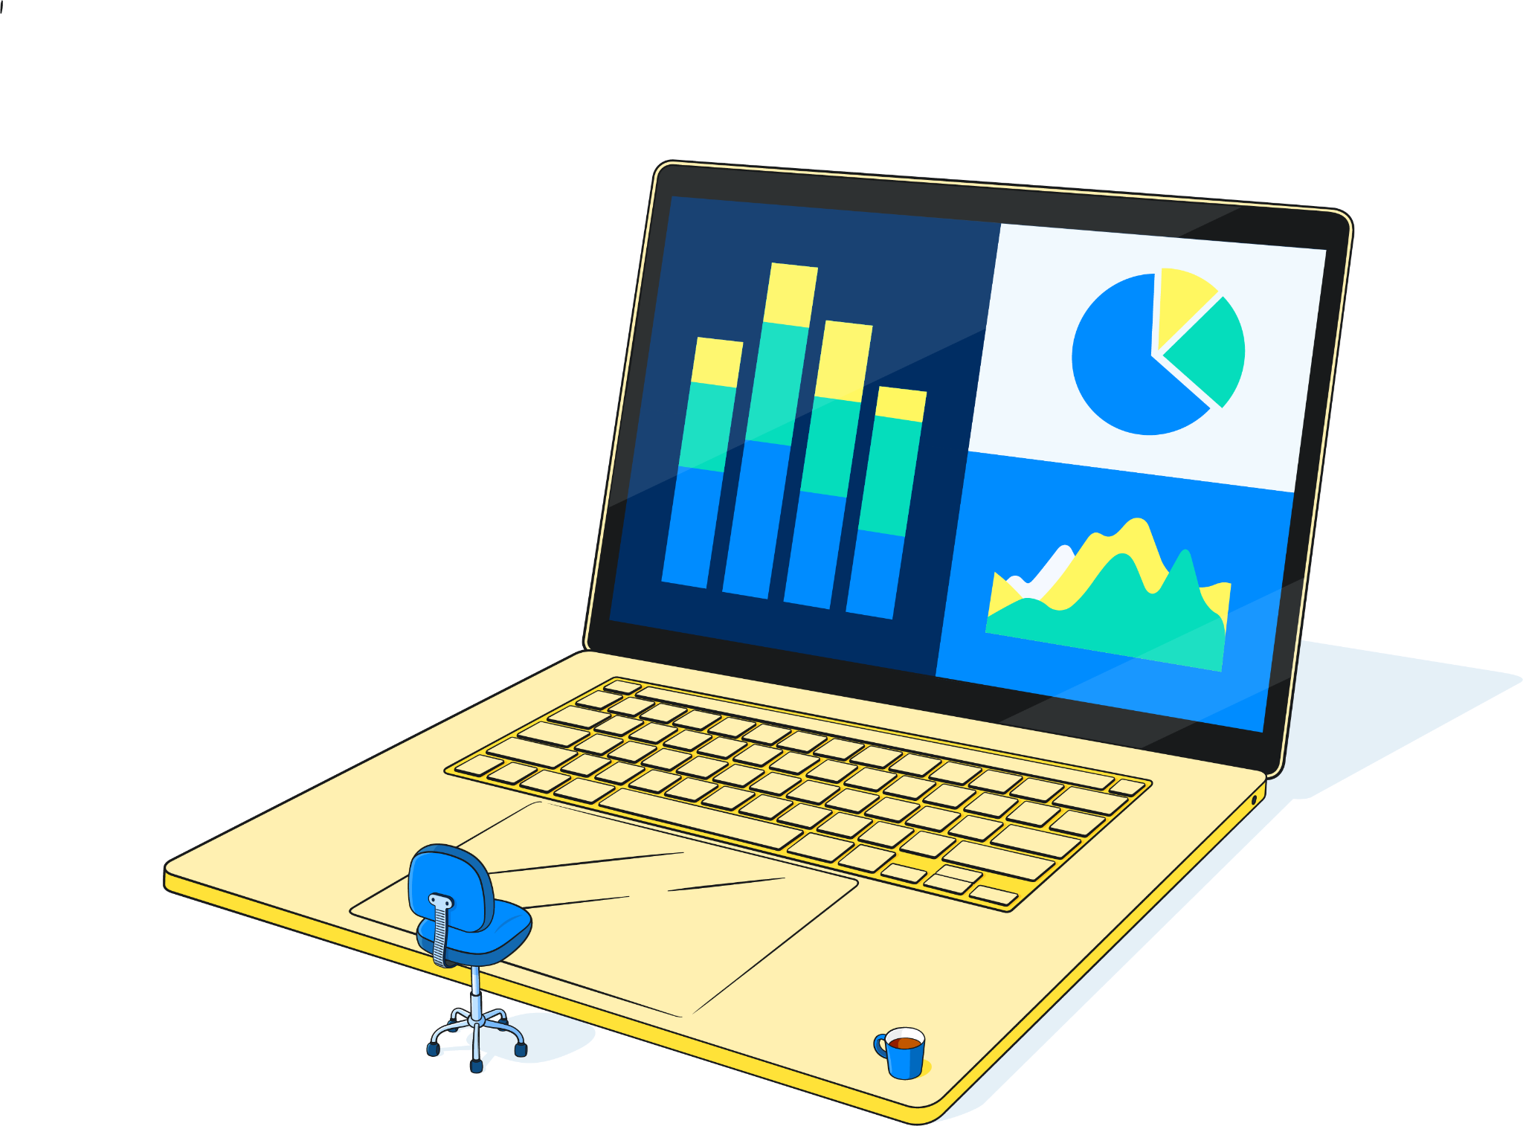

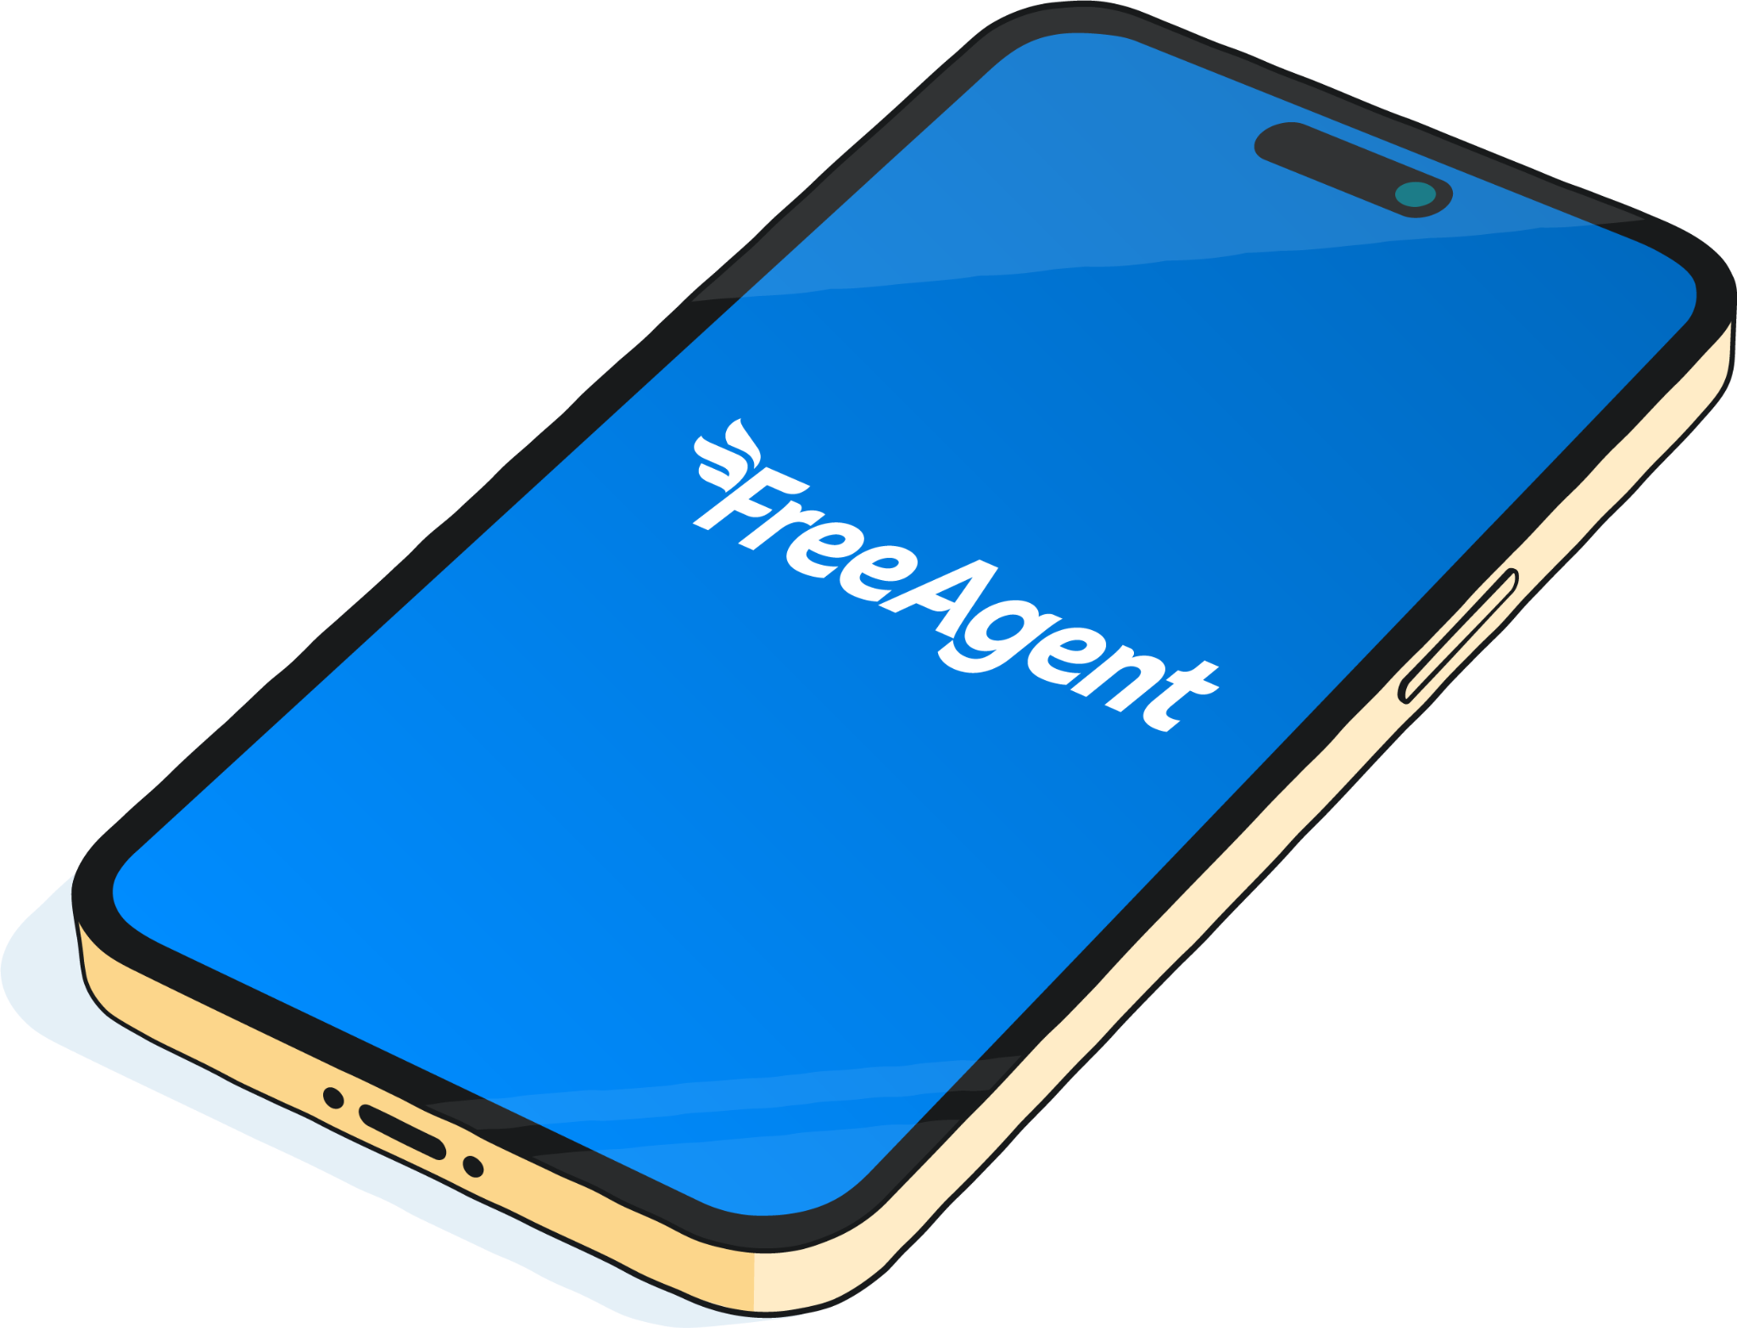

Why do we recommend FreeAgent
FreeAgent also includes…
Best match for you
Designed for small businesses to nail the daily admin
Easy-to-use app
If you can use your internet banking, you can use FreeAgent!
Data ownership
You have full ownership of your data in FreeAgent
Mobile app
Accessible, friendly, useful
on the go
Support
Award-winning customer support, if there’s ever any issues with the technology
Notes:
Best match for you → designed for small businesses to nail the daily admin
Easy-to-use app → if you can use your internet banking, you can use FreeAgent!
Data ownership → you have full ownership of your data in FreeAgent
FreeAgent also includes…
Mobile app → accessible, friendly, useful on the go
Support → award-winning customer support, if there’s ever any issues with the technology

Slide 5
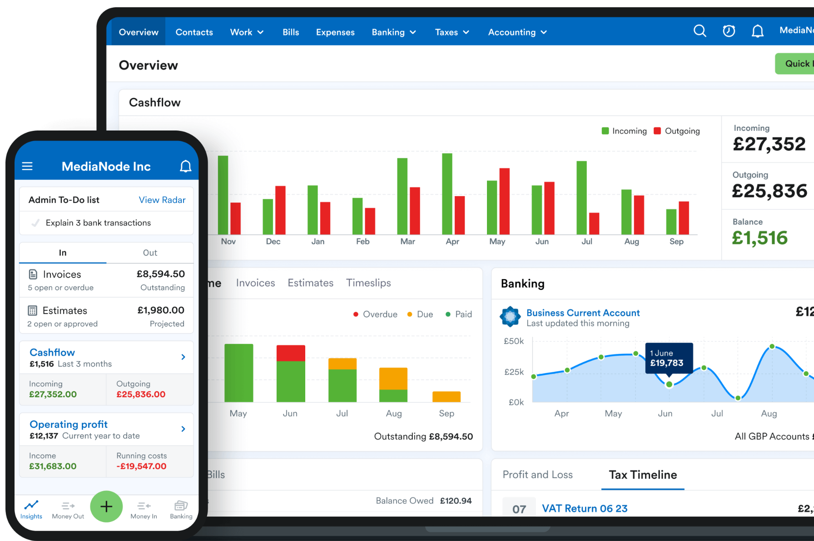
What can FreeAgent do for you?
Let’s focus on the product, going through
the main features you might find of interest:
Invoices
Tax Timeline
Cashflow
Project Management
Expenses
Mobile app
Bank feeds
Notes:
Next, let’s focus on the functionality. We’ll take you through the main features you might find of interest: invoices, Tax Timeline and Cashflow and then, we’ll head onto project management, expenses, the mobile app and bank feeds. This should give you an overview of FreeAgent and why we think this would be a good fit for you compared to what else is out there.
Invoices
Tax Timeline
Cashflow
Project Management
Expenses
Mobile app
Bank feeds

Slide 6
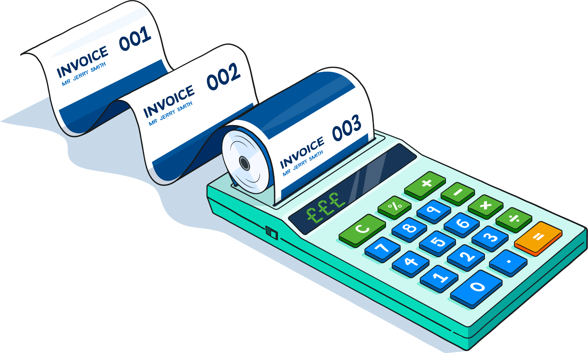
The main features that can change your day-to-day
Invoices
Send invoices and payment reminders automatically and get paid faster with online invoice payments.
Notes:
Invoices
Send invoices and payment reminders automatically and get paid faster with online invoice payments.
FreeAgent gives you great flexibility when it comes to invoicing. You can customise the design of your invoices, set up payment reminders and share payment links directly with your customers. If you have any late paying customers who you need to chase, you can see their details quickly and easily in your invoice timeline and the moble app lets you create, send and manage your invoices from anywhere.

Slide 7
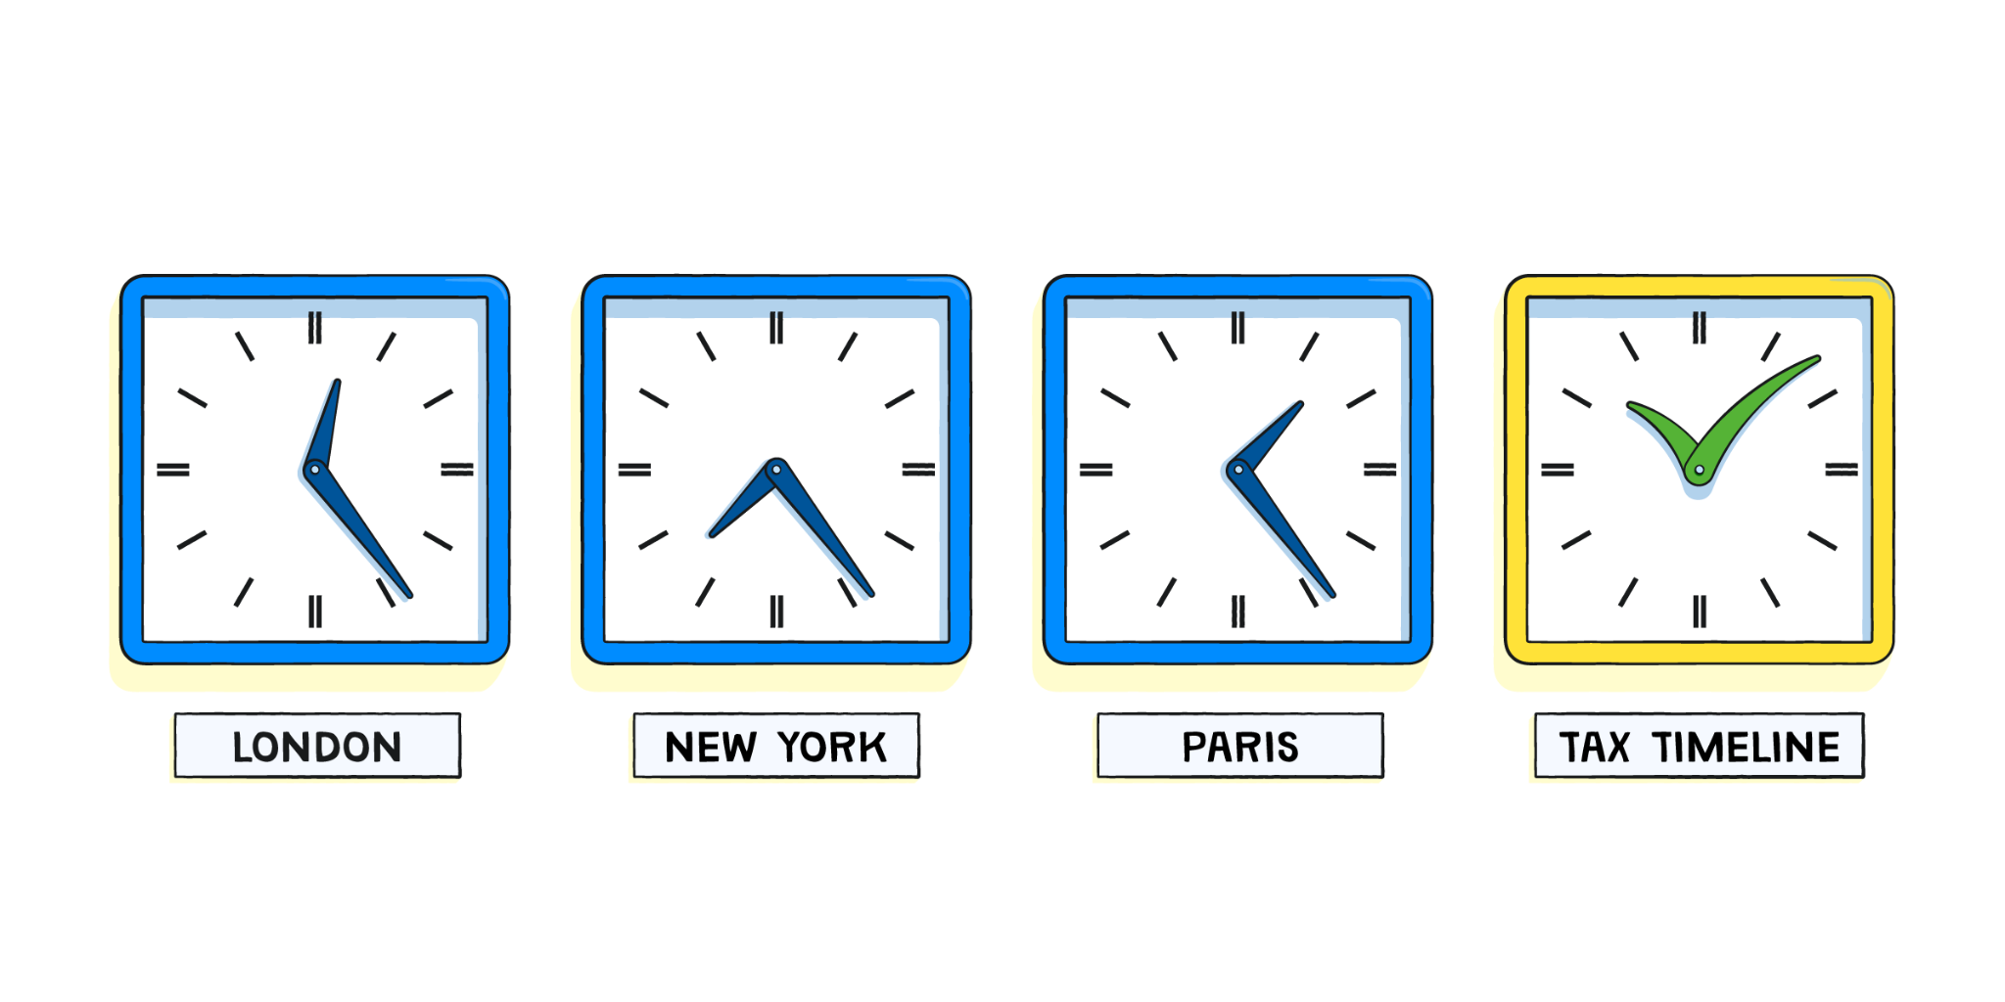
The main features that can change your day-to-day
Tax timeline
Explore a calendar overview of the important tax dates and payments for your business. Never miss a deadline again.
Notes:
Tax Timeline
Explore a calendar overview of the important tax dates and payments for your business. Never miss a deadline again.
Your personalised Tax Timeline gives you a calendar overview of the important tax dates and payments for you and your business. It’s based on the accounting dates and VAT return dates in your VAT settings. The items on the Tax Timeline will automatically update when something has been filed, marked as filed or paid off.
File a tax return
Mark a liability as paid
Filter through filed/paid and upcoming payments
Note: this is only available for clients with level 7 or above.

Slide 8
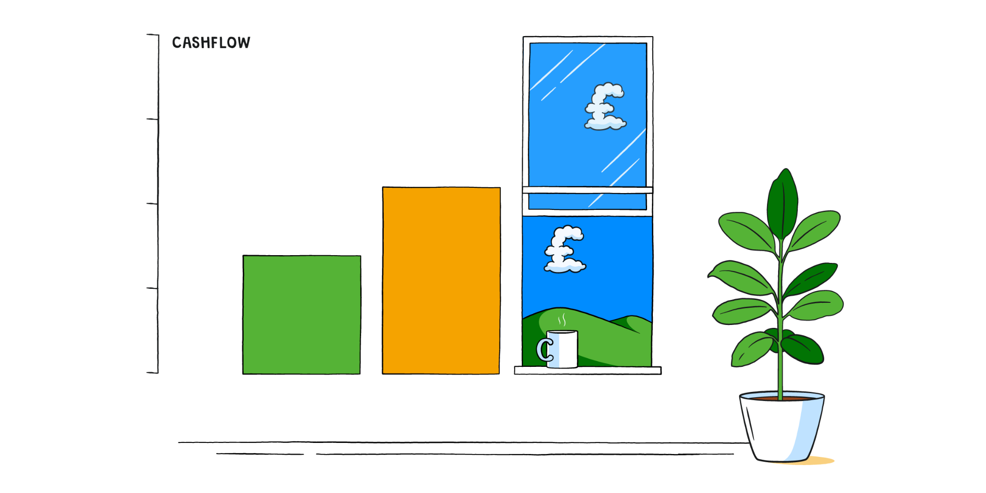
The main features that can change your day-to-day
Cashflow
A short-term cashflow forecast automatically updated using the data in your FreeAgent account. Also, get alerts of any cashflow issues with an early warning system.
Notes:
Cashflow
A short-term cashflow forecast automatically updated using the data in your FreeAgent account. Also, get alerts of any cashflow issues with an early warning system.
Get a short-term cashflow forecast that’s automatically updated using the data in your FreeAgent account
Edit events manually to create your own custom cashflow scenarios
Get alerted to any cashflow issues on the horizon with an early warning system
Know what action to take with smart suggestions to guide you through any shortfalls
Send quick invoice reminders from the Cashflow dashboard
Export your Cashflow report as a CSV or PDF
Cashflow also provides smart suggestions beside your projection. These include actions such as chasing an overdue invoice or paying an upcoming bill.

Slide 9
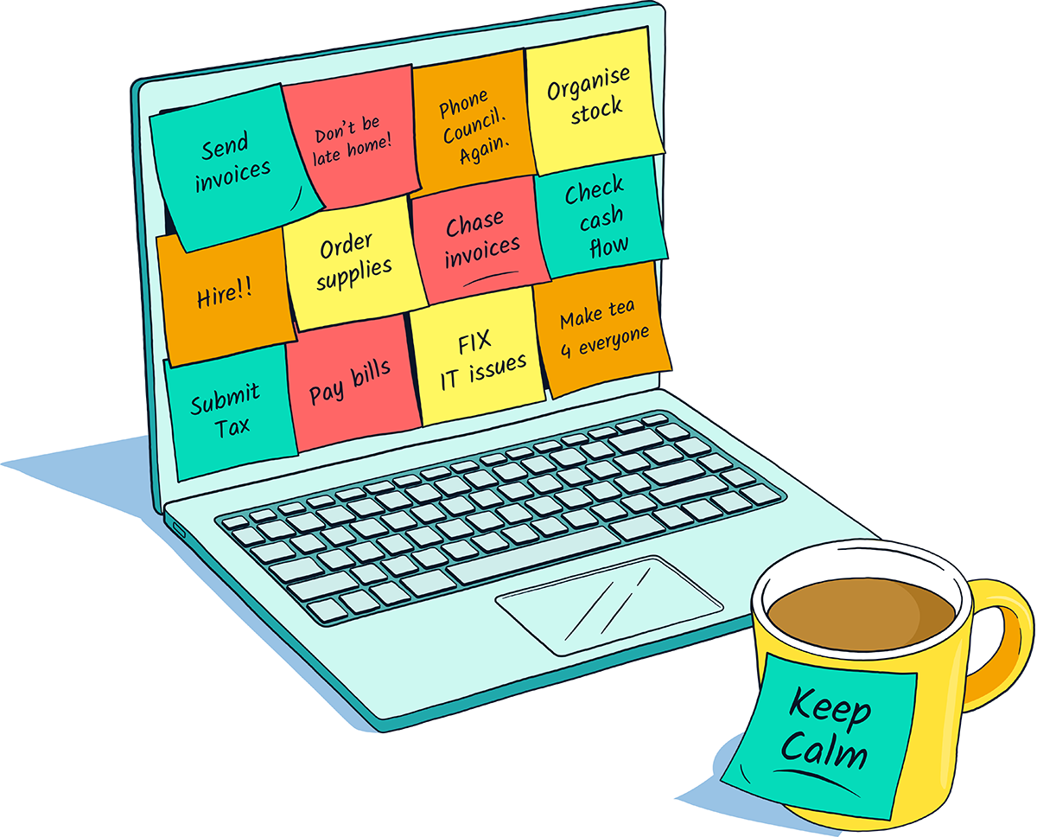
The main features that can change your day-to-day
Project Management
A short-term cashflow forecast automatically updated using the data in your FreeAgent account. Also, get alerts of any cashflow issues with an early warning system.
Notes:
Project Management
Set up and keep track of a new project to have clear visibility of your project as a whole, including profitability, estimates, tasks, time slips and expenses.
When you're working on a project, keeping track of everything can be tricky. With projects in FreeAgent, all your activity is all in one place so you can have clear visibility of your project as a whole.
Once your project is set up, build a list of tasks and track both billable and non-billable time against each task. By linking time sheets, invoices, and expenses to your project, you can see how many hours you've worked, how much you've been paid, and how much you've spent. Using this information, FreeAgent builds up a real-time view of your project's profitability.

Slide 10
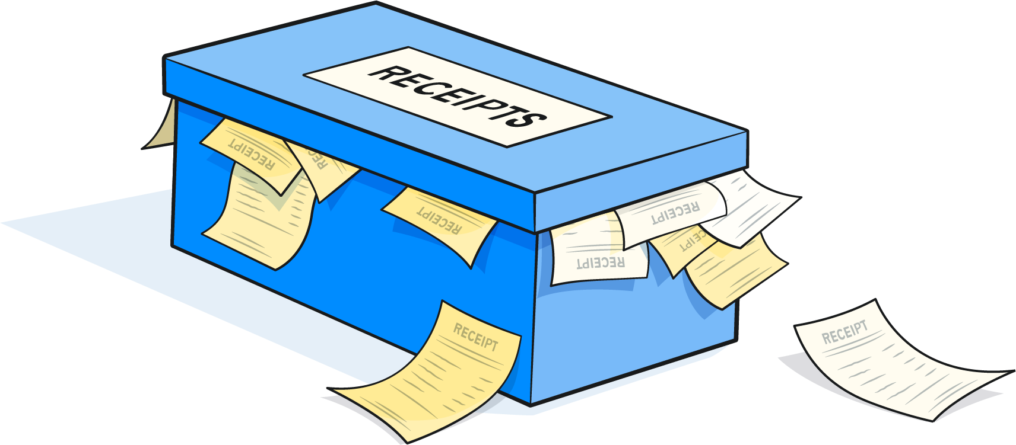
The main features that can change your day-to-day
Expenses
Record expenses and track your business costs and expenses easily while you’re on the go.
Notes:
Expenses
Record expenses and track your business costs and expenses easily while you’re on the go.
With FreeAgent you can track bank payments and out-of-pocket expenses so that recording expenses doesn’t fall behind. More specifically, with FreeAgent you can:
Track business costs and expenses quickly and easily
Record out-of-pocket expenses while you’re on the go
Keep track of supplier invoices and accounts payable status
Track employee expenses with flexible reporting
See your tax liabilities update in real time based on the expense data you enter
Record mileage claims on the go using HMRC’s allowable rates
You can even set up automatically recurring expenses so that you don’t have to worry about entering them every time.
As we’ll see, expenses as a feature is powered by the FreeAgent mobile app. We’ll dive into that next.

Slide 11


Easy access on-the-go
Mobile app
FreeAgent’s mobile app and Open Banking technology give you a clear view of your cashflow, bank balances, tax deadlines and more.
Available on iOS App Store or Google Play Store.
Bank feeds
FreeAgent connects to your bank accounts to automatically import your transactions, showing you at a glance your profit and loss in real time, including business insights for better business decisions.
Notes:
Mobile app
FreeAgent’s mobile app and Open Banking technology give you a clear view of your cashflow, bank balances, tax deadlines and more. Available on iOS App Store or Google Play Store.
You don’t have to download many different apps for each feature you need like other accounting app providers do. This is a big difference between FreeAgent and what else is out there. Their mobile app is easy and quite accessible. It’s all in one place: you submit information, scan receipts, explain a transaction or simply have a look at your account overview any time you want. Unsurprisingly, the FreeAgent mobile app won the 2021 ICB Luca Awards Client App of the Year. If you can use your internet banking app on your phone, you can use FreeAgent.
Some of the benefits of the mobile app include:
snap photos of your receipts and create expenses
send and manage invoices
track time on your phone and create timeslips
get tax timeline notifications
Bank feeds
FreeAgent connects to your bank accounts to automatically import your transactions, showing you at a glance your profit and loss in real time, including business insights for better business decisions.
Once you set up your bank feed, your transactions will flow into your FreeAgent account automatically, making it easy for us, as your accountant, to securely view your business figures from any device.
Some of the main features and benefits of bank feeds in FreeAgent include:
Bank feeds are available for all major UK banks
FreeAgent automatically explains new transactions based on previous descriptions to save even more time
Crystal-clear bank account charts, including aggregated account balances
Support for multi-currency bank accounts
Explain transactions on the go on the FreeAgent mobile app
Search your transactions easily by description, category or amount

Slide 12

Get started
with FreeAgent
✅ Connect your bank account
✅ Download the mobile app
(iOS App Store or Google Play Store)
✅ Explain your transactions
✅ Send your first invoice
✅ Add an expense
For more details, read here.
Notes:
FreeAgent created a quick checklist for new clients to go through to familiarise themselves with the app. This is particularly useful because it gives us a chance to show you that the product is easy and very straightforward. Many of the actions on this checklist are all about creating automations, saving you time already from day one of using FreeAgent. These are essential steps to get started with FreeAgent, but it won’t take us long if you’d like to go through it today.
✅ Connect your bank account
If you connect to your online bank account, FreeAgent will automatically import your transactions every day, so that you can see everything all in one place, for example on the mobile app.
✅ Download the mobile app (iOS App Store or Google Play Store)
Try the app for yourself, it’s easy to use and familiar to other apps you already use every day. If you can work your online banking app, you’ll able to work out the FreeAgent app.
✅ Explain your transactions
Once you explained a couple of transactions, powered by AI, Freeagent will automatically categorise transactions, so you won’t have to spend much more time on this.
✅ Send your first invoice
Choose a theme, add your logo, fill in the details, add a one-click payment link and then send the invoice to your client - done in just a couple of clicks. You can even invoice while you’re on the go with the FreeAgent mobile app.
✅ Add an expense
You can use the FreeAgent mobile app to snap receipts and record out-of-pocket expenses while you’re out and about, or scan your receipts and store the information there for you to deal with later.
For more details and step-by-step guides, read here.

Slide 13

You could get FreeAgent for free…
You could get FreeAgent for free while you retain a business bank account with NatWest, Royal Bank of Scotland or Ulster Bank, or make at least one transaction a month through a Mettle bank account.*
*Optional add-ons may be chargeable.
Notes:
You could get FreeAgent for free while you retain a business bank account with NatWest, Royal Bank of Scotland or Ulster Bank, or make at least one transaction a month through a Mettle bank account. Optional add-ons may be chargeable.

Slide 14
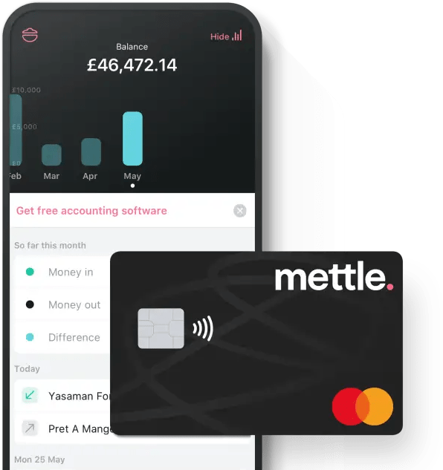
Mettle and FreeAgent for free
What’s Mettle?
Mettle is the free mobile business account by NatWest that provides small businesses and self-starters with the resources they need to start, run and grow their business. Mettle is completely free and you can apply in minutes. Check if you’re eligible for a Mettle account.
The offer with FreeAgent
Mettle by NatWest is a free business bank account for small businesses that gives you access to FreeAgent accounting apps for free.*
*For as long as Mettle is your primary business account in FreeAgent. Optional add-ons may be chargeable.
Notes:
What’s Mettle?
Mettle is the free mobile business account by NatWest that provides small businesses and self-starters with the resources they need to start, run and grow their business.
Mettle is completely free and you can apply in minutes. Check if you’re eligible for a Mettle account.
The offer with FreeAgent
Mettle by NatWest customers can access FreeAgent for free. For as long as Mettle is your primary business account in FreeAgent. Optional add-ons, such as Amazon and Smart Capture, incur a small monthly cost.

Slide 15
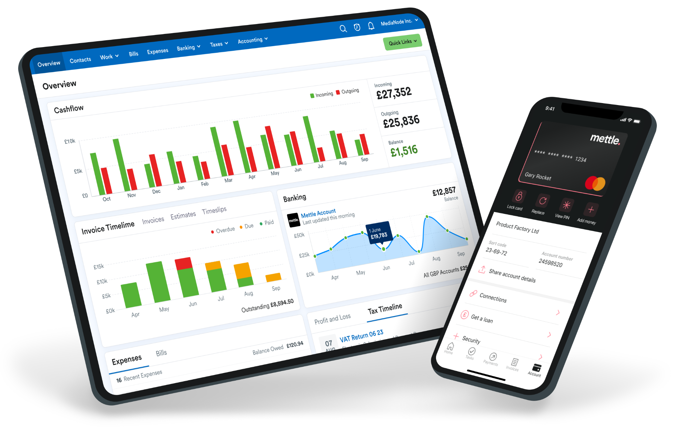
Get started with Mettle and FreeAgent
✅ Download the app from the iOS App Store
or the Google Play Store or apply online.
✅ Go through the Mettle account application process. It should only take a few minutes.
✅ Let us know your account number and sort code once your Mettle account is open and we’ll take care of setting up your free FreeAgent account.
Notes:
FreeAgent created a quick checklist for Mettle clients to go through to familiarise themselves with the app. This is particularly useful because it gives us a chance to show you that the product is easy and very straightforward. These are essential steps to get started with Mettle and FreeAgent, but it won’t take us long if you’d like to go through it today.
✅ Download the app from the iOS App Store or the Google Play Store or apply online.
✅ Go through the Mettle account application process. It should only take a few minutes.
✅ Let us know your account number and sort code once your Mettle account is open and we’ll take care of setting up your free FreeAgent account.

Slide 16

Thank you

