Slide 1
Lakota Health & Advocacy
Introduction

Slide 2
Content
Content | Page
About | 3
What is Lakota Health? | 4
What is an Advocate? | 8
Why is it important for us as Lakota to be Health Advocates? | 12
Closing | 17

Slide 3
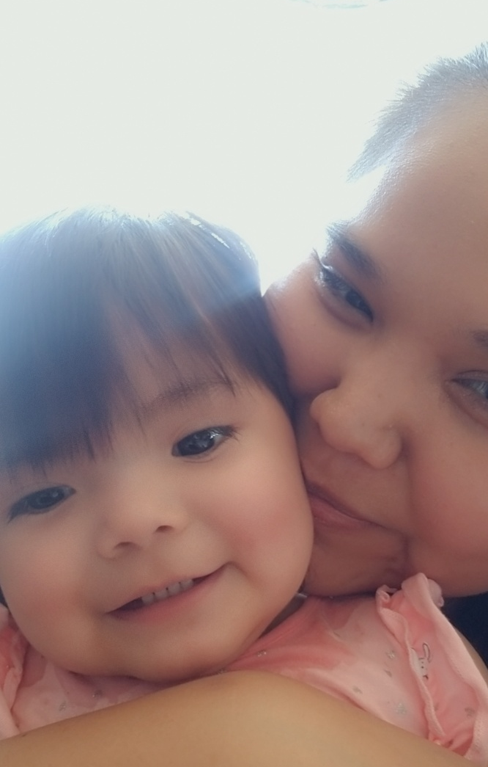
Introduction
About me:
Katrina Fuller
Sicangu Lakota
BA in Behavioral Neuroscience and Anthropology
Health Initiative Director at Sicangu CDC
About SCDC Health Initiative:
Four Initiatives: Health, Food Sovereignty, Education, and Housing.
www.sicangucdc.org
www.facebook.com/sicangucdc/
3-sisters partnership

Slide 4
What is Lakota Health?

Slide 5
What does it mean to be Lakota?
7 Lakota Values
Waohola - Respect
Waunsila - Compassion
Wowicake - Honesty
Wawokiye - Generosity
Unsiiciyapi - Humility
Woksape - Wisdom
Wowacintanka – Perseverance
Values
Connectedness
Mitakuye oyasin
Mitakuye Oyasin
Animals
Plants
Spirits
Family
Nation
Generational – time
Knowledge & Experiences
Knowledge
Lakota Language
Ceremonies & Songs
Medicinal Plants knowledge
Traditional Foods
History
7 Generation Sustainability
Notes:
Our question is what is Lakota Health? Or we can phrase it as, what does it mean to be Healthy Lakota People?

Slide 6
What does it mean to be Healthy as Lakota?
Mitakuye Oyasin
Physical
Emotional
Spiritual
Mental
Environmental
Social
Financial
Lakota Values
Waohola - Respect
Waunsila - Compassion
Wowicake - Honesty
Wawokiye - Generosity
Unsiiciyapi - Humility
Woksape - Wisdom
Wowacintanka – Perseverance
Values
Connectedness
Mitakuye oyasin
Knowledge & Experiences
Knowledge
Shooting an arrow
Purification - Sweat
Ceremonies & Songs
Medicinal Plants & Healthy foods
7gen - Sustainable harvesting and hunting
History and relationships
Supporting your family, buffalo
Notes:
Our question is what is Lakota Health? Or we can phrase it as, what does it mean to be Healthy Lakota People?

Slide 7
Lakota Health
Lakota Health is founded on our Lakota values, knowledge, and experiences. Lakota Health is holistic and connected on many different levels and areas such as:
Areas:
Physical
Emotional
Spiritual
Mental
Environmental
Social
Financial
And more?
Levels:
Individual
Family
Community
Region
National
World
Notes:
It is holistic because we recognize the connection between these areas and each other.

Slide 8
What is a Lakota Health advocate?

Slide 9
What is a Lakota Health Advocate?
Definition: Advocacy is an activity by an individual or group that gives support or recommendations of a particular cause or policy. A Health Advocate simply promotes health.
Our Lakota approach to Health Advocacy covers the many areas and levels we discussed earlier around Lakota Health.

Slide 10
Who can be a Health Advocate?
YOU
Children aka “Little Health Advocates”
Parents
Grandparents
Cousins
Friends
Trusted Strangers
Communities (Community members and Community Representatives)
Organizations (like SCDC Health Initiative)
RST Government (Council and Executives)
Online
In-person
Over the phone

Slide 11
What does this look like for us on Tribal Lands?
A Lakota Health Advocate promotes Lakota Health. What does this look like for us on Tribal Lands?
Promote Access and Resolve barriers to services that improve and maintain holistic health.
Resolve medical bills, student loans, or any other bill.
Mentorship on ceremonies and cultural knowledge ie sweat, sundance, etc.
Access to running water and electricity
Navigating the process to getting a home.
Applying for help and benefits such as EBT, TANF, GA, student tuition and testing waivers, etc.
Continuing Education
Childcare
Navigating the local healthcare systems and Insurance ie Indian Health Services, Horizon Health, Winner Hospital, Valentine Hospital, SF Dental etc.
Different levels of financial obligations ie IHS contract health, insurance copays & deductible etc.
Different levels of quality and trusted/stable medical professionals
Different types of services offered at differing times of the week or month.
Understanding and Advocating for our selves in our Government to Government relationship with the US.
Education
Voting
Census 2020
Accountability of Treaties

Slide 12
Why is Health Advocacy Important for us as Lakota?

Slide 13
Our History of health
Our history of health is linked to Colonization and intergenerational trauma.
Introduction of Alcohol
Abuse in schools and the Boarding School Era
Killing of buffalo to almost extinction
Removal of lands & forced placement on reservations
Removal and desecration of historical and sacred sites
Displacement of families through urbanization
Killing and oppressing our Lakota language, culture, knowledge, and ceremonies
Monopolization of goods and services on reservations
Not following treaty obligations

Slide 14
Our History of health

Slide 15
Current Holistic health statistics
Life Expectancy = 56 yrs
(SD Dept. Health, 2015)
Unemployment Rate = 83%
(BIA.gov)
Educational Attainment of H.S. Diploma or higher = 77.9%
(2012-2016 ACS)
Median Household Income = $26,938
(2012-2016 ACS)
Poverty Rate = 48.9%
(2012-2016 ACS)
Buffalo, M., & Bordeaux, S. (2017). Sicangu Oyate, Rosebud Sioux Tribe Community Profile. Report by the Rosebud Sioux Tribe Health Administration, 2017.

Slide 16
What does it look Like to be a health advocate here on the Rosebud Reservation? Everyone needs some help.
Example 1. You advocate for yourself!
Advice: Always ask questions.
Example 2. You or someone else advocates for you or another individual.
Advice: Believe the person you’re advocating for, because other medical professionals may not.
Example 3. A larger organization advocates for you and your community.
Advice: Larger organizations need support and to stay connected to current issues. You are that supportive voice.
Example 4. Accountability for Treaty Obligations
Advice: Understanding that we are a sovereign nation, and enforcing that.

Slide 17
Pilamayaye!
What we covered:
What is Lakota Health?
What is a Lakota Health Advocate?
Why is Health Advocacy Important for us as Lakota?
www.Sicangucdc.org
www.Facebook.com/Sicangucdc
Katrina Fuller, Health Initiative Director
Katrina.Fuller@sicangucorp.com

