Slide 1
Lakota Health & Advocacy
COVID19

Slide 2
Content
Content | Page
About | 3
How can we be Health Advocates during a Pandemic? | 4
RST Community Resources | 10
Closing | 11

Slide 3
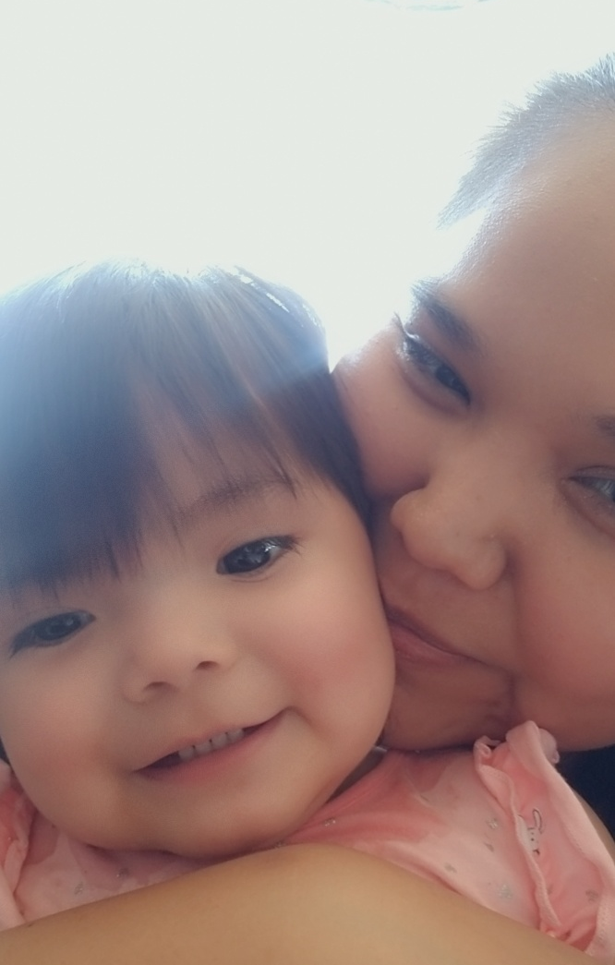
Introduction
About me:
Katrina Fuller
Sicangu Lakota; Antelope community member
BA in Behavioral Neuroscience and Anthropology
Health Initiative Director at Sicangu CDC
About SCDC Health Initiative:
Four Initiatives: Health, Food Sovereignty, Education, and Housing.
www.sicangucdc.org
www.facebook.com/sicangucdc/
3-sisters partnership: Sicangu CDC, Tatanka Fund CDFI, REDCO.

Slide 4
How can we be Health Advocates during a Pandemic?

Slide 5
Our approach to health advocacy – Lakota style
Values
Connectedness
Mitakuye oyasin
Being a good Health Advocate means you will have to do some online research!
What is COVID19?
Who is affected and how?
Are there treatments?
How do we stay safe?
Preventing contraction and spread
Treatment after contraction
Addressing other Holistic Health Areas
Knowledge & Experiences
Notes:
Our question is what is Lakota Health? Or we can phrase it as, what does it mean to be Healthy Lakota People?

Slide 6
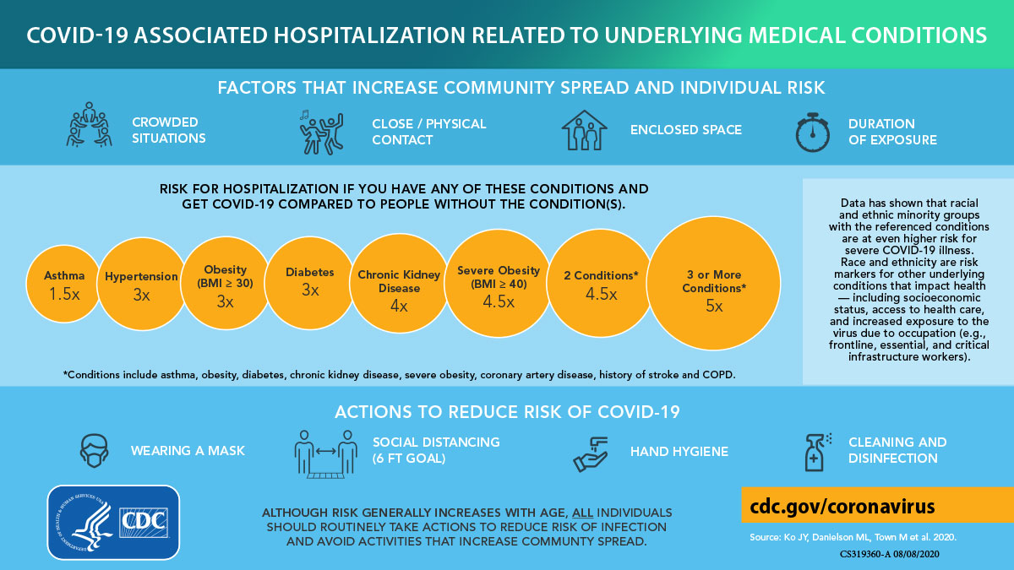
Understanding COVID19
Notes:
It is holistic because we recognize the connection between these areas and each other.

Slide 7
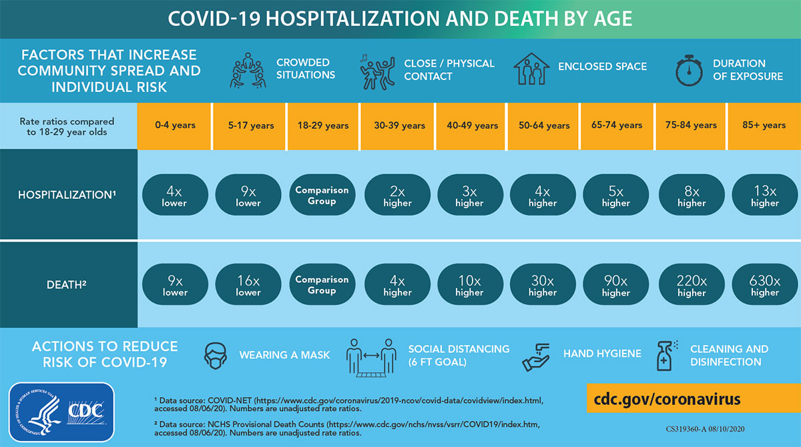
Understanding COVID19
About 35% of the Rosebud Sioux Tribe is over age 35+.
(ACS, 2014-2018)
Notes:
It is holistic because we recognize the connection between these areas and each other.

Slide 8
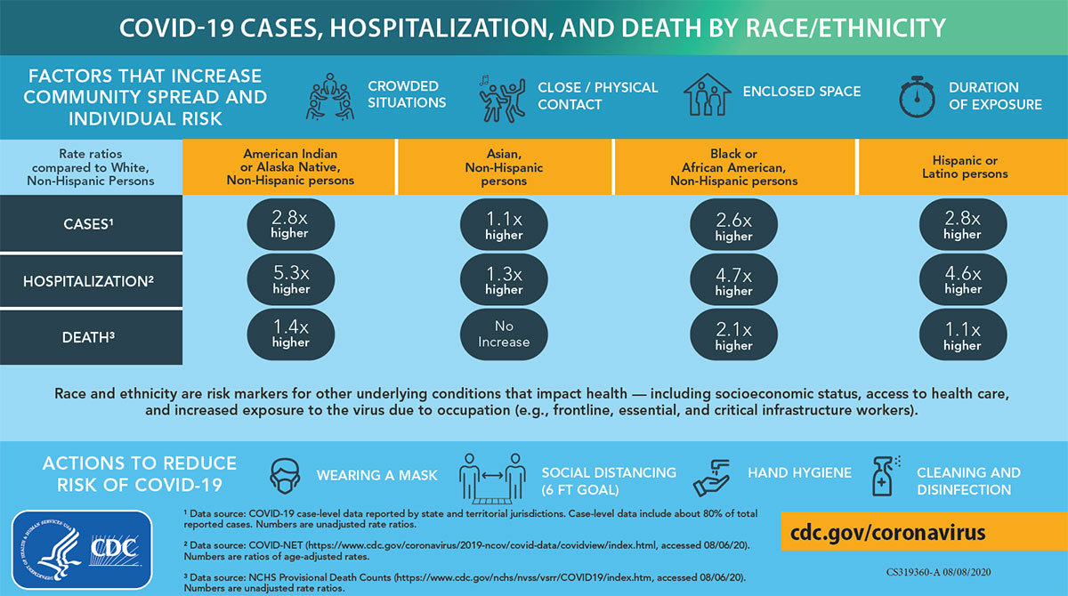
Understanding COVID19
Notes:
It is holistic because we recognize the connection between these areas and each other.

Slide 9
After doing our research, How do we advocate?
We all should prevent Contraction and Spread by:
Social Distancing
Wearing Face Masks
Washing Hands
Avoiding Large Gatherings
Track and maintain our family’s health ie temperature, symptoms, daily list of contacts
Getting Tested
Being Respectful and Compassionate because we ALL will need help.
SELF CARE
Promote Access and Resolve barriers to services that improve and maintain holistic health.
We are all accountable for social distancing
Access to face masks ie DIY, sewers, family, tribe
Ability to social distance– self-discipline and parenting, nature walks, home quarantine plan, tribal quarantine,
Staying connected – phone, internet, social media
Tracking health the best way we can
Navigating local resources, local healthcare systems and Insurance ie Indian Health Services, Horizon Health, Winner Hospital, Valentine Hospital, Tribal Health Department etc.
Keeping up to date on covid19 related info from Tribe, CDC and WHO.
Asking questions
Getting Tested and researching tests and test results.
Limiting hospital visits but maintaining medical conditions.
Understanding and Advocating for our selves in our Government to Government relationship with the US.
Census 2020
Voting – Tribal, State, US
Treaties and Sovereignty – Improving our health our way

Slide 10
RST Community Resources

Slide 11
Understanding COVID19: Doing the research!
For more information on the Pandemic: https://www.cdc.gov/coronavirus/2019-ncov/index.html
For the most updated RST COVID19 information and anouncements: https://www.rosebudsiouxtribe-nsn.gov/rst-coronavirus-information
Learn more about the Tribe’s COVID19 Response through the RST CARES office: https://www.facebook.com/Rosebud-Sioux-Tribe-Cares-Office-107687561022108
Stay updated with RST Council Meetings on the RST Youtube page: https://www.youtube.com/channel/UCrUgHaUYJ08gyvo9hjSkgPQ
Tribal Council Members (our governmental health advocates): https://www.rosebudsiouxtribe-nsn.gov/tribal-government
ST. FRANCIS MISSION SUICIDE HOTLINE: (605) 319-1280
TOKALA INAJINYO SUICIDE PREVENTION PROGRAM: (605) 856-2587
YOU THINK YOU or SOMEONE YOU KNOW HAS COVID19? THEN SPEAK WITH A NURSE (605) 747-0532 OR (605) 747-0533
Notes:
It is holistic because we recognize the connection between these areas and each other.

Slide 12
Pilamayaye!
What we covered:
How we can be Health Advocates during this Pandemic.
Learning to do the Research
Why the RST is a vulnerable population
How we can Advocate locally – 3 areas.
Community Resources
www.Sicangucdc.org
www.Facebook.com/Sicangucdc
Katrina Fuller, Health Initiative Director
Katrina.Fuller@sicangucorp.com

