Slide 1

Modular systems & Built in Redundancy
Presenter: Doug Halterman
Title: Branch Manager - Pittsburgh
Organization: H&V Equipment Sales
Notes:
Good Afternoon everyone. We are excited to host this webinar today and thanks for joining us. My name is Shaz Syed and I am the engineering applications and training manager for the Commercial division here at Bosch.
Couple of house-keeping rules before we start, you can ask questions in the chat section below during the webinar which we will answer after the presentation or use the “raise hand” feature on the top to verbally ask the question. Also, we will enable that at the end of the presentation.
The purpose of this webinar is to introduce you to the True Modular Boiler design and review the SSB product line.
Per the ASHRAE data in 2018, condensing boiler market for sizes ranging from 800 MBH to 4000 MBH is approx.. $450M USD. This also represents the biggest chunk of the commercial condensing market. In this market, there are several manufacturers fighting for the slice of this business.
We feel we have a unique product selection to compete in that market segment. Our SSB boiler is built on the fundamentals of the modular systems with built-in redundancy.
Jake Porter will be the primary presenter for this webinar and I will help to answer with any questions that may come after the webinar.

Slide 2
AGENDA
Introduction to Modular Systems
Conventional Systems
Advantages of Modularity
Redundancy in Modular Systems
Flexibility in Primary-Secondary Design
Example
SSB Features
Questions
Notes:
In this presentation, we will start with the:
Introduction to Modular Systems, then provide a brief overview of
Conventional Systems
We will highlight the Advantages of Modularity
Redundancy in Modular Systems
Flexibility in Primary-Secondary Design
Provide you an Example to make the case of modular systems
SSB Features
Finally, we will take your Questions

Slide 3
Intro to modular systems

Slide 4
WHAT ARE MODULAR SYSTEMS?
Multiple smaller units combined together, acting as “stages” in a “cascade” to reach the required capacity
Inherently redundant, a high number of stages means shutting one down subtracts less capacity from the total available
Smaller equipment per stage reduces repair cost and time, reduces specialization requirements of technicians
Water volume and heat transfer surface area per unit of energy input are consistent as plant gets larger, maintaining efficiency
4
Thermotechnology | TT/SNA-C | 2018-06-21
© Bosch Thermotechnology Corp. 2018. All rights reserved, also regarding any disposal, exploitation, reproduction, editing, distribution, as well as in the event of applications for industrial property rights.
Notes:
lets start with the definition of a true modular system. It is a simple design that uses multiple small modular boilers that are activated sequentially, with all other boilers isolated until needed. The efficiency of its design is most apparent during warmer months, when less than maximum load is needed.
In comparison with the conventional boiler systems, this will demonstrate that they are simple to design, require low maintenance, provide energy savings, and cost effective. The true modular boiler will result in 35-50% energy savings over the conventional heating system.
Modular systems combine smaller units to create larger systems as a whole. They create redundancy while still having the flexibility to meet a wide range of demand.
The smaller modules whether installed independently or in a system require less specialization for service and repair, reducing potential for downtime and overall cost of ownership.
Additionally, the overall heat transfer area per unit of energy is uniform over the range of modules in a system, creating consist efficiency over the entire heating load. (Unlike high turn-down boilers whose efficiency may be compromised at the higher turn down ranges)

Slide 5
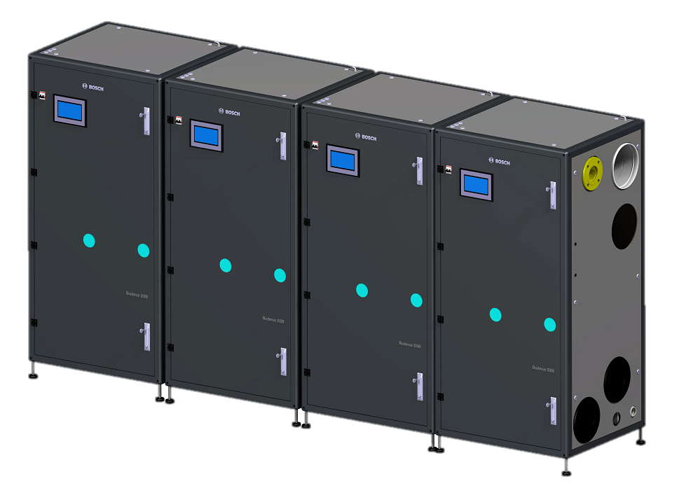
WHAT ARE MODULAR SYSTEMS? (Continued…)
As the capacity required for a given system grows, additional units are added to meet demand
  Modular systems typically allow additional units to be added easily if demand should increase
  Individual pieces are small and easy to service or replace
  Maximum installation flexibility and minimal space requirements
5
Thermotechnology | TT/SNA-C | 2018-06-21
© Bosch Thermotechnology Corp. 2018. All rights reserved, also regarding any disposal, exploitation, reproduction, editing, distribution, as well as in the event of applications for industrial property rights.
Notes:
With residences, the power needs of an HVAC system remain more or less the same regardless of who is living in the house. Commercial spaces, on the other hand, have fluctuating needs based on the nature of the business, the number of employees and the presence of equipment such as computers which may require specific temperatures. Modular systems allow you to add and subtract power levels without replacing the whole HVAC system: adjusting for new occupants, expanded business needs and the like for minimal effort.

Slide 6
CONVEnTIONAL cascading
Notes:
Conventional Cascades

Slide 7
CONVENTIONAL CASCADES
Traditional design would use one large unit with >100% of load
  “Cycling” in such systems is a given, the boiler will always exceed demand
  Such large capacity boilers come with a large footprint
  Low cycle efficiency and standby losses can account for as much as ~40% of annual fuel consumption in such installations
Better efficiency achieved using two boilers @ 65% to 100% of load
  Cycling efficiency increased by using smaller equipment, but still larger than necessary for most of the year
  Adds redundancy to the system, but one boiler being offline increases the pressure on the second unit to continue operating
7
Thermotechnology | TT/SNA-C | 2018-06-21
© Bosch Thermotechnology Corp. 2018. All rights reserved, also regarding any disposal, exploitation, reproduction, editing, distribution, as well as in the event of applications for industrial property rights.
Notes:
Large footprint – impractical for many new installations – impossible for majority of replacement applications
Single boiler application has very limited load match capabilities.
Excessive cycling (run hours) due to exceeding demand
Reduced cycle efficiency (not allowing for steady state performance)
What do you mean by conventional cascading. It does not mean old non-condensing low efficiency boilers. We are only talking about how these systems are designed.
Traditional designs would often use a single boiler for the entire system. So, each boiler would be designed for larger than 100% of the heat load.
This leads to issues such as cycling which means boiler exceeding the demand of the system requirement.
This systems will have large footprint thus making it difficult to fit through the regular door.
Finally, due to frequent cycling, the boiler takes large amount of energy to revamp every time the demand is generated.
The traditional design has evolved slightly so now we see two boilers being designed at 65% to 100% of the heating load.
This provides slight improvement in cycling hours while adding redundancy to the systems. However, this simple reduces the stress on the heat exchanger while not correcting the bigger problem.

Slide 8
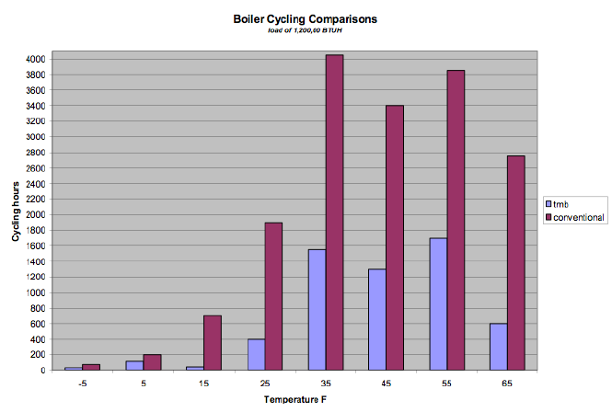
SHORTCYCLING
Occurs whenever the load is below the boiler’s lowest firing rate
  Improper control can cause cycling even at higher loads
Every cycle consumes energy initiating the combustion process, warming up the chamber, etc.
  Cycling loses can account for as much as 30% of annual fuel consumption
Chart compares modular and conventional boiler systems at varying outdoor temperatures
8
Thermotechnology | TT/SNA-C | 2018-06-21
© Bosch Thermotechnology Corp. 2018. All rights reserved, also regarding any disposal, exploitation, reproduction, editing, distribution, as well as in the event of applications for industrial property rights.
Notes:
Explain and example
1 mil btu boiler turndown 5:1
100,000 btu load
Its not until the system demand exceeds the minimal burner firing rate that you achieve a longer burner cycle and steady state efficiency.
Excessive cycling is wear and tear on the equipment. Increasing service time for replacement parts; reducing boiler lifespan.
Inefficient operation.
This Chart shows a comparison between modular and conventional cascade.
Modular system has significant reduction in run hours vs conventional cascade.
Boiler cycling “the boiler killer”. Maximum 4 boilers cycles per hour.

Slide 9
advantages of modularity

Slide 10
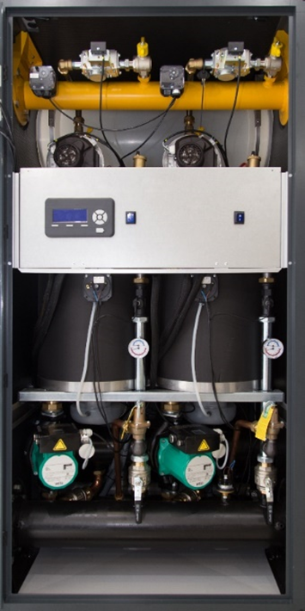
ADVANTAGES OF MODULARITY
Far less cycling will take place, as multiple units can be operating together to meet demand, only staging on or off during very large load swings
  Efficiency increases because each stage operates in a steady state, burning only the fuel required for the load
  The boiler lifecycle will be extended by the reduced cycling stresses on heat exchangers and parts
Compact design of factory completed assembly, very little clearance required in the mechanical room
  Prefabrication means no customization, but it makes installation very easy
10
Thermotechnology | TT/SNA-C | 2018-06-21
© Bosch Thermotechnology Corp. 2018. All rights reserved, also regarding any disposal, exploitation, reproduction, editing, distribution, as well as in the event of applications for industrial property rights.
Notes:
Smaller units allow ease of access for new and existing applications.
Allow for easy addition of modules (system expansion)
More closely match the system load demands
Reduce cycling (run hours). Load matching vs just high turndown (stable operation at each stage (module) means stable operation and efficiency through the entire of capacity. (SSB100-TL-4 40:1)
Minimize service time without sacrificing functionality of complete system

Slide 11
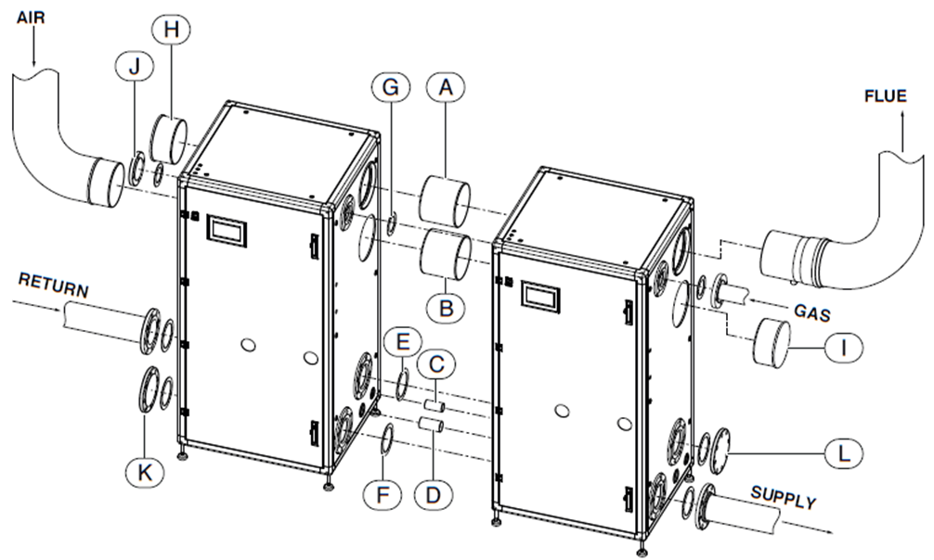
ADVANTAGES OF MODULARITY
Smaller individual pieces are easier to move into place in compact mechanical rooms
  Equipment is typically small enough to enter standard doors
Forklifts are not required, manual pump trucks or dollies are adequate
Units are light and simple, allowing same day install and start up
11
Thermotechnology | TT/SNA-C | 2018-06-21
© Bosch Thermotechnology Corp. 2018. All rights reserved, also regarding any disposal, exploitation, reproduction, editing, distribution, as well as in the event of applications for industrial property rights.
Notes:
Handling and Installation
Smaller, lighter and more compact.
Easy to get into tight spaces, through standard doors.
Individual modules do not require a hand truck.
Manual pallet jack is sufficient.
Easy to get into tight spaces, through standard doors.
Same day installation and start-up.

Slide 12
Redundancy in modular systems

Slide 13
THE VALUE OF REDUNDANCY IN BOILER SYSTEMS
Not uncommon for a boiler to be offline for ~5-10% of the year for maintenance, cleaning etc.
Larger equipment costs more to shutdown and service
Without back up, shutting down equipment for annual maintenance must be timed for when the equipment is not required
  This is difficult if the equipment is required for year-round loading
Technical issues need to be resolved urgently
  ASHRAE estimates 90%/yr @ load = <60%; 80%/yr @ load = <50%
  Stage size should be limited to 35% to 50% of load, so that even when down one stage, required capacity is available 80 to 90% of the year
13
Thermotechnology | TT/SNA-C | 2018-06-21
© Bosch Thermotechnology Corp. 2018. All rights reserved, also regarding any disposal, exploitation, reproduction, editing, distribution, as well as in the event of applications for industrial property rights.
Notes:
Why do we need redundancy?
Disadvantages of single boiler systems
have greater costs associated with service
Can be offline 5-10% of the year
Creates emergency situation (must be resolved urgently to get system back on line)
ASHRAE recommend stage size be limited to 35-50% of load to maintain capacity 80-90% of the year.
Before we talk about the value of the redundant system, lets talk about why it is needed in the first place.
We can expect any boiler to be down 5-10% of the year for maintenance and cleaning purposes.
In a conventional cascade, this can lead to several issues
Entire boiler would have to be shut off
Large the system, harder it would be to service
And requiring a back up boiler to provide service when the primary system is shut off
Another reason to have redundancy is because you are only expected to use the peak load of the boiler for less than 10% of the year. ASHRAE recommend stage size be limited to 35-50% of load to maintain capacity 80-90% of the year.

Slide 14
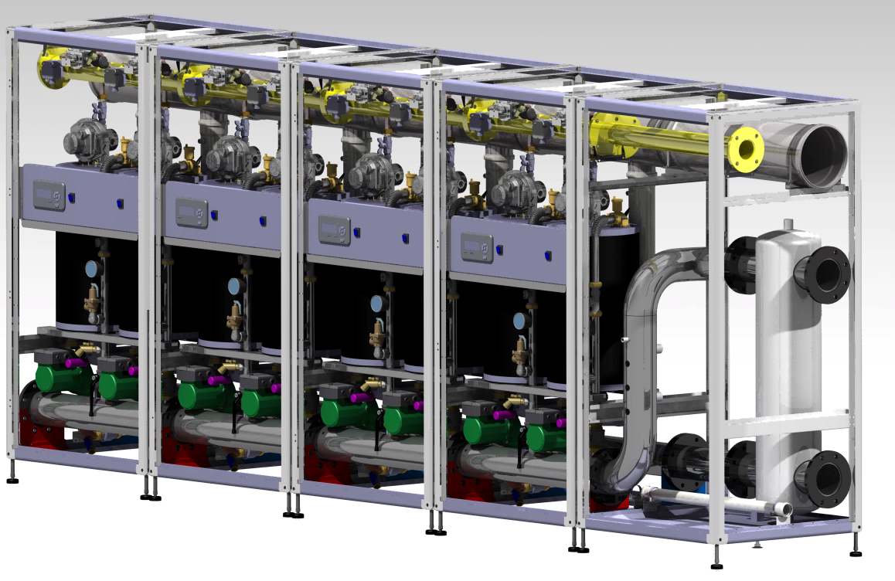
REDUNDANCY IN MODULAR SYSTEMS
Modular systems build capacity out of multiple stages, so no one stage is likely to be above 35% of load
The larger the plant, the greater the redundancy
Good redundancy factors for design are 3@50%, 4@35%, or 4@50%, depending on owner requirements
14
Thermotechnology | TT/SNA-C | 2018-06-21
© Bosch Thermotechnology Corp. 2018. All rights reserved, also regarding any disposal, exploitation, reproduction, editing, distribution, as well as in the event of applications for industrial property rights.
Notes:
The larger the plant, the greater the redundancy. As a rule of thumb, we recommend any design include 3 boiler @50%, 4 boilers @35% or 4 boilers @50% depending on the owner requirements.

Slide 15
Flexibility in primary-secondary design

Slide 16
WHAT IS PRIMARY-SECONDARY PIPING?
Most modular systems take advantage of Primary-Secondary (PS) piping, as it allows the most compact installation and greatest flexibility of design.
PS is the simplest way to connect a boiler plant to a hydronic system
  System loop activity has no impact on boiler side flow conditions, so boiler selection is not limited by system configuration, or vice versa
PS accommodates a broad range of retrofits
  Different or extra boilers can be added with no impact on system loop flow conditions, with only simple pump controls required
With “hydraulically separated” boiler plants and PS piping, more boilers can be added at any time without affecting system operation
16
Thermotechnology | TT/SNA-C | 2018-06-21
© Bosch Thermotechnology Corp. 2018. All rights reserved, also regarding any disposal, exploitation, reproduction, editing, distribution, as well as in the event of applications for industrial property rights.
Notes:
The simplest method (piping) to connect a boiler plant to a system loop without either system effecting the other.
Works with any system
Advantages: Additional modules can be added to a boiler plan without effecting system loop.

Slide 17
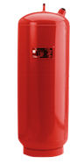

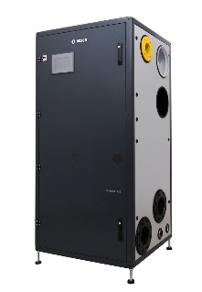
Primary-Secondary Piping w/ Decoupler
EXAMPLE OF MODULAR BOILER SYSTEM
RETURN
SUPPLY
FLOW RATES:
28.5GPM PER MODULE
57GPM PER BOILER
228GPM TOTAL
EXPANSION TANK
PRIMARY PUMP
PRIMARY PUMP
OPTIONAL
57 gpm
57 gpm
SSB BOILER 1
SSB BOILER 2
SSB1000TL4
Notes:
The alternative to placing boilers directly in the system loop is to place the boilers on a separate loop, with additional pumps used to create flow on the boiler side, injecting heat into the system loop as required. This is how our SSB series is piped. One drawback to this system is that additional motors are required for boiler side flow generation, but these motors are smaller in size and can be staged off easily when not in use. The advantage is that the system pumps only have to be sized for the system pressure drop, and because boilers can have their own dedicated circulator, you can mix and match the boiler equipment size and type freely. This makes this piping method the most retrofit friendly, because boiler plant design and configuration cannot interfere with system flow design.
The point where the two loops meet is the “decoupler”, and there’s three different conditions that can occur here (the one shown here is “closely-spaced tees”, see next slides).
NOTES (Present only if time allows):
Which is the “primary” and which is the “secondary” loop is mostly a matter of opinion. Boiler manufacturers often call the boiler loop the primary, but most others will call it the secondary.
Variable speed pumps can be used on the boiler side, and may be valuable in cases where the boiler circulators are large and have large motors. Where many small circulators are used, a large amount of boiler loop flow variation is achievable simply by staging the pumps off.
The piping connections to the plant do not need to be arranged “reverse-return” (i.e. the boiler closest to the supply connection is furthest from the return) when using this piping design, because the boiler pumps already ensure each boiler will have adequate flow.
System pumps can pump into or away from the boiler plant as desired, but if pumping towards the boilers, be aware that the pressure added by the pumps will add to the static system pressure and might exceed the boiler PRV setting (this is less of a concern if the PRV is on the boiler supply connection).

Slide 18
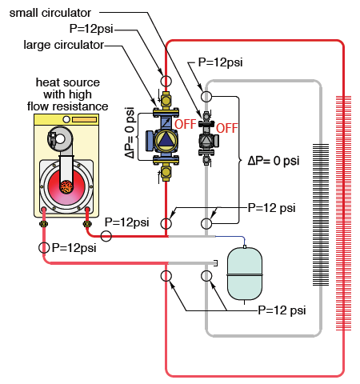
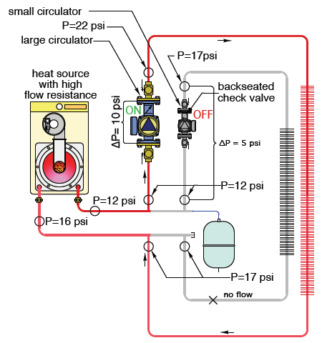
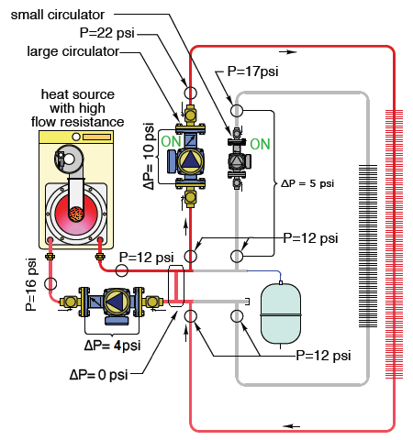
HOW PS SOLVES PRESSURE ISSUES1
When idle, the system stabilizes at 12psi static pressure. This pressure will never change where the expansion tank connects.
When the large circulator activates, it pressure locks the small loop, by creating too large a Delta-P at the small loop connections.
With hydraulic separation, the common piping has (almost) no Delta-P, so either loop can achieve flow.
19
Thermotechnology | TT/SNA-C | 2018-06-21
© Bosch Thermotechnology Corp. 2018. All rights reserved, also regarding any disposal, exploitation, reproduction, editing, distribution, as well as in the event of applications for industrial property rights.
Notes:
This sample shows why hydraulic separation matters.
System at rest, filled to 12PSI. Where the expansion tank connects, the pressure will not change as the pumps activate.
When the first pump activates, it adds 10PSI to the discharge. This pressure has to be lost through the entire loop, to get back to 12PSI at the expansion tank header connection. Because the boiler is currently part of the loop, this means that the pressure at the return header is 17PSI. This places a 5PSI back-pressure on the other system loop, which is equivalent to the pressure the smaller pump can generate, meaning it will not be able to open the seated check valve, and there will be no flow. One solution to this situation would be to use a boiler which does not have so much pressure drop, but the other option is to hydraulically separate the boilers.
With closely spaced tees, a low loss header or a four-port buffer tank installed, the system loop pumps no longer have to pull flow through the boiler plant. The 10PSI the pump generates is lost only in the loop, and the pressure at both the supply and return header is essentially the same. The small pump can then generate the desired 5PSI differential across its loop, and the boiler pump across the boiler heat exchanger. At this point, any combination of system or boiler pumps can be selected with little danger of interfering with the flow in the other loops.

Slide 19
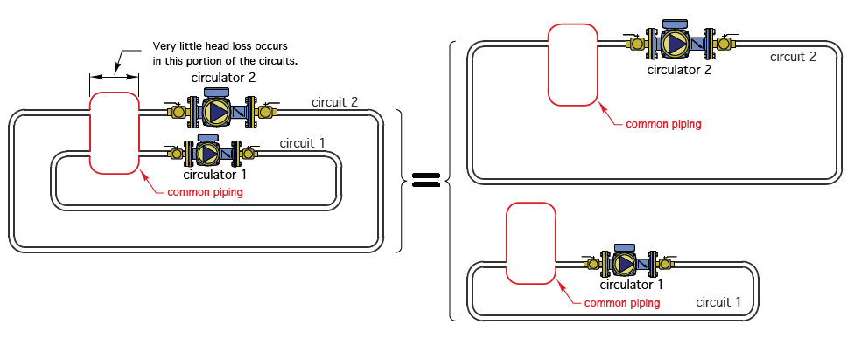
PS REQUIRES HYDRAULIC SEPARATION1
Hydraulic separation means that the pressure differential created by one pump does not interfere with the differential created by other pumps on separate loops.
20
Thermotechnology | TT/SNA-C | 2018-06-21
© Bosch Thermotechnology Corp. 2018. All rights reserved, also regarding any disposal, exploitation, reproduction, editing, distribution, as well as in the event of applications for industrial property rights.
Notes:
First the fundamentals as a refresher.
Hydraulic separation is the idea that while two loops actually share the same water, and are able to transfer heat energy form one side to the other, they do not share the same hydraulic pressure drops, and the pumps on each side can be selected as if the other side simply wasn’t there. In order to accomplish this, a “decoupler” is needed. This can be either closely spaced tees (i.e. two tees where the center points of the branch connections are closer together than four times the diameter of the straight through connections), a four-port buffer tank, or a low-loss header (which is essentially a smaller buffer tank, but which typically has air and dirt separation built in).

Slide 20
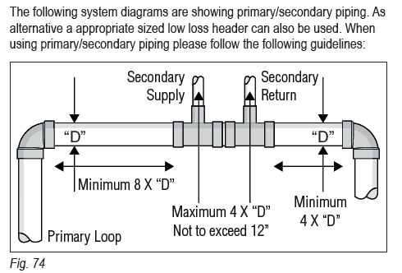
Loop “Decoupler”
HYDRAULIC SEPARATORS
Low-Loss Header
Closely-Spaced Tees
Boiler Circuit
Heating Circuit
BS
HS
D
BR
HR
Notes:
The decoupler on the left is a “Low Loss Header” or “Hydraulic Separator”, essentially a small volume 4-port buffer tank [1]. The “Closely-Spaced Tees” method on the right achieves much the same hydraulic effect, provided they are configured correctly.
Whatever method is chosen, the static pressure at all four connections of the decoupler is, in theory, precisely the same. As a result, changes in the flow rate on one side cannot have an impact on the other side, because the pressure differential cannot cross over the decoupler. But depending on the flow rates on each side, there may be a change in the flow pattern inside the decoupler itself (next slides).
NOTES (Present only if time allows):
Low-loss headers can now be provided that include air, dirt, and even magnetic separation materials inside the header, saving the need for this equipment elsewhere in the system. But from a strictly hydraulic stand point, 4-port buffer tanks are the best decoupler, as they have the lowest possible pressure drop between the connections.

Slide 21
Equal Loop Flow Rates
HYDRAULIC SEPARATORS
•
•
Boiler Circuit
V
=
V
BC
HC
Heating Circuit
100 gpm
Boiler Circuit
Heating Circuit
100 gpm
Notes:
If the flow rate on both loops is the same, then there will be no flow through the center of the decoupler itself, all the water entering will automatically exit. The supply and return temperature on both sides will be the same.
Visually this looks like pumping in series, but because the two sides are hydraulically decoupled, there is no stacking effect.

Slide 22
Boiler Flow Greater than System Flow
HYDRAULIC SEPARATORS
Mixing occurs in the header
Boiler return temperature is greater than system return temperature
  Occurs when boiler circuit ΔT is smaller than system circuit ΔT, happens if system pumps are running very slow
  Higher return water temperature reduces boiler thermal efficiencies
Boiler and system supply temperatures are equal
•
•
Boiler Circuit
V
≥
V
System Circuit
BC
HC
100 gpm
50 gpm
Heating Circuit
Boiler Circuit
150 gpm
Notes:
If we increase the boiler loop flow rate, the system flow remains unchanged, but now the extra flow passes through the decoupler and is returned to the boiler. This has the effect of increasing the boiler return temperature, which will decrease the boiler side temperature rise (or “Delta-T”), as well as the chances the boiler will form flue gas condensation, but is otherwise perfectly acceptable.
The boosted return temperature was the original objective of Primary-Secondary piping. It is derived from systems that were Primary-Only and had pumps installed at each boiler, to inject boiler supply water into the boiler’s own return line (these had multiple names, but primarily they were called 30% bypass pumps, belly pumps, and shunt pumps). By increasing boiler return temperatures, conventional boilers were prevented from producing undesirable condensation, and from the thermal shock of cold return water (more on that when we talk about cast iron boilers).

Slide 23
System Flow Greater than Boiler Flow
HYDRAULIC SEPARATORS
Mixing occurs in the header
Boiler must modulate higher to meet system setpoint demand
  Happens when boiler circuit ΔT is larger than system circuit ΔT
  SSB suits this with large HX ΔT allowance and 194°F maximum operating temperature, which is high for a condensing appliance
Boiler and system return temperatures are equal
•
•
V
≤
V
Heating Circuit
Boiler Circuit
BC
HC
100 gpm
50 gpm
Heating Circuit
Boiler Circuit
50 gpm
Notes:
On the other hand, if we decrease the boiler flow rate, the system flow rate again remains the same, and the extra system flow passes in the other direction through the decoupler unheated, and mixes with boiler supply water to create a blended system supply temperature. This means the boilers need to supply water hotter than the system target in order to mix down to the correct temperature. The boiler side Delta-T will now be larger than the system, so boilers with a wide Delta-T allowance are needed, but in this case the return temperature on the boiler loop will match the return temperature on the system.
In modern boilers where the objective is to stimulate flue gas condensation, this is the more desirable configuration.
It is imperative that the boiler plant setpoint controller reads the supply temperature on the system supply, not the boiler supply, for this reason. The mixed target is the important variable for control.
If using constant speed boilers pumps and variable speed system pumps, as the system pumps slow down and boilers stage off, the boiler loop flow rate may alternate between being higher and lower than that of the system loop, but the decoupler ensures this will not affect system performance.

Slide 24
EXAMPLE

Slide 25
EXAMPLE OF MODULAR BOILER SYSTEM*
100,000 sq. ft. of school with (2) 3,000 MBH boiler systems to heat up to 150 deg. F to heat the building
  30 btuh/sq. ft per boiler to total of 60 btuh/sq. ft per system to heating the building with 35 deg. Delta T
Engineer will select for 50% over design limits
  Provided heating load of 45- 90 btu/hr/sq. ft. boiler/system
Replace with four (4) 1000 MBH
  40 btuh/sq. ft for the building
  Data collected to show gas energy savings of 53% over the old system
  new system used only the boilers needed to meet the condition at any given time
20 deg. F day – only (1) 1000 MBH unit was utilized
  Regular school day
27
Thermotechnology | TT/SNA-C | 2018-06-21
© Bosch Thermotechnology Corp. 2018. All rights reserved, also regarding any disposal, exploitation, reproduction, editing, distribution, as well as in the event of applications for industrial property rights.
Notes:
Example of a school in IN
Existing build with (2) 3,000 MBH heating load. N=1 redundancy (full size).
Engineer designed for 50% over load / 3,000 x 1.5 = 4,500
Selected SSB100TL x 4 (4,000 MBH) as the replacement
Approximately 40 BTU sq ft /
Experienced 53% savings vs the old system
Observed single boiler operation to cover demand on a 20 degree day.
I will give you an example of a replacement system that we provided in Indiana.
Existing build with (2) 3,000 MBH heating load. N=1 redundancy (full size).
Engineer designed for 50% over load/3,000 *1.5 = 4,500
Selected SSB100TL * 4 (4,000 MBH) as the replacement
Approximately 40 BTU sq ft /
Experienced 53% savings vs the old system
Observed single boiler operation to cover demand on a 20 degree day.

Slide 26

Primary-Secondary Piping – Design Load, 3,500 KBtu/h @ 35°F ΔT
EXAMPLE OF MODULAR BOILER SYSTEM*
RETURN
115℉
SUPPLY
150℉
200 gpm
EXPANSION TANK
150℉
28 gpm
119.5℉
PRIMARY PUMP
PRIMARY PUMP
57 gpm
57 gpm
All Units Operating:
28.5gpm per module
57gpm per boiler
228gpm total
SSB BOILER 1
SSB BOILER 2
28
Thermotechnology | TT/SNA-C | 2018-06-21
© Bosch Thermotechnology Corp. 2018. All rights reserved, also regarding any disposal, exploitation, reproduction, editing, distribution, as well as in the event of applications for industrial property rights.
Notes:
Design load summary
All boilers operating
28.5 gpm per module
57 GPM per boiler flow
150 supply
119.5 return
228 GPM total
System Flow 200 GPM
150 supply temp
115 return temp
28 GPM mixed at decoupler

Slide 27
Primary-Secondary Piping – Observed Operation, 950 Kbtu/h @ 20°F OAT
EXAMPLE OF MODULAR BOILER SYSTEM*
RETURN
110℉
SUPPLY
126℉
120 gpm
EXPANSION TANK
143℉
63 gpm
110℉
PRIMARY PUMP
PRIMARY PUMP
57 gpm
57 gpm
Two Modules Operating:
28.5gpm per module
57gpm per boiler
57gpm total
SSB BOILER 1
SSB BOILER 2
29
Thermotechnology | TT/SNA-C | 2018-06-21
© Bosch Thermotechnology Corp. 2018. All rights reserved, also regarding any disposal, exploitation, reproduction, editing, distribution, as well as in the event of applications for industrial property rights.
Notes:
Narrow Delta T on the system side
Large Delta T on the Boiler Side
Increased supply temp Increased Mixing and mixing
Design load summary
28.5 gpm per module
57 GPM per boiler flow
143 supply
110 return
57 GPM total
System Flow 120 GPM
126 supply temp
110 return temp
63 GPM mixed at decoupler
Narrow Delta T on the system side
Large Delta T on the Boiler Side
Increased supply temp Increased Mixing and mixing

Slide 28
Product information

Slide 29

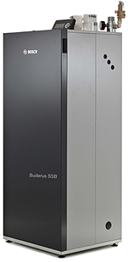
Commercial High Efficiency Boilers - SSB Series
Product Overview
Two Series Available – Single Module (255, 399 And 512) And Two Module (800, 1000SA And 1000TL)
Inputs Ranging From 255 To 4,000 MBH
96% Thermal Efficiency
2, 3 Or 4 Inch PVC, CPVC, PP Or Stainless Vent (255 to 512)
Cascade Multiple Boilers Together Using Onboard Control
Native 2-10vdc and Modbus Onboard
BACnet And LonWorks (With Additional Module)
All Connections on Top (C-Platform); Right or Left Side (D-Platform)
Compact Footprint (7.27ft²) w/ Reversible Connection (D-Platform)
Integrated Multi-speed Boiler Pumps (D-Platform)
Integrated 75PSI Pressure Relief Valves (D-Platform)
10 Year Non-prorated Heat Exchanger Warranty
6 Inch (800 and 1000 Standalone) or 10 Inch (TL) CPVC, PP or SS Vent
Notes:
The SSB boiler was designed specifically for retrofit applications, though some of its features make it well suited for projects of any type. The boilers can be used standalone, or with up to 16 heat exchangers combined in one system, giving a maximum plant output over 8,000 KBtu/h on a single point BAS connection. Modbus is native but protocol translators to BACnet MS/TP or LonWorks are available from the factory. 0-10vdc setpoint demand control is also possible, and offers the simplest and most effective way for the boilers to be operated by the BAS.
The smaller series can use any vent system without adaptors, the larger sizes are Poly-P standard but can be adapted to other high-temp plastics or stainless (in the field).

Slide 30
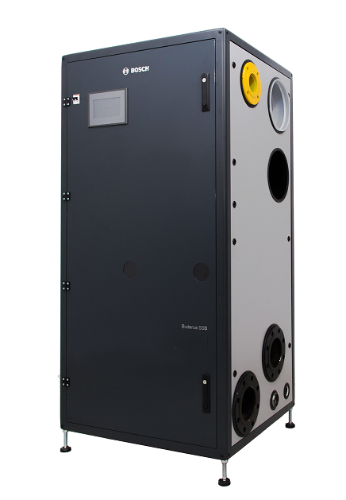
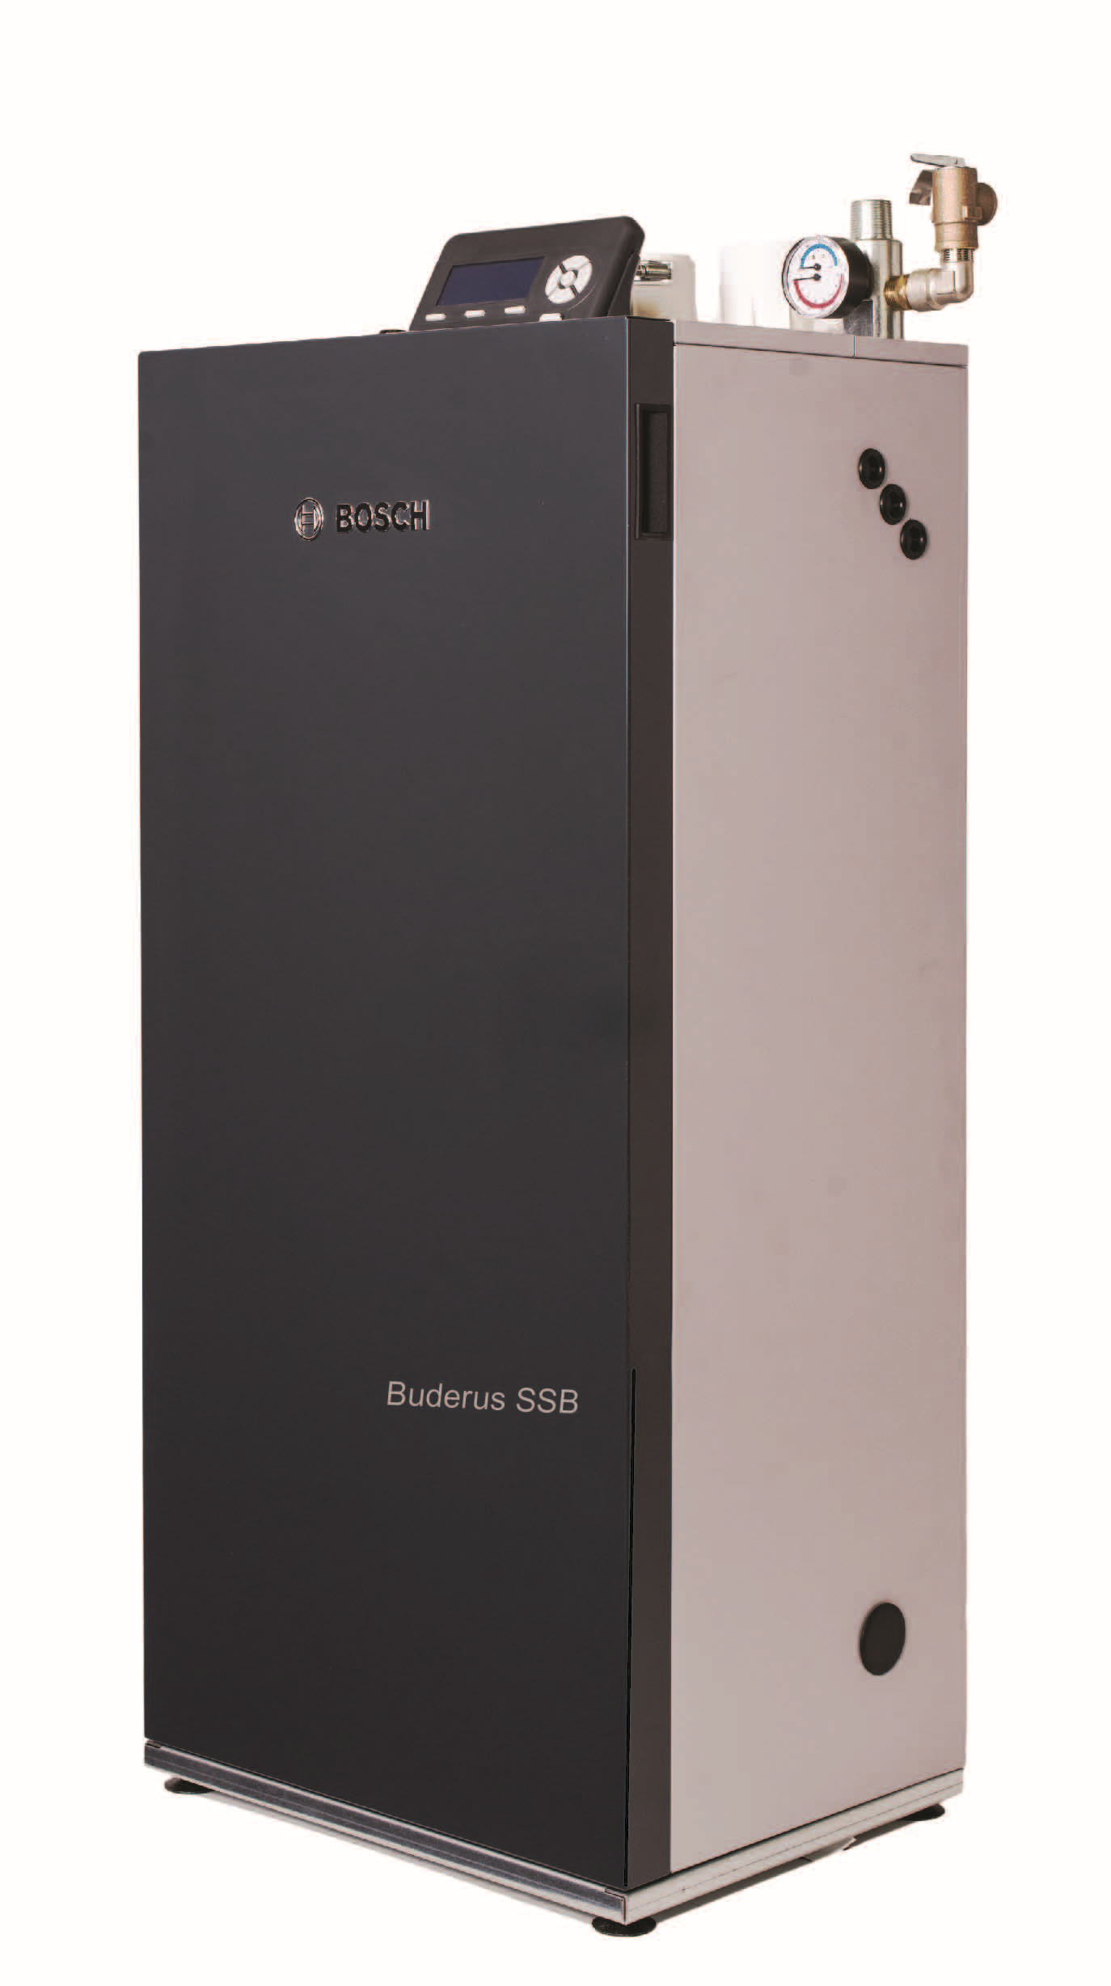
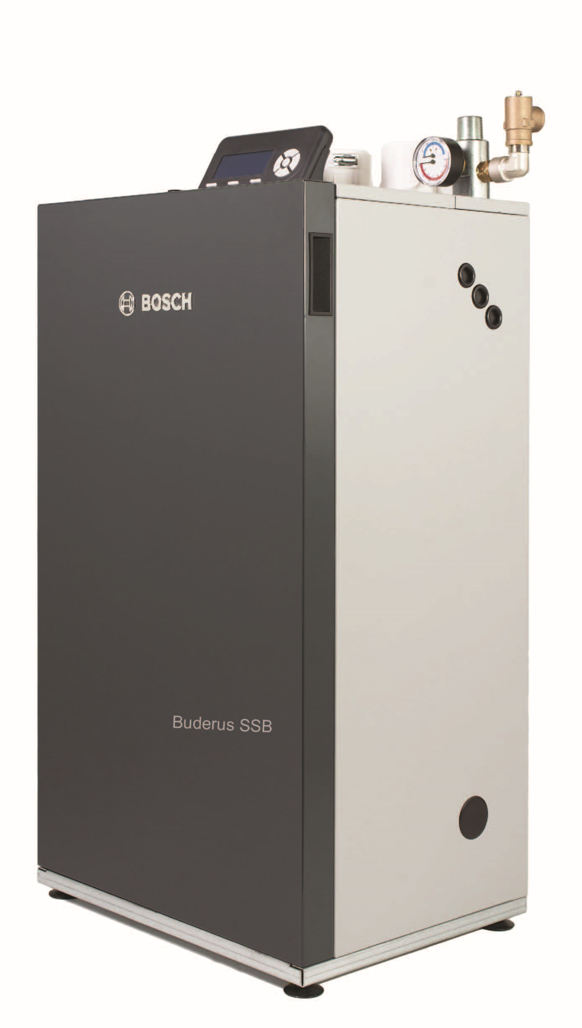
SSB Overview
Light Commercial
(C-Platform)
Commercial
(D-Platform)
Residential
SSB255SSB399
SSB512
SSB800
SSB1000
SSB1000TL
SSB85
SSB120
SSB160
Notes:
The smaller series is a compact, top-service, floor-mount boiler, ideal for low-clearance mechanical rooms in light commercial applications. The larger series offer left or right hand connection options so that the install can be tailored to the site, and it builds in all the necessary piping, venting, drains, service valves and electrical connections for installing the boiler.

Slide 31

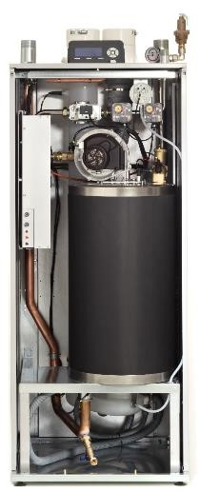
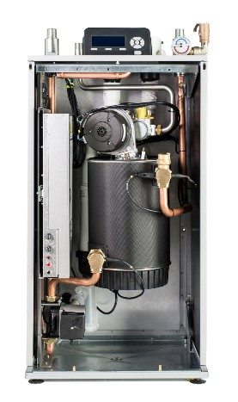
SSB Overview
Light Commercial
(C-Platform)
Commercial
(D-Platform)
Residential
SSB85
SSB120
SSB160
SSB255SSB399
SSB512
SSB800
SSB1000
SSB1000TL
Notes:
As you can see with the cabinets open. The heat exchangers, blowers, gas valves, burners, gaskets, ignitors, transformers, burner control modules, and insulation pieces are all the same between both the smaller and larger series, making parts supply for a facility owner exceedingly simple and cost effective.
The smaller series use a single heat exchanger and ignition system, requiring a field installed pump external to the boiler. The larger sizes integrate one boiler pump per each heat exchanger directly into the boiler, as well as a flow meter for each and all necessary service valves. The larger series also include high and low gas pressure switches, and a extra water pressure switch as a tertiary safety.
Both series build a low water cut-off and manual reset high limit into every unit, as well as a check valve in the vent (a.k.a. a non-mechanical non-return valve, required by CSA for CAT IV common venting), and a blocked flue switch per heat exchanger.
All of this is built into the boiler, requiring none of it to be accomplished in the field. In the case of the larger series, all that is required to complete the installation of the boiler is to bring 120v/1ph power supply and pipe it into the decoupler (i.e. the low loss header or closely spaced tees).

Slide 32
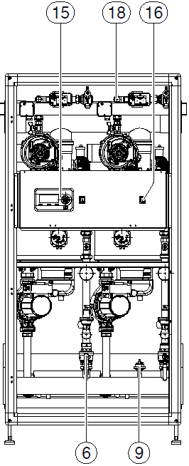
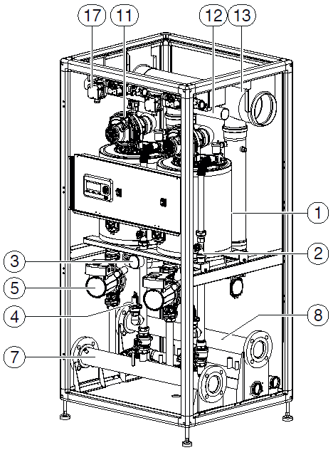
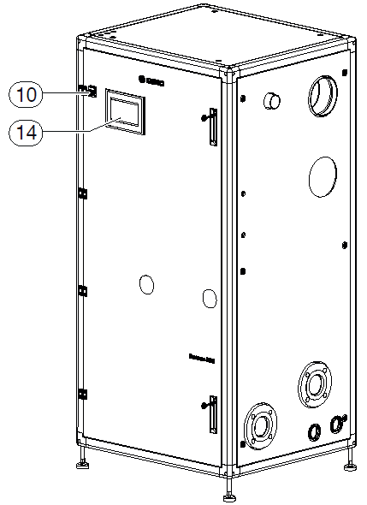
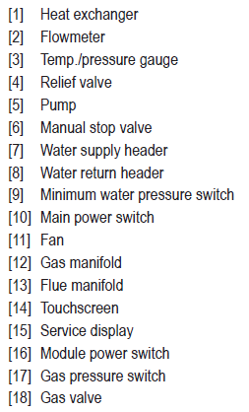
SSB Series – D-Platform Components
Product Overview
Factory Installed in Every Unit:
69%
53%
Notes:
[We will focus primarily on the larger size, as this is the more unique product.]
The large series uses a frame and panel design, with the frame supporting all of the weight of the heat echangers, as well as the vent, gas, drain, and supply and return manifolds, carrying the weight to the floor through adjustable levlling legs. The panels that fit into the frame are gasket sealed to each pentration and to the frame itself, so the cabinet is pressure tight (it‘s possible to have small infiltration, but minimal).
The front door of the boiler hinges open (left hand only) and all components can be serviced from the front. Certain things (like servicing the vent, or replacing a heat exhcnager) can be easier form the back, so rear-clearance should be left if possible, but EVERY component in the boiler can be removed from the front is desired.

Slide 33
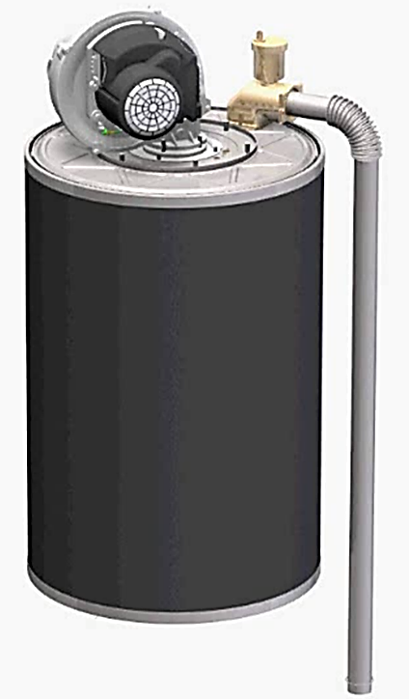
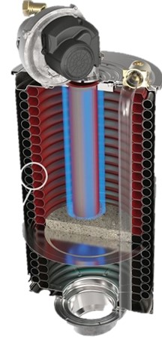
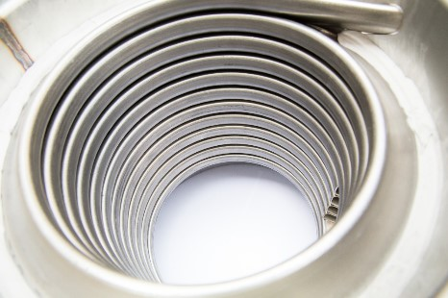
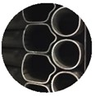
SSB Series – D-Platform Heat Exchanger
Product Overview
Double loop piping circuits
Larger pipe diameter (~1”) compared to other watertube boilers
316L stainless coil welded to top and bottom water filled headers
Coil will expand/contract on each cycle without creating stress
Maximum 54°F Delta-T for continuous operation
Integrated multi-speed pump
Integrated flow meter (real-time flow rate reading)
Integrated automatic air vent
Integrated low water cut-off with manual reset
Integrated manual reset high limit
Modulating from 20 to 100% with flat CO₂% level
Max CO level < 100ppm corrected to 3% O₂
NOx level < 10ppm corrected to 3% O₂
Notes:
The heat exchanger on this series is dual coil watertube, with two pipes coiling from the bottom header of the HX to the top simultaneously, dividing flow between them. The flue products move to the outside, and back to the inside underneath the center baffle plate making the boiler essentially a two pass design.
Because the main structure is essentially a large spring, large temperature differences on the heat exchanger simply extend the total length of the tubes slightly and do not create stress on the materials. As a result, the SSB can handle a 54F (30C) Delta-T in continuous operation. This spring action also causes slight expansion and contraction of the tube spacing, which causes any debris that might begin to build up on the tubes to crack off and fall down onto the refractory in the center of the heat exchanger.
Crucially, the SSB series uses a vertically oriented heat exchanger, a decision based on market experience with horizontal configurations. All watertube boilers will see debris build up in the combustion chamber on the tube surfaces, but in a horizontal configuration this debris, once loosened, will land on other tubes and fall into flue passages. The flexing of the tubes will slowly work this debris deeper into the gaps, so regular maintenance is needed to keep from permanently plugging. In our case, this debris lands harmlessly on the refractory, meaning we do not need service more often than once every one or two years.

Slide 34
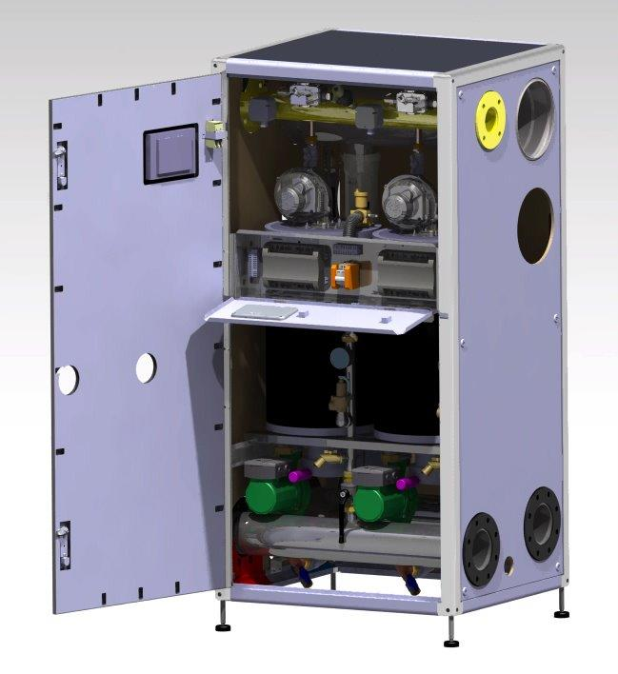
SSB Series - SSB 800/1000TL Control System
Product Overview
Main Power switch (2-pole 120VAC)
905MN Controllers
7’’ Touchscreen (24VDC)
Pump Relays – Terminal strips
905PB Service display
Notes:
In the larger size range, there are three sizes, what we call the SSB800, SSB1000, and SSB1000TL. All three use the same cabinet size, and the SSB800 and 1000 have identical connection sizes. However, the SSB1000TL uses larger connections than the other two, with everything upsized sufficiently so that up to four SSB1000TL can be attached directly together, and share a single connection for each service. Installed, that would look like what you see on the next slide.

Slide 35
SBB Series - SSB 4000TL4
2-4 Boilers Can Be Bolted Together
Product Overview
Each boiler has a Managing controller, driving the whole cascade. If communicaiton is lost, Dependent boilers/modules enter emergency mode until Manager is back online.
If Manager is unable to run but remains powered, plant operation continues as normal with the Dependent boilers rotating through lead position, and following all programmed logic.
Managing boiler
Dependent boilers
LLH*
*Not available, used to demonstrate suggested piping method.
Notes:
(Minus the low loss header, which is not currently available.)
Once bolted together, the SSB1000TL4 shown would have one 10” vent, one 10” combustion air supply, one 5” supply, one 5” return, and one 3” gas connection, as well as one PRV drain and one condensate drain connection, all shared by all four boilers and all eight heat exchangers. The parallel piping configuration, as well as all the various manifolds, are all the same basic design as you would see in a standard Primary-Secondary boiler plant, but with this configuration, all of this infrastructure is pre-assembled, pre-piped and pre-wired inside the boiler cabinet, dramatically decreasing installation cost and time requirements.

Slide 36
Questions?

