Slide 1


Session #508
Why Great Training Fails &
How to Set it Up to Succeed
Michael Milroy, trainM3/NetJets

Slide 2

“Great training transforms lives.”
Michael Milroy

Slide 3



Notes:
Making a world-class training program doesn’t guarantee success.
There was a really detailed systems training we built for a pharmaceutical company. The course was designed to walk learners through using the system as a guide by the side. The users log into the system and practice along with the course. However, when the platform launched, the company’s help desk was flooded with calls for support.
What happened?
The platform’s launch was delayed so the company decided to have the employees trained BEFORE the platform was available. That defeated the entire purpose of the training. Learning transfer between training and using on the job was very small:
Training was ineffective because the structure around the training was not in place
The delay between training and the launch of the platform allowed the Ebbinghaus’ Forgetting Curve to impact learner’s retention

Slide 4
That Sinking
Feeling

Slide 5

Chapter 1
A Case Study

Slide 6
Notes:
I want to start off with a case study. This is a project a trainer at one of our companies reached out to me for help with a postmortem on a project that failed miserably. And when I say miserably, she was telling me that there was nearly zero learning transfer for existing employees and even new hires were doing things the old way and not the way they were taught.
“I’m listening…”

Slide 7


Slide 8



Slide 9






Slide 10










Slide 11



Slide 12
Notes:
The biggest issue faced isn’t the training. No matter how amazing and effective the training would be, this project was doomed to fail before the instructor set foot in the classroom.
Right from the start, the managers:
Weren’t included in the create of the SOPs
Weren’t brought up to speed on what the SOPs were
Weren’t bought into nor instructed on the new procedures so they could only teach/coach to what they know

Slide 13
Who has the
greatest impact
on the adoption of training?
Notes:
Who has the greatest impact on a learner’s adoption of training?

Slide 14
Who has the
greatest impact
on ignoring training?
Notes:
Who has the greatest impact on a learner ignoring training?

Slide 15
The Team Managers
Role: To Be Informed
People do what makes sense to them
People do what they are incentivized to do
Notes:
It’s not that the Managers are inherently evil, but their role in this was to be informed and they were not. Without the context and direction, people do what makes sense to them, particularly continuing to work under the “old rules.” And ultimately, people put their energy to where it is being recognized and rewarded.
So ultimately, Managers were the key to the outcome of this training.

Slide 16
Chapter 2
A Shared Understanding

Slide 17


Organizational readiness
The STATE of Readiness
Organizational Readiness indicates the relationship between people, processes, systems, and performance measurement when addressing a coming change. It requires synchronization and coordination without which no implementation will be successful.
Notes:
This can sound a bit overwhelming, but we have a great, if you will, checklist to help you ensure you are on the right track.

Slide 18

Organizational
ALIGNMENT
The PROCESS for Alignment
Organizational alignment is the process of implementing strategies and philosophies to ensure that each member of an organization, from Individual Contributor to Executives, share a common goal and vision for the success of an organization.
Notes:
If you find that there is misalignment, how do you know what right looks like?

Slide 19
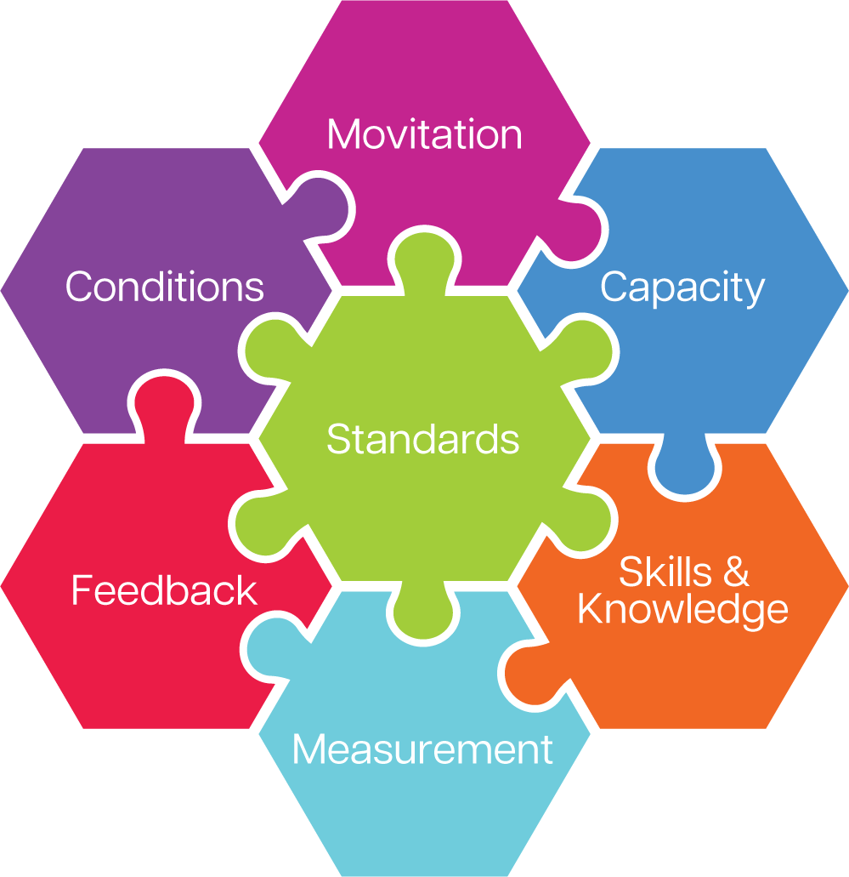
Seven Factors
of Job Performance

Slide 20
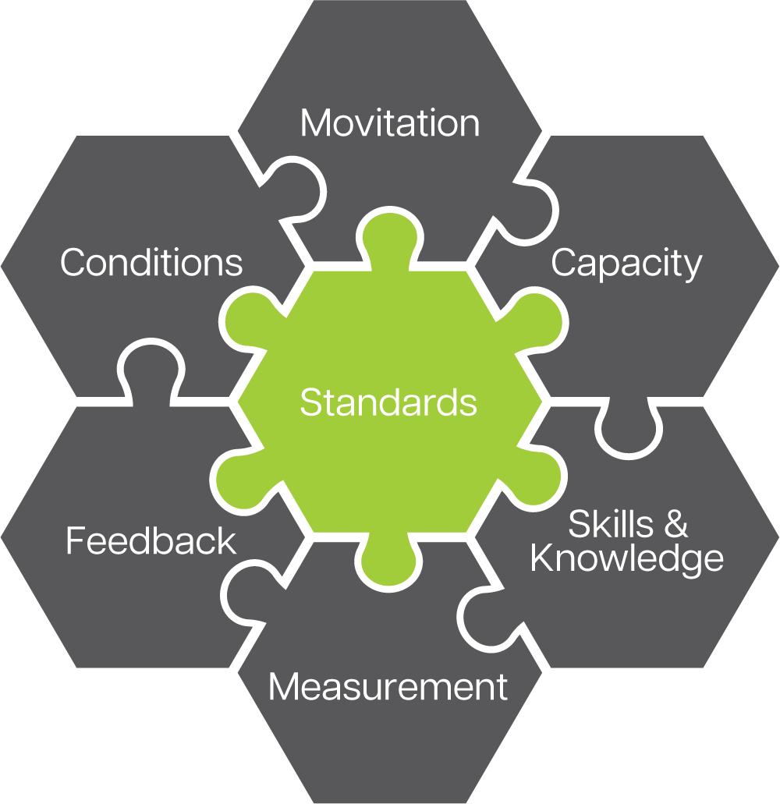
The other Factors of Job Performance rely on well-established performance standards, communicating them well, and gaining agreement about them.
Do the employees understand what is expected of them?
Are the standards clearly defined and shared?
Are Roles and Responsibilities clear and consistent?
Is there frequent dialog with the manager with employees about the Standards.
Notes:
https://youtu.be/TcF6xG3YfCM

Slide 21
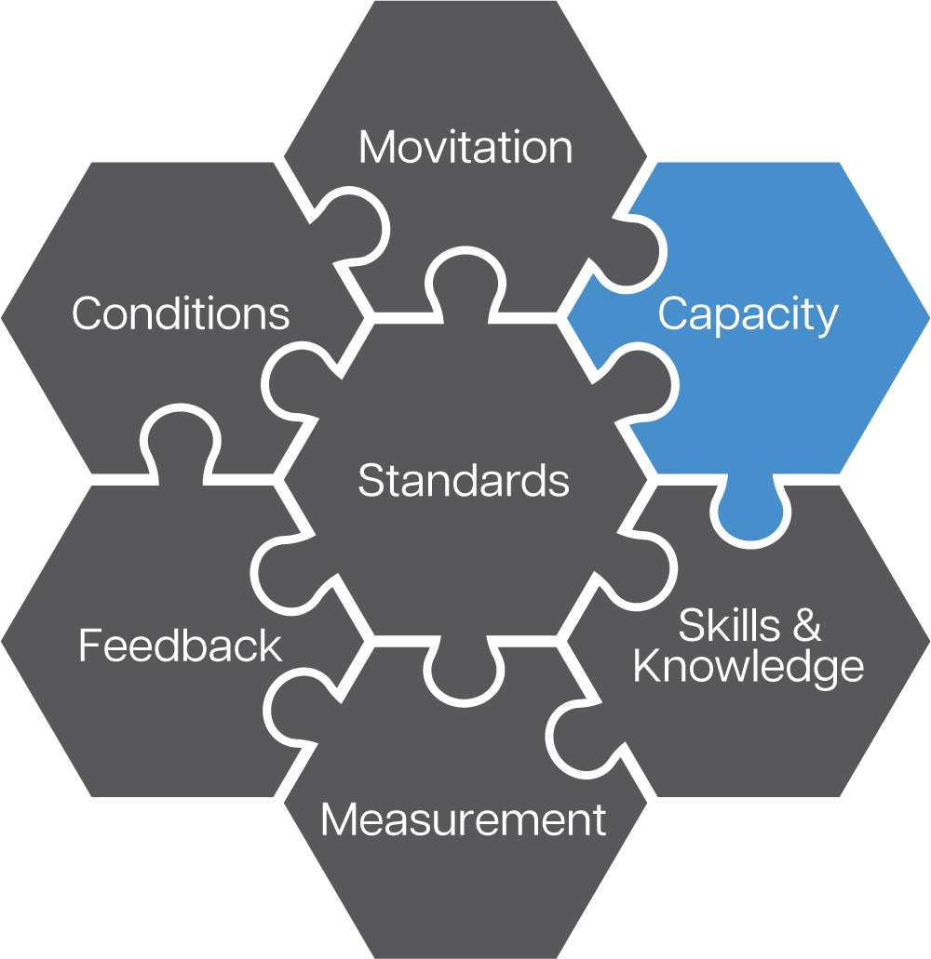
Capacity refers to the inherent ability or aptitude to perform as expected.
Does the manager understand the capacity requirements for the positions they supervise?
Do the employees in those positions have the capacity to succeed in their current position (physical, analytical, interpersonal, computational, minimal supervision, etc.)?
Notes:
https://youtu.be/TcF6xG3YfCM

Slide 22
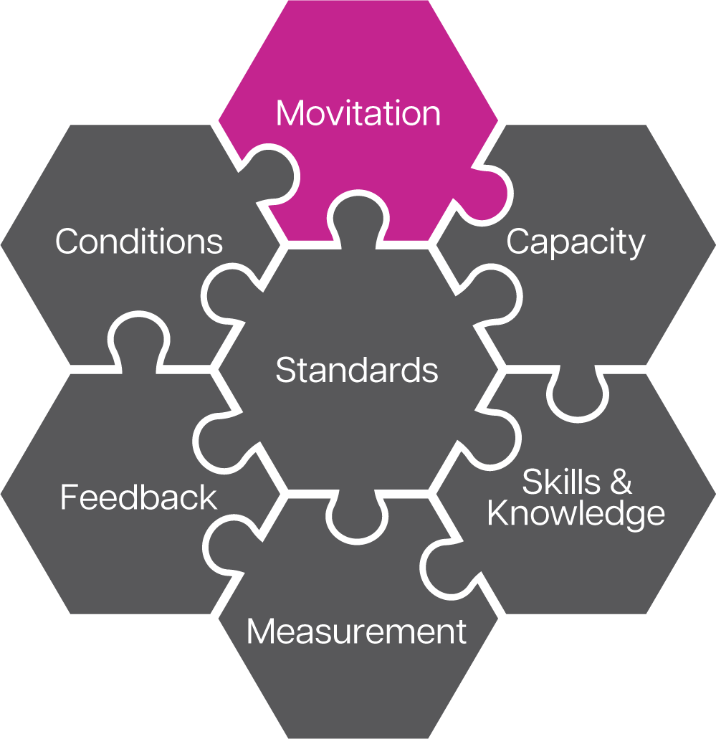
Effective managers understand what motivates their employees and know how to tap into these motivators.
Does the manager know what motivates his/her employees?
Does the manager maintain a positive work environment and engage each employee’s motivators so the employee will work with a drive, focus, and will give discretionary effort?
Notes:
https://youtu.be/TcF6xG3YfCM

Slide 23
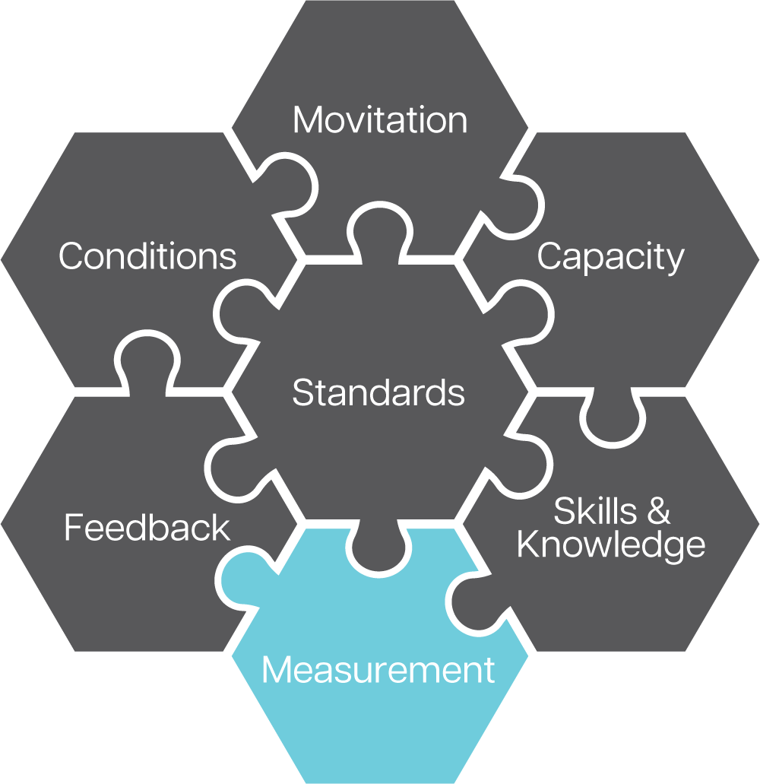
How Employees actually perform and align to agreed-to performance standards and to training, coaching, and feedback. It must be consistent.
Can the employees articulate how their performance is measured? (What is measured is what is gets done.)
Is performance consistently measured?
Are the results shared with the employees on a regular basis?
Notes:
https://youtu.be/TcF6xG3YfCM

Slide 24
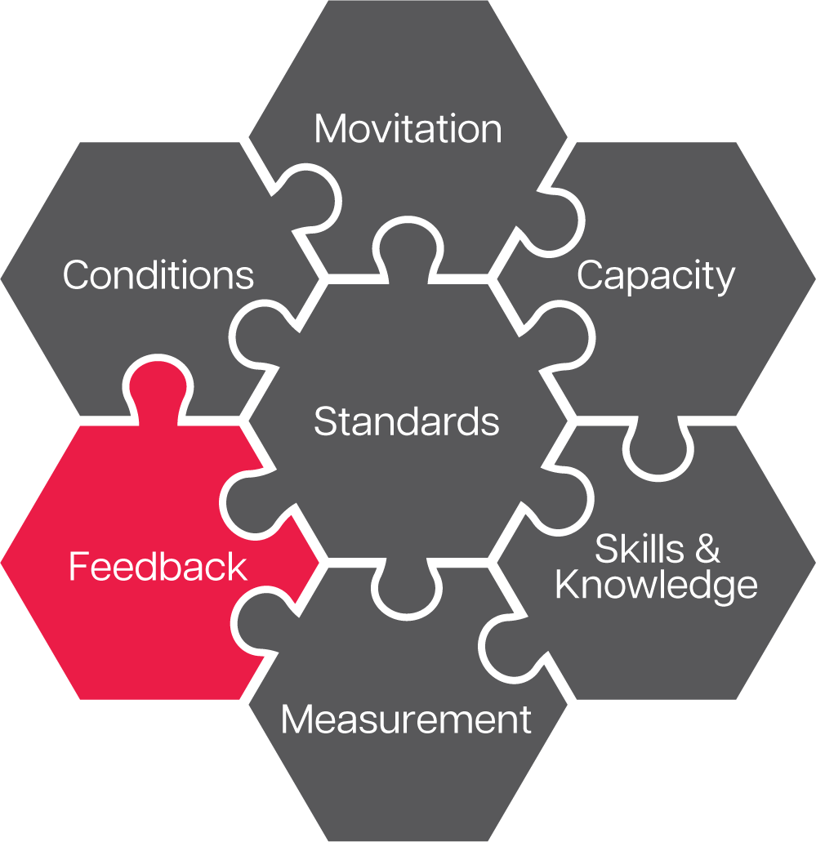
Feedback is the way we tell others the value that they have created or diminished through their job performance.
Is the manager having regular one-on-one meetings with team members?
Is performance feedback being given on a regular basis?
Has the employee been told of the performance discrepancy?
Notes:
https://youtu.be/TcF6xG3YfCM

Slide 25
Refers to the work environment that employees operate in to ensure they perform as expected. Everything from safety, time, tools, resources, information, etc. to the “work climate.”
Are all employees working in the same environment (safety, time, tools, resources, information, etc.)?
Do all employees have the capacity to perform in their current role?
Notes:
https://youtu.be/TcF6xG3YfCM

Slide 26
Chapter 3
Sunk: The Misalignment

Slide 28
STANDARDS
The new Standard Operating Procedures were developed and trained to the Individual Contributors, but not their Leaders. Thus, the Managers and Directors were working from the old standards and didn’t have foundational knowledge or buy-in to the new Standards.
Notes:
https://youtu.be/TcF6xG3YfCM

Slide 29
MEASUREMENT
The system for measuring success continued to be tied to the old way of doing things. When individuals were trained on the new Standard Operating Procedures, their managers told them to do it the old way so they would continue to meet expectations for the way their work was Measured, and success was defined.
Notes:
https://youtu.be/TcF6xG3YfCM

Slide 30
MOTIVATION
Convincing the Managers and Directors to buy-in to the new system was going to be a difficult road. Their bonuses were still tied to the Measurements geared towards the old procedures. Thus, the business wanted them to do things the new way but rewarded them for doing it the old way.
Notes:
https://youtu.be/TcF6xG3YfCM

Slide 31
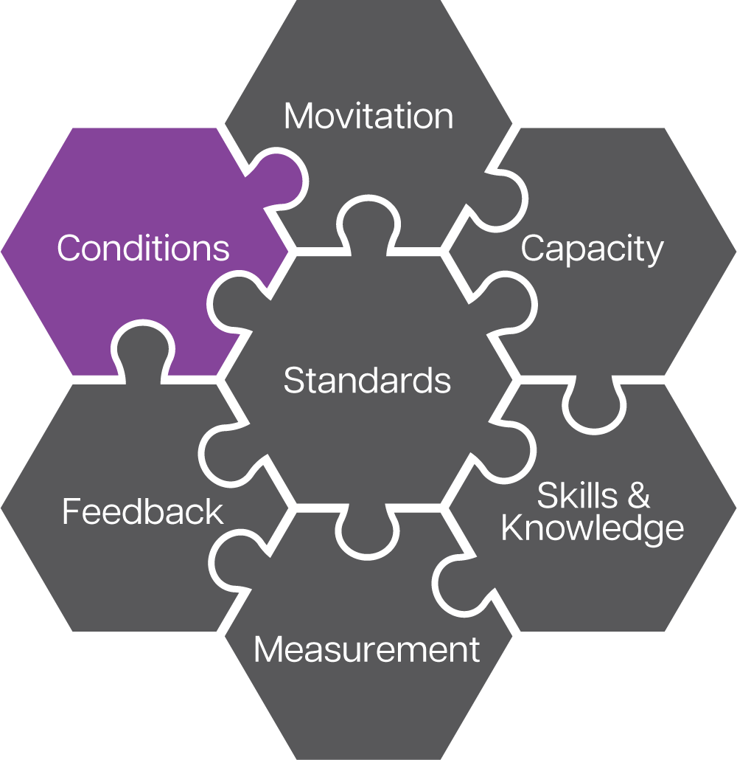
CONDITIONS
If you were a new employee to this department, how are you supposed to succeed? You were trained the new way but expected to perform by the old SOPs that you have never seen. Not only were they set up to fail by the company’s measurements, but this creates a very stressful work climate.
Notes:
https://youtu.be/TcF6xG3YfCM

Slide 32
FEEDBACK
What feedback were the employees given?
Don’t do it the way you were trained, do it this way… The managers directed their employees to return to the old way of doing things.
Notes:
https://youtu.be/TcF6xG3YfCM

Slide 33
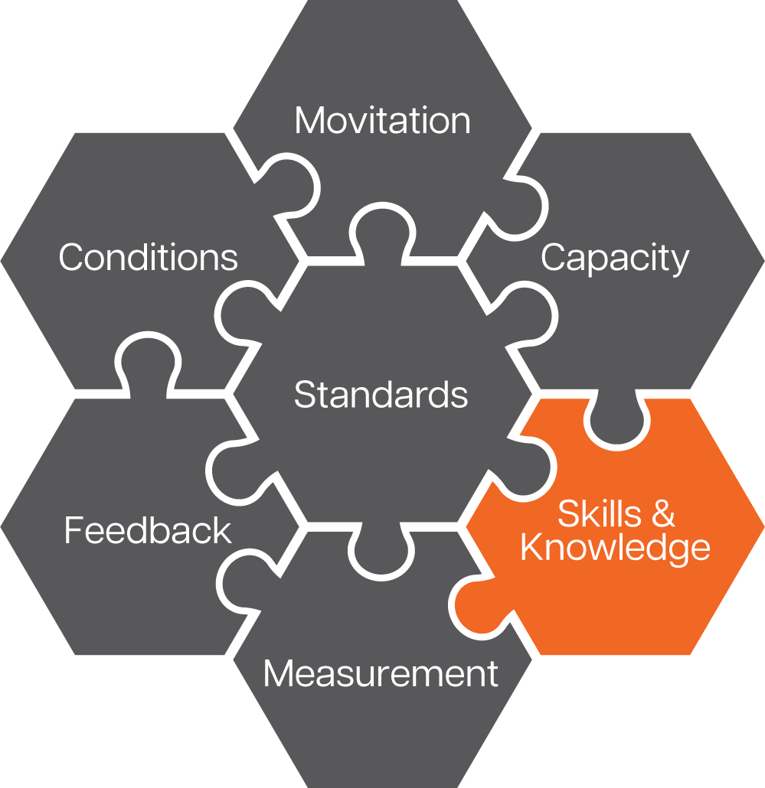
KNOWLEDGE & SKILL
Ultimately, the training had very little learning transfer.
Was it “learning scrap”?
In one sense, yes. It didn’t train the employees for how they were being judged to be successful.
In another, no, because it was Organizational Readiness, not the training.
Notes:
https://youtu.be/TcF6xG3YfCM

Slide 34
Chapter 4
Identifying Organizational Readiness Issues

Slide 35
Needs Assessment with
Organizational
Readiness Review
Notes:
Yes, the Seven Factors of Job Performance. When you are thinking of the variety of ways the business needs to be ready for your training and the changes it will create, look to these seven factors to ensure you have a comprehensive view.

Slide 36
NEEDS ASSESSMENT
Which question are we answering in our Needs Assessment?
What are the skills and knowledge your department needs that they don’t have?
Is this performance discrepancy a skills and knowledge issue, or another factor of job performance?
What skills and knowledge do we need to train to achieve this business outcome?
Notes:
Yes, the Seven Factors of Job Performance. When you are thinking of the variety of ways the business needs to be ready for your training and the changes it will create, look to these seven factors to ensure you have a comprehensive view.

Slide 37
ORGANIZATIONAL READINESS
Which question are we answering when we investigate Organizational readiness?
Are the seven factors of job performance aligned with the new behaviors and expectations delivered by the training?
Notes:
When you are conducting a Needs Assessment you are digging the red flags for Organizational Readiness. Conduct these discussions together. Let’s look at some of the questions we use to do this.

Slide 38
Criteria | Yes | No
Do employees know what to do and when to do it?
Can they clearly and accurately articulate what is expected of them?
Are there written job performance standards?
Are the written performance standards current, relevant, and achievable?
Is there agreement in the company about what is to be done, when, and how?
Notes:
https://youtu.be/TcF6xG3YfCM

Slide 39
Criteria | Yes | No
Does the employee have the physical capacity to perform as expected?
Does the employee have the computational capacity to perform as expected?
Does the employee have the interpersonal capacity to perform as expected?
Does the employee have the analytical capacity to perform as expected?
Does the employee have the capacity to work with minimal supervision?
Notes:
https://youtu.be/TcF6xG3YfCM

Slide 40
Criteria | Yes | No
Does the employee focus on all the tasks in their job inventory, or just on the tasks they enjoy?
Are reinforcements in place that encourage the employee to perform well and that discourage poor performance?
Does the employee demonstrate pride in their work, team, or company?
Does the employee believe they will be recognized fairly and/or rewarded for performing well?
Does the employee value the potential recognition and/or rewards of high performance?
Notes:
https://youtu.be/TcF6xG3YfCM

Slide 41
Criteria | Yes | No
Am I measuring my employees’ performance?
Are performance measurements based on the job performance standards?
Am I capable and equipped to measure employee performance?
Do the employees believe the performance measurements are objective?
Do the employees believe that the performance measurements are consistent?
Notes:
https://youtu.be/TcF6xG3YfCM

Slide 42
Criteria | Yes | No
Do the employees receive feedback from their direct supervisors?
Do they receive the feedback in a timely manner?
Is the feedback based on the actual job performance measures/standards?
Are the supervisors providing specific, actionable feedback?
Are the supervisors capable and trained on how to deliver feedback?
Notes:
https://youtu.be/TcF6xG3YfCM

Slide 43
Criteria | Yes | No
Are current job procedures clear, realistic, and performable?
Are employees given sufficient time to perform tasks as expected?
Are tools and equipment in good working order?
Are distractions and interruptions minimized?
Are employee empowered to perform as expected?
Notes:
https://youtu.be/TcF6xG3YfCM

Slide 44
Criteria | Yes | No
Have employees been trained on the task?
Did they ever perform the task properly in the past?
Are job aids and other forms of performance support available, current, and relevant?
Have there been any recent changes to how the task is performed?
Do employees perform the task frequently enough o remember the skill?
Notes:
https://youtu.be/TcF6xG3YfCM

Slide 45
The DUALITY OF A NEEDS ASSESSMENT
When you really dig into a Training Needs Assessment, you are really answering two questions:
IS the problem Knowledge & Skill and is a problem Learning & Development can address?
IS there Organizational Readiness and if not, where is it misaligned?

Slide 46
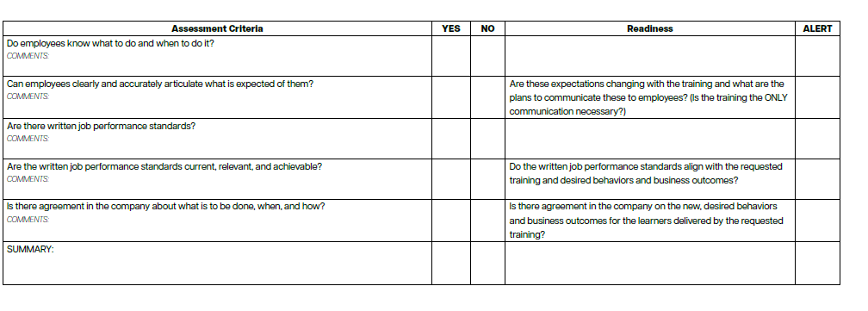
NEEDS ASSESSMENT TOOL

Slide 47
Learning transfer climate scorecard
Climate Factor | 0. Very Weak | 1. Weak | 2. Fairly Strong | 3. Very Strong | ? Don’t Know
Learner Readiness Learners understand what the training is about and how it relates to their development and job performance. Learners have the necessary background knowledge and skills to benefit from the training.
Opportunity to Use Employees have opportunities to apply their new knowledge and skills on the job soon after training. Employees have the resources (information, equipment, materials, and supplies) necessary to use the training.
Personal Capacity Employees have the time and energy to try new methods; their workloads are not too overwhelming. Employees are able to cope with the amount and pace of change in the organization.
Learner Readiness
Opportunity to Use
Personal Capacity
Perceived Relevance and Utility
Motivation
Organizational Culture
Managerial Alignment
Managerial Encouragement
Managerial Feedback and Coaching
Peer Group Impact
Personal Experience
Notes:
Additionally, Roy Pollock, the author of The Six Disciplines of Breakthrough Learning, created this Learning Transfer Climate Scorecard.
It scores
Learner Readiness
Opportunity to Use
Personal Capacity
Perceived Relevance and Utility
Motivation
Organizational Culture
Managerial Alignment
Managerial Encouragement
Managerial Feedback and Coaching
Peer Group Impact
Personal Experience

Slide 48
Chapter 5
Now What?

Slide 49
ORGANIZATIONAL UNREADINESS
Is it Learning & Development’s role to address
Organizational Readiness issues within the business?
If this is going to impact Learning & Development’s ability to deliver the promised business outcomes or the ROI of the training, then we do have the obligation to ourselves to:
Consult with the department receiving the training to alert them of the issues
Bring in the Change Management team to support the training initiative
Document that the outcome of the training is conditional upon this issues being addressed

Slide 50
Chapter 6
Putting it into Action

Slide 51
Case study: SOCIAL ENGINEERING
ISSUES:
Standards were not aligned with the expected behaviors
Leaders were not trained to provide Feedback or Coach to the training
Quality Assurance wasn’t trained or given Measurements that address the undesired behaviors
Extrinsic Motivation, like variable compensation, would not be impacted by the success or failure of an individual to adopt the new behaviors
DELIVERIES:
Delivered the new training courseware in 7 days
Documented all Organizational Readiness Issues
  Added them to Project Charter
  Consulted with Organization about these risks to the success of the training initiative
  Shared with the Change Management team

Slide 52





Great training
transforms lives.
trainM3.com
michael@trainM3.com

