Slide 1






PowerPoint® Instructions
This PowerPoint has been designed so you can easily customize it for your training session.
Throughout the presentation you’ll see icons with recommendations or videos to enhance the instruction you present to your students. A detailed explanation for each icon can be found on the next slide. Videos can be found on the Trainer Tools USB.
When you see an icon on the slide, look in the notes
section for further information.
Simply delete or move the icon off the slide before your training session begins.

Slide 2





Classroom Recommendations. Provides suggestions for enhancing your classroom presentation; from ideas for large group discussions to suggestions on the use of training aids such as examples or photos of vehicle parts and components to help illustrate the items covered within a chapter.
Lab Recommendations. Provides suggestions for activities and exercises that take place outside the classroom, but do not involve
the actual operation of the tractor-trailer or its components. Examples
of lab sessions include conducting a vehicle inspection or practicing mirror adjustment.
Range Recommendations. These recommended activities take
place on a closed-access driving range where students may practice driving skills in a controlled environment. Examples of range sessions include practicing shifting technique and successfully completing a backing maneuver.
Road Recommendations. These recommended activities take place in road and traffic conditions that support the chapter’s objectives. Examples of road sessions include proper communication with other drivers through the use of turn signals and basic vehicle control under nighttime or extreme weather conditions.
Videos. These short video clips reinforce material presented in the Student Manual. Use them to help students grasp difficult concepts or subject matter.

Slide 3
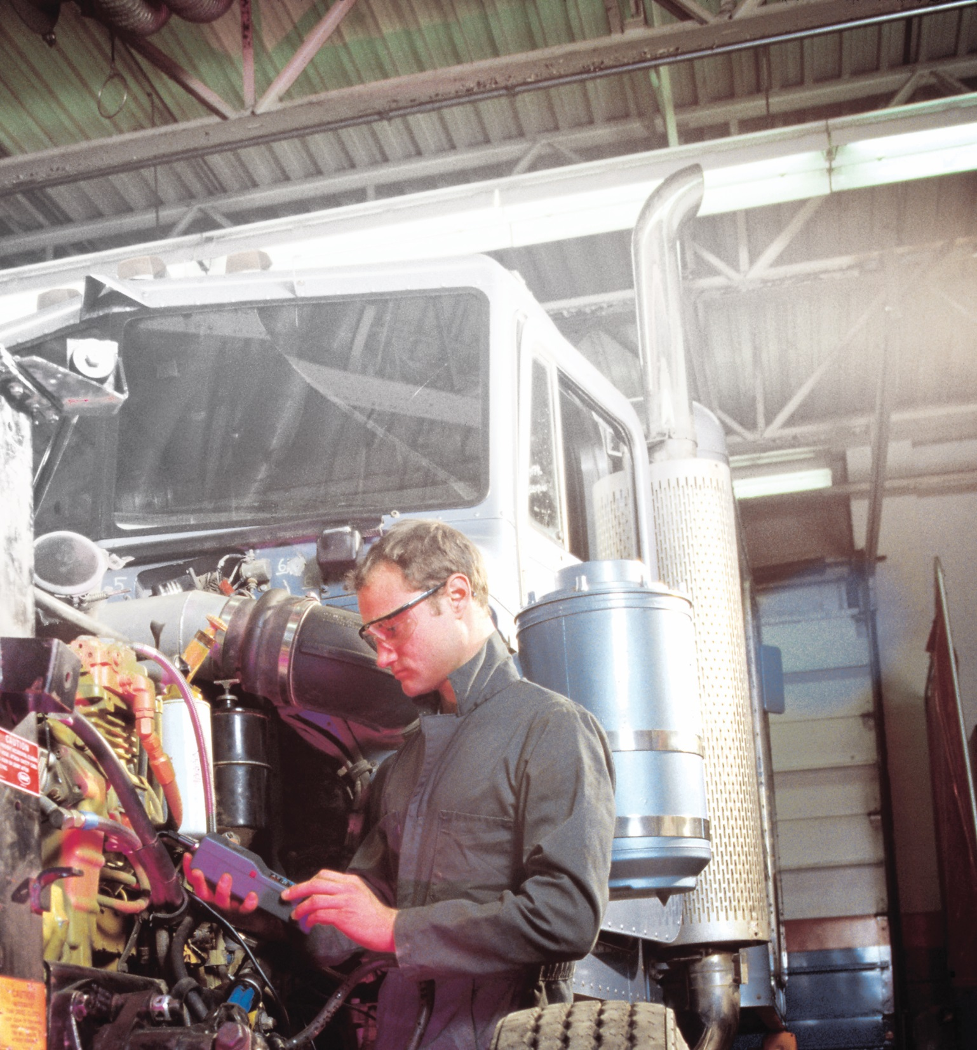
Identification and Diagnosis of Malfunctions
18
Notes:
Unit A1.4.1 Identification and Diagnosis of Malfunctions
This unit must teach driver-trainees to identify major combination vehicle systems. The goal is to explain their function and how to check all key vehicle systems, (e.g., engine, engine exhaust auxiliary systems, brakes, drive train, coupling systems, and suspension) to ensure their safe operation. Driver-trainees must be provided with a detailed description of each system, its importance to safe and efficient operation, and what is needed to keep the system in good operating condition.

Slide 4
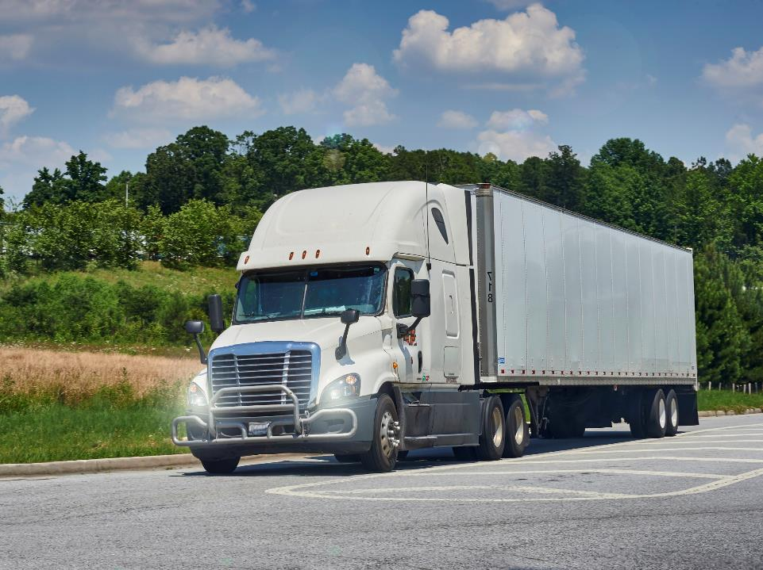
Introduction
Notes:
Introduction
As with any vehicle, a tractor-trailer is made up of many parts. Though these parts have individual jobs or functions, they work together to effectively and efficiently operate the tractor-trailer. Having a general understanding of the basics of vehicle construction and vehicle systems as well as the importance of diagnosing and reporting vehicle malfunctions will help you maintain a safe vehicle.
CLASSROOM RECOMMENDATION
This topic can seem overwhelming to some students. When possible, try to relate the parts/components discussed to parts/components on the students’ personal vehicles. Also, reassure your students that the goal of this session is to give them a basic understanding of vehicle systems—this course is not intended to make them mechanics.
Use of visuals, including examples of parts/components being discussed, or photos of these parts/components can assist in illustrating the controls and instruments covered in this chapter.
LAB RECOMMENDATION
Set up a tractor with the cab tilted or hood open. Set a trailer up behind it, but don’t connect the tractor and trailer. Review all of the components/parts by pointing them out and briefly discussing the purpose of each one. When doing this, have students break into groups of three or four so all are able to see everything clearly.

Slide 5
Objectives
Upon completion of this lesson, you will be able to:
  Explain the function of major combination vehicle systems
  Check all key vehicle systems to ensure their safe operation
  Identify what is needed to keep vehicle systems in good operating condition
Notes:
Objectives
Upon completion of this lesson, you will be able to:
Explain the function of major combination vehicle systems
Check all key vehicle systems to ensure their safe operation
Identify what is needed to keep vehicle systems in good operating condition

Slide 6
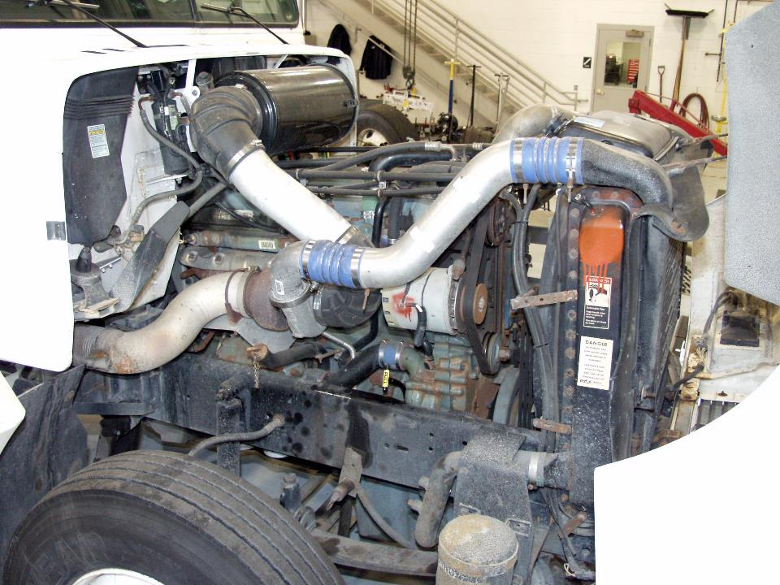
Frame
Notes:
Frame
The frame is the structure around which the vehicle is assembled. It is the vehicle’s foundation. The frame includes left and right-side frame rails and cross members connecting the frame rails. This provides strength and support to the frame. The frame is connected directly or indirectly to all parts of the truck.
The engine is secured to the frame by engine mounts. Axles and wheels are connected to the suspension system through the frame.
Some types of vehicles, including many cargo tanks and van trailers, do not have a frame. In this case, the exterior of the vehicle carries the vehicle’s weight.
CALLOUT: As you review this chapter, keep in mind that vehicle construction varies and that the parts covered may not be included on all vehicles.

Slide 7
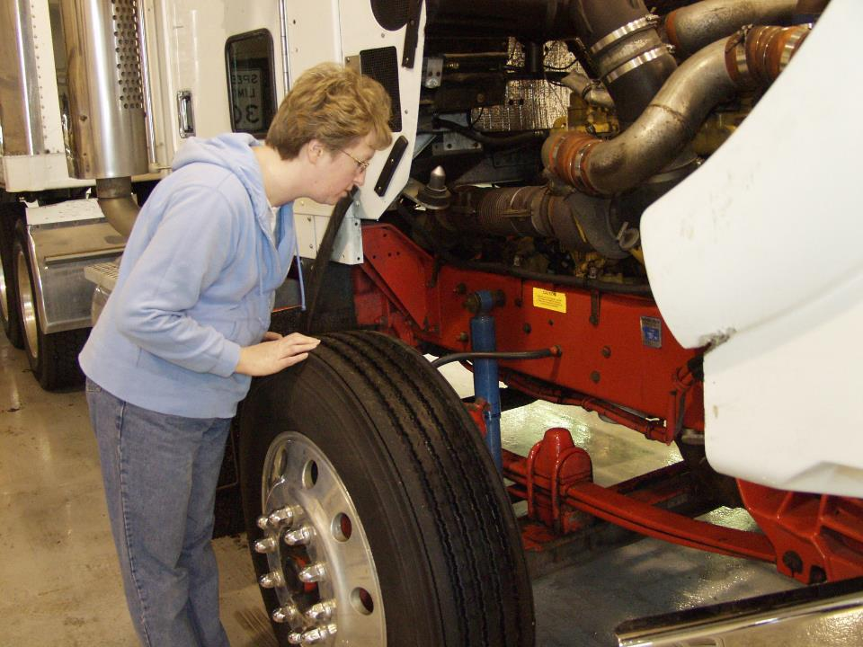
Suspension System
Notes:
Suspension system
The suspension system supports the body and frame of the truck. It is made up of springs, air bags, torque arms, and mounting brackets or hangers. The front and rear axles are attached to the suspension system and the frame rests on it.
The suspension system allows the axles to move up and down in response to ground changes without seriously affecting the load. Securing the suspension system at points spread throughout the frame allows the stress of road shocks to be distributed evenly throughout the frame.
The strength and durability of the system is determined by the size and weight of the vehicle as well as the size and weight of the cargo being hauled.
CALLOUT: During your pre-trip inspection, ensure the suspension is intact, tight, and in good working order.
Characteristics necessary for a good suspension system include:
Capacity to support the load
Ability to transmit full brake effort to the chassis frame
A cushioned ride for the driver and cargo (laden or unladen)
Secure axles to assure correct driveline alignment
Easy maintenance and lightweight parts
There are two main types of suspension systems, leaf spring and air bag suspension systems:
CALLOUT: In some cases, both leaf spring and air-ride suspension systems are combined to provide the best of both systems.
Leaf spring suspension systems use metal strips of different lengths that are connected and attached to the spring mounts or hangers.
Air-ride suspension is made up of a spring hanger with a pivot point, a suspension arm (called a control arm or tracking arm) or spring, and an air bag.
This system is most often used on trailers and truck tractors. This type of system provides a smooth ride whether the vehicle is loaded or empty.
As the vehicle’s wheels move over uneven surfaces, shock absorbers reduce the motion of the vehicle body. They are used in air bag suspension systems and most leaf spring suspension systems.
A broken or faulty suspension can, among other things, allow sudden shifts in cargo or steering, which can lead to an accident. When inspecting the suspension, check for:
• Cracked, loose, or broken spring hangers
• Cracked, loose, or damaged torque rods
• Cracked, loose, or damaged U-bolts
• Missing, misaligned, or broken leaves in any leaf spring
• Damaged air bags
• Loose or damaged air bag mounts
• Shock absorber leaks
• Loose, cracked, broken, or missing frame members.

Slide 8
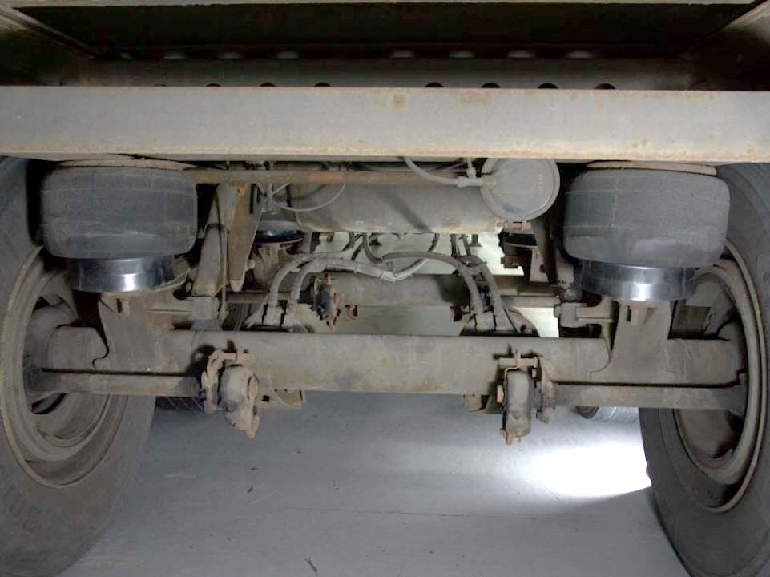
Axles
Notes:
Axles
In general, the axles connect the wheels to the rest of the vehicle and help support the weight of the vehicle and its cargo. Individual axles perform specific functions.
The front tractor axle is the steering axle. It connects the steering mechanism and brakes.
Rear tractor axles are the power or drive axles. They transfer power from the engine and drive train to the wheels and serve as the connecting point for the brakes.
Axles fall into two types or categories, dead axles and live axles.
Dead axles do not transmit power. They are used to support the load.
Live axles transmit power from the drive shaft to the wheels through a differential gear housing. The live axle(s) contain the necessary components to transmit power to the wheels.

Slide 9
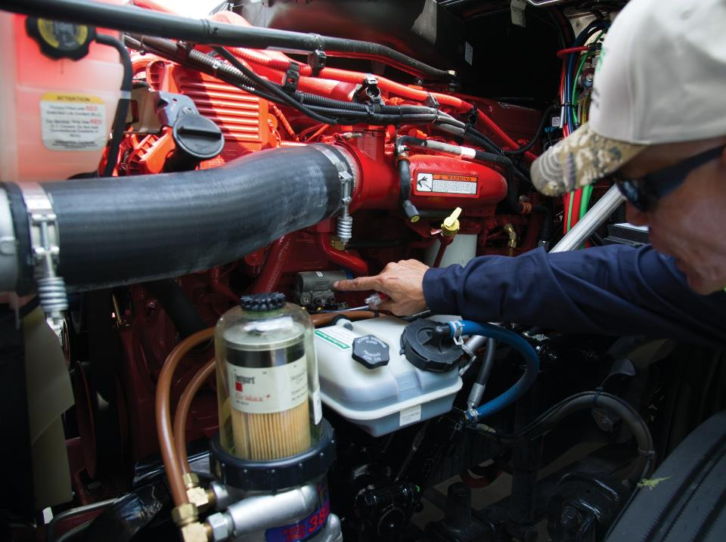
Engine
Notes:
Engine
The engine supplies the vehicle’s power. Engines are primarily fueled by diesel or gasoline, but some modern trucks use propane and natural gas, as well.
The engine on a truck-tractor is an internal combustion engine. This means the engine burns fuel within closed chambers inside the engine. The enclosed chambers are called cylinders. It is within the cylinders where the power comes from to operate the vehicle.
The engine’s parts include:
Engine block
Cylinders
Valves and injectors
Pistons
Connecting rods
Crank shaft

Slide 10
Diesel vs. Gasoline Engines | Diesel | Gasoline
Carburetor |  | X
Spark Plug |  | X
Injector | X | X
Fuel/air mix before compression |  | X
Fuel/air mix after compression | X
Notes:
Diesel vs. Gas
The diesel engine has a series of fuel injectors. Fuel and air are mixed during compression . The compression in a diesel engine is much higher and the heat created by the compression pressure causes ignition of the fuel/air mixture.
Gas engines have fuel injectors and spark plugs, or in the case of some older vehicles, a carburetor and spark plugs.
A serious engine defect could result in a breakdown or accident. When inspecting the engine compartment, make sure you check:
• All fluid levels (oil, coolant, power steering, transmission (if applicable))
• All hoses for leaks, wear, or looseness
• All belts for wear or looseness
• The alternator, water pump, and air compressor
• The engine compartment for leaks
• The electrical wiring insulation for cracks or wear

Slide 11
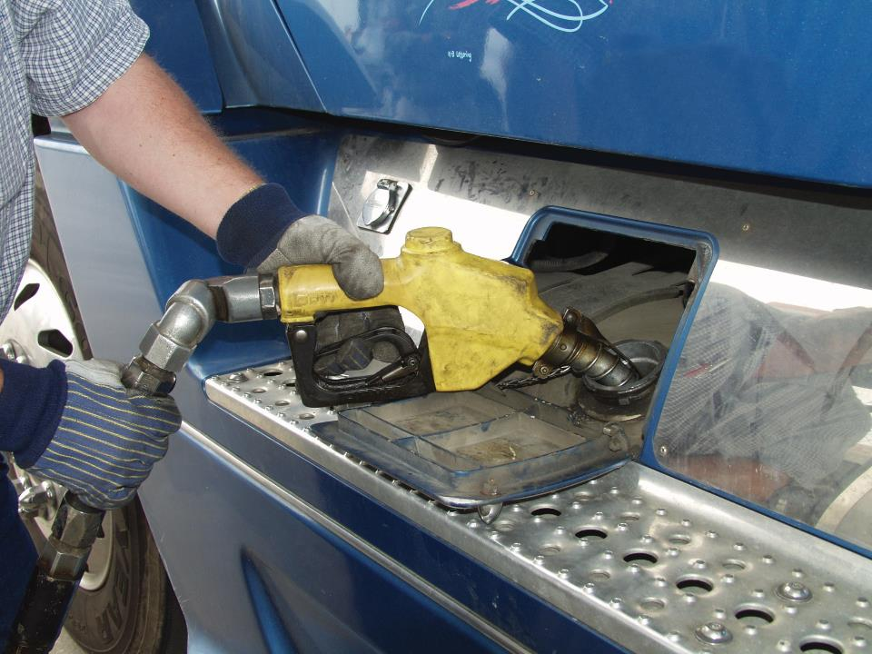
Fuel System
Notes:
Fuel System
The fuel system provides fuel for engine operation. It controls the amount of fuel sent to the engine and determines when the fuel is injected into the cylinders.
The fuel pump draws fuel from the fuel tanks through the fuel lines and fuel filters to the fuel injectors. The fuel injectors are operated by an injector pump and spray a fine mist of fuel into the engine cylinders.
Cleanliness is very important when it comes to the fuel system. Even the smallest amount of dirt or debris can damage the engine. A properly operating fuel system will eliminate many impurities, but it is also important that you use great care when fueling your vehicle.
The fuel tank is where the fuel is held. There may be one or two fuel tanks depending on the size and type of vehicle. Additional tanks may carry fuel for heaters and reefers.
A series of filters clean the fuel throughout the fuel system. These filters remove dirt, water, and rust from the fuel system.
CALLOUT: Keep the fuel cap area clean. This prevents dirt or other particles from entering the fuel tank.
Fuel system heaters are especially important for vehicles operated in cold weather. In general, there are three types of heaters:
In-tank units, which heat fuel in the tank
In-line units, which heat fuel when it is going from the tank to the injector system
Filter heaters, which help heat the fuel as it passes through the fuel filter
Some diesel trucks do not have fuel heaters. In very large engines, some of the fuel that goes through the engine is not actually burned but is returned to the fuel tanks by way of a fuel return line. This process of the fuel returning to the tank heats the fuel and some companies count on this as their “fuel heating” system.

Slide 12
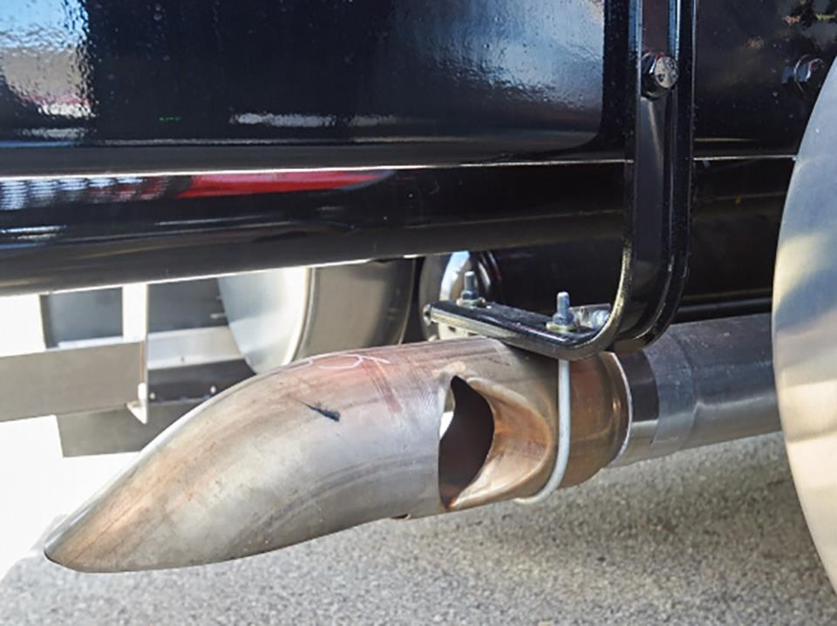
Air Intake & Exhaust System
Notes:
Air Intake and Exhaust System
Fresh air is important in the operation of an engine. The air intake and exhaust system are responsible for assuring that the engine processes enough fresh air to function properly.
The air intake system filters out dust, dirt, and water and delivers a large amount of fresh air to the cylinders.
After combustion, the exhaust system collects the used gasses, passes them through the turbo charger, and then expels them through a tailpipe or exhaust stack.
The turbocharger converts the power it gets from the exhaust gasses into power that can be used to force more air into the engine.
The aftercooler cools the intake air from the turbocharger to a temperature that can be used by the engine.
The pyrometer is an instrument that measures the temperature of exhaust gasses. The normal temperature is between 600° F and 1,000° F depending on the vehicle. If the exhaust temperature is too high, the engine and the turbocharger can be damaged.
CALLOUT: During your pre-trip inspection, make sure the exhaust is in good shape. There should be no cracks or excess soot buildup.

Slide 13
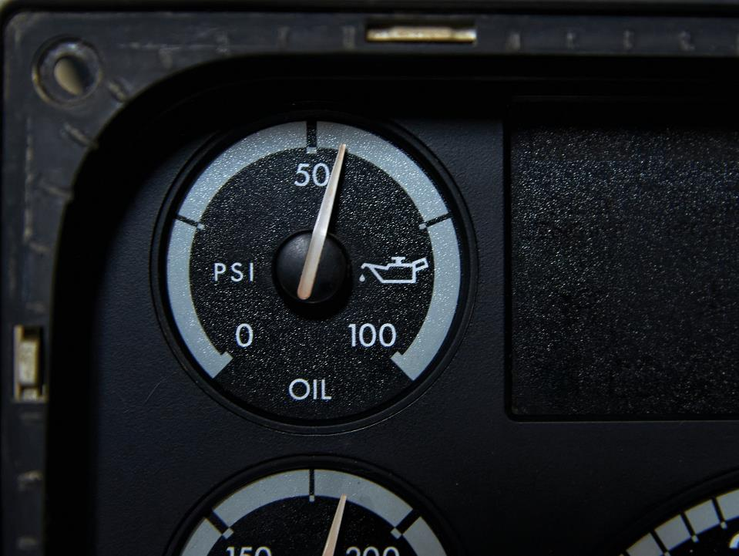
Lubrication System
Notes:
Lubrication System
The lubrication system has three purposes:
It lubricates the engine. The lubrication system delivers clean oil to parts of the engine. This allows the engine parts to move without rubbing together (friction). This increases engine efficiency and prevents damage.
It cools the engine. The moving parts of the engine create a great deal of heat. Oil flowing through the engine absorbs some of this heat and removes it from the engine, keeping engine temperature at a safe level.
It cleans the engine. Oil helps keep the engine clean. As it travels through the engine it picks up dirt and other particles that can damage the engine. These particles are filtered out of the engine. Oil also prevents rust and corrosion by coating surfaces that do not move within the engine.

Slide 14
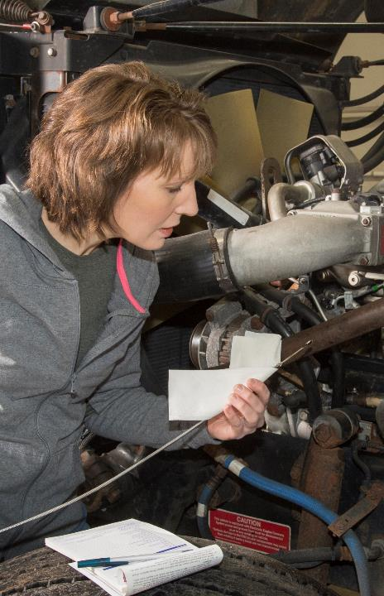
Check the oil level in the engine on a daily basis.
Notes:
Maintaining the Lubrication System
Proper preventive maintenance can go a long way in making sure your vehicle’s engine operates efficiently and effectively. It is important that the oil is changed on a regular basis according to the vehicle manufacturer’s recommendations.
As part of the oil change, the condition of the oil filter should be assessed. The oil filter is where the dirt and other contaminants that the oil removes from the engine are deposited. A clean oil filter allows clean oil to flow through the engine more freely.
It is also important to check the oil level in the engine on a daily basis. This can be done by using the dipstick. The dipstick is found at the side of the engine.
To measure the engine’s oil level:
Turn off the engine and wait a minute or two for the oil to settle
Put on gloves (the engine may be hot, and you need to protect your hands)
Remove the dipstick and wipe it off with a rag
Reinsert the clean dipstick
Remove the dipstick and verify that the oil level is between the full and “low,” or “add oil” lines
At this point, you should be able to determine the level of the oil in the engine, which is measured in gallons. If the reading isn’t clear, wipe off the dipstick, reinsert, remove, and read again.
If the dipstick reads “low” or “add oil,” do so before operating the vehicle again.
Oil Filter System
The oil filter can help prolong the life of the engine by removing contaminants as oil passes through.
There are three types of oil filter systems:
Full flow systems
Bypass systems
Combination bypass/full flow systems
In a full-flow system, all of the oil the oil pump is pumping is passing through the oil filter and going to the engine’s lubrication system.
In a bypass system, a certain percentage of the oil from the oil pump is sent to the filter and then returned to the oil sump (the bottom of the engine), rather than going to the engine’s lubrication system. The oil not diverted to the oil filter is sent to the engine.
In a combination system, the oil first runs through a full-flow oil filter, then a portion of the oil is diverted through a bypass system for additional filtering. The oil not diverted to the bypass filter is sent directly to the engine’s lubrication system.

Slide 15
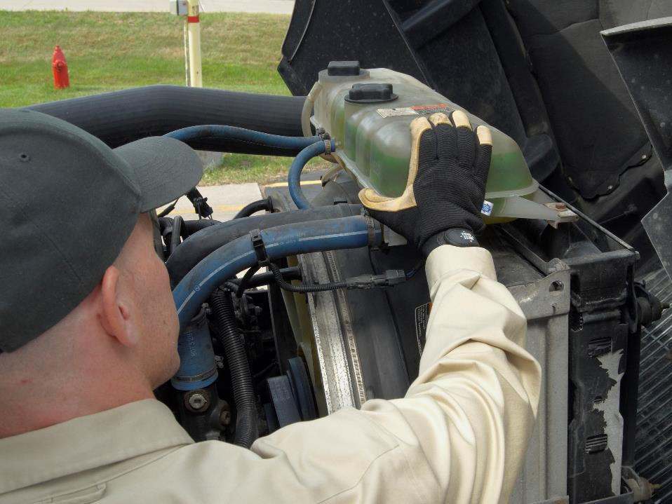
Cooling System
Notes:
Cooling System
Though heat is important to engine operation, too much heat can damage an engine. The cooling system lowers the heat level of an operating engine.
Coolant (a combination of water and antifreeze) is stored in the radiator and circulated through engine water jackets by the water pump. At this point, the coolant is collecting some of the engine’s heat and then returns to the radiator. In the radiator, the heated coolant travels through tubes which cool the coolant. The cooled coolant then recirculates, repeating the process.
Always follow the engine manufacturer’s requirements for selecting coolant. Make sure the radiator is filled with the proper amount of coolant. Too much or too little coolant can damage the engine. The climate the vehicle will be operating in will determine the level of coolant antifreeze protection necessary. It is not uncommon for vehicles that operate in extreme northern climates to use coolant that will not freeze until the temperature reaches 40° below zero Fahrenheit.
CALLOUT: If you are going to check your coolant when stopped during a trip, wait a few moments after stopping. Then, be careful when removing the radiator cap, as the engine may be hot, and you could be splashed or sprayed with hot engine coolant.

Slide 16
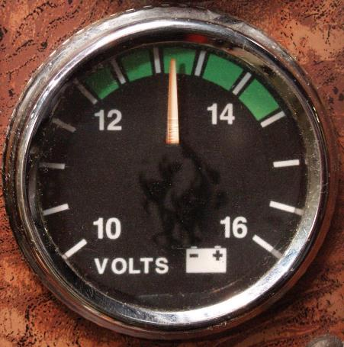
Electrical System
Notes:
Electrical System
The electrical system serves many purposes. It is used to crank or start the engine and operate the vehicle’s electrical equipment including lights and instruments.
The electrical system is comprised of four parts (circuits); charging, cranking, ignition, and lighting and accessory.
Charging Circuit
The charging circuit produces electricity. This keeps the battery charged and runs the electrical circuits. The charging circuit is comprised of the following major parts:
Battery. The battery is an electrochemical device for storing and supplying electrical energy. The battery’s energy is what activates the starter.
Alternator or generator. Most vehicles on the road today are equipped with an alternator, but some still use a generator. These devices are responsible for recharging the battery. When the engine is running, the alternator creates electricity. Most of the electricity the vehicle needs is supplied by the alternator.
Ammeter. An ammeter is a gauge on the vehicle’s instrument panel that shows the amount of current flowing from the alternator. It shows whether the battery is being charged or is discharging.
Voltmeter. The voltmeter is another gauge on the vehicle’s instrument panel. It shows if the electrical system is charging properly.
Voltage regulator. The voltage regulator is the device that controls the voltage output of the alternator or generator. The voltage regulator keeps the electrical system voltage from getting too high. If the voltage is too high, the battery and other components could overcharge, and damage could occur.

Slide 17
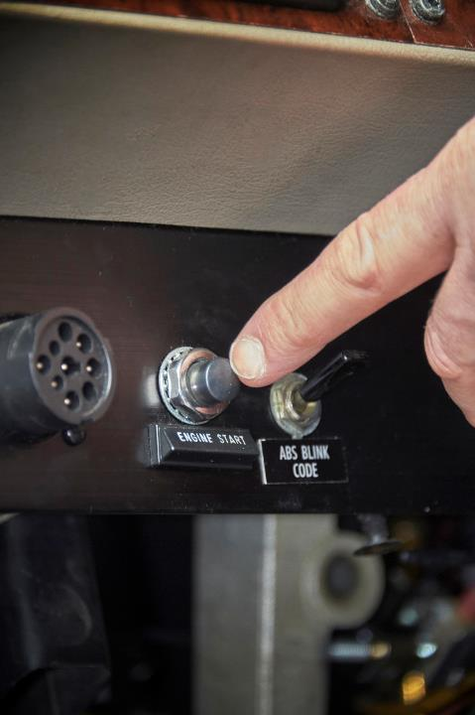
Depressing the starter switch, starts the process of moving electricity from the battery to a starter motor.
Notes:
Cranking Circuit
The cranking circuit moves electricity from the battery to a starter motor. Depressing the starter switch inside the vehicle gets this process started.
Ignition Circuit
The ignition circuit is the electrical circuit that provides sparks for each cylinder, igniting the fuel and air mixture in a gasoline engine. An ignition circuit is not needed in a diesel engine.
Lighting and Accessory Circuits
These circuits provide electricity for the vehicle’s lights, horn, instrument lights, and windshield wipers.
This system takes electrical power from the battery and/or charging system (depending on demand and engine power status) and routes it through an overload protection system (fuses or circuit breakers) to operate electric systems and accessories.
Should a wire be overloaded due to an excessive power demand being placed upon it, or become worn or damaged and come into contact with a metal portion of the vehicle (called a “short” or “short circuit”), this will cause the overload protection device to stop the flow of power to the wire. To resume flow, the cause of the overload or short must be addressed, and the overload protection device replaced (if using fuses) or reset (if using breakers).
The location of the fuse or break box varies from vehicle to vehicle. Some vehicles have “reset breakers,” which attempt to reestablish the circuit automatically when tripped. However, if the cause of the overload or short is not addressed, the reset breaker will continue to kick out every time it tries to reestablish power to the circuit.

Slide 18
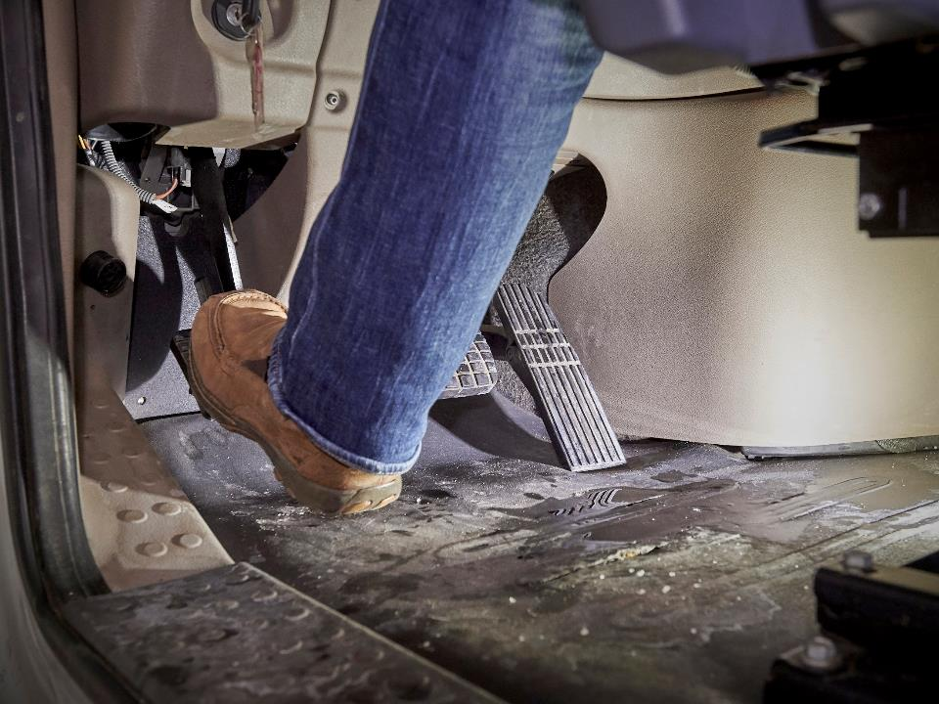
Drive Train
Notes:
Drive Train
The drive train is a series of connected mechanical parts which take the power generated by the engine and applies it to the tractor’s drive wheels.
The drive wheels are normally the rear-most axle or axles. However, in some cases all axles on the vehicle may be receiving engine power, such as in the case of a four-by-four or six-by-six tractor.
When expressing which wheels receive engine power, the first number is how many “axle ends” or “wheels” the vehicle has, the second is how many of those axle ends can receive engine power. Most tractors have either a three-axle six‑by-four configuration (six axles ends, with the rear four being the drive wheels) or a two-axle four-by-two configuration (four axle ends, the rear two of which receive engine power). A six-by-six would be a three-axle truck (six axle ends) and all six axle ends can receive engine power.
The drive train is comprised of the clutch, transmission, drive shaft, universal joints, and differential. These parts modify the engine torque (the rotational force generated by the engine’s crankshaft) into power that can be used to move the vehicle down the road. A serious defect in any of these parts could cause a breakdown or accident.

Slide 19
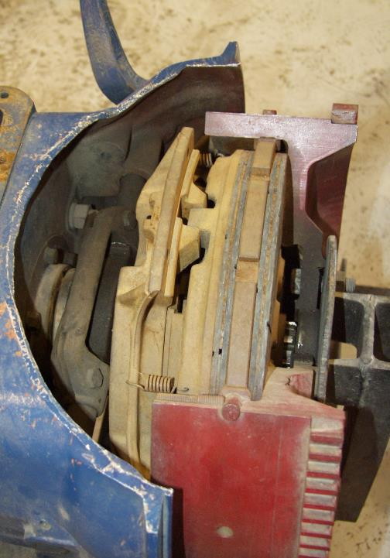
The clutch allows you to stop without stalling the engine and shift gears.
Notes:
Clutch
The clutch is the part of the power train that allows the driver to connect or disconnect the engine from the power train. The clutch allows the driver to stop without stalling the engine and shift gears. The clutch is composed of six major parts:
Clutch housing
Flywheel
Clutch disc(s)
Pressure plate
Release assembly
Clutch brake
Controls (clutch pedal and linkage)
In most trucks the clutch has three main components — one plate is squeezed tightly between two other plates. The plate in the middle is the driven member (clutch disc), which is connected to the shaft leading to the transmission. The other two plates are driving members which are connected directly to the engine. A strong spring or springs force the two driving members together. This tightens their grip on the middle plate until they all turn as one unit.
The engine flywheel is used for the first driving member. It has a smooth surface where the pressure plate pushes up against it.
The other driving member is called the pressure plate. It is a heavy steel ring which is smooth on one side. It is fastened to the cover, which is bolted to the flywheel, so they all turn together. It is fastened so it can slide back and forth when the clutch pedal is pushed and released.
The clutch disc or clutch plate is a flat disk of steel with friction facing on each side. The plate is fastened by splines to a shaft going to the transmission. It fits into grooves on the transmission input shaft, so the clutch disc and the transmission input shaft turn together.
When the pressure plate moves forward (the clutch pedal is released), the clutch disc is trapped between the flywheel and the pressure plate, allowing the engine power to turn the transmission input shaft.
When the clutch pedal is pushed, the pressure plate is pulled away from the flywheel and clutch disc, allowing the clutch disc to “free wheel.” When this happens, the engine power is not being sent into the transmission.
To stop the clutch plate from spinning free and put the transmission into gear when stopped, the driver must push the pedal all the way to the floor and activate the “clutch brake.” The clutch brake uses friction to stop the clutch plate and transmission input shaft from freewheeling, allowing the driver to put the truck into gear without having to grind or force the gears together.
To avoid damaging the clutch brake, the clutch should only be depressed halfway (just far enough to get the clutch to disengage) when the vehicle is moving. The only time it should be pushed all the way to the floor is when the vehicle is stopped, and the driver needs to put the vehicle into gear.

Slide 20
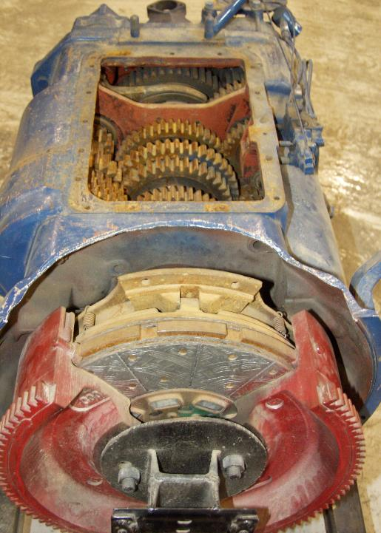
By manipulating the gears in the transmission, you can change the ratio between the engine and the rear wheels to produce more speed or torque as needed.
Notes:
Transmission
The transmission is basically a box/case of various sized gears. It is located behind the clutch and is fastened to the clutch housing.
The transmission adjusts the power generated by the engine. This provides the correct speed and torque needed. It transmits this power from the engine to the drive or powered axle(s) in order to propel the vehicle.
The transmission’s gears control the speed of the vehicle. Though the engine only operates at a certain rpm range, the gears allow the vehicle to move at different speeds.
Another property of the transmission is torque. This is what makes something rotate. The torque of the gears in a transmission is related to the amount of power a vehicle exhibits. The gears let the driver vary the force (torque) that the engine delivers to the wheels.
By manipulating the gears in the transmission, you can change the ratio between the engine and the rear wheels to produce more speed or torque as needed.
When inspecting the vehicle, check the transmission for leaks or other damage. Also, if the transmission requires transmission fluid, make sure it is at the appropriate level.

Slide 21
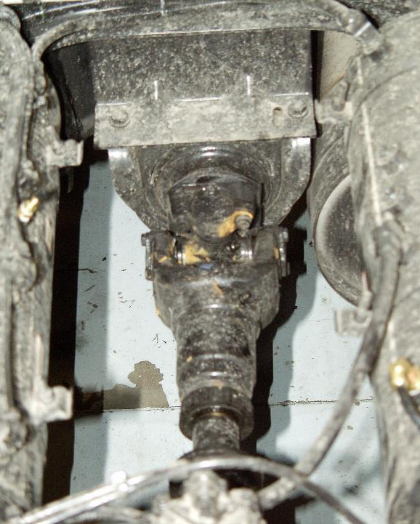
The drive shaft is a propeller which runs to the rear of the vehicle.
Notes:
Drive Shaft and Universal Joints
Behind the transmission is a propeller which runs to the rear of the vehicle. This is called the drive shaft. The drive shaft is a hollow shaft that connects the transmission to the rear of the vehicle.
At the front and rear of the shaft are universal joints. They are (in most cases) made up of two U-shaped pieces at right angles to each other and fastened together by a cross having arms of equal length.
The drive shaft transfers the twisting motion of the engine to the rear axle. The universal joints connect the shaft to the transmission and the rear axle.
The U-shaped pieces pivot on the arms of the cross. Since there are two pivots, the two shafts can be at an angle to one another and still turn around and transmit power. They do not have to be in a straight line. This is important because they become somewhat misaligned with each bump in the road. The rear axle moves up and down with the wheels, while the transmission moves very little as it is fastened to the frame. The universal joints allow the drive shaft to keep on turning smoothly even though its two ends are not always directly in line with each other.
A drive shaft is normally made up of two shafts, with a “spline” connecting the two halves. The spline area allows the drive shaft to become shorter or longer as the vehicle’s drive axle(s) move up and down when going over bumps. When inspecting the vehicle, check the drive shaft for bending or other damage.
Differential
The differential is the part of the drive train that transfers the driveline power from the drive shaft to the wheels and it splits the drive axle in half, allowing one wheel to turn at a different rate of speed than another. This helps a vehicle when turning. When performing a turn, the outside wheel must rotate faster than the inside wheel, so your right wheel is actually turning at a different speed than your left wheel. When inspecting the vehicle, check the differential for excessive wear.

Slide 22
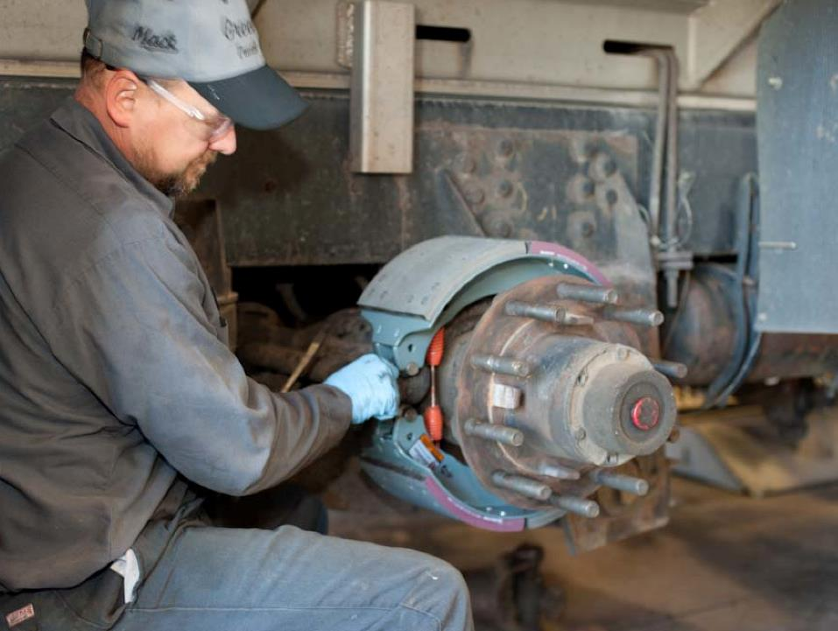
Brake System
Notes:
Brake System
The brake system is what slows down and stops a vehicle. It is made up of three major elements: service, emergency, and parking brakes.
Service brakes slow down and stop the vehicle. The service brakes are regulated by the driver by using the foot treadle and trolley valves. There are two types of service brakes — drum and disc.
Drum brakes. This metal cylinder looks like a drum that is bolted to each end of an axle. The braking mechanism is located inside the drum. To stop, the brake shoes and linings are forced/pushed against the inside of the drum. This causes friction which slows the vehicle and creates heat. When too much heat is created, the brake drum softens and stretches, resulting in the loss of braking power, making it harder, and in some cases, impossible to stop.
Disc brakes. Disc brake systems have a fixed disc attached to the inside of the wheel which rotates with the wheel. To stop, the pads and linings are squeezed against the side of the disc which creates friction to stop the vehicle.
Emergency brakes slow down and stop the vehicle when there is a failure in the air system. The red, eight-sided button on the dash controls the emergency brakes on the trailer. The tractor parking brake system doubles as the tractor’s emergency brakes and are controlled by the yellow, diamond‑shaped button.
Parking brakes prevent vehicle movement when parked. The yellow, diamond‑shaped button on the dash controls the parking brakes.
The emergency and parking brakes in air brake-equipped vehicles use spring brake chambers. These chambers will not allow the brake to release if there is not enough pressure in the brake system and will cause the brakes to apply if pressure to them is lost (such as the driver applies the parking brake, which drains the air out of them) or falls to low (such as due to a leak).

Slide 23
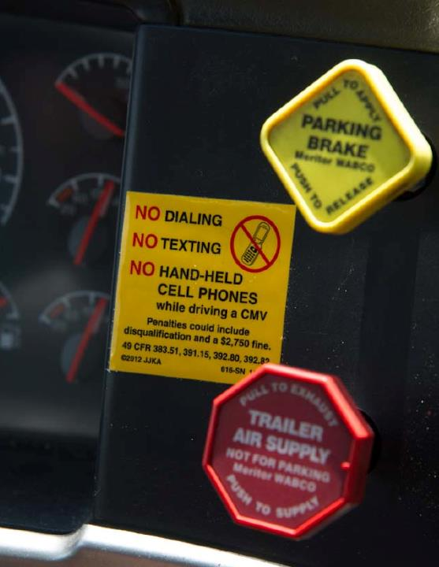
Air brakes use compressed air to maximize braking force.
Notes:
Air Brakes
Air brakes use compressed air to maximize braking force. Service brakes use the presence of air pressure to engage the brake pads, while spring-loaded emergency brakes use the absence of air pressure to engage the brake pads. The parts which make up an air brake system are listed below.
Compressor. This device is designed to build up and maintain required air pressure in the brake system reservoir. The compressor is run by the vehicle’s engine. It runs when the engine runs. The compressor may use belts and pulleys or shafts and gears, which are lubricated by the engine’s lubrication system. The normal operating range is 90-125 pounds per square inch (psi). The compressor runs until the pressure in the air reservoir reaches 125 psi. It then stops until needed.
..Governor. The governor regulates the compressor. This allows the compressor to maintain appropriate pressure in the vehicle’s air tanks by opening and closing inlet valves.
..Air tanks. Air tanks hold the compressed air. There are multiple tanks which hold air — a wet tank, dry tanks (primary and secondary), and trailer tanks. The wet tank removes most of the moisture and delivers the air to the dry tanks. The trailer tanks hold compressed air close to the trailer brake chambers for use in normal and emergency situations. The sizes of the tanks vary based on the number of tanks and the size of the brake chambers. Make sure all tanks are firmly mounted and all lines coming to and from it are in good condition before you hit the road.
CALLOUT: The number of tanks on a vehicle may vary. Some tractors have one tank, which is a combined wet and dry tank. There also may be one or two tanks on the trailer.
One-way check valve. This valve prevents air from getting back into the compressor from the air reservoirs. If air flows back, the brakes will not work.
Safety valves. Safety valves, also called pressure relief valves, keep air pressure from reaching a dangerous level. A safety valve opens (usually when pressure reaches 150 psi) and releases the air into the atmosphere, lowering the pressure in the system. If the safety valve activates often or continuously, the air governor may need servicing. This should only be done by a qualified mechanic. Never make these adjustments on your own.
Drain cocks. Drain cocks release moisture from air brake system reservoirs. The braking system could be damaged if this moisture is not removed, especially in winter, when the moisture could freeze. To prevent damage, you should drain the moisture daily, starting with the wet tank to prevent pulling the moisture from the wet tank into dry tanks. This should be done on a level surface, with the vehicle properly chocked. Allow all of the air pressure to escape to make sure all of the moisture is released.
Air pressure gauge. The air pressure gauge is located on the instrument panel. It tells you how much pressure is in the system. The normal operating range is 90-120 psi. This gauge should always be included in your visual scan of the vehicle’s instruments. This will help you detect a malfunction before it becomes an emergency. This could be one gauge with two needles or two separate gauges — primary and secondary.
Low-pressure warning signal. This signal warns you that air pressure has dropped to a potentially unsafe level (below 60 psi). Either a red warning light will light up or a buzzer will sound. If this happens, stop immediately. If you do not stop immediately, you may lose more pressure and your brakes will lock up. This must be fixed before you can continue your trip.
Air application pressure gauge. This gauge shows the amount of air pressure being applied to the brakes. When pressure is not being applied to the service brakes, the gauge will read 0 psi. (Not on all trucks.)
Treadle valve. The treadle valve (also called the foot brake or brake pedal) controls the air for the operation of the brakes. This valve is controlled by pushing (depressing) the brake pedal. The further down the brake pedal is pushed, the more air the system will receive, until it is at full capacity. Releasing the brake pedal releases the brakes by letting air exhaust from the brakes.
Independent trailer brake. The independent trailer brake (also called the trolley valve or hand valve) is a hand-operated control that applies the trailer brakes by regulating the airflow to the trailer unit. This brake should never be used for slowing down or parking. It is normally used to hold the vehicle in place on a grade while engaging the clutch and testing the trailer service brakes. (Not on all trucks.)
Tractor parking valve. This hand-controlled knob can be pushed in to release the tractor parking brake and pulled out to set the parking brake. It also operates the spring brakes.
CALLOUT: Spring brakes apply when air pressure leaves the brake chamber and release when air pressure builds up in the chamber.
Glad hands. Glad hands are connectors mounted on the front of the trailer for connecting air lines from the tractor. When the glad hands lock, the connection is secure. A glad hand seal seals the coupling, preventing dirt and debris from entering and air from escaping. You should check the glad hand seal for damage or dirt and debris before connecting the air lines. The glad hands, glad hand seals, and in many cases even the airlines themselves are color coded. The service line is usually blue, and the emergency line is usually red. If they are not color coded, the word “Emergency” or “Service” (or simply “E” or “S”) will be stamped into the glad hand itself. On the trailer, the driver’s side connector is the emergency glad hand, and the passenger side connector is the service glad hand.
When the air lines are unhooked, they should be sealed with protector plates to keep out dirt and debris. Keeping the air lines clean reduces your chances of brake failure.
VIDEOS (see Trainer Tools USB)
18.1 — Glad Hands Inspection
Quick release valve. This valve (located near the brake chambers) allows the brakes to release in a short amount of time. When you remove your foot from the valve, the pressurized air in the chambers escapes quickly into the atmosphere. This allows the brake shoes to release quickly.
Relay valve. This valve is used to speed up the application and release of the rear wheel brakes by taking air from the nearest appropriate air tank to fill the service brake chambers, rather than waiting for the air coming from the brake pedal. The air from the brake pedal “signals” the relay valves on the vehicle to open and apply the brakes using the air from the nearest appropriate tank. In other words, the relay valve is responsible for making sure that all brakes apply at the same time.
Emergency relay valve. The emergency relay valve is installed either on the trailer reservoir or on the trailer frame close to the brake chambers. This valve controls brake application and also provides for automatic trailer brake application should the trailer become disconnected from the tractor. The emergency relay valve can also release the trailer brakes quickly.
Brake chamber. The brake chambers are air chambers that are installed close to each wheel. When the brake is applied, air enters the chamber, pushing the “push rod” out of the chamber, beginning the mechanical portion of the brake application. The push rod causes the slack adjuster to rotate (the slack adjuster is the mechanism that adjusts the brake freeplay as components wear), which in turn causes the linings or pads to be forced into contact with the drums or rotor.
CALLOUT: During your pre-trip inspection, check that the brake chambers are firmly mounted and not cracked, damaged, or rusting through. Also, make sure the air brake lines are not cracked, frayed, or rubbing on anything.
Air Brake System Operation
The following steps outline the process of a basic air brake system:
The pressurized air is pumped by the compressor to the wet tank where moisture is removed.
The air then passes through the one-way check valve to the dry tanks.
When you put your foot on the brake, air flows through the service lines to apply the brakes by putting air into the service brake chambers. At the same time, air flows through the tractor protection valve and through the trailer service glad hand to apply the trailer service brakes. The air from the foot valve directly fills the brake chambers on the front axle. However, on the drive and trailer axles, the air from the foot valve causes the relay valves to open, indirectly putting air into these service brake chambers.
When you release the brake pedal, air escapes through the quick release valves on the foot valve, tractor relay valve, and trailer relay valve.

Slide 24
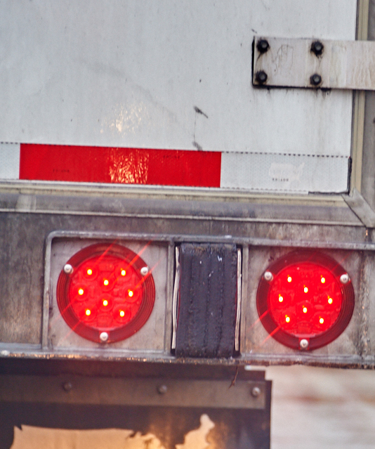
The antilock system activates when you apply pressure to the brake pedal sharply enough to lock the wheels.
Notes:
Antilock Brake Systems
The purpose of the antilock system (ABS) is to control wheel lock-up, which can cause a vehicle to skid and possibly jackknife. This is accomplished by an electronic system which senses the speed of each wheel.
When the wheel speed sensor detects an imminent lock-up, a valve is opened and air in the chamber is released. As the wheel speed increases, the valve is closed, and air is reapplied. All of this occurs automatically if the vehicle is stopping and a lock-up is sensed.
The antilock system activates when you apply pressure to the brake pedal sharply enough to lock the wheels. The computer system senses the potential for lock-up and “pumps” the brakes at a rate three to five times faster than a human could.
CALLOUT: Never pump the brakes when operating a vehicle with an antilock brake system. Let the computer do the work for you.
Most ABS-equipped vehicles have ABS malfunction warning lights. Tractors are normally equipped with a warning light for the tractor ABS, and one for the trailer ABS. Trailers are normally equipped with a yellow light at the driver’s side rear corner. These lights should turn on for a few seconds when starting your vehicle. If the light stays on or suddenly turns on while you are driving, the ABS may not be working. Though you still have properly working brakes, the antilock function may not be working. Get this checked out as soon as possible.
In certain vehicles and vehicle combinations, a warning light may turn on for a short period (a second or two) when the brakes are applied. If this happens, contact someone with knowledge of specific ABS functions to verify that this is normal for your vehicle or combination of vehicles.
Checking for Defects
A defect in the braking system can interfere with a vehicle’s ability to slow and/or stop your vehicle. When inspecting the vehicle, make sure you check:
Brake system air pressure
For defective gauges and low air warning devices
For cracks in the brake drums
Shoes or pads for proper thickness, signs of oil or grease, and wear
Brake chambers mounting to ensure it is secure
Slack adjusters for missing and loose parts and proper adjustment
Brake line securement
The air reservoir, ensuring it is properly attached to the vehicle and doesn’t contain excessive water
Air lines to the trailer for tangles, restrictions, or damage

Slide 25
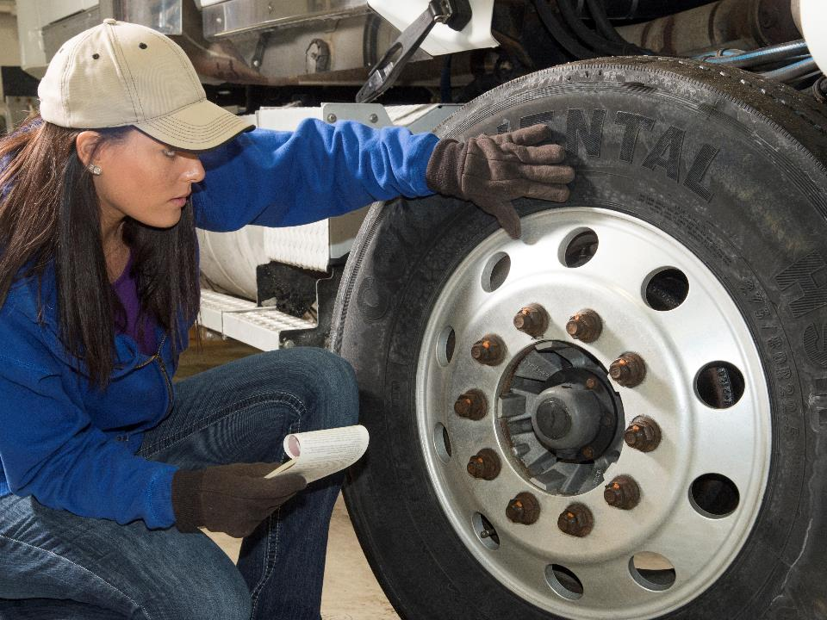
Wheels & Tires
Notes:
Wheels and Tires
A wheel is a round object with a hub that is connected to the axle. The axles connect the wheels to the rest of the vehicle and help support the weight of the vehicle and its cargo.
The tire is affixed to the wheel. The tire is the rubber that grips the road, allowing the vehicle to move.

Slide 26
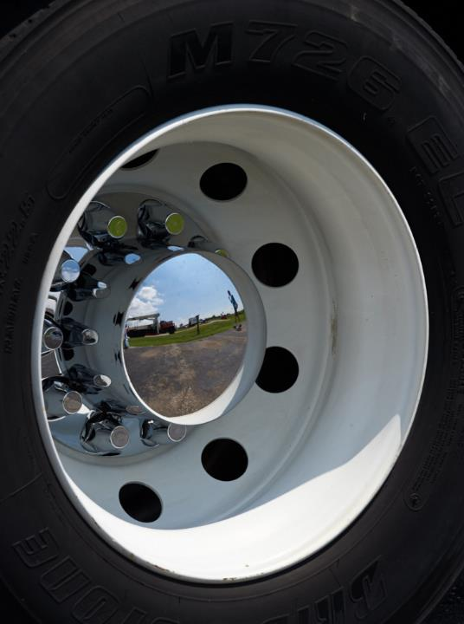
There are two types of wheels found on most trucks.
Notes:
Wheels
There are the two types of wheels found on most trucks:
Spoke wheels are made up of two pieces. One piece is the spokes. The spokes are attached to the hub. The second piece is the rim. Spoke wheels are heavier and more difficult to align and balance.
Disc wheels are made of aluminum or steel. They are easier to align because they are fastened to the hub using lug studs that are on the hub and lug holes in the rim (much like a car wheel).
There are two types of wheel mounting systems used on most trucks:
Stud piloted mounting systems use the studs on the wheel hub to guide and center the wheel.
Hub piloted mounting systems use the wheel hub to guide and center the wheel.
The wheels are fastened by either ball-seat nuts or flange nuts.

Slide 27
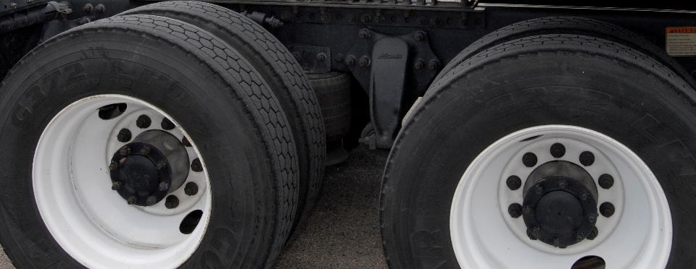
All tires on your vehicle should be the same size and type.
Notes:
Tires
There are three types of tires used on most trucks:
Radial tires. The body ply cords on radial tires run around the tire perpendicular to the tread. Radial tires also have belt plies that run circumferentially around the tire, under the tread. This type of tire construction allows for better traction and fuel mileage.
The tread on radial tires lasts 40 to 100 percent longer than other types of tires because when the surface area of radials comes in contact with the road, they have greater traction while creating less friction and less heat. This gives your vehicle greater fuel mileage and better performance.
Bias ply tires. The body ply cords on bias ply tires run diagonal across the tire. The tire may also have breakers or narrow plies under the tread. While bias ply tires wear faster than radial tires and reduce the vehicle’s fuel mileage, they are a tougher tire and are used in special applications where tire damage or wear from severe service are a concern.
Belted bias tires. The body ply cords on belted bias tires run diagonal across the tread and belted plies run circumferentially around the tire under the tread. The belts on this tire are of heavier construction.
VIDEOS (see Trainer Tools USB)
18.2 — Tire Tread and Inflation
Generally, radial and bias ply tires should not be mixed. All tires on your vehicle should be the same size and type. The differences in traction and turning capabilities among the different types of tires can cause problems if the types of tires are improperly mixed. There are ways to properly mix the tires. Consult the tire manufacturer for guidelines/instructions.
Some tires have tubes that fit between the tire and the rim. The air that keeps the tire inflated is kept in the tire tube. Flat tires are more prone to tire fires because the underinflated tube spins inside the tire, creating excessive heat.
Tubeless tires are mounted onto a single-piece wheel. The tire (instead of a tube) holds the air. Tubeless tires are lighter, easier to mount, and the most common.
Proper tire inflation is important. Underinflation can increase tread wear and reduce the life of the tires. Overinflation can damage the tires and reduce stopping efficiency. Consult the vehicle’s owner’s manual for inflation guidance.
Tire pressure should be checked regularly. This should be done with an accurate gauge when the tire is cool. If the tire is hot, the pressure reading will be higher.
CALLOUT: If you do check a heated tire, and the pressure is higher than recommended, do NOT release any air. Wait until the tire is cool and check again.

Slide 28
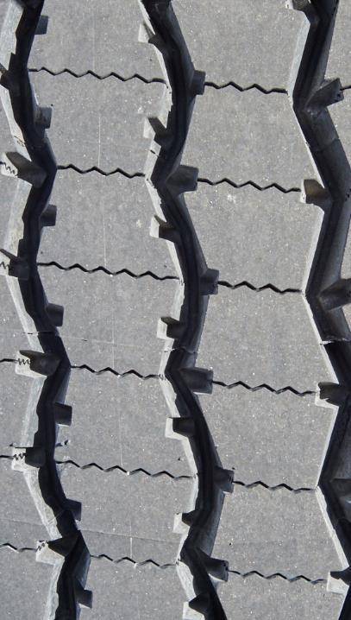
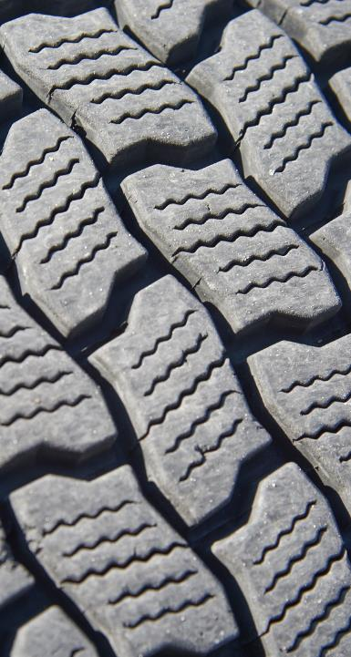
Rib tread
Lug tread
Notes:
Tread Design
There are two basic truck tire tread designs:
Rib tread. The tread groves on these tires run parallel with the tread bead. This type of tread is recommended for the front wheel positions on tractors.
Lug tread. In over the road high-torque service, lug treads provide maximum protection from wear and greater traction. Generally, these tires will last longer when installed in the drive positions when compared to rib-tread tires.

Slide 29
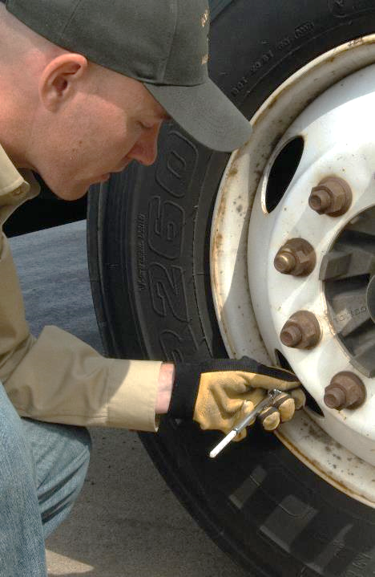
Proper tire inflation has many benefits including increased fuel efficiency, a smoother ride, and a reduced chance of a blow out or tire fire.
Notes:
Proper Tire Inflation and Care
Proper tire inflation has many benefits including increased fuel efficiency, a smoother ride, and a reduced chance of blow out or tire fire. Inspect your tires often and check the pressure with a tire gauge. Refer to the manufacturer’s specifications for correct pressure.
When inflating a tire, keep in mind the maximum pressure for the load you are carrying, making sure you do not exceed the rim or wheel rating.
During regular operation of your vehicle, the pressure of the tires should increase, as the tires get warmer. Expect increases of 10-15 psi. Greater increases, which can create an abnormal amount of heat, may indicate under inflation, excessive speed, and/or incorrect tire size. If this happens, you should stop, investigate, and correct the problem.
Underinflation — When a tire is underinflated, the following can happen:
The tread wears down more quickly
The temperature within the tire increases, possibly causing the separation of the tread from the body or belt ply
Deflation can occur, weakening the tire’s body cords, potentially causing a blowout
If you operate duals and one is underinflated (or flat) a fire can start. This occurs because:
The flat tire flexes into the other tire and/or
The remaining tire is carrying the load intended for two tires
Overinflation. An overinflated tire becomes rigid, making it easier for the tire to be cut or punctured by objects on the road. Overinflation also makes the ride less smooth, as the tires are unable to absorb shock.
Tire care. Tires should be rotated periodically based on manufacturer recommendations. This will help in evenly distributing wear.
As well as being a good, safe practice, inspecting tires is required by the Federal Motor Carrier Safety Regulations (FMCSRs). Section 392.7 states a driver must be satisfied that certain vehicle parts and accessories are in good working condition prior to driving the vehicle. This includes tires.
Appropriate tire condition and tread depth is also addressed in the FMCSRs. Section 393.75 states you may not drive your vehicle if a tire has any of the defects listed below:
Body ply or belt material exposed through the tread or sidewall
Any tread or sidewall separation
The tire is flat or has an audible leak, or
The tire has a cut that exposes the ply or belt material
Section 393.75 also states any tire on the front wheels must have a tread groove pattern depth of at least 4/32 of an inch when measured at any point on a major tread groove. All other tires must have a tread groove pattern depth of at least 2/32 of an inch when measured in a major tread groove.
Matching and spacing of duals—If two tires of differing diameters are positioned together, the larger tire will begin to overheat and bulge out at the sides due to taking on more of the load. The smaller tire will wear irregularly because it doesn’t have proper contact with the road, possibly causing the tread to separate. If the larger tire bulges too far, it will begin to touch the other tire, increasing friction and heat between the two, which can cause a blowout in one or both of the tires.
To be on the safe side, allow no more than ¼ inch difference between the diameters, no matter what the tire size. Also keep the spacing between the tires at the recommended distance to prevent the tires from touching — creating a heat build-up.

Slide 30
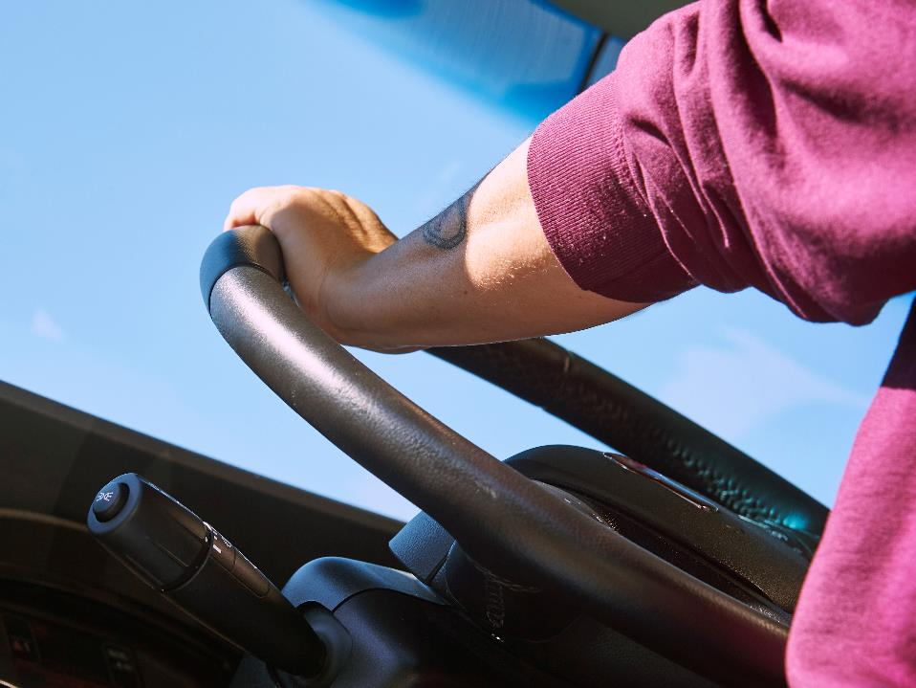
Steering System
Notes:
Steering System
The steering system is what gives you directional control of your vehicle. The components that make up the steering system include:
Steering wheel. The steering wheel controls the direction of the vehicle. It is connected to and turns the steering shaft.
Steering shaft. The steering shaft connects the steering wheel to the steering gear box.
Gear box. The gear box transfers the turning of the steering shaft to the Pitman arm.
Pitman arm. This component is connected to the steering gear box and moves the drag link.
Drag link. The drag link transfers movement from the Pitman arm to the left steering arm.
Steering arm. The right side attaches the tie rod to the wheels, the left side attaches to the drag link.
Tie rod. The tie rod connects the front wheels to together and adjusts their operating angle.
All of the parts listed must be correctly aligned. Incorrect alignment can cause difficulty in steering and improper tire wear.

Slide 31
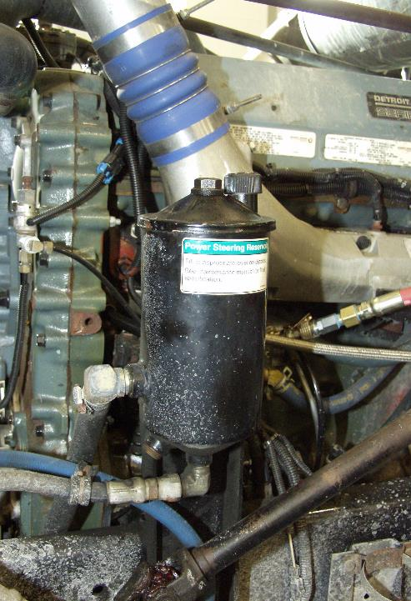
Power steering allows you greater control of your vehicle.
Notes:
Wheel Alignment
The following alignment characteristics are built into the axle by the manufacturer. They may be changed as necessary.
Caster. The caster of an axle is the amount of tilt it has. This is measured in degrees and it is recommended that the axle have positive caster (it tilts forward). When set this way, the vehicle will want to naturally move straight ahead and will recover from turns more easily. Positive caster makes it easier for you to steer.
Camber. The camber of the wheels is the degree of tilt they have with respect to the road. It is best when the truck’s wheels have a positive camber to support the load. In other words, the distance across the top of the wheels is greater than the distance across the bottom. When a heavy load is placed on the truck, it straightens out the tires with the road.
Other alignment characteristics are the result of wear and damage. The most notable of these include:
Toe-in. The wheels on the same axle are closer on the front than the back.
Toe-out. The wheels on the same axle are closer in the back than the front.
Power Steering
Power steering allows you greater control of your vehicle. There are many advantages to power steering:
It takes less effort
Reduces driver fatigue
Road shocks are better absorbed
Easier to maneuver the vehicle in difficult situations

Slide 32
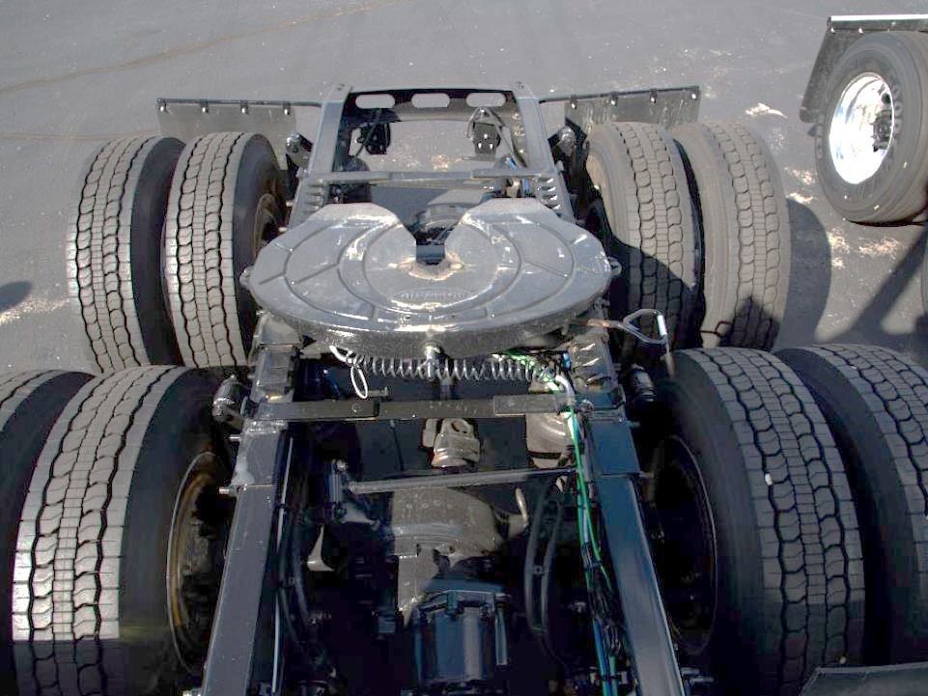
Coupling System
Notes:
Coupling System
The coupling system is what connects the tractor and trailer. Two main components make up the coupling system, the fifth wheel and kingpin.
Landing gear supports the front-end load weight of the trailer when uncoupled. Landing gear is usually cranked up or down. Landing gear has either wheels or skid feet attached to the bottom.
Fifth Wheel
The fifth wheel is a coupling device located on the tractor’s rear frame. It is used to join (couple) the front end of the trailer to the tractor. The fifth wheel is a flat, rounded plate with a V-shaped notch in the rear. The kingpin, which is located on the trailer, fits into the fifth wheel, allowing the tractor to pull the trailer.
There are several types of fifth wheels including fixed-mount and sliding/adjustable.
Fixed-mount. The fixed-mount fifth wheel is secured in a fixed position behind the cab and has three parts — the baseplate, bracket subassemblies, and frame mounting members.
Baseplate. The baseplate includes the locking mechanism. It also takes on the majority of the stress of coupling.
Bracket subassemblies. The bracket subassemblies keep the baseplate in place.
Frame mounting. The frame mounting members are structural steel angles bolted to the fifth wheel.
Sliding/adjustable. The sliding or adjustable fifth wheel slides backward and forward to accommodate different types of loads. The sliding fifth wheel may be locked into place with pins that fit into holes in the slider track or by a plunger that fits into a row of slotted holes.
Adjustment of a sliding fifth wheel may be done by hand or by a control in the cab. When adjusted by hand, the driver manually moves the pins or plunger and adjusts the fifth wheel by moving the tractor forward or backward. When adjusted from the cab, activating a switch unlocks the locking device. The driver then sets the trailer brakes and moves the tractor forward and backward until the fifth wheel is in the correct position.
Proper maintenance of the fifth wheel is important. Check the fifth wheel for cracks, breaks, and security. Make sure the fifth wheel has the right amount of grease, so it functions properly.
Missing U-bolts, cracked or broken welds, or other defects in fifth wheel mounting devices should be repaired or replaced.
Kingpin
The kingpin is attached to the upper fifth wheel plate, under the front of the trailer. It is a two-inch steel pin that attaches to the fifth wheel to couple the tractor to the trailer. Check the kingpin for excessive cracks, bending, or wear.

Slide 33
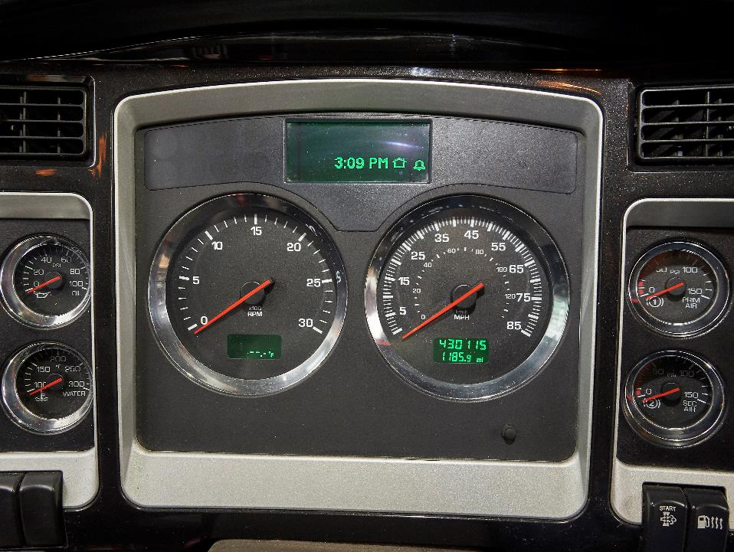
Diagnosing Malfunctions
Notes:
Diagnosing Malfunctions
You should be aware of your vehicle’s condition at all times. Your ability to spot a potential problem can help in diagnosing a vehicle malfunction. As well as being alert for warning lights and alarms, pay attention to your senses. Sights, sounds, smells, and/or the feel of the vehicle can indicate a potential problem. Report to your company anything that doesn’t seem quite right, and have it checked out.
Sight. Look at your vehicle’s gauges. Know what the proper readings are and what readings indicate a potential problem. Watch for defects in all vehicle components when performing vehicle inspections.
Sound. Listen for unusual or abnormal equipment sounds. Squeaks, squeals, thumps, and rattles can be the first sign of vehicle malfunction.
Smell. Be aware of unusual smells including burning rubber, hot oil, or fuel.
Feel. Be aware of vibration, swaying, or other movement that isn’t normal for your vehicle.
In many cases, a vehicle will give you clues that there could be a problem. Some things to watch for that may signal a possible problem include inconsistent/erratic gauge readings, unusual sounds (rattling, whining, grinding), or a sharp drop in fuel mileage.
If you notice a problem, stop your vehicle as soon as practical. If you can, try to identify the source of the problem. If the problem is one you can fix based on your knowledge/experience and company policy, do so. If you cannot fix it, report it to your company. Make sure you include a description of what you observed and how the vehicle acted/responded. Get mechanical help as soon as possible.

Slide 34
Objectives Review
You should now be able to:
  Explain the function of major combination vehicle systems
  Check all key vehicle systems to ensure their
  safe operation
  Identify what is needed to keep vehicle systems in good operating condition
Notes:
You should now be able to:
Explain the function of major combination vehicle systems
Check all key vehicle systems to ensure their safe operation
Identify what is needed to keep vehicle systems in good operating condition
CLASSROOM RECOMMENDATION
Before concluding your training session, have participants take the corresponding quiz (found on the Trainer Tools USB) to check their understanding of the material. You can customize any of the questions to fit your audience or workplace. The answer key can also be found on the Trainer Tools USB.
You may also choose to administer the quizzes before you begin your training session to help get participants thinking about the subject and/or to gauge their understanding of the topic ahead of time.

