Slide 1






PowerPoint® Instructions
This PowerPoint has been designed so you can easily customize it for your training session.
Throughout the presentation you’ll see icons with recommendations or videos to enhance the instruction you present to your students. A detailed explanation for each icon can be found on the next slide. Videos can be found on the Trainer Tools USB.
When you see an icon on the slide, look in the notes
section for further information.
Simply delete or move the icon off the slide before your training session begins.

Slide 2





Classroom Recommendations. Provides suggestions for enhancing your classroom presentation; from ideas for large group discussions to suggestions on the use of training aids such as examples or photos of vehicle parts and components to help illustrate the items covered within a chapter.
Lab Recommendations. Provides suggestions for activities and exercises that take place outside the classroom, but do not involve
the actual operation of the tractor-trailer or its components. Examples
of lab sessions include conducting a vehicle inspection or practicing mirror adjustment.
Range Recommendations. These recommended activities take
place on a closed-access driving range where students may practice driving skills in a controlled environment. Examples of range sessions include practicing shifting technique and successfully completing a backing maneuver.
Road Recommendations. These recommended activities take place in road and traffic conditions that support the chapter’s objectives. Examples of road sessions include proper communication with other drivers through the use of turn signals and basic vehicle control under nighttime or extreme weather conditions.
Videos. These short video clips reinforce material presented in the Student Manual. Use them to help students grasp difficult concepts or subject matter.

Slide 3

28
Trip Planning
Notes:
Chapter 28: Trip Planning
Unit A1.5.8 Trip Planning
This unit must address the importance of and requirements for planning routes and trips. This instruction must address planning the safest route, planning for rest stops, heavy traffic areas, railroad-highway grade crossing safe clearance and ground clearance (i.e., “high center”), the importance of Federal and State requirements on the need for permits, and vehicle size and weight limitations. The training providers must teach driver-trainees in the correct identification of restricted routes, the pros and cons of Global Positioning System (GPS)/trip routing software, and the importance of selecting fuel-efficient routes.

Slide 4
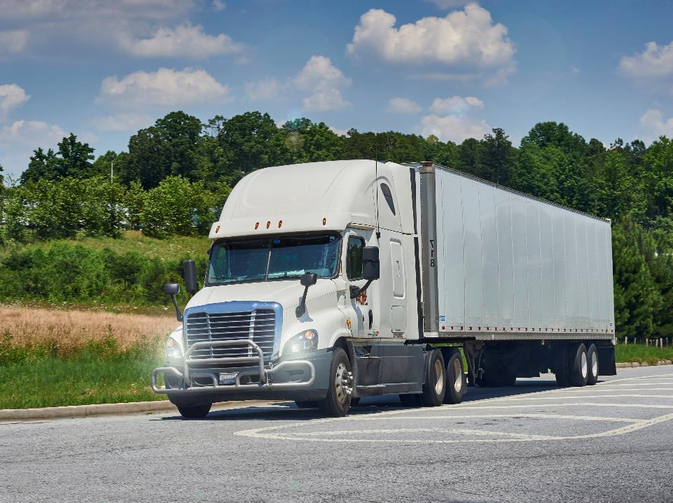
Introduction
Notes:
Introduction
The idea behind trip planning is to design the most effective, efficient, safe, and legal route between two points.
A well thought out trip plan can mean a savings of time and money for you and your motor carrier. A good plan can also mean a safe trip for you and the load you are hauling. If you have a solid plan before hitting the road, you are better able to devote all of your attention to driving.
The following are the five basic steps of trip planning:
Make sure paperwork is up to date. Have proper freight documentation, current hours-of-service records, and proper permits and licenses.
Select the route. Remember, many variables are involved including vehicle restrictions, cargo restrictions, traffic conditions, weather, and your safety.
Estimate time and plan for stops. Plan to meet the scheduled deadline, but consider driver and vehicle factors as well as weather and road conditions.
Estimate fuel use and fuel stops.
Estimate trip expenses. Understand the length and nature of the trip, what conditions to expect on the road, and plan for the unexpected.
CLASSROOM RECOMMENDATIONS
Group discussion and hands-on practice are the best way to address this subject. At least one detailed trip planning exercise is recommended.
The following is an exercise you can use to help your drivers practice their trip math skills.
Trip math challenge
You are assigned to a 1,000-mile run from Chicago, Illinois to Denver, Colorado. The vehicle you are driving gets five miles to the gallon with the type of load you are hauling. Your fuel tank capacity is 100 gallons. You plan to leave Chicago at 4 a.m. Tuesday, February 13.
What is the range of your vehicle?
How much fuel is required for the trip?
How many fuel stops will you make?
When will you arrive in Denver?
Answer key: 1) 500 miles; 2) 200 gallons; 3) About 2; 4) Varies (discuss hours-of-service compliance, route selection, and other determining factors (traffic, weather, etc.))
VIDEOS (see Trainer Tools USB)
28.1 — Estimating Trip Time

Slide 5
Objectives
Upon completion of this lesson, you will be able to:
  Describe the paperwork required for you (the driver), your cargo, and your vehicle
  Discuss considerations when selecting your route, along with how to read a map and use a global positioning system (GPS)
  List vehicle and cargo restrictions
  Describe things you should consider when estimating your trip time
  List conditions that can affect fuel usage
Notes:
Objectives
Upon completion of this lesson, you will be able to:
Describe the paperwork required for you (the driver), your cargo, and your vehicle
Discuss considerations when selecting your route, along with how to read a map and use a global positioning system (GPS)
List vehicle and cargo restrictions
Describe things you should consider when estimating your trip time
List conditions that can affect fuel usage

Slide 6
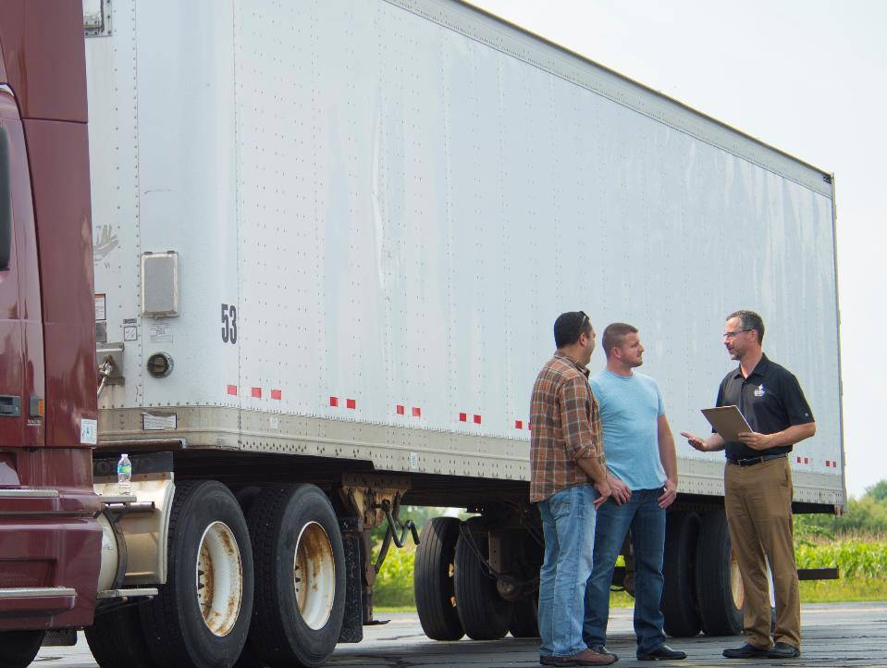
Paperwork
Notes:
Paperwork
After driving, paperwork is probably the largest task a driver deals with on a daily basis. Making sure you have all necessary and accurate paperwork before you hit the road is essential to planning an efficient and profitable trip.
Generally, the paperwork you should carry with you falls under three categories—driver, cargo, and vehicle.

Slide 7

You must carry your license with you when operating a motor vehicle.
Notes:
Driver
As the driver of a commercial motor vehicle (CMV), the Federal Motor Carrier Safety Regulations (FMCSRs) require you to carry certain documents to verify you are a qualified driver.
Operator’s license. You are required to have a valid operator’s (driver’s) license to operate a motor vehicle. You must carry this license with you when operating a motor vehicle.
The class of license you must hold is based on the type of vehicle you are operating.
The commercial driver’s license (CDL) classes are federally mandated. (See Sec. 383.91 of the FMCSRs for details.) The CDL classes are as follows:
Class A — Any combination of vehicles with a gross combination weight rating (GCWR) of 26,001 pounds or more provided the gross vehicle weight rating (GVWR) of the vehicle(s) being towed is in excess of 10,000 pounds.
Class B — Any single vehicle with a GVWR of 26,001 pounds or more, or any such vehicle towing a vehicle not in excess of 10,000 pounds GVWR.
Class C — Any single vehicle, or combination of vehicles that meets neither the definition of Class A nor that of Class B but is designed to transport 16 or more passengers (including the driver) or is used in the transportation of a placardable amount of hazardous materials.
Non-CDL classes of license vary from state to state. Consult state laws and regulations for details.
Record of duty status. Each motor carrier must require every driver to record his or her duty status for each 24-hour period.
You must complete the record of duty status by using an electronic logging device (ELD) or by using a paper log. The record must be legible and kept current to the time shown for the last change of duty status.
You must submit the original record of duty status to your motor carrier within 13 days of completion.
You must have in your possession a record for the last seven consecutive days as well as for the current day. The records must be available for inspection while you are on duty.
CALLOUT: Many carriers require drivers to submit their original records of duty status prior to the regulatory requirement of 13 days.

Slide 8
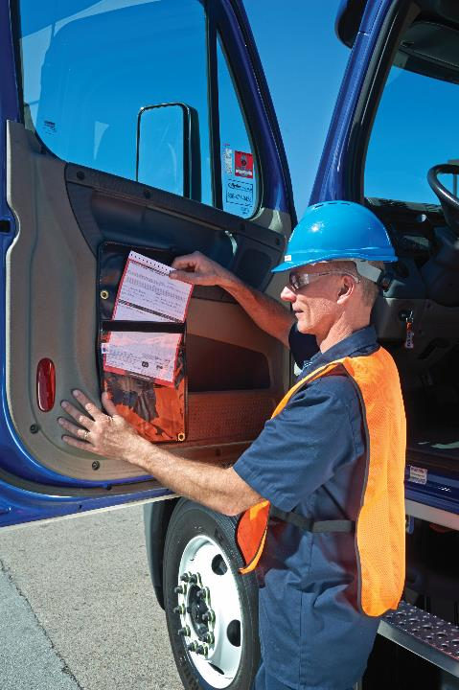
Paperwork regarding the freight you are hauling should be in proper order before you begin your trip.
Notes:
Cargo
Paperwork regarding the freight you are hauling should be in proper order before you begin your trip. This ensures the safe and accurate delivery of goods to the appropriate party.
Bill of lading. The bill of lading is the document used in transactions between a shipper and carrier. There are three distinct and important functions served by the bill of lading:
It is a receipt issued by the carrier to a shipper for goods received for transportation
It is a contract naming the parties involved, the rate/charge for transportation, and the agreement regarding the carrier’s liability in the event of damage or loss of goods
It serves as documentary evidence of title to the goods
Unless specifically instructed otherwise, the carrier’s duty is to deliver the shipment to the consignee named on the bill of lading. Possession of an original bill of lading, properly endorsed, indicates title to the goods.
This is an important document, so make sure it’s right from the beginning. If something looks incorrect or incomplete, question it. If you are not getting answers, stop what you are doing and call your dispatcher.
Bills of lading must be legibly written.
The following information must be included on the bill of lading:
Names of consignor and consignee
Origin and destination points
Number of packages
Description of freight
Weight, volume, or measure of freight (if applicable to the rating of the freight)

Slide 9

Paperwork regarding vehicle operations is completed throughout a trip.
Notes:
Vehicle
Paperwork regarding vehicle operations is completed throughout a trip. Accuracy is important, as the paperwork listed below is required by regulation and/or law.
Driver vehicle inspection report (DVIR). At the end of your day’s work on the vehicle you operated, you need to review the condition of your vehicle.
If during this post-trip inspection of your vehicle, you discover any defects or deficiencies which could affect the safe operation of your vehicle or cause a mechanical breakdown, you must complete a written report, commonly referred to as a driver vehicle inspection report (DVIR).
Though the regulations do not mandate that you carry this document in your vehicle, some motor carriers require that the DVIR stay with the vehicle as part of its vehicle maintenance policy.
Trip report. A trip report or individual vehicle mileage report (IVMR) is used to record trip information including (but not limited to):
Date of trip (starting and ending)
Trip origin and destination
Route of travel and/or beginning and ending odometer reading
Total trip miles
Unit number or vehicle identification number
The trip report must be accurate as this information is used by the carrier to file International Fuel Tax Agreement (IFTA) quarterly fuel tax returns and International Registration Plan (IRP) annual vehicle registration renewals. In the event the carrier is audited, the auditor will examine trip reports and fuel receipts for accuracy.
You should also complete a trip cost report. It tracks expenses incurred during the course of a trip. A trip cost report includes detailed information on:
Fuel purchases
Brokerage fees
Permit fees
Tolls
Scale fees
Permit credentials. You must keep certain types of carrier operations and permit credentials in your vehicle. Exactly which items you must have will depend on whether you are working for a for-hire or private motor carrier, whether you are involved in interstate or intrastate commerce, and the type of commodity you are transporting.
Operations-related and permit credentials you would be expected to have include:
Vehicle registration —Base state or IRP cab card showing active and valid registration
Tax permits — IFTA license and decals for the current licensing year on the truck, state mileage tax permits (as applicable)
Special permits — Temporary registration or fuel trip permits, including special permits such as oversize/overweight
Authority — State authority credentials (if applicable)
Bill of lading/shipping papers — Bill of lading applies to for‑hire carriage
Lease agreement — Must be carried for the duration of the lease (if applicable)
Unified Carrier Registration (UCR) — UCR does not issue a credential, however, you may carry proof of payment/receipt
CALLOUT: Though a driver is not required by the FMCSRs to complete a DVIR when no defects or deficiencies are discovered during a post-trip inspection, many motor carriers do require a driver to complete a DVIR at the end of each day’s work on a vehicle.

Slide 10

Route Selection
Notes:
Route Selection
Many factors go into the selection of an appropriate route. The shortest route may not always be the best route. Terrain, weather, traffic, road construction, and vehicle and cargo restrictions all play a part in selecting an appropriate route. You should know what route you plan to take and identify available alternate routes you can use before you depart.

Slide 11
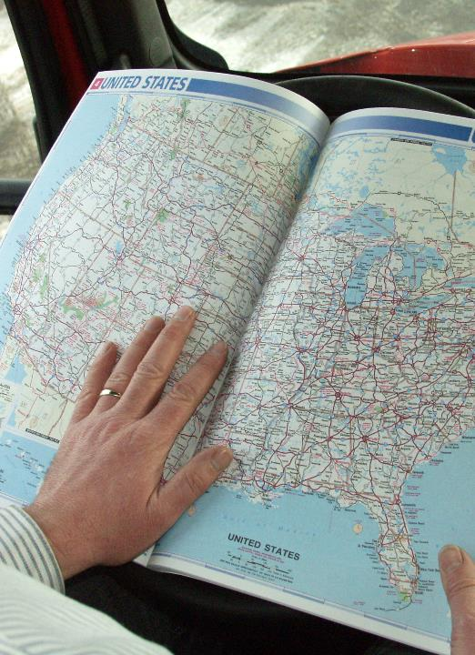
Being able to read and understand a road map is the first step in selecting an efficient route.
Notes:
Reading Maps
Being able to read and understand a road map is the first step in selecting an efficient route.
The road map is a necessary tool, helping you determine routes and locate specific destinations. Essential map reading skills you need to be proficient in include:
Locating the starting point, intermediate stops, and the destination
Laying out your route and an alternate route
Estimating point-to-point mileage using the map scale
Reading map symbols
The majority of maps are set on a box or grid pattern with letters along the top and bottom and numbers along the sides of the map. A box or key within the map lists destinations (cities, towns, streets) and where to find them within the grid system.
All maps include a scale. The scale lists how many inches represent a given number of miles. Map scales are good for figuring a rough mileage estimate. Mileage charts give a better idea of true distance.
Symbols are also included on all maps. Symbols represent everything from the size of a community to where to find a rest area. Symbols vary from map to map and all maps include a legend explaining the symbols used.
There are two types of maps most drivers rely on, highway maps and city maps.
Highway maps. Highway maps show an entire state or region. They sometimes include major cities in some detail. Features vary depending on the map, but all include major routes, road types, toll roads and freeways, population centers, and railroad crossings. Highway maps are best used to locate major highways and routes for long distance travel.
City maps. City maps provide the greatest detail. Major street names are readable and secondary streets can often be located on these types of maps.

Slide 12

Up-to-date information is available on traffic delays, road construction, and weather conditions.
Notes:
Online Resources
Keep in mind that maps do not include information on delays caused by road construction, poor weather conditions, or heavy traffic. This information is available via the internet from several sources including the Federal Highway Administration (FHWA): http://www.fhwa.dot.gov/trafficinfo.
Many states also provide trucker-specific travel information, such as rest area locations and travel/route restrictions on their department of transportation websites. In many states this information may be accessed by typing the state name and 511 into an internet search engine.

Slide 13
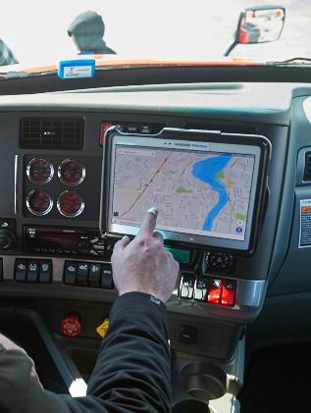
GPS can make trip planning easier, if used correctly.
Notes:
Global Positioning Systems (GPS)
The use of an electronic navigation system, also referred to as a global positioning system (GPS), can make trip planning easier for the professional driver if the driver uses the correct device properly.
Not all devices are the same. The device you may use in your personal vehicle is not the one you should be using in your CMV. You need to use a device that is designed specifically for truck drivers.
So, what’s the difference? In addition to general route information, a GPS designed for truck drivers includes information on low overpasses/bridges, route restrictions, upcoming scales, and traffic issues such as congestion and/or accidents.
Though a GPS designed for truck drivers may be more expensive, it is well worth the investment. Use of a device that does not provide this additional information could put you in a situation that you do not want to be in, such as operating on a restricted route or approaching a low bridge overpass that you did not anticipate.
VIDEOS (see Trainer Tools USB)
28.2 — Global Positioning Systems (GPS)
Using a GPS — Before beginning your trip, you will need to type in all relevant information about your vehicle, so the GPS can provide you with the appropriate route, including:
Your vehicle’s length, width, and height
Your axle weights
Hazardous materials you are transporting (if applicable)
Once you are on the road, follow the route recommended by the GPS, but always be alert to and obey all traffic signs and advisories (such as low bridge overpasses, weight limitations, detour signs). Also, do not be totally dependent on the directions provided — use common sense. Though the GPS provides a great deal of information, sometimes conditions change, and the GPS may not include the most current information.
If your GPS does not provide automatic updates of the maps, be sure to update your maps often so you have the most current information.
It’s a good idea to use paper maps in conjunction with your GPS—they continue to work even when there is no reception. Plus, a trucker’s atlas is full of great information regarding the laws of each state and scale locations.
CALLOUT: Do not engage in distracted driving. Avoid typing and entering addresses or information into the GPS when behind the wheel.

Slide 14
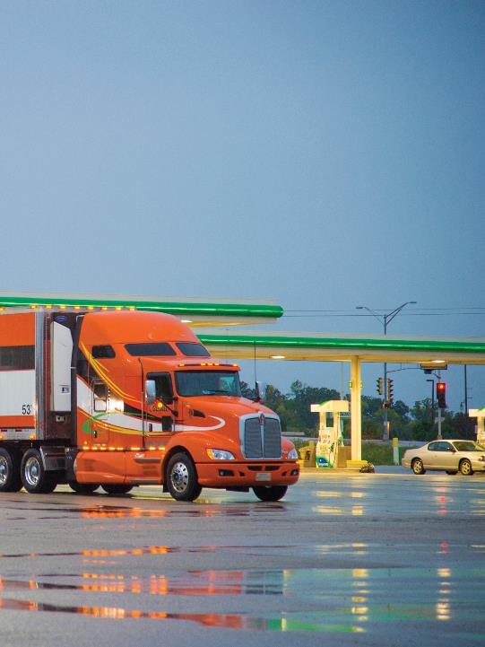
Map out two or three safe locations for each rest or refueling stop.
Notes:
Your Safety
Another factor you need to consider when planning your trip is locating a safe place to refuel, take a break, or stop at the end of your day. Map out two or three safe locations for each rest or refueling stop. In addition, make note of other locations where it is safe to stop in case your first choices are unavailable or you need to stop unexpectedly.

Slide 15
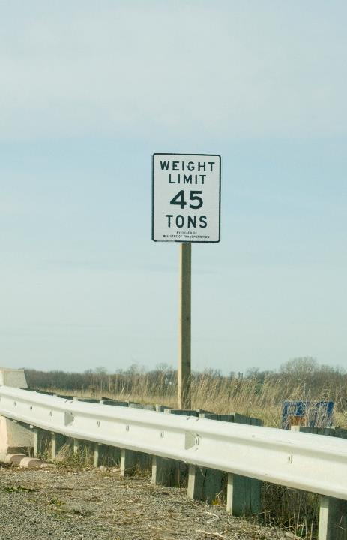
When planning your trip, consider restricted routes, weight limits, and bridges.
Notes:
Vehicle & Cargo Restrictions
Even the best planned trip can run into some unplanned delays and/or problems. Issues such as restricted routes and weight limits on roads and/or bridges must be dealt with while on the road.
Legal weight limits. Your vehicle must stay within legal limits. Federal requirements outlined in 49 CFR 658.17 are as follows:
The maximum gross vehicle weight (GVW) is 80,000 pounds except where a lower GVW is dictated by the bridge formula
The maximum gross weight on any one axle, including any one axle of a group of axles, or a vehicle, is 20,000 pounds
The maximum gross weight on tandem axles is 34,000 pounds
Vehicles are not allowed on Interstate highways if the gross weight on two or more consecutive axles exceeds the limitations prescribed in the bridge formula. The bridge formula limits the weight on groups of axles in order to reduce the risk of damage to highway bridges. Allowable weight depends on the number of axles a vehicle has and the distance between those axles. However, the single- or tandem-axle weight limits supersede the bridge formula limits for all axles not more than 96 inches apart.
Truck routes. Communities often designate certain roads as truck routes, in many cases prohibiting trucks from operating outside of these routes.
Railroad-highway grade crossing. At railroad-highway grade crossings you need to be alert and always expect a train. You must ensure you have appropriate crossing and ground clearance to safely cross the tracks.
Never cross railroad tracks unless you are sure you can completely cross the tracks without stopping. This includes when crossing multiple tracks. Remember, in addition to being unsafe, stopping on the tracks is illegal.
Railroad-highway grade crossings may have vehicle restrictions due to a low ground clearance or “high center.” If this is the case, you will need to plan on taking a different route, so you don’t get stuck on the tracks.
CALLOUT: Each state has its own weight limitations. Be aware of the regulations for the states you travel through. Also keep in mind that weight limits may be posted on individual roads or bridges. Vehicles exceeding the posted weights are prohibited.

Slide 16
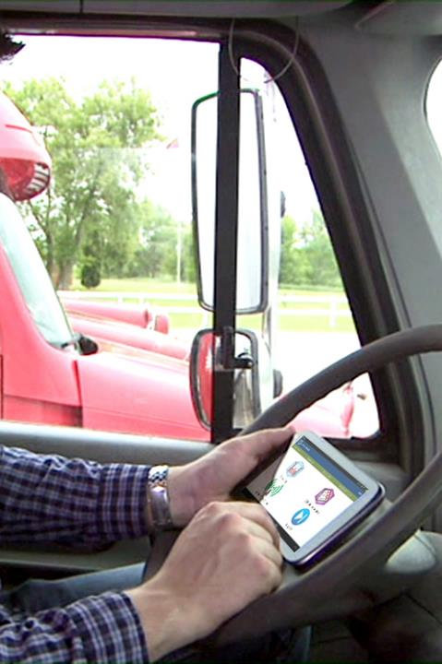
Proper trip planning will help ensure you do not go over the hours-of-service limits.
Notes:
Estimating Time
Estimating the amount of time a trip will take is necessary for planning stops, determining arrival time, and meeting scheduled deliveries or pickups. Perhaps most importantly, you need to estimate time to comply with the hours-of-service regulations. Under these regulations, located in Part 395 of the FMCSRs, the driver of a property‑carrying CMV may not drive:
More than 11 hours following 10-consecutive hours off duty
Beyond the 14th consecutive hour after coming on duty, following 10-consecutive hours off duty
If more than eight hours of driving time have passed without an interruption in driving status of at least 30 consecutive minutes, or
After being on duty more than 60 or 70 hours in any seven- or eight‑consecutive days
Proper trip planning will help ensure you do not go over the hours-of-service limits.
Trip planning should include a plan for parking overnight. Current studies on the shortage of available parking for CMVs show that many drivers are allowing 30 to 60 minutes to find parking. They are shutting down earlier to be certain they do not run too close to their driving or on-duty limits.
Many drivers estimate two hours for every 100 miles they are traveling. For longer trips that may be a bit too aggressive. It may be more accurate if you begin with the estimate of two hours for every 100 miles, but then add in extra time for things like vehicle inspections, fuel stops, and required breaks.
If you drive mainly in the western states, you may be able to average better than this figure — however, it’s important to understand that this is an average. If you drive 75 mph sometimes and 55 mph other times you may be averaging only 60 mph, so don’t plan your entire trip at 75 mph just because that’s what the posted speed limit is in the state you are running.
This holds true conversely if you are running mainly in the northeast. Even though most posted speed limits in that area are 55 mph, you may only average 45 mph or 50 mph due to increased traffic and congestion.
Keep in mind weather, traffic, road construction, and other conditions which could affect your trip time. Remember, no driver is able to drive the maximum speed limit at all times.
CALLOUT: Consideration of all the listed limits is very important in the trip planning equation.
CALLOUT: Many motor carriers set their vehicles’ governors at between 60 mph and 65 mph (many at 62 mph). If you drive for a carrier that does this, make sure you take this into account when planning your trip.
VIDEOS (see Trainer Tools USB)
28.3 — Trip Planning Best Practices

Slide 17
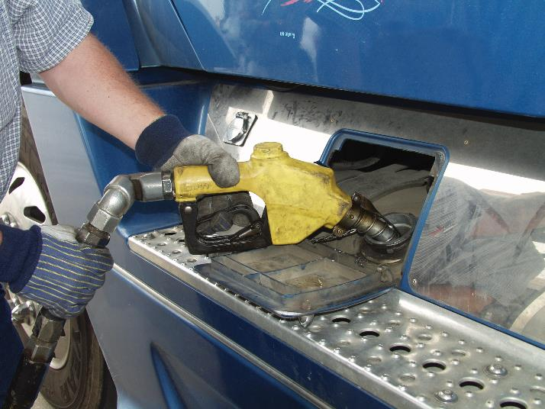
Tank capacity (gallons) X Miles per gallon (mpg) = Range
Notes:
Estimating Fuel Usage and Selecting Fuel-Efficient Routes
Fuel usage estimates are needed to plan fuel stops.
The first step in estimating fuel usage is to determine the range of the vehicle. To find the range of a vehicle, multiply the tank capacity (in gallons) by the miles per gallon the vehicle delivers.
Tank capacity (gallons) x Miles per gallon (mpg) = Range
Next, you need to look at the route you will be taking. Average fuel usage is based on several factors including:
Highway driving. In most cases highway driving allows for a consistent speed and the potential to maximize miles per gallon.
City (town) driving. The stopping and starting that is characteristic of driving within a city or town lowers a vehicle’s fuel efficiency.
Slowdowns. Slowing and stopping (whether on a highway or in a city or town) lowers a vehicle’s miles per gallon.
Idling time. Engine idling can dramatically affect fuel efficiency. On average, one gallon of fuel is burned for each hour an engine idles.
There are also factors/conditions that may not occur on a daily basis that you should keep in mind when selecting a route and estimating fuel use including:
Idling for an extended period of time. On average, each hour of idling burns a gallon of fuel. Idling during an overnight stop can burn up to 10 gallons of fuel.
Driving at higher speeds. Higher speeds can have a negative effect on a vehicle’s fuel usage. Many motor carriers have a policy that limits vehicle speed to between 62 and 68 mph to maximize fuel efficiency.
Driving in the mountains. Driving up and down steep grades can burn additional fuel, having a negative effect on a vehicle’s fuel usage.
Headwinds. Driving into the wind can also have a negative effect on a vehicle’s fuel usage.
CALLOUT: Fuel efficiency should also be taken into account when trip planning.

Slide 18
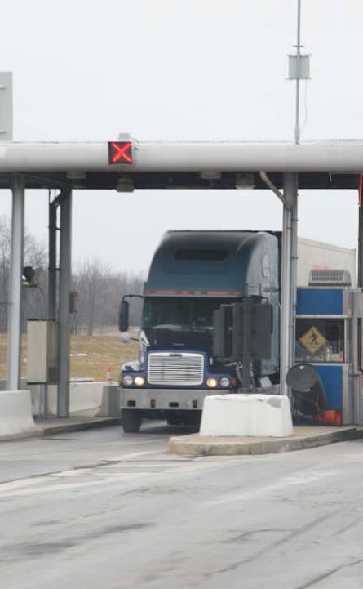
Items topping the expense list include meals, layovers, tolls, rest stops, and fuel stops.
Notes:
Estimating Trip Expenses
Estimating the amount of money a trip will cost means planning for food, layovers, fuel, tolls, and overnight stops. When estimating expenses, consider the:
Distance to be traveled
Time the trip will take
Possibility that emergency funds may be needed
Items topping the expense list include meals, layovers, tolls, rest stops, and fuel stops. In an emergency, you may need funds for towing, a service call, or an unexpected layover.

Slide 19
Objectives Review
You should now be able to:
  Describe the paperwork required for you (the driver), your cargo, and your vehicle
  Discuss considerations when selecting your route, along with how to read a map and use a global positioning system (GPS)
  List vehicle and cargo restrictions
  Describe things you should consider when estimating your trip time
  List conditions that can affect fuel usage
Copyright 2019 J. J. Keller & Associates, Inc.
Notes:
You should now be able to:
Describe the paperwork required for you (the driver), your cargo, and your vehicle
Discuss considerations when selecting your route, along with how to read a map and use a global positioning system (GPS)
List vehicle and cargo restrictions
Describe things you should consider when estimating your trip time
List conditions that can affect fuel usage
CLASSROOM RECOMMENDATION
Before concluding your training session, have participants take the corresponding quiz (found on the Trainer Tools USB) to check their understanding of the material. You can customize any of the questions to fit your audience or workplace. The answer key can also be found on the Trainer Tools USB.
You may also choose to administer the quizzes before you begin your training session to help get participants thinking about the subject and/or to gauge their understanding of the topic ahead of time.

