Slide 1






PowerPoint® Instructions
This PowerPoint has been designed so you can easily customize it for your training session.
Throughout the presentation you’ll see icons with recommendations or videos to enhance the instruction you present to your students. A detailed explanation for each icon can be found on the next slide. Videos can be found on the Trainer Tools USB.
When you see an icon on the slide, look in the notes
section for further information.
Simply delete or move the icon off the slide before your training session begins.

Slide 2





Classroom Recommendations. Provides suggestions for enhancing your classroom presentation; from ideas for large group discussions to suggestions on the use of training aids such as examples or photos of vehicle parts and components to help illustrate the items covered within a chapter.
Lab Recommendations. Provides suggestions for activities and exercises that take place outside the classroom, but do not involve
the actual operation of the tractor-trailer or its components. Examples
of lab sessions include conducting a vehicle inspection or practicing mirror adjustment.
Range Recommendations. These recommended activities take
place on a closed-access driving range where students may practice driving skills in a controlled environment. Examples of range sessions include practicing shifting technique and successfully completing a backing maneuver.
Road Recommendations. These recommended activities take place in road and traffic conditions that support the chapter’s objectives. Examples of road sessions include proper communication with other drivers through the use of turn signals and basic vehicle control under nighttime or extreme weather conditions.
Videos. These short video clips reinforce material presented in the Student Manual. Use them to help students grasp difficult concepts or subject matter.

Slide 3
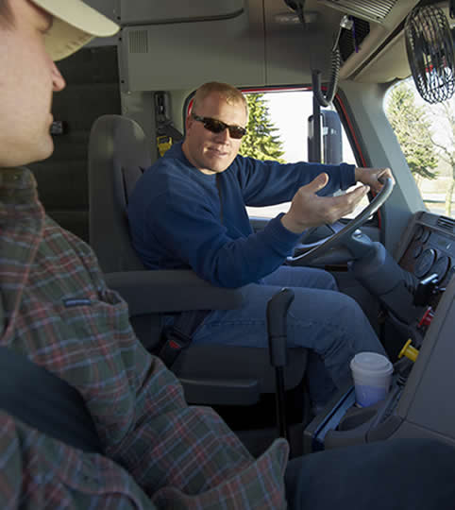
Distracted Driving
10
Copyright 2019 J. J. Keller & Associates, Inc.
Notes:
Unit A1.2.3 Distracted Driving
This unit must instruct driver-trainees in FMCSRs related to distracted driving and other key driver distraction driving issues, including improper cell phone use, texting, and use of in-cab technology (e.g., §§ 392.80 and 392.82). This instruction will include training in the following aspects: visual attention (keeping eyes on the road); manual control (keeping hands on the wheel); and cognitive awareness (keeping mind on the task and safe operation of the CMV).

Slide 4
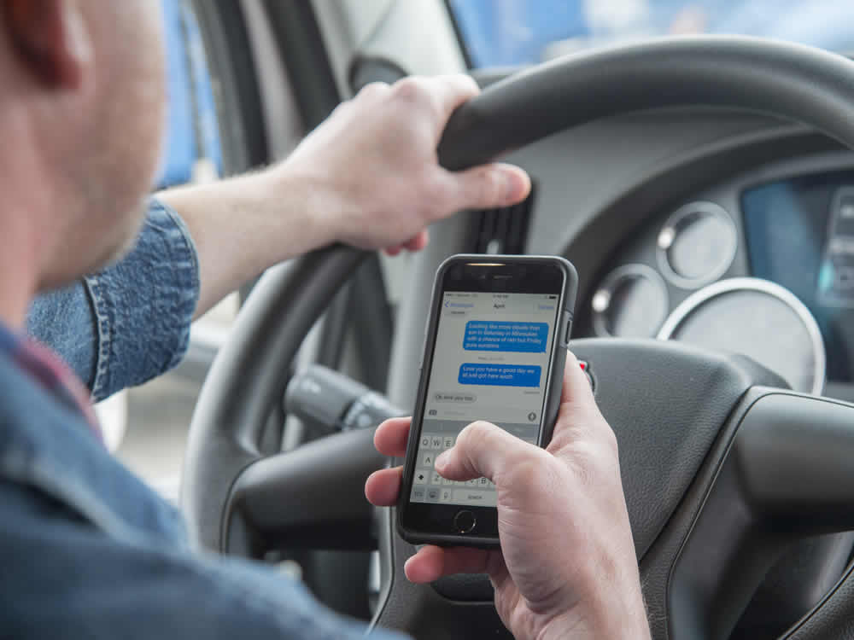
Introduction
Notes:
Distraction occurs any time you take your eyes off the road, your hands off the wheel, or your mind off driving. Common distractions can be your phone, radio, even your navigation system. Anything that you do—other than focusing on driving your vehicle safely—is a distraction.
Driving while distracted can have serious, and sometimes deadly, consequences. According to the National Highway Traffic Safety Administration (NHTSA), distracted driving accounted for 3,450 fatalities in 2016.
This PowerPoint® will provide you with information that can help you manage distractions while on the road.
CLASSROOM RECOMMENDATION
Discuss the basic principles of distracted driving—including the recognition of driving distractions and how to manage these distractions.
Discussion should also cover the regulations prohibiting and the dangers posed by cell phone use or texting. In addition to the prohibitions placed on commercial motor vehicle drivers in Part 392, Subpart H of the Federal Motor Carrier Safety Regulations, make sure you mention that there are also state and local laws and ordinances that prohibit various forms of distracted driving, including texting and cell phone use.
VIDEO
10.1 — Introduction

Slide 5
Objectives
Upon completion of this lesson, you will be able to:
Identify common driving distractions
Describe how to prevent accidents caused by distracted driving
Notes:
Upon completion of this lesson, you will be able to:
Identify common driving distractions
Describe how to prevent accidents caused by distracted driving

Slide 6
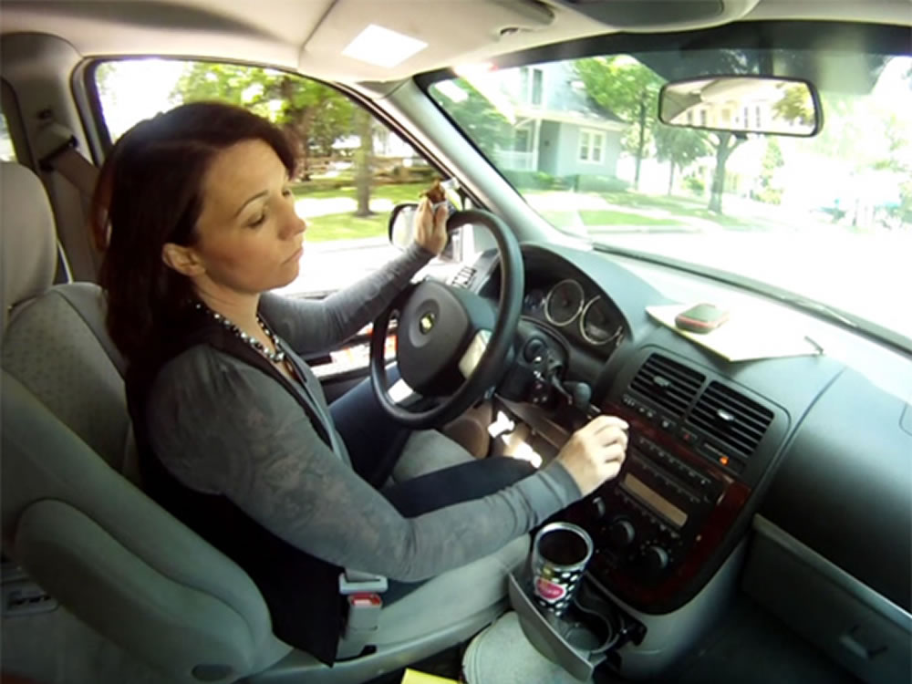
Recognizing Driving Distractions
Notes:
Recognizing Driving Distractions
VIDEO
10.2 — Types of Distractions

Slide 7
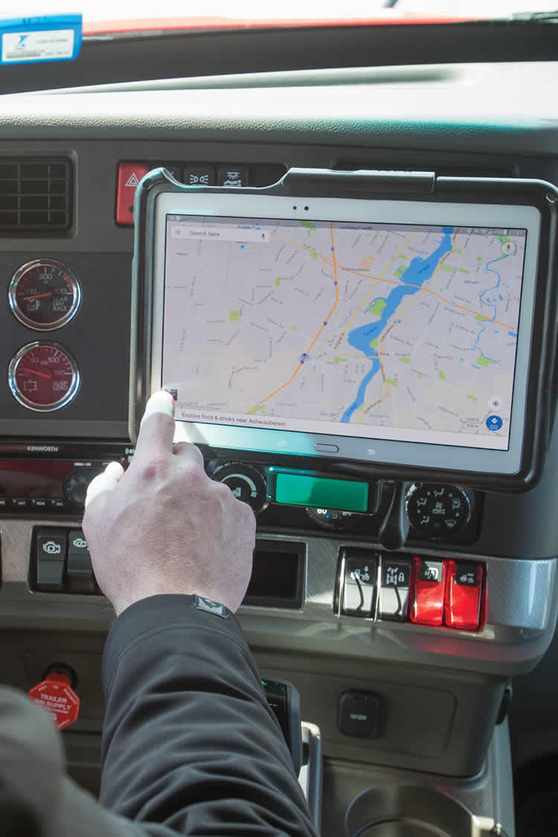
Driving distractions can be:
  Visual
  Physical
  Mental
  A combination of all three
Notes:
Driving distractions can be visual, physical, mental, or a combination of the three. Any non-driving activity you engage in is a potential distraction and increases your risk of crashing.

Slide 8

Visual distractions cause you to focus your attention away from driving.
You can’t give them more than a brief glance while driving.
Notes:
Visual distractions cause you to focus your attention away from driving. For example, a deer, beautiful scenery, or crash scene can all distract you. It’s natural to notice these types of visual distractions, but you can’t give them more than a brief glance while driving.

Slide 9
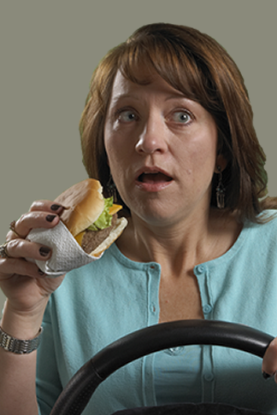
Physical distractions include things that make you take your hands off the wheel, like eating
or drinking.
Notes:
Physical distractions trigger you to take your hands off the wheel. Physical distractions include things like eating or drinking because in order to do it, you have to take at least one hand off the wheel.

Slide 10
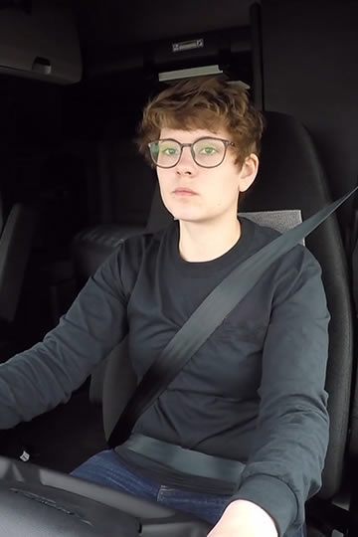
Mental distractions are thoughts that make your mind wander to something other than your driving.
Notes:
Mental distractions are thoughts that make your mind wander to something other than your driving. You’re still going through the motions of driving, but in your head, you might be worrying about being late for a pickup or delivery or daydreaming about your next vacation. It’s natural to think about something other than driving for a few seconds, but it can very quickly become a dangerous distraction if you dwell on it too long.

Slide 11
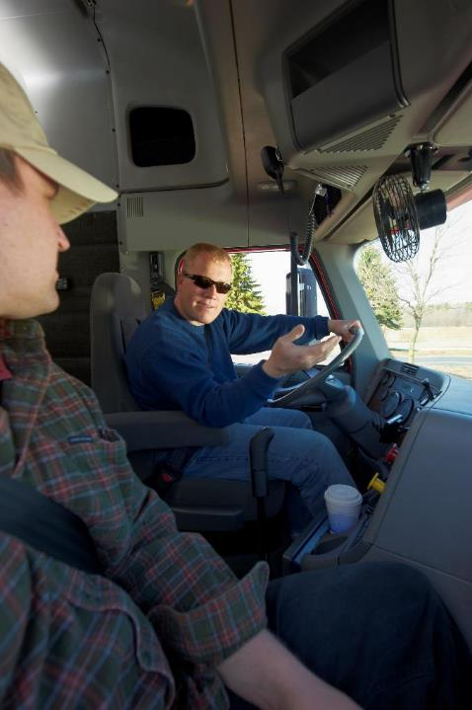
The act of listening can be a mental distraction.
Notes:
Something else that can be a mental distraction is the act of listening. Whether you’re listening to someone on your phone, having a conversation with someone in your vehicle, or listening to music, talk radio, or an audio book, it draws your focus away from driving.

Slide 12
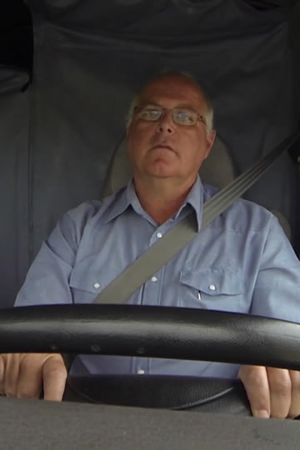
Inattention blindness
is when you miss seeing something, even it it’s directly in your line
of sight.
Highway hypnosis
is the feeling of being in a trance caused from long periods of driving without any stimulation.
Notes:
It’s a fact that people tend to go on “auto-pilot” when performing routine activities, like driving. In this situation, you may miss seeing something, even if it’s directly in your line of sight. This is called inattention blindness, and it is one of the major causes of human error and crashes.
Equally dangerous is highway hypnosis, or the feeling of being in a trance caused from long periods of driving without any stimulation, like when you’re cruising down a long, lonely stretch of highway.
CALLOUT: Help fight highway hypnosis by getting plenty of rest—at least seven to eight hours of uninterrupted sleep a night.
VIDEO
10.3 — Effects of Auto-Pilot

Slide 13
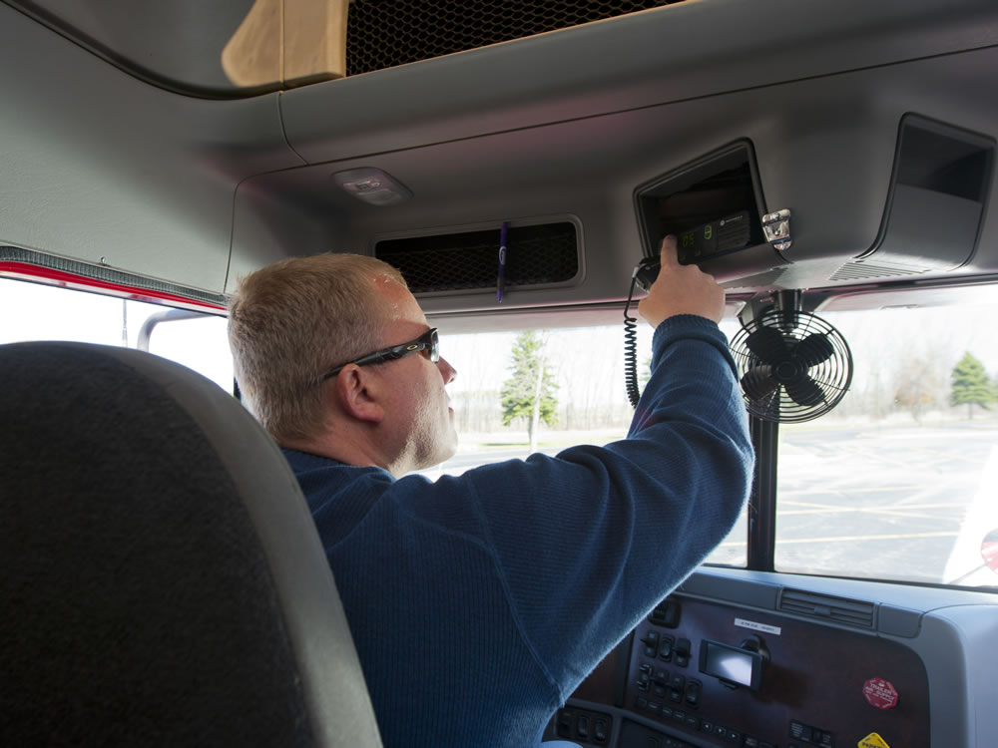
In Cab Technology
Notes:
In Cab Technology

Slide 14
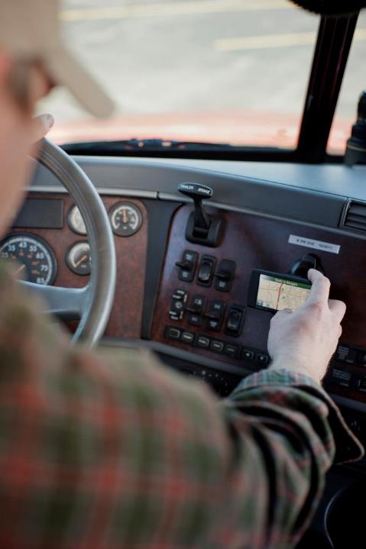
Part 392, Subpart H of the Federal Motor Carrier
Safety Regulations
limits the use of
electronic devices by drivers of commercial motor vehicles.
Notes:
Part 392, Subpart H of the Federal Motor Carrier Safety Regulations (FMCSRs) limits the use of electronic devices by drivers of commercial motor vehicles (CMVs). These federal prohibitions exist to help in reducing and preventing truck and bus accidents, fatalities, and injuries associated with distracted driving.

Slide 15
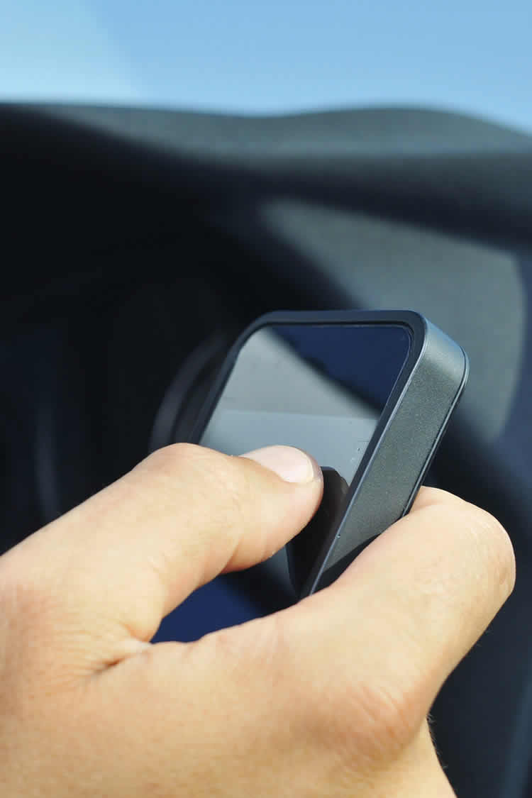
Section 392.80 of the FMCSRs prohibits a driver from texting while driving a commercial motor vehicle.
Texting combines all three types of distractions: visual, physical, and mental.
Notes:
One of the more prominent distractions for drivers is texting. Section 392.80 of the FMCSRs prohibits a driver from texting while driving a CMV.
Driving means operating a CMV, with the motor running, including while temporarily stationary because of traffic, a traffic control device, or other momentary delays.
Texting while driving is prohibited because it combines all three types of distractions: visual, physical, and mental. You have to take your eyes off the road, your hands off the wheel, and your mind off driving. In fact, studies have shown that texting while driving can impair a driver as much as driving with a blood alcohol level of .08 percent.
Sending or reading a text takes your eyes off the road for at least five seconds. At 55 mph, that’s like driving the length of an entire football field blindfolded.

Slide 16
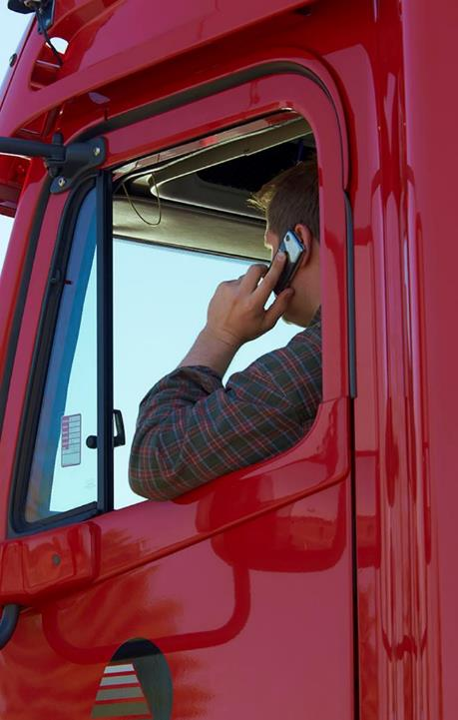
Per Section 392.82 of the FMCSRs, drivers cannot reach for, hold, dial, or answer a cell phone while driving a CMV.
This applies even when temporarily stationary!
Hands-free feature on cell phones is allowed only when it is all manageable with a single button press.
Notes:
Section 392.82 of the FMCSRs prohibits the driver of a CMV from using a hand-held mobile telephone while driving a CMV. This means that CMV drivers cannot reach for, hold, dial, or answer a cell phone.
Driving means operating a CMV on a highway, including while temporarily stationary because of traffic, a traffic control device, or other momentary delays.
CMV drivers are allowed to use the hands-free feature on cell phones. To comply, a driver must have his or her mobile telephone located where he or she is able to initiate, answer, or terminate a call by touching a single button. The driver must be in the seated driving position and properly restrained by a seat belt. Drivers can also use an earpiece, the speaker phone function, or voice-activated dialing.
CALLOUT: Texting or using a handheld mobile telephone is allowed when necessary to communicate with law enforcement officials or other emergency services.

Slide 17
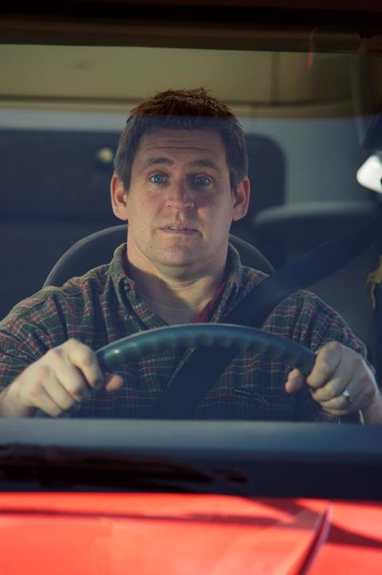
Penalties include:
  Disqualification for 60 days if two violations in a
  3-year period
  Disqualification for 120 days if three violations in a 3-year period
  Possible fine
Notes:
The penalties for using a handheld mobile telephone or texting while driving a CMV include disqualification for 60 days if convicted of two violations in a three-year period and disqualification for 120 days if convicted of three violations in a three-year period. A CMV driver can also be fined if convicted of these violations.
CALLOUT: In addition to these prohibitions, many states, counties, and municipalities have various cell phone, texting, and distracted driving laws that may also apply.

Slide 18
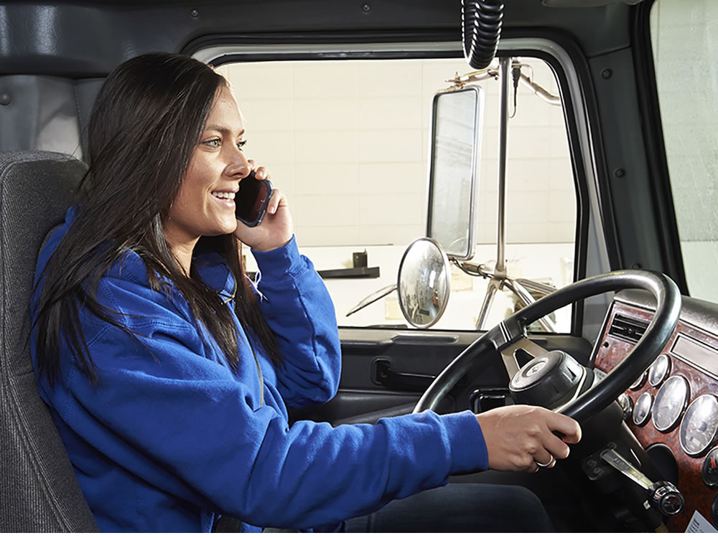
Managing Driving Distractions
Notes:
Managing Driving Distractions
VIDEO
10.4 — Managing Driving Distractions

Slide 19
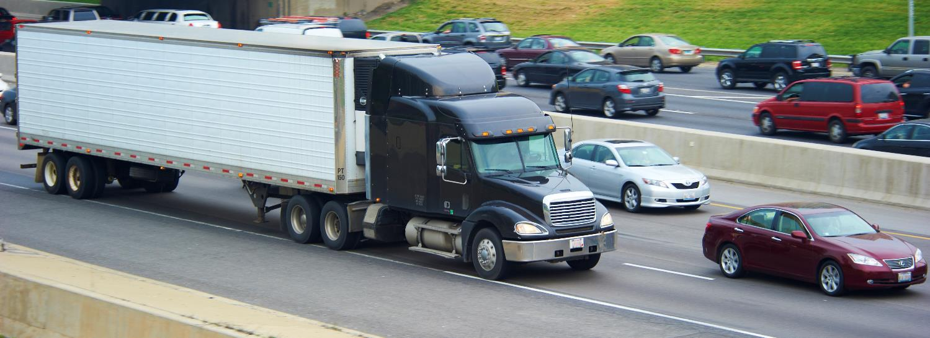
More often than not, distracted drivers are making a conscious choice to distract themselves from driving.
Even if you have a handle on distractions, it’s equally important for you to be aware of the unfocused drivers around you.
Notes:
Of course, no one wants to become a statistic. You probably believe that you have a handle on distractions. You might be absolutely committed to eliminating distractions while you’re driving. But what about the others around you?
More often than not, distracted drivers are making a conscious choice to distract themselves from driving.
This means that not only is it important for you to be a focused driver, it’s equally important for you to be aware of the unfocused drivers around you.

Slide 20

There are a few steps that you can take to help you avoid distractions that could ultimately lead to an accident.
Notes:
There are a few steps that you can take to help you avoid distractions that could ultimately lead to an accident.

Slide 21
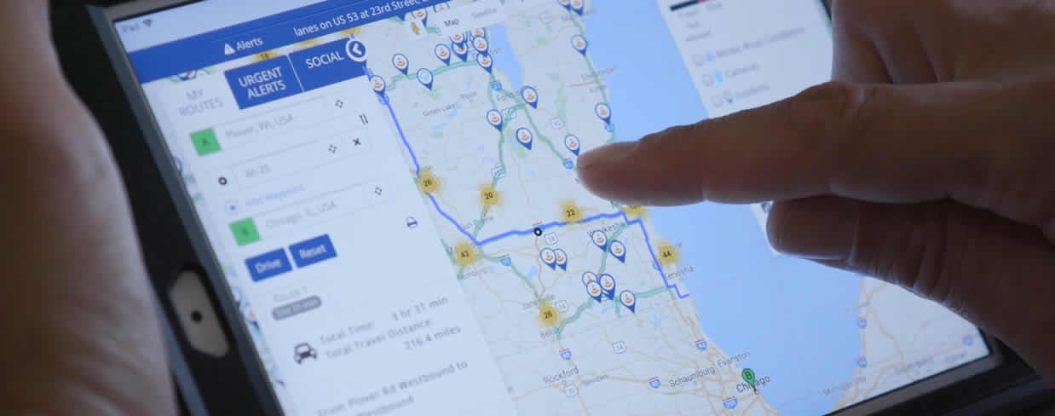
Step 1: Stay Focused
Keep your focus on driving. Avoid being distracted by being prepared to drive before you start your trip.
Notes:
Step 1: Stay Focused
Keep your focus on driving. Avoid being distracted by being prepared to drive before you start your trip. Set the GPS, tune the radio, program the MP3 player, or make any necessary calls or texts before you head out. If you can’t ignore a distraction, the answer is simple—take care of it at your next planned stop or pull over.
While operating your tractor-trailer, remain in the proper driving position with your seatbelt fastened at all times. Keeping both hands on the wheel in the 9-and-3 or 8-and-4 position will enable you to respond quickly to potential hazards.

Slide 22
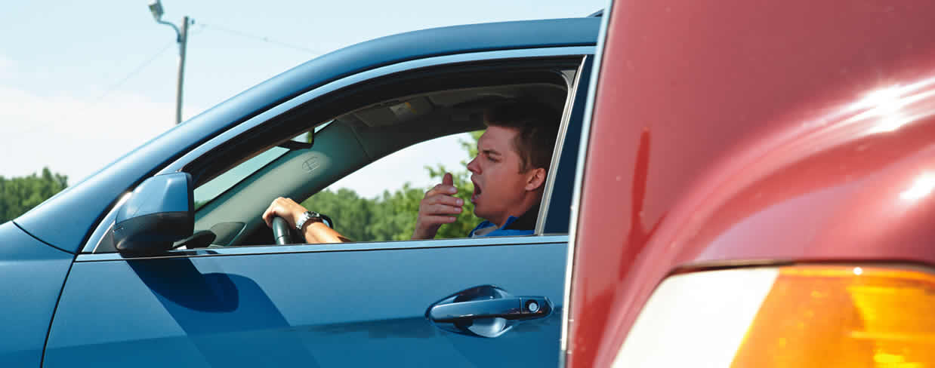
Step 2: Recognize the Signs
Recognize the signs of distracted drivers. Remember to scan for potential hazards.
Notes:
Step 2: Recognize the Signs
Recognize the signs of other distracted drivers. It’s easy to spot them by paying attention. Watch for vehicles moving faster or slower than other traffic or making dramatic changes in speed for no apparent reason. If a vehicle is weaving in and out of traffic, tailgating, or braking to squeeze into the next lane, be extra cautious.
Remember, you should scan for potential hazards (including distracted drivers) at least 12 to 15 seconds ahead of you and to both sides of your truck. Distance scanning helps you identify hazards early, providing adequate time to react/ respond to avoid a potentially dangerous situation. Scanning also helps you avoid abrupt stops and radical speed changes caused by the driving behaviors of other motorists.

Slide 23
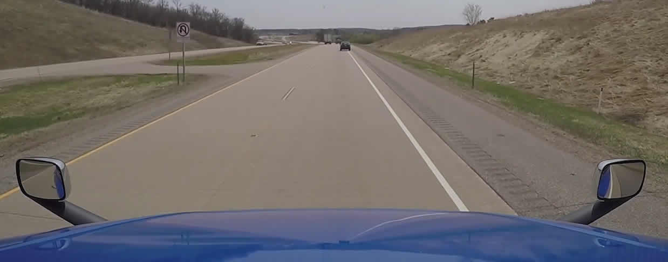
Step 3: Manage Distracted Drivers
Separate yourself from distracted drivers. At 40 mph, you need about one second in distance for every 10 feet of vehicle length.
Notes:
Step 3: Manage Distracted Drivers
The best thing you can do to separate yourself from distracted drivers is to increase your following distance. At 40 miles per hour, in good driving conditions, you need about one second in distance for every 10 feet of vehicle length between you and the vehicle ahead.
However, when you suspect another driver is distracted, double your following distance to two seconds for every 10 feet of your vehicle’s length. Make sure you’ve got a big enough “safety cushion” between your vehicle and the distracted driver’s vehicle.

Slide 24
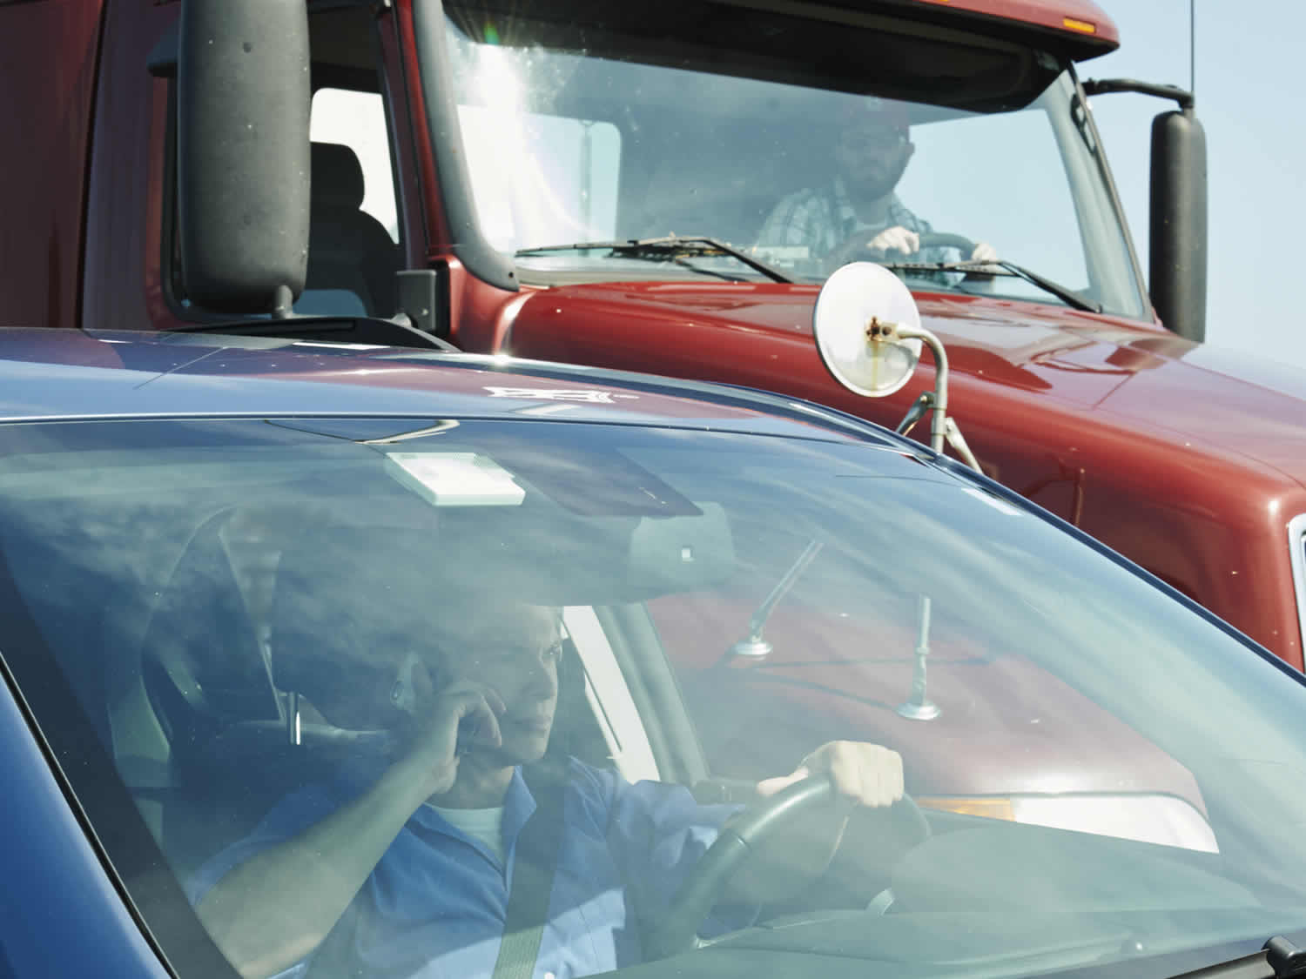
If you can’t create a safety cushion between you and a distracted driver, and you can’t move out of the other driver's way, try to establish eye contact.
Notes:
Step 3: Manage Distracted Drivers, (cont.)
If you’re on the freeway, move to the right lane as soon as you can safely do so to encourage a distracted driver to pass you. If the distracted driver is in front of you, you’re in a better position to keep an eye on that vehicle.
If you’re not on the freeway, signal and exit the road, as soon as it’s safe, to let the distracted driver get ahead of you.
If you can’t create a safety cushion between you and a distracted driver, and you can’t move out of the other driver’s way, try to establish eye contact with the driver—without becoming a distracted driver yourself.
If you make eye contact, the other driver should be aware of you, but it’s no guarantee. The driver could have “inattention blindness” and might not see you because his or her mind is somewhere else.
CALLOUT: Eye contact should be brief to ensure the driver does not misinterpret it as road rage or a threatening gesture.

Slide 25
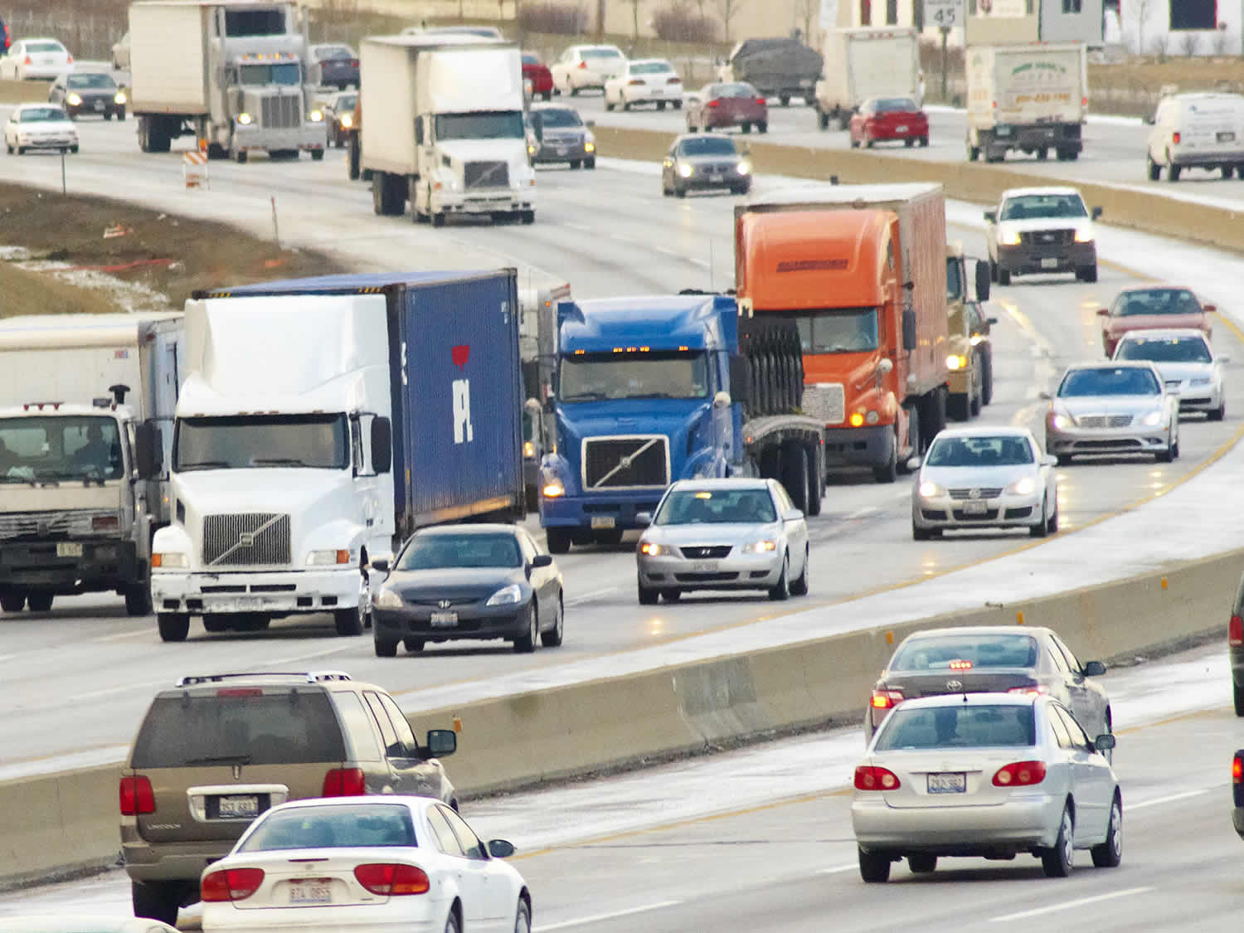
Commit to not driving while you’re distracted.
Watch out for distracted drivers around you.
Respond by managing distracted drivers once you spot them.
Notes:
The reality is, distractions can’t be eliminated entirely, so it’s crucial to be proactive by doing three important things:
Commit to not driving while you’re distracted.
Watch out for distracted drivers around you.
Respond by managing distracted drivers once you spot them.

Slide 26
Objectives Review
You should now be able to:
Identify common driving distractions
Describe how to prevent accidents caused by distracted driving
Copyright 2019 J. J. Keller & Associates, Inc.
Notes:
You should now be able to:
Identify common driving distractions
Describe how to prevent accidents caused by distracted driving
CLASSROOM RECOMMENDATION
Before concluding your training session, have participants take the corresponding quiz (found on the Trainer Tools USB) to check their understanding of the material. You can customize any of the questions to fit your audience or workplace. The answer key can also be found on the Trainer Tools USB.
You may also choose to administer the quizzes before you begin your training session to help get participants thinking about the subject and/or to gauge their understanding of the topic ahead of time.
ROAD RECOMMENDATION
Once you have presented this lesson, have your students include distracted driving observations as part of their commentary driving routine. It is important that students have an awareness of what is happening around the vehicle.

