Slide 1






PowerPoint® Instructions
This PowerPoint has been designed so you can easily customize it for your training session.
Throughout the presentation you’ll see icons with recommendations or videos to enhance the instruction you present to your students. A detailed explanation for each icon can be found on the next slide. Videos can be found on the Trainer Tools USB.
When you see an icon on the slide, look in the notes
section for further information.
Simply delete or move the icon off the slide before your training session begins.

Slide 2





Classroom Recommendations. Provides suggestions for enhancing your classroom presentation; from ideas for large group discussions to suggestions on the use of training aids such as examples or photos of vehicle parts and components to help illustrate the items covered within a chapter.
Lab Recommendations. Provides suggestions for activities and exercises that take place outside the classroom, but do not involve
the actual operation of the tractor-trailer or its components. Examples
of lab sessions include conducting a vehicle inspection or practicing mirror adjustment.
Range Recommendations. These recommended activities take
place on a closed-access driving range where students may practice driving skills in a controlled environment. Examples of range sessions include practicing shifting technique and successfully completing a backing maneuver.
Road Recommendations. These recommended activities take place in road and traffic conditions that support the chapter’s objectives. Examples of road sessions include proper communication with other drivers through the use of turn signals and basic vehicle control under nighttime or extreme weather conditions.
Videos. These short video clips reinforce material presented in the Student Manual. Use them to help students grasp difficult concepts or subject matter.

Slide 3
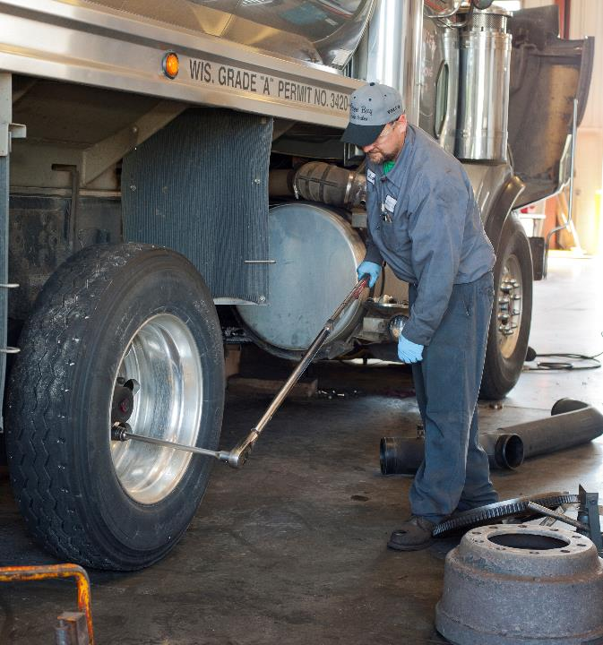
20
Maintenance
Notes:
Chapter 20 Maintenance
Unit A1.4.3 Maintenance This unit must introduce driver-trainees to the basic servicing and checking procedures for various engine and vehicle components and to help develop their ability to perform preventive maintenance and simple emergency repairs.
Unit A1.4.1 Identification and Diagnosis of Malfunctions This unit must teach driver-trainees to identify major combination vehicle systems. The goal is to explain their function and how to check all key vehicle systems, (e.g., engine, engine exhaust auxiliary systems, brakes, drive train, coupling systems, and suspension) to ensure their safe operation. Driver-trainees must be provided with a detailed description of each system, its importance to safe and efficient operation, and what is needed to keep the system in good operating condition.

Slide 4
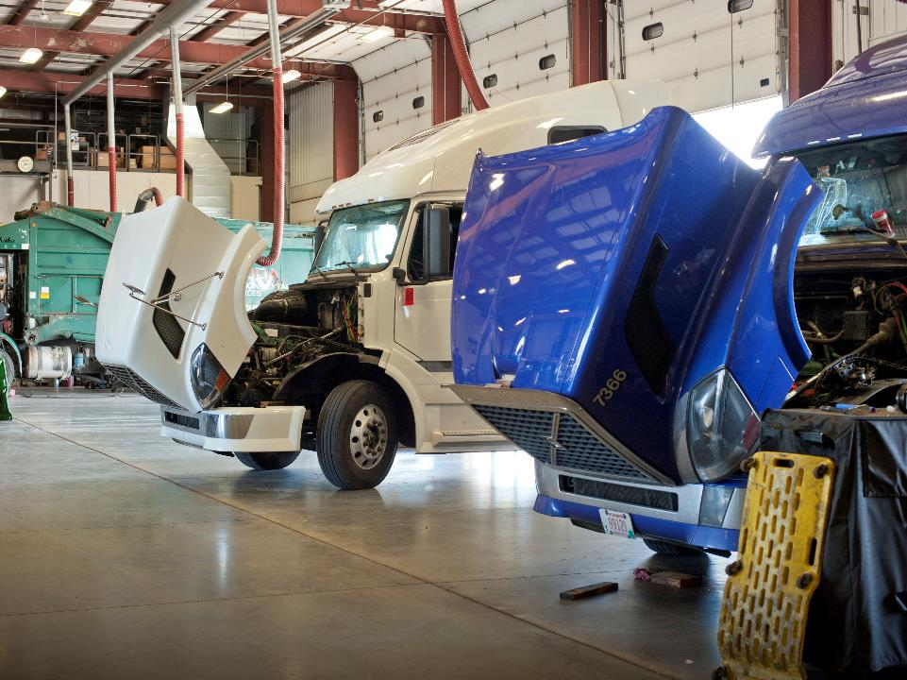
Introduction
Notes:
Introduction
In order for a safe, efficient, and economical fleet to exist, vehicles need to be inspected and maintained on a regular basis. As a professional driver, your involvement is key when it comes to a successful preventive maintenance program, as you are often the first to notice a problem or issue.
CLASSROOM RECOMMENDATIONS
The driver is an important member of a company’s preventive maintenance team. Stress this importance to your students throughout this lesson, emphasizing that though they may see their role as a small one, it is an important one.

Slide 5
Objectives
Upon completion of this lesson, you will be able to:
  List the different types of vehicle maintenance
  Identify your role in keeping a vehicle’s components in good working order
  Recognize the costs of poor vehicle maintenance
Notes:
Objectives
Upon completion of this lesson, you will be able to:
List the different types of vehicle maintenance
Identify your role in keeping a vehicle’s components in good working order
Recognize the costs of poor vehicle maintenance

Slide 6
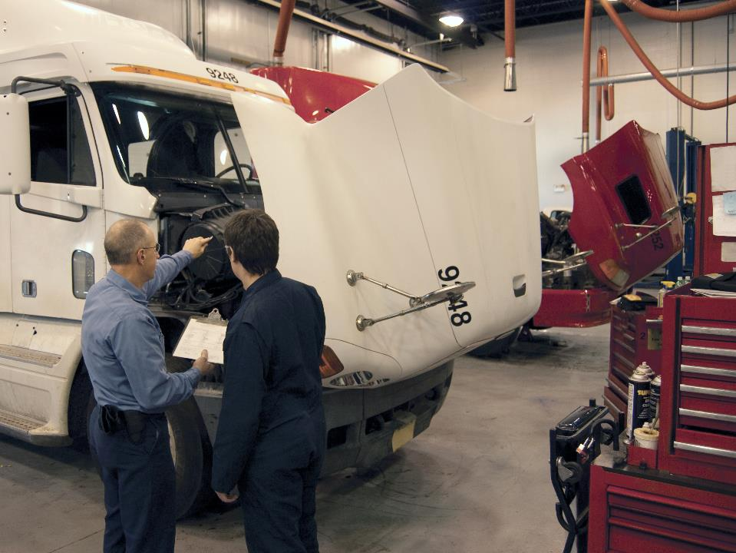
Types of Maintenance
Notes:
Types of Maintenance
Proper vehicle maintenance can go a long way in making sure your vehicle operates efficiently and effectively.
A vehicle that is not properly maintained will ultimately result in:
Citations and out-of-service orders during roadside inspections
Vehicle breakdown
An increased risk of accidents

Slide 7
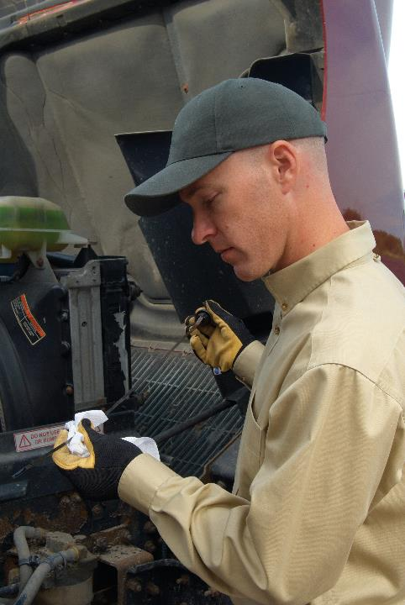
There will be times when you need to add oil or coolant, or drain moisture from fuel and air systems.
Notes:
Routine Servicing
There will be times when you need to add oil or coolant or drain moisture from fuel and air systems. Though these tasks are considered routine, if they are overlooked, it could lead to problems down the road.
Scheduled Preventive Maintenance
Section 396.3 of the Federal Motor Carrier Safety Regulations (FMCSRs) requires a motor carrier to systematically inspect, repair, and maintain its vehicles. In other words, a motor carrier must have a preventive maintenance (PM) program.
PM schedules can be arranged in various ways, including according to mileage, engine hours, or time.
Fully participating in your motor carrier’s PM effort can reduce unexpected periods of downtime, saving both money and time.
Worn, failed, or incorrectly adjusted components can cause or contribute to accidents. Preventive maintenance and periodic inspection procedures help to prevent failures from occurring while you are on the road.
Unscheduled Maintenance and Repair
Unscheduled maintenance is an unexpected expense. Examples would include repairs that are noted on your driver vehicle inspection report (DVIR) and repairs due to accidents and breakdowns.

Slide 8
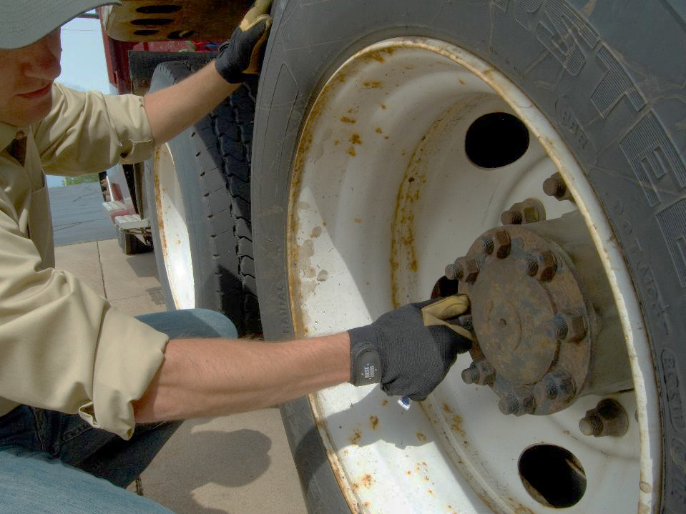
Your Responsibility
Notes:
Your Responsibility
You are ultimately responsible for the safe operating condition of your vehicle. As a professional driver, you can do the following to help keep your vehicle’s components in good working order:
Detect maintenance and repair needs as you travel, and refer them to the correct place for handling
Perform thorough pre-trip and post-trip inspections, making sure you check all pertinent components each time you do an inspection
Verify an annual vehicle inspection has been conducted on the vehicle
Don’t start or continue a trip until you are satisfied that everything is in good operating condition, and it’s safe to do so. Federal and state regulations require that you not drive a vehicle unless you are satisfied that it is in safe operating condition.
Your responsibilities when it comes to actual maintenance will depend on your company’s policy. Most companies expect you to fix simple problems such as changing out a light or replacing windshield wiper blades, but do not expect or want you to make other repairs. Never attempt to fix a problem if you do not have the appropriate training, knowledge, or tools.
CALL OUT: Never attempt to repair something you have not been trained to or know how to repair.
CALL OUT: An annual inspection form in the vehicle or an inspection decal on the vehicle serves as documentation of the annual inspection.
LAB RECOMMENDATIONS
The driver’s responsibilities when it comes to actual maintenance will depend on his or her company’s policy. Most companies expect a driver to fix simple problems, but do not expect a driver to be a master mechanic.
Knowing how to perform simple maintenance tasks can go a long way in keeping a vehicle out of the garage and on the road.
In this lesson, the instructor will demonstrate procedures for checking and/or changing certain vehicle components.
NOTE: It is good practice to use gloves when working with potentially hot vehicle components and/or fluids.
Fuel level
The following are the steps that should be taken when doing a routine check of the fuel level of the fuel tanks.
Park the vehicle on level ground.
Slowly open the fuel tank cap.
Visually check the fuel level.
Make sure the level matches/corresponds with the gauge reading in the cab.
Oil level
The following are the steps that should be taken when doing a routine check of the engine’s oil level.
Park the vehicle on level ground, shut off the engine, and allow a few minutes for the oil to drain.
Locate the vehicle’s dipstick.
Pull the dipstick out, wipe clean, and replace.
Pull out again and check the oil level.
The level should be between the fill and add marks.
Coolant level
The following steps should be followed when checking coolant level, keeping in mind that this system check is dangerous. Extreme caution should be exercised at all times.
Shut the engine off and wait for the engine to cool off.
Visually check the level of the coolant and, if necessary, add coolant (check your vehicle’s owner’s manual for specific instruction).
Power steering fluid level
The following steps should be followed when checking the power steering fluid level.
With the engine running at normal operating temperature, turn the steering wheel back and forth several times to stabilize the fluid level.
Stop the engine.
Remove the dipstick. The fluid should register between the bottom of the dipstick and the full mark.
If necessary, add fluid to bring the fluid level to the full mark, but do not overfill. (Consult the vehicle’s owner’s manual for the correct type of fluid.)
Tire air pressure
It is best to check tire air pressure when the tire is cold. The following steps should be followed when checking tire air pressure.
Park the vehicle on level ground.
Turn off the engine and secure the vehicle.
Remove the valve stem cap.
Place the air gauge over the valve stem opening.
Read the inflation pressure on the gauge.
Inflate if necessary. (Check owner’s manual for correct inflation pressure.)
Replace valve stem cap.
Changing a headlamp
The following steps should be followed when changing a headlamp.
Park the vehicle, turn off the engine, and secure the vehicle.
Remove the trim ring from the burned-out light (if applicable).
Unfasten the mounting screws.
Disconnect the light from the socket and remove.
Remove any debris (dirt, bugs, etc.) from the socket area.
Plug in the new headlamp.
Test the lamp to make sure it is working properly.
Fasten the mounting screws and replace the trim ring.
Make sure the light is clean.

Slide 9
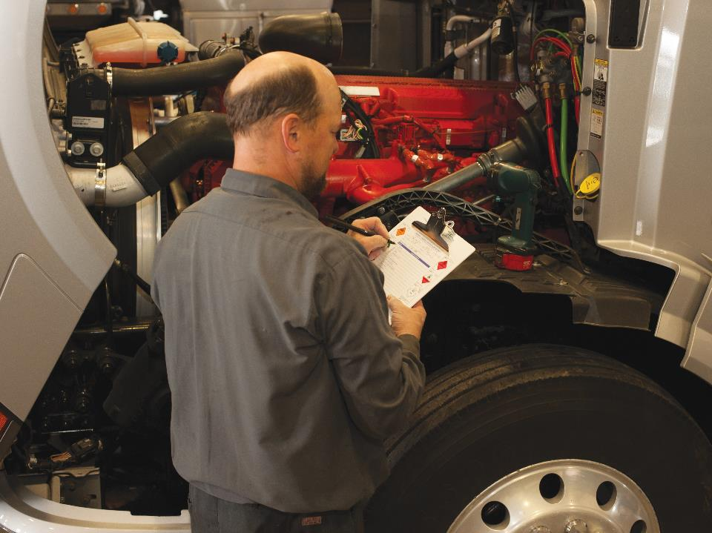
Regulatory Requirements
Notes:
Regulatory Requirements
Part 396 of the FMCSRs addresses vehicle inspection and maintenance. The regulations address systematic maintenance, pre-trip inspections, on-the-road inspections, post-trip inspections, and annual or periodic inspections.
Systematic Maintenance
Section 396.3 of the FMCSRs states that every motor carrier must systematically inspect, repair, and maintain all vehicles in its control or make provisions for systematic inspection, repair, and maintenance.
The term systematic means a regular or scheduled program to keep vehicles in safe operating condition. In other words, a motor carrier must have a preventive maintenance program.
It is up to the motor carrier to determine the time frame for conducting systematic vehicle inspections. They may be based on mileage, engine hours, or time.

Slide 10
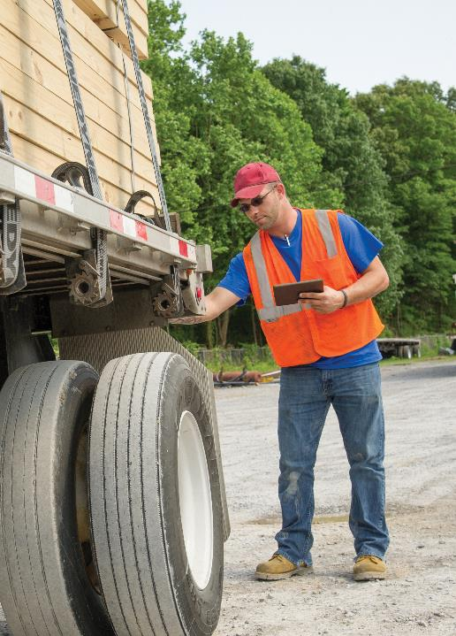
Do not operate a vehicle unless you are satisfied the vehicle is in safe operating condition.
Notes:
Pre-Trip Inspection
Section 396.13 of the FMCSRs states that before driving a motor vehicle you must:
Be satisfied that the vehicle is in safe operating condition
Review the last vehicle inspection report (see post-trip inspection)
Sign the last vehicle inspection report, only if defects or deficiencies were noted by the driver who prepared the report, to acknowledge that the report has been reviewed and that there is certification that the repairs have been performed
VIDEOS (see Trainer Tools USB)
20.1 — Pre-Trip Inspection

Slide 11
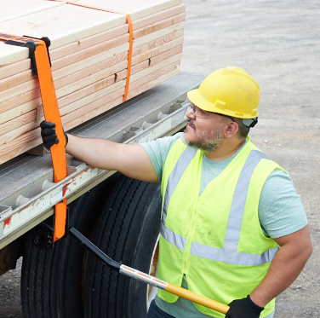
The vehicle’s cargo and load-securing devices must be checked within the first 50 miles of a trip.
Notes:
On-the-Road Inspection (En-Route)
Section 392.9 of the FMCSRs requires that you follow certain inspection rules while on the road.
The vehicle’s cargo and load-securing devices must be checked within the first 50 miles of a trip. Any necessary adjustments must be made at this time.
After the first 50 miles of the trip, the vehicle’s cargo and load-securing devices must be reexamined:
When you make a change of duty status, or
After the vehicle has been driven for 3 hours, or
After the vehicle has been driven 150 miles—whichever occurs first
These on-the-road inspection rules do not apply if you are driving a sealed vehicle and have been ordered not to open the vehicle to inspect its cargo. Also, the rules do not apply if the vehicle has been loaded in a way that makes inspection of the cargo difficult or impossible.
VIDEOS (see Trainer Tools USB)
20.2 — On the Road Inspection

Slide 12
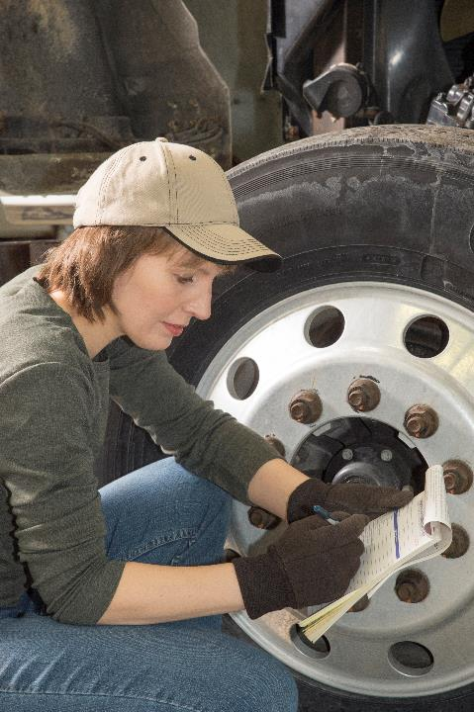
You are required to complete a driver vehicle inspection report (DVIR) if you discover defects or deficiencies.
Notes:
Post-Trip Inspection
A post-trip inspection is conducted at the end your day’s work on the vehicle you are operating. Section 396.11 requires you to complete a DVIR if defects or deficiencies are discovered. This report helps a motor carrier make necessary repairs before the vehicle returns to the road.
VIDEOS (see Trainer Tools USB)
20.3 — Post-Trip Inspection
Periodic/Annual Inspections
Section 396.17 requires a thorough and complete inspection of a commercial motor vehicle at least once each year by a qualified inspector. The inspection requirements may be met through:
A self-inspection program
An inspection performed by a commercial garage or similar business, or
A periodic inspection program administered by a state
Documentation of the periodic inspection must be carried in the vehicle. Documentation includes a written inspection report and/or inspection decal.
CALLOUT: Though not required when no defects or deficiencies are found, many motor carriers are requiring drivers to complete a DVIR at the end of every day per company policy.
CALLOUT: Several states have mandatory inspection programs that are considered equivalent to the federal annual inspection requirement.

Slide 13
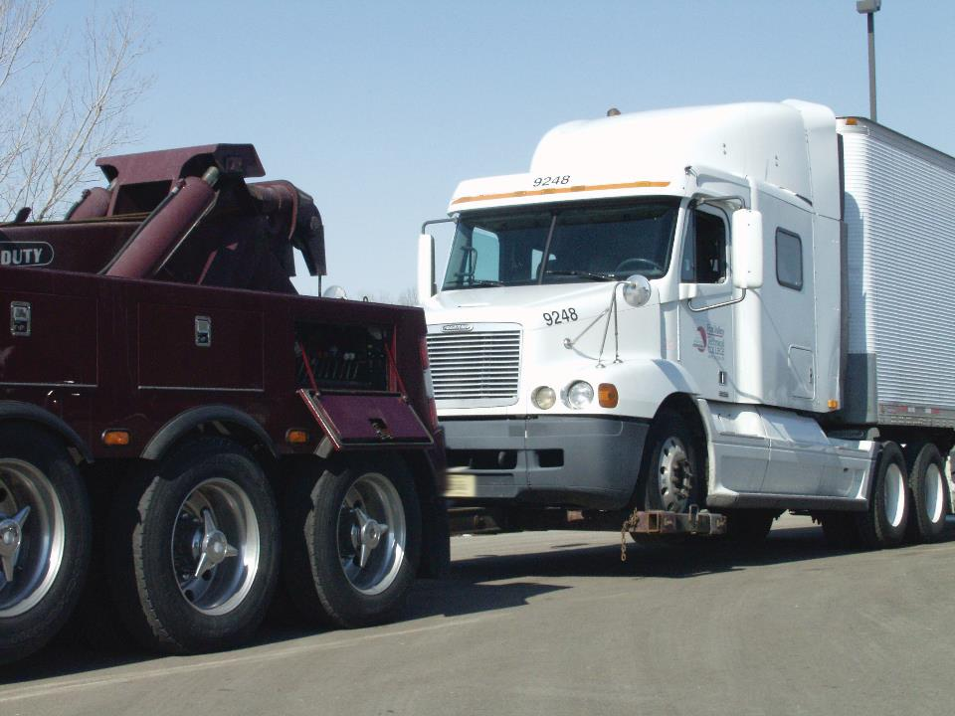
Pitfalls of Poor Vehicle Maintenance
Notes:
Pitfalls of Poor Vehicle Maintenance
It is important to report vehicle defects and deficiencies to your motor carrier as soon as they are discovered. Not reporting a problem when it first occurs can have serious consequences for both you and your motor carrier, including a vehicle breakdown or an accident.
Breakdown costs include more than the parts and labor to get the vehicle up and running once again. Every minute a truck is in the shop or placed out of service, it is not being used to bring in revenue to a carrier. An incapacitated vehicle may incur additional expense, such as:
Cost of towing
Driver wages, meals, and lodgings when unable to drive
Cost of renting another vehicle
Late delivery charges
Lost customers, and/or
Cargo transfer fee
All of these costs have a bearing on a motor carrier’s bottom line, its profitability. This in turn can play a role in your future compensation and benefits with the company.
If a defective part causes an accident, the costs incurred can include insurance deductibles, higher insurance rates, potential litigation, and a tarnished safety record for the carrier. For you it could mean potential citations and fines as well as personal injury.

Slide 14
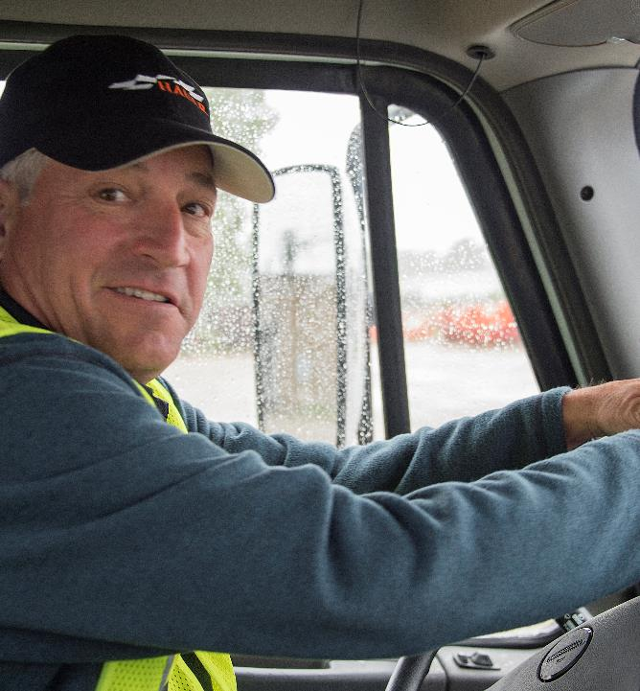
You are responsible for safely operating your vehicle.
Notes:
Driver Responsibility
As a professional driver, you are responsible for safely operating your vehicle. This responsibility includes reporting any problems with your vehicle to your company and making sure these issues are looked into.

Slide 15
Objectives Review
You should now be able to:
  List the different types of vehicle maintenance
  Identify your role in keeping a vehicle’s components in good working order
  Recognize the costs of poor vehicle maintenance
Copyright 2019 J. J. Keller & Associates, Inc.
Notes:
You should now be able to:
List the different types of vehicle maintenance
Identify your role in keeping a vehicle’s components in good working order
Recognize the costs of poor vehicle maintenance
CLASSROOM RECOMMENDATION
Before concluding your training session, have participants take the corresponding quiz (found on the Trainer Tools USB) to check their understanding of the material. You can customize any of the questions to fit your audience or workplace. The answer key can also be found on the Trainer Tools USB.
You may also choose to administer the quizzes before you begin your training session to help get participants thinking about the subject and/or to gauge their understanding of the topic ahead of time.

