Slide 1






PowerPoint® Instructions
This PowerPoint has been designed so you can easily customize it for your training session.
Throughout the presentation you’ll see icons with recommendations or videos to enhance the instruction you present to your students. A detailed explanation for each icon can be found on the next slide. Videos can be found on the Trainer Tools USB.
When you see an icon on the slide, look in the notes
section for further information.
Simply delete or move the icon off the slide before your training session begins.

Slide 2





Classroom Recommendations. Provides suggestions for enhancing your classroom presentation; from ideas for large group discussions to suggestions on the use of training aids such as examples or photos of vehicle parts and components to help illustrate the items covered within a chapter.
Lab Recommendations. Provides suggestions for activities and exercises that take place outside the classroom, but do not involve
the actual operation of the tractor-trailer or its components. Examples
of lab sessions include conducting a vehicle inspection or practicing mirror adjustment.
Range Recommendations. These recommended activities take
place on a closed-access driving range where students may practice driving skills in a controlled environment. Examples of range sessions include practicing shifting technique and successfully completing a backing maneuver.
Road Recommendations. These recommended activities take place in road and traffic conditions that support the chapter’s objectives. Examples of road sessions include proper communication with other drivers through the use of turn signals and basic vehicle control under nighttime or extreme weather conditions.
Videos. These short video clips reinforce material presented in the Student Manual. Use them to help students grasp difficult concepts or subject matter.

Slide 3
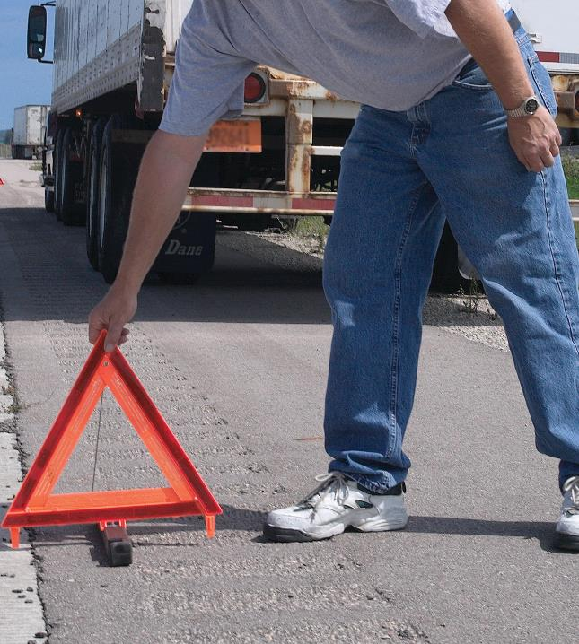
25
Post-Crash Procedures
Notes:
Chapter 25: Post-Crash Procedures
Unit A1.5.5 Post-Crash Procedures
This unit must teach driver-trainees appropriate post-crash procedures, including the requirement that the driver, if possible, assess his or her physical condition immediately after the crash and notify authorities or assign the task to other individuals at the crash scene. The training providers must teach driver-trainees how to protect the area; obtain emergency medical assistance; move on-road vehicles off the road in minor crashes so as to avoid subsequent crashes or injuries; engage flashers; place reflective triangles and other warning devices for stopped vehicles; and properly use a fire extinguisher, if necessary. The training providers must instruct driver-trainees in post-crash testing requirements related to controlled substances and alcohol.

Slide 4
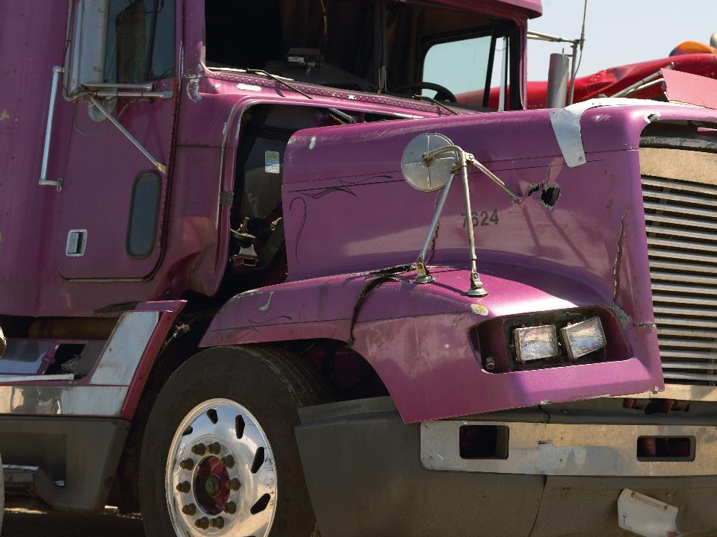
Introduction
Notes:
Introduction
No matter how safely you operate your commercial motor vehicle (CMV), there is always the possibility that you could be involved in an accident. It’s hard to imagine a day at work being any worse than being involved in an accident.
Drivers who have shared this experience will tell you being involved in an accident can feel surreal. In the immediate aftermath it’s hard to think clearly—hard to know what to do, and hard to remember, as a CMV driver, what you’re required to do. That’s why it’s important to have a solid understanding of the procedures you need to follow if you’re ever involved in an accident.
CLASSROOM RECOMMENDATIONS
It’s essential that students finish this chapter with a clear understanding of the subject. Students should have a grasp of the following key points:
Safety procedures that must be followed when involved in an accident.
Procedures for post-accident drug and alcohol testing.
Procedures to follow in the event of a vehicle fire.
INSTRUCTOR RECOMMENDATIONS (PROBLEM-SOLVING)
The following problem-solving situation is presented for you to offer to students and follow-up with discussion.
Problem-solving situation
Driver A was stopped at a stoplight. The driver of a car approaching from behind apparently did not see Driver A’s tractor-trailer soon enough and when he put on the brakes, he bumped into the rear of the trailer.
Driver A figured that the accident was very minor and assumed that the other driver was clearly at fault. There was no apparent damage to the trailer and little damage to the car.
The other driver, however, was extremely upset because his expensive sunglasses were broken in the accident. While he wasn’t hurt, he did complain that his neck was bothering him a little. To help calm the other driver, Driver A told him not to worry and that his company would probably pay for the glasses.
Since there was only very minor damage and apparently no real injuries, both drivers exchanged license numbers, names, and insurance information and drove away.
Discussion questions
How do you think Driver A handled himself at the scene of the accident?
Did Driver A take any action(s) which might have hurt him or his company later?
Did Driver A fail to take any action(s) which might hurt him or his company later?
Answers to discussion questions
Even though the accident which occurred was very minor, Driver A made some significant errors at the scene. Driver A’s bad judgment was probably prompted because he felt the accident was very minor and the other driver was clearly at fault. Also, the other driver involved was upset.
Company policy and common sense would have compelled Driver A not to volunteer that his company would pay for the broken glasses. This could be viewed as an admission that he was at fault. Second, Driver A should have insisted that the other driver receive prompt medical attention for his neck.
Finally, Driver A just drove away indicating that he did not see if the other driver received medical attention and didn’t make any attempt to report the accident at this time.

Slide 5
Objectives
Upon completion of this lesson, you will be able to:
  Describe actions you should take to help secure the scene if you have been involved in an accident
  Discuss post-accident drug and alcohol testing
  Explain procedures to follow in the event of a fire in the cab/engine, tires, or cargo of your vehicle, including how to use a fire extinguisher
Notes:
Objectives
Upon completion of this lesson, you will be able to:
Describe actions you should take to help secure the scene if you have been involved in an accident
Discuss post-accident drug and alcohol testing
Explain procedures to follow in the event of a fire in the cab/engine, tires, or cargo of your vehicle, including how to use a fire extinguisher

Slide 6
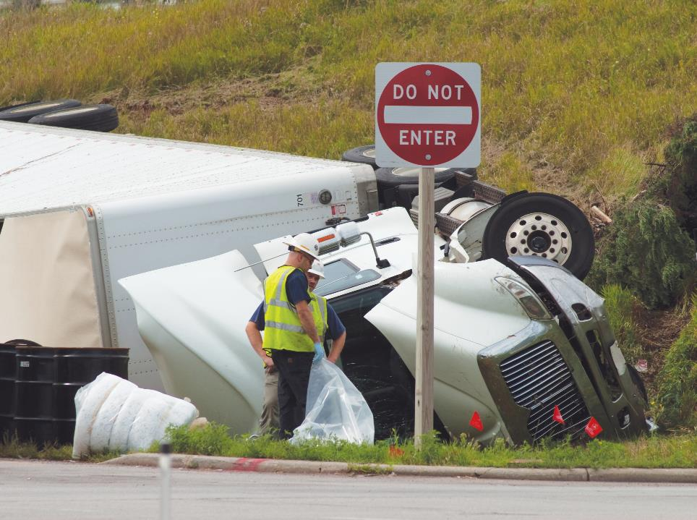
Definitions
Notes:
Definitions
In general, a crash that occurs on any type of roadway, no matter how severe, is typically referred to as an accident. But according to the Federal Motor Carrier Safety Regulations (FMCSRs) an “accident” is any occurrence involving a CMV operating on a highway in interstate or intrastate commerce that:
Involves a fatality
Causes an injury serious enough to require immediate medical treatment away from the scene, or
Results in disabling damage requiring a vehicle to be towed from the scene
A fatality means any injury which results in the death of a person at the time of the accident or within 30 days of the accident.
Disabling damage includes vehicles that could have been driven but would have been further damaged if done so. Excluded from the definition of disabling damage is:
Damage which can be temporarily fixed at the scene without special tools or parts
Tire disablement without other damage (even if no spare is available)
Headlamp or taillight damage
Damage to turn signals, horn, or windshield wipers which makes them inoperative
The term “accident” does not include incidents involving getting in or out of a parked vehicle, or that involve only the loading or unloading of a vehicle’s cargo.
CALLOUT: The definition of an accident is located in Section 390.5 of the FMCSRs.
CALLOUT: Sometimes the term “crash” is used instead of “accident.” Both terms have the same meaning.

Slide 7
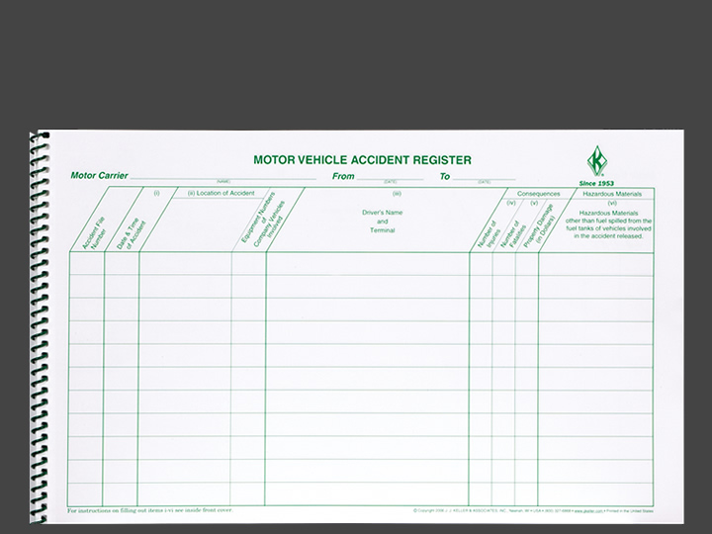
Accident Register
Notes:
Accident Register
Section 390.15(b) of the FMCSRs states that a motor carrier must keep an accident register. This register must include (at a minimum) the following information for each accident:
Date of accident
Location (city/town and state) in which the accident occurred
Driver name
Number of injuries
Number of fatalities
Whether hazardous materials, other than fuel spilled from the fuel tanks of the motor vehicles involved in the accident, were released
The accident register must also include copies of all accident reports required by state or other governmental entities or insurers.
The motor carrier must retain all of this information for three years after the date of the accident.

Slide 8
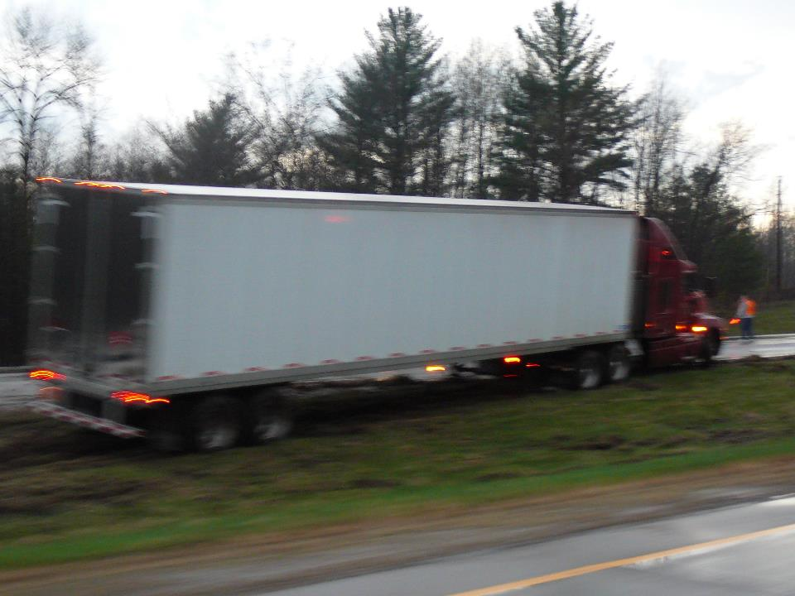
Securing the Scene
Notes:
Securing the Scene
When the unexpected happens, it is important that you know what to do and what to expect.
When an accident occurs, you must deal with immediate problems and gather and report accident information in a timely manner. The following steps can help you accomplish these tasks.
VIDEOS (see Trainer Tools USB)
25.1 — Stop Immediately
Stop Immediately
Failure to stop (or leaving the scene), when involved in an accident is a serious offense — so serious that it is listed as a disqualifying offense in Sec. 383.51 and Sec. 391.15 of the FMCSRs.
As a commercial driver’s license (CDL) holder, if you are convicted of this offense, you are disqualified from operating a CMV for one year.
In addition to being a disqualifying offense, failure to stop (or leaving the scene) is against the law and can result in fines and/or jail time.
When involved in an accident, remain calm. Get your truck as far off the road as you can, unless doing so will increase the danger, cause additional damage, or inflict injury to you or anyone else at the accident scene. Then:
Shut off the engine
Turn on your four-way flashers
Set the emergency brake
Check yourself for injuries
CALLOUT: See Sec. 383.51 of the FMCSRs for disqualification details.
CALLOUT: Many states have laws that require drivers to remove their vehicles from the road when involved in a minor accident. The goal is to prevent additional accidents that could occur due to the hazard of stopped vehicles on the roadway, and to reduce congestion and delays.

Slide 9
Next, set out emergency warning devices.
Notes:
Warning Devices
Next, set out emergency warning devices. Act quickly to help get the scene under control and prevent a bad situation from getting worse. Per the regulations, you have ten minutes to set out emergency warning devices. To set out warning devices, put on a reflective vest and walk toward oncoming traffic holding the devices in front of you for maximum visibility.
Where you place each device depends on where your truck is stopped. If you’re in the middle of a traffic lane, the devices should be placed in the center of the lane. If your truck is on the shoulder, place them along the occupied shoulder.
Emergency warning device placement direction and distance is spelled out in Part 392 of the FMCSRs and is described below:
On a two-lane road, place the first warning device four paces (or ten feet) behind your truck and the second device about forty paces (or 100 feet) behind your truck. Then, the third device should be placed about 40 paces (or 100 feet) in front of your truck.
If you’re on a divided highway or one-way road, position the first warning device four paces (or ten feet) behind your truck. Then, place the second device forty paces (or 100 feet) behind your truck, and place the third device eighty paces (or 200 feet) behind your truck.
Placing emergency warning devices when you’re parked on a hill or curve, or when there are other visual obstructions is a bit different. The goal is to give approaching drivers enough warning to react before reaching the accident scene. To ensure approaching drivers have enough time to react, place a warning device between 40 - 200 paces (or 100 - 500 feet) from your truck in the direction of the visual obstruction. Place the other two devices according to the rules for two-lane or divided highways.
Three bidirectional emergency reflective triangles, six fusees, or three liquid burning flares are acceptable warning devices with which a vehicle must be equipped. However, flame-producing devices, such as fusees and liquid burning flares, are prohibited on vehicles carrying explosives, a flammable gas, a flammable liquid, or on a motor vehicle using compressed gas as a motor fuel.
CALLOUT: When placing emergency warning devices, be alert for other drivers who may not see you on the road.
VIDEOS (see Trainer Tools USB)
25.2 — Warning Devices

Slide 10
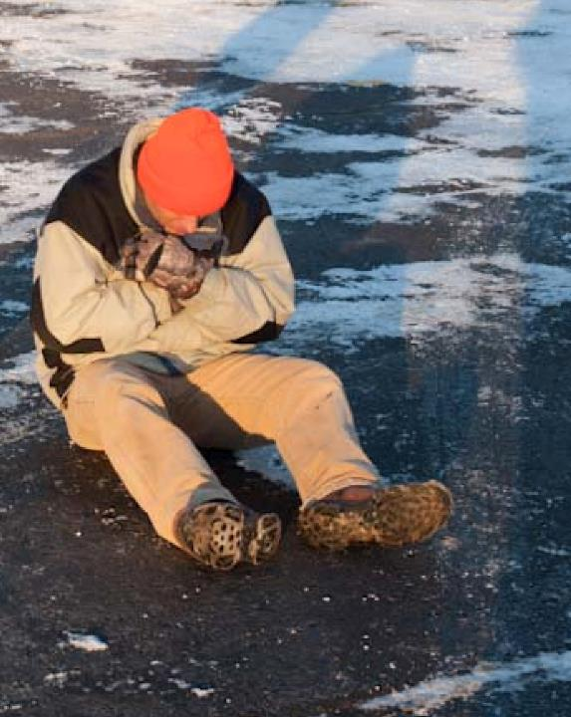
Check for injuries, including to yourself.
Notes:
Check for Injuries
If you’re involved in an accident, it’s possible to be injured without initially realizing it because the trauma and the adrenaline rush can affect your thinking. It’s important to take a moment—and a deep breath—to calm yourself, regain control of your emotions, and determine if you or others are hurt.
At a minimum, you should call for help, ask if the other party wants someone contacted, and keep him or her warm and dry. If you’re able to, keep him or her company until help arrives.
Do not move an injured person unless he or she is in immediate danger and you have no other option. Doing too much can be just as dangerous as doing nothing at all. Never attempt to do something you are not trained in.
CALLOUT: If the accident involves an unoccupied vehicle, try to find the owner. If the owner can’t be found, leave your name, the company’s name, address, and phone number in a visible location and contact law enforcement. Also, supply your company with the make, model, year, license number, and description of the vehicle.

Slide 11

Even if medical assistance isn’t needed, contacting law enforcement is still required.
Notes:
Notify Law Enforcement
Even if medical assistance isn’t needed for injured individuals at the scene of an accident, contacting law enforcement is still required. If you’re unable to, or are attending to injured persons, ask someone else at the scene to make the call.
Be prepared to provide the following information:
The exact location of the accident, (using mile markers or landmarks if necessary)
The number of injured persons and the severity of their injuries (so law enforcement can coordinate the medical response)
The extent of any vehicle or property damage
Your contact information (in case they need to contact you for additional details)
Never leave the scene of an accident to notify law enforcement unless there is no means of communicating at the accident site. If you are unable to contact authorities, someone else at the scene should perform this task.

Slide 12
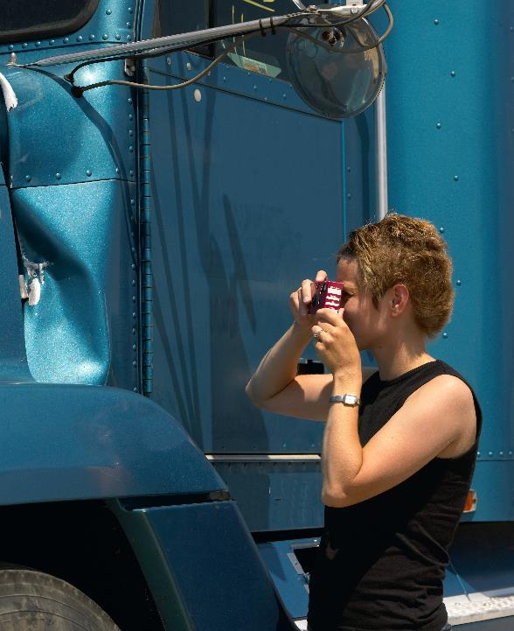
A camera or disposable camera may be the most useful item you can have at the scene.
Notes:
Document the Accident
Detail is important. Recording the information while it’s still fresh in your mind is the best way to ensure your documentation is thorough and accurate. Some states require you to complete your documentation before you leave the scene of an accident, while others do not. Your company, law enforcement, and insurance companies will need as much information about the accident as possible. When documenting the accident, you should include the:
Time and location of accident
Description of damage to vehicles and property
Name and address of all individuals involved
Injuries or fatalities
Description of the event including weather and road conditions
Name and address of insurance companies of all individuals involved
Type, make, model, and license numbers of all vehicles involved
Names and departments of any investigating officers
Many motor carriers provide accident reporting kits in their trucks. These kits can be used to answer questions in a time when you may not be thinking straight. Also, drawing a simple sketch or diagram of the situation is a good idea.
Photographs. A camera or disposable camera may be the most useful item you can have at the scene. Taking pictures will help determine how an accident occurred and how much damage was involved. But you need to know what to photograph, and what not to photograph.
Take wide shots from the fog stripe at the edge of the road toward the point of impact, showing the final location of the vehicles
Take wide shots from the centerline and all sides of the vehicles
Take close-up shots of damage and any skid marks or road debris
Never take pictures of individuals who have been injured or killed
As you’re documenting the accident and taking pictures, don’t put yourself in danger by wandering into traffic or getting in the way of law enforcement or medical responders.
VIDEOS (see Trainer Tools USB)
25.3 — Document the Accident

Slide 13
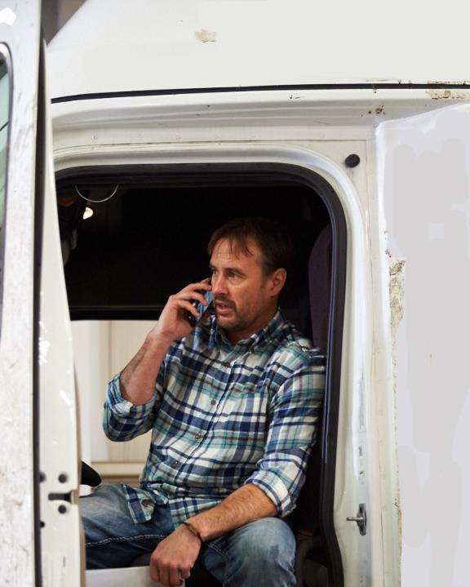
It’s critical you notify your motor carrier of the accident.
Notes:
Contact Your Motor Carrier
An accident is not only a stressful event in your life, but it can have a significant impact on your company, as well. So, it’s critical you notify your motor carrier of the accident as soon as possible and provide them with key information regarding the accident. Give them the same facts you included in your on-scene documentation. And, if your company has any additional policies regarding accident procedures, be sure to follow those, as well.
Know whom to call in the event of an accident. These names and phone numbers should always be available, possibly posted in a single place in each cab. Follow all company rules, be cooperative, and answer all questions posed by the company representative (safety director, dispatcher).

Slide 14
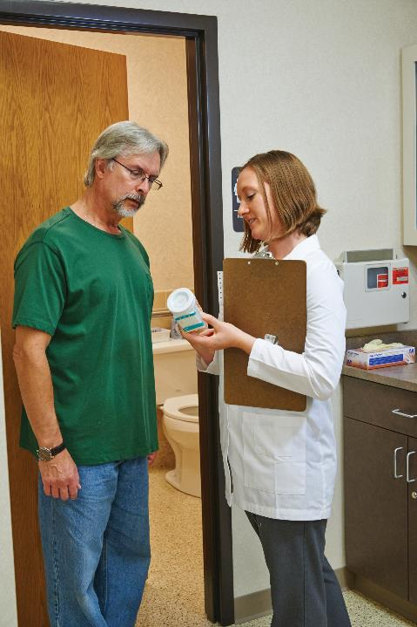
If certain conditions are met, your carrier will instruct you to go for post-accident drug and alcohol testing.
Notes:
Post-accident testing. If certain conditions are met, your carrier will instruct you to go for a post-accident drug and alcohol test. These tests are required if:
Any person involved in the accident dies
You are cited for a moving traffic violation, and the accident involved injury requiring immediate medical treatment away from the accident scene, or
You are cited for a moving traffic violation, and the accident resulted in disabling damage requiring the towing of one or more vehicles from the scene
In some cases, the officer and your company will both require you to undergo post-accident drug and alcohol testing.
Law enforcement may request testing as part of the investigation or if required under state laws
Your company will request testing to comply with the Department of Transportation (DOT) regulations
Post-accident alcohol testing is required as soon as possible when these conditions are met and when a citation is issued within eight hours of the accident.
The post-accident alcohol test must be initiated by your motor carrier within two hours but no later than eight hours of the accident.
A driver who is required to take a post-accident alcohol test may not use alcohol for eight hours following the accident or until after the test, whichever comes first.
Post-accident drug testing is required as soon as possible when these conditions are met, and when a citation is issued within 32 hours of the accident. Under the rules, the post-accident drug test must be administered within 32 hours.
If you are subject to post-accident testing you must remain available for testing. Not remaining available for testing is considered a refusal to test. A refusal to test is treated the same as failing an alcohol test or testing positive for drugs.
Nothing in the regulations should delay medical attention for those who are injured or prohibit you from leaving the scene of the accident to get help in responding to the accident or to seek emergency medical care for yourself.
Your motor carrier must provide you with necessary post-accident information, procedures, and instructions before you can operate a CMV. This will ensure you are prepared in the event of an accident.
CALLOUT: DOT-mandated post-accident testing only applies to accidents that result from operating your CMV.
However, your motor carrier may have a non-DOT policy that requires testing after all accidents. Check with your supervisor regarding your motor carrier’s policies.
CALLOUT: If the test cannot be performed within two hours, the motor carrier must prepare a record stating why the test wasn’t given. If the test cannot be performed within eight hours, the motor carrier should not give the test and must prepare a record stating why the test could not be given within that time.
CALLOUT: If the test cannot be performed within 32 hours, the motor carrier should not give the test and must prepare a record stating why the test could not be given within that time.

Slide 15
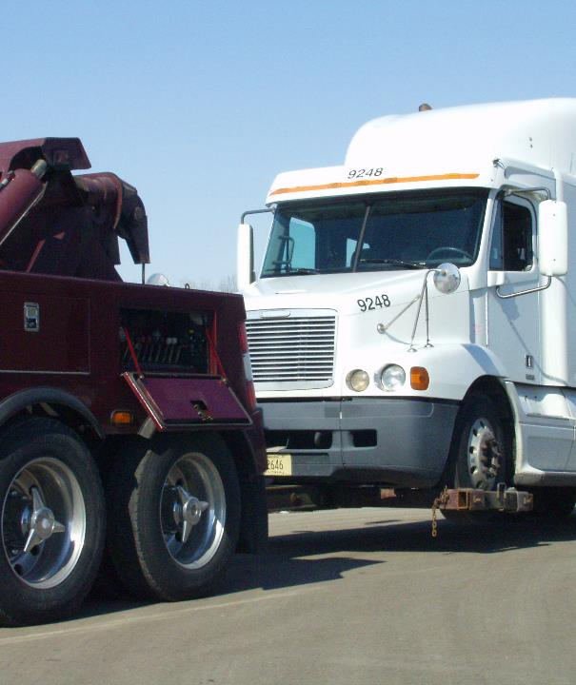
The company representative will direct you on how to handle a disabled or damaged vehicle.
Notes:
Damaged vehicle. The company representative will also direct you on how to handle a disabled or damaged CMV (towing, repair). If the vehicle is not disabled, the carrier may grant permission to drive the vehicle from the scene (providing it is given a thorough pre-trip inspection to ensure safety) to a repair station.
Preliminary Report
A preliminary accident report is often used as part of a motor carrier’s investigation into an accident.
Depending on motor carrier policy, this type of report is completed by the driver or a representative of the motor carrier.

Slide 16
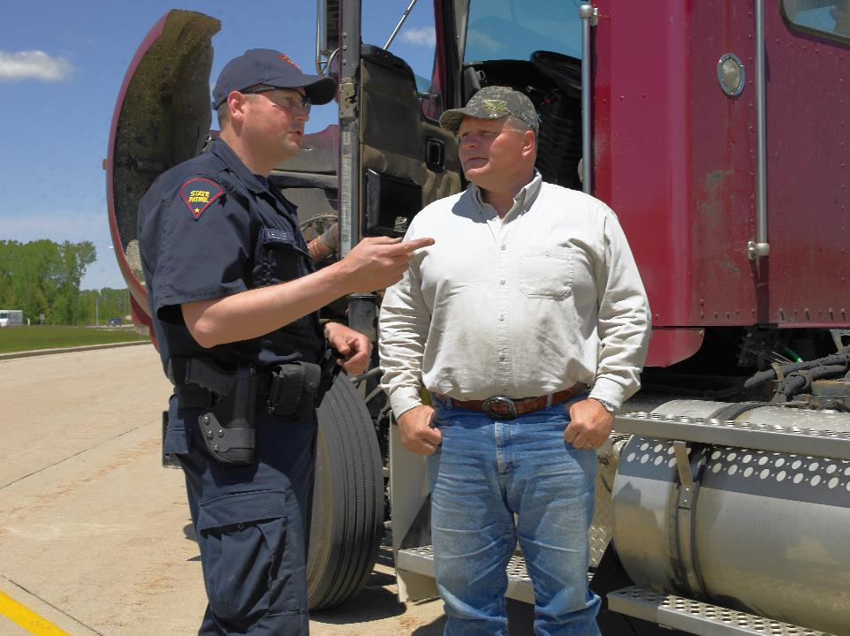
At the Scene
Notes:
At the Scene
Be polite and respectful at the accident scene. Note that anything said at the accident scene could be used against you and/or your motor carrier at a later date. You should not:
Discuss specific details of the accident with others at the scene
Volunteer unnecessary information
Admit fault, and/or
Try to settle anything at the scene — that’s the job of law enforcement, insurance representatives, and the motor carrier
To avoid problems after the accident you should:
Honestly answer questions asked by the law enforcement officials investigating the accident
Be factual
Never speculate or guess as to what may have caused the accident or who is at fault

Slide 17
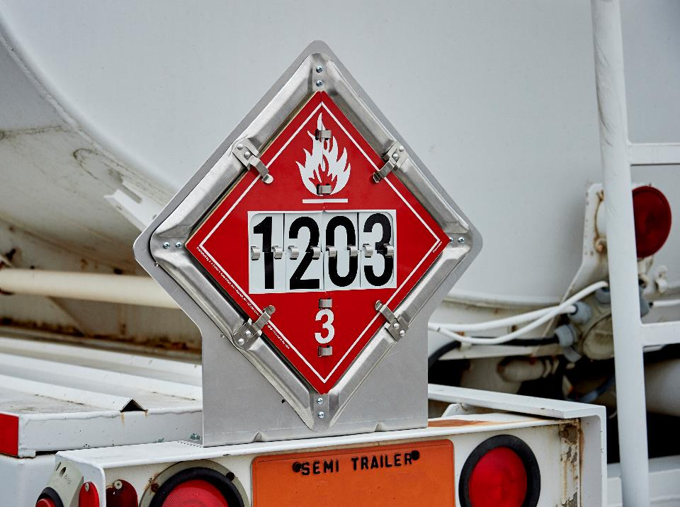
Hazardous Materials
Notes:
Hazardous Materials
When an accident or incident involves a hazardous material , there may be additional risks to safety, health, and the environment. Because of this, there are additional regulatory requirements that must be followed.
If you haul hazardous materials, your employer must provide training to you on proper procedures for responding to leaks, spills, and other emergencies.
If you are involved in an incident or accident, you must immediately report this to your company. Regulatory requirements and company policy will dictate how you handle the situation. At the very least, keep bystanders away from the area.
If a hazardous material response team is called to the scene, follow their instructions.

Slide 18
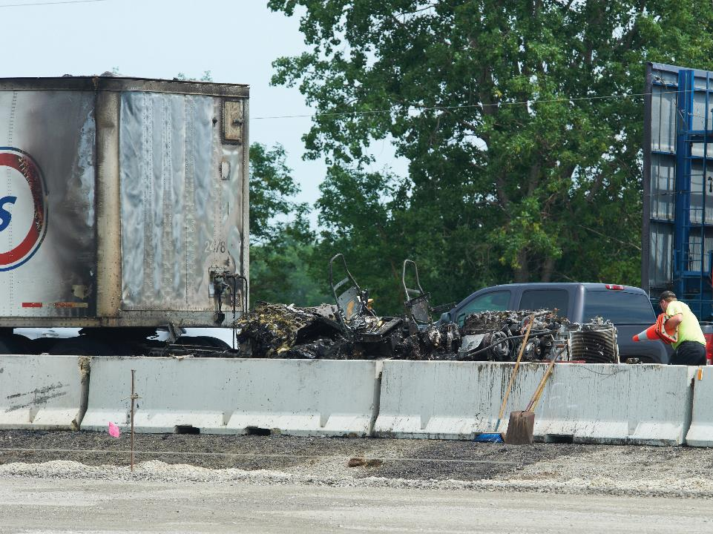
Vehicle Fires
Notes:
Vehicle Fires
A vehicle fire can be a dangerous and frightening experience. Common sense, good driving habits, and good housekeeping can prevent many vehicle fires but, unfortunately, not all fires can be prevented. You need to be prepared to face this potentially dangerous situation.

Slide 19
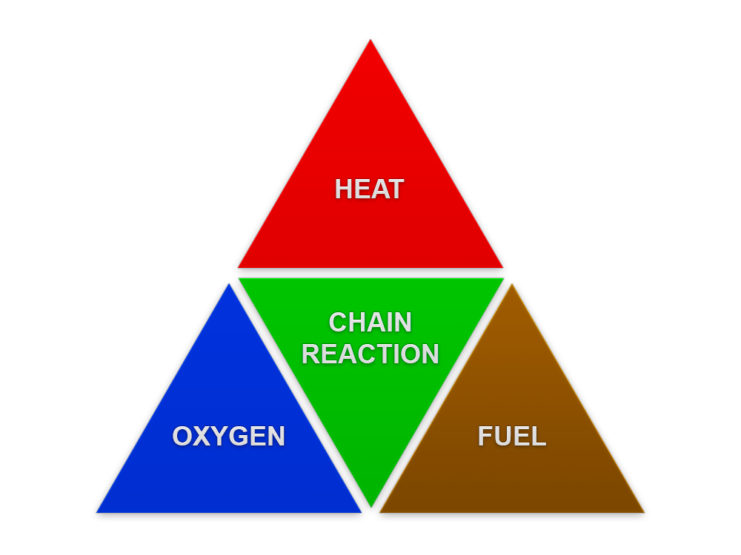
Fire is made possible by four components, commonly referred to as the “fire tetrahedron.”
Notes:
Fire Prevention
Fire is made possible by four components that are commonly referred to as the “fire tetrahedron.” The components represented by the four-sided tetrahedron are:
Oxygen
Heat
Fuel
Chemical chain reaction
Fire prevention revolves around keeping those elements from coming together. Without each of these four elements, fire, in most cases, cannot begin or continue. For example, if you don’t allow enough heat to contact a fuel, you’ll prevent fire. Or, if you use an extinguishing agent to stop the chemical chain reaction, you’ll put out the fire.
Since oxygen is almost always present in the air, this element of fire is also almost always present.
Some sources of heat or ignition include open flames, lightning, smoking, hot surfaces, frictional heat, static electricity, and sparks.
Given enough oxygen and heat, almost anything will burn. Fuel sources include
Solid materials like wood, cloth, paper, rubber, and plastics
Liquids that are flammable such as gasoline
Gases like flammable gases and vapors
Once the chain reaction of fire begins, extinguishing the fire requires the interruption of the chain reaction. You can do this by denying the fire one of the other three elements: oxygen, heat, or fuel.
Most vehicle fires occur in one of the following three areas:
Cab/engine
Tires/brakes
Cargo
Cab/engine. Good housekeeping is important. In fact, it’s one of the key strategies for fire prevention. The cab should be clean and free of debris at all times.
The engine compartment should be checked regularly. The engine should always be clean. If oils or fluids are spilled on the engine, they should be wiped up immediately. After work is finished on the engine, all rags should be removed from the area and all fluid caps should be put back where they belong.
Regular checks should be made of the following items:
Wiring and electrical system
Fuses
Battery
Exhaust system
When refueling, the engine should be turned off and all smoking materials should be extinguished. The fuel tank should be checked for signs of leakage. Also, make sure you have metal to metal contact while fueling.
Tires/brakes. Overheated tires are another way vehicle fires ignite. An underinflated tire can overheat, increasing the risk of a tire fire. A soft or flat tire should be changed as soon as possible.
If a hot tire is changed, do not place it in the spare tire rack until it has cooled down.
Brakes should also be checked regularly, as worn brakes can overheat, causing a fire.
All brakes (including the parking brake) should be fully released before a vehicle is moved.
Also, never ride the brakes. Riding the brakes can cause a fire in the brake linings that could spread to the tires.
Cargo. Periodically check your mirrors, looking for smoke. Smoking materials should never be used around a vehicle hauling hazardous materials or in the cargo area as freight is being loaded or unloaded.
Know what commodities you are hauling. This information is important so you and/or emergency crews can respond properly.

Slide 20




Wood
Cloth
Paper
Flammable liquids, gases, and greases
Class A
Class B
Electrical fires
Combustible metals
Class C
Class D
Notes:
General Classes of Fires
While all fires are made up of the same four elements, the specifics of each fire will differ, and the methods to fight these different fires will vary. Because of this, the National Fire Protection Association (NFPA) has classified four general types of fires, based on the combustible materials involved and the kind of extinguisher needed to put them out. The four fire classifications are A, B, C, and D. Each classification has a special symbol and color identification.
Class A. This type of fire is the most common. The combustible materials are wood, cloth, paper, rubber, and plastics. The common extinguishing agent is water, but dry chemicals are also effective.
Class B. Flammable liquids, gases, and greases create Class B fires. The extinguishing agents for this type of fire are foam, carbon dioxide, and dry chemical.
Class C. Class C fires are electrical fires and a nonconducting agent must be used. Carbon dioxide and dry chemical extinguishers are to be used. Never use foam or water as an extinguishing agent on these fires, because they are an excellent conductor of electricity and you could be electrocuted.
Class D. Combustible metals, such as magnesium, titanium, zirconium, and sodium fires are Class D fires. These fires require specialized techniques and extinguishing agents to extinguish them. None of the common extinguishing agents should be used since they can increase the intensity of the fire by adding an additional chemical reaction.

Slide 21
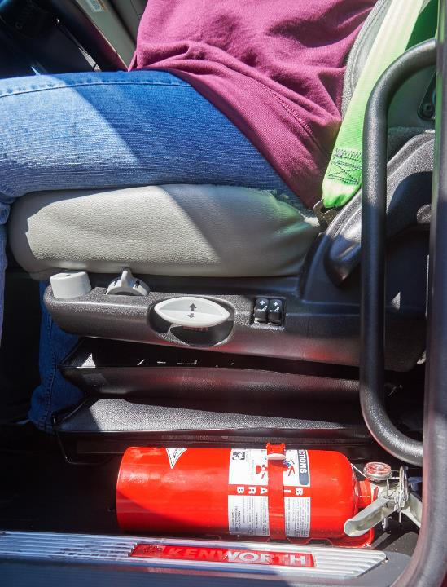
Be sure to use fire extinguishers only on fires for which they were designed.
Notes:
Fire Extinguishers
Each portable fire extinguisher contains an extinguishing agent that eliminates the heat, fuel, or oxygen of a fire. The extinguishing agent depends on the class of fire it’s meant to extinguish. The class of fire an extinguisher is used for is represented by letter symbols prominently displayed on the fire extinguisher.
Fire extinguishers can be designed to suppress more than one type of fire. If this is the case, the extinguisher will be marked with all the applicable class labels. For example, ABC or BC. A commonly-found type of ABC extinguisher contains a dry powder extinguishing agent.
Be sure to use fire extinguishers only on fires for which they were designed. Using the wrong agent on a fire may increase the intensity of the fire.
Section 393.95 of the FMCSRs requires one or two (depending on the rating) properly filled and readily accessible fire extinguishers on all CMVs. The extinguisher(s) must be securely mounted on the vehicle and must be designed and maintained to visually show whether the extinguisher is fully charged.
If a vehicle is hauling hazardous materials, it must be equipped with one fire extinguisher having an Underwriters’ Laboratories rating of 10 B:C or more.
If a vehicle is not hauling hazardous materials, it must be equipped with either one fire extinguisher having an Underwriters’ Laboratories rating of 5 B:C or more or two fire extinguishers, each with an Underwriters’ Laboratories rating of 4 B:C or more.

Slide 22
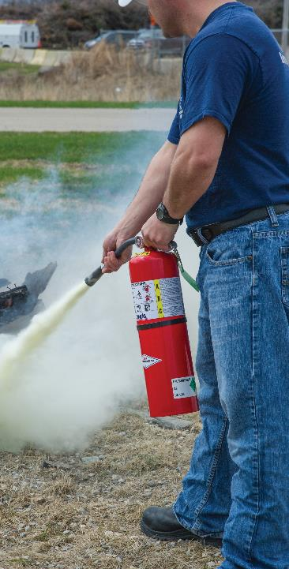
The PASS method:
  Pull the pin
  Aim at the base of the fire
  Squeeze the handle
  Sweep from side to side
Notes:
Using a Fire Extinguisher
If there is wind, make sure you have the wind at your back. You don’t want the contents of the fire extinguisher blowing back at you during discharge. And, it helps you avoid smoke and fumes.
The correct way to use a fire extinguisher is to position yourself about eight to ten feet from the fire and use a method called PASS. The acronym PASS stands for:
Pull the pin, standing back 8 to 10 feet from the fire
Aim at the base of the fire
Squeeze the handle to release the extinguishing agent
Sweep at the base of the fire with the extinguishing agent
You have to act fast when using a fire extinguisher because you only have a limited supply of extinguishing agent and operation time. Never aim high at the flames—it will not put out the fire, and you will waste your extinguishing agent.

Slide 23
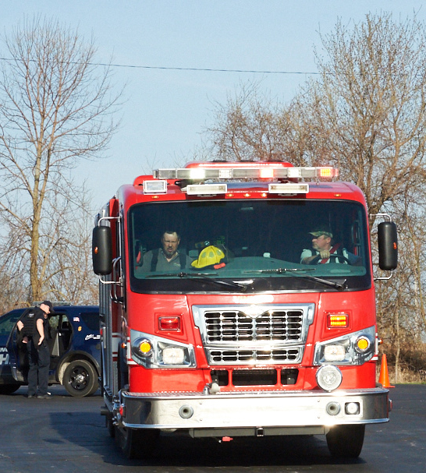
If a fire is too large to handle, leave it to the professionals.
Notes:
Putting Out Fires
The first consideration when a fire occurs is your safety and the safety of others. If possible, move the vehicle to a location away from other people, vehicles, and buildings. Getting the fire under control is the next step, but don’t take unnecessary risks. If a fire is too large or dangerous to handle, leave it to the professionals.
Cab/engine fires. The following are basic steps to follow when dealing with a cab/engine fire.
Turn off the vehicle’s engine. If you can do it safely, also look for fuel leaks.
If the fire is electrical and it can be done safely, disconnect the battery cables from the terminals.
Don’t open the hood more than necessary when fighting an engine fire. Remember, air is one of the ingredients that will help fuel a fire.
Remember, never use water on a petroleum–based fire. The use of water will cause a petroleum–based fire to spread.
Follow the directions on the fire extinguisher.
Never assume a fire is completely out. Fires often smolder, spark, and can reignite.
Tire fires. Tire fires are hard to extinguish and are dangerous. This is due to the fact that tires are made of highly flammable material. A tire fire can generate an intense amount of heat. There are several things that should be kept in mind when fighting a tire fire.
Remove the hot tire from the vehicle if you can do so safely.
Use water to fight a tire fire. Water helps cool a tire as well as extinguish flames. Fire extinguishers are good at suppressing flames, but will not be able to put out a tire fire.
Cargo fires. In many cases cargo fires are discovered by the sight or smell of smoke around cargo doors. There are several things to keep in mind when fighting a cargo fire.
Do not open the doors, if smoke is detected, until the vehicle is in a safe place and help has arrived.
Disconnect the tractor from the trailer (if possible) and move the tractor to a safe place away from the fire.
Always know what type of cargo is in the trailer. This will help firefighters determine the safest way to extinguish the flames.

Slide 24
Objectives Review
You should now be able to:
  Describe actions you should take to help secure the scene if you have been involved in an accident
  Discuss post-accident drug and alcohol testing
  Explain procedures to follow in the event of a fire in the cab/engine, tires, or cargo of your vehicle, including how to use a fire extinguisher
Copyright 2019 J. J. Keller & Associates, Inc.
Notes:
You should now be able to:
Describe actions you should take to help secure the scene if you have been involved in an accident
Discuss post-accident drug and alcohol testing
Explain procedures to follow in the event of a fire in the cab/engine, tires, or cargo of your vehicle, including how to use a fire extinguisher
CLASSROOM RECOMMENDATION
Before concluding your training session, have participants take the corresponding quiz (found on the Trainer Tools USB) to check their understanding of the material. You can customize any of the questions to fit your audience or workplace. The answer key can also be found on the Trainer Tools USB.
You may also choose to administer the quizzes before you begin your training session to help get participants thinking about the subject and/or to gauge their understanding of the topic ahead of time.

