Slide 1






PowerPoint® Instructions
This PowerPoint has been designed so you can easily customize it for your training session.
Throughout the presentation you’ll see icons with recommendations or videos to enhance the instruction you present to your students. A detailed explanation for each icon can be found on the next slide. Videos can be found on the Trainer Tools USB.
When you see an icon on the slide, look in the notes
section for further information.
Simply delete or move the icon off the slide before your training session begins.

Slide 2





Classroom Recommendations. Provides suggestions for enhancing your classroom presentation; from ideas for large group discussions to suggestions on the use of training aids such as examples or photos of vehicle parts and components to help illustrate the items covered within a chapter.
Lab Recommendations. Provides suggestions for activities and exercises that take place outside the classroom, but do not involve
the actual operation of the tractor-trailer or its components. Examples
of lab sessions include conducting a vehicle inspection or practicing mirror adjustment.
Range Recommendations. These recommended activities take
place on a closed-access driving range where students may practice driving skills in a controlled environment. Examples of range sessions include practicing shifting technique and successfully completing a backing maneuver.
Road Recommendations. These recommended activities take place in road and traffic conditions that support the chapter’s objectives. Examples of road sessions include proper communication with other drivers through the use of turn signals and basic vehicle control under nighttime or extreme weather conditions.
Videos. These short video clips reinforce material presented in the Student Manual. Use them to help students grasp difficult concepts or subject matter.

Slide 3
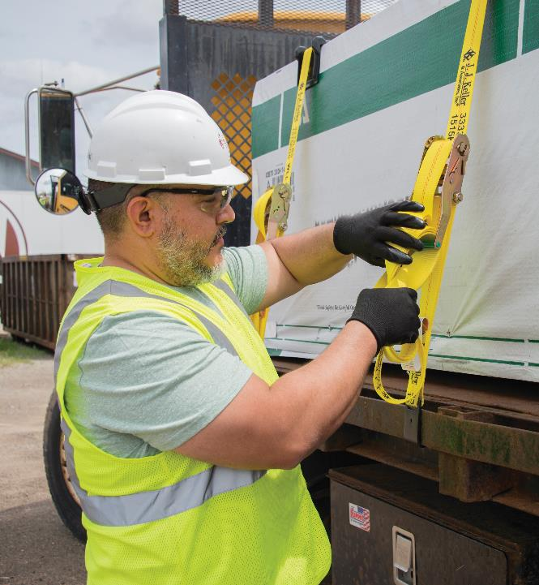
21
Handling and Documenting Cargo
Notes:
Chapter 21 Handling and Documenting Cargo
Unit A1.5.1 Handling and Documenting Cargo This unit must teach the basic theory of cargo weight distribution, cargo securement on the vehicle, cargo covering, and techniques for safe and efficient loading/unloading. The training providers must teach driver-trainees the basic cargo security/cargo theft prevention procedures. The training provider must teach driver-trainees the basic information regarding the proper handling and documentation of HM cargo.

Slide 4
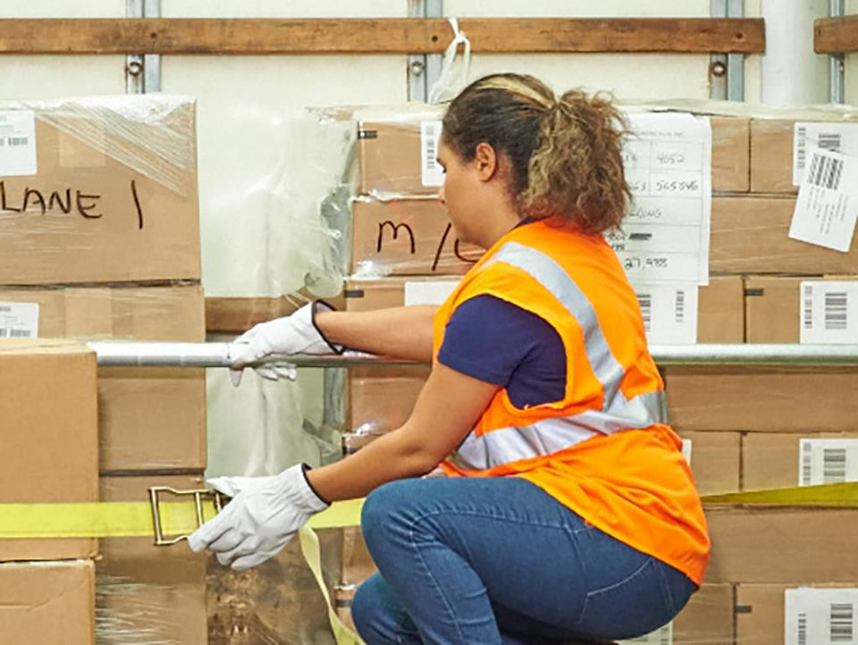
Introduction
Notes:
Introduction
Properly handling, securing, and delivering cargo are all tasks the professional driver faces on a daily basis. In addition, all drivers deal with some form of freight documentation. You’ll need to know what documents are required and what your responsibility is in handling them when out on the road.
This chapter will address the importance of properly handling cargo, cargo security, cargo securement, and weight distribution principles. In addition, it will cover the basics of cargo documentation including a general overview of the bill of lading and procedures you should follow when making pickups and deliveries.
CLASSROOM RECOMMENDATION
Properly securing, handling, documenting, and delivering cargo are all tasks the professional driver performs on a regular basis. Your students need to understand these principles in order to do their job in a safe and efficient manner.

Slide 5
Objectives
Upon completion of this lesson, you will be able to:
  Recognize cargo securement devices
  Explain how to evenly distribute your cargo
  Identify how to safely load and unload your vehicle
  Recall the functions served by, and information included on, a bill of lading
  Summarize pickup and delivery procedures
  Practice cargo theft prevention measures
Notes:
Objectives
Upon completion of this lesson, you will be able to:
Recognize cargo securement devices
Explain how to evenly distribute your cargo
Identify how to safely load and unload your vehicle
Recall the functions served by, and information included on, a bill of lading
Summarize pickup and delivery procedures
Practice cargo theft prevention measures

Slide 6
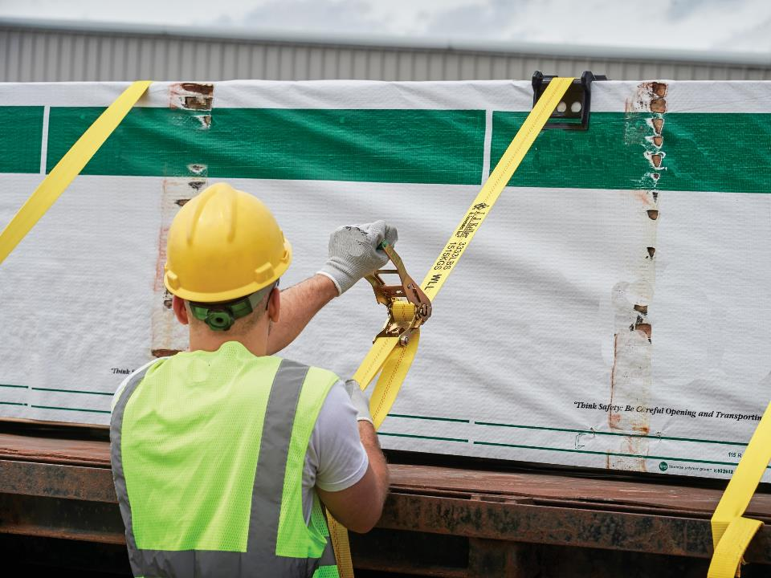
The Importance of Proper
Cargo Handling
Notes:
The Importance of Proper Cargo Handling
As a professional driver, it is your job to safely and efficiently transport cargo to the customer, making sure it arrives on time and damage free.
Your responsibility for the cargo starts as it is being loaded onto your vehicle and continues until delivery. You will need to follow applicable regulations, including state and local requirements in the areas you travel to.
CLASSROOM RECOMMENDATION
Cargo securement
Part 393, Subpart I of the FMCSRs addresses cargo securement regulations. Trying to understand these requirements can be intimidating for the beginning driver. Make sure you allow for plenty of time to answer questions and clear up any misunderstandings your students may have.

Slide 7
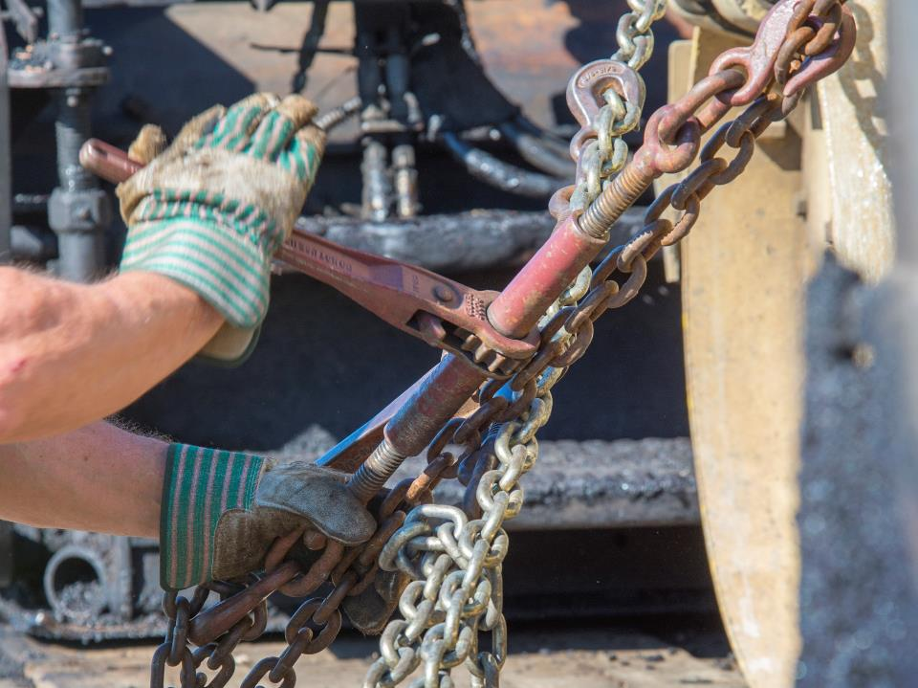
Principles & Methods of
Cargo Securement
Notes:
Principles and Methods of Cargo Securement
As cargo is being loaded on your vehicle, you need to ensure that it is properly secured. Poorly secured cargo can result in damage to cargo or vehicles, delays due to roadside enforcement, and potential accidents that can cause injuries or even loss of life.
Regulatory Requirements
Section 391.13 of the Federal Motor Carrier Safety Regulations (FMCSRs) requires that you know how to properly locate, distribute, and secure cargo. This regulation also requires you to be familiar with the methods and procedures for securing cargo in or on your vehicle.
Section 392.9 of the FMCSRs states that a vehicle may not be driven unless the vehicle’s cargo is properly distributed and adequately secured.
The vehicle’s tailgate, tailboard, doors, tarpaulins, spare tire, and other equipment used in its operation, and the means of fastening the cargo, must be secured.
In addition, the vehicle’s cargo must not:
Block your view ahead or to the right or left sides
Interfere with the free movement of your arms or legs
Prevent you from reaching emergency equipment, or
Prevent you or any other person from exiting the vehicle’s cab or driver’s compartment
You must inspect your vehicle’s cargo and load-securing devices within the first 50 miles of a trip.
After that initial inspection, you must reexamine the security of your vehicle’s load after driving for 3 hours, 150 miles, or when you make a change of duty status—whichever comes first.
You may be exempt from this requirement if your vehicle is sealed and you have been ordered not to open it to inspect, or if your vehicle is loaded in a way that makes it impractical to inspect the cargo.
Part 393, Subpart I of the FMCSRs covers load-securement specifics.
These regulations require a commercial motor vehicle to be loaded and equipped, and the cargo secured, in a way that prevents the cargo from leaking, spilling, or falling in or from the vehicle.
All cargo must be contained, immobilized, or secured to prevent shifting that adversely affects the vehicle’s stability or maneuverability.
All cargo must be firmly immobilized or secured on or within the vehicle by structures of adequate strength, dunnage or dunnage bags, shoring bars, tiedowns, or a combination of these.
Cargo that is likely to roll must be restrained by chocks, wedges, a cradle , or other equivalent means to prevent rolling. The means of preventing rolling must not be capable of becoming unintentionally unfastened or loose while the vehicle is in transit.
LAB RECOMMENDATION
Cargo securement
One of the best ways to present this lesson is by conducting hands-on exercises. With this type of subject, it is often easier to learn by observing and participating.
The purpose of the following lessons is to demonstrate how to tie down cargo in or on a trailer.
The required equipment for each of the following exercises includes a tractor and flatbed trailer, real or simulated cargo, and appropriate securement devices.
Exercise 1
Start with a trailer that has all but the last few pieces of cargo properly loaded, stacked, and secured.
Make sure the weight is properly distributed.
Discuss the importance of cargo load and weight distribution. Allow the students time to inspect the load. Point out factors showing good weight distribution and cargo securement.
Have the students finish loading the cargo under instructor supervision. If equipment used requires special training (for example, a forklift) the instructor should do the loading while students observe.
Demonstrate how to legally and safely secure the straps or chains on the trailer.
Then, under instructor supervision, the students should take turns tying down the cargo.
After each student has completed this task, review his or her work.
Exercise 2
Demonstrate to your students the proper method of tightening a tiedown assembly. Use a variety of tiedown equipment including chains, chain binders, web strapping, and rope.
Have each student progressively tighten the load under your supervision, making sure they are not damaging the cargo.
After each student completes this task, review his or her work.

Slide 8
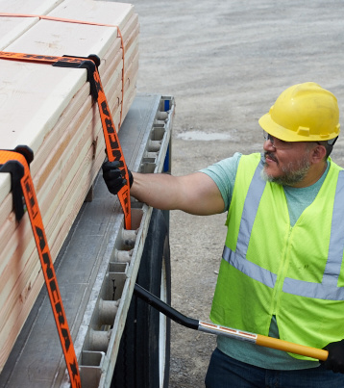
Some securement devices include:
  Tiedowns
  Ropes
  Straps
  Chains
Notes:
Securement Devices
Tiedowns. A tiedown is a combination of securing devices which forms an assembly that attaches articles of cargo to, or restrains articles of cargo on, a vehicle or trailer, and is attached to anchor points.
Cargo placed beside each other and secured by tiedowns must either:
Be placed in direct contact with each other, or
Be prevented from shifting towards each other while in transit
VIDEOS (see Trainer Tools USB)
21.1 — Tiedowns for Dry Van Trailers
21.2 — Tiedowns for Flatbed Trailers
The aggregate working load limit of tiedowns used to secure cargo against movement must be at least one-half times the weight of the article(s) secured. For example, the tiedowns used to secure cargo weighing 30,000 pounds would have to have an aggregate working load limit of 15,000 pounds. The aggregate working load limit is determined by adding together:
One-half of the working load limit of each tiedown that goes from an anchor point on the vehicle to an anchor point on an article of cargo
One-half the working load limit of each tiedown that is attached to an anchor point on the vehicle, passes through, over, or around the article of cargo, and is then attached to an anchor point on the same side of the vehicle
The full working load limit for each tiedown that goes from an anchor point on the vehicle, through, over, or around the article of cargo, and then attaches to another anchor point on the other side of the vehicle
Usually, the working load limit of a tiedown is marked on the device by the manufacturer. If it is not listed on the device, the tables in Sec. 393.108 must be used.
Section 393.110 of the FMCSRs specifies the minimum number of tiedowns that must be used.
One tiedown is required for cargo that is:
Five feet or less in length and
Weighs 1,100 pounds or less
Two tiedowns are required if the cargo is:
Five feet or less in length and
Weighs more than 1,100 pounds
If the object is longer than 5 feet, but shorter than 10 feet—no matter the weight—at least two tiedowns are required.
If the object is longer than 10 feet, two tiedowns are required—plus an additional tiedown for every additional 10 feet or part thereof.
If an individual article is blocked, braced, or immobilized to prevent movement in the forward direction by a headerboard, bulkhead, other articles which are adequately secured, or by an appropriate blocking or immobilization method, it must be secured by at least one tiedown for every ten feet of article length, or fraction thereof.
The kind of tiedown you choose will depend on the type of load you need to secure.
Ropes can be made from natural or synthetic fibers or wire. Fiber ropes are most often used to secure tarps or as an additional tiedown method for loads secured with straps. Alone, it’s simply not strong enough to secure heavier cargo. Although wire rope is very strong, it’s difficult to attach to an anchor point, which makes it an impractical choice.
Straps can be made of a web of synthetic material or a flat band of steel. Synthetic web straps are used in conjunction with a ratchet or winch-type assembly, which increases the tension and eliminates any slack in the strap. Web straps are appropriate for different sizes and weights of loads and are relatively easy to use.
Steel straps are most often used to secure boxes or crates to pallets, but it’s difficult to use as a tiedown because the driver has no way to adjust it if it loosens while en route. Load vibration can cause steel strapping to snap. It is also sharp on the edge which can damage lightweight packaging and pose a safety risk.
Chains used in the transportation industry are made of carbon steel, high tensile carbon steel, or a steel alloy. Chains are the most common type of tiedown used for securing flatbed loads because it is the strongest and most durable tiedown option there is.
When using tiedowns:
Always check the rated load limit of the tiedown to make sure it’s the proper strength for your load
Before using, check the tiedowns for signs of wear or weakness. Don’t use tiedowns that have been knotted or repaired.
Place the tiedowns flat on the load and secure them to the vehicle using hooks, bolts, rails, rings, or other approved devices. The tiedowns should be tight against the load, but not so excessively tight that they damage the load.
If the trailer you are using has rub rails, all tiedowns and other cargo securement components should be inboard of the rub rails whenever practical.
Edge protection must be used whenever a tiedown may be subject to damage (abrasion or cutting).
After use, store tiedowns in a clean, dry space.

Slide 9
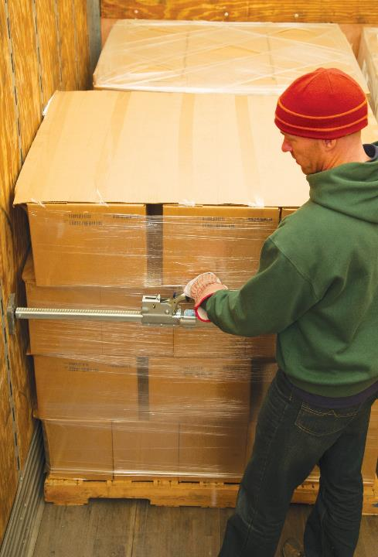
Other load securement devices include:
  Blocking
  Bracing
  Dunnage
  Friction mats
  Load bars
  Logistic straps
  Edge protection
  Tarps
Notes:
Blocking is a cargo securement procedure where you fit blocks snugly against the cargo’s front, back, or sides to prevent the cargo from sliding. Normally, blocking is secured to the cargo deck or sides with two-by-six or two-by-four blocks of wood. When using blocking, use new nails whenever possible, and pound them straight through the block (perpendicular to the deck) until the head contacts the block. At least one and a quarter inches of each nail should penetrate into the deck.
Any material used for blocking must be strong enough to withstand being split or crushed by the cargo or tiedowns. Seasoned hardwood that is free from decay, knots, and splits should be used when possible. The grain should run lengthwise, as well. Replace damaged or splintered deck boards when necessary.
VIDEOS (see Trainer Tools USB)
21.3 — Blocking
Bracing (putting pressure on a piece of cargo to keep it in place) is used to keep an article of cargo or an entire load from tipping by placing a structure, device, or another substantial article against it. Bracing may also prevent the load from shifting. The bracing you choose must be strong enough and tall enough to provide adequate securement.
VIDEOS (see Trainer Tools USB)
21.4 — Bracing
Dunnage is loose material inserted around or between articles of cargo used to aid in load securement. Types of dunnage often used include cardboard, wood, carpet, dunnage bags, or void filler.
A dunnage bag inflates to fill up an open space between two articles of cargo. Void filler, on the other hand, is material used to fill space between the cargo and the sides of the trailer.
VIDEOS (see Trainer Tools USB)
21.5 — Dunnage
Friction mats are placed between the floor and the cargo to help prevent movement during transit.
According to the FMCSA regulations, friction mats that are not marked or rated by the manufacturer are assumed to provide a resistance to horizontal movement equal to 50 percent of the cargo weight that is resting on the mat.
Usually, other forms of securement are used in conjunction with friction mats.
VIDEOS (see Trainer Tools USB)
21.6 — Friction Mats
Load bars can be used vertically or horizontally. The bars have rubber feet that are placed against the vehicle walls or ceiling and floor. The bars are placed snugly against the cargo and then tightened with a jacking device until they are tightly wedged in place against the cargo.
Load bars are normally placed across the rear of a load when the load doesn’t reach the back of the trailer and is often referred to as a “shoring bar,” a “cargo retainer bar,” or a “load locking bar.” When placed horizontally from wall to wall, a load bar prevents the cargo from shifting and tipping.
A logistic strap attaches to a trailer’s anchor points and is normally used across the rear of the cargo or to secure cargo to the side of the trailer.
VIDEOS (see Trainer Tools USB)
21.7 — Load Bars
Edge protection devices are placed on the exposed edge of an article to distribute tiedown forces over a larger area of cargo than the tiedown itself, to protect the tiedown and/or cargo from damage, and to allow the tiedown to slide freely when under tension.
Be sure to use edge protection when securement devices are placed against the exposed hard edge of a piece of cargo, otherwise the cargo may be damaged by those devices.
Edge protection prevents damage from occurring to both the device and the cargo and allows the securement device to move easily when tightened.
If you carry freight in an open cargo area, you may need to use a tarp. Tarps prevent loose material like sand, gravel, or salt from blowing or falling out of a vehicle. They can also be used to protect cargo from the weather. If you use a tarp, make sure it fully covers your load and is secured at all securing points. While traveling, check your mirrors frequently to make sure the tarp has not become loose, causing a hazard for you and/or others on the road.
VIDEOS (see Trainer Tools USB)
21.8 — Edge Protection

Slide 10
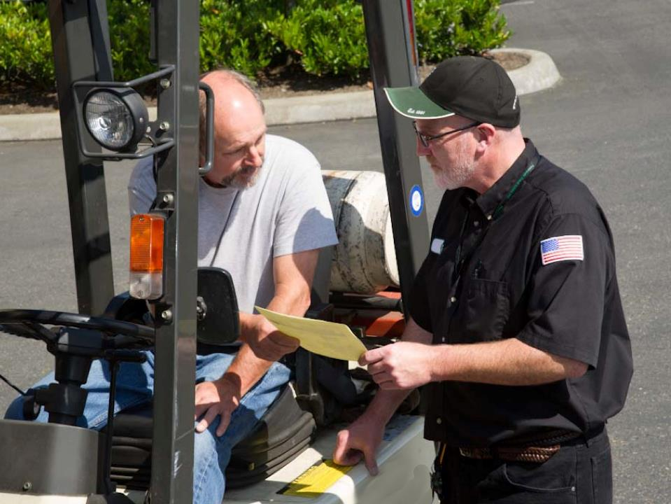
Cargo Securement Plan
Notes:
Cargo Securement Plan
A poorly-loaded or overloaded trailer can make your vehicle hard to handle and could contribute to an accident. Plus, an improperly-loaded or overloaded trailer can cause excessive wear and tear and decreased fuel efficiency.
Before loading begins, you’ll want to review the shipping information to determine the type of load you’ll be hauling and the weight and dimensions of that load. This will enable you to develop a plan for how the weight will be distributed in the trailer and what types of securement you will need to use.
Keep in mind, there are maximum permissible axle weights allowed per the regulations. Generally these weights are 20,000 pounds on a single axle, 34,000 pounds on a tandem axle, and 80,000 pounds for the maximum gross vehicle weight (GVW).
In addition, you’ll need to know the tire load—the maximum safe weight a tire can carry at a specified pressure. This rating is usually stated on the side of the tire. Coupling devices are also rated (coupling device capacity) for the maximum weight they can pull or carry.
When making a plan for cargo securement, you need to consider both the weight and placement of the cargo to be sure that weight is distributed equally throughout the trailer. Be sure to review and understand your company’s scaling procedures, and do not hesitate to contact your dispatcher if you have any questions regarding the weight of your load.
CALLOUT: Each state has its own weight limitations. Be aware of the regulations for the states you travel through.

Slide 11
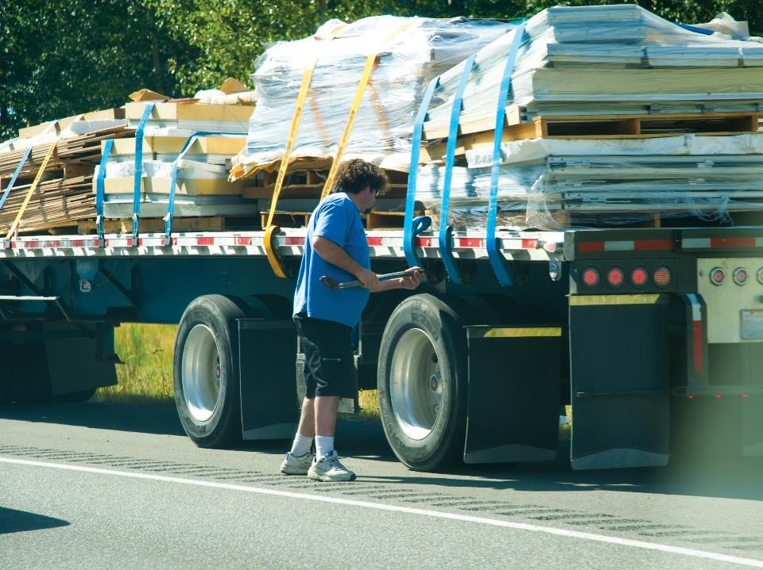
Principles of Weight Distribution
Notes:
Principles of Weight Distribution
As a professional driver, it is your responsibility to make sure your vehicle is loaded properly.
Overloading
Avoid overloading the trailer. Overloading a trailer is generally illegal and very unsafe. Overloading can:
Affect your vehicle's steering and handling
Increase braking (stopping) distance
Decrease the vehicle's turning ability
Cause excess wear and tear on your vehicle's brakes, suspension, steering
Cause you to incur a monetary fine
Keep in mind that in bad weather or when traveling through a mountainous area, it may not be safe to operate at the legal maximum weight. In addition, an overloaded truck moves slowly on upgrades and can gain too much speed on downgrades.

Slide 12
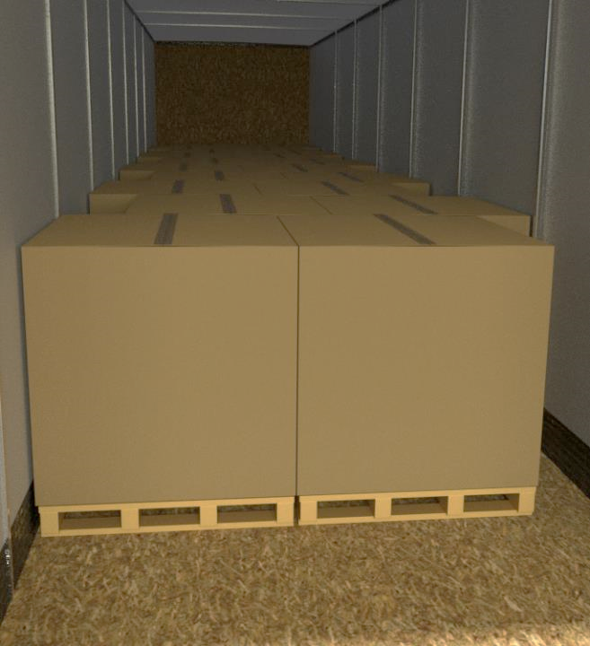
Total up the weight of all the cargo and distribute it over the floor of the trailer, front to back and side to side.
Notes:
Top-Heavy Loads
The height of a vehicle’s center of gravity is important for safe handling. A high center of gravity (heavy cargo on top or cargo piled too high) makes it easier for your vehicle to tip over. A high center of gravity is also dangerous when in a curve or when you have to swerve to avoid a hazard. Always keep the center of gravity as low as possible when placing your cargo. Load your vehicle so the heaviest cargo is on the bottom and the lightest on top. Also, distribute cargo so it’s as low as possible. If you have a partial load, distribute it evenly across the axles.
VIDEOS (see Trainer Tools USB)
21.9 — Top Heavy Loads
Weight Balance
Poor weight distribution can make vehicle handling unsafe. When you begin loading, distribute the weight as evenly as possible. Total up the weight of all the cargo and distribute it over the floor of the trailer, front to back and side to side.
Do not place the majority of the weight in any one area. You should know the manufacturer’s maximum load per square foot of the trailer floor. Cargo that’s too heavy may damage the deck.
Make sure you know the allowable individual axle weights to avoid exceeding their limits as well. If you have sliding rear tandems, placing them in the rear position puts the most weight on the tractor drive axle. If they’re in the forward position, the most weight will be put on the trailer.
Too much weight on a steering axle can cause hard steering and cause damage to the steering axle and tires. Under-loaded front axles (cargo weight is too far to the rear) can make the weight on the steering axle too light to steer safely. Too little weight on the driving axles can cause poor traction. The drive wheels may spin easily.
VIDEOS (see Trainer Tools USB)
21.10 — Weight Balance

Slide 13
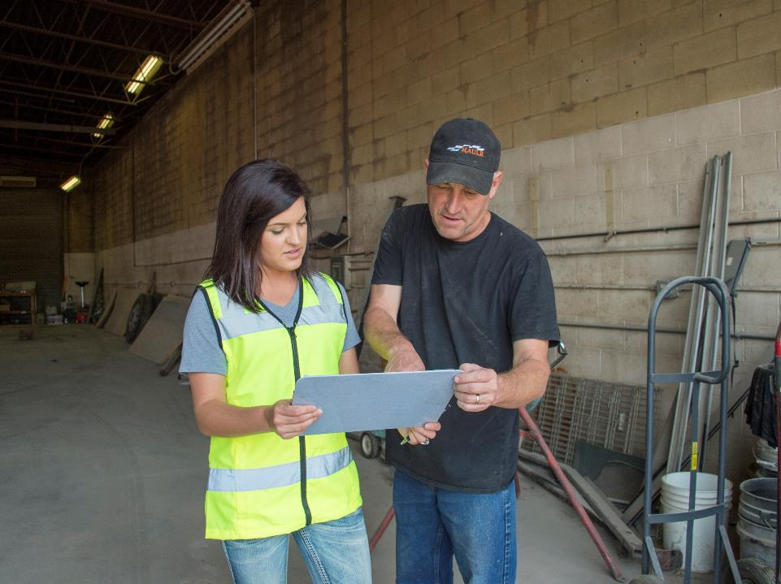
Safe Loading Responsibilities
Notes:
Safe Loading Responsibilities
You are also responsible for making sure your vehicle is loaded safely and legally. It must meet all cargo securement and weight distribution requirements.
In those instances where the shipper does the loading and you observe or supervise the loading process, keep safety in mind.
Avoid going near or under a suspended load
Stay on the same side of the trailer as the loading machine
Avoid standing between the load and the trailer
Remain within the loading machine operator’s view
Avoid standing in the loading machine’s intended path
Know what you are hauling and the amount you are hauling. Make sure the commodity and amount on your vehicle matches your bill of lading or shipping papers. Report any discrepancies to the shipper and document this on your bill of lading or shipping papers. If you have any questions about accepting the shipment, call your supervisor.
Also check and document the condition of the cargo. Do not allow any damaged, leaking, wet, or questionable cargo to be loaded on your trailer. Again, if you have any questions about accepting the shipment, call your supervisor.
CALLOUT: Resolve any cargo discrepancies before signing the bill of lading or shipping papers.

Slide 14
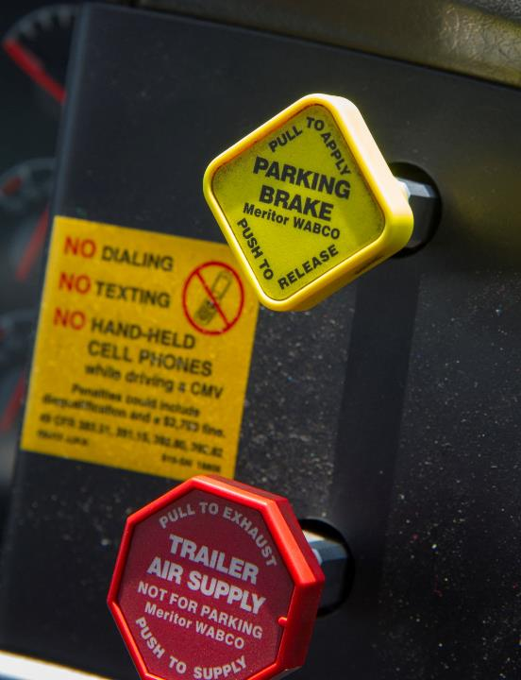
Certain procedures must be followed when loading and unloading hazardous materials.
Notes:
Loading & Unloading Hazardous Materials
There are certain procedures that must be followed when loading and unloading hazardous materials from your vehicle. These procedures, as set out in the regulations, are intended to protect you and others around your vehicle during the loading and unloading process.
Set parking brake. During the loading and unloading of any hazardous materials, the vehicle’s parking brake must be set, and all precautions taken to prevent movement of the vehicle.
Tools. Any tools used in loading or unloading hazardous materials must be used with care so as not to damage closures on packages or containers, or to harm packages.
No smoking. Smoking on or near any vehicle while loading or unloading any Class 1 (explosives), Class 3 (flammable and combustible liquid), Class 4 (flammable solid), Class 5 (oxidizer), or Division 2.1 (flammable gas) is forbidden. Care should be taken to keep all fire sources (matches and smoking materials in particular) away from any vehicle hauling these materials.
Securing packages. Packages containing any hazardous materials not permanently attached to a vehicle must be secured against any movement, including shifting or movement between packages during normal transportation.
Placards. The Hazardous Materials Regulations (HMR) requires most vehicles hauling hazardous materials to be placarded. The shipper is responsible for providing the appropriate placards. You, the driver, are responsible for putting them correctly on your vehicle and maintaining them during transportation.
Segregation. The HMR contain segregation requirements that indicate which hazardous materials may not be loaded, transported, or stored together. Hazardous materials which are in packages that require labels, in a compartment within a multi-compartmented cargo tank, or in a portable tank loaded in a transport vehicle or freight container, are subject to the segregation requirements.
CLASSROOM RECOMMENDATION
Hazardous materials
The importance of safety and security when transporting hazardous materials cannot be overemphasized. Students may not transport hazardous materials early in their driving careers, but it is still important to make certain they recognize the hazards associated with the hazmat transportation process. Use visuals to help illustrate how the potential hazards are communicated.
LAB RECOMMENDATION
Hazardous materials
This lesson is intended to help the student understand the importance of safety and security during the hazardous materials transportation process.
Present an example of a hazmat shipping paper with the basic description of a hazardous material correctly filled out. Discuss selecting the proper placard, if required, and placement on the vehicle.
Open the driver’s door of the cab and discuss proper placement of the shipping papers, making sure they are within reach of the student driver.
Doing a walk around of the vehicle, go over the various precautions that must be taken when fueling, loading, and unloading. Conduct a tire check, as well.

Slide 15
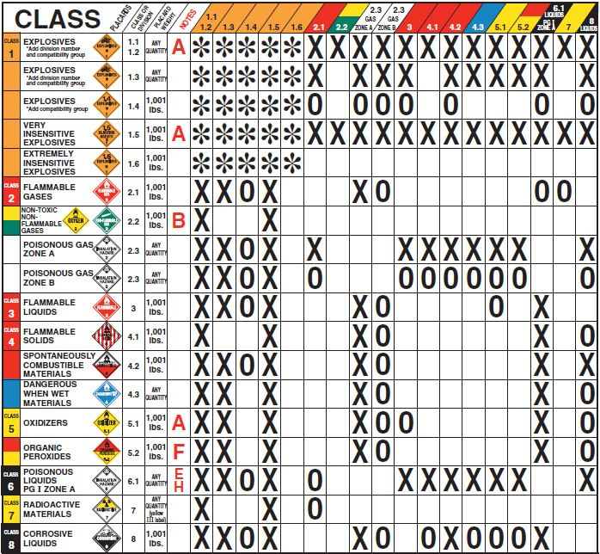
Hazardous Materials Table
Notes:
Hazardous materials may not be loaded, transported, or stored together, except as provided in the table on the next page. In addition to the following table, cyanides, cyanide mixtures or solutions may not be stored, loaded, and transported with acids if a mixture of the materials would generate hydrogen cyanide.
Also, Division 4.2 materials may not be stored, loaded, and transported with Class 8 liquids, and a Division 6.1 Packing Group I, Hazard Zone A material may not be stored, loaded, or transported with Class 3 material, Class 8 liquids, and Division 4.1, 4.2, 4.3, 5.1, or 5.2 material.
To use the table:
Locate the hazard classes or divisions of the materials you are loading—one in the vertical column, the other in the horizontal row.
Note: If the classes or divisions are not listed in the table, there are not restrictions.
Follow each to the location where they intersect.
The codes at the intersection are defined as follows:
Code - Meaning
Blank - The materials may be loaded or stored together.
X - The materials may not be loaded or stored together.
O - The materials may not be loaded or stored together unless separated so that — in the event of leakage — there will be no mixing of the materials. However, Class 8 liquids may not be loaded above or adjacent to Class 4 or Class 5 materials, except when it is known that the mixture of the contents would not cause a fire or a dangerous evolution of heat or gas.
* - Class 1 (explosive) materials must be segregated in accordance with the Compatibility Table for Class 1 materials. (See 49 CFR 177.848(f) of the HMR.)
A - Ammonium nitrate (UN1942) and ammonium nitrate fertilizer may be loaded or stored with Division 1.1 or 1.5 materials.

Slide 16
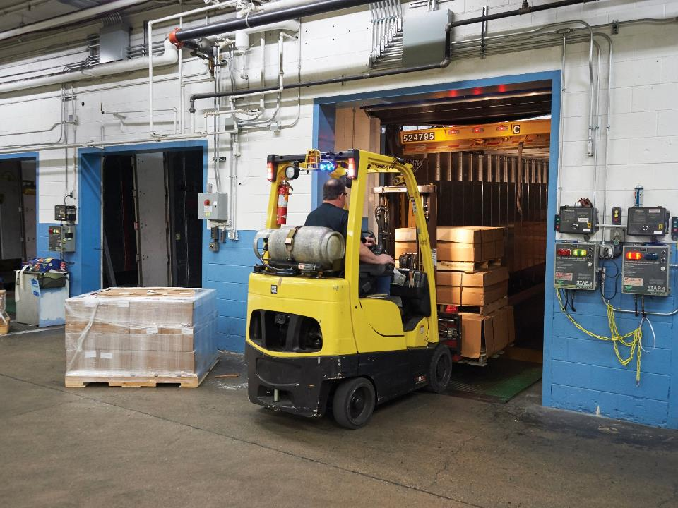
Loading/Unloading Tools
Notes:
Loading/Unloading Tools
When loading or unloading your vehicle, set the parking brake, turn off the vehicle, put the keys in your pocket, and chock the vehicle’s wheels. (You may not need to chock the vehicle’s wheels if loading/unloading from a dock equipped with a dock lock.) The following are just some of the tools you may use when loading or unloading the vehicle yourself.
Forklift
A forklift is a mechanical device used for moving materials. It is powered by an electric motor or internal combustion engine. A forklift may only be operated by an individual who has successfully completed a training program as mandated by the Occupational Safety and Health Administration (OSHA) under 29 CFR 1910.178.
CALLOUT: You must be trained and certified by your company to operate any powered equipment. Don’t operate equipment unless you are trained to use it.

Slide 17
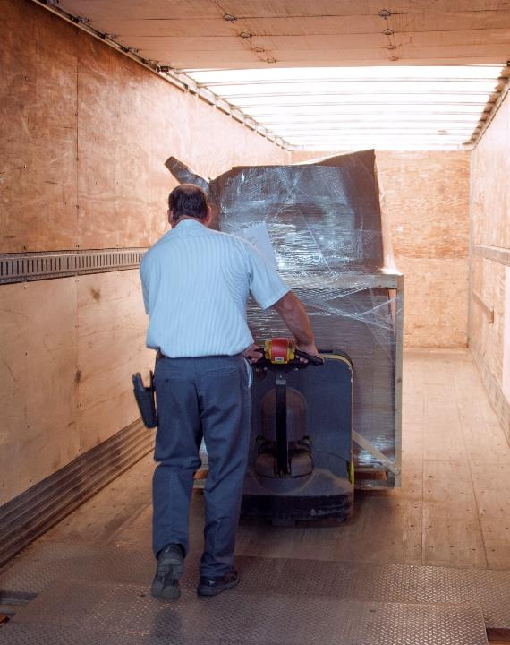
Hand pallet jacks are best for short distances and on low grades.
Notes:
Pallet Jacks
When you must move cargo on pallets, you may use a pallet jack. Pallet jacks move loads when forklifts may not be available, or space is too tight, such as on and off delivery trucks. They are designed for floor-level material handling on a hard, level surface.
Hand pallet jacks are best for short distances and on low grades.
Powered pallet jacks are useful for heavier loads or when you have to move cargo greater distances. A powered pallet jack may only be operated by an individual who has successfully completed a training program as mandated by OSHA under 29 CFR 1910.178.
Although relatively easy to use, pallet jacks must be used carefully. When using a pallet jack:
Always check the pallet jack for any defects that might affect its operation or safe use.
Make sure the items on the pallet are properly balanced and secured. Heavier items should be on the bottom with lighter ones on the top.
Position the forks well into the pallet before raising the load. If the load is too heavy, take some of the items off.

Slide 18
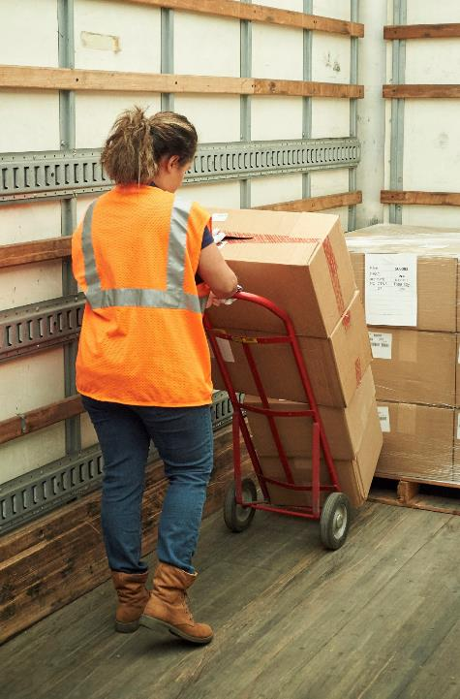
A dolly is a simple piece of equipment that will let you haul several items at one time or move heavier items with greater ease.
Notes:
Two-Wheel Dolly
A dolly is a simple piece of equipment that will let you haul several items at one time or move heavier items with greater ease. Although it’s a simple device, if not used carefully, it can crush toes, injure ankles, strain backs, and damage cargo.
To use a dolly properly:
Make sure the load is securely stacked and balanced. If so, tip the load forward slightly and push the “tongue” of the dolly completely under the load.
The load should not limit your view. If you cannot see above and around the items, split the load and make multiple trips.
Test the load by moving it a short distance. You want to be sure it can be moved without shifting or falling.
Once you’re certain you can move the load safely, check your path to make sure no people or obstacles are in your way.
Use your leg muscles to move the dolly. Keep your back straight and use one hand to steer and the other to balance the load.
Do not try to push the dolly too fast.
Make sure the floor is clean and flat before lowering the load.
When lowering the load, use your leg muscles, not your back, to set the load on the floor.

Slide 19
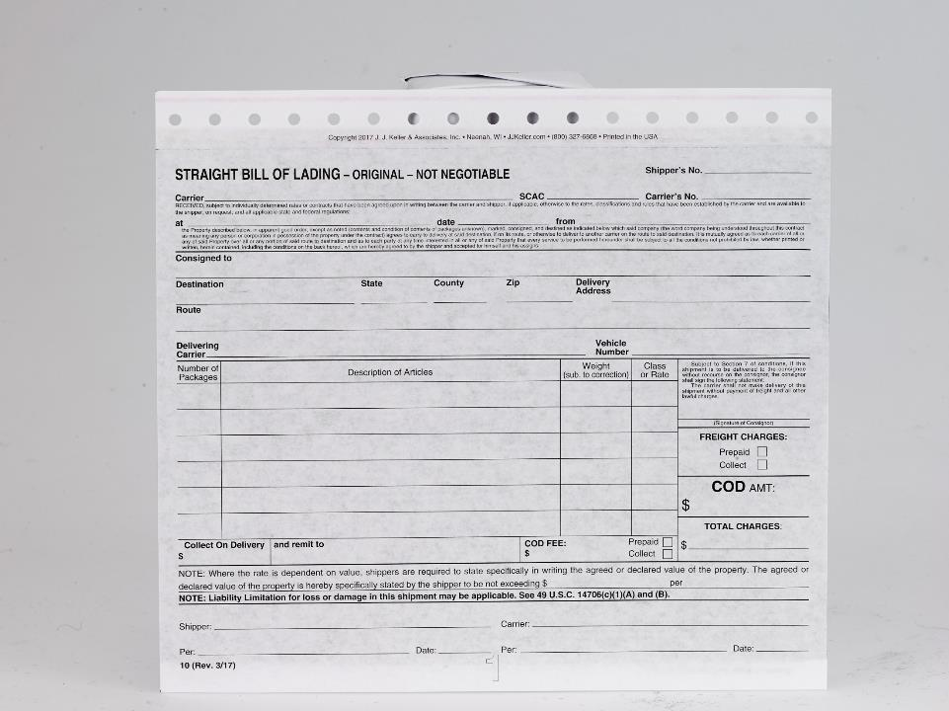
Bill of Lading
Notes:
Bill of Lading
The bill of lading is the document used in transactions between a shipper, otherwise known as the consignor, and common carrier. The front or face of the bill of lading is where the required information for transportation of the freight must be entered. The reverse side or back of the bill of lading usually contains the terms and conditions of carriage.
There are three distinct and important functions served by the bill of lading:
It is a receipt issued by the carrier to a shipper for goods received for transportation. The bill of lading states the place and date of shipment, describes the goods’ weight, dimensions, identification marks, condition, and sometimes the goods’ quality and value.
It is a contract naming the parties involved, specific rate or charge for transportation, and agreement and stipulations regarding the limitations of the carrier’s common law liability in the case of loss or injury to the goods.
It lists other obligations assumed by the parties or to matters agreed upon by them.
Certain bills of lading provide documentary evidence of title to the goods being transported. The “Order” or “Negotiable” bill of lading designates the receiver, otherwise known as the consignee, as the owner of the freight and the carrier may only deliver the cargo to the person in possession of the bill of lading. When a bill of lading is negotiated, the person to whom it is negotiated receives title to the cargo. Use of this bill of lading is very limited.
Bills of lading must be legibly written in ink, indelible pencil, or preferably, typed. It is important that all information be written or typed in the exact space provided for it.
The following information must be included on the bill of lading:
Name of consignor (shipper)
Name of consignee (receiver)
Address—Enter the street address of the consignee; post office boxes are not acceptable.
Destination—If there are two destinations of the same name within a state, insert the name of the county to indicate the correct destination clearly.
Date—Enter the exact date of delivery to the carrier.
Description of goods—The description should be complete and exact regarding quality and quantity.
Special marking and instructions—Special marks shown on the shipping units should be reproduced on the bill of lading. Special instructions (freezable, transit privileges, pick-up allowances, etc.) should be included.
Payment of freight charges—Bill of lading forms must indicate who is responsible for transportation charges. The charges may be “prepaid” or “collect.”
Section 7—The box on the face of the bill of lading referring to “Section 7 of conditions,” sometimes known as the “no recourse clause,” deals with the payment of freight charges. It is explained in Section 7 of the terms and conditions on the back of the bill of lading, and basically provides that the shipper/consignor is primarily responsible for payment of the freight and other lawful charges, unless the shipper stipulates in writing in the space provided, that the carrier makes delivery without requiring pre-payment.
Shippers who leave the Section 7 area blank, or unsigned, in effect are telling the carrier that if they do not, or are unable to collect the charges from the consignee, the carrier may return to the shipper (consignor) for payment of the freight charges, even though the terms for payment of freight charges on the bill of lading are collected on delivery.
Whether Section 7 is executed or not, this clause has a direct impact on the carrier’s ability to collect freight charges from the consignor when the charges are due and uncollectible from the consignee.

Slide 20
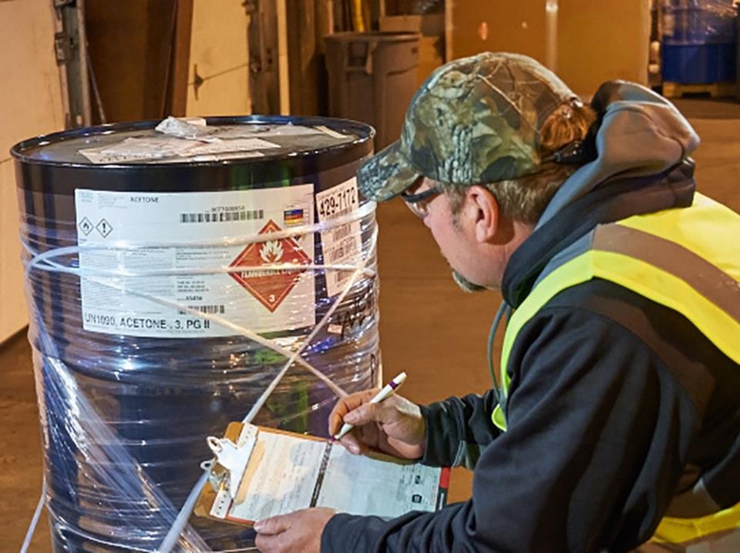
Shipping Papers for
Hazardous Materials
Notes:
Shipping Papers for Hazardous Materials
Hazardous materials are a substance/material determined and designated by the Secretary of Transportation to be capable of posing unreasonable risk to health, safety, and property when transported in commerce.
A hazardous materials shipping paper provides key information about the hazardous material being transported. Emergency responders use that information at the scene of an accident to determine what steps must be taken to keep damages to the lowest level possible. It is up to you, the driver, to make certain that information is correct, and the shipping papers are easily accessible.
CALLOUT: A hazardous materials endorsement is required on a driver’s commercial driver’s license (CDL) in order to haul placarded amounts of hazardous materials.
The HMR requires that a shipping paper have the basic description, for each hazardous material being transported. For domestic transportation, the basic description includes (in this order):
Identification number
Proper shipping name
Hazard class or division number
Subsidiary hazard class or division number entered in parentheses
Packing group, if any
The total quantity of the hazardous materials must be entered before and/or after the basic description. It must also include the appropriate unit of measure, which may be abbreviated. The number and type of packages must also be indicated.
In most cases, a numeric emergency response telephone number must be entered on the shipping paper. It can be immediately following the description of each hazardous material, or if the number applies to every hazardous material entered on the shipping paper, it can be entered once on the shipping paper in a clearly visible location.
Most hazardous material shipments must have emergency response information on, or with, the shipping papers. If the information is in association with the shipping paper, it may be in the form of the Emergency Response Guidebook (ERG), a Safety Data Sheet (SDS ), or any other form that provides all the information required by the HMR.
The following emergency response information is required:
Basic description and technical name of the hazardous material
Immediate hazards to health
Risks of fire or explosions
Immediate precautions to be taken
Immediate methods for handling fires
Initial methods for handling spills or leaks in the absence of fire
Preliminary first aid measures
This information must be on or kept with the shipping papers, away from the packages containing the hazardous material and, in a location immediately accessible in the event of an accident.

Slide 21
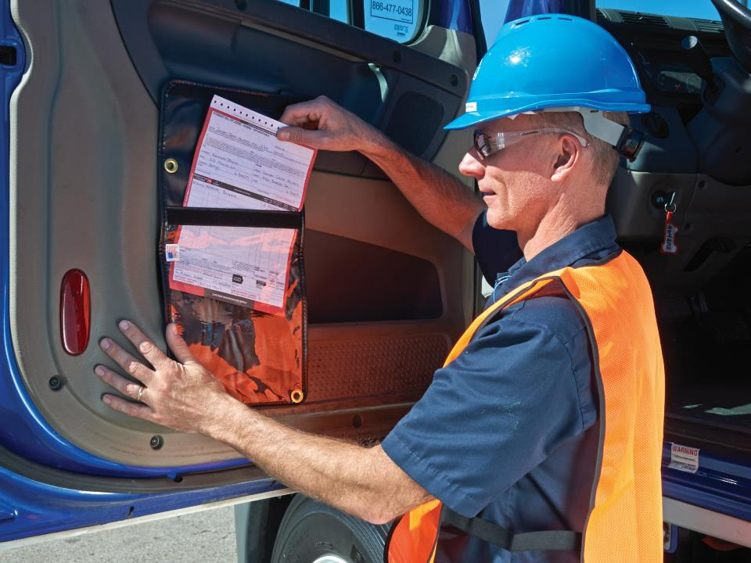
Shipping Paper Accessibility
Notes:
Shipping Paper Accessibility
Shipping papers must be readily accessible to authorities in the event of an accident or inspection. You must:
Clearly distinguish the hazardous materials shipping paper from other papers by tabbing it or having it appear first
Keep the shipping paper within immediate reach while at the vehicle controls and restrained by the lap belt, and visible to anyone entering the driver’s compartment or in a holder mounted to the inside of the driver’s door
Keep the shipping paper in a driver’s side door pouch or on the driver’s seat when you are not at the vehicle controls

Slide 22
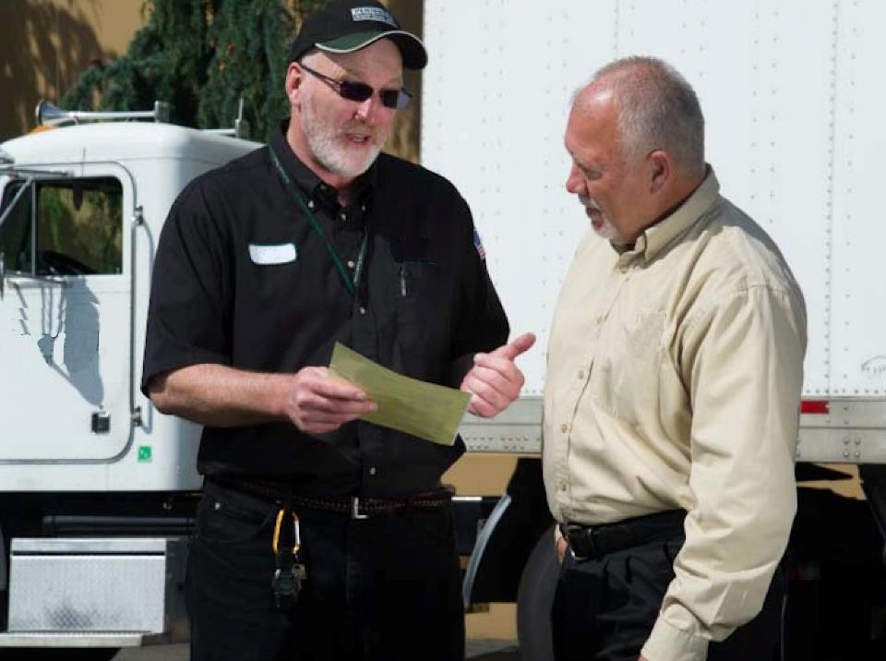
Pickup & Delivery Procedures
Notes:
Pickup and Delivery Procedures
As your motor carrier’s representative, you are responsible for the cargo you are transporting from the time it is loaded onto your vehicle until it is unloaded at the receiver. It is up to you to ensure the correct freight is delivered in a safe, complete, and legal manner.
Freight Pickup
By signing the bill of lading, you are stating that your company accepts the contract terms. Since you are acting as your company’s agent, your signature legally binds the company. It also means that you accept responsibility for the freight and that the actual freight matches the type and amount listed on the bill of lading.
Always count, inspect, and determine, in general, that the freight is properly described before signing the bill of lading. You should refuse or note in writing, on the bill of lading, if the freight is short, damaged, or poorly packed.
CALLOUT: Before signing the bill of lading, make sure the freight is properly described.
CLASSROOM RECOMMENDATION
Cargo documentation
It is important that you devote enough time to this subject. The professional driver must understand his or her responsibilities in the pick-up and delivery of freight. This protects the driver and well as his or her employer from experiencing unnecessary delays or costs.
The following are two different situations your students may face once on the road. Present and discuss each of these situations.
Situation 1
You arrive at the shipper to pick up a shipment of clothing. Reviewing the bill of lading, you find the number/type of cartons is not shown. What should you do?
Before loading, have the shipper record the correct number/type of cartons to be shipped on the bill of lading.
If you are not responsible for or allowed to perform the loading yourself, observe the loading procedure to verify the carton count.
Make sure the number and type of cartons loaded in your vehicle matches the number and type entered on the bill of lading.
Sign the bill of lading after you have loaded and verified the shipment count.
Situation 2
You arrive at a grocery store to deliver six cartons of canned soup. It is apparent that one of the boxes is damaged. What should you do?
Open the box so you can specifically describe any missing or damaged cans.
Photograph the damaged freight to clearly document the damage.
Note the damage on the paperwork.

Slide 23
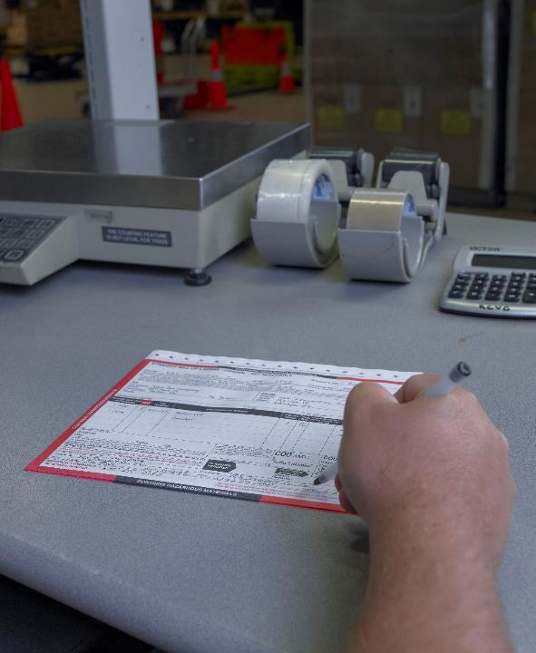
Remember, the freight is yours until the consignee signs for it.
Notes:
Freight Delivery
There are several things you need to keep in mind when delivering freight:
Make sure the delivery is made to the right person
Handle payment for merchandise correctly
Handle freight changes correctly
Get the proper signatures on the bill of lading (and freight bill if applicable)
Always follow your company’s policy dealing with short shipments, damages, or any other freight problems
If another party is unloading the freight, observe/supervise the unloading process (if possible). Remember, the freight is yours until the consignee signs for it.

Slide 24
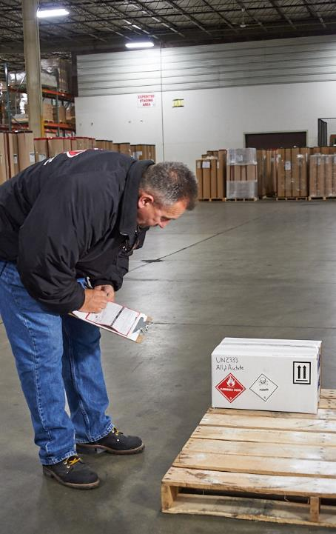
When dealing with a split shipment, be especially careful.
Notes:
Split Shipments
A split shipment is one in which cargo is picked up at more than one address. A receipted bill of lading must be furnished at each address. The bill of lading must also contain the address for each delivery.
When dealing with a split shipment, be especially careful. Check each piece against the bill of lading and/or freight bill very carefully, making sure the correct freight is delivered to the correct address.
Interline Freight
Interline freight is freight picked up from or delivered to another carrier. Use the same care when dealing with interline freight as you would when dealing with any other consignor or consignee.
Check for cargo shortage or damage before signing the connecting carrier’s bill of lading or freight bill
Don’t sign the bill of lading or freight bill if the connecting carrier refuses to acknowledge things such as shortages or damages
If equipment interchange is involved (leaving your trailer and/or hooking up a trailer belonging to another company), inspect the trailer and its contents before signing for possession
Always check with your company for instructions

Slide 25
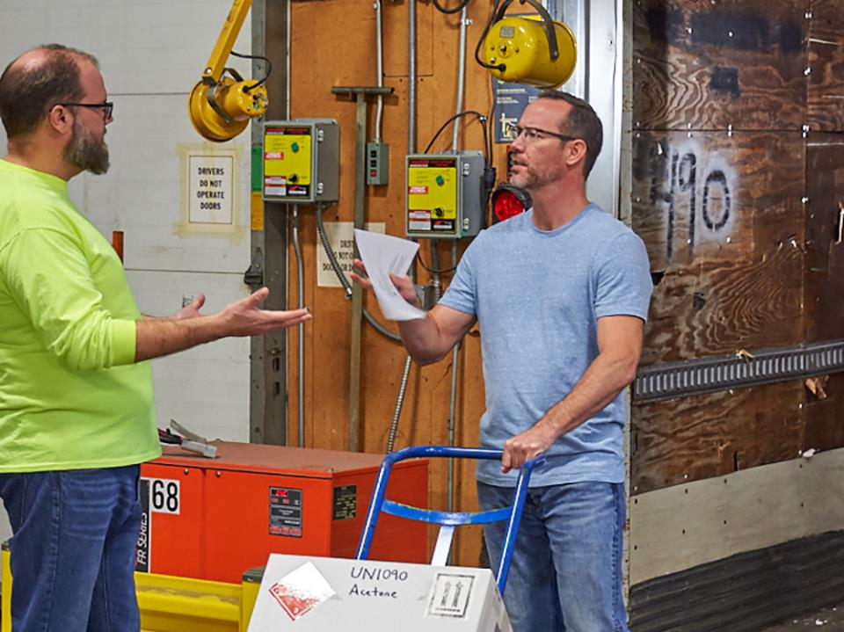
Cargo Theft
Notes:
Cargo Theft
Each year, thousands of drivers are injured, and millions of dollars are lost in thefts and robberies. There are some simple safety and security procedures that you can follow to help keep you and your cargo safe while on the road.
CALLOUT: Cargo theft usually starts at the dock when a driver is “intentionally” shorted product, so make sure this doesn’t happen to you.
When you accept the load it becomes your responsibility, so you need to raise any concerns or issues before it’s too late.

Slide 26
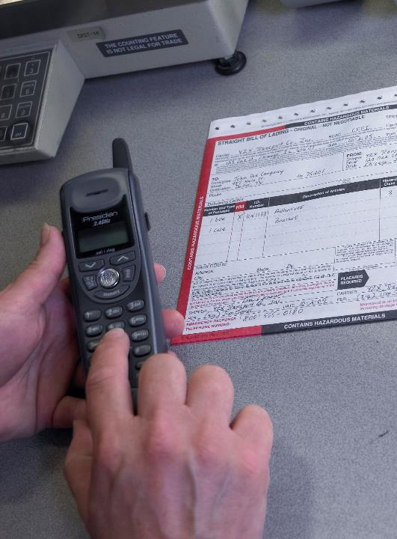
Communication between the carrier and shipper is the first step in ensuring the safety of you and your vehicle.
Notes:
Communicating in Advance
Communication between the carrier and shipper is the first step in ensuring the safety of you and your vehicle.
All involved should be aware of who is picking up a given load. This includes the carrier and shipper knowing the:
Name of the driver
Carrier assigned vehicle number
Carrier assigned trailer number (if applicable)

Slide 27

When you arrive at the shipper, be prepared to show photo identification.
Notes:
The Shipper
When you arrive at the shipper, be prepared to show photo identification. The shipper may also ask you for the name of the receiver and the destination of the materials before releasing the shipment.
When it comes to loading the vehicle, you should:
Supervise the process (if you are not loading the vehicle)
Only accept scheduled cargo and never accept an unauthorized or unscheduled box, carton, or package
Always consider requests to load unauthorized or unscheduled freight as highly suspicious and contact your carrier if you are asked to load unauthorized or unscheduled freight
Load the most valuable cargo in the nose of the trailer and as far away from the doors as possible
Make sure all cargo being loaded is free of visual damage
Thoroughly review and verify all load-related documents
Report and resolve any discrepancies on load-related documents before signing the paperwork or sealing the trailer
Once the vehicle is loaded, secure the trailer doors with a heavy-duty padlock and/or trailer seal.

Slide 28
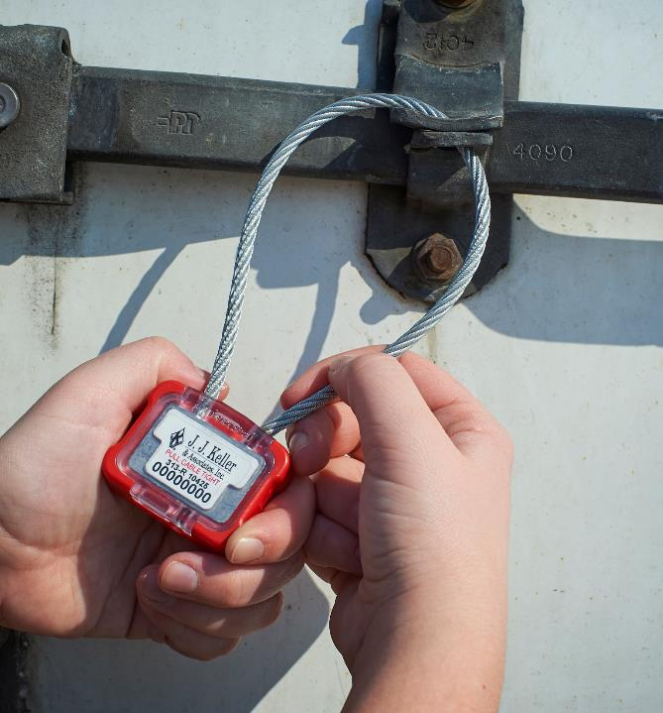
Trailer seals are often used to deter theft and maintain cargo security.
Notes:
Trailer Seals
Trailer seals are often used to deter theft and maintain cargo security. Typically, trailer seals fall into two categories, indicative seals and barrier seals.
Indicative seals. Indicative seals are manufactured for one time use and are typically made of plastic, wire, or thin strips of sheet metal marked with a serial number or an identifier. The seal is slipped through a hasp or around locking bars or handles.
They can be broken by hand or with the aid of simple tools and are not strong enough to prevent intrusion. Plastic strip seals and metal strip seals are examples of indicative seals.
Barrier seals. Barrier seals are designed to prevent intrusion and are typically made out of metal or metal cable. They often require bolt cutters or cable cutters for removal.
Examples of barrier seals include high security cables, locking bars, and padlocks.
When sealing the trailer, make sure you record the seal number(s) on the bill of lading or other designated shipping document.

Slide 29
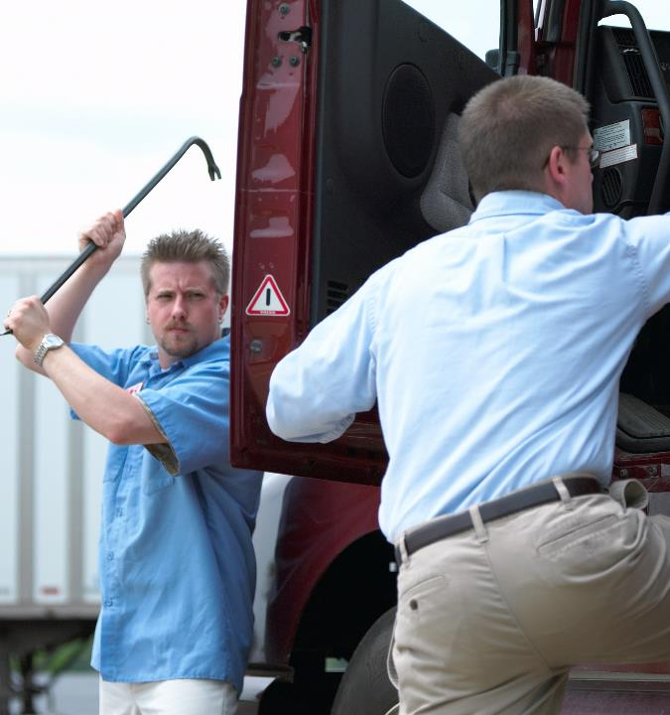
Many cargo thefts occur within a few miles of the load’s origin.
Notes:
On the Road
Many cargo thefts and hijackings occur within a few miles of a load’s origin. Because of this, you should:
Be on alert when leaving a shipper
Keep all doors locked and windows rolled up until on the road
Pay extra attention when near prime vehicle hijack areas including signal-regulated highways, railroad crossings, on ramps, and off ramps
If you suspect that you are being followed, immediately contact law enforcement and your motor carrier.

Slide 30
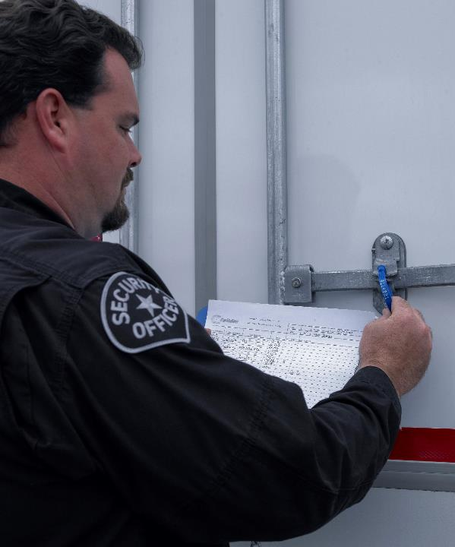
You and the
receiver should:
  Match the paperwork
  Inspect the seals
  Break the seals
  Unload
  Sign paperwork
Notes:
At the Receiver
When arriving at the receiver, you may be asked for identification as well as the bill of lading or shipping papers. When unloading the trailer, you and the receiver should:
Match the bill of lading or other load-related numbers and paperwork
Inspect the seal(s) and match the number(s) with corresponding documentation
Break the seal(s)
Unload the shipment
Sign the bill of lading or other load-related paperwork
Supervise the unloading process and report any discrepancies to your motor carrier as soon as possible.

Slide 31
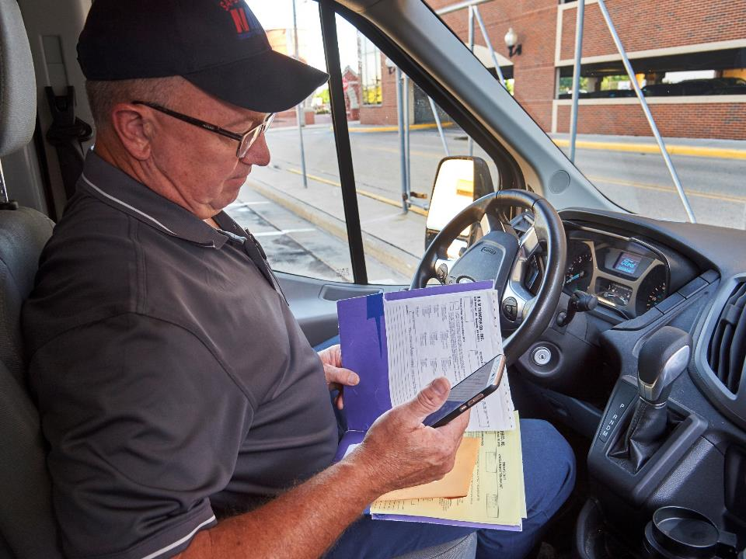
In-Transit Security Tips
Notes:
In-Transit Security Tips
The security protocols that most employers have set up were created for a reason — your safety. They cannot be ignored or viewed as an inconvenience. To do so will put you and your vehicle at risk.
The following are just a few security best practices that you as a driver may be called upon to abide by.
Communications
Many motor carriers require drivers to maintain regular communication either by phone or satellite communication system. While checking in, call from a private location to avoid anyone from overhearing your conversation.
In addition, avoid posting to social media when out on the road, as some social media sites grab your current location directly from your phone or tablet.

Slide 32
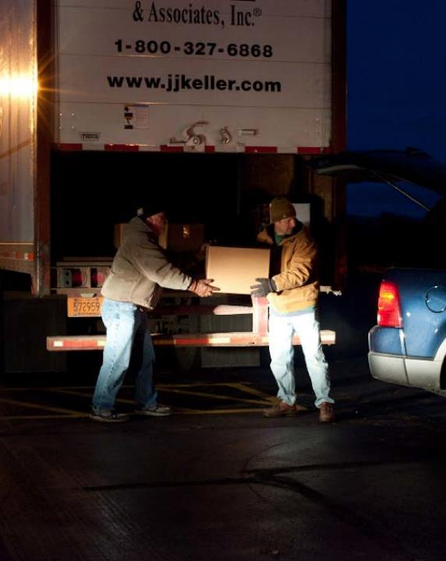
If possible, back the trailer against a wall, fence, or other closed trailer, for added security.
Notes:
Resting and Parking
Stop at only reputable truck stops or high-traffic rest areas. Open parking spaces in truck stops may be limited, but if you can, park in well-lit areas, near the door, or near security cameras. If given the choice, you never want to park in the back or far away from the truck stop entrance and walk to the front (especially at night).
When possible, the trailer should be backed against a wall, fence, or other closed trailer, for added security to the load.
When at truck stops, restaurants, or motels, the load should be parked so that you have a clear view of the vehicle. Trailer seals, pin locks, and other vehicle security devices should be used. Avoid stopping in dark or deserted areas while waiting to make deliveries. Always remember to lock your vehicle and keep the keys with you at all times.
CALLOUT: Apps can help you locate a parking spot when out on the road. While apps are great for letting you know if parking is available, they do not help you determine if the area is safe.
Talking to other drivers at your company is the best way to determine which locations and neighborhoods are safe to stop at and which should be avoided.

Slide 33

Work with your dispatcher to find a safe location to rest.
Notes:
Parking Shortages
Finding available parking is becoming more and more of a challenge for the professional driver. Parking on freeway interchange ramps or the shoulders of highways is illegal, and parking at abandoned locations is simply not safe. Use technology such as smart phone apps for guidance and talk over your options with your supervisor or dispatcher. Sometimes routine customers in the area will give you permission to stay parked overnight.
Work with your dispatcher or management when traveling to areas where parking is known to be in high demand. Together you can contact customers or other trucking companies in the area to arrange for a safe location to rest. Local authorities can also assist in finding public or privately-owned locations, such as well-lit shopping areas, that can provide drivers a safe place to spend the night when no other options are available.
VIDEOS (see Trainer Tools USB)
21.11 — Parking Shortages

Slide 34
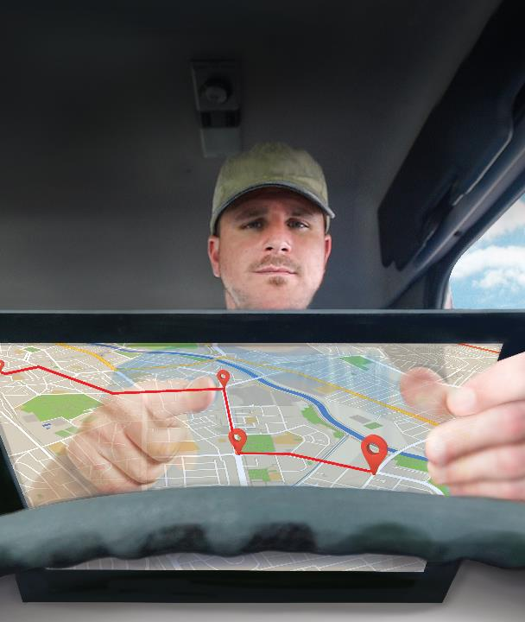
A well-thought-out trip plan can be a security tool of its own.
Notes:
Strangers Asking You to Stop
Anyone asking you to stop should be viewed as suspicious. A frequent ploy used by hijackers is to create a scenario that forces or compels a driver to stop. If someone tries to hijack or break into your truck, always assume the criminal is armed and dangerous. Do not try to be a hero. Call the police immediately for help.
Routes
A well-thought-out trip plan can be a security tool of its own. The best trip plan will involve driving directly to the destination without stopping, if possible, or with the least amount of stops or breaks needed. Take the time to map out two to three safe locations for every scheduled rest stop or refuel. As an added measure, make note of all safe locations along the route in case you need to stop sooner than you planned.
Never take a load home or to any unsecured or unauthorized parking area. Don’t discuss your load or destination with anyone other than your dispatcher. And, never ask for directions on the CB. You just don’t know who you are talking to and they may be directing you right into trouble.

Slide 35
Objectives Review
You should now be able to:
  Recognize cargo securement devices
  Explain how to evenly distribute your cargo
  Identify how to safely load and unload your vehicle
  Recall the functions served by, and information included on, a bill of lading
  Summarize pickup and delivery procedures
  Practice cargo theft prevention measures
Copyright 2019 J. J. Keller & Associates, Inc.
Notes:
You should now be able to:
Recognize cargo securement devices
Explain how to evenly distribute your cargo
Identify how to safely load and unload your vehicle
Recall the functions served by, and information included on, a bill of lading
Summarize pickup and delivery procedures
Practice cargo theft prevention measures
CLASSROOM RECOMMENDATION
Before concluding your training session, have participants take the corresponding quiz (found on the Trainer Tools USB) to check their understanding of the material. You can customize any of the questions to fit your audience or workplace. The answer key can also be found on the Trainer Tools USB.
You may also choose to administer the quizzes before you begin your training session to help get participants thinking about the subject and/or to gauge their understanding of the topic ahead of time.

