Slide 1






PowerPoint® Instructions
This PowerPoint has been designed so you can easily customize it for your training session.
Throughout the presentation you’ll see icons with recommendations or videos to enhance the instruction you present to your students. A detailed explanation for each icon can be found on the next slide. Videos can be found on the Trainer Tools USB.
When you see an icon on the slide, look in the notes
section for further information.
Simply delete or move the icon off the slide before your training session begins.

Slide 2





Classroom Recommendations. Provides suggestions for enhancing your classroom presentation; from ideas for large group discussions to suggestions on the use of training aids such as examples or photos of vehicle parts and components to help illustrate the items covered within a chapter.
Lab Recommendations. Provides suggestions for activities and exercises that take place outside the classroom, but do not involve
the actual operation of the tractor-trailer or its components. Examples
of lab sessions include conducting a vehicle inspection or practicing mirror adjustment.
Range Recommendations. These recommended activities take
place on a closed-access driving range where students may practice driving skills in a controlled environment. Examples of range sessions include practicing shifting technique and successfully completing a backing maneuver.
Road Recommendations. These recommended activities take place in road and traffic conditions that support the chapter’s objectives. Examples of road sessions include proper communication with other drivers through the use of turn signals and basic vehicle control under nighttime or extreme weather conditions.
Videos. These short video clips reinforce material presented in the Student Manual. Use them to help students grasp difficult concepts or subject matter.

Slide 3

Shifting/Operating Transmissions
5
Copyright 2019 J. J. Keller & Associates, Inc.
Notes:
Unit A1.1.5 Shifting/Operating Transmissions
This unit must introduce shifting patterns and procedures to driver-trainees to prepare them to safely and competently perform basic shifting maneuvers. This unit must include training driver-trainees to execute up and down shifting techniques on multi-speed dual range transmissions, if appropriate. The training providers must teach the importance of increased vehicle control and improved fuel economy achieved by utilizing proper shifting techniques.

Slide 4
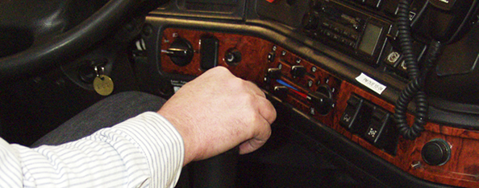
Introduction
We’ll address the knowledge and skills needed to shift safely and efficiently
Notes:
Shifting gears is one of the more difficult skills you will learn as you work toward becoming a professional driver. Mastering this skill takes coordination, patience, and practice. This chapter will address the knowledge and skills needed to shift safely and efficiently.
CLASSROOM RECOMMENDATION
Classroom presentation should focus on types of transmissions, shift patterns, how to shift, and the importance of proper shifting. Visuals can help in illustrating a variety of transmissions and shift patterns, including those used by your training program.

Slide 5
Objectives
Upon completion of this lesson, you will be able to:
  Discuss the key controls and tools available to help properly shift a manual transmission
  Identify the basic shift patterns and procedures of a manual transmission
  Describe how proper shifting techniques increase vehicle control and improve fuel economy
  Explain the characteristics of automatic, semiautomatic, and autoshift transmissions
Notes:
Upon completion of this lesson, you will be able to:
Discuss the key controls and tools available to help properly shift a manual transmission
Identify the basic shift patterns and procedures of a manual transmission
Describe how proper shifting techniques increase vehicle control and improve fuel economy
Explain the characteristics of automatic, semiautomatic, and autoshift transmissions

Slide 6
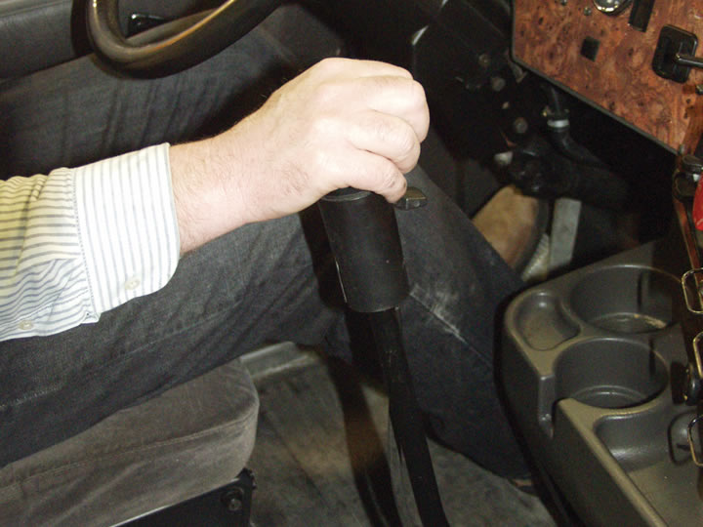
Key Elements of Shifting
Notes:
Correct shifting technique is important. It allows you to maintain control of the vehicle and operate the vehicle efficiently.

Slide 7
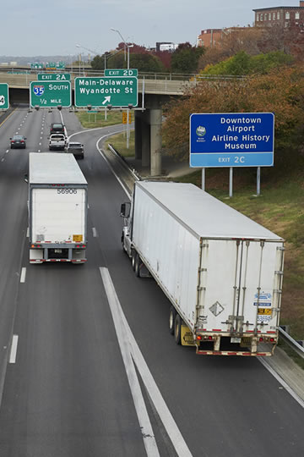
Most tractor-trailers have anywhere from seven to 18 gears.
Each gear provides the proper amount of engine power to the wheels at a specific speed, allowing the vehicle to get up
to speed.
Notes:
The number of gears, the operating revolutions per minute (RPM) range, and the maximum speed of each gear can vary, based on the type of transmission being operated.
Most tractor-trailers have anywhere from seven to 18 gears. Each gear provides the proper amount of engine power to the wheels at a specific speed, allowing the vehicle to get up to speed.

Slide 8
Gear | MPH
6 | 15
7 | 25
8 | 35
9 | 45
10 | 55
Notes:
Generally, shifting is done when the engine reaches about 1,200 to 1,800 RPMs depending on the gear and engine. The table at the right is a general guideline as to what gear you need to be in for the speed you are traveling when using a nine or ten‑speed transmission.

Slide 9
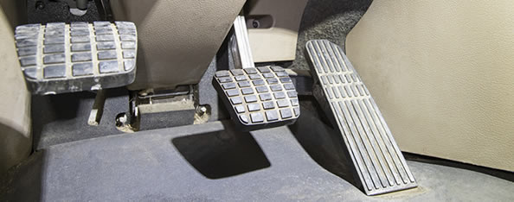
Shifting Controls
There are three controls used in shifting a manual transmission: the accelerator, shift lever, and clutch.
Notes:
There are three controls used in shifting a manual transmission: the accelerator, shift lever, and clutch.

Slide 10
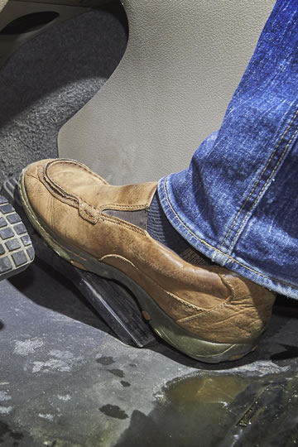
The accelerator controls the flow of fuel to the engine. That, in turn, determines the speed or RPMs of the engine in any one gear.
Notes:
Accelerator. The accelerator controls the flow of fuel to the engine. That, in turn, determines the speed or RPMs of the engine in any one gear.

Slide 11

The shift lever controls what gear the transmission is in. The gear selected determines the amount of power supplied by the engine which then transfers into
road speed.
Notes:
Shift lever. The shift lever controls what gear the transmission is in. The gear selected determines the amount of power supplied by the engine which then transfers into road speed.

Slide 12
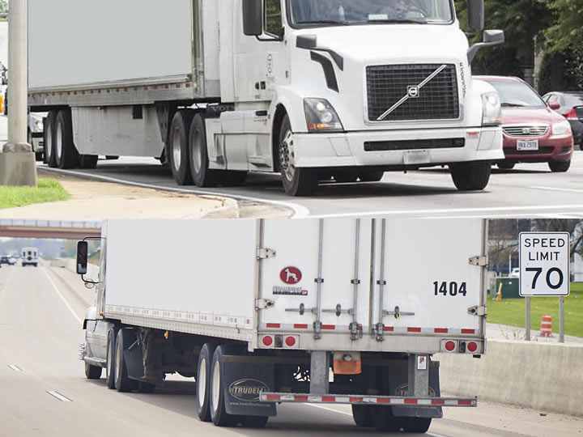
A low gear provides a great deal of power with little road speed.
A high gear provides less power, but much more road speed.
Notes:
A low gear provides a great deal of power with little road speed. Lower gears supply the power needed to build up momentum.
A high gear provides less power, but much more road speed. Higher gears allow the vehicle to obtain and maintain higher road speeds once momentum is developed.

Slide 13
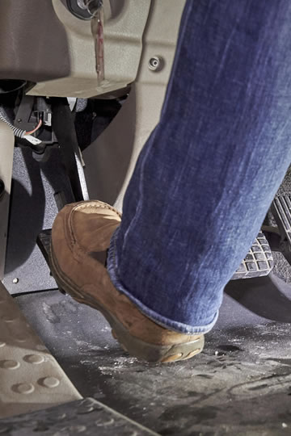
The clutch transfers power from the engine to the transmission.
Put simply, it allows you to shift gears.
Notes:
Clutch. The clutch transfers power from the engine to the transmission. Put simply, it allows you to shift gears.
When the clutch pedal is depressed (pressed down), it disengages the transmission from the engine, and gears may be safely shifted.
When the clutch pedal is fully released, the transmission and engine are engaged, and gears generally can’t be safely shifted.
Successful shifting takes coordination and precise timing. Improper timing or a lack of coordination can cause over revving of the engine and gear grinding. In addition to causing damage to the vehicle’s components, improper shifting can cause problems in controlling the vehicle.

Slide 14
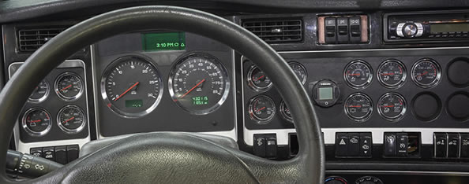
Safe Shifting Tools
The speedometer, tachometer, and governor are all necessary tools when it comes to safe shifting.
Notes:
The speedometer, tachometer, and governor are all necessary tools when it comes to safe shifting.

Slide 15
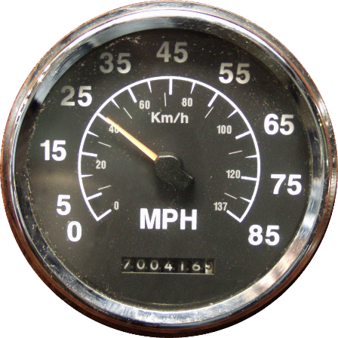
The speedometer displays the speed of a vehicle in miles per hour (mph) and/or kilometers per hour.
When your vehicle reaches the maximum speed for a gear, you must upshift. When your vehicle reaches the minimum speed for a gear, you must downshift.
Notes:
Speedometer. The speedometer displays the speed of a vehicle in miles per hour (mph) and/or kilometers per hour. For each gear, there is a range of road speed which corresponds (matches). This varies based on the type of vehicle you are operating. When your vehicle reaches the maximum speed for a gear, you must upshift. When your vehicle reaches the minimum speed for a gear, you must downshift.

Slide 16
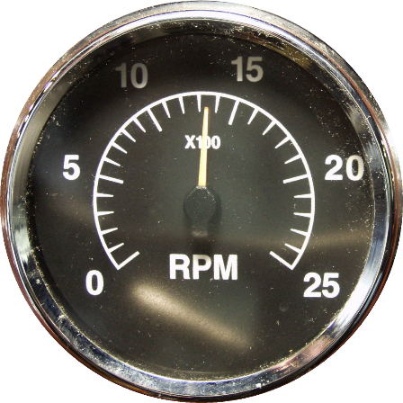
The tachometer displays engine speed in hundreds of RPMs.
When your vehicle reaches the maximum RPMs for a gear, you must upshift. When your vehicle reaches the minimum RPMs for a gear, you must downshift.
Notes:
Tachometer. The tachometer displays engine speed in hundreds of RPMs. It serves as a guide for shifting into the appropriate gear. When your vehicle reaches the maximum RPMs for a gear, you must upshift. When your vehicle reaches the minimum RPMs for a gear, you must downshift.

Slide 17
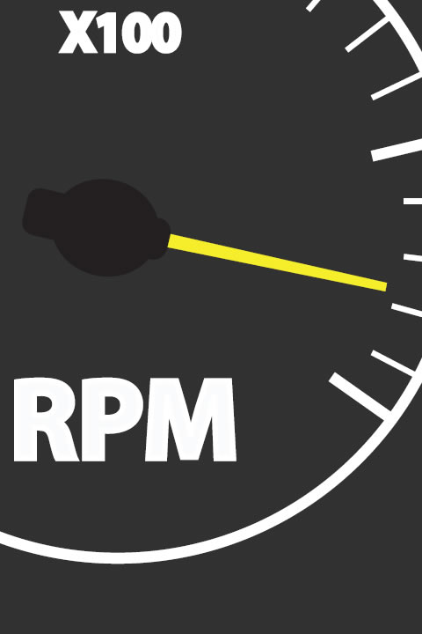
The governor prevents the engine from exceeding an RPM limit.
When going up through the gears, once the governed RPMs are reached, the only way to make the truck go faster is to shift to a higher gear.
Notes:
Governor. The governor (electronic or mechanical) prevents the engine from exceeding an RPM limit. When going up through the gears, once the governed RPMs are reached, the only way to make the truck go faster is to shift to a higher gear. When downshifting, the governor will limit how high the driver can rev the engine. This in turn determines when the transmission can be downshifted.

Slide 18
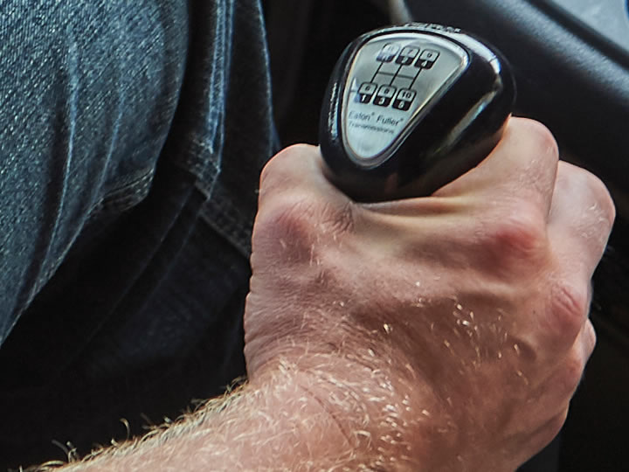
Shifting Gears
Notes:
Most heavy vehicles with manual transmissions require double clutching and RPM matching to change gears. When double clutching is done correctly, and the RPMs are matched during the shift, the gears do not grind. The following is the basic method when upshifting and downshifting.

Slide 19
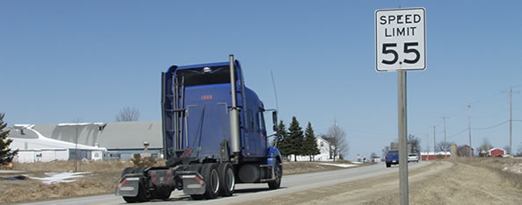
Upshifting
The purpose of upshifting is to allow a vehicle to increase speed.
Notes:
As mentioned earlier, low gears provide a great deal of power. This power is needed to get a stopped vehicle moving.
Select the highest gear possible that will allow the vehicle to move without slipping the clutch or lugging the engine. As vehicle speed increases, upshift to a higher gear to gain additional speed. The purpose of upshifting is to allow a vehicle to increase speed. Higher gears also keep RPMs low, and fuel mileage may increase with lower RPMs.

Slide 20
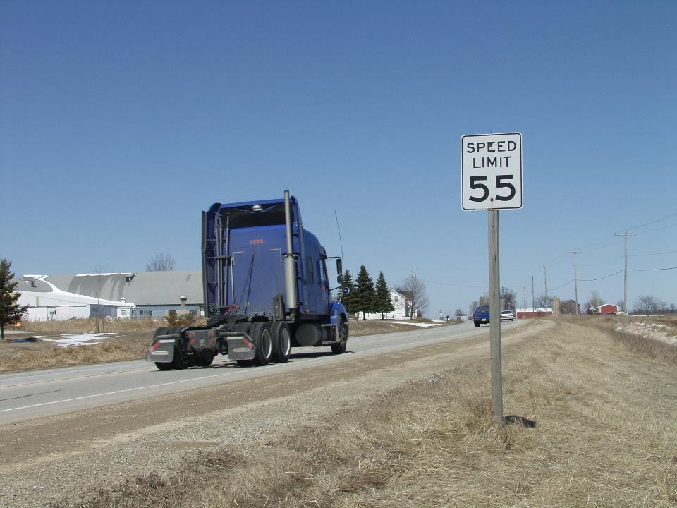
To upshift:
Release the accelerator, depress the clutch just far enough to disengage it, and shift to neutral at the same time.
Release the clutch.
Let the engine RPMs
drop the correct number
of RPMs required for the next gear.
Depress the clutch again and shift to the next higher gear at the same time.
Release the clutch and press the accelerator.
Notes:
To successfully upshift, follow these steps:
Release the accelerator, depress the clutch just far enough to disengage it (normally half-way to the floor), and shift to neutral at the same time.
Release the clutch.
Let the engine RPMs drop the correct number of RPMs (400 or 500 RPMs in most cases) required for the next gear.
Depress the clutch again and shift to the next higher gear at the same time.
Release the clutch and press the accelerator.

Slide 21
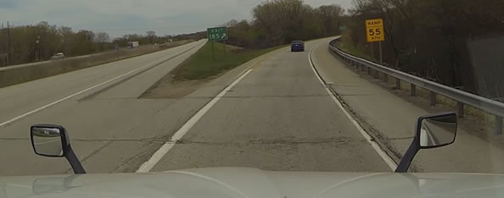
Downshifting
Downshifting aids in slowing a vehicle.
Notes:
Downshifting aids in slowing a vehicle. It acts as a braking force. Downshifting can also provide more power to the vehicle when needed. However, never downshift earlier than necessary. Early downshifting may make it impossible to get into the next lower gear as the governor will not let the engine rev high enough to complete the shift.

Slide 22
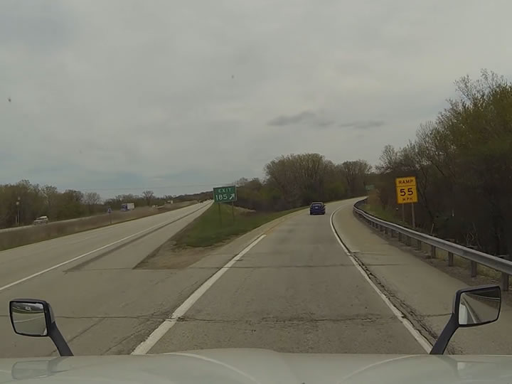
To downshift:
Check the tachometer & determine the target RPMs needed to complete the downshift.
Release the accelerator, depress the clutch, and shift to neutral at the same time.
Release the clutch.
Press the accelerator, increasing engine speed to reach the RPM required for the lower gear
Depress the clutch again and shift to the lower gear at the same time.
Release the clutch and press the accelerator.
Notes:
To successfully downshift, follow these steps:
Check the tachometer and determine the target RPMs needed to complete the downshift.
Release the accelerator, depress the clutch, and shift to neutral at the same time.
Release the clutch.
Press the accelerator, increasing engine speed to reach the RPM required for the lower gear (Normally 400 to 500 RPMs higher than the RPMs were at in the higher gear)
Depress the clutch again and shift to the lower gear at the same time.
Release the clutch and press the accelerator.
It is important to maintain correct engine speed when either upshifting or downshifting.
Consult the vehicle’s owner’s manual for the specific RPM change required to upshift and downshift. One rule (in absence of manufacturer’s recommendations) is when changing gears, change the RPM by about 500 RPM.
CALLOUT: When should you shift? Driving conditions and vehicle needs will determine when you will upshift or downshift.

Slide 23
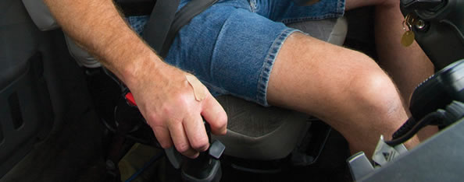
Hitting/Hunting a Gear
This skill is used when your vehicle is rolling, and you must get the transmission into the proper gear.
Notes:
There is a third shifting skill that is required when operating a vehicle with a manual transmission. Often called hitting a gear or hunting a gear, this skill is used when your vehicle is rolling, and you must get the transmission into the proper gear.
CALLOUT: “Catching a gear” is also a phrase commonly used for this shifting skill.

Slide 24
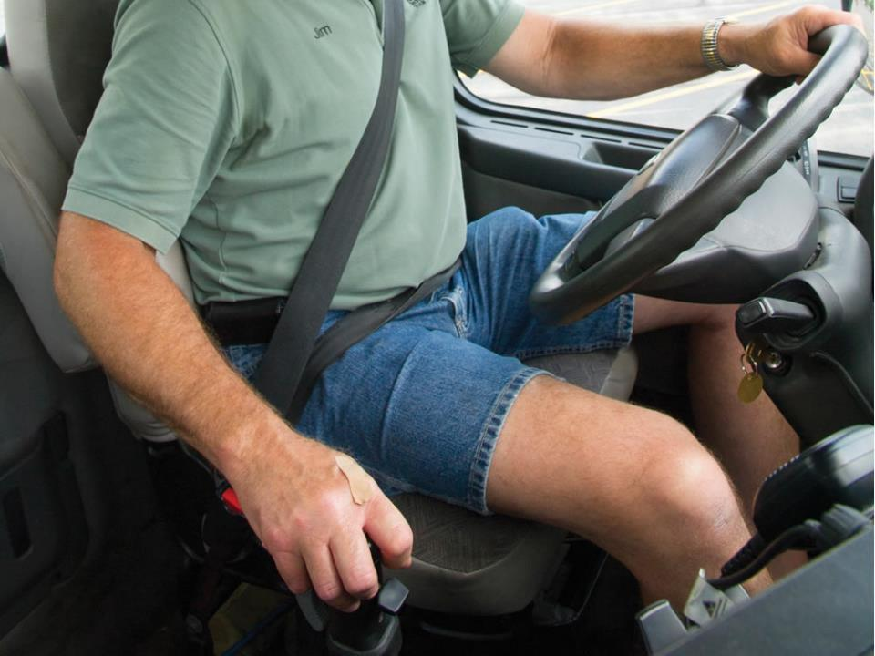
Follow these steps:
Think about how the engine should feel at that speed in that gear. For each speed, there’s a specific gear you should hunt for.
Rev the engine to the RPMs you think you need, for the gear you have decided would be appropriate, based on your mph then depress the clutch and push the shift lever lightly against the gear you think is the correct gear.
Continue this until the shift lever goes in without excessive grinding.
Notes:
When performing this skill, follow these steps:
Think about how the engine should feel at that speed in that gear. Experienced drivers also take into account the vehicle’s speed. For each speed, there’s a specific gear you should hunt for.
Rev the engine to the RPMs you think you need, for the gear you have decided would be appropriate, based on your mph then depress the clutch and push the shift lever lightly against the gear you think is the correct gear.
Continue this until the shift lever goes in without excessive grinding.
If this doesn’t work, move the shift lever and feel how changing the engine RPM changes the shift lever vibrations.
If the RPM is too high or way too low, you will hear a high-pitched grinding noise. If you are close to the right RPMs, but not matching exactly, you will hear a low pitched, slow grinding and the shifter vibrations will be larger and further apart. Once you reach the correct RPMs for your ground speed, the shift level will fall into gear. When this happens, depress the clutch and push the shift lever into place. Once you have done this, you can release the clutch and press the accelerator.

Slide 25

Good Shifting Skills
There is no exact science when it comes to the art of shifting.
Notes:
There is no exact science when it comes to the art of shifting. Experience may be the best aid in successfully performing this skill.
RANGE RECOMMENDATION
The purpose of this session is to develop the student’s shifting ability by practicing shifting technique. If you have tractors with several types of transmissions, introduce the student to each type of transmission and allow time for practice.
Divide your class into groups of three students per instructor. Each student should have at least 45 minutes to an hour behind the wheel with the instructor seated in the passenger seat. The other students may be in the cab if there’s a sleeper berth or back seat in the vehicle.
The student should drive a predetermined course, beginning in first gear, accelerating to second, then third. The student should then decelerate and downshift through first gear, stop the vehicle, and back into the original starting position.
Evaluate the student’s performance, noting errors in procedure or technique as they occur. Don’t forget to note student successes as well.
Student performance should be based on the following criteria:
Over revving
Tugging
Excessive rpm drops
Missed shifts

Slide 26
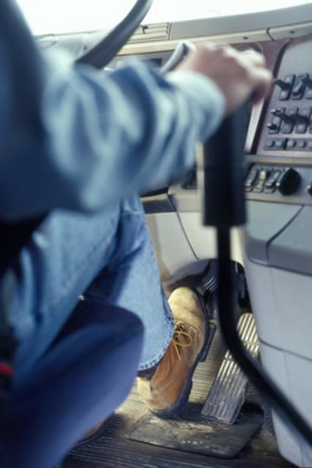
Good timing and coordination
Knowing what gear your vehicle is in at all times
Knowing what the top and bottom mph and RPM is for each gear on your vehicle
Notes:
Good shifting skills are the trademark of an accomplished, professional driver.
This includes:
Good timing and coordination
Knowing what gear your vehicle is in at all times
Knowing what the top and bottom mph and RPM is for each gear on your vehicle

Slide 27
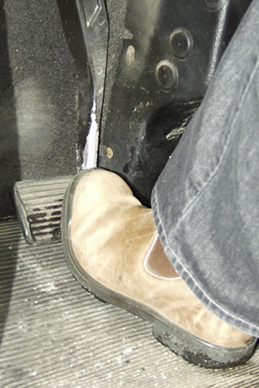
Making shifts without forcing, raking, or grinding gears
Never riding
the clutch
Always using the clutch when shifting
Notes:
Good shifting skills are the trademark of an accomplished, professional driver.
This includes:
Making shifts without forcing, raking, or grinding gears
Never riding the clutch
Always using the clutch when shifting

Slide 28
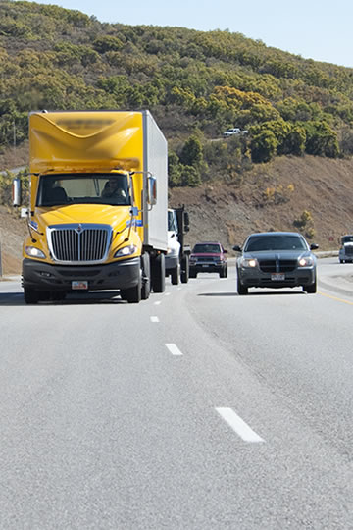
Always using the proper gear for best fuel economy
Anticipating changes in terrain and/or traffic
Never forcing the gear shift into gear
Notes:
Good shifting skills are the trademark of an accomplished, professional driver.
This includes:
Always using the proper gear for best fuel economy
Anticipating changes in terrain and/or traffic
Never forcing the gear shift into gear (you should be able to shift only using your fingers, not your entire hand and arm)

Slide 29
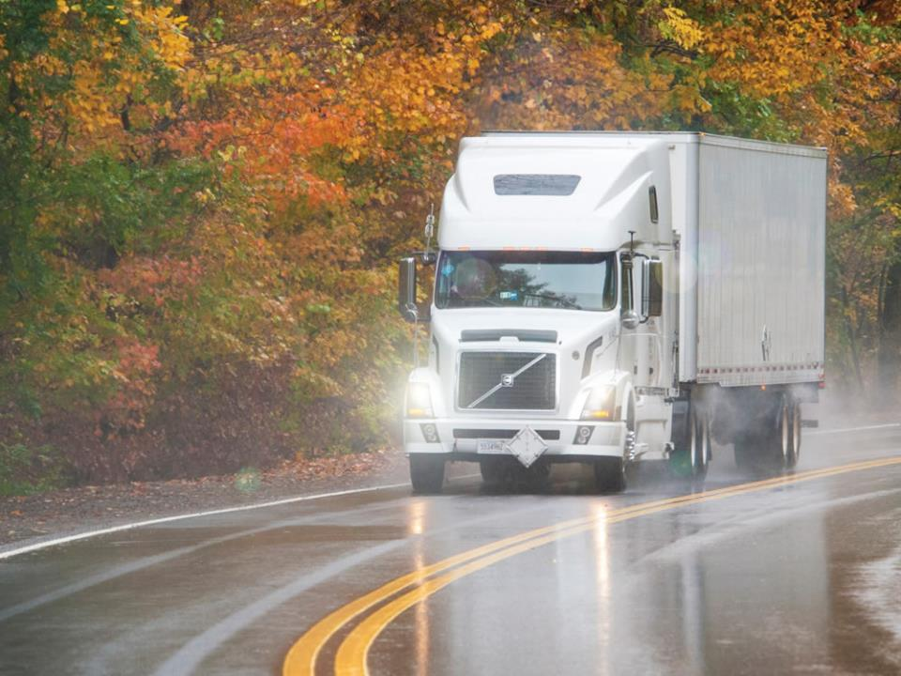
Using proper shifting technique can increase vehicle control and improve vehicle mileage/fuel economy.
When changing gears, you’re trying to get the gear you’re leaving and the gear you’re entering at approximately the same rotational speed inside the transmission.
Notes:
Using proper shifting technique can increase vehicle control and improve vehicle mileage/fuel economy. When changing gears, you’re trying to get the gear you’re leaving and the gear you’re entering at approximately the same rotational speed inside the transmission. This provides a smooth changeover. If you shift and the vehicle lurches or jerks suddenly, the gears’ RPMs aren’t matched, or you were slow engaging the clutch, causing the engine RPMs to have to jump up suddenly. These jolts can cause the drive wheels to lock momentarily. A curve or slippery surface could cause you to lose control of your vehicle.
Less than smooth shifting also puts strain on the engine and transmission:
Downshift too early and the engine screams as the RPMs jump upward, burning more fuel (if you can even complete the shift) due to the governor stopping the engine from revving high enough to catch the next lower gear
Being in too high a gear causes the motor to bog down and puts strain on your engine’s internal components (the explosion in the piston cylinder happens quickly and isn’t efficiently transferred to the transmission)

Slide 30
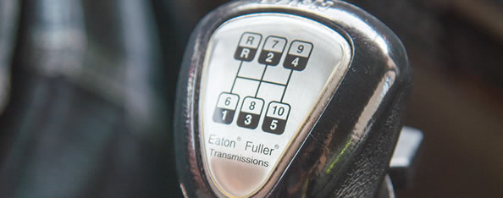
Shifting Patterns
Not all transmissions have the same shifting patterns.
Notes:
Not all transmissions have the same shifting patterns. This section will address some of the most common shift patterns currently being used.

Slide 31
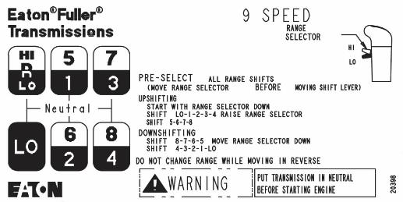
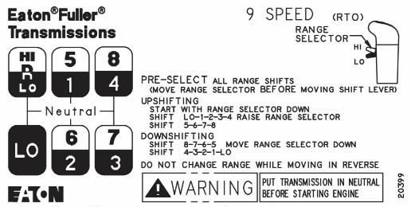
Eaton® Fuller® Nine Speed
Notes:
The Eaton® Fuller® Nine Speed transmission has a low range and high range of gears. The low range has five forward gears (low through fourth) and the high range has four gears (fifth through eighth). The range lever must be lifted or lowered to reach the high or low gears.
Upshifting—To successfully upshift, follow these steps:
Depress the clutch.
Make sure the range lever is in the low range (down).
Move the shift lever to first gear.
Double clutch when shifting to second through fourth gear.
Lift the range lever up before moving the gear lever to shift from fourth to fifth gear (as the shifter passes through neutral going from fourth to fifth (fifth will be where 1st gear was when the range control was down), the transmission will be shifted into high range)
Use normal double clutching when shifting from fifth through eighth gear.
Downshifting—To successfully downshift, follow these steps:
Use double clutching when shifting from eighth through fifth gear (make sure you are matching engine speed to road speed before shifting).
Push the range lever down before moving the gear lever to shift from fifth to fourth gear (as the shifter passes through neutral going from fifth to fourth (fourth is where eigth gear was when the range control was down), the transmission will be shifted into low range).
Use double clutching when shifting from fourth through first gear

Slide 32
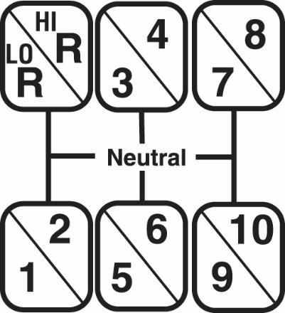
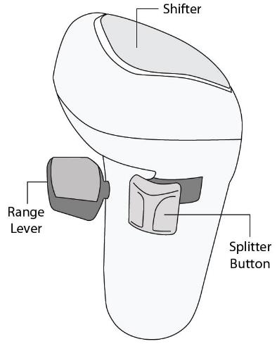
Eaton® Fuller® Super Ten
Notes:
The Eaton® Fuller® Super Ten transmission has five gear positions that are split. This cuts gear lever movement in half.
Upshifting—To successfully upshift, follow these steps:
When shifting from first to second, third to fourth, fifth to sixth, seventh to eighth, and ninth to tenth (splitter only shifts), simply move the splitter button forward, release the throttle, and allow the RPMs to drop 400 RPMs, and wait for the gear to engage.
When shifting from second to third, fourth to fifth, sixth to seventh, and eighth to ninth (requiring the shifter and the splitter to be moved):
Move the splitter button back
Release the throttle, depress the clutch, and move the shifter into neutral
Release the clutch
Once the RPMs have fallen 400 RPMs press the clutch and put the shifter into the next higher gear and re-engage the clutch while gently pressing the throttle
As the shifter moves through neutral, the splitter will shift from high to low.
Downshifting—To successfully downshift, follow these steps:
Splitter-only downshifts: Move the splitter button back, take your foot off the accelerator, wait for the gear to disengage, then gently accelerate the engine 400 RPMs to complete the downshift.
Downshifts where the shifter and splitter must be moved:
Move the splitter button forward, release the throttle, depress the clutch, and move the shifter into neutral
Release the clutch
Raise the engine speed 400 RPMs
Press the clutch and put the shifter into the lower higher gear and re‑engage the clutch while gently pressing the throttle
As the shifter moves through neutral, the splitter will shift form low to high.

Slide 33
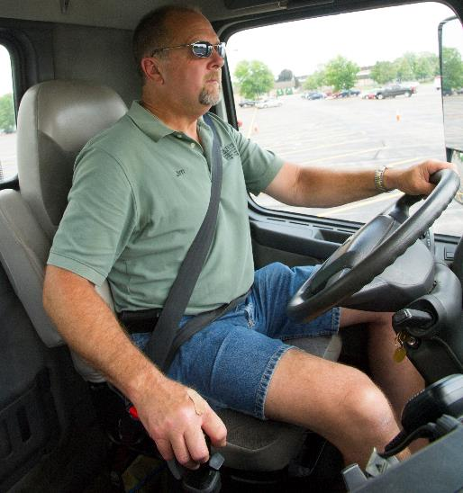
Rockwell Ten Speed
Notes:
The Rockwell Ten Speed transmission system has a low (first through fifth gear) and high (sixth through tenth gear) range of gears. A range control lever is used to reach the high range of gears.
Upshifting—To successfully upshift, follow these steps:
Depress the clutch.
Make sure the range lever is in the low range (down).
Move the shift lever to first gear (back left).
Double clutch when shifting through fifth gear.
Lift the range control lever up before moving the gear lever to shift from fifth to sixth gear (When you shift from fifth to sixth gear using the normal double clutch shifting technique – sixth will be where first was when the range control was in the low-range position – the range gear will shift automatically.)
Use normal double clutching when shifting from sixth through tenth gear.
Downshifting—To successfully downshift, follow these steps:
Use double clutching when shifting from tenth through sixth gear (make sure you are matching engine speed to road speed before shifting).
Push the range lever down before moving the gear lever to shift from sixth to fifth gear.
Use double clutching to shift from fifth through first gear (make sure you are matching engine speed to road speed before shifting).

Slide 34
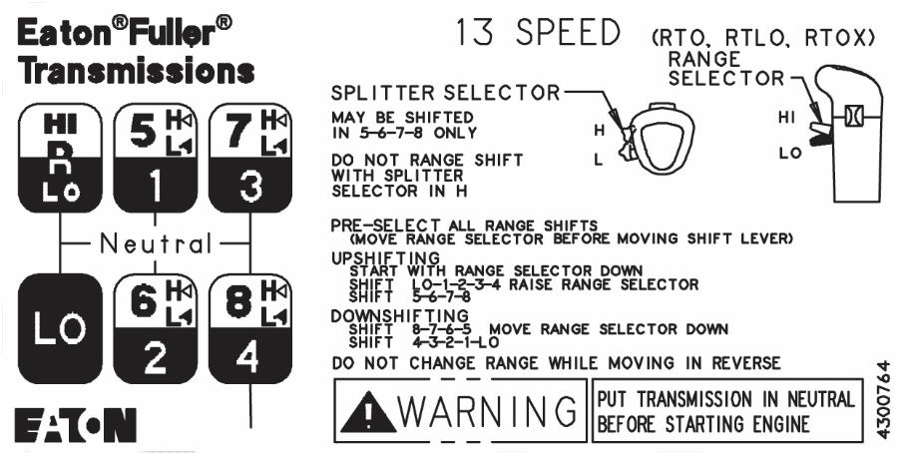
Eaton® Fuller® Thirteen Speed
Notes:
The Eaton ® Fuller® Thirteen Speed transmission has a low range and a high range. The four high-range gears are “split” into a direct drive, or low gear, and an over drive, or high gear (fifth low and high, sixth low and high, seventh low and high, and eighth low and high).
Upshifting—To successfully upshift, follow these steps:
First through fourth gear, use standard double clutch shifting techniques.
Fourth to fifth gear, move range selector to high range before beginning the shift and use the normal double clutch shifting technique.
To upshift from low to high within a gear (such as shifting from five low to five high), move the selector to high, release the throttle, and quickly release and reengage the clutch. If the gear did not catch, gently press the throttle until it does.
To upshift a gear when both the shifter and the splitter must be moved (such as from five high to six low), release the throttle/depress the clutch/move the shifter to neutral, raise the clutch, press the clutch and place the gear shift into the next higher gear when the engine RPMs have fallen 500 RPMs.
Once in the gear (and before releasing the clutch), move the splitter button to the low position.
Release the clutch and gently apply throttle until the splitter gear catches. It should catch at rough 250 RPMs above where the shifter went into gear.
Downshifting—To successfully downshift, follow these steps:
To downshift from high to low within a gear (such as eight high to eight low), move the splitter from high to low.
Press and release the clutch, then gently raise the RPMs up until the gear catches, it should catch roughly 500 RPMs higher than the RPMs were in the previous gear.
To downshift when both the shifter and the splitter must be moved (such as going from eight low to seven high), move the splitter button before beginning the downshift.
Downshift normally (raise RPMs 500 over what they were in the previous gear).
Once the shift is complete, gently apply throttle until the split gear catches (this should happen about 250 RPMs more than the RPMs in the previous gear).

Slide 35
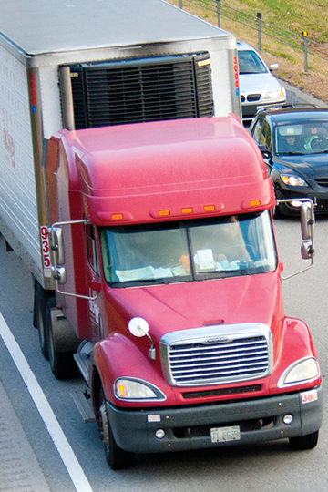
Semiautomatic Transmission
Uses electronic controls to help you shift. Like a manual transmission, a semiautomatic transmission has a clutch and gearshift lever. What is different is that the top gears automatically change.
Notes:
A semiautomatic transmission uses electronic controls to help you shift. Like a manual transmission, a semiautomatic transmission has a clutch and gearshift lever. What is different is that the top gears automatically change.

Slide 36
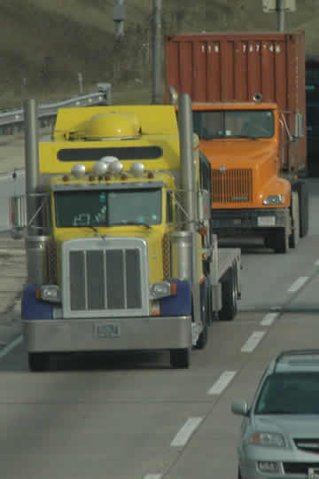
Autoshift Transmission
Has a clutch and gear select lever or button control.
Notes:
An autoshift transmission has a clutch and gear select lever or button control. The clutch is used for starting and stopping the vehicle to disengage the transmission and engine. If the transmission is in the drive position, it will shift the gears as needed based on speed and load. If it is in the hold position, the transmission will not shift unless you use the upshift or downshift button on the transmission controller. However, if you ask for an upshift or downshift when the next gear is not achievable due to current RPMs or load, the transmission will not shift.

Slide 37
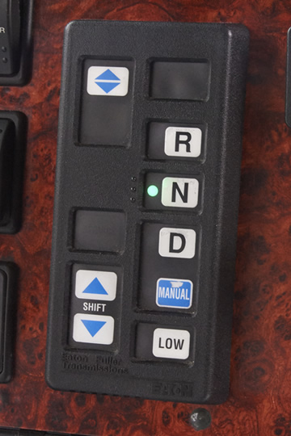
Automatic Transmission
Uses a torque converter instead of a clutch to shift gears. A lever or button is used to change gears.
Notes:
An automatic transmission uses a torque converter instead of a clutch to shift gears. A lever or button is used to change gears. The following are the range selector positions found on an automatic transmission:
Neutral—Neutral is used for starting, standing, and parking the vehicle. Never coast in neutral. This can damage the transmission as well as cause you to lose control of your vehicle.
Reverse—Reverse is used for backing. The vehicle must be stopped before shifting into reverse.
Drive (2-5)—Drive is used for normal driving conditions. It begins in second and automatically upshifts to five as you accelerate. It also automatically downshifts as you slow the vehicle.
Lower range (2-3/2-4)—This range provides engine braking and should be used when road and/or traffic conditions warrant use of a lower gear.
Low gear (2)—This gear is used when driving up a steep grade or operating in snow or mud.
Creeper gear (1)—This gear provides the greatest amount of traction and should only be used in off-road situations.

Slide 38
Objectives Review
You should now be able to:
  Discuss the key controls and tools available to help properly shift a manual transmission
  Identify the basic shift patterns and procedures of a manual transmission
  Describe how proper shifting techniques increase vehicle control and improve fuel economy
  Explain the characteristics of automatic, semiautomatic, and autoshift transmissions
Copyright 2019 J. J. Keller & Associates, Inc.
Notes:
You should now be able to:
Discuss the key controls and tools available to help properly shift a manual transmission
Identify the basic shift patterns and procedures of a manual transmission
Describe how proper shifting techniques increase vehicle control and improve fuel economy
Explain the characteristics of automatic, semiautomatic, and autoshift transmissions
CLASSROOM RECOMMENDATION
Before concluding your training session, have participants take the corresponding quiz (found on the Trainer Tools USB) to check their understanding of the material. You can customize any of the questions to fit your audience or workplace. The answer key can also be found on the Trainer Tools USB.
You may also choose to administer the quizzes before you begin your training session to help get participants thinking about the subject and/or to gauge their understanding of the topic ahead of time.

