Slide 1






PowerPoint® Instructions
This PowerPoint has been designed so you can easily customize it for your training session.
Throughout the presentation you’ll see icons with recommendations or videos to enhance the instruction you present to your students. A detailed explanation for each icon can be found on the next slide. Videos can be found on the Trainer Tools USB.
When you see an icon on the slide, look in the notes
section for further information.
Simply delete or move the icon off the slide before your training session begins.

Slide 2





Classroom Recommendations. Provides suggestions for enhancing your classroom presentation; from ideas for large group discussions to suggestions on the use of training aids such as examples or photos of vehicle parts and components to help illustrate the items covered within a chapter.
Lab Recommendations. Provides suggestions for activities and exercises that take place outside the classroom, but do not involve
the actual operation of the tractor-trailer or its components. Examples
of lab sessions include conducting a vehicle inspection or practicing mirror adjustment.
Range Recommendations. These recommended activities take
place on a closed-access driving range where students may practice driving skills in a controlled environment. Examples of range sessions include practicing shifting technique and successfully completing a backing maneuver.
Road Recommendations. These recommended activities take place in road and traffic conditions that support the chapter’s objectives. Examples of road sessions include proper communication with other drivers through the use of turn signals and basic vehicle control under nighttime or extreme weather conditions.
Videos. These short video clips reinforce material presented in the Student Manual. Use them to help students grasp difficult concepts or subject matter.

Slide 3
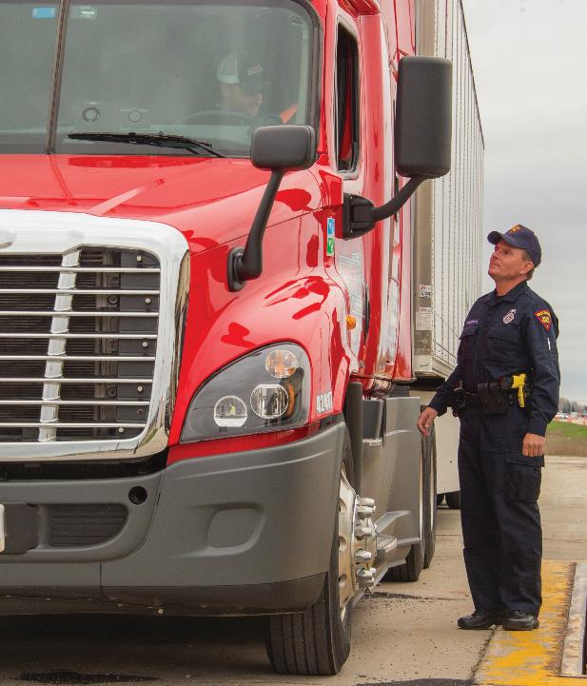
26
External Communications
Notes:
Chapter 26 External Communications
Unit A1.5.6 External Communications This unit must teach driver-trainees in the value of effective interpersonal communication techniques/skills to interact with enforcement officials. The training providers must teach driver-trainees the specifics of the roadside vehicle inspection process, and what to expect during this activity. Driver-trainees who are not English speakers must be instructed in FMCSA English language proficiency requirements. The training providers must teach driver-trainees the impact that violating Federal and state regulations has on their driving records and their employing motor carrier's records.

Slide 4
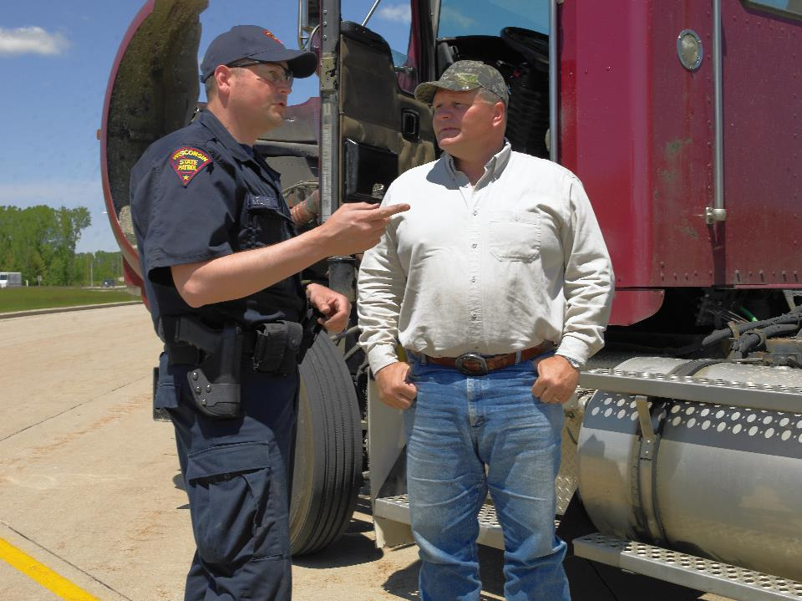
Introduction
Notes:
Introduction
Being able to communicate clearly and professionally is a skill every driver should develop. How you express yourself is a reflection of not only you, but the company you work for, as well as driving professionals across the U.S. This chapter will address how to navigate a roadside inspection with tips on communicating using verbal and non-verbal messages.
CLASSROOM RECOMMENDATIONS
Communicating clearly and professionally is a skill that every professional driver needs to develop. Having solid communication skills can make a difference in a driver’s success in many situations including during roadside inspections, when working with customers, and when dealing with the general public.
Discuss appropriate conduct during roadside inspections, including the importance of good manners, maintaining a professional attitude, respectfully and honestly answering basic questions, and never arguing with an inspector.

Slide 5
Objectives
Upon completion of this chapter, you will be able to:
  Describe the roadside vehicle inspection process
  Identify the impact that violating regulations has on your, and your carrier’s, records
  Illustrate effective communication techniques when interacting with enforcement officials
Notes:
Objectives
Upon completion of this chapter, you will be able to:
Describe the roadside vehicle inspection process
Identify the impact that violating regulations has on your, and your carrier’s, records
Illustrate effective communication techniques when interacting with enforcement officials

Slide 6
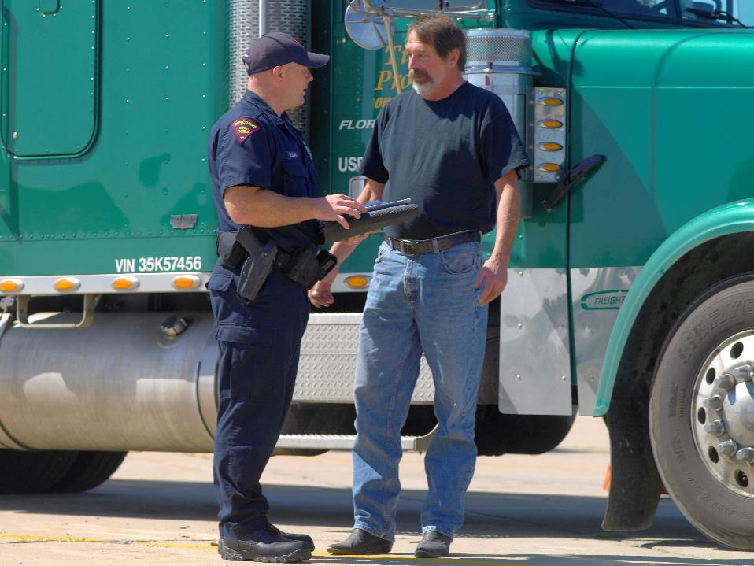
Roadside Inspection Process
Notes:
Roadside Inspection Process
Roadside inspections are conducted by law enforcement officers that are trained and certified by the Commercial Vehicle Safety Alliance (CVSA ). The purpose of the inspection is to determine whether you and/or your vehicle are in compliance with the Federal Motor Carrier Safety Regulations (FMCSRs) and the Hazardous Materials Regulations (HMRs).
Typically, these inspections occur at weigh stations, roadside, or at a motor carrier. If you are chosen for an inspection, the inspector will greet you by introducing himself or herself and explaining the type of inspection he or she intends on completing.
The majority of inspections performed are Level I inspections . A Level I inspection involves both the driver and vehicle and takes about 45 minutes to one hour to complete.
The driver portion of the inspection begins with a basic interview.
The inspector will ask for certain documents including your driver’s license, record of duty status, and the vehicle’s periodic inspection documentation.
The inspector may also ask to see the vehicle registration, lease agreement, or shipping papers.
The vehicle portion of the inspection begins with the inspector explaining the process and describing the hand signals he or she will use.
The inspector will inspect both around and under the vehicle, looking at certain vehicle components to ensure that they are in safe operating condition.
CALLOUT: CVSA is a nonprofit association comprised of local, state, provincial, territorial and federal commercial motor vehicle (CMV) safety officials and industry representatives. CVSA aims to achieve uniformity, compatibility and reciprocity of CMV inspections and enforcement by certified inspectors dedicated to driver and vehicle safety.

Slide 7
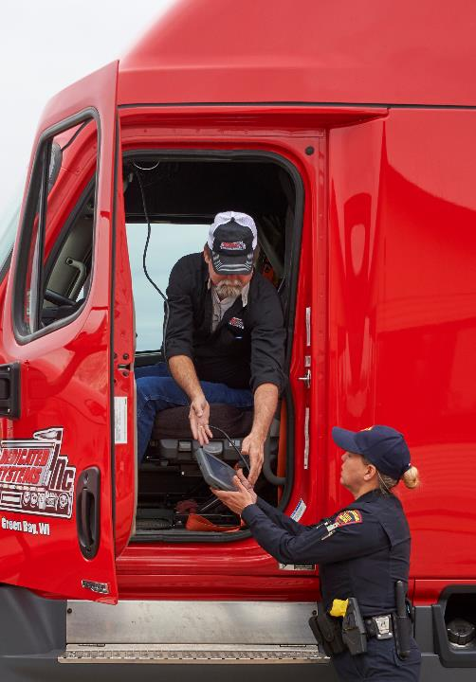
Courtesy and manners are important.
Notes:
Driver
Whenever you are the focus of an inspection, be prepared to hand over documents and credentials. These documents should be complete and up to date.
Courtesy and manners are important, as poor manners can draw the attention of the inspector. Basic information questions posed by the inspector should be answered respectfully and honestly.
Vehicle
Inspectors check your vehicle for mechanical problems, unsafe wear and tear, and anything else that could cause a crash. Inspectors will place a vehicle that they determine to be unsafe or in violation of safety regulations out-of-service. Sometimes, you can fix a problem during the inspection, but it will still be recorded in the report as out of service.
Officers will also look for non-critical deficiencies. Something as simple as a missing warning triangle can result in a violation.

Slide 8
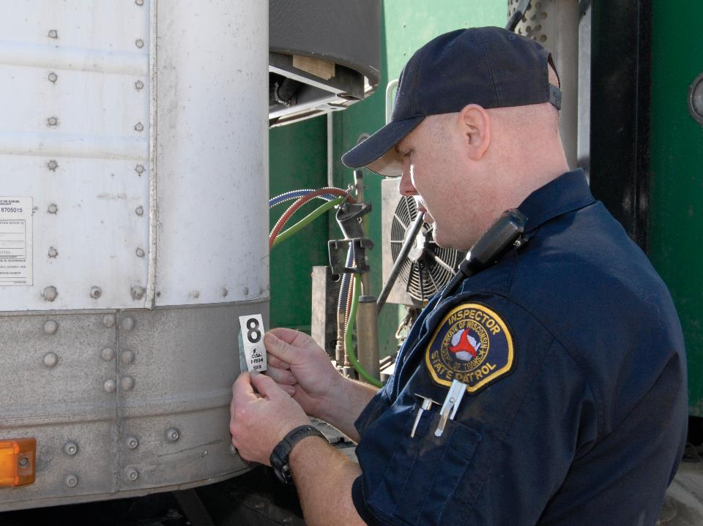
Roadside Inspection Outcomes
Notes:
Roadside Inspection Outcomes
Whether or not any violations or defects were found, you will be given an inspection report. If the inspecting officer does not automatically give you a copy, politely ask for one.
No Violations
If no critical-inspection-item defects were noted, the inspector will place a CVSA decal on your vehicle that is valid for three months. Critical inspection items are safety-related items likely to cause a crash or breakdown if not corrected in a timely manner.
Violations Found
When violations are found remain calm, be respectful, avoid argument, and ask the officer to explain the violation(s). Don’t become combative or defensive. If the inspector found only minor violations, you may be allowed to continue your trip. You might be given a fine. You will not receive a CVSA decal.
Even minor violations have serious consequences. Violations for tire defects or operating beyond the hours-of-service limits, for example, have high severity points in the Compliance, Safety, Accountability (CSA) program. They will have an immediate impact on you and the carrier.

Slide 9
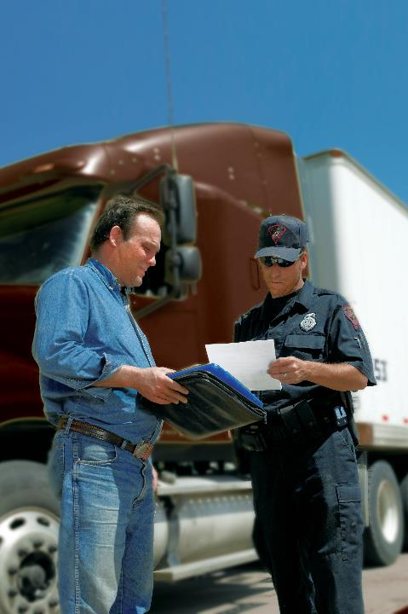
If a major safety problem was found, you, your vehicle, or both can be placed out of service.
Notes:
Out of Service
If a major safety problem was found, you, your vehicle, or both can be placed out of service. You will not be able to drive your vehicle again until all problems have been resolved.
Choosing to violate an out-of-service order carries stiff penalties. Federal regulations outline a penalty structure for drivers — however, it’s a judge’s discretion to decide the actual disqualification period and fine amount.
Your carrier cannot force you to drive a vehicle before the repairs are finished. They will be fined if they require (or allow) you to violate an out-of-service order.
An inspection resulting in violations has serious consequences for you and your carrier.
For you, violations and out-of-service orders mean:
Unscheduled down time
Lost revenue
Interrupted schedule
Fines
For your carrier, violations and out-of-service orders mean:
Poor CSA scores, which can lead to FMCSA interventions
Lost revenue
Delays in deliveries

Slide 10
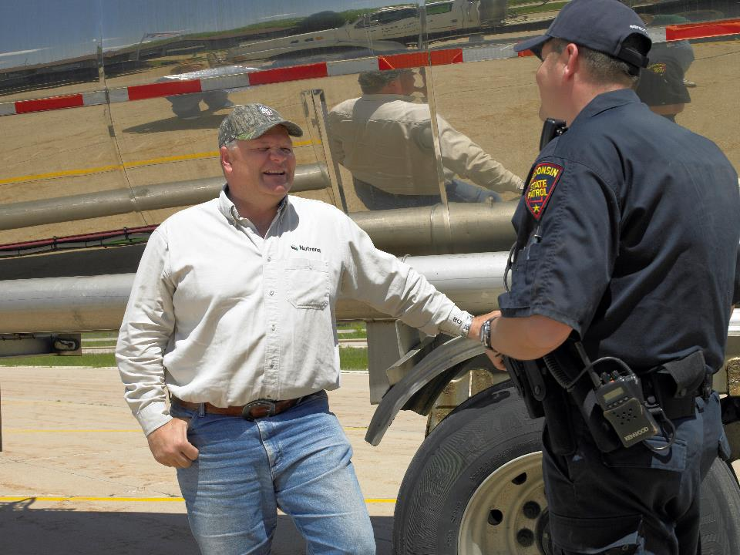
Interpersonal Communication
Notes:
Interpersonal Communication
Interpersonal communication is simply the exchange of information through verbal and non-verbal messages. In face-to-face communication, how you say something is just as important as what you say.
According to the research of Albert Mehrabian, when we communicate, 7 percent of what comes across is from the literal (verbal) content of the message, 38 percent from the tone we use, and 55 percent from our body language.
Verbal and Non-Verbal Messages
When speaking with an inspector, or any law enforcement officer, you not only have to say polite things, they need to come across as sincere. Your inspecting officer is a person, just like you, trying to do a good job.
Always be respectful. Don’t talk over the inspector or interrupt them. If violations are found, try and control your emotions. This is not a personal attack on you. The inspector is doing their job by citing problems that could cause you or others harm if you get back on the road.
Take a moment to think about what you want to say before you reply to violations. When ready, speak in a calm voice.
Body Language
Since much of our message is conveyed through body language, it is important to be in an open position—relaxed, with your arms uncrossed—when speaking with an inspector.
Listen actively. This means listening to what is being said, rather than thinking of your response. Lean in on the conversation, make eye contact, and nod when appropriate to show you are paying attention and want to hear what he or she has to say.
Don’t be confrontational in your stance. You don’t want to put your hands on your hips or clench your fists if you hear something you don’t agree with.
Do your best to keep your body posture and facial expressions friendly, or at least neutral during your interactions with enforcement officials.
Attitude
When talking to an inspection officer be helpful and courteous. Follow their instructions and provide them with the documents they request.
More often than not, a professional attitude from the driver is reciprocated by the officer. If you are unfriendly and/or rude, it may prompt the inspector to come down hard on you.
Be receptive to feedback. The inspector could give you tips that will help you along a future inspection. One way to build rapport is to acknowledge the inspector’s expertise and seek their advice.
Non-English Speakers
If English is not your first language, you still need to be able to respond to enforcement officials. Section 391.11(b)(2) of the FMCSRs requires that you be able to read, write, and speak English well enough to:
Converse with the general public
Understand highway traffic signs and signals
Respond to questions from law enforcement
Make entries on reports and records.

Slide 11
Objectives Review
You should now be able to:
  Describe the roadside vehicle inspection process
  Identify the impact that violating regulations has on your, and your carrier’s, records
  Illustrate effective communication techniques when interacting with enforcement officials
Copyright 2019 J. J. Keller & Associates, Inc.
Notes:
You should now be able to:
Describe the roadside vehicle inspection process
Identify the impact that violating regulations has on your, and your carrier’s, records
Illustrate effective communication techniques when interacting with enforcement officials
CLASSROOM RECOMMENDATION
Before concluding your training session, have participants take the corresponding quiz (found on the Trainer Tools USB) to check their understanding of the material. You can customize any of the questions to fit your audience or workplace. The answer key can also be found on the Trainer Tools USB.
You may also choose to administer the quizzes before you begin your training session to help get participants thinking about the subject and/or to gauge their understanding of the topic ahead of time.

