Slide 1






PowerPoint® Instructions
This PowerPoint has been designed so you can easily customize it for your training session.
Throughout the presentation you’ll see icons with recommendations or videos to enhance the instruction you present to your students. A detailed explanation for each icon can be found on the next slide. Videos can be found on the Trainer Tools USB.
When you see an icon on the slide, look in the notes
section for further information.
Simply delete or move the icon off the slide before your training session begins.

Slide 2





Classroom Recommendations. Provides suggestions for enhancing your classroom presentation; from ideas for large group discussions to suggestions on the use of training aids such as examples or photos of vehicle parts and components to help illustrate the items covered within a chapter.
Lab Recommendations. Provides suggestions for activities and exercises that take place outside the classroom, but do not involve
the actual operation of the tractor-trailer or its components. Examples
of lab sessions include conducting a vehicle inspection or practicing mirror adjustment.
Range Recommendations. These recommended activities take
place on a closed-access driving range where students may practice driving skills in a controlled environment. Examples of range sessions include practicing shifting technique and successfully completing a backing maneuver.
Road Recommendations. These recommended activities take place in road and traffic conditions that support the chapter’s objectives. Examples of road sessions include proper communication with other drivers through the use of turn signals and basic vehicle control under nighttime or extreme weather conditions.
Videos. These short video clips reinforce material presented in the Student Manual. Use them to help students grasp difficult concepts or subject matter.

Slide 3
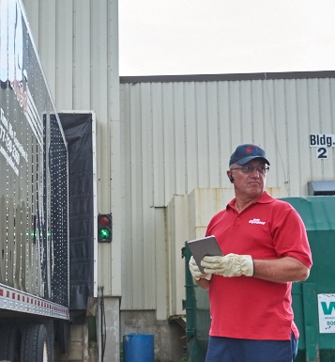
27
Whistleblower/Coercion
Notes:
Chapter 27: Whistleblower/Coercion
Unit A1.5.7 Whistleblower/Coercion
This unit must teach the driver-trainees about the right of an employee to question the safety practices of an employer without incurring the risk of losing a job or being subject to reprisals simply for stating a safety concern. The training providers must instruct driver-trainees in the whistleblower protection regulations in 29 CFR part 1978. The training providers must teach the procedures for reporting to FMCSA incidents of coercion from motor carriers, shippers, receivers, or transportation intermediaries

Slide 4
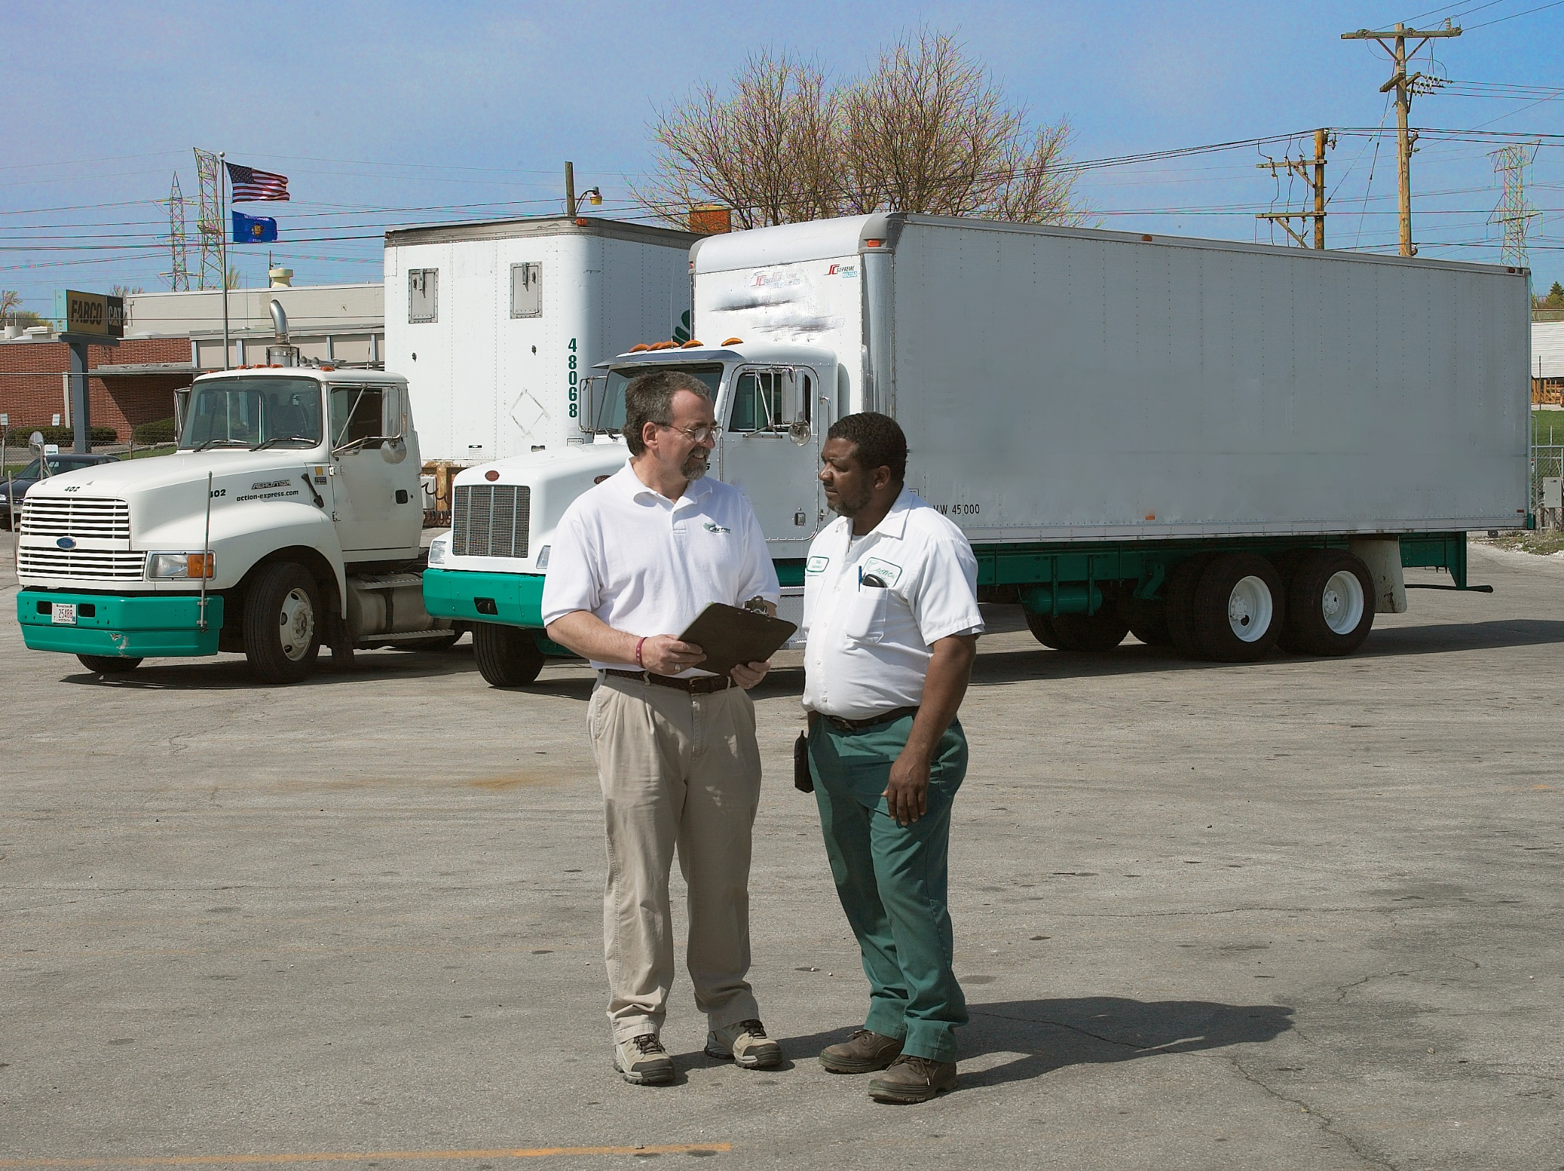
Introduction
Notes:
Having a safe workplace is serious business. There are many laws and regulations in place that are intended to keep you safe while at work. It is up to you and your employer to follow these laws and regulations.
Should your employer or another party such as a shipper, receiver, or broker encourage or try to force you to violate these rules, you do have ways to protect yourself.
Whistleblower protection and coercion regulations are intended to protect you from retaliation if you refuse to violate a law or regulation related to health, safety, or security.
CLASSROOM RECOMMENDATIONS
Whistleblower protection and coercion regulations are intended to protect a driver from retaliation if he or she refuses to violate a law or regulation related to health, safety or security. These regulations are also intended to protect a driver if he or she reports a violation to the Federal Motor Carrier Safety Administration (FMCSA) or the Occupational Safety and Health Administration (OSHA).
Discuss with your students the protections available to them and how to file a complaint with the appropriate regulatory agency.
When addressing this topic, keep in mind that this is a sensitive area for both you and your students. Make sure you handle it as such.

Slide 5
Objectives
Upon completion of this lesson, you will be able to:
  Describe the whistleblower protections that are available to you
  Discuss how you can file a complaint with the Occupational Safety and Health Administration (OSHA) if your whistleblower protection is violated
  Recognize coercion when it occurs
  Explain how to file a coercion complaint with the Federal Motor Carrier Safety Administration (FMCSA)
Notes:
Objectives
Upon completion of this lesson, you will be able to:
Describe the whistleblower protections that are available to you
Discuss how you can file a complaint with the Occupational Safety and Health Administration (OSHA) if your whistleblower protection is violated
Recognize coercion when it occurs
Explain how to file a coercion complaint with the Federal Motor Carrier Safety Administration (FMCSA)

Slide 6
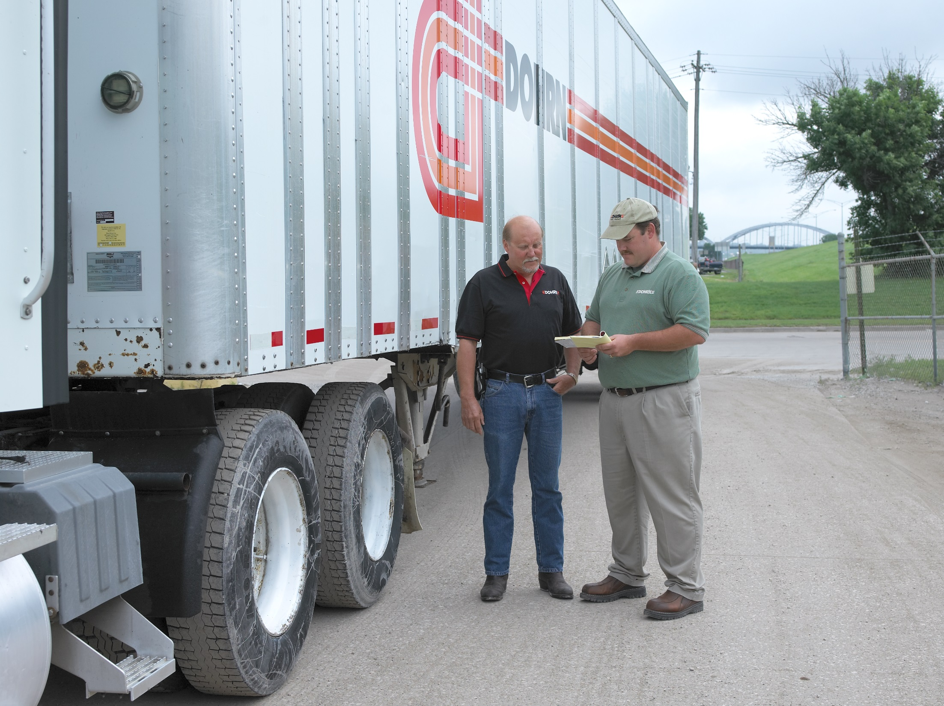
Whistleblower Protection
Notes:
Whistleblower Protection
Whistleblower protection laws are in place to protect you from retaliation if you report commercial motor vehicle (CMV) safety violations to the Federal Motor Carrier Safety Administration (FMCSA). You’re protected if you testify before FMCSA or if you refuse to operate an unsafe vehicle, drive in conditions that may cause serious bodily injury, or violate a CMV safety law.
These Occupational Safety and Health Administration (OSHA) regulations (29 CFR Part 1978) prohibit your employer from discharging, disciplining, or discriminating against you regarding pay, terms, or privileges for taking any one of the following actions:
Filing a complaint related to the violation of a CMV safety or security regulation
Having testified or testifying in the future in a proceeding related to a violation of a CMV safety or security regulation
Refusing to operate a CMV because:
You would have violated a federal safety, health, or security regulation
You had a reasonable apprehension that you, or someone else, would have been seriously injured or impaired had you operated an unsafe vehicle
Refusing to inaccurately report your hours on duty
Cooperating with a federal safety or security investigation
Providing information to an enforcement agency relating to an accident or incident resulting in injury or death to an individual or property damage in connection with CMV transportation
To qualify for the protection, you must have sought from your employer, and were unable to obtain, correction of the hazardous safety or security condition.

Slide 7
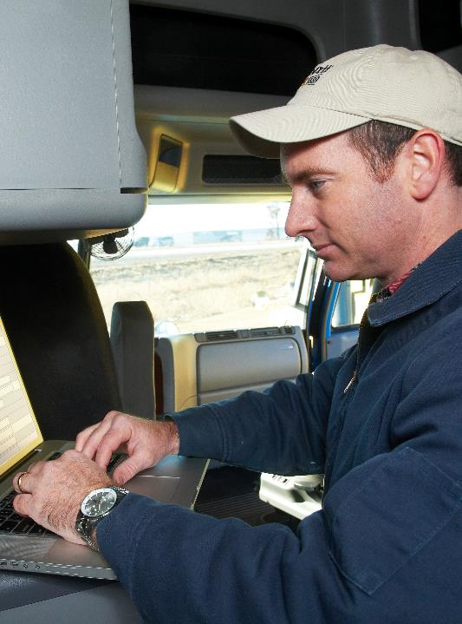
A complaint should be filed within 180 days.
Notes:
Filing a Complaint
Complaints should be filed with the OSHA office in the area where you live or work. You can find information online at www.osha.gov.
A complaint should be filed within 180 days of when the alleged violation occurred. However, there are situations where the time limit will be waived.
There are no special forms to use to file the compliant. The complaint may be filed orally or in writing.
Upon receipt of the complaint, OSHA will begin its investigation. Within 60 days of filing the complaint, OSHA will issue written findings as to whether there is reasonable cause to believe the employer retaliated against the employee in violation of the whistleblower protection regulations.

Slide 8

If OSHA confirms a violation, the employer will receive a preliminary order.
Notes:
OSHA Findings
If the investigation confirms a violation, the employer will receive a preliminary order. The order will include, where appropriate, a requirement that the employer end the violation, reinstate the employee to his or her former position, and/or pay for compensatory damages. The order may also require payment of punitive damages up to $250,000.
If the investigation finds that a violation did not occur, OSHA will notify the parties of the finding.

Slide 9
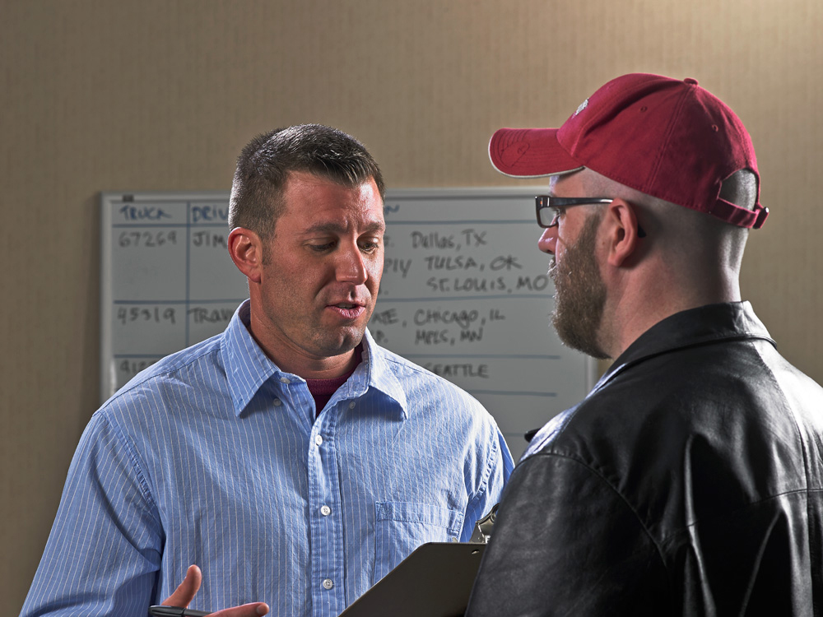
Coercion
Notes:
Coercion
A motor carrier, shipper, receiver, broker, or freight forwarder cannot coerce you to operate a CMV in violation of the FMCSRs, Hazardous Materials Regulations (HMRs), or the Federal Motor Carrier Commercial Regulations (FMCCRs) (49 CFR 356, 360, and 365-379).
It is important to note, the coercion rule located in Sections 386.12 and 390.6 of the FMCSRs, does not replace OSHA’s whistleblower protections — rather, they work in tandem with one another.
Coerce means threatening to or withholding business, employment, or work opportunities, or threatening job action against you to get you to violate the FMCSRs, HMRs, or FMCCRs.
The key to coercion is that a clear threat to the driver exists, whether implicit or explicit. These threats could include things like:
Job termination
Denial of subsequent trips or loads
Reduced pay
Forfeiture of favorable work hours or transportation jobs
Other direct retaliations
In order for a violation of the coercion rule to exist, three specific actions must have occurred:
The driver had been requested to perform a task that would have resulted in him or her violating certain provisions of the FMCSRs, HMRs, or the FMCCRs
The driver communicated the violation that would have occurred had he or she performed the task
The driver was threatened, or action was taken against the driver to get him or her to complete the task despite the regulatory violation
If any one of these three elements are missing from a conversation, then a violation of the coercion rule has not occurred.
It’s also worth noting, coercion may still have taken place even if the driver never actually followed through with the request to violate the regulations. So, a driver may still file a coercion complaint, so long as he or she was pressured to violate the regulations, appropriately communicated the violation that would occur if he or she did perform the task, and was subsequently threatened to complete the request anyway.
CALLOUT: A driver doesn’t have to cite a specific regulation number as long as he or she can explain the violation in general terms.

Slide 10

If you believe you were coerced, you may file a written complaint with the FMCSA.
Notes:
Filing a Complaint
If you believe you were coerced to violate the regulations described above, you may file a written complaint with the FMCSA.
To begin the complaint process, a driver must file a written complaint within 90 days of the event. The complaint has to be delivered to the “Division Administrator” (or state FMCSA office director) where the driver is employed. It can also be filed with the National Consumer Complaint Database at http://nccdb.fmcsa.dot.gov.
Each formal complaint must contain:
The driver’s name, address, and telephone number
The name and address of the person who allegedly coerced or attempted to coerce the driver
The rule(s) that the driver believes he or she was being pressured to violate
A short, complete statement of the facts, including the date of each alleged violation
The driver’s signature, verifying that what is stated is accurate and true.

Slide 11
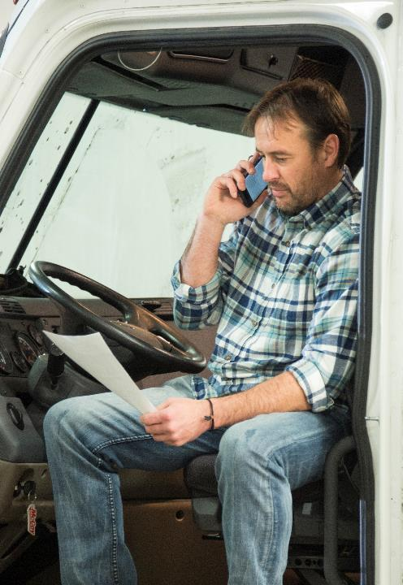
All parties involved will receive notification of the final decision.
Notes:
FMCSA Findings
When the investigation is complete, the Division Administrator will either dismiss the complaint or issue a Notice of Violation or Notice of Claim to the person(s) responsible for coercing the driver. All parties involved will receive notification of the final decision.
The FMCSA says it will take “aggressive action” when a violation of the coercion rule is confirmed. This includes civil penalties and the revocation of a carrier’s operating authority.

Slide 12
Objectives Review
You should now be able to:
  Describe the whistleblower protections that are available to you
  Discuss how you can file a complaint with the Occupational Safety and Health Administration (OSHA) if your whistleblower protection is violated
  Recognize coercion when it occurs
  Explain how to file a coercion complaint with the Federal Motor Carrier Safety Administration (FMCSA)
Copyright 2019 J. J. Keller & Associates, Inc.
Notes:
You should now be able to:
Describe the whistleblower protections that are available to you
Discuss how you can file a complaint with the Occupational Safety and Health Administration (OSHA) if your whistleblower protection is violated
Recognize coercion when it occurs
Explain how to file a coercion complaint with the Federal Motor Carrier Safety Administration (FMCSA)
CLASSROOM RECOMMENDATION
Before concluding your training session, have participants take the corresponding quiz (found on the Trainer Tools USB) to check their understanding of the material. You can customize any of the questions to fit your audience or workplace. The answer key can also be found on the Trainer Tools USB.
You may also choose to administer the quizzes before you begin your training session to help get participants thinking about the subject and/or to gauge their understanding of the topic ahead of time.

