Slide 1






PowerPoint® Instructions
This PowerPoint has been designed so you can easily customize it for your training session.
Throughout the presentation you’ll see icons with recommendations or videos to enhance the instruction you present to your students. A detailed explanation for each icon can be found on the next slide. Videos can be found on the Trainer Tools USB.
When you see an icon on the slide, look in the notes
section for further information.
Simply delete or move the icon off the slide before your training session begins.

Slide 2





Classroom Recommendations. Provides suggestions for enhancing your classroom presentation; from ideas for large group discussions to suggestions on the use of training aids such as examples or photos of vehicle parts and components to help illustrate the items covered within a chapter.
Lab Recommendations. Provides suggestions for activities and exercises that take place outside the classroom, but do not involve
the actual operation of the tractor-trailer or its components. Examples
of lab sessions include conducting a vehicle inspection or practicing mirror adjustment.
Range Recommendations. These recommended activities take
place on a closed-access driving range where students may practice driving skills in a controlled environment. Examples of range sessions include practicing shifting technique and successfully completing a backing maneuver.
Road Recommendations. These recommended activities take place in road and traffic conditions that support the chapter’s objectives. Examples of road sessions include proper communication with other drivers through the use of turn signals and basic vehicle control under nighttime or extreme weather conditions.
Videos. These short video clips reinforce material presented in the Student Manual. Use them to help students grasp difficult concepts or subject matter.

Slide 3
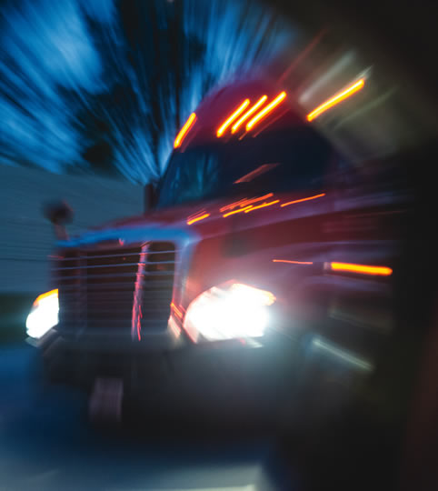
Night Operation
13
Copyright 2019 J. J. Keller & Associates, Inc.
Notes:
Unit A1.2.6 Night Operation
This unit must instruct driver-trainees in the factors affecting the safe operation of CMVs at night and in darkness. Additionally, driver-trainees must be instructed in changes in vision, communications, speed space management, and proper use of lights, as needed, to deal with the special problems night driving presents.

Slide 4
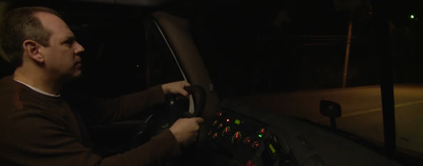
Introduction
Driving a CMV at night introduces additional challenges.
Notes:
Even in the best conditions, driving a commercial motor vehicle (CMV) requires preparation, constant alertness, and attention to detail. Driving a CMV at night introduces additional challenges. For instance:
Low light makes it harder to see
Hazards may not be recognized as quickly
A more limited sight area leaves less time to respond
CLASSROOM RECOMMENDATIONS
Any visuals used when presenting this lesson should focus on the differences between day and night driving. This should include information on the differences in range of vision when using low and high beam headlights and any applicable laws related to this subject.

Slide 5
Objectives
Upon completion of this lesson, you will be able to:
  Discuss the factors that affect the safe operation of CMVs at night as they relate to your truck, the road, and you, the professional driver
  Explain procedures that can help make
  driving at night safer
Notes:
Upon completion of this lesson, you will be able to:
Discuss the factors that affect the safe operation of CMVs at night as they relate to your truck, the road, and you, the professional driver
Explain procedures that can help make driving at night safer

Slide 6
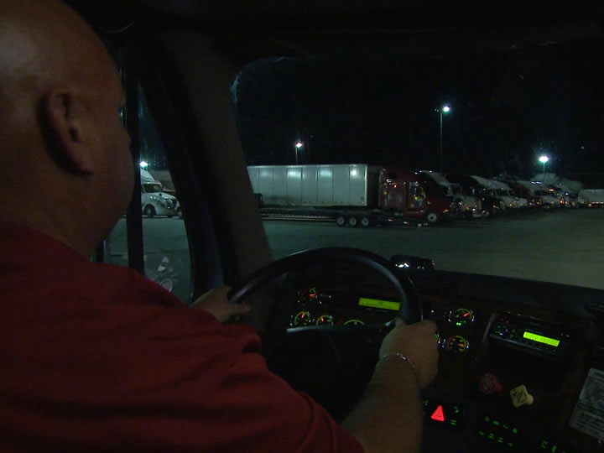
Night Driving Factors
Notes:
There are three major factors you need to focus on when driving at night:
Your truck
The road
You, the professional driver

Slide 7
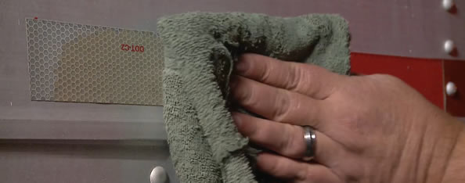
Your Truck
When you know you’ll be driving after dark, pay special attention to the lights, reflectors, and windshield.
Notes:
As a professional driver, your work day always begins with a pre-trip inspection. When you know you’ll be driving after dark, pay special attention to the lights, reflectors, and windshield during this time. At night, you need to be able to rely on your lights, especially your headlights, to help guide the way.
VIDEO
13.1 — Night Driving Pre-Trip Inspection

Slide 8
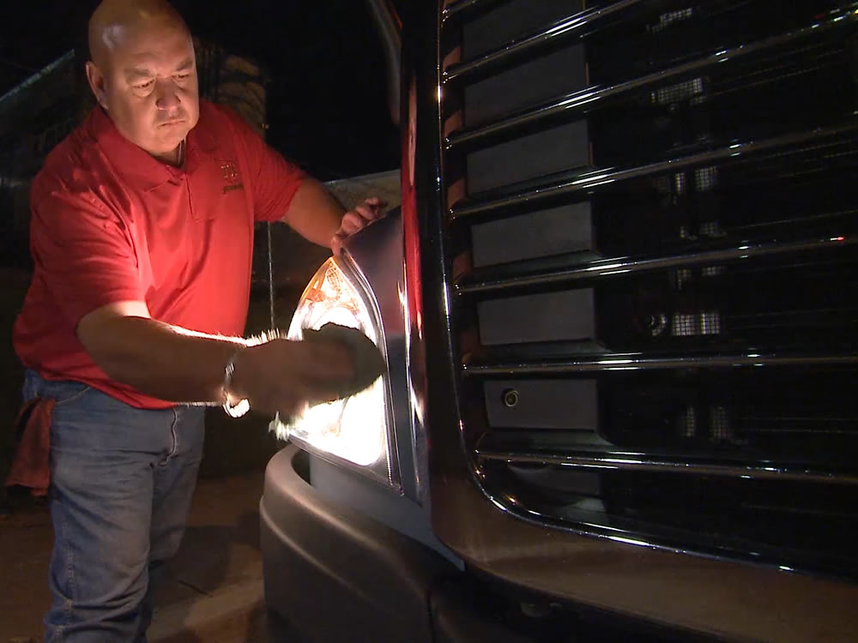
Clean your headlights with a soft cloth and check that both your low and high beams function and are properly aimed.
Dirt, dust, or grime on your headlights can reduce their effectiveness by as much as fifty percent.
Notes:
Clean your headlights with a soft cloth and check that both your low and high beams function and are properly aimed. Dirt, dust, or grime on your headlights can reduce their effectiveness by as much as fifty percent.

Slide 9
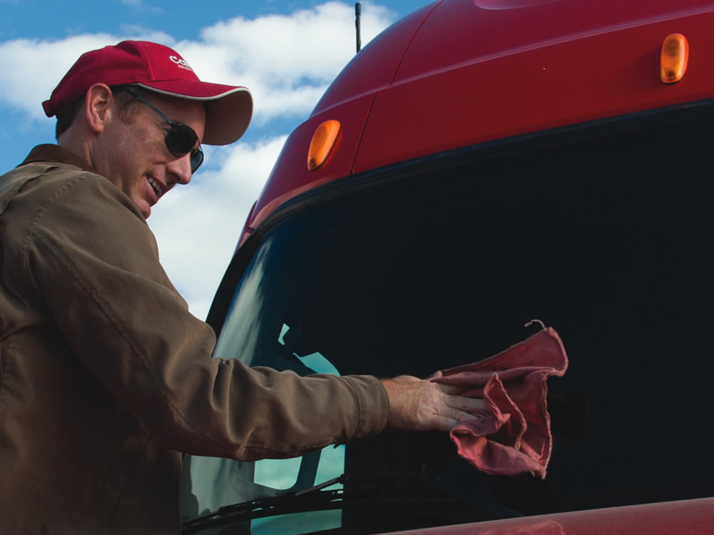
Clean your glass and mirrors; even a little dirt can cause a distractingly dangerous glare when
lit up at night.
Notes:
A dirty windshield, mirrors, or windows may not affect your visibility much in the daylight, but when they’re lit up at night by another driver’s headlights or by a setting or rising sun, even a little dirt can cause a distractingly dangerous glare. Clean your glass and mirrors, and be certain you have adequate windshield washer fluid in your reservoir.

Slide 10
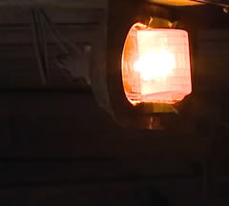
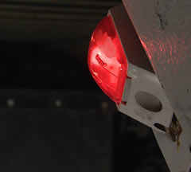
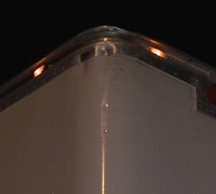
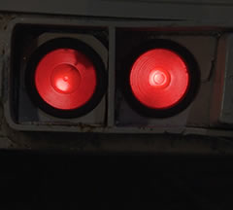
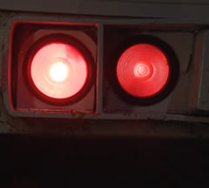
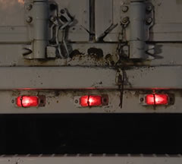
Clean off all your lights and verify they are in good working condition.
TURN SIGNALS
MARKER LIGHTS
CLEARANCE LIGHTS
TAIL LIGHTS
BRAKE LIGHTS
IDENTIFICATION LIGHTS
Notes:
At night, making sure other drivers can see you and know your intentions is especially crucial, so clean off all your lights and verify they are in good working condition. This includes your:
Turn signals
Marker lights
Clearance lights
Tail lights
Brake lights
Identification lights
It’s also a good idea to clean off all your reflectors, as well.
The importance of communicating your intention to turn, change lanes, or stop is multiplied at night. Other drivers may have a hard time seeing your vehicle and understanding your intent. Your turn signals and brake lights may be the only way to communicate this information.

Slide 11
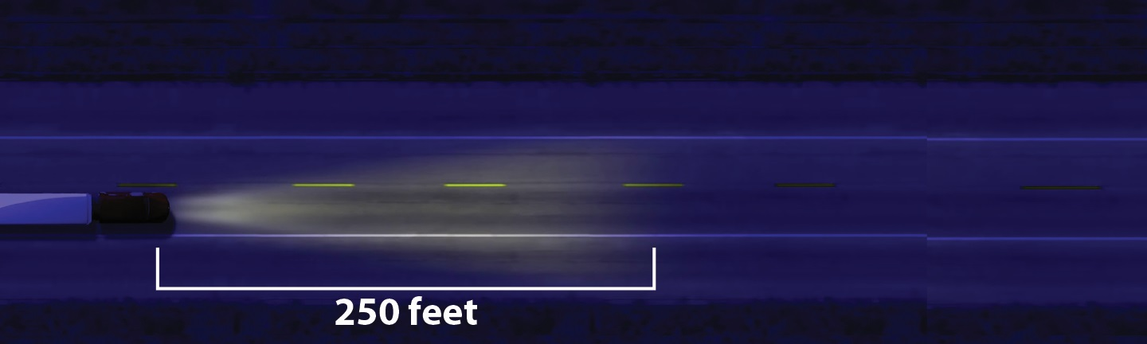
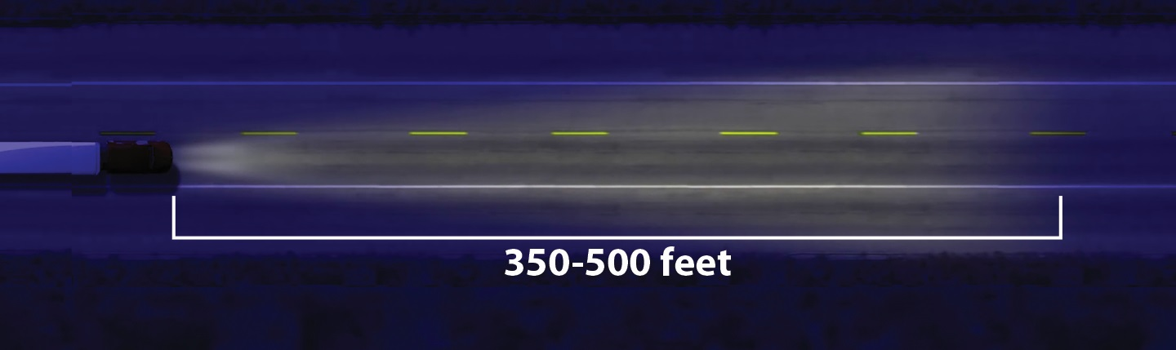
Low Beams
High Beams
Notes:
Typically, your low beams will illuminate the road ahead of you up to about 250 feet . So, in the dark at 65 miles per hour, you’ll only be able to see about two and a half seconds ahead. Clearly, this means you’ll have a much shorter time to react to potential hazards at nighttime than you do during the day.
High beams allow you to see up to 350 to 500 feet ahead, giving you more time to react than your low beams do. But even so, you still won’t have as much visibility as you do during the day.
CALLOUT: Never use high beam headlights when driving in fog.
VIDEO
13.2 — Headlights

Slide 12
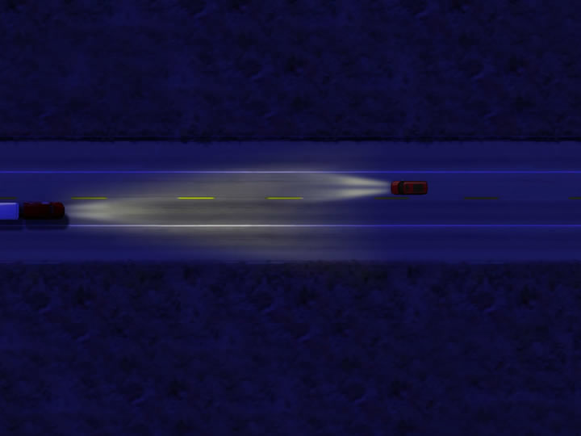
High beam headlights should be dimmed within 500 to 1,000 feet of an oncoming vehicle or within 500 feet of a vehicle you are following.
Notes:
Glare from your vehicle’s headlights can cause problems for drivers coming toward you. They can also bother drivers going in the same direction as you are, when your vehicle’s lights shine into their rearview mirrors. Use high beams only when it is safe and legal to do so. High beam headlights should be dimmed within 500 to 1,000 feet of an oncoming vehicle or within 500 feet of a vehicle you are following.
If an oncoming driver is using their high beams, look at the white line on the right side of the road rather than directly at their lights. This will offer some protection from the glare and enable your eyes to adjust more quickly once the vehicle has passed. Plus, following the white line will help ensure you keep your truck on the road.
RANGE RECOMMENDATION
As with other exercises, break your class into groups of three students per instructor. Each student should have at least 15 minutes behind the wheel.
Interacting with traffic
Prior to beginning this exercise, lay out a path or course that necessitates following the vehicle ahead, crossing the path of intersecting vehicles, and meeting other vehicles head-on.
In this exercise, the student needs to focus on appropriate following distance, speed, and use of high beam headlights.
Handling glare
Prior to beginning this exercise, lay out a path or course that necessitates the meeting of vehicles.
In this exercise, the student operates with the vehicle’s high beam headlights, dimming them at the appropriate times and maintaining appropriate following distance.

Slide 13
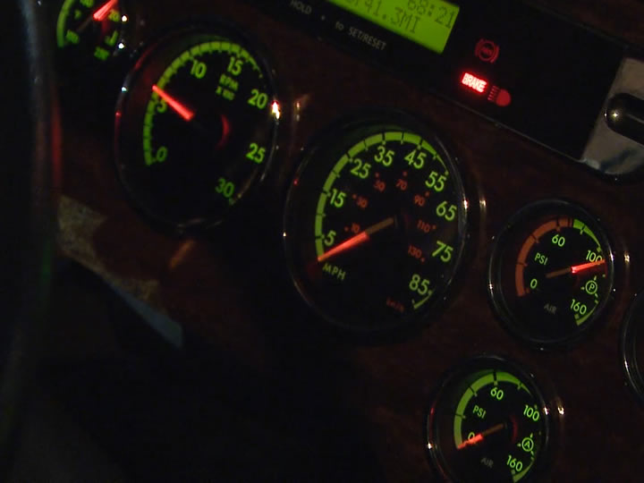
Dim the brightness of the instrument panel
Keep the dome light off
Notes:
In addition, be sure to set the interior lights of your cab for best nighttime visibility. Dimming the brightness of the instrument panel and keeping the dome light off will allow your eyes to maintain their best night vision by not having to adjust from a brightly lit interior to a very dark exterior.
Speed may need to be adjusted so the vehicle can be stopped within the range of the headlights.
Always drive within the range of the headlights. Driving outside the range of the headlights (over driving the headlights) can adversely affect your ability to recognize hazards.

Slide 14
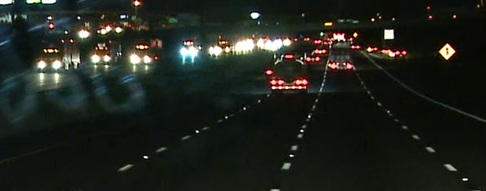
The Road
Driving after dark reduces the time you have to recognize and react to dangers on the road.
Notes:
At night, hazards aren’t as easy to see and may not be recognized as quickly as during daylight hours. Driving after dark reduces the time you have to recognize and react to dangers on the road. Try to anticipate potentially hazardous situations and be prepared to react to them, if necessary.
VIDEO
13.3 — Night Driving Road Hazards

Slide 15
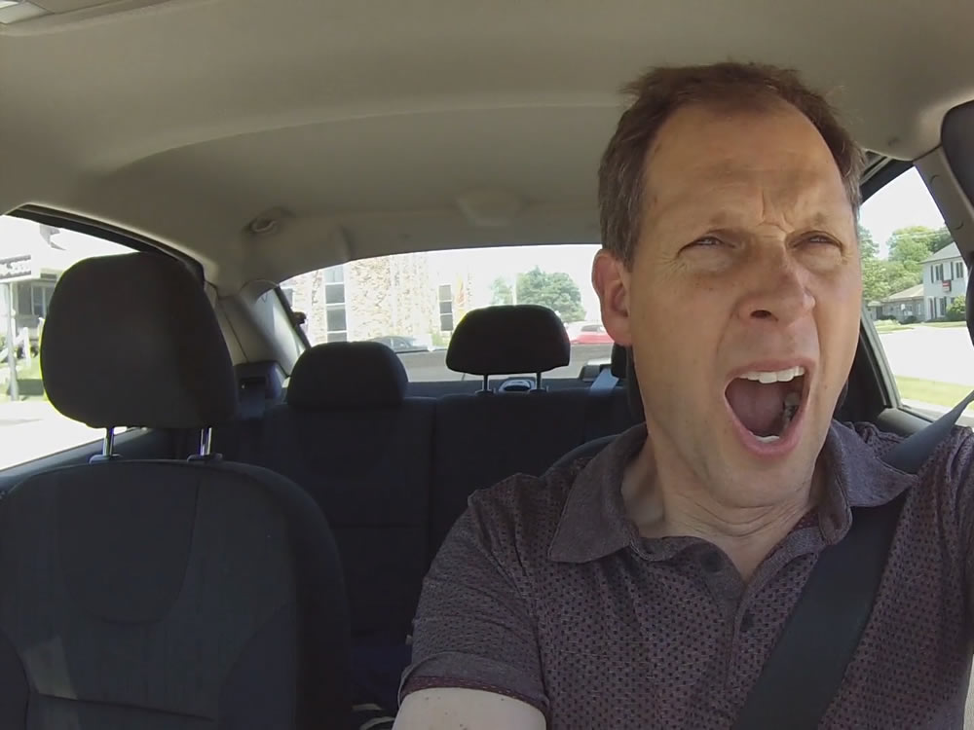
Other drivers may be drowsy…
Keep an eye out for vehicles that weave from lane to lane, stop without reason, have trouble maintaining a constant speed, or show other signs of impaired or erratic driving.
Notes:
Other drivers may be drowsy—especially late at night when people are more likely to be tired or inattentive. In the early morning hours, when bars and night spots are closing, there may be impaired drivers on the road. Keep an eye out for vehicles that weave from lane to lane, stop without reason, have trouble maintaining a constant speed, or show other signs of impaired or erratic driving. Maintaining your alertness and giving these drivers plenty of room will help ensure their driving mistakes don’t become your problems.

Slide 16
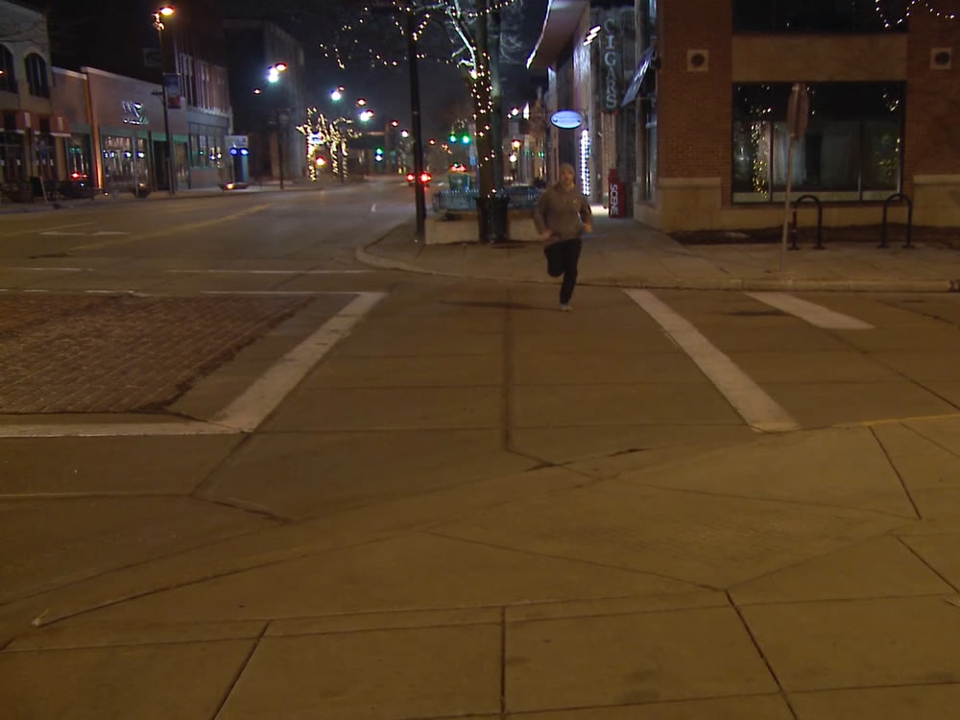
People walking, jogging, or riding bikes wearing low-visibility clothing can be difficult to see until they are very close.
Notes:
People walking, jogging, or riding bikes wearing low-visibility clothing can be difficult to see until they are very close, so be extra vigilant in urban and suburban areas. Some may also be wearing headphones. They may be completely unaware of your presence and dart out into your path unexpectedly. Or they may underestimate your speed and try to cross before you reach them. Noticing them early and being prepared to stop is your best defense.

Slide 17
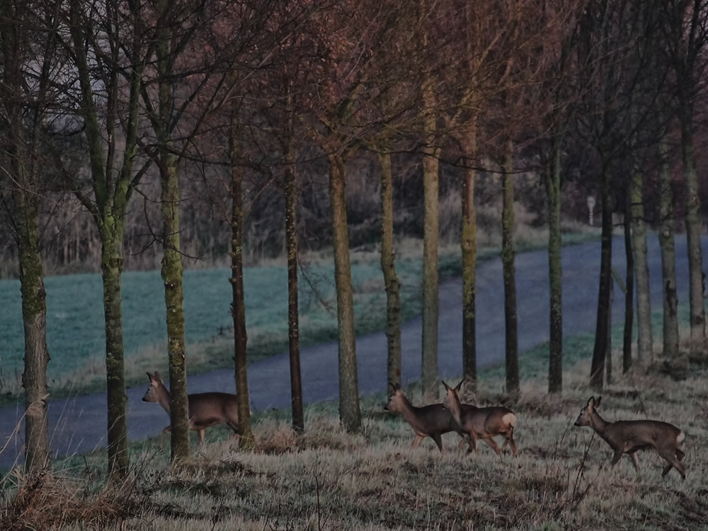
Animals may be on the move at night. Be sure not to overdrive your headlights and keep an eye on both shoulders ahead. Look for reflections of animals’ eyes or movement along the sides of the road.
Notes:
In many parts of the country, animals may be on the move at night so there’s a chance you’ll see some of them on the road. When driving in wooded areas or areas near tall grass, be sure not to overdrive your headlights and keep an eye on both shoulders ahead. As part of your visual scan, look for reflections of animals’ eyes or movement along the sides of the road.

Slide 18
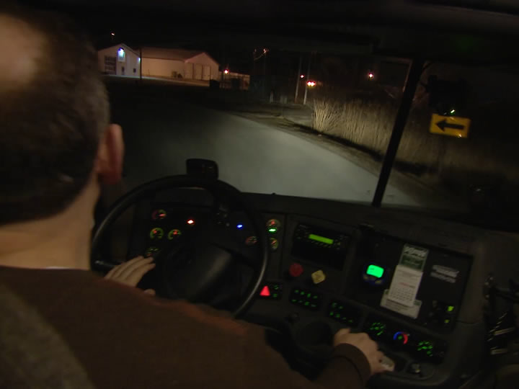
Your headlights can’t illuminate over hills or around curves, so slow down to an appropriate speed for the road you’re driving on.
Notes:
The terrain that you’re driving on can also present hazards when driving at night. Your headlights can’t illuminate over hills or around curves, so slow down to an appropriate speed for the road you’re driving on. Be sure to allow yourself adequate time to stop if a hazard appears in front of you as you round a curve or reach the crest of a hill.

Slide 19
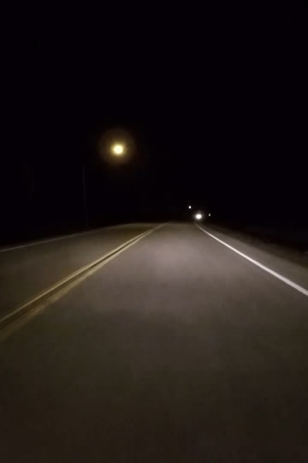
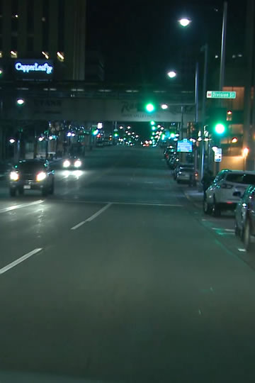
In rural areas, you need to depend solely on your vehicle’s headlights for lighting.
In urban areas, lighting levels can vary; your eyes will need to adjust accordingly.
Notes:
In rural areas, you need to depend solely on your vehicle’s headlights for lighting.
In urban areas, lighting levels can vary. Since levels vary, your eyes are required to adjust to different levels of lighting.
And, if weather conditions are contributing to reduced visibility, slow down even more. Giving up a little speed for an increase in safety is the right thing to do.
In addition to improving your chances of seeing others, make an extra effort to make sure others see you. Give other drivers time to react by increasing your following distance by at least one second at night. And, use your turn signals for every turn or lane change so your intentions are always clear.
ROAD RECOMMENDATION
As with other exercises, break your class into groups of three students per instructor. Each student should have at least 30 minutes behind the wheel for each exercise.
Rural driving
The purpose of this exercise is to allow students to practice keeping the vehicle within a narrow lane with poorly marked road edges and in the presence of oncoming vehicles.
Select a rural highway comprised of two-lane roads with narrow lanes, poorly marked road edges, and a lack of street lighting.
Watch for lane-maintaining errors including:
Drivers encroaching upon the left lane to avoid the right road edge
Right wheels dropping off the paved surface when meeting an oncoming vehicle
City driving
The purpose of this exercise is to allow students to practice tight maneuvers under nighttime conditions with intense background lighting.
Select an urban area with parked vehicles restricting the width of travel lanes, intersections that include the opportunity to turn left and right, and background lighting of a high level (store windows, signs, street lights, headlights of other vehicles).

Slide 20
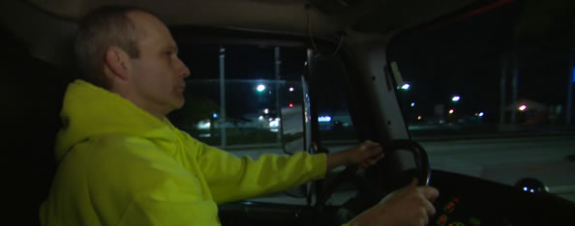
You, the Professional Driver
An important key to preparing for night driving is to be aware of your own visual limitations.
Notes:
An important key to preparing for night driving is to be aware of your own visual limitations. At night, your eyes will have to work harder to adjust to changes from light to dark and dark to light. Because your headlights don’t light the sides of the road, your side-to-side visibility is also reduced, and much of what you are able to see during the day is no longer visible.
VIDEO
13.4 — Night Driving Visual Limitations

Slide 21
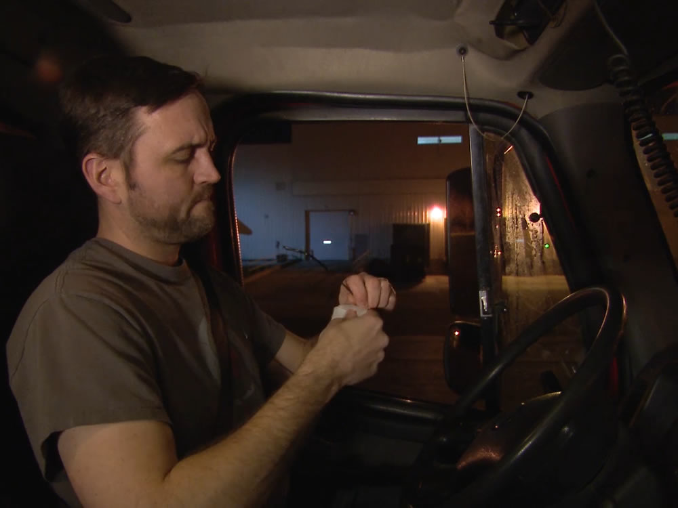
Dirty or scratched glasses can magnify glare at night. If you wear prescription glasses to drive, be sure they’re clean and free
of scratches.
Notes:
If you wear prescription glasses to drive, be sure they’re clean and free of scratches. Dirty or scratched glasses can magnify glare at night. It doesn’t make sense to clean your windshield thoroughly and then look through it with dirty glasses.

Slide 22
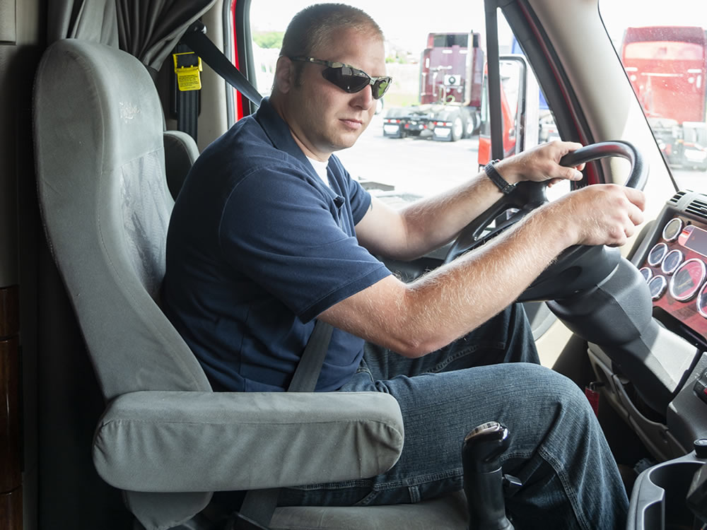
Wearing sunglasses during the day will help you see better at night and make the transition from day to night driving easier.
Notes:
Another helpful step whether you use prescription glasses or not, is to wear sunglasses during the day to reduce eye strain. This will help you see better at night and make the transition from day to night driving easier.
CALLOUT: Never wear sunglasses at night.

Slide 23
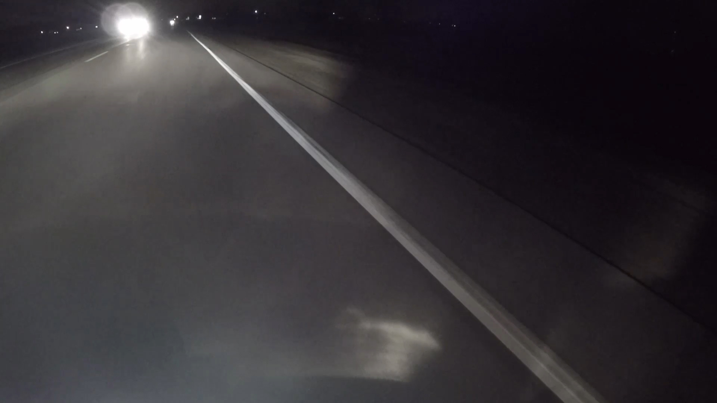
As oncoming vehicles approach, look to the right side of the road and watch for the white line. This will help you to stay on track and protect yourself from the glare that can temporarily impair your vision.
Notes:
As oncoming vehicles approach, look to the right side of the road and watch for the white line. This will help you to stay on track and protect yourself from the glare that can temporarily impair your vision. It can take several seconds for your eyes to recover from the effects of glare. This can be dangerous. At 55 miles per hour, a vehicle covers about 150 to 160 feet in two seconds. That is a substantial distance to drive with impaired vision.

Slide 24
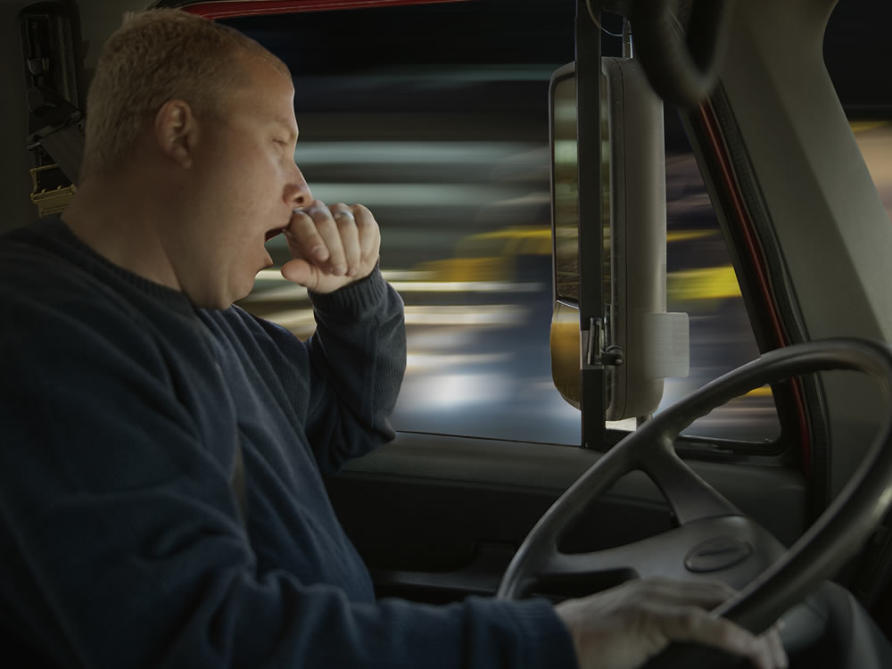
Drowsiness
Frequent or repeated yawning
Loss of visual focus
Fighting to keep your eyes open
Heavy/drooping head
Stiff or sore neck muscles
Lack of alertness
Poor memory recall
Weaving from lane to lane
Making bad driving decisions
Erratic speed control
Dozing off for a few
seconds at a time
Erratic shifting
Intermittent shifting
Following vehicles
ahead too closely
Notes:
One of the biggest hazards of night driving is fatigue. You need to be alert for other drivers who may be experiencing fatigue, but you also need to recognize how fatigue affects you. Fatigue can slow your reaction time to hazards and cause blurred vision. Some of fatigue’s warning signs include:
Drowsiness
Frequent or repeated yawning
Loss of visual focus
Fighting to keep your eyes open
Heavy/drooping head
Stiff or sore neck muscles
Lack of alertness
Poor memory recall
Weaving from lane to lane
Making bad driving decisions
Erratic speed control
Dozing off for a few seconds at a time
Erratic shifting
Intermittent shifting
Following vehicles ahead too closely
VIDEO
13.5 — Fatigue

Slide 25
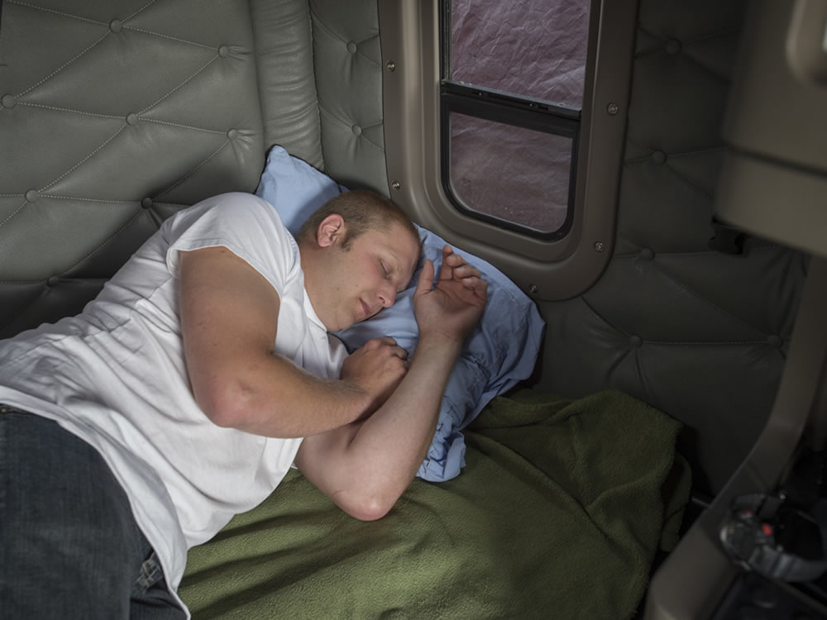
Make sure you are rested and alert.
Keep your
cab cool
Stop at regular intervals to rest
or stretch
Pull over and
get some sleep
when tired
Notes:
Make sure you are rested and alert. The cover of darkness can magnify the effects of fatigue, making night driving more dangerous. To combat fatigue when driving at night:
Keep your cab cool to help avoid the drowsiness that can come from sitting in a cab that’s too warm.
Stop at regular intervals (every couple of hours) to rest or stretch.
Pull over and get some sleep when tired. (It’s much safer to get some rest in the sleeper than to push yourself and put you, and the motoring public, in danger.)
Inexperience with operating a tractor-trailer under nighttime conditions is also a factor. As with all other aspects of driving this type of vehicle, the more practice and experience you have, the better you will be able to deal with the challenges of driving at night.
CALLOUT: Scan your mirrors. As well as maximizing visibility, this helps fight fatigue by helping you avoid staring at one point for a period of time.

Slide 26
Objectives Review
You should now be able to:
  Discuss the factors that affect the safe operation of CMVs at night as they relate to your truck, the road, and you, the professional driver
  Explain procedures that can help make
  driving at night safer
Copyright 2019 J. J. Keller & Associates, Inc.
Notes:
You should now be able to:
Discuss the factors that affect the safe operation of CMVs at night as they relate to your truck, the road, and you, the professional driver
Explain procedures that can help make driving at night safer
CLASSROOM RECOMMENDATION
Before concluding your training session, have participants take the corresponding quiz (found on the Trainer Tools USB) to check their understanding of the material. You can customize any of the questions to fit your audience or workplace. The answer key can also be found on the Trainer Tools USB.
You may also choose to administer the quizzes before you begin your training session to help get participants thinking about the subject and/or to gauge their understanding of the topic ahead of time.
RANGE RECOMMENDATION
As with other exercises, break your class into groups of three students per instructor. Each student should have at least 15 minutes behind the wheel.
Proper lane position
The vehicles on the range should be placed next to each other with enough space between the vehicles to safely operate.
The vehicles should proceed in the same direction with the drivers working to maintain a stable, suitable lane position. The drivers should also alternate between high and low beams to compare visibility.
Backing
The purpose of this exercise is to give students the opportunity to practice backing the vehicle under nighttime conditions.
As with other exercises, break your class into groups of three students per instructor. Each student should have at least 15 minutes behind the wheel
Prior to beginning the exercise, lay out an alley dock area by using cones and/or reflective tape.
Each student should take a turn backing into and pulling out of the alley dock area. The instructor and students observing should remain outside the vehicle on the driver’s side at a safe distance from the vehicle. Interrupt the backing maneuver if it veers too far off the mark or becomes dangerous. Point out the cause of the difficulties.
ROAD RECOMMENDATION
As with other exercises, break your class into groups of three students per instructor. Each student should have at least 30 minutes behind the wheel for this exercise.
Highway driving
The purpose of this exercise is to allow students to become accustomed to night driving in a relatively uncomplicated environment.
Select a route that has a limited amount of traffic, wide lanes, clearly discernible lane and edge markings, and uncontrolled intersections requiring entering or crossing traffic.
As well as continuing to stress the driving techniques covered in previous chapters, the students should be instructed in the importance of appropriate speed and position, important for passing situations.
As specific driving situations are approached (road signs, intersections, etc.), students should be instructed to dim headlights. This illustrates the difference in visibility when using low beam and high beam headlights.
The instructor and students should observe, discuss (if appropriate), and record errors in the areas of basic control, search, communication, and speed and space management. The following night driving specific errors should also be covered:
Failure to return lights to high beam after passing or overtaking a vehicle
Failure to dim headlights when meeting or overtaking another road user
Failure to reduce speed at night (when required) due to low visibility
Failure to increase following distance to compensate for reduced nighttime visibility
Acceptance of an insufficient gap when entering or crossing traffic

