Slide 1






PowerPoint® Instructions
This PowerPoint has been designed so you can easily customize it for your training session.
Throughout the presentation you’ll see icons with recommendations or videos to enhance the instruction you present to your students. A detailed explanation for each icon can be found on the next slide. Videos can be found on the Trainer Tools USB.
When you see an icon on the slide, look in the notes
section for further information.
Simply delete or move the icon off the slide before your training session begins.

Slide 2





Classroom Recommendations. Provides suggestions for enhancing your classroom presentation; from ideas for large group discussions to suggestions on the use of training aids such as examples or photos of vehicle parts and components to help illustrate the items covered within a chapter.
Lab Recommendations. Provides suggestions for activities and exercises that take place outside the classroom, but do not involve
the actual operation of the tractor-trailer or its components. Examples
of lab sessions include conducting a vehicle inspection or practicing mirror adjustment.
Range Recommendations. These recommended activities take
place on a closed-access driving range where students may practice driving skills in a controlled environment. Examples of range sessions include practicing shifting technique and successfully completing a backing maneuver.
Road Recommendations. These recommended activities take place in road and traffic conditions that support the chapter’s objectives. Examples of road sessions include proper communication with other drivers through the use of turn signals and basic vehicle control under nighttime or extreme weather conditions.
Videos. These short video clips reinforce material presented in the Student Manual. Use them to help students grasp difficult concepts or subject matter.

Slide 3
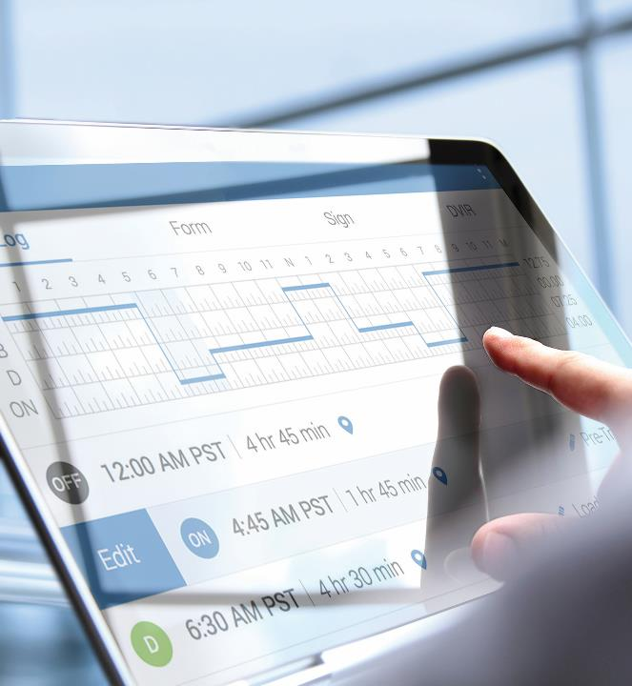
Hours of Service Requirements
23
Notes:
Chapter 23: Hours of Service Requirements
Unit A1.5.3 Hours of Service Requirements This unit must teach driver-trainees to understand that there are different hours-of-service (HOS) requirements applicable to different industries. The training providers must teach driver-trainees all applicable HOS regulatory requirements. The training providers must teach driver-trainees to complete a Driver's Daily Log (electronic and paper), timesheet, and logbook recap, as appropriate. The training providers must teach driver-trainees the consequences (safety, legal, and personal) of violating the HOS regulations, including the fines and penalties imposed for these types of violations.

Slide 4
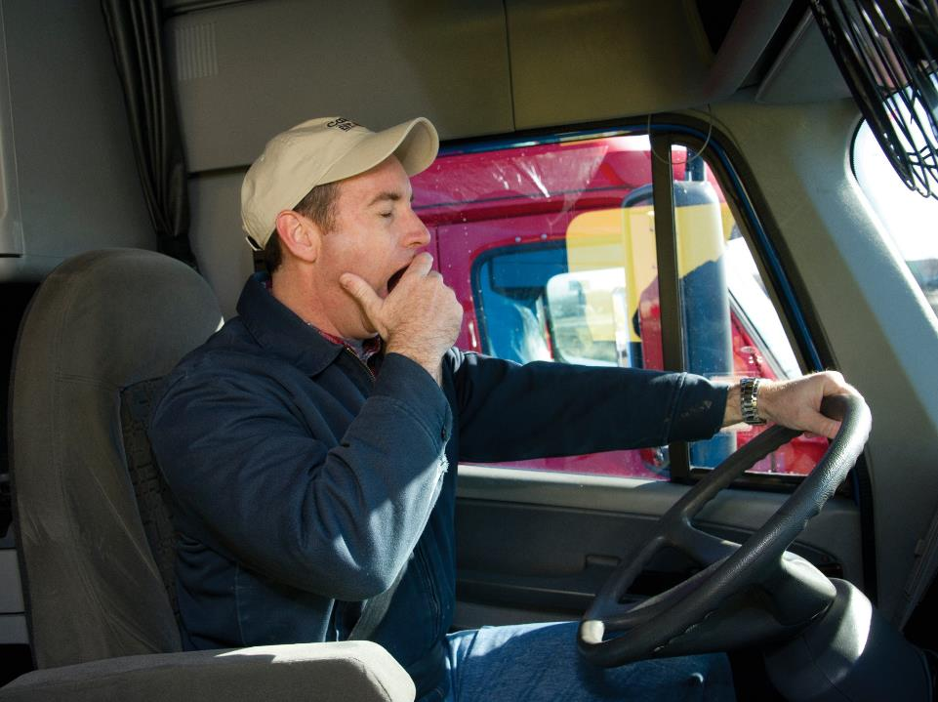
Introduction
Notes:
Introduction
The hours-of-service regulations are contained in Part 395 of the Federal Motor Carrier Safety Regulations (FMCSRs). They apply to commercial motor vehicles (CMVs) involved in interstate commerce and cover two areas:
Hours of service. The number of hours which drivers are allowed to drive and/or work in a given period of time. These are hours drivers must account for.
Driver’s record of duty status. What drivers use to keep track of their hours of service.
The specific requirements for drivers of property-carrying CMVs are covered in this chapter.
CLASSROOM RECOMMENDATIONS
Your classroom presentation should include the basic requirements of the regulations, the importance of compliance, and hands-on practice in keeping a record of duty status by using an electronic logging
device (ELD) and by using a paper log.

Slide 5
Objectives
Upon completion of this lesson, you will be able to:
  Recognize the purpose of the hours of service regulations and their impact on you
  Explain how to apply hours of service regulations, including on-duty and driving limits and the 34-hour restart provision
  Describe how to keep track of your hours of service using an electronic logging device or paper logs
  Identify which, if any, exceptions to hours of service apply to you
Notes:
Objectives
Upon completion of this lesson, you will be able to:
Recognize the purpose of the hours of service regulations and their impact on you
Explain how to apply hours of service regulations, including on-duty and driving limits and the 34-hour restart provision
Describe how to keep track of your hours of service using an electronic logging device or paper logs
Identify which, if any, exceptions to hours of service apply to you

Slide 6
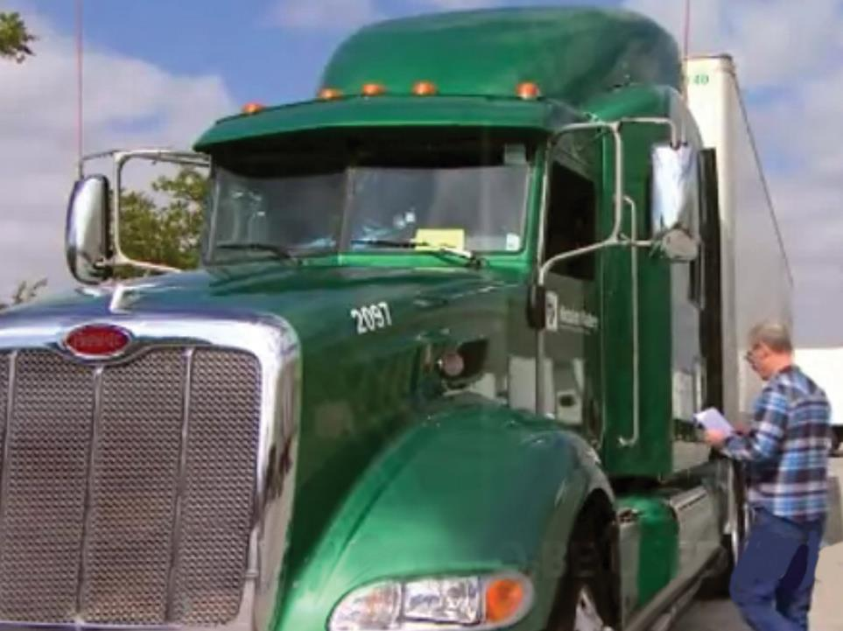
Who is Regulated?
Notes:
Who is Regulated?
The federal regulations concerning the hours-of-service requirements for drivers of property-carrying CMVs apply to you if your vehicle or combination of vehicles weighs or is rated at 10,001 pounds or more. Hours of service also apply if you transport hazardous materials in quantities large enough to require placards, no matter what the vehicle weighs or the vehicle rating.
Responsibility for compliance with the regulations lies with both you (the driver) and the carrier.

Slide 7
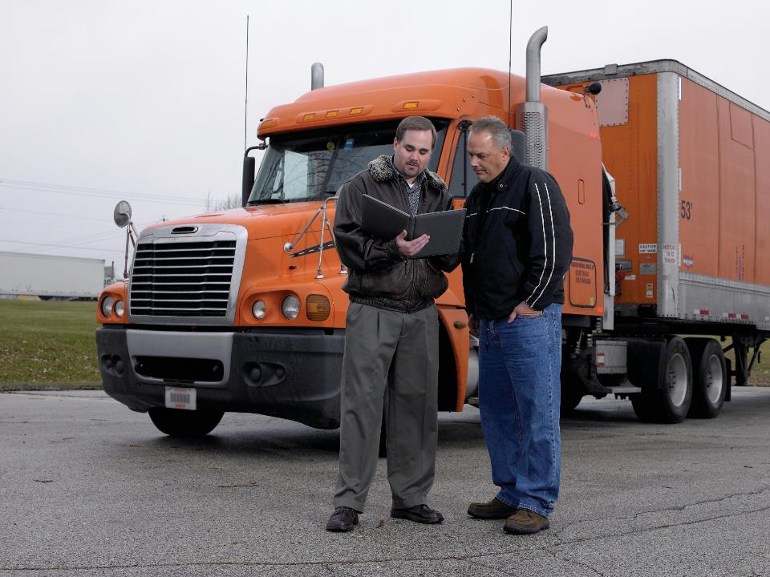
On-Duty & Off-Duty Time
Notes:
On-Duty & Off-Duty Time
In order to comply with hours-of-service regulations, you must understand the difference between being “on duty” and “off duty.” The distinction is critical if you want to stay in compliance. The more time you spend on duty, the more likely you won’t be able to do any more driving until you take some time off duty. In addition, drivers and carriers must track all of a driver’s on-duty time because too much time spent on duty can result in fatigue. Fatigue can lead to bad decisions and deadly crashes.
VIDEOS (see Trainer Tools USB)
23.1 — On-Duty Time
On-duty time is defined by the federal regulations as “all time from the time a driver begins to work or is required to be in readiness to work until the time the driver is relieved from work and all responsibility for performing work.”
The definition of on-duty time includes the following activities:
Waiting to be dispatched
Inspecting, servicing, or conditioning a CMV
Driving (all time spent at the controls of a CMV in operation)
Being in or on a CMV, other than:
time spent resting in or on a parked vehicle (except when attending to a commercial vehicle containing a Division 1.1, 1.2, or 1.3 explosive material)
time spent resting in the sleeper berth
up to three hours riding in the passenger seat of a property-carrying CMV moving on a highway immediately before or after a sleeper-berth period of at least seven consecutive hours
Loading or unloading a CMV
Repairing, obtaining assistance, or attending to a disabled CMV
Complying with drug or alcohol testing requirements
Performing any other work for a carrier
Performing compensated work for any other employer
Off-duty time includes time when you’re relieved of all duty or responsibility for performing work.
It also includes time when you’re free to choose your activities and free to leave the place where your vehicle is parked. Under certain conditions, time when you’re resting in the seat of your vehicle can also be considered off duty including the three hours before or three hours immediately after a seven-hour sleeper berth period which is spent in the passenger seat if you’re part of a driving team. To be counted as off-duty during this time, you must not be engaged in any work-related activity.
CALLOUT: Pay (or compensation) for a specific period does not dictate how your time should be logged. Pay does not automatically mean on-duty, and no pay does not automatically mean off-duty.

Slide 8
The Limits
Hours of Service Limits
14-Hour Limit
60/70-Hour Limit
Mandatory Break
11-Hour Limit
Notes:
The Limits
It is important to understand the definition of on-duty and off-duty time, so you can accurately determine how much duty time you have available under the regulations.
The hours of service regulations include four maximum limits:
14-Hour (duty) Limit
11-Hour (driving) Limit
60/70-Hour (on duty) Limit
Mandatory Break Provision
These limits are designed to keep fatigued drivers off the road and, in turn, reduce the number of fatigue-related crashes.
To begin, a driver may drive (or start his shift) only if he or she has been off duty for at least 10 consecutive hours.
14-Hour (on duty) Limit
A driver may drive only during a period of 14 consecutive hours after coming on duty (or starting his or her shift) after having been off duty for at least 10 consecutive hours. Once the driver has reached the conclusion of this 14-hour duty window, he or she may drive again only after another 10 consecutive hours off duty.
The 14-hour period is consecutive—it includes all on-duty and off-duty time accrued after coming on duty. Stopping for lunch or taking a break does not extend this 14-hour limit. Also, unforeseen events such as a breakdown or having to wait for an extended period to load or unload your vehicle does not extend this 14-hour limit.
The 14-hour limit is often misunderstood to mean that a driver must be released from duty after 14 hours. However, the hours‑of‑service rules only limit driving beyond 14 hours, not working beyond 14 hours. A driver can do non-driving work beyond the 14-hour limit, just no more driving.
CALLOUT: For example, if you begin your work day at 6:00 a.m. you may not drive a CMV after 8:00 p.m. You must have at least 10 consecutive hours off duty before you may then drive again.
11-Hour (driving) Limit
Of the 14 consecutive hours just discussed, 11 of those hours may be spent driving. All time spent at the driving controls of a CMV in operation is considered driving time, including time spent stationary in traffic delays on a public roadway. After 11 hours of driving time, you must have at least 10 consecutive hours off duty before you can drive again.
The rule does not limit a driver to 11 hours per calendar “day.” A driver could drive for more than 11 hours in one calendar day as long as he or she has 10 hours off after the first 11 hours of driving.
CALLOUT: Many states also have hours-of-service requirements that apply to intrastate operations within that specific state. State requirements may match federal requirements in whole or in part.
60-/70-Hour (on duty) Limits
The 60-hour limit states you must stop driving a CMV after you’ve accumulated 60 hours of on-duty time in a seven-day period. This rule applies to drivers who work for carriers that do not operate CMVs every day of the week.
The 70-hour limit states you must stop driving after you’ve accumulated 70 hours of on-duty time in an eight-day period. This limit applies to drivers who drive for carriers that operate at least one CMV every day of the week at any of the carrier’s locations.
All driving time and all on-duty time are counted toward your 60‑or 70-hour limit. You may continue to perform non-driving duties after you’ve hit either limit and not be in violation, but those hours must be added to the 7- or 8-day total.
Since this rule concerns a 7- or 8-day period, it’s useful to think about what constitutes a “day.” For this rule, a “day” is a 24-hour period, but each carrier can decide when the “day” begins—usually at midnight.
The important thing is the starting time of day selected by your carrier must match the starting time of day in your record of duty status.
The 60-hour or 70-hour period refers to the previous seven or eight days. It does not relate to a specific work week (such as a Sunday through Saturday). Thus, a driver doesn’t ever really “start over” counting total hours. The oldest day’s hours just drop out of consideration as each new day’s hours are added.
CALLOUT: For example, if you work under the 70-hour/8-day schedule, at the end of the day, you would add the hours worked (both on-duty and driving) during the last 7 days (today plus the preceding 6 days). If the total is 70 or more, you would have no driving hours available for the next day.
34-Hour Restart Provision
Drivers of CMVs are required to stop driving once they have accumulated 60 on-duty hours in any seven consecutive days, or 70 on-duty hours in any eight consecutive days (60-/70-hour limit). A driver who has reached this limit must take time off before getting back behind the wheel.
Drivers of property-carrying CMVs involved in interstate commerce have an option that allows them to reset their accumulated on-duty time. This option, known as the 34-hour restart provision, says that once a driver has a qualifying break of at least 34 consecutive hours, he may “restart” the seven-or eight-consecutive-day period. After the rest break, the on‑duty hours that were worked before that break no longer have to be considered when calculating the driver’s 60- or 70-hour limit. In other words, the driver’s accumulated on-duty time is “reset” back to zero.
A driver can use the 34-hour restart option no matter how many hours have accumulated against the 60- or 70-hour limit. Even if a driver exceeds the 60- or 70-hour limit, (such as by performing non‑driving work after reaching the limit) the driver can still reset his or her hours by using the restart option, without needing extra time off.
CALLOUT: “Running off your recap,” or hours you’re picking up at the start of a new “day” is an alternative to taking a 34-hour restart. Many drivers don’t realize a restart isn’t mandatory, it’s an option.
Mandatory Break Provision
According to the regulations, driving is not permitted if more than eight hours of driving time have passed without an interruption in driving status of at least 30 consecutive minutes.
This interruption in driving status must be at least a consecutive 30 minutes long and can be satisfied by either off-duty, sleeper-berth, or on-duty (not driving) time or any combination of off-duty, sleep-berth, or on-duty (not driving) time.
There is no limit on the number of breaks from driving a driver can take during the day. All breaks of less than 10 hours will count against the driver’s 14-hour limit. Breaks do not extend your workday.

Slide 9
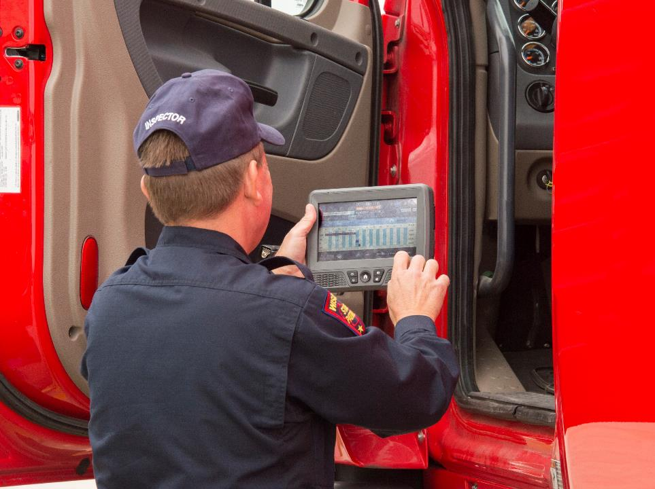
Record of Duty Status
Notes:
Record of Duty Status
In order to check your compliance with the hours-of-service limits, you must keep track of your hours of service. Enforcement officers and the FMCSA know you are complying with the hours-of-service regulations based on what you tell them on your records of duty status.
Electronic Logging Device (ELD)
A motor carrier must install and require its drivers to use an electronic logging device (ELD) that is registered with and certified by the FMCSA. All FMCSA-registered and certified ELDs are listed on the agency’s website.

Slide 10
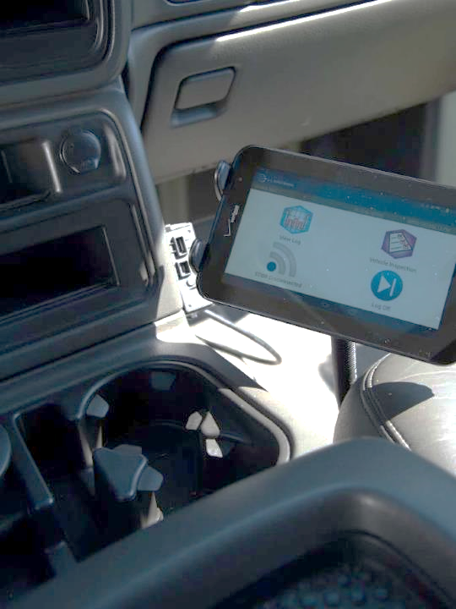
All portable devices must be mounted in the vehicle, within view while sitting in the driver’s seat.
Notes:
In-Cab Requirements
All portable devices must be mounted in the vehicle, within view while sitting in the driver’s seat. While the device must not allow entries to be made while the vehicle is in motion, you need to be able to see a malfunction indicator while driving so you know if the ELD is not operating correctly.
VIDEOS (see Trainer Tools USB)
23.2 — If Your ELD Fails
You must have the following items with you whenever the vehicle is in operation:
Records for the current day and the previous seven days in the ELD
The ELD user’s manual
An instruction sheet on data transfer during roadside inspections
An instruction sheet detailing malfunctions and the action to take
A supply of blank paper logs (at least eight days’ worth) to be used if the device fails
If the device fails , you’ll need to manually log the current day and reconstruct the previous seven days. Or, your carrier can provide the previous days’ records. However, you would need to have them in your possession before driving again in case of an inspection.
The only exception would be if the device could provide records for the previous days. In that case, you would be able to use the device to provide the previous seven days and show the officer a paper log for the current day.
CALLOUT: If a driver cannot present his or her records in the required format at the time of inspection, the driver will be in violation of the regulations. A malfunctioning logging device is not a valid excuse for not having records. The driver cannot avoid a violation by requesting his or her company send the records to the inspecting officer. The driver needs to have them in his or her possession at the time of inspection.
Data Capture
An ELD records a driver’s driving hours and duty status automatically. It captures required data at vehicle startup and shutdown, at all duty changes, once per hour while the vehicle is in operation, and when entering or ending a special driving category.
The data set must include:
Date and time
Location
Engine hours
Vehicle miles
Driver identification data
Vehicle identification data
Carrier identification data
Duty Changes & Driver Entries
When the vehicle stops, the default duty change will be to on duty, not driving. After being stopped for five minutes, the device will prompt the driver for a duty change. If the driver does not specify a duty change, the device will keep the driver on duty. This is the only non-driving duty change that can be done automatically. All other non-driving duty changes must be entered by the driver.
Duty changes to the driving line will be done automatically when the vehicle reaches five miles per hour, unless the driver has indicated in advance that he or she is entering one of the special driving categories. These categories greatly reduce unassigned drive time.
Personal use. When the driver is using a CMV as a personal vehicle to commute to a purely personal destination, the category personal use should be used if allowed by the carrier. The driving will be recorded by the device as off-duty time.
Yard move. When the driver is operating the vehicle off of the public roadway, the category yard move should be used if allowed by the carrier. The driving is captured as on-duty time and does not count toward the driver’s driving limit.
Along with duty changes, drivers will log in at the beginning of the day, enter their trailer and shipment numbers, and log out at the end of the day. The driver may also need to occasionally enter a location, if prompted.
If a vehicle moves without a driver being logged into the ELD, the ELD must prompt the driver to log in. When the driver logs in, the ELD must ask if any unassigned driving time in the device should be assigned to the driver. Any unclaimed unassigned driving time will remain displayed on the device until the driver’s carrier either assigns the time to another driver or adds an explanation about why it is unassigned.
CALLOUT: A parking lot or a yard may be considered a public roadway if travel by the public is not specifically prohibited by signs or a gate.
Creating the Record
As the day progresses, your ELD will combine the automatically collected data with your entries to create the ELD record for the day, or log. You’ll need to certify your log every 24 hours, generally at the end of your driving shift or before you start your next on‑duty work period.
CALLOUT: Leaving logs unverified for more than 24 hours may make it appear as if you’re doing so in order to adjust your time later based on how your days have gone. Don’t give that impression. Certify your logs in a timely manner. No matter what, logs must be submitted to your carrier within 13 days.
Edits
Under the rule, drivers are allowed to enter missing information and make edits to their records—just not drive time. The edit option should only be used to make corrections. Supervisors can request edits, but all supervisor proposed edits must be approved by the driver. Edits must include an explanation of why the change was made and indicate which user made the change.
Exceptions
All drivers who are required to complete a record of duty status, commonly referred to as a grid log, will need to use an ELD in place of other logging methods (paper logs) with a few exceptions.
The following are exempt from the ELD Mandate:
Drivers required to use a paper log on no more than eight days within any 30-consecutive-day period
Drivers operating in a driveaway-towaway operation in which the vehicle being driven is part of the shipment being delivered
Drivers operating in a driveaway-towaway operation in which the vehicle being transported is a motor home or recreation vehicle trailer
Drivers who are operating vehicles manufactured before model year 2000; verified through the vehicle’s VIN on the registration.

Slide 11
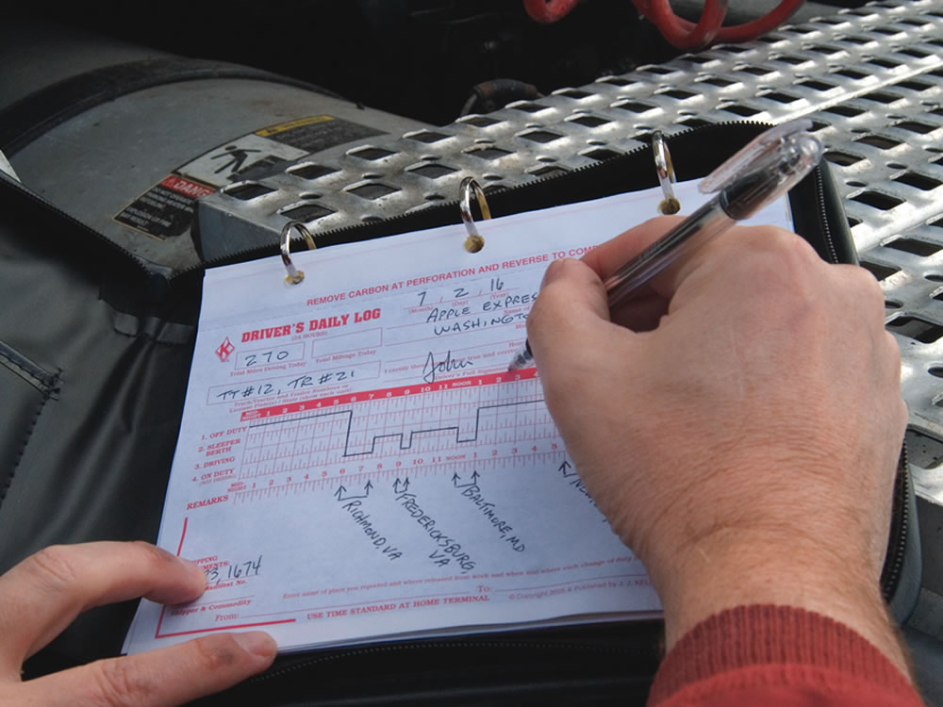
Paper log entries must be legible, in your own handwriting, filled out in duplicate, and current up to your last change of duty status.
Notes:
Paper Logs
Every driver required to complete a record of duty status needs to know how to correctly fill out a paper log. Even drivers using ELDs must be capable of performing this task in the event their ELD malfunctions and they are unable to enter or recover logs from their device.
VIDEOS (see Trainer Tools USB)
23.3 — Filling Out a Paper Log
Required Fields
Paper log entries must be legible, in your own handwriting, filled out in duplicate, and current up to your last change of duty status. Information like the company name and address may be pre-printed. All other required information must be completed by the driver.
The following fields are required on a typical paper log:
Graph Grid. The industry-standard (horizontal or vertical) graph grid on which to show your duty status for the day, including the words “Midnight” and “Noon” at the appropriate locations.
Date. Today’s date.
Total Miles Driving Today. The total number of miles you drove a CMV today.
Truck or Tractor & Trailer Number. The number(s) assigned to the CMVs you drove today, including trailer(s).
Name of Carrier. The name of the carrier(s) for whom you are driving.
Driver’s Signature/Certification. Your legal signature (generally the same as it appears on your license — it cannot be preprinted or made with a rubber stamp).
24-Hour Period Starting Time. The starting time for the 24-hour day covered by the log, usually midnight.
Main Office Address. The carrier’s main office address. It is the principal physical place of business designated by the carrier.
Remarks. A remarks area to record location for a change of duty status which is required. Most other remarks, such as pre-trip or post-trip are entered due to company policy and not required by FMCSA. However, “Remarks” are very helpful to understand any unique circumstances which can include the reason that a violation occurred.
Name of Co-Driver. The name of your co-driver, if there is one.
Total Hours. The total hours you spent in each duty status. The sum must equal 24 hours.
Shipping Document Number(s), or Name of Shipper & Commodity. Either a shipping document number OR the name of the shipper and commodity.
CALLOUT: The 24-hour starting period is selected by the driver’s home terminal.
Optional Fields
There are other fields commonly found on logs, but not required in the regulations. However, your company may require them under its policies.
“Total Mileage Today” is not the same as “Total Miles Driving Today.” This field usually only applies to teams. Use it to show the total miles that you traveled today, whether driving or riding as a passenger.
The “Home Terminal Address” is the location where you normally report for duty, which may differ from the main office address.
Note: your log must always be based on the time standard at your home terminal, no matter where you happen to be driving. You can only switch to a different local time if your home terminal changes. This may mean that the hour shown on a wall clock may not match where you are on your log.
The “From” and “To” fields are used to show your starting location and destination or turn-around point for the day.
The “Recap” section is used to keep track of where you stand on the 60- or 70-hour limits. While extremely useful for the driver, it is also an optional field.
Experienced drivers will tell you that, while not required, they use the recap section to track their compliance with the 60- or 70-hour limits on a daily basis.
The recap section on your log provides space for you to keep a running total of your accumulated hours. It tells you how many hours you’ve worked over the past 7 or 8 days (or since your last restart) and how much time you have available tomorrow before hitting the 60- or 70-hour limit.
While recaps come in many styles, the information you write into them is usually fairly standard.
Completing Your Record of Duty Status
You must complete the record of duty status in your own handwriting. Certain items, such as carrier name and main office address, may be preprinted.
There are four categories to use when recording your time:
Off duty
Sleeper berth
Driving
On duty (not driving)
The total in all four categories must add up to 24 hours.
The record must be legible and kept current to the time shown for the last change of duty status.
The location (city, town, or village and state) of all changes of duty status must be recorded in the remarks section.
If the change of duty status occurs at a location other than a city, town, or village, the location can be recorded as the:
The highway number and nearest milepost followed by the name of the nearest city, town, or village and state abbreviation
The highway number and the name of the service plaza followed by the name of the nearest city, town, or village and state abbreviation, or
The highway numbers of the nearest two intersecting roadways followed by the name of the nearest city, town, or village and state abbreviation
While an ELD records duty status in one-minute increments, a paper log grid is in 15-minute increments. To record non-driving activities that take just a few minutes on paper logs, you can flag them.
Flagging. When your activity is less than 15 minutes, you can “flag” it. This is done by drawing a line down to the Remarks area at the appropriate time(s) and entering the amount of time you spent on the activity and the location.
For example, if you drive from 9:00 a.m. until 2:00 p.m. but you stop for 6 minutes at noon to make a tire or cargo check along the way, you can draw a continuous “driving” line from 9:00 a.m. until 2:00 p.m., but at noon you draw a line down to the Remarks area and write “6 minutes, on duty,” and the location. Those 6 minutes do not have to be added to your driving time for the day (because they weren’t actually spent driving).
CALLOUT: Though not required by the regulations, many motor carriers have a policy that requires the driver to indicate the reason for a short stop (tire check, cargo check, fueling). Make sure you know your motor carrier’s policy on this issue.
CLASSROOM RECOMMENDATIONS
Log keeping exercise
In this exercise, you are to complete a daily log form for a 24-hour period based on the details listed below.
Your carrier is Another Trucking Company. Your main office address is St. Louis, Missouri.
You report to work at 7:30 a.m. today. You are assigned Tractor #367 and Trailer #1680. Your assignment for the day is to deliver a sealed load of miscellaneous freight from Cape Girardeau, Missouri to Joliet, Illinois.
After you review the shipping papers and trip instructions and conduct a pre-trip inspection, you are ready to be dispatched. The manifest number on the shipping papers is 162C and the shipper is Acme Goods.
At 8:00 a.m., you are dispatched and on the road. You drive 4 hours straight and stop for lunch at noon at a restaurant in Springfield, Illinois. You are off duty during this lunch break that ends at 1:00 p.m.
At 1:00 p.m. you spend 30 minutes fueling and checking your vehicle.
You are on the road again at 1:30 p.m. You arrive at the terminal in Joliet, IL at 4:30 p.m. You traveled 380 miles for the day. You spend the next 2 hours unloading the trailer, finishing your paperwork, and conducting a post-trip inspection. At 6:30 p.m. you are off duty and spend the night at a local hotel.

Slide 12
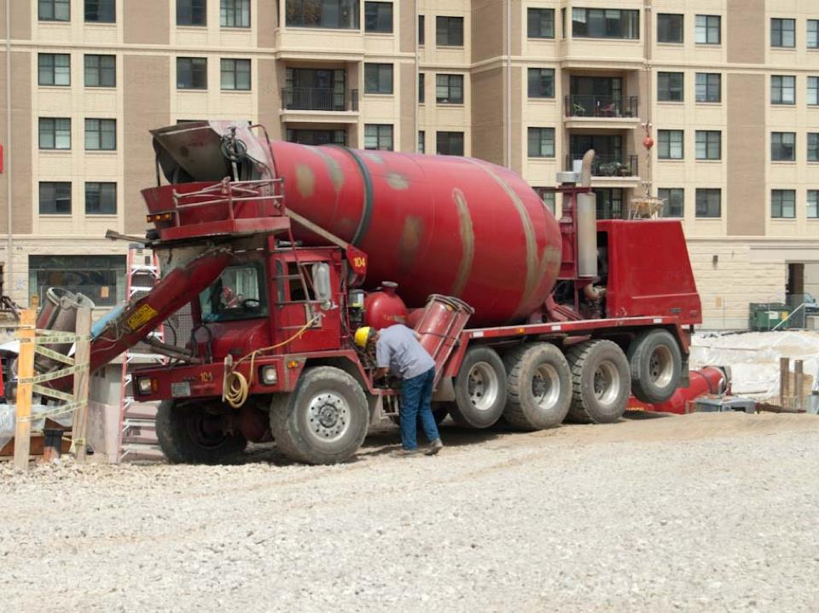
Exceptions
Notes:
Exceptions
The hours-of-service regulations include several exceptions. In general, these exceptions apply to certain types of industries (oilfield for example), types of operations (like local or short haul), and/or driving conditions (such as adverse weather). It is important to know which exceptions may apply to you and your operation as well as what criteria must be met to use the exceptions. Your carrier may allow you to use exceptions or prohibit you from using exceptions based on their policies and practices. You are not required to use exceptions.

Slide 13
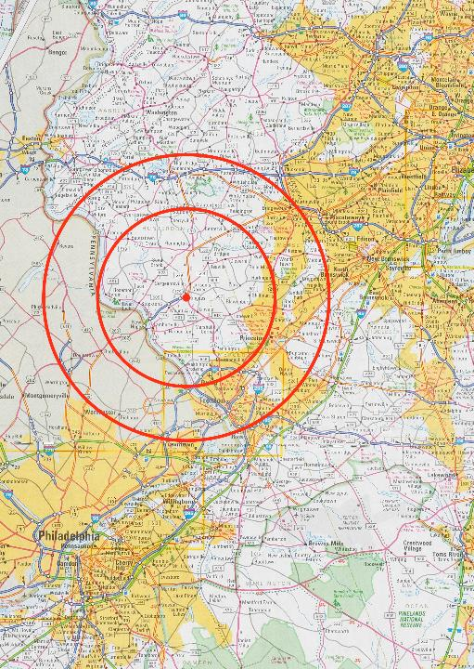
Short-haul exemptions
The red circles are used as a representation and may not be to scale.
Notes:
100 150 Air-Mile Radius (short-haul)
If you operate within a 100 150 air-mile radius (172.6 statute miles) of your normal work-reporting location, you are not required to comply with the mandatory break provision and may be exempt from the logging requirement. To use this exception, you must return to your work-reporting location and be released from duty within 14 hours. You must have at least 10 consecutive off-duty hours before working another 14 hours.
Your total daily hours as well as your start and stop time each day, must be tracked by your carrier and retained for at least six months. This information may be recorded on an exemption log, time sheet, time card, or any other form of documentation that shows the time you reported for and were released from duty as well as total number of hours.
Short-Haul (non-CDL)
If you are a short-haul operator who is not required to hold a CDL, works within a 150 air-mile radius (172.6 statute miles) of your normal work-reporting location, and returns to your normal work-reporting location each day (within the time limits), you can extend the 14-hour limit by up to two hours twice in a seven-day period and are not required to comply with the mandatory break provision. You are also exempt from keeping a record of duty status.
Your total daily hours and start and stop time each day, must be tracked by your carrier and retained for at least six months. This information may be recorded on an exemption log, time sheet, time card, or any other form of documentation that shows the time you reported for and were released from duty as well as total number of hours.
16-Hour Short Haul (“big day” exception)
For CDL-drivers of property-carrying CMVs who drive locally, there is an exception to the 14-hour rule which allows them to extend the 14-hour period by up to two hours once per week, under certain conditions.
A driver can drive a CMV after the 14th hour after coming on duty, but not after the 16th hour, if he or she:
Was released from duty at the normal work reporting location for the previous five duty tours
Returns to the normal work reporting location and is released from duty with 16 hours
Has not used this exception in the previous six consecutive days, except following a 34-hour restart

Slide 14
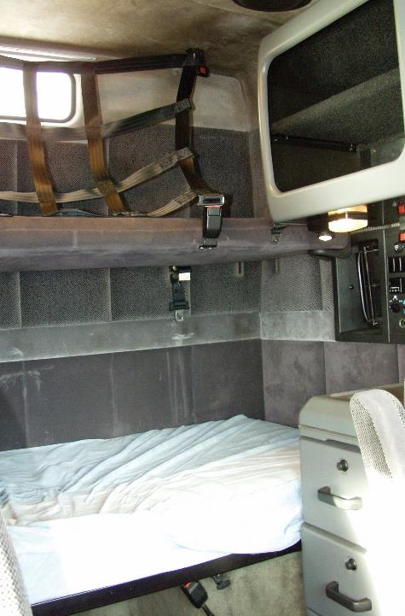
You can only record sleeper-berth time on your record of duty if the sleeper complies with regulations.
Notes:
Sleeper Berth
Instead of going “off duty,” drivers using CMVs equipped with qualifying sleeper berths can get their required rest by:
Entering the sleeper berth for 10 consecutive hours
Obtaining 10 consecutive hours of rest using a combination of off-duty and sleeper-berth time
Obtaining the “equivalent” of 10 hours of rest in two separate, non‑consecutive breaks
A “qualifying” or “regulation” sleeper berth is a sleeper berth that complies with Sec. 393.76 of the FMCSRs. You can only record sleeper-berth time on your record of duty status if the sleeper complies with that regulation.
Under option #2, the rest periods must be consecutive and not broken by any on-duty or driving activities.
Though perhaps the most confusing of all hours-of-service rules, option #3, (also known as the “split-sleeper” option) can be especially valuable for a team of drivers on a long haul, or when flexibility is required. Under this option, the equivalent of 10 hours can be accumulated by taking two rest periods, provided:
One of the rest periods is at least seven consecutive hours and is spent in the sleeper berth,
The other, separate rest period is at least two consecutive hours and is spent either in the sleeper berth, off duty, or a combination of the two, and.
Both periods total at least 10 hours (meaning a 7/3 or 8/2 split).
Driving time, in the period before and after each rest period, when added together:
• May not exceed the 11-hour driving limit, and
• May not violate the 14-hour duty limit.
The driving time limit and the 14-hour duty period limit must be re-calculated from the end of the first of the two periods.
Neither of the two rest periods count toward the 14-hour duty limit.
By using this option, a driver and co-driver team can keep their rig rolling right up to the time they reach their 60- or 70-hour limit.

Slide 15
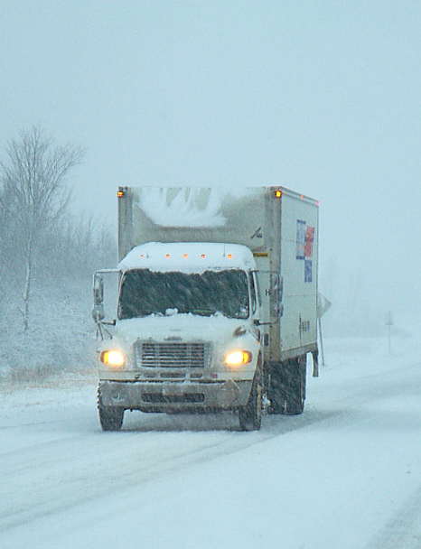
Adverse driving conditions do not include loading or unloading delays or conditions that were apparent.
Notes:
Adverse & Emergency Driving Conditions
Drivers who encounter adverse driving conditions that prevent them from safely completing their run within the 11-hour driving limit or 14 hour duty limit, increase their driving time and duty window by two hours to complete the run or reach a safe location.
The driver may not drive:
More than 13 hours following ten consecutive hours off duty; or
At the end of the 16th consecutive hour since coming on duty following ten consecutive hours off duty.
Adverse driving conditions do not include loading or unloading delays or conditions that were apparent to a:
• Driver immediately prior to beginning the duty day,
• Driver immediately before beginning driving after a qualifying rest break or sleeper berth period, or
• Motor carrier immediately prior to dispatching the driver.
Examples of conditions that were apparent include a predicted winter blizzard or rush hour traffic in a metropolitan area.
The emergency conditions exception is similar and states that in case of emergency, a driver may complete his or her run without being in violation if the run could have been completed absent the emergency. A shipper or consignee delay, mechanical breakdown, or a driver’s need to get home are not qualified emergencies.
Annotations with details in the Remarks section is very important when using either the adverse driving or emergency conditions exceptions.

Slide 16
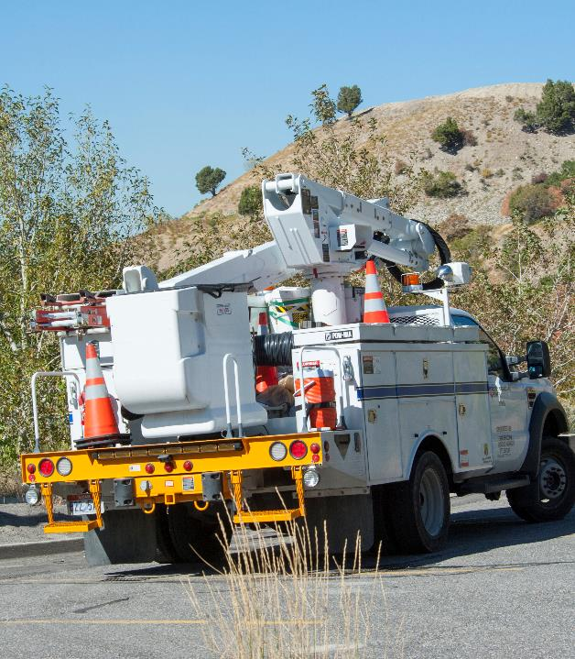
There are numerous other exceptions to the hours of service regulations.
Notes:
Hi-Rail Vehicles
If you drive an internal rail flaw detection vehicle equipped with flange hi-rails, the maximum on-duty limits in Sec. 395.3 of the FMCSRs (including the 14- and 60-/70-hour on-duty limits) do not include travel time to or from a duty assignment as long as that time does not exceed two hours per calendar day or a total of 30 hours per calendar month and is fully and accurately accounted for in company time records.
Other Exceptions
There are numerous other exceptions to the hours-of-service regulations. If any apply to you, check with your carrier and review the regulations for further details.
Other exceptions include:
Oilfield Operations
Utility Service Vehicles
Construction Material and Equipment
Agricultural Operations
Driver Salesperson
Motion Picture Drivers
Railroad Signal Employees
State of Alaska
State of Hawaii

Slide 17
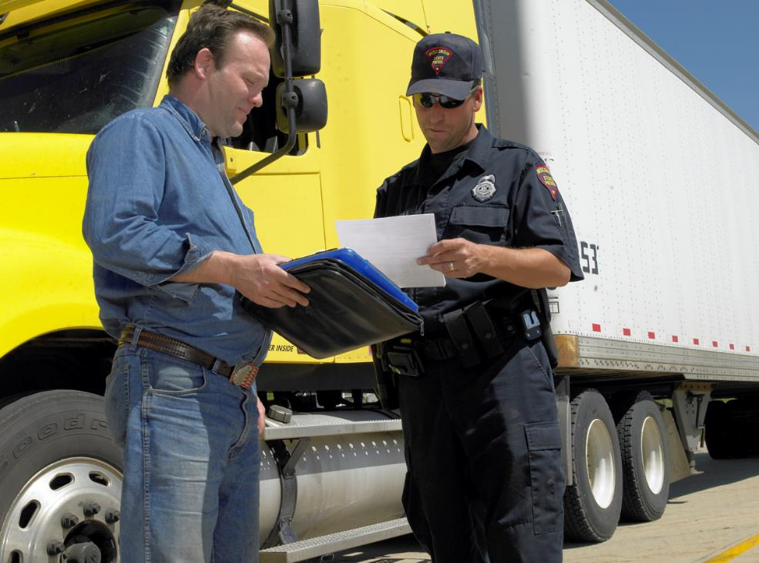
Consequences for Non-Compliance
Notes:
Consequences for Non-Compliance
The hours-of-service regulations are designed to promote safety for all road users by keeping fatigued drivers off the road. Not complying with the hours-of-service requirements can have serious consequences for both you and your motor carrier.

Slide 18

Hours of service violations can affect your and your carriers BASIC score.
Notes:
Impact on CSA BASIC Scores
Meeting the various on-duty, driving, and off-duty requirements of the hours-of-service rules and keeping an accurate, up-to-date record of duty status can be a challenge. The most common driver violations tracked in the FMCSA’s Compliance, Safety, Accountability (CSA) program are related to hours of service.
CSA is not a set of regulations — rather, it’s a system used to monitor and “score” your compliance with the existing rules, broken down into seven categories known as the BASICs (Behavior Analysis and Safety Improvement Categories). Your compliance with hours of service is scored in the “Hours of Service Compliance” BASIC. Whether your company has more or fewer violations than other companies is what will determine whether your company, and then you, get investigated by the FMCSA.
Having a trend with multiple and/or similar hours-of-service violations can add up to major problems for both drivers and carriers. Examples of violations under the Hours of Service Compliance BASIC include:
Operating when ill or fatigued
Driving after being declared out of service
Operating over hours
Keeping a false record of duty status
Having a record of duty status that is not current
Not maintaining a record of duty status when one is required, and
Failing to retain the previous seven days’ records of duty status
The driver and his or her carrier can both be held accountable for violations.

Slide 19
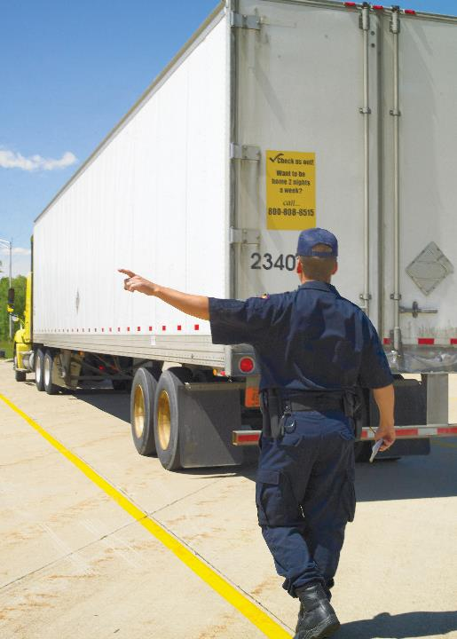
You can be declared out-of-service if you exceed maximum daily limits or fail to have a current record of duty status.
Notes:
Out-of-Service Criteria
You can be declared out of service by law enforcement for violating the out-of-service criteria, including:
Driving after being on duty in excess of the maximum duty limits, or
Failing to have a record of duty status current on the day of examination, and for the prior seven consecutive days
An out-of-service driver may not operate a CMV until he or she is in compliance with the hours-of-service limitations and recordkeeping requirements.
If the driver has been declared out of service for failing to maintain a record of duty status, he or she may not drive until having been off duty for the appropriate number of consecutive hours.
While out of service, the driver must still comply with the vehicle attendance and surveillance requirements if transporting hazardous materials.
A driver who has been declared out of service must deliver or mail a copy of the out-of-service notice to the person or place designated by the motor carrier. This must be done within 24 hours of notification.
CALLOUT: The majority of out‑of‑service orders are issued during roadside inspections.
CALLOUT: In addition to being placed out of service, a driver could receive a citation that results in fines and/or penalties.

Slide 20
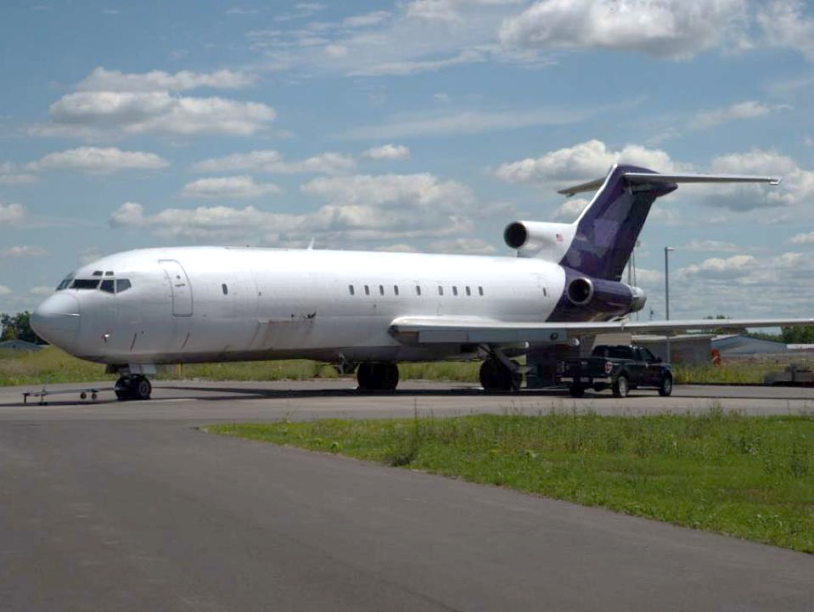
Travel Time
Notes:
Travel Time
Property-carrying drivers traveling to another location (not driving, but as a passenger) for their carrier must count this travel time as on-duty. However, if the driver takes at least 10 consecutive hours off duty upon arrival, he must be considered off duty for the entire period, which includes the travel time and the break time.
For example, you need to fly three hours away to pick up a truck and drive it back to your home terminal. If you land at the airport and go to a hotel to get 10 hours of rest before driving the vehicle back, then you can show all 13 hours as off-duty (three hours on the plane plus 10 hours off). But if you land and start the drive back without having 10 hours off, then the three hours spent flying must be counted as on-duty, not driving.

Slide 21
Objectives Review
You should now be able to:
  Recognize the purpose of the hours of service regulations and their impact on you
  Explain how to apply hours of service regulations, including on-duty and driving limits and the 34-hour restart provision
  Describe how to keep track of your hours of service using an electronic logging device or paper logs
  Identify which, if any, exceptions to hours of service apply to you
Copyright 2019 J. J. Keller & Associates, Inc.
Notes:
You should now be able to:
Recognize the purpose of the hours of service regulations and their impact on you
Explain how to apply hours of service regulations, including on-duty and driving limits and the 34-hour restart provision
Describe how to keep track of your hours of service using an electronic logging device or paper logs
Identify which, if any, exceptions to hours of service apply to you
CLASSROOM RECOMMENDATION
Before concluding your training session, have participants take the corresponding quiz (found on the Trainer Tools USB) to check their understanding of the material. You can customize any of the questions to fit your audience or workplace. The answer key can also be found on the Trainer Tools USB.
You may also choose to administer the quizzes before you begin your training session to help get participants thinking about the subject and/or to gauge their understanding of the topic ahead of time.

