Slide 1






PowerPoint® Instructions
This PowerPoint has been designed so you can easily customize it for your training session.
Throughout the presentation you’ll see icons with recommendations or videos to enhance the instruction you present to your students. A detailed explanation for each icon can be found on the next slide. Videos can be found on the Trainer Tools USB.
When you see an icon on the slide, look in the notes
section for further information.
Simply delete or move the icon off the slide before your training session begins.

Slide 2





Classroom Recommendations. Provides suggestions for enhancing your classroom presentation; from ideas for large group discussions to suggestions on the use of training aids such as examples or photos of vehicle parts and components to help illustrate the items covered within a chapter.
Lab Recommendations. Provides suggestions for activities and exercises that take place outside the classroom, but do not involve
the actual operation of the tractor-trailer or its components. Examples
of lab sessions include conducting a vehicle inspection or practicing mirror adjustment.
Range Recommendations. These recommended activities take
place on a closed-access driving range where students may practice driving skills in a controlled environment. Examples of range sessions include practicing shifting technique and successfully completing a backing maneuver.
Road Recommendations. These recommended activities take place in road and traffic conditions that support the chapter’s objectives. Examples of road sessions include proper communication with other drivers through the use of turn signals and basic vehicle control under nighttime or extreme weather conditions.
Videos. These short video clips reinforce material presented in the Student Manual. Use them to help students grasp difficult concepts or subject matter.

Slide 3
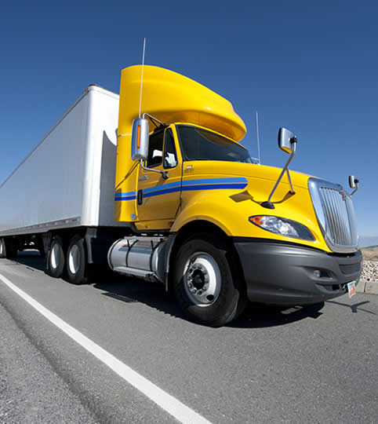
Orientation
1
Copyright 2019 J. J. Keller & Associates, Inc.
Notes:
Unit A1.1.1 Orientation
This unit must introduce driver-trainees to the combination vehicle driver training curriculum and the components of a combination vehicle. The training providers must teach the safety fundamentals, essential regulatory requirements (e.g., overview of FMCSRs and Hazardous Materials Regulations), and driver-trainees' responsibilities not directly related to CMV driving, such as proper cargo securement. This unit must also cover the ramifications, including driver disqualification provisions and fines, for non-compliance with parts 380, 382, 383, and 390 through 399 of the FMCSRs. This unit must also include an overview of the applicability of State and local laws relating to the safe operation of the CMV, stopping at weigh stations/scales, hazard awareness of vehicle size and weight limitations, low clearance areas (e.g., CMV height restrictions), and bridge formulas.

Slide 4
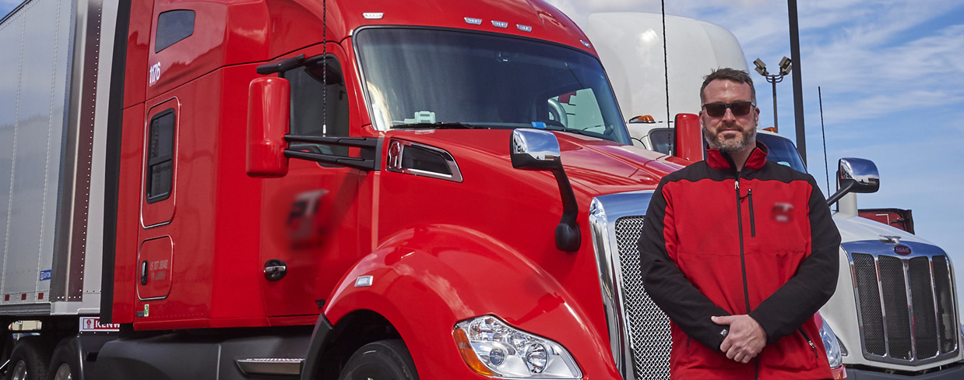
Introduction
We’ll introduce you to some of the basics of the trucking industry
Notes:
This chapter will introduce you to some of the basics when it comes to the trucking industry—how it is regulated, the qualifications you must meet, and some of the terms you need to understand.
CLASSROOM RECOMMENDATION
Begin your session by initiating a discussion on the trucking profession, the importance of the trucking industry, and the need for regulation. Also cover your school’s or company’s policies and procedures.
A large portion of this chapter covers regulatory requirements including driver qualification, driver disqualification, alcohol testing and drug testing, and size and weight limitations. This is intended to help your students understand the serious nature of this profession and affirm their decision to become a professional driver.
There may be instances from time-to-time when a student realizes he or she isn’t ready or isn’t qualified to become a professional driver. It is best to find this out at the start of training, as a student can terminate his or her instruction early on if necessary.

Slide 5
Objectives
Upon completion of this lesson, you will be able to:
  Identify the agencies responsible for regulating the trucking industry and explain the importance of complying with applicable laws and regulations
  Describe the procedure for obtaining a commercial driver’s license (CDL)
  Identify the required driver qualifications and what causes a disqualification
  Discuss alcohol and drug prohibitions and the types of testing drivers can expect under various circumstances
  Recognize the basic components of a combination vehicle and the size and weight limits established for traveling on the National Network
Notes:
Upon completion of this lesson, you will be able to:
Identify the agencies responsible for regulating the trucking industry and explain the importance of complying with applicable laws and regulations
Describe the procedure for obtaining a commercial driver’s license (CDL)
Identify the required driver qualifications and what causes a disqualification
Discuss alcohol and drug prohibitions and the types of testing drivers can expect under various circumstances
Recognize the basic components of a combination vehicle and the size and weight limits established for traveling on the National Network

Slide 6
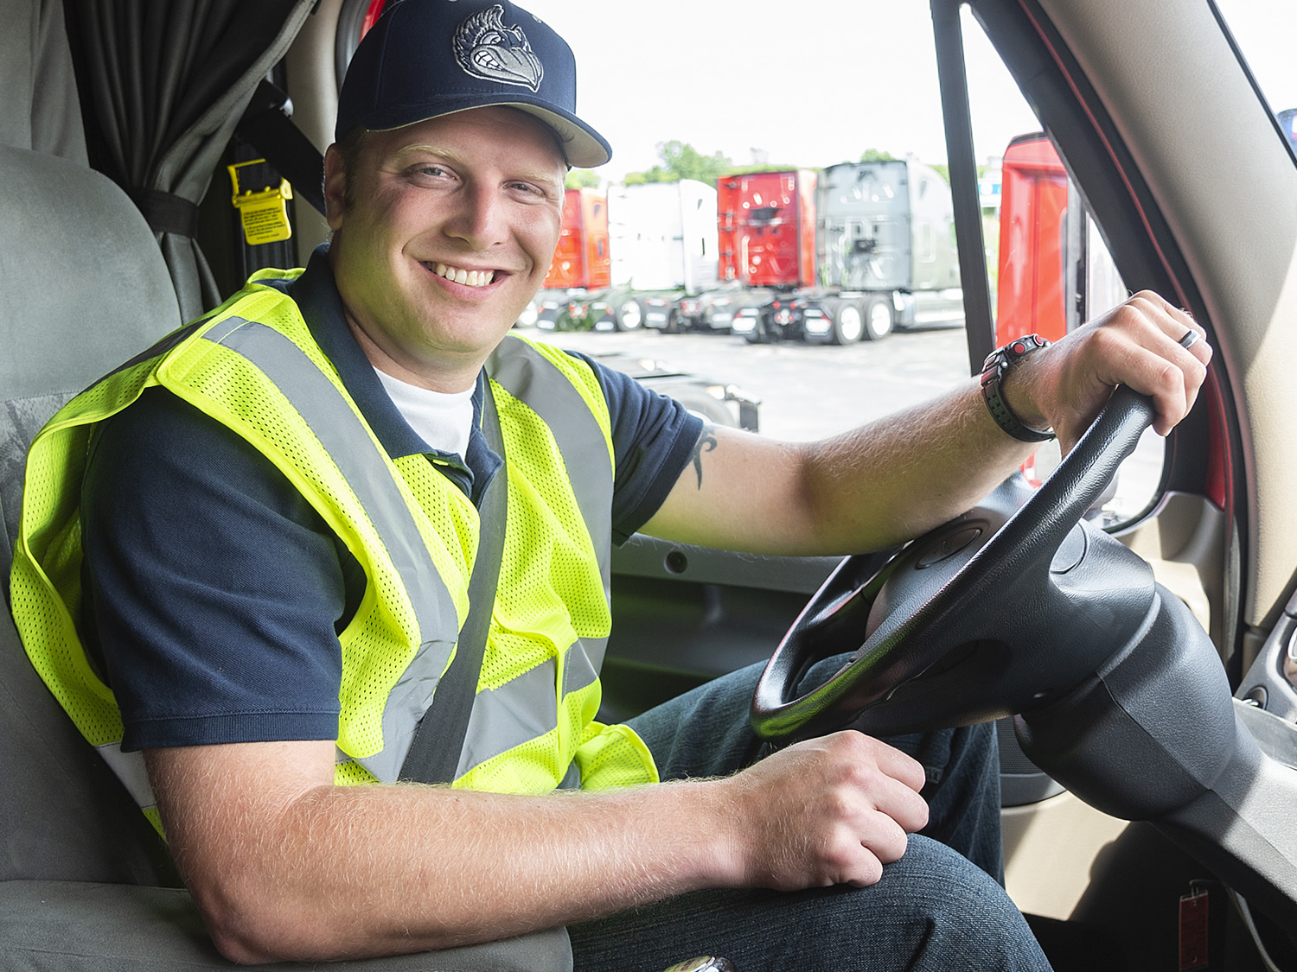
Welcome to the Trucking Industry

Slide 7
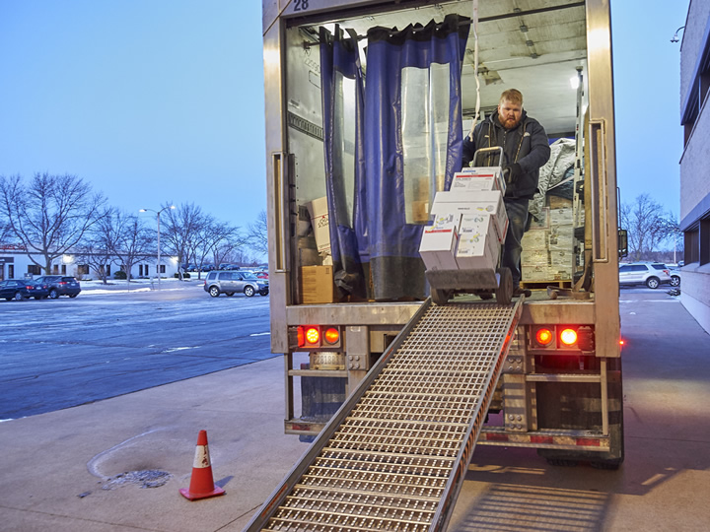
The trucking industry is essential to our nation’s economy.
Notes:
The trucking industry is essential to our nation’s economy. Trucks deliver everything from raw materials to manufacturers, to completed products to warehouses, stores, and homes. Trucks deliver seed and fertilizer to farms and food to our nation’s grocers. Virtually everything, at one time or another, is moved by a truck.

Slide 8

According to the American Trucking Associations (ATA), 10.42 billion tons of freight (primary shipments only) was transported by trucks in 2016. This represents
over two-thirds (70.6 percent) of total domestic
tonnage shipped.
Over seven million
people are employed
throughout the
economy in
trucking-related
jobs, including
3.5 million drivers.
*Source: American Trucking Associations (ATA)
Notes:
According to the American Trucking Associations (ATA), 10.42 billion tons of freight (primary shipments only) was transported by trucks in 2016. This represents over two-thirds (70.6 percent) of total domestic tonnage shipped.
Over seven million people are employed throughout the economy in trucking-related jobs, including 3.5 million drivers.*
*Source: American Trucking Associations (ATA)

Slide 9
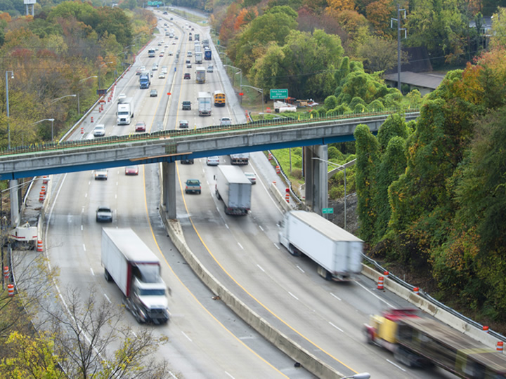
Interstate vs. Intrastate
Notes:
A motor carrier may operate in interstate commerce, intrastate commerce, or both. When determining whether transportation is considered interstate or intrastate, you need to look at two things; first the actual movement of the driver, vehicle, and its contents, and second the intent and movement of the shipment.

Slide 10
Interstate | Intrastate
Crossing state lines | Hauling cargo within a state and never crossing a state line
Traveling across U.S. borders into/from Canada or Mexico | The cargo’s trip beginning and ending in the same state
Traveling between two places within a state, but the cargo is part of a trip that began or will end in another state or foreign country | The cargo not crossing state lines by any form of transportation such as rail, air, ship, or truck

Slide 11
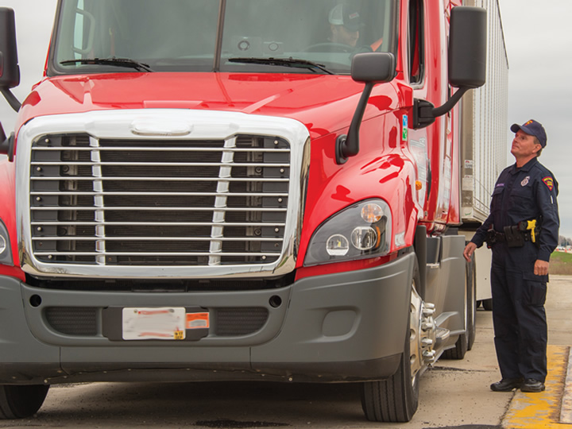
A Regulated Industry
Notes:
The trucking industry is subject to government regulation, intended in part to ensure safety for those in the industry as well as the general motoring public. Part of being a professional driver is knowing and complying with the regulations that affect you and your industry.

Slide 12

Federal Motor Carrier Safety Administration (FMCSA)
An agency of the USDOT that issues and enforces the bulk of the regulations (FMCSRs) interstate motor carriers and drivers must follow
Notes:
The Federal Motor Carrier Safety Administration (FMCSA) is an agency of the U.S. Department of Transportation (USDOT) that issues and enforces the bulk of the regulations interstate motor carriers and drivers must follow. These regulations are commonly referred to as the Federal Motor Carrier Safety Regulations (FMCSRs).

Slide 13

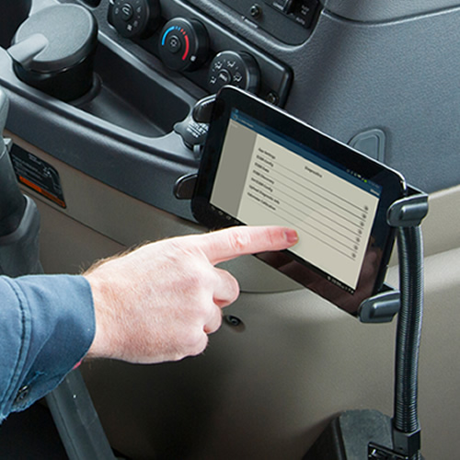
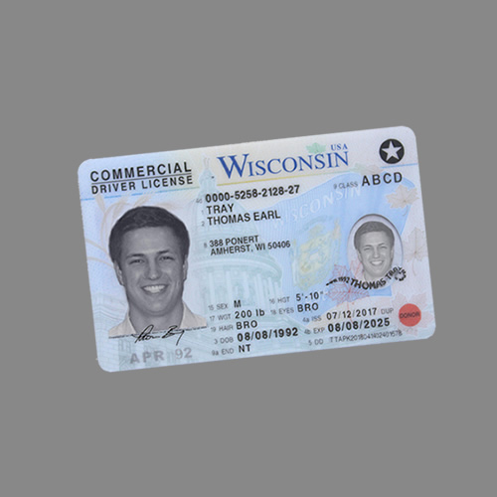
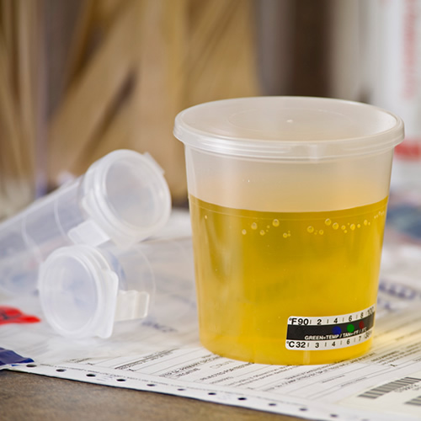
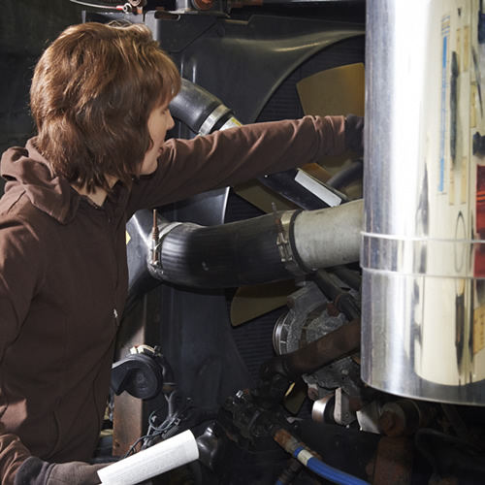
Federal Motor Carrier Safety Regulations (FMCSRs)
DRIVER QUALIFICATION & DISQUALIFICATION
HOURS OF SERVICE
COMMERCIAL DRIVER’S LICENSE STANDARDS
DRUG & ALCOHOL TESTING
VEHICLE CONDITION & INSPECTIONS
Notes:
The FMCSRs establish basic safety rules and standards for motor carriers, drivers, other employees of motor carriers, and commercial motor vehicles (CMVs). Topics covered in the FMCSRs include:
Driver qualification and disqualification
Hours of service (HOS)
Commercial driver’s license (CDL) standards
Drug and alcohol testing
Vehicle condition and inspections
Most states adopt at least some of the FMCSRs for intrastate operations. Since requirements vary from state-to-state, it is your responsibility to understand the regulations of the state you’ll be traveling in before you hit the road.

Slide 14
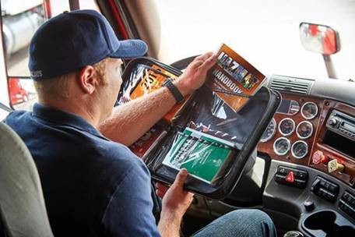
Pipeline and Hazardous Materials Safety Administration (PHMSA)
An agency of the USDOT that issues and enforces the bulk of the Hazardous Materials Regulations (HMRs)
Notes:
The Pipeline and Hazardous Materials Safety Administration (PHMSA) is an agency of the USDOT that issues and enforces the Hazardous Materials Regulations (HMR). The HMRs are located in 49 CFR Parts 105 to 180 and apply to individuals who offer for transport hazardous materials including individuals responsible for their preparation and transport, and those transporting these materials.

Slide 15
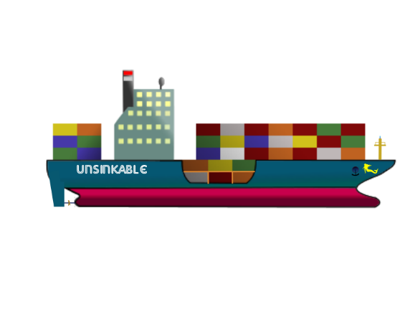
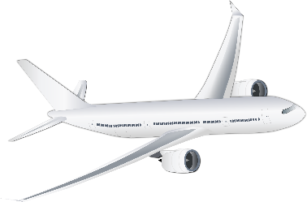
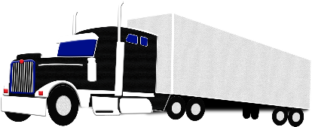
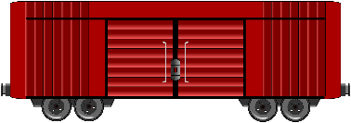
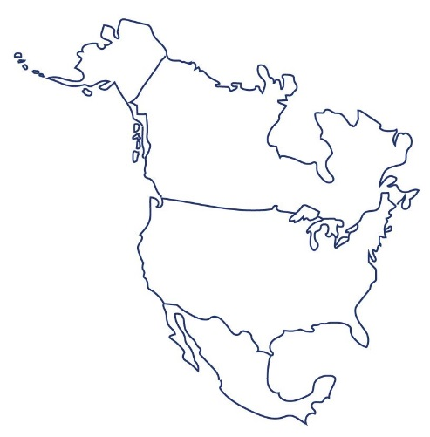


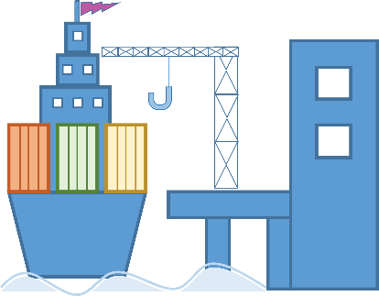
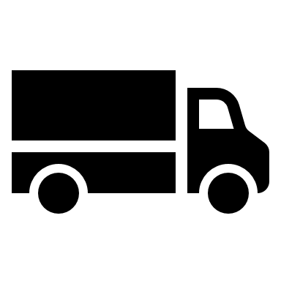
HMRs apply when:
HMRs apply when hazardous materials are offered in commerce for transport to, and transported by:
RAIL
AIR
MOTOR VEHICLE
VESSEL CARRIER
INTERSTATE
INTRASTATE
FOREIGN CARRIERS
Notes:
The regulations apply when hazardous materials are offered in commerce for transport to, and transported by:
Rail, air, motor vehicle, and vessel carriers
Interstate, intrastate, and foreign carriers

Slide 16
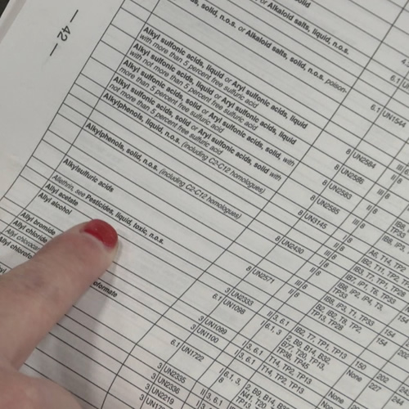
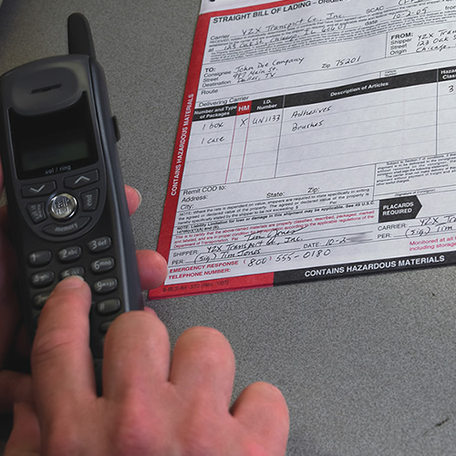
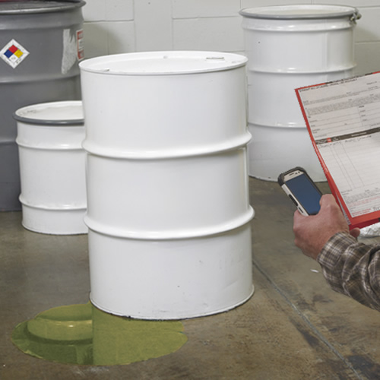
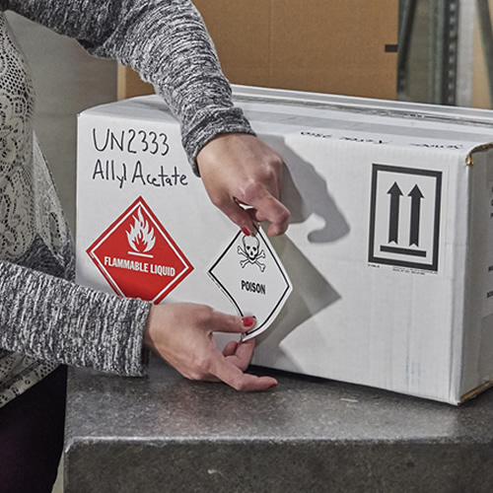

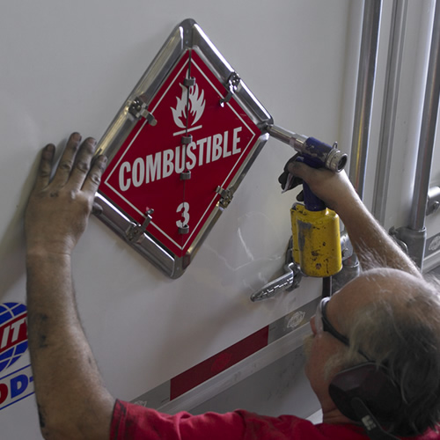
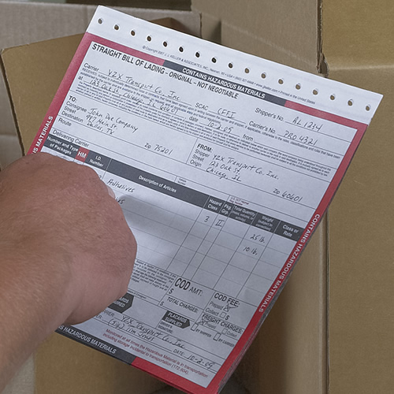
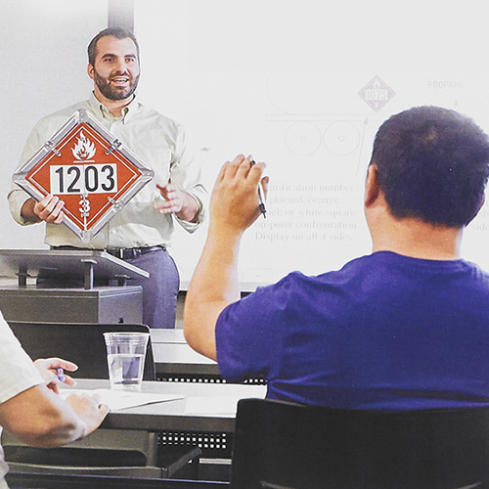
The HMRs address:
CLASSIFICATION
EMERGENCY RESPONSE
INCIDENT NOTIFICATION & REPORTIING
LABELING
MARKING
PLACARDING
SHIPPING PAPERS
TRAINING
Notes:
The HMRs address several issues including:
Classification
Emergency response
Incident notification and reporting
Labeling
Marking
Placarding
Shipping papers
Training

Slide 17
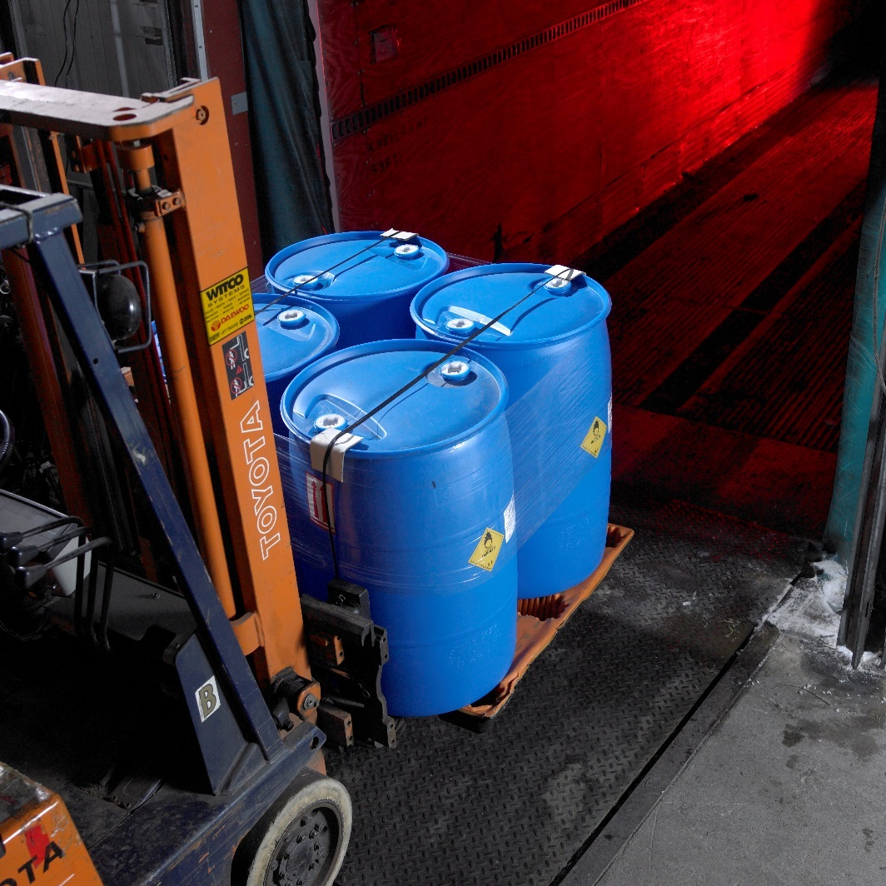
Other Regulations
Drivers and their carriers are also responsible for complying with other regulations that apply to their industry, including workplace safety, environmental, and tax laws.
Notes:
Drivers and their carriers are also responsible for complying with other regulations that apply to their industry, including workplace safety, environmental, and tax laws.

Slide 18
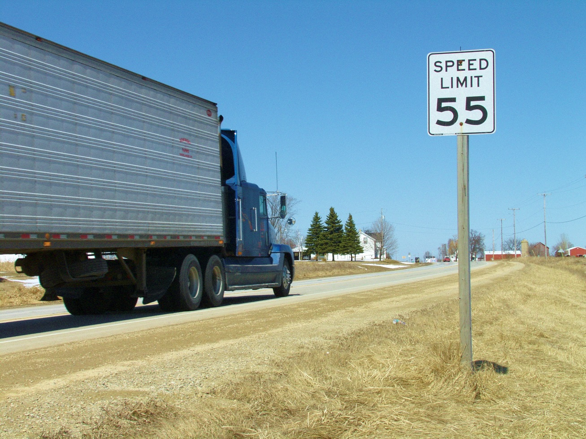
State & Local Laws & Regulations
You are subject to state and local laws and regulations.
Notes:
In addition to complying with the FMCSRs, HMRs, and other regulations that apply to the industry, you are also subject to state and local laws and regulations. Requirements range from speed limits to idling laws to routing. It is important to be aware of and follow the requirements for the areas in which you travel.

Slide 19
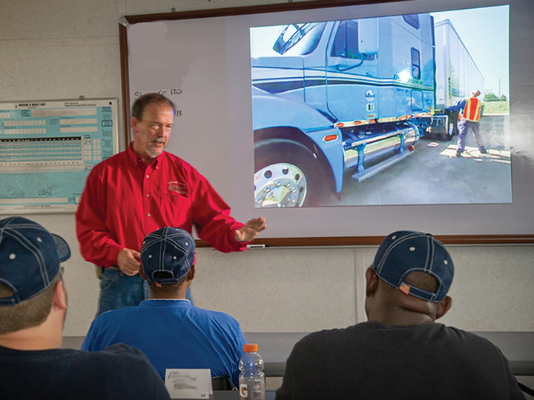
Getting Your CDL
Notes:
To become a professional driver, you must get a commercial driver’s license (CDL). In order to accomplish that, you must first get a commercial learner’s permit (CLP).

Slide 20
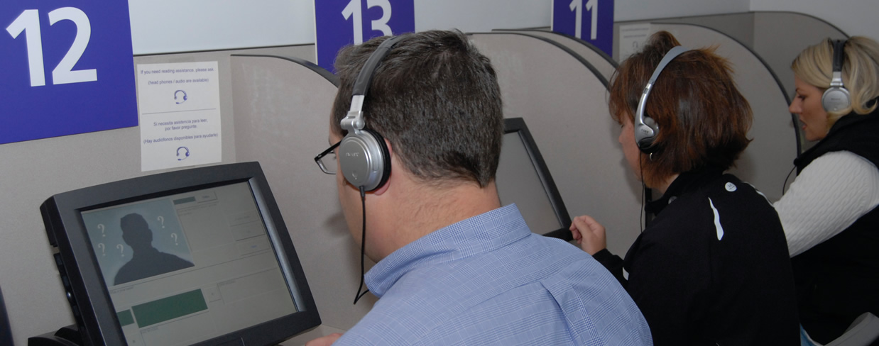
Commercial Learner’s Permit (CLP)
You must pass a general knowledge test for the class of vehicle you plan drive
Notes:
A CLP allows for behind-the-wheel training on public roads and highways.
In order to get a CLP, you must be at least 18 years old, and you must pass a general knowledge test for the class of vehicle you plan drive. You will also have to pass written tests for a combination vehicle and air brakes if the vehicle you will be driving is a combination and/or has air brakes.

Slide 21
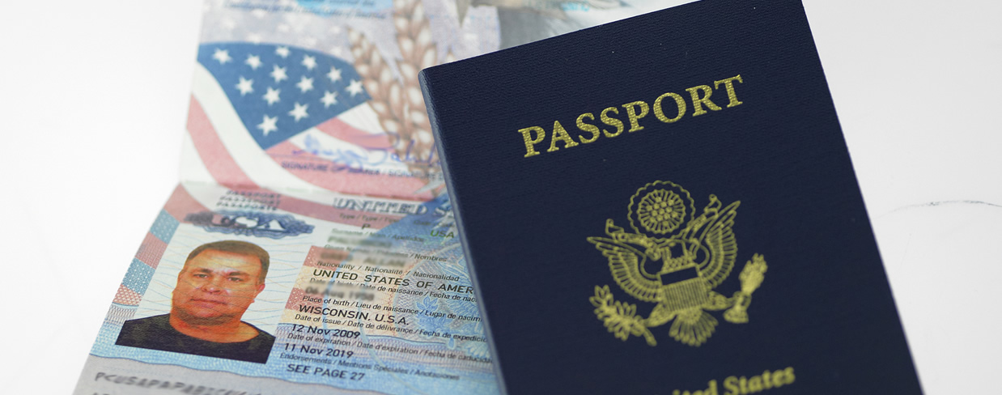
Additional requirements include:
Certifying you are not subject to disqualification
Providing proof of citizenship
Completing the CDL/med card merger process
Notes:
There are additional requirements that must be met as part of the CLP application process, including:
Certifying that you are not subject to disqualification
Providing proof of citizenship
Completing the CDL/med card merger process
Complete details are listed in your state’s CDL manual, issued by your state’s licensing agency.

Slide 22
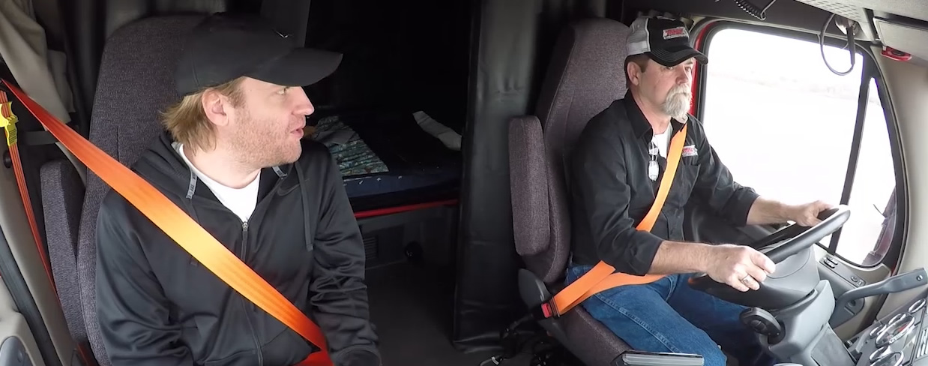
Commercial Learner’s Permit (CLP)
The CLP holder must always be accompanied by the holder of a valid CDL
Notes:
When operating a CMV, the CLP holder must always be accompanied by the holder of a valid CDL who has the proper class and endorsement(s) necessary to operate the CMV. The CDL holder must directly supervise the CLP holder by being in the front passenger seat of the vehicle, next to the CLP holder.
A CLP holder is not eligible to take the CDL skills test in the first 14 days after the issuance of the CLP.
CALLOUT: Beginning February 7, 2022, a CLP holder will need to successfully complete an entry-level driver training program before taking the CDL skills test.

Slide 23
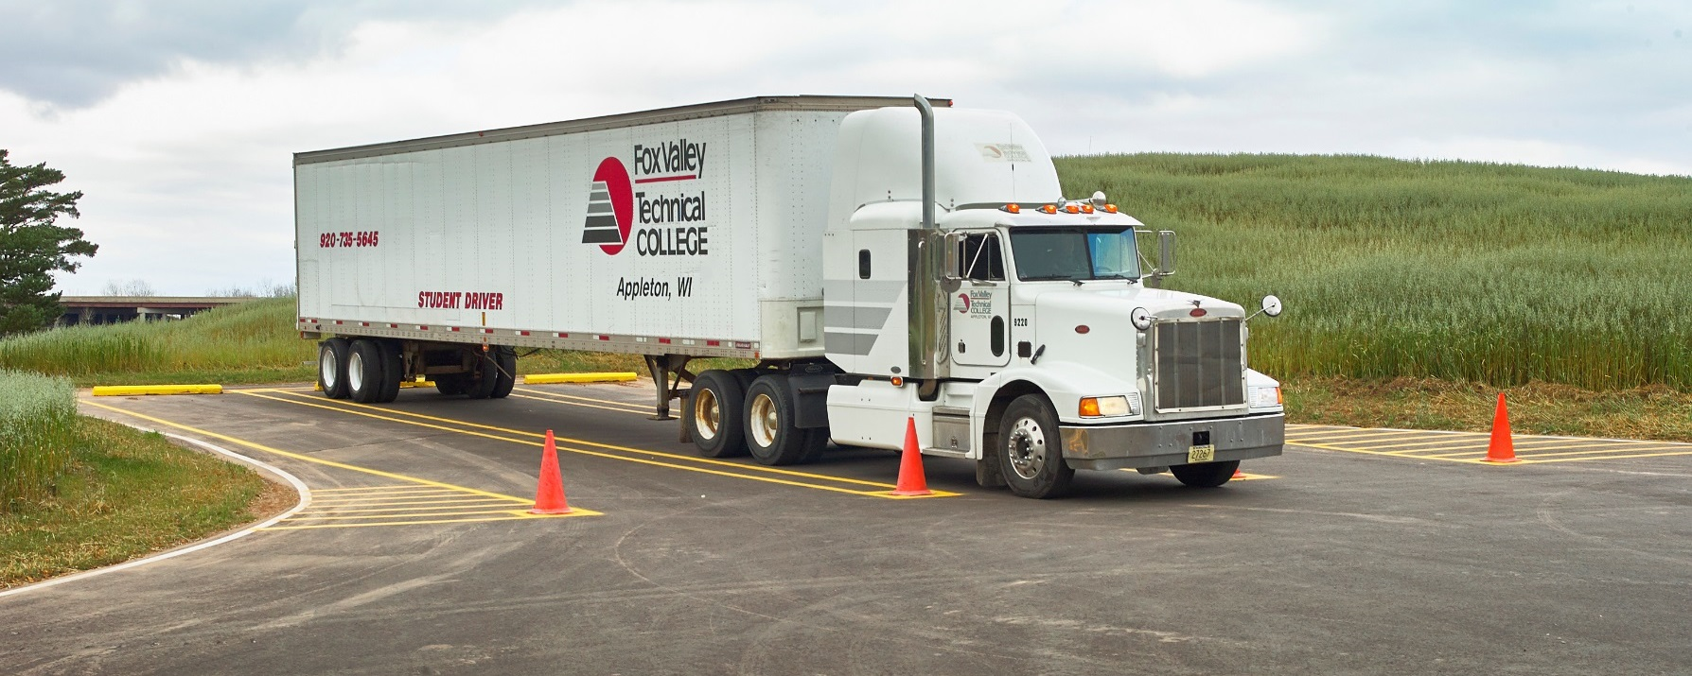
Commercial Driver’s License
You must be at least 21 years old
You need to pass a skills test
You have to provide paperwork
Notes:
In order to get your CDL, you must be at least 21 years old (to operate in interstate commerce), and will need to pass a skills test in a motor vehicle that is the type you want to operate. In other words, if you want to operate tractor-trailers that require a Class A CDL (see table below), you will need to take your skills test in a tractor-trailer.
You will also have to provide documentation and paperwork similar to the documentation and paperwork you provided when you applied for your CLP. Consult your state’s CDL manual, issued by your state’s licensing agency, for complete details.

Slide 24
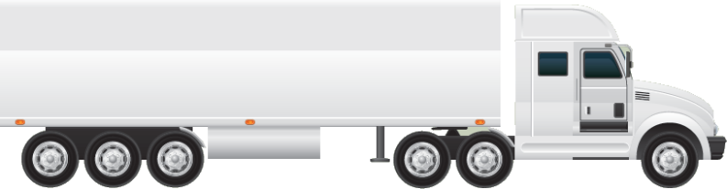
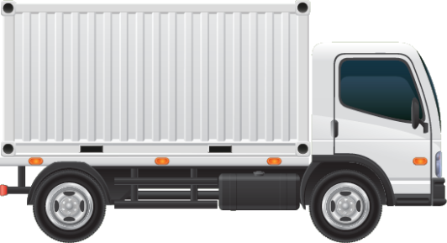
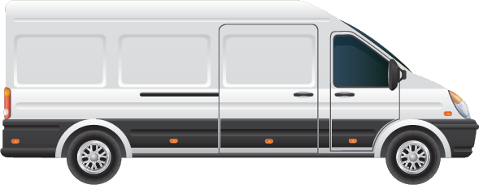
CDL Class/Group | Description
Class A (Combination Vehicle) | Any combination of vehicles with a GCWR of 26,001 pounds or more provided the GVWR of the vehicle(s) being towed is more than 10,000 pounds.
Class B (Heavy Straight Vehicle) | Any single vehicle with a GVWR of 26,001 pounds or more, or any such vehicle towing a vehicle not over 10,000 pounds GVWR.
Class C (Small Vehicle) | Any single vehicle, or combination of vehicles that doesn’t meet the definition of Class A or Class B, but is: Designed to transport 16 or more passengers (including the driver), or Used in the transportation of hazardous materials
Notes:
There are three CDL classes (sometimes referred to as groups). The classes are determined by the vehicle’s gross vehicle weight rating (GVWR) or gross combination weight rating (GCWR). The classes/groups are as follows :

Slide 25
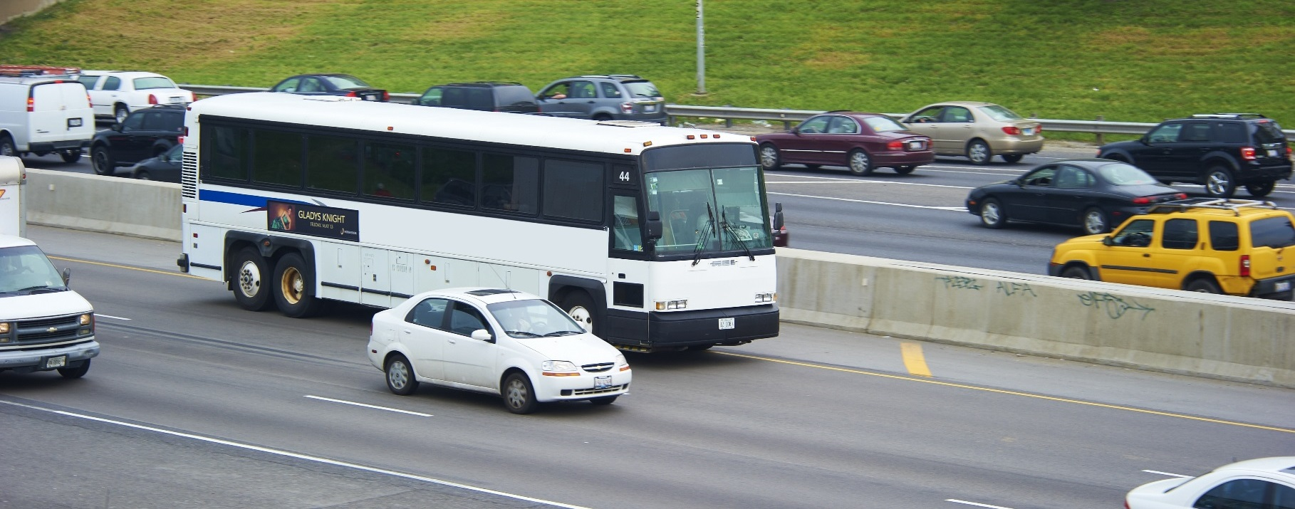
Endorsements
You must take and pass a specialized written and/or skills test for each endorsement
Notes:
You must obtain an endorsement (or endorsements) on your CLP or CDL if you plan on operating certain, specialized types of vehicles.
If you plan on driving a CMV that requires an endorsement on your CLP or CDL, you must take and pass a specialized written and/or skills test for each endorsement.
CALLOUT: The only endorsements allowed on a CLP are passenger, school bus, and tank.

Slide 26
Endorsement | Description | Written Test | Road/Skills Test
H | Hazardous Materials | X
N | Tank | X
P | Passenger | X | X
S | School Bus | X | X
T | Double/Triple Trailer | X
X | Tank and Hazardous Materials | X
Notes:
To obtain a hazardous materials endorsement, you must also comply with Transportation Security Administration (TSA) requirements. This includes providing proof of citizenship or lawful permanent residency and submitting to criminal history and intelligence-based background checks.

Slide 27
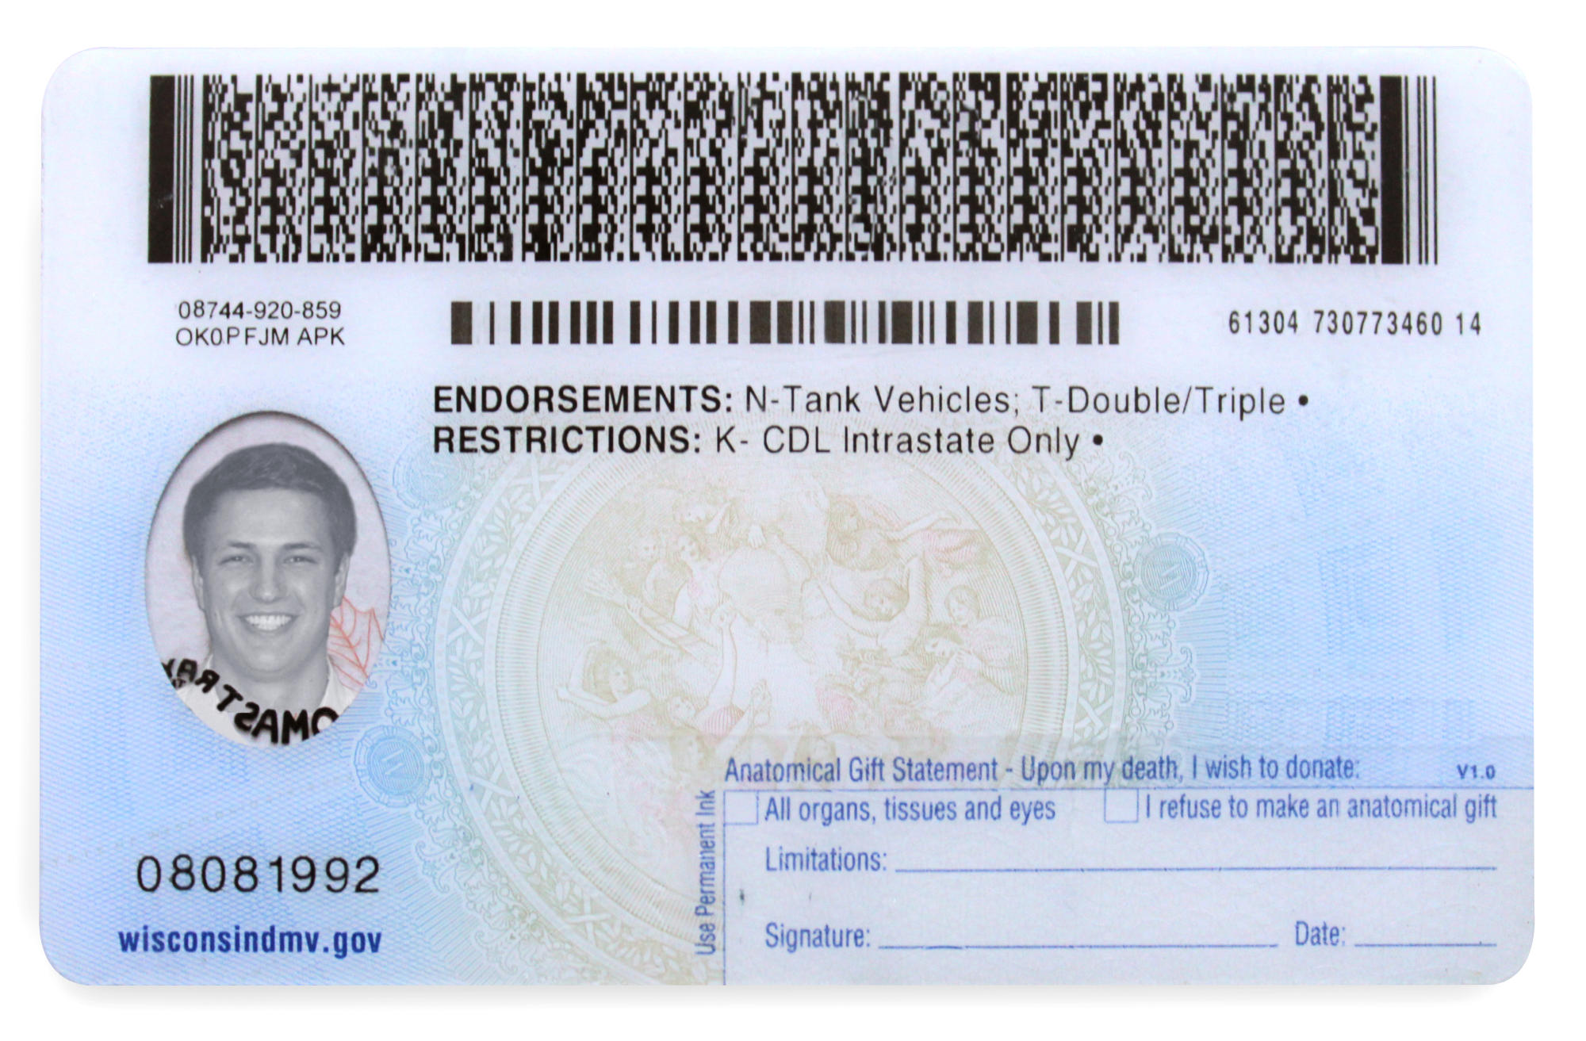
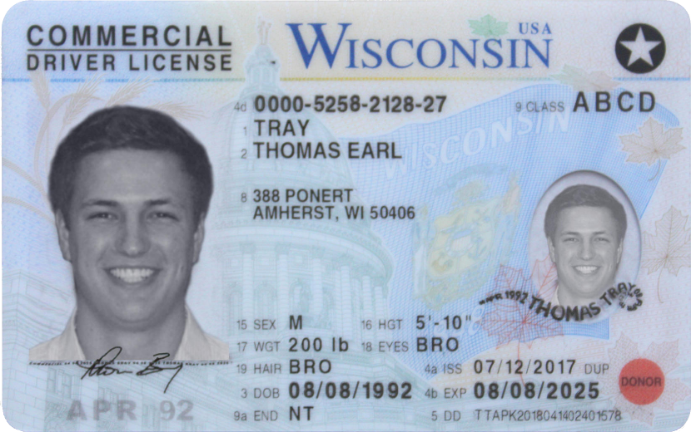
Restrictions
Notes:
Restrictions may also be placed on your CLP or CDL for various reasons. Air brake, intrastate-only, vision (glasses/contacts), and manual transmission are common restrictions that may be placed on a driver’s CDL. Typically, on a CLP or CDL, restrictions are given a letter or number and include a brief explanation.

Slide 28

Driver Qualifications
Notes:
As you will find throughout this course of instruction, there’s more to becoming a professional driver than just obtaining a CDL and hitting the road. There are additional regulatory qualifications you must meet in order to operate a CMV.

Slide 29
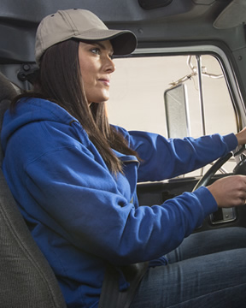
You are qualified if you:
Are at least 21 years old
Notes:
Section 391.11 of the FMCSRs states that you must meet certain requirements to operate a CMV. You are qualified if you:
Are at least 21 years old

Slide 30
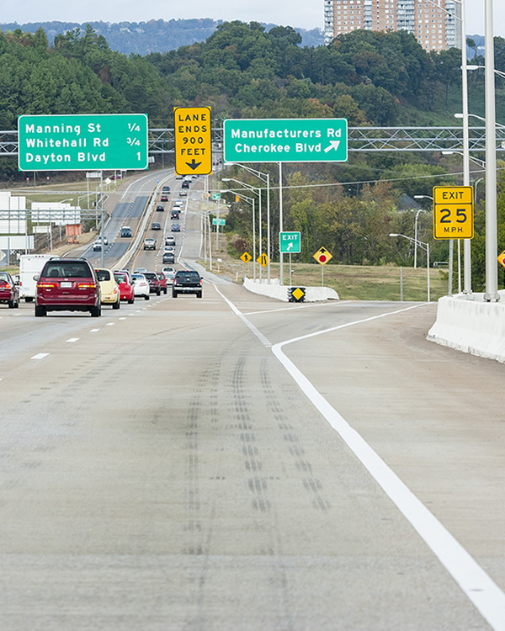
You are qualified if you:
Can read, write, and speak English well enough to:
  Speak with the
  general public
  Understand highway traffic signs and signals
  Respond to
  official inquiries
  Make entries on report and records
Notes:
Section 391.11 of the FMCSRs states that you must meet certain requirements to operate a CMV. You are qualified if you:
Can read, write, and speak English well enough to
Speak with the general public
Understand highway traffic signs and signals
Respond to official inquiries
Make entries on reports and records

Slide 31
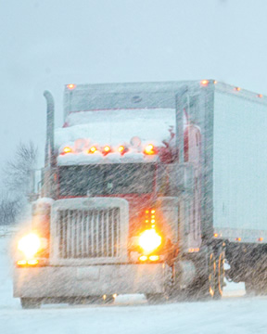
You are qualified if you:
Can drive your truck safely
Notes:
Section 391.11 of the FMCSRs states that you must meet certain requirements to operate a CMV. You are qualified if you:
Can drive your truck safely

Slide 32
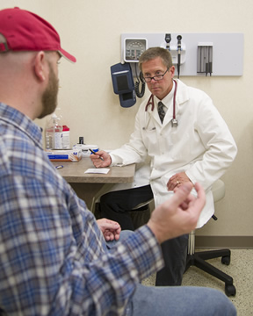
You are qualified if you:
Can pass a DOT physical exam
Notes:
Section 391.11 of the FMCSRs states that you must meet certain requirements to operate a CMV. You are qualified if you:
Can pass a DOT physical exam

Slide 33
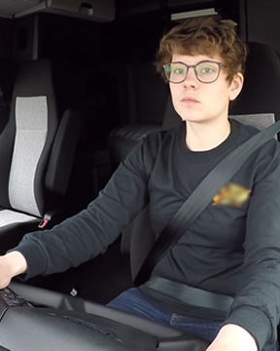
You are qualified if you:
Have only one current CDL
Notes:
Section 391.11 of the FMCSRs states that you must meet certain requirements to operate a CMV. You are qualified if you:
Have only one current CDL

Slide 34
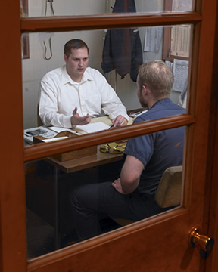
You are qualified if you:
Have given your motor carrier a list of any violations you have been convicted of in the last 12 months
Notes:
Section 391.11 of the FMCSRs states that you must meet certain requirements to operate a CMV. You are qualified if you:
Have given your motor carrier a list of any violations you have been convicted of in the last 12 months

Slide 35
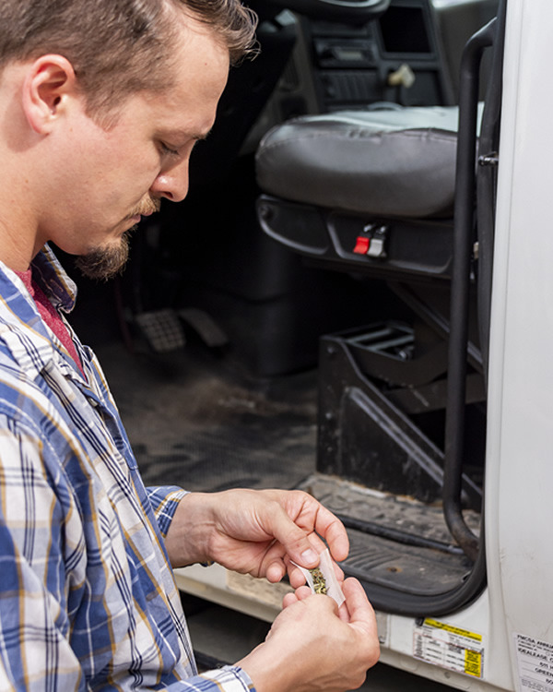
You are qualified if you:
Are not disqualified to drive a CMV
Notes:
Section 391.11 of the FMCSRs states that you must meet certain requirements to operate a CMV. You are qualified if you:
Are not disqualified to drive a CMV

Slide 36
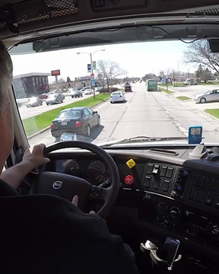
You are qualified if you:
Passed a road test
Notes:
Section 391.11 of the FMCSRs states that you must meet certain requirements to operate a CMV. You are qualified if you:
Passed a road test

Slide 37
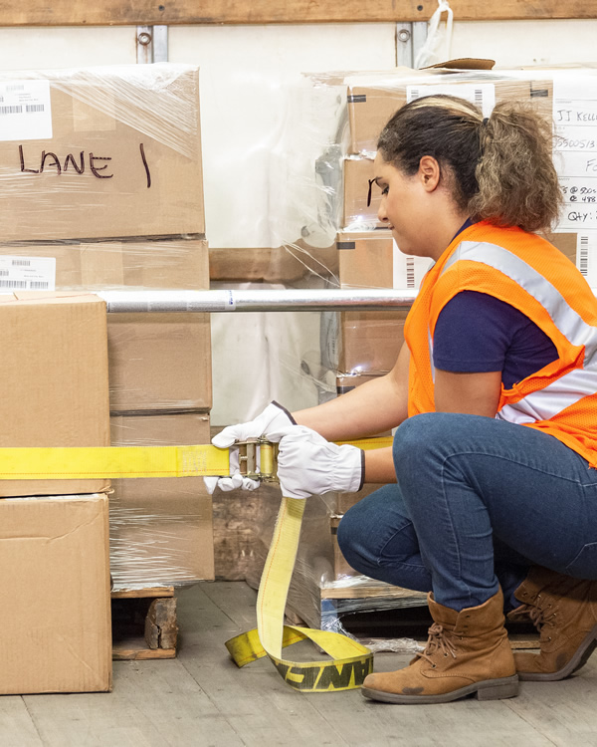
You are qualified if you:
Are familiar with the methods and procedures for securing cargo
Notes:
You must also be familiar with methods and procedures for securing cargo so that you can determine whether the cargo you transport is properly loaded, distributed, and secured. Several sections of the FMCSRs address cargo securement.

Slide 38
Regulation | Description
Section 392.9 | A CMV may not be driven, unless the vehicle’s cargo is properly distributed and adequately secured.
Part 393, Subpart 1 | A CMV must be: Secured to prevent cargo from shifting upon or within the vehicle Loaded, equipped, and secured to prevent cargo from leaking, spilling, blowing, or falling from the vehicle

Slide 39

Physical Qualification & Examination
You may not drive a CMV unless you are physically qualified and have been issued a medical examiner’s certificate
Notes:
You may not drive a CMV unless you are physically qualified and have been issued a medical examiner’s certificate (med card) stating you are physically qualified. (See Part 391, Subpart E of the FMCSRs.)

Slide 40
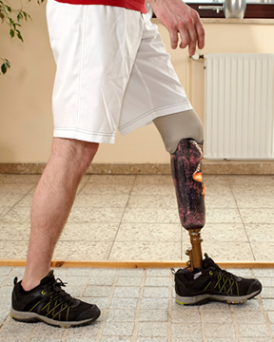
You would NOT be considered physically qualified if you have:
Lost a foot, leg, hand, or arm and have not been granted a skill performance evaluation (SPE) certificate
Notes:
You would not be considered physically qualified and may not drive a CMV if you have:
Lost a foot, leg, hand, or arm and have not been granted a skill performance evaluation (SPE) certificate
CALLOUT: A skill performance evaluation (SPE) certificate is a document issued by FMCSA which allows drivers with missing limbs or physical impairments to operate a CMV. To obtain the SPE certificate, a driver and motor carrier must apply with FMCSA.

Slide 41

You would NOT be considered physically qualified if you have:
An impairment of a hand, finger, arm, foot, or leg which interferes with your ability to perform normal tasks associated with driving a CMV and have not been granted an SPE
Notes:
You would not be considered physically qualified and may not drive a CMV if you have:
An impairment of a hand, finger, arm, foot, or leg which interferes with your ability to perform normal tasks associated with driving a CMV and have not been granted an SPE

Slide 42
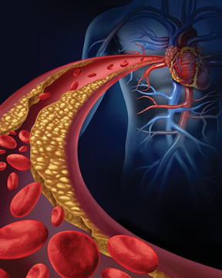
You would NOT be considered physically qualified if you have:
Heart disease, which causes chest pain, fainting, or shortness of breath
Notes:
You would not be considered physically qualified and may not drive a CMV if you have:
Heart disease, which causes chest pain, fainting, or shortness of breath

Slide 43
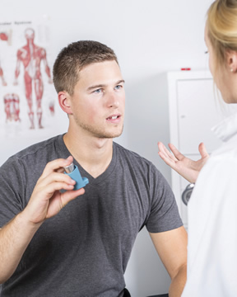
You would NOT be considered physically qualified if you have:
Chest or breathing problems like chronic asthma, emphysema, or chronic bronchitis
Notes:
You would not be considered physically qualified and may not drive a CMV if you have:
Chest or breathing problems like chronic asthma, emphysema, or chronic bronchitis

Slide 44

You would NOT be considered physically qualified if you have:
High blood pressure likely to interfere with driving
Notes:
You would not be considered physically qualified and may not drive a CMV if you have:
High blood pressure likely to interfere with driving

Slide 45

You would NOT be considered physically qualified if you have:
Loss of movement or feeling in part of your body
Notes:
You would not be considered physically qualified and may not drive a CMV if you have:
Loss of movement or feeling in part of your body

Slide 46

You would NOT be considered physically qualified if you have:
Diabetes requiring insulin for control
Notes:
You would not be considered physically qualified and may not drive a CMV if you have:
Diabetes requiring insulin for control (unless the requirements in Section 391.46 are met)
CALLOUT: A driver with diabetes mellitus that is treated with insulin for control, is physically qualified to drive a CMV if he or she:
Meets all of the other physical qualification standards in Section 391.41, or has an exemption or SPE certificate and
Has an evaluation by a treating clinician and a medical examination, performed by a medical examiner.

Slide 47

You would NOT be considered physically qualified if you have:
Any sickness which is likely to cause loss of consciousness or any loss of ability to control a CMV
Notes:
You would not be considered physically qualified and may not drive a CMV if you have:
Any sickness which is likely to cause loss of consciousness or any loss of ability to control a CMV

Slide 48

You would NOT be considered physically qualified if you have:
Any mental problems likely to interfere with your ability to drive a CMV safely
Notes:
You would not be considered physically qualified and may not drive a CMV if you have:
Any mental problems likely to interfere with your ability to drive a CMV safely

Slide 49

You would NOT be considered physically qualified if you have:
Poor vision that affects your ability to see objects that are far away (you may use glasses or contact lenses to correct your vision), objects to the side, or traffic signal colors (you may not drive if you see with only one eye)
Notes:
You would not be considered physically qualified and may not drive a CMV if you have:
Poor vision that affects your ability to see objects that are far away (you may use glasses or contact lenses to correct your vision), objects to the side, or traffic signal colors (you may not drive if you see with only one eye)

Slide 50

You would NOT be considered physically qualified if you have:
Poor hearing (you must be able to hear a loud whispered voice in your better ear at not less than
5 feet with or without the use of a hearing aid or, pass a hearing test on a doctor’s testing machine)
Notes:
You would not be considered physically qualified and may not drive a CMV if you have:
Poor hearing (you must be able to hear a loud whispered voice in your better ear at not less than 5 feet with or without the use of a hearing aid or, pass a hearing test on a doctor’s testing machine), or

Slide 51

You would NOT be considered physically qualified if you have:
A current clinical diagnosis of alcoholism
Notes:
You would not be considered physically qualified and may not drive a CMV if you have:
Or, a current clinical diagnosis of alcoholism

Slide 52

Physical Qualification & Examination
You may not drive a CMV if you use certain drugs and/or dangerous substances unless prescribed by a doctor
Notes:
Also, you are not considered physically qualified and may not drive a CMV if you use certain drugs and/or dangerous substances. There is an exception, however, that allows you to use such a drug or substance if prescribed by a doctor who is familiar with your medical history and assigned duties and who has advised you that the prescribed drug or substance will not adversely affect your ability to safely operate a CMV.

Slide 53

If physically qualified, you will get a medical examiner’s certificate
Notes:
A medical exam, performed by a medical examiner listed on the National Registry of Certified Medical Examiners (NRCME), is required to drive a CMV. If the medical examiner finds that you are physically qualified to operate a CMV, you will be given a medical examiner’s certificate.
After initial examination, you are required to have another exam every 24 months or after you have suffered a disease or injury that affected your ability to drive a CMV. The NRCME can be found at: https://nationalregistry.fmcsa.dot.gov.
CALLOUT: If the determination of whether you are physically qualified to drive a CMV is delayed pending the receipt of additional information or further examination, the examiner must inform you that the additional information must be provided within 45 days and that the pending status of the exam will be reported to FMCSA.

Slide 54

CDL/Med Card Merger
When you apply for a CLP or CDL, you must turn in a valid copy of your medical examiner’s certificate and documentation certifying that you drive under one of four categories (non-excepted interstate, excepted interstate, non-excepted intrastate, or excepted intrastate) to your state driver licensing agency.
Notes:
When you apply for a CLP or CDL, you must turn in a valid copy of your medical examiner’s certificate and documentation certifying that you drive under one of four categories (non-excepted interstate, excepted interstate, non-excepted intrastate, or excepted intrastate) to your state driver licensing agency. This information will be maintained on your driving record.
Once you have self-certified, you will not need to self-certify again until you renew, upgrade, add endorsements to, or transfer your CDL.

Slide 55

CDL/Med Card Merger
You’ll need to go for a new physical and submit your new medical examiner’s certificate before your current certificate expires or your CDL will be downgraded
Notes:
Before your medical examiner’s certificate expires, you will need to go for a new physical and submit your new medical examiner’s certificate to your state driver licensing agency. Failure to do so will result in your CDL being downgraded to a non-CDL class.
CALLOUT: It is your responsibility to keep track of the expiration date of your medical certificate, go to a certified medical examiner, and turn in the new medical certificate before it expires. If you do not do this, your license will be downgraded to a non-CDL class.

Slide 56

Driver Qualification (DQ) File
A motor carrier must keep a DQ file for each driver it employs
Notes:
A motor carrier must keep a driver qualification (DQ) file for each driver it employs. (See Part 391, Subpart E of the FMCSRs.)
Your DQ file must be kept by your employer for the entire time you are employed and for three years after you leave the employer.

Slide 57
The following must be included:
Application for employment
Initial motor vehicle record (MVR) from state(s)
Road test form and certificate (or a copy of the license or road test certificate accepted in lieu of a road test)
Medical exam certificate—original or copy
(non-CDL drivers)
MVR that includes current medical certification status and self-certification information (CLP/CDL drivers)
Notes:
The following documents must be included in your DQ file:
Application for employment
Initial motor vehicle record (MVR) from state(s)
Road test form and certificate (or a copy of the license or road test certificate accepted in lieu of a road test)
Medical exam certificate — original or copy (non-CDL drivers)
MVR that includes current medical certification status and self-certification information (CLP/CDL drivers)

Slide 58
The following must be included:
Annual MVR from state(s)
Notes concerning the annual review of your driving record
Driver’s annual list of violations
Note certifying that the medical examiner who issued your medical examiner’s certificate is listed on the NRCME
SPE certificate, medical exemption, or medical variance document (if applicable)
Notes:
The following documents must be included in your DQ file:
Annual MVR from state(s)
Notes concerning the annual review of your driving record
Driver’s annual list of violations
Note certifying that the medical examiner who issued your medical examiner’s certificate is listed on the NRCME
SPE certificate, medical exemption, or medical variance document (if applicable)

Slide 59

Driver Disqualification
Notes:
As a professional driver, disqualification is a serious issue. A driver holding a CLP or CDL can be disqualified from driving a CMV if convicted of certain offenses while driving any type of vehicle; this includes a personal vehicle. (See Sec. 383.51 of the FMCSRs.)

Slide 60

You are disqualified if convicted of:
Being under the influence of alcohol as prescribed by state law while driving a CMV or non-CMV
Notes:
You are disqualified from operating a CMV if convicted of any of the following major offenses while driving a CMV or non-CMV:
Being under the influence of alcohol as prescribed by state law
CALLOUT: Even one DUI/DWI on your off time can prevent you from operating a CMV for one year.

Slide 61

You are disqualified if convicted of:
Being under the influence of a controlled substance while driving a CMV or non-CMV
Notes:
You are disqualified from operating a CMV if convicted of any of the following major offenses while driving a CMV or non-CMV:
Being under the influence of a controlled substance

Slide 62

You are disqualified if convicted of:
Refusing to take an alcohol test as requested by a state or jurisdiction under its implied consent laws or regulations while driving a CMV or non-CMV
Notes:
You are disqualified from operating a CMV if convicted of any of the following major offenses while driving a CMV or non-CMV:
Refusing to take an alcohol test as requested by a state or jurisdiction under its implied consent laws or regulations

Slide 63

You are disqualified if convicted of:
Leaving the scene of an accident while driving a CMV or non-CMV
Notes:
You are disqualified from operating a CMV if convicted of any of the following major offenses while driving a CMV or non-CMV:
Leaving the scene of an accident

Slide 64

You are disqualified if convicted of:
Using a vehicle to commit a felony while driving a CMV or non-CMV
Notes:
You are disqualified from operating a CMV if convicted of any of the following major offenses while driving a CMV or non-CMV:
Using a vehicle to commit a felony

Slide 65

You are disqualified if convicted of:
Using a vehicle in the commission of a felony involving the manufacturing, distributing, or dispensing of a controlled substance while driving a CMV or non-CMV
Notes:
You are disqualified from operating a CMV if convicted of any of the following major offenses while driving a CMV or non-CMV:
Or, using a vehicle in the commission of a felony involving the manufacturing, distributing, or dispensing of a controlled substance

Slide 66

You are disqualified if convicted of:
Having an alcohol concentration of 0.04 or greater while driving a CMV
Notes:
You are disqualified from operating a CMV if convicted of any of the following major offenses while driving a CMV:
Having an alcohol concentration of 0.04 or greater

Slide 67

You are disqualified if convicted of:
Driving a CMV when your CDL is revoked, suspended, or cancelled, or you are disqualified from operating a CMV
Notes:
You are disqualified from operating a CMV if convicted of any of the following major offenses while driving a CMV:
Driving a CMV when, as a result of prior violations committed operating a CMV, your CDL is revoked, suspended, or cancelled, or you are disqualified from operating a CMV

Slide 68

You are disqualified if convicted of:
Causing a fatality through the negligent operation of a CMV while driving a CMV
Notes:
You are disqualified from operating a CMV if convicted of any of the following major offenses while driving a CMV:
Or, causing a fatality through the negligent operation of a CMV

Slide 69
Conviction | Disqualification Period
First conviction (not transporting hazardous materials) | 1 year
First conviction (transporting hazardous materials) | 3 years
Second conviction | Life (may be eligible for reinstatement in 10 years)
Using a vehicle in the commission of a felony involving the manufacturing, distributing, or dispensing of a controlled substance | Life (not eligible for reinstatement)

Slide 70

You are disqualified from operating a CMV if convicted of any combination of two or more of the following serious traffic violations while operating any vehicle (CMV or non-CMV):
Notes:
You are disqualified from operating a CMV if convicted of any combination of two or more of the following serious traffic violations while operating any vehicle (CMV or non-CMV):
Excessive speeding, 15 mph or more above the posted speed limit
Reckless driving
Making improper or erratic traffic lane changes
Following the vehicle ahead too closely, or
Violating a state or local law relating to motor vehicle traffic control (other than a parking violation) arising in connection with a fatal accident

Slide 71

You are disqualified if convicted of:
Excessive speeding, 15 mph or more above the posted speed limit
Notes:
You are disqualified from operating a CMV if convicted of any combination of two or more of the following serious traffic violations while operating any vehicle (CMV or non-CMV):
Excessive speeding, 15 mph or more above the posted speed limit

Slide 72

You are disqualified if convicted of:
Reckless driving
Notes:
You are disqualified from operating a CMV if convicted of any combination of two or more of the following serious traffic violations while operating any vehicle (CMV or non-CMV):
Reckless driving

Slide 73

You are disqualified if convicted of:
Making improper or erratic traffic lane changes
Notes:
You are disqualified from operating a CMV if convicted of any combination of two or more of the following serious traffic violations while operating any vehicle (CMV or non-CMV):
Making improper or erratic traffic lane changes

Slide 74

You are disqualified if convicted of:
Following the vehicle ahead too closely
Notes:
You are disqualified from operating a CMV if convicted of any combination of two or more of the following serious traffic violations while operating any vehicle (CMV or non-CMV):
Following the vehicle ahead too closely

Slide 75

You are disqualified if convicted of:
Violating a state or local law relating to motor vehicle traffic control (other than a parking violation) arising in connection with a fatal accident
Notes:
You are disqualified from operating a CMV if convicted of any combination of two or more of the following serious traffic violations while operating any vehicle (CMV or non-CMV):
Or, violating a state or local law relating to motor vehicle traffic control (other than a parking violation) arising in connection with a fatal accident

Slide 76

A driver convicted of two or more serious traffic violations while operating a non-CMV is disqualified only if the conviction results in the revocation, cancellation, or suspension of
the driver’s
driving privileges
Notes:
Note: A driver convicted of two or more serious traffic violations while operating a non-CMV is disqualified only if the conviction results in the revocation, cancellation, or suspension of the driver’s driving privileges.

Slide 77
You are disqualified from operating a CMV if convicted of any combination of two or more of the following serious traffic violations while operating a CMV:
Notes:
You are disqualified from operating a CMV if convicted of any combination of two or more of the following serious traffic violations while operating a CMV:
Driving a CMV without obtaining a CLP or CDL
Driving a CMV without a CLP or CDL in your possession
Driving a CMV without the proper class of CLP or CDL and/or endorsements for the specific vehicle group being operated or for the passengers or type of cargo being transported
Violating a state or local law or ordinance on motor vehicle traffic control prohibiting texting while driving a CMV, or
Violating a state or local law or ordinance on motor vehicle traffic control restricting or prohibiting the use of a hand-held mobile telephone while driving a CMV

Slide 78

You are disqualified if convicted of:
Driving a CMV without obtaining a CLP or CDL
Notes:
You are disqualified from operating a CMV if convicted of any combination of two or more of the following serious traffic violations while operating a CMV:
Driving a CMV without obtaining a CLP or CDL

Slide 79

You are disqualified if convicted of:
Driving a CMV without a CLP or CDL in your possession
Notes:
You are disqualified from operating a CMV if convicted of any combination of two or more of the following serious traffic violations while operating a CMV:
Driving a CMV without a CLP or CDL in your possession

Slide 80

You are disqualified if convicted of:
Driving a CMV without the proper class of CLP or CDL and/or endorsements for the specific vehicle group being operated or for the passengers or type of cargo
being transported
Notes:
You are disqualified from operating a CMV if convicted of any combination of two or more of the following serious traffic violations while operating a CMV:
Driving a CMV without the proper class of CLP or CDL and/or endorsements for the specific vehicle group being operated or for the passengers or type of cargo being transported

Slide 81

You are disqualified if convicted of:
Violating a state or local law or ordinance on motor vehicle traffic control prohibiting texting while driving a CMV
Notes:
You are disqualified from operating a CMV if convicted of any combination of two or more of the following serious traffic violations while operating a CMV:
Violating a state or local law or ordinance on motor vehicle traffic control prohibiting texting while driving a CMV

Slide 82

You are disqualified if convicted of:
Violating a state or local law or ordinance on motor vehicle traffic control restricting or prohibiting the use of a hand-held mobile telephone while driving a CMV
Notes:
You are disqualified from operating a CMV if convicted of any combination of two or more of the following serious traffic violations while operating a CMV:
Or, violating a state or local law or ordinance on motor vehicle traffic control restricting or prohibiting the use of a hand-held mobile telephone while driving a CMV

Slide 83
Conviction | Disqualification Period
Two serious traffic violations in separate incidents during any three-year period | 60 days
Three serious traffic violations in separate incidents during any three-year period | 120 days

Slide 84

Out-of-Service Violations
During a trip, you may be placed out of service by an enforcement officer for a certain period of time or until a given problem has been corrected
Notes:
During a trip, you may be placed out of service by an enforcement officer for a certain period of time or until a given problem has been corrected. This typically happens at a weigh station and/or during a roadside inspection.
Conviction for violating such an out-of-service order subjects you to a fine and disqualification period.

Slide 85
Conviction | Disqualification Period
First violation | 180 days to 1 year
Second violation (within a 10-year period) | 2 years to 5 years
Three or more violations (within a 10-year period) | 3 years to 5 years
Notes:
The penalties are more severe for drivers of passenger-carrying vehicles and drivers transporting hazardous materials.

Slide 86

You are disqualified from driving if you are convicted of operating a vehicle requiring a CDL in violation of a federal, state, or local law or regulation pertaining to one of the following six offenses at a railroad-highway grade crossing:
Notes:
You are disqualified from driving if you are convicted of operating a vehicle requiring a CDL in violation of a federal, state, or local law or regulation pertaining to one of the following six offenses at a railroad-highway grade crossing.
Failing to slow down and check that tracks are clear of an approaching train (when not required to stop)
Not stopping before reaching the crossing, if the tracks are not clear (when not required to stop)
Failing to stop before driving onto the crossing (when always required to stop)
Not having sufficient space to drive completely through the crossing without stopping
Not obeying a traffic control device or the directions of an enforcement official at the crossing
Failing to negotiate a crossing because of insufficient undercarriage clearance
If you are convicted of a railroad-highway grade crossing violation, you are subject to a disqualification period of between 60 days and one year.

Slide 87

You are disqualified if convicted of:
Failing to slow down and check that tracks are clear of an approaching train
Notes:
You are disqualified from driving if you are convicted of operating a vehicle requiring a CDL in violation of a federal, state, or local law or regulation pertaining to one of the following six offenses at a railroad-highway grade crossing .
1. Failing to slow down and check that tracks are clear of an approaching train (when not required to stop)

Slide 88

You are disqualified if convicted of:
Not stopping before reaching the crossing, if the tracks are not clear
Notes:
You are disqualified from driving if you are convicted of operating a vehicle requiring a CDL in violation of a federal, state, or local law or regulation pertaining to one of the following six offenses at a railroad-highway grade crossing .
2. Not stopping before reaching the crossing, if the tracks are not clear (when not required to stop)

Slide 89

You are disqualified if convicted of:
Failing to stop before driving onto the crossing
Notes:
You are disqualified from driving if you are convicted of operating a vehicle requiring a CDL in violation of a federal, state, or local law or regulation pertaining to one of the following six offenses at a railroad-highway grade crossing .
3. Failing to stop before driving onto the crossing (when always required to stop)

Slide 90

You are disqualified if convicted of:
Not having sufficient space to drive completely through the crossing
without stopping
Notes:
You are disqualified from driving if you are convicted of operating a vehicle requiring a CDL in violation of a federal, state, or local law or regulation pertaining to one of the following six offenses at a railroad-highway grade crossing .
4. Not having sufficient space to drive completely through the crossing without stopping

Slide 91

You are disqualified if convicted of:
Not obeying a traffic control device or the directions of an enforcement official at the crossing
Notes:
You are disqualified from driving if you are convicted of operating a vehicle requiring a CDL in violation of a federal, state, or local law or regulation pertaining to one of the following six offenses at a railroad-highway grade crossing .
5. Not obeying a traffic control device or the directions of an enforcement official at the crossing

Slide 92

You are disqualified if convicted of:
Failing to negotiate a crossing because of insufficient undercarriage clearance
Notes:
You are disqualified from driving if you are convicted of operating a vehicle requiring a CDL in violation of a federal, state, or local law or regulation pertaining to one of the following six offenses at a railroad-highway grade crossing .
6. Failing to negotiate a crossing because of insufficient undercarriage clearance

Slide 93

Alcohol & Drug Testing
Notes:
The regulations in Part 382 of the FMCSRs address alcohol misuse and drug use by CMV drivers. The purpose of the regulations is to prevent accidents and injuries that result from driver misuse of alcohol and/or abuse of drugs.

Slide 94

Alcohol Misuse & Drug Use
Alcohol misuse that could affect the performance of a safety-sensitive function is prohibited
Notes:
Alcohol misuse that could affect the performance of a safety-sensitive function is prohibited. A safety-sensitive function is defined as all time from the time a driver begins work or is required to be in readiness to work until the time he is relieved from work and all responsibility for performing work. (See Sec. 382.107 of the FMCSRs.)

Slide 95

Prohibited alcohol use includes:
Use while performing safety-sensitive functions
Notes:
Prohibited alcohol use includes:
Use while performing safety-sensitive functions

Slide 96

Prohibited alcohol use includes:
Use during the four hours before performing
safety-sensitive functions
Notes:
Prohibited alcohol use includes:
Use during the four hours before performing safety- sensitive functions

Slide 97

Prohibited alcohol use includes:
Reporting for duty
or remaining on
duty to perform
safety-sensitive functions with an alcohol concentration of 0.04 or greater
Notes:
Prohibited alcohol use includes:
Reporting for duty or remaining on duty to perform safety-sensitive functions with an alcohol concentration of 0.04 or greater
CALLOUT: If you have an alcohol concentration of 0.02 or greater but less than 0.04, you may not perform, or be permitted to perform, safety-sensitive functions for at least 24 hours.

Slide 98

Prohibited alcohol use includes:
Use during the eight hours following an accident, or until you undergo a post-accident test
Notes:
Prohibited alcohol use includes:
Use during the eight hours following an accident, or until you undergo a post-accident test

Slide 99

Prohibited alcohol use includes:
Refusal to take a required test
Notes:
Prohibited alcohol use includes:
Or, refusal to take a required test

Slide 100

Alcohol Misuse & Drug Use
Drug use that could affect performance of safety-sensitive functions is prohibited
Notes:
Drug use that could affect performance of safety-sensitive functions is prohibited.

Slide 101

Prohibited drug use includes:
Use of any drug, except by doctor’s prescription, and then only if the doctor has advised you that the drug will not adversely affect your ability to safely operate a CMV
Notes:
Drug use that could affect performance of safety-sensitive functions is prohibited, including:
Use of any drug, except by doctor’s prescription, and then only if the doctor has advised you that the drug will not adversely affect your ability to safely operate a CMV

Slide 102

Prohibited drug use includes:
Testing positive for drugs
Notes:
Drug use that could affect performance of safety-sensitive functions is prohibited, including:
Testing positive for drugs

Slide 103

Prohibited drug use includes:
Having an adulterated or substituted drug test result
Notes:
Drug use that could affect performance of safety-sensitive functions is prohibited, including:
Having an adulterated or substituted drug test result

Slide 104

Prohibited drug use includes:
Refusal to take a required test
Notes:
Drug use that could affect performance of safety-sensitive functions is prohibited, including:
Or, refusal to take a required test

Slide 105

Alcohol Misuse & Drug Use
You will be removed from all
safety-sensitive functions until you
go through a return-to-duty process
Notes:
An employer may require you to inform your company of any therapeutic drug use.
Failing an alcohol test, testing positive for drugs, or refusing to take a required alcohol and/or drug test will result in you being removed from all safety-sensitive functions until you go through a return-to-duty process.

Slide 106

The Commercial Motor Vehicle
Notes:
There are many types of CMVs you could be called upon to operate throughout your driving career. The following is a summary of some of the basic terms.

Slide 107


Tractor
Conventional Cab-Over-Engine
The power unit; used to pull vehicle(s)
Notes:
Tractor. The tractor is the power unit. It is used to pull a vehicle or vehicles (trailers, semi- trailers, tankers, flatbeds, etc.). There are two cab styles that are most common, the conventional tractor and the cab-over-engine (COE) tractor:
Conventional tractor. The engine is located under the hood of the tractor. Like passenger vehicles, the engine is in front of the driver.
Cab-over-engine (COE). The cab is over the engine. The driver is over the front wheels and the front of the tractor is flat.

Slide 108

Trailer
Semitrailer Full Trailer
Stores and carries the cargo
Notes:
Trailer. The trailer is what stores and carries the cargo. There are two types of trailers, the full trailer and the semitrailer:
Full trailer. A full trailer is supported by its own axles . No part of its weight rests on the towing vehicle.
Semitrailer. The front of a semitrailer rests on the tractor, specifically the tractor’s fifth wheel. When a semitrailer is disconnected from the tractor, its front end rests on legs commonly referred to as landing gear.

Slide 109

Fifth Wheel
Used to join the front of the trailer to the tractor
Notes:
Fifth wheel. A coupling device located at the tractor’s rear frame that is used to join the front of the trailer to the tractor. It looks like a flat rounded plate with a v-shaped notch.

Slide 110

Duals
A pair of wheels and tires mounted together on the same side of one axle
Notes:
Duals. A pair of wheels and tires mounted together on the same side of one axle.

Slide 111

Combination Vehicle
When a trailer is attached to a tractor
Notes:
Combination vehicle. When a trailer is attached to a tractor it is called a combination vehicle.

Slide 112
Axles
Tandem
Axle
Drive
Axle
Steering Axle
Notes:
Steering axle. The front axle, responsible for controlling the vehicle direction.
Drive axle. The axle or axles that are powered and actively pull the load.
Tandem axle. An assembly of two axles (could be on the tractor or the trailer).

Slide 113

Size and Weight Limitations
Notes:
The size of a CMV requires you to take vehicle width, length, weight, and height into consideration when behind the wheel.

Slide 114

Federal Size & Weight Limits
The federal size and weight limits apply to a national system of interstates commonly referred to as the National Network
Notes:
The Federal Highway Administration (FHWA) oversees the heavy truck and bus size and weight regulations in the United States. The federal size and weight limits are established in 23 CFR 658, Truck Size and Weight, Route Designations—Length, Width and Weight Limitations.
The federal size and weight limits apply to a national system of interstates commonly referred to as the National Network. The National Network includes Interstate highways and Federal-aid highways.

Slide 115
Width | National Network
 | 102 inches
Length | National Network
Semitrailers | At least 48 feet
Trailers of a twin-trailer combination | At least 28 feet
A tractor-semitrailer combination or a tractor-trailer-trailer combination | No overall limit
Tractors and double trailers | All states must allow
Weight | National System of Interstate and Defense Highways
Single axle | 20,000 pounds
Tandem Axle | 34,000 pounds
Gross weight | 80,000 pounds and compliance with the Federal Bridge Formula.
Height | No federal height limit has been established. This is enforced on a state by state basis.
Notes:
In addition to the federal requirements, each state has laws that address legal vehicle size and weight. These laws cover the legal limits for weight, height, length, and width of vehicles and/or trailer configurations.

Slide 116

The Bridge Formula
Establishes the maximum weight any set of axles on a motor vehicle may carry; limits the weight to length ratio of a vehicle crossing a bridge
Notes:
In addition to the federal weight limits listed above, the federal Bridge Formula establishes the maximum weight any set of axles on a motor vehicle may carry on the interstate highway system. The intent is to limit the weight to length ratio of a vehicle crossing a bridge, to reduce the risk of damage to bridges. This is accomplished by either spreading the weight over additional axles or by increasing the distance between axles.

Slide 117
The Bridge Formula
LN
N-1
W=500 + 12N + 36
W = Maximum weight in pounds that can be carried on a
group of two or more axles to the nearest 500 pounds
L = The distance in feet between the outer axles of any two
or more consecutive axles
N = Number of axles being considered
Notes:
W = Maximum weight in pounds that can be carried on a group of two or more axles to the nearest 500 pounds
L = The distance in feet between the outer axles of any two or more consecutive axles
N = Number of axles being considered

Slide 118

The Bridge Formula
To check compliance with the bridge formula, you'll need to know the actual weights on each axle group and measure the axle spacings on your vehicle
Notes:
The bridge formula takes into consideration two factors:
Number of axles required to handle the vehicle's weight
Distance between the axles
To check compliance with the bridge formula, you'll need to know the actual weights on each axle group and measure the axle spacings on your vehicle.

Slide 119
The Bridge Formula Example
5
4
3
2
1
1
2
3
4
5
20 ft
10,620 lb
35 ft
33,600 lb
51 ft
32,740 lb
GVW: 76,960 lb
Notes:
You need to check axles 1 through 5, 1 through 3, and 2 through 5, and ensure each axle group complies with the weight limits provided in the bridge table.
First, measure the distances between each axle group. Pretend you determined the following:
Axles 1 through 5: 51 ft
Axles 1 through 3: 20 ft
Axles 2 through 5: 35 ft
Then, determine the actual weights of the axle groups. Assume you were issued a scale ticket that showed the following:
Steer axle: 10,620 lb
Drive axle: 32,740 lb
Trailer axles: 33,600 lb
GVW: 76,960 lb
With this information you do not need to perform complex calculations using the bridge formula. The values in the bridge table are the results of various axle spacing calculations .

Slide 120

Notes:
To start, check axles 1 through 5. Axles 1 through 5 are 51 feet apart. Under column “N” in the bridge table, find the number “51,” then look under the “5 axle” column. The maximum weight for 5 axles 51 feet apart is 80,000 pounds. Your vehicle is 76,960 pounds and the gross vehicle weight is in compliance.
Then, check axles 1 through 3 (steer axles and drive axles). Axles 1 through 3 are 20 feet apart. According to the table, the maximum weight for 3 axles 20 feet apart is 51,000 pounds. Axles 1 through 3 are carrying 43,360 pounds. The first axle group is in compliance.
Finally, check axles 2 through 5 (drive axles and trailer axles). Axles 2 through 5 are 35 feet apart. According to the table, the maximum weight for 4 axles 35 feet apart is 65,500 pounds. Axles 2 through 5 are carrying 66,340 pounds.
Because your actual weight is over that which is allowed by the bridge table, you must remove weight, redistribute weight, or increase the distance between the drive axles and the trailer axles, if possible.
CALLOUT: Use of the bridge table is much easier than working through the bridge formula as listed above.

Slide 121

Weigh Stations
Facility equipped with scales to ensure drivers and their vehicles are in compliance with the size and weight laws
Notes:
A weigh station is a facility, staffed by law enforcement, that is equipped with scales to ensure drivers and their vehicles are in compliance with the size and weight laws.
Each state has different requirements when it comes to stopping at a weigh station. Some require all trucks to stop. Others require vehicles above a certain weight to stop. If in doubt about stopping, stop at the weigh station. It is better to be safe when it comes to this issue, as there can be severe penalties for unlawfully bypassing a weigh station.
CALLOUT: Often, weigh stations are also used by law enforcement to conduct roadside inspections. These inspections ensure that you and your vehicle are operating in a safe and legal manner.

Slide 122

Height Limitations (Low Clearance)
When passing under bridges and overpasses, never assume the posted height is correct, and never assume what is listed on your road atlas or GPS is accurate
Notes:
Though there isn’t a federal height limitation, it is important that you understand there will be times when you must deal with overhead clearance limitations.
When passing under bridges and overpasses, never assume the posted height is correct, and never assume what is listed on your road atlas or global positioning system (GPS) is accurate. The settling of pavement, repaving, resurfacing, or packed snow can change an overhead clearance. When in doubt, choose another route.

Slide 123
Objectives
You should now be able to:
  Identify the agencies responsible for regulating the trucking industry and explain the importance of complying with applicable laws and regulations
  Describe the procedure for obtaining a commercial driver’s license (CDL)
  Identify the required driver qualifications and what causes a disqualification
  Discuss alcohol and drug prohibitions and the types of testing drivers can expect under various circumstances
  Recognize the basic components of a combination vehicle and the size and weight limits established for traveling on the National Network
Copyright 2019 J. J. Keller & Associates, Inc.
Notes:
You should now be able to:
Identify the agencies responsible for regulating the trucking industry and explain the importance of complying with applicable laws and regulations
Describe the procedure for obtaining a commercial driver’s license (CDL)
Identify the required driver qualifications and what causes a disqualification
Discuss alcohol and drug prohibitions and the types of testing drivers can expect under various circumstances
Recognize the basic components of a combination vehicle and the size and weight limits established for traveling on the National Network
CLASSROOM RECOMMENDATION
Before concluding your training session, have participants take the corresponding quiz (found on the Trainer Tools USB) to check their understanding of the material. You can customize any of the questions to fit your audience or workplace. The answer key can also be found on the Trainer Tools USB.
You may also choose to administer the quizzes before you begin your training session to help get participants thinking about the subject and/or to gauge their understanding of the topic ahead of time.

