Slide 1






PowerPoint® Instructions
This PowerPoint has been designed so you can easily customize it for your training session.
Throughout the presentation you’ll see icons with recommendations or videos to enhance the instruction you present to your students. A detailed explanation for each icon can be found on the next slide. Videos can be found on the Trainer Tools USB.
When you see an icon on the slide, look in the notes
section for further information.
Simply delete or move the icon off the slide before your training session begins.

Slide 2





Classroom Recommendations. Provides suggestions for enhancing your classroom presentation; from ideas for large group discussions to suggestions on the use of training aids such as examples or photos of vehicle parts and components to help illustrate the items covered within a chapter.
Lab Recommendations. Provides suggestions for activities and exercises that take place outside the classroom, but do not involve
the actual operation of the tractor-trailer or its components. Examples
of lab sessions include conducting a vehicle inspection or practicing mirror adjustment.
Range Recommendations. These recommended activities take
place on a closed-access driving range where students may practice driving skills in a controlled environment. Examples of range sessions include practicing shifting technique and successfully completing a backing maneuver.
Road Recommendations. These recommended activities take place in road and traffic conditions that support the chapter’s objectives. Examples of road sessions include proper communication with other drivers through the use of turn signals and basic vehicle control under nighttime or extreme weather conditions.
Videos. These short video clips reinforce material presented in the Student Manual. Use them to help students grasp difficult concepts or subject matter.

Slide 3
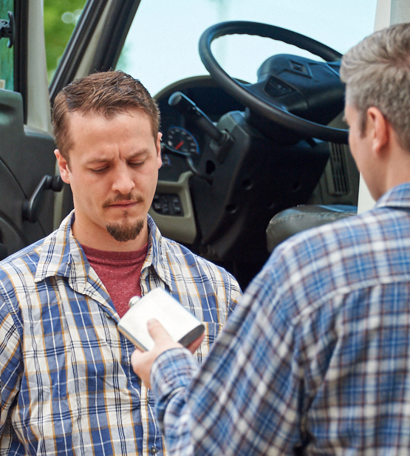
Drugs/Alcohol
29
Copyright 2019 J. J. Keller & Associates, Inc.
Notes:
Chapter 29: Drugs/Alcohol

Slide 4
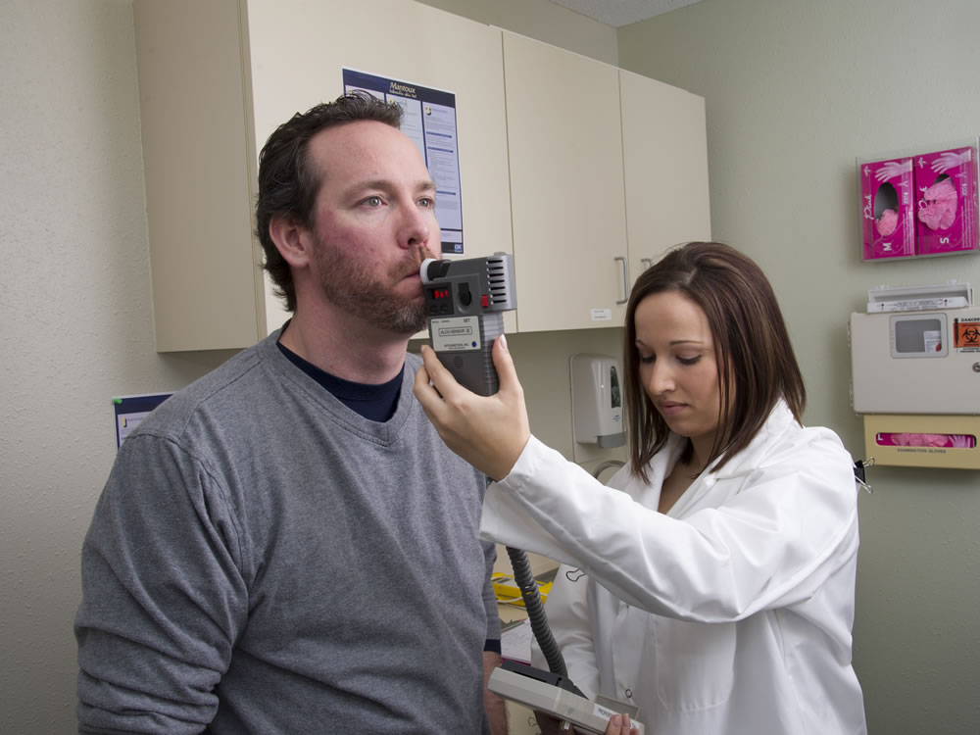
Introduction
Notes:
Introduction
Part 382 of the Federal Motor Carrier Safety Regulations (FMCSRs) addresses alcohol and drug use by, and the testing of, drivers of commercial motor vehicles (CMVs). The purpose of these regulations is to prevent vehicle accidents and injuries that are the result of driver misuse of alcohol and/or abuse of drugs. As the operator of a CMV that requires you to possess a commercial driver’s license (CDL), you are subject to the alcohol and drug testing requirements.
CLASSROOM RECOMMENDATIONS
Part 382 of the Federal Motor Carrier Safety Regulations addresses alcohol and drug use by, and the testing of, drivers of commercial motor vehicles.
Students need to understand how to comply with the requirements as well as the serious consequences of failing or refusing an alcohol or drug test.
Exercise
Presenting a situational narrative and having your students discuss how to address the issue presented can help reinforce understanding of this topic.
The following are two scenarios (including discussion questions) that can be shared with your students.
Once discussion has concluded, share the appropriate answer to the scenario.
Scenario 1
This afternoon Mary is having lunch with a friend at a local restaurant. The restaurant is well known for its margaritas. Mary considers ordering one, but she is to report to work at Acme Trucking in two hours,
ready to be dispatched on a three-day trip.
Questions for discussion:
Should Mary order a margarita?
Why or why not?
Solution: No, Mary should not order the margarita. Section 382.207 of the Federal Motor Carrier Safety Regulations (FMCSRs) prohibits a driver from performing safety-sensitive functions within four hours
after using alcohol. Also, the regulation prohibits her employer from allowing her to perform any safety‑sensitive function within four hours after using alcohol.
Scenario 2
Karl has just arrived back at the terminal. He is a local driver who runs a regular route. He is a good driver, who has a clean driving record and is dependable.
Karl has been randomly selected for alcohol and drug testing in each of the last two months. Today, upon completion of his run, when he arrives at the terminal, Karl is notified by his supervisor that he has
been selected for a random alcohol and drug test and is to proceed immediately to the local clinic.
Karl is not happy about being subject to another random test, and believes his employer is singling him out. He tells his supervisor that his last test is sufficient and that he doesn’t need to be tested again. Karl
turns in his daily paperwork, gets into his car, and goes home.
Questions for discussion:
Did Karl do the right thing by leaving?
What should Karl’s employer do?
What are the consequences (if any) of his actions?
Solution: No, Karl did not do the right thing. Though Karl has been subject to random testing in each of the last two months, he must comply with the regulations and submit to testing again.
By leaving work and going home, Karl has refused to submit to required testing. Refusing to submit is the same as testing positive for drugs or failing an alcohol test.
Karl’s employer must immediately remove him from all safety-sensitive functions. Karl may not return to any safety-sensitive functions until he is evaluated by a substance abuse professional (SAP), completes
the treatment prescribed by the SAP, and passes a return-to-duty test. Karl is then subject to a minimum of six follow-up tests in the next year and could be subject to follow-up testing for up to five years.
Also, Karl’s employer may act based on the company’s policy.

Slide 5
Objectives
Upon completion of this lesson, you will be able to:
Describe the alcohol and drug prohibitions that apply to CMV operators
Identify what types of testing drivers can expect to experience under various circumstances
Explain the alcohol and drug testing procedures
Describe the consequences of violating the prohibitions
Recognize the effects of alcohol abuse and drug use and how they impair driving abilities
Notes:
Objectives
Upon completion of this lesson, you will be able to:
Describe the alcohol and drug prohibitions that apply to CMV operators
Identify what types of testing drivers can expect to experience under various circumstances
Explain the alcohol and drug testing procedures
Describe the consequences of violating the prohibitions
Recognize the effects of alcohol abuse and drug use and how they impair driving abilities

Slide 6
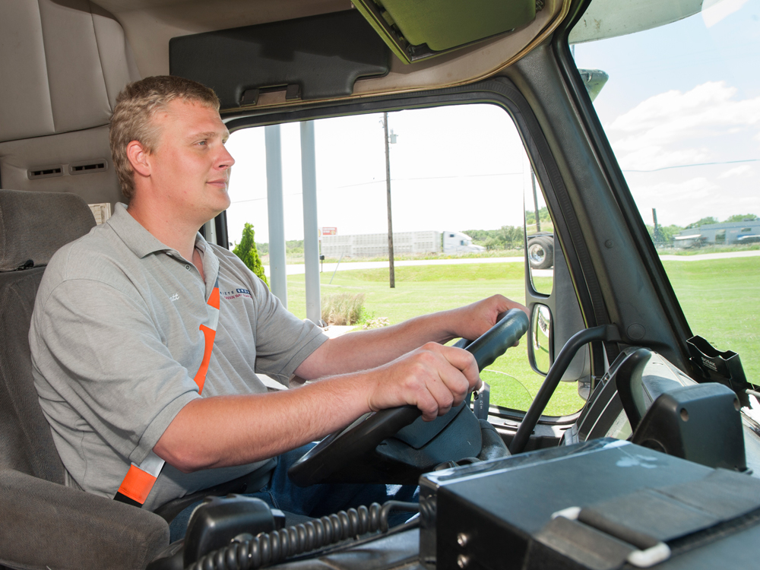
Safety-Sensitive Function
Notes:
Safety-Sensitive Function

Slide 7
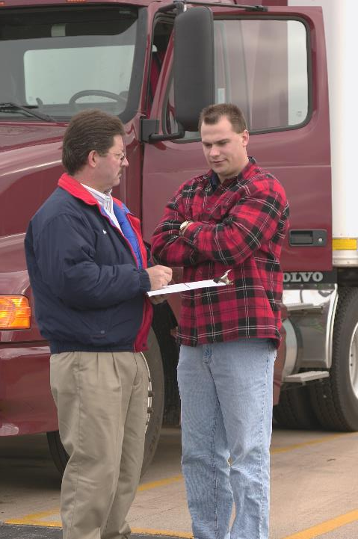
Alcohol and drug use
that could affect the performance of a
safety-sensitive function is prohibited.
All time from the time a driver begins work or is required to be in readiness to work until the time he or she is relieved from work and all responsibility for performing work.
Notes:
The Federal Motor Carrier Safety Administration (FMCSA) regulations that restrict your use of alcohol and drugs are known as “prohibitions”. Alcohol and drug use that could affect the performance of a safety-sensitive function is prohibited.
A safety-sensitive function is defined as all time from the time a driver begins work or is required to be in readiness to work until the time he or she is relieved from work and all responsibility for performing work.
CALLOUT: The definition of a safety‑sensitive function is located in Sec. 382.107 of the FMCSRs.

Slide 8
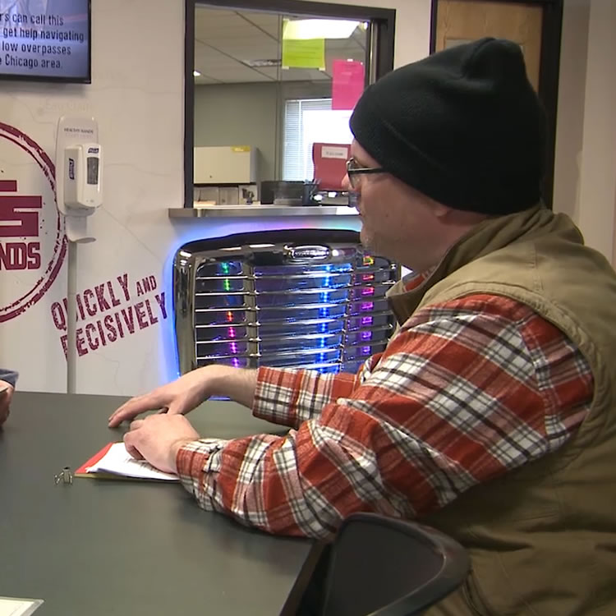
Safety-sensitive functions include:
Waiting to be dispatched
Notes:
Safety-sensitive functions include:
Waiting to be dispatched

Slide 9
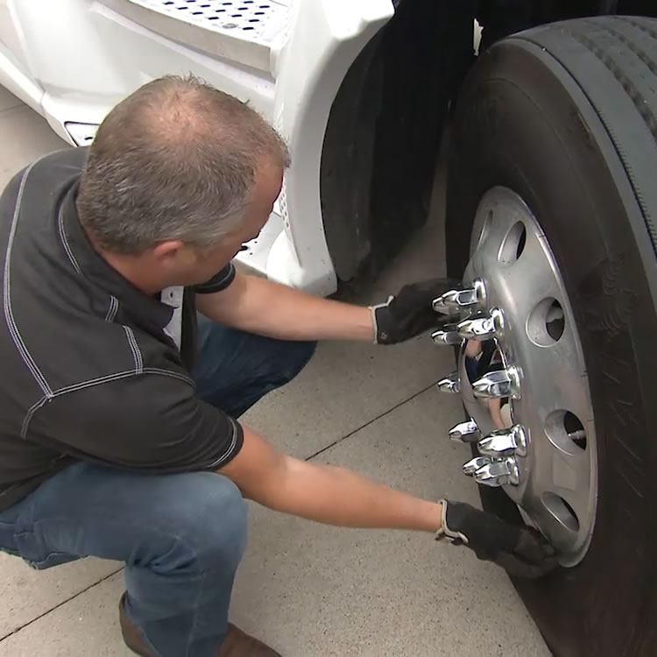
Safety-sensitive functions include:
Inspecting, servicing, or conditioning a CMV
Notes:
Safety-sensitive functions include:
Inspecting, servicing, or conditioning a CMV

Slide 10
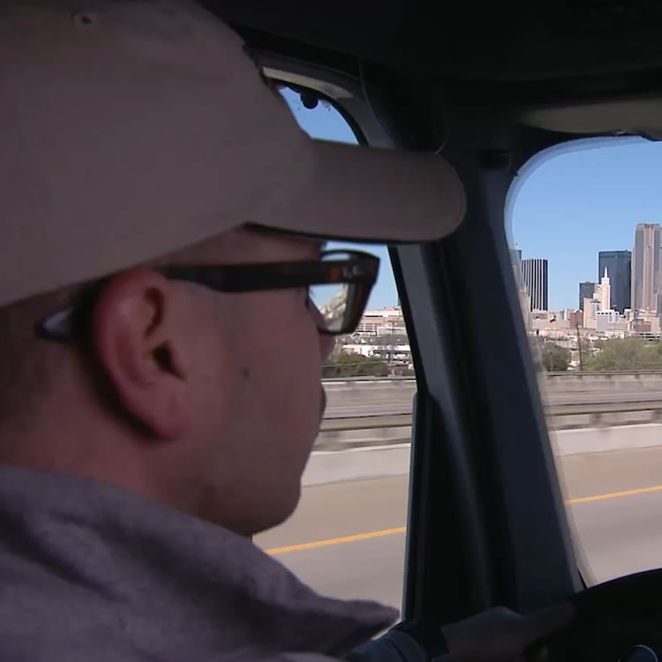
Safety-sensitive functions include:
Time at the controls of a CMV
Notes:
Safety-sensitive functions include:
Time at the controls of a CMV

Slide 11
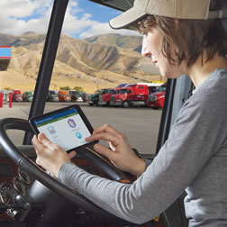
Safety-sensitive functions include:
Time in or on CMV, except sleeper-berth time
Notes:
Safety-sensitive functions include:
Time in or on CMV, except sleeper-berth time

Slide 12
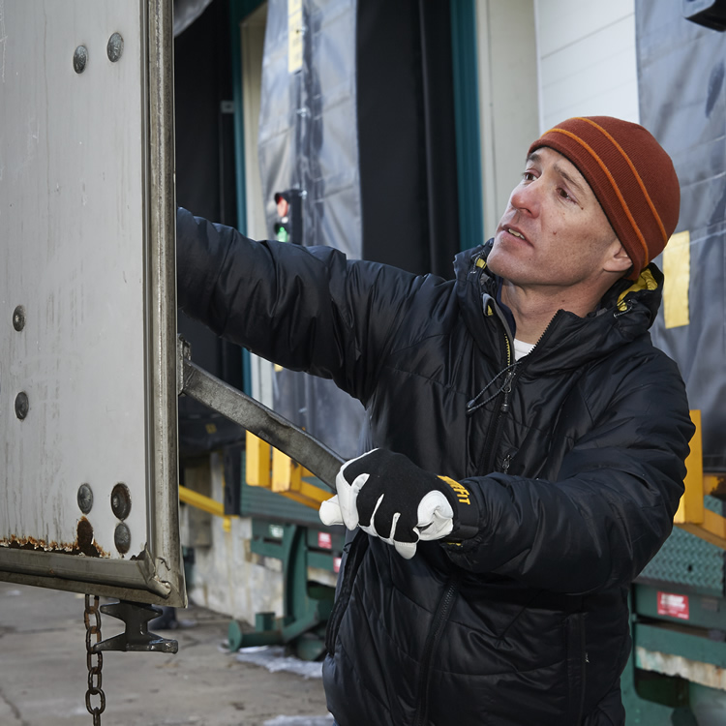
Safety-sensitive functions include:
Loading, unloading, or attending to a
CMV being loaded/unloaded; remaining ready to operate a CMV; giving/receiving receipts for shipments loaded or unloaded
Notes:
Safety-sensitive functions include:
Loading, unloading, or attending to a CMV being loaded/unloaded; remaining ready to operate a CMV; giving/receiving receipts for shipments loaded or unloaded

Slide 13
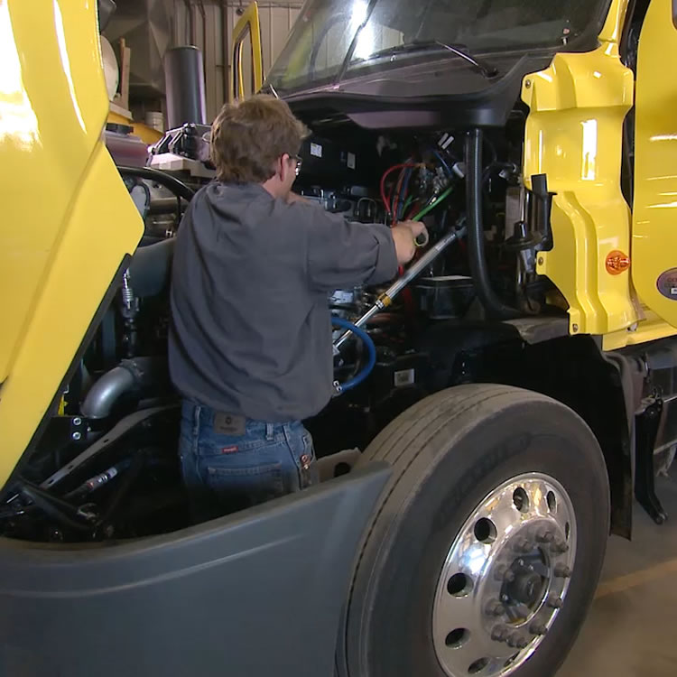
Safety-sensitive functions include:
Repairing, obtaining assistance, or in attendance of a disabled CMV
Notes:
Safety-sensitive functions include:
Repairing, obtaining assistance, or in attendance of a disabled CMV

Slide 14
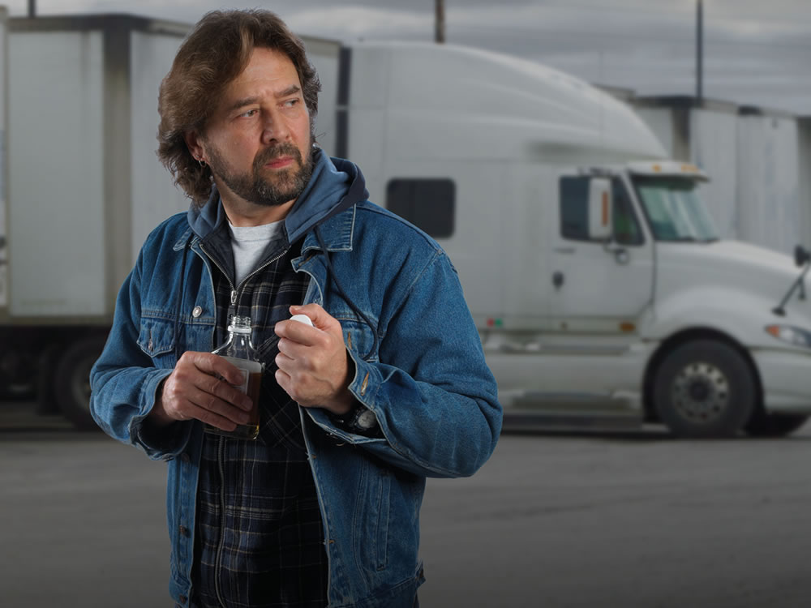
Alcohol Misuse and Drug Use
Notes:
Alcohol Misuse and Drug Use
Alcohol misuse and drug use that could affect the performance of any safety-sensitive functions is strictly prohibited.

Slide 15
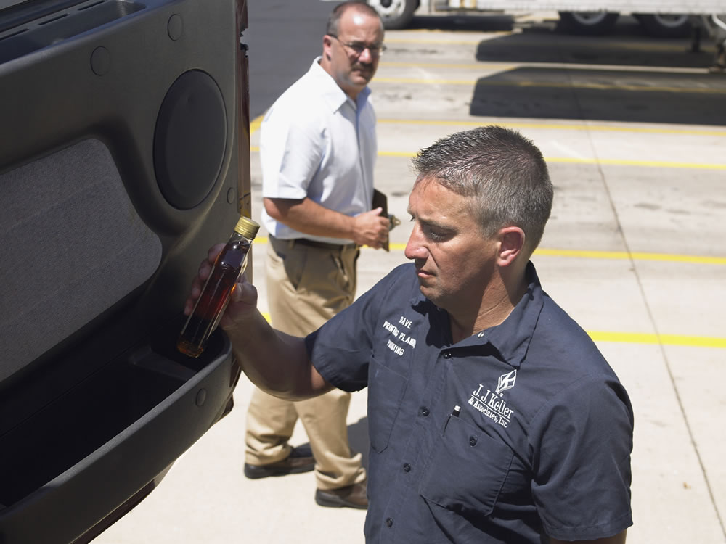
Alcohol prohibitions include:
Use while you are performing a
safety-sensitive function
Use during the four hours before you
perform a safety-sensitive function
Reporting for duty or remaining on duty to
perform a safety-sensitive function with an
alcohol concentration of 0.04 or greater
Use during the eight hours following an accident, or until you undergo a post-accident test, or
Refusing to take a required test
Notes:
Alcohol prohibitions include:
Use while you are performing a safety-sensitive function
Use during the four hours before you perform a safety-sensitive function
Reporting for duty or remaining on duty to perform a safety-sensitive function with an alcohol concentration of 0.04 or greater
Use during the eight hours following an accident, or until you undergo a post-accident test, or
Refusing to take a required test
CALLOUT: If you have an alcohol concentration of 0.02 or greater but less than 0.04, you may not perform, or be permitted to perform, safety-sensitive functions for at least 24 hours.

Slide 16
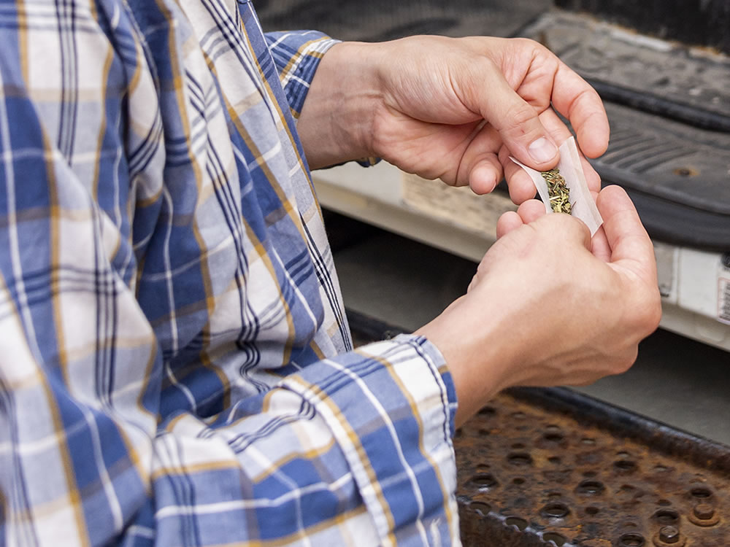
Drug prohibitions include:
Using any drug or substance identified in
21 CFR 1308.11 Schedule I
Using any non-Schedule I drug or substance
Testing positive for drugs
Having an adulterated or substituted
drug test result, or
Refusing to take a required test
Notes:
Drug prohibitions include:
Using any drug or substance identified in 21 CFR 1308.11 Schedule I
Using any non-Schedule I drug or substance (except under the direction of a licensed medical practitioner who is familiar with your medical history and has advised you that the drug will not adversely affect your ability to safely operate a CMV)
Testing positive for drugs
Having an adulterated or substituted drug test result, or
Refusing to take a required test
CALLOUT: Drugs and substances in 21 CFR 1308.11 Schedule I include opiates, opium derivatives, hallucinogenic substances, depressants, and stimulants.
CALLOUT: An employer may require you to inform your company of any therapeutic drug use.

Slide 17
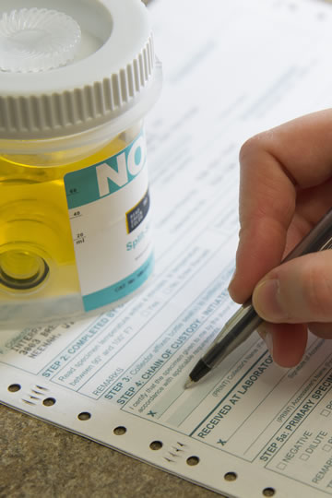
Failing an alcohol test, testing positive for drugs, or refusing to take a required alcohol and/or drug test will result in you being removed from all safety-sensitive functions until you
go through a
return-to-duty
process.
Notes:
Failing an alcohol test, testing positive for drugs, or refusing to take a required alcohol and/or drug test will result in you being removed from all safety-sensitive functions until you go through a return-to-duty process.

Slide 18
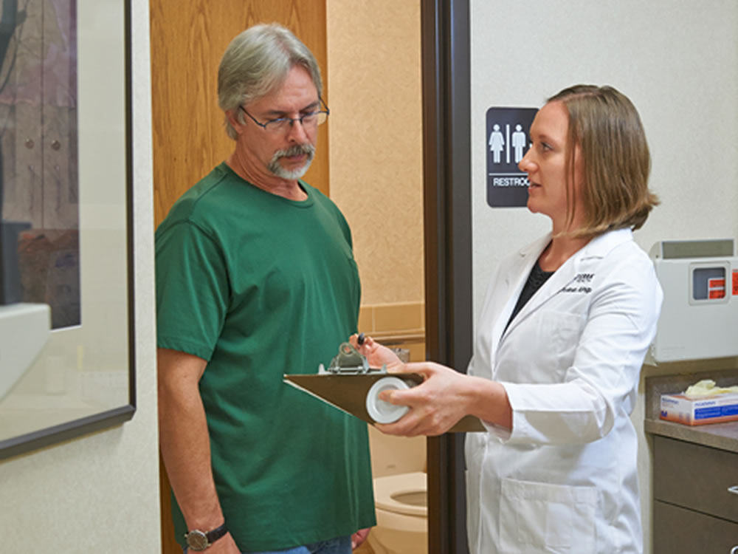
Types of Tests
Notes:
Types of Tests
There are six types of tests that are required by the regulations to ensure that drivers are not under the influence of alcohol or using drugs while on the job.
Drivers of CMVs are subject to the following tests:
Pre-Employment
Post-Accident
Random
Reasonable Suspicion
Return-to-Duty
Follow-Up

Slide 19
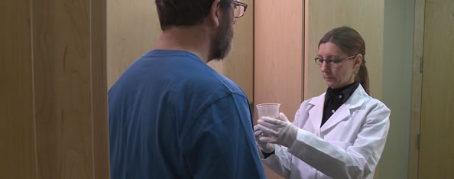
Pre-Employment
All drivers, prior to performing safety-sensitive functions for a motor carrier for the first time, must be tested for drug use and have a negative test result.
Notes:
Pre-Employment
All drivers, prior to performing safety‑sensitive functions for a motor carrier for the first time, must be tested for drug use and have a negative test result.
Pre-employment testing applies to both newly hired drivers as well as someone who transfers into a driving position from a non-driving position within the company.
While the regulations don’t specifically require it, a motor carrier may choose to include alcohol testing as part of their pre-employment process if certain criteria are met. (See Sec. 382.301 of the FMCSRs.)

Slide 20
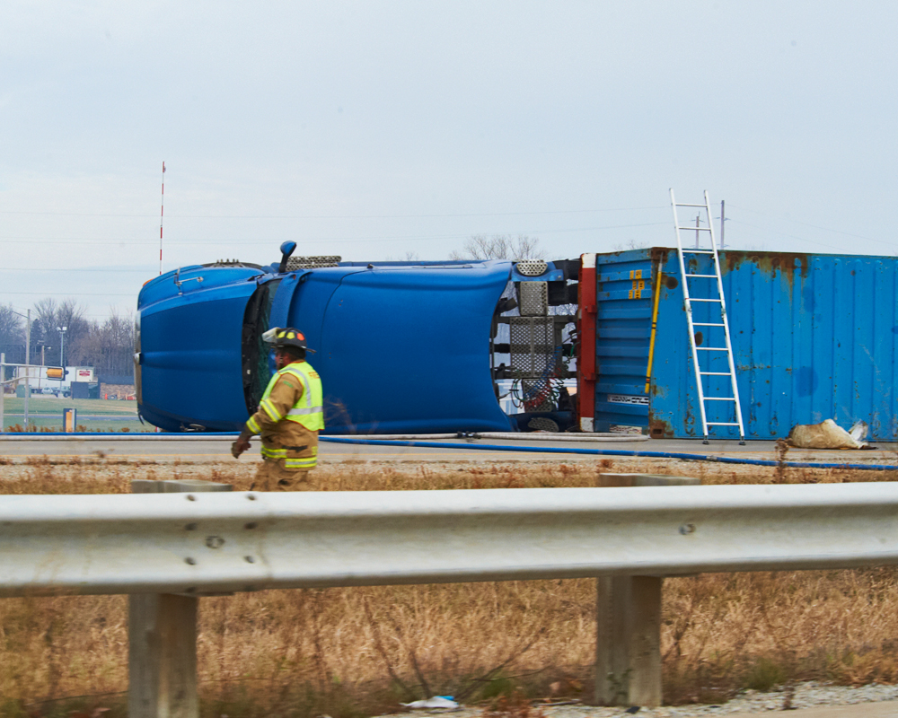
Post-Accident
Both a post-accident alcohol test and drug test are required if an accident occurred and:
  Any person involved in the accident dies
  You are cited for a moving traffic violation, and the accident involved injury requiring immediate medical treatment, or
  You are cited for a moving traffic violation, and the accident resulted in the towing of one or more vehicles from the scene
Notes:
Post-Accident
Both a post-accident alcohol test and drug test are required if an accident occurred and:
Any person involved in the accident dies
You are cited for a moving traffic violation, and the accident involved injury requiring immediate medical treatment, or
You are cited for a moving traffic violation, and the accident resulted in the towing of one or more vehicles from the scene

Slide 21
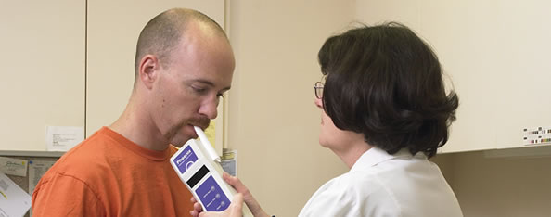
Post-Accident
Post-accident alcohol testing is required as soon as possible when these conditions are met and when a citation is issued within eight hours of the accident.
Notes:
Post-accident alcohol testing is required as soon as possible when these conditions are met and when a citation is issued within eight hours of the accident.
The post-accident alcohol test must be initiated by your motor carrier within two hours but no later than eight hours of the accident
According to the prohibitions, a driver who is required to take a post-accident alcohol test may not use alcohol for eight hours following the accident or until the driver undergoes the test, whichever comes first.
CALLOUT: If the test cannot be performed within two hours, the motor carrier must prepare a record stating why the test wasn’t given. If the test cannot be performed within eight hours, the motor carrier should not give the test and must prepare a record stating why the test could not be given within that time.

Slide 22
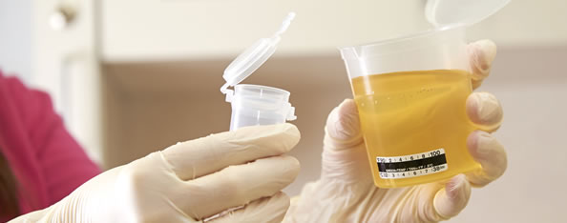
Post-Accident
Post-accident drug testing is required as soon as possible when these conditions are met, and when the citation is issued within 32 hours of the accident.
Notes:
Post-accident drug testing is required as soon as possible when these conditions are met, and when the citation is issued within 32 hours of the accident. Under the rules, the post-accident drug test must be administered within 32 hours.
If you are subject to post-accident testing you must remain available for testing. Not remaining available for testing is considered a refusal to test. A refusal to test is treated the same as failing an alcohol test or testing positive for drugs.
Nothing in the regulations should delay medical attention for those who are injured or prohibit you from leaving the scene of the accident to get help in responding to the accident or to seek emergency medical care for yourself.
Your motor carrier must provide you with necessary post-accident information, procedures, and instructions before you operate a CMV. This will ensure you are prepared in the event of an accident.
CALLOUT: If the test cannot be performed within 32 hours, the motor carrier should not give the test and must prepare a record stating why the test could not be given within that time.

Slide 23
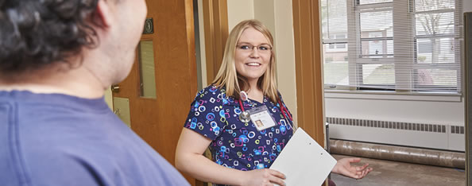
Random
Unannounced random testing is required for a certain percentage of drivers each year. Random tests must be unannounced and spread reasonably throughout the year.
Notes:
Unannounced random testing is required for a certain percentage of drivers each year. Random tests must be unannounced and spread reasonably throughout the year. When you are informed of being selected for random testing you must immediately go to the testing site.
The random tests must be reasonably spaced throughout the year. Selection of drivers for all random testing must be done using a scientifically valid method. The FMCSA only recognizes a random number table or a computer-based random number generator that is matched with drivers’ Social Security numbers, payroll identification numbers, or other comparable identifying numbers as scientifically valid.
Once you are randomly tested for drugs and/or alcohol during a calendar year, your name must be returned to the random pool for each new selection. Each driver must be subject to an equal chance of being tested during each selection process.
CALLOUT: Drawing names out of a hat is not considered a scientifically valid method of selecting drivers.

Slide 24
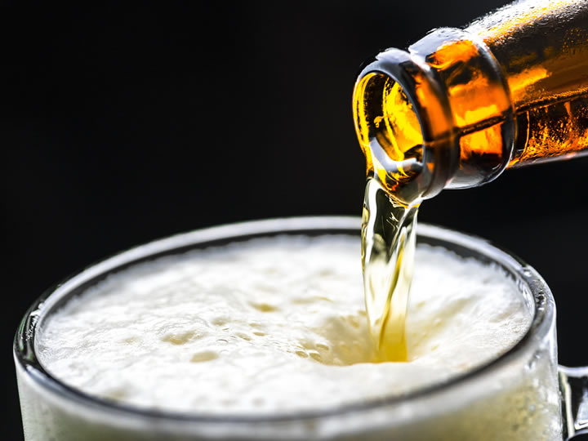
Random testing for alcohol must be completed just before, during, or immediately after performing a safety-sensitive function.
Notes:
Random testing for alcohol must be completed just before, during, or immediately after performing a safety-sensitive function.

Slide 25
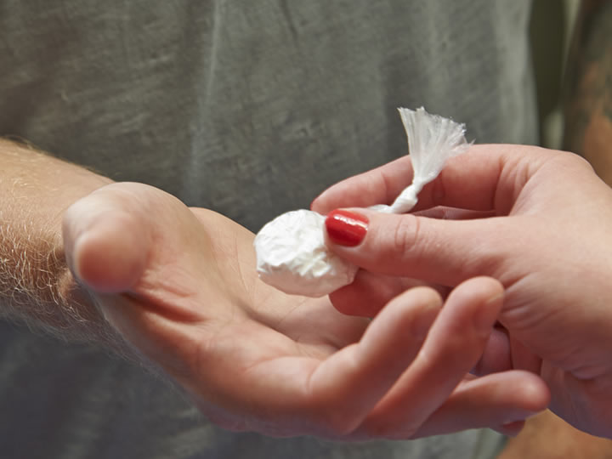
Random testing for drugs may be performed at any time while you are at work for your motor carrier.
Notes:
Random testing for drugs may be performed at any time while you are at work for your motor carrier.

Slide 26
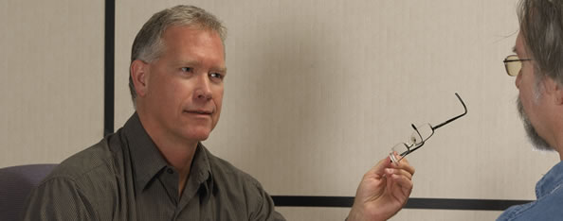
Reasonable Suspicion
Reasonable suspicion testing is required if your supervisor has reason to believe that your behavior or appearance may indicate alcohol abuse or drug use.
Notes:
Reasonable suspicion testing is required if your supervisor has reason to believe that your behavior or appearance may indicate alcohol abuse or drug use.
VIDEOS (see Trainer Tools USB)
29.1 — Reasonable Suspicion

Slide 27
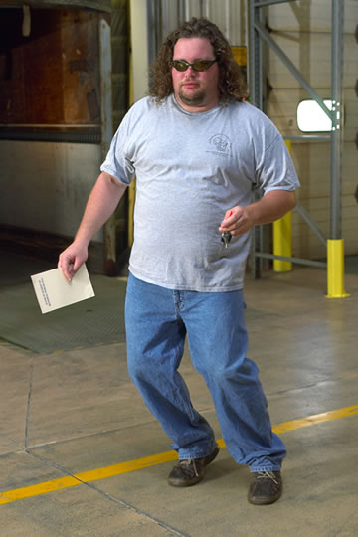
This testing must be based on the observations of a trained supervisor and his or her suspicions must be based on specific, clearly stated observations of your:
  Appearance
  Behavior
  Speech, or
  Body odors
Notes:
This testing must be based on the observations of a trained supervisor and his or her suspicions must be based on specific, clearly stated observations of your:
Appearance
Behavior
Speech, or
Body odors

Slide 28
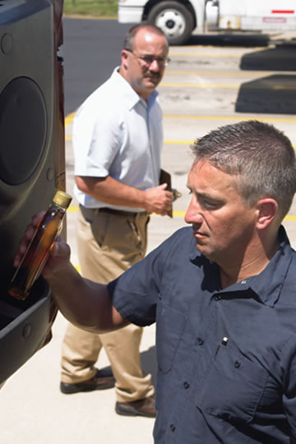
The regulations require that the supervisor:
Observe you personally
Be trained, according
to the regulations, to make a reasonable suspicion determination
Be able to document the observations that led to ordering
a reasonable
suspicion test
Notes:
Indications of the chronic and withdrawal effects of drugs may also be considered when determining reasonable suspicion for drug testing.
The regulations require that the supervisor:
Observe you personally
Be trained, according to the regulations, to make a reasonable suspicion determination
Be able to document the observations that led to ordering a reasonable suspicion test
You can’t be ordered to take a test based on a “hunch” or “intuition” or “hearsay.”
CALLOUT: You can’t be ordered to take a reasonable suspicion test because someone told your supervisor that you look like you may be impaired.

Slide 29
Observations for reasonable suspicion alcohol testing must be made just before, during, or just after you perform a safety‑sensitive function.
Notes:
Observations for reasonable suspicion alcohol testing must be made just before, during, or just after you perform a safety‑sensitive function. The person who makes the determination that reasonable suspicion exists may not conduct the alcohol test.
If reasonable suspicion is observed, but a reasonable suspicion test has not yet been administered, you must not perform safety‑sensitive functions until an alcohol test is administered and your alcohol concentration measures less than 0.02, or 24 hours have passed following the determination of reasonable suspicion.

Slide 30
Observations for reasonable suspicion drug testing may be made at any
time while you are at work
for your motor carrier.
Notes:
Observations for reasonable suspicion drug testing may be made at any time while you are at work for your motor carrier. Your motor carrier may require you to submit to a drug test at any time reasonable suspicion exists while you are on duty.
The regulations do not give a motor carrier authority to take any action, other than stated above, against you based solely on your behavior and appearance with no test result. However, the motor carrier may act independent of the regulations.
CALLOUT: Testing for reasonable suspicion must be based on the observations of a trained supervisor. The supervisor’s training must include 60 minutes of training on alcohol abuse and an additional 60 minutes of training on controlled substances use.

Slide 31

Return-to-Duty
You must be evaluated by a substance abuse professional (SAP) and participate in the education and/or treatment program prescribed by the SAP if you:
  Failed an alcohol test
  Tested positive for drugs, or
  Refused an alcohol and/or drug test
Notes:
Return-to-Duty
You must be evaluated by a substance abuse professional (SAP) and participate in the education and/or treatment program prescribed by the SAP if you:
Failed an alcohol test
Tested positive for drugs, or
Refused an alcohol and/or drug test
You must successfully comply with the education and/or treatment program prescribed by the SAP and undergo a return-to-duty test with the results indicating an alcohol concentration of less than 0.02 and/or a verified negative drug test.

Slide 32
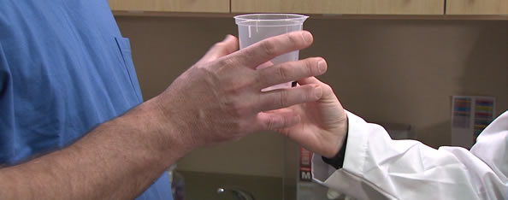
Follow-Up
The number and frequency of follow-up tests are determined by the SAP but must consist of at least six tests during the first 12 months following your return to duty.
Notes:
Follow-Up
Once you have passed the return-to-duty test, you are then subject to follow‑up testing. The number and frequency of the tests are determined by the SAP but must consist of at least six tests during the first 12 months following your return to duty. Follow-up testing may be done for up to 60 months (five years).
Follow-up testing for alcohol can only be performed when you are performing a safety-sensitive function, or immediately before or after performing a safety‑sensitive function.

Slide 33
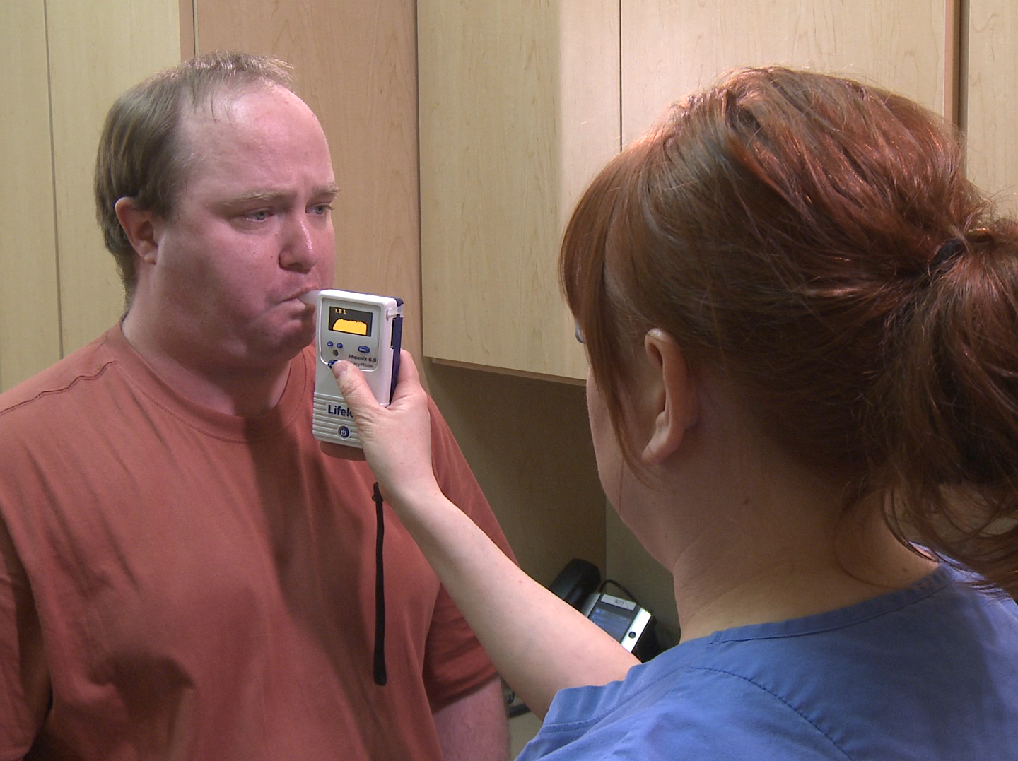
Alcohol Testing Procedures
Notes:
Alcohol Testing Procedures
VIDEOS (see Trainer Tools USB)
29.2 — Alcohol Testing Procedures

Slide 34

All alcohol testing is conducted by a trained, qualified breath alcohol technician (BAT) or screening test technician (STT) in a private setting.
The technician will introduce himself or herself, and then ask you for photo identification.
Notes:
All alcohol testing is conducted by a trained, qualified breath alcohol technician (BAT) or screening test technician (STT) in a private setting. The testing device used must be approved by the National Highway Traffic Safety Administration (NHTSA).
The technician will introduce himself or herself, and then ask you for photo identification, such as a driver’s license or employer issued identification. You may ask for the technician’s identification, as well.
The technician will complete the first part of the alcohol testing form, which includes:
Your name
Your motor carrier’s name
The reason for the test
You will be asked to complete the second part of the form stating:
You understand that you are about to be tested
All information given is correct
CALLOUT: If you refuse to sign the alcohol testing form it is considered a refusal to take the test. Refusal to take the test is treated the same way as failing a test, and the technician will immediately notify your motor carrier.

Slide 35
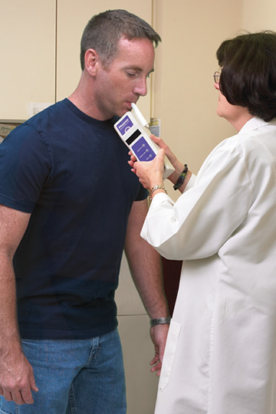
Next, a screening test will be conducted. The testing devices you may encounter include:
  Breath Testing
  Saliva
  Breath Tube
When the screening test is complete, the technician must show you the reading on the device and enter the result on the testing form.
Notes:
Next, a screening test will be conducted. Either an evidential breath testing device (EBT) or non-evidential alcohol screening device (ASD) may be used. The testing devices you may encounter include:
Breath Testing/Screening Device. You must blow forcefully into the mouthpiece of the testing device for about six seconds.
Saliva. A swab will be inserted into your mouth until saturated with saliva.
Breath Tube. You will need to blow into the device until its inflation bag fills with air (approximately 12 seconds).
When the screening test is complete, the technician must show you the reading on the device and enter the result on the testing form.
If the reading on the breath or saliva testing device is 0.02 or greater, an alcohol confirmation test must be done using an approved EBT. The test must be done after 15 minutes have passed, but within 30 minutes of the initial screening test. If the screening and confirmation test results are not the same, the confirmation test result will be the one reported to your motor carrier.
If the confirmation test result is 0.02 or greater, but less than 0.04 you must be removed from all safety-sensitive functions for at least 24 hours.
If the confirmation test result is 0.04 or greater you must be removed from all safety-sensitive functions until you have completed the return-to-duty process.
CALLOUT: During this 15 to 30 minute period, you will be asked not to eat, drink, belch, or put anything in your mouth. These steps prevent the build-up of mouth alcohol, which could lead to an artificially high result.

Slide 36
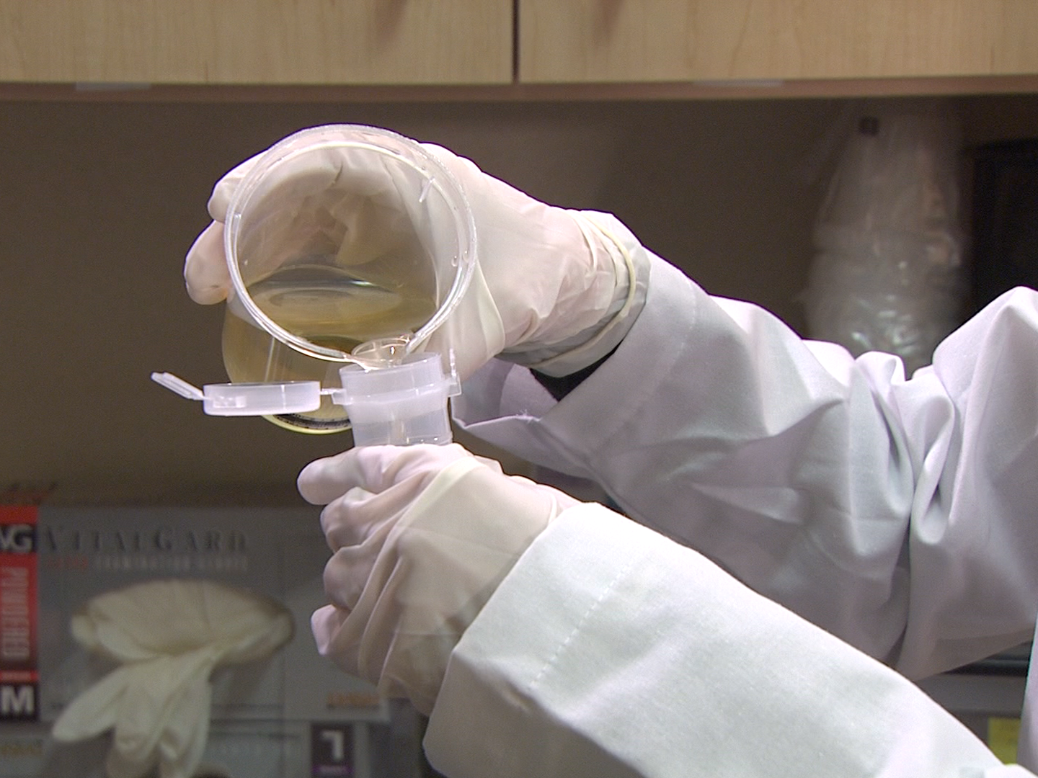
Drug Testing
Notes:
Drug Testing
VIDEOS (see Trainer Tools USB)
29.3 — Drug Testing

Slide 37
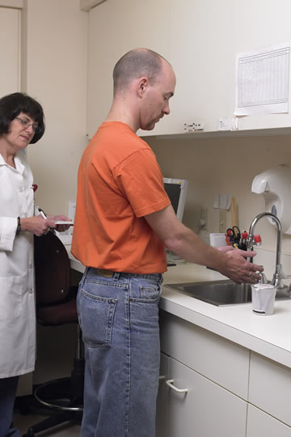
The technician will ask you to:
Provide photo identification
Remove any
outer clothing
Set aside your bag, briefcase, or purse
Empty your pockets
Fill out the Custody and Control Form
Wash and dry
your hands
Notes:
The procedures for drug testing are similar to alcohol testing.
The sample collection must be done in a setting that offers you privacy and meets security requirements. The collection site technician must be trained in the process and must use approved materials and documents.
Samples must be collected in clean, single-use specimen bottles which are to remain in their protective, sealed wrapper until the technician unwraps it in front of you. This ensures that the specimen is not tainted or contaminated.
The technician will ask you to:
Provide photo identification (or ask your carrier to positively identify you)
Remove any outer clothing (jacket, hat, gloves)
Set aside your bag, briefcase, or purse
Empty your pockets
Fill out the Custody and Control Form (CCF)
Wash and dry your hands

Slide 38
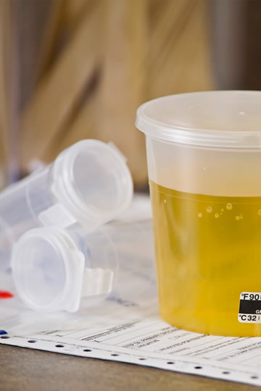
The technician divides your sample into two containers.
You must initial the labels to certify the sample collected was yours.
Notes:
The technician will then instruct you to go into a separate room and provide a sample.
After you have provided the sample, the technician will test the temperature of the sample. The technician will then divide it into two containers for the split sample, seal both containers, and place an identification label on both containers which is a process you must observe as a part of the test.
You must then initial the labels to certify the sample collected was yours. You will also be directed to read, complete, and sign the CCF.

Slide 39
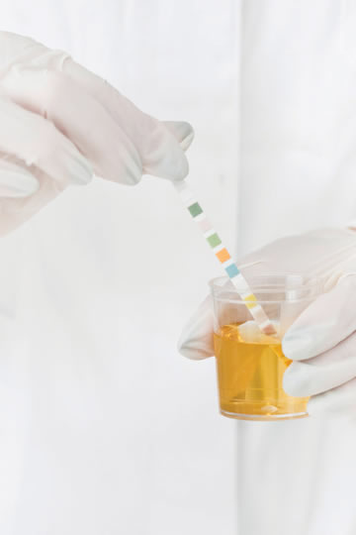
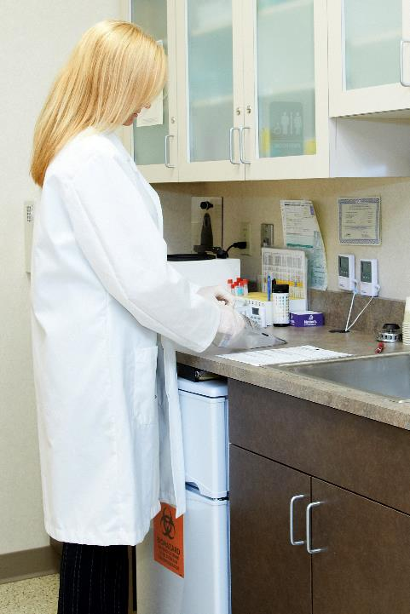
At the laboratory,
an initial test is performed on the first sample. If this test is positive for the presence of drugs, a confirmatory drug test will be conducted.
Notes:
At the laboratory, an initial test is performed on the first sample. If this test is positive for the presence of drugs, a confirmatory drug test will be conducted.
The results of the test are forwarded to the medical review officer (MRO).

Slide 40
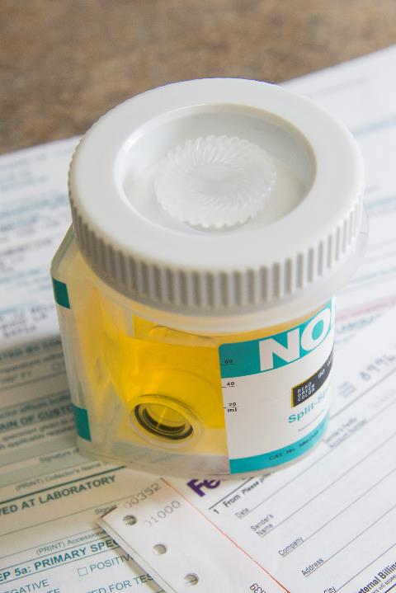
If the test results are positive, the MRO will investigate the reasons for this result.
You have 72 hours to request that the MRO order a test of the split specimen by a different certified lab.
Notes:
If the test results are positive, adulterated, substituted, or invalid, for any reason, the MRO will investigate the reasons for this result. The investigation will include contacting you to discuss the test results.
During this conversation, the MRO will ask about any possible medical reasons for the test result. This is a confidential call that gives you a chance to discuss the test results with the MRO before your motor carrier is contacted.
You have 72 hours to request that the MRO order a test of the split specimen by a different certified lab. This gives you the opportunity for an independent confirmation or rejection of the initial test result.
If the second lab verifies that the initial test result is correct, the MRO will contact you again and contact your motor carrier to report the results.

Slide 41
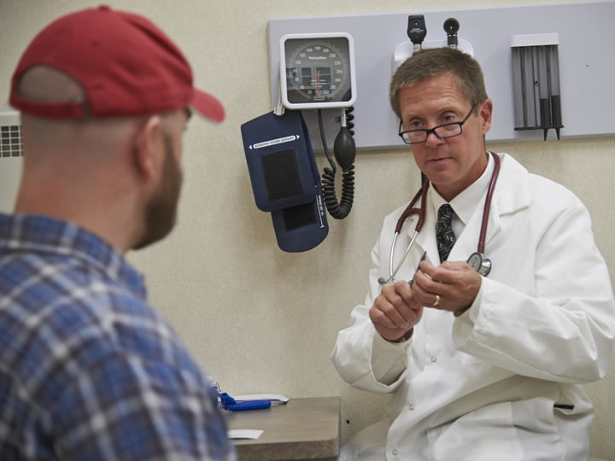
Refusing to Test
Notes:
Refusing to Test
VIDEOS (see Trainer Tools USB)
29.4 — Refusing to Test

Slide 42

A refusal to test is treated the same as a failed alcohol test or a positive drug test.
If you refuse to
be tested, you
cannot continue
to perform safety‑sensitive functions,
including driving.
Notes:
As part of the alcohol and drug regulations, you must submit to alcohol and drug testing. Refusing to be tested has serious consequences. A refusal to test is treated the same as a failed alcohol test or a positive drug test.
If you refuse to be tested, you cannot continue to perform safety‑sensitive functions, including driving for your motor carrier or any other motor carrier until you have gone through the return‑to-duty process.
CALLOUT: A refusal to test is part of your alcohol and drug records for the next five years.

Slide 43
Situations considered a refusal to submit to a test include:
  Declining to take a test
  Failing to appear for any test within a reasonable time
  Failing to remain at the testing site until the testing is complete
  Failing to provide a specimen for testing
Notes:
Situations considered a refusal to submit to a test include:
Declining to take a test
Failing to appear for any test within a reasonable time
Failing to remain at the testing site until the testing is complete
Failing to provide a specimen for testing
CALLOUT: A complete list of situations that are considered a refusal to test are listed in Sec. 382.107 of the FMCSRs.

Slide 44
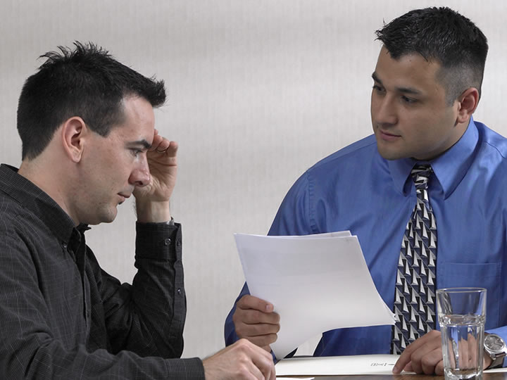
Failing an Alcohol Test or Testing Positive for Drugs
Notes:
Failing an Alcohol Test or Testing Positive for Drugs

Slide 45
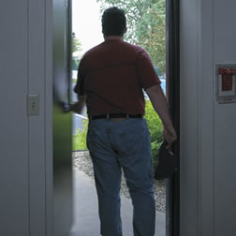
If you fail an alcohol test or test positive for drugs:
You must be removed from all safety-sensitive functions
Notes:
According to the regulations, if you fail an alcohol test or test positive for drugs, you will face the following consequences:
You must be removed from all safety-sensitive functions

Slide 46

If you fail an alcohol test or test positive for drugs:
You may not return to a safety-sensitive function until:
  An evaluation by a SAP has been done
  You have complied with prescribed treatment
  You pass a
  return-to-duty test
Notes:
According to the regulations, if you fail an alcohol test or test positive for drugs, you will face the following consequences:
You may not return to a safety‑sensitive function until:
An evaluation by a (SAP) has been done
You have complied with prescribed treatment
You pass a return-to-duty test

Slide 47
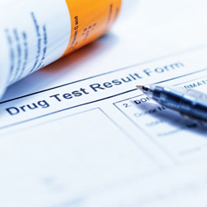
If you fail an alcohol test or test positive for drugs:
You are subject to six follow-up tests in the first 12 months after your return to duty and may be subject to follow-up testing for up to
five years.
Notes:
According to the regulations, if you fail an alcohol test or test positive for drugs, you will face the following consequences:
You are then subject to six follow-up tests in the first 12 months after your return to duty and may be subject to follow-up testing for up to five years.
CALLOUT: You may not return to safety-sensitive functions for at least 24 hours if your alcohol concentration is determined to be 0.02 or greater but less than 0.04.

Slide 48
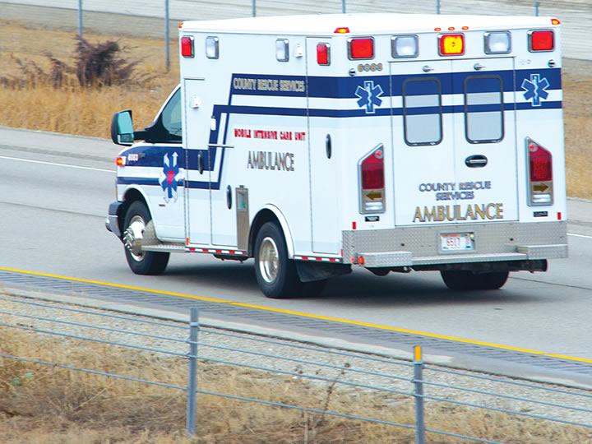
The Effects of
Alcohol Abuse & Drug Use
Notes:
The Effects of Alcohol Abuse & Drug Use

Slide 49

The symptoms of alcohol use/abuse include:
  Slowed reactions
  Dulled mental processes
  Poor coordination
  Bad judgment
Notes:
Alcohol is a central nervous system depressant found in beer, wine, and hard liquor. Alcohol “abuse” occurs when it is used intentionally for its physical and mood-altering effects.
The symptoms of alcohol use/abuse include:
Slowed reactions
Dulled mental processes
Poor coordination
Bad judgment

Slide 50
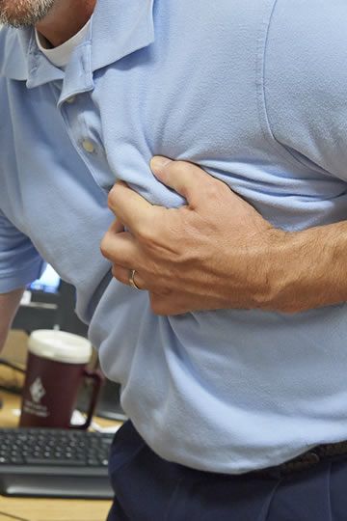
Long-term effects
of alcohol use/abuse include:
  Liver damage
  Heart attack
  Stroke
  Cancers
  Brain damage
Notes:
The long-term effects of alcohol use/abuse may include:
Liver damage
Heart attack
Stroke
Cancers (of the liver, esophagus, nasopharynx or larynx)
Brain damage (dementia, blackouts, seizures, hallucinations, peripheral neuropathy)

Slide 51
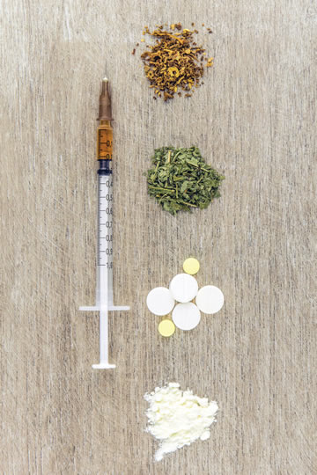
The symptoms
of drug use include:
  Slowed reactions
  Slowed thinking
  Confusion
  Anxiety
  Hallucinations
  Changes in vision
  Dizziness
Notes:
Drivers performing safety-sensitive functions are tested for: marijuana, cocaine, amphetamines, opioids, and phencyclidine (PCP).
The symptoms of drug use include:
Slowed reactions
Slowed thinking
Confusion
Anxiety
Hallucinations
Changes in vision
Dizziness
CALLOUT: 49 CFR Part 40 does not authorize the use of marijuana for any reason, including use of “medical marijuana” or “recreational marijuana” as allowed by state laws.

Slide 52

Long-term effects
of drug use include:
  Depression
  Memory loss
  Lung infections
  Cancer
  Brain damage
  Cardiac arrest
  Seizures
  Coma
  Death
Notes:
The long-term effects of drug use may include:
Depression
Irreversible memory loss
Lung infections/ bronchitis/emphysema
Cancer
Brain damage
Cardiac arrhythmias/arrest
Seizures/ convulsions/strokes
Coma
Death
Managing a large CMV on the highway and at the loading dock requires focused concentration, excellent vision, and rapid reflexes. And, these are the first abilities to be impaired by alcohol and drugs.

Slide 53
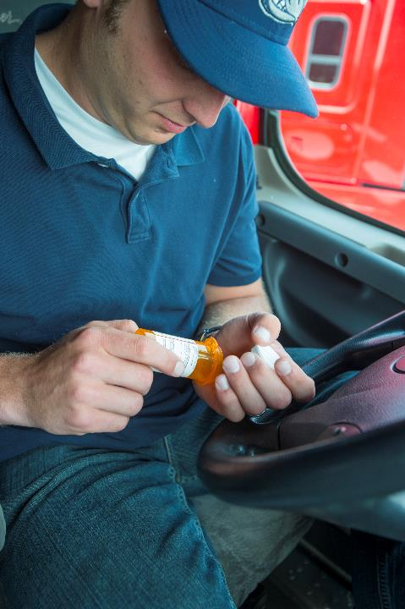
Over-the-counter medications, and even prescription medications, may interfere with your ability to drive safely.
Notes:
Over-the-counter medications, and even prescription medications, may interfere with your ability to drive safely and within the requirements of the alcohol and drug regulations. Make sure you know about the possible side effects of these drugs before taking them—especially before driving. Consult your physician if you have any questions about a prescription and read the ingredients label and directions for use on every over-the-counter drug you use.

Slide 54
Objectives Review
You should now be able to:
Describe the alcohol and drug prohibitions that apply to CMV operators
Identify what types of testing drivers can expect to experience under various circumstances
Explain the alcohol and drug testing procedures
Describe the consequences of violating the prohibitions
Recognize the effects of alcohol abuse and drug use and how they impair driving abilities
Notes:
You should now be able to:
Describe the alcohol and drug prohibitions that apply to CMV operators
Identify what types of testing drivers can expect to experience under various circumstances
Explain the alcohol and drug testing procedures
Describe the consequences of violating the prohibitions
Recognize the effects of alcohol abuse and drug use and how they impair driving abilities
CLASSROOM RECOMMENDATION
Before concluding your training session, have participants take the corresponding quiz (found on the Trainer Tools USB) to check their understanding of the material. You can customize any of the questions to fit your audience or workplace. The answer key can also be found on the Trainer Tools USB.
You may also choose to administer the quizzes before you begin your training session to help get participants thinking about the subject and/or to gauge their understanding of the topic ahead of time.

