Slide 1






PowerPoint® Instructions
This PowerPoint has been designed so you can easily customize it for your training session.
Throughout the presentation you’ll see icons with recommendations or videos to enhance the instruction you present to your students. A detailed explanation for each icon can be found on the next slide. Videos can be found on the Trainer Tools USB.
When you see an icon on the slide, look in the notes
section for further information.
Simply delete or move the icon off the slide before your training session begins.

Slide 2





Classroom Recommendations. Provides suggestions for enhancing your classroom presentation; from ideas for large group discussions to suggestions on the use of training aids such as examples or photos of vehicle parts and components to help illustrate the items covered within a chapter.
Lab Recommendations. Provides suggestions for activities and exercises that take place outside the classroom, but do not involve
the actual operation of the tractor-trailer or its components. Examples
of lab sessions include conducting a vehicle inspection or practicing mirror adjustment.
Range Recommendations. These recommended activities take
place on a closed-access driving range where students may practice driving skills in a controlled environment. Examples of range sessions include practicing shifting technique and successfully completing a backing maneuver.
Road Recommendations. These recommended activities take place in road and traffic conditions that support the chapter’s objectives. Examples of road sessions include proper communication with other drivers through the use of turn signals and basic vehicle control under nighttime or extreme weather conditions.
Videos. These short video clips reinforce material presented in the Student Manual. Use them to help students grasp difficult concepts or subject matter.

Slide 3
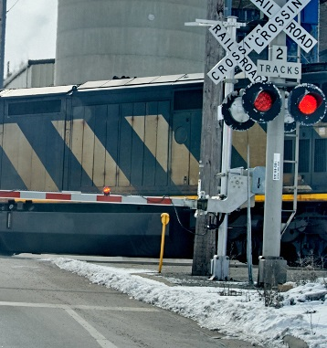
Railroad-Highway Grade Crossings
17
Notes:
Chapter 17: Railroad-Highway Grade Crossings
Unit A1.3.3 Railroad-Highway Grade Crossings
This unit must teach driver-trainees to recognize potential dangers and the appropriate safety procedures to utilize at railroad (RR)-highway grade crossings. This instruction must include an overview of various Federal/State RR grade crossing regulations, RR grade crossing environments, obstructed view conditions, clearance around the tracks, and rail signs and signals. The training providers must instruct driver-trainees that railroads have personnel available (“Emergency Notification Systems”) to receive notification of any information relating to an unsafe condition at the RR-highway grade crossing or a disabled vehicle or other obstruction blocking a railroad track at the RR-highway grade crossing.

Slide 4
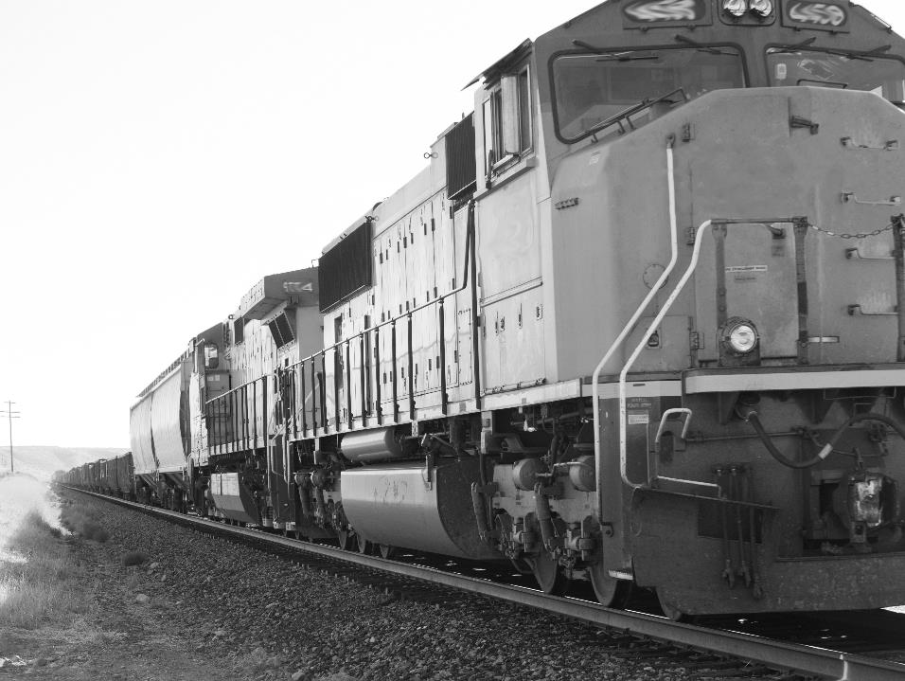
Introduction
Every driver must know how to cross railroad tracks safely.
Notes:
With over 200,000 highway-rail grade crossings in the United States, every driver must know how to cross railroad tracks safely. That is especially true for drivers of long, heavy vehicles like tractor-trailer combinations.
This chapter will address safely crossing railroad tracks including regulatory requirements, emergency procedures, and recognition of safety devices and signs.
CALLOUT: In 2017, there were 2,105 collisions at railroad crossings in the United States. According to Federal Railroad Administration data, these incidents resulted in 274 deaths and 807 injuries.
CLASSROOM RECOMMENDATION
Your classroom presentation should begin with a description of the dangers associated with highway‑rail grade crossings. Drivers can be disqualified from operating a commercial motor vehicle, lose their trucks, their cargo, or even their lives if their vehicle is struck by a train. Present some case stories of actual train/truck collisions and their causes. Pictures of these collisions alone can speak volumes about the critical importance of railway crossing safety.
Also stress the driver’s role in the equation—responsibility falls almost entirely on the highway driver to avoid collisions with trains, which always have the right of way.

Slide 5
Objectives
Upon completion of this lesson, you will be able to:
  Explain when stopping at railroad tracks is required
  Recognize the consequences of not adhering to
  highway-rail grade crossing regulations
  Identify various crossing signs, gates, and signals you may encounter
  Discuss the procedures to safely stop at railroad tracks
  Describe appropriate actions to take in the event of a railroad-related emergency
Notes:
Objectives
Upon completion of this lesson, you will be able to:
Explain when stopping at railroad tracks is required
Recognize the consequences of not adhering to highway-rail grade crossing regulations
Identify various crossing signs, gates, and signals you may encounter
Discuss the procedures to safely stop at railroad tracks
Describe appropriate actions to take in the event of a railroad-related emergency

Slide 6
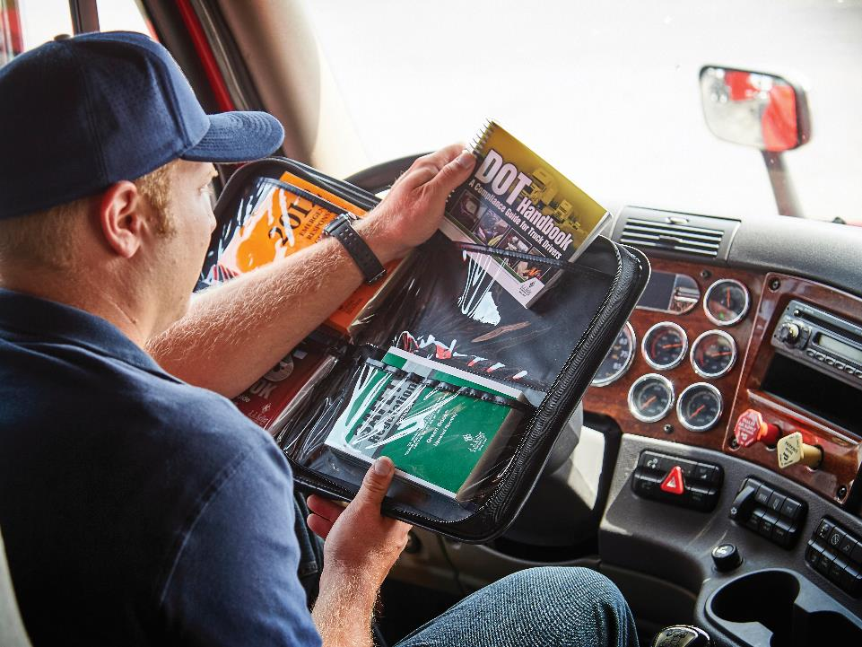
Regulations
Notes:
The Regulations

Slide 7
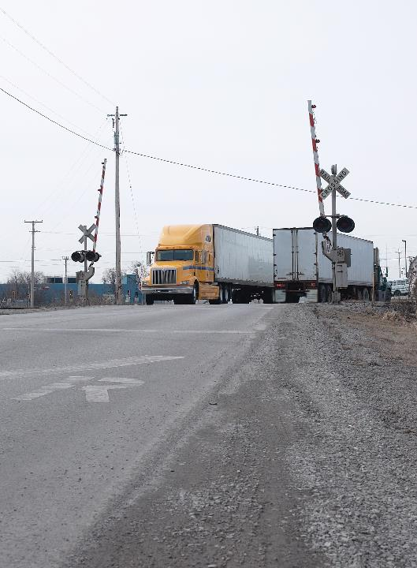
A highway-rail grade crossing is the area where a roadway crosses a railway at the same level.
Notes:
A highway-rail grade crossing is the area where a roadway (highway, road, street) crosses a railway at the same level at the crossing point (as opposed to grade-separated overpasses or underpasses).
Highway-rail grade crossing regulations for commercial motor vehicles (CMVs) are addressed in Part 392 of the Federal Motor Carrier Safety Regulations (FMCSRs).

Slide 8
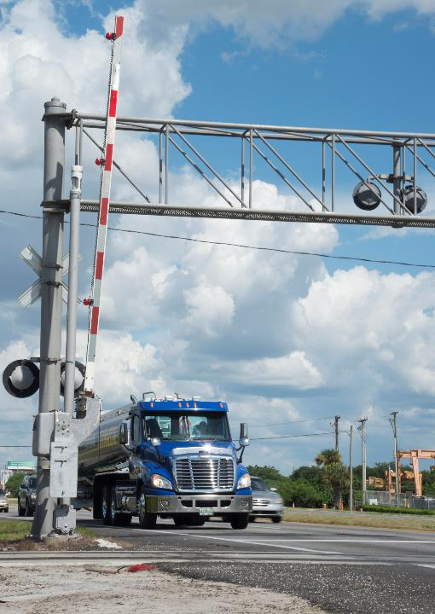
Certain CMVs must stop within 50 feet of, and no closer than 15 feet, to the railroad tracks.
Notes:
Section 392.10 requires that certain types of CMVs stop within 50 feet of, and no closer than 15 feet, to the railroad tracks. CMVs that must stop include:
Buses transporting passengers
CMVs transporting any quantity of a Division 2.3 chlorine
CMVs required to be marked or placarded with one of the following classifications:
Division 1.1
Division 1.2 or Division 1.3
Division 2.3 Poison gas
Division 4.3
Class 7
Class 3 Flammable
Division 5.1
Division 2.2
Division 2.3 Chlorine
Division 6.1 Poison
Division 2.2 Oxygen
Division 2.1
Class 3 Combustible liquid
Division 4.1
Division 5.1
Division 5.2
Class 8
Division 1.4
Cargo tank CMVs, whether loaded or empty, used for the transportation of any hazardous material
Cargo tank CMVs transporting commodities under specific circumstances (see Sec. 392.10)
CALLOUT: There are nine hazard classes established by the Hazardous Materials Regulations, some of which are further broken down into divisions.
For example, Hazard Class 2 (Gases) is further broken down into three divisions: 2.1 (Flammable gas), 2.2 (Non-flammable gas), and 2.3 (Gas poisonous by inhalation).

Slide 9
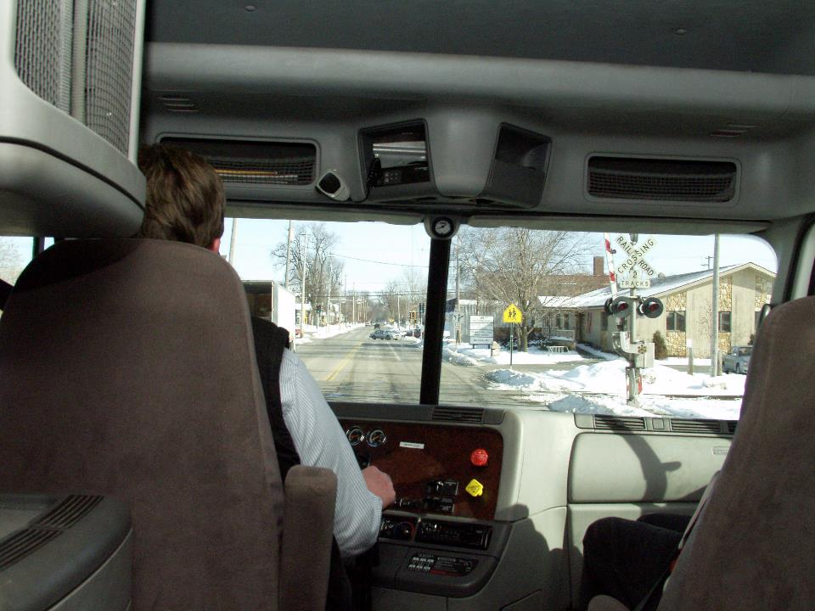
Listen, and look in both directions.
Notes:
When at a railroad crossing, you must listen and look in each direction along the tracks for an approaching train and make certain a train is not approaching. Do not shift gears when crossing the tracks. Shifting gears with a manual transmission while going across this raised surface may cause the vehicle to stall on the tracks.
VIDEOS (see Trainer Tools USB)
17.1 — Railroad Crossings

Slide 10
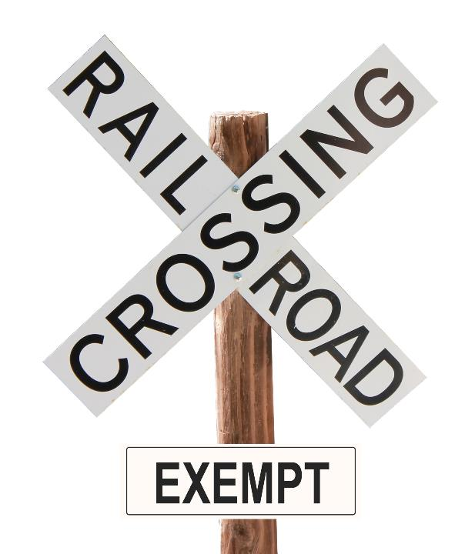
There are certain instances when stopping is not required.
Notes:
There are also certain instances when stopping at railroad tracks is not required. This includes:
A streetcar crossing, or railroad tracks used exclusively for industrial switching purposes, within a business district, as defined in Sec. 390.5 of the FMCSRs
A railroad grade crossing when a police officer or crossing flagger directs traffic to proceed
A railroad grade crossing controlled by a functioning highway traffic signal transmitting a green indication which, under local law, permits the CMV to proceed across the railroad tracks without slowing or stopping
An abandoned railroad grade crossing which is marked with a sign indicating that the rail line is abandoned
An industrial or spur line railroad grade crossing marked with a sign reading “Exempt”
CALLOUT: You may also be subject to state and local laws and regulations addressing highway-rail grade crossings. It is important to be aware of and follow the requirements for the communities in which you travel.

Slide 11
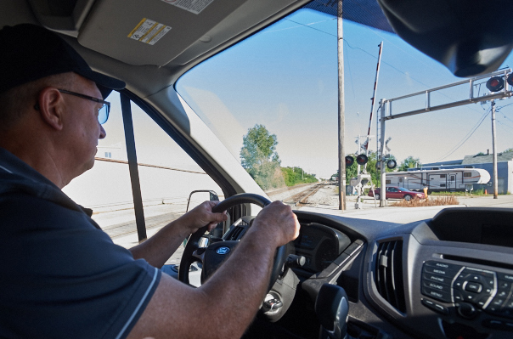
Once you start crossing, ensure you have sufficient space to drive completely through without stopping.
Notes:
If the CMV is not required to stop, Sec. 392.11 of the FMCSRs requires that the vehicle travel at a rate of speed that is slow enough to stop before reaching the tracks.
Your CMV may not cross the tracks until you are certain the crossing is clear.
Also, Sec. 392.12 of the FMCSRs states that you must ensure that you have sufficient space to drive completely through a highway-rail grade crossing without stopping.

Slide 12
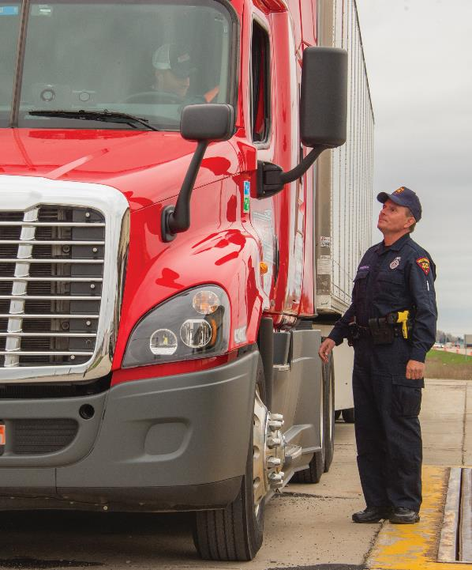
Railroad crossing offenses will disqualify you from operating a CMV.
Notes:
Driver Disqualification
A conviction for any one of the following six highway-rail grade crossing offenses while operating a CMV requiring a commercial driver’s license will disqualify you from operating a CMV.
Failing to slow down (if you are not required to stop at all times) and checking that the tracks are clear of an approaching train
Failing to stop (if you are not required to stop at all times) before reaching the crossing if the tracks are not clear
Failing to stop (if you are required to stop at all times) before driving onto the crossing
Failing to have sufficient space to drive completely through the crossing without stopping
Failing to obey a traffic control device or the directions of an enforcement officer at the crossing
Failing to negotiate a crossing because of insufficient undercarriage clearance
The disqualification period ranges from 60 days for the first conviction to one year for three or more convictions in a three-year period.
CALLOUT: See Section 383.51 of the FMCSRs for details.

Slide 13
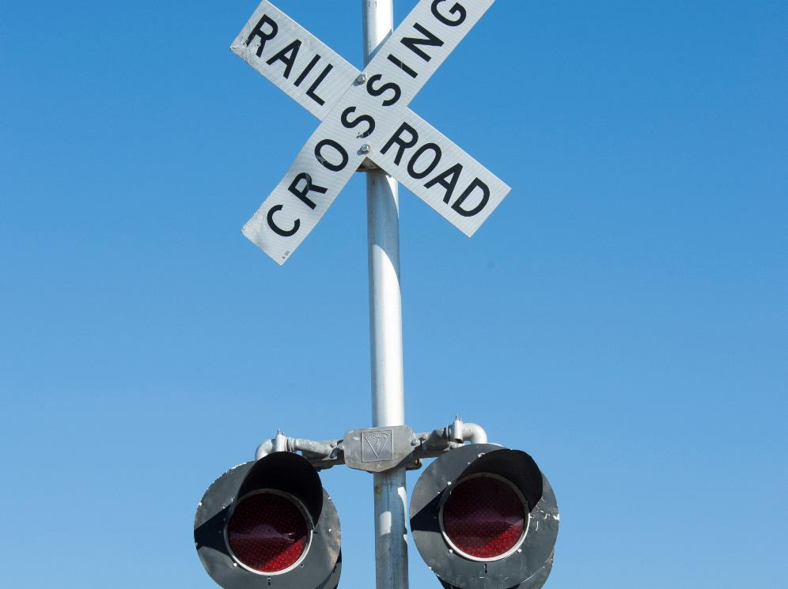
Signs & Signals
Notes:
Signs and Signals
It is important to know and understand the various signs and signals that are posted to alert you to an upcoming crossing.

Slide 14
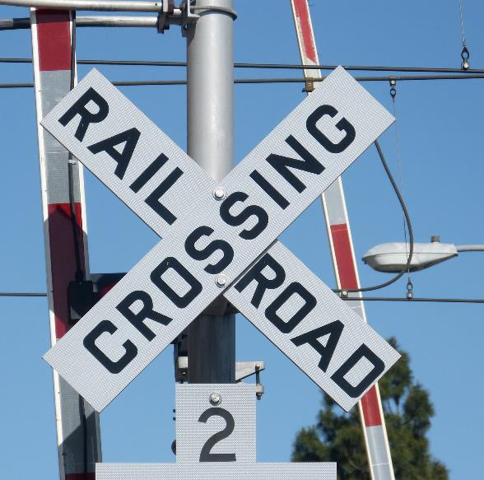
Signs are passive warning devices.
Advance Warning Sign
Pavement Markings
Crossbuck Sign
Number Sign
Stop Sign
Yield Sign
Exempt Sign
Do Not Stop on Tracks Sign
Tracks Out of Service Sign
Parallel Track Sign
Low Ground Clearance Sign
Notes:
Signs
Signs are passive warning devices. They are not electronic and do not give notice of the approach of a train. Passive devices are intended to direct the driver’s attention to the crossing, so the driver may exercise caution.
Advance warning sign. An advance warning sign is a round, yellow warning sign with a black “X” and “RR.” These signs are located alongside the highway in advance of the crossing and serve to alert motorists to the crossing.
The advance warning sign is usually the first sign you see when approaching a highway-rail grade crossing.
Pavement marking. The white letters “R&R” can be set into the surface of, applied to, or attached to, the pavement in advance of a crossing, to advise, warn, or guide traffic.
Crossbuck sign. A crossbuck sign is one of the oldest warning devices. It is a white, regulatory, X-shaped sign with the words “Railroad Crossing” in black lettering. It is located alongside the highway prior to the railroad tracks.
In most cases, the crossbuck sign is installed on the right-hand side of a public roadway on each approach to the highway-rail grade crossing. A crossbuck sign is a passive yield sign and is considered the same as a “Yield” sign. The crossbuck sign is required at all public highway-rail grade crossings.
Number sign. At multiple-track crossings, a sign indicating the number of tracks will be on the post below the crossbuck.
Stop sign. A standard, red regulatory stop sign with lettering is intended for use where motor vehicle traffic is required to stop. This sign can be added to the crossing, requiring all vehicles to come to a complete stop before crossing the railroad tracks.
Yield sign. The yield sign assigns right-of-way. Vehicles controlled by a yield sign need to avoid interference with other vehicles, including trains, which are given the right-of-way.
Exempt sign. This sign is placed in advance of and at crossings authorized by state law or regulation to inform placarded hazardous materials vehicles, buses, and other highway users that a stop is not required, except when a signal, train crew member, or uniformed police officer indicates that a train, locomotive, or other railroad equipment is approaching the crossing.
Do not stop on tracks sign. This sign is a black and white regulatory sign placed at a crossing when an engineering study or experience determines there is a high potential for vehicles stopping on the tracks.
Tracks out of service sign. This sign is for use at a crossing in lieu of the crossbuck when a railroad track has been abandoned or its use discontinued.
Parallel track sign. This sign is a diamond-shaped yellow advance warning sign located on a roadway parallel to the railroad tracks, indicating the road ahead will cross the tracks. This sign is intended to warn motorists making a turn that there is a highway-rail grade crossing immediately after the turn.
Low ground clearance sign. The low ground clearance sign is of particular importance to truck drivers. It’s used at railroad grade crossings where conditions are sufficiently abrupt to create hang-up of long wheelbase vehicles or trailers with low ground clearance.

Slide 15
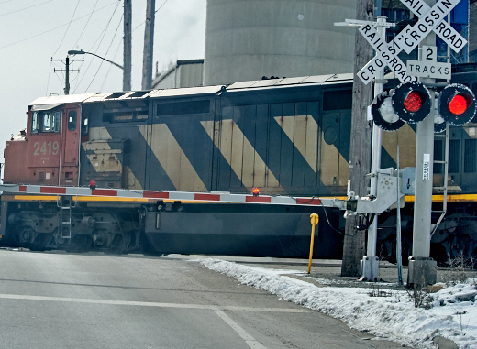
Signals are active warning devices.
Standard Gates
Standard Bells
Flashing Light Signals
Notes:
Signals
Signals are active warning devices. They activate automatically when a train approaches a highway-rail grade crossing and offer the greatest amount of protection against incident.
Standard gate. A standard gate assembly is an active traffic control device used with flashing lights and normally accompanied by a crossbuck sign, flashing light signals, and other passive warning signs. It consists of a drive mechanism and a fully reflectorized red and white striped gate arm with lights, which in the down position extend across the approaching lanes of highway traffic about four feet above the top of the pavement. The flashing light signal may be supported on the same post with the gate mechanism or separately mounted.
When no train is approaching or occupying the crossing, the gate arm is in an upright, vertical position. In a normal sequence of operation, the flashing light signals and the lights on the gate arm in its normal upright position are activated immediately upon detection of a train. The gate arm is designed to start its downward motion not less than three seconds after the signal lights start to operate, reach its horizontal position before the arrival of any train, and remain in that position as long as the train occupies the crossing. When the train clears the crossing, and no other train is approaching, the gate arm ascends to its upright position.
Standard bell. A standard bell is a device which, when activated, provides an audible warning. It may be used with flashing light signals and gates and is most effective as a warning to pedestrians and bicyclists.
A standard bell is designed to ring loudly when a train is approaching, to warn people in the surrounding area. When used, the bell is usually mounted on top of one of the signal support masts. The bell is usually activated whenever the flashing light signals are operating.
Flashing light signal. A flashing light signal is a device installed on a standard mast which, when activated, displays red lights flashing alternately. Flashing light signals activate upon the approach or presence of a train at a highway-rail grade crossing and require a complete stop by the highway user.
Flashing light signals are mandatory with gates. When both are activated, the gate arm light nearest the tip will be illuminated continuously and the other two lights shall flash alternately in unison with the flashing light signals. The typical flashing light signal assembly on a side-of-the-roadway location includes a standard crossbuck sign and, where there is more than one track, an auxiliary “number of tracks” sign, all of which indicate a highway-rail grade crossing ahead. A bell may be included in the assembly and operated in conjunction with the flashing lights.
Flashing light signals are found at all types of public highway-rail grade crossings. They normally are placed to the right of the approaching highway traffic on all roadway approaches to a crossing.

Slide 16
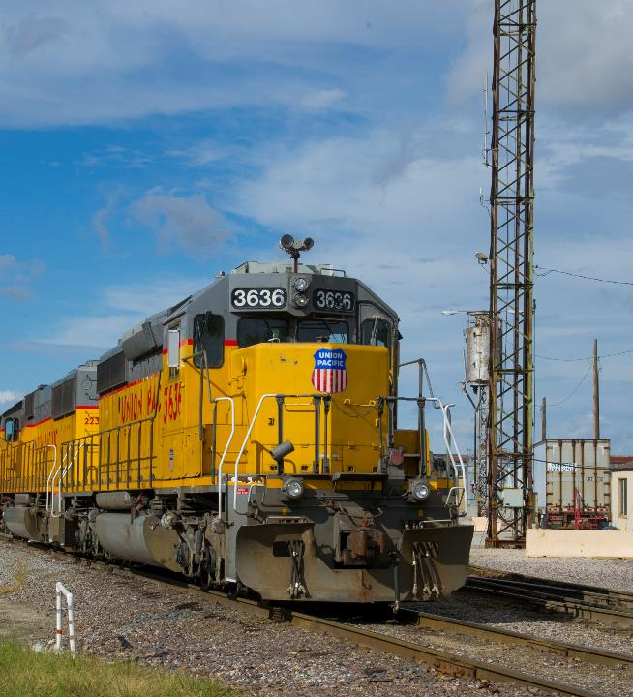
Safety Tips
Trains always have the right-of-way.
Notes:
Safety Tips
Trains have the right of way 100 percent of the time. On a level road, with good surface conditions, it takes about 14 seconds for an 80,000 pound 53-foot rig to cross a single track, and more than 15 seconds to cross a double track.
Anytime a railroad crosses a highway, the potential for disaster exists. At these crossings, you need to be alert, and always expect a train.
As you approach a railroad crossing, slow down and look as far down the tracks as you can in both directions. If your visibility is limited for any reason, slow down enough that you could make a complete stop before reaching the tracks if you needed to.
Shift into the gear you want to use to cross the tracks before you reach them. You should never shift gears while you’re crossing. You don’t want to miss a gear and stall your truck in the middle of the tracks.
It’s also a good idea to lower your windows and listen for a train before crossing over the tracks.

Slide 17
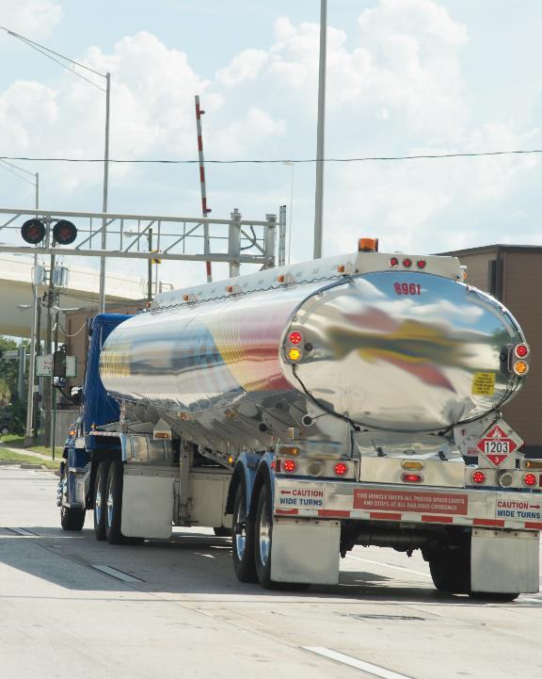
Always follow safe work practices when it comes to railroad crossings.
Notes:
The following are additional safety practices that should be followed when it comes to railroad crossings:
Check for traffic behind you and make sure other drivers know your intentions.
Freight trains do not travel at fixed times, and passenger train schedules can vary.
It is extremely difficult to judge a train’s speed as well as its distance from the crossing. If you are unsure that you can safely cross, wait until the train has passed.
Never race a train to the crossing.
Never drive around lowered gates. It is dangerous and illegal.
Use a pull-out lane, if available.
Turn on your four-way flashers in traffic, if necessary.
If the warning lights at the crossing begin to flash after you have started to cross the tracks, keep going and don’t back up.
Don’t begin to cross until you are sure you can completely cross the tracks without stopping. Remember, in addition to being unsafe, stopping on the tracks is illegal.
If your vehicle has a low ground clearance, select another route to make sure you don’t get stuck on the tracks.
When crossing multiple tracks, watch for a second train.

Slide 18
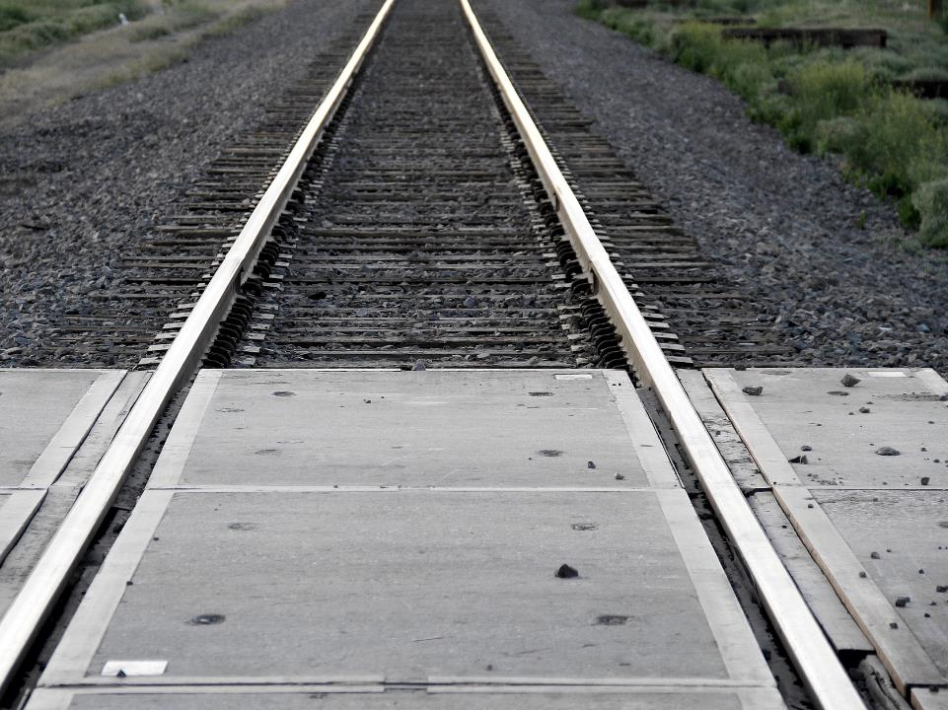
Stuck on the Tracks
If you get stuck on the tracks, get out of your vehicle immediately.
Notes:
Stuck on the Tracks
If you get stuck on the tracks, you should follow these steps:
Get out of the vehicle immediately. Take your cell phone. Move far away from the vehicle to avoid being near the point of impact.
Look for an emergency telephone number posted at the crossing and call it. If there is no posted emergency number, call 911 immediately. Give your exact location, using landmarks and the Department of Transportation (DOT) number from the crossing.

Slide 19
Objectives Review
You should now be able to:
  Explain when stopping at railroad tracks is required
  Recognize the consequences of not adhering to
  highway-rail grade crossing regulations
  Identify various crossing signs, gates, and signals you may encounter
  Discuss the procedures to safely stop at railroad tracks
  Describe appropriate actions to take in the event of a railroad-related emergency
Notes:
You should now be able to:
Explain when stopping at railroad tracks is required
Recognize the consequences of not adhering to highway-rail grade crossing regulations
Identify various crossing signs, gates, and signals you may encounter
Discuss the procedures to safely stop at railroad tracks
Describe appropriate actions to take in the event of a railroad-related emergency
CLASSROOM RECOMMENDATION
Before concluding your training session, have participants take the corresponding quiz (found on the Trainer Tools USB) to check their understanding of the material. You can customize any of the questions to fit your audience or workplace. The answer key can also be found on the Trainer Tools USB.
You may also choose to administer the quizzes before you begin your training session to help get participants thinking about the subject and/or to gauge their understanding of the topic ahead of time.
RANGE RECOMMENDATIONS
As with emergency maneuvers, nothing can replace practice and experience when it comes to rail crossings, and there is no better place to practice and gain experience than the safe, controlled environment of a driving range.
If a replica of a highway-rail grade crossing is available for practice, use it. You should not attempt to use a real crossing to practice anything but non-emergency maneuvers. Never practice getting stuck or breaking down on an active rail line.
Judging distances
The purpose of this exercise is to help your students gain an understanding of the distances involved at rail crossings. If possible, take the class to a nearby crossing where you know one or more trains will be passing by during the class.
First, measure out the 15-50 foot stopping distance to give students an idea of how far away from the rails they need to stop, when required to stop. Have each student view the distance from a tractor cab.
Next, measure the clearance around the tracks, indicating how far a passing train sticks out from the rail (approximately 3 feet).
Measure the distance required to accommodate a tractor and 53-foot trailer on the far side of the tracks.
Using a stopwatch, have students guess how long it will take an approaching train to reach the crossing. This can be a good demonstration of the optical illusion—trains are often faster and closer than they appear.
Finally, measure the amount of time it takes a tractor-trailer unit to clear a set of tracks, beginning from a stop.
Don’t leave the scene until students have taken an up-close look at the warning devices at the crossing.
Facing problems
As mentioned, a driving range is the ideal place to practice dangerous situations. The purpose of this exercise is to develop the students’ ability to handle emergencies safely. Have students simulate getting stuck on the tracks, getting stuck between gates, dealing with a small containment area, etc., until they are able to safely and effectively deal with the situation.

