Slide 1






PowerPoint® Instructions
This PowerPoint has been designed so you can easily customize it for your training session.
Throughout the presentation you’ll see icons with recommendations or videos to enhance the instruction you present to your students. A detailed explanation for each icon can be found on the next slide. Videos can be found on the Trainer Tools USB.
When you see an icon on the slide, look in the notes
section for further information.
Simply delete or move the icon off the slide before your training session begins.

Slide 2





Classroom Recommendations. Provides suggestions for enhancing your classroom presentation; from ideas for large group discussions to suggestions on the use of training aids such as examples or photos of vehicle parts and components to help illustrate the items covered within a chapter.
Lab Recommendations. Provides suggestions for activities and exercises that take place outside the classroom, but do not involve
the actual operation of the tractor-trailer or its components. Examples
of lab sessions include conducting a vehicle inspection or practicing mirror adjustment.
Range Recommendations. These recommended activities take
place on a closed-access driving range where students may practice driving skills in a controlled environment. Examples of range sessions include practicing shifting technique and successfully completing a backing maneuver.
Road Recommendations. These recommended activities take place in road and traffic conditions that support the chapter’s objectives. Examples of road sessions include proper communication with other drivers through the use of turn signals and basic vehicle control under nighttime or extreme weather conditions.
Videos. These short video clips reinforce material presented in the Student Manual. Use them to help students grasp difficult concepts or subject matter.

Slide 3
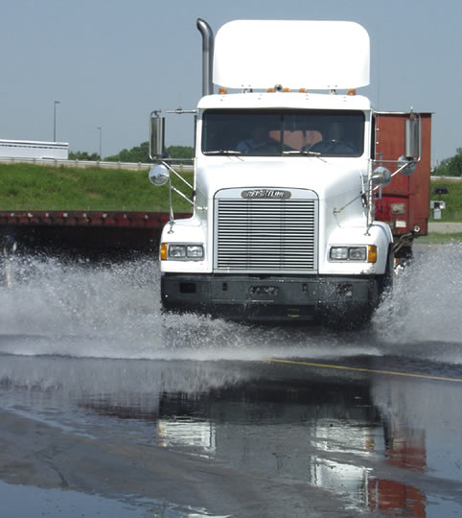
Skid Control/Recovery, Jackknifing, and Other Emergencies
16
Copyright 2019 J. J. Keller & Associates, Inc.
Notes:
Unit A1.3.2 Skid Control/Recovery, Jackknifing, and Other Emergencies
This unit must teach the causes of skidding and jackknifing and techniques for avoiding and recovering from them. The training providers must teach the importance of maintaining directional control and bringing the CMV to a stop in the shortest possible distance while operating over a slippery surface. This unit must provide instruction in appropriate responses when faced with CMV emergencies. This instruction must include evasive steering, emergency braking, and off-road recovery, as well as the proper response to brake failures, tire blowouts, hydroplaning, and rollovers. The instruction must include a review of unsafe acts and the role the acts play in producing or worsening hazardous situations.

Slide 4
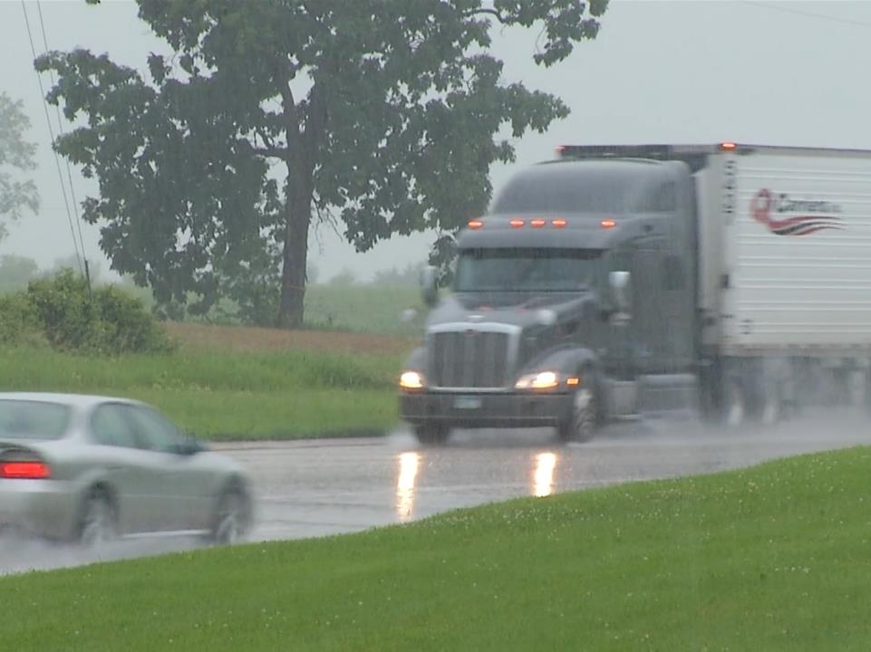
Introduction
Notes:
Introduction
Loss of vehicle control is scary. Even the most prepared and alert driver will experience a skid, tire blowout, or other emergency during his or her driving career. This chapter will address what causes a vehicle to skid and skid recovery. It also goes over appropriate responses to other common emergencies, teaching you how to maintain directional control.
CLASSROOM RECOMMENDATION
Your classroom presentation should focus on the importance of emergency maneuvers. Stress that the safest way to handle an emergency is to prevent it from happening in the first place.
Visuals can aid in illustrating specific technical elements before heading out to the range. Discussion can also aid in understanding of the topic.

Slide 5
Objectives
Upon completion of this chapter, you will be able to:
  Identify the major causes of skids and jackknifing and employ techniques for avoiding and recovering from them
  Explain the importance of maintaining directional control
  Indicate appropriate responses when faced with CMV emergencies such as brake failure, a tire blowout, hydroplaning, and rollovers
  Recognize unsafe acts that play a role in producing or worsening hazardous situations
Notes:
Upon completion of this lesson, you will be able to:
Identify the major causes of skids and jackknifing and employ techniques for avoiding and recovering from them
Explain the importance of maintaining directional control
Indicate appropriate responses when faced with CMV emergencies such as brake failure, a tire blowout, hydroplaning, and rollovers
Recognize unsafe acts that play a role in producing or worsening hazardous situations

Slide 6
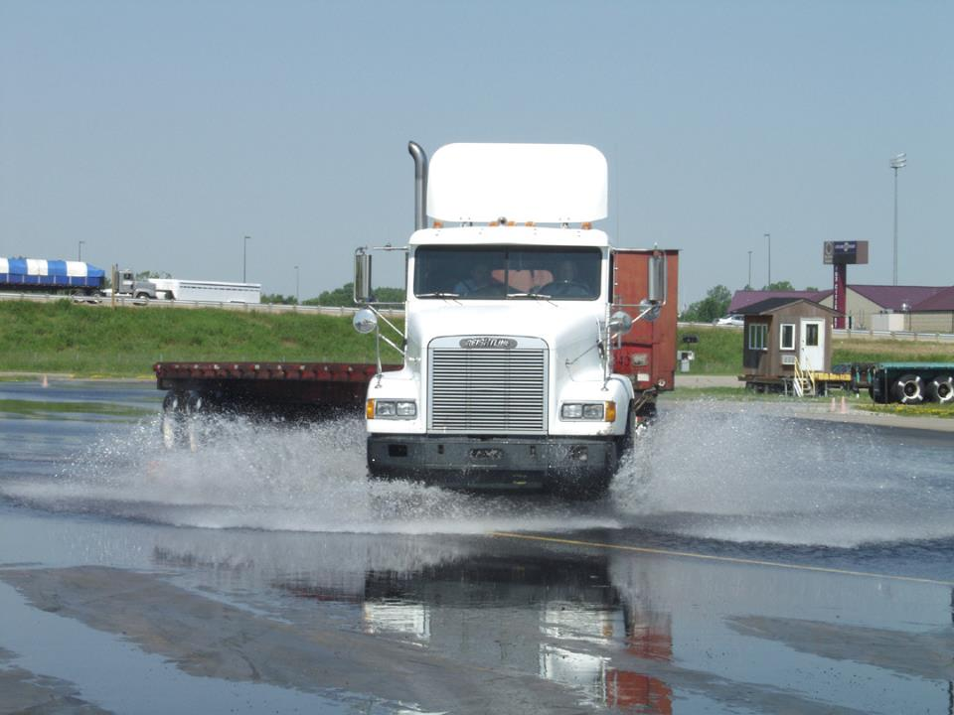
Causes of Skids
Notes:
Causes of Skids
A skid happens when a vehicle’s tires lose their grip on the road.
Factors that affect vehicle control include traction, wheel load, and force of motion. If there is an imbalance among these vehicle control factors, a skid may occur.
Traction
Traction is the grip your tires have on a road surface. Traction plays a part in determining how much control you have over your vehicle. If traction is poor, control of your vehicle is poor, which can lead to a skid.
Wheel Load
Wheel load is the downward force of weight on a wheel. Weight of the vehicle and load distribution determine wheel load. Although wheel load can increase downward force and the amount of tire tread on the road, this may not improve traction.
Force of Motion
Force of motion is determined by the weight and speed of the vehicle. The heavier the vehicle and its cargo and the faster it travels, the greater the force. Speeding up, braking too quickly, or changing direction too quickly can affect the force of motion.
The major causes of skids include overbraking, oversteering, overacceleration, and driving too fast for road conditions.
Overbraking occurs when you are braking too hard, resulting in the vehicle’s wheels locking up.
Oversteering happens when you are turning the wheels more sharply than the vehicle can turn.
Overacceleration means you’re are supplying too much power to the drive wheels, causing them to lose traction.
Driving too fast for conditions results in the most serious skids.

Slide 7
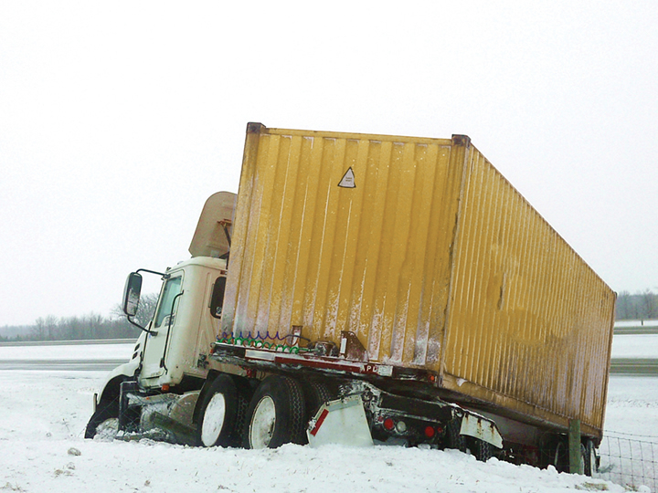
Tractor-Trailer Skids
Notes:
Tractor-Trailer Skids
Tractor-trailer skids are classified based on what occurs during the skid. There are four major kinds of skids:
Trailer jackknife
Tractor jackknife
Front wheel skid
All-wheel skid

Slide 8
Overbraking or oversteering can cause a trailer jackknife.
Notes:
Trailer Jackknife
Overbraking or oversteering can cause a trailer jackknife. When a trailer jackknife occurs, the trailer’s tires are locked, causing it to skid.
When overbraking, the trailer will continue to move forward at a higher speed than the tractor. Not being able to move forward, it will slide around.
When taking a curve too fast for surface conditions, the rear of the trailer may continue in the same direction as it was originally heading while the tractor and the front of the trailer turn.
To prevent a trailer jackknife:
Inspect your air system and check brake adjustments during your pre-trip inspection
Adjust your speed to suit conditions
Read the road ahead (distance scanning)
Brake before entering a curve, not during
Avoid hard braking

Slide 9
A tractor jackknife occurs when the drive wheels lose traction.
Notes:
Tractor Jackknife
A tractor jackknife occurs when the drive wheels lose traction. This can be caused by wheel lock-up or overacceleration. In this situation, the drive wheels attempt to take over the front wheels, causing the rear of the tractor to swing out. The tractor follows the path of least resistance while the trailer continues in its original direction. Then, as the trailer pivots, it pushes the rear of the tractor outward, resulting in a jackknife.
To prevent a tractor jackknife:
Avoid overbraking, overacceleration, and sudden downshifts
Load your cargo properly, making sure it is secure
Pay special attention to the brake system and tire tread when performing your pre-trip inspection

Slide 10
Front wheel skids are caused by reduced front wheel traction.
Notes:
Front Wheel Skid
Front wheel skids are caused by reduced front wheel traction. Reduced front wheel traction can be caused by an excessive load on the fifth wheel, lack of tread on the front tires, hydroplaning, oversteering, or brake system malfunction.
In a front wheel skid, the front end tends to go in a straight line regardless of how much you turn the steering wheel. On a very slippery surface, you may not be able to steer around a curve or a turn.
A good inspection of the following vehicle components can aid in preventing front wheel skids:
Tires
Front wheel alignment
Suspension system
Fifth wheel lubrication
A reduction of vehicle speed on wet or slippery pavement can also help in preventing front wheel skids.

Slide 11
In an all-wheel skid, all wheels are locked.
Notes:
All-Wheel Skid
In an all-wheel skid, all wheels are locked. Friction/traction changes from rolling to sliding as the wheels are not turning. Usually, during an all-wheel skid, your vehicle continues in a straight line in spite of your efforts to steer. The main cause of this is overbraking on slippery surfaces.
The best way to prevent an all-wheel skid is by avoiding excessive speed and braking, especially on slippery surfaces.

Slide 12
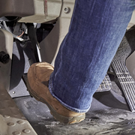

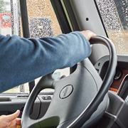
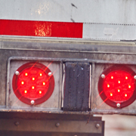
Skid Recovery
1
2
3
4
Notes:
Skid Recovery
The following technique can be used to recover from the majority of tractor-trailer skids:
Stop braking or accelerating. Disengage the clutch and steer. If you have an automatic transmission, shift it into neutral. This allows the drive wheels to roll again, keeping them from sliding any further.
Turn quickly. When your vehicle begins to slide sideways, quickly steer in the direction you want the vehicle to travel.
Countersteer. As your tractor turns back on course, it has the tendency to keep turning. Countersteering prevents your vehicle from skidding in the other direction.
Stop your vehicle. Once your vehicle is again traveling in a correct path, you can use your brakes to stop. A light, steady application is the preferred technique.
VIDEO
16.1 — Skid Recovery

Slide 13
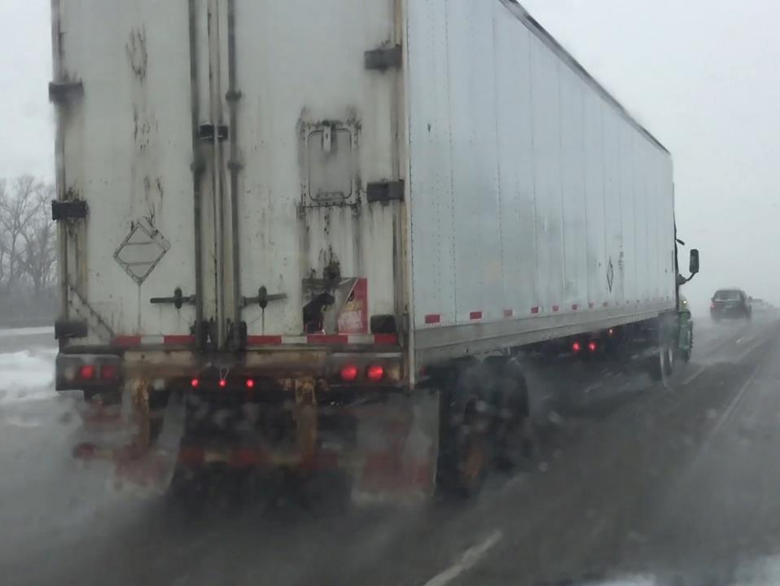
Slippery Surfaces
Notes:
Slippery Surfaces
Maintaining vehicle control and safely stopping can be a challenge when operating in slippery conditions, such as snow or ice.
Different surfaces have a different amount of traction. For example, a snow-packed or ice-covered surface will have only one-fifth (20 percent) of the traction that the same surface does when it’s wet.
Traction is needed for accelerating, turning, and braking. As vehicle speed increases, more traction is needed. If traction is poor, you must reduce your speed in order to maintain vehicle control and stop safely.
As a general rule, you can drive about one-half your normal speed on packed snow. On ice, reduce vehicle speed to about one-third of your normal speed.
Following distance should also be increased when operating in slippery conditions. Opening up room in front of you will help you to avoid making sudden speed or direction changes that can result in losing control of your vehicle. Increasing following distance also allows you more room to stop safely.
CALLOUT: These are suggested guidelines. Only you, the professional driver can determine a safe speed when it comes to traveling in adverse conditions.

Slide 14
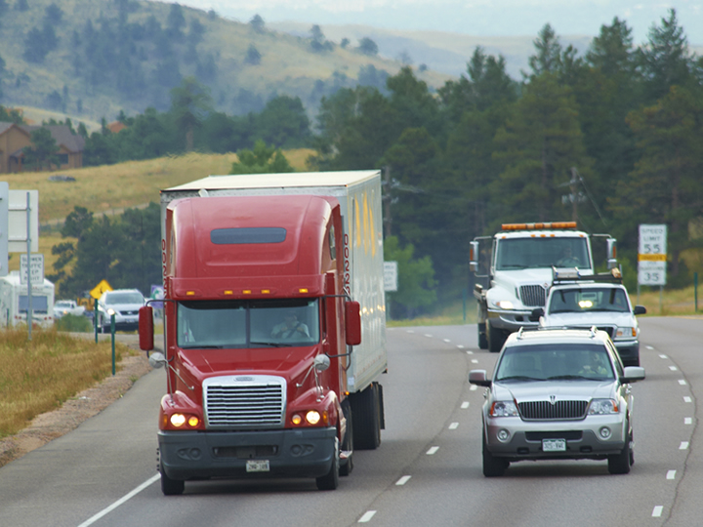
Evasive Steering
Notes:
Evasive Steering
Generally, steering to avoid an emergency is safer than trying to stop before you reach the hazard. If an escape path is available, evasive steering provides a better chance of avoiding a collision. Constant visual scanning, adequate following distance, and good driver and vehicle preparation are key to escaping.
The two most common escape routes are another lane of traffic and the shoulder of the road. If a lane is available, a quick lane change is the best option. If a lane change is impossible or dangerous, the shoulder of the road can be used.
Evasive steering, when done correctly, is generally safe. A number of factors can affect the outcome of an evasive steering maneuver. Be aware of these factors. React accordingly.
The best results are achieved when you are hauling stable cargo with a low center of gravity and are able to steer onto a firm road or shoulder.
CALLOUT: Steering, braking, road conditions, and vehicle speed can play a part in the outcome of an evasive maneuver.
General Procedures
When evasive steering, minimize the amount of turning by starting the maneuver as soon as you see the emergency/hazard. The earlier you initiate an evasive maneuver, the less steering is needed to avoid the emergency/hazard:
Turn only as much as needed. Avoid over steering. Keep in mind that the more you steer, the greater the chance of a jackknife or rollover.
Turn as quickly as possible. Use hand-over-hand steering. Each turn of the wheel should be about 180 degrees. Placing your hands in the 9:00 and 3:00 positions while driving allows you to turn 180 degrees without letting go of the steering wheel.
Ease your foot off of the accelerator to gradually reduce vehicle speed.
Brake before turning. A firm braking application reduces your speed before turning. This allows your vehicle to turn more sharply and also reduces the chance of a jackknife or rollover.
After making the evasive turn, be prepared to countersteer immediately. Smooth, quick countersteering is required to keep your vehicle from going outside its escape path—off the shoulder or into another lane of traffic. Begin to countersteer as soon as your vehicle clears the obstacle.
Though important at all times (and required per the regulations), the use of a seat belt is extremely important when involved in an evasive maneuver. A quick turn could cause you to slide out of the driver’s seat, causing you to lose control of your vehicle if you are not wearing a seat belt.
Details of how an evasive maneuver is performed depend on the specific situation. These special maneuvers may be needed for emergencies involving oncoming, stopped, and merging vehicles.
CALLOUT: Avoid braking while turning. Braking could cause the tractor and trailer wheels to lock-up, which can result in a loss of control as the vehicle is more likely to skid during braking, unless you have a full anti-lock braking system (ABS). With full ABS you can brake and steer at the same time without losing control of your vehicle.
RANGE RECOMMENDATION
Divide your class into groups of three students per instructor. Each student should have at least 90 minutes behind the wheel with the instructor seated in the passenger seat. The other students should be located at specific areas on the range, observing wheel movement and braking technique. Make sure the students are observing from a safe distance.
The purpose of this exercise is to develop the student’s ability to perform several evasive steering maneuvers including:
Left and right evasive steer
Evasive steer and stops
Controlled brake, evasive steer, brake
Range layout consists of a marked entryway leading to a right or left path from which there is an exit.
Evasive steering right or left. During this maneuver, the instructor directs the student to:
On command, accelerate to 30 mph, moving toward the barrier of markers
On command, steer either right or left around the barrier, with no braking
Perform the maneuver as smoothly and quickly as possible
Return to the starting point
Repeat the exercise
Evasive steering with controlled brake and stop. During this maneuver, direct the student to repeat the steps in the first maneuver, except, after steering right or left, bring the vehicle to a stop as quickly as possible using the controlled braking technique.
Brake-evasive steer-stop during the maneuver. Direct the student to repeat the steps in the first maneuver, except, as soon as the right or left command is given, the student should:
Brake to reduce speed before evasive steering
Release brakes and steer
Reapply brakes to stop and steer as quickly as possible
Watch for failure to perform the following procedures properly.
Minimize turn. Start as early as possible and turn only as much as needed.
Turn quickly. Use hand-over-hand technique with each turn approximately 180 degrees.
Avoid braking in the turn. This could lock the wheel, resulting in a possible loss of control.
Countersteer. The student must be prepared to countersteer quickly and initiate the countersteer as soon as the front of the trailer clears the obstacle.
Brake to stop. When stab braking, apply the brakes partially when the tires lock and then release partially. This achieves maximum braking when applied. Releasing avoids a skid. Reapply the brake when the wheels start rolling. Repeat sequence until vehicle slows sufficiently.
At the conclusion of the lesson, the student should be able to steer in the correct direction on command, keep the vehicle’s wheels from locking when braking, and avoid hitting exercise markers.

Slide 15
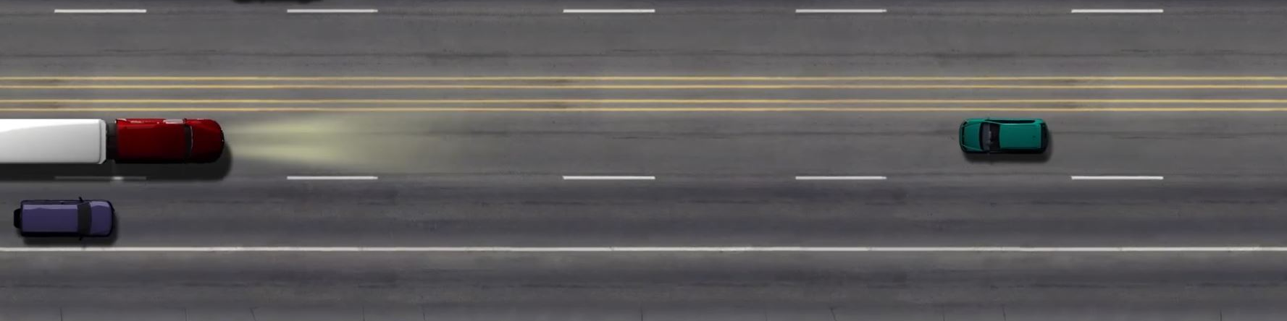
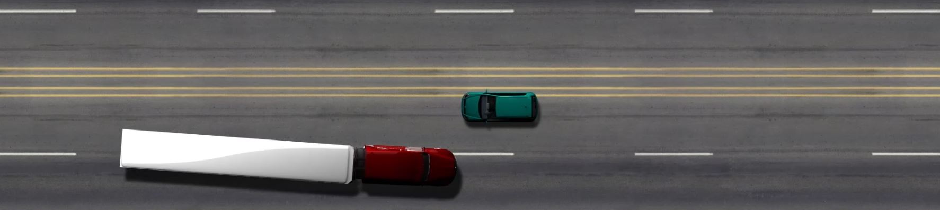
Flash your lights and sound your horn to alert the driver of an oncoming vehicle.
Steer to the right to avoid a head-on-collision.
Notes:
Avoiding an Oncoming Vehicle
Seeing a vehicle coming straight towards you is scary, but you can avoid disaster.
If there’s time, flash your lights and sound your horn to alert the other driver of the danger
If there’s no time, steer to the right to avoid a head-on collision
CALLOUT: Don’t steer to the left, as you could become involved in a head-on collision.
VIDEO
16.2 — Avoiding an Oncoming Vehicle

Slide 16
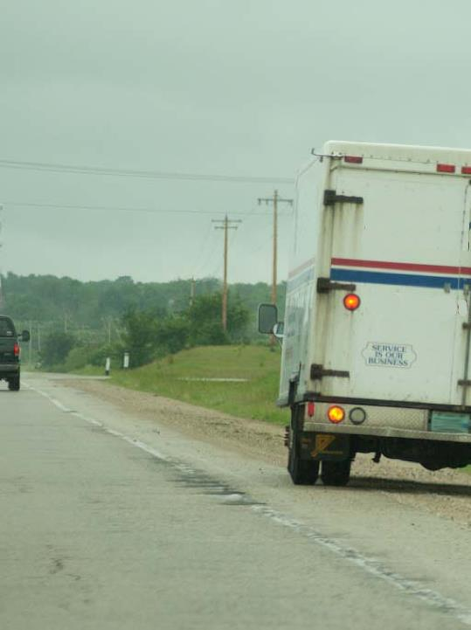
Always look about 12 to 15 seconds ahead of your vehicle so you have enough time to stop and avoid a potentially dangerous situation.
Notes:
Avoiding a Stopped or Stationary Vehicle
Always look about 12 to 15 seconds ahead of your vehicle so you have enough time to stop and avoid a potentially dangerous situation. If you can’t stop, slow down and steer to the right, either to the adjacent lane or the shoulder
On a multi-lane road, steer into the adjacent lane on the left if there’s not another vehicle there already. If you’re in the middle lane, choose to steer into the lane which presents the least danger. Otherwise, evade to the right. It is better to force a vehicle onto the shoulder than to force another vehicle into oncoming traffic.
VIDEO
16.3 — Avoiding a Stopped or Stationary Vehicle

Slide 17
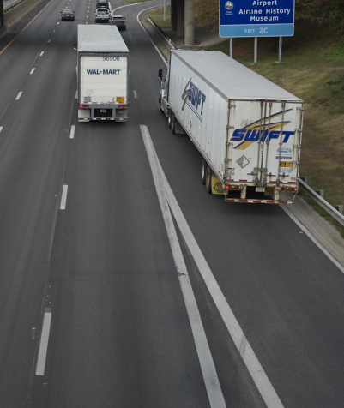
Merging vehicles present another potential danger to drivers already on
the road.
Notes:
Avoiding a Merging Vehicle
Merging vehicles present another potential danger to drivers already on the road. When another vehicle merges causing an emergency situation, sound your horn to alert the other driver
If you have time to apply the brakes, let the merging vehicle get in front of you
If the adjacent left lane is open, steer into it
Never swerve into the path of oncoming traffic or force another vehicle on your left into oncoming traffic
VIDEO
16.4 — Avoiding a Merging Vehicle

Slide 18
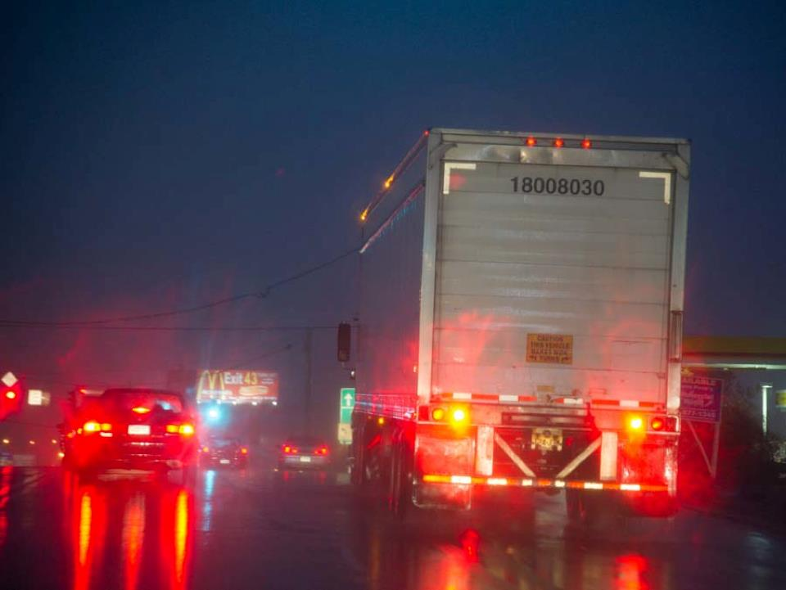
Emergency Braking
Notes:
Emergency Braking
Over-application of the brakes will lockup your vehicle’s wheels, causing your vehicle to skid and possibly jackknife. You could also lose control of your vehicle. Proper emergency braking allows you to bring your vehicle to a stop within a minimum distance while maintaining control of the vehicle.
There are two emergency braking techniques that can be used to safely stop your vehicle, controlled and stab braking.
CALLOUT: If you drive a vehicle with ABS, you should read and follow the braking directions found in the vehicle’s owner’s manual.
Controlled Braking
In controlled braking, you maintain a steady pressure on the brakes, applying them just short of lock-up. Keep in mind that it is difficult to precisely anticipate the point of lock-up. Developing this skill requires practice in the vehicle you’re operating.
Stab Braking
When stab braking, fully apply the brakes. Then, release the brake pedal partially when the wheels lock. Applying the brakes achieves maximum braking. Releasing or backing off the brakes avoids a skid. When the wheels roll again, reapply the brakes. Make sure you allow time for the wheels to roll again between each stab. Reapplying the brakes too quickly will cause a skid. Repeat the stab braking sequence until your vehicle has slowed enough for a safe stop or turn maneuver.
CALLOUT: If you drive a vehicle with anti-lock brakes, you should read and follow the directions in the vehicle’s owner’s manual for guidance on emergency braking.
RANGE RECOMMENDATION
Divide your class into groups of three students per instructor. Each student should have at least 90 minutes behind the wheel with the instructor seated in the passenger seat. The other students should be located at specific areas on the range, observing wheel movement and braking technique. Make sure the students are observing from a safe distance.
The purpose of this exercise is to develop the student’s ability to bring the vehicle to a quick, controlled stop in an emergency situation.
The range layout must provide an alley, marked by cones or lines, that is 12 feet wide and at least 100 feet long. This is where the vehicle can be brought to a controlled stop. At the head of the alley should be a “braking point,” clearly marked, to signal the point where the brakes should be applied.
The student’s vehicle will approach the maneuver area. Upon reaching the braking point, they must apply the brakes and bring the vehicle to a stop.
Each session could consist of:
One “full lockup” stop at 10 mph
Three “stab” braking stops at 10 mph, 20 mph, and 30 mph
Watch for failure to perform the following procedures properly:
Full lockup
Application of brakes until lockup occurs
Maintenance of pressure
Stab braking
Full application of brakes
Partial release of brake when wheels lock
Allowing time for brake systems to recover
Wheels rolling again
Reapplication of brakes too quickly (resulting in a skid)
Repetition of sequence until vehicle slows sufficiently
Also watch for the following problems:
Too rapid of application. Student doesn’t allow brake system to recover and restore rolling traction.
Stiffening at the wheel. Using too firm and stiff of a grip on the wheel, resulting in the inability to turn the wheel quick enough.
Cheating on maneuver. Approaching too slowly or braking too soon.
Under application. If stopping distance doesn’t decrease after repeated rounds, the student may not be applying maximum braking pressure.
At the conclusion of this lesson, the student should be consistently using the minimum stopping distance and be able to maintain tractor and trailer alignment.
NOTE: If your students are operating vehicles with antilock brakes (ABS), follow the braking directions found in the vehicle’s owner’s manual.

Slide 19
Off-Road Recovery
Notes:
Off-Road Recovery
In many emergencies, the roadside provides the best escape path. The use of the roadside is better than colliding with another vehicle.
Drivers are often fearful of leaving the roadway. Many fear that an accident/crash will be the result of their using the roadside for an evasive maneuver. The fact is that many of the reported roadside crashes are the result of fatigued or impaired driving. Keep in mind that many evasive maneuvers are successful and are never reported.
Successful off-road recovery often requires leaving the roadway immediately. Too often drivers react too late. Most crashes/accidents that involve off-road recovery are due to incorrect technique.
Off-road recovery is generally safe when the roadside is wide enough to accommodate the vehicle and firm enough to support the vehicle.
RANGE RECOMMENDATION
Divide your class into groups of three students per instructor. Each student should have at least 90 minutes behind the wheel with the instructor seated in the passenger seat. The other students should be located at specific areas on the range, observing wheel movement and braking technique. Make sure the students are observing from a safe distance.
The purpose of this exercise is to develop the student’s ability to perform off-road maneuvers once the vehicle’s wheels have left the road. This exercise involves the right wheels and all wheels leaving and returning to the road surface.
This exercise should be performed along the edge of the paved range surface. This surface should be gravel, measuring at least 12 feet in width and 65 feet in length with a drop-off of about five or six inches. Traffic cones should force the vehicle off the pavement at the beginning of the gravel surface and back onto the pavement at the end of the gravel surface.
The student’s vehicle will approach the off-road recovery area and upon reaching the barrier across the paved surface, the student is to steer off the pavement onto the gravel surface. After passing the last cone on the left, the student will return to the paved surface.
Each session should consist of partial (right wheel only) and complete (all wheels) off-road recovery at 10 mph, 20 mph, and 30 mph.
Observe for failure to perform the following procedures properly:
Drive between the two cones marking entry to the exercise area
Steer into off-road areas as far as required
Keep a firm grip on the wheel and maintain course, avoiding braking
When past the last cone on the right, steer left sharply, and/or
As soon as the right wheel clears the pavement, steer sharply to the right.
Also watch for the following problems:
Not turning far enough up onto the gravel surface
Braking while on the gravel surface
Edging back on the road rather than turning sharply
Not countersteering quickly enough, and/or
Over countersteering
The student shouldn’t lock the vehicle’s brakes or knock over cones when performing the exercise.
NOTE: These exercises should never be attempted by the instructor or any student while driving on any public roadways, as this could create a serious safety situation.

Slide 20
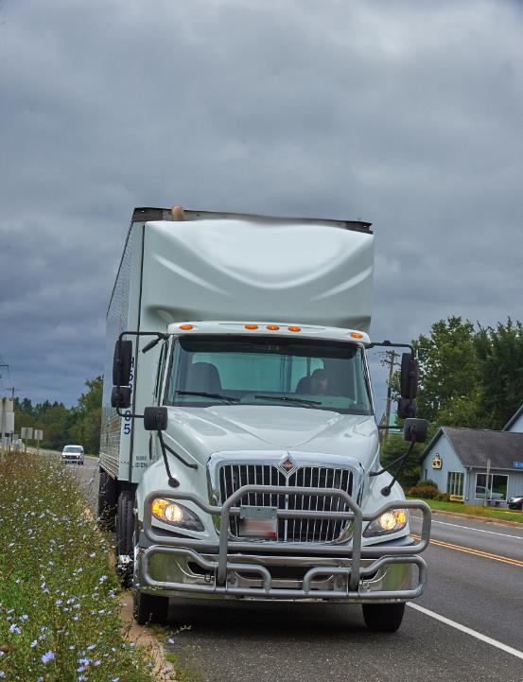
Stay on the roadside until your vehicle comes to a complete stop. When the situation has passed, signal and check your mirror before returning to the travel lane.
Notes:
General Procedures
If you need to leave the road to avoid a collision, brake before turning, reduce speed as much as possible, and use controlled or stab braking to prevent loss of control. If you are operating a vehicle with an ABS, keep braking until a safe speed is achieved.
Minimize turning. Keep one set of wheels on the pavement if possible. This will aid in traction and help you maintain control. Maintain as straight a course as possible. Remember, each turn creates the danger of a skid.
If the roadside is clear, fight the tendency to return to the roadway. Grasp the steering wheel firmly and concentrate on steering.
Stay on the roadside until your vehicle comes to a complete stop. When the situation has passed, signal and check your mirror before returning to the travel lane.
If the roadside is blocked by a parked vehicle, sign, or other obstacle, you’ll need to return to the road more quickly. If this happens, allow your vehicle to slow as much as possible before returning to the road. Then, turn the steering wheel sharply toward the roadway. Attempting a gradual return to the roadway can cause you to lose control of your vehicle. Turning sharply allows you to determine the point of return to the road and allows you to countersteer.
Upon returning to the roadway, countersteer. Turn quickly in the direction of the roadway. Turn as soon as the right front wheel (steering axle) rides up onto the surface. Both turning back onto the roadway and countersteering should be executed as a single, integrated steering maneuver.
Often, if a truck is too close to the edge of the roadway, the wheels will drop off the pavement. If this happens, avoid immediate return to the roadway. You can maintain control easily with one side of the rig on the pavement. The vehicle may overturn or veer across the roadway if you try to return to the road too quickly.
When your vehicle’s wheels drop off the pavement, follow the same procedure as off-road recovery.

Slide 21
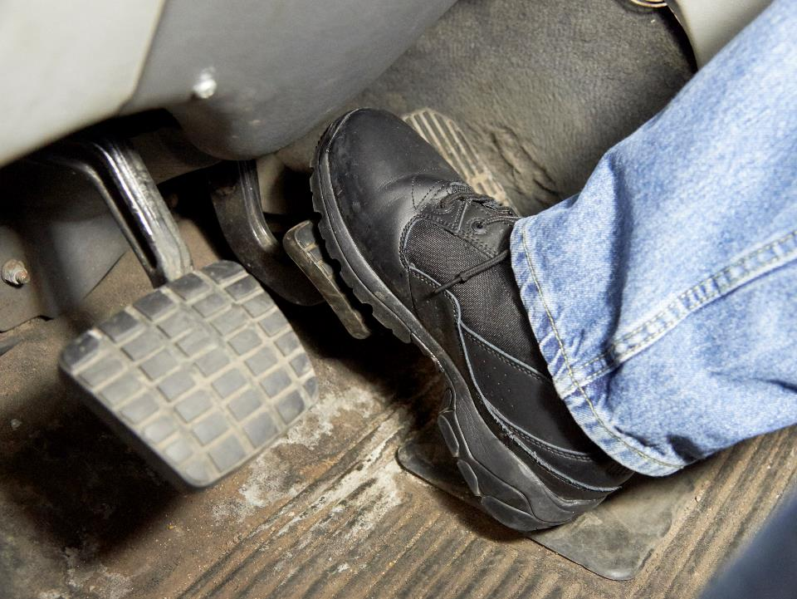
Brake Failure
Notes:
Brake Failure
A well-maintained brake system rarely fails completely. Despite this, brake failures do occur. The result of brake failure is a vehicle that is not under your control. Like all other emergency situations, keeping your cool is key to bringing your vehicle under control in this situation.
There are four common causes of brake failure:
Loss of air pressure
Air blockage
Brake fade
Mechanical failure
Loss of air pressure. A warning buzzer will sound and/or a light will illuminate on the instrument panel when air pressure is too low. Stop immediately. Continued loss of air pressure could cause your brakes to completely fail. This will lock-up your brakes and not allow your vehicle to move.
Your emergency brakes should apply automatically when air loss reaches a critical level (between 20 to 40 psi). This happens when there is still enough air in the system to stop your vehicle. Do keep in mind that even when everything works as designed, air loss could happen too quickly, and the air could be exhausted before the vehicle is stopped. Also, the independent trailer brake valve won’t activate the trailer brakes, as they also depend on the air system.
The brakes will activate automatically on a vehicle equipped with spring-loaded parking brakes when air pressure fails. This will generally bring the vehicle to a stop.
Air blockage. A blockage can prevent air from reaching the brakes. This is commonly caused by water freezing in the air system or dirt through the glad hands.
Brake fade. On long downgrades, brakes may overheat and fade. The brakes will lose their ability to stop wheel rotation. The brakes won’t cool quickly.
Mechanical failure. Brake failure can result from a failure in the mechanical linkage. Rarely are all brakes affected at once. Usually, in this situation, the vehicle can be stopped.

Slide 22
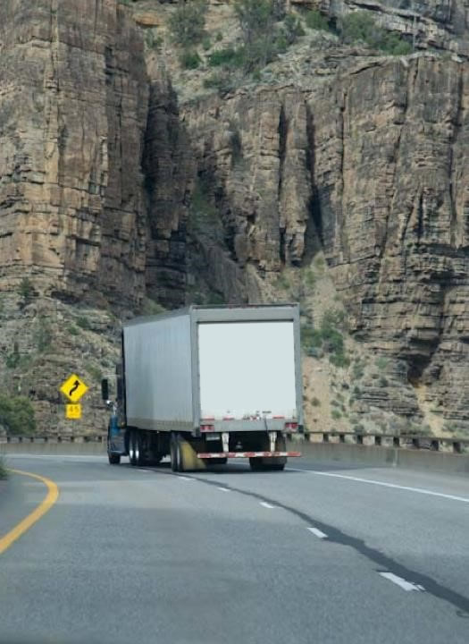
Make a move to slow your vehicle as soon as you are aware that your brakes aren’t working.
Notes:
Downgrade Procedures
If your vehicle’s brakes fail on a downgrade, you will have to look outside your vehicle for something to help slow and stop. One option is the use of an escape ramp. Escape ramps are intended to safely stop a runaway vehicle. Escape ramps use a soft material such as gravel or sand to slow and stop a vehicle.
If an escape ramp isn’t available, an open field or side road that is flat or turns uphill are options.
Make a move to slow your vehicle as soon as you are aware that your brakes aren’t working. The longer you wait, the greater the vehicle’s speed and the harder it is to stop.

Slide 23
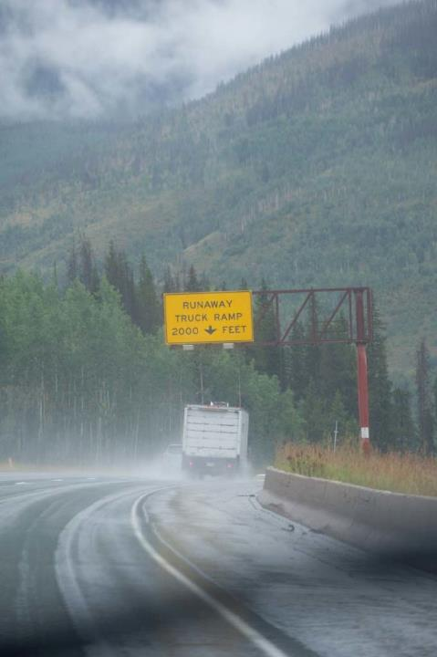
While slowing your vehicle, look for an escape route.
Notes:
General Procedures
The following steps should be followed if your vehicle’s brake system fails:
Downshift. If on a relatively flat road, putting a vehicle into a lower gear will help to slow it down. Continue to downshift until your vehicle has slowed to a point that you can apply the parking brake. Do not try to downshift if you are on a downgrade.
Escape route. While slowing your vehicle, look for an escape route. A safe escape route may include an open field, side street, or escape ramp. Turning uphill is another way to slow and stop your vehicle. If you do use a hill to slow your vehicle, make sure it doesn’t start rolling backward after stopping by applying the parking brake.

Slide 24
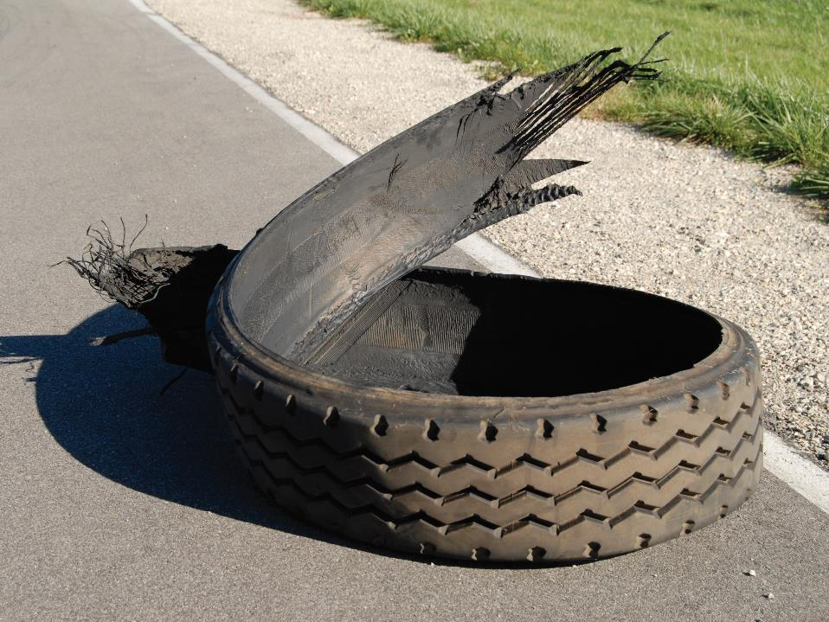
Tire Blowouts
Notes:
Tire Blowouts
The term “blowout” refers to a sudden loss of tire inflation. Blowouts can result from worn tires, cracks in the tire casing, or damage from debris, potholes, or nails. Remember, a careful pre-trip inspection can prevent blowouts caused by wear.
A blowout of a front tire disrupts steering and can cause the vehicle to veer in the direction of the blowout. With a rear tractor tire blowout, you may feel the rear of the tractor slide from side to side. A trailer tire blowout is harder to detect. You may hear the tire blowing out, see it in your mirrors, or you may experience some difficulties in handling the vehicle.
The sooner you are aware of a tire blowout, the more time you have to react. The major signs of tire failure are sound, vibration, and changes in your truck’s handling.
Sound. The loud bang of a blowout is an easily recognizable sign. Any time you hear a tire blow, assume it is one of your vehicle’s tires.
Vibration. If your vehicle thumps or vibrates heavily, it may be a sign that one of the tires has gone flat.
Handling. If steering feels heavy, it’s probably a sign that one of the front tires has failed. At times, rear tire failure will cause a vehicle to fishtail or slide back and forth.
In order to successfully deal with a tire blowout:
Stay alert so that you recognize the signs of a tire blow-out
Grip the steering wheel firmly
Steer to maintain your position in the driving lane
Accelerate carefully to overcome the drag
Stay off the brake until your truck slows (unless you’re about to collide with something)
Pull off the road safely and stop as soon as speed and traffic conditions allow it
VIDEO
16.5 — Tire Blowout

Slide 25
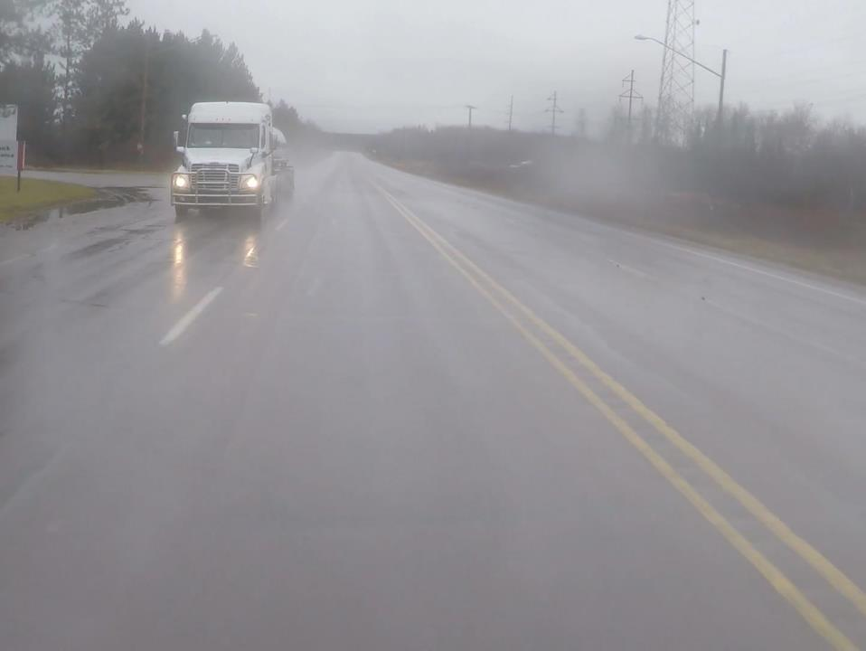
Hydroplaning
Notes:
Hydroplaning
A heavy rain that causes water to stand on the roadway can cause a vehicle to hydroplane. Hydroplaning occurs when tires lose traction (contact with the road) and skim along the water’s surface, thus causing dangerous loss of directional control.
The faster a vehicle travels on standing water, the greater the chance of hydroplaning. This is because traction is only present when a vehicle’s tires have contact with the road. If the tires are riding on a wall of water, they lose traction.
The best way to prevent hydroplaning is by slowing down.
Should your vehicle begin to hydroplane, don’t make sharp or sudden turns or apply the brakes hard. Slow down until contact with road surface is reestablished.

Slide 26
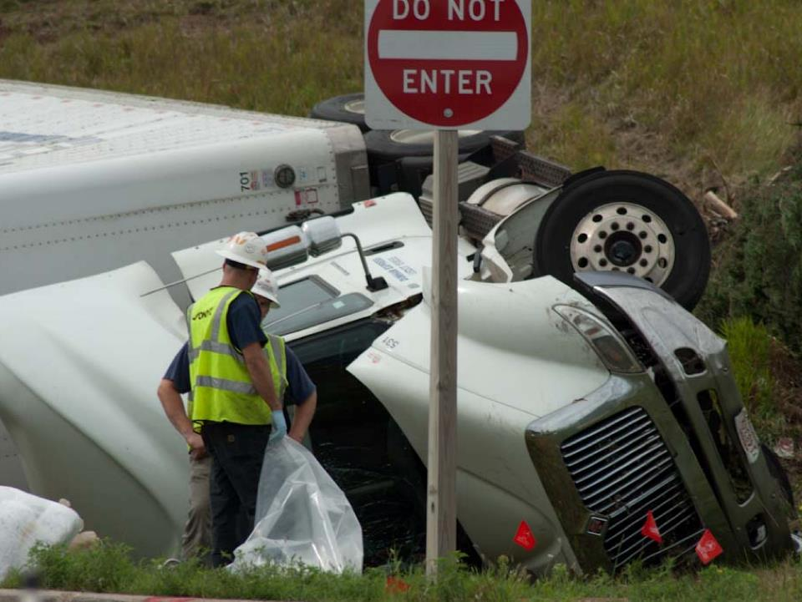
Rollovers
Notes:
Rollovers
Rollovers are one of the leading causes of death for the professional truck driver. Rollovers can be prevented. The main causes of vehicle rollovers include:
Driving too fast on ramps, curves, and turns
Driving too fast on slippery roads or in windy conditions
Inattentive driving
Swerving
Improper load securement
To prevent a rollover:
Drive at a safe speed in curves. Remember, posted speed limits are for cars. Reduce your speed by at least 5 miles per hour below the posted speed limit.
Slow down and use caution when traction is reduced.
Watch out for soft shoulders. They can grab your tires and pull you off the road if you get too close.
Don’t brake during a lane change.
Don’t make sudden maneuvers.
Never drive when tired.
Make sure your load is properly secured before you start driving.

Slide 27
Objectives Review
You should now be able to:
  Identify the major causes of skids and jackknifing and employ techniques for avoiding and recovering from them
  Explain the importance of maintaining directional control
  Indicate appropriate responses when faced with CMV emergencies such as brake failure, a tire blowout, hydroplaning, and rollovers
  Recognize unsafe acts that play a role in producing or worsening hazardous situations
Notes:
You should now be able to:
Identify the major causes of skids and jackknifing and employ techniques for avoiding and recovering from them
Explain the importance of maintaining directional control
Indicate appropriate responses when faced with CMV emergencies such as brake failure, a tire blowout, hydroplaning, and rollovers
Recognize unsafe acts that play a role in producing or worsening hazardous situations
CLASSROOM RECOMMENDATION
Before concluding your training session, have participants take the corresponding quiz (found on the Trainer Tools USB) to check their understanding of the material. You can customize any of the questions to fit your audience or workplace. The answer key can also be found on the Trainer Tools USB.
You may also choose to administer the quizzes before you begin your training session to help get participants thinking about the subject and/or to gauge their understanding of the topic ahead of time.

