Slide 1






PowerPoint® Instructions
This PowerPoint has been designed so you can easily customize it for your training session.
Throughout the presentation you’ll see icons with recommendations or videos to enhance the instruction you present to your students. A detailed explanation for each icon can be found on the next slide. Videos can be found on the Trainer Tools USB.
When you see an icon on the slide, look in the notes
section for further information.
Simply delete or move the icon off the slide before your training session begins.

Slide 2





Classroom Recommendations. Provides suggestions for enhancing your classroom presentation; from ideas for large group discussions to suggestions on the use of training aids such as examples or photos of vehicle parts and components to help illustrate the items covered within a chapter.
Lab Recommendations. Provides suggestions for activities and exercises that take place outside the classroom, but do not involve
the actual operation of the tractor-trailer or its components. Examples
of lab sessions include conducting a vehicle inspection or practicing mirror adjustment.
Range Recommendations. These recommended activities take
place on a closed-access driving range where students may practice driving skills in a controlled environment. Examples of range sessions include practicing shifting technique and successfully completing a backing maneuver.
Road Recommendations. These recommended activities take place in road and traffic conditions that support the chapter’s objectives. Examples of road sessions include proper communication with other drivers through the use of turn signals and basic vehicle control under nighttime or extreme weather conditions.
Videos. These short video clips reinforce material presented in the Student Manual. Use them to help students grasp difficult concepts or subject matter.

Slide 3
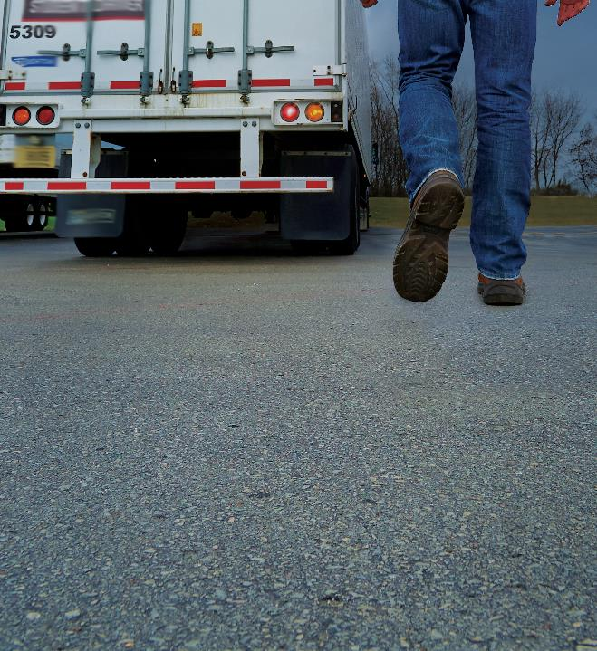
31
Human Trafficking
Notes:
Chapter 35: Human Trafficking

Slide 4
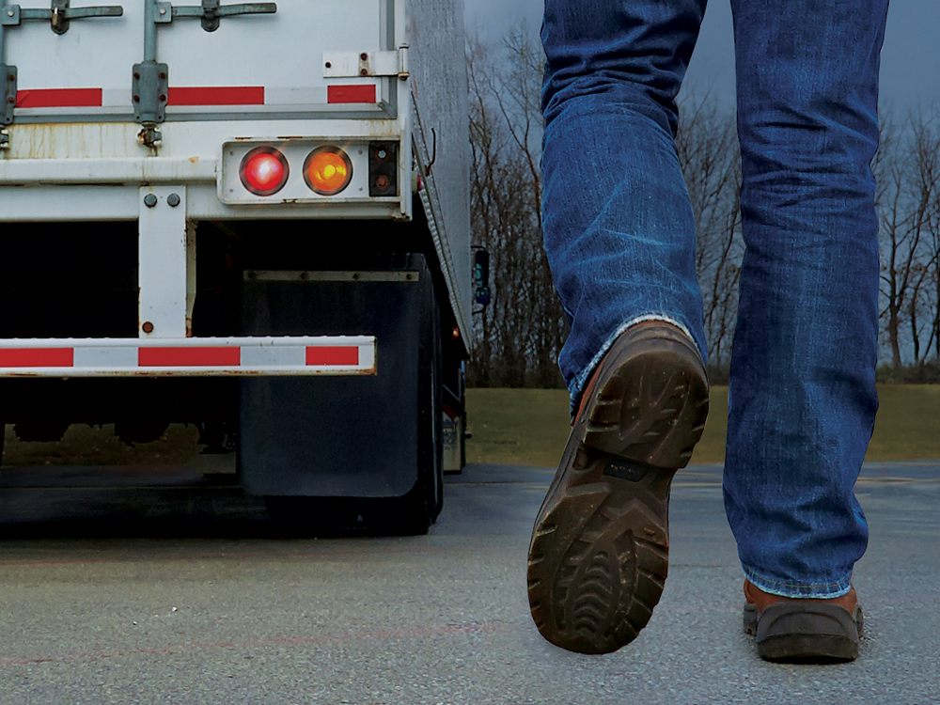
Introduction
Notes:
Introduction
Human trafficking is a serious crime. Every day, women, men, girls, and boys are forced into commercial sex trafficking, forced labor situations, and domestic servitude.
As a professional driver, the nature of your job allows you to observe, identify, and report these crimes. Drivers tend to frequent the most common places where many of these exchanges happen, including motels, restaurants, truck stops, rest areas, and gas stations. That puts you in a position to help disrupt established trafficking networks and enable law enforcement to rescue victims before it’s too late.
In this chapter you will learn what human trafficking is, how to recognize it, and what you can do about it.
CLASSROOM RECOMMENDATIONS
Human trafficking is a serious crime. Every day, people are forced into commercial sex trafficking, domestic servitude, and forced labor situations.
The nature of the professional driver’s job puts him or her on the front lines when it comes to observing, identifying, and reporting these crimes.
Students need to understand what human trafficking is, how to recognize it, and what can be done.
Do not underestimate the sensitive and dangerous nature of this topic. As you are presenting this lesson, stress the precautions that should be taken to ensure the safety of all involved.
Consider working with law enforcement. Many law enforcement agencies offer materials and/or speakers on this topic.

Slide 5
Objectives
Upon completion of this lesson, you will be able to:
  Describe human trafficking and identify those who are most at risk
  Recognize the signs of human trafficking
  Explain how to respond appropriately when you suspect human trafficking is taking place
Notes:
Objectives
Upon completion of this lesson, you will be able to:
Describe human trafficking and identify those who are most at risk
Recognize the signs of human trafficking
Explain how to respond appropriately when you suspect human trafficking is taking place

Slide 6
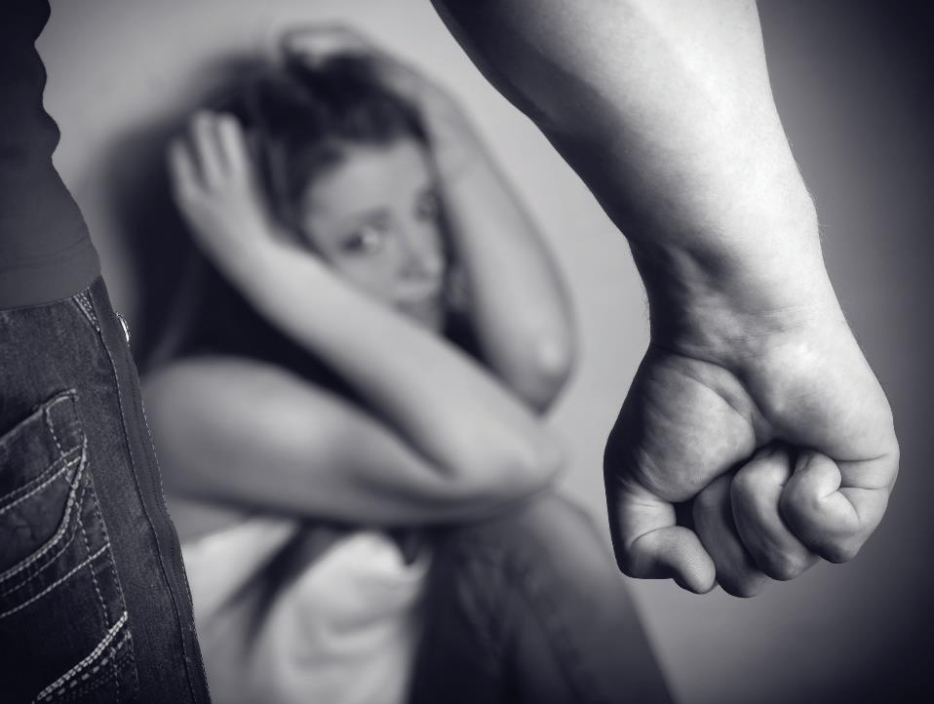
What is Human Trafficking?
Notes:
What is Human Trafficking?
Human trafficking is the use of force, fraud, or coercion to cause a person to provide labor or commercial sex. In short, it is a form of modern-day slavery.
While human traffickers often physically abuse their victims, the crime most often involves psychological abuse. Victims of human trafficking are often lured with false promises of love and affection, well-paying jobs, stability, or education. Human traffickers use violence, personal/family threats, and manipulation to control their victims.
Examples of human trafficking include:
Sex trafficking. Traffickers use manipulation or force to make their victims perform sex acts for money. Sex trafficking includes men and women of all ages, even those under the age of 18.
Forced labor. In this type of labor trafficking, force, fraud, or coercion is used to make a person work— often for long hours in deplorable conditions—for little or no pay. It can also include forcing a person to work to pay off a debt (real or made-up by the trafficker).
Domestic servitude. Another form of labor trafficking, a person works in a private residence as a nanny, maid, or household help, and is not free to leave the property, is abused, and is underpaid, not paid at all, or receives “payment-in-kind,” meaning that they are paid in food and accommodations.
CALLOUT: Whenever a child performs a commercial sex act, it is considered human trafficking. When an adult performs a commercial sex act, it is human trafficking if the person was coerced, threatened, or forced to commit the act.

Slide 7

People at Risk
Notes:
People at Risk
Victims of human trafficking can be of any gender, race, or nationality. They can be of any economic status—rich, poor, or middle class.
Traffickers take advantage of people who are suffering from extreme hardships or acts of violence, experience any form of discrimination or harassment, or face social instability.
Certain populations are especially vulnerable, including those who are:
LGBTIQ (lesbian, gay, bisexual, transgender/transsexual, intersex, or queer/questioning)
Disabled
Displaced (runaway/homeless)
Migrants fleeing crisis/seeking asylum
Affiliated with a minority religious group, or
Minors in the child welfare and juvenile justice systems
The bottom line, victims tend to be those who are vulnerable to being exploited.
VIDEO
31.1 — People at Risk

Slide 8
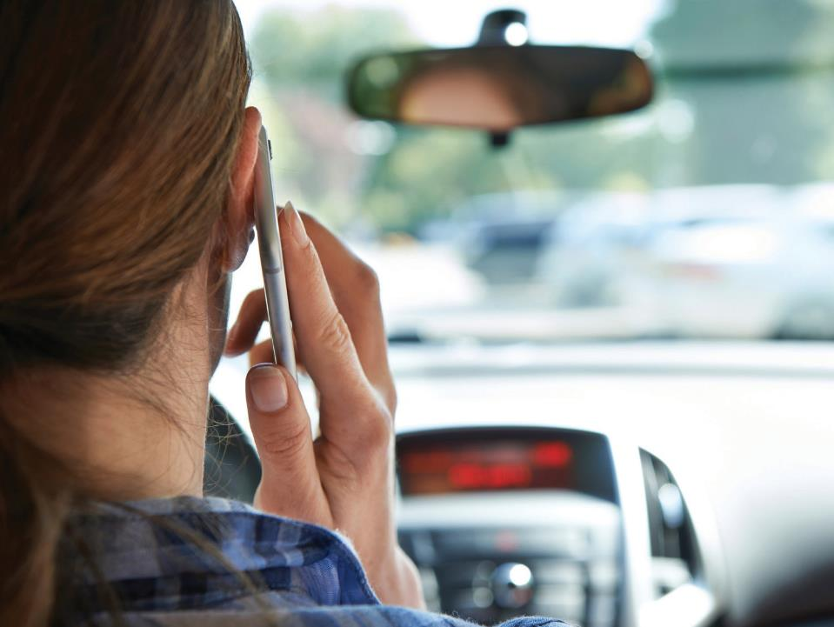
Watch for these Signs
Notes:
Watch for these Signs
As a professional driver, you see and hear many things each day while on the road, including at truck stops, gas stations, restaurants, rest areas, and motels. It is important that you understand the signs of human trafficking, as they may not be as obvious as you think.
Trafficker Profile
There is no standard, specific description or profile for a human trafficker. Traffickers can be as varied as their victims. They can be women or men, young or old, and of any race. How they manipulate their victims may not be apparent either. Physical restraints are not typically used and at times, victims are psychologically manipulated so badly, they don’t even realize they are victims.
Some traffickers may work alone, while others may be part of a gang or trafficking circle, spanning multiple communities or states.
VIDEO
31.2 — Watch for These Signs

Slide 9

Watch for things that seem out of the ordinary.
Notes:
Potential Trafficking Victims
When it comes to identifying a human trafficking victim, you need to pay attention to details. A victim being kidnapped and held hostage is a common perception when it comes to human trafficking. While there are cases like this, these are the minority. Most victims are held hostage psychologically. Traffickers are good at identifying potential victims and exploiting their vulnerabilities.
Watch for things that seem out of the ordinary, like:
An unaccompanied minor or a minor that isn’t in school, but who probably should be at that time of day
A person appearing to be isolated or scared to be in public
A person traveling with no personal possessions
A young person with a much older “boyfriend” or “girlfriend,” or an older same-sex or platonic friend
A person that possesses several cell phones, electronic devices, or hotel access cards
A person wearing sexually provocative clothing that is inappropriate for the weather and/or for his or her age
The way people act can indicate that they are victims of trafficking. Body language that should raise a red flag would include persons who:
Aren’t allowed to speak for themselves or look to another person to answer for them
Avoid eye contact
Sound like they have been coached on what to say
Are confused about where they are or where they are going
Appear fearful or submissive
Make sexual comments that are not typical of their age group
Do not trust law enforcement or other authorities
Finally, a person’s physical appearance may be an obvious sign that he or she is a victim of sex or labor trafficking:
The person appears to be deprived of basic needs—food, water, sleep, or medical care
The person has visible cuts and bruises or untreated wounds or broken bones
The person appears to be under the influence of drugs and/or alcohol
The person has a tattoo in the shape of a dollar sign, crown, barcode, someone’s name, or the word “Daddy”
VIDEO
31.3 — Potential Trafficking Victims

Slide 10
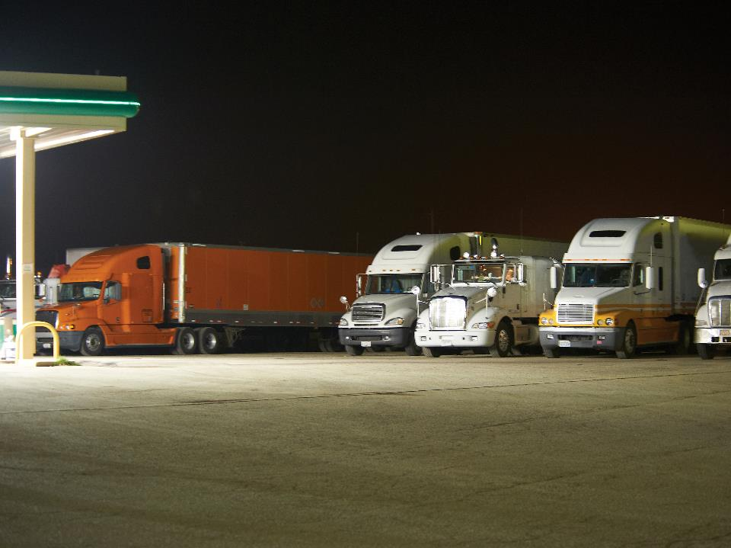
Vehicles Used for Trafficking
Notes:
Vehicles Used for Trafficking
Transportation can be a critical part of human trafficking, as traffickers may move their victims around to maximize profits. Traffickers often use interstate highways to transport victims from one city or state to the next.
When in and around truck stops, restaurants, parking lots, service stations, and hotels, be on the lookout for vehicles in a truck parking area that don’t belong, such as a recreational vehicle among parked tractor-trailers. Vehicles, taxis, or ride-sharing services that drop a person off at a truck, truck stop, or hotel and pick up the person 20 to 30 minutes later can be suspicious.
Watch for unusual signals or flashing lights between parked vehicles. Sometimes, flashing lights are a signal that a person is looking for a sexual encounter.
VIDEO
31.4 — Vehicles Used for Trafficking

Slide 11
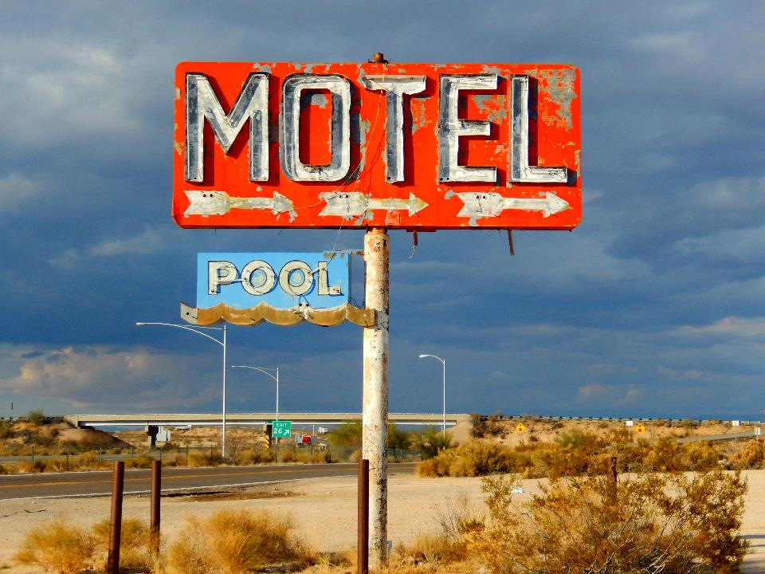
Locations Used for Trafficking
Notes:
Locations Used for Trafficking
While human trafficking typically happens in larger, more populous states such as California and Texas it also occurs in cities, suburbs, and rural towns across the U.S.
Some businesses are unknowingly used by traffickers to carry out their crimes. These business owners often have no idea that their business is being used to further human trafficking. In other instances, the business may be profiting from the human trafficking crimes by taking a cut of the trafficker’s profits in exchange for allowing the trafficking activities to continue without consequences.
The following types of businesses are often targeted and/or used by human traffickers:
Sex trafficking: Truck stops/service stations, massage parlors (fake or legitimate), motels/hotels, restaurants, strip clubs, bus stations
Labor trafficking: Farms, restaurants, door-to-door sales, maid/cleaning services, hospitality industry, traveling carnivals, elderly care facilities
VIDEO
31.5 — Locations used for Trafficking

Slide 12
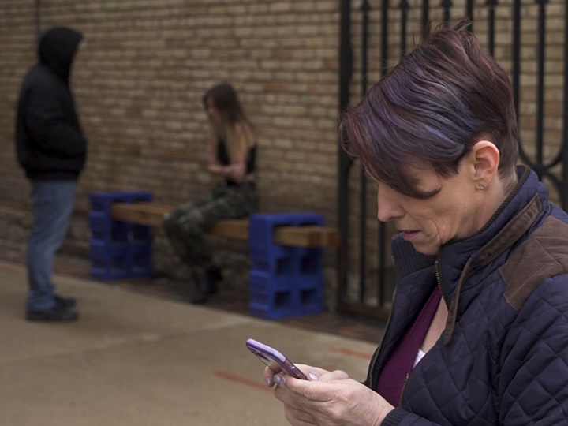
Know How to Respond
Notes:
Know How to Respond
If you believe you’ve witnessed a human trafficking situation or have encountered a victim, act. Remember, those involved in sex or labor trafficking are crime victims. They did not choose the life that they are living and deserve your compassion and respect.
Approaching the Victim
If it’s safe for you and the victim, try to engage him or her in a private conversation to see how he or she reacts. You can ask questions like:
Are you okay?
Do you feel safe?
Have you been hurt or threatened?
Where are your parents?
Do you have your own money?
Has your family been threatened?
Do you know where we are right now?
Do you know where you’re going?
What do you do for work?
During your conversation, watch for any indication the victim needs help. In many cases, a victim will be too scared to tell you the truth or accept your help. This short interaction may give you enough proof that something is going on. Trust your instincts.
Contacting Authorities
If you suspect human trafficking, contact law enforcement as soon as possible. If you believe you are witnessing a crime in progress, dial 911. The quicker you act the better.
When contacting law enforcement, provide as much detail as possible, including:
A description of the people (height, weight, hair color, age, clothing) and vehicles (make, model, vehicle color, license plate number) involved
The address/location where the suspicion activity took place
The specific time and date you observed the suspicious activity
Never approach a trafficker. Leave this to law enforcement to handle. Approaching a trafficker can put both you and the victim in danger and could possibly interfere with the potential prosecution of the trafficker.
CALL OUT: In addition to calling 911, you can report human trafficking by contacting:
The National Human Trafficking Hotline at (888) 373-7888 or texting HELP to BeFree (233733)
Federal law enforcement at (866) DHS-2-ICE (347-2423) or online at ice.gov/tips
VIDEO
31.6 — Know How to Respond

Slide 13
Objectives Review
You should now be able to:
  Describe human trafficking and identify those who are most at risk
  Recognize the signs of human trafficking
  Explain how to respond appropriately when you suspect human trafficking is taking place
Copyright 2019 J. J. Keller & Associates, Inc.
Notes:
You should now be able to:
Describe human trafficking and identify those who are most at risk
Recognize the signs of human trafficking
Explain how to respond appropriately when you suspect human trafficking is taking place
CLASSROOM RECOMMENDATION
Before concluding your training session, have participants take the corresponding quiz (found on the Trainer Tools USB) to check their understanding of the material. You can customize any of the questions to fit your audience or workplace. The answer key can also be found on the Trainer Tools USB.
You may also choose to administer the quizzes before you begin your training session to help get participants thinking about the subject and/or to gauge their understanding of the topic ahead of time.

