Slide 1






PowerPoint® Instructions
This PowerPoint has been designed so you can easily customize it for your training session.
Throughout the presentation you’ll see icons with recommendations or videos to enhance the instruction you present to your students. A detailed explanation for each icon can be found on the next slide. Videos can be found on the Trainer Tools USB.
When you see an icon on the slide, look in the notes
section for further information.
Simply delete or move the icon off the slide before your training session begins.

Slide 2





Classroom Recommendations. Provides suggestions for enhancing your classroom presentation; from ideas for large group discussions to suggestions on the use of training aids such as examples or photos of vehicle parts and components to help illustrate the items covered within a chapter.
Lab Recommendations. Provides suggestions for activities and exercises that take place outside the classroom, but do not involve
the actual operation of the tractor-trailer or its components. Examples
of lab sessions include conducting a vehicle inspection or practicing mirror adjustment.
Range Recommendations. These recommended activities take
place on a closed-access driving range where students may practice driving skills in a controlled environment. Examples of range sessions include practicing shifting technique and successfully completing a backing maneuver.
Road Recommendations. These recommended activities take place in road and traffic conditions that support the chapter’s objectives. Examples of road sessions include proper communication with other drivers through the use of turn signals and basic vehicle control under nighttime or extreme weather conditions.
Videos. These short video clips reinforce material presented in the Student Manual. Use them to help students grasp difficult concepts or subject matter.

Slide 3
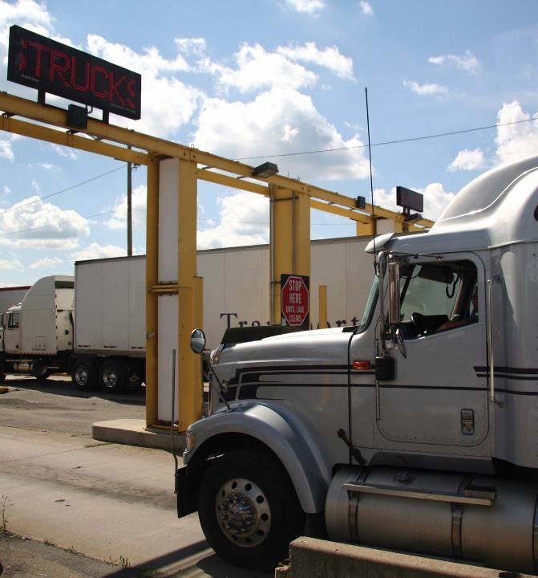
34
Crossing the Canadian Border
Notes:
Chapter 34: Crossing the Canadian Border

Slide 4
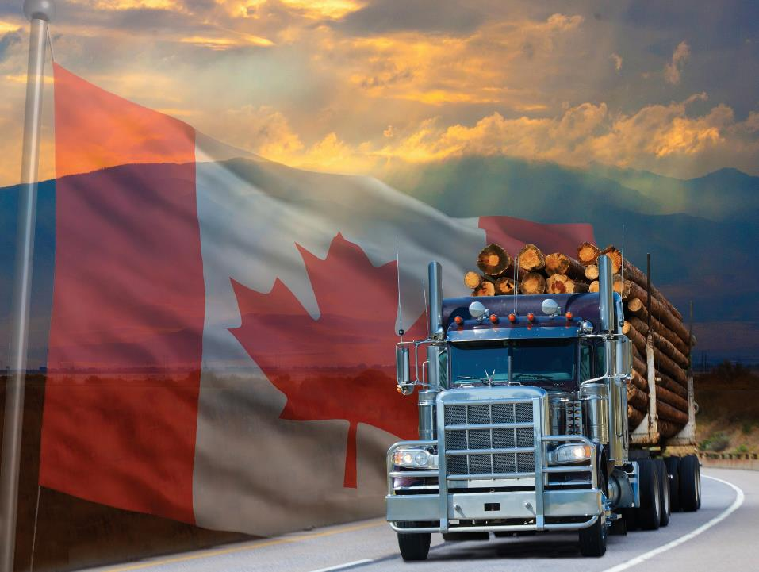
Introduction
Notes:
Introduction
Every day, many professional drivers cross the U.S. borders without incident. For the new professional driver however, the thought of delivering goods into another country might seem like a daunting task.
Being aware of and knowledgeable about some of the processes and procedures can help make your border crossing experience smooth and relatively easy.
CLASSROOM RECOMMENDATIONS
Focus on the importance of understanding the differences between driving in the United States and driving in Canada. Areas of particular importance that should be covered are cross-border expectations, paperwork, and the importance of professionalism at all times when dealing with port and/or border authorities.

Slide 5
Objectives
Upon completion of this lesson, you will be able to:
  Discuss general requirements for crossing the
  Canadian border
  Describe the process used to cross the border into Canada and back into the United States
  List general differences between the U.S. and Canada when it comes to compliance issues including
  hours of service, daily vehicle inspections, and vehicle sizes and weights
Notes:
Objectives
Upon completion of this lesson, you will be able to:
Discuss general requirements for crossing the Canadian border;
Describe the process used to cross the border into Canada and back into the United States; and
List general differences between the U.S. and Canada when it comes to compliance issues including hours of service, daily vehicle inspections, and vehicle sizes and weights.

Slide 6
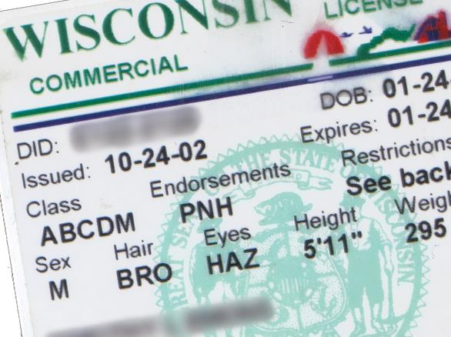
General Requirements
Notes:
General Requirements
Travel into Canada is relatively common for the professional driver. Because U.S. drivers are allowed to operate into Canada without restriction, entry into and operation throughout Canada requires adequate preparation and paperwork.
Personal Credentials/Identification
To enter the country, Canada requires proof of identification and citizenship. This means carrying a current passport, passport card, your commercial operator’s license, an “enhanced” driver’s license, or a Free and Secure Trade (FAST) card.
An enhanced driver’s license provides proof of identity and U.S. citizenship, is issued in a secure process, and includes technology that makes travel easier. This type of license can be used for entering the United States from a foreign country through a land port of entry, in addition to serving as your license to drive.
The FAST program is a trusted traveler agreement between the United States and Canada. Drivers that meet eligibility criteria are able to obtain a FAST card that is valid for a five-year period. The FAST card may be used to meet proof of citizenship that’s required when crossing into Canada and back to the United States.
If you are a permanent resident of the United States but not a citizen, then you will be required to present proof of your immigration status and show your visa.

Slide 7

Certain types of convictions that are considered misdemeanors in the U.S. may be felonies in Canada.
Notes:
Prior Convictions
Certain types of convictions that are considered misdemeanors in the United States may be considered serious criminal (felony) offenses in Canada. If a professional driver has a felony conviction in the United States, the driver may not be admitted into Canada. Through Canada’s rehabilitation program, this denial of admittance may not be permanent. If you have been convicted of a crime considered to be a felony in Canada, you may be eligible for entry into Canada after five years from the end of your sentence.
If you have a felony conviction and need to enter Canada for a short time on a very limited basis, a special permit may be issued by the Citizenship and Immigration Canada consulate offices in the United States, but this is not guaranteed.

Slide 8

Certain personal items must be declared.
Notes:
Declaring Personal Items
Certain personal items carried over the border into Canada must be “declared” to the Canada Border Services Agency (CBSA). Personal items you must declare include:
Tobacco
All animals, plants, and their products
Explosives, fireworks, and ammunition
Firearms and weapons (note that most weapons, including switchblades and other knives, mace spray, brass knuckles, and tasers, are prohibited and may be confiscated at the border)
Prescription drugs with a clearly identifying label (if possible, you should also carry a letter from your doctor indicating your prescription)
CALLOUT: Know and follow the rules and regulations of the country you are traveling in, as enforcement does not consider ignorance of these requirements as a valid reason for noncompliance.

Slide 9
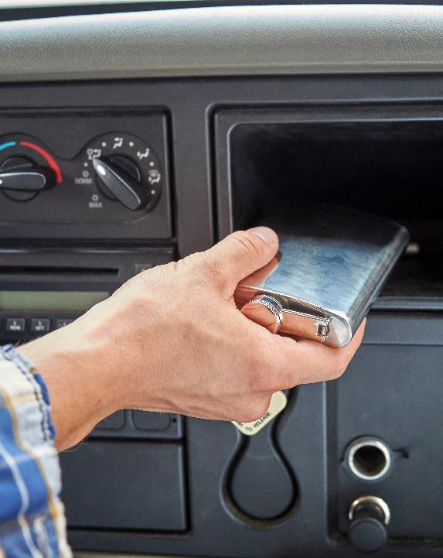
Some items
are prohibited.
Notes:
Prohibited Items
In Canada, professional drivers are prohibited from having alcohol in the cab of their vehicle under any circumstances. Other generally prohibited items include weapons, such as mace and handguns, as well as illegal drugs.

Slide 10
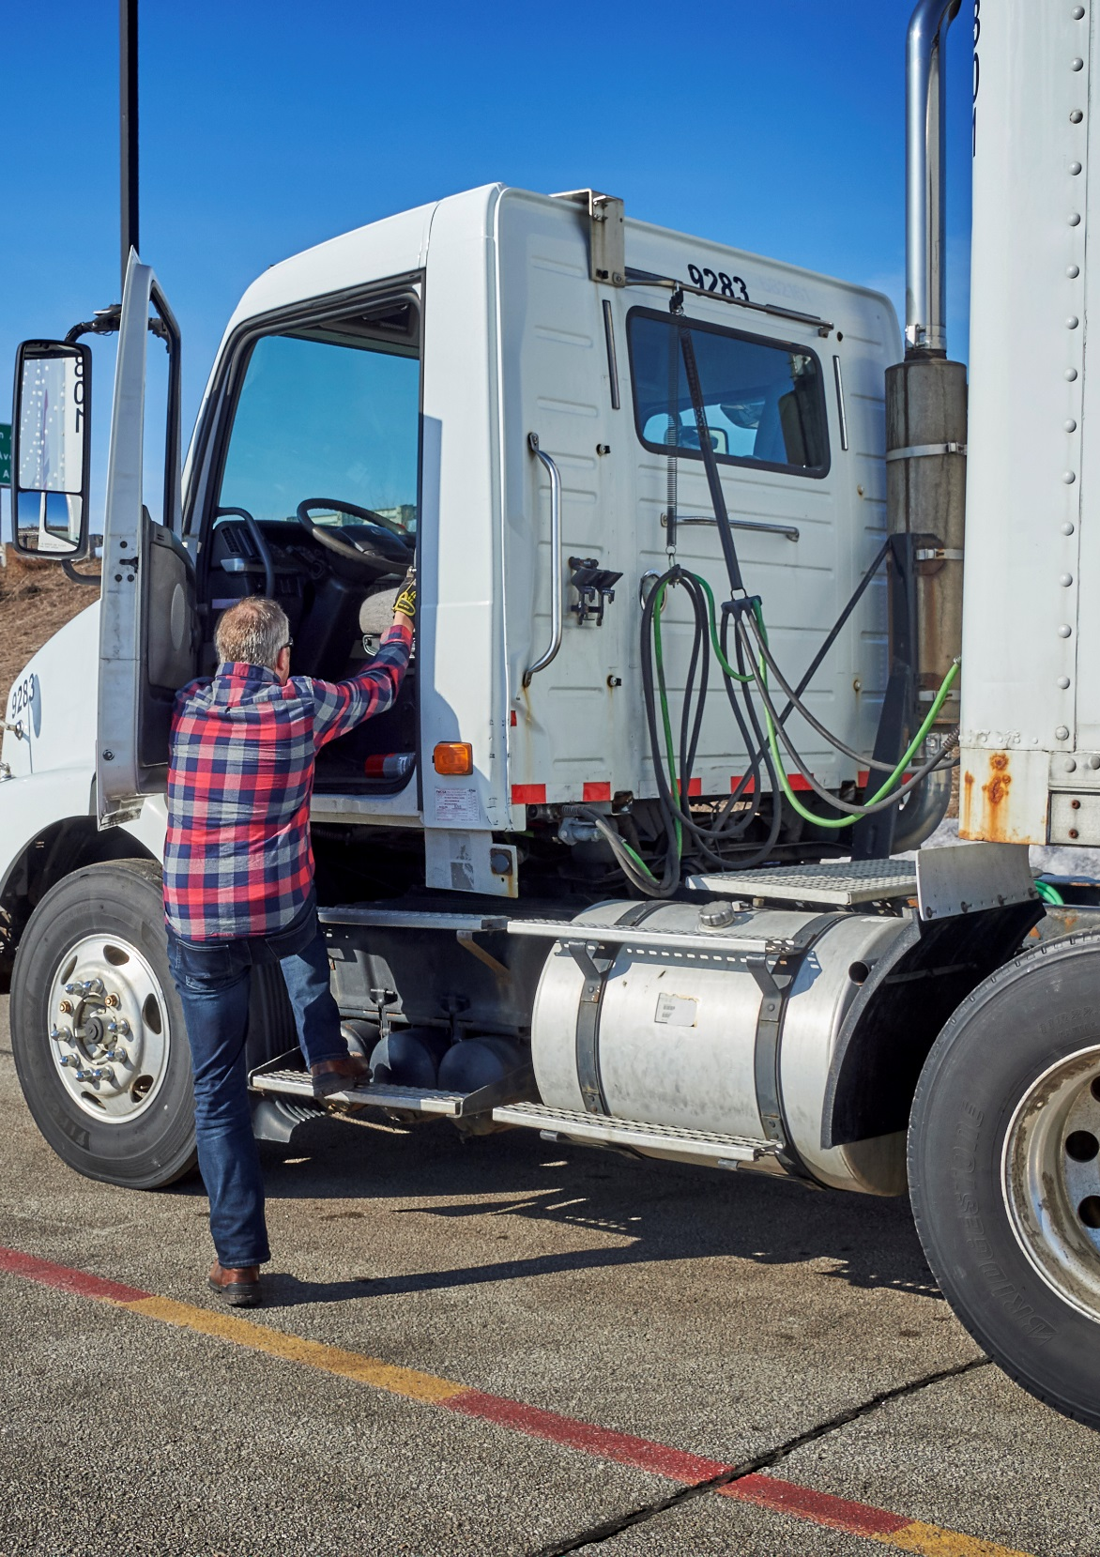
Before leaving for Canada, make sure vehicle credentials are in order:
  Registration
  Applicable safety certificates
  Fuel tax registration
  Permits
Notes:
Vehicle Credentials/Safety Compliance
Before leaving for Canada, you need to ensure that your vehicle registration, applicable safety certificates, fuel tax registration, and permits are all in order. Carriers will usually provide the necessary credentials to their drivers, but it is your responsibility to make sure you have everything you need and it is current.
You will also want to make sure your vehicle and load meet the vehicle size and weight limits for where you will be traveling in Canada. More information on sizes and weights will be discussed a little later in this chapter.

Slide 11
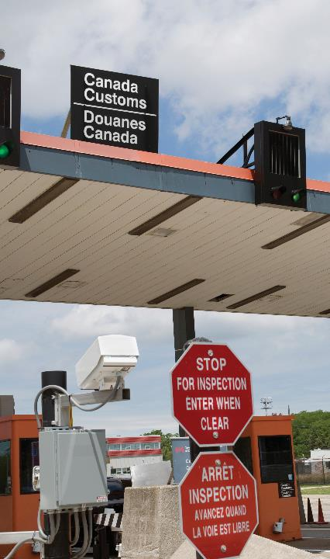
Border station hours may be limited in rural areas.
Notes:
Border Station Hours
While many border crossing locations are in operation 24 hours a day, 7 days a week, some border crossings in rural areas may have limited operating hours. Be sure to check with your intended border crossing office to ensure the office will be open when you arrive.

Slide 12
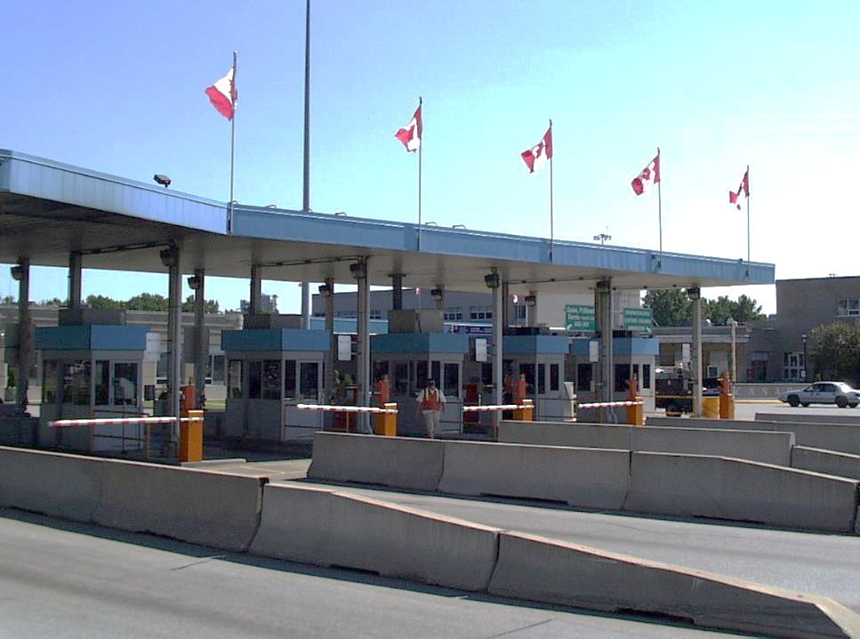
Crossing the Canadian Border Procedures
Notes:
Crossing the Canadian Border Procedures
Crossing the border into Canada requires patience and a general understanding of the paperwork and procedures required by the CBSA. If you have done your homework in these areas, your border crossing should be relatively painless.
Border Station Entry
When you approach most border stations, you will find there are certain lanes specified for the various vehicles entering the station. Use the designated commercial lanes, regardless of how long they are, at the border crossing station. Watch for signs that will direct you to the proper areas. It is important to remember crossing into Canada is a well-established systematic process. If you follow the signs and the directions of the officials at the border, your problems should be minimal.
Questioning
Upon arrival at the border, be prepared to answer a series of questions pertaining to your truck, your freight, your purpose for entering Canada, and your background or citizenship.
Officers will ask questions to make sure you are not involved in any illegal activity and you have met all documentation requirements for you, your vehicle, and your load. Some possible questions you may be asked include:
How long will you be visiting Canada?
Where will you be staying while in Canada?
What will you be doing in Canada during your stay?
What is your date of intended return to the United States?
Do you have items to declare?
Do you have any weapons in your possession?
What are you hauling?
Are you traveling alone?
Answer all questions directly and honestly. Be sure to listen closely and follow all further instructions from the CBSA officers.
Customs Inspections
CBSA may inspect your cab and cargo for illegal drugs, weapons, plants, certain foods (such as fresh fruits and vegetables), and animals that are not permitted into Canada. They may also search for illegal aliens or undeclared passengers. Last, they may inspect your cargo to ensure what you are carrying matches the paperwork you have provided.
Paperwork
The type of cargo you are hauling can determine what types of paperwork you will be required to submit at the border. Some shipments that are going to Canada are released or cleared by the CBSA at the border, and some shipments are released or cleared at warehouses or other inland locations. The way cargo is released can also change the type of paperwork needed to transport a shipment into and out of Canada.

Slide 13
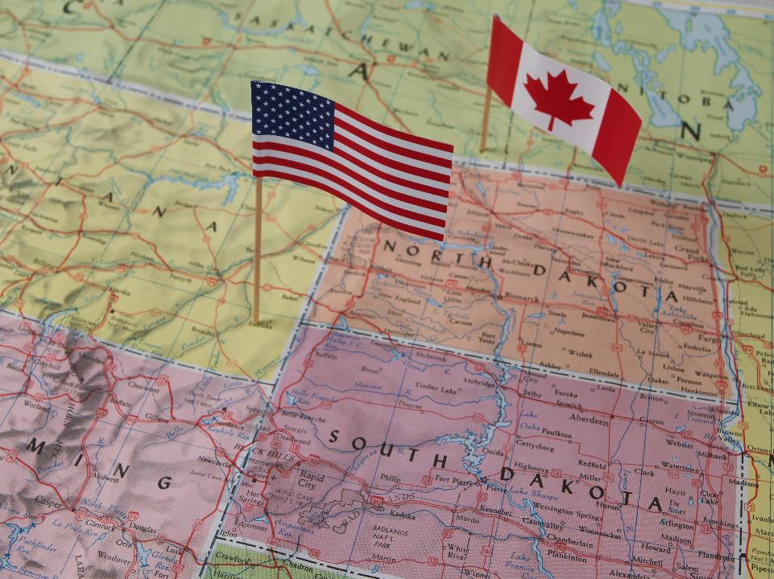
Border Crossing Programs
Notes:
Border Crossing Programs
There are several different types of border crossing programs in which you or your carrier may be involved. These border crossing programs were created to expedite shipments and drivers across the Canadian border while ensuring the shipments are legal and secure. Some of these programs are listed below.
PARS
The Pre-Arrival Review System (PARS) is a program that allows shipments to be released directly into Canada without additional inspection at the border. The exporter/shipper will provide advance cargo documentation to CBSA, who will then look over the cargo documentation for accuracy and validity. When the driver arrives at the border, the driver’s paperwork is matched to the information previously sent by the exporter or shipper. If everything matches, CBSA will then usually release the cargo without further inspection.
CSA
Customs Self Assessment (CSA) is a program under which carriers and drivers can take advantage of streamlined clearance options for eligible goods. Carriers must apply for the CSA program and meet certain conditions before becoming a CSA participant.
FAST
U.S. Customs and Border Protection (CBP) and Canada’s CBSA have aligned to create the Free and Secure Trade Program (FAST). This program establishes a harmonized clearance process for low-risk shipments and helps expedite shipments across the border. Dedicated FAST lanes at border crossings allow drivers and carriers with FAST clearance to cross the border much more quickly. Carriers and/or drivers must pre-apply for FAST through the U.S. CBP or Canada’s CBSA.
U.S. ACE/Canada eManifest
U.S. Customs and Border Protection’s Automated Commercial Environment (ACE) provides a single, centralized online access point to connect U.S. Customs and Border Protection (CBP) and the trade community. The ACE online portal provides access to other government agencies with trade and border enforcement responsibilities.
ACE or another electronic data interchange (EDI) is required of motor carriers for submission of electronic manifest information for land entry into the U.S.
eManifest is Canada’s equivalent to ACE and it can be used for land entry into Canada.

Slide 14

Returning to the United States from Canada
Notes:
Returning to the United States from Canada
Upon returning to the United States after your trip to Canada, you will be required to show identification, such as your CDL, and proof of citizenship (your passport). You should already have these items available, as you needed them to enter Canada.
If you are returning with freight, you will also be required to show proper credentials and paperwork for the freight, similar to what you needed when you entered Canada with a load.

Slide 15
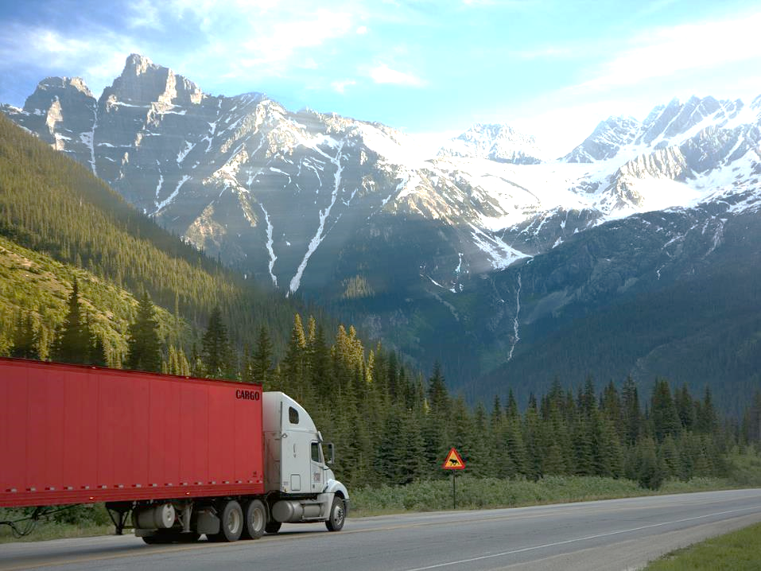
Motor Carrier Safety and Licensing
Notes:
Motor Carrier Safety & Licensing
As referenced earlier, while operating in Canada, you need to be aware of some differences in the safety regulations as they apply to the professional driver. As in the United States, you need to be in compliance when operating in Canada.
Canada’s Hours of Service
Canada’s hours-of-service requirements are different from those in the United States. Canada has two sets of rules, one set for drivers that operate south of the 60th parallel and one set for drivers that operate north of the 60th parallel. The 60th parallel runs along the northern borders of British Columbia, Alberta, Saskatchewan, and Manitoba. The south of the 60th parallel rules apply to Canada’s 10 provinces. The rules north of the 60th parallel apply to the Yukon Territory and the Northwest Territories and are slightly less restrictive than the rules for drivers operating south of the 60th parallel.

Slide 16
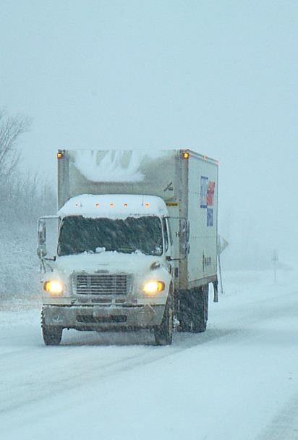
Limits South of 60th Parallel.
Notes:
General Rules South of 60
If you are driving south of the 60th parallel, you are allowed to drive:
13 hours in a day or work shift , but you must stop driving after accumulating:
14 on-duty hours in the day or work shift, or
After reaching the 16th consecutive hour since your last eight-hour break
You must take 10 hours off duty in a day. This time does not need to be consecutive. Finally, you cannot drive without having at least 24 consecutive hours off duty in the preceding 14 days.
At least eight hours of off-duty time must be consecutive and precede the initial on-duty time in a day. The additional two hours of the total 10 off-duty hours required daily can be distributed throughout the day in blocks of no less than 30 minutes.
Drivers may defer up to two hours of the mandatory 10 hours off duty to the following day.
VIDEOS (see Trainer Tools USB)
34.1 — Canada HOS - Limits South of 60th Parallel
Adverse Conditions
If you encounter conditions such as snow, sleet, fog, or unusual road or traffic conditions on a run that could normally be completed in 13 hours, you are allowed up to an additional two hours of driving time to complete the run. The 14- and 16-hour rules still apply, and you will still have to take eight consecutive hours of off-duty time. However, you can reduce the additional two required off-duty hours by the amount of your delay.
To use this exception, you must not have known or been able to foresee the situation at the time you began your run. The reason for using the exception must be recorded on your log.
Split Sleeper Rules
Drivers operating a commercial vehicle fitted with a sleeper berth can accumulate their mandatory off-duty time in two separate periods. For a single driver south of the 60th parallel, neither period can be shorter than two hours, the total of the two periods must be at least 10 hours, and the off-duty time must be spent in the sleeper berth.
You must stop driving after accumulating 13 driving hours, 14 on-duty hours or 16 total hours when adding up the time before and after each of the two rest periods.
Team drivers can also use the sleeper-berth option, but each of the two rest periods must be at least four hours long, and the total of the two periods must be at least eight hours. Team drivers must still obtain at least 10 hours off duty in a day.
As with single drivers, you must stop driving after accumulating 13 driving hours, 14 on-duty hours, or 16 total hours when adding up the time before and after each of the two rest periods.
Cycles
Under Canada’s rules, you must comply with either of two long-term limits, known as Cycle 1 or Cycle 2.
If you are following Cycle 1, you cannot drive after accumulating 70 hours of on-duty time during any period of seven days.
If you are following Cycle 2, you cannot drive after accumulating 120 hours of on-duty time in any period of 14 days; or 70 hours of on-duty time without having taken at least 24 consecutive hours of off-duty time.
You may reset your current cycle and begin a new one, or switch between cycles, only if you take the following supplementary off-duty time:
For Cycle 1, or to switch from Cycle 1 to Cycle 2, at least 36 consecutive hours
For Cycle 2, or to switch from Cycle 2 to Cycle 1, at least 72 consecutive hours
Once you have taken the required off-duty time, you may begin a new cycle. Your accumulated hours are set back to zero and your driving hours begin to accumulate again.

Slide 17

Limits North of
60th Parallel.
Notes:
General rules North of 60
If you are driving north of the 60th parallel, you cannot drive after accumulating 15 hours of driving time or 18 hours of on-duty time in work shift, or if 20 consecutive hours have passed since your last eight-hour break. Upon reaching these limits, you must take at least eight consecutive hours of off-duty time before driving again. Finally, you cannot drive without taking at least 24 consecutive hours of off-duty time in the preceding 14 days.
The “adverse driving conditions” allowance is the same as it is for drivers south of the 60th parallel.
VIDEOS (see Trainer Tools USB)
34.2 — Canada HOS - Limits North of 60th Parallel
Split Sleeper Rules
When driving north of the 60th parallel, single drivers operating a commercial vehicle fitted with a sleeper berth can obtain their mandatory off-duty time by accumulating the time in two separate periods. Neither period can be shorter than two hours, the total of the two periods must be at least eight hours and the off-duty time must be spent in the sleeper berth.
You must stop driving after accumulating 15 driving hours or 18 total hours when adding up the time before and after each of the two rest periods.
Team drivers can also use the sleeper-berth option, but each of the two rest periods must be at least four hours long, and the total of the two periods must be at least eight hours.
As with single drivers, you must stop driving after accumulating 15 driving hours or 18 total hours when considering the time before and after each of the two rest periods.
Cycles
Under Canada’s north of 60th parallel rules, you must follow either Cycle 1 or Cycle 2 to account for your on-duty time.
If you are following Cycle 1, you cannot drive after accumulating 80 hours of on-duty time during any period of seven days.
If you are following Cycle 2, you cannot drive after accumulating 120 hours of on-duty time in any period of 14 days; or 80 hours of on-duty time without having taken at least 24 consecutive hours of off-duty time.
The cycle reset is 36 hours for Cycle 1 and 72 hours for Cycle 2.

Slide 18
US/Canada HOS Comparison Chart
Time, Cycle, Etc | Canadian HOS Regulations (south of 60) | U.S. HOS regulations
Daily Driving Time | 13 hours per day or workshift after 8 hours off | 11 hours after 10 hours off-duty
Daily On-Duty Time | No driving after 14 on-duty hours per day or workshift after 8 hours off | No driving after the 14th consecutive hour after coming on-duty
Daily Off-Duty Time | 8 hours before driving, 10 hours per day, 24 consecutive hours within past 14 days | 10 consecutive hours off duty; 30 minute break from driving required when more than 8 hours of driving have passed without an interruption in driving status of at least 30 consecutive minutes
Length of Workday | No driving after 16 consecutive hours | No driving after 14 consecutive hours
Duty Cycle | 70 hours/7 days (Cycle 1) 120 hours/14 days (Cycle 2) | 60 hours/7 days 70 hours/8 days
Cycle Reset | 36 hours for Cycle 1 72 hours for Cycle 2 (upon reaching 70th hour in Cycle 2, driver must take 24 consecutive hours off-duty | 34 hour restart
Notes:
US/Canada HOS Comparison Chart

Slide 19
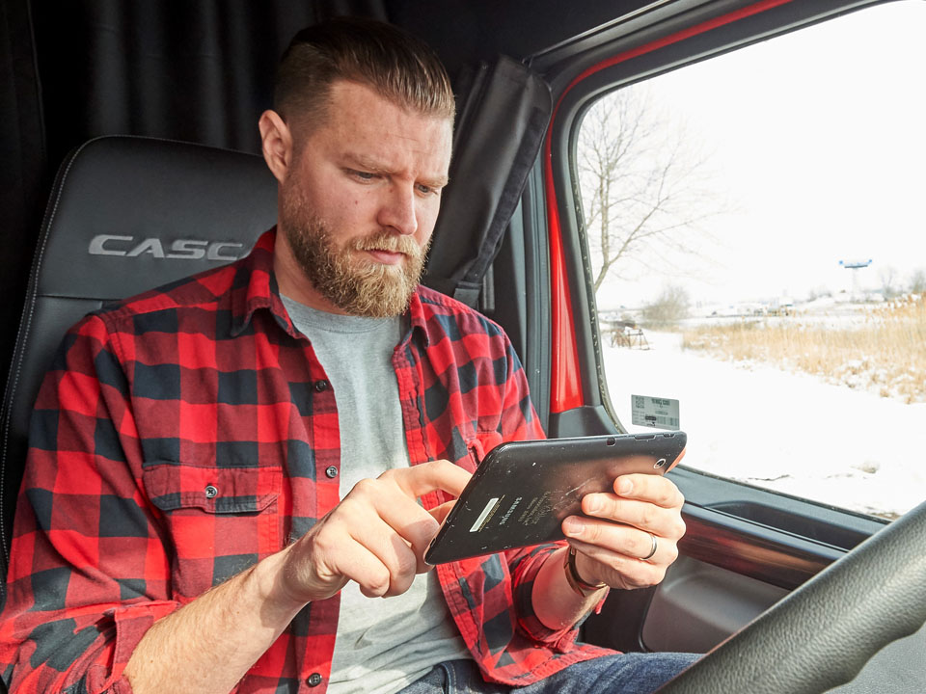
Canada’s Record of Duty
Status Requirements
Notes:
Canada’s Record of Duty Status Requirements
While operating in Canada, you need to be aware of Canada’s record of duty status requirements.
You must track your hours to show compliance with the hours-of-service limits. Enforcement officers will use your record of duty status to make sure you’re complying with the hours-of-service regulations. A complete record of duty status is needed for each 24-hour period.
You need to be able to provide a record of duty status for the current day and the previous 14 days, when an officer asks for it. It doesn’t matter whether you’re using an ELD or a manual record of duty status. And it must be current up to the last change of duty status.

Slide 20
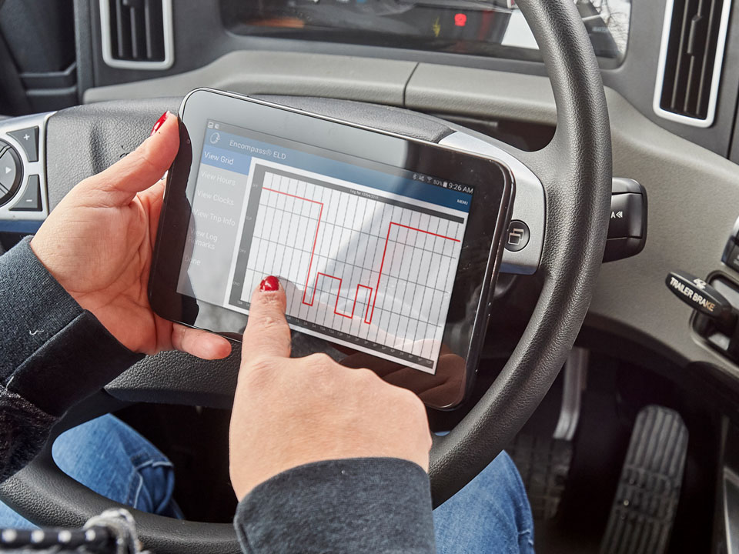
Electronic Logging Device (ELD)
Notes:
Electronic Logging Devices (ELDs) in Canada
The ELD rules are similar to, but different from, the ELD rules in the United States. You will need to use an ELD if you drive for a federally regulated carrier, operate in Canada, and are required to keep a record of duty status.
The Canadian ELD final rule has many technical requirements for electronic logging systems compared to electronic recording devices (ERDs), which were allowed in Canada to generate electronic logs prior to ELDs.
Transport Canada requires drivers to use ELDs certified by an accredited third-party certification body. Any ELD used in Canada must be certified to meet all ELD technical requirements. You can find a list of certified ELDs on Transport Canada’s website.
ELDs need to be connected to your vehicle’s electronic control module (ECM). This allows the ELD to record the required vehicle information (for example, vehicle speed, distance, and engine hours).
ELDs also need to capture information about certain data fields, including:
Drive time recording,
Edits,
Unassigned driving events,
Malfunctions, and
Data transfers to enforcement.
You’ll need to carry certain documents with you. They should be in the vehicle cab or in an electronic format. If you’re stopped for an inspection, the officer will check for these items.
You’ll need the following items while driving in the United States and Canada:
The ELD user’s manual,
An instruction sheet on data transfer during roadside inspections, and
An instruction sheet for the driver about malfunctions and how to fix them.
You’ll need the following items while driving in Canada:
Records for the current day and the previous 14 days,
A supply of blank paper records of duty status (at least 15 days’ worth) to use if the ELD fails, and
You must be able to transmit the electronic records during roadside inspections. Most drivers do this by email, but you may be able to transfer records using USB or Bluetooth.
ELD Exceptions
You may use a manual log instead of ELDs if you meet certain requirements:
Your motor carrier holds a special permit or has been issued a statutory exemption under the federal Motor Vehicle Transport Act,
Your vehicle is subject to a rental agreement of 30 days or less (the rental agreement cannot be extended or renewed),
Your vehicle was manufactured before model year 2000, or
You also do not need to use an ELD if you operate within a 160-kilometer radius of your home terminal and meet the other conditions.
Drivers do not need to use an ELD if they drive within a 160-kilometer (100-mile) air radius of their home terminal and meet the following requirements:
The driver must return to the home terminal each day to begin a minimum of eight consecutive hours of off-duty time; and
The employer keeps detailed time records for at least six months, showing, for each day, the cycle, the driver’s on-duty times, and the driver’s supporting documents.
Drivers must use an ELD if any one of these conditions is not met.
VIDEOS (see Trainer Tools USB)
34.3 — Canada HOS - ELD Basics

Slide 21
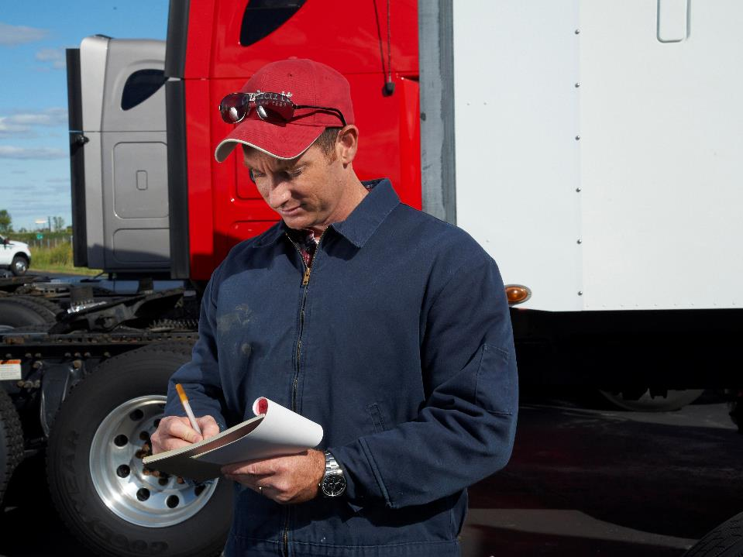
Canada’s Manual Record of Duty Status Requirements
Notes:
Canada’s Manual Record of Duty Status Requirements
Manual records of duty status are full records you complete without using an ELD. A paper record of duty status is the most common. Some carriers and drivers also use a computer program or application that is not connected to the engine to help them complete the record. You can only log manually if you are exempt from using an ELD or if the ELD malfunctions.
All manual log entries completed on paper must be:
legible,
in your own handwriting, and
signed after the last entry.
All manual log entries completed with a computer program or application must be:
up to date,
able to be printed when an officer asks, and
signed electronically or printed and signed after the last entry.
Canada requires the following items to be recorded on a manual log:
Date;
Start time (if different than midnight);
Driver’s name and driver’s signature at the end of the day;
Co-driver’s name, if applicable;
Driver’s cycle;
Commercial vehicle license plates or unit numbers;
Starting/ending odometer reading of each of the commercial vehicles operated by the driver;
Names and the addresses of the driver’s home terminal and the carrier’s principal place of business;
Number of hours of off-duty time and on-duty time each day during the 14 days immediately before the beginning of the day, if a log was not required the day before;
If the driver is deferring off-duty time, a note that indicates whether the driver is on day 1 or day 2 of the deferral;
Starting/ending odometer reading of any personal use of the vehicle (up to 75 kilometers [47 miles] per day);
Total distance driven for the day, minus any personal use;
Location of duty status changes, as that information becomes known; and
Total hours spent in each duty status.
VIDEOS (see Trainer Tools USB)
34.4 — Canada HOS - Manual Logs

Slide 22
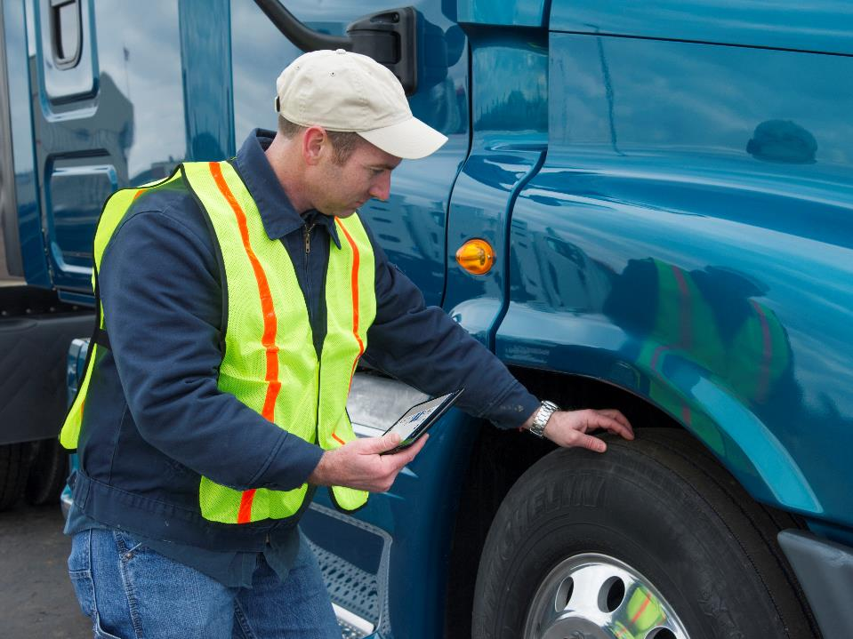
Vehicle Trip Inspections
Notes:
Vehicle Trip Inspections
Canada requires a documented daily vehicle inspection of vehicles, which needs to be performed on a vehicle at least once every 24-hour period. Drivers are required to carry a copy of the daily vehicle inspection report, which may be no more than 24 hours old. The United States requires a documented post-trip inspection report only when vehicle defects or deficiencies are discovered.
The United States and Canada have a reciprocal agreement in place for trip inspection reporting. A condition of the reciprocal agreement requires a U.S.-based driver to carry his or her previous days’ post-trip inspection when traveling in Canada, defects or no defects. Be sure you have proof of a post-trip inspection before entering Canada, even if no defects or deficiencies are discovered on your vehicle.
CALLOUT: Though U.S. regulation only requires that a DVIR be completed when no defects or deficiencies are discovered, Canada requires that the last day’s DVIR be carried on the vehicle (defect or no defect). This means that you need to have a completed DVIR on your vehicle even if you did not find any defects or deficiencies on your vehicle.

Slide 23
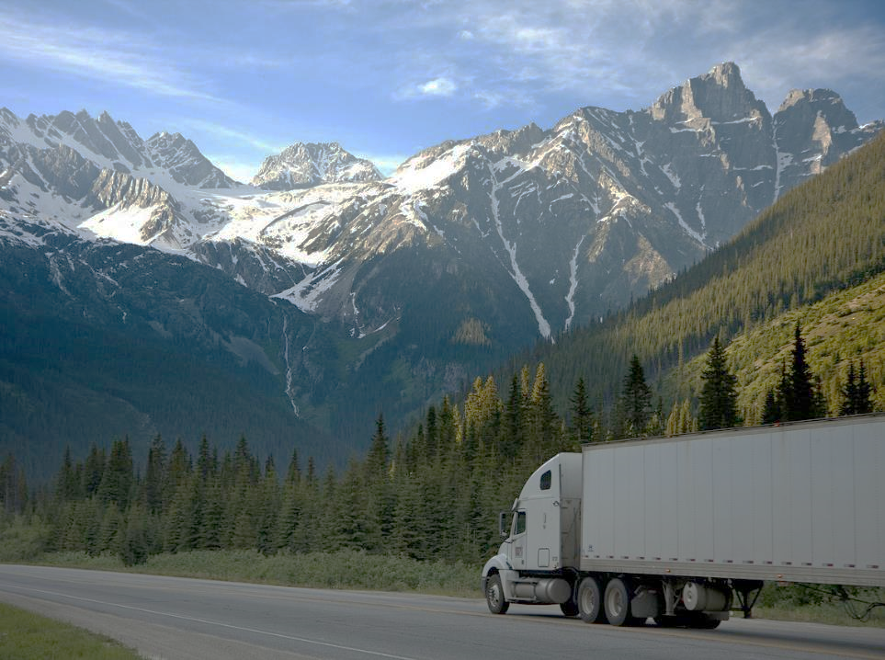
Operating Authority/Canadian
Safety Credentials
Notes:
Operating Authority/Canadian Safety Credentials
For-hire operating authority in the United States is granted by the Federal Motor Carrier Safety Administration (FMCSA). In Canada however, a federal for‑hire operating authority does not exist. Instead, Canada-based carriers, both private and for-hire, must obtain a safety operating authority called a safety fitness certificate from their respective base province or territory. In most Canadian jurisdictions, the requirements for a carrier to obtain a safety fitness certificate only apply to Canada-based carriers. However, two provinces, Ontario and Quebec, both require U.S.-based carriers to obtain a safety registration within those provinces.
In Ontario, it is called the Commercial Vehicle Operator Registration and in Quebec it is called the Registration Identification Number. Both registrations allow Ontario and Quebec to track the safety performance of U.S. carriers operating in the provinces. While operating in these provinces, you may have to produce credentials showing that your carrier is registered under these programs.
IFTA/IRP Credentials
Because the International Fuel Tax Agreement (IFTA) and the International Registration Plan (IRP) apply to the lower 48 states and 10 Canadian provinces (and the District of Columbia for IRP), you must have proper IFTA and IRP credentials when operating in Canada. For IFTA, you will have a copy of the IFTA license in your cab and IFTA decals on both sides of your cab.
For IRP, you will have a cab card listing your vehicle’s registered weight in all of the states and provinces. The carrier will likely provide you with all necessary documentation and permits.
Canadian enforcement officers may ask to see your IFTA and IRP credentials at any time. You may provide proof of your IFTA and IRP credentials by presenting an electronic image of the IFTA license and IRP cab card on a phone, tablet, or laptop.

Slide 24
Vehicle Sizes and Weights
Size and Weight Limitations
Height 4.15 m (13 ft. 6 in.)
Width 2.60 m (8 ft. 6 in.)
Length:
 | Straight Truck 12.5 m (41 ft.)
 | Semitrailer 16.2 m (53 ft.)
 | Truck-trailer 23.0 m (75 ft. 6 in.)
 | Tractor-trailer 23.0 m (75 ft. 6 in.)
Weight:
 | Straight truck 24,250 kg (53,462 lb.)
 | Tractor-semitrailer 46,500 kg (102,515 lb.)
 | Truck-full trailer 53,500 kg (117,947 lb.)
Notes:
Vehicle Sizes and Weights
The vehicle size and weight requirements in Canada are different than the requirements in the United States.
In Canada, the vehicle size and weight requirements are established by each jurisdiction. For example, the size and weight requirements in British Columbia may not be the same as the requirements in Ontario. In order to create uniformity among the Canadian jurisdictions, all jurisdictions agreed to a “Memorandum of Understanding” (MOU) on vehicle size and weights.
The MOU establishes the following size and weight limitations:
Height 4.15 m (13 ft. 6 in.)
Width 2.60 m (8 ft. 6 in.)
Length:
Straight truck 12.5 m (41 ft.)
Semitrailer 16.2 m (53 ft.)
Truck-trailer 23.0 m (75 ft. 6 in.)
Tractor-trailer 23.0 m (75 ft. 6 in.)
Weight:
Straight truck 24,250 kg (53,462 lb.)
Tractor-semitrailer 46,500 kg (102,515 lb.)
Truck-full trailer 53,500 kg (117,947 lb.)
Even though the MOU is in place, a Canadian jurisdiction may adopt less restrictive size and weight limits for roads within their jurisdiction. Refer to the individual jurisdiction’s size and weight regulations for more information.

Slide 25
Metric Measurement and Conversions
Metric | English
1 meter | 3.28 feet
1 kilometer | 0.621 miles
1 kilogram | 2.2046 pounds
1 liter | 0.264 gallons
English | Metric
1 foot | 0.3048 meters
1 mile | 1.6093 kilometers
1 pound | 0.454 kilograms
1 gallon | 3.785 liters
Notes:
Metric Measurements and Conversions
Canada uses the metric system, which is unlike the United States, where the English system is used. Common conversions of the English and metric systems include the following:
1 meter = 3.28 feet
1 kilometer = 0.621 miles
1 kilogram = 2.2046 pounds
1 liter = 0.264 gallons
1 foot = 0.3048 meters
1 mile = 1.6093 kilometers
1 pound = 0.454 kilograms
1 gallon = 3.785 liters
To convert a metric measurement to an English measurement, simply multiply by the English conversion equivalent. For example:
To convert 80 kilometers to miles: 80 x 0.621 = 49.7 miles
To convert 20 meters to feet: 20 x 3.28 = 65.6 feet
Canada uses degrees Celsius to represent temperature. To convert Celsius temperatures to Fahrenheit, multiply the degrees Celsius by 1.8 and add 32. For example, to convert 25º C to ºF: multiply (25ºC x 1.8) + 32 = 77ºF
Currency
Canada has its own currency and the denominations are similar to United States currency. However, Canada is different in that they do not use pennies, and a single dollar is a coin, referred to as a “loonie.” Canada also has a two‑dollar coin that’s referred to as a “toonie.” Paper money starts with the $5 bill.
The value of a Canadian dollar compared to a U.S. dollar is different. Depending on many economic factors, a Canadian dollar may be worth less, or more, than a U.S. dollar. When exchanging U.S. currency into Canadian currency, an exchange rate is set. The exchange rates fluctuate often.
When entering Canada, you may be able to exchange U.S. dollars for Canadian dollars near the border. If you do not wish to exchange money upon entering Canada, some retailers near the border may accept U.S. currency or you can use a credit card. Before doing so, first ensure that your card may be used in a foreign country. Note that your credit card provider may charge a foreign transaction fee to use the card in a foreign country.
CALLOUT: Speed limit signs in Canada are posted using the metric system. Be sure to remember that 100 km/hour is actually 62 miles/hour.

Slide 26
Objectives Review
You should now be able to:
  Discuss general requirements for crossing the Canadian border
  Describe the process used to cross the border into Canada and back into the United States
  List general differences between the U.S. and Canada when it comes to compliance issues including hours of service, daily vehicle inspections, and vehicle sizes and weights
Copyright 2019 (Rev. 4/21) J. J. Keller & Associates, Inc.
Notes:
You should now be able to:
Discuss general requirements for crossing the Canadian border;
Describe the process used to cross the border into Canada and back into the United States; and
List general differences between the U.S. and Canada when it comes to compliance issues including hours of service, daily vehicle inspections, and vehicle sizes and weights
CLASSROOM RECOMMENDATION
Before concluding your training session, have participants take the corresponding quiz (found on the Trainer Tools USB) to check their understanding of the material. You can customize any of the questions to fit your audience or workplace. The answer key can also be found on the Trainer Tools USB.
You may also choose to administer the quizzes before you begin your training session to help get participants thinking about the subject and/or to gauge their understanding of the topic ahead of time.

