Slide 1






PowerPoint® Instructions
This PowerPoint has been designed so you can easily customize it for your training session.
Throughout the presentation you’ll see icons with recommendations or videos to enhance the instruction you present to your students. A detailed explanation for each icon can be found on the next slide. Videos can be found on the Trainer Tools USB.
When you see an icon on the slide, look in the notes
section for further information.
Simply delete or move the icon off the slide before your training session begins.

Slide 2





Classroom Recommendations. Provides suggestions for enhancing your classroom presentation; from ideas for large group discussions to suggestions on the use of training aids such as examples or photos of vehicle parts and components to help illustrate the items covered within a chapter.
Lab Recommendations. Provides suggestions for activities and exercises that take place outside the classroom, but do not involve
the actual operation of the tractor-trailer or its components. Examples
of lab sessions include conducting a vehicle inspection or practicing mirror adjustment.
Range Recommendations. These recommended activities take
place on a closed-access driving range where students may practice driving skills in a controlled environment. Examples of range sessions include practicing shifting technique and successfully completing a backing maneuver.
Road Recommendations. These recommended activities take place in road and traffic conditions that support the chapter’s objectives. Examples of road sessions include proper communication with other drivers through the use of turn signals and basic vehicle control under nighttime or extreme weather conditions.
Videos. These short video clips reinforce material presented in the Student Manual. Use them to help students grasp difficult concepts or subject matter.

Slide 3
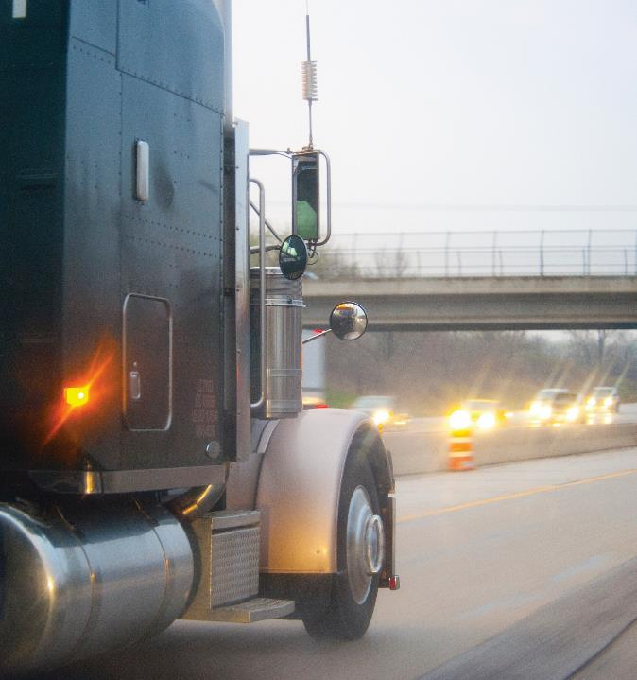
Hazard Perception
15
Notes:
Chapter 15: Hazard Perception
Unit 1.3.1 Hazard Perception The unit must provide instruction for recognizing potential hazards in the driving environment in order to reduce the severity of the hazard and neutralize possible emergency situations. The training providers must teach driver-trainees to identify road conditions and other road users that are a potential threat to the safety of the CMV and suggest appropriate adjustments. The instruction must emphasize hazard recognition, visual search, adequate surveillance, and response to possible emergency-producing situations encountered by CMV drivers in various traffic situations. The training providers must also teach driver-trainees to recognize potential dangers and the safety procedures that must be utilized while driving in construction/work zones.

Slide 4
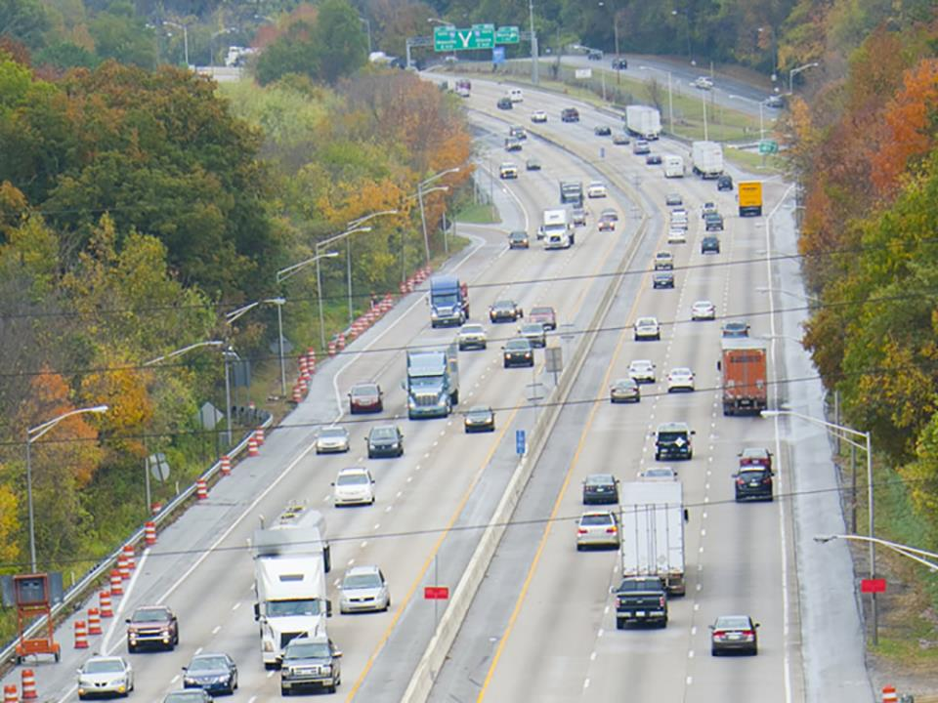
Introduction
Notes:
Introduction
Any road user or road condition can be a potential hazard. Learning to recognize hazards is a skill that you should continually work on and will continually develop as you proceed in your professional driving career. This chapter will introduce you to the nature of hazards, the clues to recognizing them, and how to respond to possible emergency situations.
CLASSROOM RECOMMENDATIONS
Stress the importance of hazard recognition. Make sure you cover road hazards, user hazards, visual search, and responding to emergency situations in detail.

Slide 5
Objectives
Upon completion of this lesson, you will be able to:
  Identify hazardous road conditions and road users
  Explain how to avoid or mitigate hazards
  Respond to emergency traffic situations
Notes:
Objectives
Upon completion of this lesson, you will be able to:
Identify hazardous road conditions and road users
Explain how to avoid or mitigate hazards
Respond to emergency traffic situations

Slide 6
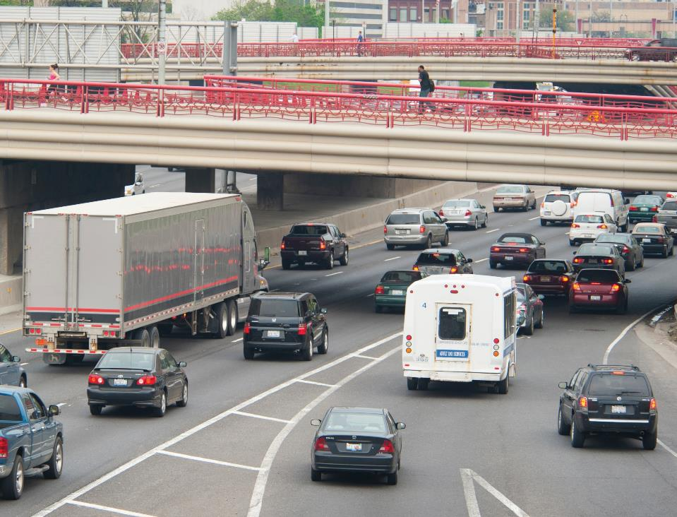
Hazard Recognition
Notes:
Hazard Recognition
A hazard is any road condition or road user that can pose a potential danger to the motoring public. Being aware of and anticipating potential hazards is key to effective hazard perception which, in turn, helps in preventing accidents.
In some ways, hazard perception is like doing detective work. You should continually look for clues; that is, signs that you could be dealing with a potential hazard. This includes scanning the road ahead and the area around your vehicle. The clues or signs you are looking for fall into two major categories, road hazards and user hazards.

Slide 7
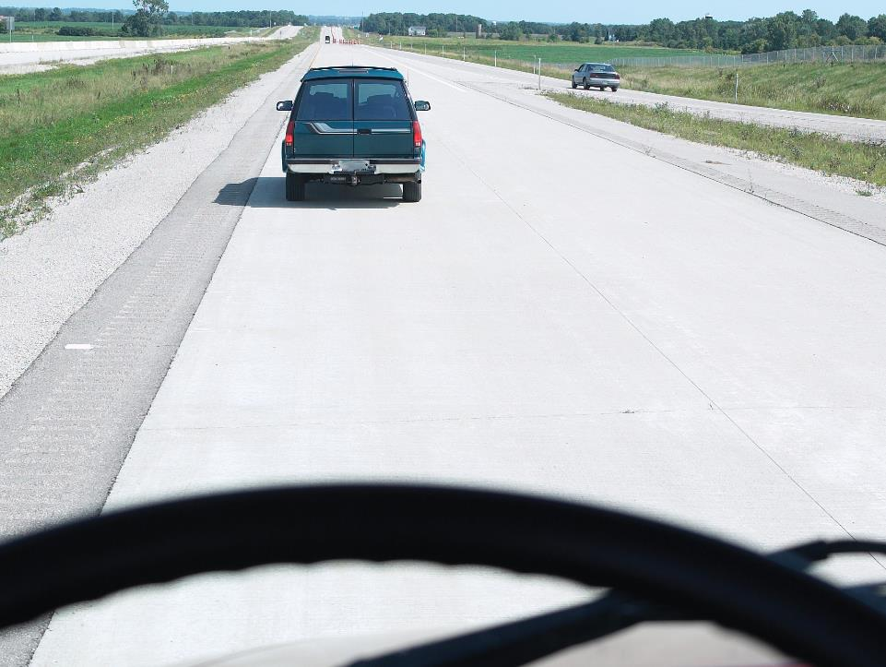
Road Hazards
Notes:
Road Hazards
Road hazards appear in many different forms. They may be naturally occurring, man-made, or a combination. Road hazards are characteristics of the road surface that could affect your ability to control your vehicle or see clearly.
Road hazards include:
Pavement drop-offs
Road construction/work zones
Road debris
Off-ramps
On-ramps
Pavement Drop-offs
Sometimes, the pavement drops off sharply near the edge of the road (such as the shoulder). Driving too close to the edge can cause a vehicle to suddenly tilt. This can cause a vehicle to hit roadside objects (tree limbs, signs). Also, it can be hard to steer when crossing a drop-off.
VIDEOS (see Trainer Tools USB)
15.1 — Pavement Drop-offs

Slide 8
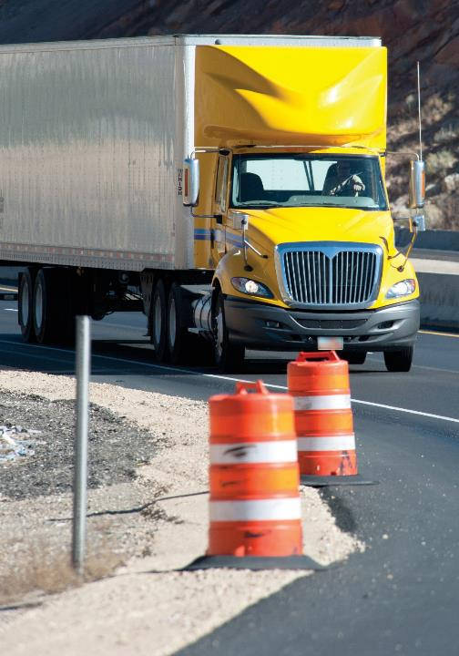
The importance of hazard perception is magnified when it comes to operating in a work zone.
Notes:
Road Construction/Work Zones
Traveling through a work zone can present several challenges. There may be narrow lanes, sharp turns, poor visibility, unclear lane markings, changing traffic patterns, or uneven surfaces. In addition, other drivers may be confused or unsure where they should be in work zones causing them to drive erratically. Workers and construction vehicles may also be working on or near the road.
The importance of hazard perception is magnified when it comes to operating in a work zone. According to Federal Highway Administration (FHWA) data, one in every three work zone crashes involved a large truck (gross vehicle weight rating over 10,000 pounds). Angle, rear-end, and head-on collisions were the most common types of crashes.
VIDEOS (see Trainer Tools USB)
15.2 — Road Construction/Work Zones
To stay safe when driving through a work zone:
Pay close attention. Your undivided attention should be on the task at hand — safely navigating through the work zone. Eliminate all activities that pose a distraction. Watch the traffic around you and be prepared to react.
Be aware of your vehicle’s blind spots. Vehicles may be hidden in your vehicle’s “No- Zone.” Don’t change lanes unless absolutely necessary and avoid sudden lane changes.
Watch for signs. Orange, diamond-shaped signs are posted to give you advance warning of lane closings, construction areas, and workers ahead. This is especially important if you travel through the same areas frequently, as lane closures or traffic patterns may change.
Maintain a safe distance from workers and equipment. Use the lane furthest from the work zone when possible.
Don’t speed. As well as being one of the major causes of work zone crashes, the majority of states impose enhanced fines for speeding in work zones.
Don’t tailgate. Maintain a safe following distance by leaving plenty of room between vehicles.
Watch for and obey road crew flaggers. Follow their instructions/directions. Road crew flaggers have the same authority as a regulatory sign. You could be cited for disobeying their directions.
Be patient. Slow down and pay attention to your surroundings. Even if you don’t see workers and/or equipment in a work zone that doesn’t mean they are not there. Observe and obey all work zone signs until you have exited the work zone.
Plan ahead. Keep up with the latest road conditions for the areas in which you travel. Many states maintain websites that keep drivers current with the latest road conditions. Schedule plenty of time to make your trip or if possible, take an alternate route.

Slide 9
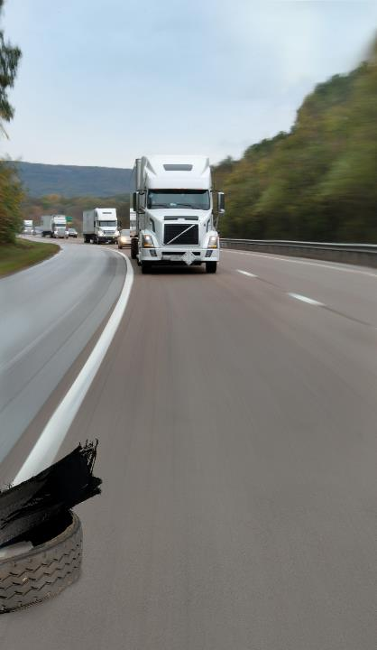
Foreign objects or debris can be a road hazard.
Notes:
Road Debris
Foreign objects (debris) can be a road hazard. Debris can be a danger to tires and wheel rims, can interfere with electrical and brake lines, and get caught between dual tires causing severe damage.
Some obstacles that appear harmless can actually be very dangerous. For example, a box or bag that appears to be empty may contain a heavy material, causing damage to your vehicle. It is very important to keep an eye out for objects in the road, and spot them early enough in order to avoid them without making unsafe, sudden moves. Never follow the vehicle in front of you too closely. Doing so could cause the vehicle to block your view of road debris until it is too late for you to react.
VIDEOS (see Trainer Tools USB)
15.3 — Road Debris

Slide 10
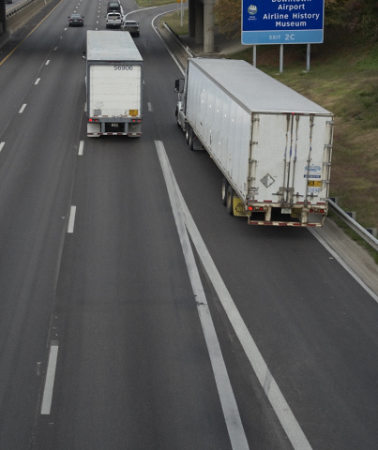
Off-ramps and on-ramps can be dangerous.
Notes:
Off-Ramps
Freeway and turnpike exits can be particularly dangerous. Curved off‑ramps often have speed limit signs posted, but the posted speed is the recommended speed for an automobile and may not be safe for a larger vehicle. Trucks generally should travel at least 5 mph less than the ramp speed limit. The curving off ramps are a transition area where the weight/center of gravity of the load will have a significant impact on rollover potential. Adjust speed for the surface conditions expected on the ramp well before entering a curve.
Exits that go downhill and turn at the same time can be especially dangerous since the downhill grade makes it difficult to reduce speed.
On-Ramps
A driver entering a freeway or turnpike may not be paying attention. He or she may not notice a vehicle approaching from behind or the side. In some cases, on-ramps have a short upgrade. This makes it difficult for a heavy vehicle to get up to speed and merge. Use your vehicle’s left turn signal to alert drivers on the highway that your intention is to merge onto the roadway where they are traveling.
VIDEOS (see Trainer Tools USB)
15.4 — Off Ramps and On Ramps

Slide 11
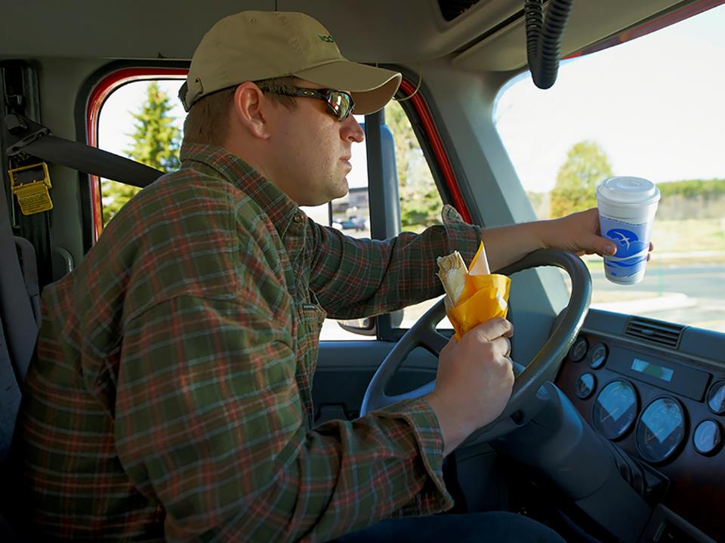
User Hazards
Notes:
User Hazards
Anticipating a situation is key to avoiding a user hazard. The following are considered user hazards:
Intersections
Blocked vision
Parked vehicles
Pedestrians/animals
Disabled vehicles
Inattentive/distracted drivers
Confused/impaired drivers
Fatigued drivers
Accidents
Railroad Crossings

Slide 12
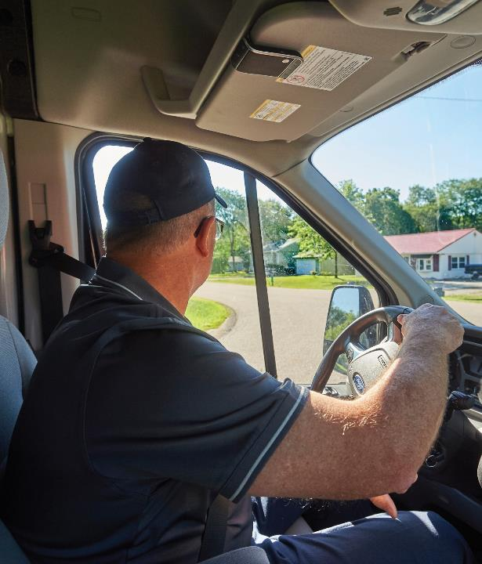
When making turns at intersections slow down, signal early, and shift into the correct gear before you turn.
Notes:
Intersections
Vehicles may be hidden by a blind intersection or alley. A driver may not have a clear view of traffic and may pull into the intersection or roadway. Always be prepared to stop.
When making left-hand turns slow down, signal early, and shift into the correct gear before you turn left from as far right as possible to allow enough room for the trailer to turn.
When making right-hand turns slow down and signal early, shift into the correct gear before you turn, pull the tractor far enough into the intersection to avoid curbing the trailer, and keep an eye out for vehicles who try to slip past you on the right.

Slide 13
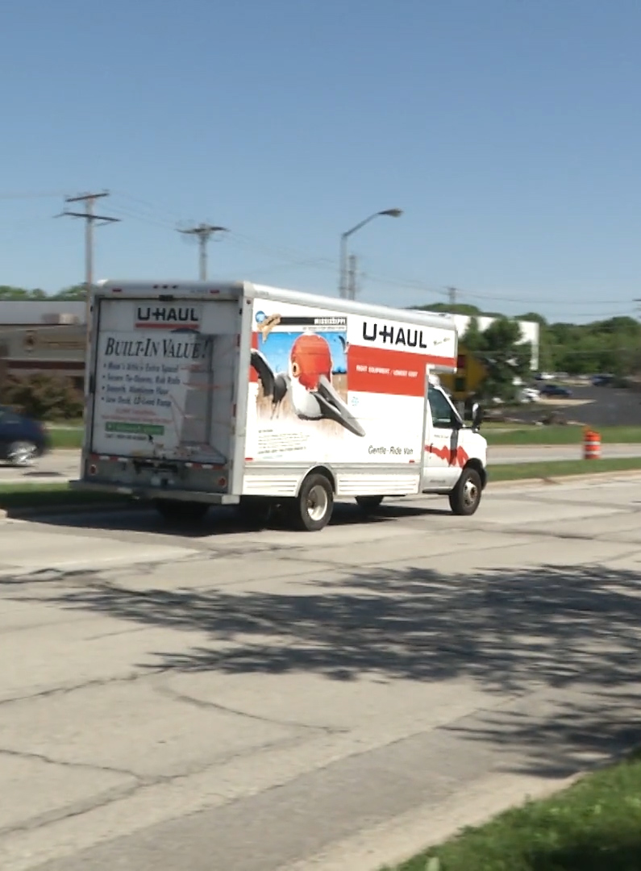
People who can’t see others can be a danger.
Notes:
Blocked Vision
People who can’t see others can be a danger. It is important to be alert for drivers whose vision is blocked by too much cargo in their rear seat, or dirty or snow-covered windows. Rental trucks should also be watched carefully. In many cases, rental truck drivers aren’t used to the limited vision they have to the sides and rear of the truck.

Slide 14
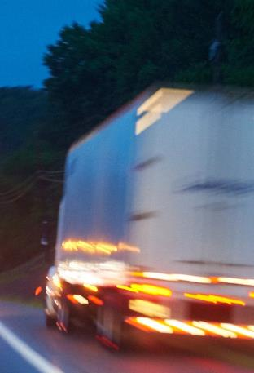
A parked vehicle can be hazardous when it begins to pull into traffic.
Notes:
Parked Vehicles
A parked vehicle can be hazardous when it begins to pull into traffic. Watch for movement inside the vehicle, or movement of the vehicle itself, which indicates people are inside. Keep an eye out for brake lights, backup lights, exhaust coming out of the vehicle’s tailpipe, or other clues that a driver is about to move.
VIDEOS (see Trainer Tools USB)
15.5 — Parked Vehicles

Slide 15
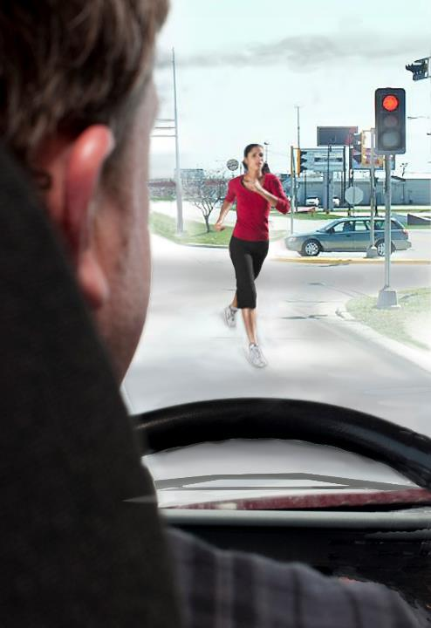
Watch for children, people, and animals.
Notes:
Pedestrians/Animals
Joggers often times wear earbuds, preventing them from hearing what’s going on around them. Also, some joggers do not wear light-colored or reflective clothing when jogging before sunrise or after sunset.
Cell phone use by pedestrians is another common distraction—taking the user’s focus away from his or her surroundings.
Children aren’t always aware of their environment. They may run into the road or between parked vehicles to retrieve a ball or chase another child. Pay extra attention when traveling through school zones and at bus stops.
In addition, keep an eye out for animals which can suddenly dart out from behind trees and bushes and onto the road in front of you.
VIDEOS (see Trainer Tools USB)
15.6 — Pedestrians/Animals

Slide 16
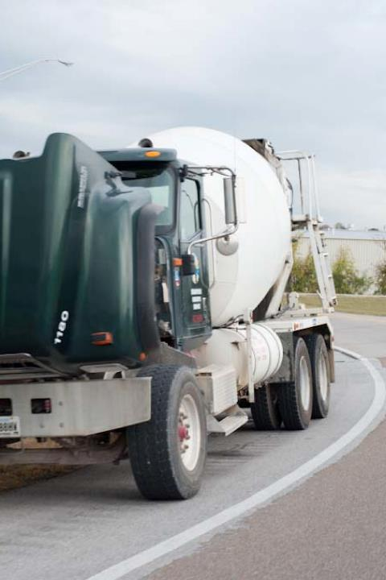
Drivers changing a tire or working on an engine may not pay attention to traffic going by.
Notes:
Disabled Vehicles
Drivers changing a tire or working on an engine may not pay attention to traffic going by. If you see jacked-up wheels, a raised hood, or activated four-way flashers in the distance, move over one lane to maximize your space.
CALLOUT: Many states have “move-over” laws, requiring you to move over one lane when a disabled vehicle and/or emergency responder is stopped on the side of a multi-lane road. Make sure you understand the requirements for the states in which you travel.
VIDEOS (see Trainer Tools USB)
15.7 — Disabled Vehicles

Slide 17

Texting, cell phone use, eating, and drinking are all common driver distractions.
Notes:
Inattentive/Distracted Drivers
People who are distracted can be a hazard. Texting, cell phone use, eating, and drinking are all common driver distractions. Pay attention to where other drivers are looking. If their eyes are on something other than the road, they may not see you.
CALLOUT: Distracted drivers make a conscious choice to distract themselves from driving whether it’s texting, looking at their GPS, or slowing down to look at an accident.
This means not only is it important for you to be a focused driver, it’s equally as important for you to be aware of the unfocused drivers around you.
VIDEOS (see Trainer Tools USB)
15.8 — Other Drivers

Slide 18

Yawns and head bobs are both signals a fellow driver is sleepy.
Notes:
Confused/Impaired Drivers
Confused or impaired drivers often drive erratically, cross lanes of traffic, or even slow or stop suddenly and without warning. Confusion is common near freeway or turnpike interchanges and major intersections.
Tourists unfamiliar with an area can be hazardous. Clues to watch for when looking for tourists include cargo carriers, trailers, and out-of-state license plates.
Hesitation is another sign of confusion. Keep an eye out for vehicles driving very slowly, frequent use of brakes, or drivers looking at signs, their GPS, or paper maps.
Fatigued Drivers
Fatigued drivers vary their speed and can wander into other driving lanes. Yawns and head bobs are both signals a fellow driver is sleepy. Remember, drivers are most fatigued during their internal clock’s “low points” which occur in the early morning hours and mid-afternoon.

Slide 19
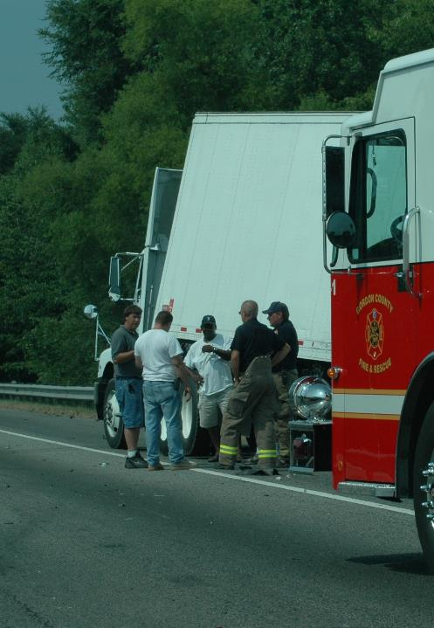
People involved in an accident could be injured or disoriented and may not pay attention to the traffic around them.
Notes:
Accidents
People involved in an accident could be injured or disoriented and may not pay attention to the traffic around them. Passing drivers tend to slow down and look at the crash. Some even stop completely. And, Good Samaritans who stop to try to help may run across the road without looking.

Slide 20
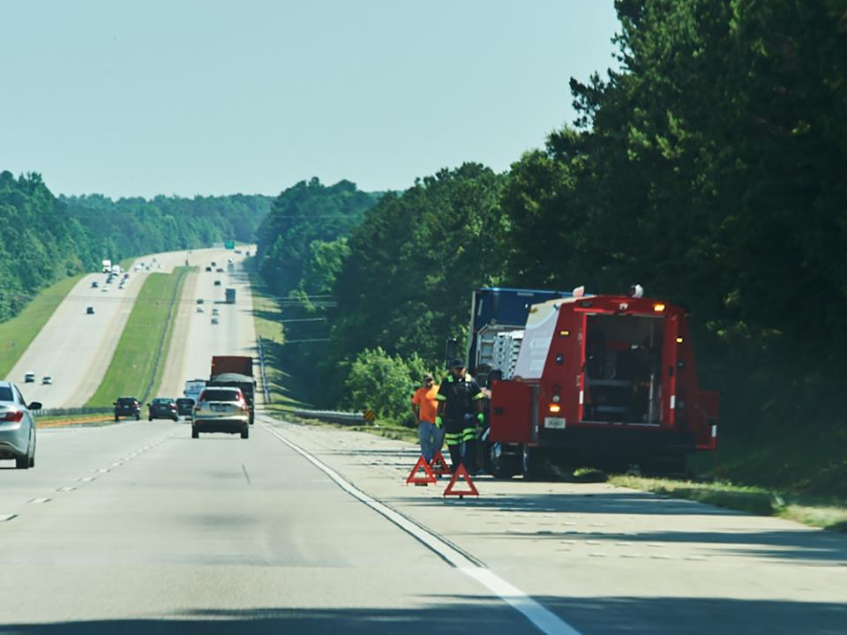
Visual Search
Notes:
Visual Search
Strong observation skills as well as the ability to think fast and quickly develop a plan are important. A hazard can easily turn into an emergency situation. You need to continually scan your entire sight area to identify hazards early. Spotting hazards early gives you time to react, and ideally, avoid a potentially dangerous situation. Looking 12 to 15 seconds ahead of your vehicle is a good general rule to follow. In addition, use your mirrors to periodically scan (about every four seconds) behind and to the sides of your vehicle.
Maneuvering to avoid hazards puts a lot of strain on your equipment, especially things like your tires, brakes, and steering system. Before you hit the road make sure that all the parts you rely on for slowing down, swerving, and stopping are in good working order before you hit the road. Always maintain a safe distance between your truck and the vehicle in front of you. Typically, you’ll want to allow one second for every ten feet of your truck’s length, plus another second when going over 40 miles per hour.
Adequate Surveillance
It is important that you recognize any and all road and user hazards that could affect your ability to travel safely. Remember, hazard perception is similar to detective work because you are continually looking for signs (clues) of potential hazards. Always be alert. Continually scan the road, following solid visual search technique.

Slide 21

Responding to Emergency Situations
Notes:
Responding to Emergency Situations
The safest and best way to avoid an emergency situation is to prevent it from happening in the first place, but no matter how safely you operate your vehicle, there is always the possibility that you may encounter an emergency situation. Knowing how to respond can go a long way in preventing a crash.
In order to avoid a crash, in addition to recognizing hazards, you should always be planning ahead. You should be asking yourself “what if” questions.
Think about having an escape route before you need to use it. This might mean changing lanes, driving onto the shoulder, or executing an emergency stop.
Changing Lanes
In most situations, slowing down and changing lanes should be your preferred escape route. To do so safely you’ll need to start the maneuver as soon as you see the hazard. This means you need to know what’s beside you at all times, so check your mirrors often.
Steer only as much as you need to. Oversteering can cause a skid, jackknife, or roll over. The less you have to steer the more likely you are to maintain control.
Driving onto the Shoulder
If your escape route involves driving onto the shoulder, be ready for the change in road surface. Anticipating the difference between the pavement and a gravel shoulder will help you maintain control.
Emergency Stop
If you have to hit the brakes in an emergency situation, the key is to maintain directional control.
Apply steady pressure on your brakes throughout the maneuver and trust your brakes to help you maintain steering control.

Slide 22
Objectives Review
You should now be able to:
  Identify hazardous road conditions and road users
  Explain how to avoid or mitigate hazards
  Respond to emergency traffic situations
Notes:
You should now be able to:
Identify hazardous road conditions and road users
Explain how to avoid or mitigate hazards
Respond to emergency traffic situations
CLASSROOM RECOMMENDATION
Before concluding your training session, have participants take the corresponding quiz (found on the Trainer Tools USB) to check their understanding of the material. You can customize any of the questions to fit your audience or workplace. The answer key can also be found on the Trainer Tools USB.
You may also choose to administer the quizzes before you begin your training session to help get participants thinking about the subject and/or to gauge their understanding of the topic ahead of time.
ROAD RECOMMENDATION
The purpose of this exercise is to get your students into the habit of recognizing hazards. Students will operate a vehicle on a route that includes common roadway and traffic hazards.
Students should be split into teams of three. Each student should spend about 15-20 minutes at a time behind the wheel, and if possible (and safe) the other students should observe while riding in the sleeper berth or back seat of the vehicle. Each student should spend a total of about two hours behind the wheel.
When selecting a route, make sure it includes the following conditions:
Narrow roads
Degraded surfaces
Deteriorating roadside conditions
Overhead obstructions
Also, make sure the route includes the following traffic conditions:
Parked vehicles
Pedestrian traffic in the road
Merge points
Congested areas
The driver’s recognition of a hazard or potential hazard can be inferred by:
Comments made
Change of vehicle speed
Change of vehicle direction, or
Signaling
Remember, any potential threat to safety qualifies as a hazard.

