Slide 1






PowerPoint® Instructions
This PowerPoint has been designed so you can easily customize it for your training session.
Throughout the presentation you’ll see icons with recommendations or videos to enhance the instruction you present to your students. A detailed explanation for each icon can be found on the next slide. Videos can be found on the Trainer Tools USB.
When you see an icon on the slide, look in the notes
section for further information.
Simply delete or move the icon off the slide before your training session begins.

Slide 2





Classroom Recommendations. Provides suggestions for enhancing your classroom presentation; from ideas for large group discussions to suggestions on the use of training aids such as examples or photos of vehicle parts and components to help illustrate the items covered within a chapter.
Lab Recommendations. Provides suggestions for activities and exercises that take place outside the classroom, but do not involve
the actual operation of the tractor-trailer or its components. Examples
of lab sessions include conducting a vehicle inspection or practicing mirror adjustment.
Range Recommendations. These recommended activities take
place on a closed-access driving range where students may practice driving skills in a controlled environment. Examples of range sessions include practicing shifting technique and successfully completing a backing maneuver.
Road Recommendations. These recommended activities take place in road and traffic conditions that support the chapter’s objectives. Examples of road sessions include proper communication with other drivers through the use of turn signals and basic vehicle control under nighttime or extreme weather conditions.
Videos. These short video clips reinforce material presented in the Student Manual. Use them to help students grasp difficult concepts or subject matter.

Slide 3
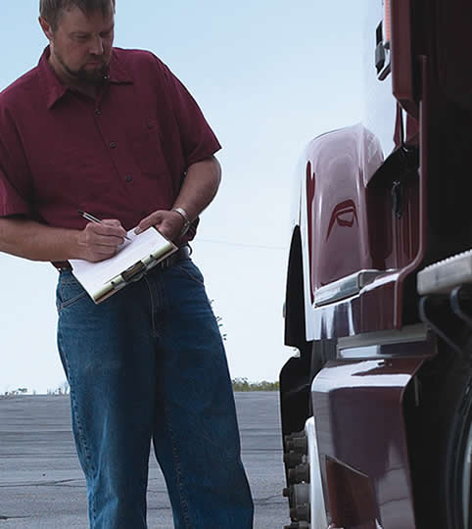
Pre- and Post-Trip Inspections
3
Copyright 2019 J. J. Keller & Associates, Inc.
Copyright 2019 J. J. Keller & Associates, Inc.
Notes:
Unit A1.1.3 Pre- and Post-Trip Inspections
This unit must teach the driver-trainees to conduct pre-trip and post-trip inspections as specified in §392.7 and 396.11, including appropriate inspection locations. Instruction must also be provided on en route vehicle inspections.

Slide 4
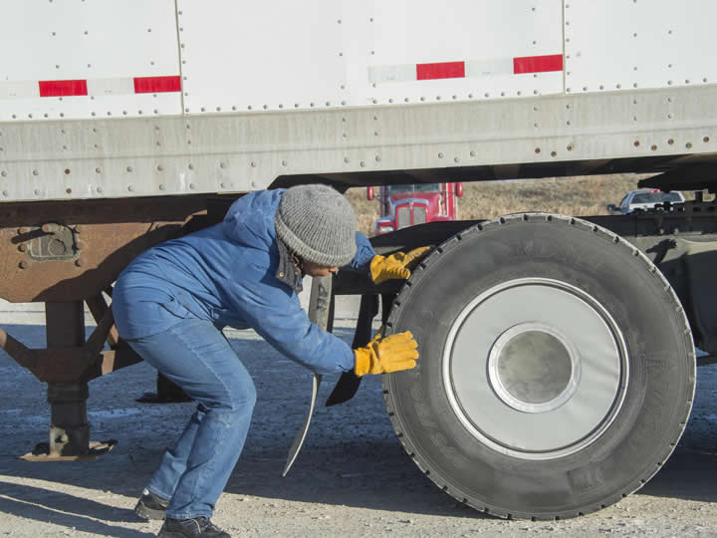
Introduction
Notes:
As well as being a regulatory requirement, proper vehicle inspections can go a long way in ensuring your vehicle’s safe and efficient operation. Vehicle inspections can help in finding mechanical problems before they cause a breakdown or accident. This can help in avoiding costly on the road repairs as well as delays in deliveries.
CLASSROOM RECOMMENDATION
Stress the importance of vehicle inspections. Present examples of problems/accidents/incidents that could have been avoided if the driver had conducted a thorough vehicle inspection. Use personal experience, industry statistics, and/or media accounts to help illustrate your point.

Slide 5
Objectives
Upon completion of this lesson, you will be able to:
  Conduct an accurate and efficient pre-trip inspection
  Explain when an on-the-road inspection is required and how to complete one
  Complete a proper post-trip inspection
  Explain when a Driver Vehicle Inspection Report (DVIR) is required, and how to complete one
Notes:
Upon completion of this lesson, you will be able to:
Conduct an accurate and efficient pre-trip inspection
Explain when an on-the-road inspection is required and how to complete one
Complete a proper post-trip inspection
Explain when a Driver Vehicle Inspection Report (DVIR) is required, and how to complete one

Slide 6
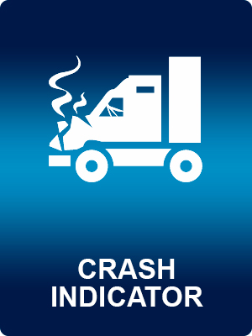
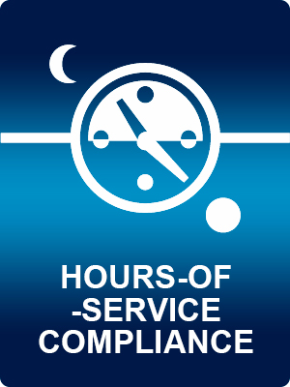
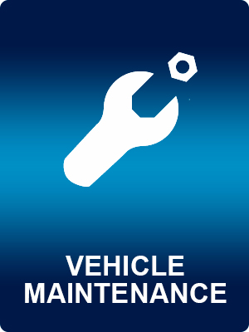

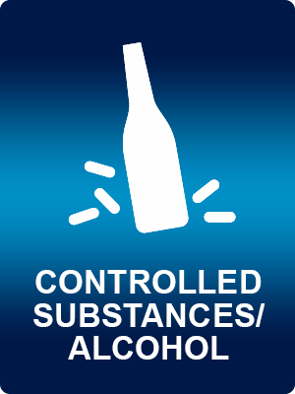


The Importance of Inspections
Use of these icons does not indicate endorsement by the Federal Motor Carrier Safety Administration. FMCSA is the owner and author of CSA.
Notes:
In addition to finding mechanical problems before they cause a breakdown or accident, a thorough vehicle inspection program can also play a role in avoiding citations and/or out-of-service orders during a roadside inspection.
Vehicle maintenance is so important that it is one of seven categories that a motor carrier is rated on under the Federal Motor Carrier Safety Administration’s (FMCSA) Compliance, Safety, Accountability (CSA) program. This initiative aims to improve large truck and bus safety and reduce commercial vehicle-related crashes, injuries, and fatalities.
CALLOUT: Vehicle maintenance violations are frequently cited during roadside inspections.

Slide 7
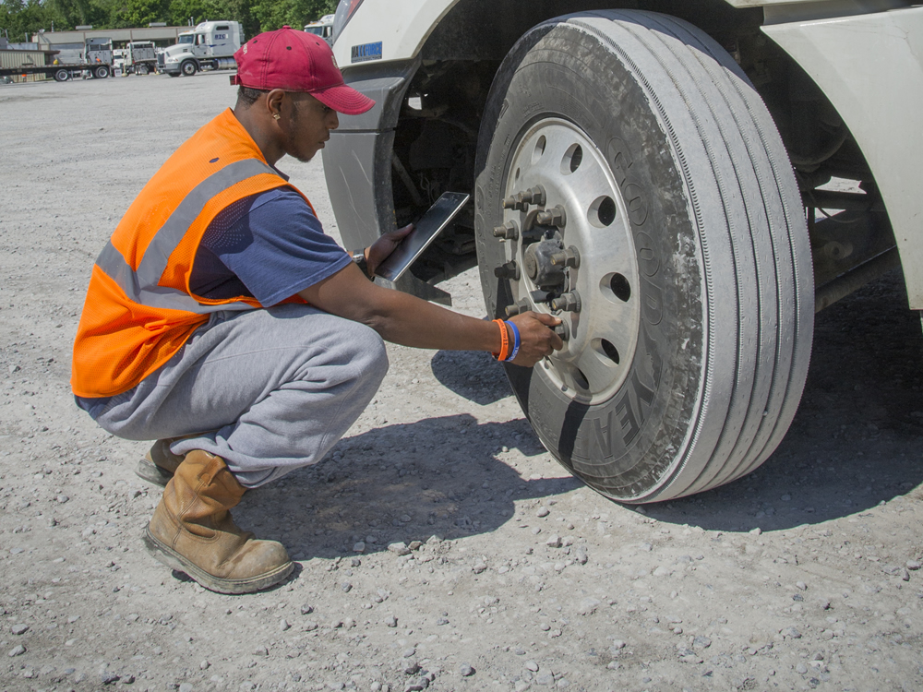
Inspection Locations
Notes:
No matter the type of inspection you are conducting, your safety is the first priority. Inspections should never be conducted along the side of a road or any other high-traffic area.
Also, make it a habit to wear a reflective vest when inspecting your vehicle. The vest increases your visibility to other drivers.

Slide 8

Inspection Locations
All inspections should be conducted in low-traffic areas, including:
  The yard of a motor carrier, shipper,
  or receiver
  The parking lot of a truck stop, restaurant, hotel
  A rest area
Notes:
All inspections should be conducted in low-traffic areas, including:
The yard of a motor carrier, shipper, or receiver
The parking lot of a truck stop, restaurant, hotel
A rest area

Slide 9
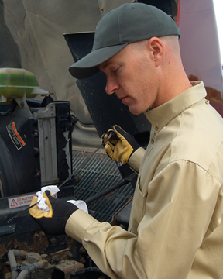
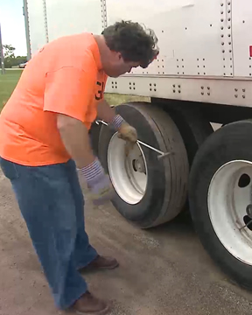
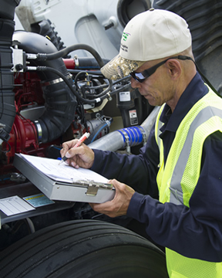
Types of Required Inspections
Notes:
Three types of inspections are required by the Federal Motor Carrier Safety Regulations (FMCSRs), pre-trip, on-the-road (en-route), and post-trip inspections.
VIDEO
3.1 — Types of Inspections

Slide 10
Pre-Trip Inspection
Performed before taking your vehicle on the road
Allows you to identify problems that could cause a breakdown or accident before you start your route
Notes:
Pre-trip inspection (§392.7, §392.8, §396.13). A pre-trip inspection is performed before taking your vehicle on the road. Doing a pre-trip inspection allows you to identify problems that could cause a breakdown or accident before you start your route.

Slide 11
On-the-Road Inspections
Helps you spot problems while there’s still time to manage them, before they result in a breakdown or accident
Notes:
2. On-the-road (en-route) inspection (§392.9). On-the-road inspections help you spot problems while there’s still time to manage them, before they result in a breakdown or accident.

Slide 12
Post-Trip Inspection
Conducted at the end your day’s work
May include DVIR
Helps a motor carrier make necessary repairs before the vehicle returns
to the road
Notes:
3. Post-trip inspection (§396.11). A post-trip inspection is conducted at the end your day’s work on the vehicle you are operating. This inspection includes filling out a driver vehicle inspection report (DVIR) if defects or deficiencies are discovered. This report helps a motor carrier make necessary repairs before the vehicle returns to the road.
CALLOUT: Though not required when no defects or deficiencies are found, many motor carriers are requiring drivers to complete a DVIR at the end of every day.

Slide 13
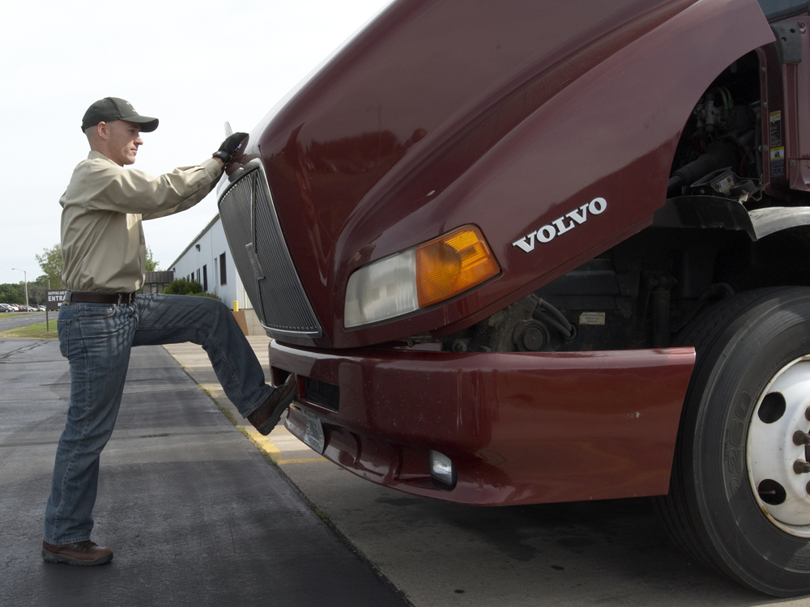
Pre-Trip Inspection
Notes:
The FMCSRs require a pre-trip inspection before each trip to identify problems that could cause a breakdown or accident.
LAB RECOMMENDATION
Have your students break into groups of three or four and demonstrate the pre-trip inspection process. Make sure you explain each step of the inspection process and each part/component/system you are inspecting. Point out potential problems/defects.
After the students have observed the process, they should each take a turn conducting a pre-trip inspection. The student should verbally explain each step he or she is following during the inspection. (You may want to “plant” some vehicle defects prior to the session.) Encourage each student to ask questions as they arise during the inspection process.
As the student proceeds through the inspection process, be ready to correct the student and/or provide suggestions.
Once all of the students have conducted the inspection, review any errors or problems that may have occurred as well as “planted” defects they may have missed or misdiagnosed.
Students should continue to conduct pre-trip inspections prior to every range or road session. This will help the students develop good habits.

Slide 14
You must inspect:
Service brakes, including trailer brake connections
Parking brakes
Steering mechanism
Lighting devices
and reflectors
Tires
Horn
Windshield wiper(s)
Rear-vision mirror(s)
Coupling devices
Wheels and rims
Emergency
equipment
Notes:
You must inspect the following parts and accessories and be sure they are in good working order prior to driving a commercial motor vehicle:
Service brakes, including trailer brake connections
Parking (hand) brakes
Steering mechanism
Lighting devices and reflectors
Tires
Horn
Windshield wiper or wipers
Rear-vision mirror or mirrors
Coupling devices
Wheels and rims
Emergency equipment
CALLOUT: The regulatory requirements are the minimum when it comes to pre-trip inspections. The professional driver includes these components as part of a thorough and complete five-step inspection.

Slide 15
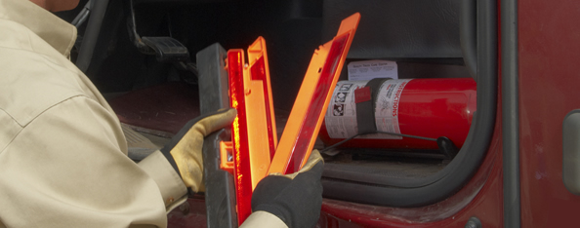
Pre-Trip Inspection
You must ensure the required emergency equipment, including fire extinguishers, spare fuses, and warning devices, is in place and ready for use
Notes:
You must ensure the required emergency equipment, including fire extinguishers, spare fuses, and warning devices, is in place and ready for use.

Slide 16
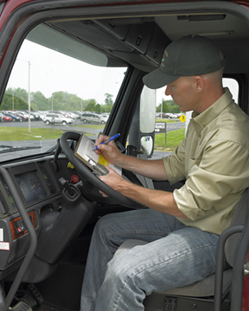
Before driving, you must:
Be satisfied that the vehicle is in safe operating condition
Review the last vehicle inspection report
Sign the report
Notes:
Before driving the vehicle, you must:
Be satisfied that the vehicle is in safe operating condition
Review the last vehicle inspection report (see post-trip inspection)
Sign the report, only if defects or deficiencies were noted by the driver who prepared the report, to acknowledge that the report has been reviewed and that there is certification that the repairs have been performed

Slide 17





The Five-Step Pre-Trip Inspection
1 2 3 4 5
Notes:
The Five-Step Pre-Trip Inspection
By doing a pre-trip inspection the same way every time, you are less likely to forget to check an important vehicle component. The following five-step routine is recommended.
CALLOUT: Once you have this process mastered, it should take you about 15 to 20 minutes to complete.
VIDEO
3.2 — Pre-Trip Inspection

Slide 18
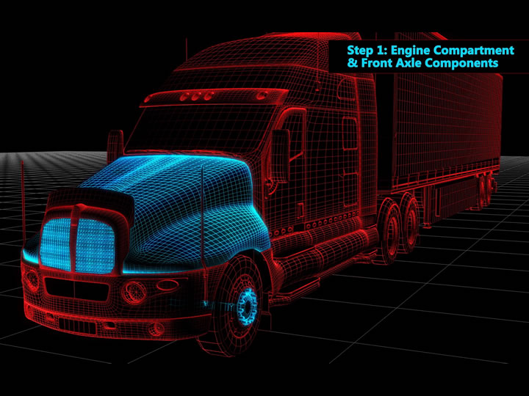
Copyright 2019 J. J. Keller & Associates, Inc.
Notes:
Step 1: Engine Compartment & Front Axle Components

Slide 19
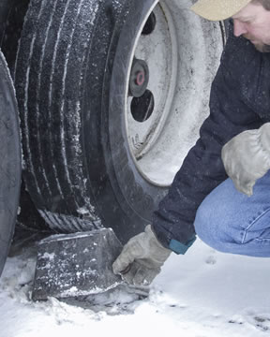
Before you begin:
Make sure the parking brakes have been set
Put your vehicle’s keys in your pocket
Chock the wheels
Open the hood
Notes:
Step 1: Engine Compartment & Front Axle Components
Before you inspect the engine compartment and front axle components:
Make sure the parking brakes have been set
Put your vehicle’s keys in your pocket
Chock the wheels
Open the hood

Slide 20
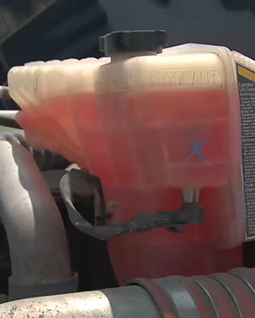
Ensure the:
Fluid levels are between the “add” and “full” lines
Auxiliary oiler is
in good condition
Hoses are not leaking, worn, or loose
Notes:
Step 1: Engine Compartment & Front Axle Components
Verify that everything under the hood appears to be in good condition and has no obvious issues. Begin your inspection of the engine compartment on the passenger side. Ensure the:
Fluid levels (including oil, washer fluid, coolant, transmission, and any other fluids on this side) are between the “add” and “full” lines
Auxiliary oiler (if there is one) is in good condition
Hoses are not leaking, worn, or loose

Slide 21
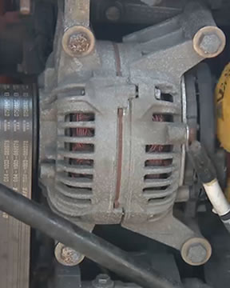
Ensure the:
Belts are not
worn or loose
Alternator is
in good shape
Wiring under
the hood is in
good condition
Notes:
Step 1: Engine Compartment & Front Axle Components
Verify that everything under the hood appears to be in good condition and has no obvious issues. Begin your inspection of the engine compartment on the passenger side. Ensure the:
Belts are not worn or loose
Alternator is in good shape. Making sure :
The mounting bolts are tight
The wire connections are good
Nothing’s cracked, frayed, or rubbing
There’s no charring or other damage
Wiring under the hood is in good condition, including making sure the insulation does not have cracks or wear
CALLOUT: Generally speaking, you want less than an inch of play on a belt. Check the belt’s slack by pushing on it mid-span; the smaller the belt, the less movement you should see.

Slide 22
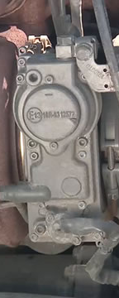
Ensure the:
Air conditioning compressor mounts are tight, and the belt is riding on the pulleys like it should
Exhaust system is secure, not leaking, has no signs of cracks or excessive soot build up, and is not touching wires, fuel, or air lines
Turbo charger is not cracked, damaged, or leaking exhaust, gas, or oil
Notes:
Step 1: Engine Compartment & Front Axle Components
Verify that everything under the hood appears to be in good condition and has no obvious issues. Begin your inspection of the engine compartment on the passenger side. Ensure the:
Air conditioning compressor mounts are tight, and the belt is riding on the pulleys like it should
Exhaust system is secure, not leaking, has no signs of cracks or excessive soot build up, and is not touching wires, fuel, or air lines
Turbo charger is not cracked, damaged, or leaking exhaust, gas, or oil
CALLOUT: Note that the air conditioning compressor may be on the other side.
CALLOUT: You’d have good reason to suspect the turbo charger was leaking if you saw black soot, marring, or any separation from the couplers.

Slide 23
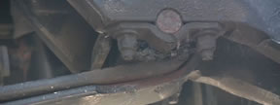
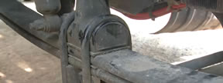
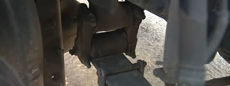
Make sure the:
Suspension is intact, tight, and in good working order
  Front hanger
  U-bolts
  Hanger and shackle
  Springs
Notes:
Step 1: Engine Compartment & Front Axle Components
Continue your inspection by examining the tractor’s front axle on the passenger side. Make sure the:
Suspension is intact, tight, and in good working order. Specifically, check :
The front hanger is tight and not damaged
The U-bolts in the center are tight
The hanger and shackle set at the rear is tight and not damaged
The springs are not cracked or damaged
CALLOUT: If airbags are present, check that the plates on top/bottom are not cracked and the air bag is not damaged.

Slide 24
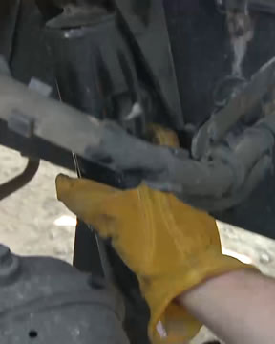
Make sure the:
Shock absorber is not loose, the shock tower is not cracked or damaged, bushings are good, and there’s no leaking fluid
Tie rod end and steering arm running to the right spindle is tight, castle pins are in place, and nothing is bent
Notes:
Step 1: Engine Compartment & Front Axle Components
Continue your inspection by examining the tractor’s front axle on the passenger side. Make sure the:
Shock absorber is not loose, the shock tower is not cracked or damaged, bushings are good, and there’s no leaking fluid
Tie rod end and steering arm running to the right spindle is tight, castle pins are in place, and nothing is bent

Slide 25
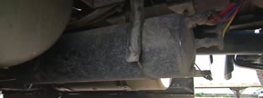
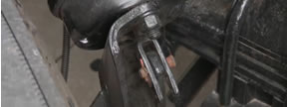
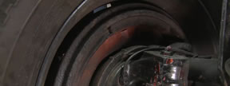
Make sure the:
Brake assembly is in good condition
  Air tank
  Air brake lines
  Brake chambers
  Pushrod and adjuster
  Slack adjusters
  Brake shoes
  Brake drum or pads
Notes:
Step 1: Engine Compartment & Front Axle Components
Continue your inspection by examining the tractor’s front axle on the passenger side. Make sure the:
Brake assembly is in good condition. Specifically, make sure:
The air tank is firmly mounted and all lines coming to and from it are in good condition
The air brake lines are not cracked, frayed, or rubbing on anything
The brake chambers are firmly mounted and not cracked, damaged, or rusting through
The pushrod and adjuster are in good working order—the slack adjust attachment point functions and is in good condition, the clevis and clevis pins show no sign of wear or damage, and the jam nuts are tight
The slack adjusters have an appropriate amount of free play
Brake shoes have at least a quarter-inch lining
There is no grease, oil, or cracks present in the brake drum or pads
CALLOUT: One inch is the maximum amount of free play you’ll want to see on the push rod when the brakes are released. Check with your safety or maintenance department if you are unsure of how to check the free play on the slack adjusters.
CALLOUT: If they’re not visible, reach in and feel the lining. (brake shoes)

Slide 26
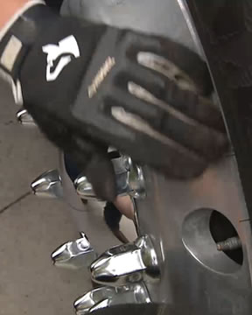
Make sure the:
Inside of the rim is free of oil, grease, or leakage, and that the outside of the rim isn’t cracked or bent
Notes:
Step 1: Engine Compartment & Front Axle Components
Continue your inspection by examining the tractor’s front axle on the passenger side. Make sure the:
Inside of the rim is free of oil, grease, or leakage, and that the outside of the rim isn’t cracked or bent. Also, verify there are no illegal welds of the rim.

Slide 27
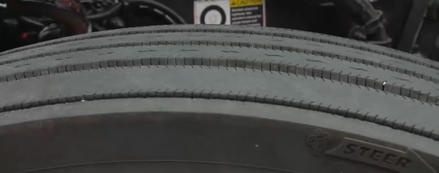
Engine Compartment &
Front Axle Components
Look at the tread and overall condition of the tire
Notes:
Step 1: Engine Compartment & Front Axle Components
Look at the tread and overall condition of the tire. Tires are the number three expense for a trucking company, but probably a driver’s number one cause of problems.
Your steer-tire tread needs to be more than 4/32 of an inch deep. Use a tread-depth gauge to verify the tread, if possible. When in doubt, have a mechanic check it, just to be safe.
When you examine your tires, look for chunks of missing tread, damage, bruising, cuts, or gouges. Front tires take a lot of abuse, so watch for uneven wear or feathering, too. In addition, check that the outside of the rim isn’t cracked or bent.
CALLOUT: Tread depth referenced in this PowerPoint is the regulatory minimum. It is best to exceed these tread depths.
VIDEO
3.3 — Tire Tread Check

Slide 28
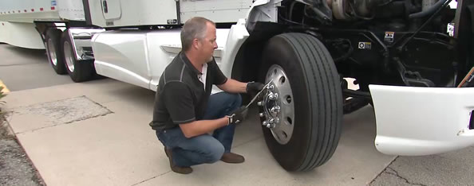
Engine Compartment &
Front Axle Components
Use a tire pressure gauge to check inflation
Notes:
Step 1: Engine Compartment & Front Axle Components
Use a tire pressure gauge during your pre-trip inspection to check inflation. Be sure you check your tire pressure when the tires are cold. Your reading will be off anywhere from 5 to 20 percent if you gauge them when they’re hot from traveling down the road.

Slide 29
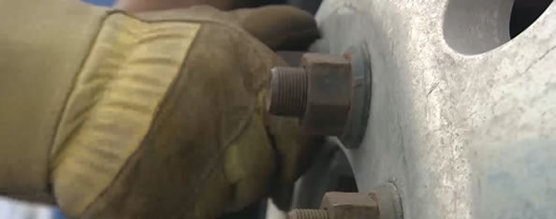
Engine Compartment &
Front Axle Components
Verify your lug nuts are tight and in good shape
Notes:
Step 1: Engine Compartment & Front Axle Components
Next, verify your lug nuts are tight and in good shape. Signs they might be loose include shiny metal, new rust, or corrosion on the studs or the face of the rim.
If you see any signs of cracking between lug nuts, that’s an indication they’ve been loose for a while. If a lug nut’s loose enough to turn by hand, you’re on the verge of losing a wheel.

Slide 30
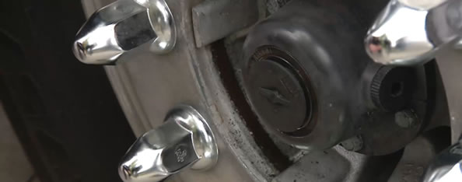
Engine Compartment &
Front Axle Components
Be sure the oil level inside the hub is above the bottom edge of the sight glass
Notes:
Step 1: Engine Compartment & Front Axle Components
Be sure the oil level inside the hub is above the bottom edge of the sight glass.
Continue your inspection by checking the driver’s side of the engine compartment.
CALLOUT: If a tractor trailer’s hub leaks out all of its lubricant, or the lugs are allowed to loosen and fail, the wheels could fall off en route.

Slide 31
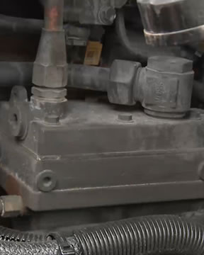
Air Compressor
Check for leaks
Confirm all connections are good
Confirm the air line running off the compressor isn’t cracked, frayed, or rubbing
Make sure the belt
slack is correct and
that the belt itself is
not cracked or frayed
Notes:
Step 1: Engine Compartment & Front Axle Components
The air compressor is the core component for all air lines on your tractor trailer. If it’s damaged, everything else from here on down will not function properly, if at all.
The air compressor on some vehicles is gear-driven, so there won’t be a compressor belt. Whether it uses oil and coolant from the engine or has its own fluids, check it for leaks. Confirm that all connections are good, and that the air line running off the compressor isn’t cracked, frayed, or rubbing.
If it is belt-driven, make sure the belt slack is correct and that the belt itself is not cracked or frayed.
CALLOUT: The air compressor may be on the other side of the engine.

Slide 32

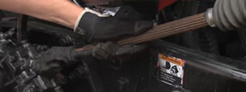
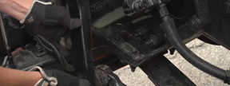
Check that your:
Power Steering components are in good condition
  Fluid level
  Steering column
  U-joints & knuckles
  Pitman arm
  Ball joints
  Drag link running back
Notes:
Step 1: Engine Compartment & Front Axle Components
Check that your power steering components are in good condition Specifically, make sure:
Power steering fluid is between the “add” and “full” lines and the cap is secure
Steering column doesn’t have excessive play
U-joints and knuckles are in good shape
Pitman arm coming off the gear box is tight
Ball joints are tight and in good condition, and have tight castle nuts and castle pins are in place
Drag link running back has a seated, tight, and well-greased ball joint, and the castle nut and pin are in place

Slide 33
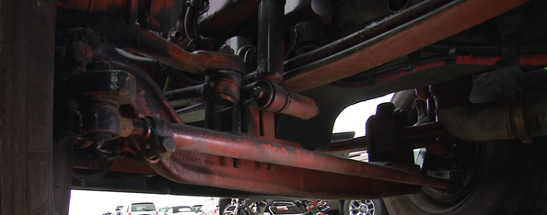
Engine Compartment &
Front Axle Components
To finish up step one, examine the tractor’s front axle on the driver’s side
Notes:
Step 1: Engine Compartment & Front Axle Components
To finish up step one, examine the tractor’s front axle on the driver’s side.
Check the suspension on this side same as you did on the other side—hangers (both front and rear,) bolts, shackles, U-bolts, and springs.
Also check out the shock absorber, tie rod end, and steering arm on this side, too.
Again, you’ll inspect the brake assembly the same on this side as you did on the other—brake lines, chambers, pushrod and adjusters, brake shoes, and brake drums.
Check the inside of the rim for oil, grease, or leakage, be sure the tire is in good condition, and examine the outside rim, lug nuts, and hub oil level.
It’s easy to get complacent with the under-the-hood check. Automatic slack adjusters, oilers, and greasers have eliminated a lot of the mechanical problems with newer vehicles.
But things still can and do go wrong, so you need to stay on your toes.

Slide 34
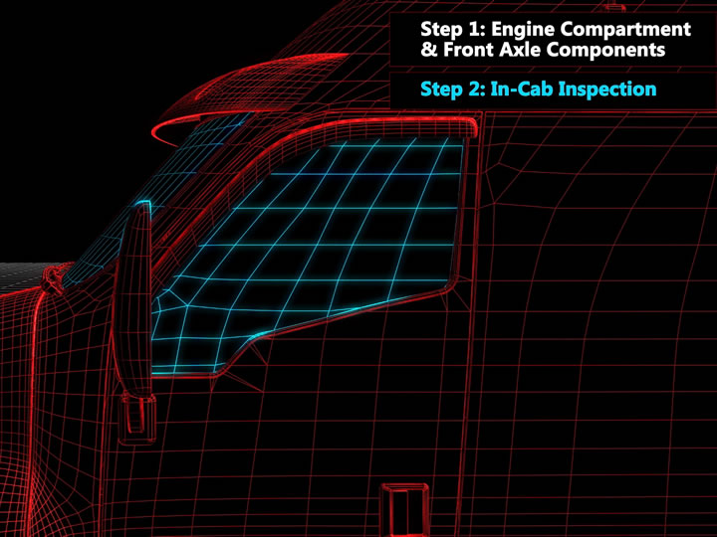
Notes:
Step 2: In-Cab Inspection

Slide 35
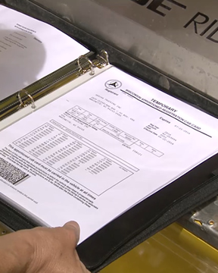
Open the door and ensure the:
Vehicle registration
is valid, and your
vehicle contains all the needed paperwork
Annual inspection sticker (or annual inspection report) is present and valid
Notes:
Step 2: In-Cab Inspection
The inspection of the interior of the cab may be the easiest part of a pre-trip inspection, but that doesn’t mean it’s not every bit as important as every other step. A clean and orderly cab can make an inspection go more smoothly and reduce hazards within the cab.
Open the driver’s side door and ensure the:
Vehicle registration is valid, and your vehicle contains all the needed paperwork
Annual inspection sticker (or annual inspection report) is present and valid

Slide 36
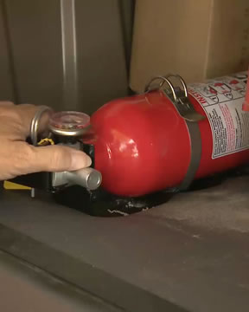
Open the door and ensure the:
Fire extinguisher is mounted, accessible, fully charged, and appropriate for the cargo being hauled
Safety equipment is accounted for and is adequately secured
Notes:
Step 2: In-Cab Inspection
Open the driver’s side door and ensure the:
Fire extinguisher is mounted, accessible, fully charged, and appropriate for the cargo being hauled
Safety equipment is accounted for (including three reflective triangles, spare fuses, and any personal protective equipment) and is adequately secured
CALLOUT: The fire extinguisher must have an Underwriters’ Laboratories (UL) rating of at least 5 B:C. If you are hauling hazmat, the fire extinguisher must have a UL rating of at least 10 B:C.

Slide 37
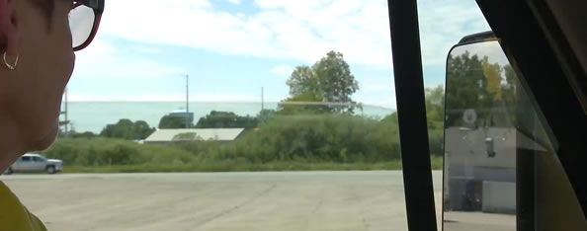
In-Cab Inspection
Make sure windows operate, glass is clean and free of cracks. Get rid of any visual obstructions.
Notes:
Step 2: In-Cab Inspection
Climb into your cab using three points of contact and continue the inspection. Make sure the windows operate and that the glass all around the cab is clean and free of cracks. Also, get rid of any visual obstructions.

Slide 38

In-Cab Inspection
Adjust your seat; check your seatbelt; adjust your mirrors
Notes:
Step 2: In-Cab Inspection
Adjust your seat so you can reach the wheel and controls comfortably, and check to see your seat belt is functional. Be sure your mirrors are clean, tight, and in good condition. Get yourself into a comfortable seated position and adjust your mirrors as needed.

Slide 39
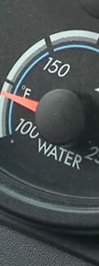
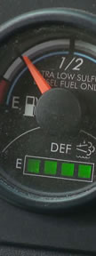

In-Cab Inspection
Check the gauges
  Oil pressure
  Coolant temp
  Tachometer
  Speedometer
  Fuel Air pressure
  Ammeter
  Voltmeter
Notes:
With the transmission in neutral, depress the clutch and start the engine. Check that the gauges are functioning properly. Specifically, make sure:
The oil pressure comes up in a few seconds, starts out high and drops as the engine warms up
The coolant temp is low after start up and comes up as the engine warms up
The tachometer is working—around 600 revolutions per minute (RPMs) at idle speed is normal
The speedometer reads zero (verify that it’s working once you start moving)
The fuel gauge shows that the truck has fuel (and remember how full it says the tank is, so you can verify it during the walk-around portion of your pre-trip)
The primary and secondary air pressure gauges both read low, and charge appropriately
The ammeter and voltmeter both register positive

Slide 40
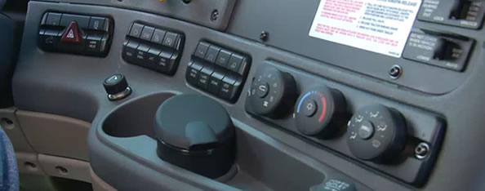
In-Cab Inspection
Check that all the switches function properly
Notes:
Step 2: In-Cab Inspection
Then, check that all the switches function properly. Flip the flashers, blower motor, heater, and defroster on and off to ensure they all work as they should.

Slide 41
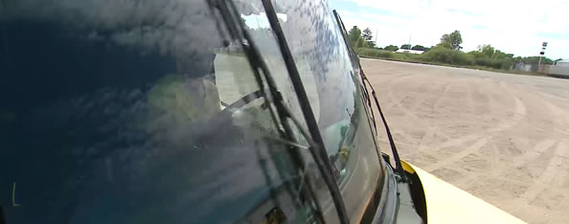
In-Cab Inspection
Verify your ABS indicator is not on; give the horns a try; turn on your wipers; test that your washer fluid works
Notes:
Step 2: In-Cab Inspection
Verify your anti-lock brake system (ABS) indicator is not on and give the horns a try—both the city horn and the air horn. Turn on your wipers, and test that your washer fluid works.

Slide 42
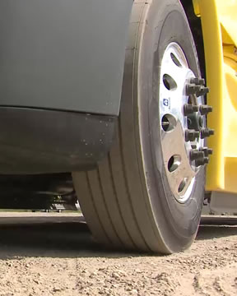
In-Cab Inspection
Check for play in the steering wheel to figure out how much you have to move it before your steer tires move
Notes:
Step 2: In-Cab Inspection
Check for play in the steering wheel to figure out how much you have to move it before your steer tires move. The free play should be no more than 10 percent of the wheel’s diameter. That’s two inches or less on a 20-inch steering wheel.
Losing steering control at highway speeds is incredibly dangerous. If there is excessive free play in the steering wheel, document it on a pre-trip report, if your company uses one, and report it to your company immediately.
If this is the case, try to determine what’s causing the excessive free play so you are able to provide your company with as much detail as possible to assist with troubleshooting the problem.
Bottom line, you should never operate a vehicle you know you won’t have total control of.

Slide 43
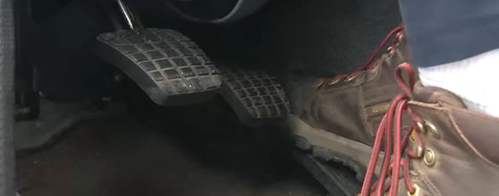
In-Cab Inspection
Inspect your clutch, accelerator and brake pedals, and transmission controls for looseness, sticking, or damage
Notes:
Step 2: In-Cab Inspection
Finally, inspect your clutch, accelerator and brake pedals, and transmission controls for looseness, sticking, or damage. And, before you finish the in-cab portion of your inspection, take a few seconds to sit and listen for unusual noises which could signal a problem.

Slide 44
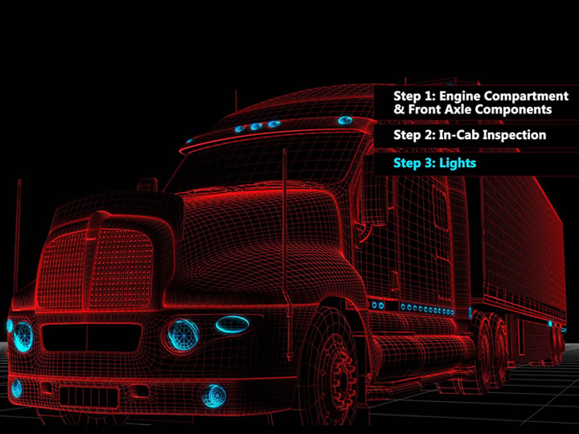
Notes:
Step 3: Lights

Slide 45
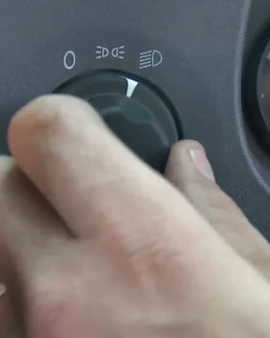
Check each light:
Ensure the parking brake is set and turn on your low beams headlights and emergency flashers
Notes:
Step 3: Lights
Inoperative or defective lighting is a commonly cited violation during roadside inspections. It's also one that can be easy for officers to spot.
Follow these steps to check each of your tractor trailer’s lights.
Ensure the parking brake is set and turn on your low beams headlights and emergency flashers.

Slide 46
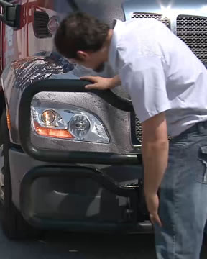
Check each light:
Get out and look to see that the lights are on and appropriately aimed, and that your four-ways are working
Notes:
Step 3: Lights
Follow these steps to check each of your tractor trailer’s lights.
Get out and look to see that the lights are on and appropriately aimed, and that your four-ways are working.

Slide 47
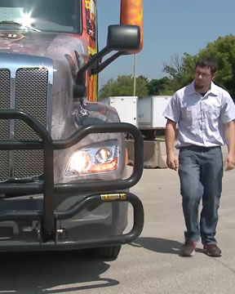
Check each light:
Turn on the high beam headlights and get out to confirm they are working and appropriately aimed, as well
Notes:
Step 3: Lights
Follow these steps to check each of your tractor trailer’s lights.
Turn on the high beam headlights and get out to confirm they are working and appropriately aimed, as well.

Slide 48
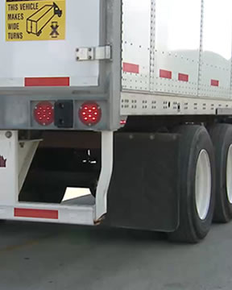
Check each light:
Move around to the back of the trailer to ensure your tail lights and rear emergency flashers work properly
Notes:
Step 3: Lights
Follow these steps to check each of your tractor trailer’s lights.
Move around to the back of the trailer to ensure your tail lights and rear emergency flashers work properly.

Slide 49
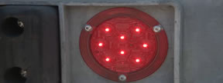


Check each light:
Turn on your parking lights, and move around the truck to ensure your parking, clearance, side-marker, and identification lights, are all secure and functioning properly
Notes:
Step 3: Lights
Follow these steps to check each of your tractor trailer’s lights.
Turn on your parking lights, and move around the truck to ensure your parking, clearance, side-marker, and identification lights, are all secure and functioning properly.

Slide 50

Check each light:
On your next lap around, check your front, side, and rear turn signals on
both the left and
the right sides
Notes:
Step 3: Lights
Follow these steps to check each of your tractor trailer’s lights.
On your next lap around, check your front, side, and rear turn signals on both the left and the right sides.

Slide 51

Check each light:
Ensure your
brake lights are functioning properly
Notes:
Step 3: Lights
Follow these steps to check each of your tractor trailer’s lights.
Ensure your brake lights are functioning properly. This isn’t always easy to do by yourself. It’s best to have someone help you.
Check with your safety or maintenance department on what to do if another person isn’t available to help you check your brake lights. They may suggest backing up against something reflective or offer an alternate solution.
While it’s easy to spot and is a relatively easy fix, a damaged or defective light can be very dangerous. That’s why this problem is considered more serious than many other areas in the eyes of roadside inspectors.
CALLOUT: If your tail lights are loose or fall out, the trailer lights might stop working altogether. The traffic behind you will have no idea when you’re turning, stopping, or changing lanes.

Slide 52

Notes:
Step 4: Walk-Around

Slide 53

Walk-Around
Check to see the truck is not leaning to one side or the other
Notes:
Step 4: Walk-Around
This part of your vehicle inspection includes a detailed assessment of the exterior of both your tractor and trailer.
Complete your walk-around by starting at the front of the tractor. Check to see the truck is not leaning to one side or the other. If you see that your truck is leaning, you’ll want to figure out why. Leaning is normally caused by defects in the suspension, problems with the frame, flat tires, or a significant shift in cargo.

Slide 54

Ensure the:
Windshield isn’t cracked or chipped
Wiper blades fit
snugly against the glass and the blades are in good condition
Bumper is secure
Notes:
Step 4: Walk-Around
Then, ensure the:
Windshield isn’t cracked or chipped
Wiper blades fit snugly against the glass and the blades are in good condition
Bumper is secure

Slide 55

Ensure the:
License plate is legible and properly attached
Body is free of damage
Ground beneath
your truck is free
of leaking fluid
Notes:
Step 4: Walk-Around
Then, ensure the:
License plate is legible and properly attached
Body is free of damage
Ground beneath your truck is free of leaking fluid

Slide 56

Walk-Around
Make sure the door operates as it should, and the weather seal is in place
Check that your company name and the vehicle’s USDOT number are visible on this side
Notes:
Step 4: Walk-Around
For the rest of your exterior inspection, check the top, then down, then under, starting at the front of the tractor and trailer on the driver’s side.
Make sure the door operates as it should, and the weather seal is in place—it’s great protection from both weather and road noise, but unfortunately it tends to wear out quickly.
Check that your company name and the vehicle’s USDOT number are visible on this side.

Slide 57

Walk-Around
Look over your access ports, steps, and side fairing to be sure they’re in good condition
Notes:
Step 4: Walk-Around
Look over your access ports, steps, and side fairing to be sure they’re in good condition.

Slide 58

Walk-Around
Check that the batteries are properly secured and not damaged or leaking
Notes:
Step 4: Walk-Around
And, check the batteries. Be sure they are properly secured and not damaged or leaking.

Slide 59

Walk-Around
Verify that the fuel level in the tank is consistent with what you saw on the gauge inside the cab
Be sure the fuel cap closes tightly
Inspect the fuel tank to see that the steps, mountings, and strapping are tight
Check for fuel leaks
Notes:
Step 4: Walk-Around
Look inside the fuel tank to visually verify that the fuel level in the tank is consistent with what you saw on the gauge during your in-cab inspection.
Then, be sure the fuel cap closes tightly, and the gasket or seal is in good condition.
Inspect the fuel tank itself to see that the steps, mountings, and strapping are tight. These steel straps will easily cut through an aluminum fuel tank if they’re not properly secured.
And, check underneath the truck for any fuel leaks.

Slide 60

Walk-Around
Verify there are conspicuity markings
on the back of the cab
Rear windows
should be clean and
in good condition
Notes:
Step 4: Walk-Around
Verify there are conspicuity markings in place on the back of the cab.
And, rear windows are an advantage. If you’ve got one, it should be clean and in good condition.

Slide 61

Walk-Around
If the service line is loose or damaged, you will suffer a serious leak when you apply the brakes, increasing your vehicle’s stopping distance and draining out your air tanks
If the emergency line is loose or damaged, it could cause the trailer brakes to lock up
Give the air lines from the tractor to the trailer a good once-over, or you could lose air supply to the trailer
Notes:
Step 4: Walk-Around
Give the air lines from the tractor to the trailer a good once-over. Check the connections, the lines themselves, and the suspension spring.
If the air lines are rubbing or not connected correctly, you will lose air supply to the trailer.
If it is the emergency line that is loose or damaged, it could cause the trailer brakes to lock up.
If it is the service line that is loose or damaged, you will suffer a serious leak when you apply the brakes, which will greatly increase your vehicle’s stopping distance and drain out your air tanks.
VIDEO
3.4 — Air Lines

Slide 62


Walk-Around
Pull the glad hands off and examine the seals
  Only rotate them when you hook them up
  Do not push or pull them
Notes:
Step 4: Walk-Around
Pull the glad hands off and examine the seals. If a seal is kinked, cut, or torn, replace it. If you don’t have an airtight seal, there’s going to be a leak at the glad hand and the truck won’t be able to maintain air pressure.
To avoid damaging the glad hand seals, only rotate them when you hook them up. Don’t push or pull them.

Slide 63

Walk-Around
Verify your trailer light connection is good and locked into place
Check the exhaust bracket mounts and cab air ride suspension system to make sure everything’s in good condition
Notes:
Step 4: Walk-Around
Verify your trailer light connection is good and locked into place. Although you probably would have noticed a problem during your inspection of your lights if there was something wrong with these connections.
And, check the exhaust bracket mounts and cab air ride suspension system to make sure everything’s in good condition.

Slide 64

Walk-Around
Look over the frame rails and cross members to see if anything is cracked, bent, or damaged
Check out the header making sure the rivets are tight, the seams are good, and nothing is damaged
Notes:
Step 4: Walk-Around
Look over the frame rails and cross members. Confirm that nothing’s cracked, bent, or damaged.
Check out the header at the front of the trailer. Make sure the rivets are tight, the seams are good, and nothing is damaged.

Slide 65

Walk-Around
Inspect the top rail
and down the side to the bottom frame rail to be sure they are free
of damage
Ensure the apron isn’t cracked or damaged, and that all the apron bolts are accounted for and in good condition
Notes:
Step 4: Walk-Around
Inspect the top rail and down the side to the bottom frame rail to be sure they are free of damage.
Ensure the apron isn’t cracked or damaged, and that all the apron bolts are accounted for and in good condition.

Slide 66



Walk-Around
Examine the fifth wheel
  Pins
  Bolts
  Angle irons
  Flat metal
  Frame
  Pivots
  Jaws
  Locking mechanism
Notes:
Step 4: Walk-Around
Next, examine the fifth wheel itself. If your vehicle has a sliding fifth wheel, make sure the pins are securely locking that fifth wheel into place.
Inspect the vertical and horizontal bolts to ensure they’re all tight and check the angle irons and flat metal for cracks or damage. Then, crawl under the trailer and look at the fifth wheel from behind to verify the frame and pivots are good, there’s nothing cracked or damaged, the jaws are closed around the shank of the kingpin, and, if the fifth wheel has a visible locking mechanism, it is in place.
The fifth wheel is an inspection point that you absolutely must get right. You need to know what you’re looking at and what you’re doing. If a mistake is made and you don’t catch it in your pre-trip inspection, you will lose your trailer during your first hard turn or over your first big bump.
Talk to your safety or maintenance department to understand how to determine if your specific fifth wheel is fully locked.

Slide 67

Ensure the:
Drive line, drive shaft, U-joints, and differentials are in good condition
Notes:
Step 4: Walk-Around
Continue the inspection, ensuring the:
Drive line, drive shaft, U-joints, and differentials are in good condition

Slide 68


Ensure the:
Suspension is intact, tight, and in good working order
  Front hanger
  U-bolts
  Rear hanger
  Springs
Notes:
Step 4: Walk-Around
Continue the inspection, ensuring the:
Suspension is intact, tight, and in good working order. Specifically, check:
The front hanger is tight and not damaged
The U-bolts in the center are tight
The hanger at the rear is tight and not damaged
The springs are not cracked or damaged

Slide 69

Ensure the:
Shock absorbers
are intact
Conspicuity markings
on the brackets of the mudflaps are present
Air ride suspension air bags aren’t leading
or damaged
Landing gear’s mounting iron and bracing are in good shape
Notes:
Step 4: Walk-Around
Continue the inspection, ensuring the:
Shock absorbers are intact
Conspicuity markings on the brackets of the mudflaps are present
Air ride suspension air bags aren’t leaking or damaged
Landing gear’s mounting iron and bracing are in good shape

Slide 70


Walk-Around
Examine the tractor’s drive tires on the
driver’s side
Tire tread needs to be more than $2/{32}$” deep
Inspect the brake assembly, rims, tires, and lug nuts
Check for leaks at the differentials and hubs
Notes:
Step 4: Walk-Around
Continue your inspection by examining the tractor’s drive tires on the driver’s side.
Your drive tire tread needs to be more than 2/32 of an inch deep, (whereas, if you remember, your steer tires need to be 4/32 of an inch deep.)
You’ll inspect the brake assembly, rims, tires, and lug nuts. Because you won’t have an oil sight glass on your drive axles, check for leaks at the differentials and hubs instead.

Slide 71

Walk-Around
Ensure your landing gear is all the way up and is in good condition
Notes:
Step 4: Walk-Around
Ensure your landing gear is all the way up and is in good condition. Check that the handle is working and stowed properly, and none of the welds, bolts, or bracings are damaged in any way.

Slide 72

Walk-Around
Ensure the conspicuity markings are in place and in good condition, the cross members are in good shape, and the air lines and electrical bundles are protected.
Notes:
Step 4: Walk-Around
Continue down the driver’s side of the trailer toward the back, checking top, down, then under.
Ensure the conspicuity markings are in place and in good condition along this entire side, the cross members are in good shape, and the air lines and electrical bundles are protected.

Slide 73

Walk-Around
Ensure the trailer skirt is secure and free of damage, and that the ABS light is correctly mounted and not turned on
Notes:
Step 4: Walk-Around
Look to see the trailer skirt is secure and free of damage, and that the ABS light is correctly mounted and is not turned on.

Slide 74

Walk-Around
Check that the front and rear axles, slider linkage, and frame carriage assembly are all in good shape and the locking pins are all in place
Notes:
Step 4: Walk-Around
Check that the front and rear axles, slider linkage, and frame carriage assembly are all in good shape and the locking pins are all in place. If the slide mechanism is unlocked for some reason, the trailer axles will come out from under the trailer the first time the brakes are applied with any amount of force.
VIDEO
3.5 — Slide Mechanism

Slide 75

Walk-Around
Examine the
trailer’s front and
rear axles; inspect the brake assembly
Check the suspension and shock absorbers
Look for oil or grease on the insides of the rims
Notes:
Step 4: Walk-Around
Continue your inspection by climbing under the trailer and examining the trailer’s front and rear axles. Here, you’ll inspect the brake assembly—brake lines, chambers, pushrod and adjusters, brake shoes, and brake drums.
Check the suspension—hangers (both front and rear,) bolts, shackles, U-bolts, and springs.
Also check out the shock absorbers and look for oil or grease on the insides of the rims, too.

Slide 76

Walk-Around
Ensure driver’s side tires are in good condition
  Outside rims
  Lug nuts
  Hub oil levels
Check between dual tires to make sure the rims are tight together and nothing is wedged between the tires
Notes:
Step 4: Walk-Around
Then, return to the driver’s side of the trailer and ensure the tires are in good condition. Also examine the outside rims, lug nuts, and hub oil levels.
If the trailer has dual tires, check between the tires to make sure the rims are tight together and nothing is wedged between the tires.
If necessary, based on the configuration of your trailer, crawl back under the trailer and check the rear axle components if you couldn’t complete this from in front of the front axle.

Slide 77

Continue behind the back of the trailer, checking top, down, then under:
Look for the required
ID markers and conspicuity tape
Inspect the door frame
Notes:
Step 4: Walk-Around
Continue behind the back of the trailer, checking top, down, then under.
Look for the required ID markers and conspicuity tape.
Inspect the door frame. If the load isn’t sealed, open the door to confirm it operates and that you have the right cargo inside.

Slide 78

Continue behind the back of the trailer, checking top, down, then under:
Check out the back bumper, the stop bar, and the step tread
Confirm rear mud flaps are properly attached and are not torn, damaged, or dragging on the road
Notes:
Step 4: Walk-Around
Check out the back bumper, the stop bar for a sliding tandem, and the step tread to be sure they’re all in good condition.
Confirm your rear mud flaps are properly attached and are not torn, damaged, or dragging on the road.

Slide 79

Continue the top, down, then under inspection on the passenger side:
Side of the trailer
Conspicuity markings
Slider assembly
Frame carriage
Cross members
Airlines
Electrical bundles
Tires
Rims
Hubs
Trailer skirt
Trailer header
Coupling device area
Notes:
Step 4: Walk-Around
Continue the top, down, then under visual inspection on the passenger side. In addition to checking anything that couldn’t be seen under the vehicle from the driver’s side, you’ll want to check everything as you did on the driver’s side. This includes the:
Side of the trailer
Conspicuity markings
Slider assembly
Frame carriage
Cross members
Airlines
Electrical bundles
Tires
Rims
Hubs
Trailer skirt
Trailer header
Coupling device area
CALLOUT: If your truck has dual drive tires, check that the rims are tight together, the tires are evenly spaced, and that nothing is wedged between the duals.

Slide 80
Continue the top, down, then under inspection on the passenger side:
Check the brake assembly, tires, rims, lug nuts, and hubs
Inspect the exhaust system to ensure it is free of black soot
Examine the tractor on the passenger side:
  Check the door
  Verify the company name and USDOT number are visible
  Confirm the access ports, steps, and side fairing are in good condition
Notes:
Step 4: Walk-Around
Continue the top, down, then under visual inspection by examining the tractor’s drive tires on the passenger side. Again, check the brake assembly, tires, rims, lug nuts, and hubs.
Inspect the exhaust system, this time as far forward as can be seen to ensure it is free of black soot.
Finish your walk-around inspection by examining the tractor on the passenger side. Check the door, verify the company name and USDOT number are visible, and confirm the access ports, steps, and side fairing are in good condition.
The walk-around portion of your pre-trip inspection probably feels like a lot to remember… because it is. But following the sequence as we’ve discussed will help you get in the habit of checking each item in the same order every time.

Slide 81

Notes:
Step 5: Brake System Check

Slide 82

LAB-PS
Leaks
Alarms
Button pop-out
Parking brakes
Service brakes
Notes:
Step 5: Brake System Check
Avoid the potentially disastrous effects of failed brakes with a thorough review of the brake system. This inspection is often called the LAB-PS check, which stands for leaks, alarms, button pop-out, parking brakes, and service brakes.

Slide 83

Idle until air pressure
is over 100 psi, then:
Release the parking brake
Charge the trailer brakes
Apply the foot brake
Turn off the engine
Watch the gauges
Continue pumping down
Notes:
Step 5: Brake System Check
Make sure the wheels are still chocked so the truck can’t roll away, and then turn the engine on to build up air pressure. Once the vehicle has been idling for a minute or two and the air pressure is over 100 pounds per square inch (psi):
Release the parking brake and charge the trailer brakes
Apply the foot brake
Turn off the engine
Watch the gauges. The vehicle shouldn’t leak more than 4 psi per minute (3 psi if you only have a tractor) for a full 60 seconds. Turn the key back on, pump the air pressure down, and notice where the low-pressure indicator comes on. It should activate before 60 psi.
Continue pumping down. The brake buttons should pop out somewhere between 20-40 psi, switching over from the parking brake to the emergency brake.

Slide 84

With the clutch in and
the shifter in neutral:
Start up the vehicle to see how long it takes to build air pressure back up
Rev the vehicle up to about 1400 RPM and watch the air pressure build up
Notes:
Step 5: Brake System Check
With the clutch in and shifter in neutral:
Start up the vehicle to see how long it takes to build air pressure back up
Rev the vehicle up to about 1400 RPM and watch the air pressure build up. It should take less than 45 seconds to go from 85-100 psi.

Slide 85

Remove the wheel chocks, then:
Check to make sure all the brakes will hold; are functioning properly
Notes:
Step 5: Brake System Check
Before moving on to the next step of the brake check, be sure to remove the wheel chocks. Then:
Check to make sure the parking brakes will hold
Put it in the lowest gear possible, release the tractor brake with the trailer brake still applied, and tug forward gently in the lowest forward gear to verify the trailer parking brakes will hold
Engage the tractor brake, release the trailer brake and tug forward gently in the lowest forward gear to verify the tractor brakes will hold
Release the parking brakes, roll ahead slowly, and then step on the foot brake to make sure the service brakes function—the vehicle should not pull to one side or have a delay stopping

Slide 86

On-the-Road Inspection
Notes:
On-the-Road Inspection (§392.9)
VIDEO
3.6 — On the Road Inspection

Slide 87

On-the-Road Inspection
Conducting on-the-road inspections help you spot problems while there’s still time to manage them,
before they result in a breakdown or accident.
Notes:
While a thorough pre-trip inspection gives you peace of mind about the safety and performance of your vehicle, equipment can easily deteriorate during the course of the day. Some damage and defects are out of your control but conducting on-the-road inspections help you spot problems while there’s still time to manage them, before they result in a breakdown or accident. Make it a habit to stop every few hours to check your truck and trailer, even if you’re not required to, so you can help avoid problems.

Slide 88

Complete a short walk-around inspection every time you stop:
Get off the road
Park in a safe location
Pause at each axle group
Do a quick scan of all your lights, mirrors, and tires
Notes:
Complete a short walk-around inspection every time you stop. The first step in completing an on-the-road inspection is to get off the road and park in a location where it is safe to move around the vehicle. This inspection is done at a walking pace, pausing only for a few seconds at each axle/axle group, so the entire inspection should only take a minute or two. Also, do a quick scan of all your lights, mirrors, and tires.

Slide 89

On-the-Road Inspection
The FMCSRs require that the vehicle’s cargo and load-securing devices be checked within the first 50 miles of a trip.
After the first 50 miles check them:
  When you make a change of duty status
  After the vehicle has been driven for 3 hours, or
  After the vehicle has been driven 150 miles
Notes:
The FMCSRs require that the vehicle’s cargo and load-securing devices be checked within the first 50 miles of a trip. Any necessary adjustments must be made at this time.
After the first 50 miles of the trip, the vehicle’s cargo and load-securing devices must also be reexamined when you make a change of duty status, after the vehicle has been driven for 3 hours, or after the vehicle has been driven 150 miles—whichever occurs first.
Inspection of the cargo and load securing devices is not required if your vehicle is sealed and you have been ordered not to open the vehicle. Also, you are not required to inspect the cargo and load securing devices if the vehicle is loaded in a way that makes inspection of the cargo impossible.
CALLOUT: Though you may not be able to inspect the cargo and load securing devices, this does not give you a pass on reviewing your vehicle’s condition while on the road.

Slide 90

On-the-Road Inspection
Gauges are there to help warn you of any potential problems you may not be aware of from your spot in the driver’s seat
Notes:
Gauges are there to help warn you of any potential problems you may not be aware of from your spot in the driver’s seat. Pay close attention to them when driving and be in tune with what your truck is telling you.
Engage all of your senses and be aware of the sounds, smells, and feel of the vehicle. If anything seems out of the ordinary, stop to see what’s going on.

Slide 91

On-the-Road Inspection
Test your tires
  Use a hammer or
  tire thumper
  Feel for excessive heat by the hub
Notes:
Focus your on-the-road inspection on your lights, mirrors, and tires. It won’t do you any good to use an actual pressure gauge to test your tires when they’re hot, since the reading can be off anywhere from 5 to 20 percent.
Instead, use a hammer or tire thumper to check for firmness. Also, put your hand close to the hub and feel for excessive heat caused by a failing tire or bearing. Be careful not to touch anything, you don’t want to burn your hand in the process.

Slide 92

Post-Trip Inspection
Notes:
Post-Trip Inspection (§396.11)
VIDEO
3.7 — Post-Trip Inspection

Slide 93

Post-Trip Inspection
Post-trip inspections help identify any potential safety issues that need to be addressed before
the next driver of
the vehicle takes
over—even if that
next driver is you.
Notes:
At the end of every work day, you’ll need to conduct a post-trip inspection. Post-trip inspections help identify any potential safety issues that need to be addressed before the next driver of the vehicle takes over—even if that next driver is you.

Slide 94

Post-Trip Inspection
If you discover any defect or deficiency you believe might compromise the vehicle’s safe operation, document it on a DVIR and report it to your company
Notes:
During your post-trip inspection, you’ll inspect the same items you did in your pre-trip. The only exception is you won’t be able to check things that are affected by heat, like oil, tire pressure, brake shoes and drums, hub oil, and exhaust components.
If you discover any defect or deficiency with your brakes, steering, lighting, tires, or other items that you believe might compromise the vehicle’s safe operation, document it on a DVIR and report it to your company. This also includes any minor defects you were told about during a roadside inspection that you were not able to get repaired during the day.
Then, before the vehicle can be operated again, your company has to certify that any defective items have been repaired, or that those items were inspected by a mechanic or company official and do not need to be corrected to safely operate the vehicle.

Slide 95

The DVIR must contain:
ID of the vehicle
List of defects or deficiencies
Required signatures:
  The driver who prepared it
  A mechanic or other company official
  The next driver of the vehicle
Notes:
At minimum, drivers of property-carrying CMVs must prepare a DVIR whenever a defect is discovered. However, some companies require their drivers to submit a DVIR every day, even if no defects were discovered during the trip or found when conducting the post-trip inspection.
Whether your company chooses to use paper or electronic forms, your DVIR must contain a few important items.
An identification of the vehicle, such as the truck and trailer vehicle or license plate number
A list of any defects or deficiencies which could affect vehicle safety or result in a breakdown
Spaces for the three required signatures:
The driver who prepared it
A mechanic or other company official (indicating the repairs were completed or were not necessary)
The next driver of the vehicle (even if the next driver is you)
While post-trip inspections don’t allow you to check everything, they at least provide you with a peace of mind knowing you’re leaving the vehicle in good shape for the next driver.
CALLOUT: Section 396.11 of the FMCSRs requires that a DVIR be completed and signed by the driver of a property-carrying CMV whenever a defect or deficiency is discovered.
CALLOUT: Check with your company to understand their expectations for completing DVIRs.

Slide 96

Intermodal Equipment
If you are hauling intermodal equipment and it has a defect or deficiency, you must complete a DVIR and turn it in to the intermodal equipment provider
Notes:
Intermodal equipment. If you are hauling intermodal equipment and it has a defect or deficiency, you must complete a DVIR and turn it in to the intermodal equipment provider. The DVIR must include the name of the motor carrier responsible at the time the defect or deficiency was discovered, the motor carrier’s and intermodal equipment provider’s USDOT numbers, a unique identifying number for the intermodal equipment, the date and time the report was submitted, a list of defects or deficiencies, and your signature.
Before the intermodal equipment can be transported again, any defect or deficiency that affects the safety of operation of the equipment must be repaired. The intermodal equipment provider must certify on the DVIR that the defects or deficiencies were repaired or that repair is unnecessary.

Slide 97

Special Rigs
Notes:
Special Rigs
Special rigs require additional, and in some cases unique inspection procedures. A summary of the additional procedures for four types of vehicles (multiple trailers, tankers, refrigerated units, and intermodal chassis) follows.

Slide 98

Multiple Trailers
Notes:
Multiple Trailers
Special attention should be given to:
Air lines, valves, and glad hands between the two trailers
Valve positions
Brake operation
Hook up of emergency lines and glad hands
Pintle hook latches and safety chains

Slide 99

Tankers
Notes:
Tankers
Special attention should be given to:
Dome covers to tank compartments
Hoses and pumps (fastened and secured)
Valve position and condition
Cap securement
Certification tag and test/inspection dates (if using the tanker to haul hazardous materials)
Emergency shut off valves
Condition of the tank
Proper display of hazardous materials placards (if applicable)

Slide 100

Refrigerator Units (Reefers)
Notes:
Refrigerator Units (Reefers)
Special attention should be given to the condition of the trailer, including looking for:
Holes in the walls, ceilings, or floor
Cleanliness
Air circulation ducts
Locks and seals on the doors
Securement of rails or racks on the ceiling
Water, oil, and coolant levels in the refrigerator unit
Thermostat on the refrigerator unit

Slide 101

Intermodal Chassis
Notes:
Intermodal Chassis
Special attention should be given to:
Tie down bolsters
Locking pins, clevises, clamps, and hooks
Secondary catches (or latches)
Sliding frame
Connections

Slide 102
Objectives Review
You should now be able to:
  Conduct an accurate and efficient pre-trip inspection
  Explain when an on-the-road inspection is required and how to complete one
  Complete a proper post-trip inspection
  Explain when a Driver Vehicle Inspection Report (DVIR) is required, and how to complete one
Copyright 2019 J. J. Keller & Associates, Inc.
Notes:
You should now be able to:
Conduct an accurate and efficient pre-trip inspection
Explain when an on-the-road inspection is required and how to complete one
Complete a proper post-trip inspection
Explain when a Driver Vehicle Inspection Report (DVIR) is required, and how to complete one
CLASSROOM RECOMMENDATION
Before concluding your training session, have participants take the corresponding quiz (found on the Trainer Tools USB) to check their understanding of the material. You can customize any of the questions to fit your audience or workplace. The answer key can also be found on the Trainer Tools USB.
You may also choose to administer the quizzes before you begin your training session to help get participants thinking about the subject and/or to gauge their understanding of the topic ahead of time.

