Slide 1






PowerPoint® Instructions
This PowerPoint has been designed so you can easily customize it for your training session.
Throughout the presentation you’ll see icons with recommendations or videos to enhance the instruction you present to your students. A detailed explanation for each icon can be found on the next slide. Videos can be found on the Trainer Tools USB.
When you see an icon on the slide, look in the notes
section for further information.
Simply delete or move the icon off the slide before your training session begins.

Slide 2





Classroom Recommendations. Provides suggestions for enhancing your classroom presentation; from ideas for large group discussions to suggestions on the use of training aids such as examples or photos of vehicle parts and components to help illustrate the items covered within a chapter.
Lab Recommendations. Provides suggestions for activities and exercises that take place outside the classroom, but do not involve
the actual operation of the tractor-trailer or its components. Examples
of lab sessions include conducting a vehicle inspection or practicing mirror adjustment.
Range Recommendations. These recommended activities take
place on a closed-access driving range where students may practice driving skills in a controlled environment. Examples of range sessions include practicing shifting technique and successfully completing a backing maneuver.
Road Recommendations. These recommended activities take place in road and traffic conditions that support the chapter’s objectives. Examples of road sessions include proper communication with other drivers through the use of turn signals and basic vehicle control under nighttime or extreme weather conditions.
Videos. These short video clips reinforce material presented in the Student Manual. Use them to help students grasp difficult concepts or subject matter.

Slide 3
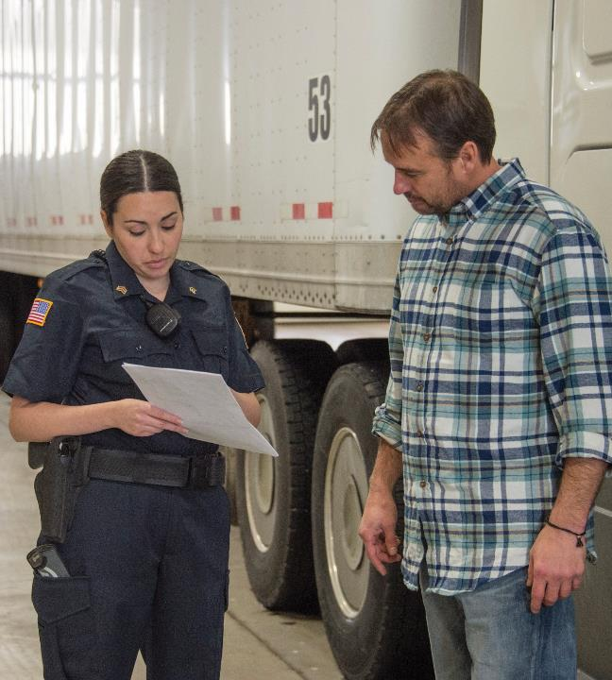
19
Roadside Inspections
Notes:
Chapter 19 Roadside Inspections
Unit A1.4.2 Roadside Inspections This unit must instruct driver-trainees on what to expect during a standard roadside inspection conducted by authorized personnel. The training providers must teach driver-trainees on what vehicle and driver violations are classified as out-of-service (OOS), including the ramifications and penalties for operating a CMV when subject to an OOS order as defined in section 390.5.

Slide 4
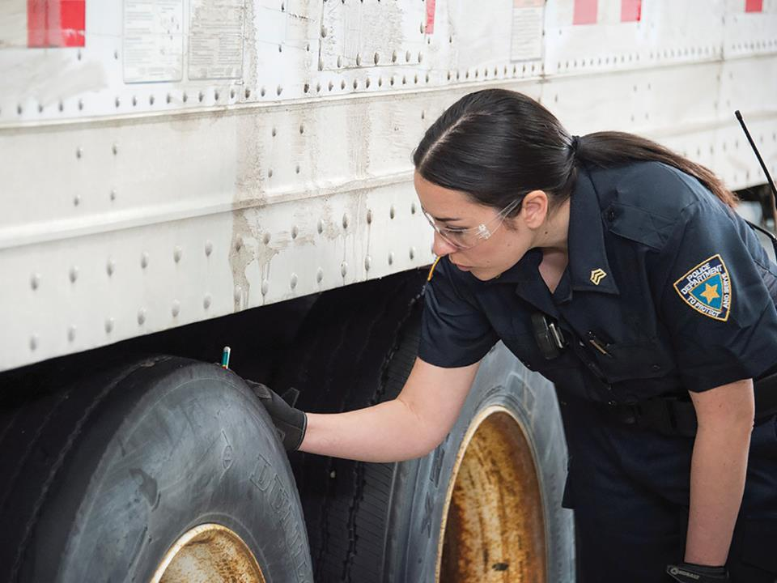
Introduction
Notes:
Introduction
Roadside inspections are conducted by specially trained enforcement personnel, following specific inspection criteria and guidelines. They’re working hard to ensure highways are safe for your families and for you to get the job done. On average, one hundred inspections will reveal more than twenty out-of-service (OOS) violations. Lights, tires, and brakes are the usual culprits, and even though some defects do pop up on the road, inspectors can often tell the difference between recent wear and practiced neglect. Get in the habit of preparing your paperwork and conducting your pre-trip, en route, and post-trip inspections with the same attention an officer will give you if you are selected for an inspection.
CLASSROOM RECOMMENDATIONS
A roadside inspection is an examination of a driver and/or his or her commercial motor vehicle (CMV) by law enforcement.
The inspection determines if the driver and/or his or her CMV are in compliance with the Federal Motor Carrier Safety Regulations (FMCSRs) and/or the Hazardous Materials Regulations (HMRs).
Over three million roadside inspections are conducted in the United States each year by law enforcement officers who are trained and follow specific guidelines. The goal is to assure that both safe drivers and safe vehicles are on the road.
Discuss the serious nature of roadside inspections with your students. A poor inspection can contribute to poor Compliance, Safety, Accountability (CSA) scores. A poor inspection can also lead to the driver and/or vehicle being placed out of service.
Also discuss the importance of being prepared. The vehicle should be neat, clean, and well maintained. The driver should have all paperwork up-to-date and complete.

Slide 5
Objectives
Upon completion of this lesson, you will be able to:
  Demonstrate how to prepare for a roadside inspection
  Recognize what happens during a roadside inspection
  Explain what to expect as the result of a
  roadside inspection
Notes:
Objectives
Upon completion of this lesson, you will be able to:
Demonstrate how to prepare for a roadside inspection
Recognize what happens during a roadside inspection
Explain what to expect as the result of a roadside inspection

Slide 6
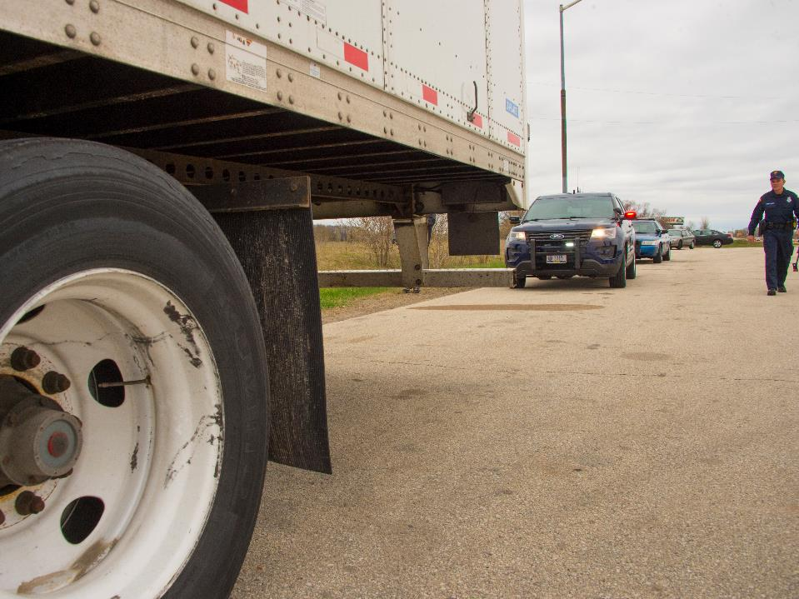
Roadside Inspection Basics
Notes:
Roadside Inspection Basics
Roadside inspections are conducted by law enforcement officers that are trained and certified by the Commercial Vehicle Safety Alliance (CVSA).
Typically, these inspections are conducted at weigh stations, roadside, or at a motor carrier. The selection of drivers and vehicles to be inspected as well as the inspection procedures that must be followed are specific and uniform across North America. In other words, a roadside inspection in Vermont should be conducted in the same way as an inspection in New Mexico.
LAB RECOMMENDATIONS
One way to introduce your drivers to the roadside inspection process is by having them observe the process. This can be accomplished by either making arrangements to observe the process at a weigh station or by inviting law enforcement to demonstrate the process at your location.
CALLOUT: CVSA is a nonprofit association comprised of local, state, provincial, territorial, and federal commercial motor vehicle safety officials and industry representatives. CVSA aims to achieve uniformity, compatibility, and reciprocity of commercial motor vehicle inspections and enforcement by certified inspectors dedicated to driver and vehicle safety.
Who Gets Inspected
You may be selected for several reasons:
The Inspection Selection System (ISS) recommended an inspection due to your company’s past performance during roadside inspections or because there is not enough information about your carrier in the system
Inspectors spotted a violation or a defect
Inspectors noticed your vehicle is dirty
An officer stopped you for a traffic violation and conducted an inspection
Your motor carrier may choose to use a weigh station bypass system that pre-clears vehicles on the highway, allowing the vehicles to bypass the scales. Carriers using bypass systems such as PrePass®, NORPASS, or Drivewyze® have already had their credentials, permit and insurance information, and safety status approved. Do note that even if you have one of these bypass systems installed on your vehicle, your vehicle can still be pulled across the scales and then inspected. Always follow instructions and pull in if you are told to do so.
Also, even if your vehicle recently passed an inspection, you and your vehicle could be inspected again. There are several reasons why this could happen, including if an inspector spots a defect or the ISS recommends an inspection.
VIDEOS (see Trainer Tools USB)
19.1 — Who Gets Inspected?

Slide 7
There are eight different levels of inspections.
Level I
Complete inspection
Level II
The officer doesn’t get under the vehicle
Level III
Inspection of documents and credentials only
Focused on the vehicle
Level IV
Onetime check of a specific piece of equipment
Level V
Level VI
Vehicles hauling highway route-controlled quantities of radioactive materials
Level VII
Directed at school buses, taxis, shuttles, and other vehicles
Level VIII
Electronic inspection of driver and vehicle as it rolls through the inspection facility
Notes:
Types of Inspections
There are eight different levels of inspection you may be subject to:
Level I, which is a complete inspection of the driver and vehicle, is the most thorough. First, the inspector will conduct a basic interview with you, asking you questions about your trip. He or she will review your driver’s license and record of duty status and ask for your vehicle’s periodic inspection documentation as well as other paperwork related to your trip.
The inspector will then conduct a thorough inspection of your vehicle. He or she will look around and under your vehicle, inspecting certain vehicle components.
A Level I inspection can take as long as an hour to complete.
Level II is like the Level I, except the officer won’t get under the vehicle. Level II inspections typically happen during bad weather, at portable inspection sites, during traffic stops, or when conducting a Level I inspection is not practical. This inspection usually lasts about 30 minutes.
Level III is an examination of driver documents and credentials only, including your:
Commercial driver’s license (CDL)
Record of duty status
Shipping papers
Vehicle “cab card” (vehicle’s registration) and fuel license (paper or electronic)
Annual vehicle inspection documentation
CALLOUT: A Level III inspection can quickly switch to a Level I or II if your paperwork is out of order or the officer notices a vehicle violation.
Level IV inspections are usually a onetime check of a specific piece of equipment, like air brakes or leaf springs. During a Level IV Inspection, officers are collecting data on specific equipment for a scientific study or as part of a special enforcement activity.
Level V inspections are focused on your vehicle. It’s the same process as the vehicle portion of a Level I Inspection. Level V Inspections are often completed at your carrier’s terminal as part of a compliance review or after a crash when the driver is not available for various reasons.
Level VI inspections check vehicles hauling highway route-controlled quantities of radioactive materials. While it’s a higher inspection standard than a Level I inspection, it affects far fewer drivers. If you haul highway route‑controlled quantities of radioactive material, consult your carrier for more information about this type of inspection.
Level VII inspections are conducted when the requirements of the other levels of inspection do not apply. They may be directed at school buses, taxis, shuttles, and other intrastate/intra-provincial operations. Training and other details are determined by the jurisdiction.
Level VIII inspections occur while your vehicle is in motion. It is an electronic inspection of the driver and vehicle as it rolls through the inspection facility. There is no direct interaction with an enforcement officer.

Slide 8
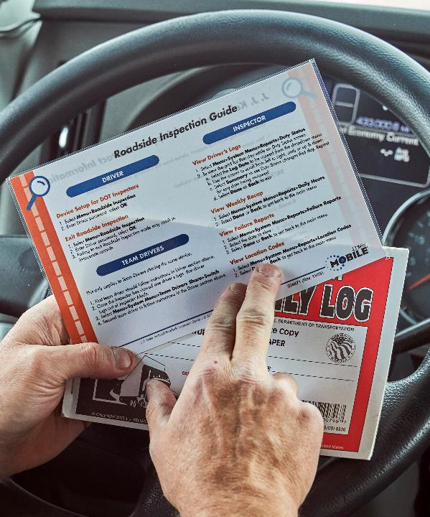
Since roadside inspections can happen to anyone at any time, it’s essential to be prepared.
Notes:
Preparing for an Inspection
Since roadside inspections can happen to anyone at any time, it’s essential to be prepared. Do a thorough pre-trip inspection every time. The regulations require you to be satisfied with the condition of your vehicle before operation.
A solid inspection will identify problems before your wheels start rolling. Understand what counts as deficiencies and defects, and don’t start your route unless everything is in good condition. Servicing your vehicle before you’re on the road will take less time and cost far less than being stopped with an out-of-service order that needs to be addressed while en route.
As a professional driver, you should keep your required credentials (CDL) with you at all times, your record of duty status current at all times, and your cab, appearance, and vehicle paperwork neat. Keep garbage and papers off the dash. Inspectors may see a messy cab and think the vehicle is poorly maintained. Don’t give them any reasons to switch from a simple inspection of your paperwork to a full inspection just because your cab is disorganized.
The documents you may need for a roadside inspection should be readily available in the cab of your vehicle at all times. Make sure all your documents are in order before every trip and stay in order until your trip’s end.
Keep your record of duty status current to your last change of duty to avoid a violation. This will include today’s current activity and the previous seven consecutive days, which must be in your possession and available for inspection while on duty.

Slide 9
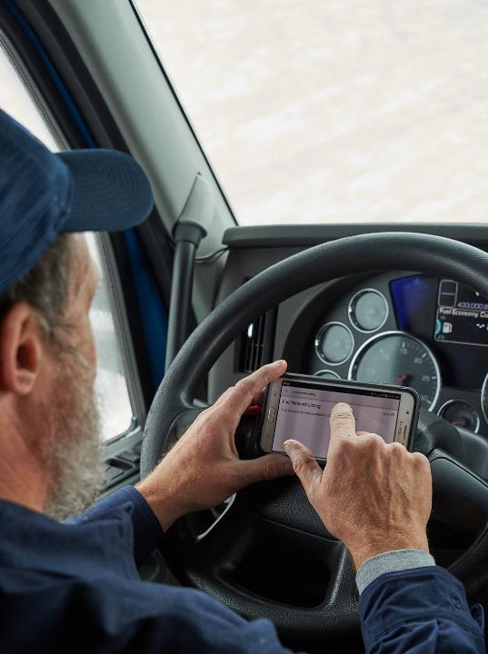
If you are using an ELD, you must be able to display or print the prior seven days’ logs and the current day.
Notes:
Drivers operating with an electronic logging device (ELD) must be able to display or print the prior seven days’ logs and the current day as a backup. The primary means of transmission must be via telematics (using wireless web services and email) or local transfer (using Bluetooth and USB). You must know how to execute the correct method of transfer in addition to displaying or printing the logs as backups in case the transfer methods don’t work.
VIDEOS (see Trainer Tools USB)
19.2 — Transfer of ELD Data
If you are using an ELD, you must have:
The user’s manual for the ELD
An instruction sheet describing the data transfer mechanisms supported by the ELD
An instruction sheet describing what to do when an ELD malfunctions
Step-by-step instructions to produce and transfer the required hours-of-service records to an authorized safety official
If your vehicle is placarded for hazardous materials, you will need to have a current copy of your hazardous materials Certificate of Registration or another document bearing the registration number identified as the “U.S. DOT Hazmat Reg. No.” The registration identifies the carrier and proves your company is authorized to transport placarded hazardous materials.
Hazardous materials paperwork must be within reach from the driver’s seat. When leaving your vehicle, put your paperwork either on the driver’s seat or in the driver’s door pouch.
Lastly, plan to maintain a positive attitude, and be ready to cooperate with officers. Acting courteously and professionally will help you pass the inspection and make the process go more smoothly.

Slide 10
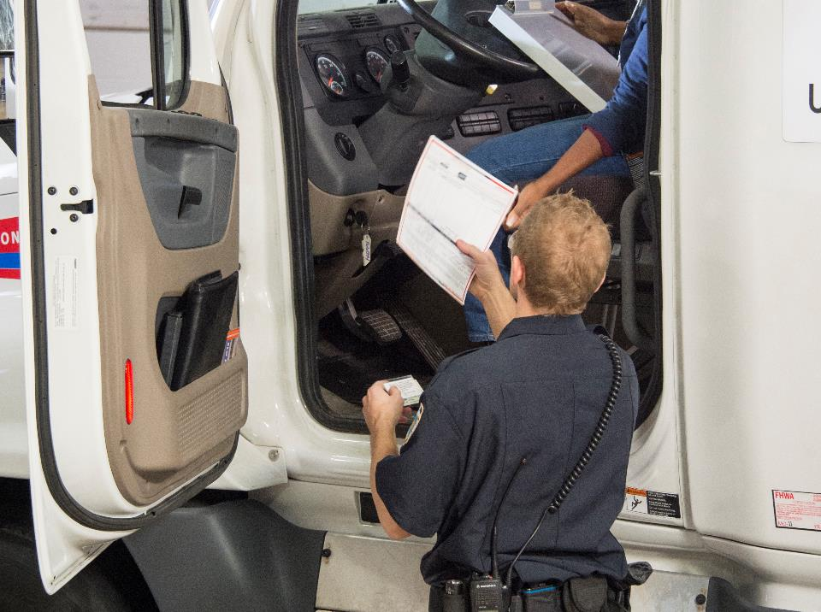
The Roadside Inspection Process
Notes:
The Roadside Inspection Process
Roadside inspections will focus primarily on three separate components— the driver, the vehicle, and required documentation. If you are chosen for an inspection, the inspector will greet you by introducing himself or herself and explaining the type of inspection he or she intends on completing.
Driver
Whenever you are the focus of an inspection, be prepared to hand over documents and credentials. The officer will request a current driver’s license.
The inspector will verify your record of duty status. He or she will review your vehicle’s periodic inspection documentation as well as other paperwork related to your trip. Continue to follow the inspector’s directions throughout the process.
A driver can be placed out of service for some of the following reasons:
Hours-of-service violations
Operating over hours
Keeping a false record of duty status
Having the incorrect type of record of duty status
Operating without a record of duty status when required
Driving while sick or fatigued
Driving with an invalid license
Driving while under the influence of alcohol or drugs
Not being medically qualified

Slide 11
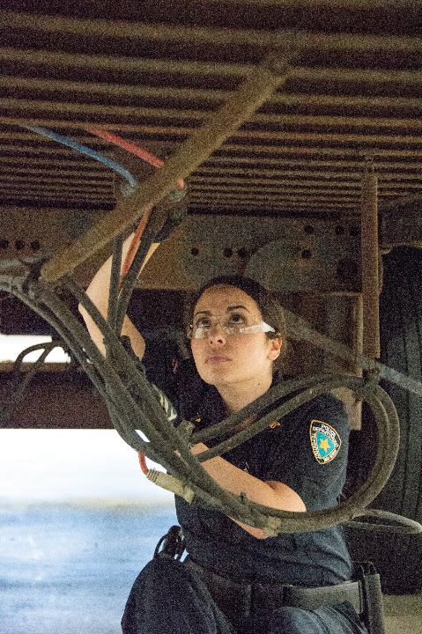
Your vehicle will be inspected for mechanical problems, unsafe wear and tear, and anything else that could cause a crash.
Notes:
Vehicle
Inspectors check your vehicle for mechanical problems, unsafe wear and tear, and anything else that could cause a crash. Inspectors will place a vehicle that they determine to be unsafe or in violation of safety regulations out-of-service.
Your vehicle can be placed out of service for defects in these areas:
Brake system
Coupling devices and pintle hooks
Exhaust and fuel system
Lighting system
Steering mechanism
Frame and trailer bodies
Tires, wheels, rims, and hubs
Windshield wipers
Load securement
Suspension

Slide 12
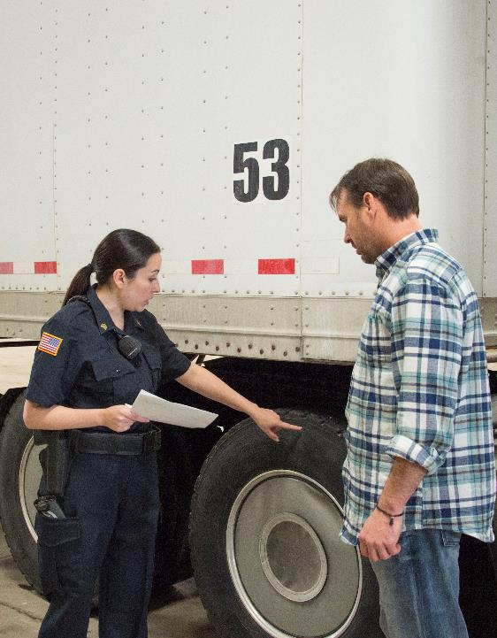
Tires are an easy target for inspections. Your tires need to be in good condition and have the proper tread depth.
Notes:
Sometimes, you can fix a problem during the inspection, but it will still be recorded in the report as out of service. For problems with electrical systems, brakes, air hoses, or other major mechanical defects, you will have to contact your carrier for a service call.
Refer to the CVSA North American Standard Out-of-Service Criteria for a complete listing of all out-of-service criteria. Note that Department of Transportation (DOT) regulations should also be followed.
One of the most common vehicle violations is the condition and operation of the braking system. Make sure your hoses are tightly connected and not rubbing or dragging. The inspector will check the trailer brakes and pad thickness, looking for cracks in the drums and making sure the whole system is ready for the road.
Tires are an easy target for inspections. Your tires need to be in good condition and have the proper tread depth. The front wheels must have a tread groove pattern depth of at least 4/32 of an inch when measured at any point on a major tread groove. All other tires must have a tread groove pattern depth of at least 2/32 of an inch when measured in a major tread groove.
Officers look for non-critical deficiencies also. Something as simple as a missing warning triangle—there must be three—can result in a violation.

Slide 13
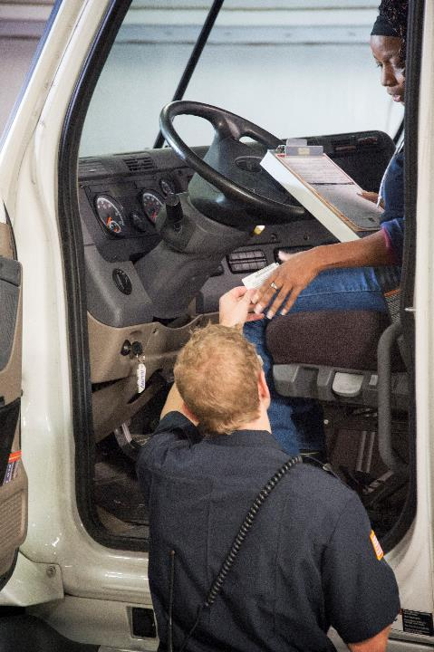
Inspectors will look at your paperwork after the vehicle inspection.
Notes:
Documents
Inspectors will look at your paperwork after the vehicle inspection.
You will need to show your:
CDL
Hours-of-service records
Vehicle “cab card” (vehicle’s registration) and fuel license (paper or electronic)
Shipping papers or bills of lading (which show where you came from, where you’re going, and what you’re hauling)
If you are hauling hazardous materials, the inspector will check your shipping papers for ID numbers, proper documentation of the load, and reportable quantities. Emergency responders need this important information in case of a hazardous materials incident involving your vehicle.
You must give your paper or electronic record of duty status to the officer who will conduct a thorough review of your compliance with the limits and logging requirements for the current day and the previous seven days.
When using an electronic log, the officer will verify if the device is mounted properly. Also, the ELD must be capable of being reviewed by the inspector without the inspector having to enter the cab.
When providing an ELD to an officer, the following items must be included in an ELD packet onboard your CMV:
A user’s guide for the ELD
Data transfer instructions
Reporting and recordkeeping instructions in case of ELD malfunction
At least eight days of blank driver log grids in case the history needs to be recreated
Enforcement will want to transfer the data into their software, so they can analyze the data within seconds instead of reviewing logs manually.

Slide 14
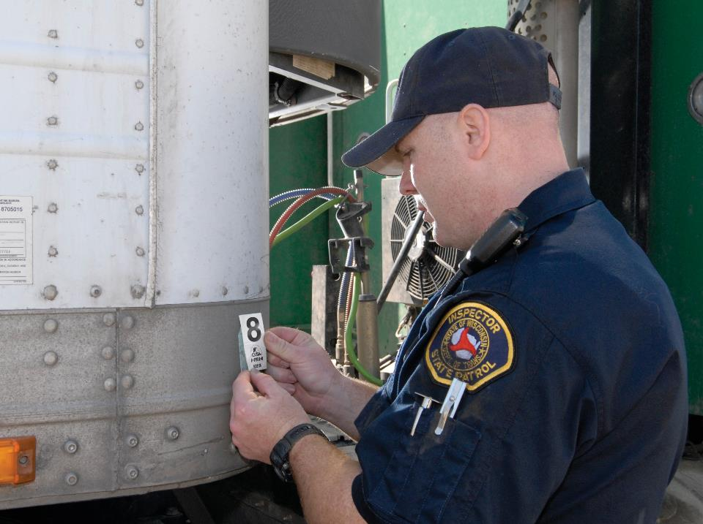
Roadside Inspection
Report & Results
Notes:
Roadside Inspection Report & Results
At the end of your roadside inspection, the inspector will give you a report and explain any violations or defects.
Inspection Report
You will get a report even if no problems were found.
If you are not given a report, politely ask the inspector to provide you with a copy. If you do not get one, contact your supervisor or other carrier official for instructions before leaving the inspection site.
You’re required to turn in this report to your carrier when you get to the next terminal or facility. If you are not going to be at your carrier’s facility within the next 24 hours, you will need to send it to them by mail or other means (i.e. fax, scan and email, etc.).
Your carrier needs to address any problems with your vehicle and return the form to the issuing agency—using the address on the form—within 15 days.
Inspection Outcomes: No Violations
The inspector will put a CVSA decal on your vehicle as long as there are no critical inspection item defects noted. Critical inspection items are the safety-related items that are likely to cause a crash or breakdown if not corrected in a timely manner, including anything related to the tires, brakes, lights, coupling devices, cargo securement, frames, driveshafts, wheel assemblies, suspensions, wipers, steering, and fuel system. The decal will be valid for three months.
VIDEOS (see Trainer Tools USB)
19.3 — Inspection Decals
The inspector will put the decal in one of the following places:
On a power unit, the inspector will place it on the lower right corner of the outside of the passenger’s windshield
On trailers, the inspector will place it on the lower right corner near the front
On cargo tanks, the inspector will place it on the right side of the undercarriage near the front of the cargo tank or eye level on the right side near the front of the cargo tank
On passenger buses, the inspector will place it on the window of the passenger door at the inspector’s eye level
CALLOUT: If no violations of the critical vehicle inspection items are found during an eligible inspection, a CVSA decal will be applied as a visual indicator that the vehicle successfully passed inspection conducted by a CVSA-certified inspector. The Level I and Level V inspections are the only inspections eligible for issuance of a CVSA decal.
Inspection Outcomes: With Violations
If the inspector found minor violations, you may be allowed to continue (however, a fine may be written). You will not, however, receive a CVSA decal.
Keep in mind, any violations you receive still have serious consequences. Certain types of violations have high severity points in the Compliance, Safety, Accountability (CSA) program, and will have an immediate impact on you and the carrier.
VIDEOS (see Trainer Tools USB)
19.4 — Failed Inspection and the Consequences

Slide 15
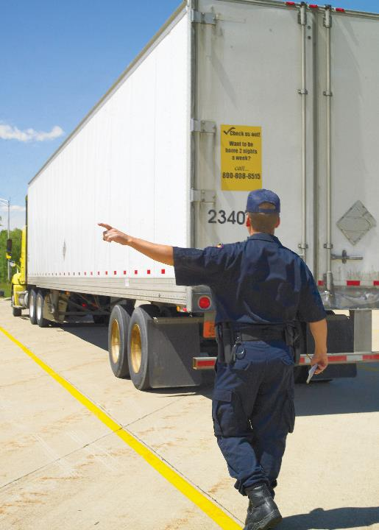
If an inspector finds major safety problems, you or the vehicle will be placed out of service.
Notes:
Inspection Outcomes: Out of Service
If an inspector finds major safety problems, you or the vehicle will be placed out of service. This means that you won’t be able to drive your vehicle again until the problems have been addressed. Inspectors can place you, your vehicle, or both out of service.
Violating an out-of-service order carries stiff penalties. Federal regulations outline a penalty structure for drivers; however, it’s a judge’s discretion to decide the actual disqualification period and fine amount.
The penalty schedule is as follows:
First violation: disqualification for 180 days to one year
Second violation during a 10-year period: disqualification for two to five years
Third or subsequent violation during a 10-year period: disqualification for three to five years
CALLOUT: Penalties are more severe for violating an out-of-service order while transporting hazardous materials.
Your carrier cannot force you to drive a vehicle before the repairs are finished. They will be fined if they require (or allow) you to violate an out‑of‑service order.
An inspection resulting in violations has serious consequences for you, the other drivers for your carrier, and your carrier itself:
For you, violations and out-of-service orders mean:
Unscheduled down time
Lost revenue
Interrupted schedule
Fines
For your carrier’s other drivers, violations and out-of-service orders mean:
More random inspections because:
The carrier gets a bad reputation with inspectors
Your carrier’s ISS rating is higher
For your carrier, violations and out-of-service orders mean:
Poor CSA scores, which can lead to Federal Motor Carrier Safety Administration (FMCSA) interventions
Lost revenue
Delays in deliveries

Slide 16
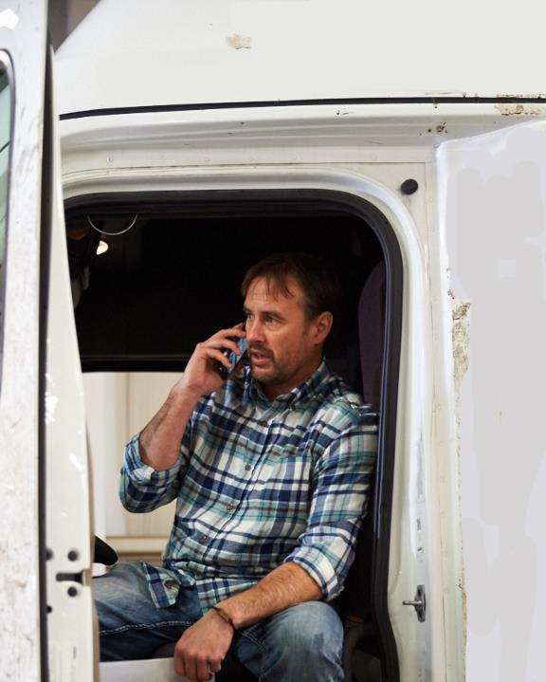
If you disagree with how the officer conducted the inspection—or with the results—avoid arguing with the inspector. Instead, discuss it with your carrier and allow them to resolve the issue.
Notes:
How to File a Complaint
If you feel your rights were violated during a roadside inspection, call your carrier and ask them to file a formal complaint through the agency the officer works for.
If you disagree with how the officer conducted the inspection—or with the results—avoid arguing with the inspector. Instead, discuss it with your carrier and allow them to resolve the issue with a supervisor at the agency that conducted the inspection. If a resolution can’t be reached, you must use the DataQs system to file a Request for Data Review (RDR) regarding a roadside inspection.
To help speed up the review process, document why you thought there was no violation or why you believe the officer made an error and provide this to be included with the challenge.
Your carrier representative will login to the DataQs site to enter an RDR, refer to the “Inspection Event”, and choose one of the following:
Incorrect Violation
Assigned to Wrong Carrier
Assigned to Wrong Driver
Missing Record
Duplicate Record
Incorrect Information

Slide 17
Objectives Review
You should now be able to:
  Demonstrate how to prepare for a roadside inspection
  Recognize what happens during a roadside inspection
  Explain what to expect as the result of a
  roadside inspection
Copyright 2019 J. J. Keller & Associates, Inc.
Notes:
You should now be able to:
Demonstrate how to prepare for a roadside inspection
Recognize what happens during a roadside inspection
Explain what to expect as the result of a roadside inspection
CLASSROOM RECOMMENDATION
Before concluding your training session, have participants take the corresponding quiz (found on the Trainer Tools USB) to check their understanding of the material. You can customize any of the questions to fit your audience or workplace. The answer key can also be found on the Trainer Tools USB.
You may also choose to administer the quizzes before you begin your training session to help get participants thinking about the subject and/or to gauge their understanding of the topic ahead of time.

