Slide 1






PowerPoint® Instructions
This PowerPoint has been designed so you can easily customize it for your training session.
Throughout the presentation you’ll see icons with recommendations or videos to enhance the instruction you present to your students. A detailed explanation for each icon can be found on the next slide. Videos can be found on the Trainer Tools USB.
When you see an icon on the slide, look in the notes
section for further information.
Simply delete or move the icon off the slide before your training session begins.

Slide 2





Classroom Recommendations. Provides suggestions for enhancing your classroom presentation; from ideas for large group discussions to suggestions on the use of training aids such as examples or photos of vehicle parts and components to help illustrate the items covered within a chapter.
Lab Recommendations. Provides suggestions for activities and exercises that take place outside the classroom, but do not involve
the actual operation of the tractor-trailer or its components. Examples
of lab sessions include conducting a vehicle inspection or practicing mirror adjustment.
Range Recommendations. These recommended activities take
place on a closed-access driving range where students may practice driving skills in a controlled environment. Examples of range sessions include practicing shifting technique and successfully completing a backing maneuver.
Road Recommendations. These recommended activities take place in road and traffic conditions that support the chapter’s objectives. Examples of road sessions include proper communication with other drivers through the use of turn signals and basic vehicle control under nighttime or extreme weather conditions.
Videos. These short video clips reinforce material presented in the Student Manual. Use them to help students grasp difficult concepts or subject matter.

Slide 3
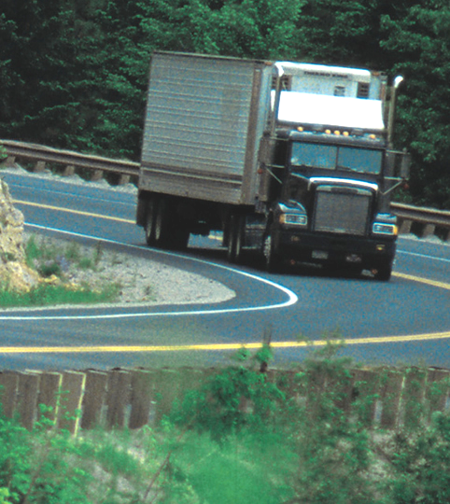
Basic Control
4
Copyright 2019 J. J. Keller & Associates, Inc.
Notes:
Unit A1.1.4 Basic Control
This unit must introduce basic vehicular control and handling as it applies to combination vehicles. This unit must include instruction addressing basic combination vehicle controls in areas such as executing sharp left and right turns, centering the vehicle, maneuvering in restricted areas, and entering and exiting the interstate or controlled access highway.

Slide 4
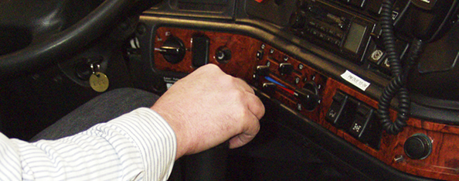
Introduction
We’ll address basic control issues you need to master in order to become a professional driver
Notes:
Operating a tractor-trailer is very different from operating a car or pickup truck. Everything about a tractor-trailer, from starting the engine to backing and turning, requires a new set of knowledge and skills. This chapter will address basic control issues you need to master in order to become a professional driver. It is important that you have a good understanding of these issues, as many of the skills covered in this chapter are the foundation for future lessons.
CLASSROOM RECOMMENDATION
Stress that basic control is the foundation to learning all the skills and techniques required to safely operate a tractor-trailer. Mastery of these skills is important. Much of this lesson will be taught on the driving range.
Prior to beginning lessons on the range, spend time covering all of the safety processes and procedures that must be followed to ensure everyone’s safety on the range.
Consider giving a short test or quiz at the end of your discussion and require a minimum passing score prior to allowing the student to operate on the range. This ensures that your students understand your safety policies and procedures, and that they understand the serious nature of safety while on the range.

Slide 5
Objectives
Upon completion of this lesson, you will be able to:
  Discuss how to start up and shut down the engine of a tractor-trailer
  Describe how to put a tractor-trailer in motion and come to a complete stop
  Identify ways to maneuver through turns, curves, and roundabouts, and enter/exit highways safely
  Explain how to successfully straight line back a tractor-trailer
Notes:
Upon completion of this lesson, you will be able to:
Discuss how to start up and shut down the engine of a tractor-trailer
Describe how to put a tractor-trailer in motion and come to a complete stop
Identify ways to maneuver through turns, curves, and roundabouts, and enter/exit highways safely
Explain how to successfully straight line back a tractor-trailer

Slide 6
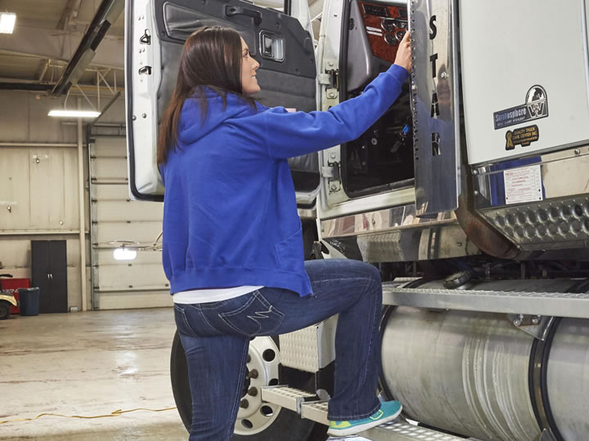
Starting, Warming Up, and Shutting Down
Notes:
There is a specific procedure that must be followed when starting up and shutting down a tractor-trailer engine. This section will address the proper procedure for starting a four-cycle diesel engine:
LAB RECOMMENDATION
Starting and turning off the engine.
The objective of this lesson is for the student to develop proper procedures and habits for starting and turning off a tractor-trailer engine.
First, divide students into groups of three or four. Then, demonstrate the process of starting and shutting down the engine. Explain each step of the process. Include an explanation of proper gauge reading required for vehicle operation.
After this instructor-led demonstration, each student should take a turn starting, warming- up, and shutting down the engine. The instructor should be in the cab with each student to correct errors and answer questions.

Slide 7
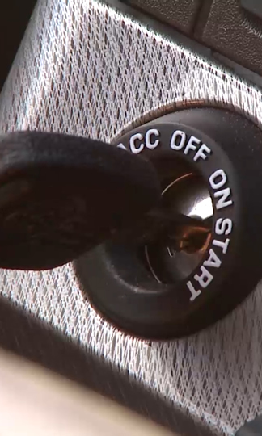
Engine Start-Up
Apply the parking brake
Depress the clutch pedal completely to the floor, and make sure
the truck is in neutral
Turn the ignition switch/key on
Operate the starter
Ease off the clutch
Check all instruments and gauges
Notes:
Engine Start-Up
Apply the parking brake (if not already applied).
Depress the clutch pedal completely to the floor, and make sure the truck is in neutral.
Turn the ignition switch/key on.
Operate the starter (push the button). If the engine doesn’t start in 15-20 seconds, turn the ignition switch/key off for at least one minute and try again.
Once the engine has started, and the transmission is in neutral, ease off the clutch.
Check all instruments and gauges. Pay extra attention to the oil pressure gauge. In warm weather, the oil pressure should come up to operating level in three to five seconds. If it does not, you should immediately shut the vehicle off, as severe damage could result.
CALLOUT: It is important you understand these procedures, so you can prevent damage to your vehicle’s engine.

Slide 8
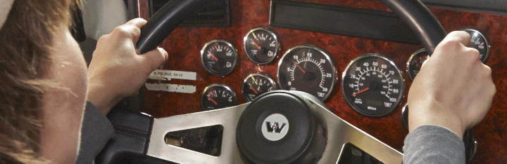
Engine Warm-Up
Generally done at a low RPM level
A short period of idling time is recommended
Engine warm-up is complete when the water temperature reaches 170°F – 195°F
Notes:
Engine Warm-Up
Engine warm-up is generally done at a low revolution per minute (RPM) level (800‑1,000 RPMs). This allows the oil to warm and circulate, and oil pressure to build up.
During warm-up, the cylinder walls become coated and bearings are lubricated. Coolant temperature increases, and air pressure builds up as well.
Usually, a short period of idling time is required/recommended. Check the operator’s manual for specific details on the vehicle you are driving. However, you should avoid excessive idling. Most recently manufactured engines don’t need to idle for more than a few minutes. This can waste fuel and cause unnecessary wear on the engine.
Also, several states and municipalities have laws and/or regulations limiting the amount of time an engine is allowed to idle. Make sure you are aware of any laws and/or regulations that may limit or prohibit you from idling your vehicle’s engine.
When driving during warm-up, keep RPMs low and avoid high RPMs when accelerating in first gear. Shift to the next highest gear as soon as possible. Keep all acceleration smooth and easy.
Engine warm-up is complete when the water temperature reaches 170°F – 195°F. You will not typically reach this temperature by just sitting and idling so you need to proceed slowly at low RPMs, until this temperature range has been reached.

Slide 9
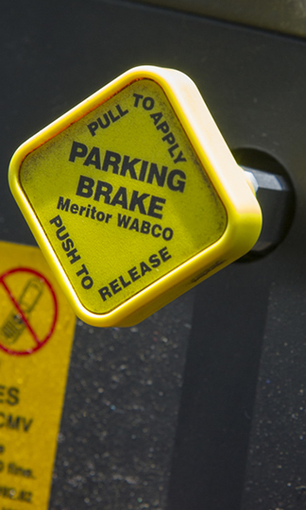
Engine Shutdown
Depress the clutch
and move the gear
shift to neutral
Set the parking brakes
Turn the engine off
Notes:
Engine Shutdown
Depress the clutch and move the gear shift to neutral.
Set the parking brakes.
Turn the engine (key or switch) off.
Engine cool down can be as important as a proper warm-up. Engine cool down allows heat generated during normal operation to dissipate. The appropriate cool down period will vary based on engine type as well as the nature of the trip and cargo hauled. Engine damage can occur if there isn’t a sufficient cool down period.

Slide 10
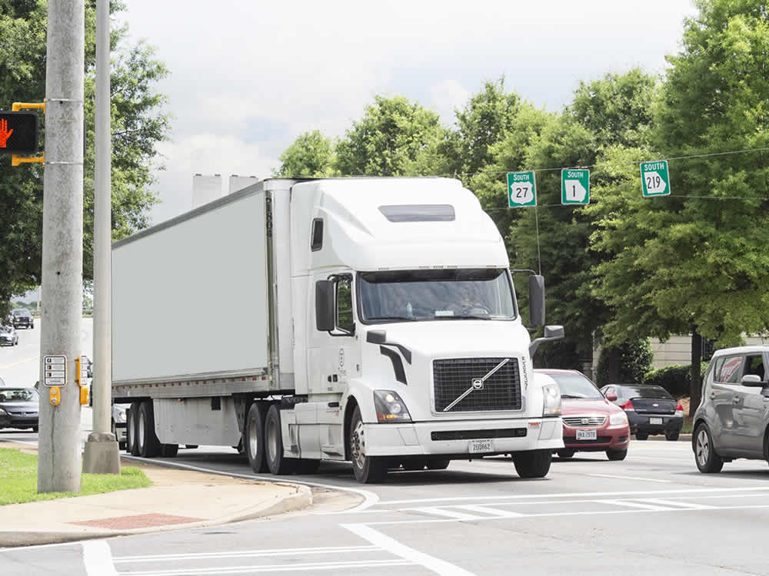
Putting the Vehicle in
Motion & Stopping
Notes:
Operating a tractor-trailer requires more specific skills and driver expertise than those required in your personal vehicle. This includes:
Putting the tractor-trailer in motion
Stopping the tractor-trailer
Testing the tractor-trailer hook-up
LAB RECOMMENDATION
Putting the vehicle in motion.
The objective of this lesson is to give the student practice in putting the vehicle in motion, testing the tractor-trailer hook-up, moving forward and backward in a straight line, and stopping.
Again, students should be divided into groups of three or four. Demonstrate the exercise described below for the students, then have the students perform the exercise.
In a range area of about 300 feet, put the vehicle in motion and test the hook-up.
After testing the hook-up, move the vehicle about 100 feet and stop.
Move another 100 feet and stop.
Travel the remaining 100 feet and stop.
Finally, back the tractor-trailer, in a straight line, 300 feet, back to the starting area.
As each student performs the exercise, the instructor should be in the cab to correct errors and answer any questions posed.

Slide 11
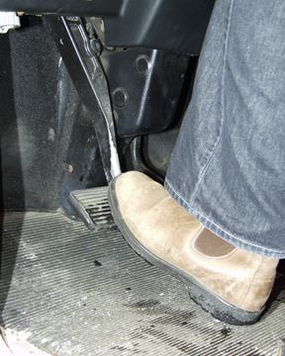
Putting a Tractor-Trailer in Motion
Release the tractor and trailer parking brakes
Depress the clutch fully, engaging the clutch brake, and place the transmission in the lowest gear
Release the clutch to the friction point; release the clutch until it’s fully engaged
Notes:
Putting a Tractor-Trailer in Motion
Release the tractor and trailer parking brakes.
Depress (press down on) the clutch fully, engaging the clutch brake, and place the transmission in the lowest gear.
Release the clutch to the friction point. This is the point where the clutch engages. A decrease in the RPMs is a sign that the friction point has been reached. Then gradually release the clutch until it’s fully engaged. As you engage the clutch, a slight increase in engine RPMs may be needed to avoid stalling the engine (100-300 RPMs is normal).

Slide 12
Putting a Tractor-Trailer in Motion
When the vehicle starts to move, gradually increase engine RPMs
When the vehicle is in motion, take your foot off the clutch pedal until you are ready to shift again or stop
Try to avoid excessive clutch slipping
Notes:
Putting a Tractor-Trailer in Motion
When the vehicle starts to move, gradually increase engine RPMs to increase vehicle speed by depressing the throttle.
When the vehicle is in motion with the clutch fully engaged, take your foot off the clutch pedal until you are ready to shift again or stop.
Try to avoid excessive clutch slipping. Engage the clutch as smoothly as possible without stalling the engine. To avoid slipping the clutch, use very little additional fuel until the clutch is completely engaged.

Slide 13
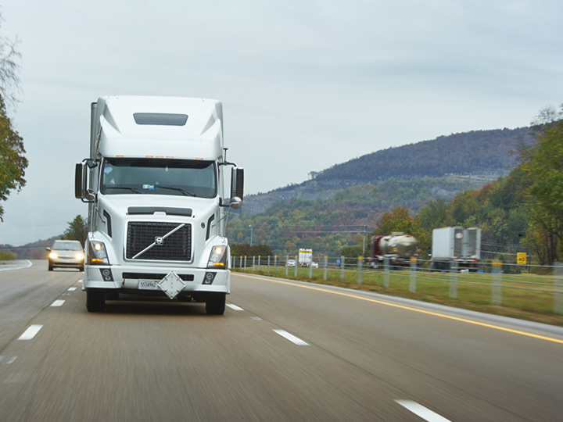
Speed up slowly and gradually
Hold the steering wheel firmly in
both hands
Make sure your vehicle is centered in the lane of travel
Notes:
Putting a Tractor-Trailer in Motion
Once you are moving, speed up slowly and gradually. Hold the steering wheel firmly in both hands, with your hands at the opposite sides of the steering wheel.
Make sure your vehicle is centered in the lane of travel. Because of the width of your vehicle, you have little room on either side of your lane of travel. Centering your vehicle gives you the maximum clearance available to each side.

Slide 14
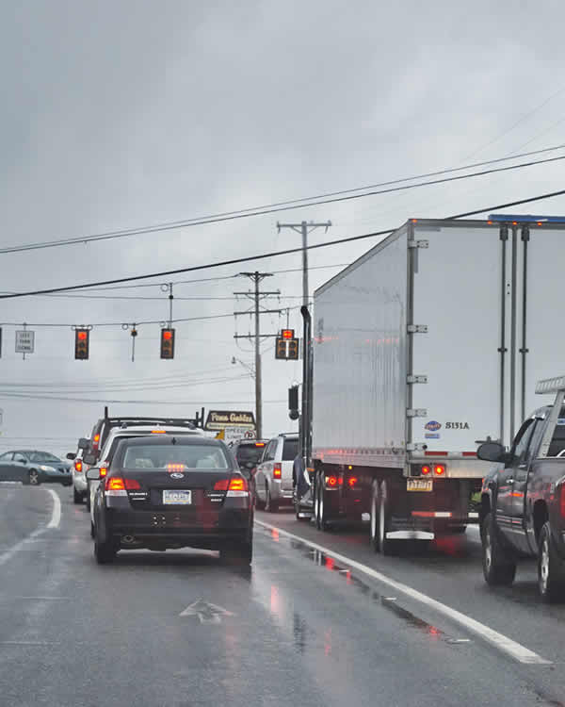
Stopping a Tractor-Trailer
Release the accelerator pedal
Depress the brake pedal gradually
Downshift to the appropriate gear
Notes:
Stopping a Tractor-Trailer
Release the accelerator pedal.
Depress the brake pedal gradually. The amount of brake pressure needed depends on how much room you have to stop.
As the vehicle begins to slow, downshift to the appropriate gear.

Slide 15
Stopping a Tractor-Trailer
Release some
brake pressure; when the engine is almost at idle, depress the clutch
Maintain enough brake pressure to keep the vehicle stationary
Notes:
Stopping a Tractor-Trailer
As the vehicle slows, release some brake pressure. When the engine is almost at idle, depress the clutch (the truck should stop within the next 50-75 feet).
After stopping, maintain enough brake pressure to keep the vehicle stationary. If you’re parking the truck, put the gearshift lever in neutral, set (apply) the parking brakes, and release the clutch.

Slide 16
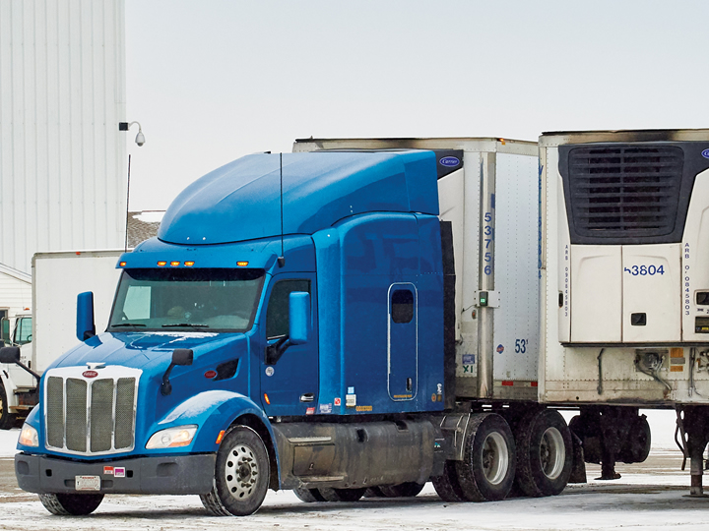
Testing the Tractor-Trailer Hook-Up
For vehicles with an independent trailer brake control
Release the tractor and trailer brakes
Depress the clutch and move the gearshift to the lowest gear
Engage the independent trailer brake control to apply the trailer brakes
Release the clutch to the friction point
Pull gently against the locked trailer brakes; stop as soon as you feel the engine start to drag down
Disengage the clutch
Reset the brake
Notes:
Testing the Tractor-Trailer Hook-Up
The coupling must be tested every time a trailer is connected to a tractor or dolly.
For vehicles with an independent trailer brake control (hand valve /trolley valve):
Release the tractor (parking) and trailer (emergency) brakes.
Depress the clutch and move the gearshift to the lowest gear.
Engage the independent trailer brake control to apply the trailer brakes.
Release the clutch to the friction point.
Pull gently against the locked trailer brakes. Stop as soon as you feel the engine start to drag down—preventing the vehicle from easily moving forward.
Disengage the clutch.
Reset the brake.

Slide 17
Testing the Tractor-Trailer Hook-Up
For vehicles without an independent trailer brake control
Release the tractor brake
Depress the clutch and move the gearshift to the lowest forward gear
Release the clutch to the friction point
Pull gently against the locked trailer brakes
Disengage the clutch
Reset the brake
Notes:
Testing the Tractor-Trailer Hook-Up
For vehicles without an independent trailer brake control (hand valve/trolley valve):
Release the tractor (parking) brake.
Depress the clutch and move the gearshift to the lowest forward gear.
Release the clutch to the friction point.
Pull gently against the locked trailer brakes. Stop as soon as you feel the engine start to drag down—preventing the vehicle from easily moving forward.
Disengage the clutch.
Reset the brake.

Slide 18
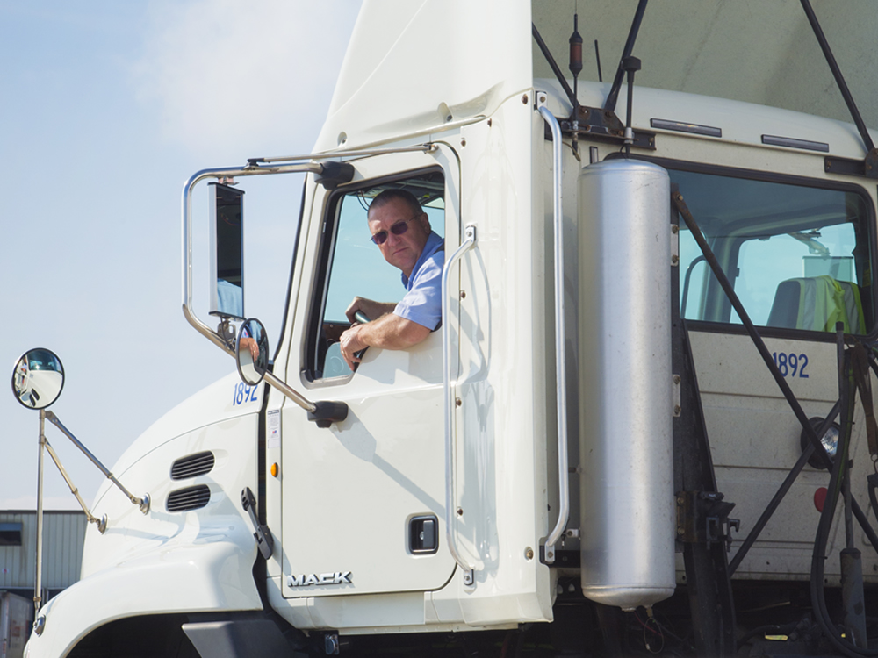
Straight Line Backing
Notes:
Though backing is a basic tractor-trailer maneuver, it is one of the most difficult to master. The information in this chapter is a basic overview of and introduction to straight line backing, the simplest of all backing maneuvers.

Slide 19
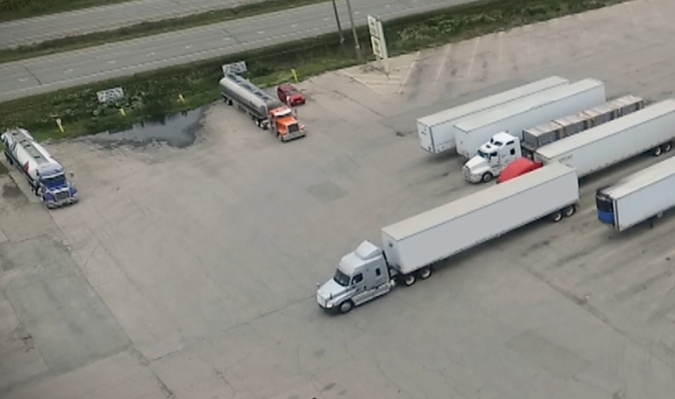
Position the vehicle properly
Notes:
When executing a straight line backing maneuver:
Position the vehicle properly. Put the vehicle in position by moving forward until the tractor and trailer are straight in front of one another and the front (steering) wheels are straight.

Slide 20
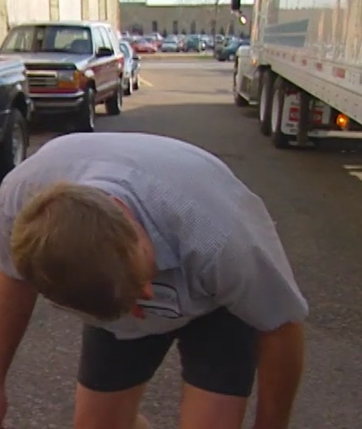
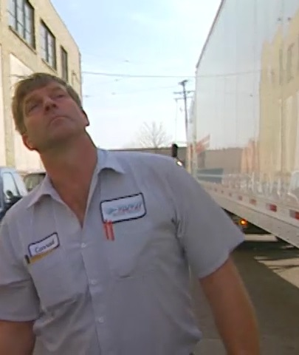
Clear the area
Notes:
When executing a straight line backing maneuver:
Clear the area. Make sure the area behind your vehicle is clear of other vehicles, people, and other obstacles. Get out and walk around the vehicle. Check:
To the rear of the vehicle
Above, under, and to the sides of the vehicle
In front of the vehicle
For adequate swing clearance
CALLOUT: Once you have completed your safety checks, you shouldn’t delay moving the vehicle. Any delay could allow time for a hazard to move into your vehicle’s path. If there is a delay, you should conduct the safety checks a second time.

Slide 21
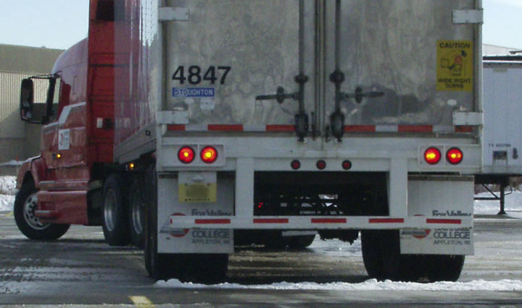
Watch speed
Notes:
When executing a straight line backing maneuver:
Watch speed. Turn on your vehicle’s four-way flashers and then put the vehicle in reverse. Using an idle speed, back as slowly as possible, but don’t ride the clutch or brakes. Backing slowly makes it easier to correct errors or stop quickly if necessary.

Slide 22
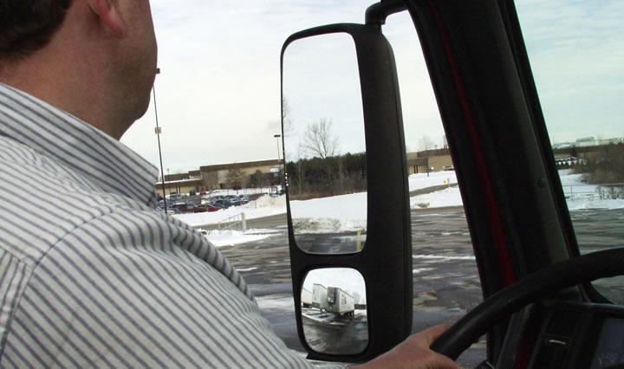
Check behind
Notes:
When executing a straight line backing maneuver:
Check behind. Constantly check behind your vehicle when backing. Make sure all doors are closed and continually check all mirrors. If you are unsure as to what may be behind your vehicle, stop, get out of your vehicle, and check your path.

Slide 23
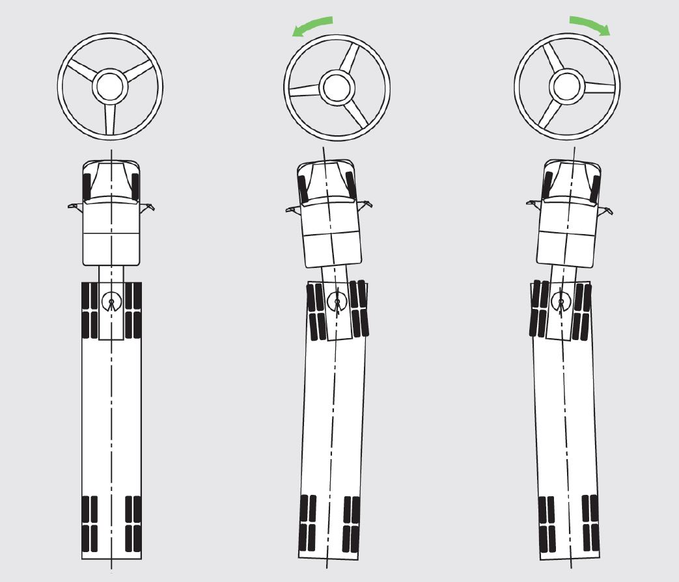
Steering
Notes:
When executing a straight line backing maneuver:
Steering. Keep the vehicle on path and don’t over steer. If drifting starts, try to correct it by turning the steering wheel in the direction of the drift as soon as it occurs. Only slight movement is required if the drift is caught right away.

Slide 24
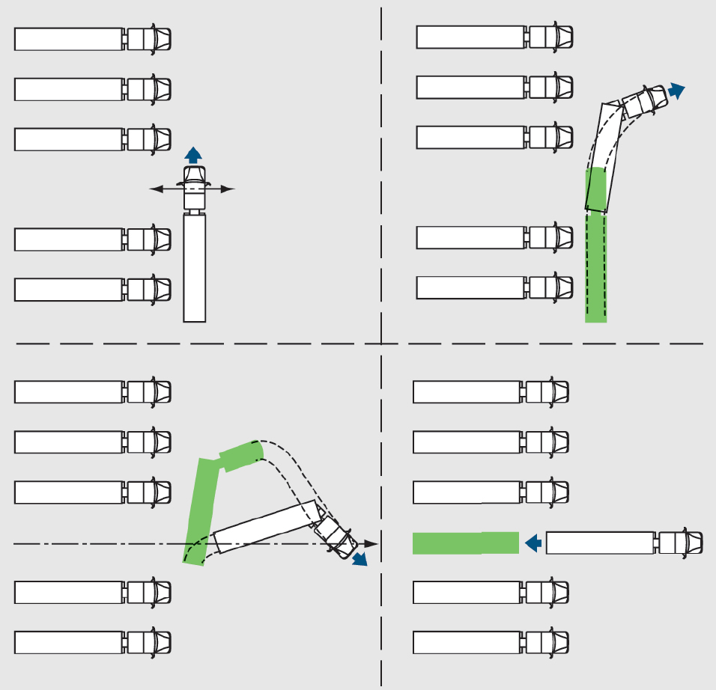
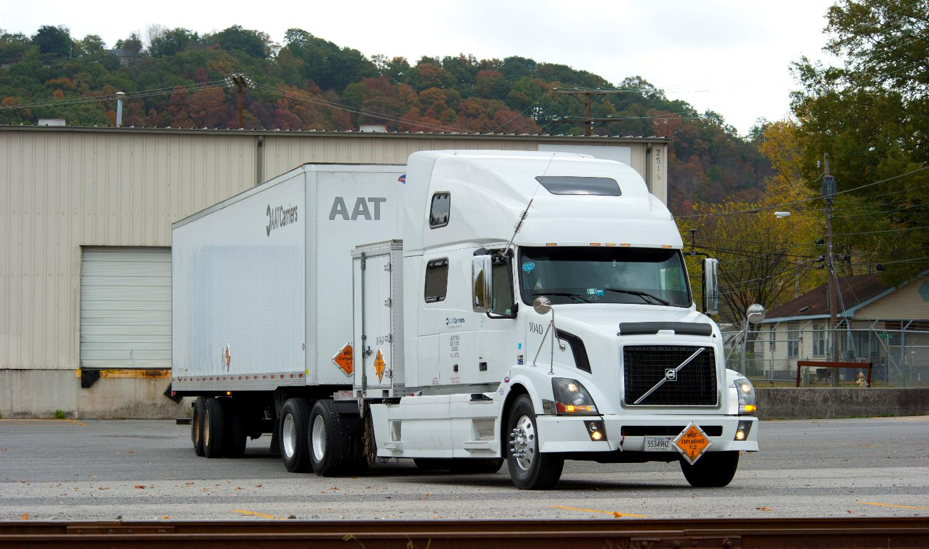
Pull up and start again
Notes:
When executing a straight line backing maneuver:
Pull up and start again. If your vehicle is too far out of position, pull up and start again. It is easier and safer to start over than reposition the vehicle while backing.

Slide 25
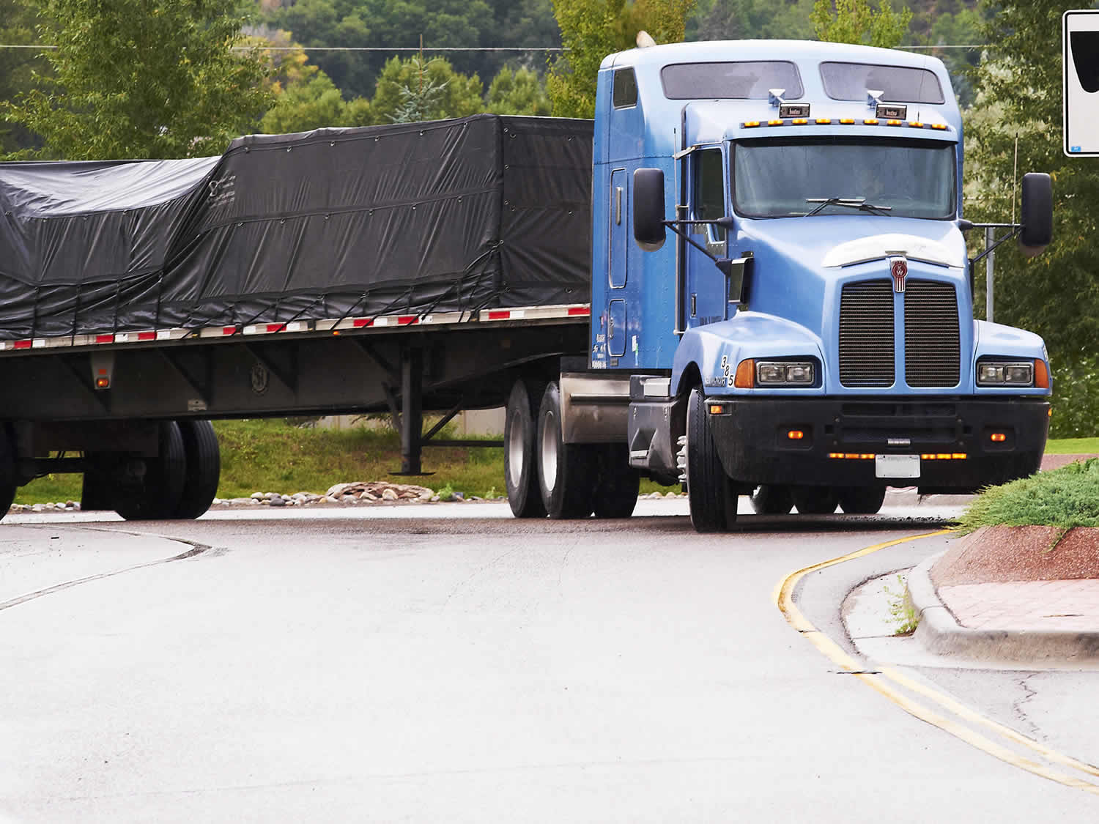
Turning
Notes:
Turning
Tractor-trailers are some of the biggest vehicles on the road and don't handle the same way a smaller, personal vehicle does. When it comes to turning, there are some basics to keep in mind that will help you stay on the road and avoid causing any damage with your vehicle.
LAB RECOMMENDATION
Turning the tractor-trailer.
The objective of this lesson is to give the student practice in developing appropriate turning skills. As with the other exercises, first demonstrate the exercise, then have the student perform the exercise with the instructor in the cab to correct errors and answer questions.
The most commonly used and recommended turning exercises are:
Serpentine
Figure 8
Restricted figure 8
Simple turns
Restricted turns
Sharp turns
Combination turns

Slide 26
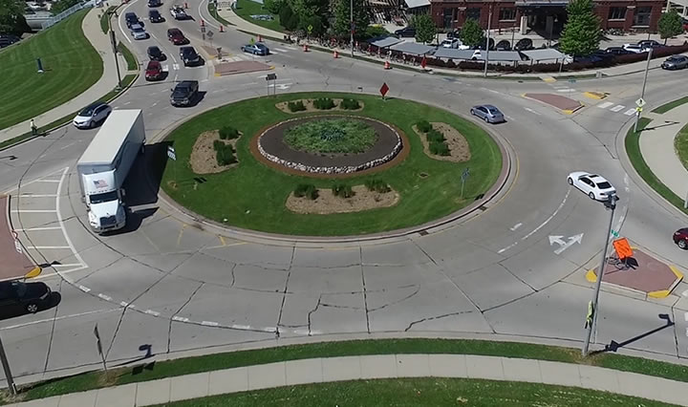
Turning Radius
Notes:
Turning Radius. Your vehicle’s turning radius determines its maneuverability. Having a tighter turning radius means you can make a tighter turn. The opposite is also true. A wide turning radius means you need more room to make your turn.
CALLOUT: Your turning radius is much tighter when you don’t have a trailer attached. Get the feel for your turning radius, both with and without a trailer, to understand your limitations when turning.

Slide 27
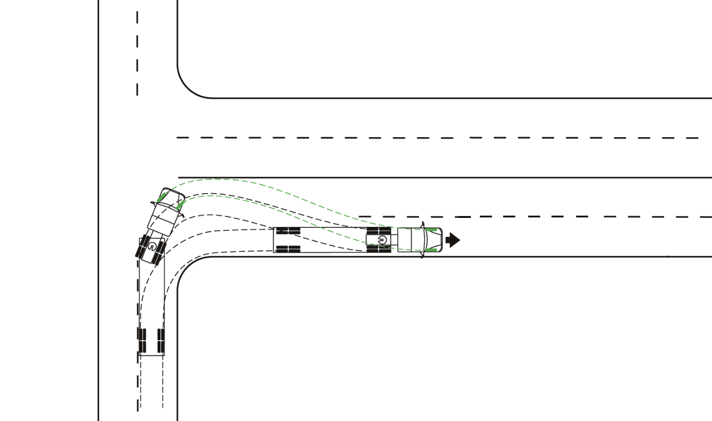
Off-Tracking
Off-tracking occurs when the wheels on the tractor follow a different path than the wheels on the trailer through a curve or turn. The rearmost wheels follow the shortest path.
Notes:
Off-Tracking. Off-tracking is an issue with all combination vehicles, especially the largest of them. Off-tracking occurs when the wheels on the tractor follow a different path than the wheels on the trailer through a curve or turn. The rearmost wheels follow the shortest path. And the longer the vehicle, the greater the problem.
Factors that determine off-tracking in a tractor-trailer unit include:
Distance between the kingpin and rear trailer wheels (the greater the distance between the kingpin and rear trailer wheels, the more off-tracking occurs)
Amount of sideways drag of the rear tires (the more sideways drag, the greater the off-tracking)
Radius of the curve

Slide 28
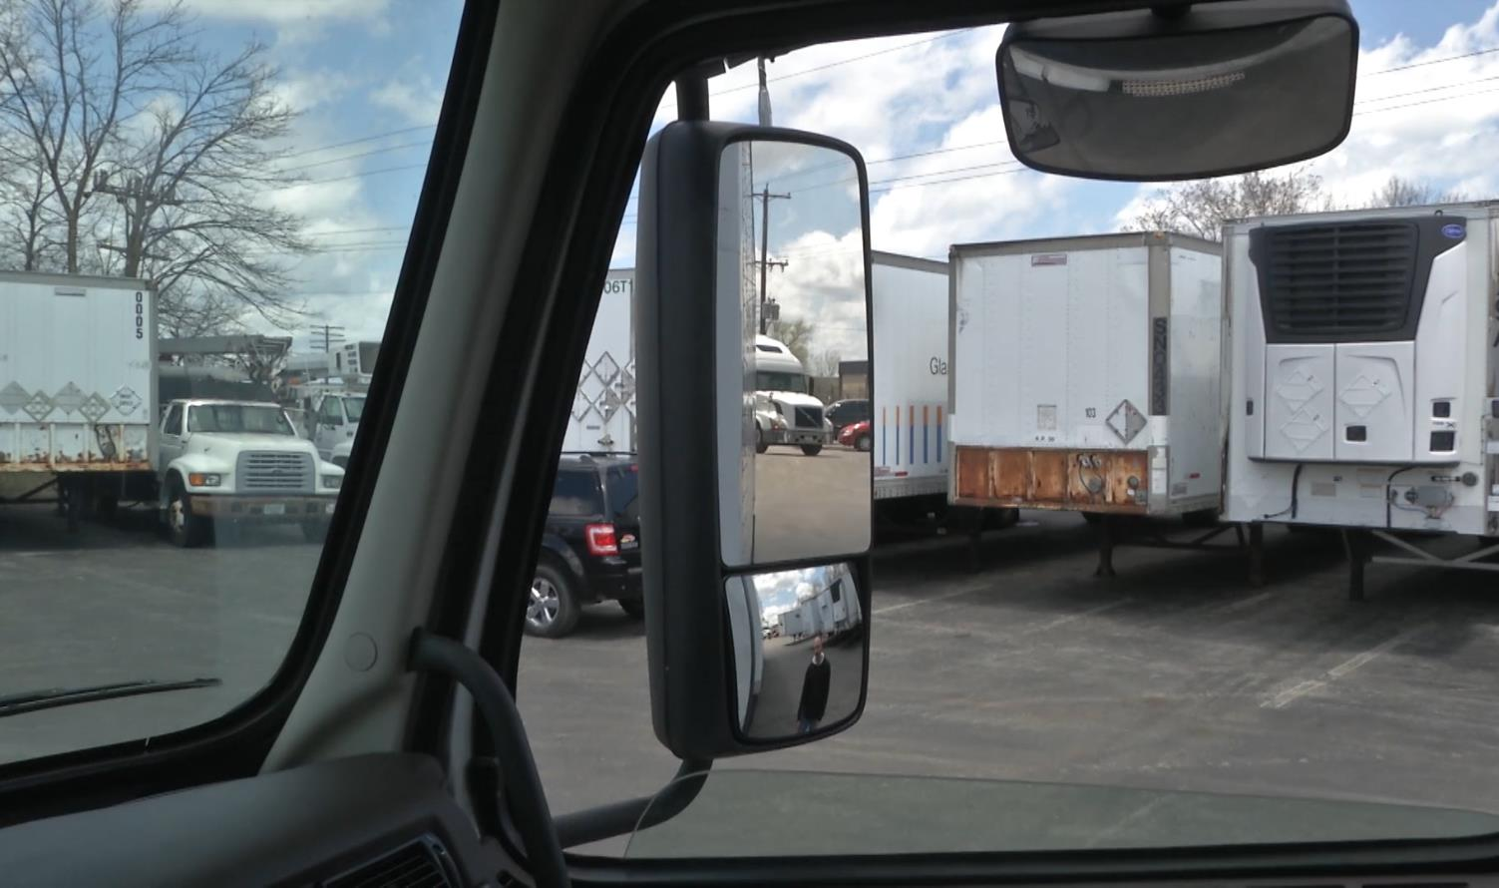
Visibility
Set your mirrors appropriately to maximize your visibility and acknowledge any blind spots before heading out.
Notes:
Visibility. Visibility is always a challenge. A pedestrian, a bicyclist, or even an automobile can easily move into a blind spot without you noticing. Most tractors are equipped with plane (flat) mirrors and convex (curved) mirrors. Even with a convex mirror, you only have 40 percent visibility to the right, so using a combination of both your plane and convex mirrors while you drive is best. Set your mirrors appropriately to maximize your visibility and acknowledge any blind spots before heading out.

Slide 29

Planning
Planning your route before you leave is a good way to help prevent you from driving on roads or through intersections that aren’t appropriate for your vehicle.
Notes:
Planning. Planning your route before you leave is a good way to help prevent you from driving on roads or through intersections that aren’t appropriate for your vehicle. For example, when you’re in a city, plan to stay on posted truck routes. These routes are specifically designated for commercial motor vehicles, which will help you avoid tight and dangerous intersections.

Slide 30
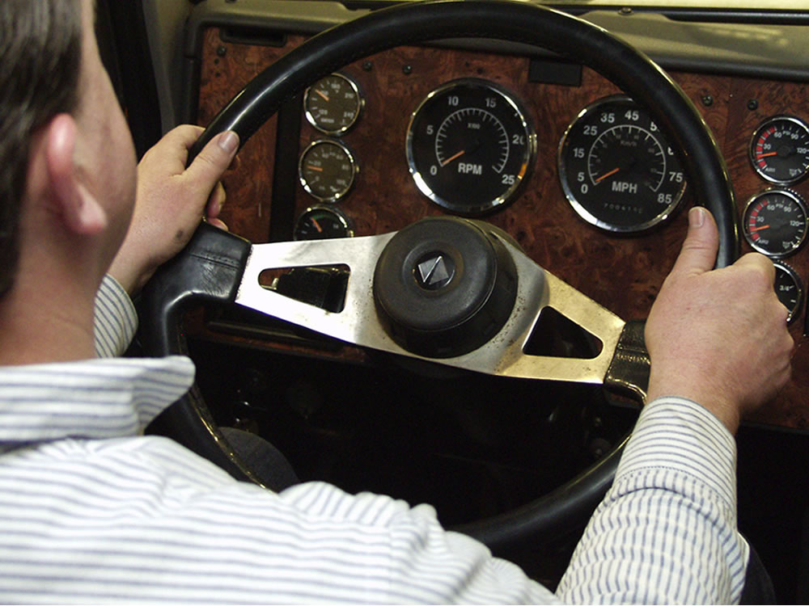
Steering a Tractor-Trailer
Notes:
Steering a Tractor-Trailer
Hold the steering wheel firmly with both hands. Your hands should be on opposite sides of the wheel. If you don’t have a firm hold, the wheel could pull away from your hands if you hit a curb or pothole or there’s a steer tire blow-out.
Losing steering control at highway speeds is very dangerous. Check for free play in the steering wheel as part of your pre-trip inspection. The free play should be no more than 10 percent of the wheel’s diameter.

Slide 31
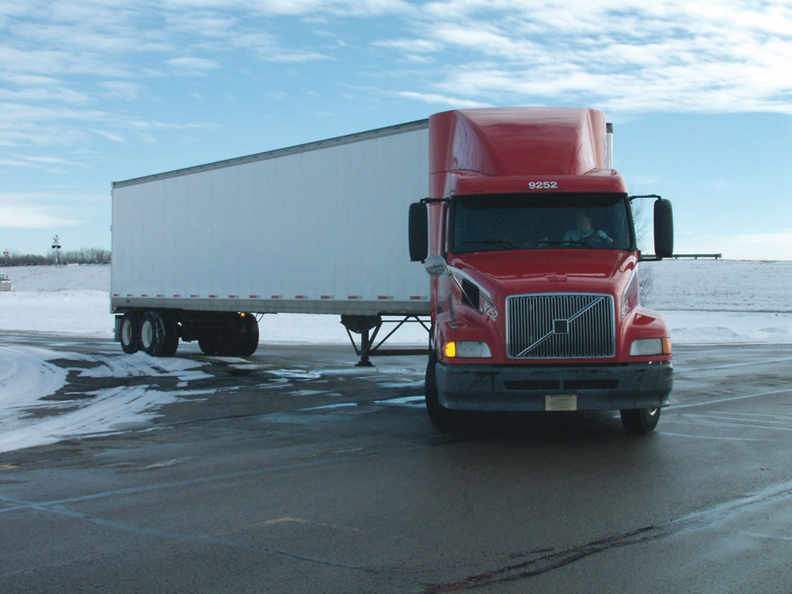
Right Turns
Notes:
Right Turns
Making a safe right turn involves good judgment, accurate steering, and proper speed and space control.
Before you turn, signal early to let other drivers and pedestrians know your intentions. Signal at least 100 feet before the turn; earlier if traffic is heavy.
When approaching an intersection, adjust your vehicle’s speed. The sharper the turn, the slower the vehicle should be moving. This allows you to use all available space.
Shift into the correct gear before the turn and complete the turn in the same gear. This allows you to keep both hands on the wheel during the turn.
For right turns, pull your tractor-trailer into the intersection before beginning the turn. Getting about one-half of the rig past the corner will help account for off-tracking. If you fail to pull far enough into the intersection, it could cause you to run over the curb or hit a fixed object, such as a street sign. Once the vehicle has reached that point, turn the steering wheel.
As you’re turning right, continue to scan the road ahead and to the sides, and pay special attention to your right-side mirrors. Doing so will help you avoid troublesome situations, like when an impatient driver tries to move into the right lane before you complete your turn.
Immediately after the turn is complete, turn the steering wheel back to straighten out the wheels.
Most intersections aren’t designed to give you the turning radius you need, so you might have to swing wide into another lane for a successful turn using either a button hook or jug handle turn.
VIDEO
4.1 — Right Turns

Slide 32
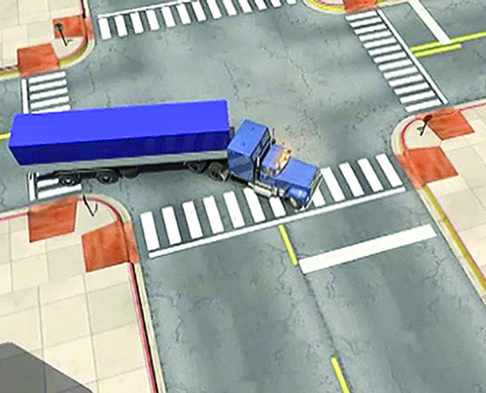
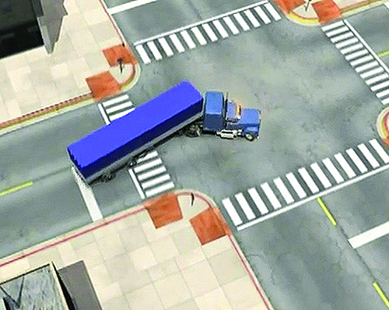
Button Hook Jug Handle
Where your vehicle swings wide into an extra lane in the cross street while making the right turn
Involves steering left on the street you are on before turning right during a right turn
Notes:
Right Turns
A button hook turn is where your vehicle swings wide into an extra lane in the cross street while making the right turn. This turn is otherwise known as a square corner turn. This type of turn is the preferred method in tight areas.
A jug handle turn involves steering left on the street you are on before turning right during a right turn.

Slide 33
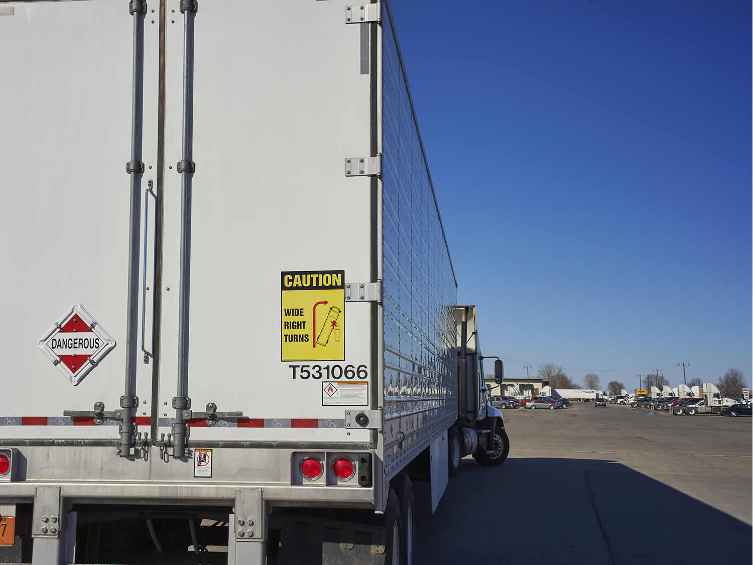
Common Mistakes
  Approaching the intersection too fast
  Turning from
  the wrong lane
  Forgetting to gear down
  Swinging left before turning right
  Shifting gears
  while turning
  Failing to allow
  for off-tracking
  Forgetting to watch the right mirror before, during, and after the turn
Notes:
Right Turns
Some of the most common mistakes drivers make when executing right turns include:
Approaching the intersection too fast
Turning from the wrong lane
Forgetting to gear down
Swinging left before turning right
Shifting gears while turning
Failing to allow for off-tracking
Forgetting to watch the right mirror before, during, and after the turn

Slide 34
Left Turns
Notes:
Left Turns
In comparison with right turns, left turns are less hazardous to execute because you have better visibility on the left side of your vehicle. But that doesn’t mean you can afford to get careless.
As with right turns, signal early to make your intentions known and reduce vehicle speed when approaching the intersection.
Size up the intersection. Determine how much space you’ll have to make the turn. Identify potential obstacles, including oncoming vehicles, and decide which lane you should be in.
In most cases, you’ll be turning from the lane nearest the center line. If there are multiple turn lanes, however, start in the rightmost lane. If you’re on a one‑way street, start in the far-left lane.
Shift into the correct gear, keep the vehicle’s wheels straight before starting the turn, and complete the turn in the same gear.
When turning left, stay on the right side of your lane and pull halfway past the center of the intersection before beginning the turn. Continue to scan the road ahead and to the sides and pay special attention to your left-side mirrors as you turn. Be sure to look over your left shoulder — this might help you see things before your mirrors do. And, just like you do with right turns, allow room for off-tracking on left turns, as well.
Watch your mirrors before, during, and after the turn. Turn the steering wheel back to the right immediately upon completion of the turn.
VIDEO
4.2 — Left Turns

Slide 35
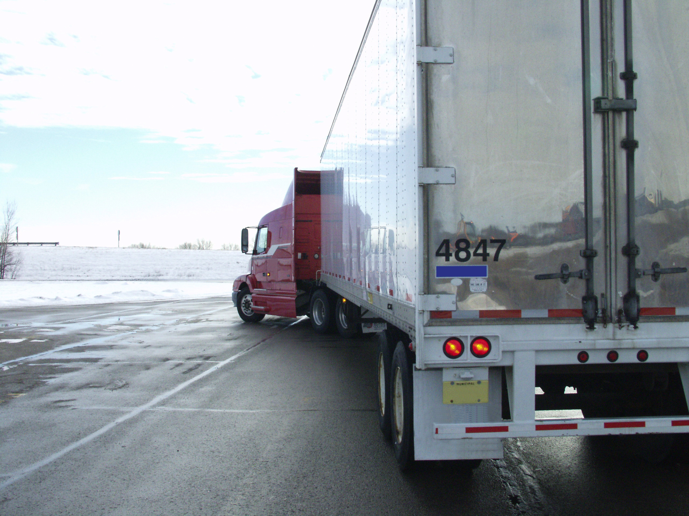
Common Mistakes
  Approaching the intersection
  too fast
  Turning from the wrong lane
  Forgetting to gear down
  Shifting gears while turning
  Failing to allow for off-tracking
  Forgetting to watch the
  right mirror before, during,
  and after the turn
  Failing to allow enough space between them and oncoming traffic to execute the turn successfully
Notes:
Left Turns
The most common errors made when executing a left turn are the same as those for right turns, except you can eliminate “swinging left before turning right.” In addition, drivers fail to allow enough space between them and oncoming traffic to execute the turn successfully.

Slide 36

Curves
Notes:
Curves
Look ahead and recognize upcoming curves.

Slide 37
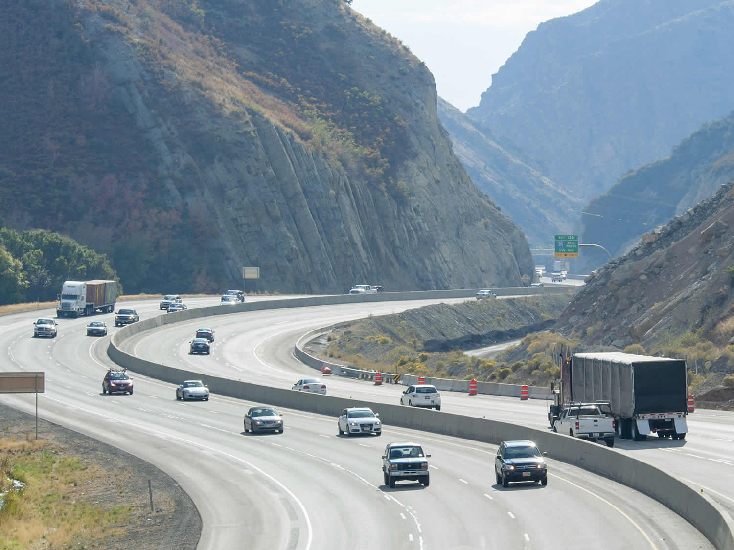
Left Traveling Curve
Keep the front of the vehicle as close to the outer edge of the road as possible
Right Traveling Curve
Keep the vehicle close
to the center of the road without crossing the center line
Notes:
When approaching a left traveling curve, keep the front of the vehicle as close to the outer edge of the road as possible. This will keep your trailer from running over the center line on a curve.
When approaching a right traveling curve (not a corner), keep the vehicle close to the center of the road without crossing the center line. Failure to keep toward the center could result in the rear of your vehicle running off the road, on to the shoulder, or hitting something on the right side.

Slide 38

Roundabouts
Notes:
Roundabouts
Roundabouts are circular intersections which allow for the continuous flow of traffic where two or more roads intersect. Although roundabouts can have one lane or multiple lanes, all traffic in a roundabout flows in one direction, and entering vehicles yield to traffic already in the roundabout. By design, roundabouts require vehicles to travel at lower speeds to safely navigate through them.
Before entering a roundabout, know what direction you’ll be going and, if it’s a multi-lane roundabout, make sure you’re in the correct lane as you approach it.
As you enter the roundabout, keep off-tracking in mind. If you’re turning right, you’ll need to position your tractor to the far-left of your lane. This allows room for off-tracking to the right side as the turn is completed.
When traveling straight through a roundabout, start with your tractor on the left side of the lane. Then, as you move forward, drive your tractor to the far-right side of your lane. As you begin to exit, stay to the right side of your lane until your rear wheels leave the roundabout.
When turning left, move into the roundabout in the left lane, and keep your tractor to the far left of the lane. As the tractor moves through the turn, the trailer will off-track to the left. Your trailer may ride up onto the truck apron (the raised section of pavement surrounding the middle island of the roundabout) and that’s okay. Truck aprons are specifically designed to help larger vehicles turn safely through a roundabout.
As you drive through the roundabout, you will have little to no visibility to the right until you start to make the turn to exit the roundabout. Regardless of the direction you’re headed, watch your mirrors and take it slow to ensure you come out of a roundabout safely.
While maneuvering through roundabouts can be more challenging for large tractor-trailers, being alert for traffic around you and planning ahead can make negotiating a roundabout much easier.
VIDEO
4.3 — Roundabouts

Slide 39
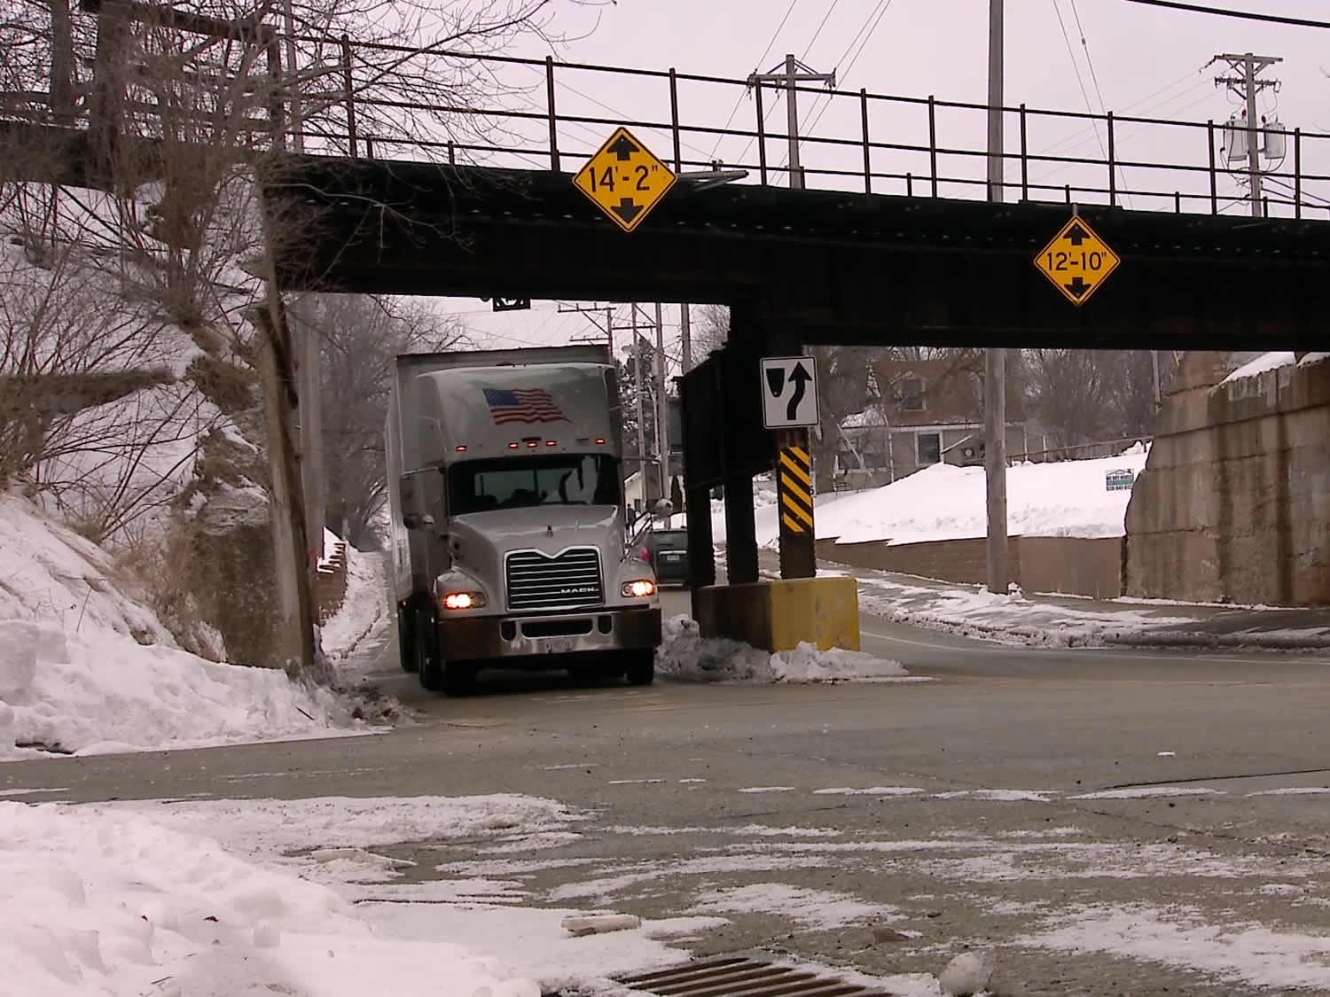
Restricted Areas
Notes:
Restricted Areas
There will be times when you have to deal with restrictions to the front, sides, or back of your vehicle as well as above your vehicle. It is important to understand these challenges and know how to manage them.
When on the road, be aware of the clearances around and above your vehicle. Continually scan and use your mirrors. Pay attention to signs that indicate vehicle weight, width, or height limitations. Include consideration of these limitations in your trip planning.
Awareness of your surroundings is also important when at the dock or in a parking lot. Continually scan, watching for tight spaces and overhangs as well as other vehicles and pedestrians.

Slide 40
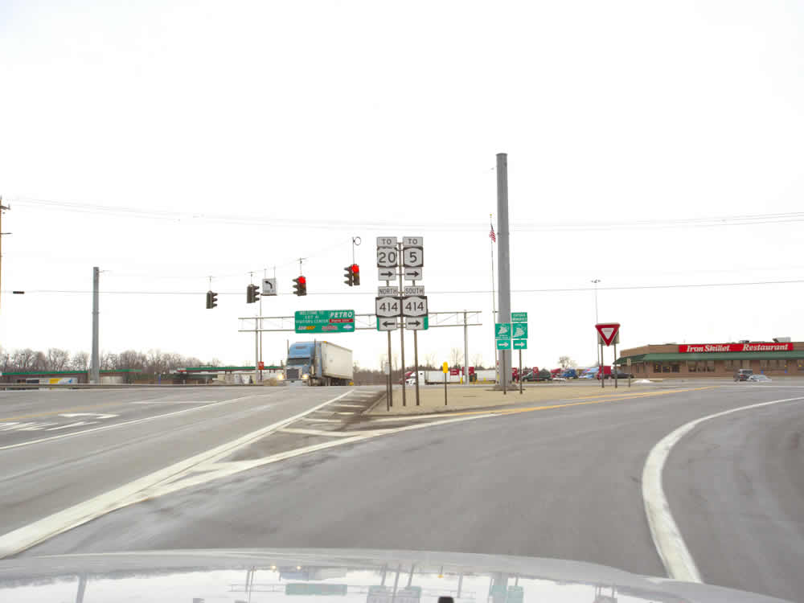
On Ramps/Off Ramps
Notes:
On Ramps/Off Ramps
The weight of your vehicle’s load as well as the ramp’s length and degree of turn will determine how much time is needed to get your vehicle up to speed to safely merge with oncoming traffic on an interstate or closed-access highway. The size of your vehicle will determine how much space is needed to enter traffic.
VIDEO
4.4 — On and Off Ramps

Slide 41
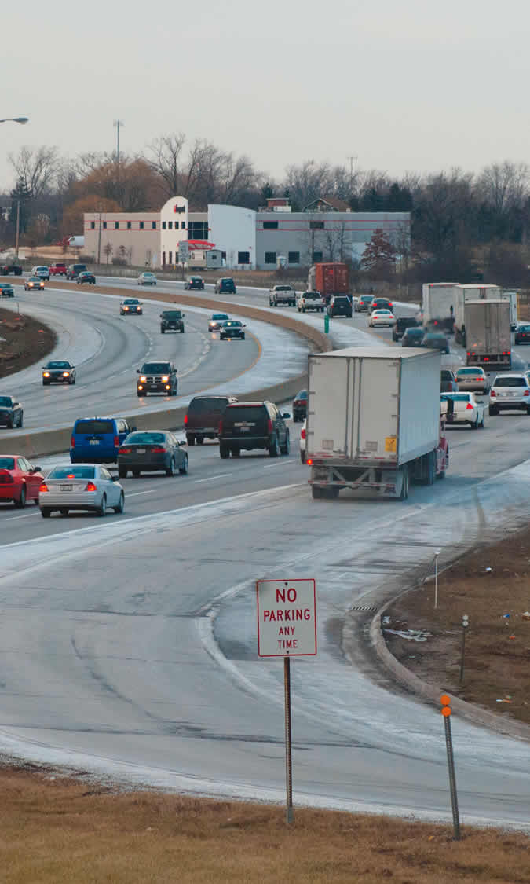
When entering traffic:
Size up the traffic
Signal early
Watch for an opening
Build up speed to merge smoothly
Watch all mirrors
Watch for
oncoming traffic
Notes:
On Ramps
When entering traffic:
Size up the traffic
Signal early
Watch for an opening
Build up speed to merge smoothly
Watch all mirrors
Watch for oncoming traffic
When entering a freeway or turnpike make sure you are paying full attention. Watch for vehicles approaching from behind or the side.
In some cases, on-ramps have a short upgrade. This makes it difficult for a heavy vehicle to get up to speed and merge. Engaging the left turn signal can be helpful in alerting drivers on the highway that your intention is to merge onto the roadway where they are traveling.

Slide 42
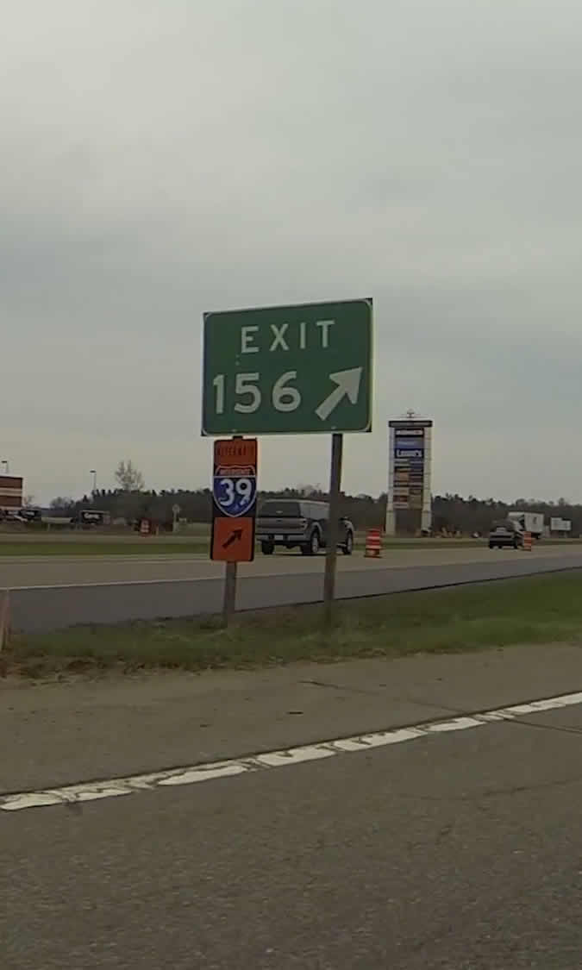
When leaving the interstate or
closed-access highway:
Signal and get into
the exit lane as soon
as possible
Check your mirrors to monitor the speed of traffic behind
Shift down to a lower gear and make the exit
Notes:
Off Ramps
When leaving the interstate or closed-access highway:
Signal and get into the exit lane as soon as possible
Check your mirrors to monitor the speed of traffic behind
Shift down to a lower gear and make the exit
Freeway and turnpike exits can be particularly dangerous. Curved off‑ramps often have speed limit signs posted, but the posted speed is the recommended speed for an automobile and may not be safe for a larger vehicle carrying cargo. Trucks generally should travel at a speed that is at least 5 mph less than the ramp speed limit. The curving off ramps are a transition area where the weight/center of gravity of the load will have a significant impact on rollover potential. Adjust speed for the surface conditions expected on the ramp well before entering a curve. Exits that go downhill and turn at the same time can be especially dangerous since the downhill grade makes it difficult to reduce speed.

Slide 43
Objectives Review
You should now be able to:
  Discuss how to start up and shut down the engine of a tractor-trailer
  Describe how to put a tractor-trailer in motion and come to a complete stop
  Identify ways to maneuver through turns, curves, and roundabouts, and enter/exit highways safely
  Explain how to successfully straight line back a tractor-trailer
Copyright 2019 J. J. Keller & Associates, Inc.
Notes:
You should now be able to:
Discuss how to start up and shut down the engine of a tractor-trailer
Describe how to put a tractor-trailer in motion and come to a complete stop
Identify ways to maneuver through turns, curves, and roundabouts, and enter/exit highways safely
Explain how to successfully straight line back a tractor-trailer
CLASSROOM RECOMMENDATION
Before concluding your training session, have participants take the corresponding quiz (found on the Trainer Tools USB) to check their understanding of the material. You can customize any of the questions to fit your audience or workplace. The answer key can also be found on the Trainer Tools USB.
You may also choose to administer the quizzes before you begin your training session to help get participants thinking about the subject and/or to gauge their understanding of the topic ahead of time.

