Slide 1






PowerPoint® Instructions
This PowerPoint has been designed so you can easily customize it for your training session.
Throughout the presentation you’ll see icons with recommendations or videos to enhance the instruction you present to your students. A detailed explanation for each icon can be found on the next slide. Videos can be found on the Trainer Tools USB.
When you see an icon on the slide, look in the notes
section for further information.
Simply delete or move the icon off the slide before your training session begins.

Slide 2





Classroom Recommendations. Provides suggestions for enhancing your classroom presentation; from ideas for large group discussions to suggestions on the use of training aids such as examples or photos of vehicle parts and components to help illustrate the items covered within a chapter.
Lab Recommendations. Provides suggestions for activities and exercises that take place outside the classroom, but do not involve
the actual operation of the tractor-trailer or its components. Examples
of lab sessions include conducting a vehicle inspection or practicing mirror adjustment.
Range Recommendations. These recommended activities take
place on a closed-access driving range where students may practice driving skills in a controlled environment. Examples of range sessions include practicing shifting technique and successfully completing a backing maneuver.
Road Recommendations. These recommended activities take place in road and traffic conditions that support the chapter’s objectives. Examples of road sessions include proper communication with other drivers through the use of turn signals and basic vehicle control under nighttime or extreme weather conditions.
Videos. These short video clips reinforce material presented in the Student Manual. Use them to help students grasp difficult concepts or subject matter.

Slide 3
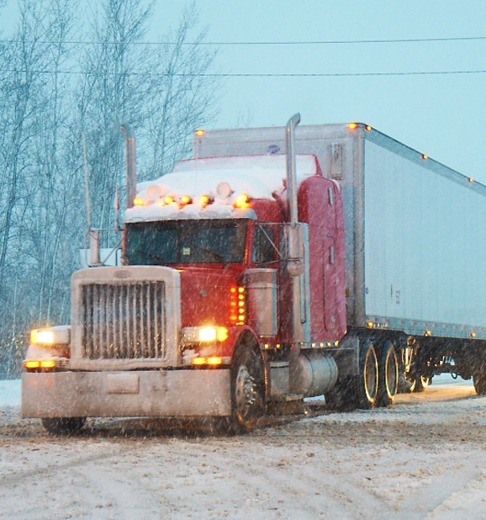
Extreme Driving Conditions
14
Notes:
Chapter 14: Extreme Driving Conditions
Unit A1.2.7 Extreme Driving Conditions
This unit must teach driver-trainees about the specific problems presented by extreme driving conditions. The training provided will emphasize the factors affecting the operation of CMVs in cold, hot, and inclement weather and on steep grades and sharp curves. The training provider must teach proper tire chaining procedures.

Slide 4
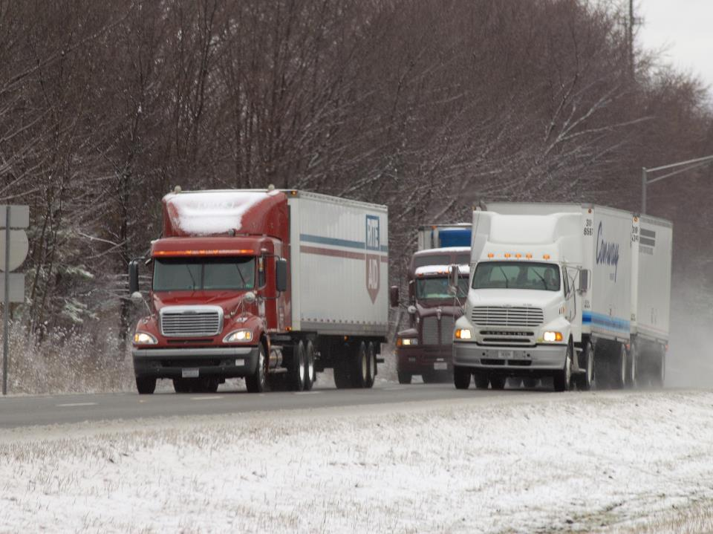
Introduction
Notes:
Introduction
Extreme driving conditions demand increased preparation and awareness. Both you and your vehicle must be in top form. This chapter will introduce you to the challenges of operating a tractor-trailer in extreme driving conditions.
CLASSROOM RECOMMENDATIONS
Weather and geography may make it difficult to present this topic and follow-up with appropriate range or street practice. There are two ways to approach presenting this topic.
Present the weather-related part of the program when conditions permit.
Present the entire chapter at one time, and then incorporate range and street practice into other sessions as weather permits.

Slide 5
Objectives
Upon completion of this lesson, you will be able to:
  Identify common ways to prepare for driving in adverse weather conditions
  Describe when tire chains are appropriate and proper tire chaining procedures
  Discuss how to safely operate a vehicle in snow, ice, wind, rain, and fog
  Explain ways to stay safe in extreme heat or
  cold temperatures
  Recognize the challenges of driving on steep grades and around sharp curves
Notes:
Objectives
Upon completion of this lesson, you will be able to:
Identify common ways to prepare for driving in adverse weather conditions
Describe when tire chains are appropriate and proper tire chaining procedures
Discuss how to safely operate a vehicle in snow, ice, wind, rain, and fog
Explain ways to stay safe in extreme heat or cold temperatures
Recognize the challenges of driving on steep grades and around sharp curves

Slide 6
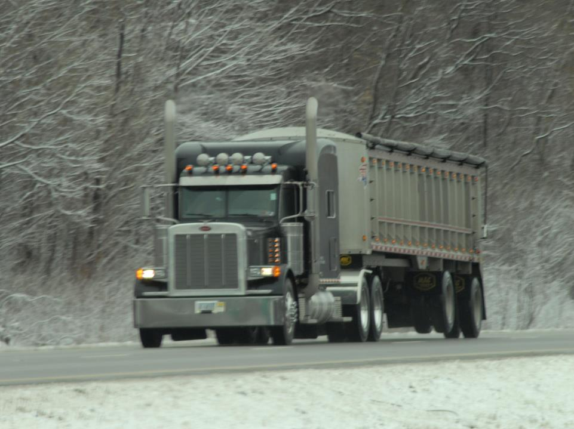
Vehicle Preparation
Notes:
Vehicle Preparation
Adverse weather conditions (including snow, ice, rain, fog, and high winds) demand increased preparation for you and your vehicle. Reduced traction (the grip of your tires on the road) increases stopping distances and decreases vehicle maneuverability and control. Reduced visibility decreases your ability to clearly see hazards.
During the winter months, conditions can change quickly. Being prepared is key to successfully operating in snow, ice, and extreme cold. During your regular vehicle inspections, pay close attention to the items listed below.
VIDEOS (see Trainer Tools USB)
14.1 — Extreme Weather Vehicle Preparation

Slide 7
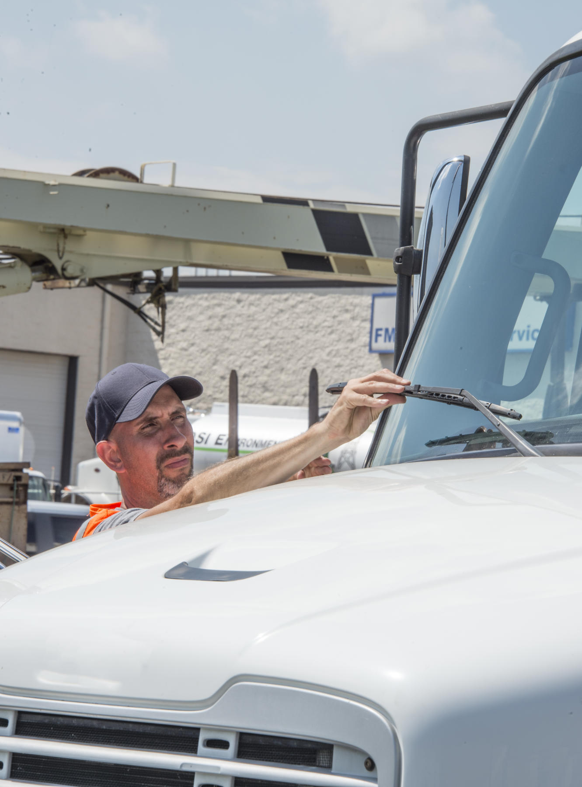
Coolant level and antifreeze concentration
Defrosting and
heating equipment
Windshield wipers
and washers
Notes:
Coolant Level and Antifreeze Concentration
Make sure the cooling system is full and there’s enough antifreeze in the vehicle’s system. A low coolant level can affect the engine’s performance as well as the operation of the vehicle’s defroster and heater. Antifreeze concentration can be checked with a tester designed for this purpose.
Defrosting and Heating Equipment
Make sure the vehicle’s defrosters and heater are working and that you know how to operate this equipment. Also check the heaters for the mirrors and fuel tank(s). Properly working defrosters and heaters are necessary to keep snow and ice from building up on your windows and mirrors and helps to prevent ice from forming in your fuel tank.
Windshield Wipers and Washers
Make sure the wiper blades are in good condition. The wiper blades need to press against the window hard enough to wipe the windshield clean. This is important in keeping snow off of the windshield. Also make sure the windshield washer works and there’s an appropriate type and amount of washer fluid (fluid that will not freeze in cold weather) in the reservoir. Also check the reservoir for cracks or other damage.

Slide 8
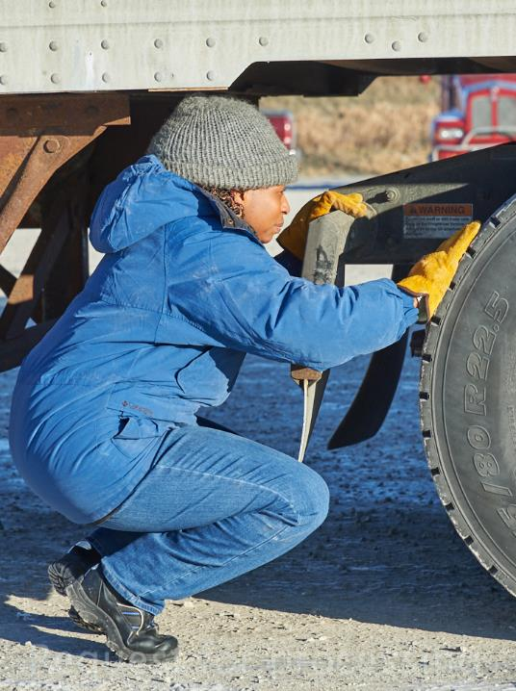
Tires
Tire chains
Brakes
Lights and reflectors
Windows and mirrors
Notes:
Tires
Check tire tread depth. The drive tires must provide enough traction to operate on wet pavement and snow. The steering tires must have enough traction to steer the vehicle. The front wheels must have a tread depth of at least 4/32 inch on every major groove to be legal. Other wheels must have a tread depth of at least 2/32 inch to be legal. Also check tire pressure, mounting, and inflation.
Tire Chains
You may be faced with conditions that require the use of chains (per state or local law). Prepare for this possibility by carrying the proper size and number of chains as well as extra cross-links. Check the chains for broken hooks, worn or broken cross-links, and bent or broken side chains. Make sure chain slack adjusters are also available if you need them.
CALLOUT: Some states and some motor carriers require chains while others prohibit them, so it’s crucial to know what state laws and company policies apply along your route of travel.
Before you drive with tire chains, you need to know how to install them and how your tractor‑trailer will handle when driving with them.
Brakes
Brake balance should be checked. The brakes should apply pressure equally at the same time. Check adjustment and take up any slack. Be careful when setting your brakes in very cold weather. If there is a lot of moisture on them, they could freeze together, and you may not be able to release them. One way to avoid this is to lightly ride your brake when exiting the highway or while going through the parking lot. This will help warm the brakes and get rid of moisture.
Also, keep air tanks as moisture-free as possible. Drain both tractor and trailer tanks daily. Moisture in the air lines can cause the vehicle’s brakes to freeze. If your vehicle has other moisture-control equipment (alcohol evaporators, spitter valves), make sure the equipment is working properly.
Lights and Reflectors
Visibility of lights and reflectors is very important in poor weather conditions. Make sure the vehicle’s lights and reflectors are clean (free of dirt, snow, ice, road salt) and check them often. In poor weather, the condition of your lights and reflectors play a big part in determining your range of sight and how well others can see your vehicle.
Windows and Mirrors
Remove all ice, snow, and debris from the windshield by using a snow brush and/or scraper and the windshield defroster to ensure you have no visual obstructions.

Slide 9
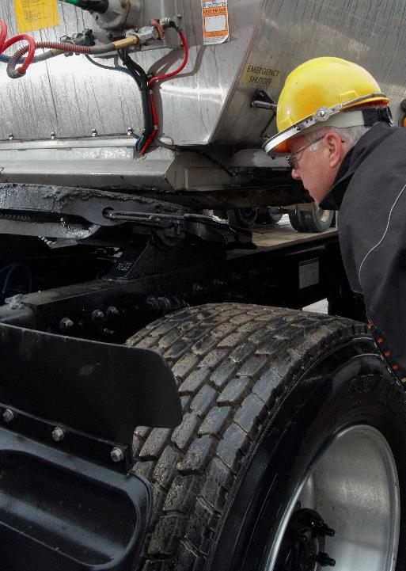
Hand holds, steps, and
deck plates
Exposed wiring and air lines
Fuel tank
Exhaust system
Coupling devices
Notes:
Hand Holds, Steps, and Deck Plates
Reduce your chances of slipping and falling by removing all ice and snow from the handholds, steps, and deck plates.
Exposed Wiring and Air Lines
Remove ice and snow from wiring and air lines. At or below zero degrees, plastic air lines can become brittle and can break very easily. Snow and ice build-up can cause them to sag and possibly get snagged on the tractor, trailer, or the tires.
Fuel Tank
Make sure the fuel tank is full before starting out. It should be topped off regularly if bad weather is expected. This will help keep water out of the fuel, which can freeze in fuel lines and filters. This is also a good precautionary measure to make sure you don’t run out of fuel and become stranded in a dangerous situation. It’s also a good idea to always know where upcoming fuel stops are located even if it’s not where you plan on stopping.
Exhaust System
Loose exhaust system connections can cause carbon monoxide to leak into your vehicle. Carbon monoxide is poisonous. It can kill you if you are exposed to it, especially if you are in an area with poor ventilation, like a truck cab with the windows rolled up.
Coupling Devices
Before coupling, remove all snow and ice. In below freezing temperatures, the jaws of the coupling device may not lock if the grease is frozen. Double check the locking mechanism and make sure the fifth wheel is lubricated with a winter-grade lubricant. This will help prevent the grease from freezing and help steering on slippery roads.

Slide 10
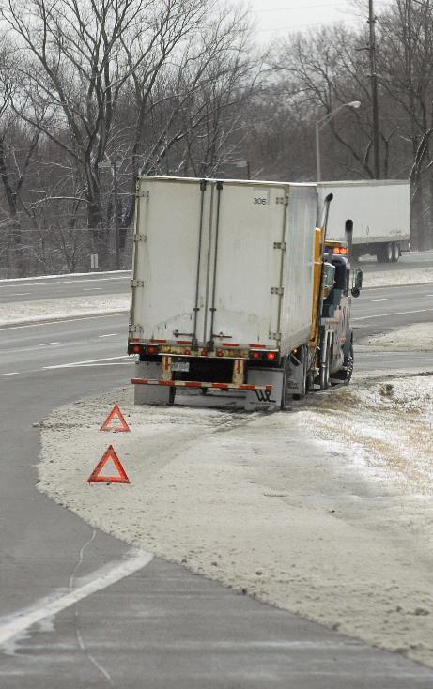
Windshield scraper
Snow brush
Extra windshield washer fluid
Small shovel
Flashlight
Spare batteries
Jumper cables
Warning devices
Notes:
Emergency Equipment
When it comes to your vehicle and inclement weather, you should have the following items with you on the road:
Windshield scraper
Snow brush
Extra windshield washer fluid
Small shovel
Flashlight
Spare batteries
Jumper cables
Warning devices

Slide 11
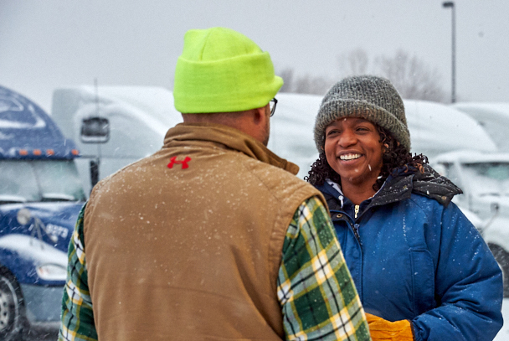
Driver Preparation
Notes:
Driver Preparation
If you find yourself stalled or stranded in a winter storm, in extreme cold temperatures, or in extreme heat, you are at risk of serious injury.
In sub-zero temperatures, frostbite and hypothermia can set in quickly. In extreme heat, dehydration and other heat-related illnesses can set in quickly.

Slide 12

For your protection and safety bring extra water, food, and other items.
Notes:
Emergency Equipment
For your protection and safety during the winter months, you should have the following items:
Drinking water
Extra food
Medicine (as needed)
Hats
Insulated boots with good traction
Gloves
Extra clothes and blankets
Proper outerwear (heavy jacket, heavy coveralls)
For your protection and safety during the summer months, you should have the following items:
Drinking water
Extra food
Medicine (as needed)

Slide 13

Check the forecast before heading out.
Notes:
Check the Forecast
Being prepared includes checking the forecast before heading out. Many websites offer detailed, hour-by-hour weather forecasts, so make time to consult one of these sites as part of your preparation routine.
Also check the battery charge on your cellphone. Many apps can alert you when extreme weather is about to strike. In addition, you don’t want to find yourself stranded or caught in bad weather without being able to call for help.
Make sure the radio works so you can listen to local forecasts.
Dispatchers are often in touch with drivers all over the country so they too, can be a valuable source of information regarding the current weather conditions along your route.

Slide 14
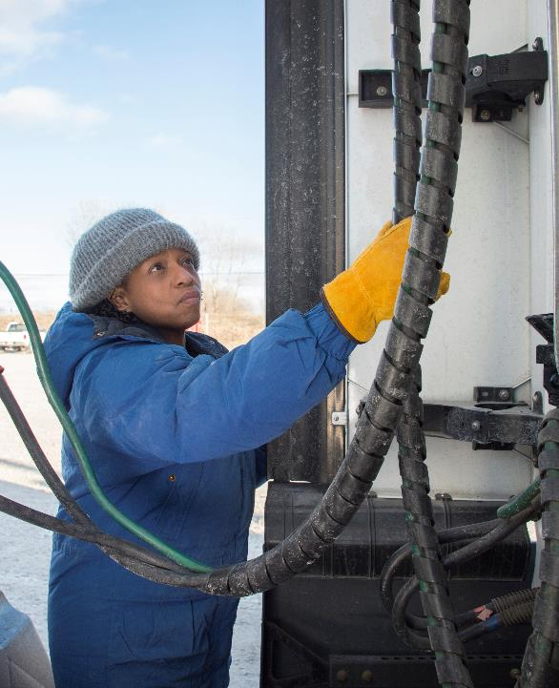
Dress in layers when exposed to cold.
Notes:
Preventing Cold-Related Illnesses
When exposed to cold temperatures, the body begins to lose heat faster than it can be produced. Prolonged exposure to cold will eventually use up the body’s stored energy. The result is hypothermia, or abnormally low body temperature.
When out in extreme cold, dress in layers and wear a coat, hat, scarf, and gloves.

Slide 15
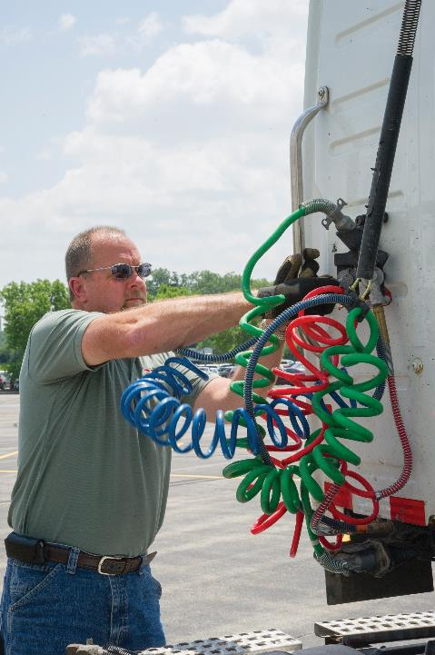
Wear light-colored, loose-fitting, breathable clothing when exposed to heat.
Notes:
Preventing Heat-Related Illnesses
Avoiding heavy exertion, extreme heat, sun exposure, and high humidity are basic steps to prevent heat-related illnesses, such as heat cramps, heat exhaustion, and heat stroke. When out in extreme heat:
Wear light-colored, loose-fitting, breathable clothing (such as cotton)
Try to schedule heavy, outdoor work in the coolest part of the day
Take breaks in shaded or cool areas
Drink water frequently

Slide 16
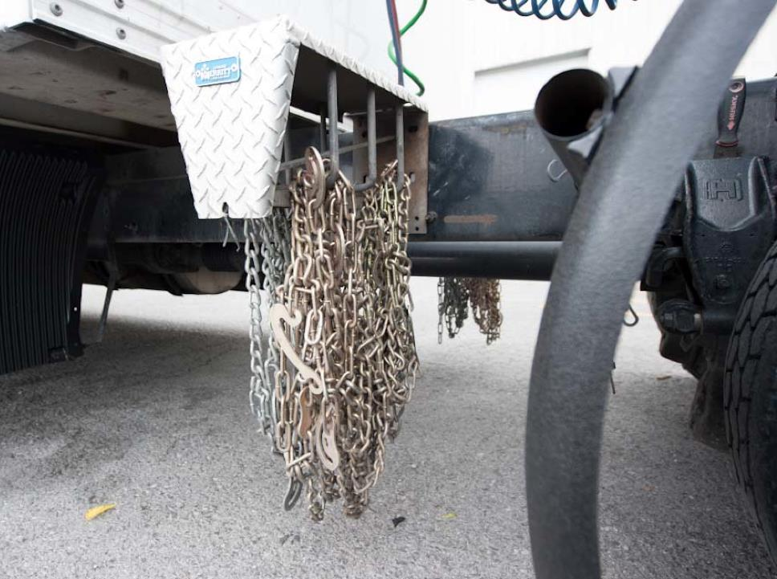
Tire Chain Installation
Notes:
Tire Chain Installation
Tire chains are constructed to grip the tire around the sides and provide traction across the tread. Installed on the drive wheels, they improve uphill traction. On trailer wheels, they improve traction for downhill braking. Chains help keep your vehicle on the road, and they decrease your chances of getting stuck.
Chains are most effective in heavy snow. In light, dry snow they provide little traction advantage, but do provide some stability. Most chains are not effective on glare ice.
When installing chains, they should be snug, but not too tight. They are designed to creep or move on the tires to prevent gouging or breakage. Chains should be regularly checked and retightened as necessary to prevent them from becoming loose and slapping against the trailer or catching on the suspension or fuel tank.
Use extreme caution when installing chains:
Pull well off the road (most areas that require chains have “chain-up” areas)
Park on a level surface
Wear a reflective vest so others can see you
Work facing traffic
Know where you are going if confronted by an out-of-control vehicle
Watch your footing
Watch your own vehicle, making sure it doesn’t slide
CALLOUT: Many states have laws and/or regulations addressing the type and number of chains that must be used on certain highways and the dates in which they must be carried in the vehicle and used if necessary. Make sure you understand state and local laws for the states in which you travel.
LAB RECOMMENDATIONS
The purpose of this session is to provide practice in the use of tire chains; developing student skill in mounting and removing tire chains.
Break your students into groups of three students per instructor. The instructor should demonstrate the proper procedure for mounting and removing tire chains. Then each student should take a turn safely and properly mounting and removing a set of tire chains. The instructor and students should observe the student performing the mounting and removing of the chains, making sure all procedures properly followed. Also, watch for the following common problems:
Chains too tight: Can result in gouged or worn tires
Chains too slack: Can result in premature chain failure

Slide 17
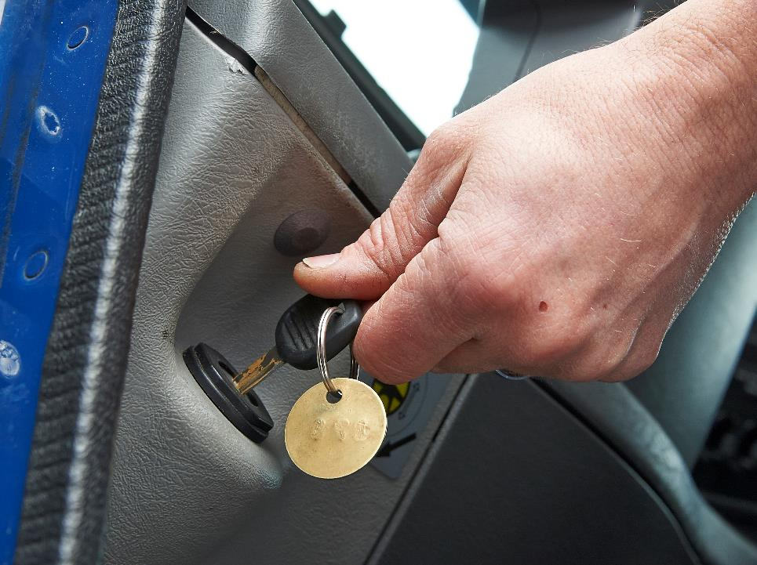
Cold Weather Starting
Notes:
Cold Weather Starting
The colder it is, the harder it is to start any type of engine. There are a number of devices that can help in starting your vehicle’s engine.
Ether and Ether-Based Fluids
There are both good and bad points to using ether to help start your vehicle in cold temperatures. On the good side, ether has a very low flash point and can ignite easily at cold temperatures. On the bad side, if ether is not used properly, it can damage the engine. Also, it can be dangerous to use as it is highly volatile. Too much ether could crack your engine block, cause vapor lock, or cause other serious internal damage. Should you spill some on your clothes, stay away from cigarettes, lighters, and heaters, and change immediately.
Ether and ether-based fluids come in a variety of forms including:
Aerosol sprays
Pressurized cylinders
Driver-controlled, automatic injection systems
Aerosol sprays and pressurized cylinders are used manually and require the placement of ether into the air intake. The automatic injection system is activated by either the driver turning on a switch in the cab or the vehicle automatically injecting ether when the vehicle is started.
No matter what form of ether you may use, always use extreme caution to prevent an accident and/or injury.
Glow Plugs
Glow plugs are electric heating elements that warm air coming into the engine from the air intake. Consult your vehicle’s owner’s manual for specific operating instructions.
Preheaters
Preheaters keep the engine warm while your vehicle is parked for an extended period of time. Most truck tractors use an in-block type of preheater. In-block heaters fit into the freeze plug holes in the lower water jacket. They are then plugged into an electrical outlet. Coolant is heated to 160°F and the heated coolant is circulated throughout the engine. This eliminates warm-up, allowing you to use normal starting procedures.
In extremely cold areas, coolant heaters are frequently supplemented with battery box heaters, oil sump heaters, and fuel heaters. Consult your vehicle’s owner’s manual and maintenance personnel for proper operation.

Slide 18
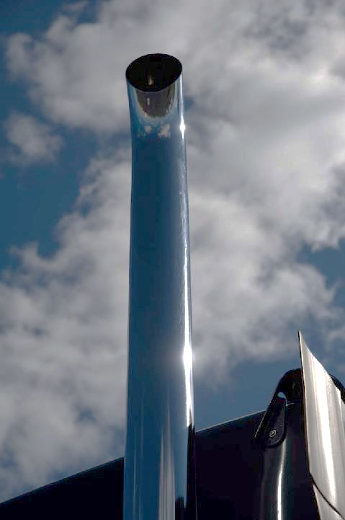
If you don’t see vapor or smoke, the engine may not be getting fuel.
Notes:
If Your Engine Doesn’t Start
If your vehicle’s engine won’t start with the use of starting aids, check the fuel and electrical systems. To make sure your vehicle is getting enough fuel, watch the exhaust stack while cranking your engine. If you don’t see vapor or smoke, the engine may not be getting fuel. Don’t continue to crank the engine, as this will run down the battery. Check the fuel tank and fuel lines for ice blockage. Also check the fuel tank vent.
Never crank the engine for more than 15 seconds. If the engine is getting fuel, but isn’t starting, there could be a problem in the electrical system. Check the battery for terminal corrosion, loose connections, cracks in cables, and moisture on cables.
If your vehicle has an air starter, it needs an air supply to start. If there is no air, you’ll need to resupply air from either an air compressor or another tractor. Check the vehicle’s owner’s manual for specific procedures.

Slide 19
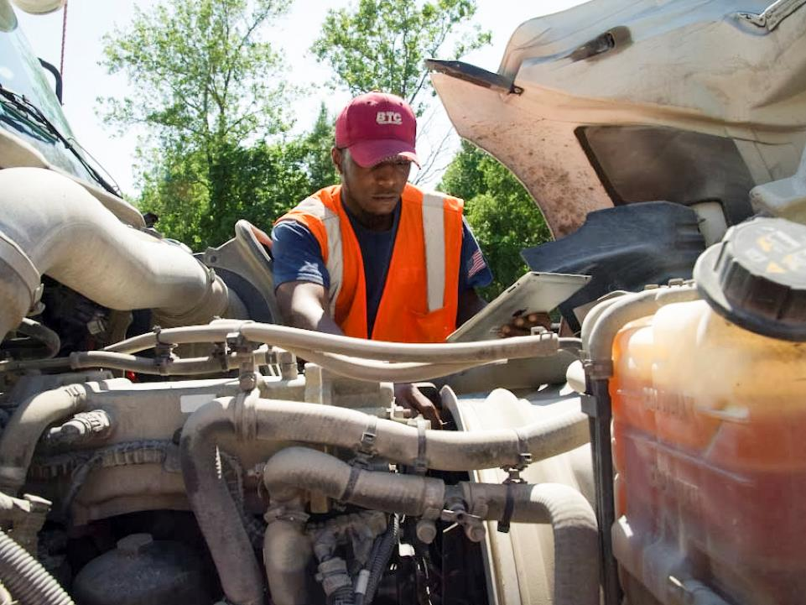
Operating in Hot Weather
Notes:
Operating in Hot Weather
The greatest issue for a vehicle in hot weather is the potential for overheating. Appropriate inspection and maintenance can aid in preventing this from happening. This includes paying extra attention to the cooling system, including looking for leaks, damage, and/or deterioration to the:
Radiator and radiator cap
Fan and fan belt
Water pump
Water hoses
Also, make sure the cooling system is full and there’s enough antifreeze in the vehicle’s system.

Slide 20
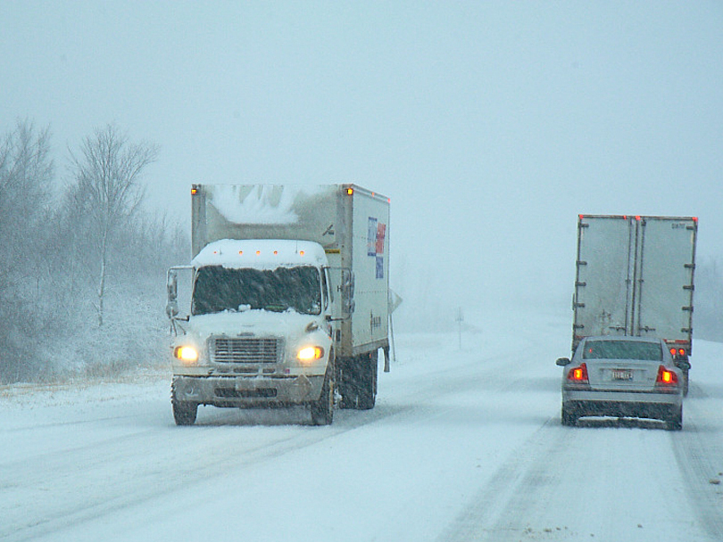
Extreme Weather
Notes:
Extreme Weather
Whether it’s foggy, rainy, windy, snowy, or icy, you’ll want to reduce your speed, increase your following distance, and turn on your low beam headlights. However, each weather condition brings its own unique set of challenges. When driving through inclement weather there are certain actions every driver should take to keep themselves and others safe on the road.

Slide 21
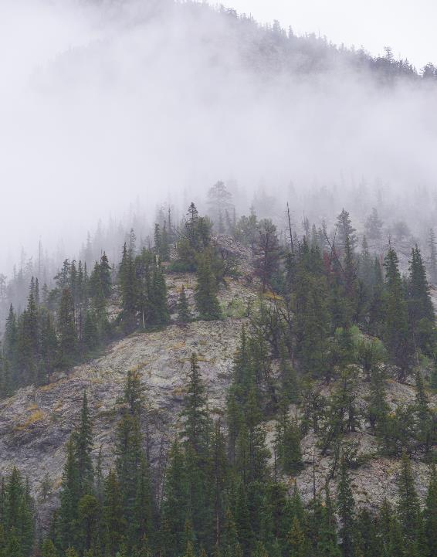
Fog limits your ability to see and judge distance.
Notes:
Fog
Fog limits your ability to see far enough ahead and to judge distances. It also limits the ability of other drivers to see you. You’ll need to consider how long it would take you to stop your truck if there was a stalled car, an animal, or a crash scene ahead of you.
Slow down to 20-30 miles per hour. In dense fog (where visibility is limited to three vehicle lengths) slow down even further to 10‑15 miles per hour.
When visibility at an intersection is compromised by fog, lower the driver and passenger side windows to listen for any cross traffic you may not be able to see. As an additional safety measure, sound your horn before proceeding through intersections to let approaching drivers know you’re there.
Fog can contain a lot of moisture, so use the intermittent feature on your wipers to maintain adequate vision ahead.
CALLOUT: Note that these are suggested guidelines. Only you, the professional driver can determine a safe speed when it comes to traveling in adverse conditions.
VIDEOS (see Trainer Tools USB)
14.2 — Extreme Weather Fog

Slide 22
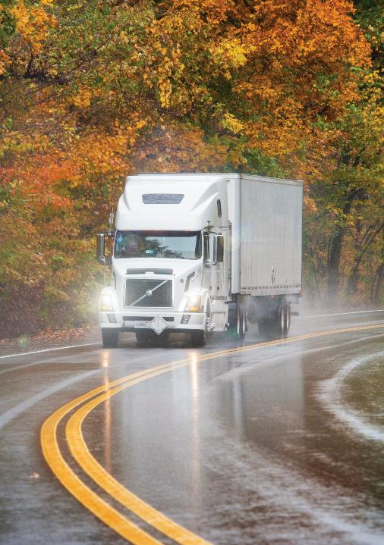
Rain can reduce your traction when it mixes with the oil and dirt on the road.
Notes:
Rain
Rain affects your visibility and can reduce your traction when it mixes with the oil and dirt on the road. Heavy rain can cause a vehicle to hydroplane or cause the vehicle’s tires to lose traction and skim along the water’s surface. When a vehicle hydroplanes, its tires are not in contact with the road and traction is lost, resulting in a loss of vehicle control. In order to avoid hydroplaning, slow down.
Rain makes it difficult to see other drivers and the road. Use your wipers to increase your visibility and turn on your low beam headlights to help other drivers see you.
Because visibility is limited, and traction is reduced, increase the distance between you and the vehicle ahead in case you need to make an emergency maneuver. And, do not use cruise control during a rain storm or anytime you are driving on wet roads.
When driving in heavy rain or deep standing water, your vehicle’s brakes will get wet. Water in the brakes can reduce their effectiveness. This can cause a lack of braking power, wheel lock-ups, pulling to one side or the other, and vehicle jackknife (if pulling a trailer).
If possible, avoid driving through deep puddles or flowing water. If you can’t avoid this, take the following steps:
Slow down
Place the vehicle transmission in a low gear
Increase engine speed (rpm)
Cross the water while keeping light pressure on the brakes
When out of the water, keep light pressure on the brakes for a short distance. This heats up and dries out the brakes. Make a test stop if it is safe to do so. Check behind you to make sure no one is following, then apply the brakes to make sure they work correctly. If they aren’t working correctly, again apply light pressure on the brakes and travel a short distance. Do not apply too much brake pressure, as this can cause the brake drums and linings to overheat.
VIDEOS (see Trainer Tools USB)
14.3 — Extreme Weather Rain

Slide 23

High-profile vehicles are vulnerable to the wind.
Notes:
Wind
Wind can pose a different set of challenges for the professional driver. Tractor-trailers and other high-profile vehicles are vulnerable to the effects of wind. These effects increase if you are hauling a light or top-heavy load or are pulling a combination of units.
As wind speed increases, the applied force is multiplied exponentially, causing control problems for even the experienced driver.
When dealing with high winds:
Keep both hands on the steering wheel
Reduce your speed
Watch your mirrors
Steer slightly into the wind to keep your vehicle on the road
Pay attention to wind speed. Watch for high wind warning signs. Look for signs of high winds such as bent trees, choppy water, fully-extended flags, and flying debris.
If you do not feel that you are in full control of your vehicle, pull over until conditions improve.
VIDEOS (see Trainer Tools USB)
14.4 — Extreme Weather Wind

Slide 24
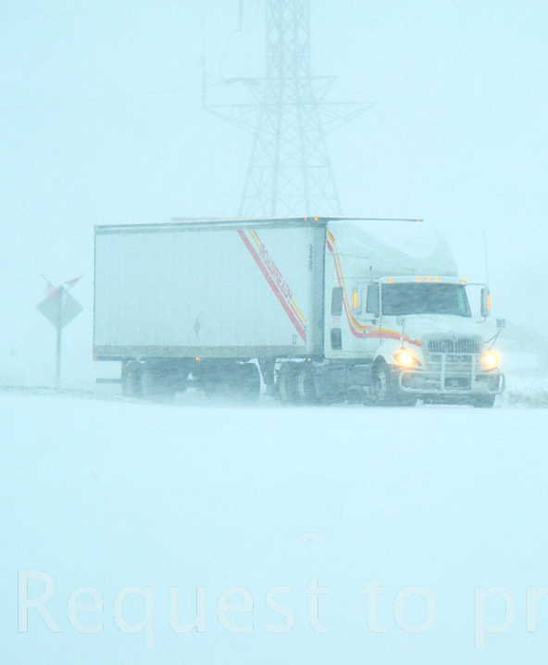
Snow can have a profound impact on visibility and traction.
Notes:
Snow
Falling and accumulating snow can have a profound impact on both visibility and traction.
If operating properly, your vehicle’s defroster and windshield wipers will keep the windshield clean and clear. However, you will need to stop to clean off the side windows and mirrors. Never drive if you cannot see in all directions. In addition, snow can build up on your vehicle’s lights and reflectors. This reduces your visibility and the ability of other drivers to see your vehicle. Frequently clean all lights and reflectors.
Light, powdery snow can cover the road and form a slick, smooth surface. A heavier, slushy snow can affect vehicle control. If the snow becomes hard packed, it can form an icy surface. Vehicle speeds should be reduced by at least one-half in snowy conditions.
To stay safe, you should take the following actions when driving in snow:
Give yourself plenty of travel time and be alert
Adjust your speed to conditions
Keep an adequate distance from the vehicle ahead of you
Use a lower gear to help maintain traction—especially on hills
Accelerate, brake, and turn slowly (and carefully) to minimize the chance of a dangerous skid
VIDEOS (see Trainer Tools USB)
14.5 — Extreme Weather Snow

Slide 25
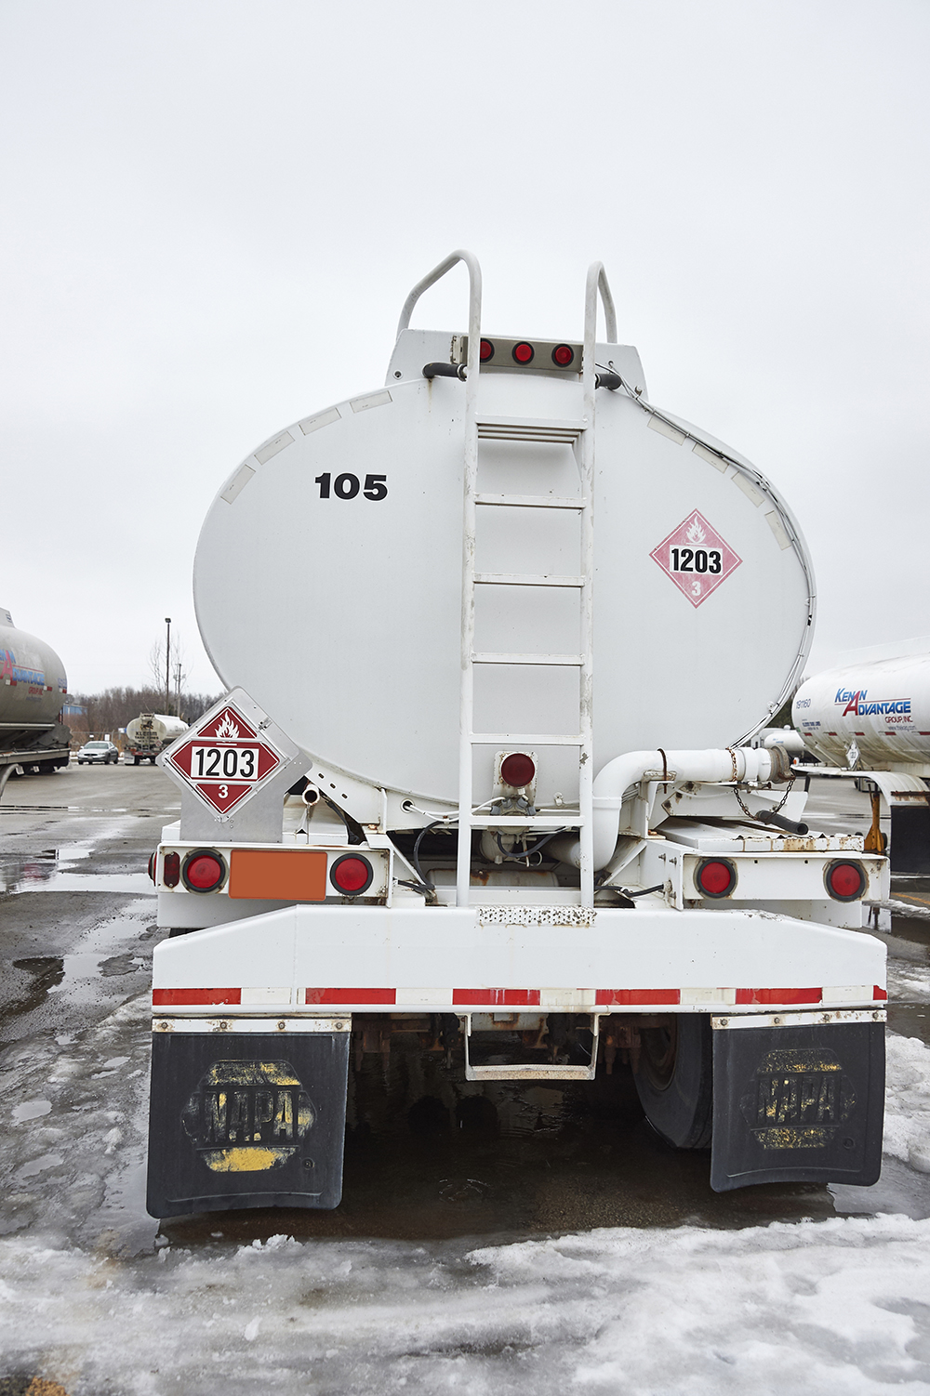
Ice can create slick road conditions, even when other weather conditions are favorable, and visibility is good.
Notes:
Ice
Ice can create slick road conditions, even when other weather conditions are favorable, and visibility is good. If you must drive, reduce your speed to 10-15 miles per hour and increase your following distance to give yourself more control and some margin for safety when reacting to an icy patch.
Slippery surfaces reduce traction, causing a vehicle’s drive wheels to spin easily. This impairs your ability to maneuver the vehicle. Proper tire inflation and tread as well as proper weight on the drive wheels increases traction and improves maneuverability.
Drop down to a lower gear to help improve traction. Accelerate and decelerate slowly (and carefully), slow down for turns, and do not oversteer.
While ice is most common in snowy conditions, it can also be present during mist, drizzle, freezing rain, and heavy fog when temperatures drop below freezing.
If ice starts to form on the front of your outside mirrors, it may also be present on the road. Another clue is road spray. If conditions have been rainy or snowy, yet there’s no road spray, it might be because the moisture that would otherwise be spraying off the tires of other vehicles is freezing to the roadway.
Black ice is one of the most dangerous road conditions, as most drivers aren’t aware of black ice until it is too late. Black ice forms when temperatures drop rapidly and hover around the freezing mark (32°F). In black ice conditions, the road appears to be wet and shiny in headlights, when it is actually icy.
The most common places for black ice to form include:
Bridges
Beneath underpasses
Dips in the road where water can collect and freeze
Shaded areas from buildings, trees, hills, and embankments
The lower side of banked curves
VIDEOS (see Trainer Tools USB)
14.6 — Extreme Weather Ice

Slide 26
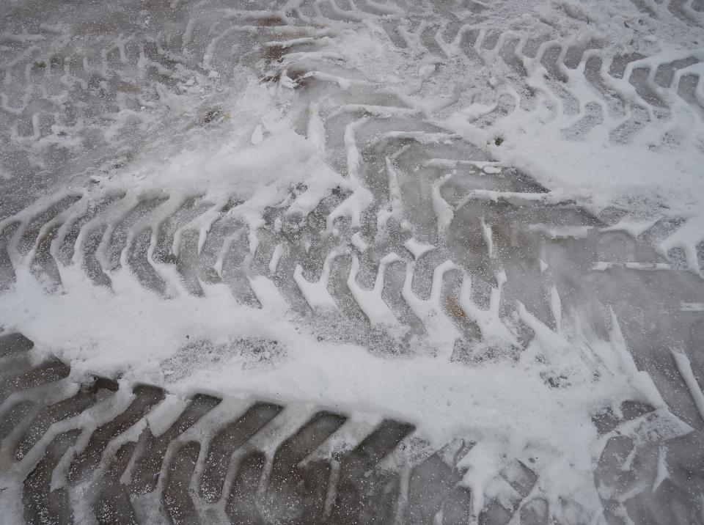
All Slippery Surfaces
Notes:
All Slippery Surfaces
Whether driving in rain, fog, snow, or ice some other tips to keep in mind when operating on what could be a slippery road include the following:
Don’t brake any harder than necessary
Don’t use the engine brake or speed retarder
Never pump antilock brakes
Don’t pass slower vehicles unless necessary
Go slow and steady. Avoid having to slow down and speed up
Take curves at slower speeds and don’t brake while in curves
Know that roads become more slippery as temperatures rise to the point where ice begins to melt
Road temperatures and air temperatures can vary widely
Don’t drive next to other vehicles
Keep a larger following distance
If you see a traffic jam ahead, slow down or stop until it has cleared
Try to anticipate stops so you can slow down gradually
When You Should Pull Off the Road
As a general rule, anytime you don’t feel safe, you can’t see, or you can’t control the vehicle it’s time to get off the road.
If the weather becomes too dangerous, find a safe place to pull over until conditions improve.

Slide 27
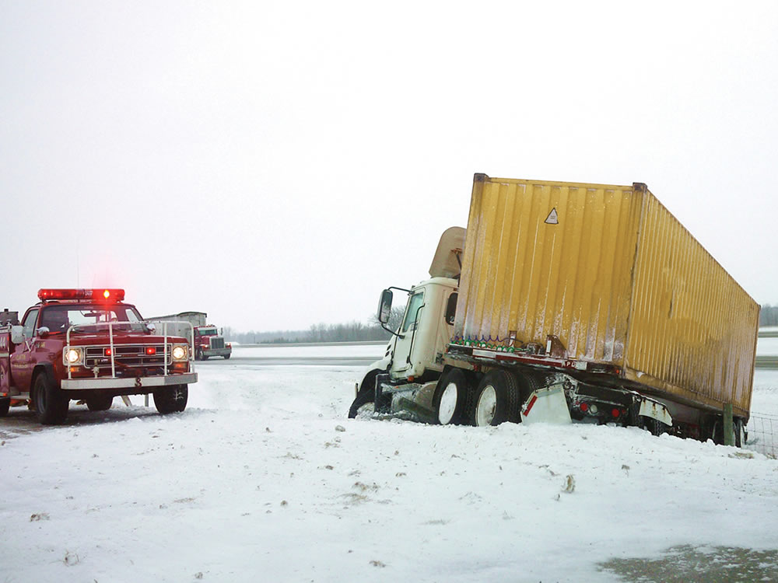
Skidding & Jackknifing
Notes:
Skidding and Jackknifing
There are three basic causes of skidding and jackknifing: overaccelerating, overbraking, and oversteering.
Overaccelerating. Too much acceleration sends too much power to the drive wheels, causing them to spin.
Overbraking. Braking too hard for conditions causes wheels to lockup.
Oversteering. Turning the steering wheel too quickly can cause the front wheels to slide, the drive tires to slide, or the trailer to skid or swing out.
CALLOUT: Driver error is a major contributor when it comes to skidding and jackknifing.

Slide 28
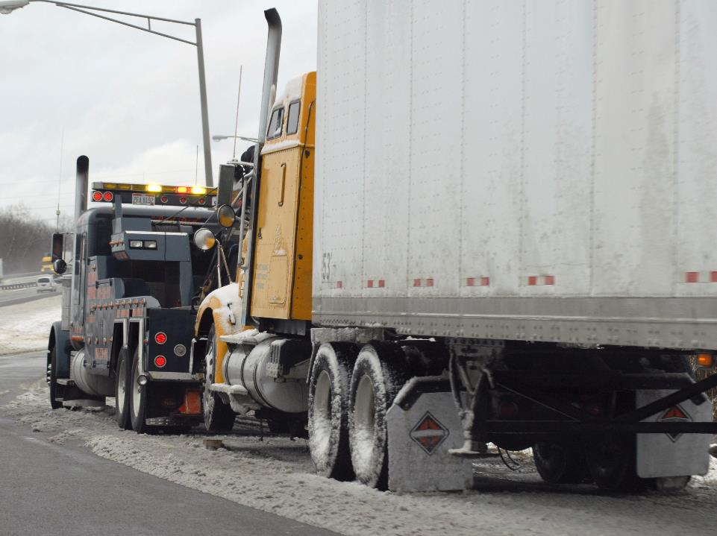
Freeing a Stuck Vehicle
Notes:
Freeing a Stuck Vehicle
In extreme conditions, even the most experienced of drivers can find their vehicle has become stuck. To help prevent this, avoid soft shoulders, deep snow, muddy roads, and icy/slippery surfaces whenever possible.
If you do get stuck, don’t panic, and take the following steps:
Avoid spinning the drive wheels and rocking. This digs the vehicle in deeper. On ice or snow, spinning wheels warm the ice or snow under the tires, reducing traction even more.
Use traction aids. Dig out from in front of the wheels. Scatter sand or gravel in the wheel path. Lay loose chains in front of the vehicle’s tires.
When ready to try pulling out, start with the steering wheel facing straight ahead. Don’t turn the wheels until the vehicle is moving.
Start in second or third gear, using very little power. This keeps the wheels from spinning and gives a smoother application of force.
Accelerate smoothly and gently. Ease off at the first sign of spinning or slipping. Allowing the wheels to continue spinning can cause you to dig in deeper and/or cause a spin out.
Towing
If all of the procedures to free your vehicle fail, you may need to call a tow truck. Remember, even if towing is necessary, you are still responsible for your vehicle and cargo. You, not the tow truck operator, need to stay in charge of the situation. Supervise the operation. If the tow truck operator does something wrong or unsafe, stop the operation and correct the problem.
The tow chain or cable should be hooked to the vehicle following these steps:
Make sure there’s enough chain or cable, so once freed, your vehicle doesn’t lurch into the tow truck.
In hooking up, pass the chain or cable through the hole in the bumper, but do not hook it to the bumper.
Attach the chain or cable to a solid portion of the frame or a frame cross member. (Some vehicles are equipped with tow hooks protruding from the frame.) Be careful not to get the chain around the steering tie-rod or spring shackles along with the axle.
Before towing, agree on a procedure to be followed. Know the direction the tow truck will pull and the direction your vehicle is to be steered. Agree on a signal that you can both clearly hear or see for stopping (if you run into problems) or for when your rig is clear. Also, make sure all bystanders are out of the way just in case a chain or cable snaps.
As the towing procedure starts, accelerate the tractor gently — just enough to turn the wheels slowly. When you have been pulled clear, signal the tow truck driver to stop accelerating immediately. Apply the tractor-trailer brakes. This prevents your vehicle from rear ending the tow truck.

Slide 29
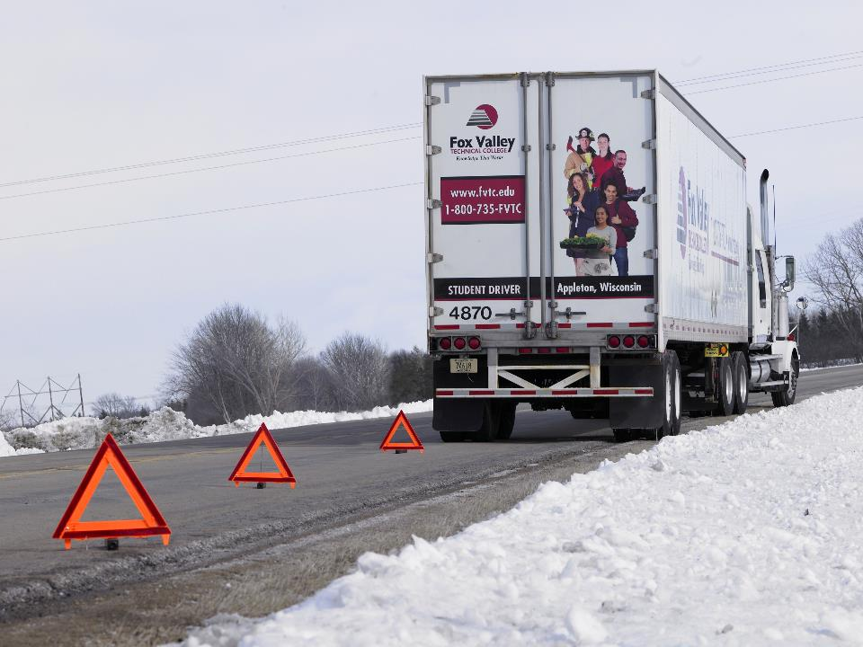
Breakdowns
Notes:
Breakdowns
A vehicle breakdown can be dangerous at any time, but it is especially dangerous in adverse weather conditions. In the winter, exposure to wind and cold can cause frostbite. Blowing and drifting snow can be disorienting. If your vehicle breaks down in adverse conditions, stay in the cab.
Put on extra clothing to stay warm. Use your food and beverage supply cautiously. Depending on weather conditions and the amount of traffic on the road, you could be stranded for a while. If the vehicle’s engine is able to run, idle the engine to keep the truck warm.
In the summer, extended exposure to high heat and humidity can lead to heat-related illnesses such as heat cramps, heat exhaustion, and heat stroke.
If your vehicle breaks down, roll down the windows in your cab, stay out of direct sunlight, and drink water as necessary. Call 911 for assistance and stay with your vehicle.
Don’t try to walk for help unless it is absolutely necessary. If you must leave your vehicle, leave a note on the steering wheel stating when you left, where you were headed, and when you think you may return.

Slide 30
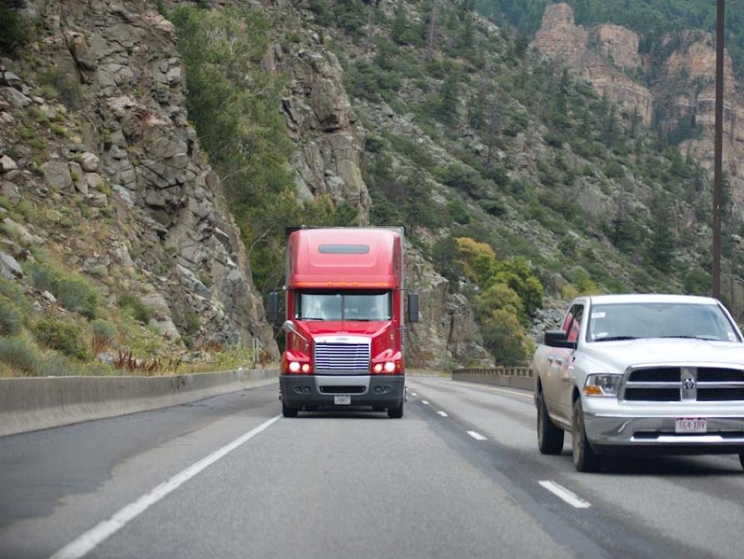
Mountain Driving
Notes:
Mountain Driving
In mountain driving, gravity plays a major role on both upgrades and downgrades. Because of this, it is important that your vehicle’s brakes are in top condition. If your vehicle is equipped with an air brake system, you should:
Make sure the compressor is maintaining full reservoir pressure
Watch the pressure drop on full application (within limitations)
Monitor the slack adjusters for full push rod travel (within specifications)
Listen for audible air leaks (applied and released)
Monitor the drums for overheating
Monitor trailer protection valve operation
CALLOUT: There are several ways to address the topic of mountain (uphill/downhill) driving. The approach taken in this text is the one recommended in the commercial driver’s license manual distributed by state driver licensing agencies.

Slide 31
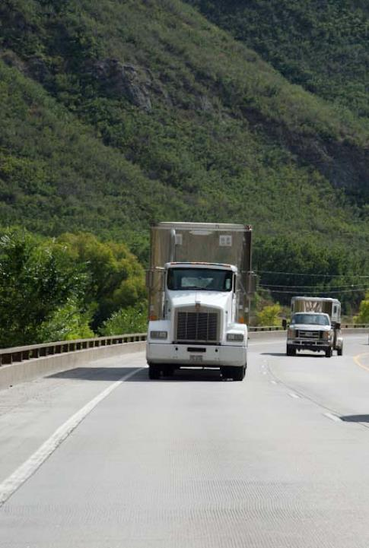
The force of gravity causes vehicles to slow down on upgrades.
Notes:
Upgrades
The force of gravity causes all vehicles to slow down on upgrades (an incline in the road), making it difficult to maintain a constant speed.
The steepness and length of the grade, as well as the weight of the load on the vehicle, all play a part in which gear you select to safely travel on an upgrade. The steeper and/or longer the grade and the heavier the load, the lower the gear you should select. If you select a gear that is too high for conditions, your vehicle could overheat and possibly stall.
The vehicle’s gauges should also be monitored as the vehicle heads uphill. The task of traveling uphill causes all of the vehicle’s components to work harder than when traveling on a flat roadway.
This additional work causes the engine to create more heat. If the vehicle’s gauges indicate high temperatures, a decrease in engine oil pressure, or if water and exhaust gas temperature readings are abnormal, pull over in a safe area and allow the engine to cool down.
When traveling uphill on a multi-lane road, travel in the right lane. This will allow smaller, faster vehicles to pass safely. Put on your four-way flashers. Continue to pay attention to the traffic surrounding your vehicle, especially to the left and rear.

Slide 32
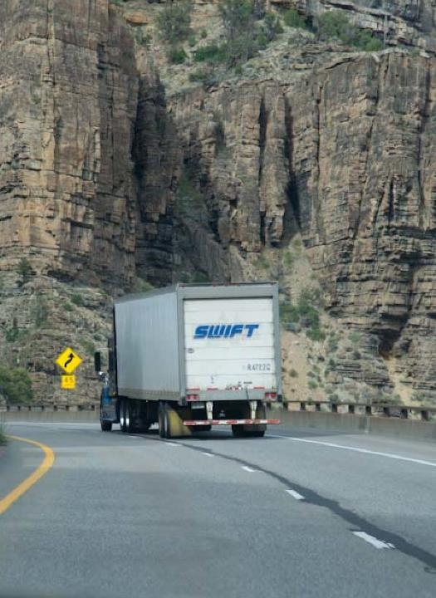
Gravity’s pull forces vehicles to speed up on downgrades.
Notes:
Downgrades
Gravity’s pull forces all vehicles to speed up on downgrades (downward slope of a road). To help combat the forces of gravity when traveling downhill, select:
An appropriate speed
A low gear
Proper braking technique
An appropriate speed is one that is slow enough to allow a vehicle’s brakes to hold the vehicle without the brakes overheating and fading. If you have to continually increase the pressure applied to the brakes to get the same stopping power, the brakes will eventually fade until there’s little to no stopping control.
When selecting an appropriate speed, consider the total weight of the vehicle and its cargo, the grade’s steepness and length, and weather and road conditions.
As with upgrades, stay to the right, allowing other vehicles to pass. Put on your four-way flashers. Also, be aware of any warning signs along the roadway. The signs may indicate maximum vehicle size or safe rate of speed for handling the grade.
The braking effect of the engine should be used as the primary way to control the vehicle’s speed. The engine’s braking effect is greatest when it is near the governed revolutions per minute (RPMs) and the transmission is in the lower gears.
Before starting down a grade, shift the transmission into an appropriate gear. Once a vehicle’s speed has been built up, it will be difficult, if not impossible, to downshift.
If you attempt to downshift with a manual transmission, the vehicle may get stuck in neutral. This can cause a vehicle to coast downhill and lose all braking effect, creating what can be a very dangerous situation.
Forcing an automatic transmission to shift into a lower gear can damage the transmission and can cause the vehicle to lose all braking effect.
How Brakes Can Fail
Anytime a brake is used, heat is created. The rubbing of the brake pad against the brake drum or disc is what creates this heat. Excessive heat, caused by excessive braking, can cause brakes to fail.
All brakes must be adjusted and operating properly to safely and efficiently control a vehicle.
If some brakes are out of adjustment, others may become overworked, causing them to overheat and fade, leaving a driver with little or no braking control.
As with all vehicle components, brake adjustment should be checked often, but it should be given even more attention when you are ready to head downhill.
Braking Technique
The following is proper braking technique for a vehicle traveling in the proper, low gear.
Identify a safe speed for the load and grade. In most cases, this speed will be less than the posted speed limit. Keep in mind that posted speed limits are meant for cars.
When that speed is reached, apply the brakes hard enough to feel a definite slowdown.
Once the vehicle’s speed has been reduced by five miles per hour below the vehicle’s safe speed, release the brakes. The application of the brakes should last about three seconds.
When the vehicle’s speed increases back to or above the safe speed, repeat the first two steps.
For example, if the vehicle’s safe speed is 30 miles per hour, don’t apply the brakes until the vehicle’s speed has reached 30 miles per hour. Then, the brakes should be applied just hard enough to gradually reduce the vehicle’s speed to 25 miles per hour. Once at 25 miles per hour, the brakes may be released.
CALLOUT: Pay close attention to the signs posted at the top of the grade. Take note of the steepness of the grade, the total miles to descend the grade, the posted speed limit, and the distance to the next escape ramp.

Slide 33
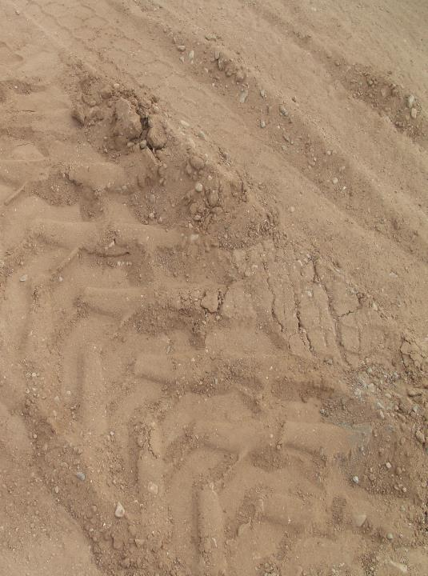
Escape ramps are found on steep mountain downgrades.
Notes:
Escape Ramps
Escape ramps are found on steep mountain downgrades. They are designed to help in safely stopping a runaway vehicle. These ramps can help save lives when a vehicle’s brakes fail. There are four basic types of escape ramps.
Gravity ramps. Gravity ramps are found on steep ascending grades. They are constructed of a pea gravel surface with mounds of sand or gravel at the end of the ramp.
Sand piles. Sand piles contain mounds or ridges tall enough to drag the undercarriage of a vehicle.
Arrester beds. Arrester beds have large masses of loose material (at least 18 inches deep), causing a vehicle to sink.
Ramp and arrester bed combinations. This combination relies on both loose surface material and long grades to slow a vehicle.
CALLOUT: Always be prepared for the worst. Know the location of the escape ramps and have a plan on how you use the escape ramp if your vehicle has an equipment failure.

Slide 34
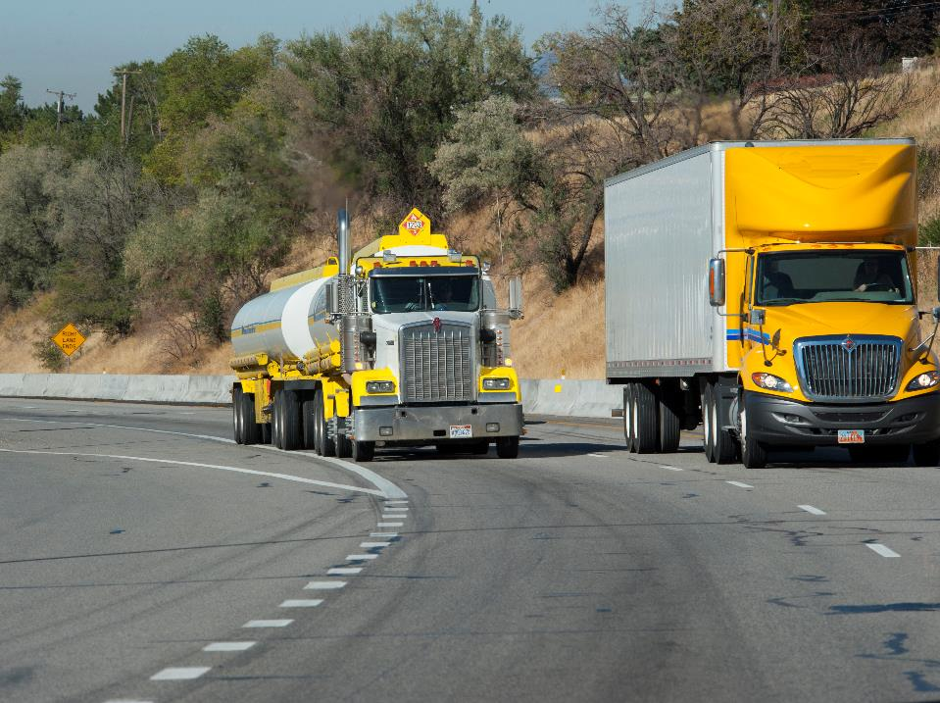
Sharp Curves
Notes:
Sharp Curves
At any time, a sharp curve can present a challenge to the professional driver, but it can be even more of a challenge when operating in extreme driving conditions.
The Science of Curves
Centrifugal force is the outward and sideways pushing force against a vehicle on a curve. A truck will roll over (away from the center of a curve) when the centrifugal force is too great to counteract. Centrifugal force increases with speed. In other words, driving too fast on a curve can cause a truck to roll over.
CALLOUT: When a cargo load has a higher center of gravity, your vehicle becomes more dangerous on the road. A top-heavy load is more likely to tip and roll over when you drive around a curve. Always keep the center of gravity as low as possible when placing your cargo.
Safe Driving Practices
When on a curve, remember the posted speed limit is intended for cars, not larger commercial motor vehicles. In good driving conditions, reduce your speed by at least five to 10 miles per hour below the posted speed limit. Reduce your speed even further when driving in extreme conditions (snow, ice, rain, wind, etc.).
Also, reach your targeted speed before entering the curve, never use cruise control, and keep your eyes on the road.

Slide 35
Objectives Review
You should now be able to:
  Identify common ways to prepare for driving in adverse weather conditions
  Describe when tire chains are appropriate and proper tire chaining procedures
  Discuss how to safely operate a vehicle in snow, ice, wind, rain, and fog
  Explain ways to stay safe in extreme heat or
  cold temperatures
  Recognize the challenges of driving on steep grades and around sharp curves
Notes:
You should now be able to:
Identify common ways to prepare for driving in adverse weather conditions
Describe when tire chains are appropriate and proper tire chaining procedures
Discuss how to safely operate a vehicle in snow, ice, wind, rain, and fog
Explain ways to stay safe in extreme heat or cold temperatures
Recognize the challenges of driving on steep grades and around sharp curves
CLASSROOM RECOMMENDATION
Before concluding your training session, have participants take the corresponding quiz (found on the Trainer Tools USB) to check their understanding of the material. You can customize any of the questions to fit your audience or workplace. The answer key can also be found on the Trainer Tools USB.
You may also choose to administer the quizzes before you begin your training session to help get participants thinking about the subject and/or to gauge their understanding of the topic ahead of time.

