Slide 1






PowerPoint® Instructions
This PowerPoint has been designed so you can easily customize it for your training session.
Throughout the presentation you’ll see icons with recommendations or videos to enhance the instruction you present to your students. A detailed explanation for each icon can be found on the next slide. Videos can be found on the Trainer Tools USB.
When you see an icon on the slide, look in the notes
section for further information.
Simply delete or move the icon off the slide before your training session begins.

Slide 2





Classroom Recommendations. Provides suggestions for enhancing your classroom presentation; from ideas for large group discussions to suggestions on the use of training aids such as examples or photos of vehicle parts and components to help illustrate the items covered within a chapter.
Lab Recommendations. Provides suggestions for activities and exercises that take place outside the classroom, but do not involve
the actual operation of the tractor-trailer or its components. Examples
of lab sessions include conducting a vehicle inspection or practicing mirror adjustment.
Range Recommendations. These recommended activities take
place on a closed-access driving range where students may practice driving skills in a controlled environment. Examples of range sessions include practicing shifting technique and successfully completing a backing maneuver.
Road Recommendations. These recommended activities take place in road and traffic conditions that support the chapter’s objectives. Examples of road sessions include proper communication with other drivers through the use of turn signals and basic vehicle control under nighttime or extreme weather conditions.
Videos. These short video clips reinforce material presented in the Student Manual. Use them to help students grasp difficult concepts or subject matter.

Slide 3

22
Environmental Compliance Issues
Notes:
Chapter 22 Environmental Compliance Issues
Unit A1.5.2 Environmental Compliance Issues
This unit must teach driver-trainees to recognize environmental hazards and issues related to the CMV and load, and make the driver-trainee aware that city, county, State, and Federal requirements may apply to such circumstances.

Slide 4
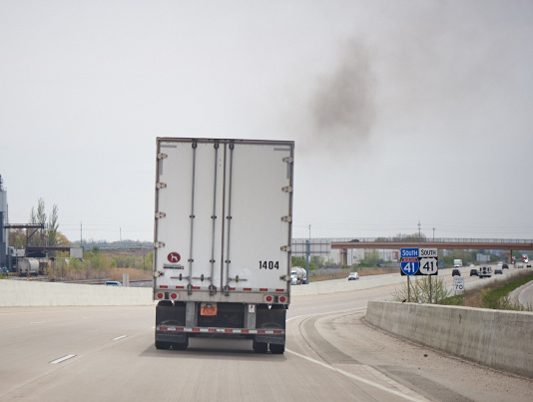
Introduction
Notes:
Introduction
In this chapter, we will discuss the environmental hazards and issues related to the operation of commercial motor vehicles (CMVs). We will also address some of the environmental requirements you must comply with as a professional driver.
CLASSROOM RECOMMENDATIONS
Emissions, idling, and fuel use all have an impact on the environment.
Discuss how limiting idling and the use of idle reduction technology can have a positive impact on reducing air pollution and increasing fuel efficiency.
Include information on idling laws in your discussion. Note that in addition to state-specific idling laws, many municipalities have laws limiting the amount of time or the location where a vehicle may idle.

Slide 5
Objectives
Upon completion of this lesson, you will be able to:
  Recognize environmental hazards and issues related to a CMV and its load
  Discuss how government regulations and laws vary in regard to environmental hazards
  Identify actions you can take to help the environment
  Describe how to handle a hazardous materials incident
Notes:
Objectives
Upon completion of this lesson, you will be able to:
Recognize environmental hazards and issues related to a CMV and its load
Discuss how government regulations and laws vary in regard to environmental hazards
Identify actions you can take to help the environment
Describe how to handle a hazardous materials incident

Slide 6
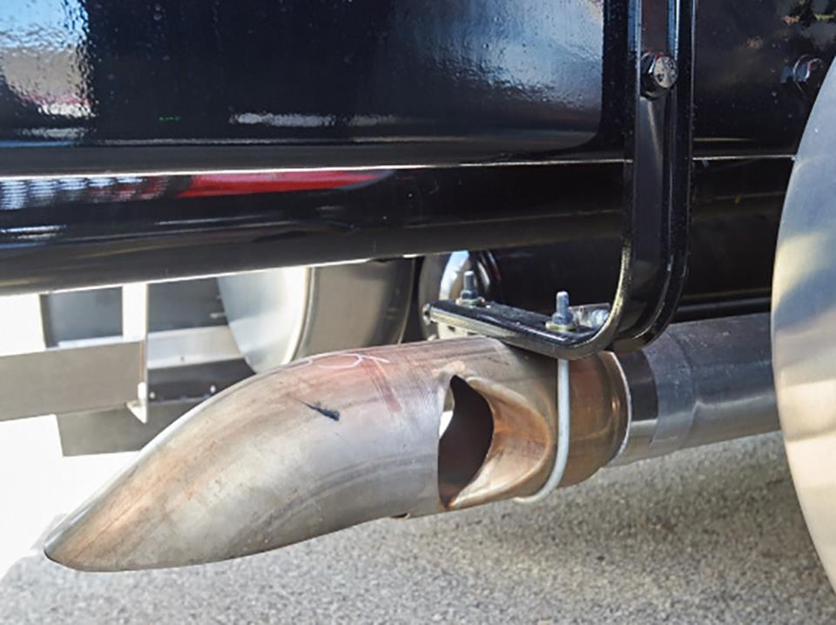
Air Pollution
Notes:
Air Pollution
Air pollution has negative impacts on the health and welfare of all of us. Air pollution contributes to smog and poor air quality, which in turn can contribute to lung cancer, acute respiratory symptoms, chronic bronchitis, and decreased lung function.
Nitrogen oxides are a group of gases made up of nitrogen and oxygen that cause acid rain and smog. The burning of fossil fuels such as diesel, gasoline, and coal releases nitrogen oxides into the atmosphere.
According to Environmental Protection Agency (EPA) statistics, in the United States, the transportation sector is responsible for over 50 percent of nitrogen oxide emissions.
As freight activity in the U.S. increases, EPA projects that air emissions from freight transportation will exceed the growth in emissions from all other transportation activities, including passenger transportation.
The bottom line is that anything that the trucking industry and those associated with the industry can do to lower these numbers will be of benefit to all of us.
Emissions
In 2000, EPA introduced a program that set new vehicle emissions standards for diesel fuel trucks as well as new diesel standards in order to fuel these trucks. The vehicle program began to take effect with model year 2007 vehicles.
It is anticipated that by 2030, the date it is expected that most vehicles will have the post-2007 engines, nitrous oxide emissions will be reduced by 2.6 million tons per year.

Slide 7
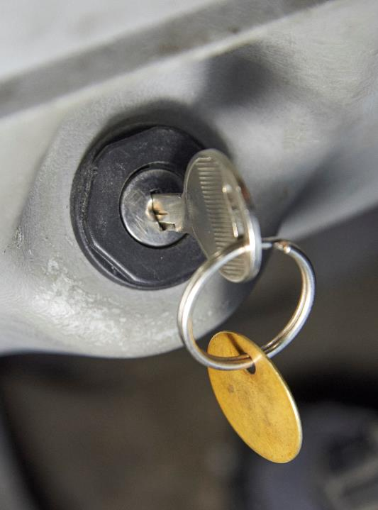
Shut off the engine when you are not in the vehicle.
Currently, just under one-quarter of all states have idling laws.
Notes:
Idling
Limiting the amount of time your vehicle’s engine idles can have an impact on air pollution, fuel efficiency, and your company’s bottom line.
The Department of Transportation estimates that on average, a truck idles for about 2,000 hours each year, burning about one gallon of diesel fuel per hour. At $2.50 per gallon, a year’s worth of idling adds up to $5,000.
Engine idling also has an impact on maintenance costs. Long duration idling accelerates oil and oil filter deterioration, causing the need for more frequent oil and oil filter changes. Also, the longer an engine idles, the more wear on the engine and the sooner the engine will need servicing.
The easiest way to reduce idling is by getting into the habit of shutting off the engine when no one is in the vehicle. Next, minimize or eliminate idling time while waiting or during breaks.
Today’s modern diesel engines do not need to “warm up” for an extended period of time when being started. Starting and stopping the engine for short periods of time does not cause damage. Also, engine cool down time should be kept to a minimum at the end of the day.
Currently, just under one-quarter of all states have idling laws. Listed below are the general requirements in place within the states that do have them. Note that this listing does not include exceptions to these requirements nor does it include municipal (county, city, village) requirements. This information is provided as a guideline. Consult actual laws and regulations for complete requirements.
CALLOUT: There are also many municipalities throughout the country that have idling laws. Always make sure you know and understand these requirements for the areas in which you travel.

Slide 8
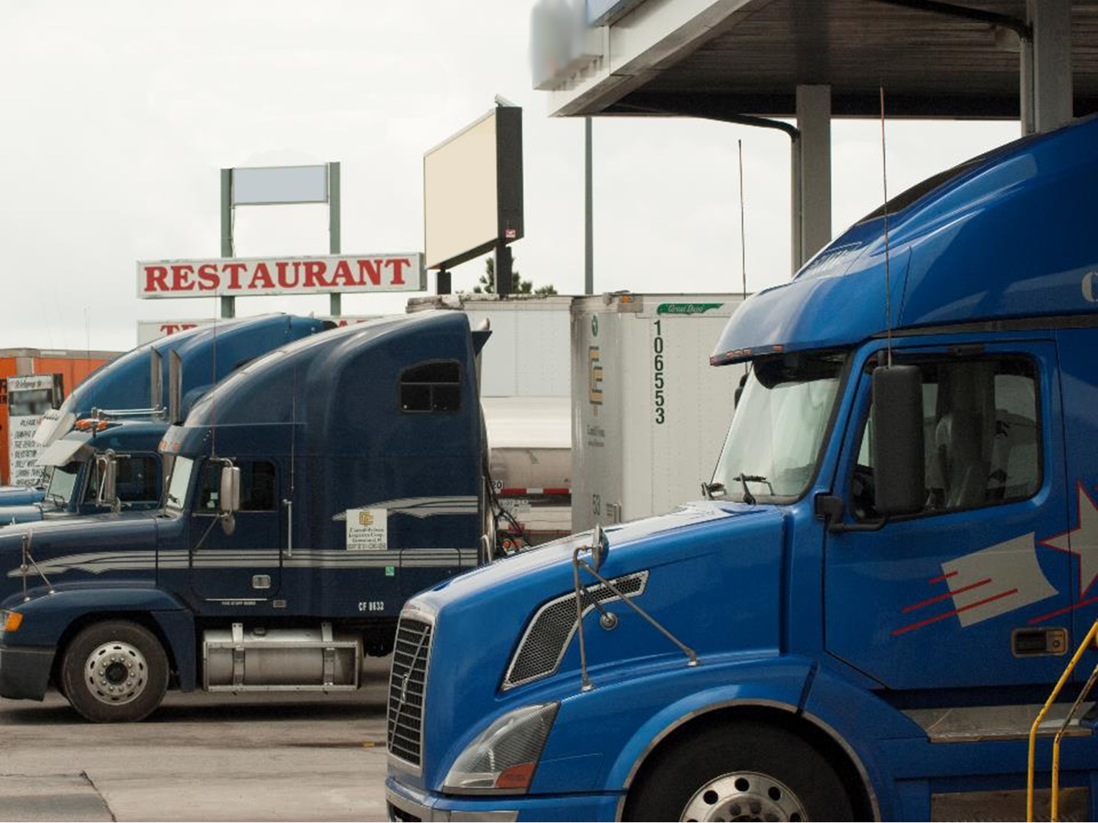
Idle Reduction Technology
Notes:
Idle Reduction Technology
There are technologies available that can assist in reducing the amount of time a vehicle idles, reducing fuel consumption, emissions, and stress on a vehicle’s engine parts and components.
The use of auxiliary power units (APUs) is increasing throughout the industry. APUs provide electricity and other services to a truck cab when the vehicle is stopped, and the engine is off. APUs are considered to be environmentally friendly and cost friendly, as they use less fuel than an idling engine.
Other idle reduction technologies include:
Fuel Operated Heaters (FOHs), which provide heat only and can be used in conjunction with cooling systems depending upon the cab comfort needs.
Battery Air Conditioning (BAC) Systems, which use batteries to power an independent electric cooling system. Typically, these systems integrate a FOH to supply heating.
Electrified Parking Spaces (EPS), also referred to as Truck Stop Electrification (TSE) use electricity-powered components to provide the driver with climate control and auxiliary power without having to idle the main engine.
An EPS system operates independently of the truck’s engine and allows the truck engine to be turned off as the EPS system supplies heating, cooling, and electrical power.
CALLOUT: Many states have adopted regulations that allow an additional 400 to 550 pounds total in gross, axle, tandem, or bridge formula limits when APUs or other idle reduction technology is used. Make sure you understand the requirements related to APUs or other idle reduction technology for the states in which you travel.

Slide 9
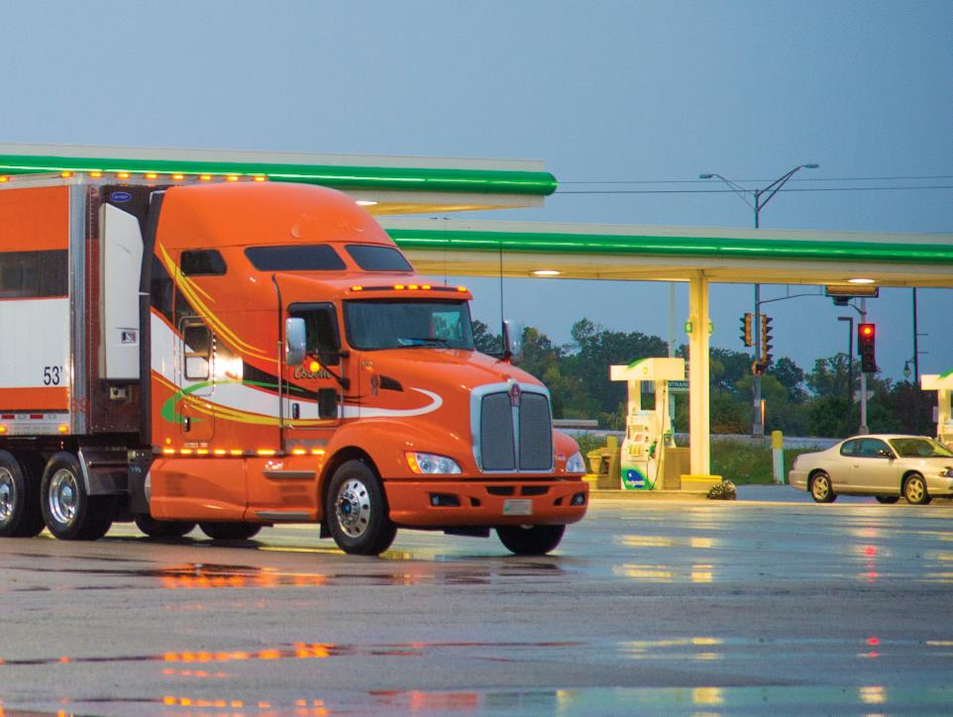
Fuel Efficiency
Notes:
Fuel Efficiency
Fuel efficiency, which means getting the most miles you can per gallon, is a goal every professional driver should try to reach. With the volatility of fuel prices, you need to be aware of the importance maintenance and driving habits play when it comes to fuel conservation.
Vehicle Maintenance
Section 396.3 of the Federal Motor Carrier Safety Regulations (FMCSRs) states that every motor carrier must systematically inspect, repair, and maintain all vehicles in its control or make provisions for this regular, scheduled program of maintenance.
As well as being a regulatory requirement, routine maintenance can contribute to an overall fuel conservation program.
Oil, fuel, and air filters should be changed according to the vehicle manufacturer’s specifications. As well as allowing impurities to damage the vehicle’s engine, dirty filters can decrease fuel efficiency.
Fluid levels should be checked. Low fluid levels can lead to additional draw on the engine due to additional friction in components, reducing fuel mileage.
Fuel system integrity must also be inspected. Problems in the fuel system need to be corrected early. Leaking fuel lowers mileage.

Slide 10
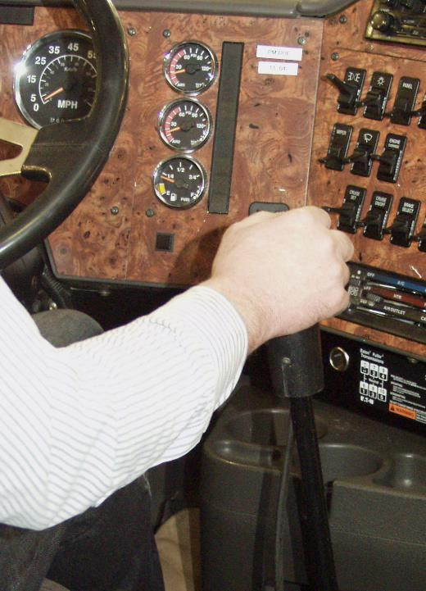
Your driving habits and behaviors can play a part in your vehicle’s efficiency.
Notes:
Vehicle Inspection
As well as being mandated in Parts 392 and 396 of the FMCSRs, routine vehicle inspection is another preventive maintenance tool that should be used to aid in conserving fuel.
Leaking or dragging wheel bearings, dragging brakes, damaged aerodynamic components, and tire inflation and condition are all issues than can be corrected to help improve fuel efficiency. For example, by maintaining properly inflated tires that are in good condition, you can improve your mileage by one to three percent.
Driving Habits & Behaviors
Your driving habits and behaviors can play a part in your vehicle’s efficiency. The following are some of these habits and behaviors.
Starting the engine. If the vehicle’s engine does not start after 30 seconds of cranking, stop and wait a couple of minutes before trying again. Long periods of cranking an engine can waste fuel. Don’t pump the accelerator or rev the engine after it starts.
Acceleration and braking. Smooth and steady is the rule of thumb when it comes to acceleration. The faster the acceleration, the more fuel that is burned. Also, every time you accelerate, slow, and then reaccelerate, more fuel is burned. Ease to a cruising speed by avoiding “jackrabbit” starts and stops.
Progressive shifting. Progressive shifting is the practice of keeping the shifting revolutions per minute (RPMs) low in low gears and increasing the shifting RPMs as you work up through the gears. This reduces equipment wear, cuts down on vehicle noise, and saves fuel.
Speed. Maintain an even speed by using cruise control on open highways and flat terrain. Set the cruise control at a rate that allows for a steady speed.
Keep in mind that faster speeds use more fuel. Studies have found that every mile per hour of additional speed over 55 mph uses an additional 2 percent in fuel.
Faster speeds also increase air resistance, causing the engine to work harder at higher speeds.
Weight. Do not keep unnecessary items in your vehicle, including equipment and/or tools you don’t use. Additional weight can reduce fuel efficiency.
Aerodynamics. Items attached to the vehicle can reduce aerodynamic performance and in turn reduce fuel efficiency. The larger the object, the greater the reduction. Avoid attaching items to the vehicle that can reduce aerodynamic performance and consider aerodynamics when loading flatbed trailers.

Slide 11
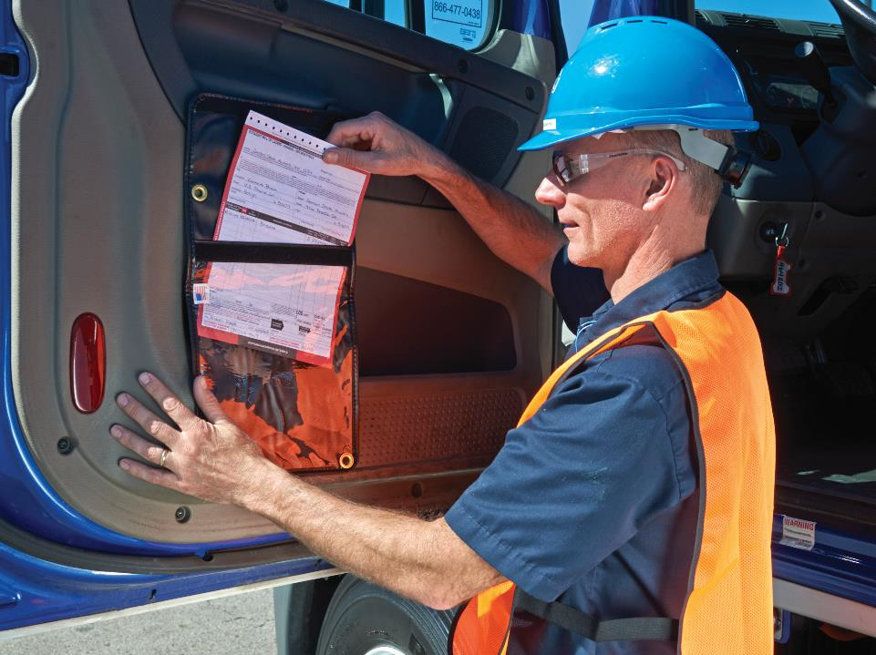
Hazardous Materials
Notes:
Hazardous Materials
Being a good environmental steward is also part of your job as a professional driver. Hopefully you won’t have to deal with a hazardous materials incident, but it is important to know what to do should a spill occur so that you can ensure your safety and the safety of others, as well as prevent damage to the environment.
Emergency Response
How you respond to a hazardous materials incident will depend on the type of material you are transporting and your company’s policies and procedures. You will need to consult with your company for specifics on this issue.
When transporting hazardous materials, you are required to carry emergency response information that is immediately available to you and any entity responding to, or investigating, a hazardous materials incident.
Part 172, Subpart G of the Hazardous Materials Regulations (HMRs) provides specifics as to the emergency response information that you must maintain. The information must be:
Legible and in English
Presented on the shipping paper or by another document such as an Emergency Response Guidebook (ERG)
Kept with the shipping papers, so it is readily available in case of an accident or incident
Kept within immediate reach while you are at the vehicle controls and restrained by the lap belt
Visible to anyone entering the driver’s compartment or in a holder mounted to the inside of the driver’s door
Maintained in the driver’s side door pouch or on the driver’s seat when you are not in the vehicle
CALLOUT: See 49 CFR 172, Subpart G for specifics on emergency response information.

Slide 12

A report by phone must be made as soon as possible (within 12 hours) under certain circumstances.
The National Response Center (800) 424-8802
Notes:
Incident Notification/Reporting
Sections 171.15 and 171.16 of the HMRs require that certain types of hazardous materials incidents be reported to the Pipeline and Hazardous Materials Administration (PHMSA).
A report by phone must be made as soon as possible (within 12 hours) under certain circumstances, including when a hazardous materials incident results in death, injury, or evacuation of the public. The report must be made to the National Response Center at (800) 424-8802.
A written follow-up report must be submitted to PHMSA within 30 days. The “Hazardous Materials Incident Report” (DOT-F-5800.1) must be used.

Slide 13
Objectives Review
You should now be able to:
  Recognize environmental hazards and issues related to a CMV and its load
  Discuss how government regulations and laws vary in regard to environmental hazards
  Identify actions you can take to help the environment
  Describe how to handle a hazardous materials incident
Copyright 2019 J. J. Keller & Associates, Inc.
Notes:
You should now be able to:
Recognize environmental hazards and issues related to a CMV and its load
Discuss how government regulations and laws vary in regard to environmental hazards
Identify actions you can take to help the environment
Describe how to handle a hazardous materials incident
CLASSROOM RECOMMENDATION
Before concluding your training session, have participants take the corresponding quiz (found on the Trainer Tools USB) to check their understanding of the material. You can customize any of the questions to fit your audience or workplace. The answer key can also be found on the Trainer Tools USB.
You may also choose to administer the quizzes before you begin your training session to help get participants thinking about the subject and/or to gauge their understanding of the topic ahead of time.

