Slide 1






PowerPoint® Instructions
This PowerPoint has been designed so you can easily customize it for your training session.
Throughout the presentation you’ll see icons with recommendations or videos to enhance the instruction you present to your students. A detailed explanation for each icon can be found on the next slide. Videos can be found on the Trainer Tools USB.
When you see an icon on the slide, look in the notes
section for further information.
Simply delete or move the icon off the slide before your training session begins.

Slide 2





Classroom Recommendations. Provides suggestions for enhancing your classroom presentation; from ideas for large group discussions to suggestions on the use of training aids such as examples or photos of vehicle parts and components to help illustrate the items covered within a chapter.
Lab Recommendations. Provides suggestions for activities and exercises that take place outside the classroom, but do not involve
the actual operation of the tractor-trailer or its components. Examples
of lab sessions include conducting a vehicle inspection or practicing mirror adjustment.
Range Recommendations. These recommended activities take
place on a closed-access driving range where students may practice driving skills in a controlled environment. Examples of range sessions include practicing shifting technique and successfully completing a backing maneuver.
Road Recommendations. These recommended activities take place in road and traffic conditions that support the chapter’s objectives. Examples of road sessions include proper communication with other drivers through the use of turn signals and basic vehicle control under nighttime or extreme weather conditions.
Videos. These short video clips reinforce material presented in the Student Manual. Use them to help students grasp difficult concepts or subject matter.

Slide 3
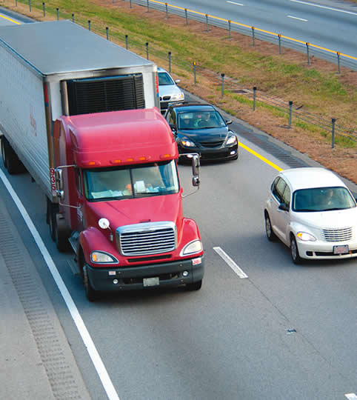
Visual Search
8
Copyright 2019 J. J. Keller & Associates, Inc.
Notes:
Unit A1.2.1 Visual Search
This unit must teach driver-trainees to visually search the road for potential hazards and critical objects, including instruction on recognizing distracted pedestrians or distracted drivers.

Slide 4
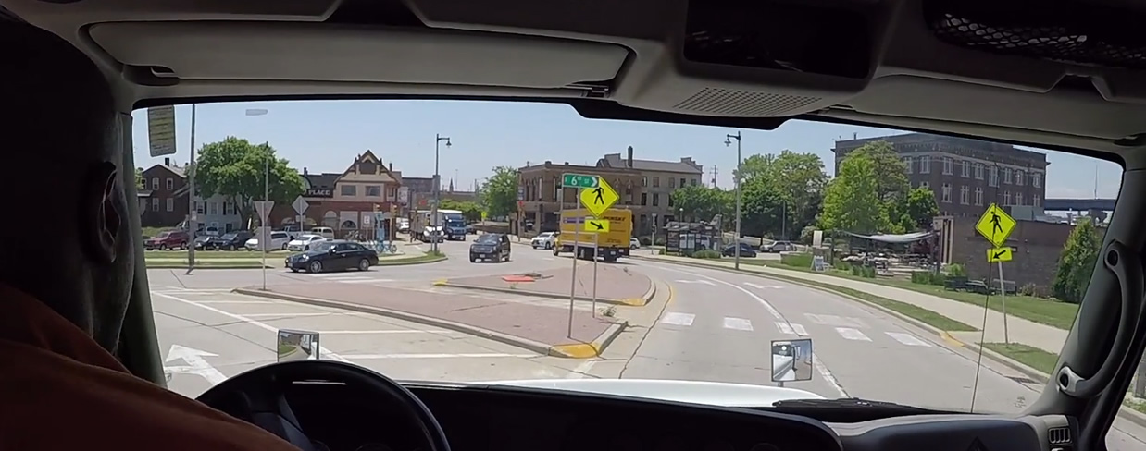
Introduction
We’ll introduce you to the skills required to conduct an effective visual search
Notes:
A safe driver is aware of what is going on around his or her vehicle. In this chapter you will be introduced to the skills required to conduct an effective visual search.
CLASSROOM RECOMMENDATION
This is the first of a series of chapters designed to get your students ready to operate on the road. Discuss the importance of mastering the skills that will be covered when it comes to safe operations.

Slide 5
Objectives
Upon completion of this lesson, you will be able to:
  Explain the importance of continuously scanning your surroundings
  Discuss how to perform a proper visual scan in front of, to the sides, and behind your vehicle
  Recognize potential hazards you must be aware of and react to while driving
  Identify signs of a distracted driver and pedestrian
  Describe the different types of mirrors and what each is designed for
  Explain how to properly adjust your mirrors and use them while driving
Notes:
Upon completion of this lesson, you will be able to:
Explain the importance of continuously scanning your surroundings
Discuss how to perform a proper visual scan in front of, to the sides, and behind your vehicle
Recognize potential hazards you must be aware of and react to while driving
Identify signs of a distracted driver and pedestrian
Describe the different types of mirrors and what each is designed for
Explain how to properly adjust your mirrors and use them while driving

Slide 6
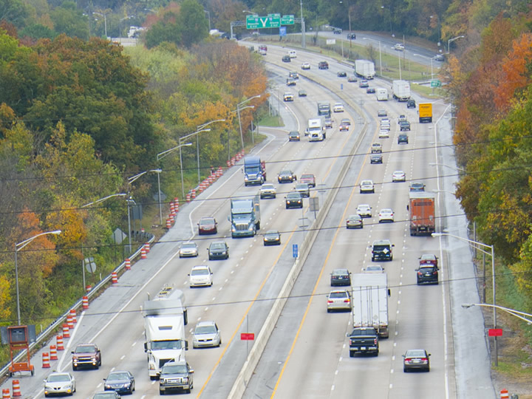
Scanning Your Entire Sight Area
Notes:
A tractor-trailer covers more distance than your car or truck when stopping, changing lanes, or reacting to problems on the road. Because of this, it’s important that you continually scan your entire sight area. This includes focusing on:
The road, vehicles, and other hazards straight ahead
Vehicles and other hazards to the left and right
Vehicles behind you

Slide 7
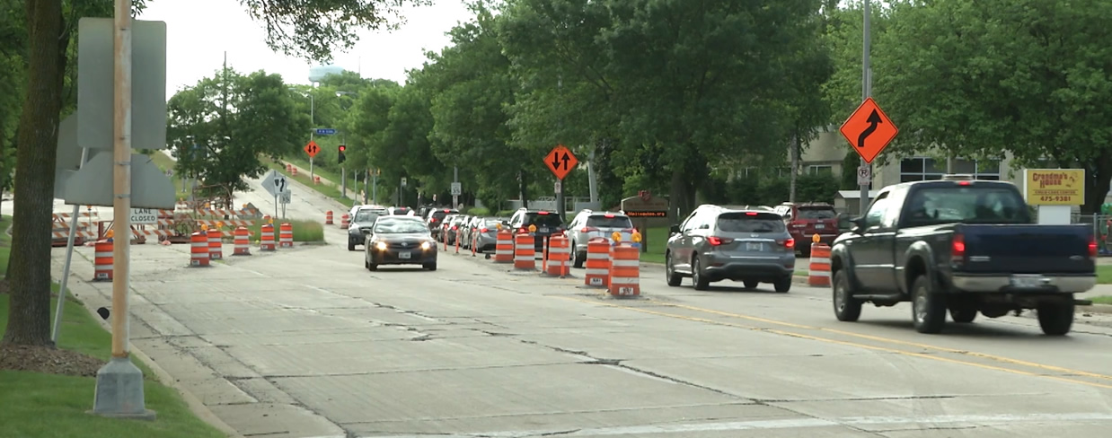
Distance Scanning
Distance scanning helps you identify hazards early & helps you avoid abrupt stops and radical speed changes caused by the driving behaviors of other motorists
Notes:
Distance scanning helps you identify hazards early, providing adequate time to react/respond to avoid a potentially dangerous situation. Distance scanning also helps you avoid abrupt stops and radical speed changes caused by the driving behaviors of other motorists.
It’s not enough to keep your eyes on the vehicle in front of you. If you’re not scanning at least five cars ahead, you may not be able to anticipate and react to changes in traffic. Watch road signs that warn of curves in the road, changes in traffic patterns, or construction zones.
CALLOUT: Effective scanning can help reduce fatigue since your eyes are continually moving and not fixed on a single object.
VIDEO
8.1 – Distance Scanning

Slide 8
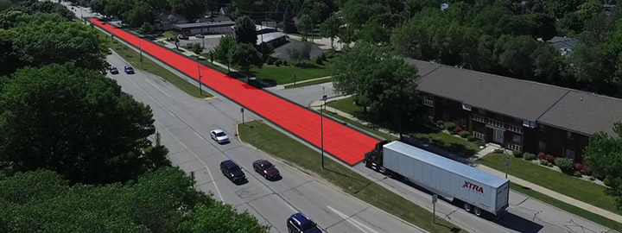
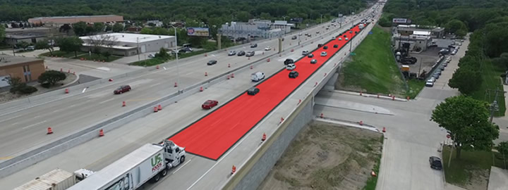
Look about
12 to 15 seconds
ahead of your vehicle
Notes:
As a general rule, look about 12 to 15 seconds ahead of your vehicle. In the city, 12 to 15 seconds is equal to about two to three blocks. On the highway, 12 to 15 seconds is equal to just over one quarter of a mile. If you can’t see that far ahead because of weather conditions or low-visibility, reduce your speed. If there is a problem up ahead, slowing down gives you time to:
Spot the problem
Decide on the best way to avoid the problem
Maneuver safely away from the problem

Slide 9
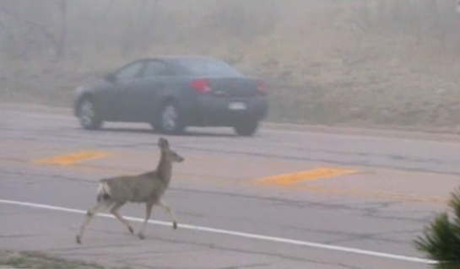
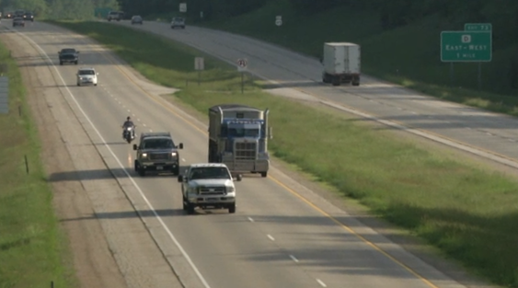
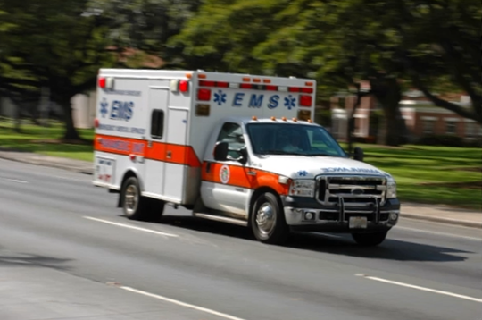
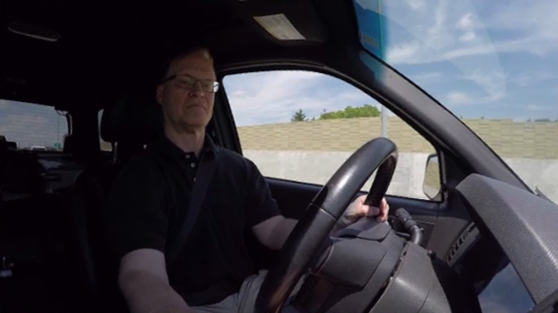
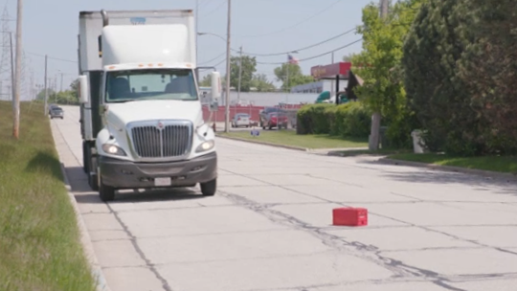
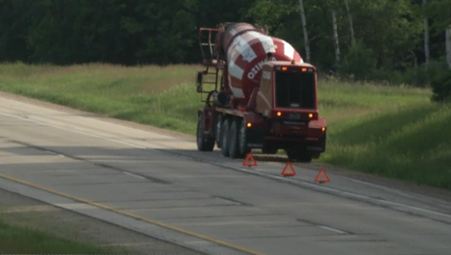
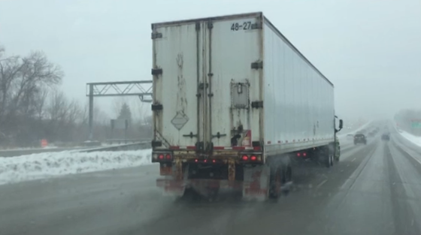
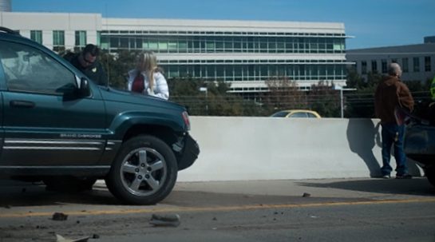
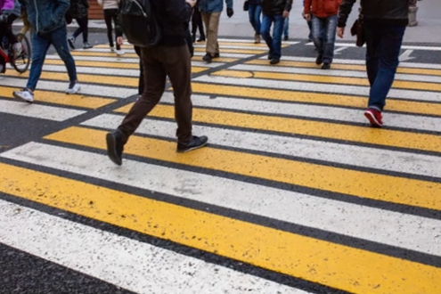
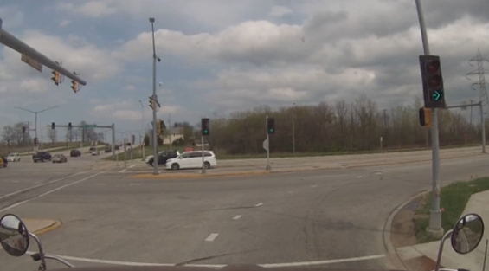
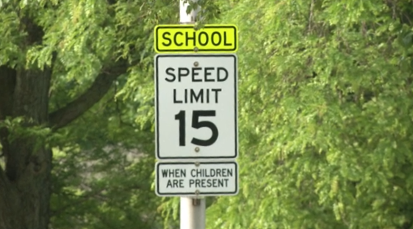
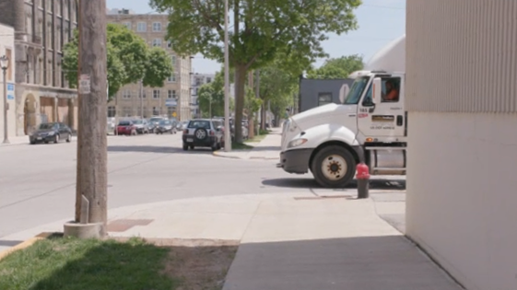
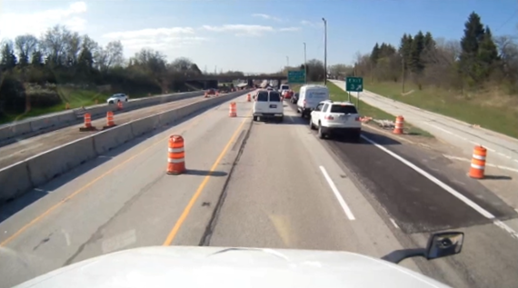
Distance Scanning
OTHER VEHICLES
ANIMALS
DISTRACTED DRIVERS
EMERGENCY VEHICLES
DEBRIS
STOPPED VEHICLES
WEATHER
ACCIDENTS
PEDESTRIANS
TRAFFIC SIGNALS
INTERSECTIONS
ROAD SIGNS
CONSTRUCTION
Notes:
When scanning ahead, pay special attention to anything that could affect your path of travel including:
Other vehicles
Distracted or aggressive drivers
Pedestrians
Road signs and traffic signals
Debris
Animals
Weather-related hazards (ice, rain, snow)
Intersections
Work/construction zones
Stopped vehicles
Emergency vehicles
Accidents

Slide 10
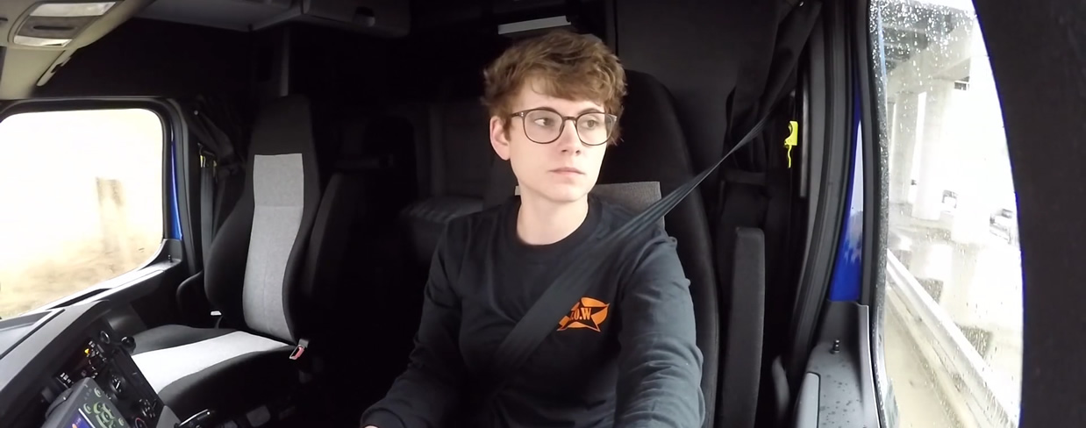
Scanning to the Sides
Use your mirrors to check for vehicles
in your blind spot and beside your tractor and trailer
Notes:
As well as looking ahead, you should be periodically scanning to the sides of your vehicle. Use your mirrors to check for vehicles in your blind spot and beside your tractor and trailer. Be alert. Know what is going on at all times.
There are certain situations where scanning to the sides is critical including crosswalks, intersections, roundabouts, school zones, and railroad crossings.

Slide 11
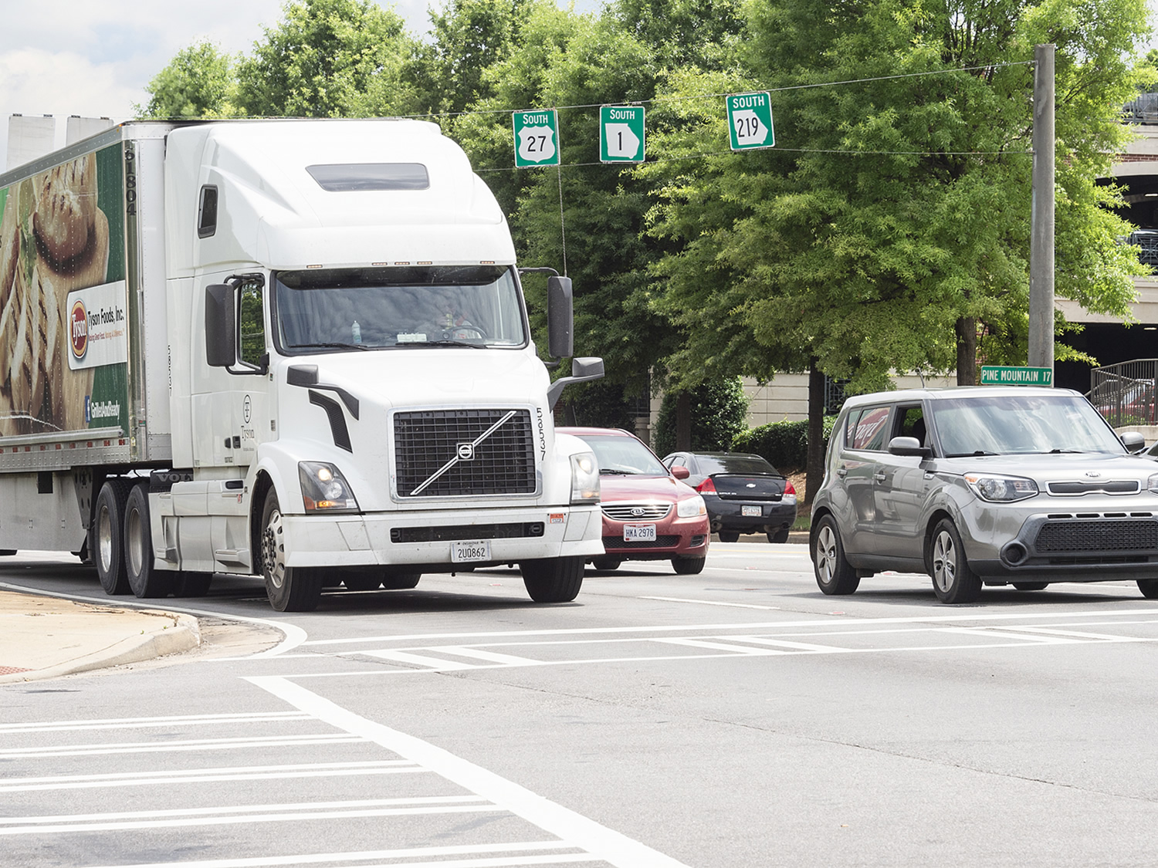
Crosswalks
Notes:
At crosswalks you should use extra caution. Watch the entire area, but pay additional attention to what is happening to your right. Pedestrians, bicycles, etc. are often hidden from your line of sight when closest to your vehicle. Also, remember to always yield the right of way to pedestrians when turning on green.

Slide 12
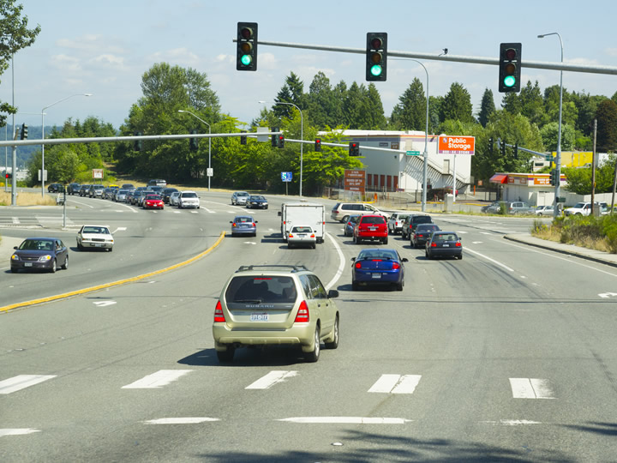
Intersections
Notes:
At intersections, you may not have a clear view of traffic and may pull into the intersection or roadway. Always be prepared to stop. When approaching an intersection, move your vehicle forward slowly. Look left, right, and left again. Start to pull into the intersection, continuing to scan as you pull through. Be ready to yield, stop, or take evasive action.
Additional caution must be used when turning at an intersection. When making a right turn, continue to scan the road ahead and to the sides, and pay special attention to your right-side mirrors. Doing so will help you avoid troublesome situations, like when an impatient driver tries to move into the right lane before you complete your turn.
When making a left turn, scan the road ahead and to the sides, and pay special attention to your left-side mirrors as you turn. Be sure to look over your left shoulder—this might help you see things before your mirrors do.
VIDEO
8.2 – Turning at Intersections

Slide 13
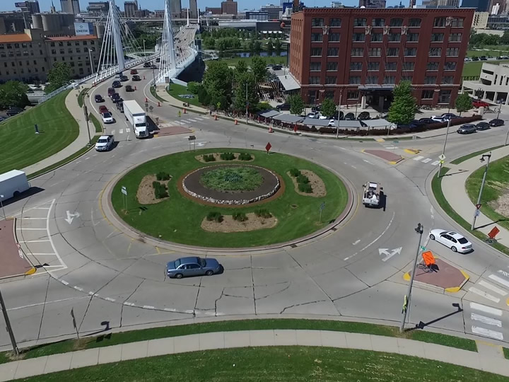
Roundabout
Notes:
When driving in a roundabout, watch your mirrors, keep your eyes on traffic around you, and take it slow to ensure you come out of the roundabout safely.
VIDEO
8.3 – Roundabouts

Slide 14
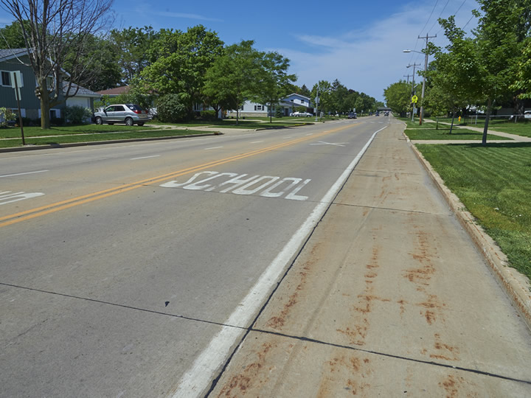
School Zones
Notes:
School zones are another place where you need to be especially careful. Children aren’t always aware of their environment. They may run into the road or between parked vehicles to retrieve a ball or chase another child. Pay extra attention when traveling near parks, trails, school zones, and at bus stops.

Slide 15
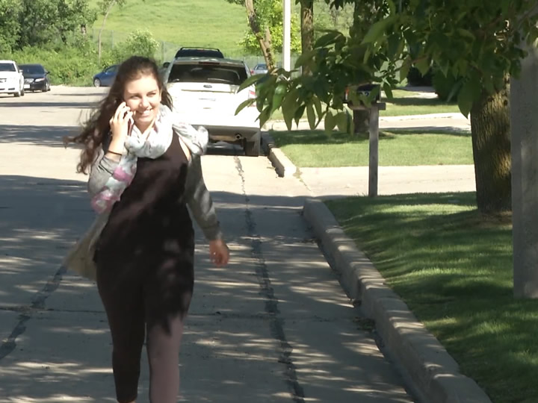
School Zones
Notes:
In cities, scanning to the sides is especially crucial to your safety and the safety of others. Cars parked along the shoulder create increased hazards that may not be seen if you are not constantly scanning. Often, people will walk between cars or will open their door into traffic without even looking. By scanning you can avoid a possible accident or injury caused by the inattentiveness of others.

Slide 16
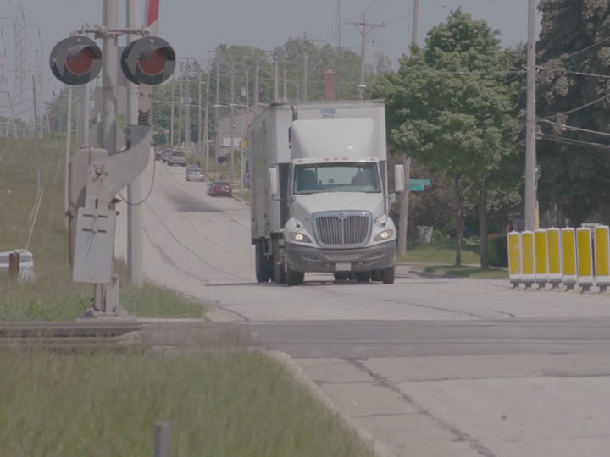
Railroad Crossing
Notes:
As you approach a railroad crossing, slow down and look as far down the tracks as you can in both directions. If your visibility is limited for any reason, slow down enough that you could make a complete stop before reaching the tracks if you needed to.

Slide 17
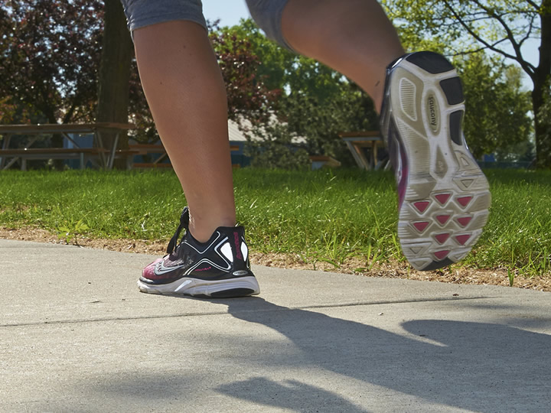
Pedestrians
Notes:
Finally, always keep an eye out for pedestrians and animals.
People walking or riding bikes wearing low-visibility clothing can be difficult to see until they are very close, so be extra vigilant in urban and suburban areas.
Some may also be wearing headphones. They may be completely unaware of your presence and dart out into your path unexpectedly. Or they may underestimate your speed and try to cross before you reach them. Noticing them early and being prepared to stop is your best defense.

Slide 18
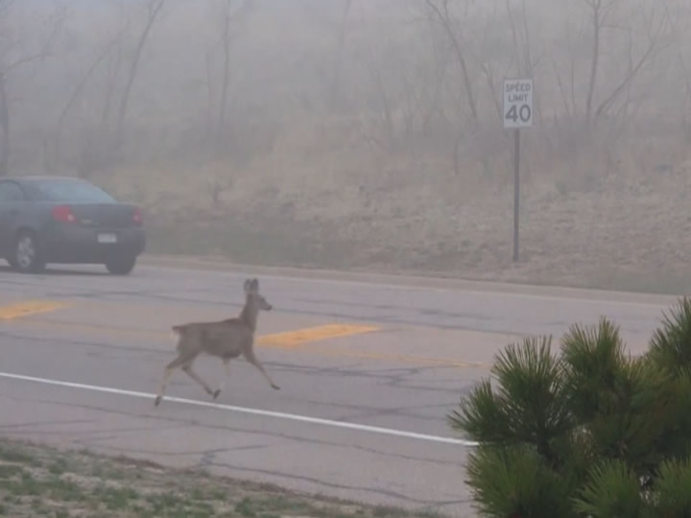
Animals
Notes:
In many parts of the country, animals may be on the move at night so there’s a chance you’ll see some of them on the road. When driving in wooded areas or areas near tall grass, be sure not to overdrive your visibility and keep an eye on both shoulders ahead. As part of your visual scan, look for reflections of animals’ eyes or movement along the sides of the road.

Slide 19
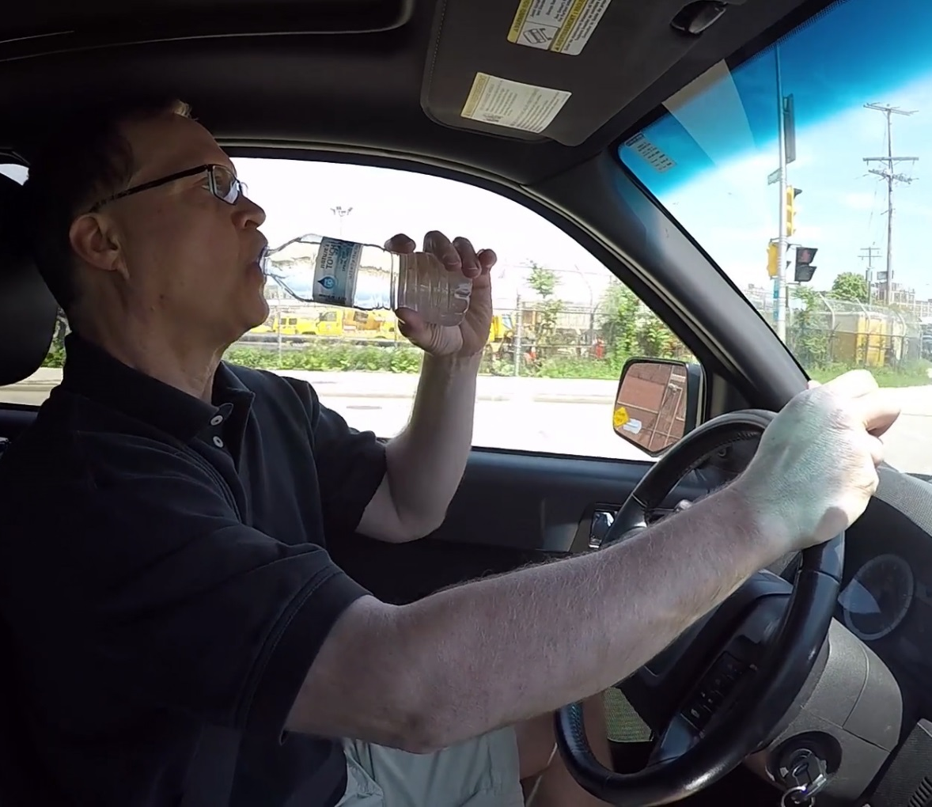
Distracted Drivers
Talk on phone
Text
Eat
Drink
Notes:
An effective visual search includes being able to recognize the signs of a distracted driver. This includes observing a driver taking part in a distracting activity (like talking on a cell phone, texting, eating, or drinking).
CALLOUT: Pay attention to where other drivers are looking. If their eyes are on something other than the road, they may not see you.

Slide 20
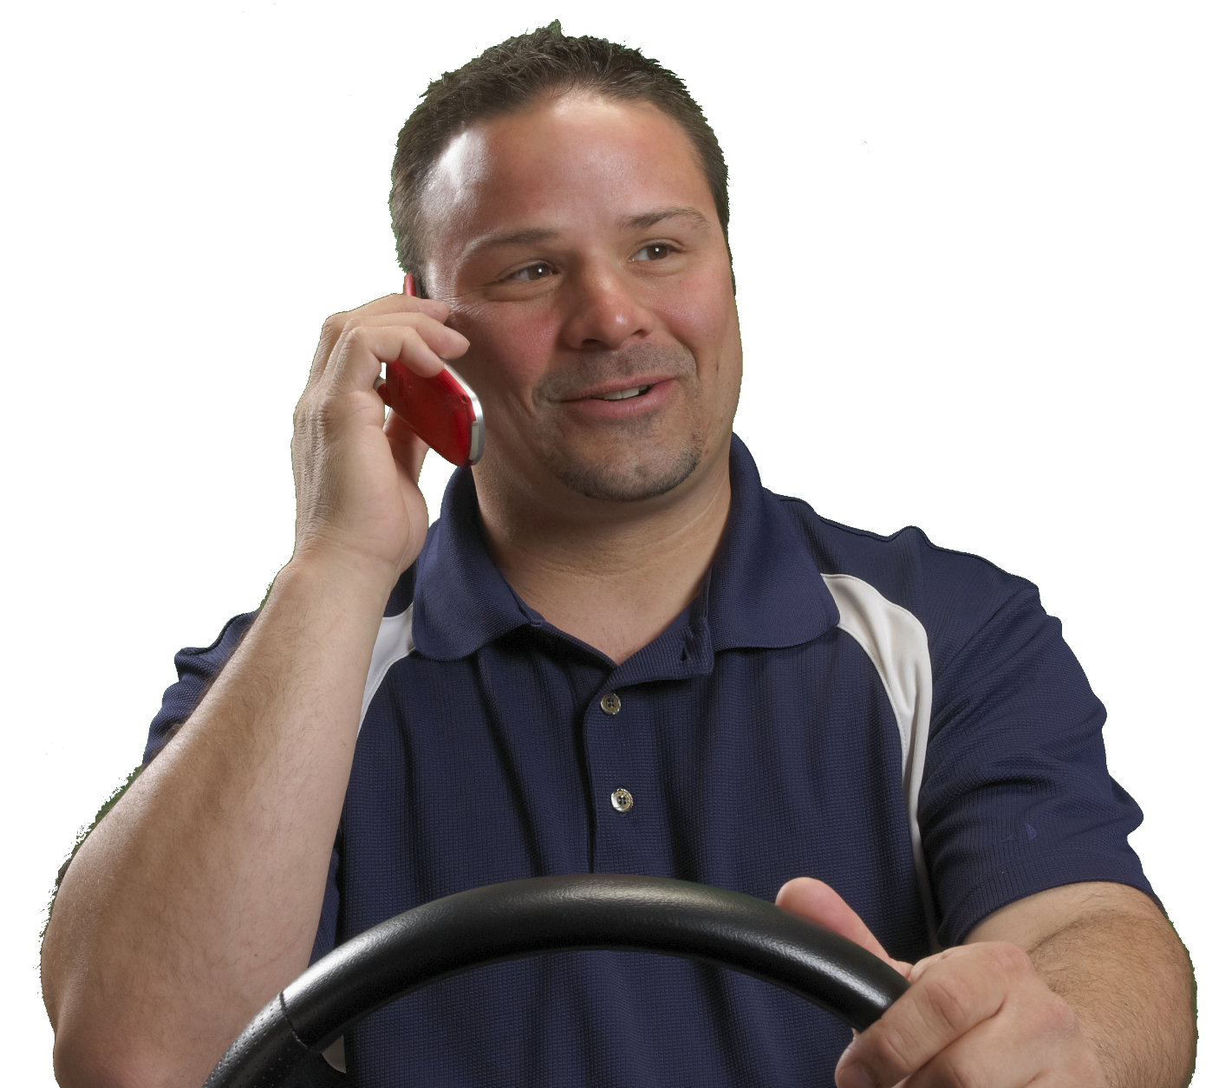
Distracted Drivers
Slow/Speed up for no reason
Don’t drive with flow of traffic
Unable to remain in lane
Cut off drivers
Tailgate
Break traffic rules
Notes:
Other driver behaviors that can signal a lack of attention include:
Not being able to remain within a single lane of travel
Unexplained slowing or speeding up of the vehicle
Not driving with the flow of traffic
Cutting off other drivers
Tailgating
Breaking traffic rules (running a red light/stop sign, passing in a no passing zone, etc.)

Slide 21
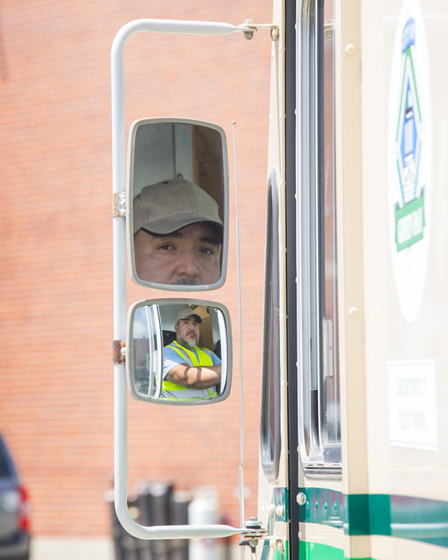
Seeing to the Rear
Scan your mirrors (and gauges) every four seconds
Notes:
Scan your mirrors (and gauges) every four seconds.

Slide 22
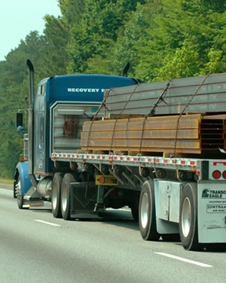
Seeing to the Rear
Check load and cargo security
Notes:
Check load and cargo security. Watch for loose or falling cargo. If operating a flatbed, watch for loose straps, ropes, chains, or tarps.

Slide 23
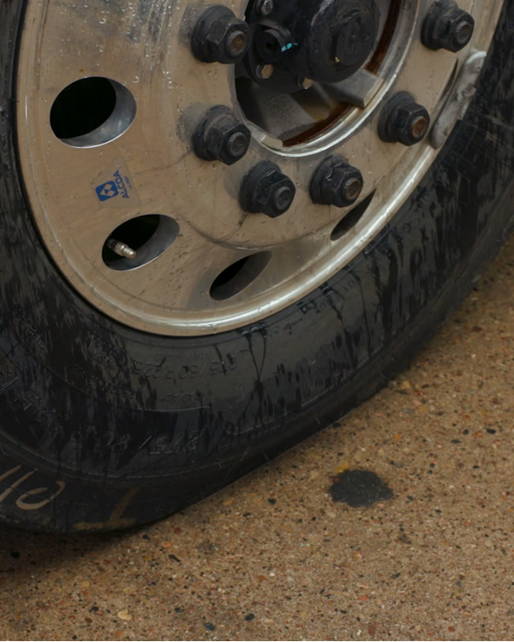
Seeing to the Rear
Keep an eye on your tires
Notes:
Keep an eye on your tires. Look for potential problems including flat or damaged tires or tire fires.

Slide 24
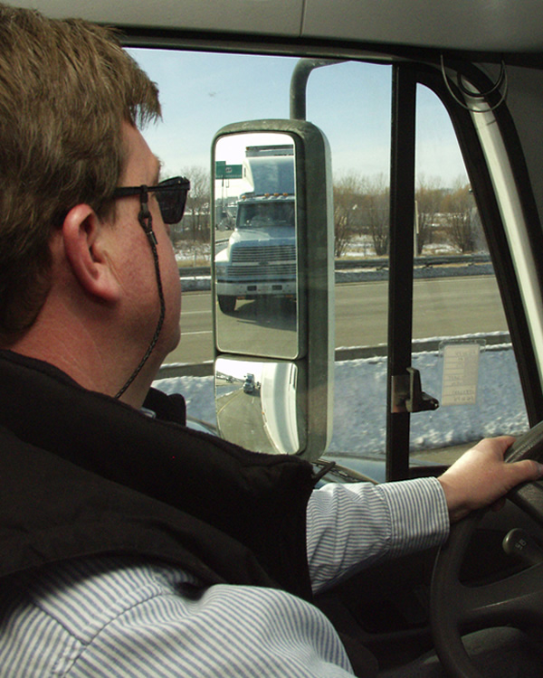
Seeing to the Rear
Use your mirrors when changing lanes
Check your mirrors when you slow down, merge, or turn
Notes:
Use your mirrors when changing lanes. Check your mirrors:
Before you change lanes (making sure there’s room to change lanes)
After you signal (making sure no one/nothing moved into your blind spot)
Right after you begin the lane change (making sure your path is still clear)
After you complete the lane change
Also check your mirrors when you slow down, merge, or turn. Use of mirrors is also important when approaching alleys and intersections. Mirrors must be used more frequently when in traffic tie-ups and when approaching or driving alongside parked or stopped vehicles.

Slide 25
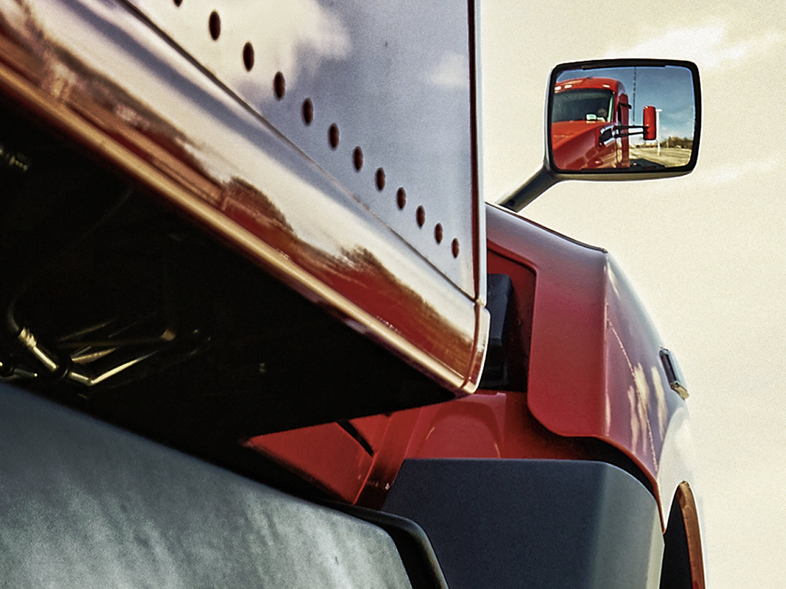
Types of Mirrors
Notes:
Mirrors provide your only view of the rear of your vehicle. You should check your mirrors about every four seconds, and always use them before changing speeds or your position in traffic. Also, use mirrors to assist in checking your vehicle’s blind spots. Tractors are equipped with the following types of mirrors:
Plane (west coast)
Convex
Fender
LAB/RANGE RECOMMENDATION
This lesson is intended to help the student understand proper mirror adjustment.
Prior to beginning the lesson, position the tractor-trailer in a straight line with an unobstructed view to the rear. Also place the mirrors out of adjustment.
Divide your students into groups of three or four. One student should sit behind the wheel. Two other students should act as reference objects for proper mirror adjustment:
One should stand 100 feet to the rear and 15 feet to the left side of the trailer
One should stand 100 feet to the rear and 15 feet to the right side of the trailer
Each student should take at least two turns behind the wheel adjusting the mirrors and making judgments about the distance of the objects in each mirror’s field of view.
At the conclusion of this exercise, ask your students to share any challenges or issues they may have had in properly adjusting the mirrors.
VIDEO
8.4 – Mirrors

Slide 26
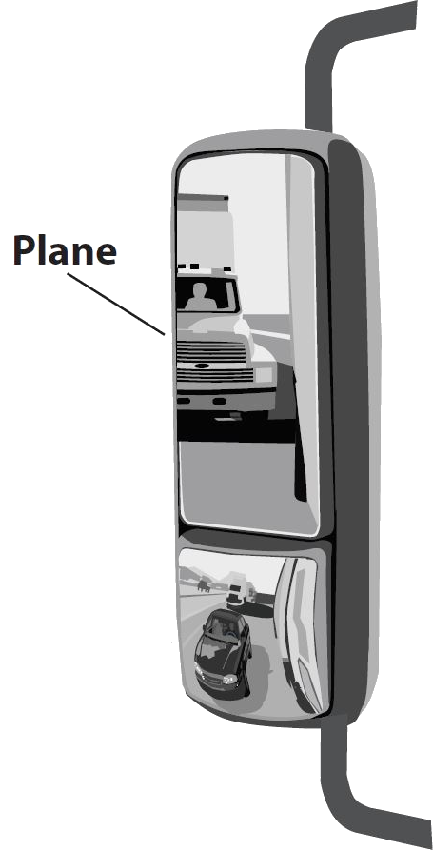
Plane (West Coast) Mirrors
Enable you to see down the sides and toward the rear of your trailer and the roadway behind it
Notes:
A plane mirror enables you in seeing down the sides and toward the rear of your trailer and the roadway behind. It doesn’t give as wide a view as the convex mirror does, but it does allow for better visibility down the length of the trailer. The left mirror is closer and reflects a larger image, which means you have a greater field of view from that mirror.

Slide 27
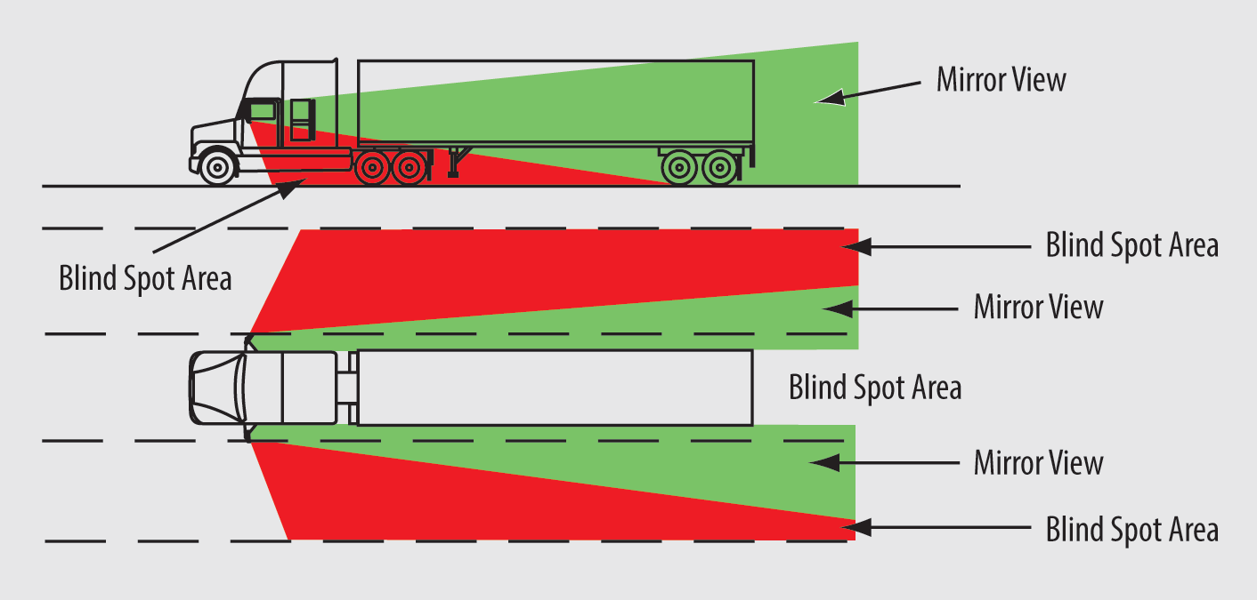
Plane (West Coast) Mirrors
Notes:
Remember that mirrors do not allow you to see everything. There are blind spots on both sides of your vehicle. This makes lane changes, passing, and other maneuvers challenging. Tight turns can also pose a problem. You can’t see smaller vehicles or pedestrians that are next to the vehicle. Along with using your mirrors, signal and wait a moment before changing direction or lanes.

Slide 28
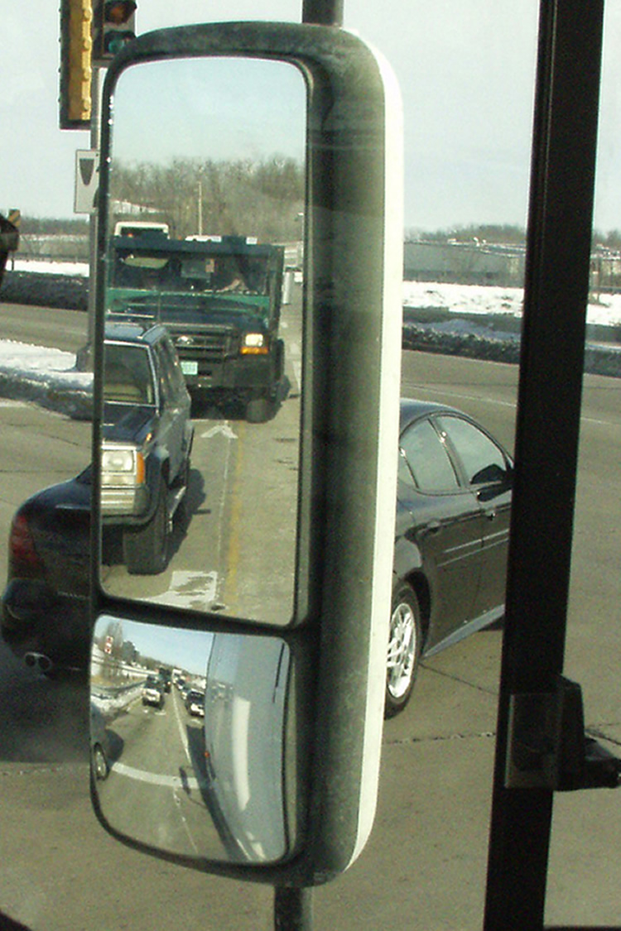
Plane Mirrors
Images appear similar to those in your personal vehicle
Notes:
Images in your side mirror will appear to be similar to those when you are driving your car or truck. When using your plane mirror in this situation, you should be able to judge the speed and distance of overtaking vehicles.

Slide 29
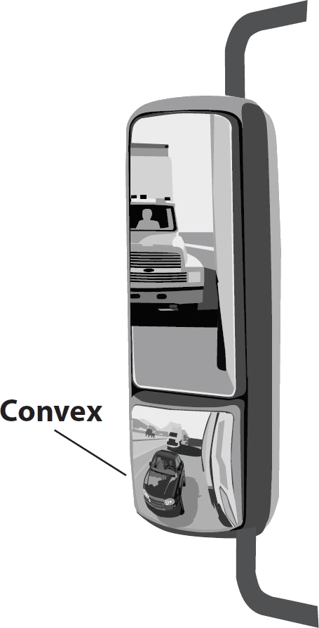
Convex Mirrors
Designed with an outward curvature to provide a wide-angle view
Provide the best close-up view of the sides of
your vehicle
Notes:
Convex mirrors are designed with an outward curvature to provide a wide-angle view. Convex mirrors provide the best close-up view of the sides of your vehicle.

Slide 30
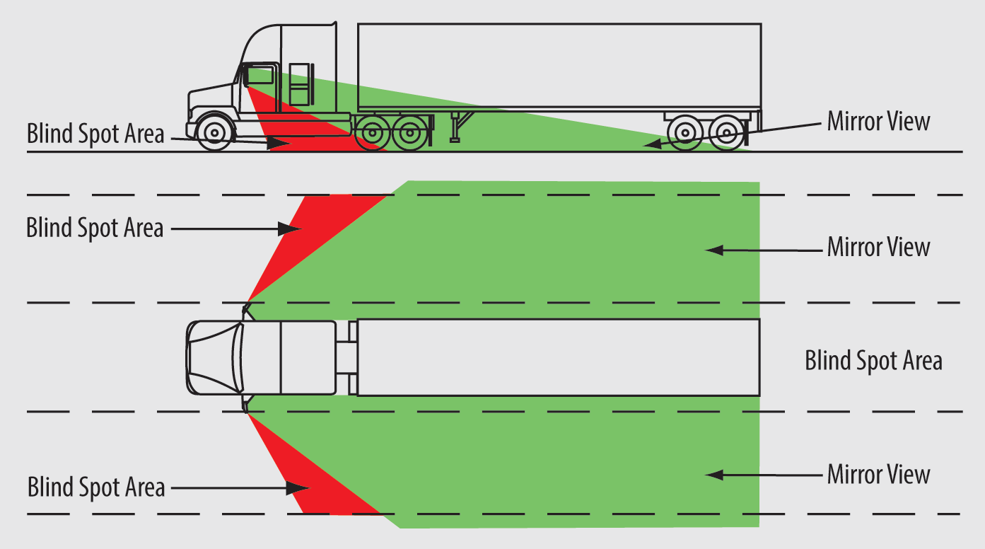
Convex Mirrors
Notes:
They give a broader view than plane mirrors and, if adjusted correctly, eliminate much of the blind area.

Slide 31
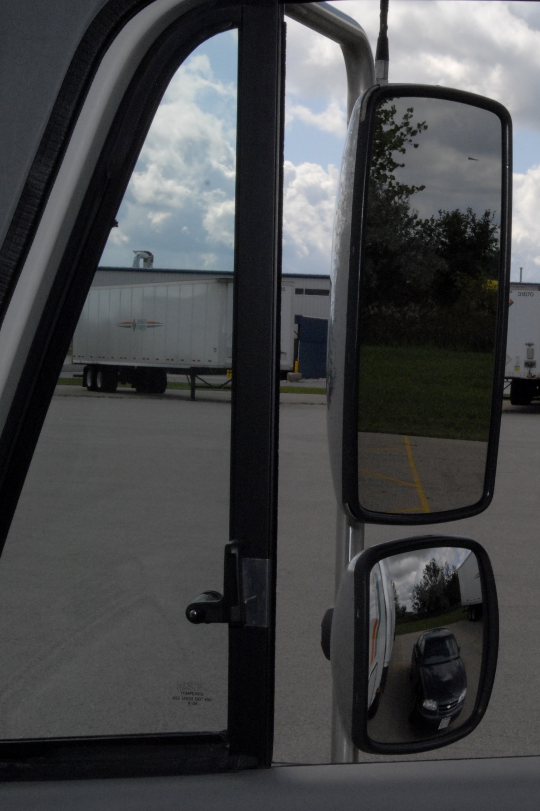
Convex Mirrors
Show a
distorted image
Vehicles appear smaller and farther away than they really are
Notes:
One negative aspect of convex mirrors is that they show a distorted image. Overtaking vehicles appear smaller and farther away than they really are. When using this mirror, you need to gain a solid understanding of what you are looking at. This will take practice as this view is not something you are used to in your personal vehicle.

Slide 32
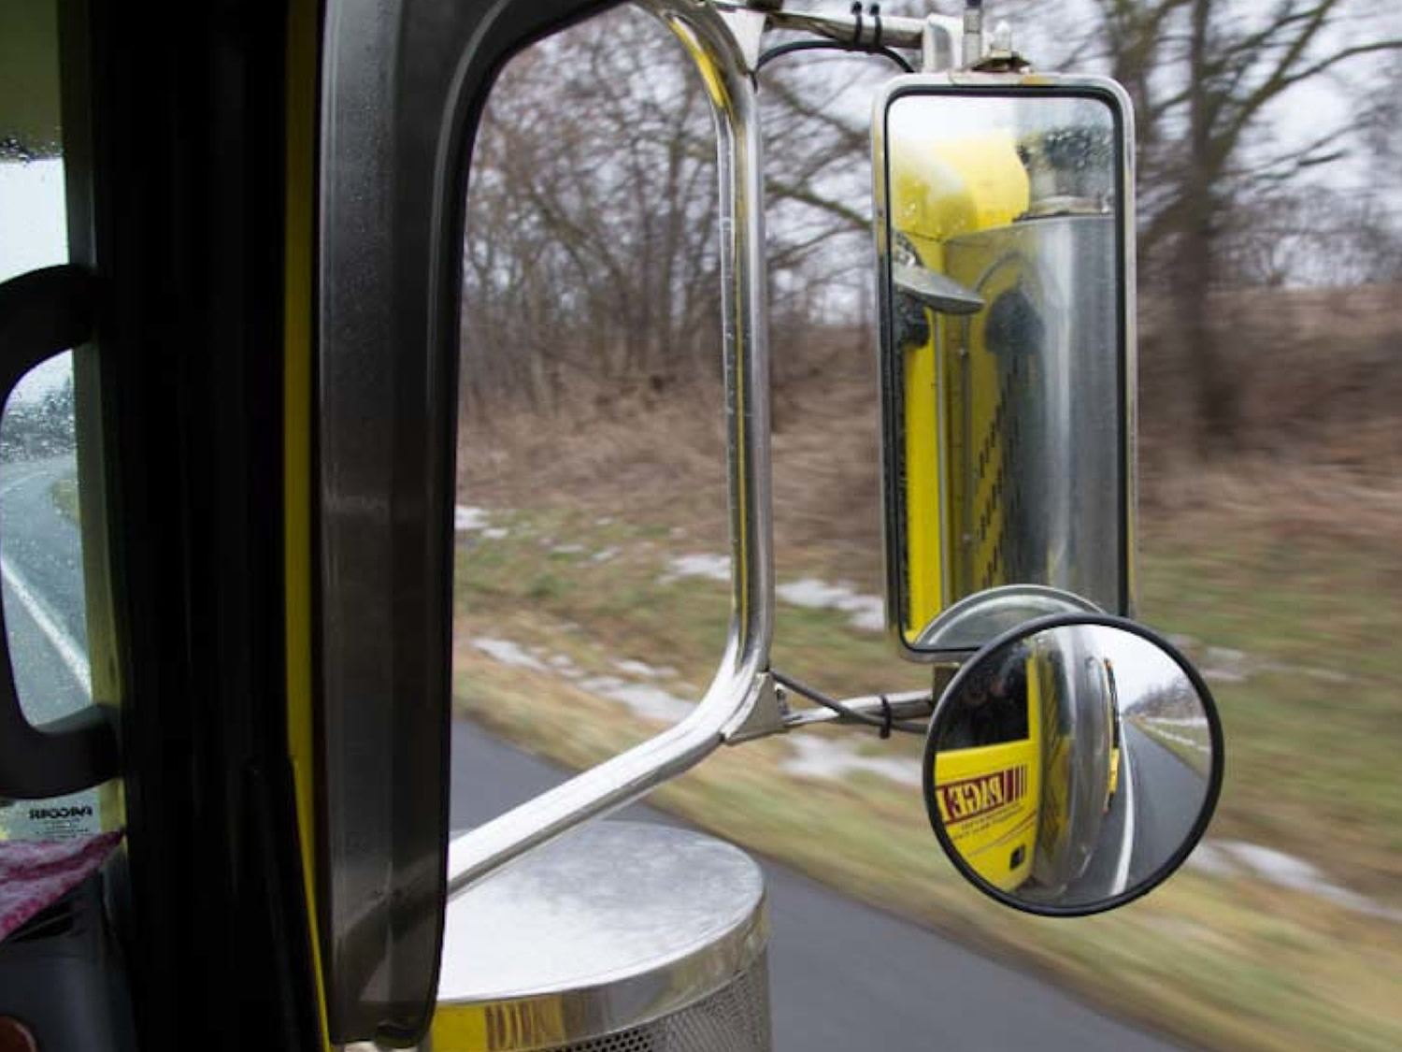
A combination of plane and convex mirrors works best
Notes:
A combination of plane and convex mirrors works best. They provide maximum side and rear vision. The drawback is that the combination can be a bit confusing at first. In addition to making sure your mirrors are properly adjusted, it is important that you keep them clean. Dirty mirrors may not affect your visibility much in the daylight, but when they’re lit up at night by another driver’s headlights or by a setting or rising sun, even a little dirt can cause a distractingly dangerous glare.
CALLOUT: Some trucks are equipped with hood-mounted convex tri-pod mirrors, which provide the most visibility down the side of the truck.

Slide 33
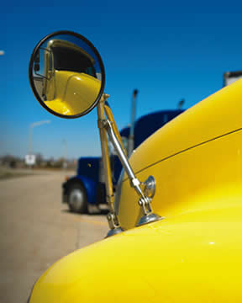
Fender Mirrors
Help you see areas behind and to the sides of your vehicle, including some blind spots around your vehicle
Notes:
Some vehicles also make use of fender mirrors, which are mounted on the right and left corners of the front fenders. Fender mirrors help you see areas behind and to the sides of your vehicle, including some blind spots around your vehicle. While not on every commercial motor vehicle, they do provide an additional level of sight around the vehicle which adds to safer driving operations in many instances.

Slide 34
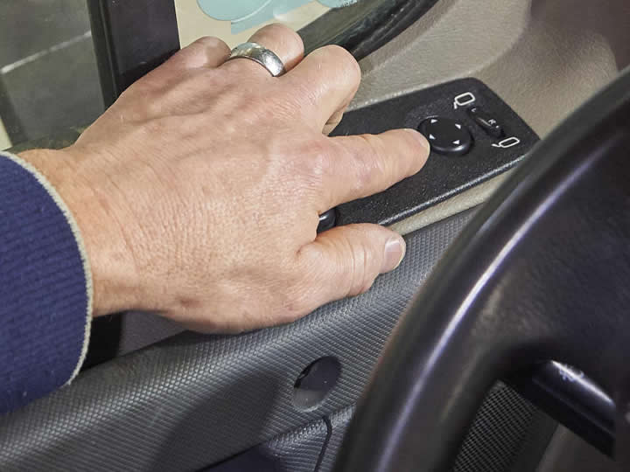
Adjusting Mirrors
Notes:
Proper adjustment of your vehicle’s mirrors is important. It ensures that you have the best view possible to the sides and rear of your vehicle.
CALLOUT: Check mirror adjustment regularly. Your vehicle should be straight before making adjustments.

Slide 35
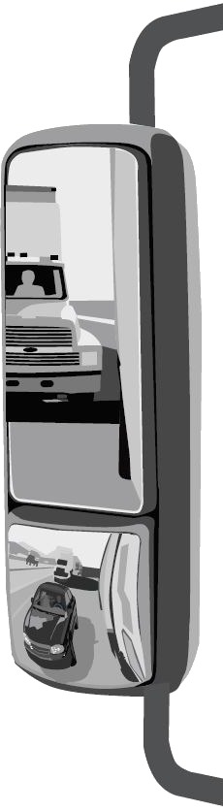
Plane Mirrors
Left side. You should see the trailer body on the inside vertical edge of the mirror.
Right side. You should see the trailer body on the inside vertical edge of the mirror.
Notes:
Left side. You should see the trailer body on the inside vertical edge of the mirror. The rest of the mirror should show what is next to and behind the trailer. You should be able to see a point on the ground about 30 feet away on the bottom, horizontal edge of the mirror.
Right side. You should see the trailer body on the inside vertical edge of the mirror. The rest of the mirror should show what is next to and behind the trailer. You should be able to see a point on the ground about 60 feet away on thebottom, horizontal edge of the mirror.

Slide 36
Convex Mirrors
Left side. You should see part of the trailer on the inside vertical edge of the mirror.
Right side. You should see part of the trailer on the inside vertical edge of the mirror.
Notes:
Left side. You should see part of the trailer on the inside vertical edge of the mirror. The top, horizontal edge of the mirror should show a point on the ground that is about 35 feet away. The bottom, horizontal edge should show a point on the ground that is about seven feet away.
Right side. You should see part of the trailer on the inside vertical edge of the mirror. The top, horizontal edge of the mirror should show a point on the ground that is about 65 feet away. The bottom, horizontal edge of the mirror should show a point on the ground that is about eight feet away.

Slide 37
Objectives Review
You should now be able to:
  Explain the importance of continuously scanning your surroundings
  Discuss how to perform a proper visual scan in front of, to the sides, and behind your vehicle
  Recognize potential hazards you must be aware of and react to while driving
  Identify signs of a distracted driver and pedestrian
  Describe the different types of mirrors and what each is designed for
  Explain how to properly adjust your mirrors and use them while driving
Copyright 2019 J. J. Keller & Associates, Inc.
Notes:
You should now be able to:
Explain the importance of continuously scanning your surroundings
Discuss how to perform a proper visual scan in front of, to the sides, and behind your vehicle
Recognize potential hazards you must be aware of and react to while driving
Identify signs of a distracted driver and pedestrian
Describe the different types of mirrors and what each is designed for
Explain how to properly adjust your mirrors and use them while driving
CLASSROOM RECOMMENDATION
Before concluding your training session, have participants take the corresponding quiz (found on the Trainer Tools USB) to check their understanding of the material. You can customize any of the questions to fit your audience or workplace. The answer key can also be found on the Trainer Tools USB.
You may also choose to administer the quizzes before you begin your training session to help get participants thinking about the subject and/or to gauge their understanding of the topic ahead of time.
ROAD RECOMMENDATION
Below is the outline for a commentary driving exercise. In commentary driving, the student should be able to identify (out loud) obstacles and potential obstacles while driving. The following are general rules:
Identify obstacles by using short phrases such as:
Stop sign
Upcoming stop light, or
Vehicle passing ahead
Identify only the most important/critical obstacles. It’s impossible to point out all obstacles without becoming distracted.
Students shouldn’t look at the instructor while talking.
Identify, don’t explain.
Visual search exercise
The purpose of this session is to allow students to practice visual search under highway conditions.
As with other exercises, break your class into groups of three students per instructor. Each student should have two to three hours behind the wheel.
The route you select for this session should expose the student to a broad range of roadways under low density traffic conditions. When selecting a route, keep in mind that this may be the student’s first experience driving a tractor-trailer on a public roadway. That alone could cause anxiety for the student and could pose a distraction. It isn’t necessary to select a route with a large volume of traffic. The route you select should include the following:
Path obstructions that force a change in speed or direction that are observable from a distance
Intersections at which left and right turns may be made
Blind intersections at which the student must yield the right-of-way
Multi-lane streets that permit lane changes
Freeway interchanges, including weave-type interchanges that are used to enter, exit, and traverse
Lane control signs and signals
Tight turns (alleys, driveways, etc.)
Follow these procedures during the session:
Each student should spend a maximum of 20 minutes behind the wheel. As this is probably the student’s first on-the-road experience, the intensity and stress of the activity can cause fatigue within a short period of time.
The student should use commentary driving techniques for up to one-half of the time he or she is behind the wheel. If this seems to be too distracting to the student at first, discontinue the use of commentary driving until the student is more confident.
As the instructor, you should give directions involving changes in speed or direction well in advance.
Make sure your students perform the following maneuvers at some point during the session: lane changes, right and left turns, and entering, exiting, and traveling through a freeway interchange.
When you are confident that the students have had sufficient practice under low-density traffic conditions, additional practice should be taken in moderate traffic conditions, but avoid high density traffic situations.

