Slide 1






PowerPoint® Instructions
This PowerPoint has been designed so you can easily customize it for your training session.
Throughout the presentation you’ll see icons with recommendations or videos to enhance the instruction you present to your students. A detailed explanation for each icon can be found on the next slide. Videos can be found on the Trainer Tools USB.
When you see an icon on the slide, look in the notes
section for further information.
Simply delete or move the icon off the slide before your training session begins.

Slide 2





Classroom Recommendations. Provides suggestions for enhancing your classroom presentation; from ideas for large group discussions to suggestions on the use of training aids such as examples or photos of vehicle parts and components to help illustrate the items covered within a chapter.
Lab Recommendations. Provides suggestions for activities and exercises that take place outside the classroom, but do not involve
the actual operation of the tractor-trailer or its components. Examples
of lab sessions include conducting a vehicle inspection or practicing mirror adjustment.
Range Recommendations. These recommended activities take
place on a closed-access driving range where students may practice driving skills in a controlled environment. Examples of range sessions include practicing shifting technique and successfully completing a backing maneuver.
Road Recommendations. These recommended activities take place in road and traffic conditions that support the chapter’s objectives. Examples of road sessions include proper communication with other drivers through the use of turn signals and basic vehicle control under nighttime or extreme weather conditions.
Videos. These short video clips reinforce material presented in the Student Manual. Use them to help students grasp difficult concepts or subject matter.

Slide 3

32
CSA
Notes:
Chapter 32: CSA

Slide 4
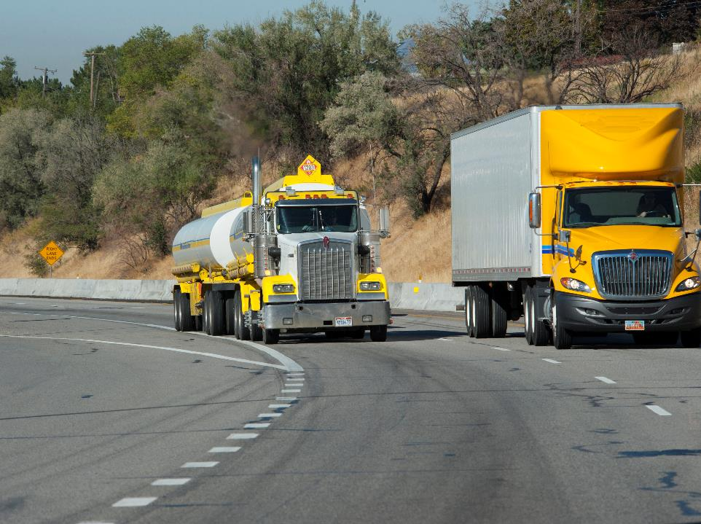
Introduction
Notes:
Introduction
When it comes to topics of importance in the motor carrier industry, Compliance, Safety, Accountability (CSA) is at the top of the list. So, what is CSA and how does it affect you and your future as a professional driver? This chapter will help you answer this and many more questions on the topic.
CLASSROOM RECOMMENDATIONS
Your classroom presentation should include the major components of Compliance, Safety Accountability (CSA), how they work together, and the impact CSA has on both the professional driver and his or her employer.
Stress the importance of the role the professional driver plays in CSA. How the driver fares under CSA will have an impact on his or her employer and potentially his or her professional driving career.
Discuss how, in order to maintain good scores, a motor carrier will need to be mindful of its safety performance. This means taking a critical look at everything from vehicle maintenance to driver performance. A driver whose performance could have a negative impact on a motor carrier’s scores may be a less desirable candidate when it comes to the hiring process.

Slide 5
Objectives
Upon completion of this lesson, you will be able to:
  Discuss the goal of the Compliance, Safety, Accountability (CSA) system
  List the four major components of the CSA system
  Describe the seven Behavior Analysis and Safety Improvement Categories (BASICs), BASIC scores, and strategies for keeping your BASIC scores low
  Recognize actions that can be taken by the FMCSA in
  an intervention
Notes:
Objectives
Upon completion of this lesson, you will be able to:
Discuss the goal of the Compliance, Safety, Accountability (CSA) system
List the four major components of the CSA system
Describe the seven Behavior Analysis and Safety Improvement Categories (BASICs), BASIC scores, and strategies for keeping your BASIC scores low
Recognize actions that can be taken by the FMCSA in an intervention

Slide 6
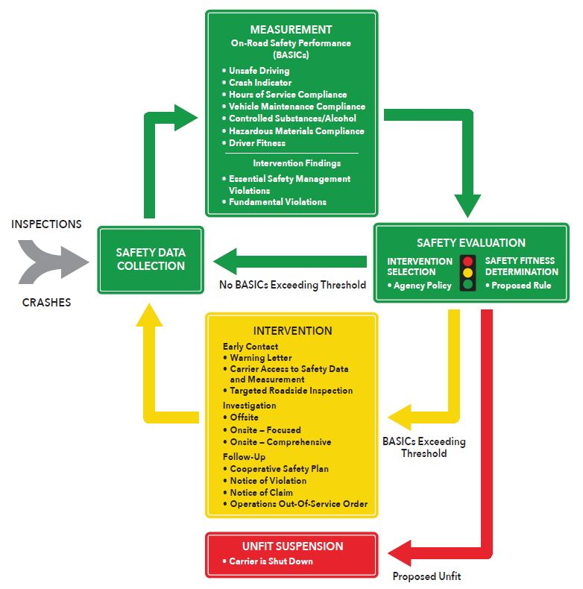
What is CSA?
Notes:
What is CSA?
CSA, which stands for Compliance, Safety, Accountability, is a driver and carrier monitoring and evaluation system that is designed to identify and intervene with drivers and carriers who are not in compliance with safety regulations. It is implemented by the Federal Motor Carrier Safety Administration (FMCSA). CSA applies to:
Any interstate motor carrier that operates commercial motor vehicles (CMVs) and has a US Department of Transportation (USDOT) number
Any interstate or intrastate motor carrier that operates vehicles transporting hazardous materials
All drivers who drive CMVs in interstate commerce
A CMV is defined in Section 390.5 of the Federal Motor Carrier Safety Regulations (FMCSRs) as:
Having a gross vehicle weight rating or gross combination weight rating, or gross vehicle weight or gross combination weight of 10,001 pounds or more, whichever is greater; or
Designed or used to transport more than 8 passengers (including the driver) for compensation; or
Designed or used to transport more than 15 passengers (including the driver), and is not used to transport passengers for compensation; or
Transporting hazardous materials in a type or quantity requiring placarding
Simply put, CSA is a system used by the FMCSA to identify safety problems early, so they can be addressed before they lead to tragedies on the highway. It addresses enforcement in a way that allows for contact with a larger number of motor carriers and drivers earlier in the safety evaluation process. This allows FMCSA to address problems before they become serious. In the past, FMCSA’s enforcement system primarily focused on motor carriers and didn’t place an emphasis on drivers. FMCSA believes that by tracking both motor carriers and drivers, the agency has a more complete picture of compliance.
The CSA system consists of four major components:
Data collection which is gathering information about your compliance on the road
Safety measurement which involves analyzing the data using a process of ‘valuing’ your violations
Safety evaluation which is the comparison of results to other drivers and carriers
Interventions which is taking action where drivers and carriers are not performing up to safety standards

Slide 7
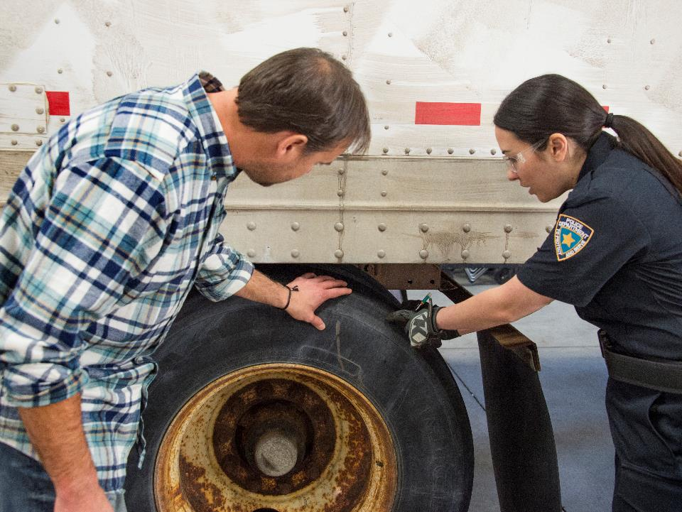
Data Collection
Notes:
Data Collection
The first component in the CSA system is data collection. FMCSA uses three data sources to gather information about motor carrier and driver compliance:
Roadside inspections
Law enforcement crash reports
FMCSA Investigations
The roadside inspection is where the majority of data about motor carriers and drivers is gathered. The roadside inspection is an examination of both the driver and his or her CMV by law enforcement. This examination determines if the driver and his or her vehicle are in compliance with the FMCSRs and Hazardous Materials Regulations.
Data collection takes place during all roadside inspections such as those at weigh stations or ones that occur as a result of moving violations. Violations found during the roadside inspection are entered into the system. When no violations are found, that is also entered into the system.
All state-reported crashes involving a CMV are entered into a database and eventually scored—even if the driver wasn’t at fault or could not have prevented the crash.
Finally, if a carrier is targeted for investigation by the FMCSA, any unreported safety-related data discovered during this process may also be added to the database.

Slide 8
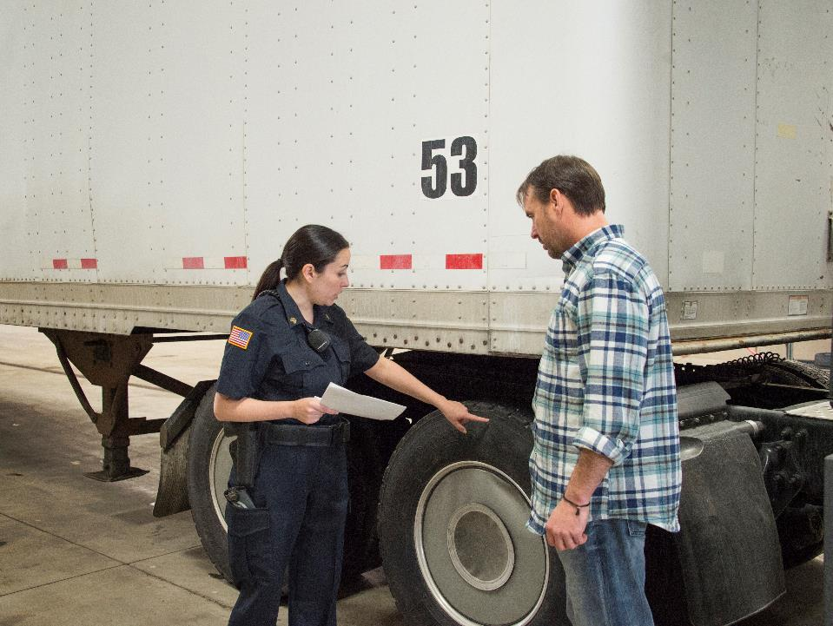
Safety Measurement System (SMS)
Notes:
Safety Measurement System (SMS)
The second component of the CSA system is the Safety Measurement System (SMS). The SMS quantifies the on-road safety performance and compliance history of motor carriers and drivers to:
Identify candidates for interventions
Determine the specific safety problems exhibited by a driver or motor carrier
Monitor whether safety problems are getting worse
Every month, the SMS measures roadside violation and crash data performance and calculates a score in the seven Behavior Analysis and Safety Improvement Categories (BASICs).
Motor carriers are measured on the previous 24 months and drivers are measured on the previous 36 months.

Slide 9
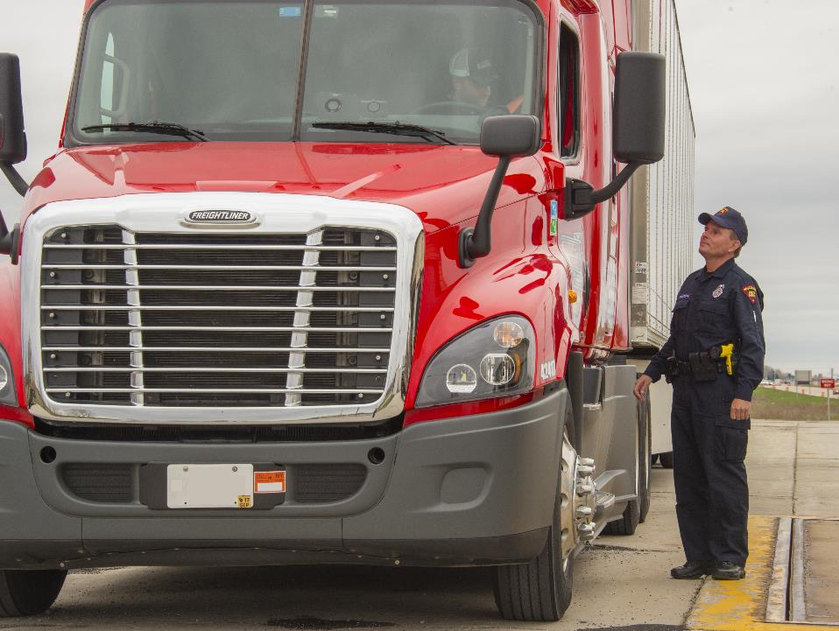
Behavior Analysis & Safety Improvement Categories (BASICs)
Notes:
Behavior Analysis and Safety Improvement Categories (BASICs)
The Behavior Analysis and Safety Improvement Categories (BASICs) are seven categories of safety behaviors measured in the SMS. The BASICs are behaviors that can lead to crashes. The seven BASICs are:
Unsafe driving
Hours-of-service compliance
Driver fitness
Controlled substances and alcohol
Vehicle maintenance
Hazardous materials (HM) compliance
Crash indicator
Knowing what the seven BASICs are, how they are scored, and what those scores can mean for you and your carrier is very important. We’ll take an in-depth look at each of the BASICs.

Slide 10

Unsafe driving includes:
  Speeding
  Reckless driving
  Improper lane change
  Following too close
  Not using your seatbelt
  Texting while driving
Notes:
Unsafe Driving
Unsafe driving addresses the operation of CMVs by drivers in a dangerous or careless manner. Examples of violations that fall under this BASIC include:
Speeding
Reckless driving
Improper lane change
Following too closely
Not using your seatbelt
Texting while driving
These types of violations often trigger roadside inspections, so steering clear of moving violations is a key strategy for minimizing roadside inspections.
If the FMCSA has determined the driver could have avoided, prevented, or stopped the violation, the driver is considered the responsible party and the violation is entered into the driver’s data—as well as the carrier’s data—in the SMS.
However, if the driver receives a warning, citation, or a ticket that’s issued by an officer who has not entered it on a roadside inspection report, there is no entry into the SMS. Only data on roadside inspection reports submitted by trained officers becomes part of the CSA database.
The Unsafe Driving BASIC includes some of the more serious violations tracked by the CSA.
The best approach to ensure a low score in this BASIC is to avoid driving violations—especially high severity violations. Practice defensive driving. Keep yourself fresh and alert to prevent poor driving decisions. And, take advantage of any training programs your carrier offers.

Slide 11

You can avoid violations by thoroughly understanding the hours-of-service regulations.
Notes:
Hours-of-Service Compliance
Examples of violations that fall under this BASIC include:
Operating a CMV while ill or fatigued
Hours-of-service violations
Record of duty status violations
Understanding how and when to complete a record of duty status is one of the key elements of the Hours-of-Service Compliance BASIC.
You can avoid violations by thoroughly understanding the hours-of-service regulations, by keeping your record of duty status with you, and by keeping it accurate, truthful, and up-to-date. And, of course, don’t drive if you’re ill or fatigued, out of hours, or if you’ve received an out-of-service order.
CALLOUT: One of the most cited offenses during a roadside inspection is the record of duty status violation. It is important that you understand and follow the hours-of-service regulations.

Slide 12

Make sure you are properly licensed
and trained.
Notes:
Driver Fitness
Contrary to what you might assume about the name of this BASIC, Driver Fitness does not refer to the physical fitness of drivers. The Driver Fitness BASIC uses violations noted in roadside inspections that are associated with driver training, driver qualifications, and driver licensing as related to the types of vehicles drivers operate and the loads they transport.
Examples of violations that fall under this BASIC include:
Failure to have a valid and/or appropriate license
Failure to have proper endorsements
Failure to have valid medical certification
Failure to train hazmat employees
Since driver qualifications and training are key elements of this BASIC, you can ensure a low score by being properly licensed and trained, and by keeping your training current.
If your job involves transporting hazardous materials, be sure you’ve received the training you need to be qualified to carry these loads. You should always have a valid license of the correct class with the necessary endorsements for the type of truck and type of load you are transporting.
And, every driver should be able to pass a physical exam, so you should have current medical certification on file with your driver licensing agency at all times.

Slide 13

Regulations prohibit you from drinking any alcohol for at least four hours before your shift begins.
Notes:
Controlled Substances and Alcohol
Like the other BASICs, this has nothing to do with receiving a citation or ticket for operating under the influence while driving your personal vehicle. For a controlled substance or alcohol violation to become part of the SMS—recorded under this BASIC—it must be noted by a trained officer in a roadside inspection report or during a carrier investigation.
Examples of violations that fall under this BASIC include:
Operating under the influence of alcohol or drugs
Possession of drugs or alcohol in a CMV
Possession, use, or under the influence of alcohol within four hours prior to duty
Violating an alcohol- or drug-related out-of-service order
For drivers, staying on the good side of this BASIC is pretty simple—don’t operate a vehicle under the influence of alcohol or drugs. Misuse of illegal, prescription, or even over-the-counter medications can affect driving abilities.
The regulations prohibit you from drinking any alcohol for at least four hours before your shift begins. In fact, the regulations prohibit having any alcohol whatsoever with you in the CMV, even unopened purchases you intend for personal use later.
To avoid on-the-road problems in this area, your carrier may choose to establish and enforce policies that are stricter than the regulations mandate. For example, drivers might be required to be alcohol-free for 12 or 24 hours before coming on duty rather than the regulation’s minimum four hours.
Carriers do this because if there is an investigation, the presence of such a policy sends a clear signal to the FMCSA that the carrier is serious about the Controlled Substances and Alcohol BASIC.

Slide 14
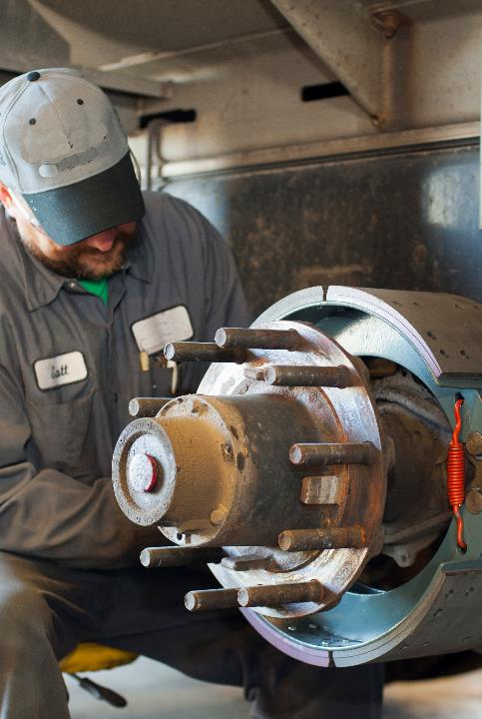
Proper vehicle maintenance is paramount to safety.
Notes:
Vehicle Maintenance
Proper vehicle maintenance is paramount to safety, and some vehicle maintenance issues have a considerable bearing on crash causation. Examples of violations that fall under this BASIC include:
Defective brakes, lights, and other mechanical components
Failure to make required repairs
Failure to inspect the vehicle or prepare inspection reports
Improper load securement
Operating an out-of-service vehicle
The obvious way to keep your score low for this BASIC is to make sure you complete all required vehicle inspections and cargo checks, know what to do when on-road repairs are needed, and know of and use proper cargo securement techniques.
Finally, make sure you report any problems to your carrier immediately, so they can be addressed. By actively resolving vehicle issues, you increase the likelihood that you’ll have violation-free roadside vehicle inspections which will help lower scores in the Vehicle Maintenance BASIC.
CALLOUT: The condition of your vehicle is an extremely important issue, as the roadside inspection is where most data will be gathered. Chapters 3 and 19 address vehicle inspections and chapters 18 and 20 address preventive maintenance and diagnosing and reporting vehicle malfunctions.

Slide 15
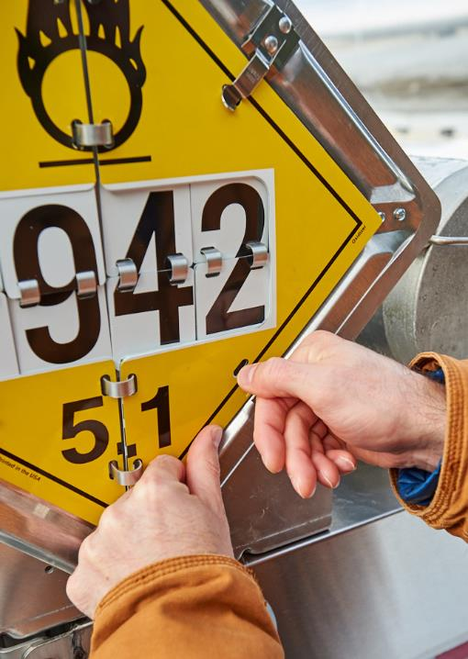
Violations include:
  Leaking containers
  Improper placarding
  Failure to have proper hazmat documentation
  Hazmat routing violations
Notes:
Hazardous Material (HM) Compliance
The Hazardous Materials (HM) Compliance BASIC addresses the unsafe handling of hazardous materials on a CMV. As a driver, your key responsibilities in this area are to make sure that any hazardous materials you transport have been properly packaged, labeled, and documented before they are loaded on your vehicle. You also need to make sure that hazardous materials are properly secured, and that hazmat paperwork is where it should be—in the cab.
Examples of violations include:
Leaking containers
Improper placarding
Failure to have proper hazmat documentation
Hazmat routing violations
The surest path to prevent violations in the Hazardous Materials Compliance BASIC is knowledge. Knowledge gained by understanding the regulations related to transporting hazardous materials and knowledge gained by inspecting your load and taking action when you identify a problem.

Slide 16
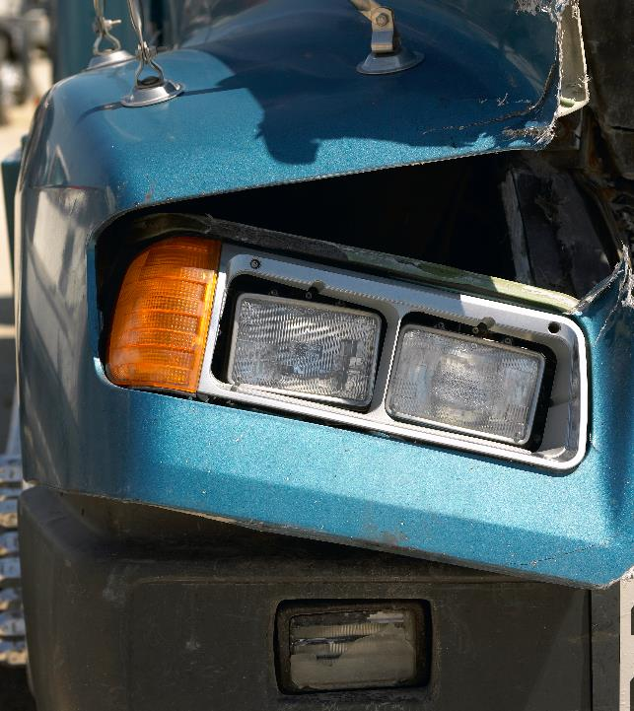
Monitoring crash events is a critical part of SMS.
Notes:
Crash Indicator
At its core, CSA is designed to prevent crashes, so it’s not surprising that monitoring crash events is a critical part of the SMS. Unlike the other six BASICs, which each relate to a specific category of behavior, the Crash Indicator BASIC collects data on one of the more extreme consequences of unsafe driving behaviors.
The Crash Indicator BASIC uses state-generated crash reports to add data points to both the driver’s and the carrier’s SMS record. It’s important to note that under the current system all crashes are recorded. It doesn’t matter who was at fault—if you’re involved in a crash while operating a CMV, even as a victim, that crash will become part of the SMS database.
However, crashes used for this measure include only recordable crashes—those that result in a fatality, an injury requiring immediate treatment away from the scene, or requiring vehicles to be towed from the scene due to disabling damage.
To avoid being involved in a crash, you need to drive defensively, operate within the traffic rules and regulations, and anticipate the actions of other drivers on the road. And, it means training. Upgrading and refreshing your skills on a regular basis is an effective way to avoid involvement in a crash.

Slide 17
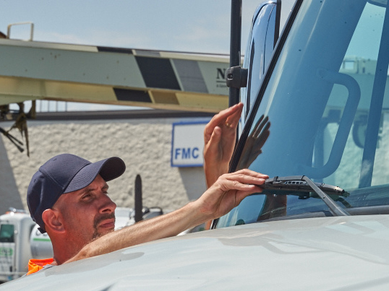
Assigning Value
Notes:
Assigning Value
To make sure the comparisons that occur as part of the safety evaluation process are applied fairly, all safety-related violations are given numerical values, which are ultimately used to generate scores for both the carrier and driver measurement systems. Each safety-related event is assigned to one of the seven BASICs. It then receives a number value, called a severity weight, between one and ten with ten being the most severe. This number value is based on the violation’s seriousness in relation to causing a crash. The higher the severity weight, the more likely the carrier and driver will be in a crash based on statistics.
Examples of low severity weight violations include:
A general form and manner violation on your record of duty status
A defective/inoperative windshield wiper on your vehicle
Not carrying spare fuses on your vehicle (when required)
Examples of high severity weight violations include:
A false record of duty status
No or improper load securement
Violating an out-of-service order
Use or possession of drugs
It’s important to note that four of the seven BASICs have an out-of-service penalty, or “kicker.” This penalty applies to the Hours-of-Service Compliance, Driver Fitness, Vehicle Maintenance, and Hazardous Materials Compliance BASICs.
Any time a driver is ordered out-of-service for a violation that is placed in one of these BASICs, the violation severity is increased by two. So, if the violation originally had a severity weight of seven and the driver was placed out-of-service, the severity weight for the violation is increased to nine.
As well as receiving a severity weight value between one and ten, safety‑related events are also time weighted. This is a way of putting more emphasis on recent violations than on past violations.
For drivers, If the violation occurred within:
The previous 12 months, the time weight is 3
Within 12 to 24 months, the time weight is 2
Within 24 to 36 months the time weight is 1
Using this method, the value of each violation diminishes over time and is eliminated after 36 months.
For carriers, the time weights for safety data are different:
The previous 6 months, the time weight is 3
Within 6 to 12 months, the time weight is 2
Within 12 to 24 months, the time weight is 1
These two data points—severity weighting and time weighting—are multiplied together to give a result called the “full value” of the violation. Again, some violations are scored against both the driver and the carrier, but some violations are scored against the carrier only.
When the full values of all violations in certain BASICs are added together and the FMCSA applies statistical tools, the result is a number that can be used for a fair comparison among drivers and carriers. It bears emphasizing that this number is not the score. To reach the score, drivers’ and carriers’ measure within each BASIC are compared to similar drivers and carriers.
CALLOUT: Remember, under this system, both the driver and motor carrier are scored. Data stays with the motor carrier for 24 months and with the driver for 36 months.

Slide 18

Safety Evaluation
Notes:
Safety Evaluation
The safety evaluation is the third component in the CSA system.
For carriers, the comparison process starts by dividing carriers into safety event groups, also referred to as peer groups, based on the number of violations, inspections, or crashes the carrier has had in the last two years.
The driver process is similar in most BASICs, except that in the Unsafe Driving and Crash Indicator BASICs, drivers are all in one large safety event group.
Within each safety event group, drivers and carriers are given a percentile ranking—and it’s this percentile rank that is the BASIC Score. The carrier or driver with the best measure receives a percentile rank of 0, while the carrier or driver with the worst measure receives a percentile rank of 100.
If one or more of the BASIC percentiles exceed a threshold, the carrier or driver becomes a candidate for an intervention.

Slide 19
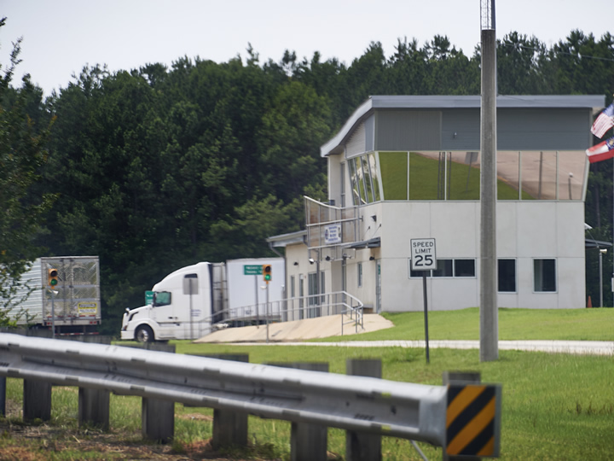
Interventions
Notes:
Interventions
Interventions are the fourth component in the CSA system. Interventions are actions FMCSA can take against a motor carrier and driver based on safety measurement scores and enforcement history.
Motor Carrier Interventions
Motor carrier interventions can be triggered by one or more deficient BASICs, a high crash rate, a complaint, or a fatal crash.
Intervention selection is influenced by safety performance, whether the motor carrier transports hazardous materials or passengers, and intervention history.
Interventions that are applied to carriers are designed to be progressive—increasing in severity as more serious safety issues are identified. Interventions include:
Warning letters advising of apparent safety problems and the potential consequences
Targeted roadside inspections to verify the issues covered in the warning letters are being addressed and corrected
Off-site investigations involving the collection and reviewing of documents without sending an FMCSA investigator to the motor carrier’s place of business
Focused on-site investigations at the carrier’s place of business, focusing on a particular safety problem
Comprehensive on-site investigations conducted at the carrier’s place of business when a carrier exhibits broad and complex safety problems through multiple deficient BASICs
Cooperative safety plans developed and followed voluntarily by a carrier to address safety problems after an investigation
Notices of violation which put a carrier on notice of specific, serious regulatory violations that must be corrected and the intent of the FMCSA to enforce its regulations
Notices of claim which include a formal document served on the violator to compel compliance and deter severe or persistent unsafe behavior
Settlement agreements to contractually bind a carrier to take actions to improve safety
Unfit suspensions to place the motor carrier out-of-business (currently, this process can only be used as part of a compliance review)
Driver Interventions
If your carrier is subject to an intervention due to a high BASIC score, the FMCSA will review all of the carrier’s drivers—looking for high scores.
If the investigation confirms significant driver violations, the FMCSA can take action against drivers, such as a “notice of violation” or a “notice of claim.” These actions could result in significant fines for the identified drivers.

Slide 20
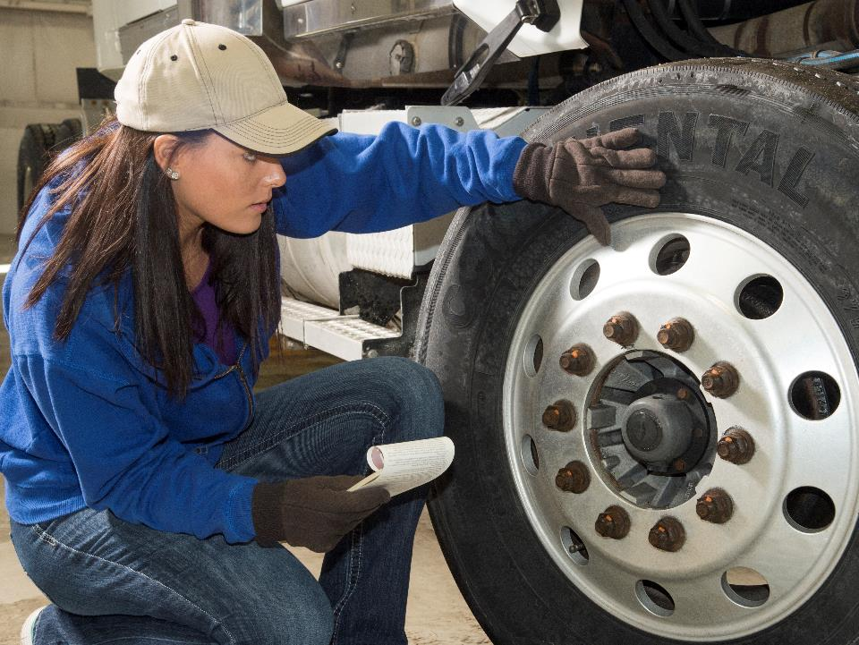
Your Role in CSA
Notes:
Your Role in CSA
As you can see, your actions (or inactions) can play a huge part in the scoring of both you and your motor carrier under CSA. So, how do you ensure positive scores?
Since the majority of data will be gathered during roadside inspections, it is important to have roadside inspections with no violations. How do you do this?
Take care of your vehicle:
Conduct thorough pre-trip and post-trip vehicle inspections
Get problems with your vehicle repaired as soon as possible
Make sure your vehicle is on a regular maintenance schedule
Also, make sure all of your paperwork is current and up to date, including your:
Records of duty status
Commercial driver’s license
And, to keep your BASIC score low:
Drive defensively
Know the regulations
Continue to upgrade your training
Remember, positive scores will reflect well on you as a professional driver.
CALLOUT: Remember that appropriate conduct and courtesy can help when it comes to ensuring a positive outcome during a roadside inspection.

Slide 21

CSA-Related Data
Notes:
CSA-Related Data
As part of the CSA initiative, FMCSA has been working to make accurate and timely information about motor carriers and drivers available to the industry.
As a new driver who will be applying for work with motor carriers in the near future, it is important that you are aware of and understand one of these initiatives, FMCSA’s Pre-Employment Screening Program (PSP).
PSP allows motor carriers to electronically access driver inspection and crash records as part of the hiring process.
Drivers must give their written consent before records may be released to a motor carrier. Records will be protected in accordance with federal privacy laws.
Drivers may also access this data to verify its accuracy and correct any discrepancies. If you feel a violation was wrong, was assigned to you in error, or is otherwise incorrect, there is an appeal process you can pursue.
Appeals are handled through an FMCSA web portal called DataQs. You will have to sign up for a DataQs account—which is free—to challenge any incorrect data in the system.
The information provided includes the most recent five years of crash data and three years of roadside inspection data from FMCSA’s Motor Carrier Management Information System (MCMIS).
MCMIS is comprised of driver data, including:
Inspection and compliance review results
Enforcement data
State-reported crashes
Motor carrier census data
FMCSA states that by accessing this data, motor carriers will be able to better assess the potential safety risks of prospective driver-employees.
CALLOUT: Your records will be reviewed by prospective employers as part of the hiring process.

Slide 22
Objectives Review
You should now be able to:
  Discuss the goal of the Compliance, Safety, Accountability (CSA) system
  List the four major components of the CSA system
  Describe the seven Behavior Analysis and Safety Improvement Categories (BASICs), BASIC scores, and strategies for keeping your BASIC scores low
  Recognize actions that can be taken by the FMCSA in an intervention
Copyright 2019 J. J. Keller & Associates, Inc.
Notes:
You should now be able to:
Discuss the goal of the Compliance, Safety, Accountability (CSA) system
List the four major components of the CSA system
Describe the seven Behavior Analysis and Safety Improvement Categories (BASICs), BASIC scores, and strategies for keeping your BASIC scores low
Recognize actions that can be taken by the FMCSA in an intervention
CLASSROOM RECOMMENDATION
Before concluding your training session, have participants take the corresponding quiz (found on the Trainer Tools USB) to check their understanding of the material. You can customize any of the questions to fit your audience or workplace. The answer key can also be found on the Trainer Tools USB.
You may also choose to administer the quizzes before you begin your training session to help get participants thinking about the subject and/or to gauge their understanding of the topic ahead of time.

