Slide 1






PowerPoint® Instructions
This PowerPoint has been designed so you can easily customize it for your training session.
Throughout the presentation you’ll see icons with recommendations or videos to enhance the instruction you present to your students. A detailed explanation for each icon can be found on the next slide. Videos can be found on the Trainer Tools USB.
When you see an icon on the slide, look in the notes
section for further information.
Simply delete or move the icon off the slide before your training session begins.

Slide 2





Classroom Recommendations. Provides suggestions for enhancing your classroom presentation; from ideas for large group discussions to suggestions on the use of training aids such as examples or photos of vehicle parts and components to help illustrate the items covered within a chapter.
Lab Recommendations. Provides suggestions for activities and exercises that take place outside the classroom, but do not involve
the actual operation of the tractor-trailer or its components. Examples
of lab sessions include conducting a vehicle inspection or practicing mirror adjustment.
Range Recommendations. These recommended activities take
place on a closed-access driving range where students may practice driving skills in a controlled environment. Examples of range sessions include practicing shifting technique and successfully completing a backing maneuver.
Road Recommendations. These recommended activities take place in road and traffic conditions that support the chapter’s objectives. Examples of road sessions include proper communication with other drivers through the use of turn signals and basic vehicle control under nighttime or extreme weather conditions.
Videos. These short video clips reinforce material presented in the Student Manual. Use them to help students grasp difficult concepts or subject matter.

Slide 3

35
Basic Business Practices
Notes:
Chapter 35: Basic Business Practices

Slide 4

Introduction
Notes:
Introduction
As a professional driver, your workplace is the nation’s highways and the facilities you travel to when picking up goods or making deliveries. In this chapter we will touch on some basic business practices including cost and fuel management. We’ll discuss the importance of maintaining a professional image, and talk about the hiring process. Whether you are an owner-operator or a company driver, these concepts can affect your income and success.
CLASSROOM RECOMMENDATIONS
The focus of this chapter is the basic business concepts that every driver should know. Topics addressed include cost management, maintaining a professional image, and the hiring process. Stress that basic business practices are paramount to the continued success of all drivers.
If possible, have a driver, owner-operator, or trucking company executive come in to the classroom and speak about how business practices relate to the professional truck driver.
Invite a recruiter from a trucking company to address what trucking companies are looking for when it comes to hiring professional drivers.
Active classroom discussion is an important tool when covering this topic. Do make sure the discussion remains focused. Discussion on this topic can easily stray into a complaint session about everything from rude motorists to nightmare job interviews.
Exercise
Role playing can also be very helpful in giving your students a “taste of reality.” The following is a role‑playing exercise you can use with your students.
The instructor plays the role of the interviewer. Read the following job description to your students prior to beginning the interview process.
Wanted, Truck Driver: The Little Trucking Company, a for-hire, common carrier of general commodities seeks a relief driver. The hours vary and include work on the dock and as a yard jockey. The desired candidate must be dependable and willing to take last minute assignments.
Select one or more students (as time permits) to take turns “interviewing for the job.” Conduct a brief (5-10 minute) job interview in front of the class.
Once the interview has concluded, ask the other students to evaluate the interview. Offer your own input as well. Point out the things the “interviewee” did well as well as the things he or she didn’t do well.

Slide 5
Objectives
Upon completion of this lesson, you will be able to:
  Discuss the difference between rolling costs and fixed costs
  Describe how driving habits can affect fuel management
  List ways you can maintain a professional appearance and attitude
  Identify basic elements in the hiring process
Notes:
Objectives
Upon completion of this lesson, you will be able to:
Discuss the difference between rolling costs and fixed costs
Describe how driving habits can affect fuel management
List ways you can maintain a professional appearance and attitude
Identify basic elements in the hiring process

Slide 6
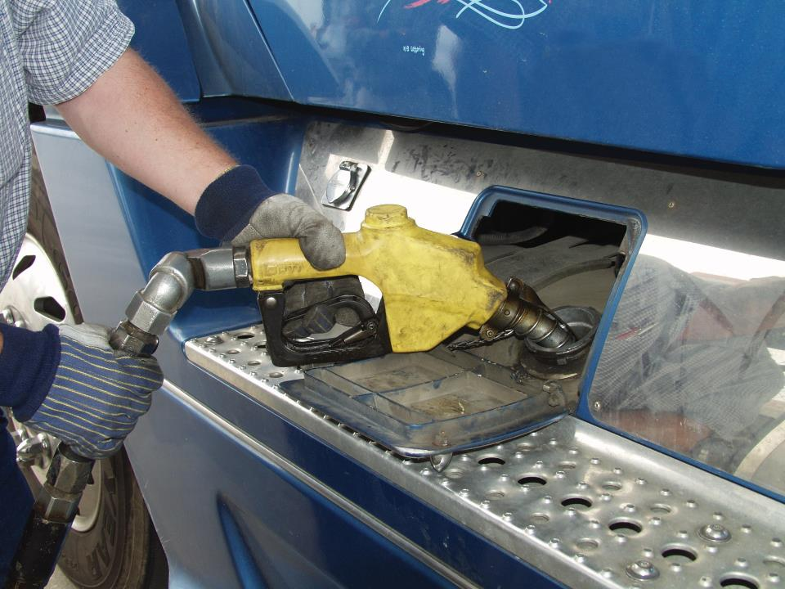
Cost Determination & Control
Notes:
Cost Determination and Control
Cost is the greatest single issue you will deal with as a trucking professional. Excessive costs, or lack of an effective cost control program, can cause any truck driver to become unprofitable.
There are two main categories of costs you should be familiar with as a business person, rolling costs and fixed costs.
Rolling Costs
Rolling costs, also referred to as variable costs, are difficult to predict because they are always changing. These types of costs typically get budgeted as an estimate or assumption. When you look at what type of freight you want to haul, and where you want to run, rolling costs can become a substantial factor in your decision.
Rolling costs include such things as:
Your pay
Fuel
Tires
Road tax
Tolls
Vehicle depreciation
Loading and unloading fees
Fines
Accidents and claims
As you can see from this list, there are many rolling costs that can use up a substantial portion of your revenue. How you control these costs will have a direct impact on how successful you are as a truck driver and professional business person.
CALLOUT: It is important to understand these concepts as they apply to both company drivers and owner-operators.

Slide 7

Fixed costs are known costs that do not change based on how many miles you drive.
Notes:
Fixed Costs
Fixed costs are those costs that can be placed into a budget and don’t change over time. They are known costs that do not change based on how many miles you drive. This is important to remember as these costs will continue, whether you spend the majority of your time on the road or take time off.
Fixed costs include:
Vehicle payments
Finance charges
Liability insurance
Health insurance
Vehicle insurance
Cargo insurance
Facility rent or mortgage (if you have one)
Property taxes
Professional services (legal, accounting, etc.)
Professional dues and subscriptions
Fixed costs are the easiest to budget for because they are always there and don’t change. Your fixed costs become a base for what you need to create in revenue each month to succeed.

Slide 8
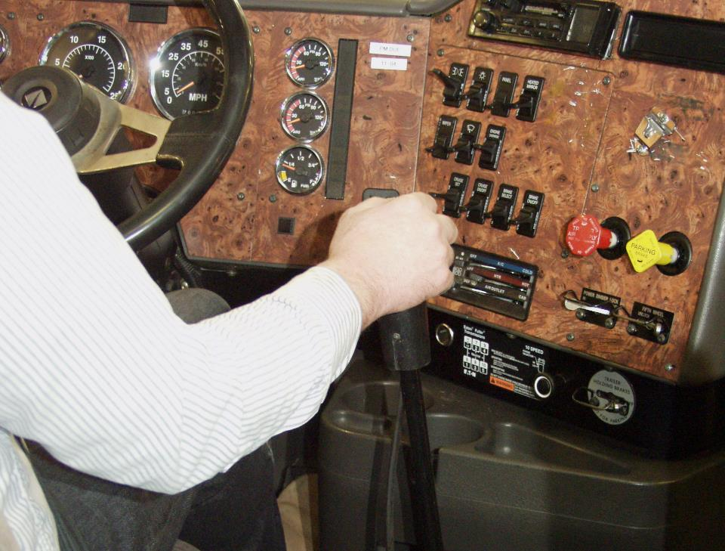
Fuel Management
Notes:
Fuel Management
Fuel costs will be one of the biggest expenses you will deal with as a truck driver. Even if you don’t own your own truck, it’s important to understand how fuel and fuel mileage strategies can affect your bottom line.
Driving Habits and Performance
Your driving habits can be one of the largest factors when it comes to fuel mileage, as driving technique can influence fuel mileage by as much as a mile per gallon.
The following are some driving techniques that can improve fuel mileage:
Progressive shifting
Operating at a slower speed
Limiting or eliminating engine idling
Many companies currently have fuel bonus programs in place for their company drivers. This incentive could create thousands of dollars in extra revenue for you, as a company driver, just by doing some of the things that you have been taught in this manual about proper driving technique. For an owner-operator, a fuel bonus program is the realization that he or she has saved thousands of dollars in fuel costs every month just by exercising good driving practices.

Slide 9

Growing Revenue
Notes:
Growing Revenue
Whether you get paid by the mile, the trip, or the hour, revenue is controlled by you, the driver. How much you make is directly determined by how much you want to do and what you want to pay others to do for you.
You may think that as a company driver or even as an owner-operator you have little control over what you get paid. That is incorrect. While you may not be able to adjust your rate per mile whenever you want to, you can control how many miles you run (within the hours-of-service limits), how you run those miles, and how you schedule your time off.
As we talked about earlier, your creation of revenue should initially be driven by your costs — how much do you need to make to break even? In addition to that, you should have an amount in mind as to what you want and/or need to realize an acceptable standard of living for yourself and your family. Keeping this in mind, you can now determine how much revenue is necessary to accomplish these benchmarks and operate accordingly.
If you are an owner-operator, how you run your truck affects your bottom line. Remember those fixed costs? Well, they don’t change as you drive more or less each month. If you want to realize a larger net revenue (what’s in your pocket at the end of the month), then try running more miles than you did the previous month. The fixed costs won’t increase but your gross revenue will. This in turn, creates more money for you.
How do you do this? Run smart, not hard. Decide ahead of time where it makes the most sense to run, based on freight availability, and schedule accordingly. The end result could be a greater realization of income without sacrificing home time.
CALLOUT: Keep in mind that any decisions made must comply with the hours-of-service limits.

Slide 10
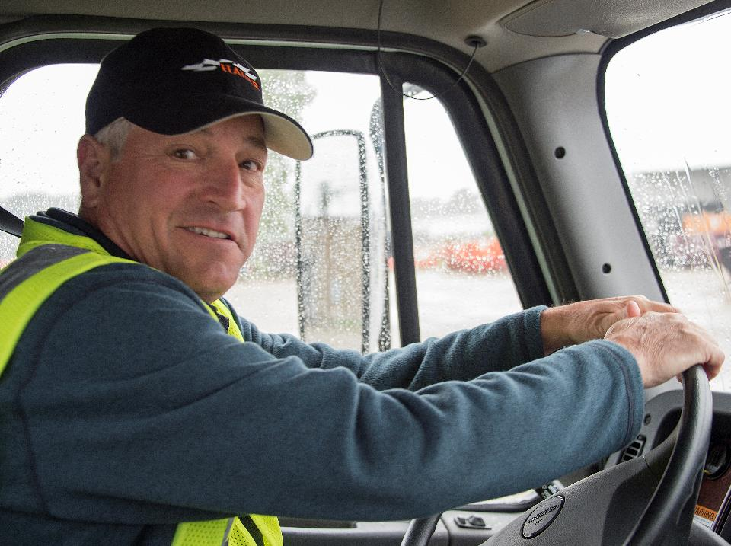
Trucking Industry Image
Notes:
Trucking Industry Image
As with any group or industry, it only takes the bad actions of a few individuals to give the whole group a poor public image. Drivers who are rude and aggressive, including those who speed, tailgate, and cut off other drivers, are responsible for leaving fellow motorists with a bad impression of the professional driver and the trucking industry.
There are many consequences for an industry that has a poor public image. Public and media outcry can have a strong effect on the entire industry. In some cases, this can spur new or changed laws and regulations that can be costly to the trucking industry. How does this affect you? Legislation that is unfavorable to the industry (increased taxes, road restrictions) can lead to less profit, which can mean fewer jobs.
Remember, it is often said that when something bad happens to someone, that individual tells ten others of his or her experience.

Slide 11
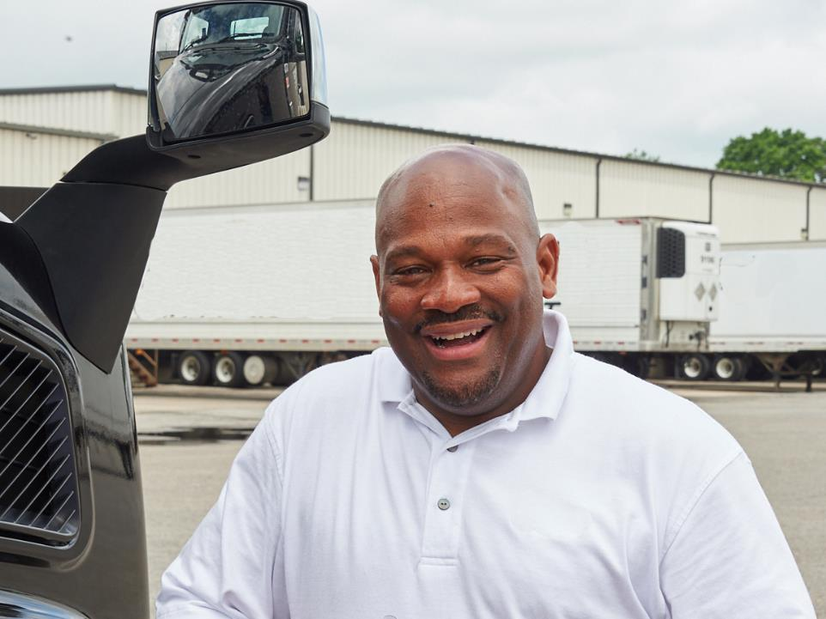
Contact with the Public
Notes:
Contact with the Public
You are the face of your company. Everything from your conduct to your attitude and appearance play a part in how your company is viewed by the public.
The Rules of the Road
Projecting a professional image on the road includes following all laws and regulations as well as practicing good driving habits, including:
Following posted speed limits
Maintaining a safe distance between vehicles
Making sure there is a clear path when changing lanes
Signaling at the appropriate time when planning to turn
Making sure there is adequate space to safely pass
Being courteous when using high-beam headlights—don’t blind other drivers
Never using the vehicle’s size to intimidate others
Being aware of other drivers, vehicles, and the flow of traffic
Laws and regulations are intended to protect everyone. Follow all laws and regulations.

Slide 12
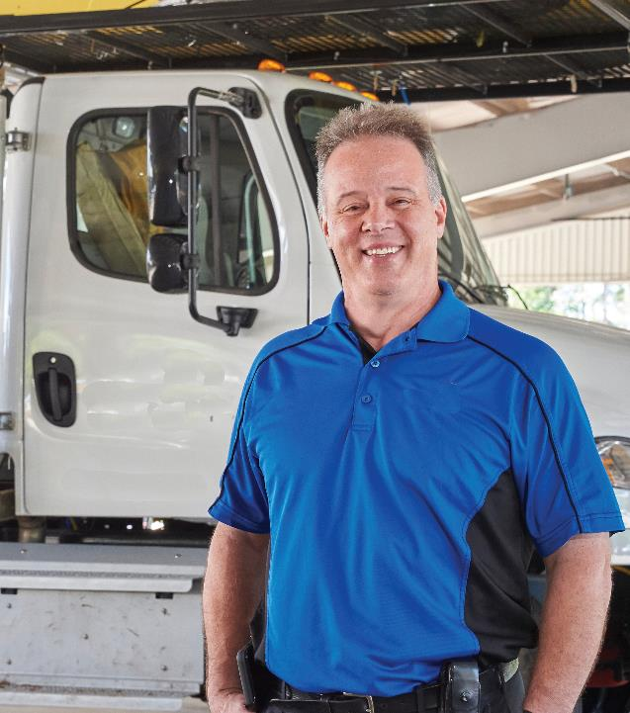
Your vehicle should be clean and well maintained.
Your clothes should be neat, clean, and appropriate for the workplace.
Notes:
Appearance
Often, the first impression is a lasting one. Vehicle and personal appearance are important factors when it comes to first impressions.
Vehicle. Your vehicle is a rolling advertisement for your company. Because a first impression is a lasting one, how you drive and how your vehicle is cared for plays a role in how your company is viewed by your current customers, potential customers, and the general public.
Your vehicle should be clean and well maintained. A dirty or poorly maintained vehicle sends the message that your company doesn’t care.
Include vehicle neatness and condition in your regular vehicle inspection process.
Driver. When it comes to your personal appearance, neatness counts. As previously stated, you are a representative of your company.
Your clothes should be neat, clean, and appropriate for the workplace. Your hair should be combed and if you have a beard or mustache, keep it trimmed.

Slide 13

Customer Relations
Notes:
Customer Relations
In today’s business world, the majority of contact between a business and its customers is done via phone or computer. In many cases, the professional driver is the only representative of the company the customer ever deals with face to face.
Because of this, how you conduct yourself plays a huge part in how your company is viewed by both current and potential customers.
Punctuality
Be on time. The customer is probably setting his or her work schedule around when the shipment will arrive. If you are going to be late, you or your company’s dispatcher should make a short phone call to the customer letting him or her know when you will arrive. This can save a lot of time and problems for both your company and your customer.
Courtesy
Always be polite and friendly. Frustrations should never be taken out on the customer. You should never argue with the customer. A customer’s impression can lose or gain business for your company. You should make every effort to be courteous at all times.
Knowledge
Know and follow company rules in handling cargo and documentation.
Know your company’s procedure for dealing with freight problems. A prompt solution is good customer service.
Also, be aware of what types of services your company offers. A customer may ask if your company can handle a certain type of shipment, deliver to a specific area, or carry a specific product. If you don’t know the answer, let the customer know you’ll find out and then get back to them promptly.
Respect
Respect the customer’s property. Make all deliveries as you would like deliveries made to your own home. All cargo must be handled carefully. No one wants to see their order mishandled.
Respect the requests of the customer. Make every effort to follow the customer’s rules and be aware of special delivery or pick-up instructions.
Always use extra caution when driving on the customer’s property. Watch for low telephone and power lines as well as porches, overhangs, steps, and loading docks that stick out from buildings. Follow posted directions, don’t speed, and watch for pedestrians.

Slide 14

Never take a customer’s anger personally.
Notes:
How to Handle an Angry Customer
When a customer is angry, how you handle the situation can make or break your company’s relationship with the customer.
Never take a customer’s anger personally. Instead, focus on fixing the problem that caused the customer’s anger. Always be courteous and remain calm.
The following steps should be followed when dealing with this type of situation:
Apologize for the situation, even if it isn’t your fault. You don’t have to take blame for the situation but should apologize.
Express concern that things didn’t go as planned, but never be patronizing. An angry customer wants to know that you and your company care.
Even if your company isn’t at fault, assure the customer the company will do its best to make things right.
Determine what steps the company can take to make things right. This may require contact with your supervisor for advice and/or directions as to what can or cannot be done.
Try to come to some sort of solution with the customer before leaving. If you need to return to your company to work with your supervisor or others at the company to correct the problem, assure the customer that you will contact him or her as soon as possible. Make sure you follow up on this promise.
If you are able to offer solutions to the problem before leaving, let the customer choose the course of action that is most convenient.
Follow up with the customer to make sure the course of action agreed to worked out as planned.
Following up shows that you and your company care about the customer and want to continue a positive business relationship.

Slide 15
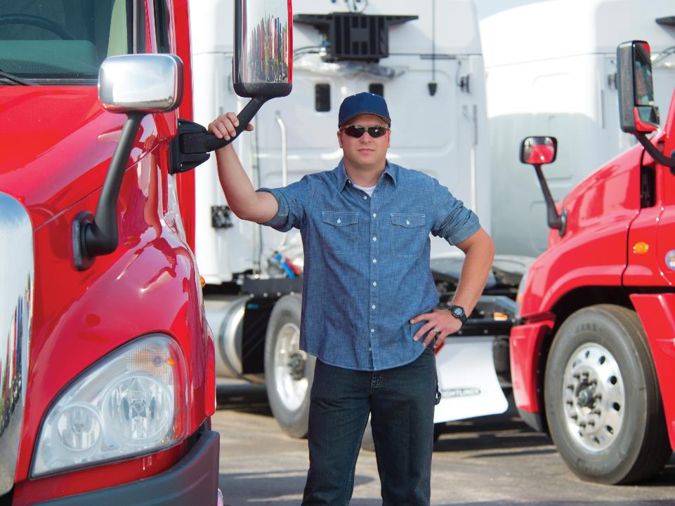
What Do Employers Look For?
Notes:
What Do Employers Look For?
As previously mentioned, as a professional driver, you are the face of your company. Because of this, employers are looking for just the right professional to fit their company’s image when hiring. They are looking for someone who is not only qualified based on federal regulations and company policy, but fits their company’s culture.
General Job Qualifications
The following are some of the things a prospective employer is looking for when hiring a driver:
A general knowledge of the various types of vehicles used by the trucking industry as well as vehicle systems and components
An understanding of the language of the industry
The ability to safely drive assigned vehicles
A basic understanding of cargo handling techniques and procedures
A prospective employer is also looking for an individual who has a good, positive attitude. This means being interested in the job, mature, responsible, enthusiastic, and safety minded.

Slide 16

Company Policy
Notes:
Company Policy
Each motor carrier has its own policies and procedures. Some of the policies may vary from what you have learned in this driver training manual but do keep in mind that you should always operate safely and legally. It is illegal for an employer to require you to violate federal, state, or local laws/regulations.
A typical company policy covers:
Hours of work
Compensation (pay and benefits)
Safety rules
Vehicle inspection and maintenance requirements
Rules for trips
Public/customer relations

Slide 17
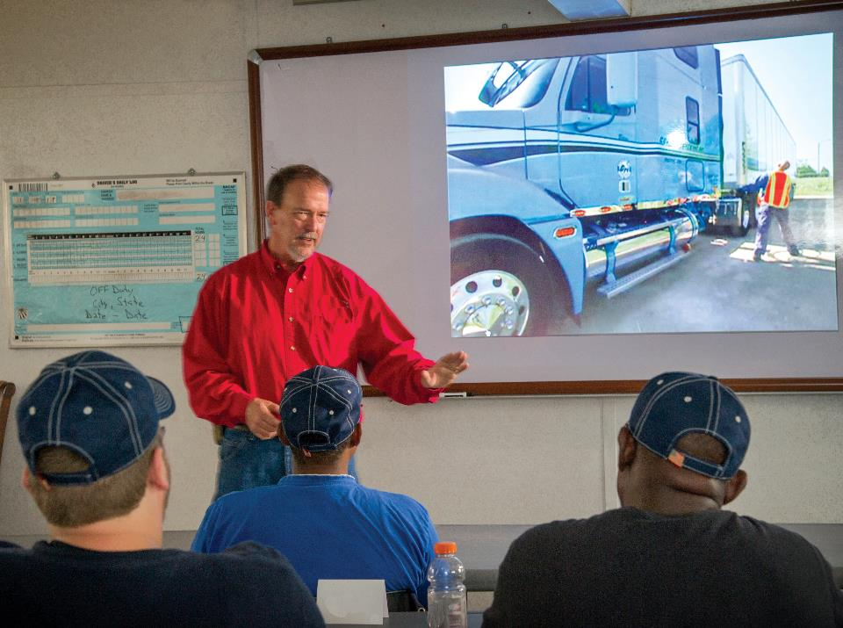
Opportunities for Advancement
Notes:
Opportunities for Advancement
Experience plays a part in the hiring process. As with most professions, the higher paying, more lucrative driving jobs go to drivers with a certain level of experience and skill as well as a safe driving record.
Know that completing your driving education is a solid first step in achieving whatever driving goal you may have.
When working in this type of situation, put your best foot forward, show enthusiasm, and above all do a good job. This will help you in advancing your career.

Slide 18

Applying for a Job
Notes:
Applying for a Job
The application process for a tractor-trailer driver involves a certain amount of paperwork, tests, and an interview process.
Much of the paperwork you will be required to fill out is mandated by the Federal Motor Carrier Safety Regulations (FMCSRs).
Application for Employment
Section 391.21 of the FMCSRs requires a motor carrier to obtain certain, specific information from you, including (but not limited to):
Your name, address, date of birth, and Social Security number
The issuing state, number, and expiration date of your CDL
Information on your experience operating motor vehicles
A list of all motor vehicle accidents in the past three years
A list of all violations of motor vehicle laws in the past three years
A list of all employers in the past ten years

Slide 19
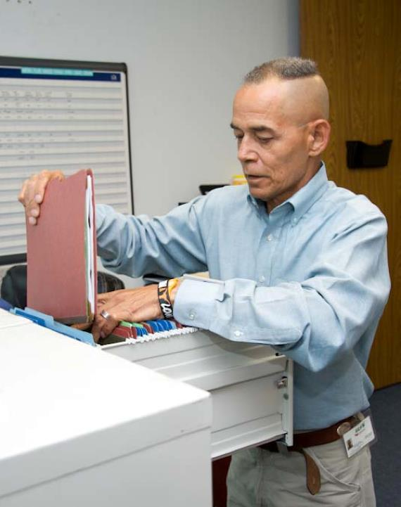
Motor carriers are required to obtain information about your work and driving history.
Notes:
Investigations and Inquiries
Section 391.23 of the FMCSRs requires a motor carrier to obtain information about your work and driving history. You will be required to fill out paperwork giving your permission to the motor carrier to conduct these investigations.
The motor carrier is also required to check your drug and alcohol testing history for the past three years. You will be required to fill out paperwork giving your permission for the motor carrier to obtain this information from your past employers (driving jobs only).

Slide 20

You will be required to complete certain tests before you can operate a CMV.
Notes:
Testing
You will also be required to complete a certain battery of tests before you can operate a commercial motor vehicle for a prospective employer.
Road test. Section 391.31 of the FMCSRs requires that you complete a road test before operating a commercial motor vehicle for a motor carrier.
In order to pass the road test, you will need to successfully complete several tasks including:
A pre-trip inspection
Coupling and uncoupling a combination vehicle
Placing a vehicle in operation and driving in traffic
Braking and parking
Upon successful completion of the road test, you will be given a certificate and a copy will be placed in your driver qualification file .
Written exam. Though a written exam hasn’t been required for many years, some carriers still require this test as a way of evaluating a driver’s understanding of the FMCSRs.
Physical exam. Section 391.41 of the FMCSRs requires you to pass a physical exam before you can operate a commercial motor vehicle. As a commercial driver’s license (CDL) holder, you must present a valid physical exam certificate (med card) to your state licensing agency to be added to your driving record. Your carrier must have evidence of a valid medical exam in your driver qualification file by maintaining a current copy of your driving record.
Pre-employment drug test. Section 382.301 of the FMCSRs requires you to pass a pre-employment drug test before driving a CMV. Though a pre-employment alcohol test isn’t required by the FMCSRs, some companies do require this as company policy.
CALLOUT: A motor carrier may accept another motor carrier’s road test if it was conducted in the last three years. Also, your valid CDL may be accepted if you do not have a double/triple or tanker endorsement. Keep in mind that a motor carrier may still require a road test even though you could meet the exception.
CALLOUT: Per Sec. 391.51 of the FMCSRs, a motor carrier is required to maintain a driver qualification (DQ) file for each CMV driver it employs. The file must contain specific documents to show evidence that the driver is qualified to drive a CMV.
CALLOUT: In addition to turning in the medical card, you must self-certify with your state of license.

Slide 21

The job interview is an important part of the application process.
Notes:
Job Interview
The job interview is an important part of the application process. Be prepared for the interview:
Learn all you can about the company — talk to current and past employees and/or visit the company’s website
Be prepared to ask intelligent questions
Make sure you have the necessary paperwork and information with you
Dress neatly
Be well rested
Get to the interview site a little early
When asked, present your qualifications honestly
Be positive and responsive to questions asked
Keep the conversation focused on the job and why you are the best candidate
The interviewer should volunteer information about the company, work conditions, and company policies. If they don’t, you should ask. Don’t wait until you are on the job to find this out.
Keep in mind that most people are nervous in job interviews. Be yourself. Try to relax and enjoy the experience. Make sure you end the interview on a positive note. Thank the interviewer for his or her time and interest and make sure you express your interest in the job and company. Before leaving, ask what will happen next, including what procedure the company will follow in making a decision.

Slide 22
Objectives Review
You should now be able to:
  Discuss the difference between rolling costs and fixed costs
  Describe how driving habits can affect fuel management
  List ways you can maintain a professional appearance and attitude
  Identify basic elements in the hiring process
Copyright 2019 J. J. Keller & Associates, Inc.
Notes:
You should now be able to:
Discuss the difference between rolling costs and fixed costs
Describe how driving habits can affect fuel management
List ways you can maintain a professional appearance and attitude
Identify basic elements in the hiring process
CLASSROOM RECOMMENDATION
Before concluding your training session, have participants take the corresponding quiz (found on the Trainer Tools USB) to check their understanding of the material. You can customize any of the questions to fit your audience or workplace. The answer key can also be found on the Trainer Tools USB.
You may also choose to administer the quizzes before you begin your training session to help get participants thinking about the subject and/or to gauge their understanding of the topic ahead of time.

