Slide 1






PowerPoint® Instructions
This PowerPoint has been designed so you can easily customize it for your training session.
Throughout the presentation you’ll see icons with recommendations or videos to enhance the instruction you present to your students. A detailed explanation for each icon can be found on the next slide. Videos can be found on the Trainer Tools USB.
When you see an icon on the slide, look in the notes
section for further information.
Simply delete or move the icon off the slide before your training session begins.

Slide 2





Classroom Recommendations. Provides suggestions for enhancing your classroom presentation; from ideas for large group discussions to suggestions on the use of training aids such as examples or photos of vehicle parts and components to help illustrate the items covered within a chapter.
Lab Recommendations. Provides suggestions for activities and exercises that take place outside the classroom, but do not involve
the actual operation of the tractor-trailer or its components. Examples
of lab sessions include conducting a vehicle inspection or practicing mirror adjustment.
Range Recommendations. These recommended activities take
place on a closed-access driving range where students may practice driving skills in a controlled environment. Examples of range sessions include practicing shifting technique and successfully completing a backing maneuver.
Road Recommendations. These recommended activities take place in road and traffic conditions that support the chapter’s objectives. Examples of road sessions include proper communication with other drivers through the use of turn signals and basic vehicle control under nighttime or extreme weather conditions.
Videos. These short video clips reinforce material presented in the Student Manual. Use them to help students grasp difficult concepts or subject matter.

Slide 3
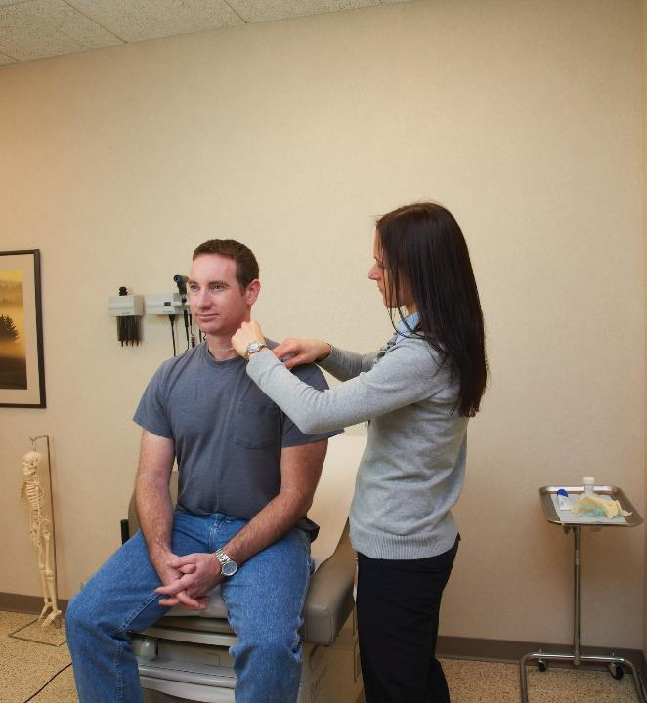
30
Medical Requirements
Notes:
Chapter 30 Medical Requirements
Unit A1.5.10 Medical Requirements This unit must teach driver-trainees the Federal rules on medical certification, medical examination procedures, general qualifications, responsibilities, and disqualifications based on various offenses, orders, and loss of driving privileges (49 CFR part 391, subparts B and E).

Slide 4
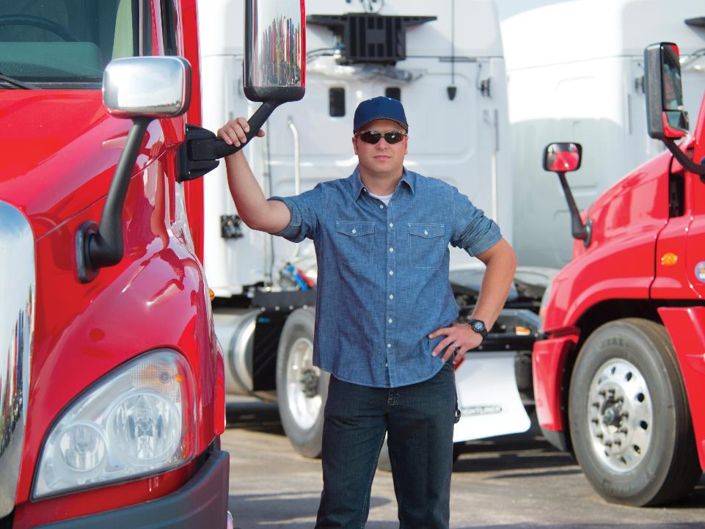
Introduction
Notes:
Introduction
There’s more to becoming a professional driver than just obtaining an operator’s license and hitting the road. This chapter covers some of the regulatory requirements you must meet in order to be qualified to operate a commercial motor vehicle (CMV).
CLASSROOM RECOMMENDATIONS
This chapter introduces the student to basic regulatory requirements related to qualification and disqualification in Part 391 of the Federal Motor Carrier Safety Regulations. If a driver cannot meet the requirements he or she is not qualified to operate a commercial motor vehicle in interstate commerce.
Distribute a copy of the regulations being covered and discuss how non-compliance can lead to a disruption in a driver’s career, and in some cases an end to a driver’s career.

Slide 5
Objectives
Upon completion of this lesson, you will be able to:
  List the general and physical qualifications drivers must meet in order to operate a commercial motor
  vehicle (CMV)
  Explain the process of obtaining a medical
  examiner’s certificate
  Identify how a driver can become disqualified from driving a CMV
Notes:
Objectives
Upon completion of this lesson, you will be able to:
List the general and physical qualifications drivers must meet in order to operate a commercial motor vehicle (CMV)
Explain the process of obtaining a medical examiner’s certificate
Identify how a driver can become disqualified from driving a CMV

Slide 6
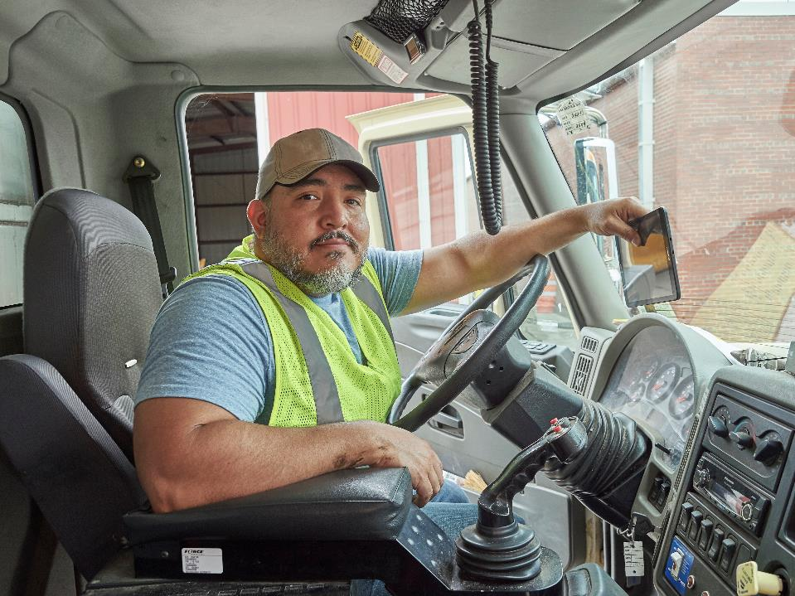
General Qualifications
Notes:
General Qualifications
A person is qualified to drive a CMV in interstate commerce if he or she :
Is 21 years of age or older
Can read and speak the English language well enough to:
Speak with the general public
Understand highway traffic signs and signals
Respond to official inquiries
Make entries on reports and records
Can safely operate a CMV
Is physically qualified to drive a CMV
Has one valid CMV operator’s license
Has given his or her motor carrier a list of violations from the past 12 months
Has not been disqualified to drive a CMV
Has successfully completed a road test
In addition, the driver should be familiar with the methods and procedures for securing cargo. All drivers should be able to determine if the cargo they are hauling is properly secured and its weight evenly distributed on the trailer.
CALLOUT: See Sections 391.11 and 391.13 of the Federal Motor Carrier Safety Regulations (FMCSRs) for complete details.

Slide 7

General Disqualifications
Notes:
General Disqualifications
Section 391.15 of the FMCSRs addresses disqualification for drivers operating a CMV as defined in Section 390.5. This definition includes a vehicle or combination of vehicles weighing or rated at 10,001 pounds or more, a vehicle of any size transporting placardable hazardous materials, and certain types of passenger‑carrying vehicles.
A driver may be disqualified from driving a CMV if he or she:
Drove a CMV while under the influence of alcohol or drugs
Used a CMV to transport drugs
Left the scene of an accident with a CMV
Committed a felony offence involving a CMV
The disqualification period ranges from six months to three years depending on the severity of the offense and the driver’s previous disqualification record.
CALLOUT: This section addresses the disqualification provisions in Sec. 391.15. Additional disqualification provisions, applying to CDL holders (Sec. 383.51) are covered in chapter 1.

Slide 8

You can be disqualified for texting or using a hand-held mobile telephone.
Notes:
Texting and hand-held phone violations
A driver must not text or use a hand-held mobile telephone while driving a CMV. The disqualification period is 60 days for a second violation in a three‑year period and 120 days for a third violation in a three-year period.
Out-of-Service Order Violations
During a trip, a driver may be placed out of service by an enforcement officer for a certain period of time or until a given problem has been corrected.
A driver convicted of violating such an out-of-service order will be subject to a fine and disqualification period of 90 days to five years depending on the severity of the offense and previous disqualification record.

Slide 9
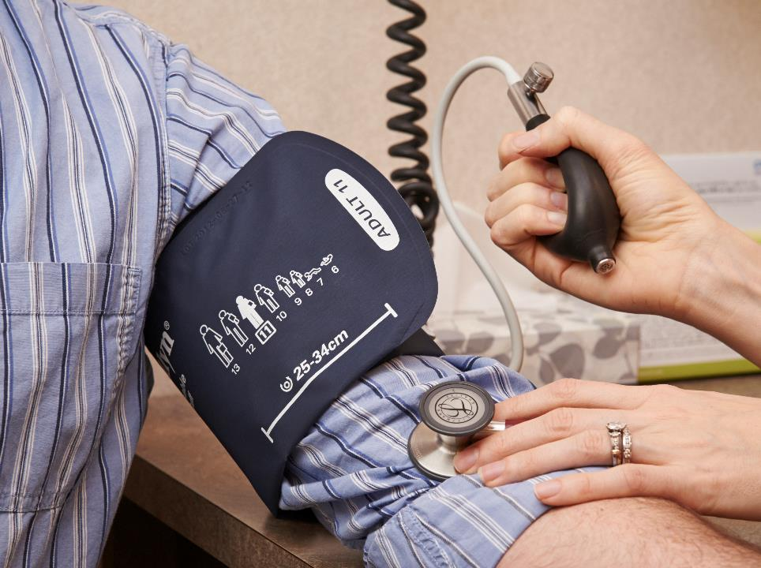
Physical Qualifications
Notes:
Physical Qualifications
Because a driver’s health is critical to his or her own safety and the safety of those he or she shares the road with, the Federal Motor Carrier Safety Administration (FMCSA) requires all drivers to undergo a formal medical examination.
Physical Requirements
The medical examination must be conducted by a certified medical examiner listed on the FMCSA National Registry of Certified Medical Examiners (NRCME).
A driver is required to have an exam if:
He or she has never been certified before
He or she has not been certified during the previous 24 months or since his or her last medical certificate expired
His or her ability to perform normal duties has been impaired
The medical examiner will issue a medical examiner’s certificate and classify a driver as being “qualified” if he or she does not have any health conditions that would negatively impact his or her ability to safely operate a CMV. Such conditions include:
Missing limb
Impairment of any fingers, hands, arms, legs, or feet
Insulin-treated diabetes mellitus (unless the requirements in Section 391.46 are met)
Heart attack or any other cardiovascular disorders
Respiratory dysfunction
High blood pressure
Rheumatic, arthritic, orthopedic, muscular, neuromuscular, or vascular disease
Epilepsy
Mental disorders
Vision impairment
Hearing impairment
Drug use
Alcoholism
Medical examiners have a great deal of discretion to certify drivers — even those with a potentially problematic medical condition. Also, some drivers who would otherwise be medically unqualified have the option to apply for a special variance or exemption that allows them to receive a medical certificate. If that’s the case, the driver must have — and carry — proof of the exemption.
For example, if a driver has a missing or impaired limb but wears a fitted prosthetic device, a medical examiner may conduct a skill performance evaluation (SPE) to grant him or her permission to drive a CMV. During the SPE, the driver must demonstrate the ability to operate a CMV safely by completing on-and off-road activities in order to receive an SPE certificate.
CALLOUT: A driver with diabetes mellitus that is treated with insulin for control, is physically qualified to drive a commercial motor vehicle if he or she:
Meets all of the other physical qualification standards in Section 391.41, or has an exemption or skill performance evaluation (SPE) certificate and
Has an evaluation by a treating clinician and a medical examination, performed by a medical examiner.

Slide 10
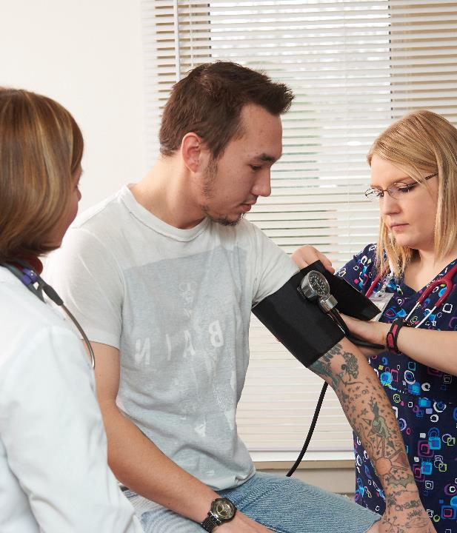
Each driver must undergo a physical exam at least once every 24 months.
Notes:
Medical Examiner’s Report and Certificate
Each driver must undergo a physical examination at least once every 24 months (if no health conditions arise before then).
The driver will complete section one of the required Medical Examination Report. During the exam, the medical examiner will fill out and sign the report, which will then be maintained for at least three years at the medical examiner’s office.
If the medical examiner confirms the person is physically qualified to operate a CMV, he or she will issue the driver a medical examiner’s certificate. The driver will fill in his or her driver’s license number, state, and address, and sign the certificate. The medical examiner will complete the rest, sign it, and give the original to the driver.

Slide 11
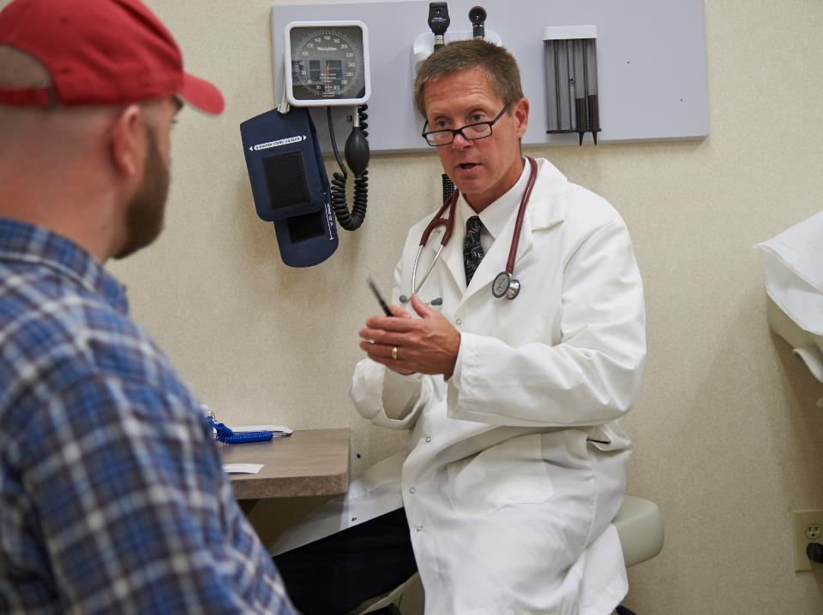
Medically Unqualified
Notes:
Medically Unqualified
Any driver who does not meet one or more of the physical qualification standards in Sec. 391.41 of the FMCSRs is considered medically unqualified. When a driver is medically unqualified, the examiner should:
Complete the physical exam of the driver
Discuss the reason(s) for not certifying the driver
Discuss any steps that can be taken to meet the certification standards
The medical examiner must not medically certify any driver who:
Fails to meet a physical qualification requirement cited in the standards (e.g., vision, hearing, or epilepsy), or
Has a medical condition that endangers the health and safety of the driver and the public
When someone is found medically unqualified, the examiner must document the details behind the decision on the Medical Examination Report form by:
Marking the “Does not meet standards” box
Noting the reason for not certifying the driver
Documenting the discussion with the driver explaining the rationale for the decision
Before a medically unqualified driver can return to CMV driving, a medical examiner must find the driver to be medically fit for duty.

Slide 12
Objectives Review
You should now be able to:
  List the general and physical qualifications drivers must meet in order to operate a commercial motor
  vehicle (CMV)
  Explain the process of obtaining a medical
  examiner’s certificate
  Identify how a driver can become disqualified from driving a CMV
Copyright 2019 J. J. Keller & Associates, Inc.
Notes:
You should now be able to:
List the general and physical qualifications drivers must meet in order to operate a commercial motor vehicle (CMV)
Explain the process of obtaining a medical examiner’s certificate
Identify how a driver can become disqualified from driving a CMV
CLASSROOM RECOMMENDATION
Before concluding your training session, have participants take the corresponding quiz (found on the Trainer Tools USB) to check their understanding of the material. You can customize any of the questions to fit your audience or workplace. The answer key can also be found on the Trainer Tools USB.
You may also choose to administer the quizzes before you begin your training session to help get participants thinking about the subject and/or to gauge their understanding of the topic ahead of time.

