Slide 1






PowerPoint® Instructions
This PowerPoint has been designed so you can easily customize it for your training session.
Throughout the presentation you’ll see icons with recommendations or videos to enhance the instruction you present to your students. A detailed explanation for each icon can be found on the next slide. Videos can be found on the Trainer Tools USB.
When you see an icon on the slide, look in the notes
section for further information.
Simply delete or move the icon off the slide before your training session begins.

Slide 2





Classroom Recommendations. Provides suggestions for enhancing your classroom presentation; from ideas for large group discussions to suggestions on the use of training aids such as examples or photos of vehicle parts and components to help illustrate the items covered within a chapter.
Lab Recommendations. Provides suggestions for activities and exercises that take place outside the classroom, but do not involve
the actual operation of the tractor-trailer or its components. Examples
of lab sessions include conducting a vehicle inspection or practicing mirror adjustment.
Range Recommendations. These recommended activities take
place on a closed-access driving range where students may practice driving skills in a controlled environment. Examples of range sessions include practicing shifting technique and successfully completing a backing maneuver.
Road Recommendations. These recommended activities take place in road and traffic conditions that support the chapter’s objectives. Examples of road sessions include proper communication with other drivers through the use of turn signals and basic vehicle control under nighttime or extreme weather conditions.
Videos. These short video clips reinforce material presented in the Student Manual. Use them to help students grasp difficult concepts or subject matter.

Slide 3
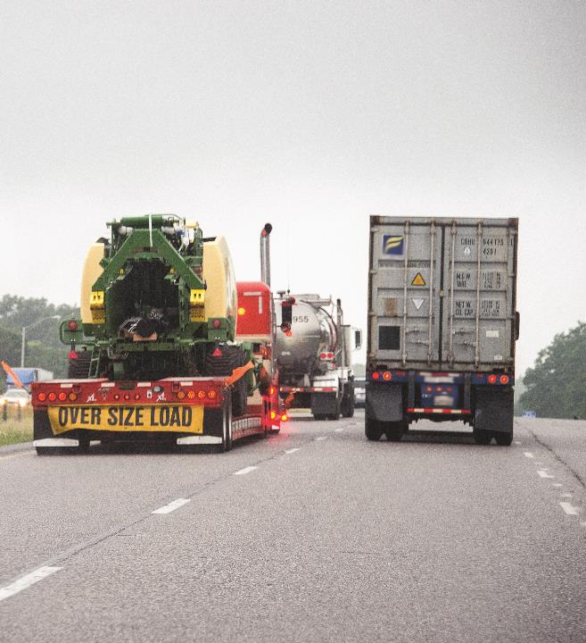
33
Special Rigs
Notes:
Chapter 33: Special Rigs

Slide 4
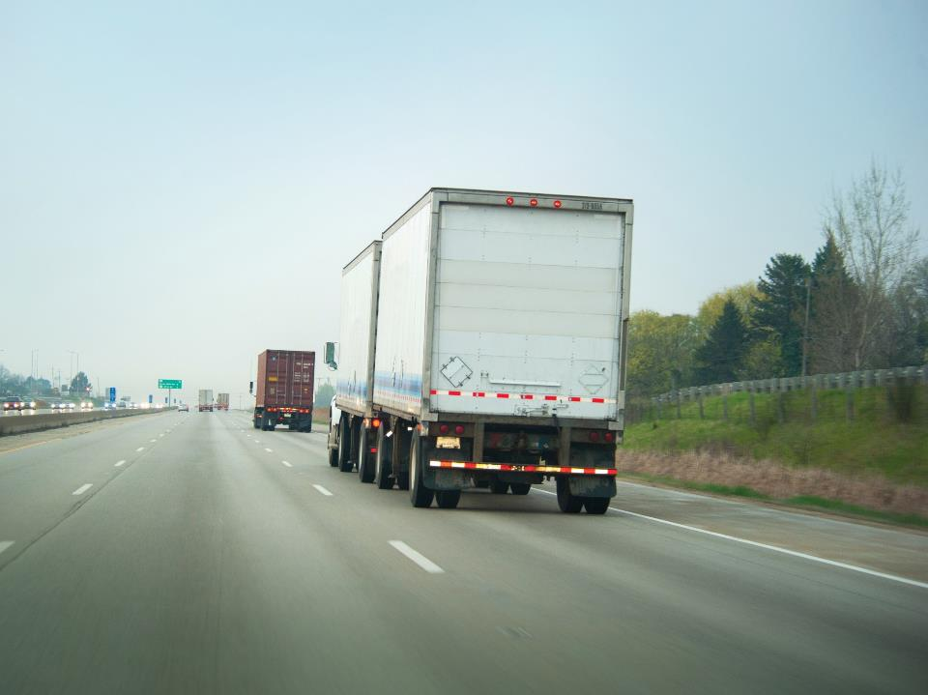
Introduction
Notes:
Introduction
A “special rig” is any combination vehicle that differs from the standard tractor and dry freight trailer with five axles and up to 18 wheels.
This chapter will describe the most common special rigs, their handling characteristics, and some of the special skills required to operate them.
CLASSROOM RECOMMENDATIONS
Students need to be aware of special rigs and their special requirements but learning to drive them should fall within a separate program.
Your visuals should show a wide variety of special rigs supported by your commentary on the unique character of each. You will want to mention such things as special handling characteristics, unique inspection procedures, and information on where special rigs are used.

Slide 5
Objectives
Upon completion of this lesson, you will be able to:
  Describe the various types of multiple articulation vehicles and the unique hazards each present
  Recognize the characteristics that constitute an
  oversize vehicle
  Discuss how to safely operate high center of
  gravity vehicles
  Identify what type of loads are naturally unstable while driving and how to minimize instability
  Explain what makes a special cargo vehicle different than a standard tractor-trailer
  Discuss hazards associated with construction vehicles and how to stay safe
Notes:
Objectives
Upon completion of this lesson, you will be able to:
Describe the various types of multiple articulation vehicles and the unique hazards each present
Recognize the characteristics that constitute an oversize vehicle
Discuss how to safely operate high center of gravity vehicles
Identify what type of loads are naturally unstable while driving and how to minimize instability
Explain what makes a special cargo vehicle different than a standard tractor-trailer
Discuss hazards associated with construction vehicles and how to stay safe

Slide 6
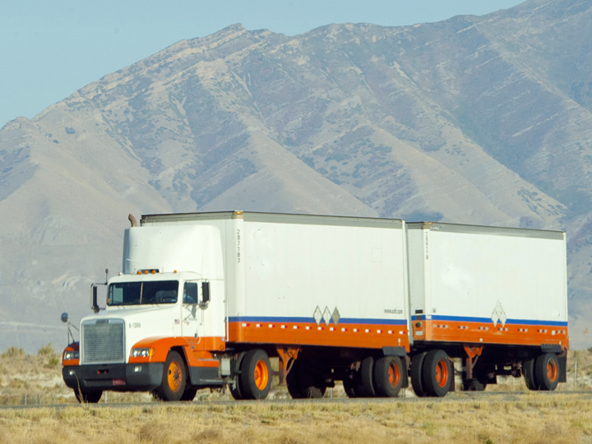
Multiple Articulation Vehicles
Notes:
Multiple Articulation Vehicles
Multiple articulation vehicles, also known as longer combination vehicles (LCVs), have several joints or points at which two parts of the vehicle are joined. A typical tractor-trailer unit has only one joint, located at the connection between the kingpin and fifth wheel. Multiple articulation vehicles, as the name implies, have two or more joints and include various types of doubles and triples.
CALLOUT: Federal and state regulations often restrict operation of special rigs in some way. These restrictions should be well known to motor carriers that use special rigs.

Slide 7
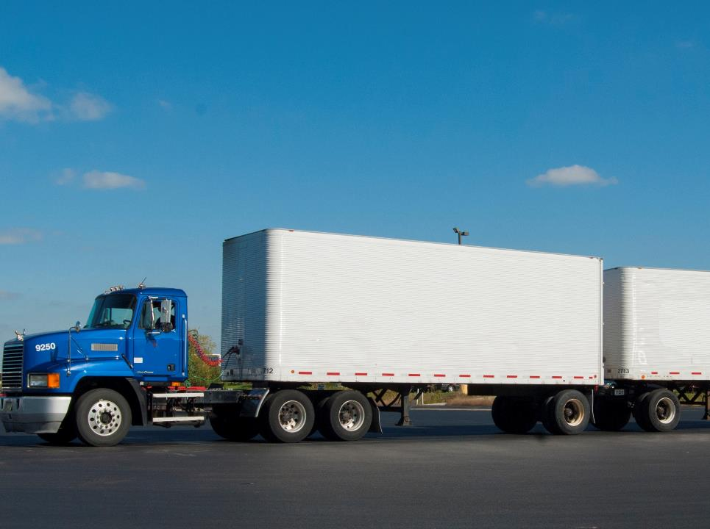
While a standard tractor-trailer unit has one point of articulation or joint, doubles have three.
Notes:
Doubles
Doubles consist of a tractor and two semi-trailers , with the second trailer converted to a full trailer using a converter gear (a set of wheels with a fifth wheel, called a converter dolly). The converter dolly is connected to the first trailer by one or two drawbar(s) with an eye(s) connected to a pintle hook(s) on the back of the first trailer.
While a standard tractor-trailer unit has one point of articulation or joint, doubles have three, which include:
Front trailer kingpin and fifth wheel
Pintle hook and eye
Converter gear fifth wheel and kingpin of the second trailer
There are some defining characteristics and handling requirements of several types of doubles.
A Western double has two equal-length trailers, typically 24 to 31 feet long, and an overall length of 60 to 75 feet. The trailers may be dry vans, tankers, flatbeds, or dumps.
A Turnpike double has longer trailers than a Western double, generally 35 to 48 feet, with an overall vehicle length of around 100 feet or more. They typically are equipped with nine axles.
A Rocky Mountain double is composed of a longer trailer in the front and a shorter trailer in the rear. Generally, the front (semi) trailer is 40 to 53 feet long, and the rear (full) trailer is 26 to 29 feet long. Overall length is generally 80 to 100 feet.
A B-train is composed of two semi-trailers. On the first trailer, tandem rear axles are to the rear of the trailer body so the second axle is under the nose of the second semitrailer. A fifth wheel mounted above the second axle eliminates the need for a converter dolly. This also eliminates one articulation point normally found on a double rig. B-trains have two articulation points rather than three.
Trailer and overall length will vary. Generally, there will be two 40-foot trailers or one 40-foot and one 27-foot trailer.
CALLOUT: Before you are able to haul doubles, you’ll need a double/triple trailers endorsement on your commercial driver’s license (CDL). In order to obtain this endorsement, you will need to successfully complete a doubles/triples knowledge test.
CALLOUT: Many states limit or prohibit the operation of doubles, depending on the weight and length involved. You may need to obtain state permits before driving in certain states.

Slide 8
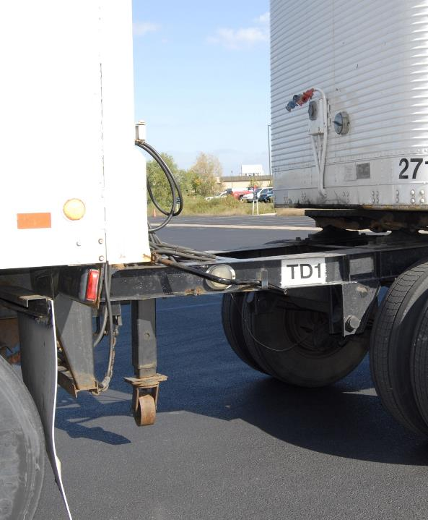
Doubles add steps to the normal coupling and inspection procedures.
Notes:
Coupling Doubles
Doubles add steps to the normal coupling and inspection procedures. The drawbar and pintle hook must be properly in place and hooked. Safety chains need to be in place, electrical cords need to be attached, all air lines must be hooked up properly, and valves must be opened or shut as required. These items must be checked closely during pre-trip and en-route inspections as well.

Slide 9
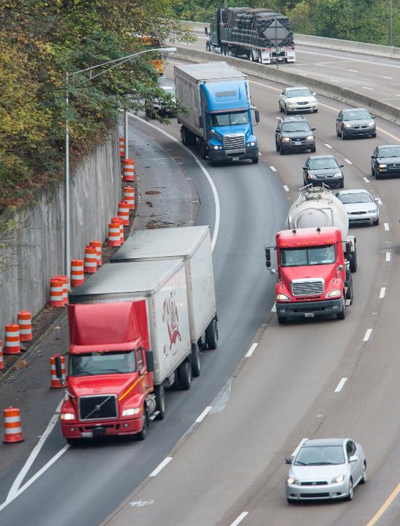
Extra caution must be used when driving doubles.
Notes:
Driving Doubles Safely
The first step in pulling doubles safely is to make sure the weight is distributed correctly between the units. You should check your bills of lading to determine the total weight of the load you will be hauling. You need to make sure that you (or the yard driver) have arranged your set in the proper order. Ideally, the nose of the lead trailer should be the heaviest, and then taper the weight back. For example, 12,000 pounds on the nose of the lead trailer, 10,000 pounds on the rear, then 10,000 pounds on the nose of the rear trailer, then 8,000 pounds on the rear.
If tapering the weight of the load is not an option, the lead trailer should be the heavier of the two, preferably by a minimum of 1,000 pounds. You may not get enough drive traction if the rear trailer is heavier, because you need plenty of weight over the drive axles . Even if you have double drive axles, you could still have drive traction problems if your weight isn’t distributed properly.
Trucks with multiple trailers have a dangerous “crack-the-whip” effect. Cracking the whip is a term used to describe an amplification of side-to-side movement through the trailer set. When you make a quick lane change or overcompensate for a whipping or swaying motion, the crack-the-whip effect can turn the rear trailer over. There have been many accidents where only the rear trailer in a double set overturned.
“Rearward amplification” is what causes the crack-the-whip effect. Standard doubles have a rearward amplification of almost 1.5, which means that for every foot of sideways movement at the tractor, the rear trailer moves one and a half feet.
To avoid “cracking the whip,” steer gently and smoothly. As we just mentioned, if you make a sudden movement with your steering wheel, your rear trailer could tip over. Follow far enough behind other vehicles so that you won’t have to try to do a rapid steering maneuver to avoid an accident.
Look far enough down the road to avoid being surprised and having to make a sudden lane change. At night, drive slowly enough to see obstacles with your headlights before it’s too late to change lanes or stop gently. Slow down to a safe speed before going into a turn or curve.
If you do find yourself in an instance where your trailers begin to “crack the whip,” remain calm. Do not step on the brakes, and, whatever you do, do not try to steer sharply to try to stop it.
Simply back off the accelerator and use light adjustments of the steering wheel to try to stabilize the movement. Once you have your vehicle under control, downshift one or two gears so that you are driving at a more reasonable speed for your load and driving conditions.
Control your speed whether fully loaded or empty. Combination vehicles take longer to stop when they are empty than when they are fully loaded. In addition, when lightly loaded, the very stiff suspension springs and strong brakes give poor traction and make it very easy to lock up the wheels. Your tractor can jackknife very quickly, and your trailer may swing out and strike other vehicles.
When pulling doubles, you have to be conscious of your speed-to-space ratio. Adjust this ratio according to your configuration. You should allow more following distance and look farther ahead, so you can brake early. Don’t be caught by surprise and have to make a “panic” stop.
When the wheels of a trailer lock up, the trailer will tend to swing around. This type of jackknife is often called a “trailer jackknife”. Trailer jackknifes are more likely to happen when the trailer is empty or lightly loaded.
The earliest and best way to recognize that the trailer has started to skid is by seeing it in your mirrors. Any time you apply the brakes hard, check the mirrors to make sure the trailer is staying where it should be. Once the trailer swings out of your lane, it’s very difficult to prevent a jackknife.
If any of the trailers do not have an anti-lock brake system (ABS), stop using the brake. Release the brakes to get traction back. Do not use the trailer handbrake (if you have one) to “straighten out the rig.” This is the wrong thing to do since the brakes on the trailer wheels caused the skid in the first place. Once the trailer wheels grip the road again, the trailer will start to follow the tractor and straighten out. If you need to, this is when you can reapply the brakes.
If the tractor and trailers all have working ABS, the system should start cycling and allow the vehicle to straighten out without having to release the brake.
All trailers and converter dollies built on or after March 1, 1998, are required to have antilock brakes, or ABS. These trailers and dollies will have an extra yellow lamp on the left side to signal if there is a problem with the ABS. However, many trailers and converter dollies built before this date have been voluntarily equipped with ABS, so the presence of the ABS light may be a more reliable indicator than the date of manufacture.

Slide 10
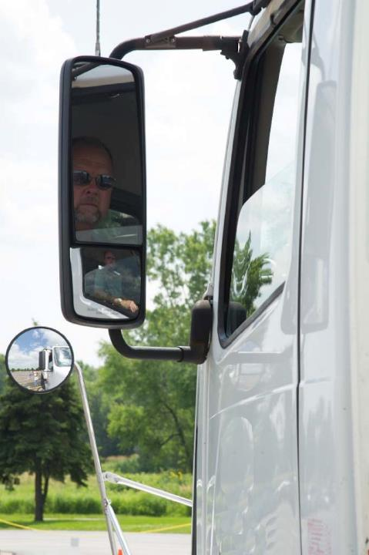
Backing doubles is significantly more difficult than backing other vehicles.
Notes:
Turning, Parking, & Backing Doubles
Doubles are also more difficult to maneuver when moving slowly, thanks to their large size and two points of articulation.
When a vehicle goes around a corner, the rear wheels follow a different path than the front wheels. This is called off tracking or “cheating.” Longer vehicles will off track more. The rear wheels of the tractor will off track some, and the rear wheels of the trailer will off track even more. When there are two trailers, the rear wheels of the second trailer will off track the most.
Steer the front end wide enough around a corner so the rear end does not run over the curb, pedestrians, etc. However, keep the rear of your vehicle close to the curb. If you cannot complete your turn without entering another traffic lane, turn wide as you complete the turn. This is better than swinging wide before starting the turn because it will keep other drivers from passing you on the inside.
When parking a double, be aware of how parking lots are arranged in order to avoid a long and difficult exit. Stop at places where you are able to pull straight through. Avoid getting boxed in by other vehicles, which may cause you to have to attempt to back out.
Backing doubles is significantly more difficult than backing other vehicles. It’s a maneuver that should be avoided, if possible. If you must back your double, make sure your trailers are perfectly straight, and don’t back for more than ten feet.

Slide 11
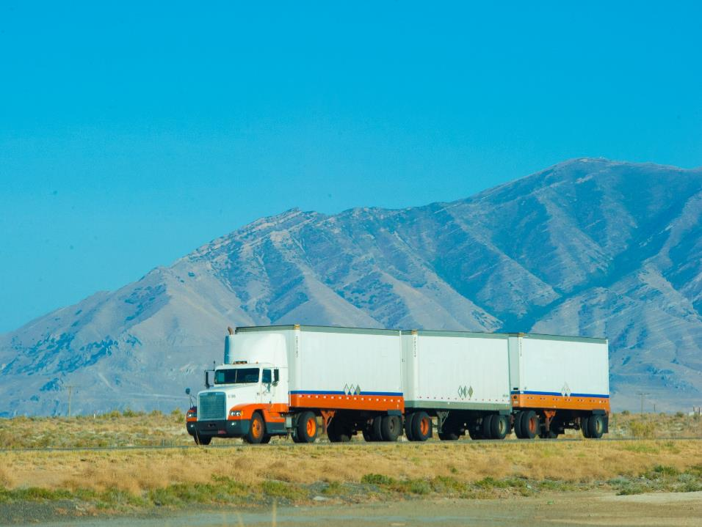
Triple trailers require drivers to have more advanced operating skills.
Notes:
Triples
Triple trailers are made up of three semi-trailers, with the second and third converted to full trailers using converter gear and connected, as with doubles, by drawbar and pintle hook.
There are three kingpin/fifth wheel connections and two eye/pintle hook connections. Trailers are typically 27 to 28 feet long, with overall lengths of up to 100 feet.
Triple trailers require drivers to have more advanced operating skills. Their length requires additional time and space for making turns, stopping, and performing other maneuvers. Some maneuvers, such as backing, should never be attempted.

Slide 12
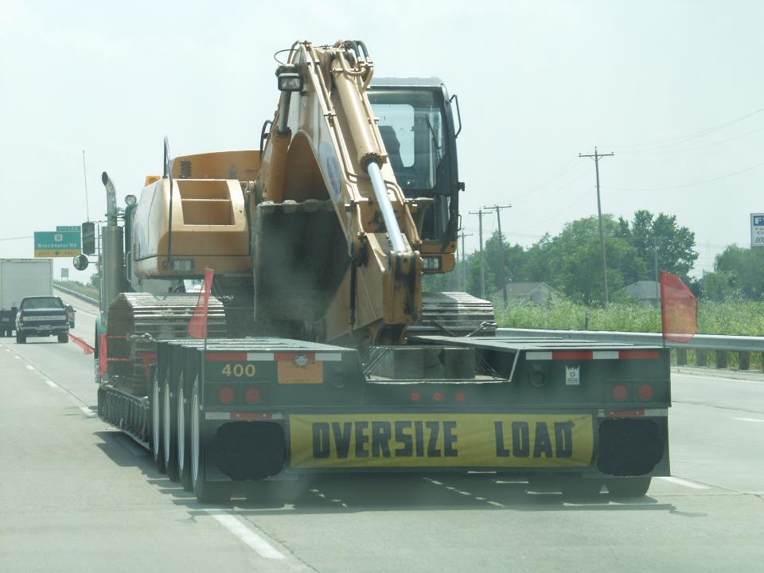
Oversized Vehicles
Notes:
Oversize Vehicles
Oversize-vehicle trailer types may include lowboys, drop frames, flatbeds, open-top vans , and extendable trailers. There can be a number of wheel and axle combinations depending on weight, size of cargo, and state regulations. Many oversize vehicles are equipped with outriggers to support oversized loads. Converter dollies may be attached to the trailer or tractor by a fifth wheel and kingpin, or to the cargo itself to distribute weight over more axles and support longer loads.
Typically, the cargo that creates or makes necessary an oversize vehicle is over dimensional or overweight. Oversize vehicles are usually operated with special permits and on designated highways. Requirements will vary depending on type of cargo, size, weight, and state regulations.
The following are some examples of oversize trailer types:
The deck on a double-drop low bed with two axles is at a standard flatbed height over the fifth wheel and dual rear axles but drops close to the ground in between. These trailers are used to carry large, heavy loads. Outriggers may be used to extend the sides of the trailer to support wider loads.
Typically equipped with two, three, or four axles, a removable gooseneck low bed trailer has a removable gooseneck , allowing the trailer to rest on the ground for easier loading and unloading of heavy equipment. These trailers are often used for front loaders, bulldozers, and backhoes. Outriggers may be used to extend the sides of the trailer.
A folding gooseneck low bed trailer is similar to the removable gooseneck trailer, but the gooseneck folds to the ground to allow loading and unloading.
A hydraulic sliding axle trailer, as the name implies, has rear axles that can hydraulically slide forward and a bed that slopes to the ground, allowing for easier loading and unloading of heavy equipment.
A hydraulic tail low bed trailer, with a fixed gooseneck, has a hydraulically operated ramp in the rear, allowing for the loading and unloading of heavy equipment.
A low-bed semi-trailer can be attached to a multi-axle jeep dolly to increase the trailer’s capacity. Part of the cargo rests on the dolly and part on the trailer.

Slide 13
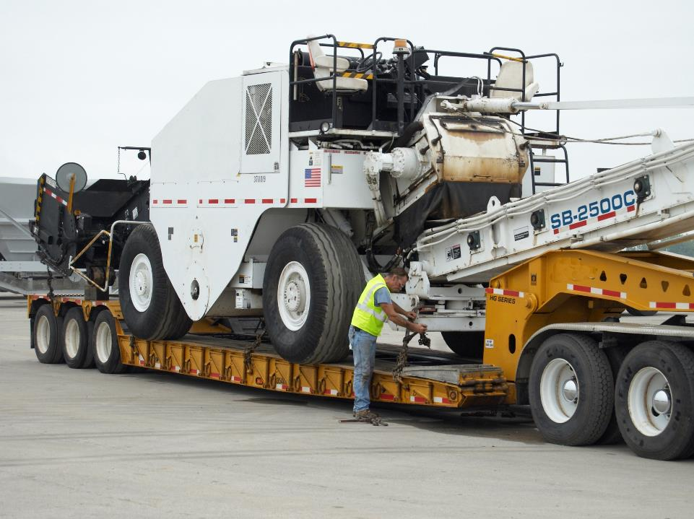
Low-Clearance Vehicles
Notes:
Low-Clearance Vehicles
Low-clearance vehicles are designed to haul heavy, oversized cargo or to accommodate greater cubic capacity loads. Special training and skills are required before operating these trailers. There are two basic kinds of low‑clearance vehicles:
A double-drop frame drops right behind the kingpin and right in front of the trailer axles, close to the ground. Double-drop frames are especially susceptible to bottom clearance problems at curbs, railroad crossings, and other places where the pavement is uneven.
The single-drop frame has a single drop located right behind the kingpin — it only drops about half as much as a double-drop frame. Single-drop frames can handle taller loads than conventional trailers, and bottom clearance problems are not as significant as with double-drop trailers. A single-drop low bed is also called a drop-deck or step-deck trailer.
Both types of trailers are designed with enough clearance behind the kingpin to prevent the back of the tractor from hitting the dropped portion of the trailer, as long as the unit is properly adjusted. The driver must ensure the fifth wheel is back far enough to allow for adequate clearance.

Slide 14
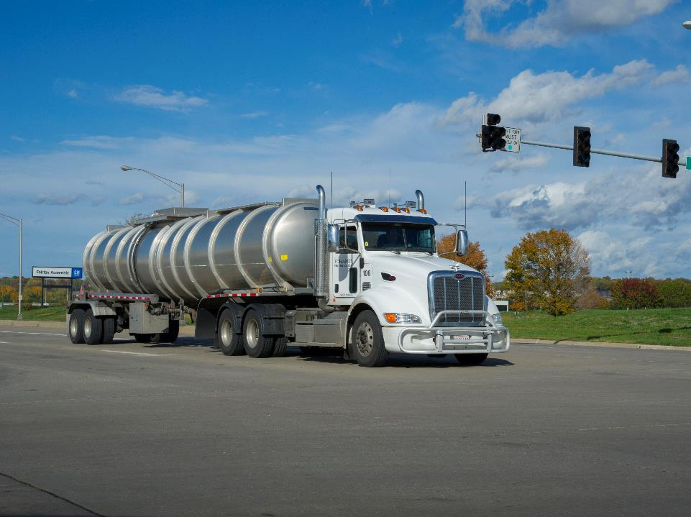
Vehicles with Unstable Loads
Notes:
Vehicles with Unstable Loads
In a high center-of-gravity vehicle, the majority of the weight is high off the ground, so the greatest danger is in the vehicle’s tendency to tip, especially when navigating curves.
High center-of-gravity vehicles require the driver to plan ahead to avoid abrupt steering and braking. Whenever feasible, this type of vehicle should be loaded with the heaviest material low in the trailer and forward (weight permitting) for improved handling.
Examples of high center-of-gravity vehicles include dry bulk tankers, liquid tankers, livestock trailers, and some reefers (refrigerated units).

Slide 15
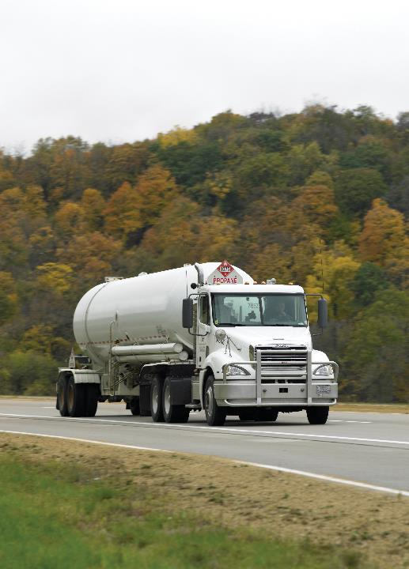
Liquid surge is what makes handling a liquid tanker difficult.
Notes:
Dry Bulk Tankers
Dry bulk tankers are generally cylindrical in shape and are used to haul dry bulk goods such as cement, limestone, flour, and sugar. They are generally loaded through the top and unloaded through the bottom.
Liquid Tankers
Liquid tankers are generally semi-trailers, either oval, round, or occasionally square in shape. There are cold tankers, hot tankers, and pressurized tankers. Liquid tankers may contain one compartment or several, and they may or may not contain baffles.
Liquid surge is what makes handling this type of vehicle difficult. To avoid rollover, drivers must accelerate and turn slowly, and avoid braking when navigating corners.
Vehicle inspections must include checking for leaks, checking all hoses, valves, fittings, the emergency valve release, ladders, catwalks, and any special emergency equipment.
CALLOUT: Before operating a tank vehicle, you’ll need a tank endorsement on your CDL. In order to obtain this endorsement, you will need to successfully complete a knowledge test.
CALLOUT: If you are hauling hazardous materials, in addition to the tank endorsement, you will need a hazardous materials endorsement on your CDL. In order to obtain this endorsement, you will need to successfully complete a knowledge test and pass a federal security threat assessment.

Slide 16
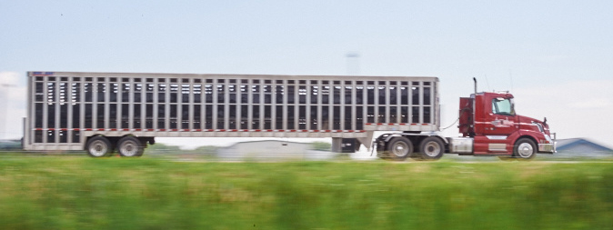
Live cargo can create problems.
Notes:
Livestock Trailers
Livestock trailers have a flat floor or double-drop frame and are used to carry live animals, including cattle, sheep, and pigs. Slots or holes in the sides allow livestock to breathe. Livestock trailers often have side doors in addition to, or instead of, rear doors.
Trailer length will vary and will have a fixed tandem or spread axle. Smaller animals such as pigs or sheep are often carried in trailers converted to accommodate two or three decks.
Live cargo can create problems. Put simply, animals shift. You need to maintain a speed at which you can safely keep the vehicle under control. When stopping, tap brakes lightly to set the animals, then gradually apply brakes. Never attempt to haul livestock without proper training. Livestock hauling is unique in that the driver is responsible for the animals’ health and safety en-route.

Slide 17
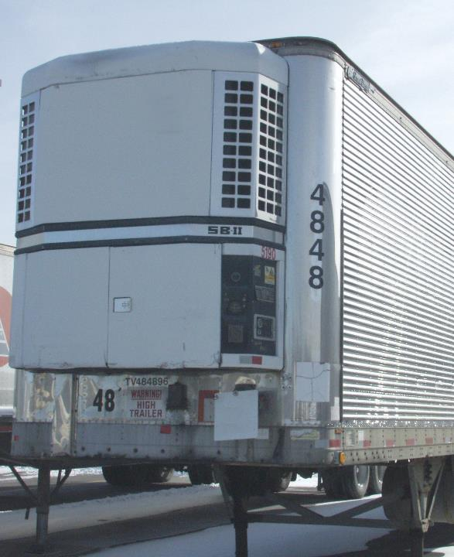
Reefers require special care and the same caution while driving as liquid tankers and livestock transport.
Notes:
Refrigerated Trailers
Refrigerated trailers, or reefers, come in basically two types:
Nose mounts have the refrigeration unit mounted on the upper front of the trailer
Belly mounts, as the name implies, have the refrigeration unit mounted under the trailer
Reefers are most often van- or box-type trailers. Some have racks or rails suspended from the roof, on which animal carcasses are hung, and which can make them unstable. Handling requires the same care as liquid tankers and livestock transport.
Others have separate compartments to keep some cargo frozen while other cargo is kept cool. Slotted floors allow for air or gas circulation. Floors, walls, and roofs are insulated.
Refrigerated trailers have their own engines powered by diesel fuel or liquefied petroleum gas and have their own fuel tank. Most reefer units have a safety mechanism that shuts the reefer engine down if it gets low on oil or water. Make sure the fluids are where they should be to prevent an unexpected shutdown that could ruin your load.
Check the outside of the trailer for any cracks, dents, holes, or other damage that could affect the cooling unit. Damage to the exterior of the trailer could allow the air inside to escape—forcing the unit to work harder in order to maintain its internal temperature.
Confirm the trailer contains the proper amount of insulation and that it can accommodate the required temperature of the load that will be transported. Check for any holes or cracks in the interior walls to see if any insulation is exposed.
Make sure floor channels and drains are open, clear, and not clogged with debris. If the trailer is equipped with an air chute (or canopy), check that it is in good condition and will function properly.
The inside of the trailer should also be clean and sanitary with no trash or debris on the floor. Strong odors could indicate rotting food from a prior shipment—if odors are present thoroughly inspect the trailer to avoid the possibility of cross contamination. In some cases, it may be necessary to get the trailer washed out or even sanitized before it can be loaded with a new shipment.
All openings should be well-sealed, and the gaskets should be in good working order—not cracked or torn. A proper seal is necessary to prevent air from getting in or out. Check that the rear and vent doors close properly and also have a tight seal.
Ensure the unit is actually cooling the trailer appropriately before hitting the road.
Other reefer inspection procedures include checking the fuel, coolant, oil, and refrigerant levels regularly. Some carriers and shippers will require you to stop at specific intervals and record the temperature in the trailer on a temperature log.
VIDEOS (see Trainer Tools USB)
33.1 — Refrigerated Trailers

Slide 18
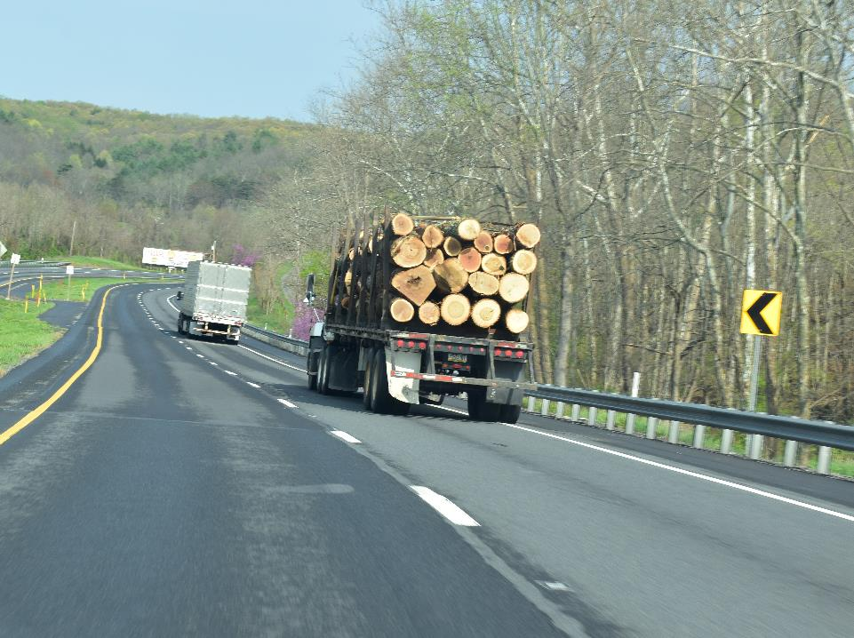
Special Cargo Vehicles
Notes:
Special Cargo Vehicles
A special cargo vehicle is any vehicle designed to haul primarily one particular type of cargo. Two of the most common types of special cargo vehicles are pole trailers and auto transporters.
Pole Trailers
Pole trailers are designed to carry poles, steel girders, logs, and other types of long, narrow cargo. These trailers can be lengthened or shortened as needed to fit the load. Generally, a pole trailer is equipped with two U-shaped cradles (known as bunks) to hold the cargo in place. In some cases, the load itself becomes the body of the trailer — in others, a steel beam forms the body.
CALLOUT: Cargo securement requirements for these and other special cargo vehicles are addressed in Part 393, Subpart I of the Federal Motor Carrier Safety Regulation (FMCSRs).

Slide 19
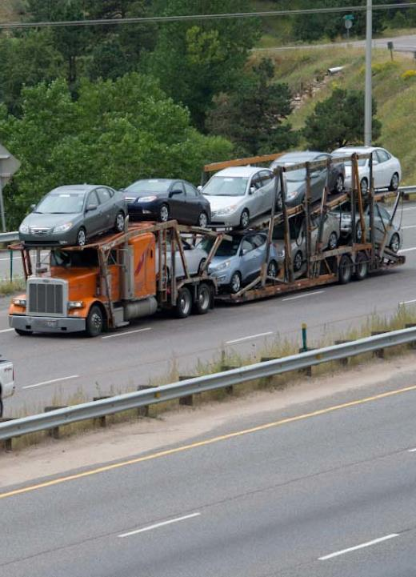
Auto transporters generally hold six to ten automobiles.
Notes:
Auto Transporters
Auto transporters generally hold six to ten automobiles. Sometimes, a rack holds a car atop the tractor itself. These trailers are equipped with ramps in the rear to be used for loading and unloading. Auto transporters have a very low ground clearance. Overhead clearance may vary with each load of vehicles being transported. Pay extra attention to overhead clearances.

Slide 20
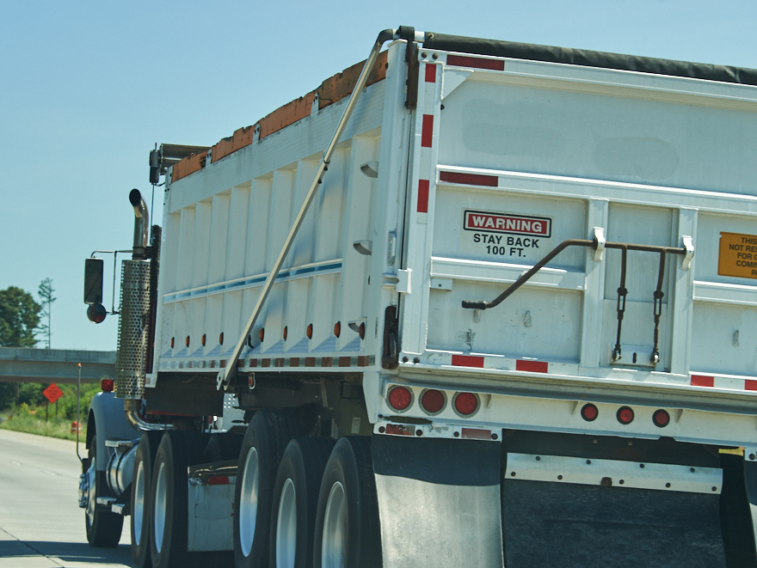
Construction Vehicles
Notes:
Construction Vehicles
Vehicles used in the construction industry have their own issues when it comes to safe handling. Two of the types of vehicles most commonly used are dump trucks and cement/ready mix trucks.
Dump Trucks
A dump truck carries loose construction and landscaping materials, such as dirt, stones, and sand. A dump truck has a dump bed, which is hinged to allow the cargo in the bed to be dumped on the ground behind the truck.
Overloading and improper load distribution are two issues that can create handling problems with this type of vehicle. Always make sure that weight is evenly distributed, and that the load does not cause you to exceed the vehicle’s gross vehicle weight rating (GVWR) or the weight capacity of the tires, axles, and wheels.
The tailgate should be properly closed and latched, and if a tarp is used, make sure it is securely fastened before driving.
Cement/Ready Mix Trucks
Cement/ready mix trucks transport cement in a truck equipped with a rotating drum, referred to as a mixer. The drum must rotate at all times to ensure the cement does not harden in the drum before it is poured at a construction site.
The drum causes this type of vehicle to be top-heavy. Like other top-heavy vehicles, you must use extra caution when navigating curves, at corners, and when stopping. You must also pay extra attention to overhead clearances.
The truck’s chutes and other attachments must be secured before driving.

Slide 21
Objectives Review
You should now be able to:
  Describe the various types of multiple articulation vehicles and the unique hazards each present
  Recognize the characteristics that constitute an
  oversize vehicle
  Discuss how to safely operate high center of
  gravity vehicles
  Identify what type of loads are naturally unstable while driving and how to minimize instability
  Explain what makes a special cargo vehicle different than a standard tractor-trailer
  Discuss hazards associated with construction vehicles and how to stay safe
Copyright 2019 J. J. Keller & Associates, Inc.
Notes:
You should now be able to:
Describe the various types of multiple articulation vehicles and the unique hazards each present
Recognize the characteristics that constitute an
oversize vehicle
Discuss how to safely operate high center of
gravity vehicles
Identify what type of loads are naturally unstable while driving and how to minimize instability
Explain what makes a special cargo vehicle different than a standard tractor-trailer
Discuss hazards associated with construction vehicles and how to stay safe
CLASSROOM RECOMMENDATION
Before concluding your training session, have participants take the corresponding quiz (found on the Trainer Tools USB) to check their understanding of the material. You can customize any of the questions to fit your audience or workplace. The answer key can also be found on the Trainer Tools USB.
You may also choose to administer the quizzes before you begin your training session to help get participants thinking about the subject and/or to gauge their understanding of the topic ahead of time.

