Slide 1






PowerPoint® Instructions
This PowerPoint has been designed so you can easily customize it for your training session.
Throughout the presentation you’ll see icons with recommendations or videos to enhance the instruction you present to your students. A detailed explanation for each icon can be found on the next slide. Videos can be found on the Trainer Tools USB.
When you see an icon on the slide, look in the notes
section for further information.
Simply delete or move the icon off the slide before your training session begins.

Slide 2





Classroom Recommendations. Provides suggestions for enhancing your classroom presentation; from ideas for large group discussions to suggestions on the use of training aids such as examples or photos of vehicle parts and components to help illustrate the items covered within a chapter.
Lab Recommendations. Provides suggestions for activities and exercises that take place outside the classroom, but do not involve
the actual operation of the tractor-trailer or its components. Examples
of lab sessions include conducting a vehicle inspection or practicing mirror adjustment.
Range Recommendations. These recommended activities take
place on a closed-access driving range where students may practice driving skills in a controlled environment. Examples of range sessions include practicing shifting technique and successfully completing a backing maneuver.
Road Recommendations. These recommended activities take place in road and traffic conditions that support the chapter’s objectives. Examples of road sessions include proper communication with other drivers through the use of turn signals and basic vehicle control under nighttime or extreme weather conditions.
Videos. These short video clips reinforce material presented in the Student Manual. Use them to help students grasp difficult concepts or subject matter.

Slide 3
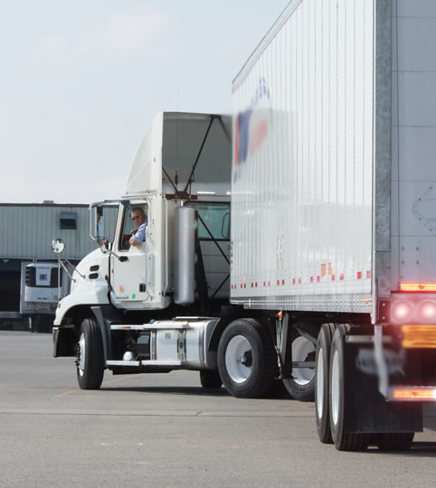
Backing and Docking
6
Copyright 2019 J. J. Keller & Associates, Inc.
Notes:
Unit A1.1.6 Backing and Docking
This unit must teach driver-trainees to back and dock the combination vehicle safely. This unit must cover “Get Out and Look” (GOAL), evaluation of backing/loading facilities, knowledge of backing set ups, as well as instruction in how to back with the use of spotters.

Slide 4
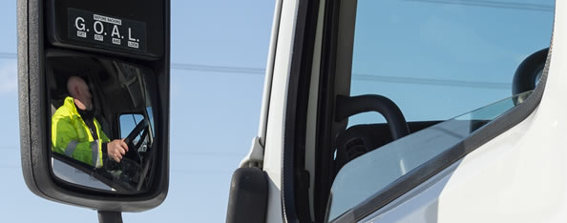
Introduction
We’ll focus on the basics of backing including safe backing and the types
of backing maneuvers commonly used
Notes:
Backing is one of the most difficult maneuvers a professional driver performs. Successfully backing a tractor-trailer requires skill, practice, patience, and good judgment. Improper or inattentive backing can result in lost time, lost wages, additional paperwork, damage to trailers, buildings or other equipment, and even personal injury.
This chapter focuses on the basics of backing including safe backing and the types of backing maneuvers commonly used.
CLASSROOM RECOMMENDATION
Focus on the importance of steering while backing, the types of backing maneuvers your students will encounter, and the rules for backing safely. Much of this lesson will be taught on the driving range.

Slide 5
Objectives
Upon completion of this lesson, you will be able to:
  Recognize the steering principles required for successfully backing your tractor-trailer
  Recall general guidelines to stay safe while backing your tractor-trailer
  Describe the appropriate backing maneuver to use based on the situation
  Explain additional precautions to take when backing in parking lots and loading dock areas
Notes:
Upon completion of this lesson, you will be able to:
Recognize the steering principles required for successfully backing your tractor-trailer
Recall general guidelines to stay safe while backing your tractor-trailer
Describe the appropriate backing maneuver to use based on the situation
Explain additional precautions to take when backing in parking lots and loading dock areas

Slide 6
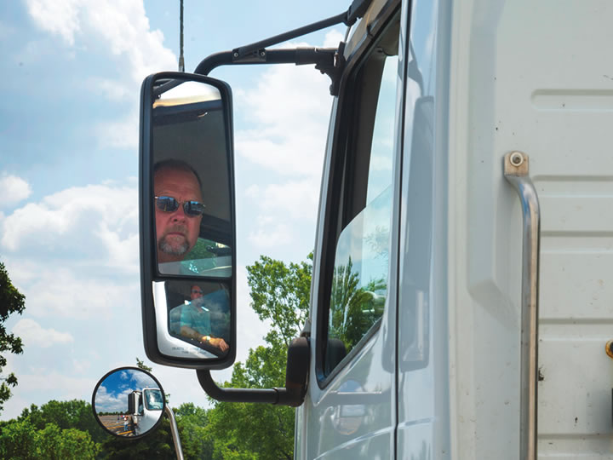
Backing Dangers
Notes:
In the future, when you park your vehicle at a truck stop, wayside, or other location, do it so you can drive forward whenever possible, even if it means parking a little farther away.

Slide 7
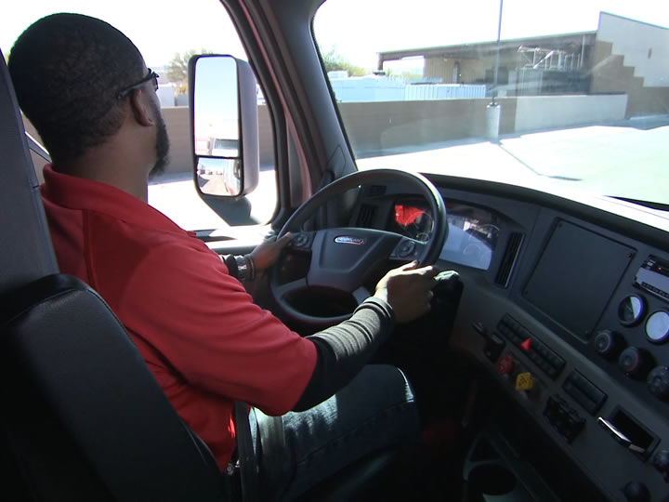
You should never back if you don’t have to for two reasons:
  Backing gives you limited visibility. You will always have a blind spot and that blind spot will constantly shift as you back.
  When backing, your tractor and trailer will each follow a different path.
Notes:
You should never back if you don’t have to for two reasons:
Backing gives you limited visibility. You will always have a blind spot and that blind spot will constantly shift as you back.
When backing, your tractor and trailer will each follow a different path.

Slide 8
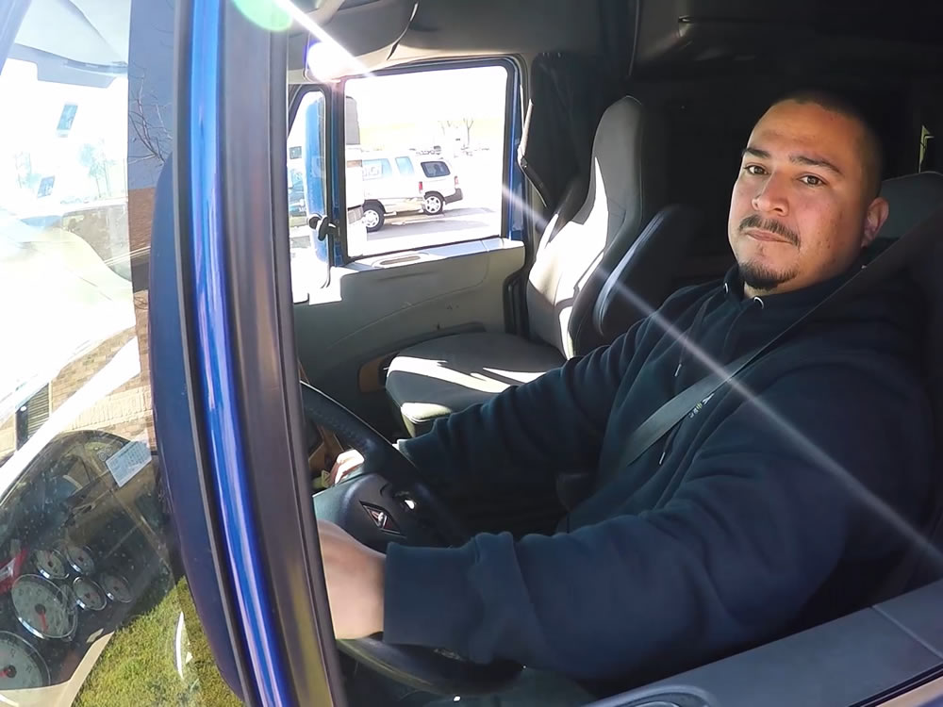
General Backing Guidelines
Notes:
All backing maneuvers have the potential to become dangerous. In most backing situations, even a second or two is enough time for someone or something to get in the path of a vehicle. Backing safely requires that you take certain precautions every time you prepare to back your tractor-trailer.
RANGE RECOMMENDATION
Divide students into groups of three or four. Start by explaining the backing maneuver that will be covered in the day’s lesson. Then walk through the appropriate safety checks and demonstrate the maneuver. After the instructor-led demonstration, each student should take a turn performing the appropriate safety checks and the actual backing maneuver.
Walk next to the cab door so you can coach, correct, and assist each student. Use the following criteria to evaluate student performance:
The student doesn’t hit any course markers or cross any marked boundaries.
The student doesn’t need more than three pull-ups when performing a specific backing maneuver.
The vehicle ends up parked where and how directed.

Slide 9
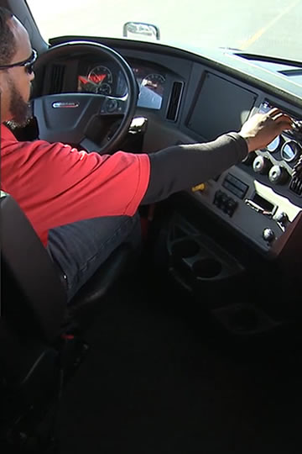
Eliminate Noise
Eliminate noise and other distractions so you can concentrate on backing without interruption. Shut off anything that makes sound such as your radio, CB, cab fans, and phone. Roll down your window.
Notes:
Eliminate noise and other distractions so you can concentrate on backing without interruption. Shut off anything that makes sound such as your radio, CB, cab fans, and phone. Roll down your window. Your ears will help you back safely.

Slide 10
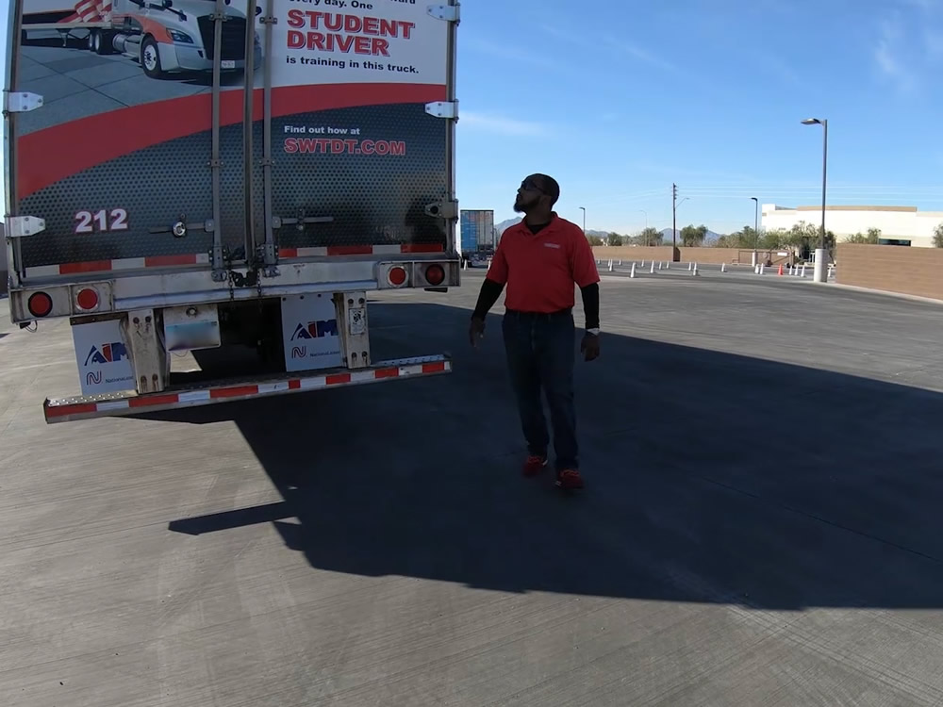
Get Out and Look (GOAL)
Stop the truck.
Secure your vehicle.
If you shut off the engine, pocket the keys.
Walk around and check all sides of your vehicle.
Notes:
Stop the truck. Secure your vehicle by setting the parking brakes and turning on the four-way flashers. If you shut off the engine, pocket the keys. Next, walk around and check all sides of your vehicle. Are there any people or equipment, parked vehicles, or debris? It is a good idea to walk all the way to the loading dock to ensure a clear path. While surveying the area around you, don’t forget to look up. Overhead obstructions can include wires, pipes, tree limbs, awnings, even window air conditioners. In addition, you will also want to be aware of underside “snags” such as steep dock approaches. Also, make sure you warn others that the truck is backing.
If you have any doubt about backing at all—either before or during—get out and look as many times as necessary to ensure you can back safely. There is no such thing as being too cautious.
Once the safety checks have been made, don’t delay in moving the vehicle. Any delay could allow time for another potential hazard. If there is a delay, conduct the safety checks a second time.

Slide 11
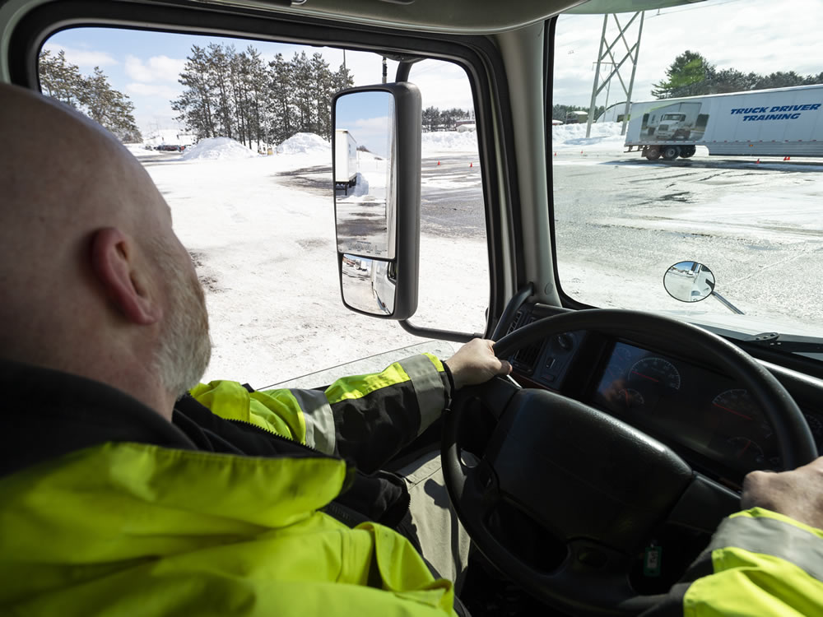
Back Slowly
Keep an eye on your mirrors and always back as slowly as possible. Make sure you are in the lowest gear, and don’t ride the clutch. Use your four-way flashers and your backup alarm.
Notes:
Keep an eye on your mirrors and always back as slowly as possible. Make sure you are in the lowest gear, and don’t ride the clutch. Use your four-way flashers and your backup alarm. If you don’t have a backup alarm, periodically tap your horn.

Slide 12
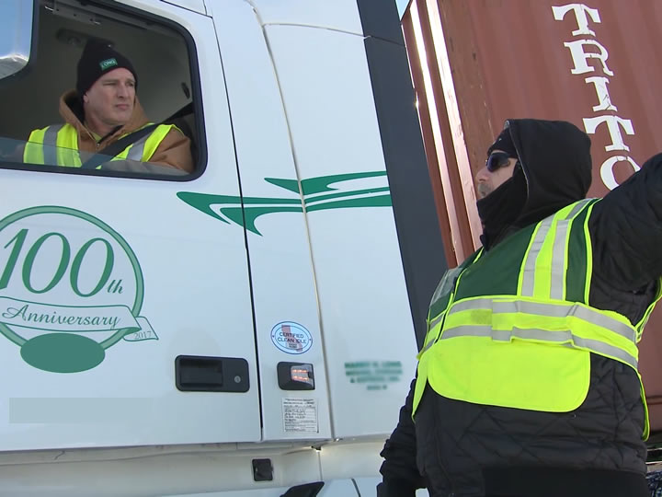
Use a Spotter
Backing can be a lot easier with the help of a qualified and experienced spotter. You and your spotter should agree on the hand signals he or she will use—the most important signal
being stop.
Notes:
If possible, use a spotter. Backing can be a lot easier with the help of a qualified and experienced spotter. You and your spotter should agree on the hand signals he or she will use—the most important signal being stop. Since docking areas can be noisy, you never want to depend on voice signals alone.
Ideally, the spotter should wear a reflective vest or other bright clothing to increase his or her visibility. If, at any time, you can’t see the spotter in your mirrors, stop immediately. The spotter needs to be positioned where you can see him or her, and where he or she has a clear view of your vehicle’s path.
It is important to note that you, the driver, are ultimately responsible if anything does go wrong during backing.
CALLOUT: Some motor carriers have a policy on the use of spotters. Know your motor carrier’s policy before using a spotter.
VIDEO
6.1 — Spotter

Slide 13
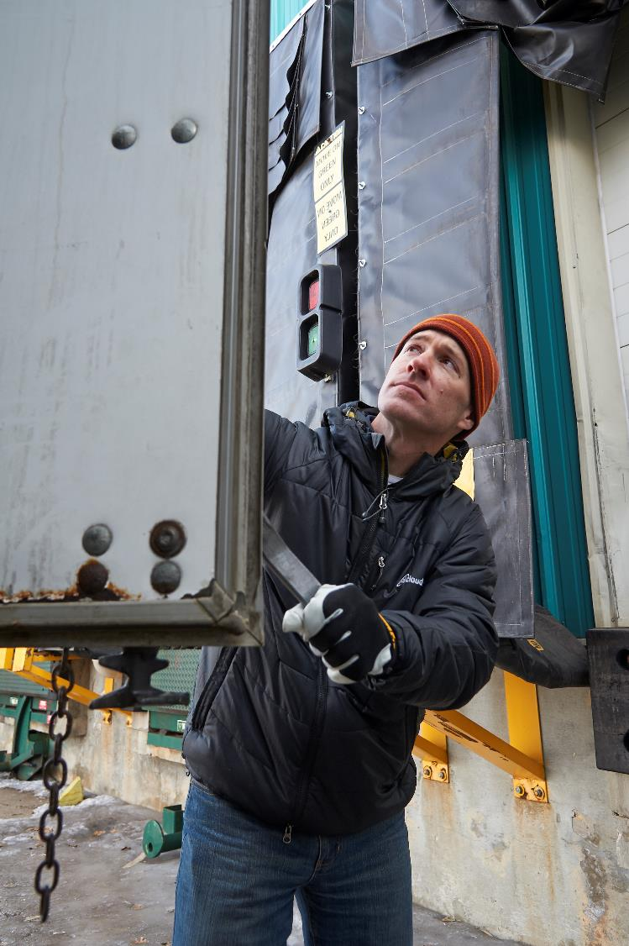
Open Your Doors
If you’re backing up to a loading dock with a trailer that has cargo doors that open out, make sure they’re secured in the open position.
When you reach
your target, chock your wheels.
Notes:
If you’re backing up to a loading dock with a trailer that has cargo doors that open out, make sure they’re secured in the open position. This will prevent you from having to pull forward, open the doors, and back again. Securing the doors will ensure they will not swing open and cause damage or break off during your approach to the dock.
When you reach your target, chock your wheels.

Slide 14
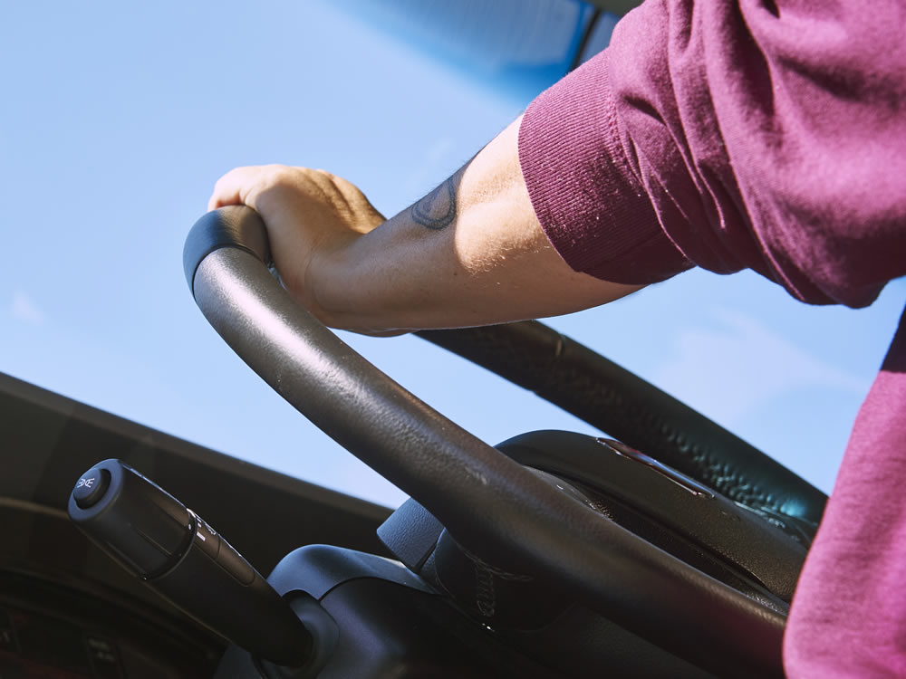
Steering Principles
Notes:
The techniques/procedures used for backing a tractor-trailer are very different from those used to back your personal vehicle. In most personal vehicles, the front axle serves as the steering axle. In the case of a tractor-trailer, the rear tractor axle steers the trailer.
The amount of turning or movement of the trailer is proportional to the angle between the tractor and trailer. The greater the angle, the more the trailer will pivot and the less rearward movement there will be.
VIDEO
6.2 — Steering Techniques

Slide 15
Always steer in the opposite direction you want the trailer to move.
Changing the tractor’s direction of travel changes the trailer’s direction of travel.
Notes:
Steering is a technique, and while it seems like a simple activity, some drivers may struggle with this. There are two basic principles you must understand in order to back correctly:
Always steer in the opposite direction you want the trailer to move. If you want the trailer to go to the right, turn the steering wheel to the left, and vice versa.
Changing the tractor’s direction of travel changes the trailer’s direction of travel.

Slide 16
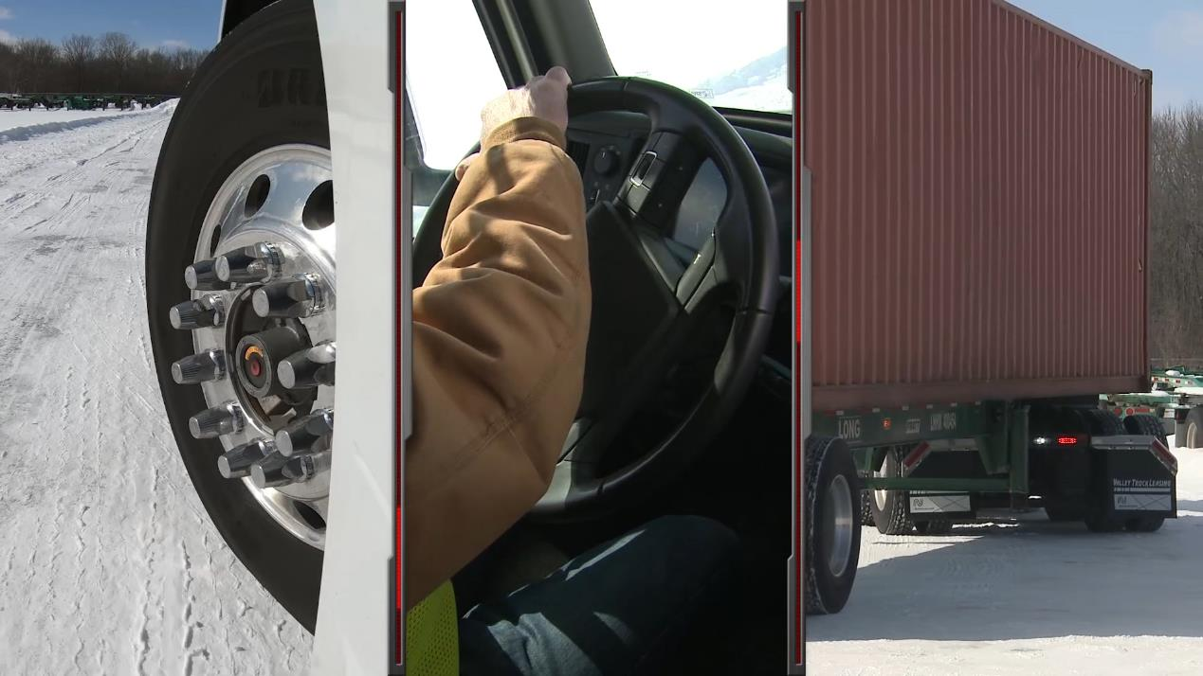
Jacking refers to the change in trailer direction that you want to create.
The trailer will “jack,” or move in the opposite direction of the way you turn the steering wheel. If you want the trailer to jack to the right, turn the steering wheel to the left.
Notes:
Backing involves a combination of steering techniques—jacking, chasing, following and push-pull.
Jacking refers to the change in trailer direction that you want to create. The trailer will “jack,” or move in the opposite direction of the way you turn the steering wheel. If you want the trailer to jack to the right, turn the steering wheel to the left.

Slide 17
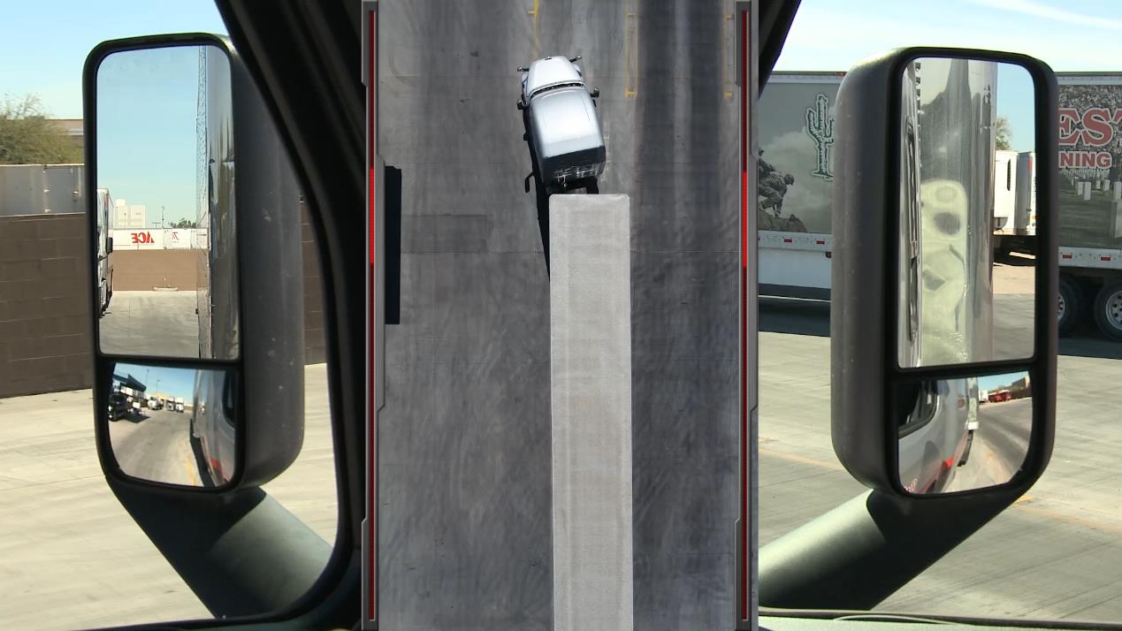
Chasing means steering just enough for the tractor to follow the path of the trailer.
If the trailer drifts off path, just turn the steering wheel in the direction of the drift to correct the trailer’s path.
Notes:
Chasing means steering just enough for the tractor to follow the path of the trailer. If the trailer drifts off path, just turn the steering wheel in the direction of the drift to correct the trailer’s path.

Slide 18
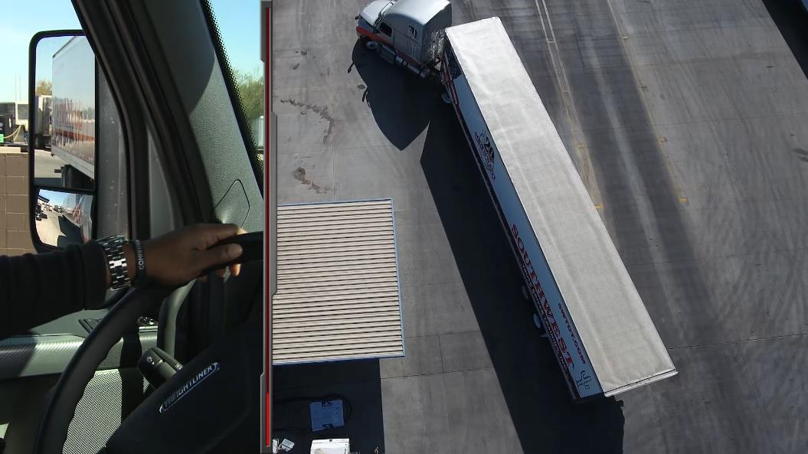
Following involves turning the steering wheel toward the trailer until the
tractor/trailer angle remains constant.
If the trailer needs to turn more, the driver turns the wheel away from the trailer. If the trailer needs to turn less, the driver turns the wheel toward the trailer. When the trailer is back on course, the driver countersteers to follow the trailer.
Notes:
Following involves turning the steering wheel toward the trailer until the tractor/trailer angle remains constant. If the trailer needs to turn more, the driver turns the wheel away from the trailer. If the trailer needs to turn less, the driver turns the wheel toward the trailer. When the trailer is back on course, the driver countersteers to follow the trailer.

Slide 19
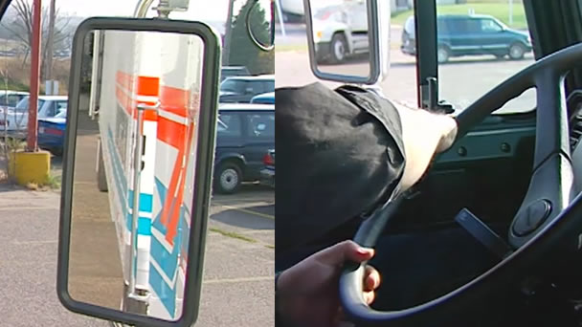
Use the push-pull steering technique to stay on path.
That is, when the trailer gets bigger in one mirror, you’re off track. Just push the steering wheel toward that mirror to correct your drift.
Notes:
Use the push-pull steering technique to stay on path. That is, when the trailer gets bigger in one mirror, you’re off track. Just push the steering wheel toward that mirror to correct your drift.

Slide 20
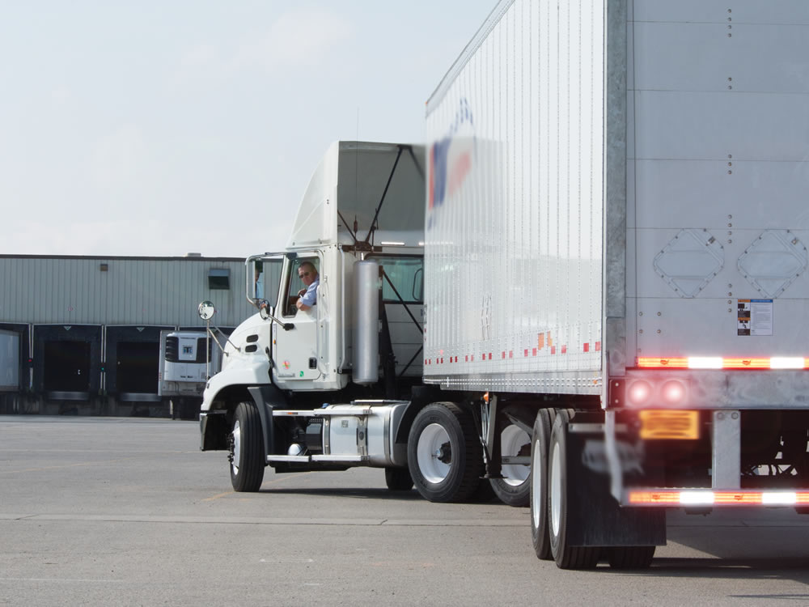
Sight Side & Blind Side Backing

Slide 21
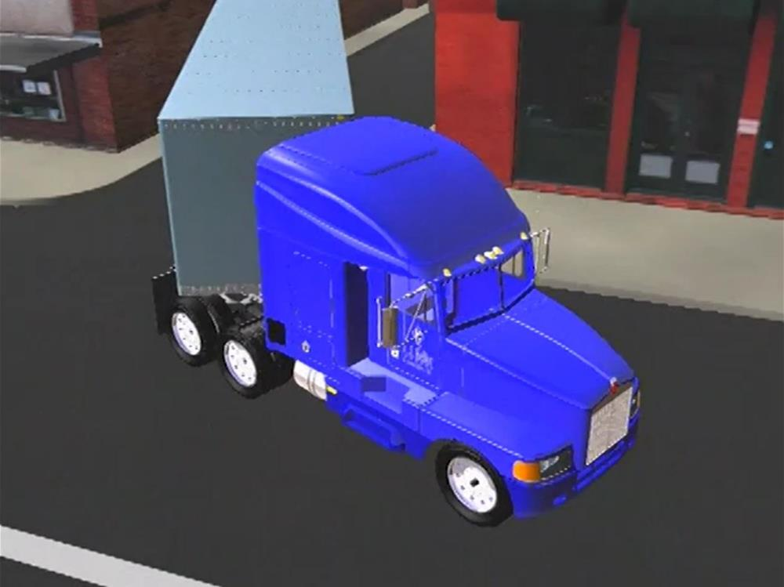
Sight side backing means you are backing toward the left side of the vehicle.
You can see along the intended path of the trailer. Sight side backing is preferred, as you have maximum visibility.
Notes:
Sight side backing means you are backing toward the left side of the vehicle. You can see along the intended path of the trailer. Sight side backing is preferred, as you have maximum visibility.

Slide 22
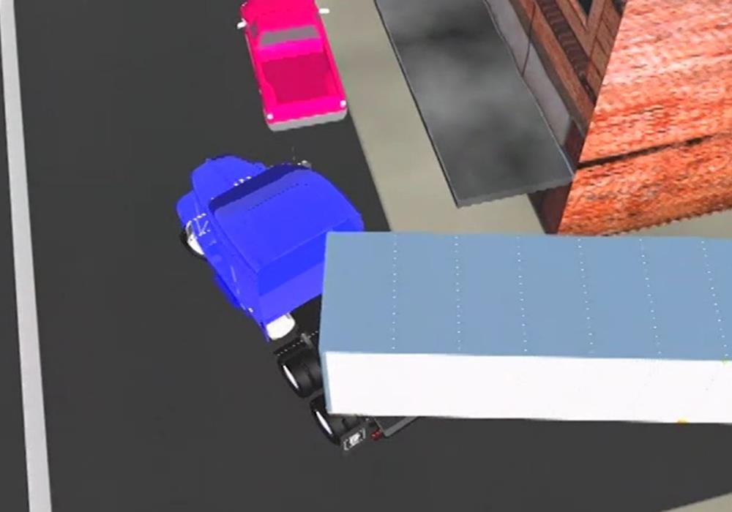
Blind side backing means you are backing toward the right side of the vehicle.
You can only see where you are going in your rear-view mirrors. Blind side backing is more difficult and dangerous than sight side backing. You have limited visibility.
Notes:
Blind side backing means you are backing toward the right side of the vehicle. You can only see where you are going in your rear-view mirrors. Blind side backing is more difficult and dangerous than sight side backing. You have limited visibility and have more of a chance of hitting something. Blind side backing should be avoided when possible. But, if you must, use a spotter and stop every few feet to check your clearance.

Slide 23
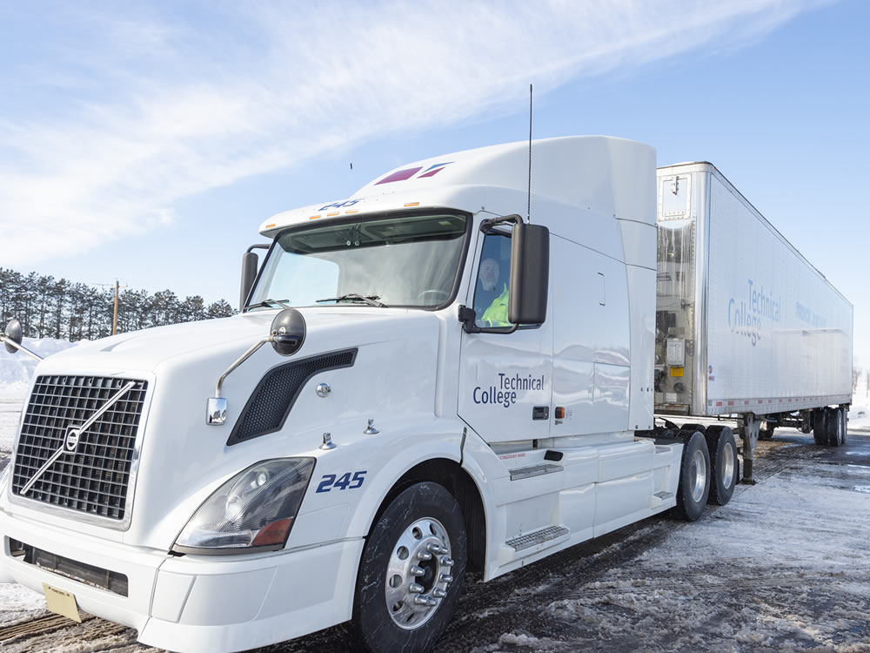
Basic Backing Maneuvers
Notes:
The following are the basic backing maneuvers you need to master in order to safely perform your job:
Straight line backing
Alley dock or curved backing
Sight side jackknife backing
Blind side jackknife backing
Offset backing, sometimes referred to as parallel parking

Slide 24
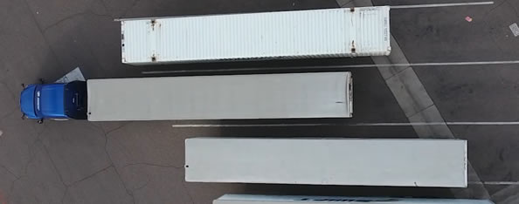
Straight Line Backing
Fundamental in learning all other backing maneuvers
Notes:
Straight line backing is the simplest of the backing techniques and is fundamental in learning all other backing maneuvers. Straight line backing should be mastered before attempting other backing maneuvers.
VIDEO
6.3 — Straight Line Backing

Slide 25
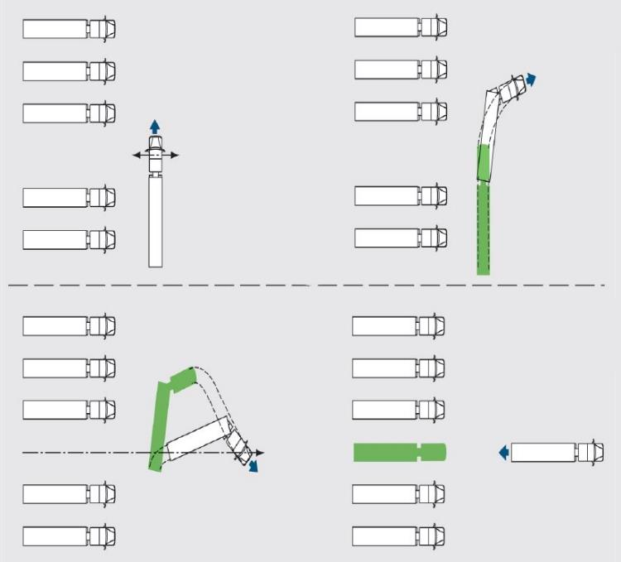
Line up so you have
as straight a shot
as possible
Back slowly
Use both mirrors
Stay on path by using push-pull steering
Don’t over steer
If you drift too far, pull up, re-position the trailer, and start over
Notes:
To perform a straight line backing maneuver:
Line up so you have as straight a shot as possible
Back slowly
Use both mirrors
Stay on path by using push-pull steering
Don’t over steer
If you drift too far, pull up, re-position the trailer, and start over

Slide 26
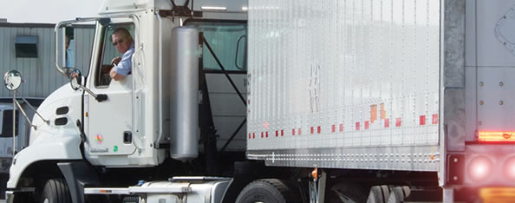
Alley Dock or Curved Backing
Alley dock backing combines sight side backing and straight-line backing
Notes:
Alley dock backing combines sight side backing and straight-line backing. The maneuver involves backing while turning into a space that is 90 degrees to the truck. This occurs most often at loading docks when you must back in from off the street or between two vehicles. Alley dock backing requires patience and extreme caution.
VIDEO
6.4 — Alley Dock Backing

Slide 27
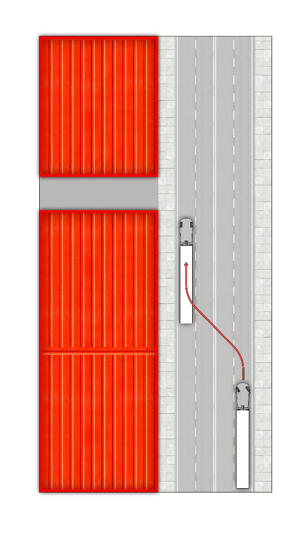
Step 1
Approach the alley at a right angle, with the dock area on your left
Check your left mirror for clearance
Turn left to get the rear of the trailer as close to the alley as possible
Notes:
Step 1
Approach the alley at a right angle, with the dock area on your left
Check your left mirror for clearance
Turn left to get the rear of the trailer as close to the alley as possible

Slide 28
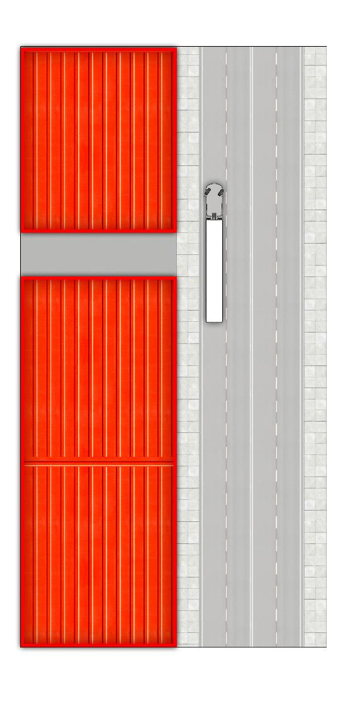
Step 2
Turn right to straighten out, getting as close to the alley as possible
Step 3
Check your right side for clearance
Turn your wheel to the right when the nose of the trailer passes the center of the alley
Notes:
Step 2
Turn right to straighten out, getting as close to the alley as possible
Step 3
Check your right side for clearance
Turn your wheel to the right when the nose of the trailer passes the center of the alley

Slide 29
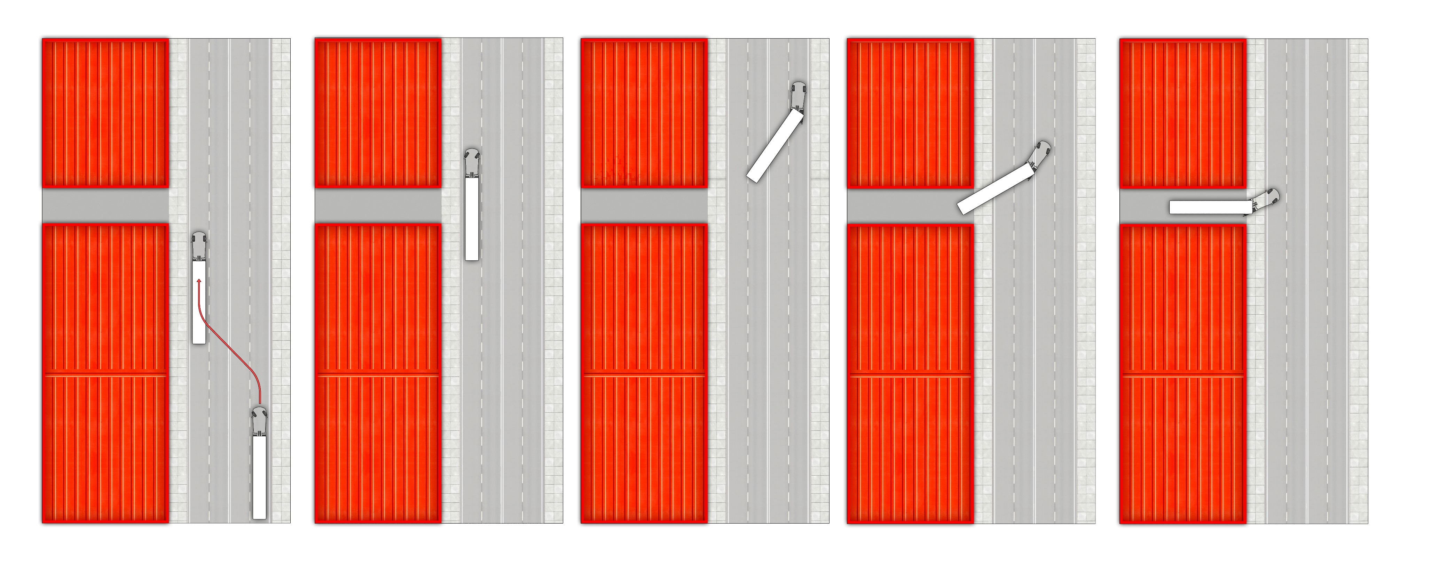
Step 4
Turn hard left when the tractor has used ¾ of the forward space
Stop your rig when tractor is parallel to the starting position (tractor-trailer will be in an arc)
Get Out And Look (GOAL)
Notes:
Step 4
Turn hard left when the tractor has used ¾ of the forward space
Stop your rig when tractor is parallel to the starting position (tractor-trailer will be in an arc)
Get Out And Look (GOAL)

Slide 30
Step 5
Check to see the left rear corner of your trailer and your target
Check your clearance behind and between trailers or other obstacles
Map the path you want the trailer to run toward the dock
Open and secure your trailer doors
Notes:
Step 5
Check to see the left rear corner of your trailer and your target
Check your clearance behind and between trailers or other obstacles
Map the path you want the trailer to run toward the dock
Open and secure your trailer doors

Slide 31
Step 6
Return to the vehicle and start backing with straight steering
Jack the steering if the trailer path is too wide
Turn the wheels left to chase, if the trailer is turning too short
Notes:
Step 6
Return to the vehicle and start backing with straight steering
Jack the steering if the trailer path is too wide
Turn the wheels left to chase, if the trailer is turning too short

Slide 32
Step 6, (cont.)
Turn the wheels
hard left just before the trailer is on the target line
Straighten the tractor so the tractor and trailer finish in a straight line
Stop about three or four feet from the dock
Notes:
Step 6
Turn the wheels hard left just before the trailer is on the target line
Straighten the tractor so the tractor and trailer finish in a straight line
Stop about three or four feet from the dock

Slide 33
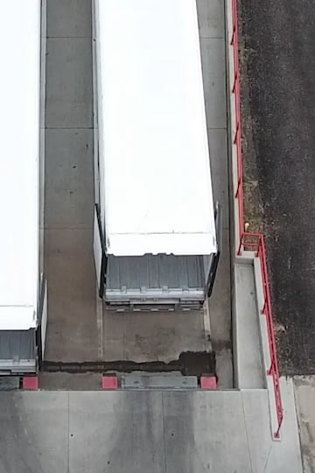
Step 7
Secure the vehicle
Get out and check the remaining space
Ease the trailer to
the dock
Notes:
Step 7
Secure the vehicle
Get out and check the remaining space
Ease the trailer to the dock

Slide 34
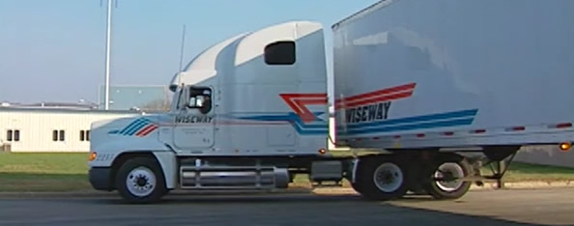
Sight Side Jackknife Backing
Use jackknife backing to position your tractor as close as possible to the side of the dock, so it doesn’t stick out into traffic
Notes:
Sometimes, you won’t have the luxury of ending your maneuver with a straight-line back. You may need to use jackknife backing to position your tractor as close as possible to the side of the dock, so it doesn’t stick out into traffic.
When you need to back and turn toward the driver’s side—the sight-side backing maneuver—you have the advantage of being able to see your trailer’s path out of your left mirror. However, there’s a large area you cannot see—that’s the area to the right of your rig.

Slide 35
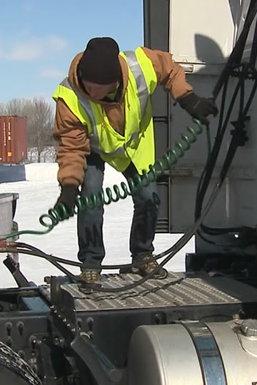
Make sure air and electrical lines are long enough and won’t be torn off or pinched
Notes:
Make sure air and electrical lines are long enough and won’t be torn off or pinched

Slide 36
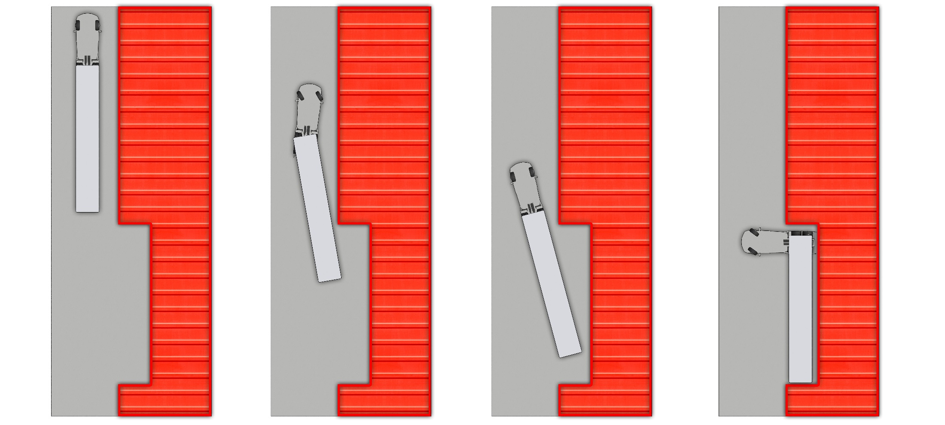
Pull past the dock while parallel to it
Check your clearance and think about the path
Notes:
Pull past the dock while parallel to it
Check your clearance and think about the path

Slide 37
Follow alley docking or offset backing steps until the rear wheels are four to eight feet from the turning point
Notes:
Follow alley docking or offset backing steps until the rear wheels are four to eight feet from the turning point

Slide 38
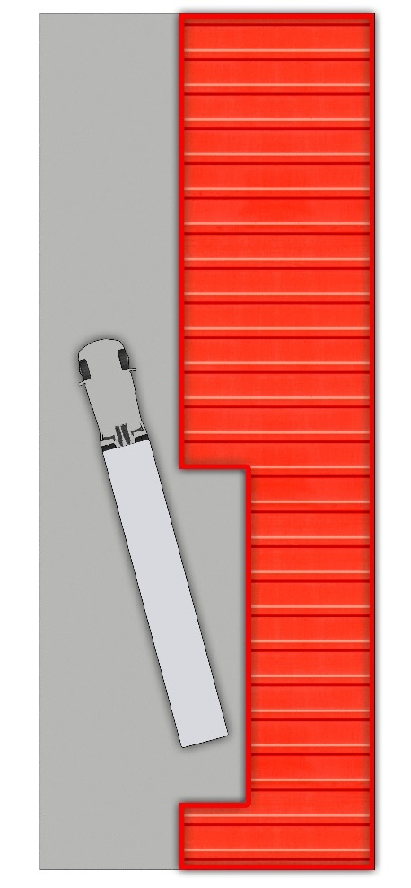
Turn your wheel to the right
Notes:
Turn your wheel to the right

Slide 39
Give the wheel a sharp turn to the right when it’s about to reach the dock
Avoid over jacking and damaging
the tractor
Lower the landing gear for stability when loading or unloading
Notes:
Give the wheel a sharp turn to the right when it’s about to reach the dock
Avoid over jacking and damaging the tractor
Lower the landing gear for stability when loading or unloading (remember to raise the gear before driving away)

Slide 40
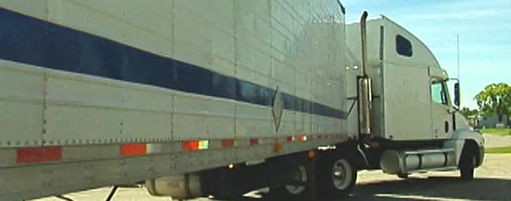
Blind Side Jackknife Backing

Slide 41
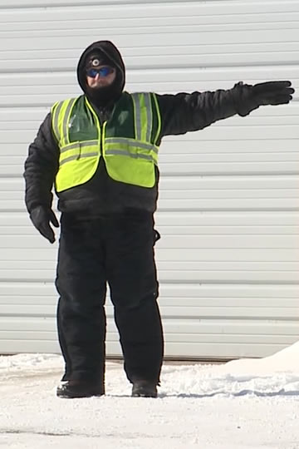
Use a qualified spotter
Notes:
Use a qualified spotter (Keep the spotter in sight every second and stop every few feet to check clearances and ensure a clear path.)

Slide 42
Position the vehicle
Notes:
Position the vehicle

Slide 43
Turn the wheel to the left when the rear wheels reach the midpoint of the alley
Notes:
Turn the wheel to the left when the rear wheels reach the midpoint of the alley

Slide 44
Keep the spotter in sight
Notes:
Keep the spotter in sight

Slide 45
Turn the wheel hard to the left when the trailer is almost to the dock
Avoid jacking at more than a 90-degree angle
Notes:
Turn the wheel hard to the left when the trailer is almost to the dock
Avoid jacking at more than a 90-degree angle

Slide 46
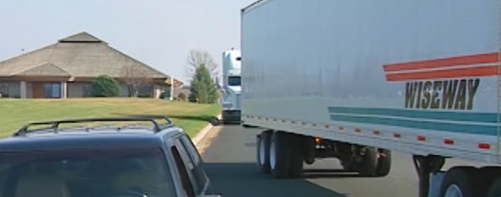
Offset Backing
The most difficult backing maneuver to accomplish
Notes:
Offset backing, sometimes referred to as parallel parking, is the most difficult backing maneuver to accomplish. Look for other options and use offset backing only when you must. This technique may also help if the trailer did not wind up directly in front of the target.
VIDEO
6.5 — Offset Backing

Slide 47
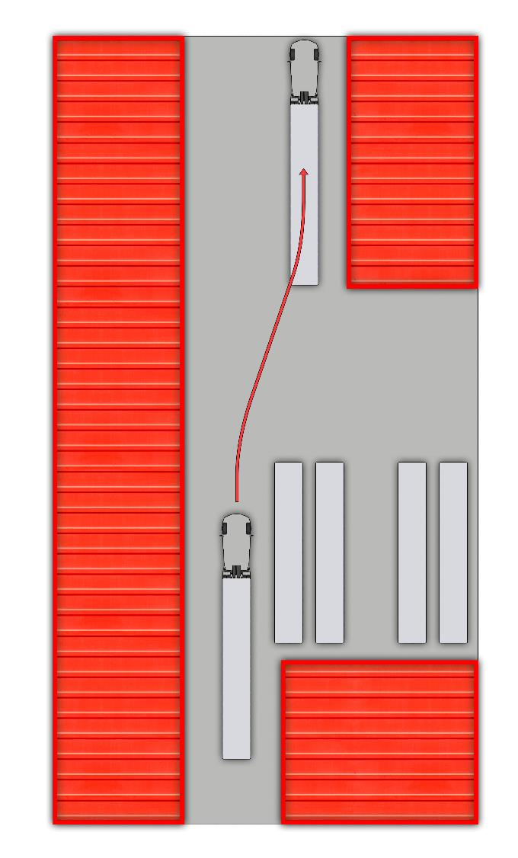
Drive past the spot, leaving three to eight feet from the end of your trailer to the opening
Check for clearances and obstructions
Notes:
Drive past the spot, leaving three to eight feet from the end of your trailer to the opening
Check for clearances and obstructions

Slide 48
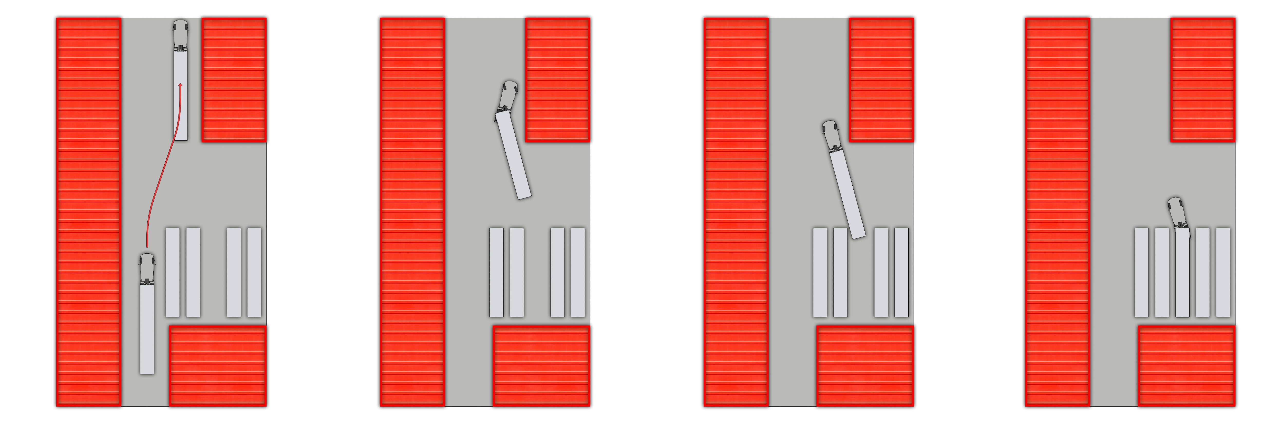
Turn the wheel slightly to the left when backing
Increase the turn
Verify the back right side of the trailer is heading to the back right side of the parking space
Continue until the front of the trailer is even with the front of the space
Notes:
Turn the wheel slightly to the left when backing
Increase the turn
Verify the back right side of the trailer is heading to the back right side of the parking space
Continue until the front of the trailer is even with the front of the space

Slide 49
Turn the steering wheel hard to the right, so it jacks the tractor into position
Notes:
Turn the steering wheel hard to the right, so it jacks the tractor into position

Slide 50
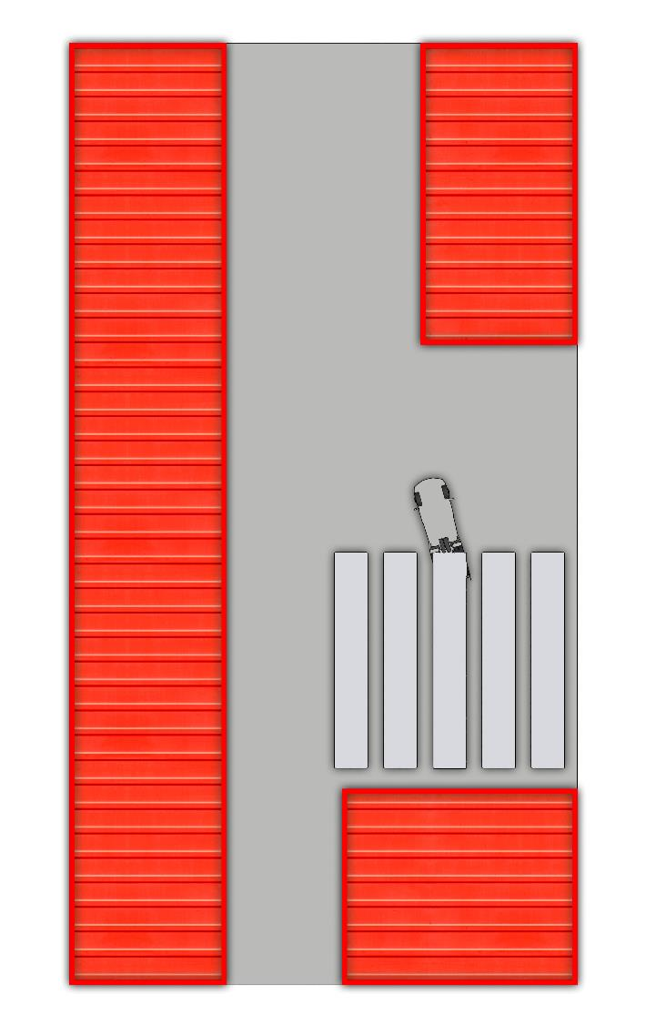
Turn the wheel sharply to the left and back up until you are in the space
Pull forward to adjust your position and your clearance
Notes:
Turn the wheel sharply to the left and back up until you are in the space
Pull forward to adjust your position and your clearance

Slide 51
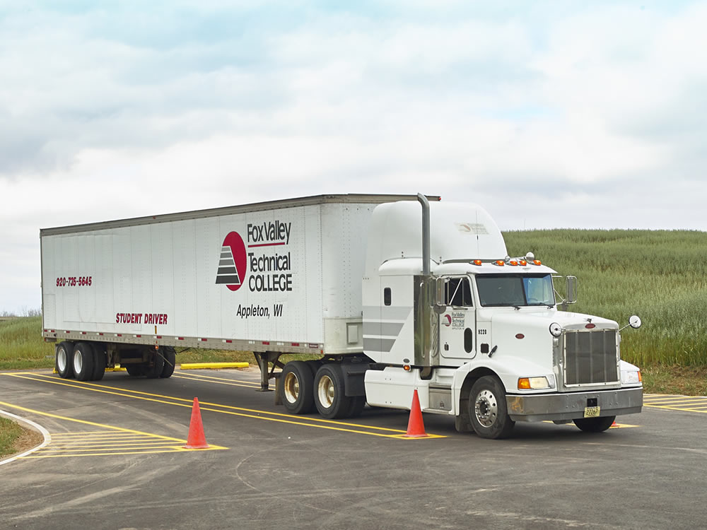
Backing Safely
Notes:
Proper position is essential to successful backing. The easiest and safest position to start from is straight. However, keep in mind that most backing situations do not give the room needed to line up in a completely straight manner.

Slide 52
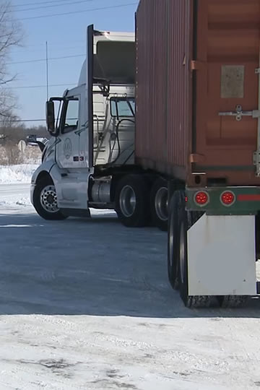
Be patient
Back as slowly as possible, using the lowest reverse gear
Don’t accelerate
(use idle speed) or
ride the clutch
Don’t over steer
Back to the left
side (sight side) whenever possible
Notes:
When it comes to all backing maneuvers:
Be patient
Back as slowly as possible, using the lowest reverse gear
Don’t accelerate (use idle speed) or ride the clutch
Don’t over steer
Back to the left side (sight side) whenever possible

Slide 53
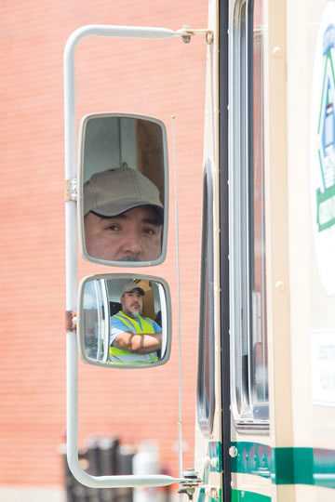
Use your
vehicle’s mirrors
Use your vehicle’s
horn and flashers to alert others
Eliminate noise and keep the windows
open to listen
Watch for fixed objects
Restart the backing maneuver instead of backing poorly
Notes:
When it comes to all backing maneuvers:
Use your vehicle’s mirrors
Use your vehicle’s horn and flashers to alert others
Eliminate noise and keep the windows open to listen
Watch for fixed objects
Restart the backing maneuver instead of backing poorly

Slide 54
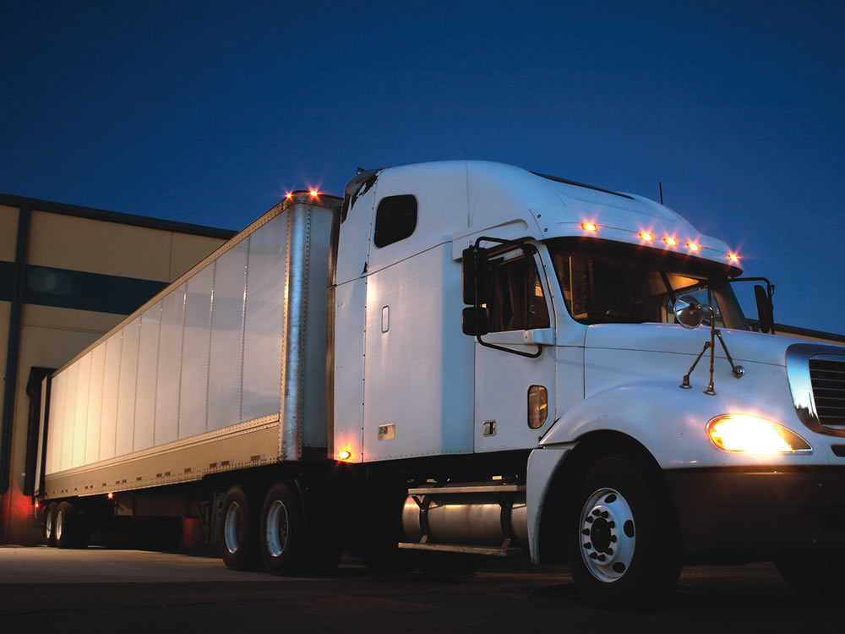
Loading Docks & Parking Lots
Notes:
Loading docks and parking lots each present a different set of challenges for the professional driver. The following are a few tips for dealing with these situations.

Slide 55
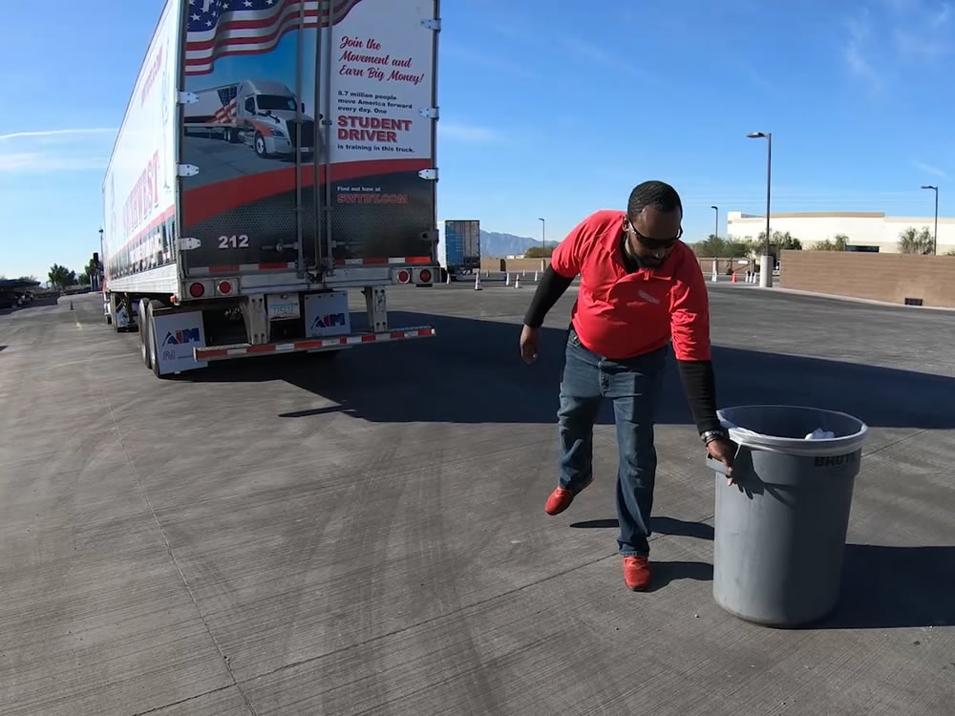
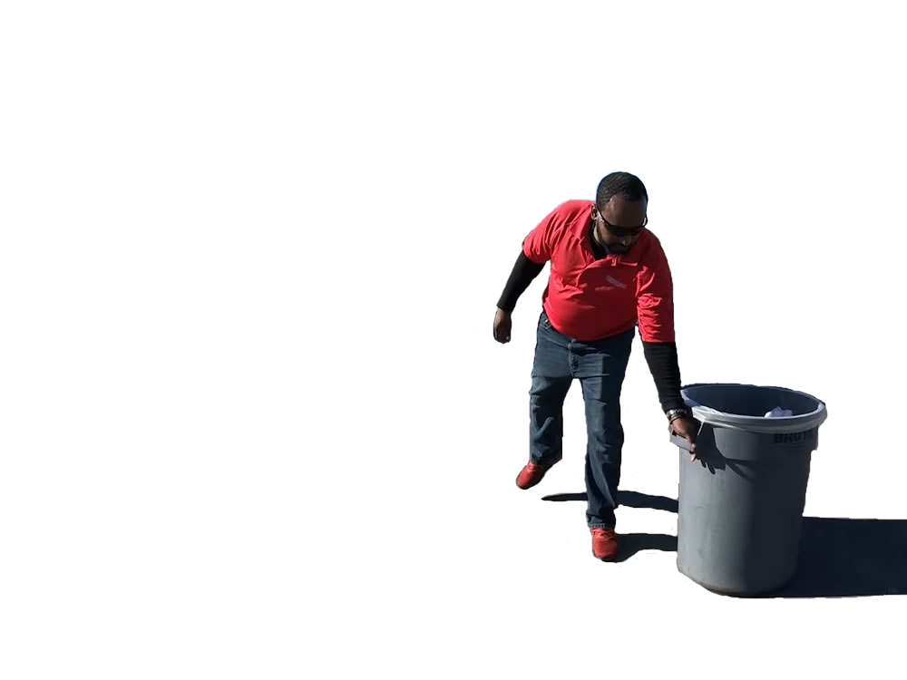
When making your usual check around your vehicle (GOAL) before starting to back, pay extra attention to:
Parked vehicles and stationary objects
Alleyways or driveways where vehicles could enter or exit your path
of travel
Unusual clearances around the dock and any nearby barriers
Notes:
Evaluate the receiving area before backing into position. When making your usual check around your vehicle (GOAL) before starting to back, pay extra attention to:
Parked vehicles and stationary objects
Alleyways or driveways where vehicles could enter or exit your path of travel
Unusual clearances around the dock and any nearby barriers

Slide 56
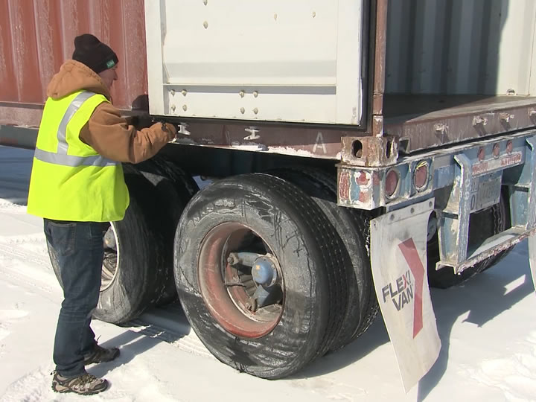
Carefully open your trailer doors before backing in to the loading dock. Secure the doors in the open position and make sure the cargo is secure and didn’t shift in transit.
Notes:
Carefully open your trailer doors before backing in to the loading dock. Secure the doors in the open position and make sure the cargo is secure and didn’t shift in transit. The last thing you want to have to deal with at a dock is an open trailer door swinging and being damaged or torn off, or cargo falling out of the trailer.
Slow and steady is key at the loading dock. It is acceptable to restart a backing maneuver. Your vehicle must be centered as you approach the dock. If your vehicle is not centered, you risk causing damage to both your vehicle and the dock.
Some shippers and receivers also require you to chock your tires. Wheel chocks are used (in addition to parking brakes) to ensure your vehicle will not roll forward during the loading or unloading process.

Slide 57
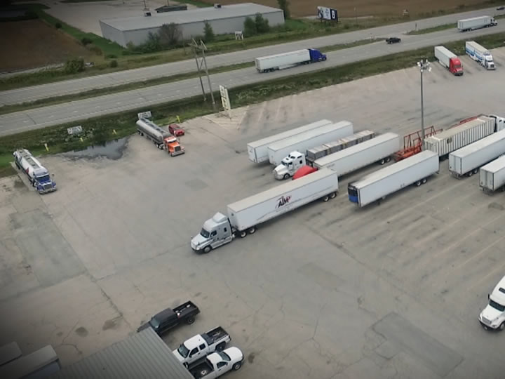
When driving through a parking lot, evaluate the:
  Direction of traffic flow through the lot
  Location of parking stalls
  Positions of entrances and exits
Notes:
When driving through a parking lot, evaluate the:
Direction of traffic flow through the lot
Location of parking stalls
Positions of entrances and exits
Carefully position your vehicle so you do not strike a parked vehicle. Get out of the vehicle and determine clearances before you back. Because most parking lots have open access to the public, you need to be even more aware of the possibility of cars and pedestrians moving into your path.
If you have to stop your backing maneuver for any reason, conduct another check around your vehicle before restarting your backing maneuver.

Slide 58
Objectives Review
You should now be able to:
  Recognize the steering principles required for successfully backing your tractor-trailer
  Recall general guidelines to stay safe while backing your tractor-trailer
  Describe the appropriate backing maneuver to use based on the situation
  Explain additional precautions to take when backing in parking lots and loading dock areas
Copyright 2019 J. J. Keller & Associates, Inc.
Notes:
You should now be able to:
Recognize the steering principles required for successfully backing your tractor-trailer
Recall general guidelines to stay safe while backing your tractor-trailer
Describe the appropriate backing maneuver to use based on the situation
Explain additional precautions to take when backing in parking lots and loading dock areas
CLASSROOM RECOMMENDATION
Before concluding your training session, have participants take the corresponding quiz (found on the Trainer Tools USB) to check their understanding of the material. You can customize any of the questions to fit your audience or workplace. The answer key can also be found on the Trainer Tools USB.
You may also choose to administer the quizzes before you begin your training session to help get participants thinking about the subject and/or to gauge their understanding of the topic ahead of time.

