Slide 1






PowerPoint® Instructions
This PowerPoint has been designed so you can easily customize it for your training session.
Throughout the presentation you’ll see icons with recommendations or videos to enhance the instruction you present to your students. A detailed explanation for each icon can be found on the next slide. Videos can be found on the Trainer Tools USB.
When you see an icon on the slide, look in the notes
section for further information.
Simply delete or move the icon off the slide before your training session begins.

Slide 2





Classroom Recommendations. Provides suggestions for enhancing your classroom presentation; from ideas for large group discussions to suggestions on the use of training aids such as examples or photos of vehicle parts and components to help illustrate the items covered within a chapter.
Lab Recommendations. Provides suggestions for activities and exercises that take place outside the classroom, but do not involve
the actual operation of the tractor-trailer or its components. Examples
of lab sessions include conducting a vehicle inspection or practicing mirror adjustment.
Range Recommendations. These recommended activities take
place on a closed-access driving range where students may practice driving skills in a controlled environment. Examples of range sessions include practicing shifting technique and successfully completing a backing maneuver.
Road Recommendations. These recommended activities take place in road and traffic conditions that support the chapter’s objectives. Examples of road sessions include proper communication with other drivers through the use of turn signals and basic vehicle control under nighttime or extreme weather conditions.
Videos. These short video clips reinforce material presented in the Student Manual. Use them to help students grasp difficult concepts or subject matter.

Slide 3
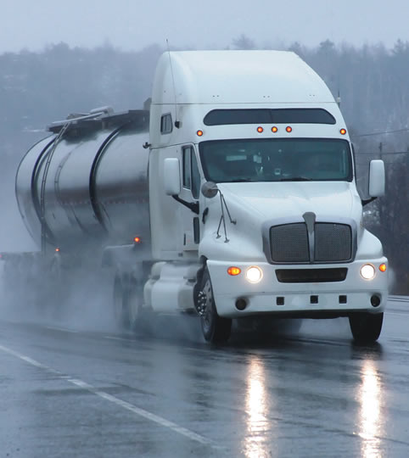
Communication
9
Copyright 2019 J. J. Keller & Associates, Inc.
Notes:
Unit A1.2.2 Communication
This unit must instruct driver-trainees on how to communicate their intentions to other road users. Driver-trainees must be instructed in techniques for different types of communication on the road, including proper use of headlights, turn signals, four-way flashers, and horns. This unit must cover instruction in proper utilization of eye contact techniques with other drivers, bicyclists, and pedestrians.

Slide 4
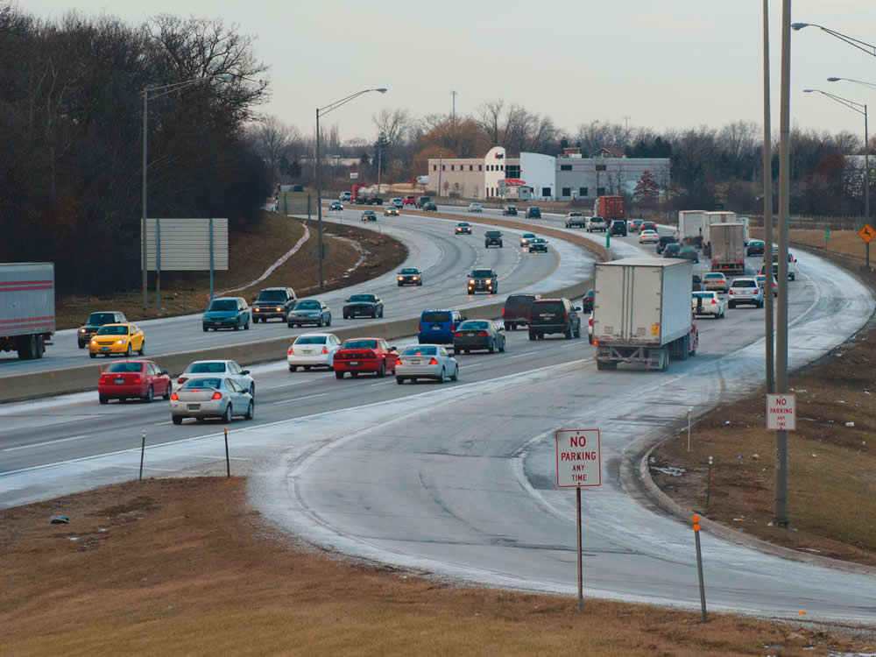
Introduction
Notes:
In this chapter, you will be introduced to the basic principles of communication. This includes the appropriate processes and procedures on your part when it comes to communicating with others as well as developing the skills to understand the communications of others.
Seeing and being seen is key when it comes to communication. Seeing is being able to focus your attention on the road and the task of driving without getting distracted. Being seen is making your presence and intentions known to other drivers.
CLASSROOM RECOMMENDATION
This is the second of a series of chapters designed to get your students ready to operate on the road. Discuss the basic principles of communication,—how drivers and road users communicate with each other, including the use of eye contact, turn signals, brake lights, and other means.
Also discuss the types of policies that are common within the industry.
VIDEO
9.1 — Introduction

Slide 5
Objectives
Upon completion of this lesson, you will be able to:
Describe ways to communicate your intent while driving through the use of turn signals and brake lights
Discuss how to communicate your presence through the use of headlights, horns, warning devices, and eye contact
Explain how eye contact techniques can help you communicate with bicyclists, pedestrians, and other drivers
Notes:
Upon completion of this lesson, you will be able to:
Describe ways to communicate your intent while driving through the use of turn signals and brake lights
Discuss how to communicate your presence through the use of headlights, horns, warning devices, and eye contact
Explain how eye contact techniques can help you communicate with bicyclists, pedestrians, and other drivers

Slide 6
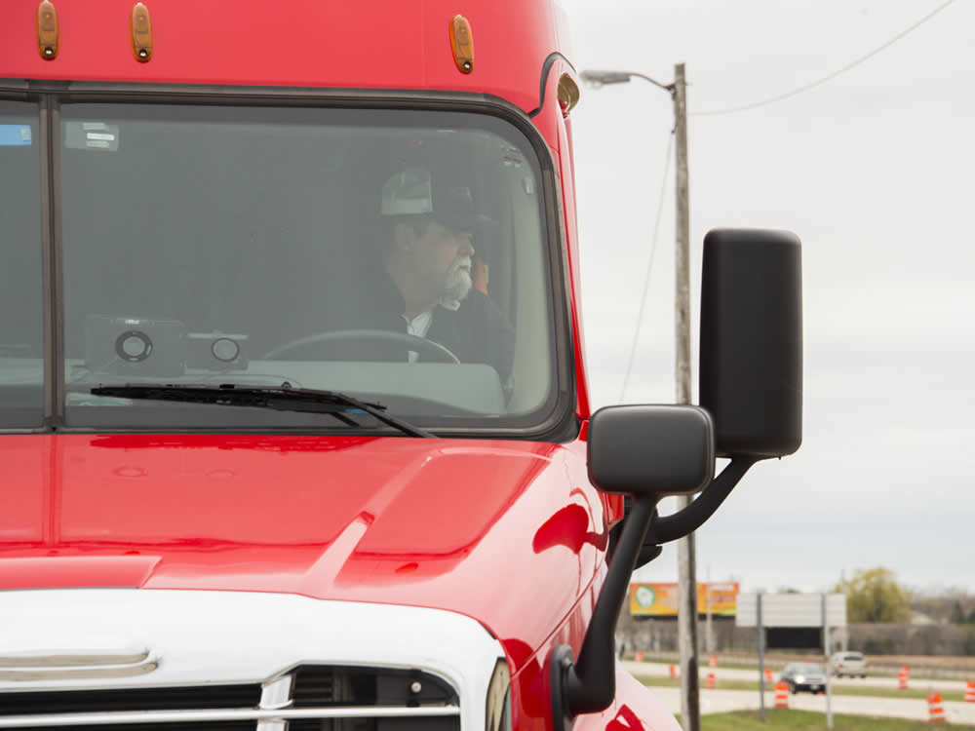
Communicating Your
Intent While Driving
Notes:
Communicating Your Intent While Driving
VIDEO
9.2 — Signals

Slide 7
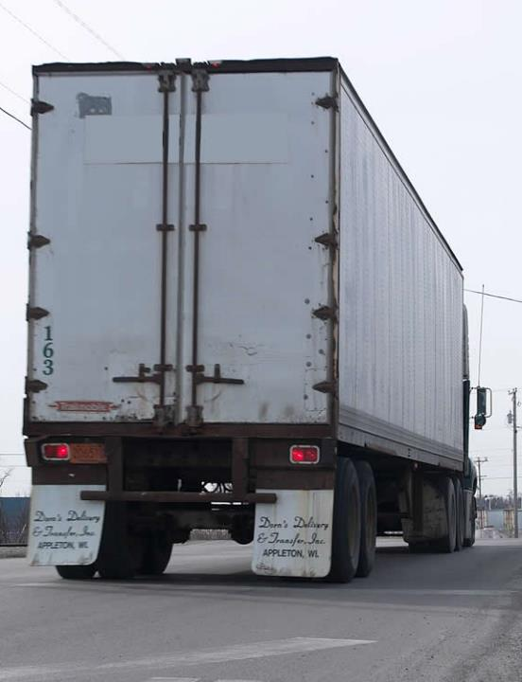
Like you, other drivers are not mind readers.
Use your
turn signals
and brake lights to communicate intent!
Notes:
Like you, other drivers are not mind readers. They can’t know what you are going to do if you don’t tell them. Clear communication of your intentions is important. Basic methods of visibly communicating your intent include:
Turn signals
Brake lights

Slide 8
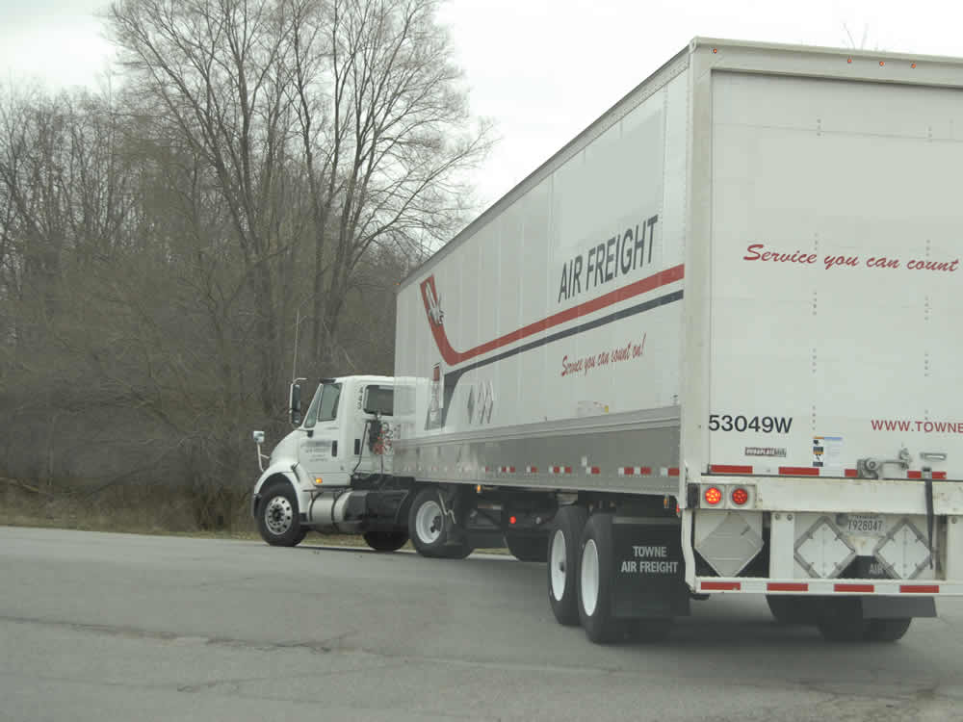
Turn Signals
Communicate your intent to change direction.
  Turn
  Change lanes
  Pass another
  vehicle
  Merge
  Exit a highway
  Parallel park
  Pull into traffic
  from the curb
Notes:
Turn signals communicate your intent to change direction. Signal anytime you plan to:
Turn
Change lanes
Pass another vehicle
Merge
Exit a highway
Parallel park
Pull into traffic from the curb
Always use turn signals in these situations, even if you don’t see any other vehicles around. Remember, your vehicle does have blind spots and the most dangerous vehicles are the ones you can’t see. Here are some standard turn signal guidelines you should follow:

Slide 9
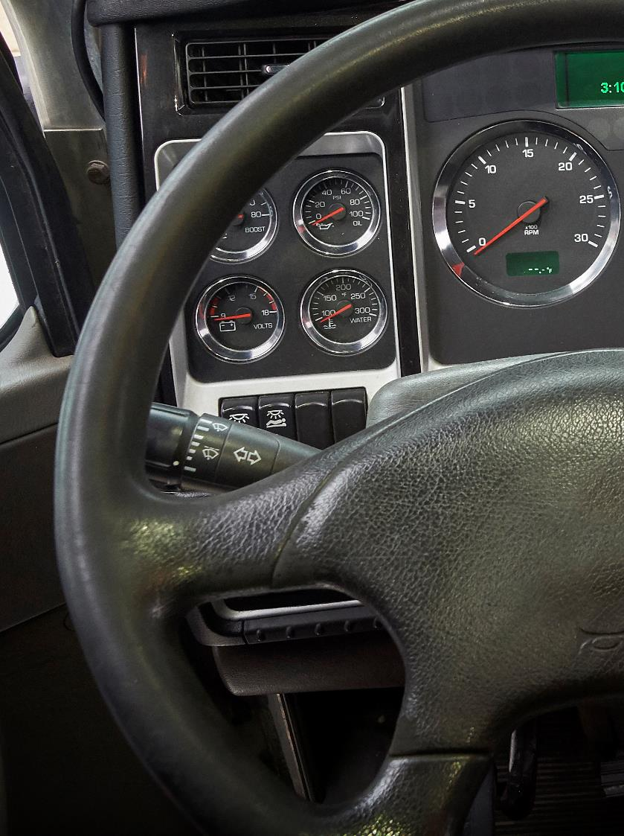
Signal early.
Signal well in advance of making your move.
Notes:
Signal early. Signal well in advance of making your move. In the city, signal half a block before turning. On the highway, signal about 500 feet in advance. Your turn signal should blink at least three times before you begin your move. Change lanes slowly to give a vehicle in your blind spot time to react or alert you of their presence.

Slide 10
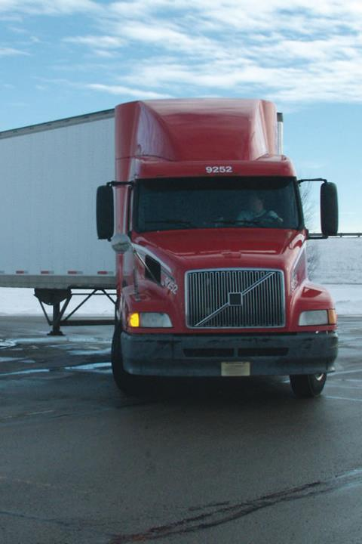
Signal continuously.
Don’t cancel the signal until after you’ve completed the move.
Notes:
Signal continuously. Keep both hands on the wheel to turn safely. Don’t cancel the signal until after you’ve completed the move.

Slide 11
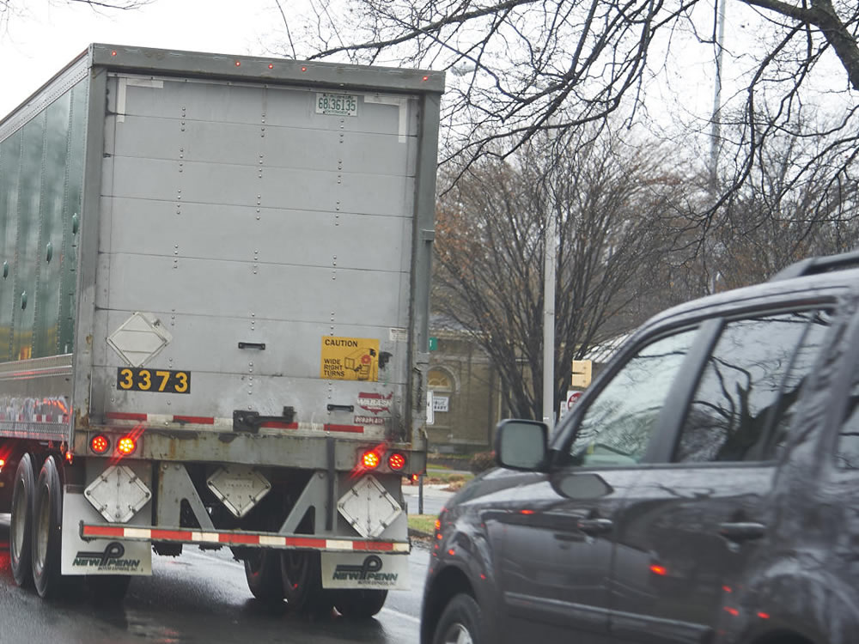
Brake Lights
Communicate your intent to slow down or stop.
A few light taps on the brake pedal (causing
your brake lights to flash) should warn drivers following your vehicle.
If you are driving very slowly or are stopped, use your four-way emergency flashers.
Notes:
There will be times that you will need to let other drivers know that you are slowing down. Other drivers may not expect you to be slowing down, especially when approaching a steep grade, setting up for a turn, or stopping to load, unload, or park. A few light taps on the brake pedal (causing your brake lights to flash) should warn drivers following your vehicle. If you are driving very slowly or are stopped, use your four-way emergency flashers.
Because of the size of your vehicle and the difficulty other drivers may have seeing in front of it, it is important that you communicate early when traffic is slowing or stopping.

Slide 12
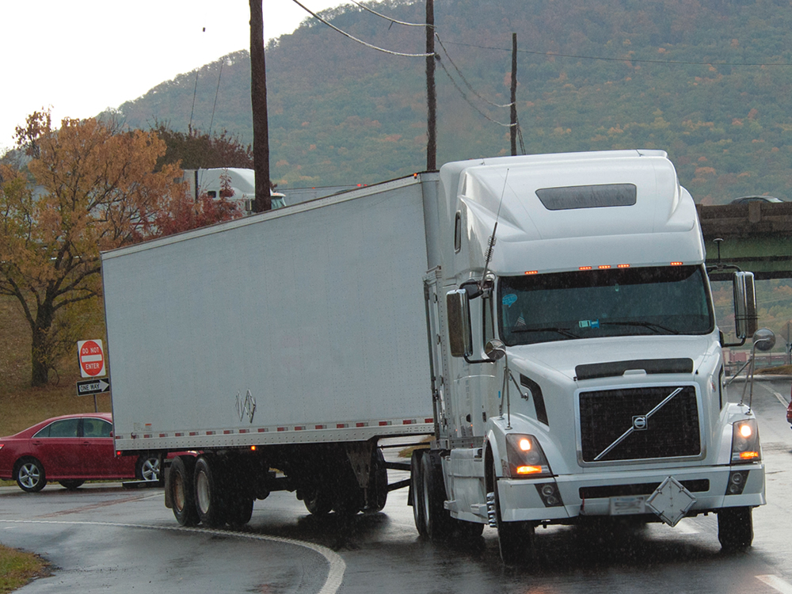
Communicating Your Presence While Driving
Notes:
Communicating Your Presence While Driving

Slide 13
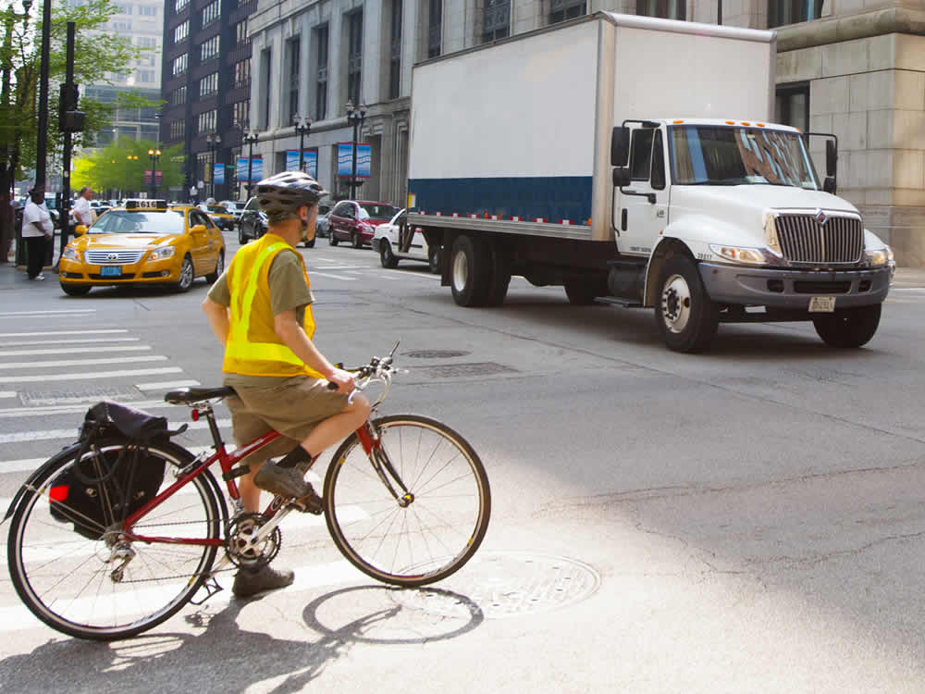
Others may not notice your vehicle, even when it is in plain sight. Communicating your presence can help prevent an accident.
Notes:
Others may not notice your vehicle, even when it is in plain sight. Communicating your presence can help prevent an accident.
Whenever you’re about to pass a pedestrian or bicyclist, assume they don’t see you and could suddenly move in front of your vehicle. When it is safe and legal to do so, move your vehicle to the left of your lane, tap the horn lightly or, at night, flash your headlights off and on (if it is safe and legal). Tap the horn or flash your lights from a distance, if possible, so you don’t startle the pedestrian or bicyclist. Make eye contact.

Slide 14
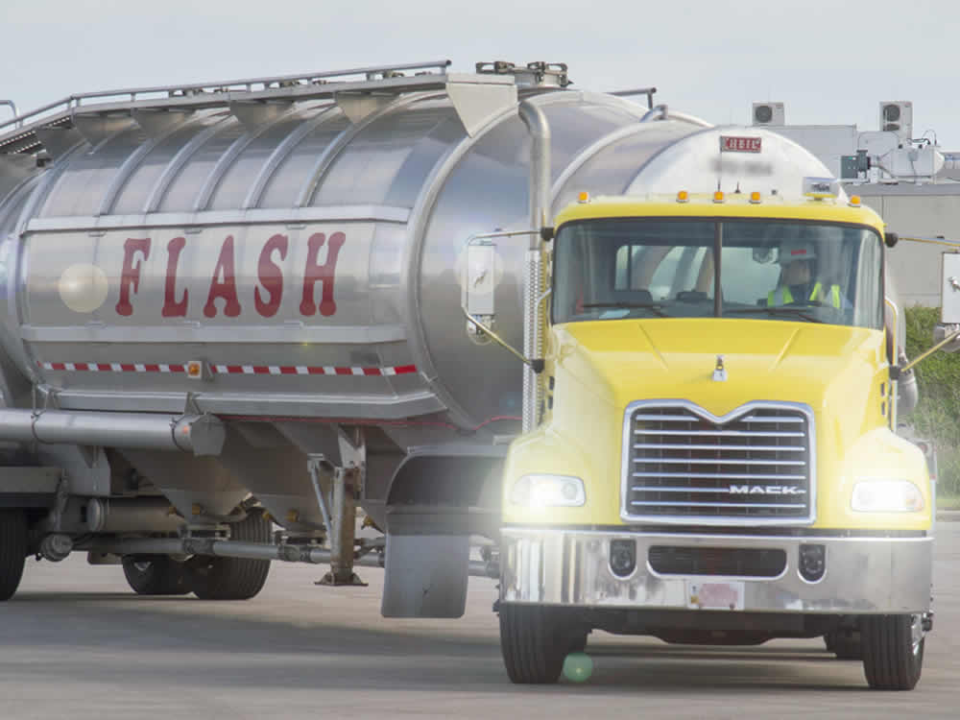
Headlights
Many companies require headlights, or at least your daytime running lights, to be on at all times when traveling.
Regardless, from dusk to dawn your headlights should be turned on.
Notes:
Many companies require headlights, or at least your daytime running lights, to be on at all times when traveling. Regardless, from dusk to dawn your headlights should be turned on. This helps you see the road, and it helps other drivers see you. Some state laws require the use of headlights any time your windshield wipers are on, but it’s a good idea to have them on whenever you encounter rain, fog, snow, or blowing dust.
VIDEO
9.3 — Headlights

Slide 15
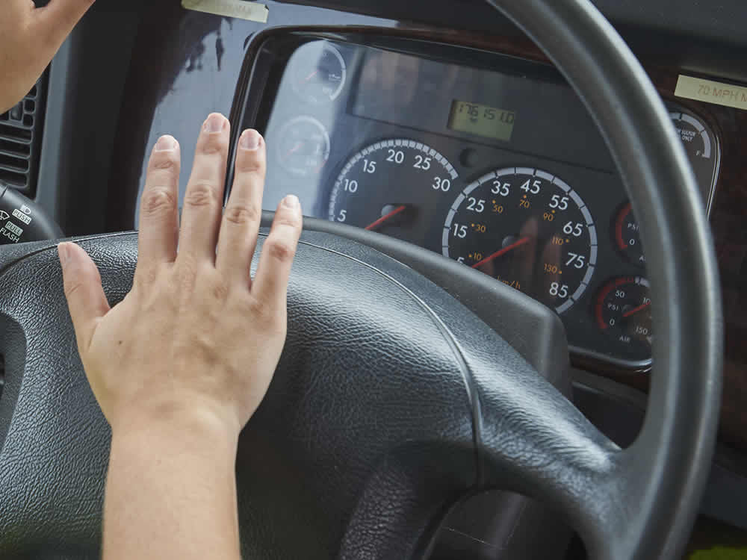
Horns
Your vehicle’s horn lets other drivers and pedestrians know you are there. Only use your horn when necessary.
Use only your vehicle’s electric horn or city horn. The air horn is extremely loud and can distract or frighten others.
Notes:
Your vehicle’s horn lets other drivers and pedestrians know you are there. Only use your horn when necessary. For example, to help in preventing an accident. If you see another driver who is not paying attention and drifting into your lane, a light tap on the horn should be enough to get his or her attention. When used unnecessarily it can be dangerous. You could startle other drivers or even anger them. You don’t want to cause either, and you especially don’t want to set off a road rage incident. Keep in mind, a light tap sends a much different message than a long blast.
In general, use only your vehicle’s electric horn or city horn. The air horn is extremely loud and can distract or frighten others. The horn should be used for communicating your presence and to warn of immediate danger
VIDEO
9.4 — Horns

Slide 16
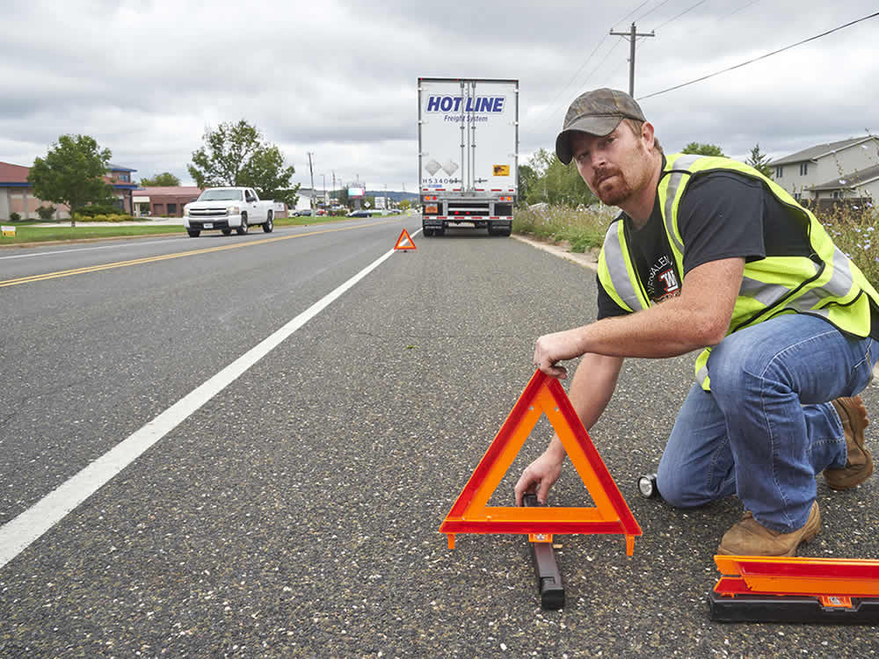
Warning Devices
You have 10 minutes to set out emergency warning devices, such as reflective triangles or flares.
Notes:
Section 392.22 of the Federal Motor Carrier Safety Regulations (FMCSRs) addresses when and how warning devices must be set out on the highway.
When a vehicle is stopped on the traveled portion of the highway or the shoulder of the highway, you must immediately activate your vehicle’s four-way flashers. You then have 10 minutes to set out emergency warning devices, such as reflective triangles or flares.
When placing the devices, you should hold them in front of you, and if possible wear a high-visibility vest to help you be clearly visible to traffic.
You should remain alert for vehicles that may not see you along the roadway.
CALLOUT: Turn on your four-way flashers when you need to slow down unexpectedly to give other drivers a heads up you are reducing your speed.

Slide 17
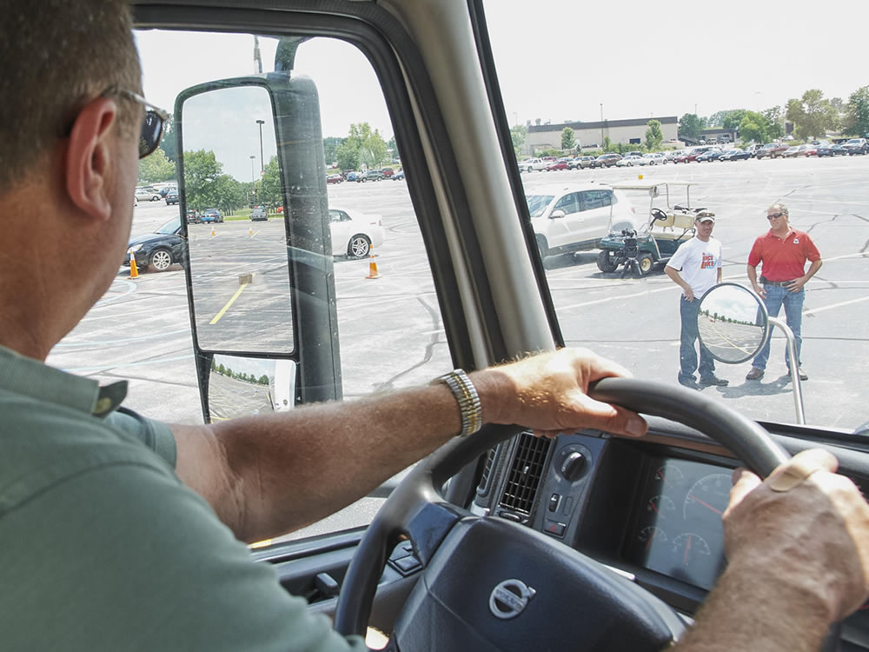
Eye Contact
Eye contact helps you acknowledge to the other driver, bicyclist, or pedestrian that you are aware of their presence. It also helps you to know that they are aware of your presence.
Notes:
Eye contact is another tool that can be used to communicate with other drivers, bicyclists, and pedestrians. Eye contact helps you acknowledge to the other driver, bicyclist, or pedestrian that you are aware of their presence. It also helps you to know that they are aware of your presence.
You need to be careful when it comes to eye contact. It should be brief to ensure the driver, pedestrian, or bicyclist does not misinterpret your good intentions as road rage or a threatening gesture.
Note that eye contact is just one technique that should be used when communicating presence and/or intent.
CALLOUT: Never direct traffic. Some drivers will try to help others by signaling when it is safe to pass or pull out by flashing lights, blowing the horn, or using hand signals. This could cause an accident, resulting in injury, damage, and potential liability. You could very easily be found at fault for the mistake of someone else if you signaled them to move.

Slide 18
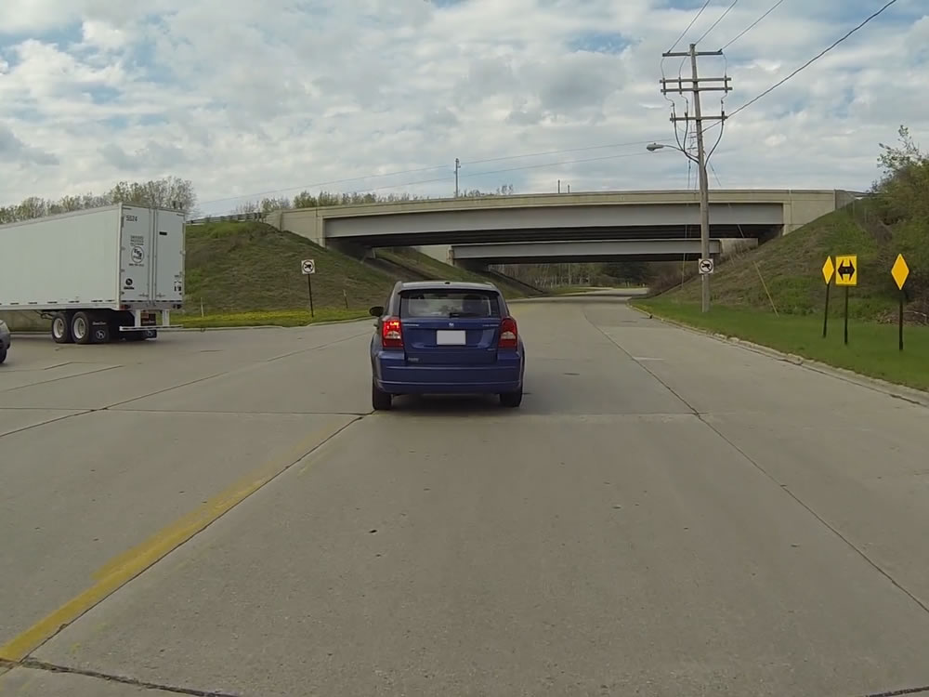
Communication from Others
Notes:
Communication from Others
VIDEO
9.5 — Communication from Other Drivers

Slide 19
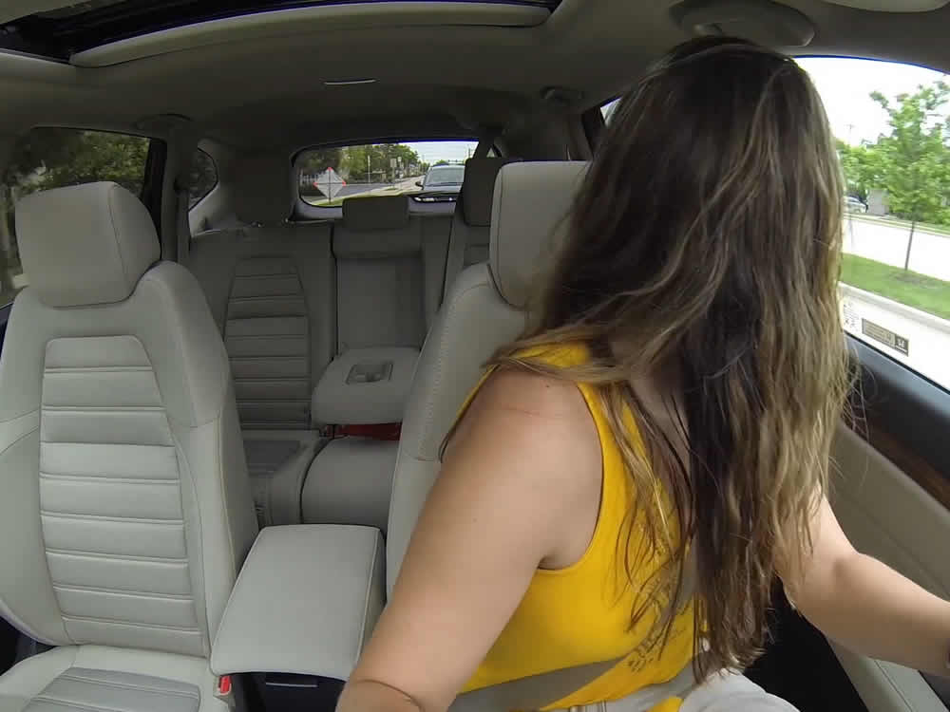
Watch for:
Obvious means of communication (turn
signals, lights, horn)
Driver movement in a vehicle, such as shifting around in the seat or looking in the mirror
Sudden slowing or a slight position change
in a lane
Turned front wheels or visible exhaust
from a parked car
Distracted drivers—they tend to sporadically change their speeds and hug or enter other
lanes unintentionally
Notes:
As a safe and professional driver, you must effectively communicate your intentions and it is just as important that you watch for and understand the signals of other drivers.
As well as the obvious means of communication (turn signals, lights, horn), there are other, more subtle communications you need to watch for when on the road.
For example, driver movement in a vehicle, such as shifting around in the seat or looking in the mirror, may indicate possible directional changes. Observing the vehicle itself can give you clues as to a driver’s intentions, as well. Sudden slowing or a slight position change in a lane may indicate a direction change. Turned front wheels or visible exhaust from a parked car may indicate the vehicle is going to pull out of a parking space.
Distracted drivers are generally easy to spot, as they tend to sporadically change their speeds and hug or enter other lanes unintentionally. Rather than focusing on the road, these drivers may be eating, texting, talking on the phone, or fiddling with their radio.
Be alert to the obvious, and sometimes not so obvious, communication of others as ways to anticipate and avoid potential problems. Also, avoid becoming fixated on another drivers’ bad habits to the extent that you become distracted yourself. Move your eyes from a distraction quickly back to the task of “seeing.”

Slide 20
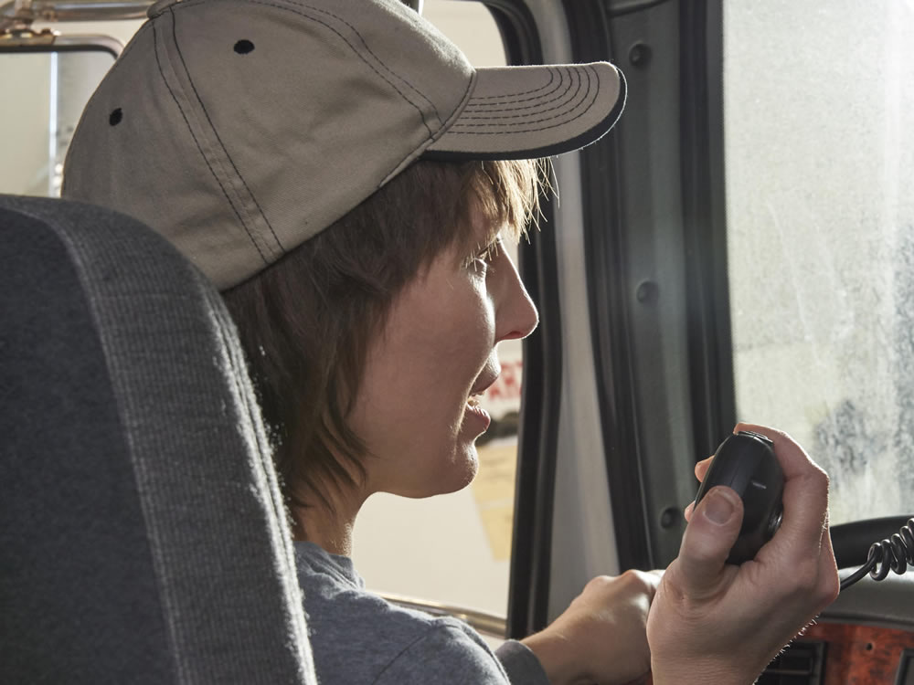
Communication Tools
Notes:
Communication Tools

Slide 21
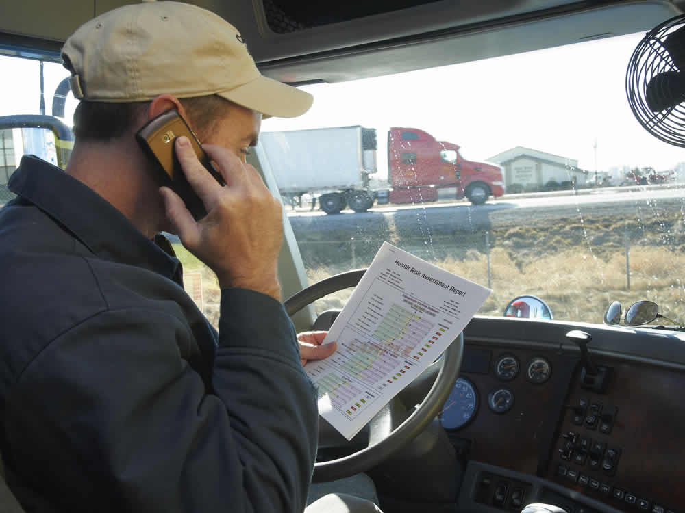
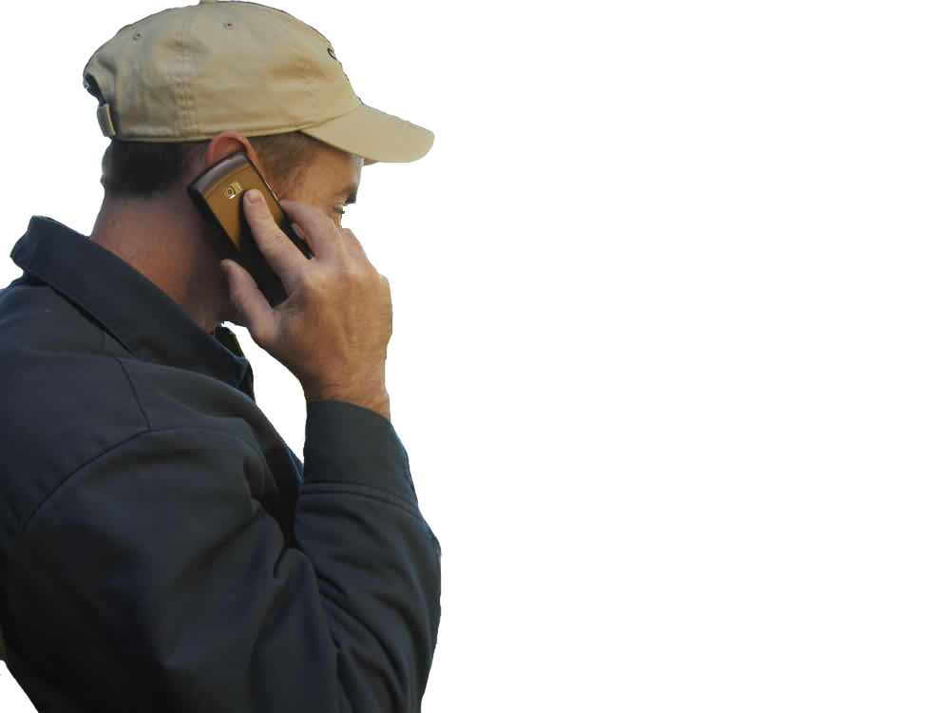
Your CB radio and cell phone give you a link to:
  Your company
  Other drivers
  Your family
  Your friends
Use these tools responsibly and legally.
Notes:
As a professional driver, on the road for many hours per day and potentially many days at a time, communication with others is important. Your CB radio and cell phone give you a link to your company, other drivers, your family, and your friends. It is important that these tools are used responsibly and legally.

Slide 22
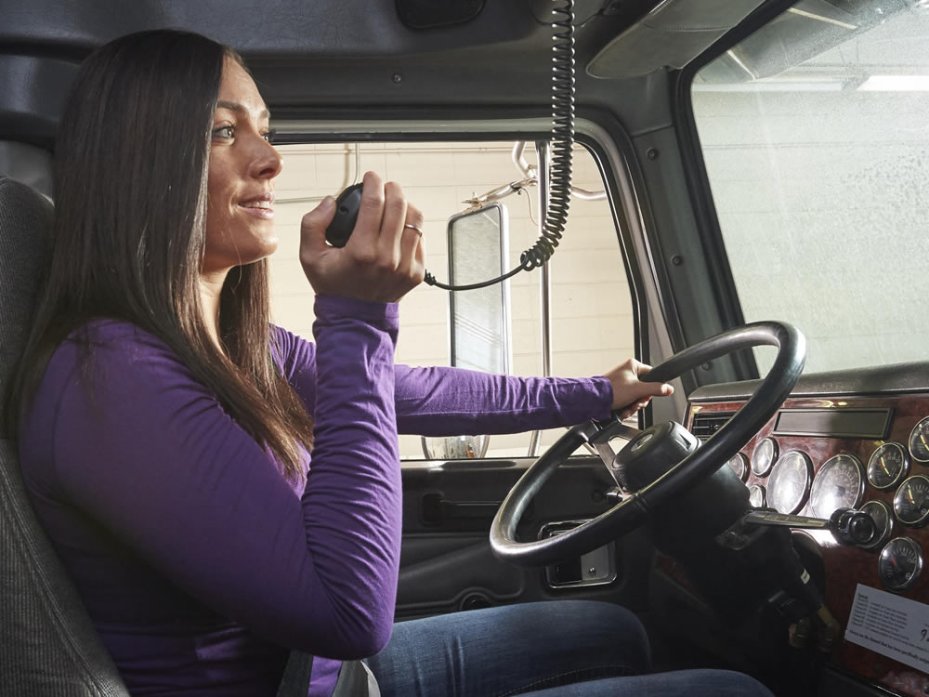
CB Radio
The citizen’s band (CB) radio, when used appropriately, can provide information about weather and traffic conditions and provide a way for you to notify authorities of an accident or other
road hazard.
Notes:
The citizen’s band (CB) radio can be a good communication tool if used safely and legally. When used appropriately, CBs can provide information about weather and traffic conditions and provide a way for you to notify authorities of an accident or other road hazard.
The CB should be used appropriately. Avoid idle chatter and never use offensive language over the CB.

Slide 23
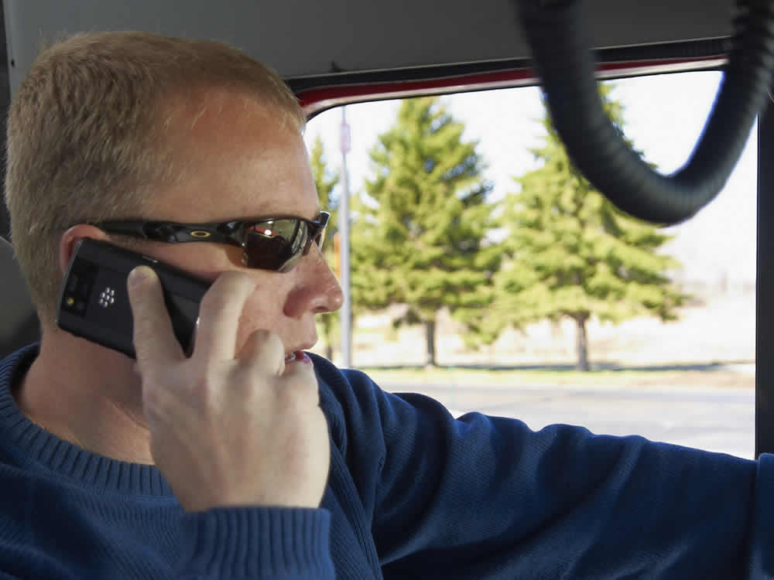
Cell Phone
Section 392.82 of the FMCSRs prohibits a driver from using a hand-held mobile telephone while driving a commercial
motor vehicle.
Notes:
Like the CB, a cell phone can be a good communication tool if used safely and legally.
Section 392.82 of the FMCSRs prohibits a driver from using a hand-held mobile telephone while driving a commercial motor vehicle (CMV). Use of a hand-held mobile telephone includes:
Using at least one hand to hold a mobile telephone to conduct voice communication
Dialing or answering a mobile telephone by pressing more than a single button, or
Reaching for a mobile phone in a manner that requires a driver to maneuver so he or she is no longer in a seated driving position, restrained by a seat belt

Slide 24
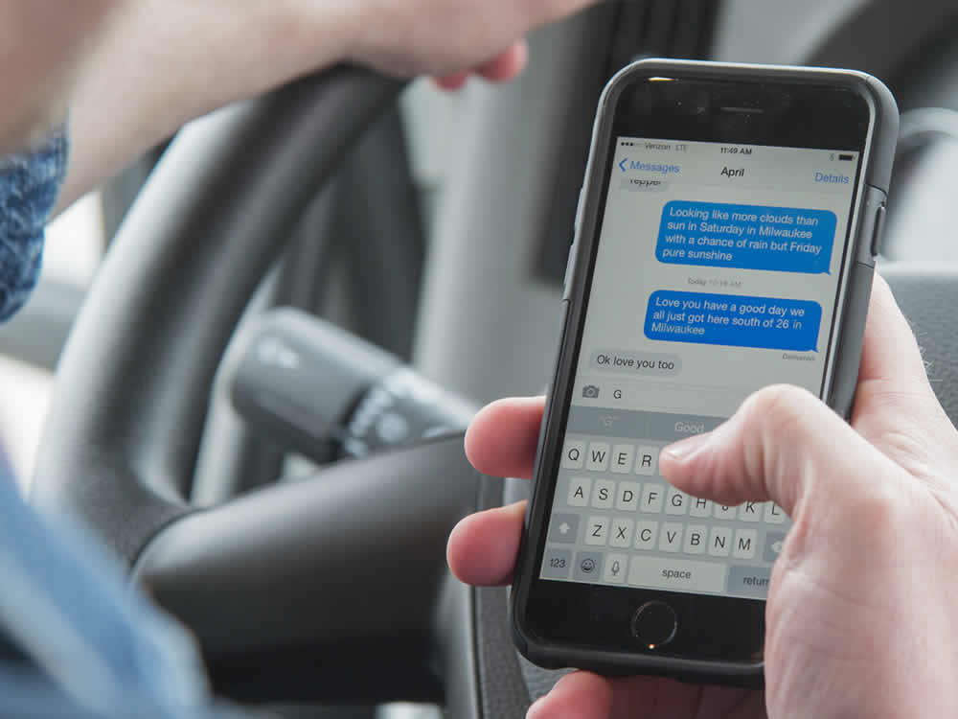
Electronic Device
Texting while driving a CMV is prohibited.
Texting is defined as manually entering text into, or reading text from an
electronic device.
Notes:
Section 392.80 of the FMCSRs prohibits a driver from texting while driving a CMV.
Texting is defined as manually entering text into, or reading text from an electronic device. This includes (but is not limited to):
E-mailing
Instant messaging
Short messaging
A command or request to access a webpage
Engaging in any other form of electronic text retrieval or electronic text entry for future or present communication
CALLOUT: Cell phone use and texting are allowed when necessary to communicate with law enforcement officials or other emergency services.

Slide 25
Objectives Review
You should now be able to:
Describe ways to communicate your intent while driving through the use of turn signals and brake lights
Discuss how to communicate your presence through the use of headlights, horns, warning devices, and eye contact
Explain how eye contact techniques can help you communicate with bicyclists, pedestrians, and other drivers
Copyright 2019 J. J. Keller & Associates, Inc.
Notes:
You should now be able to:
Describe ways to communicate your intent while driving through the use of turn signals and brake lights
Discuss how to communicate your presence through the use of headlights, horns, warning devices, and eye contact
Explain how eye contact techniques can help you communicate with bicyclists, pedestrians, and other drivers
CLASSROOM RECOMMENDATION
Before concluding your training session, have participants take the corresponding quiz (found on the Trainer Tools USB) to check their understanding of the material. You can customize any of the questions to fit your audience or workplace. The answer key can also be found on the Trainer Tools USB.
You may also choose to administer the quizzes before you begin your training session to help get participants thinking about the subject and/or to gauge their understanding of the topic ahead of time.
ROAD RECOMMENDATION
The purpose of this session is to allow the student to apply the communication procedures taught in the classroom. The student will operate over routes requiring many turns and lane changes. He or she will be observed and rated for use of communication practices as well as visual search practices.
As with other exercises, break your class into groups of three students per instructor. Each student should have at least one hour behind the wheel.
The route you select for this session should have more turns and lane changes than the typical route. This will provide more opportunities for turn signal use and practice in performing turning maneuvers. Select a route that allows for both right and left turns onto and off of multi-lane roads. As well as providing practice turning, this allows for additional practice changing lanes.
While one student is driving, the other students should be observing his or her performance and recording communication errors. Communication errors are listed below:
Signaling turns. Errors in signaling right and left turns at intersections.
None: Failure to activate the signal at any point in the turn.
Late: Failure to activate the signal before reaching the intersection.
Early: Misleading other road users by an early signal.
Canceling. Failure to cancel a signal properly.
Late: Canceling more than 5 seconds after a turn is completed.
Early: Canceling the signal while in a turn.
Lane changing. Errors in signaling lane changes.
None: Failure to activate the signal at any point in the lane change.
Late: Failure to activate the signal soon enough before starting a lane change.
Inappropriate: Signaling a lane change when there is no gap to move into and enough time to wait for a gap to appear.
Position: Failure to use vehicle position to communicate intention to change lanes.
Flashers: Failure to activate emergency flashers when slowing or stopped as provided for by state law.
Brake lights: Failure to flash brake lights when slowing or stopping unexpectedly.
Use of horn. Errors in using electric or air horns.
Insufficient: Failure to use horn under appropriate circumstances.
Improper: Using the horn improperly or using the wrong horn.
Interpreting communication. Errors involving recognition and interpretation of communication from others.
Receiving: Failure to react and adjust to the communications of others.
Misinterpreting: Misinterpreting communications from others reacting accordingly.
Students should also note signaling lapses of other drivers as they occur, and comment on the hazard they present to other road users.

