Slide 1






PowerPoint® Instructions
This PowerPoint has been designed so you can easily customize it for your training session.
Throughout the presentation you’ll see icons with recommendations or videos to enhance the instruction you present to your students. A detailed explanation for each icon can be found on the next slide. Videos can be found on the Trainer Tools USB.
When you see an icon on the slide, look in the notes
section for further information.
Simply delete or move the icon off the slide before your training session begins.

Slide 2





Classroom Recommendations. Provides suggestions for enhancing your classroom presentation; from ideas for large group discussions to suggestions on the use of training aids such as examples or photos of vehicle parts and components to help illustrate the items covered within a chapter.
Lab Recommendations. Provides suggestions for activities and exercises that take place outside the classroom, but do not involve
the actual operation of the tractor-trailer or its components. Examples
of lab sessions include conducting a vehicle inspection or practicing mirror adjustment.
Range Recommendations. These recommended activities take
place on a closed-access driving range where students may practice driving skills in a controlled environment. Examples of range sessions include practicing shifting technique and successfully completing a backing maneuver.
Road Recommendations. These recommended activities take place in road and traffic conditions that support the chapter’s objectives. Examples of road sessions include proper communication with other drivers through the use of turn signals and basic vehicle control under nighttime or extreme weather conditions.
Videos. These short video clips reinforce material presented in the Student Manual. Use them to help students grasp difficult concepts or subject matter.

Slide 3
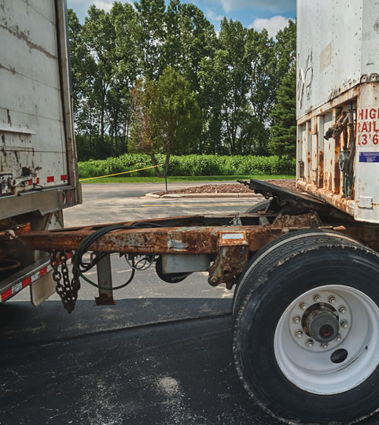
Coupling and Uncoupling
7
Copyright 2019 J. J. Keller & Associates, Inc.
Notes:
Unit A1.1.7 Coupling and Uncoupling
This unit must provide instruction for driver-trainees to develop the skills necessary to conduct the procedures for safe coupling and uncoupling of combination vehicle units, as applicable.

Slide 4
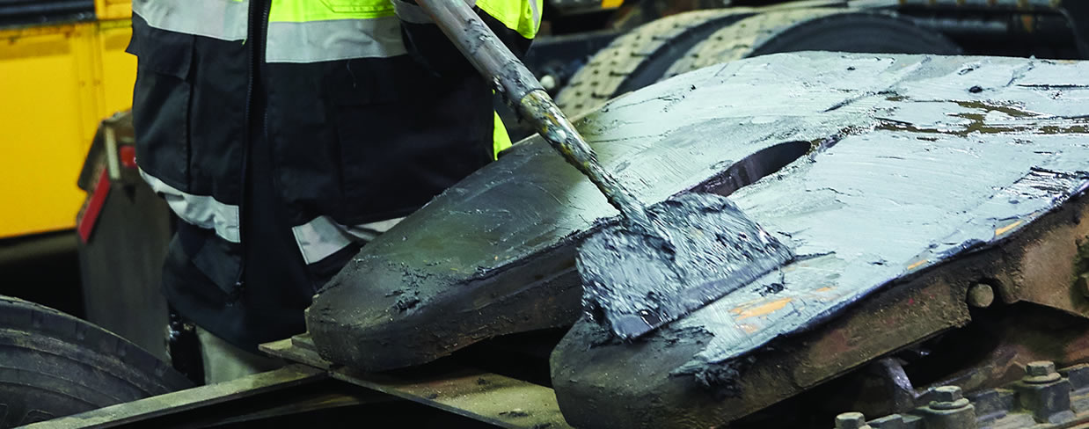
Introduction
We’ll present the step-by-step procedures that must be followed to help you develop the skills necessary for safe coupling and uncoupling of tractor-trailer units
Notes:
Proper coupling and uncoupling skills are vital for safe tractor-trailer operations. Incorrect coupling and uncoupling can be very dangerous, resulting in trailers being dropped, air and electrical lines being torn, cab damage, freight damage, and other serious consequences, including injury or death.
This chapter will present the step-by-step procedures that must be followed to help you develop the skills necessary for safe coupling and uncoupling of tractor-trailer units.
CLASSROOM RECOMMENDATION
Begin the session by stressing that the coupling/uncoupling procedure is a hazardous but necessary prerequisite for the operation of a tractor-trailer. Improper or careless coupling or uncoupling can lead to serious damage or injury to the driver and other personnel, the vehicle, the load, and the public. The hazards can be minimized, however, by following a sequence of steps that lead to a secure, safe vehicle. Each step in the process involves its own dangers, and drivers must learn how to avoid all of them.
Point out that, while learning the basic steps for proper coupling/uncoupling is a good start, practice makes perfect. In addition, drivers are likely to encounter many variables in the real world that are not found in an educational setting.
Drivers, especially new drivers, must practice the coupling/uncoupling maneuver repeatedly until it can be performed safely from memory. Then, as new situations and hazards are presented, the student will be able to adjust the procedure to account for these situations.
In the classroom, be sure to discuss any special variations that exist between the steps covered in this chapter and the steps required for the equipment you will be using in the lab and/or on the range.

Slide 5
Objectives
Upon completion of this lesson, you will be able to:
  Describe how to properly couple and uncouple combination vehicles
  Identify how to inspect and test combination vehicle components to ensure safe operation
  Explain how to operate landing gear, pull releases, and position converter dollies
Notes:
Upon completion of this lesson, you will be able to:
Describe how to properly couple and uncouple combination vehicles
Identify how to inspect and test combination vehicle components to ensure safe operation
Explain how to operate landing gear, pull releases, and position converter dollies

Slide 6
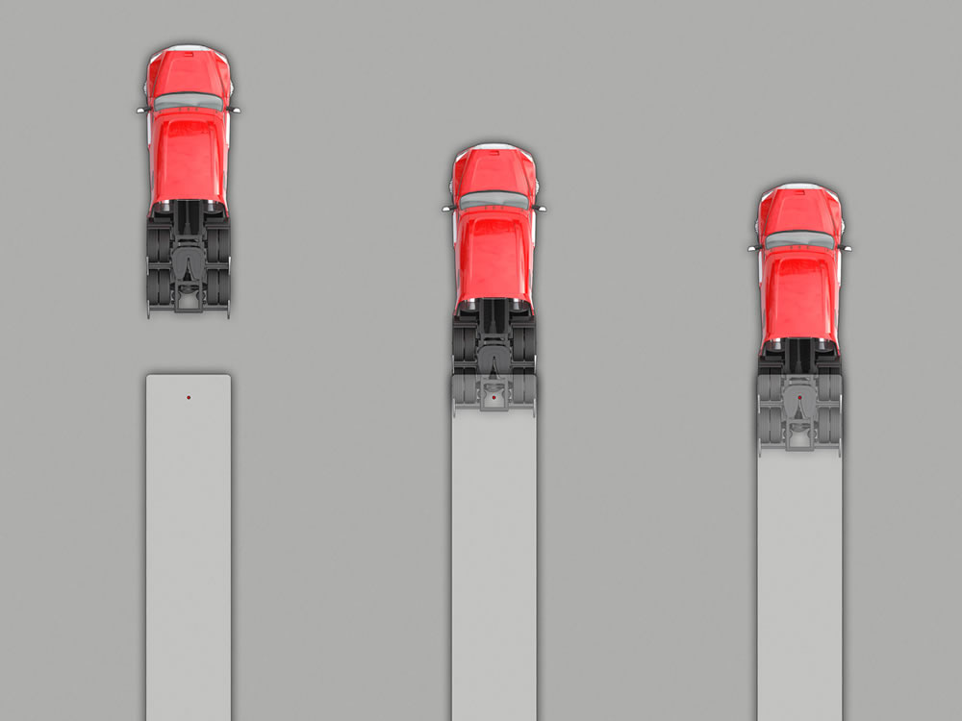
Coupling Tractor-Trailers
Notes:
Coupling, or the act of connecting the tractor to the trailer, is a skill you will become quite familiar with. It must always be done with care because a dropped trailer is more than embarrassing—it’s a costly mistake that can damage the tractor, trailer, and the load. The following is a general 16-step approach to coupling.
CALLOUT: The process of coupling can vary based on the type of vehicle, as well as the policies and procedures set in place Fifth wheel by your motor carrier.

Slide 7
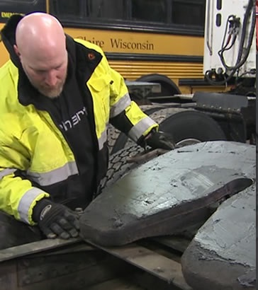
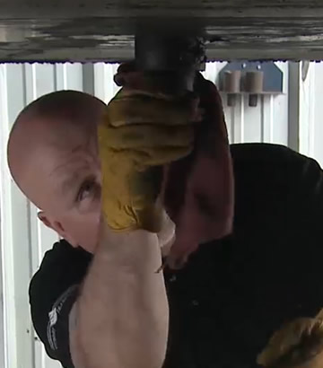
Inspect the Fifth Wheel & Kingpin
Step 1:
Notes:
To help ensure a safe connection, the tractor’s fifth wheel and the trailer’s kingpin must be inspected before attempting to couple the tractor to the trailer. When inspecting the fifth wheel and kingpin, you should:
Check for damaged, loose, or missing parts.
Make sure the mounting of the fifth wheel to the tractor is secure. Make sure there are no cracks in the frame or in any of the weld points and that all attached bolts are secure.
Grease the fifth wheel plate, if necessary. The result of an improperly greased fifth wheel will be steering problems caused by increased friction between the tractor and trailer. This is especially noticeable in turns.
Ensure that the fifth wheel is in the proper position for coupling. It should be tilted down toward the rear of the tractor, with the jaws open, and the release handle in the released or unlocked position.
If you have a sliding fifth wheel, make sure that the fifth wheel is in the locked position and that all pins are seated correctly to prevent movement of the fifth wheel.
Check the trailer’s kingpin and overall structural integrity, as well as the trailer’s surroundings. If the trailer landing gear or frame is damaged, coupling may prove difficult or impossible.
Verify the shipment is correct and that it is secured appropriately. In some situations, the shipment may need to be secured before coupling can be undertaken.
Make sure the position of the fifth wheel will not allow the tractor to strike the landing gear or the trailer to strike the back of the tractor cab.
Check the trailer kingpin to ensure that it’s not loose, bent, or broken.
VIDEO
7.1 — Inspecting the Fifth Wheel and Kingpin

Slide 8
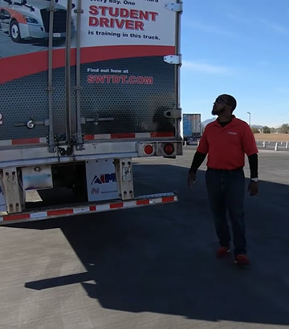
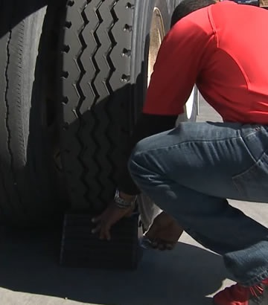
Check Area & Secure Trailer
Step 2:
Notes:
The coupling procedure must be done in a location that provides enough space to maneuver safely. The area near the trailer must be clear. If there is no room and the trailer moves rearward or sideways during coupling, damage to the surroundings may occur. In addition, the trailer should be secured against movement before backing the tractor up to the trailer, in the event your tractor makes contact with the trailer.
Make sure the area around the vehicle is clear.
Check the cargo, if any, to make sure it will not shift when the tractor and trailer are coupled.
Chock the trailer wheels, or if the trailer has spring brakes, make sure they are applied.
Make sure the trailer sliding axle assembly is locked in place.

Slide 9
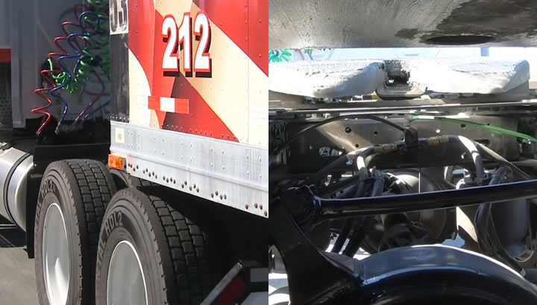
Position the Tractor
Step 3:
Notes:
Get into the tractor. Position the tractor squarely and directly in front of the trailer, not at an angle. The kingpin should be aligned with the throat of the fifth wheel. Back the tractor up to the trailer until just before the fifth wheel contacts the trailer apron. Use your mirrors to make sure the drive wheels are centered under the trailer (there is the same amount of space between the drive wheels and the side of the trailer on both sides).
Backing under the trailer at an angle might push the trailer sideways and damage or break the landing gear, potentially causing the trailer to fall or hit something. If you must back at an angle, get out of the cab frequently to check the alignment of the fifth wheel to the kingpin.
When positioning the tractor, use your outside mirrors to look along both sides of the trailer and your drive axle tires. It is important that you frequently check both the left and right mirrors in order to get a true picture of the alignment between the units.
If the trailer is eight feet wide, the outside edge of the drive axle tires and the edge of the trailer should form a straight line.
If the trailer is wider (many are now eight and a half feet wide), adjust your position accordingly, so the tractor tires are inside the outside edge of the trailer by a few inches.

Slide 10
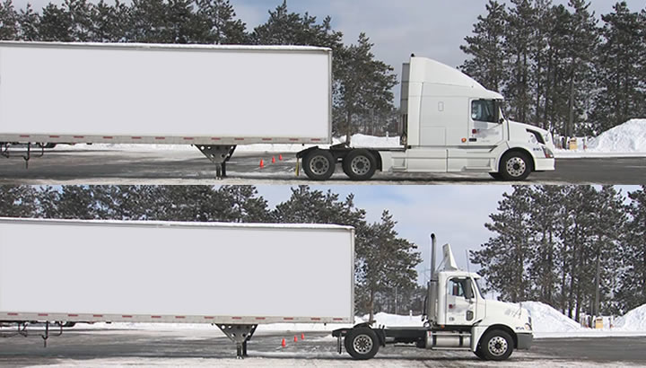
Back Slowly into Position
Step 4:
Notes:
Begin slowly backing the tractor up towards the front of the trailer. Stop just as the fifth wheel touches the trailer or when the rear of the fifth wheel is under the trailer. If driving a sleeper cab (or another vehicle that has no rear window), back until the rear axle is just under the front of the trailer and stop. When backing up to the trailer, if the trailer is so low that it appears the tractor tires or frame will not go under the trailer, get out and raise the trailer height. Don’t bump the trailer or lift it up onto the fifth wheel. At this point, you should be able to compare the fifth wheel height with the trailer height.
VIDEO
7.2 — Backing into Position and Checking the Trailer Height

Slide 11
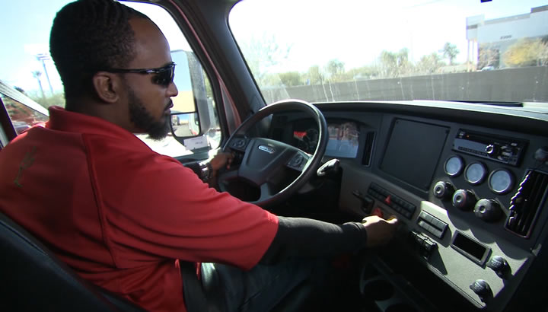
Secure the Tractor
Step 5:
Notes:
Shift the transmission into neutral and engage the parking brake before exiting the cab.

Slide 12
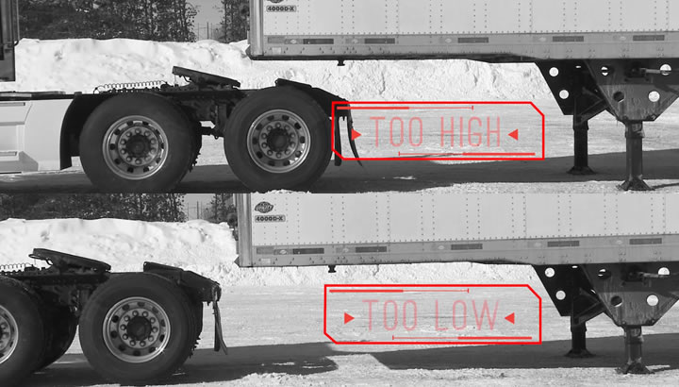
Check the Trailer Height
Step 6:
Notes:
Check the height of the trailer in relation to the fifth wheel. The trailer should be low enough that it will make contact with the back or “lower half” of the fifth wheel and will be raised slightly by the tractor when the tractor is backed under it.
If the trailer is too low, the tractor may strike and damage the nose of the trailer. If the trailer is too high, it may not couple correctly or completely miss the pin, possibly striking the rear of the cab.
Raise or lower the trailer as needed by cranking the landing gear up or down, and/or raise or lower the fifth wheel using the tractor’s adjustable air suspension, if so equipped. Secure the landing gear crank when desired height is reached.
Finally, make sure the kingpin is lined up to enter the “throat” of the fifth wheel when the tractor moves straight back, and make sure the jaws are open if the tractor has been moved any distance.
CALLOUT: Never go under a trailer that is not supported by a tractor or that has a tractor frame under it to catch it should the landing gear fail.

Slide 13
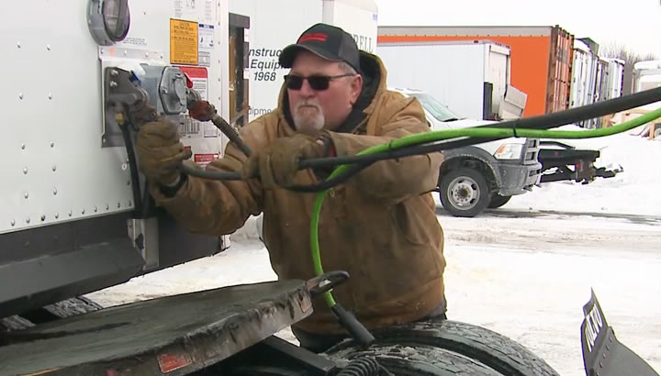
Connect the Air Lines
Step 7:
Notes:
Before connecting the tractor to the trailer, check your trailer brakes. Most trailers will already have the brakes set, but if your trailer was manufactured prior to 1975, you may need to ensure that the brakes are set by supplying air to them before backing under the trailer. The connection must be done properly for the brakes to work correctly.
There are two air lines to be connected: the “service” line and the “emergency” line. There are several ways the lines may be distinguished from one another:
They may be stamped with the words “Service” and “Emergency”
They may be color coded, with blue or black for the service line and red for the emergency line
The glad hands may be coded by shape, with square glad hands for the service line and round glad hands for the emergency line
The driver’s side glad hand connection on the trailer is the emergency, the passenger’s side is the service connection.
Check all four glad hand seals (rubber grommets) for cracks or other damage, and then connect the tractor’s emergency air line to the trailer’s emergency glad hand (usually on the right side when facing the trailer). Line the center holes up with the tractor glad hand 90 degrees away from the locked position and then rotate the tractor glad hand into the locked position on the trailer glad hand.
Make sure air lines are safely supported so they won’t be crushed or caught while the tractor is backing under the trailer. Make sure there is enough slack in the lines, so the glad hands won’t uncouple.
CALLOUT: If air lines are loose or rubbing, you’ll lose air supply to the trailer. If the emergency line is loose or damaged it could cause the trailer brakes to lock up. If it’s the service line, you’ll suffer a serous leak when you apply the brakes which will increase stopping distance and drain out your air tanks.
CALLOUT: Some carriers do not want their drivers connecting the glad hands at this point if the trailer has spring brakes. If this is the case, the glad hands will be connected after the tractor and trailer are connected rather than at this time, and Step 8 would be skipped.

Slide 14
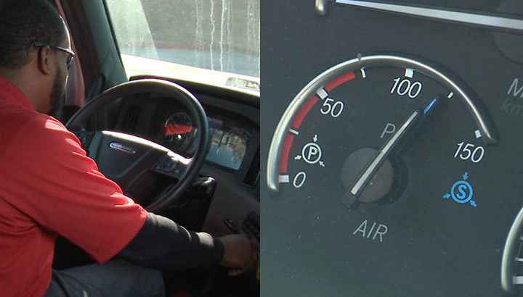
Supply Air to the Trailer
Step 8:
Notes:
Supply air to the trailer ONLY if you have determined that the brakes are not already set (pre-1975 trailer), or if you can’t tell whether they are set or not. From the cab, with the engine off, push in the air supply knob or move the tractor protection valve control from the “emergency” to the “normal” position to supply air to the trailer brake system.
Wait until the air pressure is normal. Check the air brake system pressure gauge for signs of major air loss and listen for escaping air (a sign that a problem exists).
Apply and release the trailer brakes and listen for the sound of the trailer brakes. You should hear the brakes activate when they are applied and hear air escape when they are released.

Slide 15
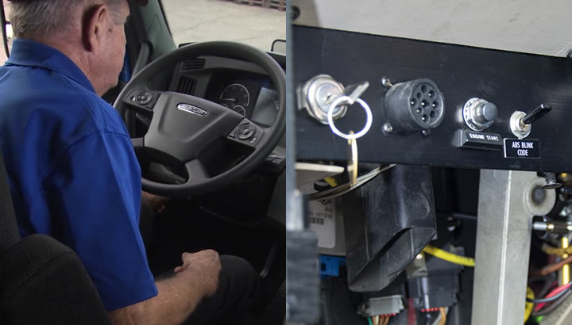
Start the Engine & Set the Trailer Brakes
Step 9:
Notes:
When you’re sure the trailer brakes are working, start the engine. Make sure the air pressure is up to normal.
Apply the trailer brakes (if they are not already applied) by pulling out the air supply knob or moving the tractor protection valve control from normal to emergency.

Slide 16
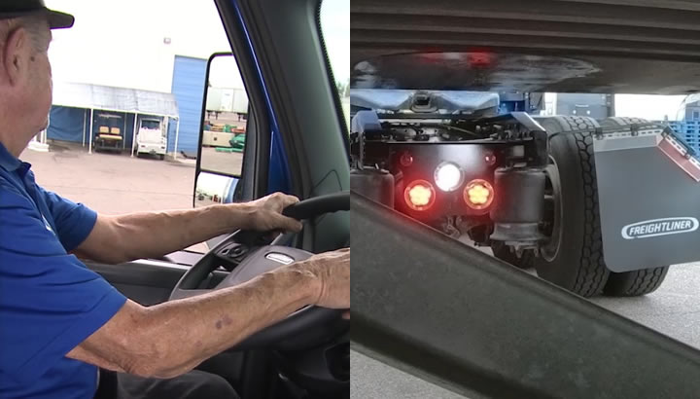
Back Under the Trailer
Step 10:
Notes:
At this point in the process, it’s time to make the main connection. Put the tractor into the lowest reverse gear and release the tractor’s parking brake.
Slowly back the tractor under the trailer. The trailer apron should contact the fifth wheel, lifting the trailer onto the tractor. This lifting action should be visible in your mirror. If the trailer does not lift when the fifth wheel goes under the trailer apron, stop, set the tractor parking brakes, and recheck the trailer height compared to the fifth wheel. Stop when you hear and/or feel the fifth wheel’s jaws close around the kingpin.
Hitting the kingpin too hard could cause extensive damage to the kingpin, fifth wheel, landing gear, and/or cargo.

Slide 17
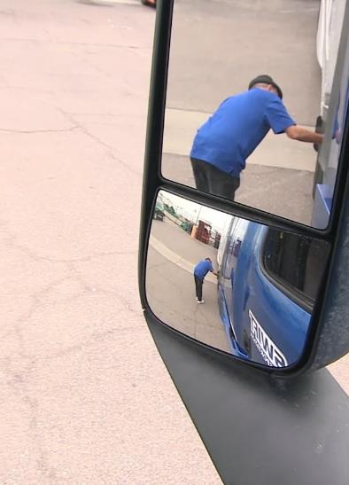
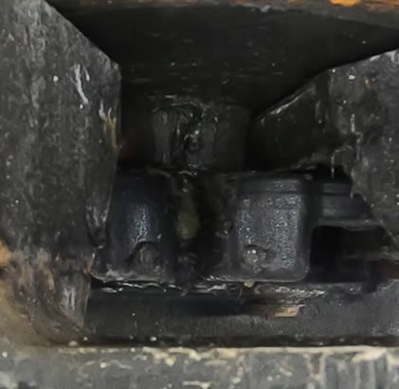
Check the Connection
Step 11:
Notes:
With the trailer brakes still locked, put the tractor in low gear and gently pull forward, to check that the trailer is locked onto the tractor. Stop as soon as you feel resistance from the trailer and repeat the test two more times—once with the steering wheel turned to the left and once again with it to the right. This is generally referred to as the “tug test.”

Slide 18
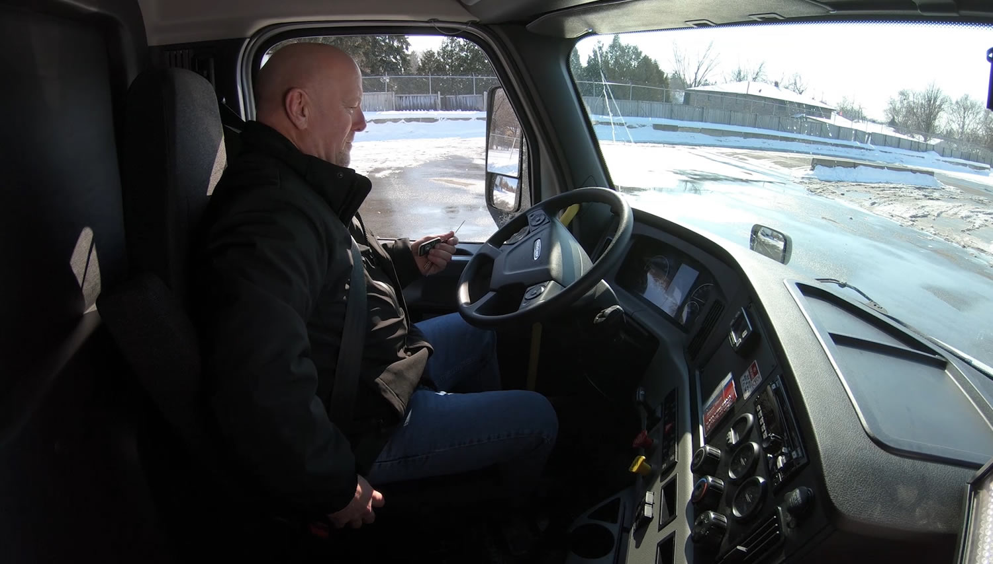
Secure the Vehicle
Step 12:
Notes:
Once the connection is solid, put the transmission in neutral and apply the tractor parking brakes. Shut off the engine and take the key with you so someone else won’t move the truck while you’re under it inspecting the coupling.

Slide 19
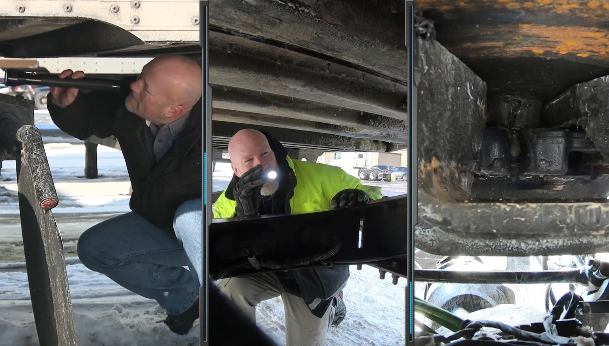
Inspect the Coupling
Step 13:
Notes:
Make sure the coupling is safe and secure. This will require you to go under the trailer to inspect the coupling, so bring a flashlight. Check the following:
Make sure there’s no space between the upper (apron) and lower (platform) fifth wheel. The trailer apron and fifth wheel plate should be in full contact. If there is space, something is wrong. Fix the problem before doing anything else (the ground may be uneven, or the kingpin may be on a ridge inside the jaws or on top of the closed fifth wheel jaws, which would allow the trailer to come loose very easily).
Go under the trailer and look into the throat of the fifth wheel (use a flashlight). Make sure the fifth wheel jaws have closed and locked around the shank of the kingpin, not the head.
Check that the release arm is in the locked position.
Check that the safety latch is in position over the release arm, if there is one. (On some fifth wheels, the latch must be put in place by hand.)
If the coupling isn’t right, don’t move the vehicle.
VIDEO
7.3 — Inspecting the Coupling

Slide 20
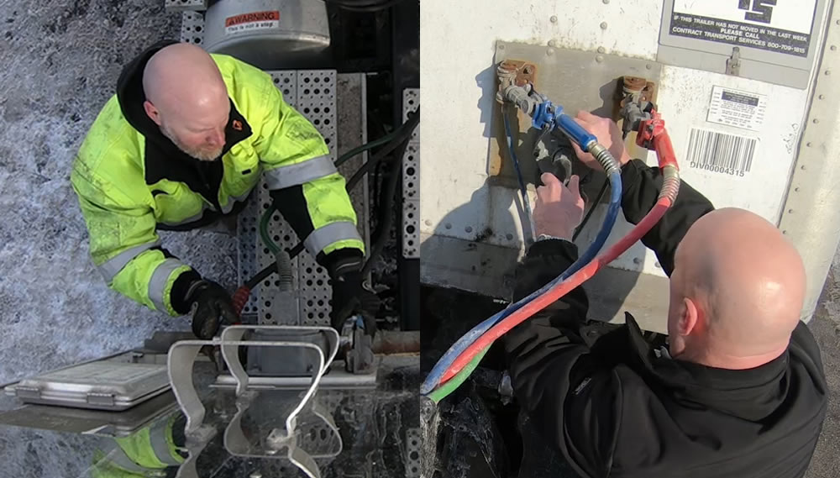
Connect the Electrical Cord & Check the Air Lines
Step 14:
Notes:
Plug the electrical cord into the trailer and fasten the safety latch. Don’t force the connection if it doesn’t fit. If you did not connect the glad hands earlier due to the carrier’s procedures, this is when they would be connected using the procedures discussed in Step 7.
Check both the air lines and electrical cord for proper securement and signs of damage. A good way to do this is to set your tractor brakes, release the trailer brakes, and listen for any air leakage.
Make sure the air lines and electrical cord won’t snag any moving parts of the vehicle or rest on the catwalk.

Slide 21
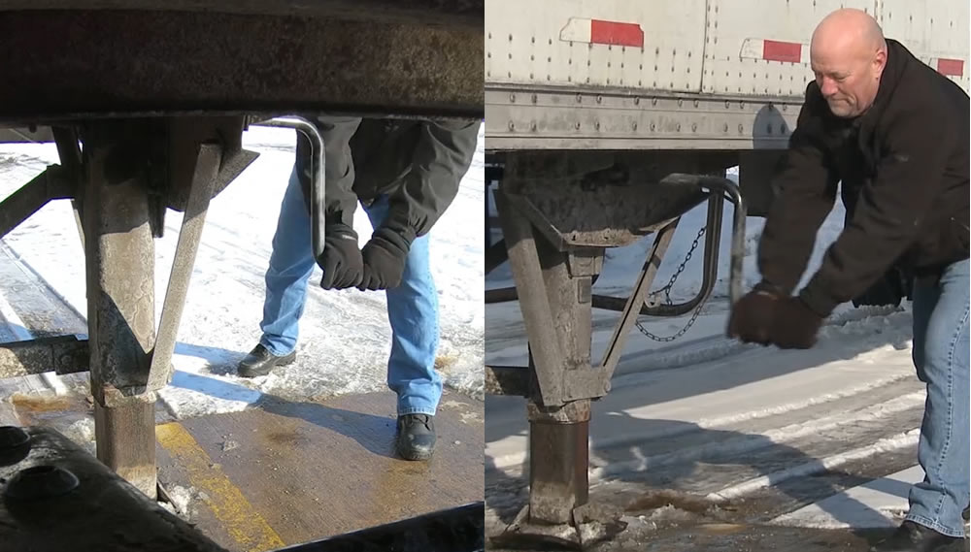
Raise the Landing Gear
Step 15:
Notes:
The first thing you should do whenever you’re about to raise or lower landing gear is to give the components a good visual inspection.
Examine the landing gear. Make sure there are no cracks and that everything is in alignment.
Grab the crank handle and put it into low gear.
Stand facing the front or back of the rig. With your feet shoulder width apart, use both hands, and crank until the weight is on the tractor.
Once the load is off the landing gear you can shift into high gear.
Face the trailer, keep your feet apart, and place one hand on the trailer for stability.
Crank the landing gear up completely making sure not to spin the handle quickly.
After raising the landing gear, secure the crank handle safely.
When the full weight of the trailer is resting on the tractor, do the following:
Check for enough clearance between the rear of the tractor frame and the landing gear. This is especially important with a tandem axle tractor and/or a sliding fifth wheel. If there isn’t enough clearance, the tractor may hit the landing gear during sharp turns.
Check that there’s enough clearance between the top of the tractor tires and the nose of the trailer.
Conduct a full pre-trip inspection of the trailer.
CALLOUT: Never drive with your landing gear only partially raised, as it may catch on railroad tracks or other obstructions.
CALLOUT: The most common injuries that result from improperly cranking the landing gear include knocked out teeth, broken nose, strains and sprains, and torn ligaments.
CALLOUT: To make sure you have completed this procedure correctly, set your trailer brakes, release your tractor brakes, and give a gentle tug against the trailer.
VIDEO
7.4 — Landing Gear

Slide 22
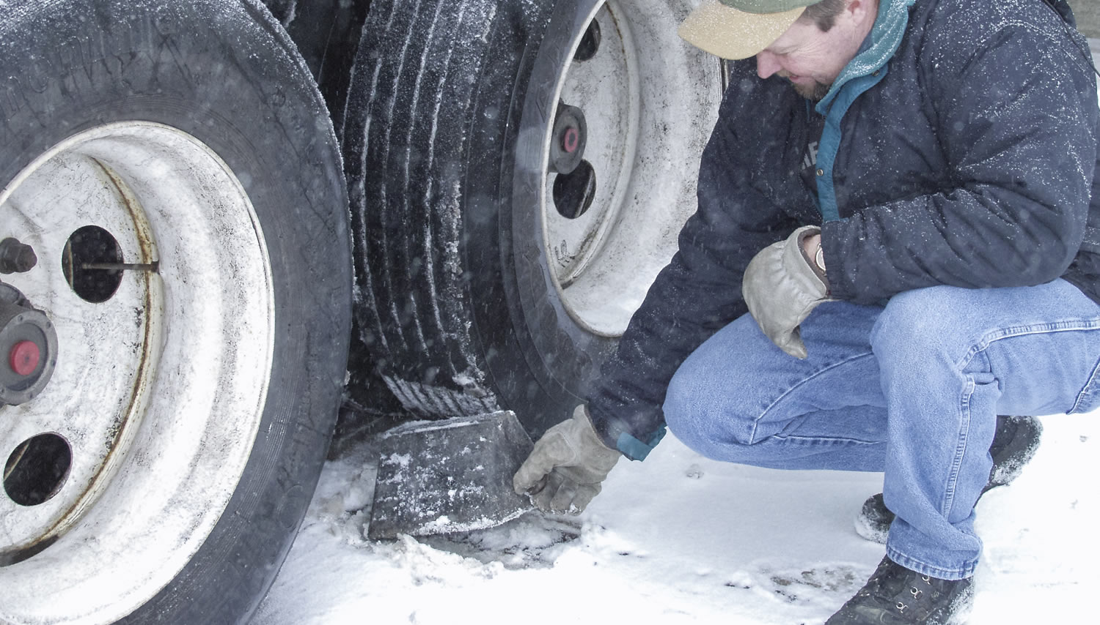
Remove Chocks
Step 16:
Notes:
Finally, remove and store the wheel chocks in a safe place.

Slide 23
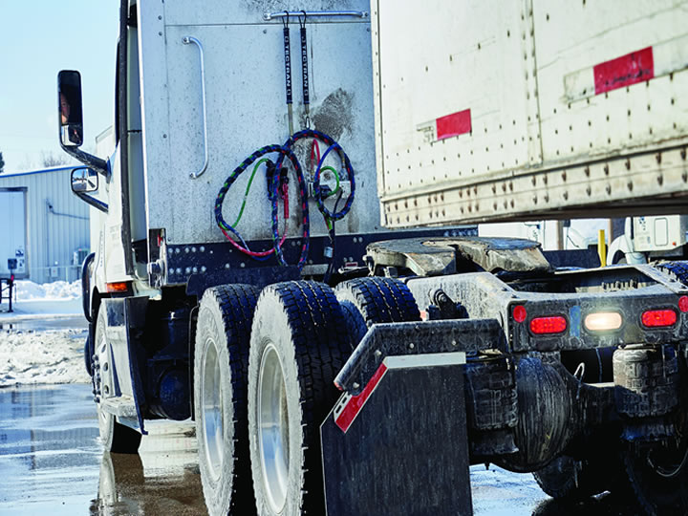
Uncoupling Tractor-Trailers
Notes:
Uncoupling, or the act of disconnecting the tractor from the trailer, may be simpler than coupling, but you still need to follow procedure to do it safely and correctly. The following 12- step approach to uncoupling will help protect you, your vehicle, your cargo, and others from damage and injury.

Slide 24
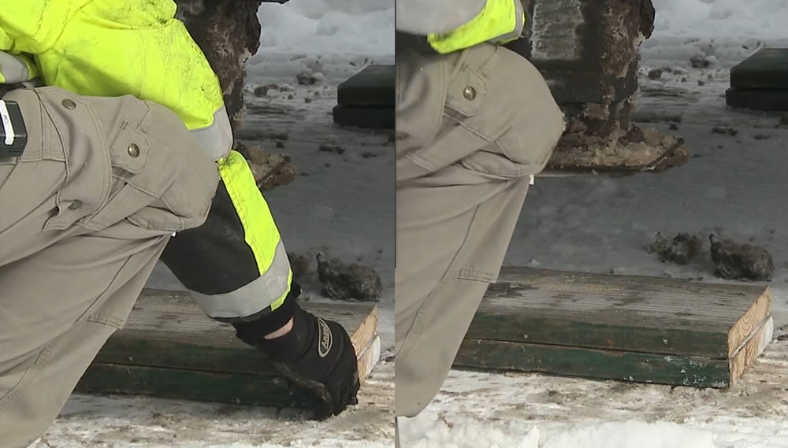
Position the Rig
Step 1:
Notes:
Make sure the surface of the parking area is level and that it can support the weight of the trailer. Look for areas that are designated for dropping trailers. Some such areas have a concrete slab for the landing gear to be placed on. Dirt, sand, and gravel surfaces can cause problems, as can hot blacktop. If necessary, use trailer supports, such as boards to spread the weight of the trailer over a wider area, preventing the trailer from sinking. The boards must be thick enough and strong enough to take the weight, and they must be large enough to spread the weight over a wider area.
Align the tractor with the trailer. Pulling out at an angle can damage the landing gear.

Slide 25
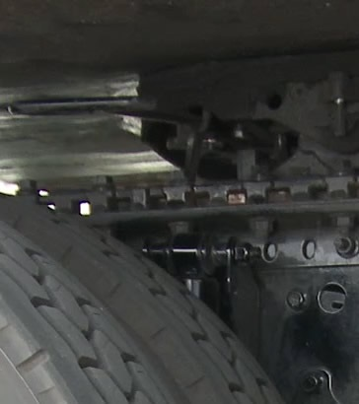
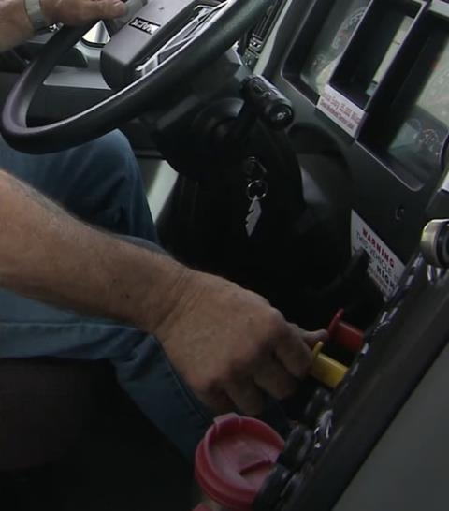
Secure the Trailer & Ease Pressure on Locking Jaws
Step 2:
Notes:
Pull out the trailer air supply button to lock the trailer brakes. Then, ease pressure on the fifth wheel locking jaws by backing up gently. This will help you release the pressure of the locking jaws against the kingpin.
Put the tractor parking brakes on while the tractor is pushing against the kingpin. This will hold the rig with pressure off the locking jaws. Place the transmission in neutral and turn off the engine.

Slide 26
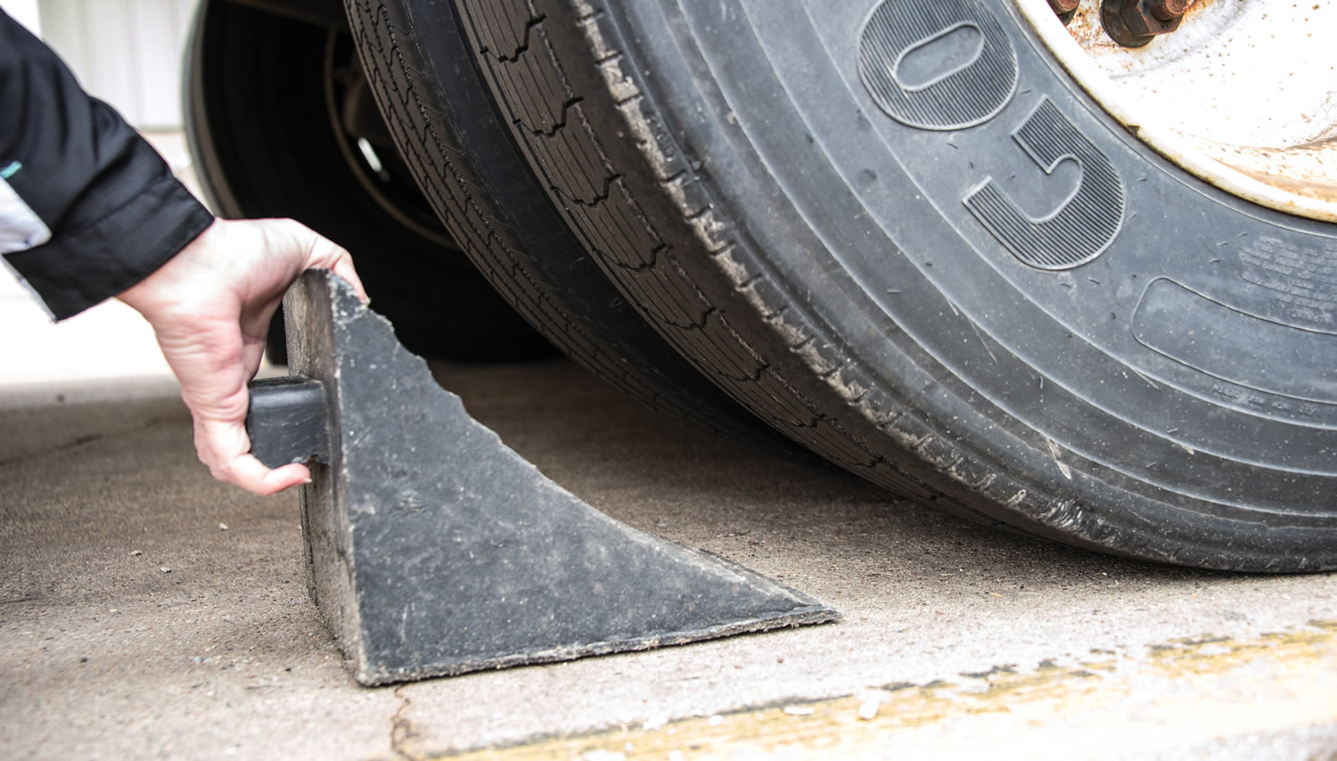
Chock the Trailer Wheels
Step 3:
Notes:
Chock the trailer wheels, or if the trailer has spring brakes, make sure they are applied. (The air could leak out of the trailer air tank, releasing its emergency brakes if the trailer is a pre-1975 trailer that does not have spring brakes. The trailer could then move if it didn’t have the wheels chocked.)

Slide 27
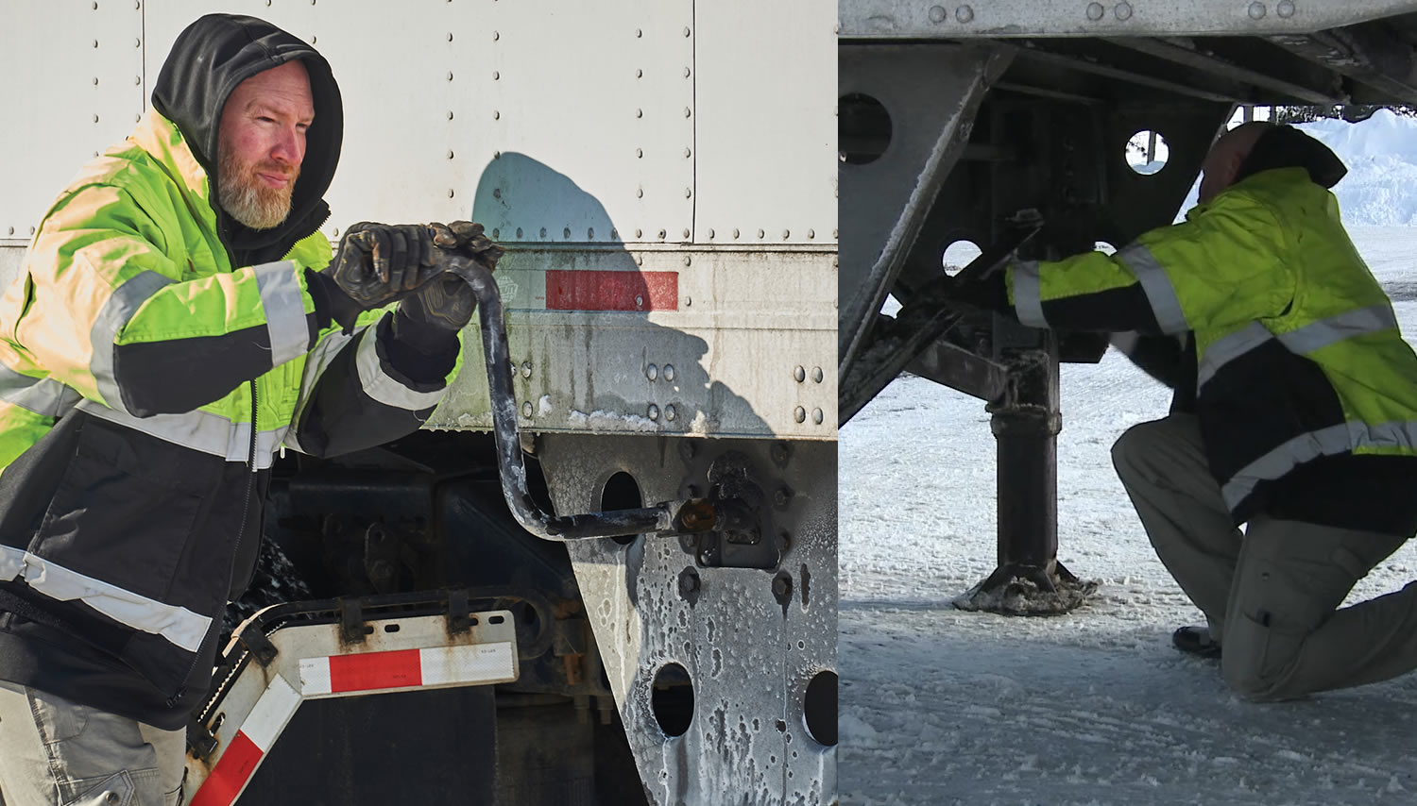
Lower the Landing Gear
Step 4:
Notes:
Check the landing gear for damage, excessive rust, cracks, broken welds, or other problems. Lower the landing gear until it makes firm contact with the ground.
Make sure both supports are firmly touching the ground. If they are not, find more level ground before dropping the trailer.
If the trailer is loaded, after the landing gear makes firm contact with the ground, turn the crank in low gear a few extra turns to lift some weight off the tractor. This will make it easier to unlatch the fifth wheel and to couple next time. Do not lift the trailer off the fifth wheel. Also, the trailer landing gear will not have to absorb a “jolt” when the tractor is pulled out from under it.
Always put the landing gear in low gear when done lowering, even when uncoupling an empty trailer. If it is left in high and loaded, the next driver may not be able to turn the landing gear crank handle enough to get it out of its stowed position. Once done with the landing gear crank, place it in the stowed position.
If your tractor has air ride, lower the landing gear in low gear until you hear the air ride system begin releasing air.

Slide 28
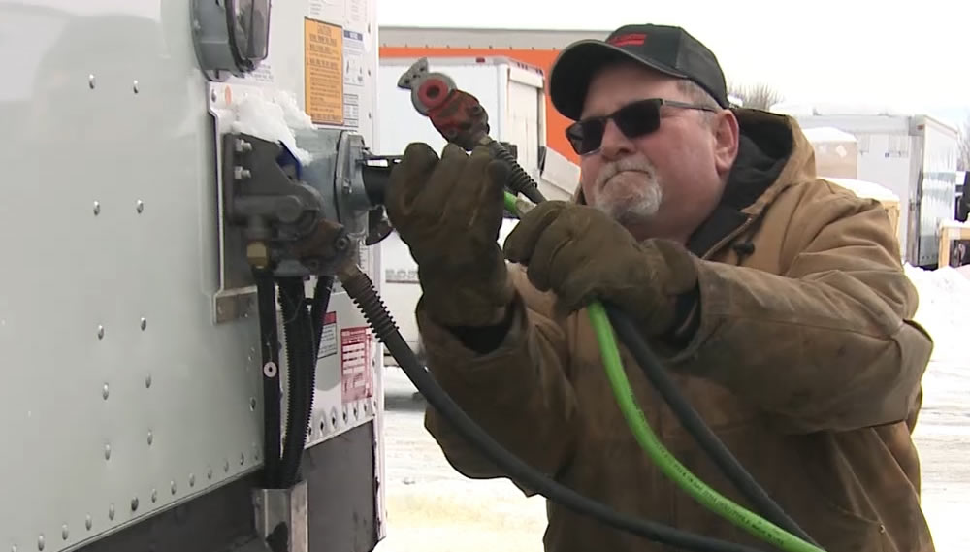
Disconnect Air
Lines & Electrical Cord
Step 5:
Notes:
Disconnect the air lines from the trailer. Connect the air line glad hands to the dummy couplers on the back of the cab, or couple them together.
Hang the electrical cord with the plug facing down to prevent moisture from entering it. Make sure the lines are supported so they won’t be damaged while driving the tractor.

Slide 29
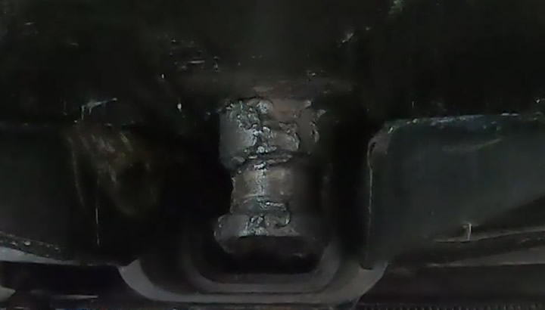
Unlock the Fifth Wheel
Step 6:
Notes:
Some trucks have a manual fifth wheel release. Before pulling the release, thoroughly inspect your fifth wheel to ensure it is safe for operation.
To pull the fifth wheel release handle properly:
Bend at the knees (rather than the hips) to position yourself close enough to reach the handle
Use a release hook to reach the handle
Keep your legs and feet clear of the rear tractor wheels
Square yourself up with the handle and pull straight out — if the fifth wheel has a handle locking mechanism, it may be necessary to hold the lock out of the way when pulling the handle or to rotate or lift the handle to allow it to be pulled to the unlocked position
Carefully stand back up
If you are unable to pull the fifth wheel release handle, double check that you are releasing any locking device and/or pulling the fifth wheel release handle using the correct action (such as rotating or pulling up before pulling out). If you are pulling the handle correctly and it still will not release, ease pressure on the fifth wheel jaws by reentering the cab, release just the tractor brakes, and push back against the kingpin. Set the tractor parking brake while the tractor is pushing against the kingpin. (See Step 2 above.)

Slide 30
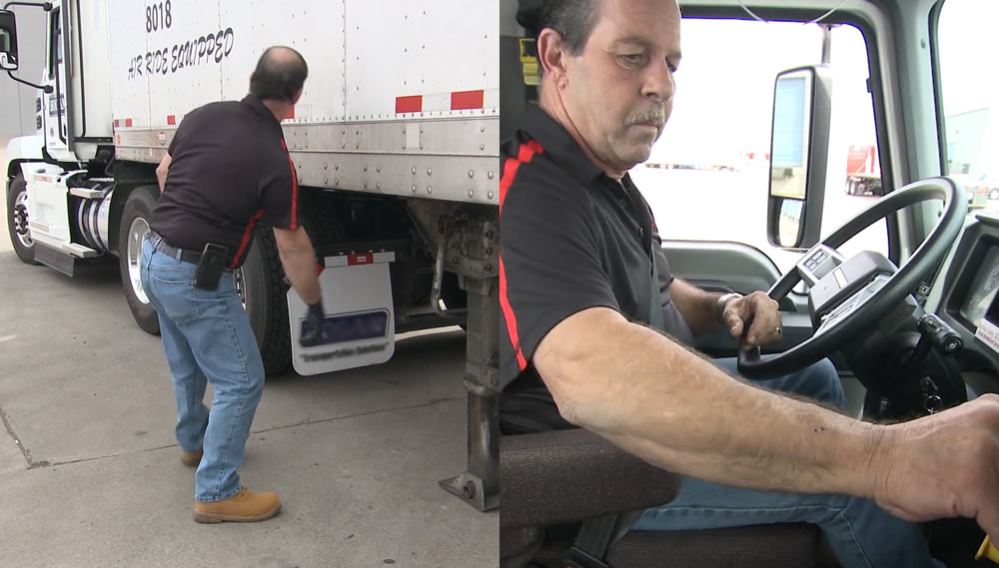
Lower the Air Suspension
Step 7:
Notes:
If your tractor is air ride equipped and has an air suspension “dump” or “lower” valve, drive forward one foot and move the switch to “dump” or “lower.” Wait for the air bags to drain so the rear of the tractor doesn’t jump when pulling clear of the trailer. Do not pull the fifth wheel out from under the trailer until the air ride is fully deflated.

Slide 31
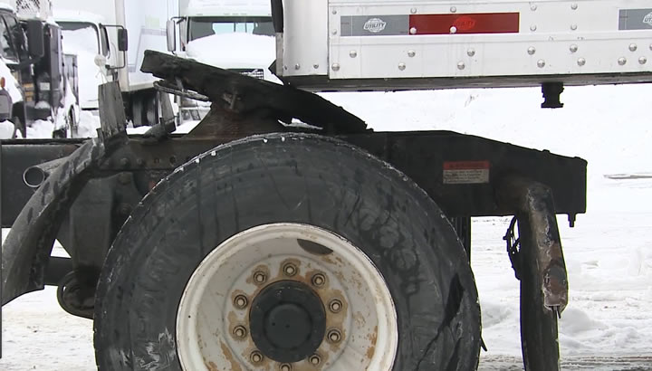
Pull the Tractor Partially Clear
Step 8:
Notes:
Release the tractor’s parking brake and pull the tractor forward until the fifth wheel just begins to clear the trailer’s apron plate. Stop with the tractor frame still under the trailer, to prevent the trailer from falling to the ground if the landing gear should collapse or sink.

Slide 32
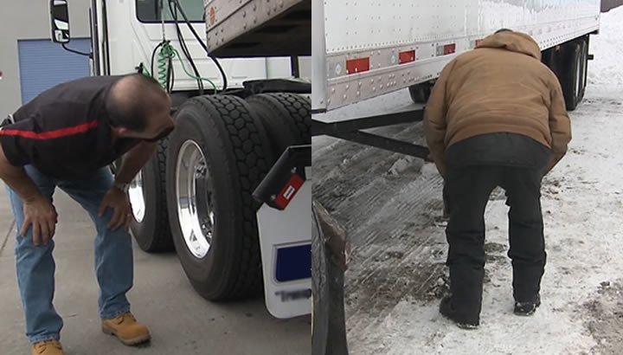
Secure the Tractor
Step 9:
Notes:
Apply the parking brake, place the transmission in neutral, and exit the cab.

Slide 33
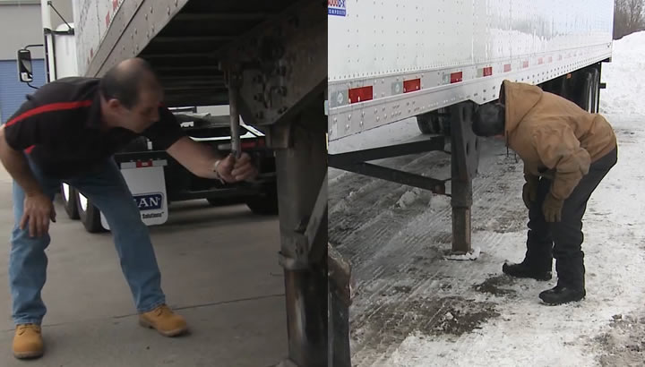
Inspect the Trailer Supports
Step 10:
Notes:
Make sure the ground is supporting the trailer. Make sure the landing gear isn’t damaged.

Slide 34
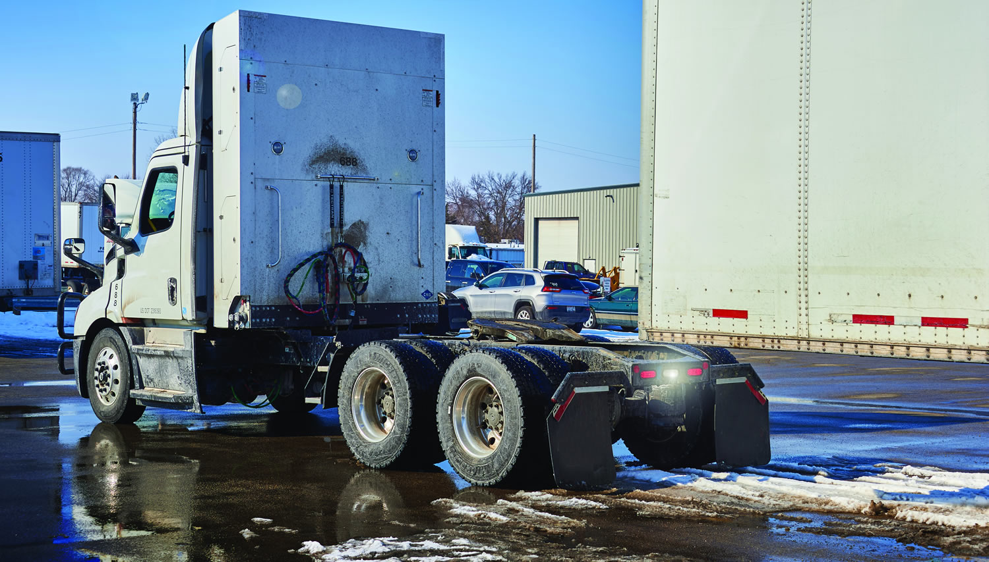
Pull the Tractor Clear
Step 11:
Notes:
Release the parking brakes, check the area, and slowly drive the tractor clear of the trailer. If necessary, use a trailer safety jack to support the trailer.

Slide 35
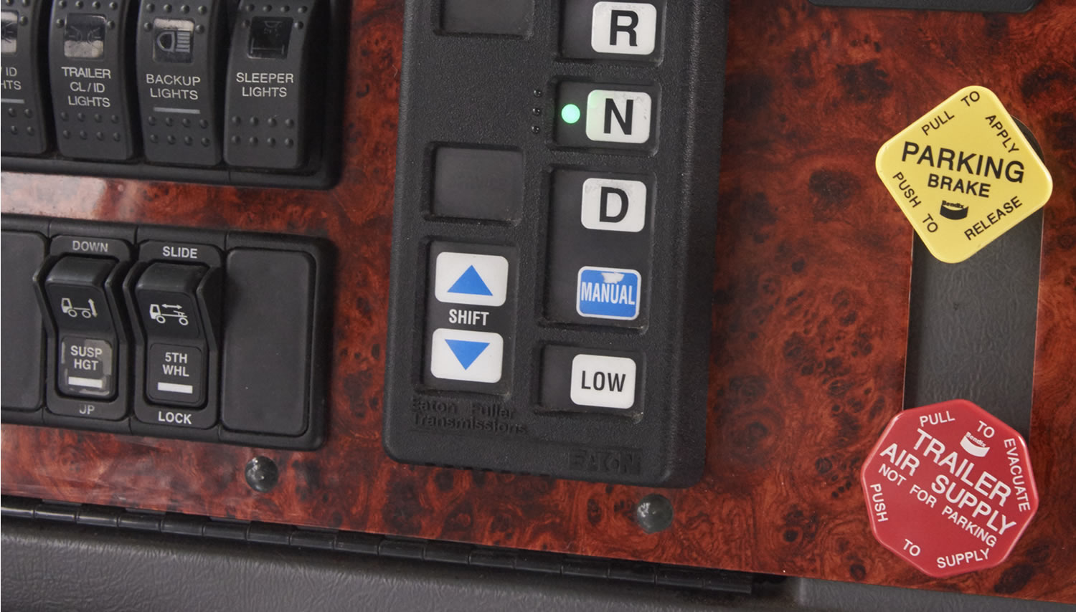
Raise the Air Suspension
Step 12:
Notes:
If your tractor has an air suspension, reinflate the air bags (see Step 7 above).

Slide 36
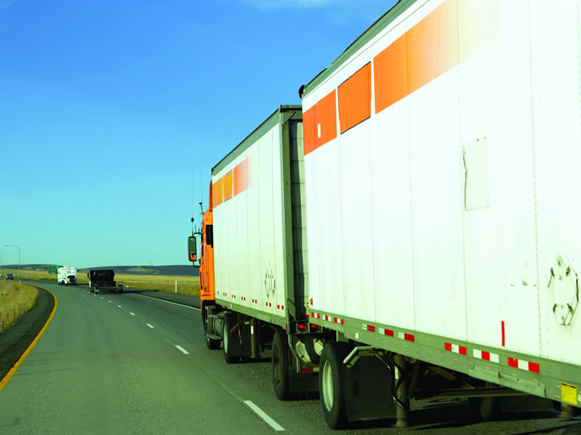
Coupling Doubles/Twin Trailers
Notes:
It is every bit as important to stay on task when you’re working with “doubles” as it is with “singles.” The procedures for coupling twin trailers are a bit more complicated than those for single trailers, but with a bit of practice you’ll do just fine. The most important thing to remember is the more heavily loaded trailer must always be in first position behind the tractor. The lighter trailer should be in the rear.
The following steps should be followed when coupling twin trailers.

Slide 37
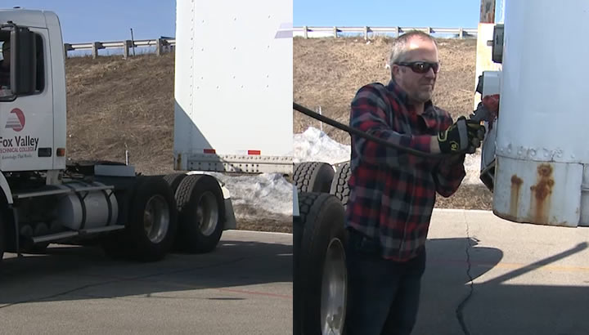
Secure the Rear Trailer
Step 1:
Notes:
If the second trailer doesn’t have spring brakes (pre-1975), drive the tractor close to the trailer, connect the emergency air supply line, charge the trailer air tank, and disconnect the emergency line. This will set the trailer emergency brakes (if the slack adjusters are correctly adjusted). Chock the wheels.

Slide 38
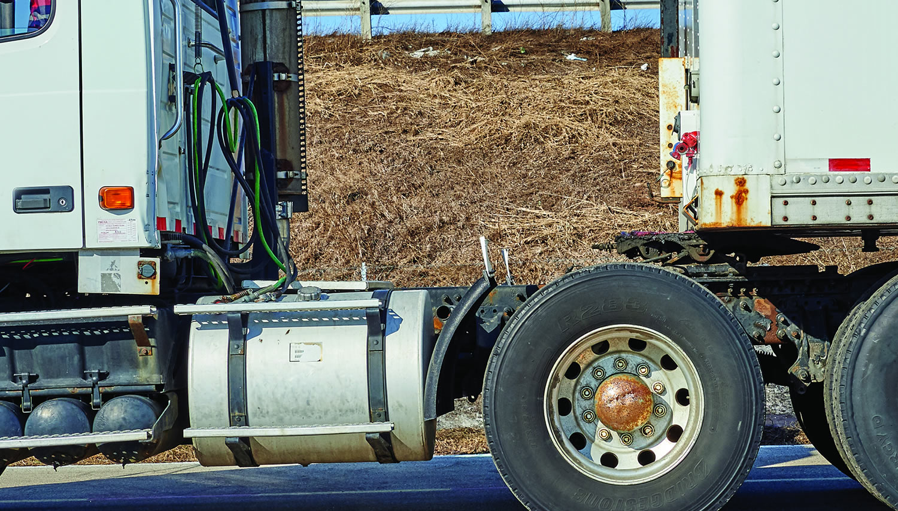
Couple the
Tractor & First Trailer
Step 2:
Notes:
Using the procedures for coupling tractor-trailers discussed previously (the 16 steps), couple the tractor and the first trailer.

Slide 39
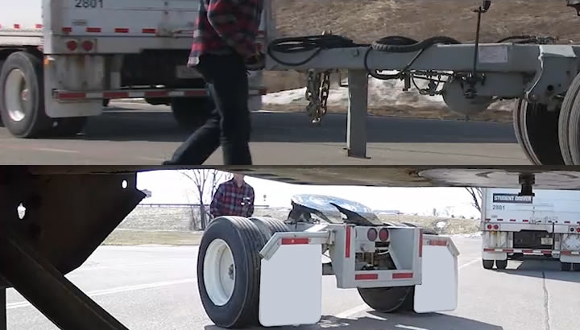
Position the Converter Dolly
Step 3:
Notes:
Manually roll the dolly into position in front of the rear trailer (or use the tractor to move the dolly).
Roll the converter dolly to the front of the rear trailer. Stop just before the fifth wheel makes contact with the front of the trailer apron plate. Then, set the dolly’s parking brake.

Slide 40
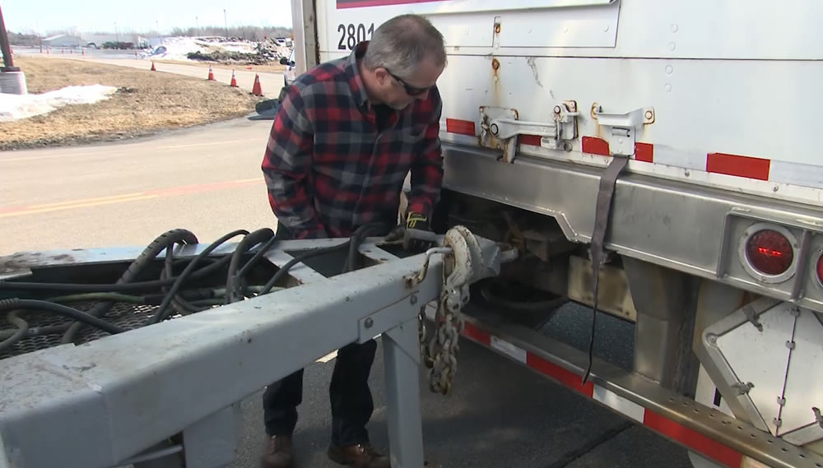
Connect the Dolly to the Front Trailer
Step 4:
Notes:
Back the first trailer into position in front of the dolly tongue. Hook the dolly to the front trailer, lock the pintle hook, and connect the safety chains. Next, secure the converter gear support in the raised position. Connect the air and electrical lines from the converter dolly to the rear of the front trailer. Stow the dummy connectors that were on the back of the trailer. If necessary, open the valves at the rear of the front trailer so the converter dolly brakes will release when the front trailer’s spring brakes are released.

Slide 41
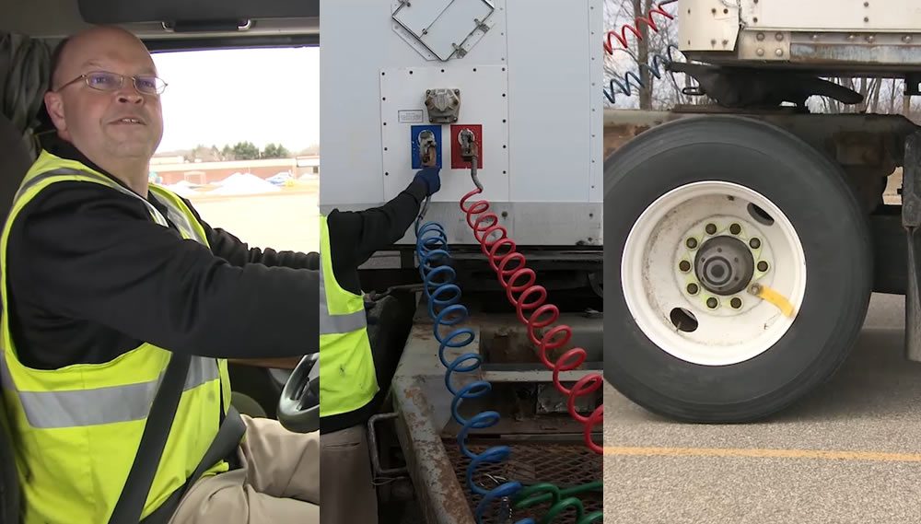
Connect the Dolly to the Rear Trailer
Step 5:
Notes:
Verify the rear trailer brakes are locked and/or the wheels chocked.
Make sure the trailer height is correct. It must be slightly lower than the center of the fifth wheel, so the trailer is raised slightly when the dolly is pushed underneath. If the converter dolly has an air ride suspension, it may be necessary to “charge” the converter dolly air system to raise the suspension to the operating position to accurately judge the fifth wheel height. This will involve making sure the tractor parking brake is set and charging the front trailer and converter dolly air systems by pushing the trailer button in. The rear trailer height should be such that the front of the rear trailer raises slightly as the converter dolly goes under it, allowing the kingpin to enter the fifth wheel correctly and preventing damage to the landing gear.
Back the converter dolly under the rear trailer. The rear trailer should raise slightly as the converter dolly goes under it, allowing the kingpin to enter the fifth wheel correctly and preventing damage to the landing gear.
Test the coupling by pulling against the pin of the number two trailer.
Make a visual check of the coupling. There should be no space between the upper (apron) and lower (platform) fifth wheel, the fifth wheel release arm should be in the locked position, and the locking jaws should be closed around the kingpin.
Connect air hoses and electrical cord from the converter dolly to the rear trailer, and from the front trailer to the converter dolly (if not done earlier).
Close the converter dolly air tank petcock or tank drain valve (if you had to open it to move the converter dolly) and the shut-off valves at the rear of the second trailer (service and emergency shut-offs).
Open the shut-off valves at the rear of the first trailer (if not opened earlier) and on the dolly (if so equipped).
Raise the landing gear completely on the second trailer.
Charge the trailers (push the trailer air supply knob in) and check for air at the rear of the second trailer by opening the emergency line shut-off. If air pressure isn’t there, something is wrong, and the brakes won’t work. A valve may be closed or possibly an air line is crossed.

Slide 42
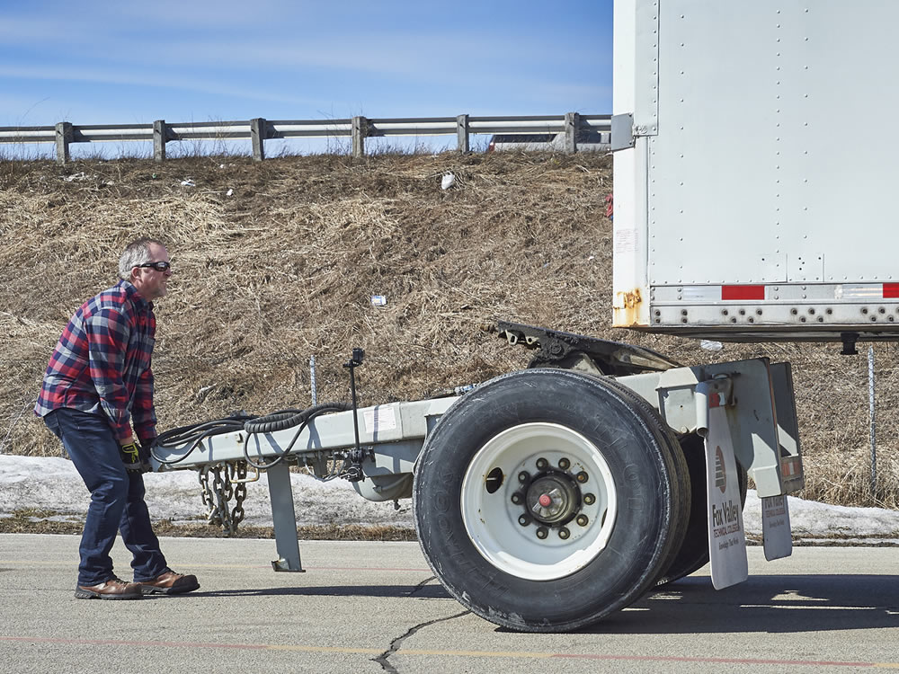
Uncoupling Doubles/Twin Trailers
Notes:
Like coupling twin trailers, the procedures for uncoupling twin trailers are a bit more complicated than those for single trailers. The following steps should be followed when uncoupling twin trailers.

Slide 43
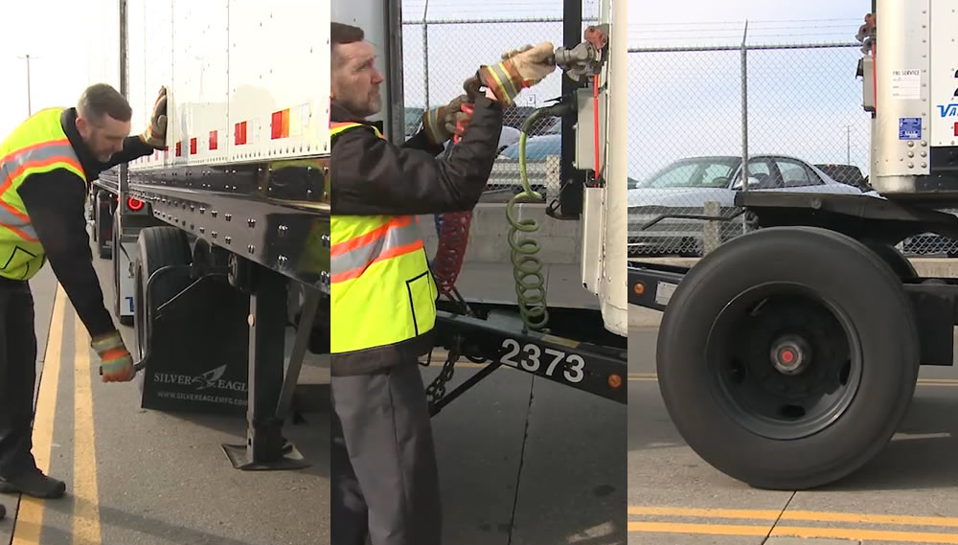
Uncouple the Rear Trailer
Step 1:
Notes:
Park your rig in a straight line on firm, level ground.
Apply the parking brakes so the rig won’t move.
Chock the wheels of the second trailer, if it doesn’t have spring brakes.
Lower the landing gear of the second trailer enough to remove some weight from the dolly.
Close the air shut-offs at the converter dolly or the rear of the front trailer to shut off air flow to the rear trailer.
Disconnect the air and electric lines going from the converter dolly to the rear trailer and secure them.
Release the dolly brakes (if necessary).
Release the converter dolly fifth wheel latch.
Slowly pull the tractor, first trailer, and dolly forward to pull the dolly out from under the rear trailer.
CALLOUT: Never unlock the pintle hook with the dolly still under the rear trailer. The dolly tow bar may fly up, possibly causing injury, and at the very least, making it very difficult to recouple.
CALLOUT: For directions on how to unlock the fifth wheel, refer back to Step 6 under ‘Uncoupling Tractor-Trailers’ above.

Slide 44
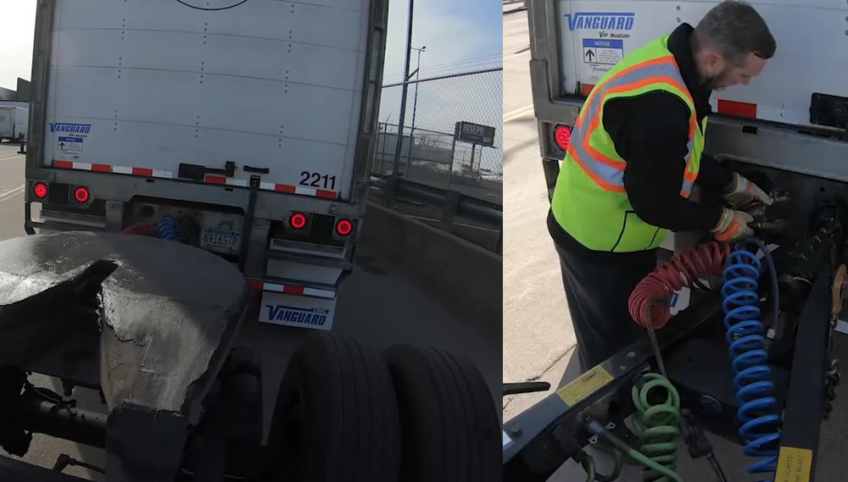
Uncouple the Converter Dolly
Step 2:
Notes:
Use the front trailer to move the converter dolly to the location you want to unhook it. Lower the dolly landing gear.
Disconnect the safety chains and the air and electrical lines from the converter to the front trailer.
Apply the converter gear spring brakes or chock the wheels.
Release the pintle hook on the first trailer.
Slowly pull clear of the dolly.

Slide 45
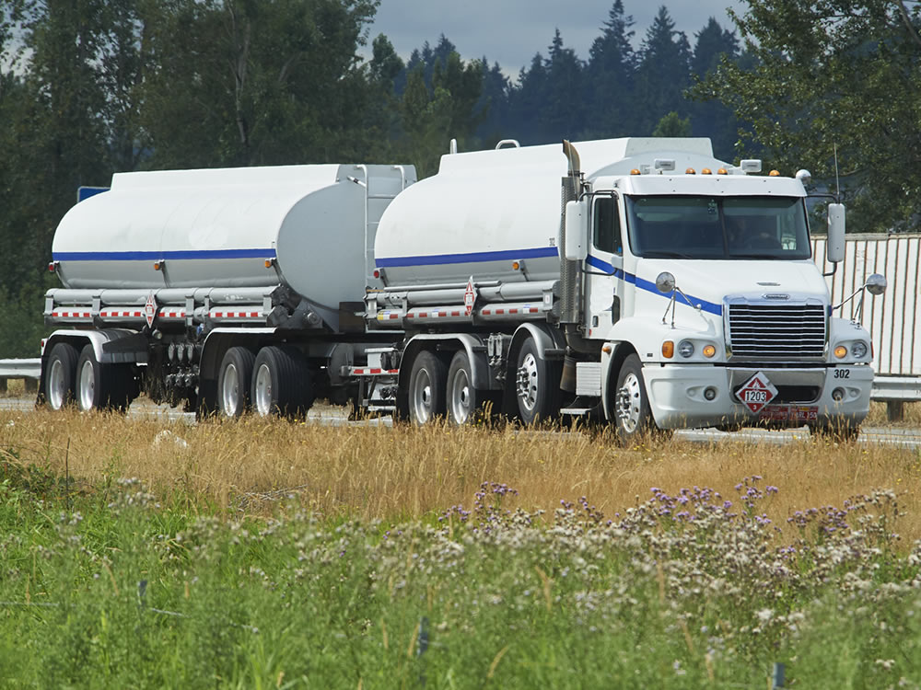
Other Combinations
Notes:
The methods and procedures described in this chapter apply to the most common tractor-trailer combinations. However, there are additional types of combinations, as well as other ways of coupling and uncoupling them. While they won’t be covered here, it’s your responsibility to learn the right way to couple and uncouple the vehicle(s) you’ll drive.

Slide 46
Objectives Review
You should now be able to:
  Describe how to properly couple and uncouple combination vehicles
  Identify how to inspect and test combination vehicle components to ensure safe operation
  Explain how to operate landing gear, pull releases, and position converter dollies
Copyright 2019 J. J. Keller & Associates, Inc.
Notes:
You should now be able to:
Describe how to properly couple and uncouple combination vehicles
Identify how to inspect and test combination vehicle components to ensure safe operation
Explain how to operate landing gear, pull releases, and position converter dollies
CLASSROOM RECOMMENDATION
Before concluding your training session, have participants take the corresponding quiz (found on the Trainer Tools USB) to check their understanding of the material. You can customize any of the questions to fit your audience or workplace. The answer key can also be found on the Trainer Tools USB.
You may also choose to administer the quizzes before you begin your training session to help get participants thinking about the subject and/or to gauge their understanding of the topic ahead of time.
LAB RECOMMENDATION
Hands-on experience is a vital part of learning the coupling/uncoupling procedure. Have each of your students practice the steps involved in coupling and uncoupling a tractor-trailer unit until they can perform the steps safely and efficiently.
Safety must be the first priority. Demonstrate the proper procedures and discuss all of the hazards involved before students attempt this procedure. Note that you may need to alter the procedural steps discussed in this chapter depending on the types of equipment available. When carrying out the demonstration, describe:
Each step of the procedure as it is being performed
What you are checking and why
The possible consequences of failing to follow the procedure
How to recognize a properly functioning component, a component that is in imminent danger of failing or malfunctioning, and a component that has already failed, malfunctioned, or is missing
How to handle situations that are less than ideal, such as unlevel surfaces, angled backing, air leaks, mismatched glad hands, etc.
Divide your class into groups of three students per instructor. Each student should receive a minimum of one hour of hands-on coupling and uncoupling time. Be sure to observe students during the practice session.
RANGE RECOMMENDATION
Following the initial practice sessions, students must have additional practice to gain proficiency. The most efficient way to achieve this is to uncouple rigs at the end of every range session, then couple them at the start of each new session each day, throughout the remainder of the course. Students who require more practice than others should be given additional coupling and uncoupling assignments.
If you are using several rigs on the range, keep at least 25 feet of space on all sides to allow enough room.

