Slide 1






PowerPoint® Instructions
This PowerPoint has been designed so you can easily customize it for your training session.
Throughout the presentation you’ll see icons with recommendations or videos to enhance the instruction you present to your students. A detailed explanation for each icon can be found on the next slide. Videos can be found on the Trainer Tools USB.
When you see an icon on the slide, look in the notes
section for further information.
Simply delete or move the icon off the slide before your training session begins.

Slide 2





Classroom Recommendations. Provides suggestions for enhancing your classroom presentation; from ideas for large group discussions to suggestions on the use of training aids such as examples or photos of vehicle parts and components to help illustrate the items covered within a chapter.
Lab Recommendations. Provides suggestions for activities and exercises that take place outside the classroom, but do not involve
the actual operation of the tractor-trailer or its components. Examples
of lab sessions include conducting a vehicle inspection or practicing mirror adjustment.
Range Recommendations. These recommended activities take
place on a closed-access driving range where students may practice driving skills in a controlled environment. Examples of range sessions include practicing shifting technique and successfully completing a backing maneuver.
Road Recommendations. These recommended activities take place in road and traffic conditions that support the chapter’s objectives. Examples of road sessions include proper communication with other drivers through the use of turn signals and basic vehicle control under nighttime or extreme weather conditions.
Videos. These short video clips reinforce material presented in the Student Manual. Use them to help students grasp difficult concepts or subject matter.

Slide 3
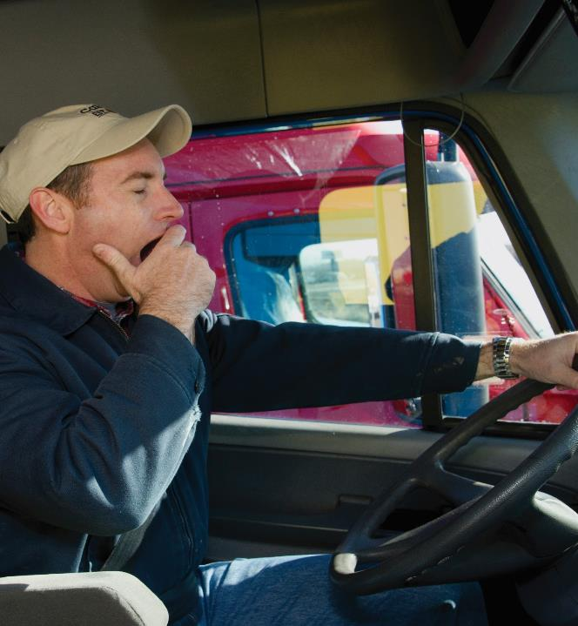
24
Fatigue and Wellness Awareness
Notes:
Chapter 24: Fatigue and Wellness Awareness
Unit A1.5.4 Fatigue and Wellness Awareness
This unit must teach driver-trainees about the issues and consequences of chronic and acute driver fatigue and the importance of staying alert. The training providers must teach driver-trainees wellness and basic health maintenance information that affect a driver's ability to safely operate a CMV.

Slide 4
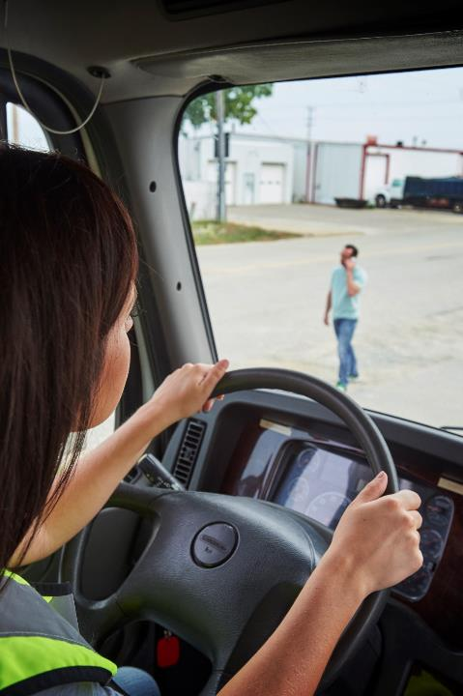
Introduction
A healthy driver is a safe and alert driver.
Notes:
Introduction
A healthy driver is a safe and alert driver. Achieving a healthy and safe lifestyle can be challenging when done on the road, but it can be done. This chapter will focus on several of the factors that contribute to driver health and wellness.
CLASSROOM RECOMMENDATIONS
A healthy driver is a safe and alert driver. This chapter focuses on several of the factors that contribute to driver health and wellness—from safe lifting practices to personal safety and security. It’s essential that students finish this section with a clear understanding of the subject.
Discuss how a healthy lifestyle is possible while on the road, but that is takes discipline to achieve. Cover the importance of a healthy diet, exercise, and sleep.

Slide 5
Objectives
Upon completion of this lesson, you will be able to:
  Describe ways you can maintain a healthy diet and good exercise habits while on the road
  Discuss what stress is along with ways you can
  manage stress
  Identify signs of driver fatigue
  List safe work practices
  Describe back safety and proper lifting
  List steps you can take to ensure your personal security
Notes:
Upon completion of this lesson, you will be able to:
Describe ways you can maintain a healthy diet and good exercise habits while on the road
Discuss what stress is along with ways you can manage stress
Identify signs of driver fatigue
List safe work practices
Describe back safety and proper lifting
List steps you can take to ensure your personal security

Slide 6

Personal Health & Driving
Notes:
Personal Health and Driving

Slide 7
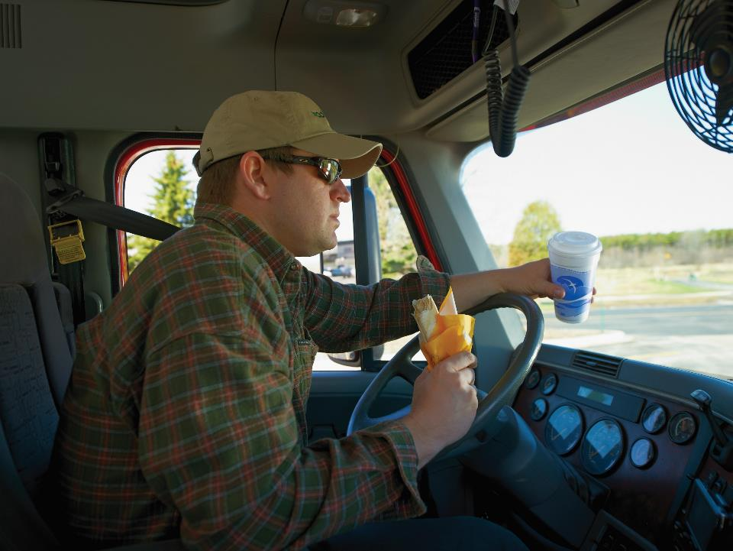
Life on the road can lead to
bad habits…
Notes:
VIDEOS (see Trainer Tools USB)
24.1 — Personal Health & Driving
Life on the road can lead to a lot of bad habits, including:
Minimal exercise
Unhealthy eating habits
Over consumption of caffeine
Smoking
It is important to incorporate good habits, including eating well, getting plenty of rest, and having an exercise routine. Remember, a healthy driver is an alert, safe driver. Weight, diet, and exercise all work together when it comes to your health.

Slide 8
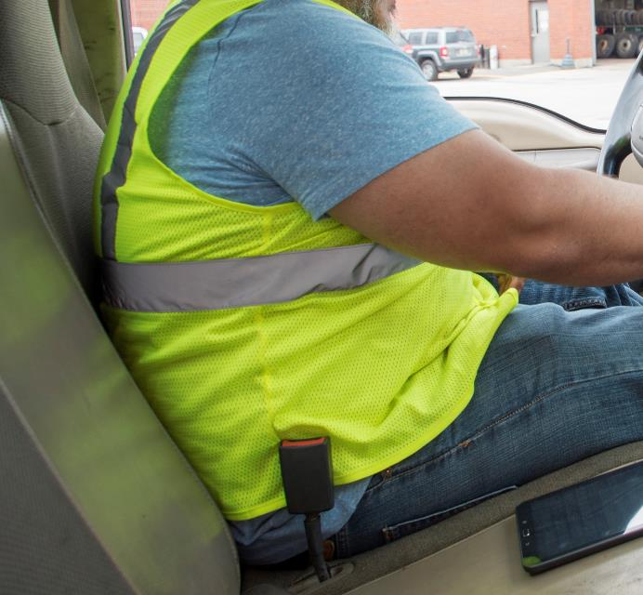
Being overweight
contributes to
health problems.
Notes:
Weight
Being overweight can contribute to various health problems including unhealthy cholesterol levels, high blood pressure, diabetes, back pain, and joint stress. It can also cause you to feel fatigued. A healthy diet and physical activity can help control your weight, and in turn, prevent certain health problems.

Slide 9

Include fruits and vegetables, whole grains, low-fat dairy, and lean protein in your diet.
Notes:
Diet
Whether at home or on the road, it is important to maintain a healthy diet. A healthy diet includes eating a variety of foods on a daily basis that are rich in nutrients and low in calories. This includes vegetables and fruits, whole grains, low-fat dairy, and lean protein.
Vegetables and fruits. Vegetables and fruits are full of nutrients that help in promoting good health. Select vegetables and fruits of various colors and varieties. Choose red, orange, and dark green vegetables such as tomatoes, sweet potatoes, and broccoli with meals.
Also select a variety of fruits and vegetables as snacks such as apples, pears, berries, and carrots.
Whole grains. When selecting bread, rice, or pasta, try to select whole grains. Whole grains provide more nutrients than refined grains.
Examples of whole grains include oatmeal, brown rice, and whole wheat pasta. At least half of the grains consumed on a daily basis should be whole grains.
Low-fat dairy. Milk, cheese, and yogurt are included in the dairy group. Select fat-free (skim) or low-fat (one percent) milk, cheese, and yogurt.
Lean protein. Meat, poultry, seafood, eggs, nuts, and seeds are considered part of the protein group. Select lean cuts of meat or low-fat meat and poultry.

Slide 10

Limit salt, fats, oils, and added sugars.
Notes:
Limit fat, oil, added sugar, salt. Limiting fats, oils, and added sugars is also important when it comes to a healthy diet as these foods provide calories, but little in nutritional value. Too much sodium (salt) can increase blood pressure.
CALLOUT: Oils low in saturated fats are a much healthier choice. Use olive, avocado, or peanut oils for cooking or creating salad dressings and sauces.

Slide 11

Drink at least eight 8-ounce glasses of water every day.
Notes:
Drink water. Water is a key ingredient to health and wellness. You need water to process the nutrients you eat, cleanse your body of toxins and impurities, and replenish you after exercise or physical exertion, especially in extreme heat.
Normally, you should drink at least eight 8-ounce glasses of water every day. If you are working in extreme heat, you will need to drink at least 8 ounces of cool water every 15 to 20 minutes.

Slide 12

Plan ahead and pack healthy foods.
Notes:
Eating Healthy on the Road
Being on the road can present additional challenges when it comes to healthy eating. Your options can be limited when it comes to the menu at a truck stop or fast food outlet. Planning ahead and packing healthy foods before starting a trip is one way to combat this problem.
There are lots of healthy choices that can be purchased from the grocery store before leaving on a trip. They can be carried in a small cooler in the vehicle. These choices include fresh fruit, cut up vegetables, and string cheese. Ready‑to-eat cereals and unsalted nuts are other healthy foods that can be taken on the road.
Making healthy food choices can be a challenge when stopping at a restaurant or truck stop. Being an informed diner is half the battle when it comes to being a healthy diner.
Many restaurant and fast food chains are offering healthy choices and starting to post calories on their menus. Also, many post nutritional information on their websites. If possible, this information should be checked out before ordering. If this isn’t possible, look for key words such as grilled, whole grain, and low fat to help in making informed mealtime decisions.
For breakfast, skip the sweet rolls and pancakes. Items such as oatmeal, whole grain cereals, and fresh fruit are healthier selections.
When it comes to lunch and dinner, look for terms such as grilled, steamed, or broiled when selecting meat, whole grain when selecting breads, buns, and pasta, and low fat when choosing dairy products.
At a salad bar, select vegetables and fruit and use salad dressing sparingly. Avoid prepared salads such as potato or pasta salads as they often contain dressings or sauces that are high in fat or sugar.
Beverages are another issue to consider. Sodas and sweetened coffees are full of sugars and calories. Low-fat milk and unsweetened tea or coffee are better choices.

Slide 13
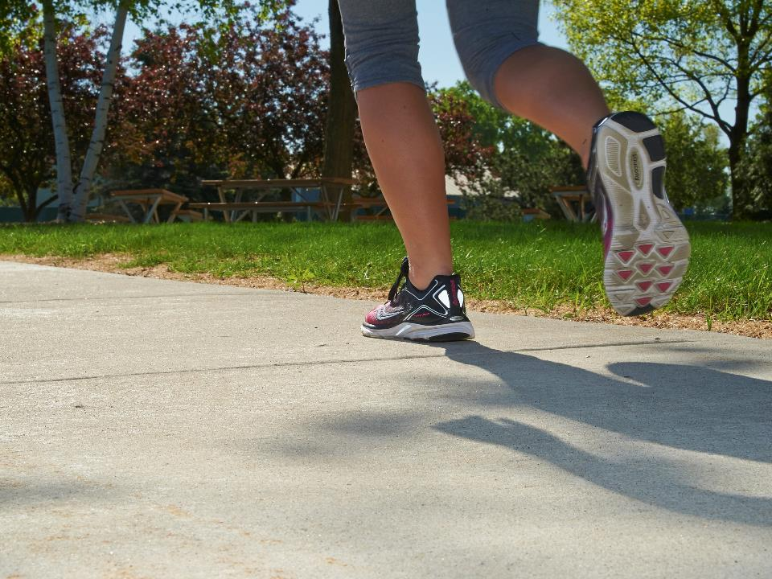
Regular physical activity is important to your overall health and fitness.
Notes:
Exercise
Regular physical activity is important to overall health and fitness. Being physically active can help with:
Losing weight or maintaining a healthy weight (when combined with proper diet)
Well-being
Sleep
Strengthening muscles and bones
Beneficial physical activity includes:
Aerobic activities, including brisk walking, jogging, bicycling, and swimming
Resistance, strength building, and weight-bearing activities, including lifting weights and push-ups
Balance and stretching activities, including gentle stretching, dancing, yoga, and martial arts
So how much physical activity is necessary? The U.S. Department of Agriculture (USDA) recommends that adults do at least two and a half hours of moderate physical activity each week . This activity can be broken down into increments of as little as 10 minutes at a time.
Moderate physical activities include brisk walking, bicycling, and golf (when walking and carrying clubs). It is also recommended that muscle-strengthening activities such as push-ups, sit-ups, and lifting weights be done two or more days a week.
CALLOUT: Moderate physical activity for 30 minutes a day can help improve your well-being.

Slide 14
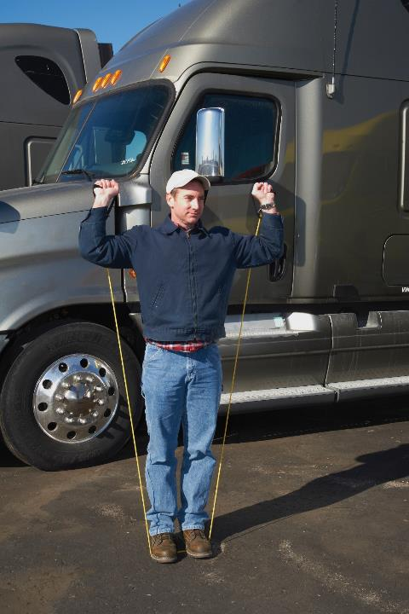
Some drivers carry exercise equipment with them.
Notes:
Exercise on the Road
Being on the road can present challenges when it comes to getting in some physical activity on a regular basis, but it is important you make it a priority. Professional drivers spend many hours behind the wheel, and a lack of movement can take its toll. Sitting for long periods of time can lead to fatigue, back pain, and even blood clots. Having a “game plan” can help in getting in some form of physical activity.
The “game plan” may include making time during a stop to take a walk or planning to stop at a facility that includes exercise equipment.
Some drivers carry exercise equipment such as hand weights or resistance bands to do simple exercises in their vehicle.
When stopped for deliveries, pickups, or a break, take a quick walk—even if it’s just around your rig.

Slide 15

Medically, stress can cause you
to suffer.
Headaches
High blood pressure
Pain
Breathing trouble
Digestive orders
Obesity
Insomnia
Fatigue
Notes:
Stress
Stress is a physical or mental response to the pressures of an event or factors of living in general. Though we tend to speak of it in a negative context, stress can be positive or negative.
Biologically, when stress occurs, your body releases hormones which accelerate your breathing and heart rate, increase your blood sugar levels and blood pressure, and improve blood clotting. Your body gets into a survival mode, readying itself for a physical emergency.
As stress continues, your body temporarily adjusts to the stress. If stress is removed during this adjustment period, your body returns to normal. However, if stress goes on for prolonged periods of time, your body fails to adjust and wears out. This can weaken your defenses and lead to disease.
Medically, stress can cause you to suffer headaches, high blood pressure, pain, breathing trouble, digestive disorders, obesity, insomnia, and fatigue.
Psychologically, you may suffer frustration, irritability, anger, impatience, worry, and/or a lack of self-confidence. To compound matters, your job can be affected too. Stress can lead to accidents, a loss of priorities, rushing, and anger or inappropriate behavior.
Use one or more of the following stress-reduction techniques to help you deal with stress:
Take breaks
Exercise
Maintain a balanced diet
Get proper rest
Practice deep breathing or yoga
Manage your time and set priorities to do the most important things first
Laugh and cry to release tension
Talk to a friend or counselor

Slide 16
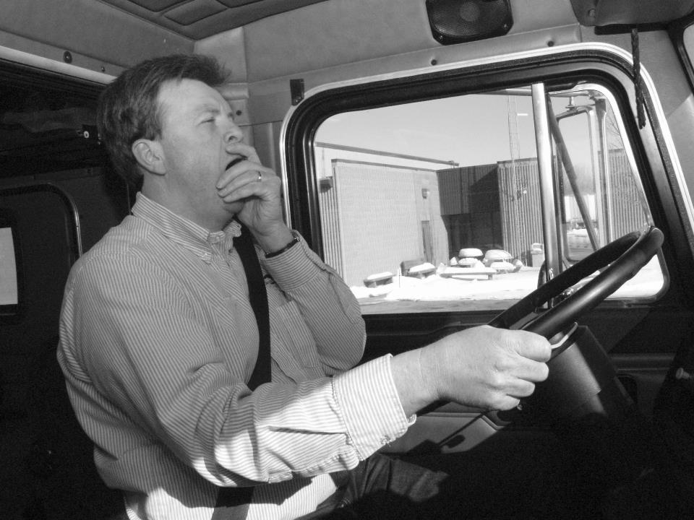
Fatigue
Notes:
Fatigue

Slide 17
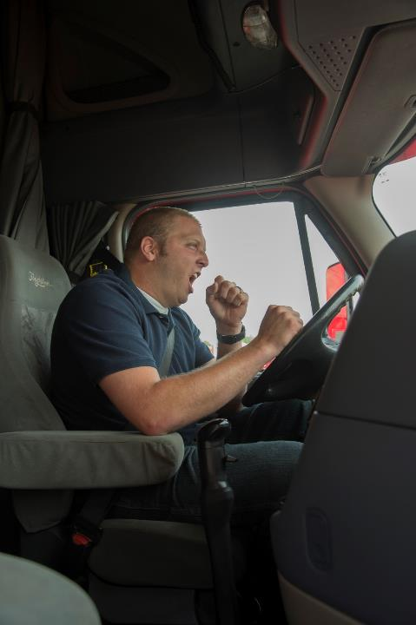
Sleep, like food and water, is necessary for human survival.
Notes:
Fatigue is a generic term used to describe anything from being sleepy to exhausted. Two major causes of fatigue are sleep loss and changes to the body’s circadian rhythm (internal clock).
Sleep loss. Sleep, like food and water, is necessary for human survival. Depriving your body of sleep is like starving yourself or not drinking water.
In general, most adults need seven to eight hours of uninterrupted sleep to feel well-rested. Sleep loss of as little as two hours can negatively affect alertness and performance. This can include reduced judgment, slowed reaction time, lack of coordination, and poor attitude/mood.
In addition, sleep-deprived people also tend to eat more and crave food with simple carbohydrates, which are high in sugar.
There is a regulation that prohibits a driver from driving (or a carrier from allowing a driver to drive) a commercial motor vehicle (CMV) when ill or fatigued, or while the driver’s ability or alertness is so impaired (or so likely to become impaired) that it makes it unsafe for him or her to operate a CMV.
Circadian rhythm. Put simply, circadian rhythm is your body’s internal or biological clock. For most people, their clock runs on a 24-hour cycle with times when they feel energized and awake (high points) and other times when they feel sleepy and lethargic (low points).
Time cues, such as sunlight and darkness and your work/rest schedule, keep your body clock set to a certain schedule.
Most everyone’s clock is set for two low points. One is between 2:00 a.m. and 6:00 a.m. The other is between 1:00 p.m. and 5:00 p.m. The more dangerous of the two is between 2:00 a.m. and 6:00 a.m., since most people are programmed to sleep when it is dark out. This makes fighting fatigue difficult when driving at night.
A person’s low point is generally 12 hours after the mid-point of their last sleep cycle. In other words, if you were asleep from 10:00 p.m. to 6:00 a.m. your low point in the afternoon would occur at 2:00 p.m. Knowing this, you could intentionally plan for a break during that time to help stay fresh.
If your body’s internal clock is moved to a different schedule (because of a change in time zones, or changing from day to night shift), your body needs time to adjust.
CALLOUT: See Section 392.3 of the Federal Motor Carrier Safety Regulations (FMCSRs) for complete details.
VIDEOS (see Trainer Tools USB)
24.2 — Fatigue

Slide 18
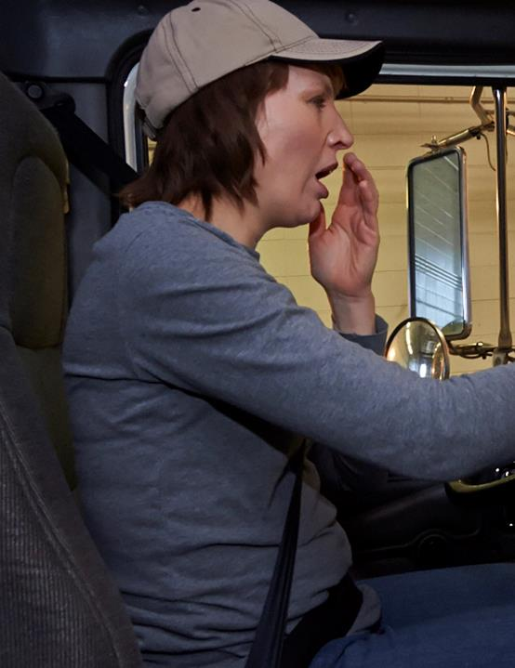
Signs of fatigue:
Lack of alertness
Drowsiness
Yawning
Trouble focusing eyes
Head drooping
Reduced reaction time
Erratic shifting
Intermittent braking
Following too closely
Lane deviations
Bad driving decisions
Notes:
Signs of Fatigue
An alert driver is a safe driver. Being fatigued:
Makes you less able to pay attention to the road
Slows your reaction time if you have to brake or steer suddenly
Affects your ability to make good decisions.
There are several signs that indicate you are fatigued, including:
Lack of alertness
Drowsiness
Yawning
Trouble focusing eyes/trying to keep them open
Head drooping
Reduced reaction time
Erratic shifting, intermittent braking, following vehicles too closely
Lane deviations
Bad driving decisions

Slide 19

To help fight fatigue, get a solid eight hours
of sleep.
Notes:
Fighting Fatigue
To help fight fatigue, you should get a solid eight hours of sleep, try to establish a regular sleep and waking schedule, and avoid driving during low points.

Slide 20

Sleep apnea can cause daytime drowsiness and poor concentration.
Notes:
Sleep Apnea
Sleep disorders can also contribute to fatigue. One of the more common sleep disorders is sleep apnea.
Sleep apnea is a breathing disorder characterized by brief pauses of breathing during sleep. When this happens, the person who is sleeping gasps for air, wakes up enough to get back into a normal breathing pattern, then falls back to sleep. Often, this happens in such a short period of time the person sleeping doesn’t realize what just occurred.
The process can repeat itself up to 600 times a night. Though the person suffering from sleep apnea doesn’t fully wake up during these breathing episodes, his or her sleep pattern is disrupted enough that the sleep period isn’t refreshing, causing daytime sleepiness and poor concentration.
Early detection and treatment for sleep apnea is important because sleep apnea may be linked with serious medical conditions, including irregular heartbeat, high blood pressure, heart attack, and stroke.

Slide 21

Alcohol Use & Drug Abuse
Notes:
Alcohol Use and Drug Abuse

Slide 22
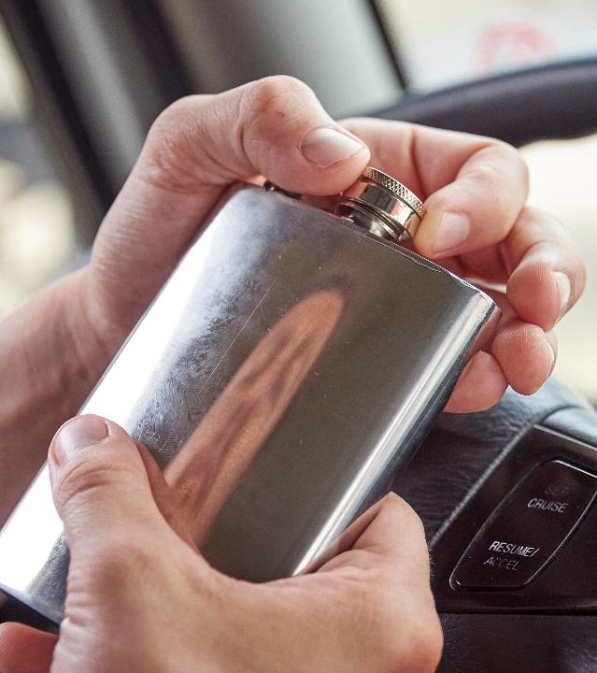
Driving, drugs, and drinking are a deadly mix.
Notes:
Driving, drugs, and drinking are a deadly mix. Alcohol and/or drug use can decrease your skill and thinking abilities. It can reduce coordination, slow your reaction rate, and dull mental processes.
You should never use alcohol or drugs to help you stay awake or remain alert. Part of being a professional driver is knowing when it is safe to drive.
It is your responsibility to comply with the applicable alcohol and drug regulations as well as your company’s policy on this subject.
CALLOUT: This section addresses the alcohol and drug prohibitions in Part 392 of the FMCSRs.

Slide 23
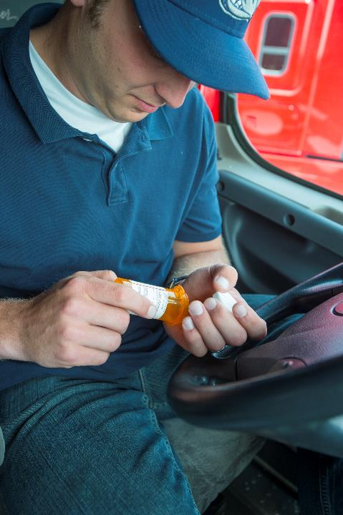
Laws prohibit driving under the influence of drugs or alcohol.
Notes:
Prohibitions
The FMCSRs address the use of alcohol by commercial drivers. Prohibited behaviors, as listed in Sec. 392.5 of the FMCSRs include:
Alcohol consumption four hours prior to coming on duty, or while having physical control of, or operating a commercial motor vehicle
Alcohol use, being under the influence of alcohol, or having any measurable amount of alcohol concentration or detected presence of alcohol while on duty, operating, or in physical control of a commercial motor vehicle, or
Being on duty or operating a commercial motor vehicle with alcohol in possession, with the exception of transporting a manifested shipment of alcoholic beverages
The FMCSRs also address the use of drugs by commercial drivers. Section 392.4 of the FMCSRs states that drivers may not be on duty and possess, be under the influence of, or use any of the following drugs or substances:
Any 21 CFR 1308.11 Schedule I substance
An amphetamine or any formulation thereof (including, but not limited, to ‘‘pep pills’’ and ‘‘bennies’’)
A narcotic drug or any derivative thereof, or
Any other substance, to a degree which renders the driver incapable of safely operating a motor vehicle

Slide 24
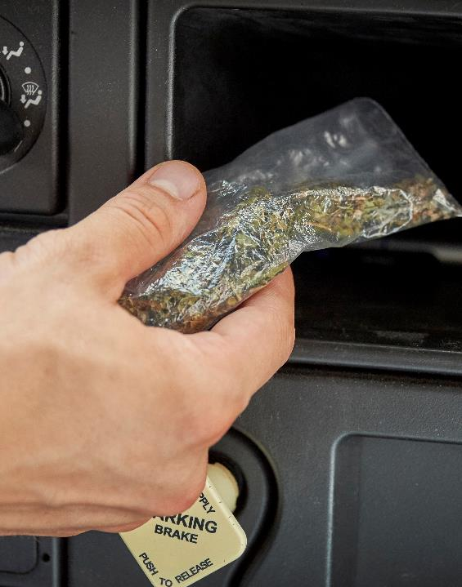
You will be disqualified if convicted of driving under the influence of drugs or alcohol.
Notes:
Driver Disqualification
Under Sec. 383.51 of the FMCSRs, certain offenses committed in any kind of vehicle (work or personal) will be held against a driver who possesses a CDL. This means that any CDL driver who is convicted of being under the influence of alcohol or drugs (in any kind of vehicle) as prescribed by state law will be disqualified from operating a vehicle requiring a CDL for a period of one year for a first offense. If the offense occurred in a vehicle hauling hazardous materials, the penalty is stiffer with a three-year disqualification. Any subsequent offenses in any kind of vehicle will lead to a lifetime disqualification.

Slide 25

Safe Work Practices
Notes:
Safe Work Practices
Safety on the job includes more than a general knowledge of the regulations. It includes common sense and following your motor carrier’s policies and procedures related to safe workplace practices.
Accidents often occur when you face a new job or a change at work. When something in your workplace changes, think about your safety. If you are not sure about how to proceed, ask questions. If you discover a hazard, report it.

Slide 26
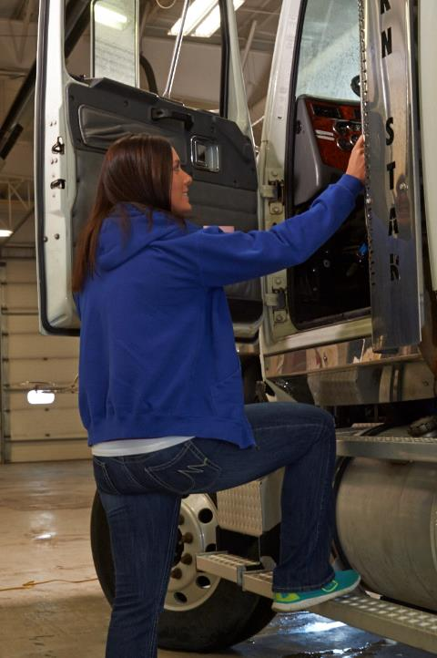
When entering or exiting your vehicle, always:
Use handrails
Face the steps
Maintain three points of contact
Notes:
Vehicle Entry and Exit
Believe it or not, there are proper ways of climbing up, getting into and out of cabs and seats, and getting down from motor vehicles:
Always use handrails, face the ladder or steps, and maintain three points of contact (two feet and one hand, or one foot and two hands) at all times
Always use anti-slip surfaces for climbing or stepping
Never jump from or to ladders, steps, or walkways
VIDEOS (see Trainer Tools USB)
24.3 — Vehicle Entry & Exit

Slide 27
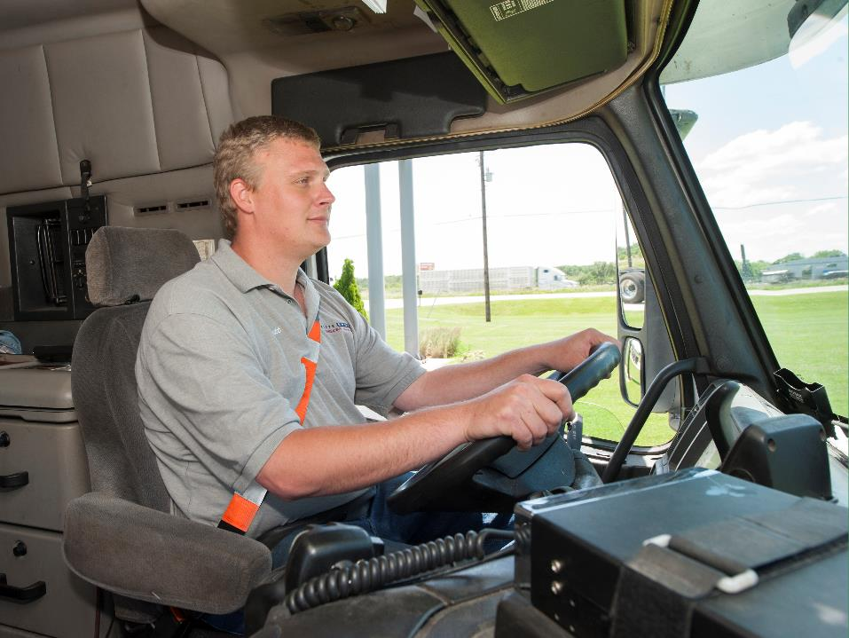
The key to staying comfortable and productive behind the wheel starts with a proper seated position.
Notes:
Proper Seated Position
The key to staying comfortable and productive behind the wheel starts with a proper seated position. When you’re in the right position, all of your joints should work easily rather than be stressed while you drive.
Develop a routine so every time you enter your cab you set your driving position properly. Sit upright with your lower back in a position that allows the seat to support your lower back area, also known as your lumbar.
Your hands should rest on the wheel comfortably without having to stretch. Position your hands at the recommended 9- and -3 or 8-and-4 positions so you can use the large muscles of your shoulders and upper arms to do the work of steering. This position should also give you straight-forward access to shift gears without stretching or stressing your arm or wrist.
When driving, avoid slouching or sitting with a lean, and try not to rest your left arm on the door arm rest for long periods of time. Change positions regularly to help keep from getting stiff.

Slide 28
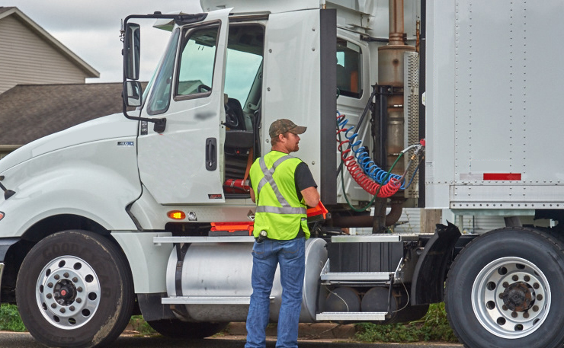
Only stop on the side of the road if it’s an emergency situation.
Notes:
Stopping on the Side of the Road
Because it is so dangerous, you should only stop on the side of the road if it’s an emergency situation. The most common injuries are sustained when drivers are struck by other vehicles.
If you have no choice but to stop on the side of the road, try to avoid small or “soft” shoulders—especially after periods of heavy rain or during the spring thaw.
If you must stop at the side of the road:
Use your blinker when pulling to the side
Use your four-way flashers while pulled over
Face traffic when walking around your vehicle
Wear a bright colored, reflective vest
Place warning devices as required by the regulations
VIDEOS (see Trainer Tools USB)
24.4 — Stopping on the Side of the Road

Slide 29
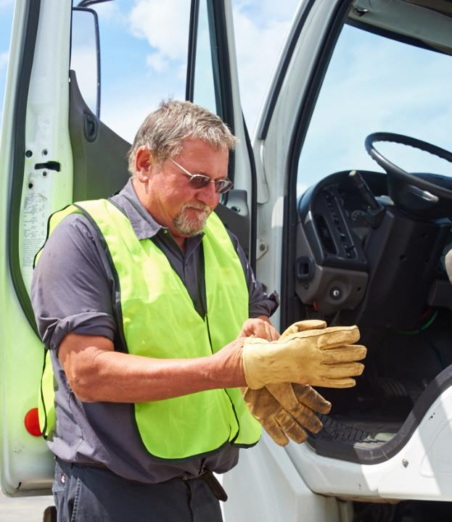
Wear your personal protective equipment.
Notes:
Personal Protective Equipment (PPE)
It is important that appropriate personal protective equipment (PPE) be used to prevent injury when loading or unloading your vehicle or working at a warehouse, dock, or other facility.
Occupational Safety and Health Administration (OSHA) regulations require that all PPE fit correctly, be in good shape, and be appropriate for the job. OSHA regulated PPE that may be used includes:
Hand protection (gloves)
Foot protection (steel-toed work shoes)
Eye protection (goggles)
Head protection (hard hat)

Slide 30
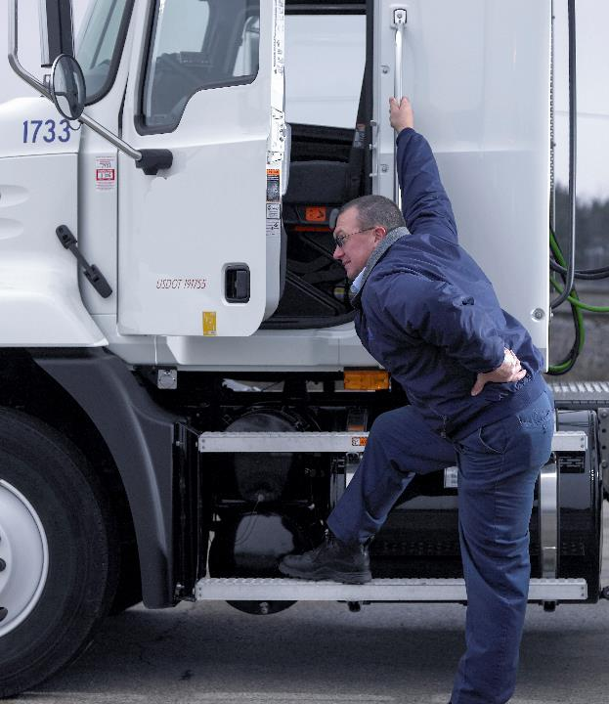
Most back pain is self-inflicted due to a lifetime of bad habits and poor techniques.
Common causes of back
pain include:
Poor posture
Poor physical fitness
Poor diet
Awkward sleeping positions
Stress
Sudden movements
Improper lifting
Notes:
Back Safety
Whether you’re at home or at work, a healthy back impacts every aspect of your life. Knowing more about how your back works will help you understand how to use it properly.
Your backbone—otherwise known as your spine—has three main jobs:
To support your upper body and keep it movable
To protect your spinal cord and nervous system
To absorb shock as you move
A healthy spine has a slight S-shape to it, created by three continuous curves: The cervical (or neck and upper back) area, the thoracic (or middle back) area, and the lumbar (or lower back) area.
Most of your weight rests in the lumbar area so if an injury occurs, this will typically be the first area affected.
Back pain (that can ultimately lead to back injuries) usually doesn’t occur from a single, traumatic incident. Most back pain is self-inflicted due to a lifetime of bad habits and poor techniques. Over time, they can lead to a more serious back injury, sometimes even long before you develop any symptoms. Common causes of back pain include:
Poor posture
Poor physical fitness
Poor diet
Awkward sleeping positions
Stress
Sudden movements
Improper lifting

Slide 31

There are five steps to a proper lifting technique.
Step 1: Make sure you can carry the load to its destination before attempting the lift.
Notes:
Proper Lifting
Injury to the back must be taken seriously, as it can cause a lifetime of pain and discomfort. There are five steps to a proper lifting technique:
Step 1: Make sure you can carry the load to its destination before attempting the lift.
Make sure your path is clear of all obstacles
You can break up a long carry by stopping halfway to reposition your grasp
CLASSROOM RECOMMENDATIONS
Lifting technique (Interactive demonstration)
Back problems are one of the most common causes of lost work time for the professional driver. The nature of the job, including prolonged periods of sitting and lifting heavy objects can contribute to back pain and injury.
A demonstration of proper lifting technique is one way to illustrate to your students what can be done to help ensure back health.
Once you have demonstrated proper lifting technique, have a volunteer from the class take a turn. Discuss how the student performed in the exercise, offering suggestions if steps were missing or done incorrectly.

Slide 32
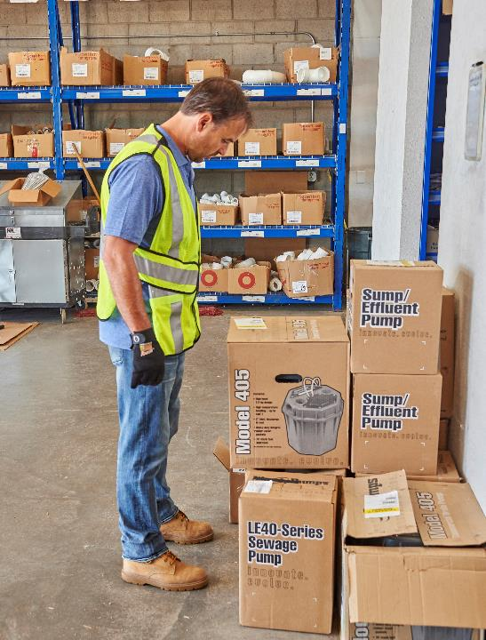
Step 2: Size up the load before trying to lift it. It it’s too heavy, get some help.
Notes:
Step 2: Size up the load before trying to lift it. If it’s too heavy, get some help.
Stretch before you lift, and stretch out frequently during sessions of repeated lifting
Test the weight by lifting one of the corners
Anything over 50 pounds is considered a heavy lift
Use mechanical aids such as hoists, carts, or dollies as needed
Request help if you need it

Slide 33
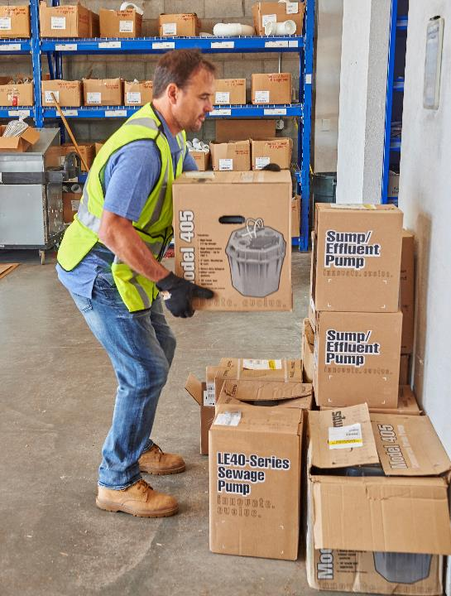
Step 3: Bend your knees. Let your legs do the work.
Notes:
Step 3: Bend your knees. Let your legs do the work.
Place your feet apart and close to the object
Center yourself over the load, bend your knees, and get a good handhold
Lift straight up, smoothly
Never bend at the waist, or lift with a rounded back

Slide 34
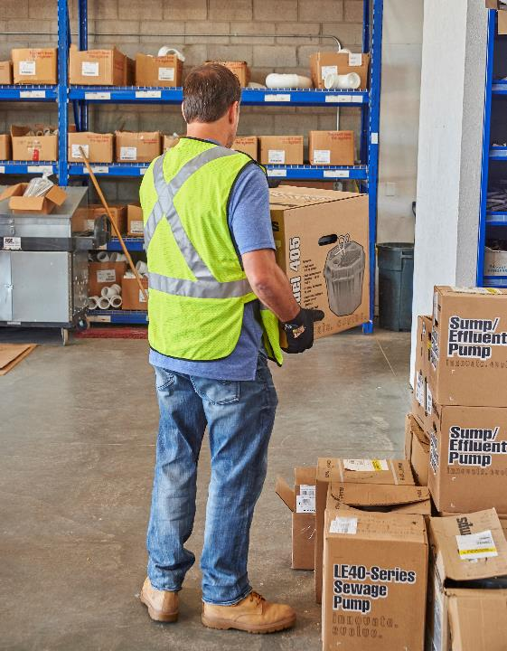
Step 4: Never twist or turn your body once you have made the lift.
Notes:
Step 4: Never twist or turn your body once you have made the lift.
Keep the load steady and close to your body
Never carry a load above your head or at your side

Slide 35

Step 5: Set the load down properly.
Notes:
Step 5: Set the load down properly.
Bend your knees
Keep your back upright
Let your legs do the work
Take your time
Keep your head up
Tighten the abdominal muscles
Pivot your feet before you move another direction, do not twist
Always push, don’t pull an object. Pushing puts less strain on the back.

Slide 36
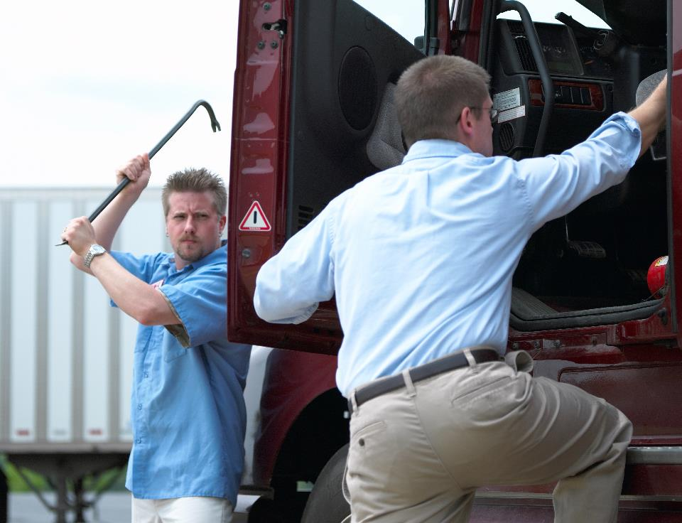
Protect yourself from physical attacks and the loss of personal items.
Notes:
Personal Security
It’s important that drivers protect themselves from physical attacks and the loss of personal items.
Steps that you can take to ensure your safety include:
Being conscious of vehicles that may be following you
Being suspicious of anyone who asks about the load or its destination
Never sharing information about the load, pick-up and delivery schedules, or routing
Never leaving items of value in plain sight in your vehicle
Locking the vehicle when stopped
Parking in well-lit areas at night
Always being aware of your surroundings
Safeguarding your wallet, credit card(s), and receipts
Never pulling large amounts of cash out of your wallet
Being alert at all times when using an ATM
Inspecting the vehicle and its seals/locks at the end of each stop/rest period
CLASSROOM RECOMMENDATIONS
Safety and security (discussion)
Focus on the concept of awareness of surroundings and being alert at all times. Keep in mind that some students may not have experienced large cities, high security situations, and suspicious actions, as these situations are not typical to their home area. Because of this, added discussion about truck driving being a nationwide experience and the related challenges that each driver will face needs to take place.
Consider enlisting the assistance of an area law enforcement agency. Many have officers who specialize in this topic and/or offer the use of topic-related training materials.
VIDEOS (see Trainer Tools USB)
24.5 — Staying Safe When on the Road

Slide 37
Objectives Review
You should now be able to:
  Describe ways you can maintain a healthy diet and good exercise habits while on the road
  Discuss what stress is along with ways you can
  manage stress
  Identify signs of driver fatigue
  List safe work practices
  Describe back safety and proper lifting
  List steps you can take to ensure your personal security
Copyright 2019 J. J. Keller & Associates, Inc.
Notes:
You should now be able to:
Describe ways you can maintain a healthy diet and good exercise habits while on the road
Discuss what stress is along with ways you can manage stress
Identify signs of driver fatigue
List safe work practices
Describe back safety and proper lifting
List steps you can take to ensure your personal security
CLASSROOM RECOMMENDATION
Before concluding your training session, have participants take the corresponding quiz (found on the Trainer Tools USB) to check their understanding of the material. You can customize any of the questions to fit your audience or workplace. The answer key can also be found on the Trainer Tools USB.
You may also choose to administer the quizzes before you begin your training session to help get participants thinking about the subject and/or to gauge their understanding of the topic ahead of time.

