Slide 1






PowerPoint® Instructions
This PowerPoint has been designed so you can easily customize it for your training session.
Throughout the presentation you’ll see icons with recommendations or videos to enhance the instruction you present to your students. A detailed explanation for each icon can be found on the next slide. Videos can be found on the Trainer Tools USB.
When you see an icon on the slide, look in the notes
section for further information.
Simply delete or move the icon off the slide before your training session begins.

Slide 2





Classroom Recommendations. Provides suggestions for enhancing your classroom presentation; from ideas for large group discussions to suggestions on the use of training aids such as examples or photos of vehicle parts and components to help illustrate the items covered within a chapter.
Lab Recommendations. Provides suggestions for activities and exercises that take place outside the classroom, but do not involve
the actual operation of the tractor-trailer or its components. Examples
of lab sessions include conducting a vehicle inspection or practicing mirror adjustment.
Range Recommendations. These recommended activities take
place on a closed-access driving range where students may practice driving skills in a controlled environment. Examples of range sessions include practicing shifting technique and successfully completing a backing maneuver.
Road Recommendations. These recommended activities take place in road and traffic conditions that support the chapter’s objectives. Examples of road sessions include proper communication with other drivers through the use of turn signals and basic vehicle control under nighttime or extreme weather conditions.
Videos. These short video clips reinforce material presented in the Student Manual. Use them to help students grasp difficult concepts or subject matter.

Slide 3
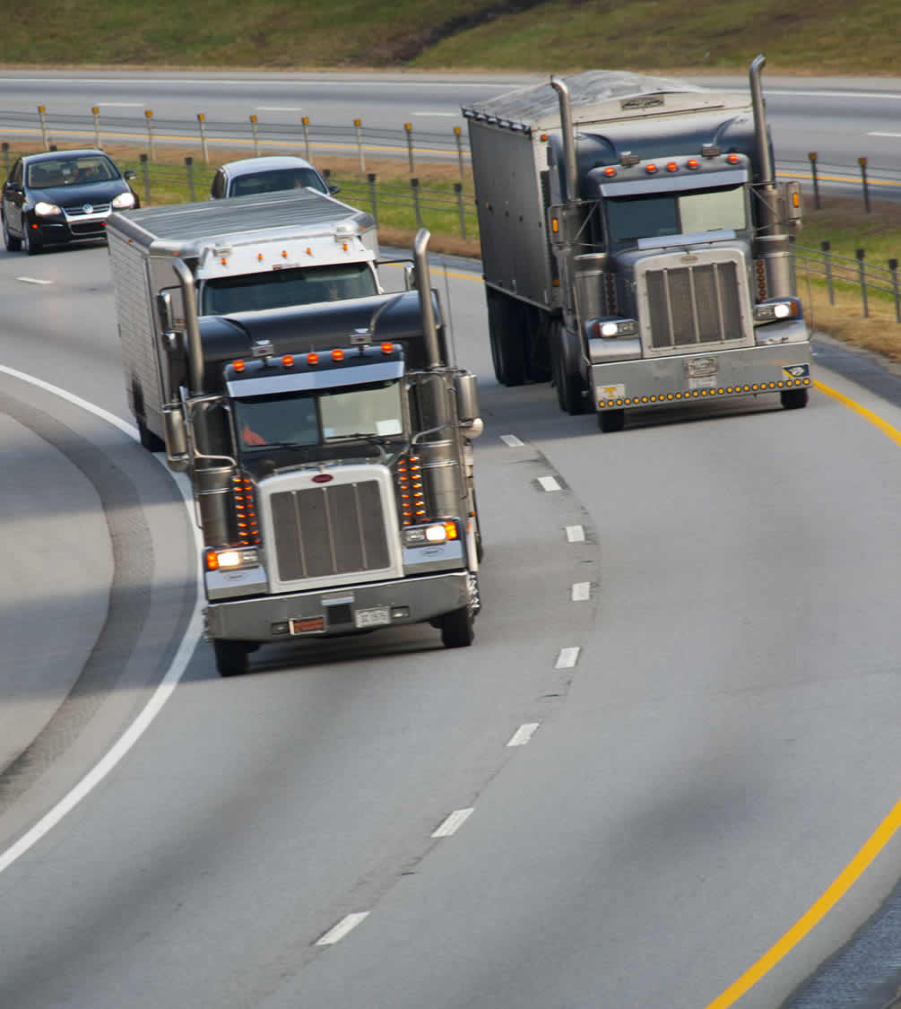
Speed Management
11
Copyright 2019 J. J. Keller & Associates, Inc.
Notes:
Unit A1.2.4 Speed Management
This unit must teach driver-trainees how to manage speed effectively in response to various road, weather, and traffic conditions. The instruction must include methods for calibrating safe following distances taking into account CMV braking distances under an array of conditions including traffic, weather, and CMV weight and length.

Slide 4
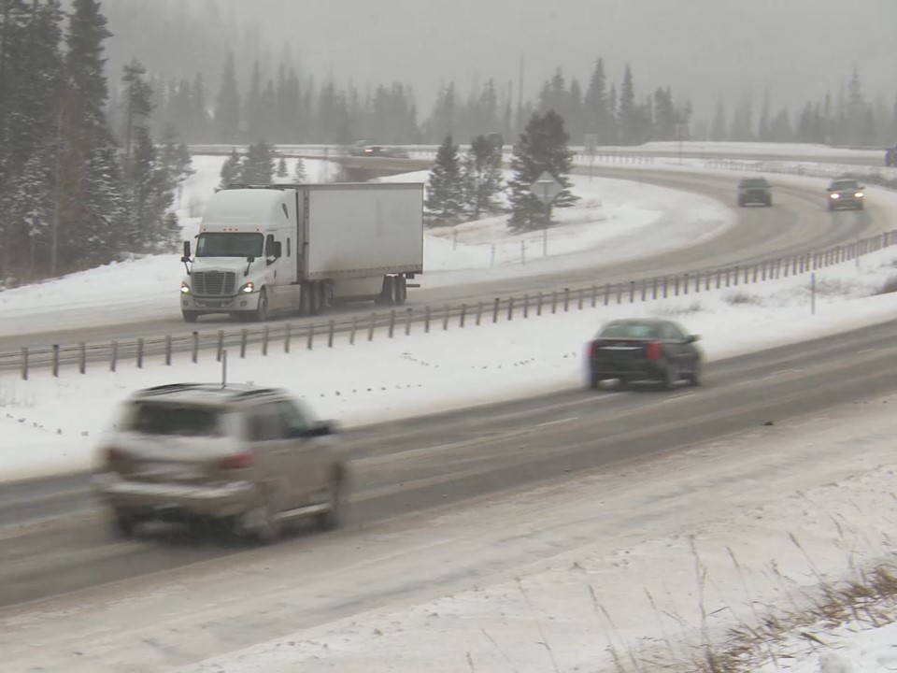
Introduction
Notes:
Proper speed management means operating at the appropriate speed for all road conditions. This includes taking into account the condition of the road, visibility, and traffic speed and flow.
This chapter focuses on the importance of managing your vehicle’s speed in order to stop safely.
CLASSROOM RECOMMENDATION
Make sure that your students understand that speed management is both a safety and image issue.
As a safety issue, excessive speed and/or driving too fast for conditions are often cited as reasons/causes of accidents.
As an image issue, your future professional drivers need to understand that speeding and other dangerous actions are magnified when operating a tractor-trailer. The actions of a handful of irresponsible drivers who speed can paint a negative picture of all drivers within this industry.

Slide 5
Objectives
Upon completion of this lesson, you will be able to:
Discuss the three factors that affect your
stopping distance
Recognize ways to manage your vehicle’s speed through curves and on grades
Describe why you should adjust your speed when you encounter poor road conditions, inclement weather, and heavy traffic
Explain why maintaining a safe speed is important as a professional driver
Notes:
Upon completion of this lesson, you will be able to:
Discuss the three factors that affect your stopping distance
Recognize ways to manage your vehicle’s speed through curves and on grades
Describe why you should adjust your speed when you encounter poor road conditions, inclement weather, and heavy traffic
Explain why maintaining a safe speed is important as a professional driver

Slide 6
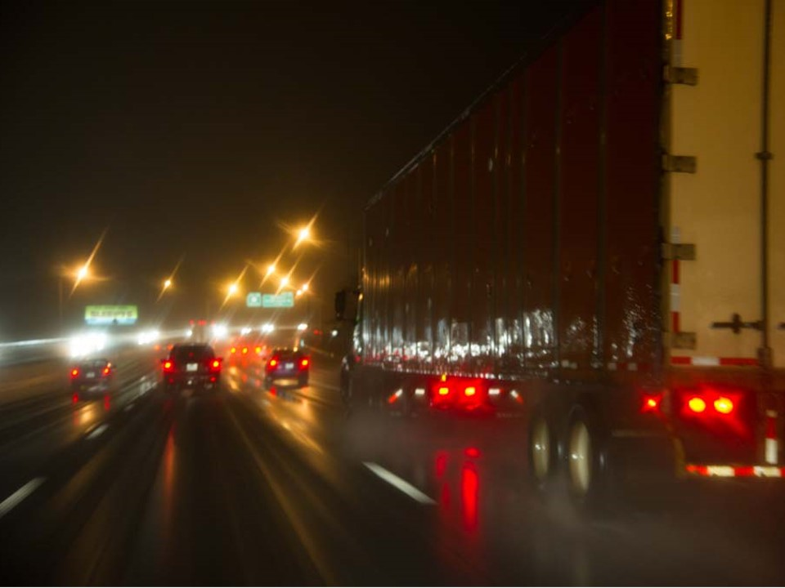
Stopping Distance
Notes:
Stopping Distance
RANGE RECOMMENDATION
Stopping distance
In this exercise, an instructor or student accompanied by an instructor will perform four runs of varying speeds (10 mph, 15 mph, 20 mph, 25 mph) on the same course to demonstrate the effect speed plays on stopping distance. The other students will observe this exercise from a safe distance with an instructor providing instruction on the relationship of speed to driver perception distance, reaction distance, vehicle braking distance, and total stopping distance.
On each trip down the course, once the vehicle has reached the appropriate speed, the driver will be instructed to stop as quickly as possible. Mark the points where the driver is told to brake, where he or she hits the brakes, and where the vehicle finally comes to a complete stop.
Once all four runs have been completed, compare the differences for each run.
VIDEO
11.1 — Stopping Distance

Slide 7
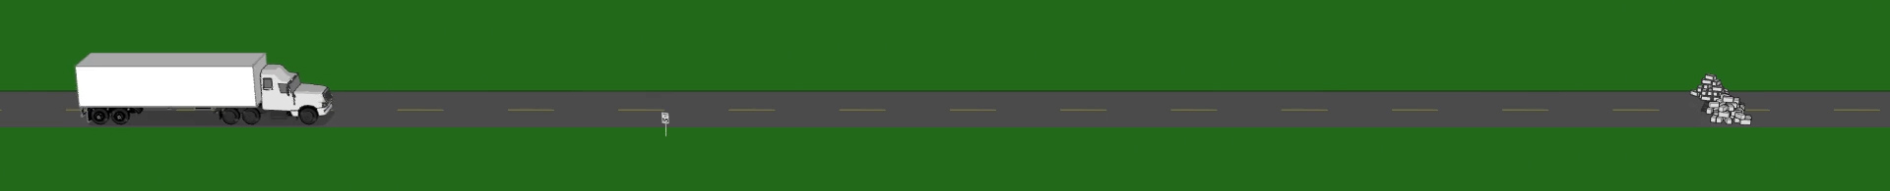
In order to manage speed, you need to understand the three factors involved in stopping a vehicle:
  Perception distance
  Reaction distance
  Braking distance
Notes:
You should always be able to stop within your field of vision. In other words, you should be able to stop within the distance you can see ahead.
In order to manage speed, you need to understand the three factors involved in stopping a vehicle:
Perception distance
Reaction distance
Braking distance

Slide 8
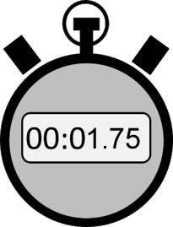
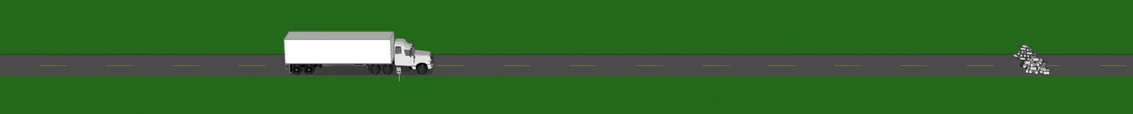
Perception Distance
The distance a vehicle travels from the time you see a hazard until your brain recognizes it.
145’
Notes:
Perception distance is the distance a vehicle travels from the time you see a hazard until your brain recognizes it. The perception time for an alert driver is approximately 1¾ of a second. At 55 mph, a commercial motor vehicle (CMV) travels roughly 145 feet in that amount of time.

Slide 9
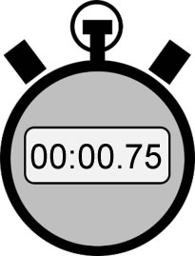
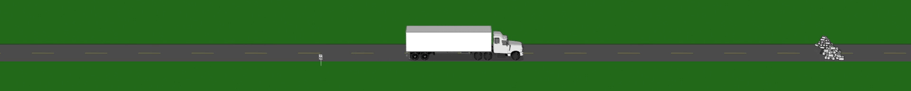
Reaction Distance
The distance a vehicle travels from the time your brain tells your foot to move from the accelerator until your foot hits the brake pedal.
60’
Notes:
Reaction distance is the distance a vehicle travels from the time your brain tells your foot to move from the accelerator until your foot hits the brake pedal. The average driver has a reaction time of ¾ of a second. At 55 mph, that accounts for an additional 60 feet traveled.

Slide 10
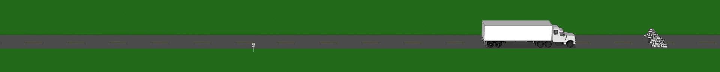
Braking Distance
The distance it takes a vehicle to stop once the brakes have been applied.
Distance is affected by weight, length, and speed of the vehicle, as well as road and weather conditions.
Notes:
Braking distance is the distance it takes a vehicle to stop once the brakes have been applied. Braking distance is affected by weight, length, and speed of the vehicle, as well as road and weather conditions.
Weight. The heavier the CMV, the more work the brakes have to do to stop it. But, brakes, tires, springs, and shock absorbers on heavy vehicles are designed to work best when the vehicle is fully loaded. Empty CMVs require greater stopping distances, as an empty vehicle has less traction than a full vehicle.
Length. The longer the vehicle, the more space it needs to stop. For example, a 40-foot truck, traveling at 40 mph needs at least four seconds of space, a 60-foot truck at the same speed needs at least six seconds of space.
Speed. The faster you drive, the greater your braking distance. When traveling at 60 mph, the braking distance is nine times greater than when traveling an 20 mph.

Slide 11

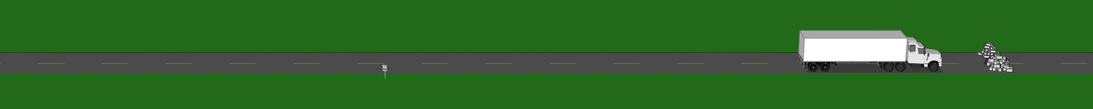
Braking Distance
If your vehicle has air brakes, as most CMVs do, there could be another ½ second delay before your brakes engage.
30’
Notes:
If your vehicle has air brakes, as most CMVs do, there could be another ½ second delay before your brakes engage. In that time, your CMV will travel another 30 feet or so.
CALLOUT: This delay is often referred to as brake lag.

Slide 12

Total Stopping Distance
Total Stopping Distance
Perception + Reaction + Braking
Distance Distance Distance
=
450’
Notes:
When you add together the perception, reaction, and braking distance, a loaded CMV traveling at 55 miles per hour in ideal conditions could travel a total distance of 450 feet and take about seven seconds to stop. When traveling at higher speeds that stopping distance will be even greater.

Slide 13
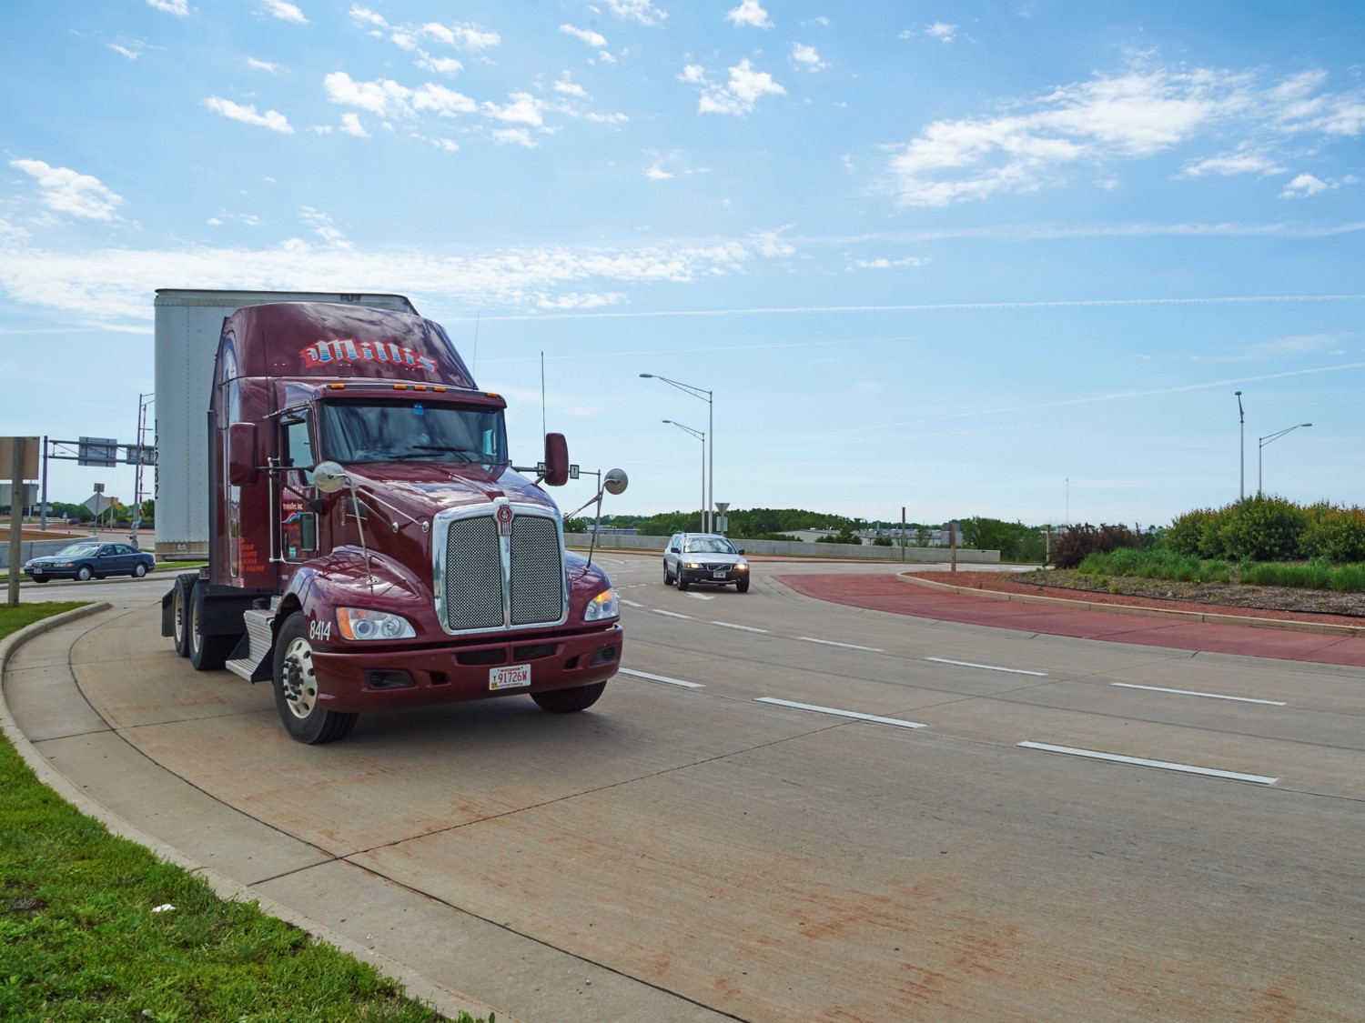
Road Design
Notes:
Road Design
RANGE RECOMMENDATION
Vehicle maneuverability
In this exercise, a student driver, accompanied by an instructor, will perform three runs of varying speeds (10 mph, 15 mph, 20 mph) on a serpentine course. Make sure you use the same driver for all three runs to assure consistency, as student skill may vary. The other students should observe this exercise from a safe distance with an instructor pointing out the differences in vehicle maneuverability in each run.
After the demonstration, discuss the effects speed had on vehicle maneuverability.

Slide 14
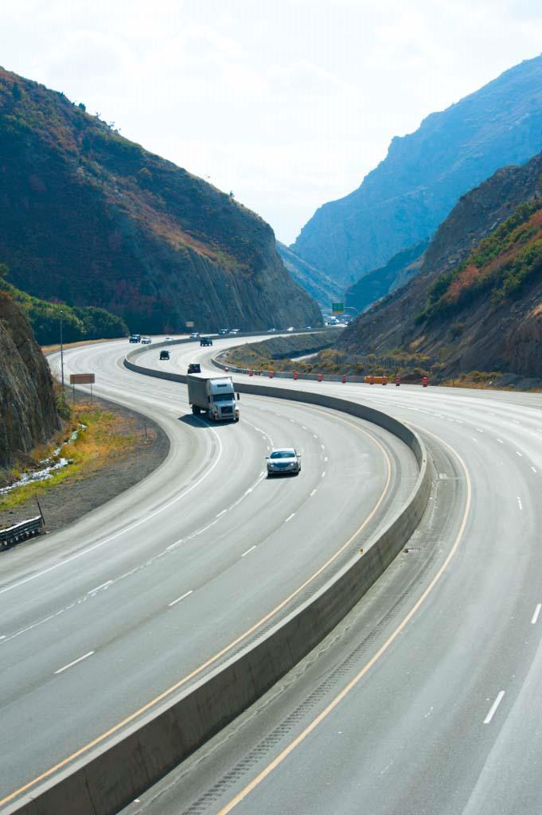
How a road is designed will also play a part in how you manage your vehicle’s speed.
Curves or grades will create additional factors to take
into consideration.
Notes:
How a road is designed will also play a part in how you manage your vehicle’s speed. When operating a CMV on a curve or grade, you will need to take factors into consideration that you may not have to address when operating your car or truck.

Slide 15
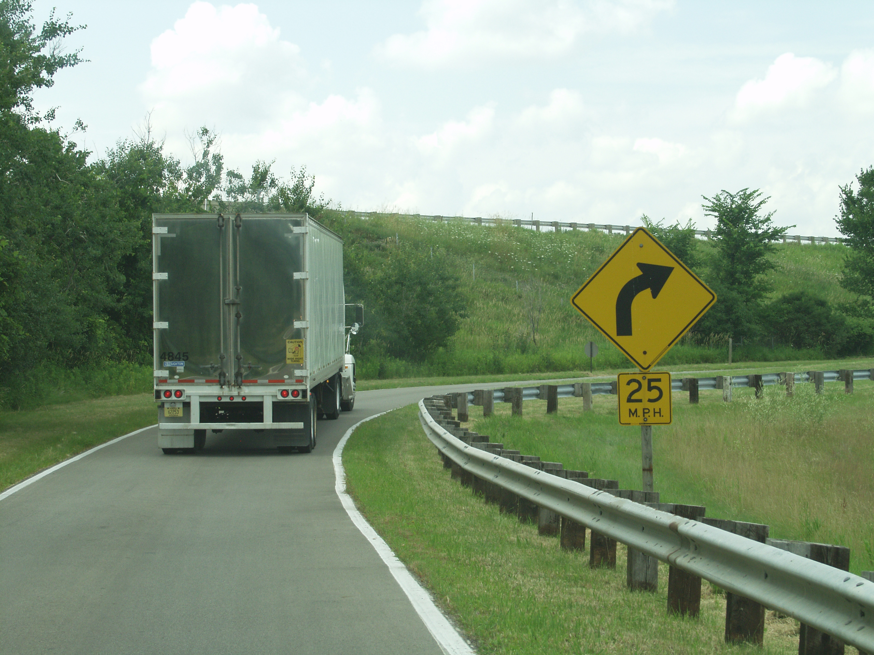
Slow to a safe speed before entering a curve, at least five mph below the posted speed limit.
Posted speed limits
on curves are designed with cars in mind.
Notes:
The posted speed limits on curves are designed with cars in mind. Driving a tractor-trailer through a curve too fast (at or above the posted speed limit) can cause several problems, including skidding off the road or rolling the vehicle over.
Slow to a safe speed before entering a curve, at least five mph below the posted speed limit. Slow down as needed, but keep in mind that braking in a curve can be dangerous. It is easier to lock your vehicle’s wheels and cause a skid.
Never exceed the posted speed limit in a curve. Also, to help maintain vehicle control, be in a gear that will let you accelerate slightly as you go through the curve.

Slide 16
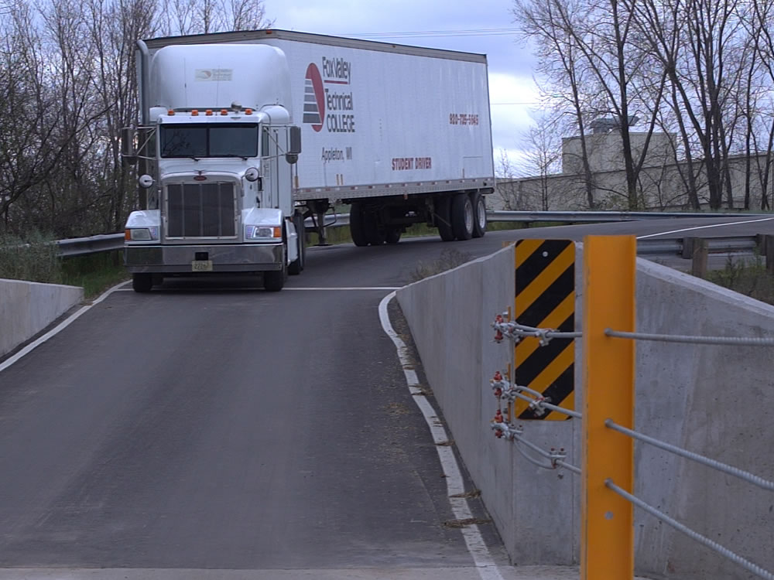
On a downgrade, your vehicle is working with gravity, resulting in an increase in speed.
On an upgrade, your vehicle has to work harder to fight the pull of gravity and maintain its speed.
Notes:
Gravity and vehicle weight play a part in speed management when driving on upgrades and downgrades.
On an upgrade, your vehicle has to work harder to fight the pull of gravity and maintain its speed. To maintain speed, you must place more pressure on the accelerator, and/or possibly shift to a lower gear.
On a downgrade, your vehicle is working with gravity, resulting in an increase in speed. Vehicle weight also has an impact on truck speeds going down a grade. Heavier trucks want to accelerate faster than lighter ones. You must use care in maintaining a safe and even speed.

Slide 17
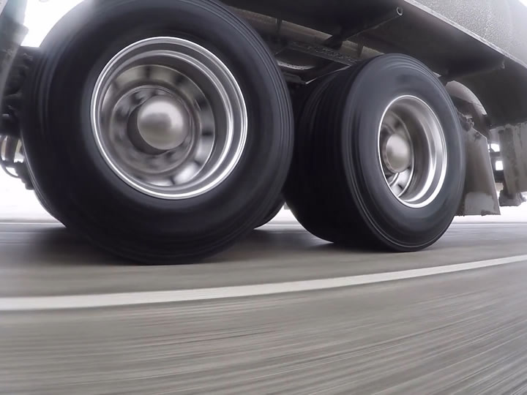
Road Conditions
Notes:
Road Conditions
VIDEO
11.2 — Road Hazards

Slide 18
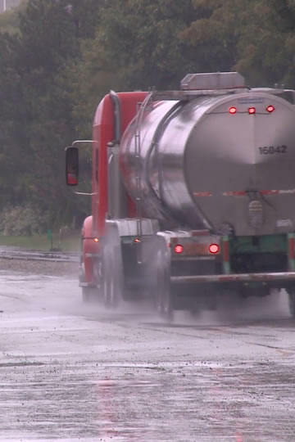
The condition of the road will play a part in determining a safe speed to travel.
If you encounter any
of the following, you should slow down and use extra caution.
Notes:
The condition of the road will play a part in determining a safe speed to travel. If you encounter any of the following, you should slow down and use extra caution.

Slide 19
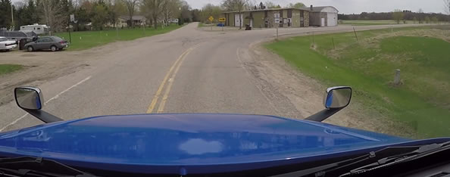
Drop-Offs
Driving too near the edge of the road can tilt your vehicle toward the side of the road.
Notes:
There are times when you will encounter the pavement dropping off sharply at the edge of the road. Driving too near the edge of the road can tilt your vehicle toward the side of the road. This can make it difficult to steer your vehicle should you cross the drop-off when going off the road or trying to return to the road.

Slide 20
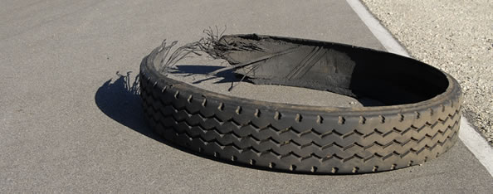
Foreign Objects
Things that have fallen onto the road can be a danger to you, your vehicle, and other motorists.
Notes:
Things that have fallen onto the road can be a danger to you and other motorists. They can be a danger to your tires and wheel rims and can get caught between dual tires. Foreign objects in the road can also cause damage to electrical and brake lines.
Though an object may appear to be harmless, you cannot be certain. That box or bag that appears to be empty may contain something that could cause damage to your vehicle.

Slide 21
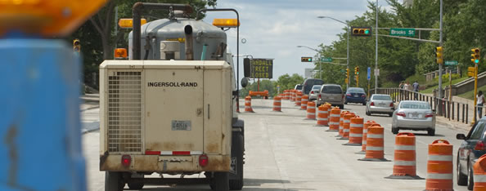
Road Construction
Be careful of narrower lanes, sharp turns, and uneven surfaces. Watch for construction workers and distracted drivers. Drive slow.
Notes:
Road construction poses its own set of hazards. Narrower lanes, sharp turns, and uneven surfaces are all hazards experienced in a work zone.
Watch for construction workers and pay attention to other drivers who may be distracted.
Reduced speed limits are also posted in work zones. Make sure you travel at or below the posted speed limit. Many states have enhanced penalties for exceeding the speed limit in a work zone.

Slide 22
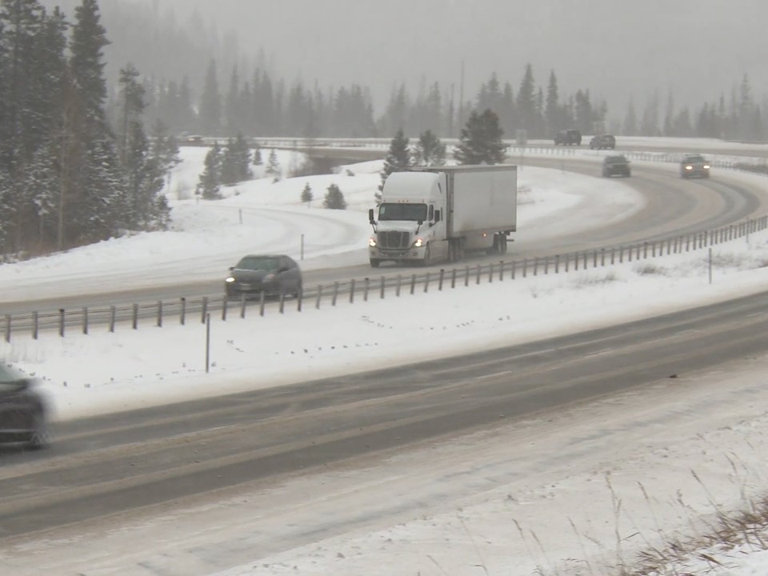
Weather Conditions
Notes:
Weather Conditions
VIDEO
11.3 — Weather Conditions

Slide 23
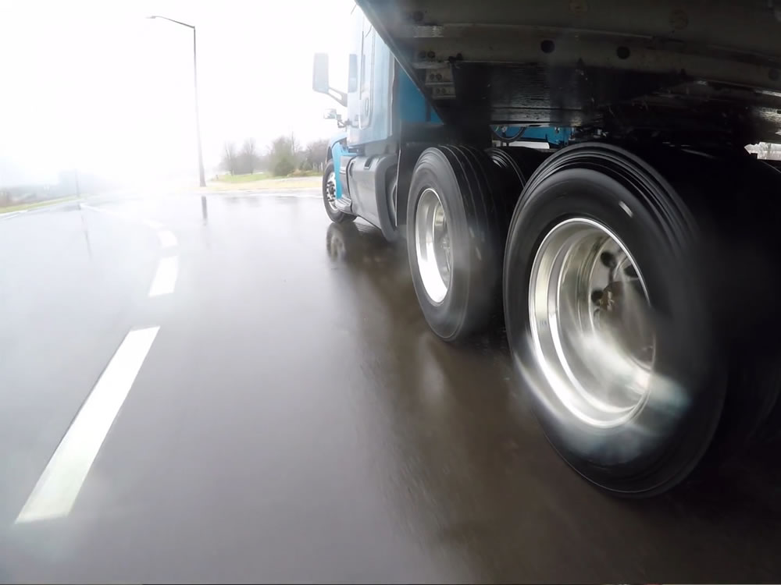
Traction and visibility are two factors that are affected by extreme weather conditions.
Traction is necessary for vehicle control.
Notes:
Traction and visibility are two factors that are affected by extreme weather conditions. Traction is necessary for vehicle control. The less friction between a vehicle’s tires and the road, the less traction. Certain road conditions reduce traction and lower speeds are necessary.
When driving in poor weather conditions such as rain, fog, or snow, or when driving at night, you will need to slow down so you can stop your vehicle within your field of vision.

Slide 24
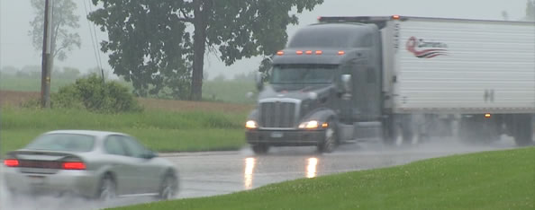
Rain
Rain can reduce a vehicle’s traction.
Notes:
Rain can affect a vehicle’s traction. As rain begins to fall, it mixes with oils on the road, causing them to rise to the road’s surface. Until enough rainfall breaks down and washes them away, there will be a layer of slippery oil between a vehicle’s tires and the road. This condition can last anywhere from a few minutes to a few hours.
New pavement is more slippery when wet than old pavement. New pavement has a greater concentration of oils that have yet to be washed away by years of rain. White foam on the road is an indication of oil and water mixing, a clue that the road surface is slippery.
Heavy rain can cause a vehicle to hydroplane or cause the vehicle’s tires to lose traction and skim along the water’s surface. When a vehicle hydroplanes, its tires are not in contact with the road and traction is lost, resulting in a loss of vehicle control. If recent rainfall has been heavy, approach standing water with caution. When it rains, vehicle speeds should be reduced by at least one-third.

Slide 25
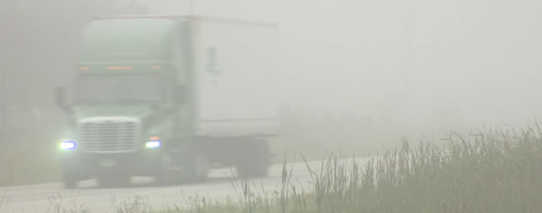
Fog
Fog limits your ability to see far enough ahead and to judge distances. It also limits the ability of other drivers to see you.
Notes:
Fog is the most common visibility challenge you’ll face when driving. Fog limits your ability to see far enough ahead and to judge distances. It also limits the ability of other drivers to see you.
Fog is often unexpected, and visibility can deteriorate quickly. If you come upon fog, reduce your vehicle speed, use low beam headlights, drive within the range of your headlights, and never assume the fog will clear once you have entered it.

Slide 26
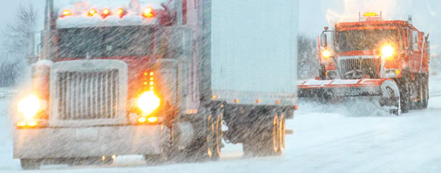
Snow
Snow causes reduced traction and limited visibility. If the snow becomes hard packed, it can form an icy surface.
Notes:
Snow causes reduced traction and limited visibility. Light, powdery snow can cover the road and form a slick, smooth surface. A heavier, slushy snow can affect vehicle control. If the snow becomes hard packed, it can form an icy surface.
Vehicle speeds should be reduced by at least one-half in snowy conditions. Remember, when determining vehicle speed in snowy conditions, you must be confident that you can safely stop and maneuver based on road conditions.

Slide 27
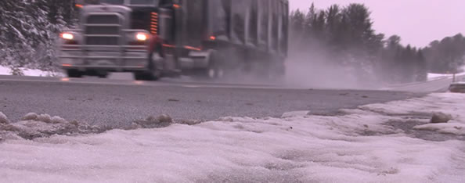
Ice
When temperatures are near freezing, you have to be alert to the potential for black ice.
Copyright 2019 J. J. Keller & Associates, Inc.
Notes:
Ice-covered roads can be even more dangerous than snow-covered roads. When temperatures are near freezing, you have to be alert to the potential for black ice. Black ice forms when temperatures drop rapidly and moisture on the road freezes into a smooth, nearly invisible, slippery surface. In black ice conditions, the road appears to be wet, when actually it is icy.
To check for ice formation, feel the front of the vehicle’s mirrors or antenna. If ice is forming there, it is also forming on the road. Also watch the spray off of other vehicles. If the spray stops, ice may be forming.
At the very least, you should slow your vehicle speed by one-half in icy conditions. As with snowy conditions, when determining vehicle speed, you must be confident that you can safely stop and maneuver based on road conditions. If conditions seem too hazardous, get off the road and find a safe place to stop until the weather improves.
When the temperature drops, bridges can freeze before the road does. If slippery conditions are likely, avoid any change (acceleration, shifting, or braking) in driving habits while crossing a bridge. Maintain a smooth and steady speed.

Slide 28
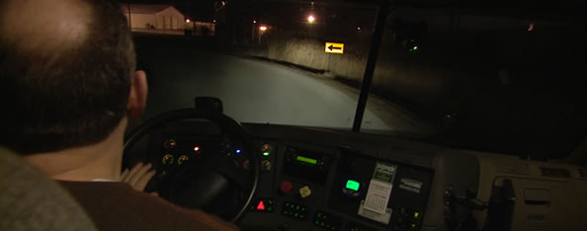
Night Driving
Hazards aren’t as easy to see, and you may not recognize them as quickly as you would during the day.
Notes:
At night, hazards aren’t as easy to see, and you may not recognize them as quickly as you would during the day. Because of this, you should reduce vehicle speed, increase following distance, and drive within the range of your headlights. Over driving the headlights can adversely affect visibility as well as your ability to stop for hazards.
When rounding a curve, headlights shine straight ahead (off the road) reducing vision. Reducing vehicle speed is the best way to deal with curves.

Slide 29
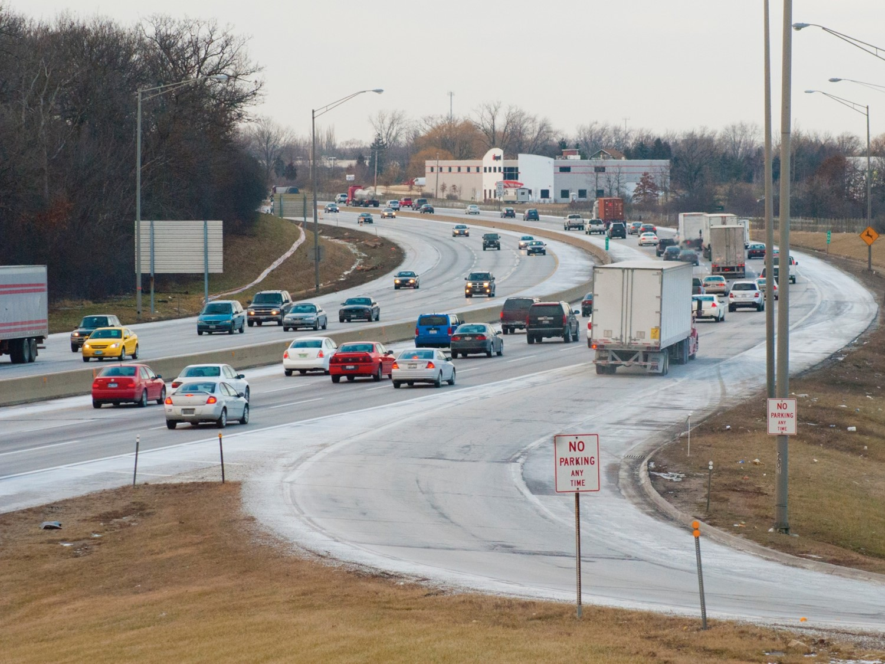
Heavy Traffic
Notes:
Heavy Traffic

Slide 30
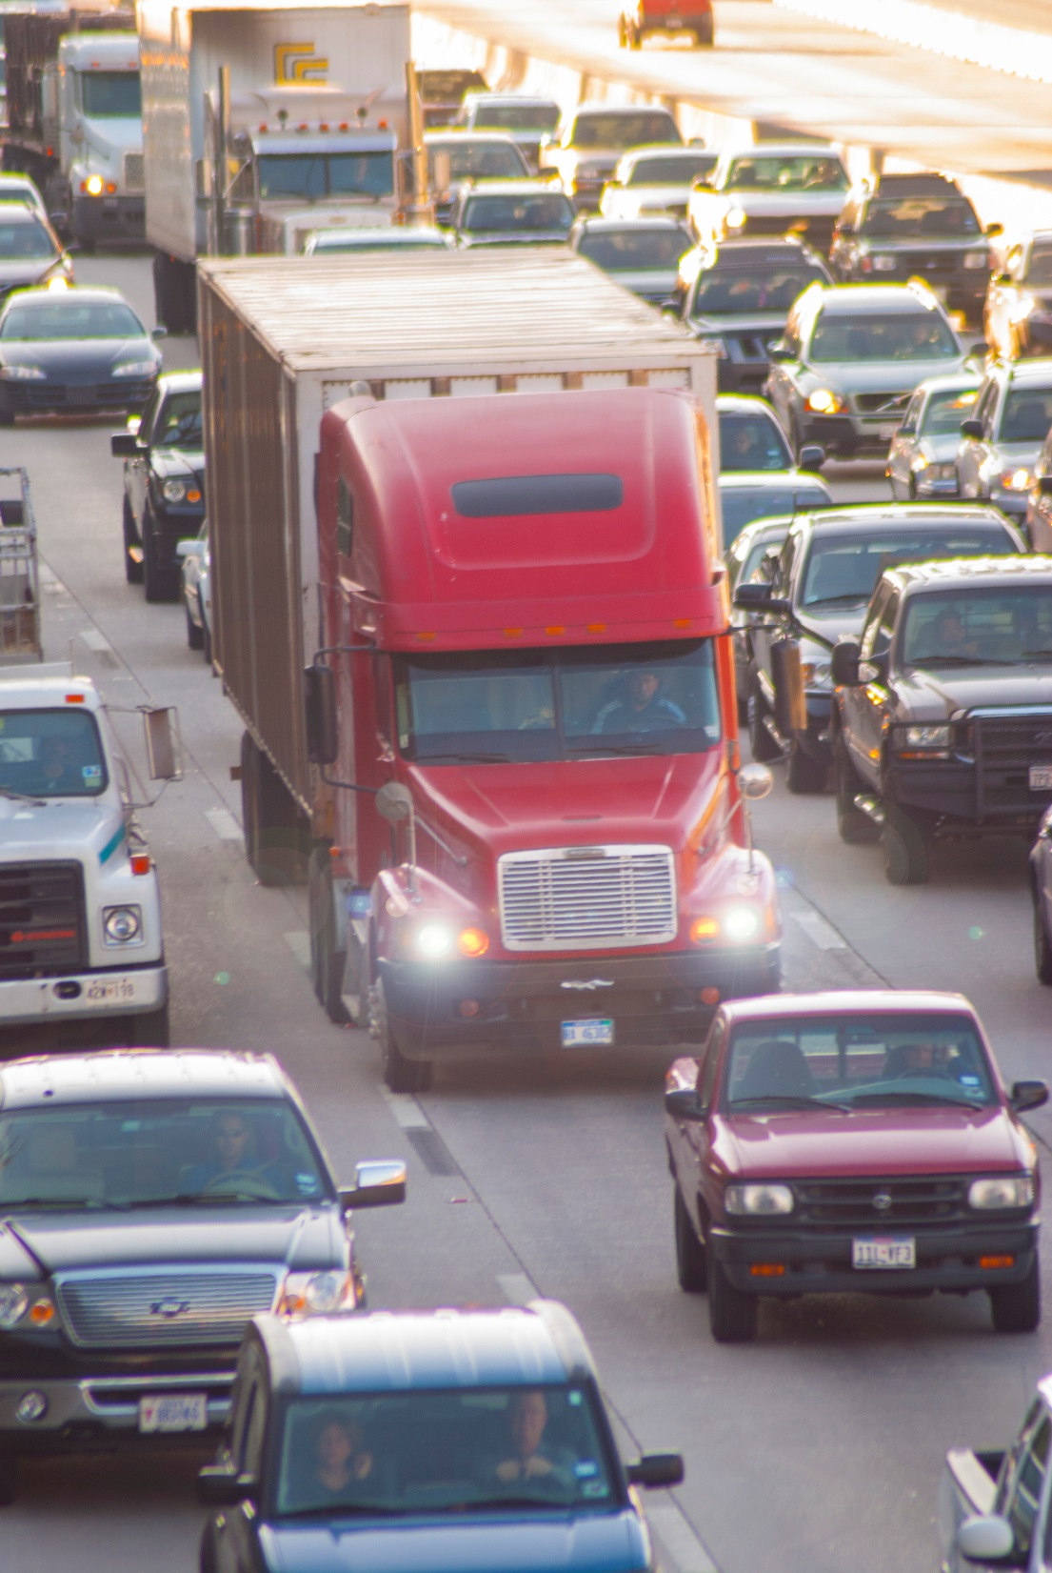
It is best to go with the flow of traffic when safe and legal to do so.
Notes:
When driving in heavy traffic, the safest speed is generally the speed of the other vehicles on the roadway, provided you can maintain an adequate following distance and you are not violating the posted speed limit. If you are unable to maintain a safe following distance, slow your vehicle three to four miles per hour less than the flow of traffic.
Often, drivers believe that exceeding the speed limit can save (or make up) time. When operating in traffic, this isn’t always the case. If you are traveling faster than the speed of other traffic, you will have to pass other vehicles. This increases your chances of being involved in an accident. This type of driving can also add to your level of fatigue which can also increase your chances of being involved in an accident.
It is best to go with the flow of traffic when safe and legal to do so.

Slide 31
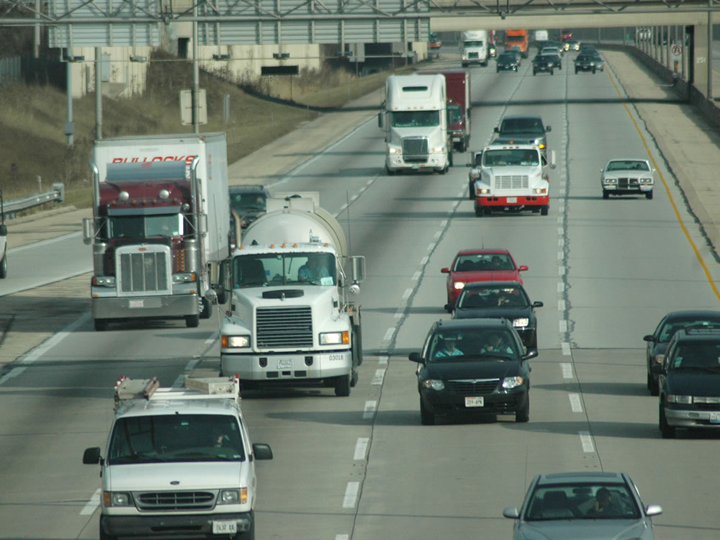
Maintain a Safe Speed
Notes:
Maintain a Safe Speed

Slide 32
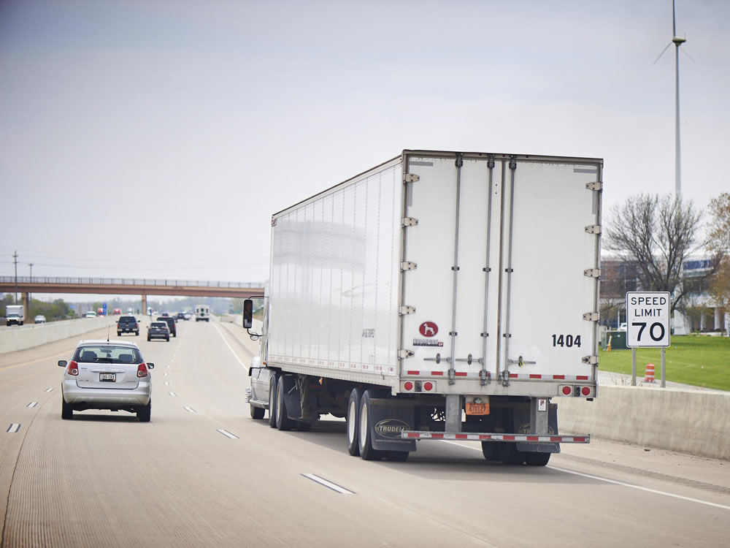
Speed limits take into account several issues, including sight distance limitation, road conditions, and traffic volume.
There are many
reasons why you
should not speed.
Notes:
Speed limits are based, in part, on the principles of good speed management. They take into account several issues, including sight distance limitation, road conditions, and traffic volume. There are many reasons why you should not speed, including accidents, penalties, maintenance costs, and fuel economy.

Slide 33
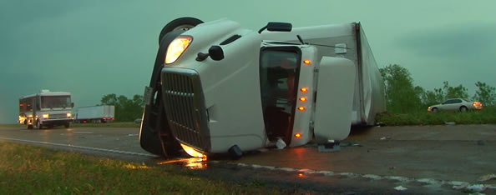
Accidents
Accidents are more likely to occur at higher speeds.
Notes:
Accidents are more likely to occur at higher speeds. There’s less reaction time and you aren’t able to have as much control of your vehicle.

Slide 34
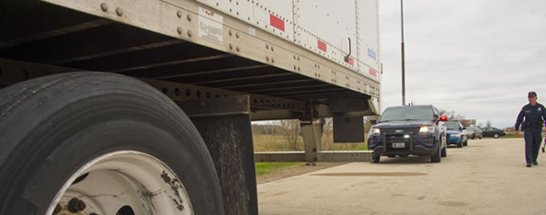
Penalties
Excessive speeding can disqualify you from operating a CMV. Speeding convictions are costly and become part of your driving record.
Notes:
Two or more convictions for excessive speeding (15 mph or more over the speed limit) in either a commercial or non-commercial vehicle (including your personal vehicle) can disqualify you from operating a CMV. Section 383.51 of the Federal Motor Carrier Safety Regulations (FMCSRs) states that you can be disqualified for a period of 60-120 days for excessive speeding violations.
All speeding convictions (whether they prompt disqualification or not) become part of your permanent driving record. Your driving record must be reviewed by your employer each time you begin work for a new motor carrier and then at least once each year.
Also, speeding convictions can be costly. As well as incurring fines, speeding convictions may be tracked by your insurance carrier, prompting higher premiums.

Slide 35
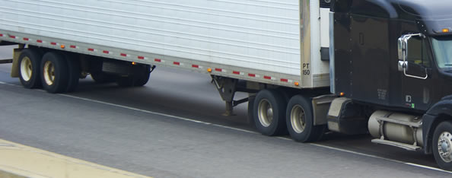
Maintenance Costs
Tires and brakes wear out faster at higher speeds. As speed increases, so does overall wear.
Notes:
Higher speeds can affect maintenance costs. Tires and brakes wear out faster at higher speeds. As speed increases, so does overall wear.

Slide 36
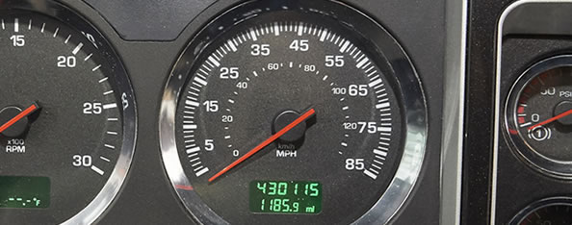
Fuel Economy
Tires and brakes wear out faster at higher speeds. As speed increases, so does overall wear.
Notes:
Your speed has a direct and substantial effect on your fuel economy. By adjusting your speed down, even a couple miles per hour, you can positively affect your fuel mileage and save thousands of dollars over the course of a year.

Slide 37
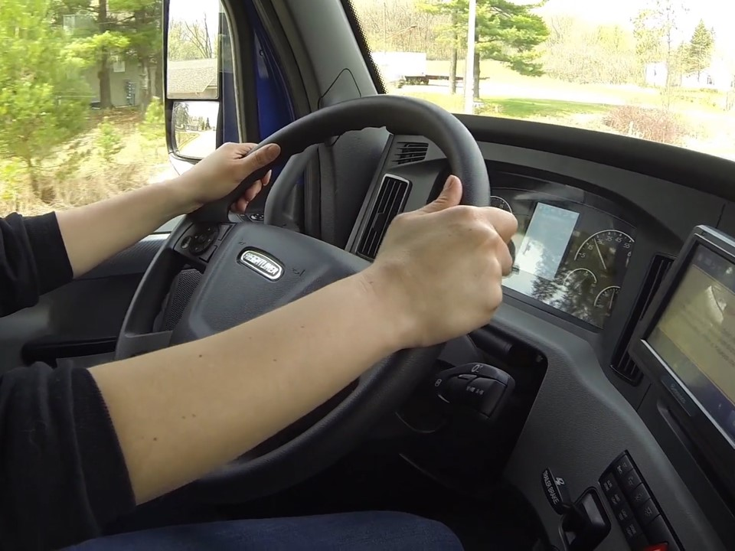
Use of Cruise Control
Notes:
Use of Cruise Control

Slide 38
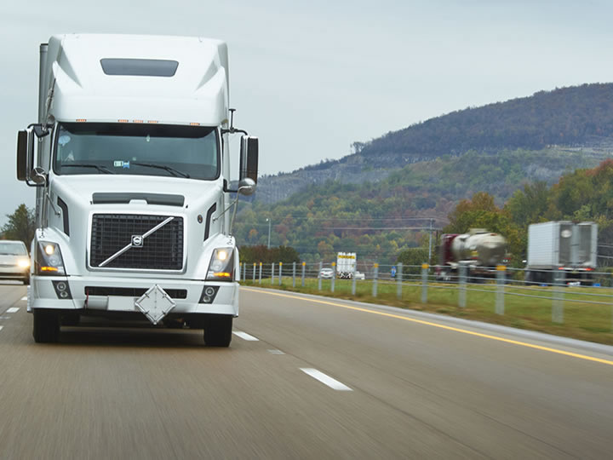
Only use cruise control:
  In good driving conditions
  During daylight hours
  On roads that have light traffic, few curves or hills, and a consistent speed limit
Notes:
Due to safety concerns, many motor carriers have policies that limit or prohibit the use of cruise control.
If your motor carrier allows use of cruise control, it should only be used in good driving conditions, during daylight hours, on roads that have light traffic, few curves or hills, and a consistent speed limit.

Slide 39
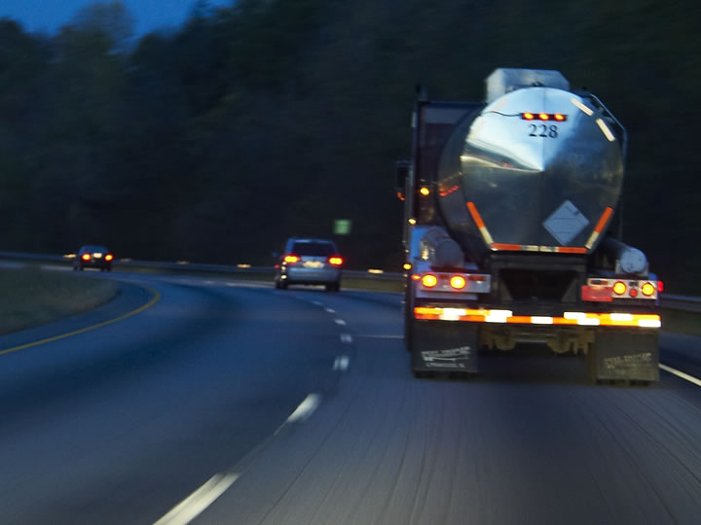
Never use cruise control:
  When operating in adverse driving conditions, including wet, icy, or slippery roads
  During rush hour, in heavy traffic, or on congested highways
  At night
  When you are tired
  or fatigued
Notes:
Cruise control should never be used in the following situations:
When operating in adverse driving conditions, including wet, icy, or slippery roads
During rush hour, in heavy traffic, or on congested highways
At night
When you are tired or fatigued

Slide 40
Objectives Review
You should now be able to:
Discuss the three factors that affect your
stopping distance
Recognize ways to manage your vehicle’s speed through curves and on grades
Describe why you should adjust your speed when you encounter poor road conditions, inclement weather, and heavy traffic
Explain why maintaining a safe speed is important as a professional driver
Copyright 2019 J. J. Keller & Associates, Inc.
Notes:
You should now be able to:
Discuss the three factors that affect your stopping distance
Recognize ways to manage your vehicle’s speed through curves and on grades
Describe why you should adjust your speed when you encounter poor road conditions, inclement weather, and heavy traffic
Explain why maintaining a safe speed is important as a professional driver
CLASSROOM RECOMMENDATION
Before concluding your training session, have participants take the corresponding quiz (found on the Trainer Tools USB) to check their understanding of the material. You can customize any of the questions to fit your audience or workplace. The answer key can also be found on the Trainer Tools USB.
You may also choose to administer the quizzes before you begin your training session to help get participants thinking about the subject and/or to gauge their understanding of the topic ahead of time.

