Slide 1






PowerPoint® Instructions
This PowerPoint has been designed so you can easily customize it for your training session.
Throughout the presentation you’ll see icons with recommendations or videos to enhance the instruction you present to your students. A detailed explanation for each icon can be found on the next slide. Videos can be found on the Trainer Tools USB.
When you see an icon on the slide, look in the notes
section for further information.
Simply delete or move the icon off the slide before your training session begins.

Slide 2





Classroom Recommendations. Provides suggestions for enhancing your classroom presentation; from ideas for large group discussions to suggestions on the use of training aids such as examples or photos of vehicle parts and components to help illustrate the items covered within a chapter.
Lab Recommendations. Provides suggestions for activities and exercises that take place outside the classroom, but do not involve
the actual operation of the tractor-trailer or its components. Examples
of lab sessions include conducting a vehicle inspection or practicing mirror adjustment.
Range Recommendations. These recommended activities take
place on a closed-access driving range where students may practice driving skills in a controlled environment. Examples of range sessions include practicing shifting technique and successfully completing a backing maneuver.
Road Recommendations. These recommended activities take place in road and traffic conditions that support the chapter’s objectives. Examples of road sessions include proper communication with other drivers through the use of turn signals and basic vehicle control under nighttime or extreme weather conditions.
Videos. These short video clips reinforce material presented in the Student Manual. Use them to help students grasp difficult concepts or subject matter.

Slide 3
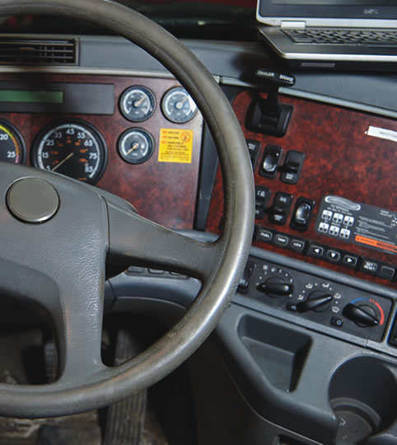
Control Systems/Dashboard
2
Copyright 2019 J. J. Keller & Associates, Inc.
Notes:
Unit A1.1.2 Control Systems/Dashboard
This unit must introduce driver-trainees to vehicle instruments, controls, and safety components. The training providers must teach driver-trainees to read gauges and instruments correctly and the proper use of vehicle safety components, including safety belts and mirrors. The training providers must teach driver-trainees to identify, locate, and explain the function of each of the primary and secondary controls including those required for steering, accelerating, shifting, braking systems (e.g., ABS, hydraulic, air), as applicable, and parking.

Slide 4
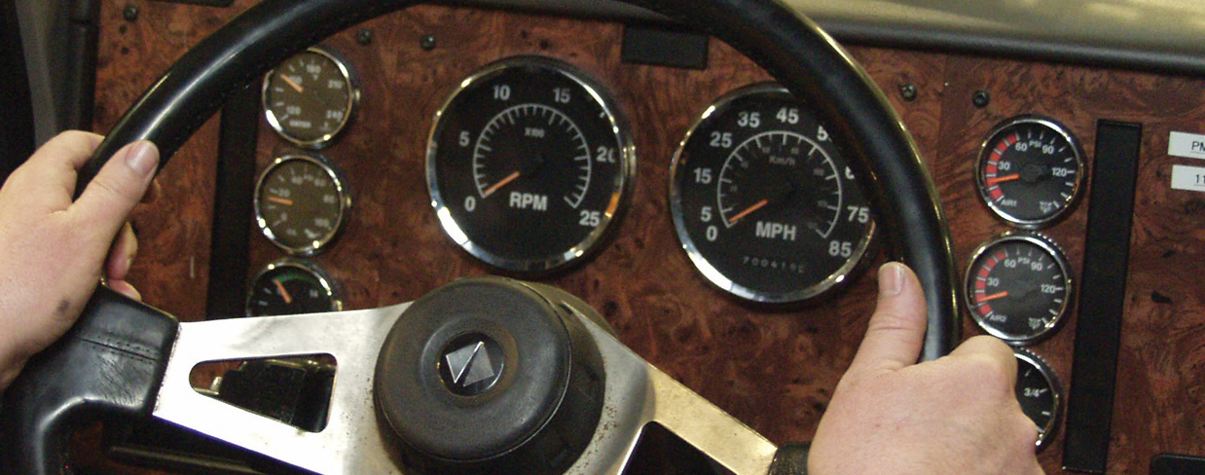
Introduction
We’ll introduce you to the controls and instruments found in CMVs
Notes:
As a professional driver, it is important that you understand the function of all controls and instruments of any vehicle you operate. Commercial motor vehicles (CMVs) are nothing like your personal vehicle. CMVs have numerous systems, controls, and instruments that you usually do not see in a personal vehicle.
This chapter will introduce you to the controls and instruments found in CMVs.
CLASSROOM RECOMMENDATION
Begin your session by stressing the importance of understanding vehicle controls and instruments. Make sure your students understand that vehicle controls are often the first (and sometimes only) indication that something is malfunctioning on the vehicle.
Students need to identify, locate, and explain the function of each of the primary and secondary controls.

Slide 5
Objectives
Upon completion of this lesson, you will be able to:
  Explain the purpose of a CMV’s engine controls
  Locate a CMV’s primary controls and discuss the function of each
  Describe the purpose of a vehicle’s secondary controls and identify their locations
  Recognize all vehicle instruments and explain the acceptable operating range for each
  Identify warning devices commonly found on a CMV
Notes:
Upon completion of this lesson, you will be able to:
Explain the purpose of a CMV’s engine controls
Locate a CMV’s primary controls and discuss the function of each
Describe the purpose of a vehicle’s secondary controls and identify their locations
Recognize all vehicle instruments and explain the acceptable operating range for each
Identify warning devices commonly found on a CMV

Slide 6
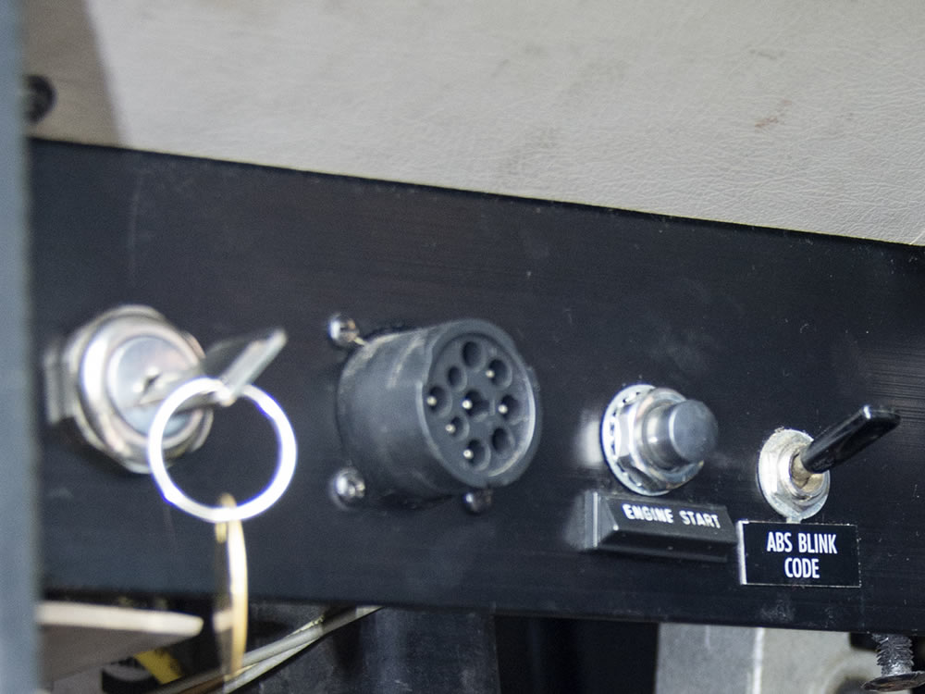
Engine Controls
Notes:
The engine controls are what you use to start up and shut down your CMV’s engine. Though similar in most vehicles, engine controls do vary somewhat based on the type of engine and engine manufacturer. Never operate a CMV until you have familiarized yourself with its instruments and controls.

Slide 7
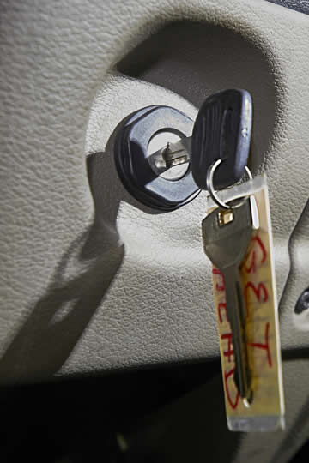
The engine control switch starts the engine. It must be on to start
the engine.
Notes:
The engine control switch starts the engine. It must be on to start the engine.

Slide 8
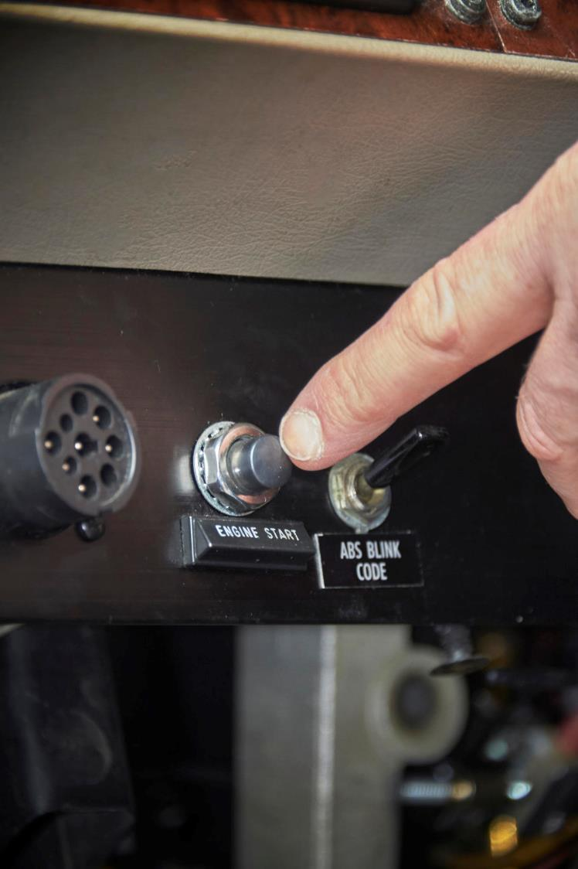
If the truck you are operating has a starter button, you must turn the engine key to the on position and then push the starter button. Normal cranking time should
be about three to
five seconds.
Notes:
Some trucks have a starter button. If the truck you are operating has a starter button, you must turn the engine key to the on position and then push the starter button. Normal cranking time should be about three to five seconds.

Slide 9
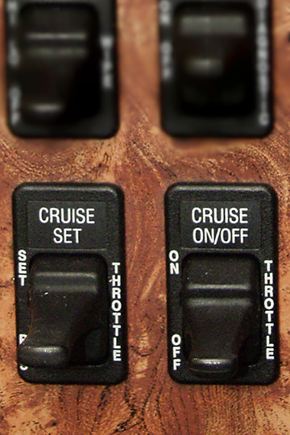
Cruise control allows the vehicle to maintain a steady, constant speed without depressing
the accelerator.
Notes:
Cruise control allows the vehicle to maintain a steady, constant speed without depressing the accelerator.

Slide 10
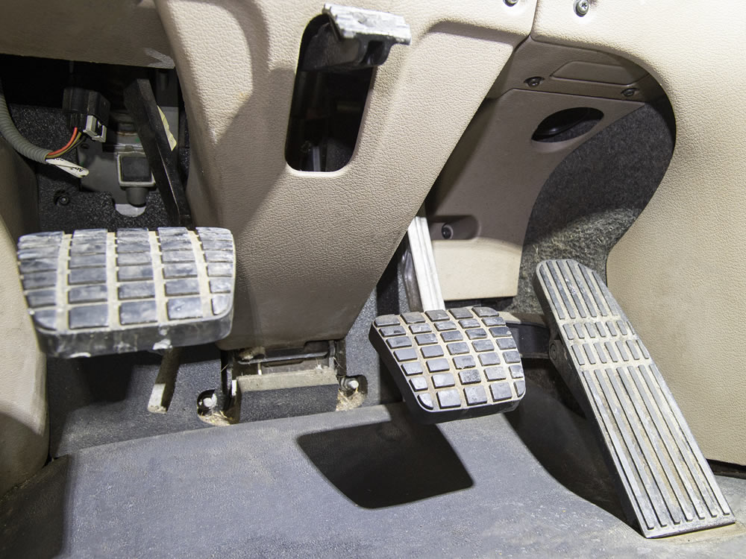
Primary Vehicle Controls
Notes:
The primary controls are the controls required for steering, accelerating, braking, and parking a CMV.

Slide 11
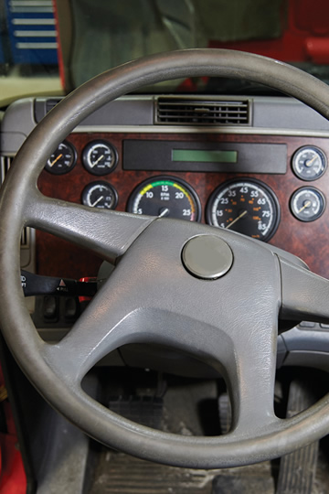
The steering wheel is used to steer the CMV. It has a larger diameter than your personal vehicle’s steering wheel.
Notes:
The steering wheel is used to steer the CMV. It has a larger diameter than your personal vehicle’s steering wheel.

Slide 12
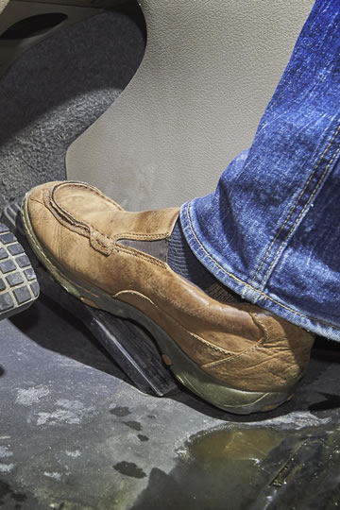
The accelerator pedal (throttle) controls the CMV’s speed.
You push the throttle down to increase speed and release it to reduce speed.
Notes:
The accelerator pedal controls the CMV’s speed. It is operated the same way on a CMV as on a car. During your training, you may also hear this referred to as the throttle.
You push the throttle down to increase speed and release it to reduce speed. Proper use of the throttle allows you to safely control the vehicle’s speed, avoiding excessive use of the vehicle’s service brakes.

Slide 13
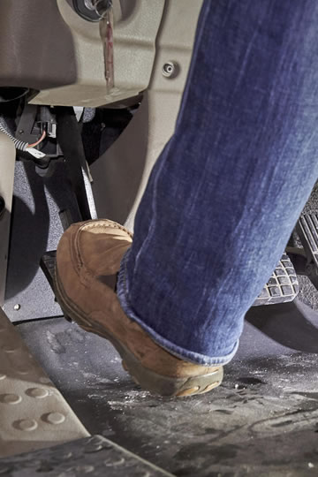
The clutch pedal is used to engage and disengage the clutch and to shift gears.
Notes:
The clutch pedal is used to engage and disengage the clutch and to shift gears.
Extensive damage can be caused to the transmission or drive train if the clutch isn’t operated properly.

Slide 14
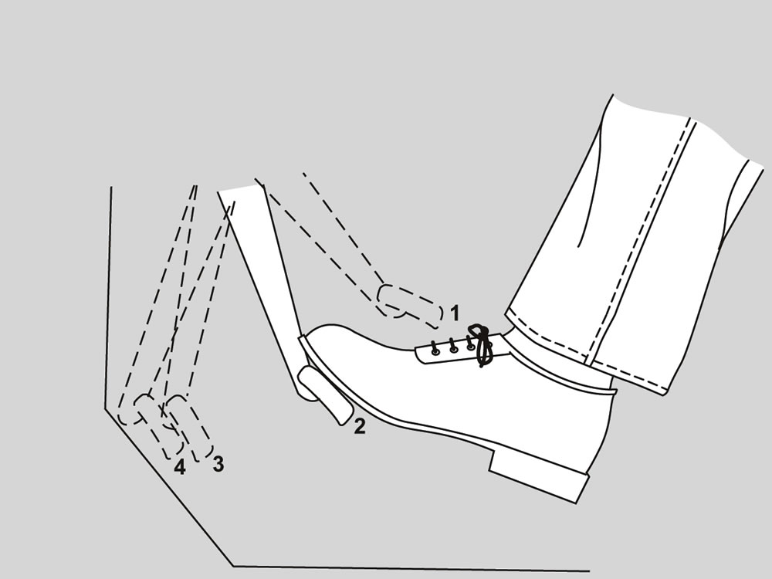
Engaged
Free Play
Disengaged
Clutch Brake
Notes:
There are four basic clutch positions:
Engaged. When the clutch is engaged, the pedal is fully released (your foot isn’t depressing the pedal). The engine and drive train are connected, if the vehicle is in gear.
Free play. Free play is the amount of movement possible without engaging or disengaging the clutch. Free play is necessary to prevent excessive clutch wear. Normal free play is about one to two inches.
Disengaged. The clutch is disengaged when the pedal is depressed about three to eight inches. In this position, the engine and drive train are separated. The clutch must be disengaged to start the engine or shift gears.
Clutch brake. When disengaged, the transmission of a CMV spins. Because of this, the use of the clutch brake will stop the transmission from turning. This is done while at a stop, not while moving. By depressing the clutch pedal to the floor, the clutch brake will be engaged, bringing the transmission to a stop, which makes it possible to shift into the desired starting gear (forward or reverse).

Slide 15
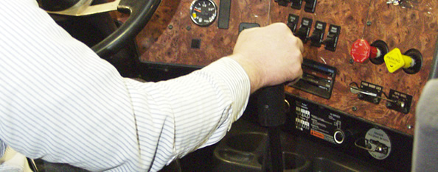
Transmission Controls
The transmission controls vary depending on the type of transmission in the truck
Notes:
The transmission controls vary depending on the type of transmission in the truck.

Slide 16

A manual transmission uses a clutch and a gear shift lever. You have to manually change gears.
Notes:
A manual transmission uses a clutch and a gear shift lever. You have to manually change gears.
The gear shift lever may include a range selector lever, allowing you to switch between high and low ranges. The down position includes the low range of gears and the up position includes the high range of gears. A splitter valve or button allows you to split gears on 13 and 18 speed transmissions.

Slide 17
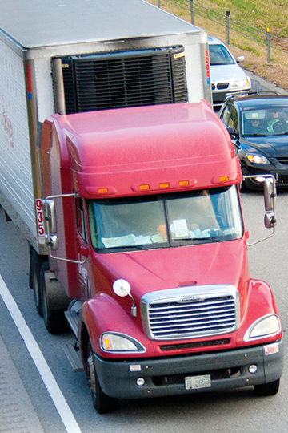
A semiautomatic transmission includes a clutch and gear shift lever. There could also be a control pad with push-buttons on it, instead of a gear shift lever. Some gear changes are done by an on-board computer and some are
done manually.
Notes:
A semiautomatic transmission includes a clutch and gear shift lever. There could also be a control pad with push-buttons on it, instead of a gear shift lever. Some gear changes are done by an on-board computer and some are done manually.

Slide 18
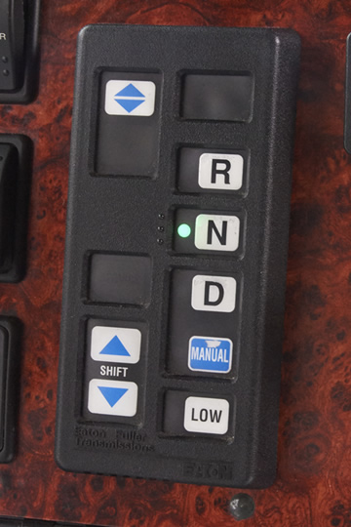
An automatic transmission only has a gear shift lever, or touch pad. A clutch may not be needed in some models. All gear changes are done by an on-board computer and hydraulics.
Notes:
An automatic transmission only has a gear shift lever, or touch pad. A clutch may not be needed in some models. All gear changes are done by an on-board computer and hydraulics.

Slide 19
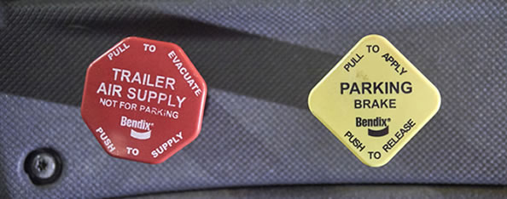
Brake Controls
The brakes are used to slow or stop the vehicle
Notes:
The brakes are used to slow or stop the vehicle. The air brake control system is complex and involves several separate controls.

Slide 20
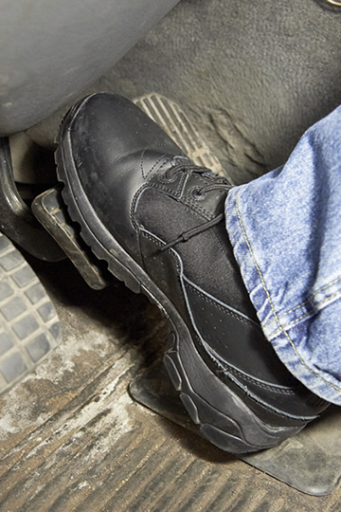
The foot brake control valve operates both the tractor’s and trailer’s service brakes. When depressed, it supplies air pressure to all brake chambers.
Notes:
The foot brake control valve (also called the service brake, foot valve, or treadle valve) operates both the tractor’s and trailer’s service brakes. When depressed, it supplies air pressure to all brake chambers.

Slide 21
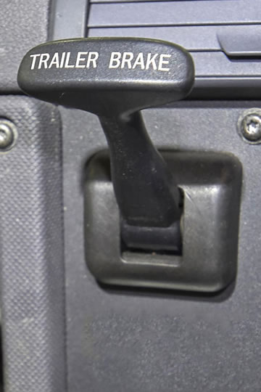
The trailer brake
hand-control valve operates the service brakes on the trailer only.
It is only used in
special situations.
Notes:
The trailer brake hand-control valve (also called the hand valve, trolley valve, or independent trailer brake) operates the service brakes on the trailer only. It is only used in special situations. It shouldn’t be used to hold equipment in place while parked or to slow the vehicle. Improper use could cause the trailer to skid or jackknife.

Slide 22
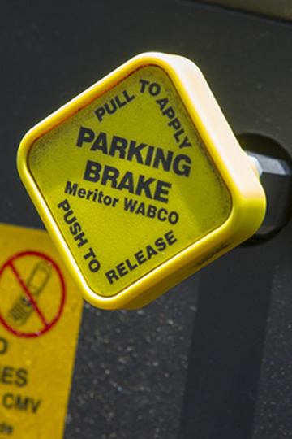
The parking brake control valve is a yellow, diamond-shaped knob that allows the driver to activate the parking brake.
The parking brake
should only be used when the vehicle is completely stopped.
Notes:
The parking brake control valve is a yellow, diamond-shaped knob that allows the driver to activate the parking brake. The parking brake should only be used when the vehicle is completely stopped. The parking brake should always be engaged (pulled out) before you leave the driver’s seat or turn the engine off. Failure to engage (pull out) the parking brake could cause the vehicle to roll, even if it is assumed that the vehicle is on level ground.

Slide 23
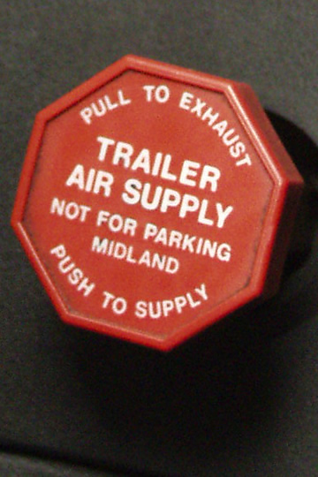
The trailer air supply valve is a red eight-sided button that controls air supply to the trailer brakes. It must be released (pushed in) for normal operation with a trailer and applied (pulled out) for operation on a tractor without a trailer.
Notes:
The trailer air supply valve is a red eight-sided button that controls air supply to the trailer brakes. It must be released (pushed in) for normal operation with a trailer and applied (pulled out) for operation on a tractor without a trailer. It closes automatically if the airlines to the trailer are broken.

Slide 24
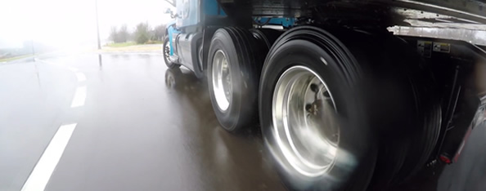
Antilock Brakes
Help prevent wheels from locking and losing traction, which can cause a loss of vehicle control
Notes:
Since 1998, the National Highway Traffic Safety Administration (NHTSA) has required that all newly manufactured truck tractors be equipped with an antilock braking system (ABS). When used properly, antilock brakes help prevent wheels from locking and losing traction, which can cause a loss of vehicle control.
The biggest difference between ABS and other brake systems is how you use the brake pedal to stop the vehicle. With traditional brakes, you would pump the brake pedal should a wheel or wheels begin skidding. With ABS, firm and continuous pressure on the pedal is needed to make the brakes work properly.

Slide 25
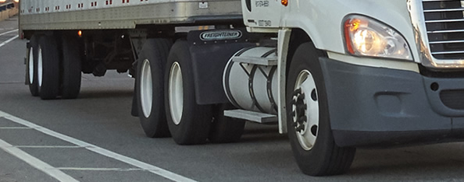
Auxiliary Brakes & Retarders
Reduce the vehicle’s speed without using the service brakes
Notes:
Auxiliary brakes and retarders reduce the vehicle’s speed without using the service brakes. They keep service brakes from being overused and becoming overheated. They should only be used on dry road surfaces. There are three basic classes of auxiliary brakes and retarders. Few trucks have all three types of auxiliary brake systems. Most have one. Know which type your truck has and how it operates.

Slide 26
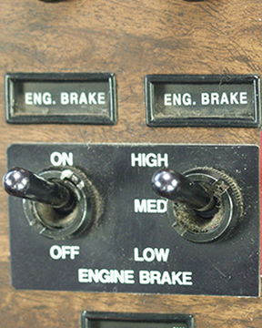
Exhaust Brakes
Valve is installed in the exhaust manifold that keeps exhaust gasses from escaping; this build up of back pressure in the engine, prevents it from increasing speed.
Controlled by an on/off switch in the cab or an automatic control switch on the accelerator
or clutch.
Notes:
Exhaust brakes. Exhaust brakes are considered the simplest form of heavy vehicle retarder. A valve is installed in the exhaust manifold that keeps exhaust gasses from escaping. This builds up back pressure in the engine, preventing it from increasing speed. Exhaust brakes are usually controlled by an on/off switch in the cab or an automatic control switch on the accelerator or clutch.

Slide 27
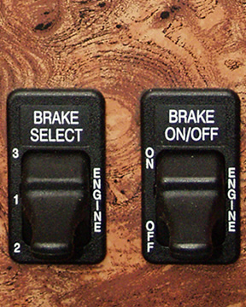
Engine Brakes
Built into the head of the engine and alter valve timing, turning the engine into an
air compressor.
Operated using a switch mounted on the dashboard and when your foot leaves the accelerator and clutch.
Notes:
Engine brakes. Engine brakes are built into the head of the engine and alter valve timing, turning the engine into an air compressor. Engine brakes are operated using a switch mounted on the dashboard and when your foot leaves the accelerator and clutch.

Slide 28
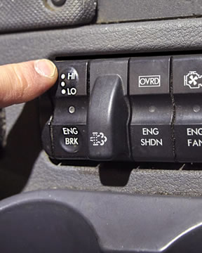
Electric Retarders
Contain electromagnets which slow the rotors attached to the drive train.
Operated by a switch in the cab.
Notes:
Electric retarders. Electric retarders contain electromagnets which slow the rotors attached to the drive train. Electric retarders are operated by a switch in the cab.

Slide 29
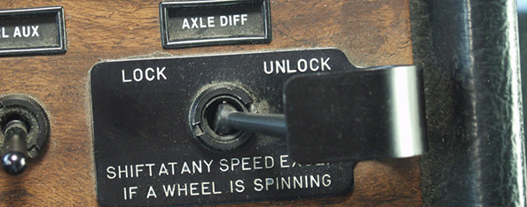
Interaxle Differential Lock
Unlocks and locks the rear tandem axles
Notes:
An interaxle differential lock unlocks and locks the rear tandem axles. In the unlocked position, the axles turn independently of each other on a dry surface. In the locked position, power to the axles is equalized to prevent wheels lacking traction from spinning.
Interaxle differential locks should never be employed (locked in) any longer than is absolutely necessary.

Slide 30
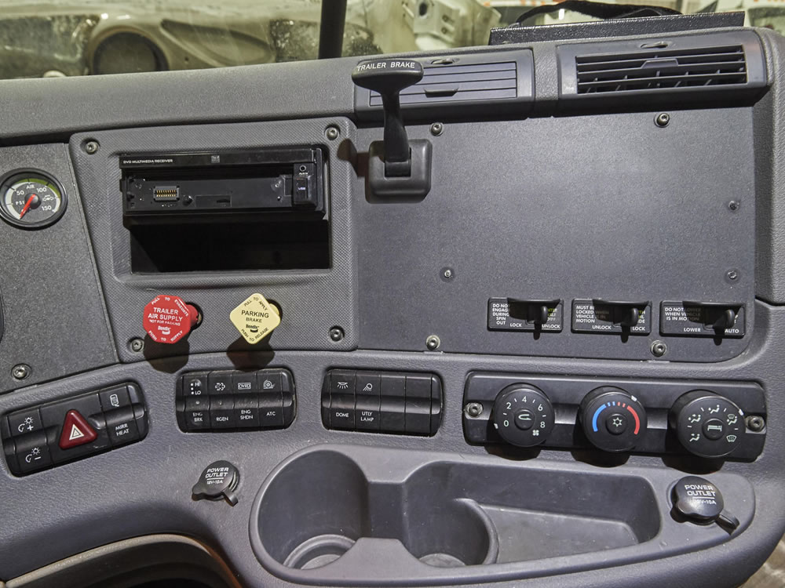
Secondary Vehicle Controls
Notes:
Secondary vehicle controls assist you in safely operating your vehicle. Some are similar to the secondary controls in your car, while others are unique to trucks. Make sure you are familiar with and know how to operate all secondary vehicle controls before you hit the road.
The number, type, and location of the controls vary from vehicle to vehicle, but typically fall within the following major categories: seeing, communication, climate/comfort controls, and driver safety.

Slide 31
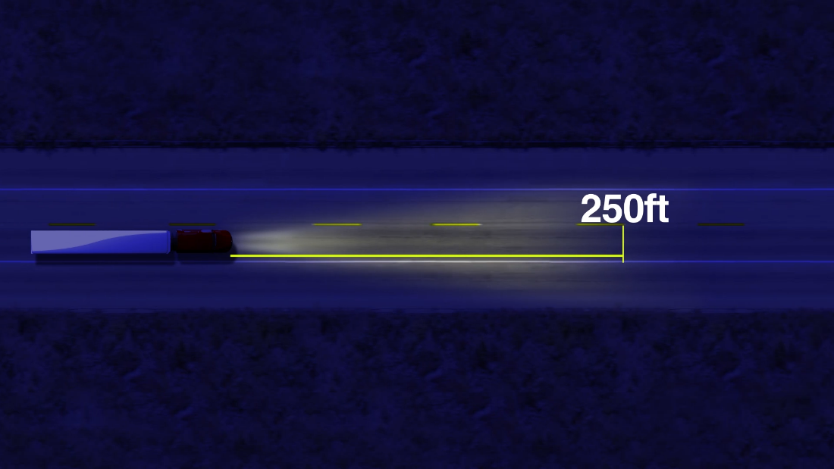
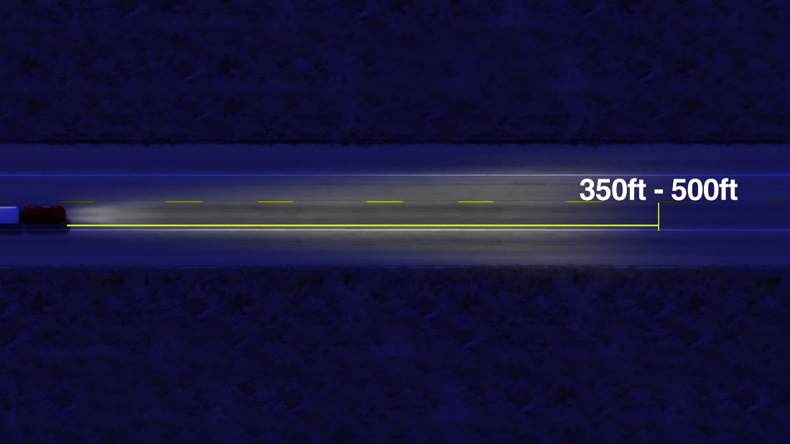
Seeing
Lights allow you to see and be seen.
They should be used from dusk to dawn and in adverse weather conditions.
Notes:
Lights allow you to see and be seen. They should be used from dusk to dawn and in adverse weather conditions. At night, in good weather, low-beam headlights allow you to see about 250 feet ahead. High-beam headlights allow you to see about 350 feet to 500 feet ahead.
CALLOUT: Make sure you know your company’s policy on light use.
VIDEO
2.1 — Lights

Slide 32
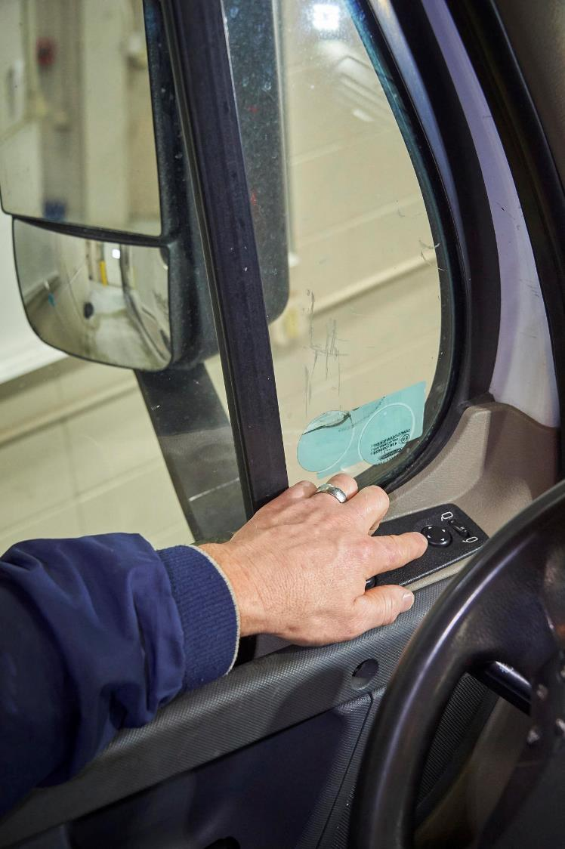
Seeing
Mirrors allow you to see to the sides and rear of your vehicle.
When adjusting your mirrors, make sure you are seated in your vehicle, in your normal driving position, with your seat belt buckled.
Notes:
Mirrors allow you to see to the sides and rear of your vehicle. Make sure your mirrors are clean and properly adjusted each time you get into your vehicle. This ensures you have the best view possible to the sides and rear of your vehicle.
When adjusting your mirrors, make sure you are seated in your vehicle, in your normal driving position, with your seat belt buckled. Your vehicle should be as straight as possible, and it should be stopped on a flat surface.
CALLOUT: Mirror requirements are located in Section 393.80 of the FMCSRs.
VIDEO
2.2 — Mirrors

Slide 33
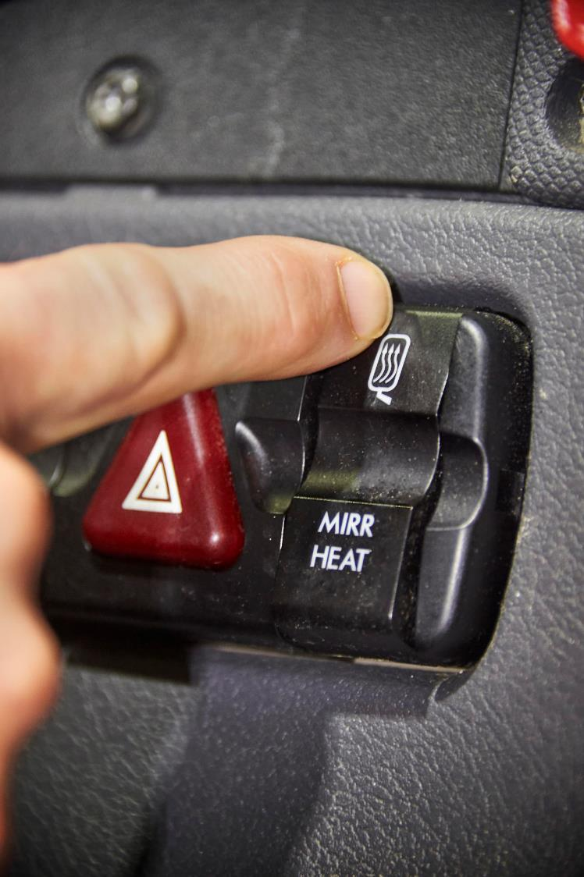
Seeing
Some vehicles have mirror heaters that can be turned on to assist in keeping snow and ice from accumulating.
Notes:
Some vehicles have mirror heaters that can be turned on to assist in keeping snow and ice from accumulating.

Slide 34
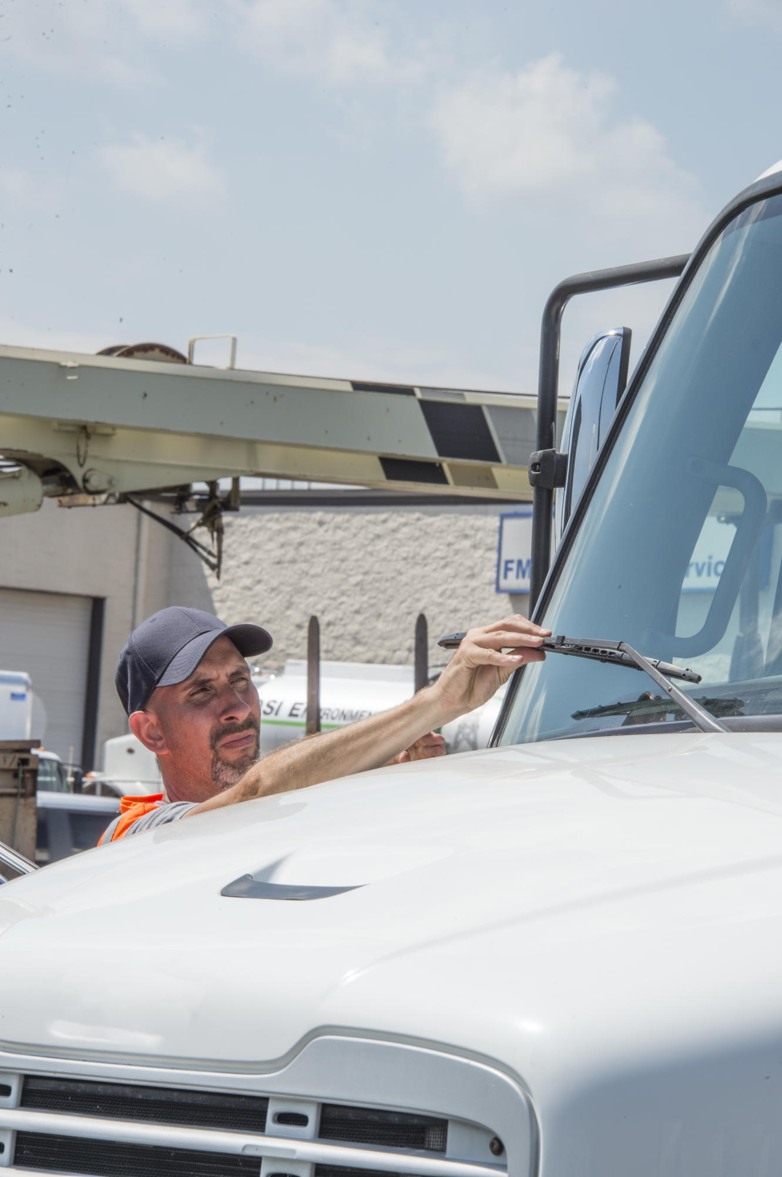
Seeing
Windshield wipers and washers help you keep your windshield clean and free of debris.
Wiper blades should press against the windshield hard enough to wipe the windshield clean; windshield washer should be in good condition and full.
Notes:
Windshield wipers and washers help you keep your windshield clean and free of debris. Wiper blades should press against the windshield hard enough to wipe the windshield clean. The windshield washer should be in good condition (no cracks or damage) and filled with a washer fluid that will not freeze in cold weather.
CALLOUT: Windshield wiper and washer requirements are located in Section 393.78 of the FMCSRs.

Slide 35
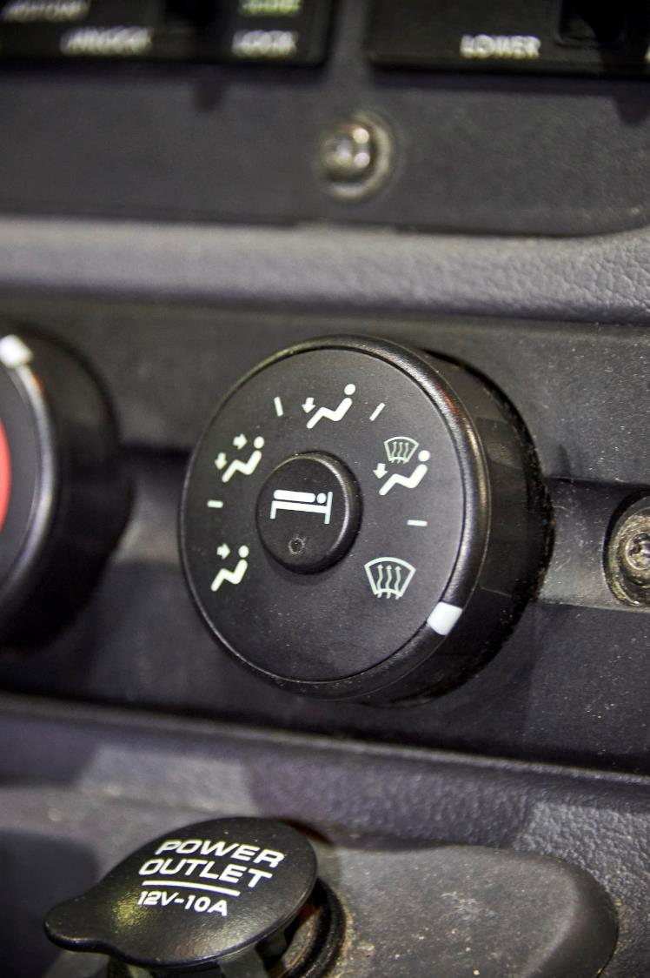
Seeing
The defroster keeps your windows from fogging-up or icing-up in cold weather.
Temperature and fan controls allow you to select an appropriate temperature and air flow.
Notes:
The defroster keeps your windows from fogging-up or icing-up in cold weather. Temperature and fan controls allow you to select an appropriate temperature and air flow.

Slide 36
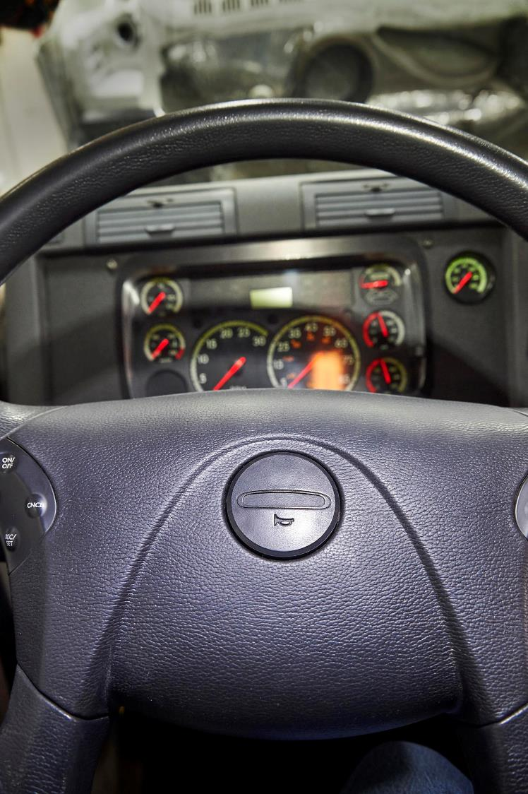
Communication
Your vehicle’s horn communicates your presence and is used to warn others when a potentially dangerous situation arises. It should be used responsibly.
Notes:
Your vehicle’s horn communicates your presence and is used to warn others when a potentially dangerous situation arises. It should be used responsibly.
CALLOUT: Horn requirements are located in Section 393.81 of the FMCSRs.
VIDEO
2.3 — Horn

Slide 37
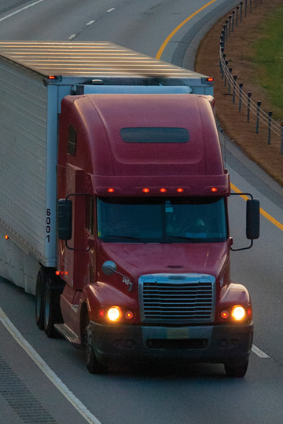
Communication
Lights, turn signals, and four-way flashers allow you to communicate with other motorists. Make sure you know where all controls are located and how to use them before you begin to operate
your vehicle.
Notes:
Lights, turn signals, and four-way flashers allow you to communicate with other motorists. Make sure you know where all controls are located and how to use them before you begin to operate your vehicle.
CALLOUT: Light requirements are located in Part 393, Subpart B of the FMCSRs.

Slide 38
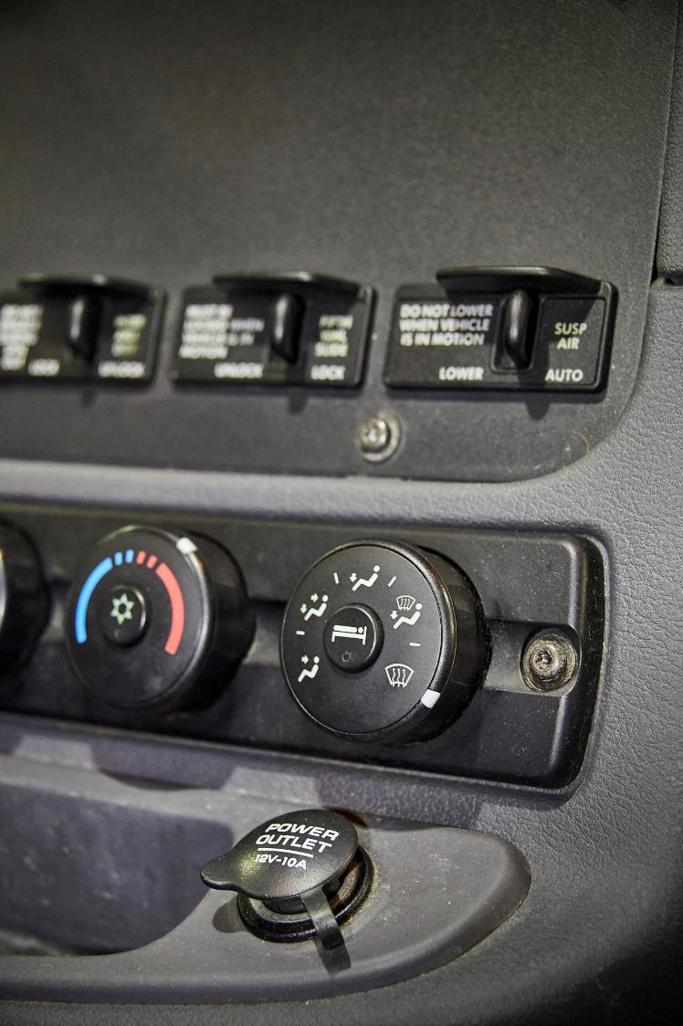
Climate/Comfort Controls
The heater controls temperature for your comfort and safety in
cold weather.
Notes:
The heater in your vehicle controls temperature for your comfort and safety in cold weather. Temperature and fan controls allow you to select a comfortable temperature and air flow. There are regulatory requirements for the manufacture, installation, and maintenance of the vehicle’s heater.
CALLOUT: Heater requirements are located in Section 393.77 of the FMCSRs.

Slide 39
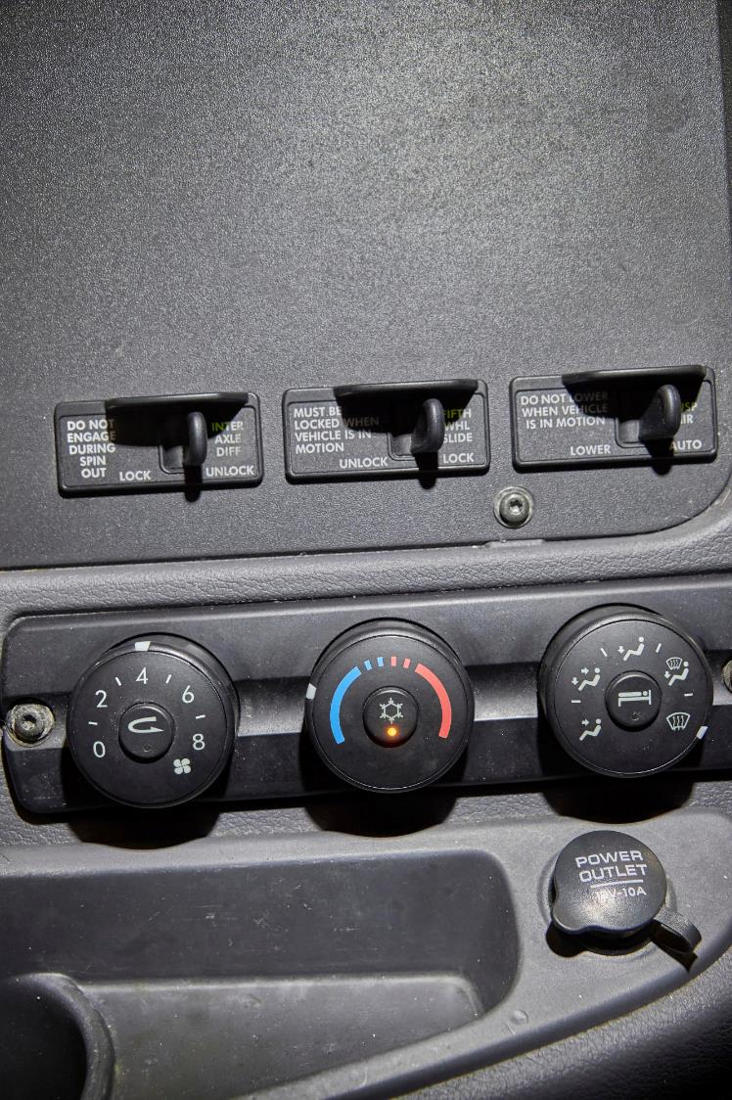
Climate/Comfort Controls
The air conditioner controls temperature for your comfort and safety in hot weather.
Notes:
The air conditioner in your vehicle controls temperature for your comfort and safety in hot weather. Temperature and fan controls allow you to select a comfortable temperature and air flow. There are no regulatory requirements related to air conditioners.

Slide 40
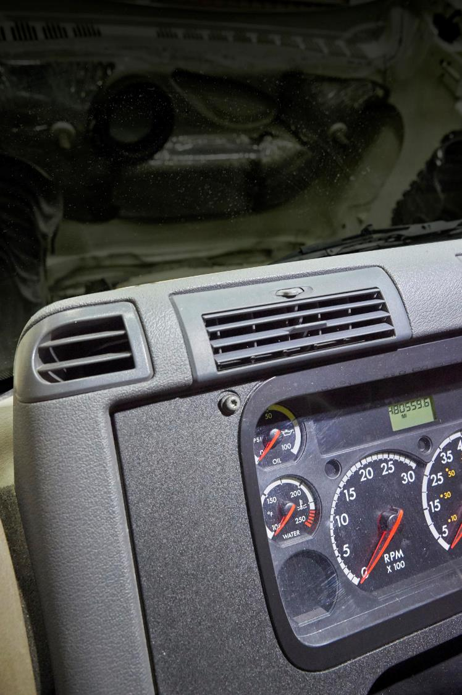
Climate/Comfort Controls
Air vents allow for a flow of fresh air in your vehicle.
Notes:
Air vents allow for a flow of fresh air in your vehicle. Temperature and fan controls allow you to select a comfortable temperature and air flow.

Slide 41
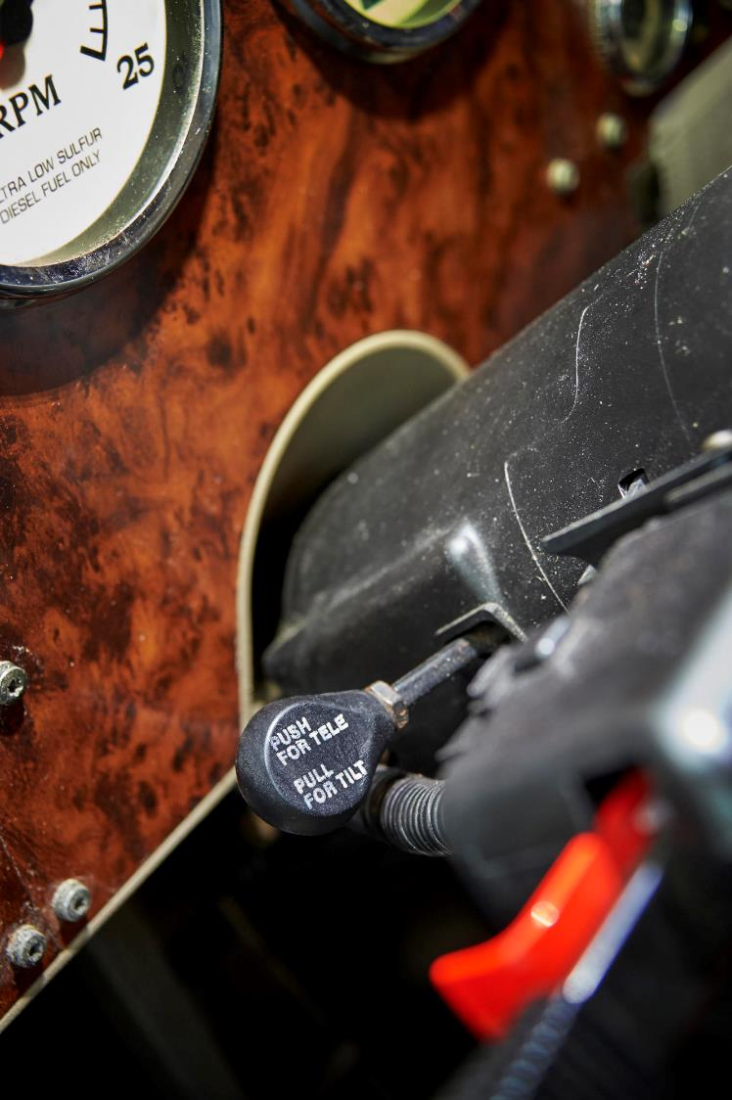
Climate/Comfort Controls
Many vehicles have a steering wheel adjustment control or switch that allows you to adjust the angle of your steering wheel.
Notes:
Many vehicles have a steering wheel adjustment control or switch that allows you to adjust the angle of your steering wheel.

Slide 42
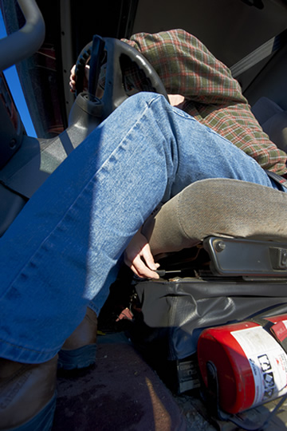
Climate/Comfort Controls
Seat position and adjustment control allow you to position
your seat so that you are able to comfortably reach the vehicle’s pedals
and controls.
A lever or switch is located either under or at the side of the seat.
Notes:
Seat position and adjustment control allow you to position your seat so that you are able to comfortably reach the vehicle’s pedals and controls. A lever or switch is located either under or at the side of the seat, so you can make the appropriate adjustments.

Slide 43
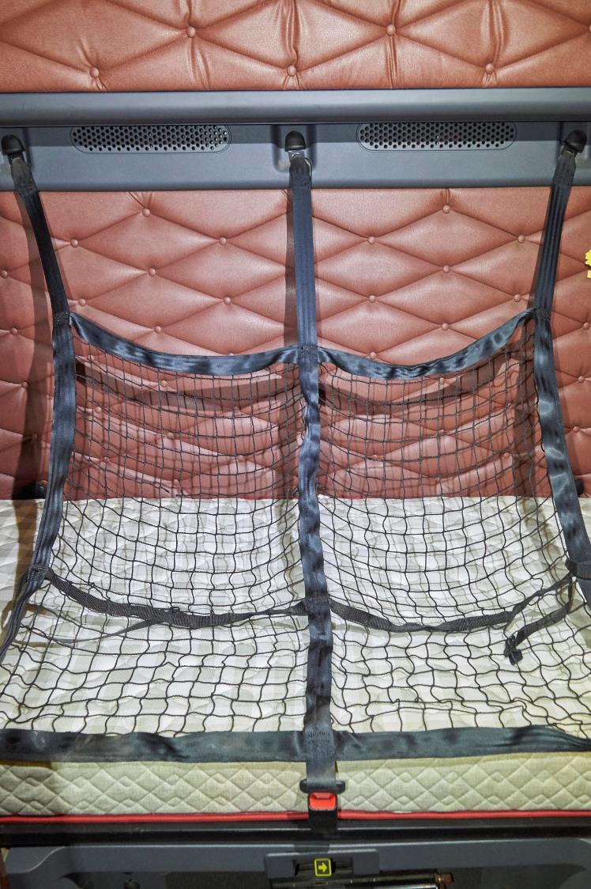
Driver Safety
When team driving, and using your vehicle’s sleeper berth, bunk restraints are used in to prevent you from being ejected when your vehicle suddenly slows
or stops.
Notes:
When team driving, and using your vehicle’s sleeper berth, bunk restraints are used in to prevent you from being ejected when your vehicle suddenly slows or stops.
CALLOUT: Sleeper-berth requirements are located in Section 393.76 of the FMCSRs.

Slide 44
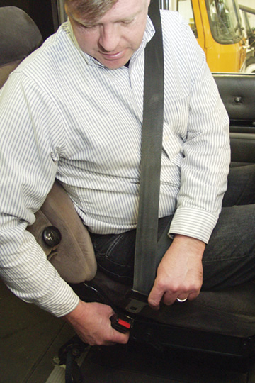
Driver Safety
In addition to protecting you from injury as a driver, a seat belt helps you keep control of the vehicle.
Notes:
Seat belt use remains one of the easiest and most important means of protection when on the road.
Studies have shown that if you are in a crash while using a seat belt, your chances of being hurt or killed are greatly reduced. A seat belt will move with you and lock up if a crash occurs. A seat belt keeps you from being thrown from the vehicle and against parts inside of your vehicle. In addition to protecting you from injury as a driver, a seat belt helps you keep control of the vehicle.
It is important to wear the seat belt correctly.
A shoulder harness is worn across the shoulder and chest with minimal, if any slack. The shoulder harness should not be worn under the arm or behind the back. Wearing the harness the wrong way could cause serious internal injuries in a crash.
The lap belt should be adjusted so that it is snug and lies low across your hips after fastening.
CALLOUT: If a seat belt assembly is installed, it must be used. (See Section 392.16 of the FMCSRs.)

Slide 45
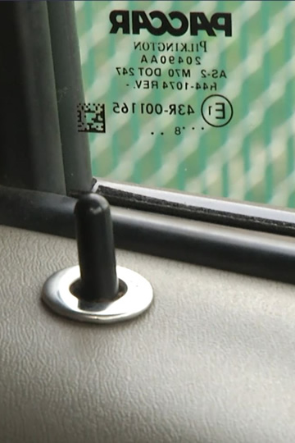
Driver Safety
Door locks keep you and your possessions safe on the road and when stopped.
Notes:
Door locks keep you and your possessions safe on the road and when stopped. Always make it a practice to lock your doors after you enter your truck, while on the road, and when you exit your truck.
VIDEO
2.4 — Door Locks

Slide 46
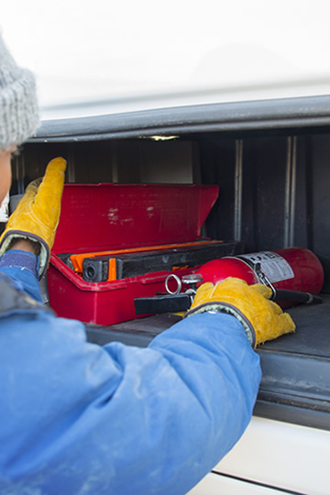
Driver Safety
All CMVs must be equipped with at least one properly filled and readily accessible
fire extinguisher.
Notes:
All CMVs must be equipped with at least one properly filled and readily accessible fire extinguisher. The extinguisher must be securely mounted on the vehicle and must be designed and maintained to visually show whether it is fully charged.
CALLOUT: Fire extinguisher requirements are located in Section 393.95 of the FMCSRs.

Slide 47
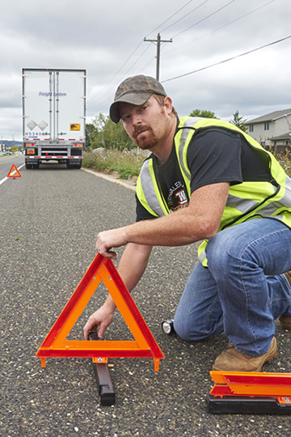
Driver Safety
Warning devices are used to provide additional visibility and alert other drivers when stopped in the event of an accident or breakdown.
Notes:
Warning devices are used to provide additional visibility and alert other drivers when stopped in the event of an accident or breakdown. All commercial motor vehicles must be equipped with three bidirectional emergency reflective triangles, six fusees, or three liquid burning flares. These devices must be set out within ten minutes of stopping.
CALLOUT: Warning device requirements are located in Part 392 and Section 393.95 of the FMCSRs.

Slide 48
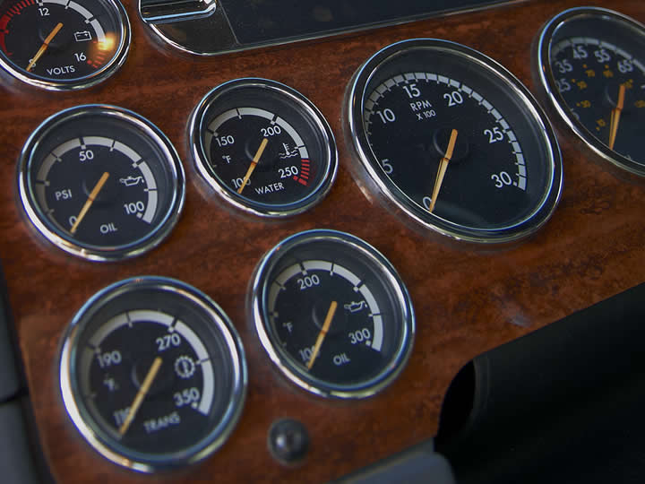
Vehicle Instruments
Notes:
Vehicle instruments monitor and report on the operating condition of your vehicle. They warn you of potential problems. Below is a representation of common instruments found in a CMV. There can be variations. Make sure you are familiar with the instruments in your vehicle.
VIDEO
2.5 — Vehicle Instruments

Slide 49
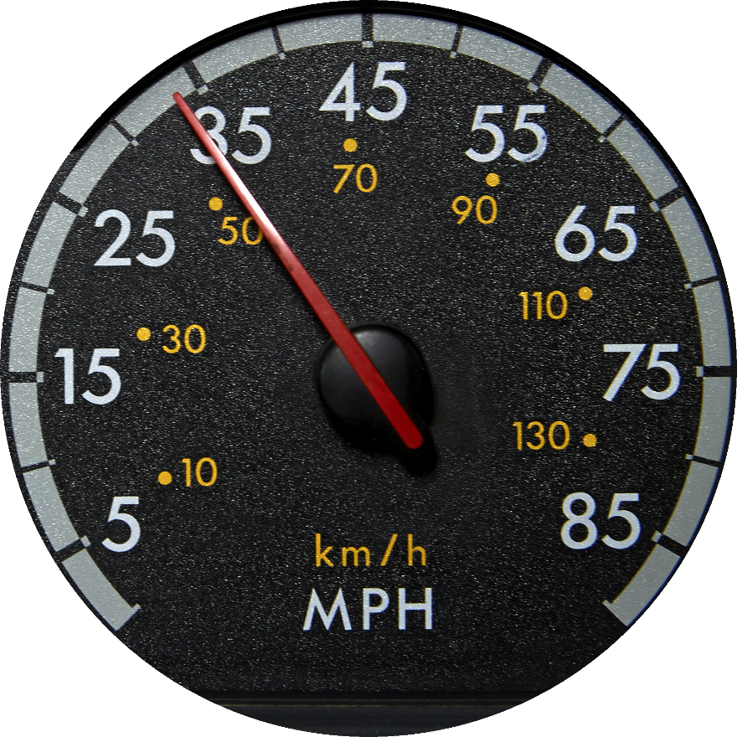
Speedometer
Shows the speed of the vehicle in miles per hour (mph) and/or kilometers per
hour (km/h)
Notes:
The speedometer shows the speed of the vehicle in miles per hour (mph) and/or kilometers per hour (km/h). A speedometer is required on all CMVs.

Slide 50
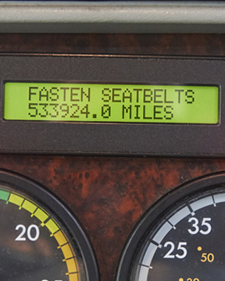
Odometer
Indicates the total number of miles (or kilometers) traveled by a vehicle
Notes:
The odometer indicates the total number of miles (or kilometers) traveled by a vehicle.

Slide 51
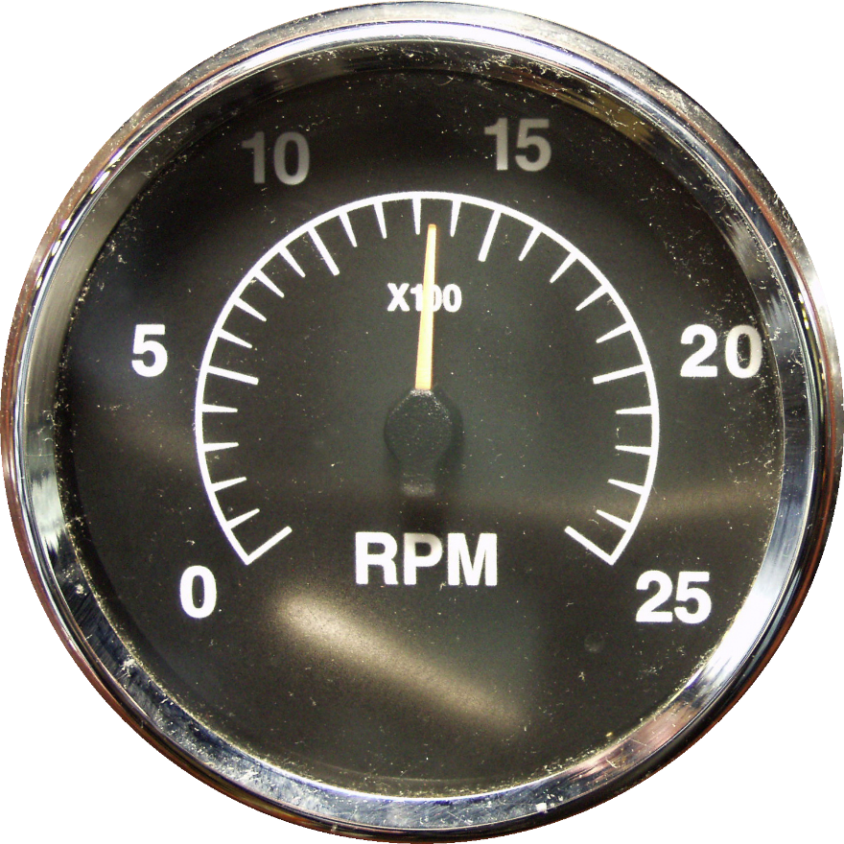
Tachometer
Shows engine speed in hundreds of revolutions per
minute (RPM)
Notes:
The tachometer shows engine speed in hundreds of revolutions per minute (RPM). It serves as a guide for shifting into the appropriate transmission gear. It also assists you in effectively using the engine and transmission when accelerating and decelerating and for fuel efficiency.

Slide 52
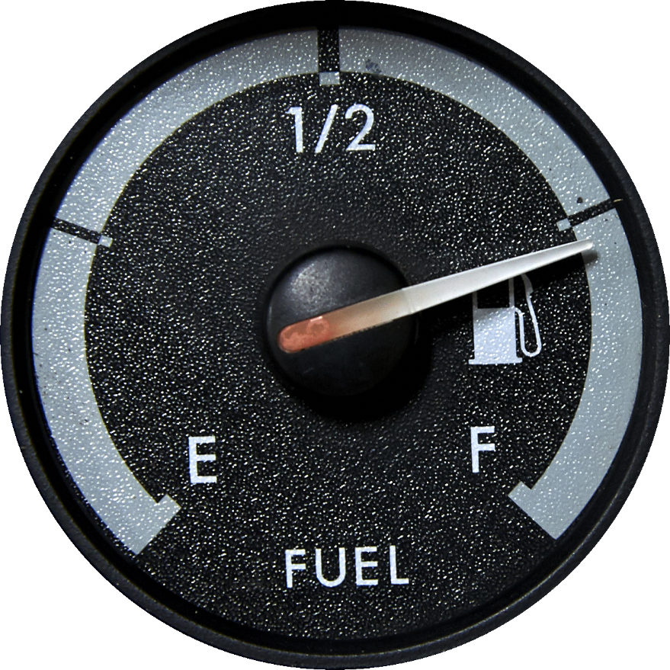
Fuel Gauge
Shows how much fuel is left in the vehicle’s fuel tank(s)
Notes:
The fuel gauge shows how much fuel is left in the vehicle’s fuel tank(s). Since fuel gauges aren’t always accurate, you should check the fuel tank(s) visually before you start a trip.

Slide 53
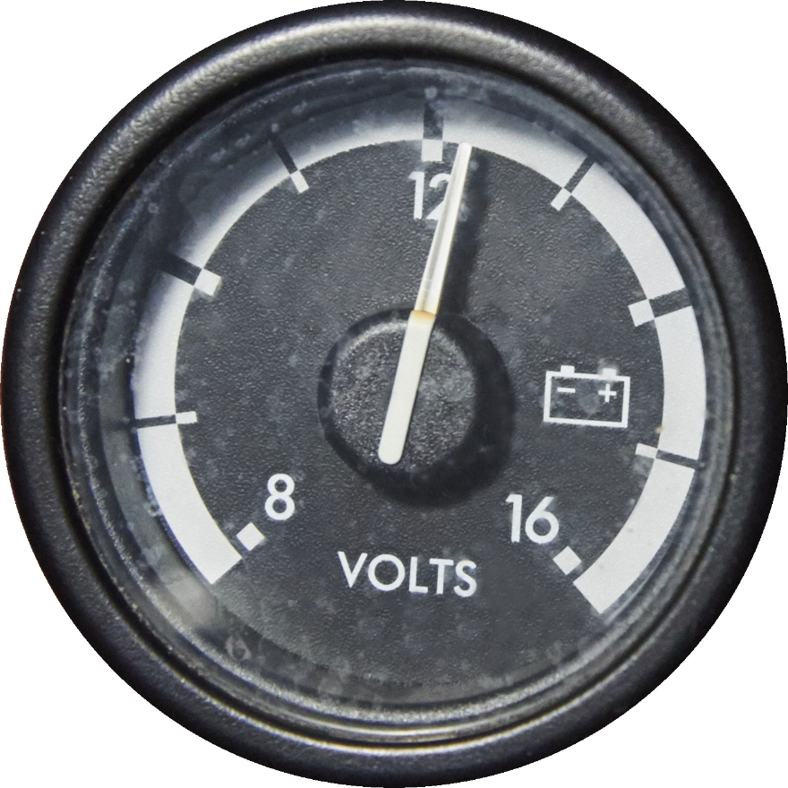
Voltmeter
Measures the voltage in the vehicle’s electrical system
Notes:
The voltmeter measures the voltage in the vehicle’s electrical system. Consult the vehicle’s operator’s manual to determine a normal reading for the vehicle you are operating. In most vehicles, a normal reading is between 13 and 14.5 volts during operation. Higher or lower than normal voltage can shorten the life of a battery.

Slide 54

Ammeter
Measures the amount of battery being charged or discharged
Notes:
The ammeter measures the amount of battery being charged or discharged. A normal reading is slightly to the charged side. A continuous high charge or continuous discharge are signs of problems.
Ammeters are not found on all CMVs. If your vehicle does not have one, refer to the voltmeter for charging issues.

Slide 55

Air Pressure Gauge
Measures pressure of air in the reservoir, or tanks in pounds per square inch (psi)
Notes:
The air pressure gauge measures pressure of air in the reservoir, or tanks in pounds per square inch (psi). A truck may be equipped with one or two air pressure gauges. These gauges are referred to as the primary and secondary air pressure gauges. The air pressure gauge is required on every CMV equipped with air brakes.
When the engine starts, air pressure starts building. It continues to build until maximum pressure is reached (about 120 psi).

Slide 56

Oil Pressure Gauge
Tells you if the engine is being properly lubricated
Notes:
The oil pressure gauge tells you if the engine is being properly lubricated. In warm weather, oil pressure should register on the oil pressure gauge within a few seconds after the vehicle is started and gradually rise to normal operating range (30 psi to 50 psi). In cold weather it could take 30 to 60 seconds to get a reading.
Normal range varies from vehicle to vehicle based on engine speed and oil viscosity. If pressure is low or doesn’t register, the engine isn’t being lubricated properly. This can cause the engine to be ruined within a short time period. Know the operating range of your vehicle and stop and investigate anytime there’s a loss in pressure or pressure doesn’t register.

Slide 57

Coolant Temperature Gauge
Measures the temperature of water and coolant in the engine block
Notes:
The coolant temperature gauge measures the temperature of water and coolant in the engine block. The cooling system protects the engine from damage caused by heat.
Normally, an engine operates at about 170°-195° F. This can vary, so consult your vehicle’s operator’s manual for specifics. If the gauge registers above the normal range, the engine may be overheating. If that is the case, you should immediately turn off the engine.

Slide 58

Oil Temperature Gauge
Indicates the temperature of the engine oil
Notes:
The oil temperature gauge indicates the temperature of the engine oil. The normal engine oil temperature is between 180° and 225° F. This can vary, so consult your vehicle’s operator’s manual for specifics.
A high oil temperature can cause thinner oil, decreasing oil pressure. This can result in engine damage.

Slide 59

Exhaust Pyrometer Gauge
Shows the temperature of the exhaust gasses in the manifold
Notes:
The exhaust pyrometer gauge shows the temperature of the exhaust gasses in the manifold. If the vehicle has an exhaust pyrometer, it could be used to determine when the vehicle has cooled enough to shut down the engine.

Slide 60

Axle Temperature Gauge
Measures the temperature of the front and rear drive axles
Notes:
The axle temperature gauge measures the temperature of the front and rear drive axles. Above normal readings may indicate bad bearings.

Slide 61

Warning Devices
Let you know when pressures or temperatures reach a dangerous level
Notes:
Warning devices let you know when pressures or temperatures reach a dangerous level.
It is important that you understand what these warning indicators mean, and what you should do if an indicator light, buzzer, or alarm comes on while driving.

Slide 62

Warning Devices
Low-pressure warning alarm/light
Coolant level alarm
Oil level alarm
Oil pressure warning light
Notes:
The low-pressure warning alarm/light indicates when there is inadequate pressure in the air brake system. This warning will go off when the pressure drops below 60 psi. Continued operation of the vehicle is unsafe. At 20 to 45 psi, the tractor protection valve closes, completely shutting off the air supply to the trailer. A vehicle without sufficient air pressure should not be operated.
The coolant level alarm lights up when the level starts dropping, indicating a probable leak.
The oil level alarm lights up when the oil level drops below what is normal for operation.
The oil pressure warning light indicates when oil pressure drops too low for safe operation.

Slide 63

Warning Devices
Coolant temperature warning light
Pyrometer warning light
Differential warning light
ABS light
Notes:
The coolant temperature warning light indicates when the temperature is too high for normal operation.
The pyrometer warning light indicates when exhaust temperatures are abnormal.
The differential warning light may stay lit up when the interaxle differential is in the locked position.
The ABS light indicates that the ABS function is not operating.

Slide 64
Objectives Review
You should now be able to:
  Explain the purpose of a CMV’s engine controls
  Locate a CMV’s primary controls and discuss the function of each
  Describe the purpose of a vehicle’s secondary controls and identify their locations
  Recognize all vehicle instruments and explain the acceptable operating range for each
  Identify warning devices commonly found on a CMV
Copyright 2019 J. J. Keller & Associates, Inc.
Notes:
You should now be able to:
Explain the purpose of a CMV’s engine controls
Locate a CMV’s primary controls and discuss the function of each
Describe the purpose of a vehicle’s secondary controls and identify their locations
Recognize all vehicle instruments and explain the acceptable operating range for each
Identify warning devices commonly found on a CMV
CLASSROOM RECOMMENDATION
Before concluding your training session, have participants take the corresponding quiz (found on the Trainer Tools USB) to check their understanding of the material. You can customize any of the questions to fit your audience or workplace. The answer key can also be found on the Trainer Tools USB.
You may also choose to administer the quizzes before you begin your training session to help get participants thinking about the subject and/or to gauge their understanding of the topic ahead of time.
LAB RECOMMENDATION
From the driver’s seat of the tractor, point out all of the controls and instruments to your students. When doing this, have students break into groups of three or four so all are able to see everything clearly. Point out or demonstrate each of the controls and instruments. Start the engine so your drivers can see how each of the instruments should read.

