Slide 1






PowerPoint® Instructions
This PowerPoint has been designed so you can easily customize it for your training session.
Throughout the presentation you’ll see icons with recommendations or videos to enhance the instruction you present to your students. A detailed explanation for each icon can be found on the next slide. Videos can be found on the Trainer Tools USB.
When you see an icon on the slide, look in the notes
section for further information.
Simply delete or move the icon off the slide before your training session begins.

Slide 2





Classroom Recommendations. Provides suggestions for enhancing your classroom presentation; from ideas for large group discussions to suggestions on the use of training aids such as examples or photos of vehicle parts and components to help illustrate the items covered within a chapter.
Lab Recommendations. Provides suggestions for activities and exercises that take place outside the classroom, but do not involve
the actual operation of the tractor-trailer or its components. Examples
of lab sessions include conducting a vehicle inspection or practicing mirror adjustment.
Range Recommendations. These recommended activities take
place on a closed-access driving range where students may practice driving skills in a controlled environment. Examples of range sessions include practicing shifting technique and successfully completing a backing maneuver.
Road Recommendations. These recommended activities take place in road and traffic conditions that support the chapter’s objectives. Examples of road sessions include proper communication with other drivers through the use of turn signals and basic vehicle control under nighttime or extreme weather conditions.
Videos. These short video clips reinforce material presented in the Student Manual. Use them to help students grasp difficult concepts or subject matter.

Slide 3
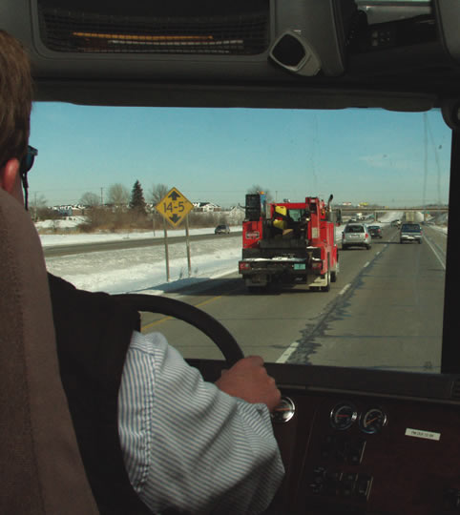
Space Management
12
Copyright 2019 J. J. Keller & Associates, Inc.
Copyright 2019 J. J. Keller & Associates, Inc.
Notes:
Unit A1.2.5 Space Management
This unit must teach driver-trainees about the importance of managing the space surrounding the vehicle under various traffic and road conditions.

Slide 4
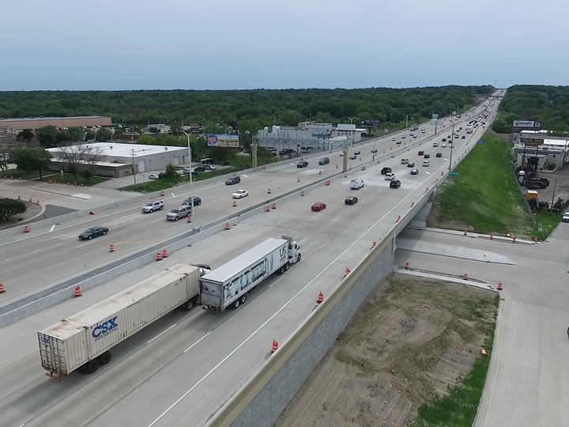
Introduction
Notes:
Proper space management means maintaining a “safe space” around your vehicle to ensure the safety of everyone on the road.
This includes managing the space surrounding your vehicle. It also includes managing space when making turns and when crossing traffic, as well as when sharing the road with distracted drivers.
This chapter focuses on the importance of managing your vehicle’s space.
CLASSROOM RECOMMENDATION
As with speed management, space management is also a safety and image issue. Following too closely is often cited as the reason/cause of accidents. From an image perspective, your students need to understand that like speeding, tailgating and cutting other drivers off paints a negative picture of drivers and the industry.

Slide 5
Objectives
Upon completion of this lesson, you will be able to:
Explain the importance of proper space management
Describe how to maintain an appropriate cushion of space
Discuss how to safely execute a right and left turn in a tractor-trailer
Recognize the signs of distracted drivers and identify how to manage them appropriately
Notes:
Upon completion of this lesson, you will be able to:
Explain the importance of proper space management
Describe how to maintain an appropriate cushion of space
Discuss how to safely execute a right and left turn in a tractor-trailer
Recognize the signs of distracted drivers and identify how to manage them appropriately

Slide 6
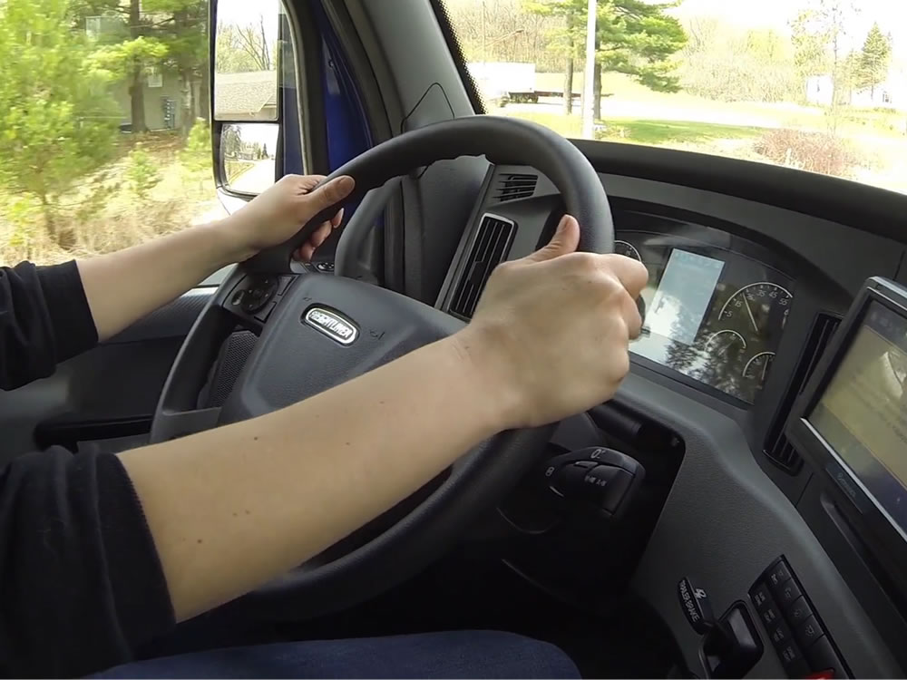
Managing Space
Notes:
Managing Space

Slide 7
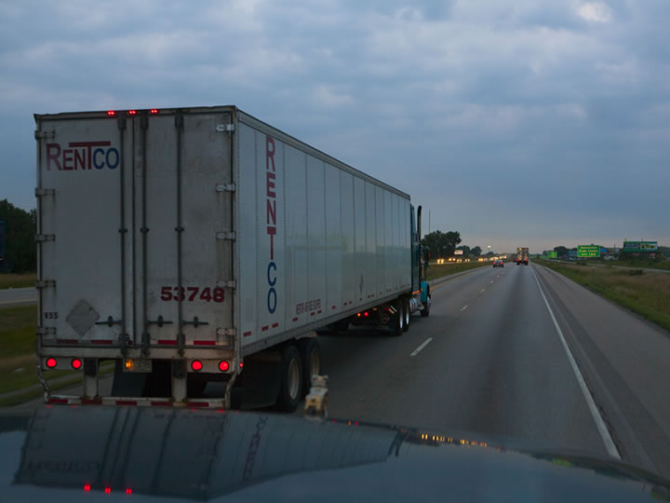
Proper space management is the practice of maintaining enough space around your vehicle to operate safely.
There must be enough of a cushion to allow you to make positional adjustments when unsafe situations arise.
Notes:
Proper space management is the practice of maintaining enough space around your vehicle to operate safely. This includes the space ahead of, behind, to the sides, above, and below your vehicle. There must be enough of a cushion to allow you to make positional adjustments when unsafe situations arise.

Slide 8
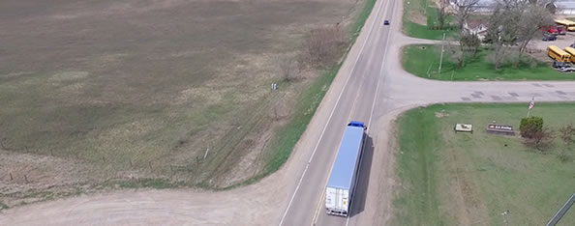
Ahead
The amount of space needed depends on the speed you’re traveling, the condition of the road, and the weather.
Copyright 2019 J. J. Keller & Associates, Inc.
Notes:
The space ahead of your vehicle is the most important, and one of the easiest to monitor and adjust. The amount of space needed depends on the speed you’re traveling, the condition of the road, and the weather.
VIDEO
12.1 — Managing Space Ahead of Your Vehicle

Slide 9
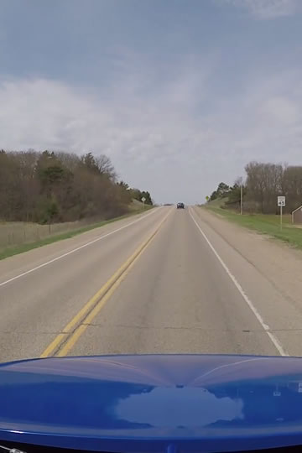
Allow one second
of space for each
10 feet of vehicle length at speeds of
40 mph or less.
At greater speeds, add
an additional second.
Notes:
One guideline to follow when operating in good driving conditions is to allow at least one second of space for each 10 feet of vehicle length at speeds of 40 miles per hour or less. At greater speeds, or if you suspect you are sharing the road with an impaired or distracted driver, add an additional second. In poor driving conditions, such as rain, ice, snow, or fog, slow down and allow for a greater cushion since your truck will take longer to stop than when in dry conditions.
When driving through a construction zone slow down, obey the posted speed limit, allow for a greater cushion in the event of sudden braking, and increase that cushion even more in poor driving conditions.
To determine how much space you have, wait until the vehicle ahead passes a fixed object in plain sight (like a mile marker or road sign). Then, count off the seconds until you reach the same spot. Compare your count with the rule of one second for every ten feet of length and add one additional second if you’re traveling over 40 mph.
CALLOUT: In construction zones, speeding and following too closely are among the top reasons professional drivers end up involved in collisions.

Slide 10
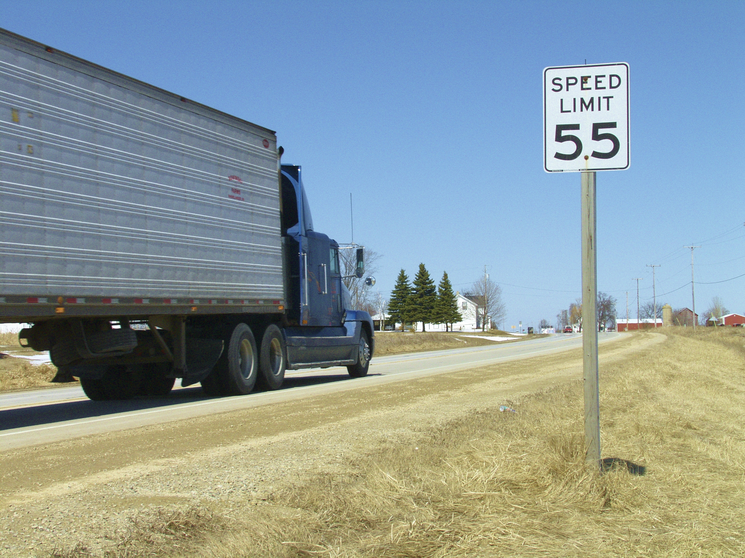
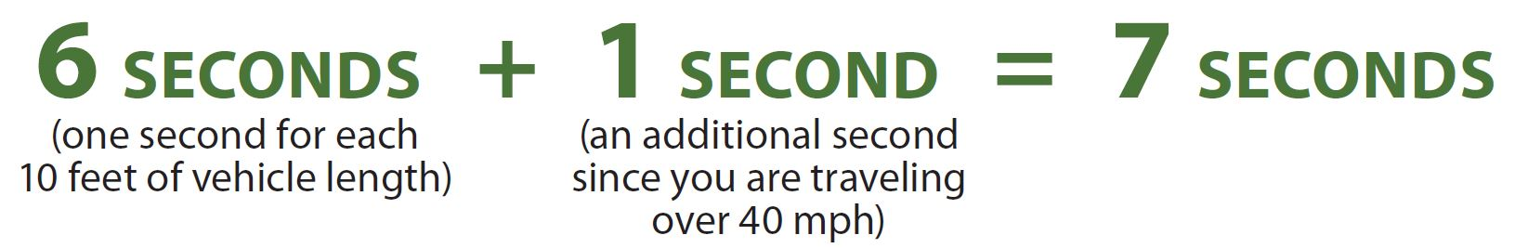
If you are driving a 60-foot vehicle at 55 miles
per hour…you should have
at least seven seconds
of space ahead.
Notes:
For example, if you are driving a 60-foot vehicle at 55 miles per hour (in good weather conditions), and only counted three seconds, you are following too closely. You should have at least seven seconds of space ahead.
After some practice, and experience on the road, you’ll be able to easily determine how far back you should follow.

Slide 11
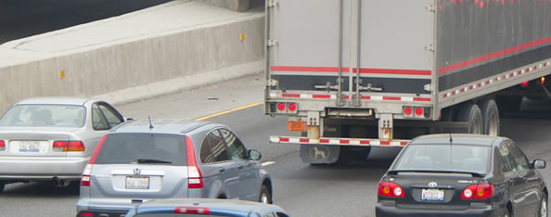
Behind
When being tailgated, stay to the right lane, slow down, and give the other driver plenty of chances to pass.
Notes:
It is impossible to keep other drivers from following too closely (tailgating) or being distracted, but there are some things that can be done to make it safer. Stay to the right lane, slow down, and give the other driver plenty of chances to pass.
VIDEO
12.2 — Managing Space Behind Your Vehicle

Slide 12
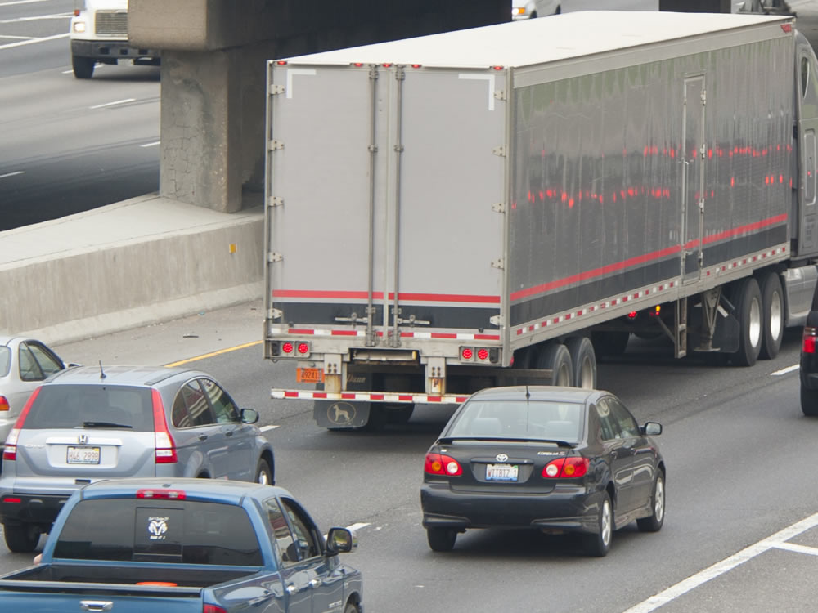
Avoid quick changes
Increase your following distance
Don’t speed up
Avoid tricks
Notes:
The following are steps you can take to help prevent an accident if you find that you are being tailgated:
Avoid quick changes. If you have to slow down or turn, signal early and gradually reduce your vehicle’s speed.
Increase your following distance. Opening up room in front of you will help you to avoid making sudden speed or direction changes. This also makes it easier for the tailgater to get around you.
Don’t speed up. It’s safer to be tailgated at a low speed than a high speed.
Avoid tricks. Don’t turn on your taillights or flash your brake lights.
CALLOUT: Never brake-check a tailgater. Intentionally slamming on your brakes could cause an accident, or could provoke an aggressive driver to make a reckless maneuver.

Slide 13
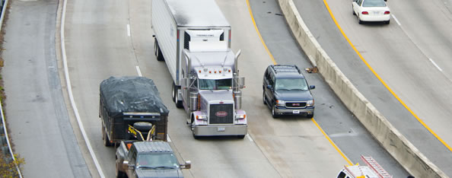
To the Sides
Don’t hug the center line
Avoid hugging the right side of the road
Avoid travelling alongside other vehicles
Notes:
A commercial motor vehicle (CMV) often takes up most of the lane it is traveling in. There are several things you should avoid to ensure there is plenty of space between your vehicle and other road users:
Don’t hug the center line. It becomes very easy to drift across the center line into oncoming traffic.
Avoid hugging the right side of the road. A soft shoulder can cause control problems.
Avoid travelling alongside other vehicles. Another driver may change lanes suddenly, turning into your vehicle, or your vehicle may be trapped, unable to change lanes. Also, try to avoid driving alongside others in strong winds, especially cross winds. The problem is most prevalent for empty or light trucks.
When driving through a construction zone, use the furthest lane from the work zone when possible. This provides for extra space between the side of your vehicle and the construction workers.
VIDEO
12.3 — Managing Space to the Sides of Your Vehicle

Slide 14
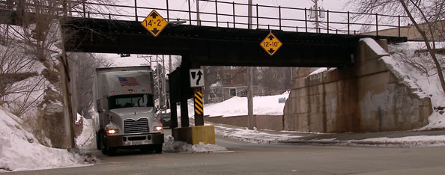
Above
Adequate space above is needed to clear bridges, overpasses, trees, and powerlines. Never assume the heights posted on bridges and overpasses are correct.
Notes:
Adequate space above is needed to clear bridges, overpasses, trees, and powerlines. Never assume the heights posted on bridges and overpasses are correct. Repaved roads or packed snow may reduce the clearances since the heights were posted.
Overpasses can be a challenge to navigate, as the roadway under an overpass may not be flat. The road may slope down and then back up again. Because of this, the clearance posted may not apply from the start to the end of your travel under an overpass.
Overpasses should be avoided whenever possible.
CALLOUT: You should always know the height of your tractor-trailer. To be safe, add six to eight inches when determining your clearance distance.
CALLOUT: When heading into a city, be especially diligent to check your route ahead of time for low overpasses.
VIDEO
12.4 — Managing Space Above Your Vehicle

Slide 15
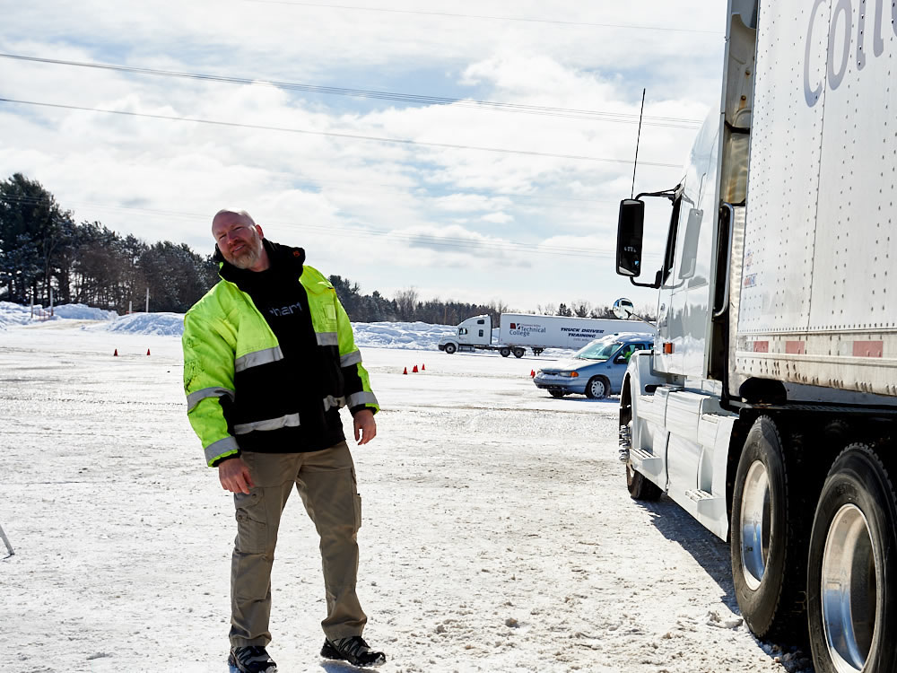
Get
Out
And
Look
Notes:
The weight of a vehicle’s cargo can also change its height. An empty vehicle sits higher on the road than a loaded one. Be aware of how a road is graded. Road grade can cause a high-sitting vehicle to tilt, which can be a problem for low-clearance areas. If you have doubts about whether there is enough space to proceed, stop your vehicle and Get Out And Look (GOAL) or take another route.
You also need to be aware of what is above before backing your CMV. When checking around your vehicle for obstacles prior to backing, make sure you check above your vehicle. Look for trees, branches, wires, canopies, etc. It is easy to miss seeing them while backing.

Slide 16
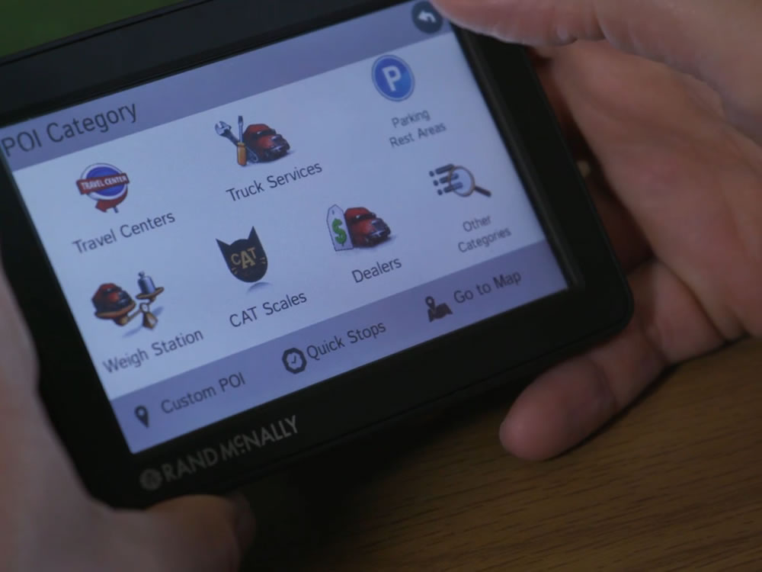
A GPS designed for professional truck drivers can provide information on low overpasses and bridges.
Notes:
Global positioning system (GPS). While nothing is as fool-proof as getting out of the vehicle to check your overhead clearance, a GPS designed for professional truck drivers can provide information on low overpasses and bridges.
Free, cell-phone based apps are fine for the everyday driver, but you require one specifically designed for the needs of a CMV driver.
When using a GPS designed for a CMV driver, keep in mind that the information may not always be accurate. Always use your best judgement in addition to the information on your GPS.

Slide 17
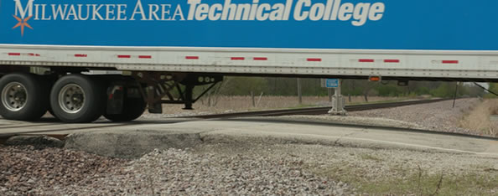
Below
Driveways, railroad tracks, dirt roads, and unpaved lots can be a challenge. Slow and steady is the rule in these cases.
Notes:
It’s very easy to forget the space under your vehicle. That space can be very small when the vehicle is heavily loaded.
Driveways, railroad tracks, dirt roads, and unpaved lots can be a challenge. Slow and steady is the rule in these cases. You don’t want your trailer’s landing gear to get hung up or damaged. This is also one of the reasons why you should always crank the landing gear up all the way.
VIDEO
12.5 — Managing Space Below Your Vehicle

Slide 18
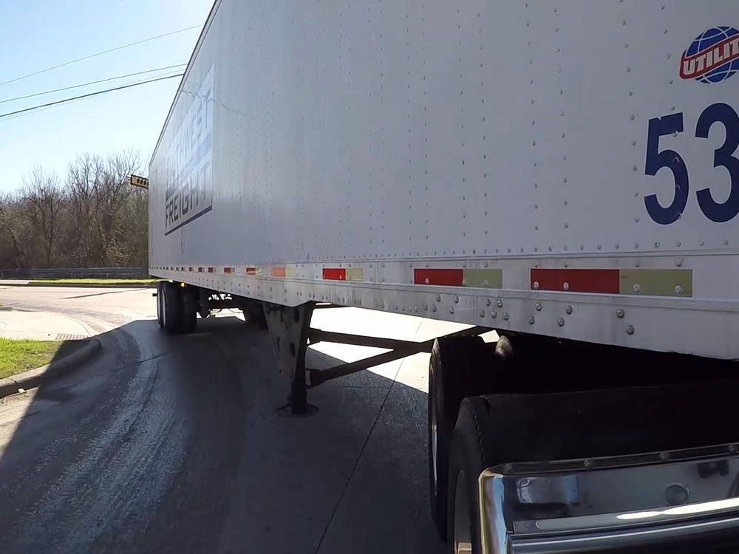
Turning Space
Notes:
Turning Space

Slide 19
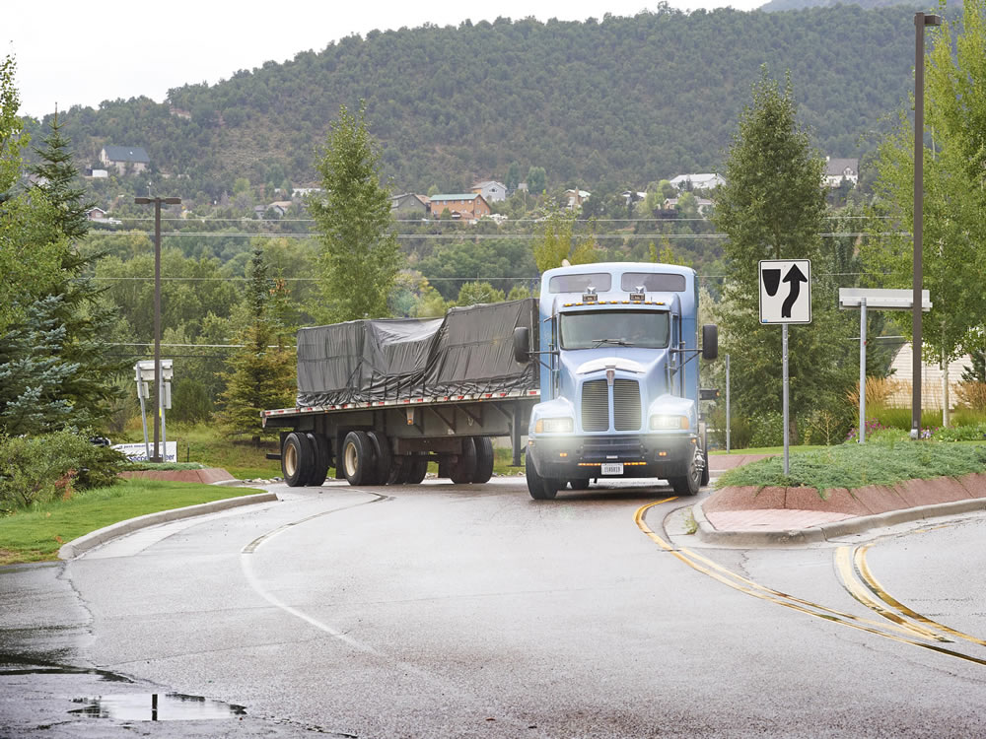
CMVs run the risk of hitting other vehicles or objects every time they turn.
Notes:
In a CMV, every turn is a tight one. Correct procedures are important because of wide turning and off-tracking. CMVs run the risk of hitting other vehicles or objects every time they turn.

Slide 20
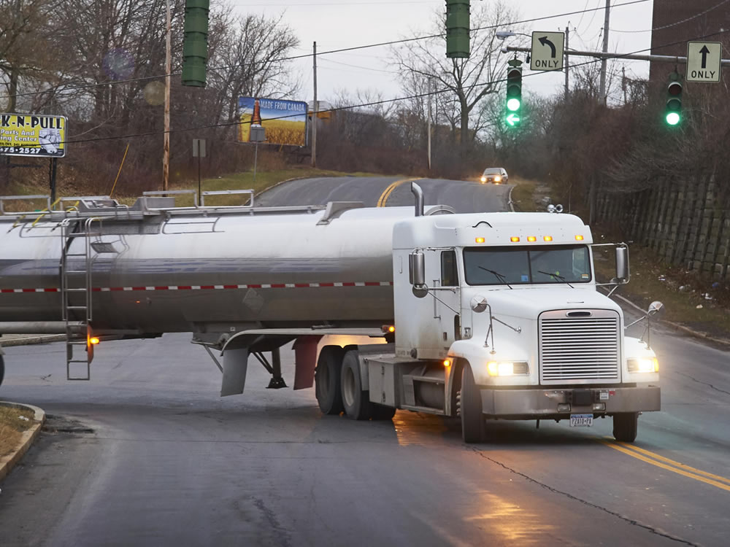
Right Turns
Notes:
When making a right turn, proceed slowly. Pull your tractor-trailer straight into the intersection before beginning the turn. If you fail to pull far enough into the intersection to account for “off-tracking,” it could cause you to run over the curb or hit a fixed object, such as a street sign.
As you’re turning right, continue to scan the road ahead and to the sides, and pay special attention to your right-side mirrors.
If you are unable to make the right turn without swinging into another lane, turn wide as you complete the turn. Keep the rear of your vehicle close to the curb. Though you can position your vehicle to make it hard for drivers to pass you on the right, never assume you blocked traffic completely. Keep an eye on the right side of the vehicle, assuming that smaller vehicles may try to pass on the right.
Don’t turn wide to the left as you start the turn. A driver who is following may think you are turning left and try to pass on the right.
If you must cross into the oncoming lane to make a turn, watch for vehicles approaching. Give them room to go by or stop, but never back up. You might hit someone behind your vehicle.

Slide 21
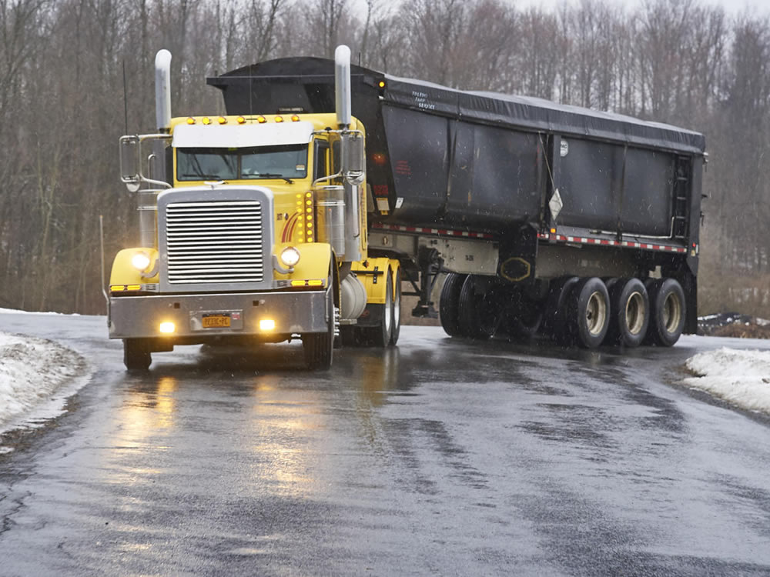
Left Turns
Notes:
When executing a left turn, make sure the vehicle has reached the center of the intersection before starting the turn. Starting it too soon will lead to the trailer taking a shorter path, called off-tracking. Anything in that path will be run over (light poles, traffic signs, other vehicles).
If there are two turning lanes, always take the lane furthest to the right. Don’t start on the inside lane, as you may have to swing right to make the turn.

Slide 22
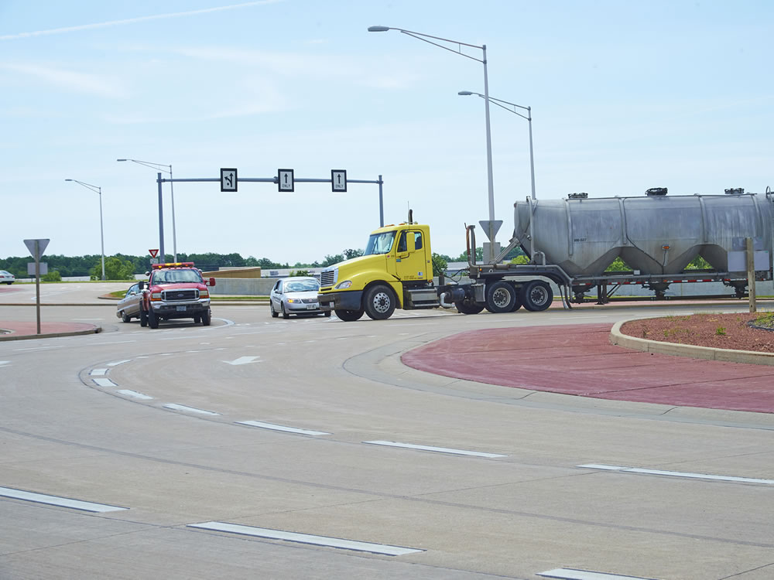
Roundabouts
Notes:
Before entering a roundabout, proceed slowly, and make sure you’re in the correct lane as you approach it.
As you enter the roundabout, keep off-tracking in mind. If you’re turning right, you may need more space than what is provided in your lane of travel, and in some cases your vehicle may need all of the available space. Be alert for surrounding traffic.
When making a through movement, select the correct lane, and if possible keep traffic to the left. Check for surrounding traffic, and continually check your mirrors until you have safely cleared the roundabout.
When turning left, select the lane that keeps traffic on your “sight side,” if possible. Keep in mind that your vehicle may off-track onto the truck apron. Continually check your mirrors until you clear the roundabout.
CALLOUT: As you drive through a roundabout, you have little to no visibility to the right until you start to make the turn to exit the roundabout. Regardless of the direction you’re headed, watch your mirrors and take it slow to ensure you come out of a roundabout safely.

Slide 23
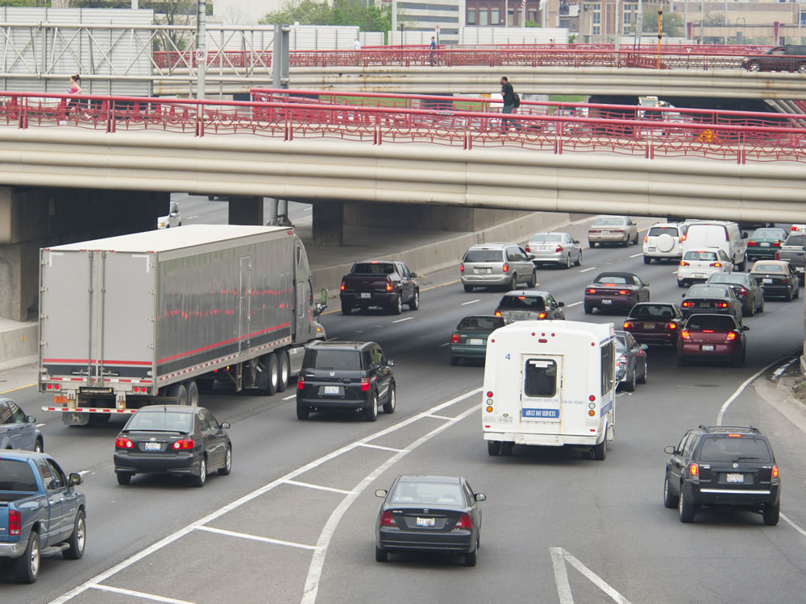
Space When Crossing and Entering Traffic
Notes:
Space When Crossing and Entering Traffic
ROAD RECOMMENDATION
Timing gaps
The purpose of this activity is to enable students to distinguish acceptable or unacceptable gaps in crossing traffic, entering traffic, and passing a vehicle.
1. Crossing traffic. This maneuver can be performed at the same intersection as the timing acceleration maneuvers.
The procedure at the intersection will include the following steps:
Pick out a vehicle approaching from either direction and ask the student to say “now” at the last instant he or she thinks that the truck could pull safely across the street/road.
Observers should assess the driver’s judgment immediately after the “now” signal is given.
Time the interval from the moment the student says “now” to the moment the vehicle crosses the truck’s path.
Compare the time recorded with that required to accelerate the truck across the same or a similar intersection.
The activity should continue until the driver has two consecutive correct judgments. Performance is assessed as follows:
Correct: The gap is at least two seconds and no more than five seconds longer than the acceleration time recorded earlier. The tractor-trailer could have crossed without interfering with the progress of the approaching vehicle.
Too close: The gap time is less than two seconds greater than the acceleration time. The tractor-trailer would have interfered with the progress of the approaching vehicle.
Too far: The gap time is more than five seconds greater than the acceleration time. The tractor-trailer would have passed up an acceptable gap, potentially delaying other vehicles behind the tractor-trailer.
2. Entering traffic. This maneuver can be performed at the same intersection as the timing acceleration maneuvers.
This exercise is performed in the same manner as the previous exercise, except the instructor will time the gap between the moment the student says “now” and the time the vehicle reaches the selected landmark.
Performance is assessed the same way as the previous exercise.
3. Passing a vehicle. This exercise should be performed on a two-lane road with very little traffic.
The procedure will include the following steps:
As an oncoming vehicle approaches, ask the student to say “now” at the last instant he or she thinks that the truck could pull out and pass a vehicle ahead.
Observers should assess the driver’s judgment immediately after the “now” signal is given.
Time the interval from the moment the student says “now” to the moment the oncoming vehicle passes the truck.
Compare the time recorded with that required to complete a pass in the timing acceleration activity earlier.
The activity should continue until the driver has two consecutive correct judgments. Performance is assessed as follows:
Correct: The gap is at least two seconds and no more than five seconds longer than the passing time recorded earlier. The tractor-trailer could have passed the vehicle ahead without interfering with the progress of the oncoming vehicle.
Too close: The gap time is less than two seconds greater than the passing time. Had the tractor-trailer attempted to pass, it would have caused the oncoming driver to slow down or caused the tractor-trailer to cut off the vehicle being passed.
Too far: The gap time is more than five seconds greater than the separation time. The tractor—trailer would have passed up an acceptable gap, potentially delaying other vehicles behind the tractor-trailer.
As with previous exercises, break your students into groups of three per instructor. Each student should have about two hours behind the wheel to complete these exercises. The students who are not behind the wheel should be kept involved — observing from the sleeper berth or back seat of the vehicle. Ask the students to watch for various situations and conditions. Also ask them questions to keep them involved.

Slide 24
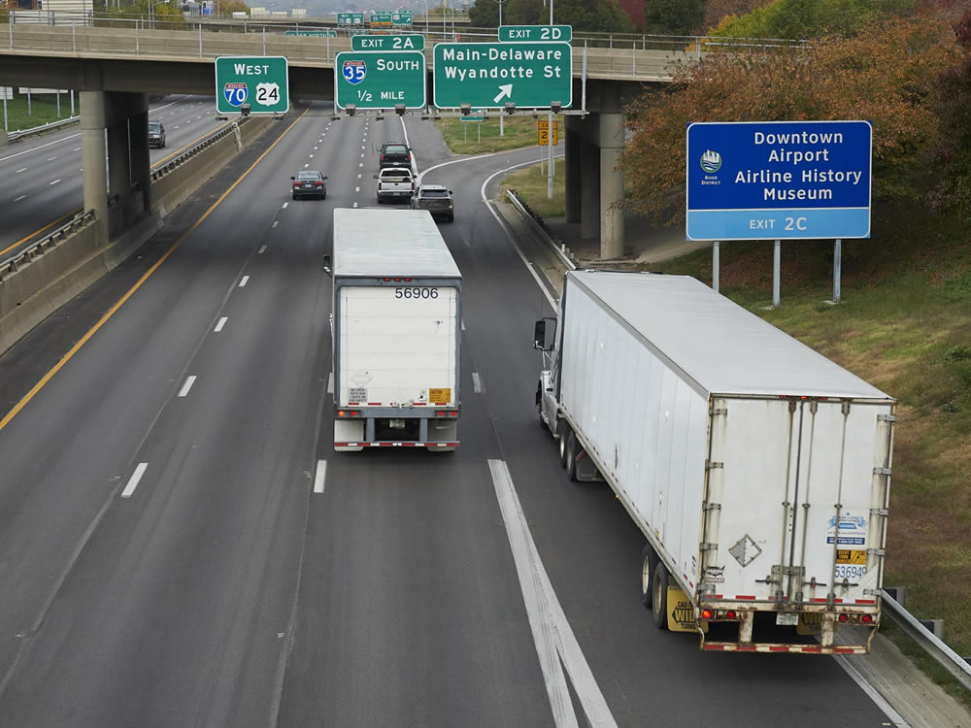
You will need a larger gap to enter traffic than you would in your personal vehicle.
Notes:
Because of slow acceleration and the length of your vehicle, you will need a larger gap to enter traffic than you would in your personal vehicle. Also keep in mind that acceleration varies with the load. Allow more room if your vehicle is heavily loaded.

Slide 25
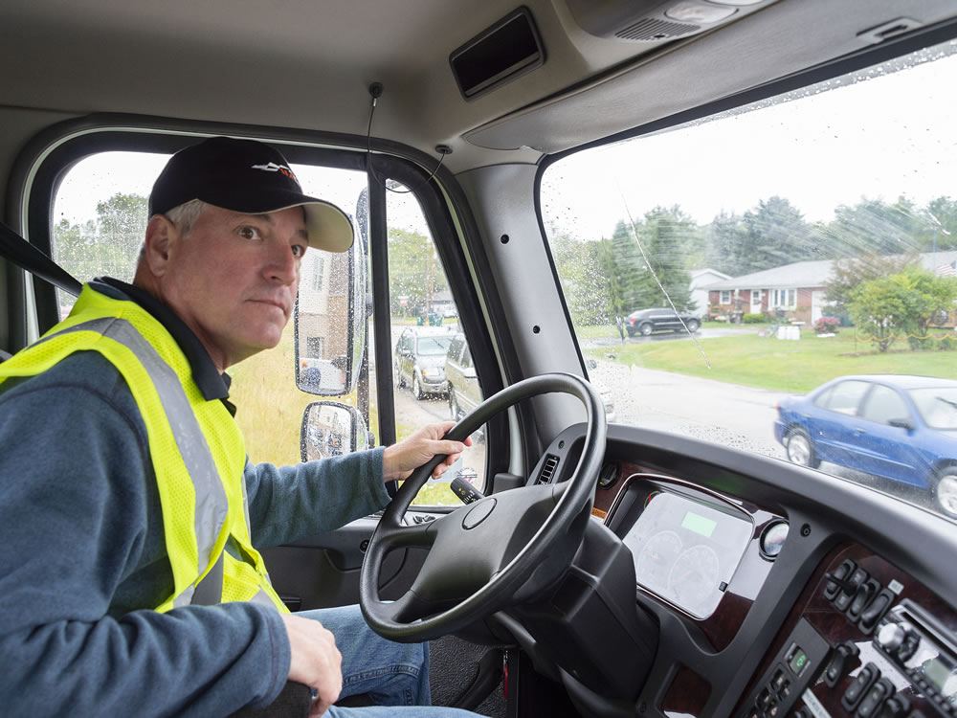
It can take seven to 15 seconds to clear an intersection.
Notes:
Before starting across a road, make sure you can get all the way across before traffic reaches you. It can take seven to 15 seconds to clear an intersection. If you miss a gear or cross a large intersection, it could take longer.
ROAD RECOMMENDATION
Timing acceleration
In this exercise, students will determine the amount of time needed to safely cross traffic at an intersection, enter traffic at an intersection, and pass a vehicle.
1. Crossing traffic. When selecting an intersection for this exercise, consider the following: The street from which the intersection is approached should allow the tractor-trailer to remain at the intersection for up to a minute without interfering with traffic that may follow. (For example: seldom used road/street, driveway/parking lot exit, or road where the vehicle can be safely pulled to the curb if necessary.)
The traffic in the cross street should be of relatively low density. The posted speed on the cross street should be between 35 mph and 55 mph.
After coming to a stop, the student should be directed to proceed across the intersection. Using a stopwatch (or counting) the instructor should determine the interval between the time the truck begins to move forward and the time the trailer has completely cleared the intersection. The time should be recorded for future reference.
2. Turning into traffic. This maneuver can be performed at the same intersection as the crossing traffic maneuver. Instead of crossing the intersection, the student will be directed to turn right or left. The instructor should determine the interval between the time the truck begins the maneuver and the time it has reached a selected landmark around the corner.
3. Passing a vehicle. Select a multi-lane highway with a posted speed of between 40 mph and 45 mph.
Upon overtaking a slower moving vehicle, the instructor will direct the driver to follow at a safe distance. When the adjacent lane is clear, pass the vehicle, and return to the original lane of travel when there is an acceptable gap (as determined by the instructor).
As with previous exercises, break your students into groups of three per instructor. Each student should have about two hours behind the wheel to complete these exercises. The students who are not behind the wheel should be kept involved — observing from the sleeper berth or back seat of the vehicle. Ask the students to watch for various situations and conditions. Also ask them questions to keep them involved.

Slide 26
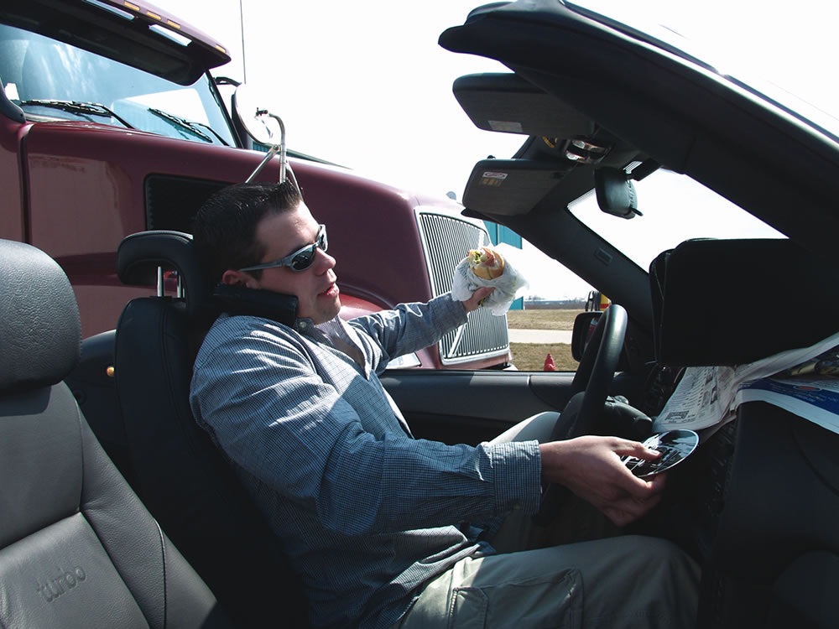
Distracted Drivers
Notes:
Distracted Drivers

Slide 27
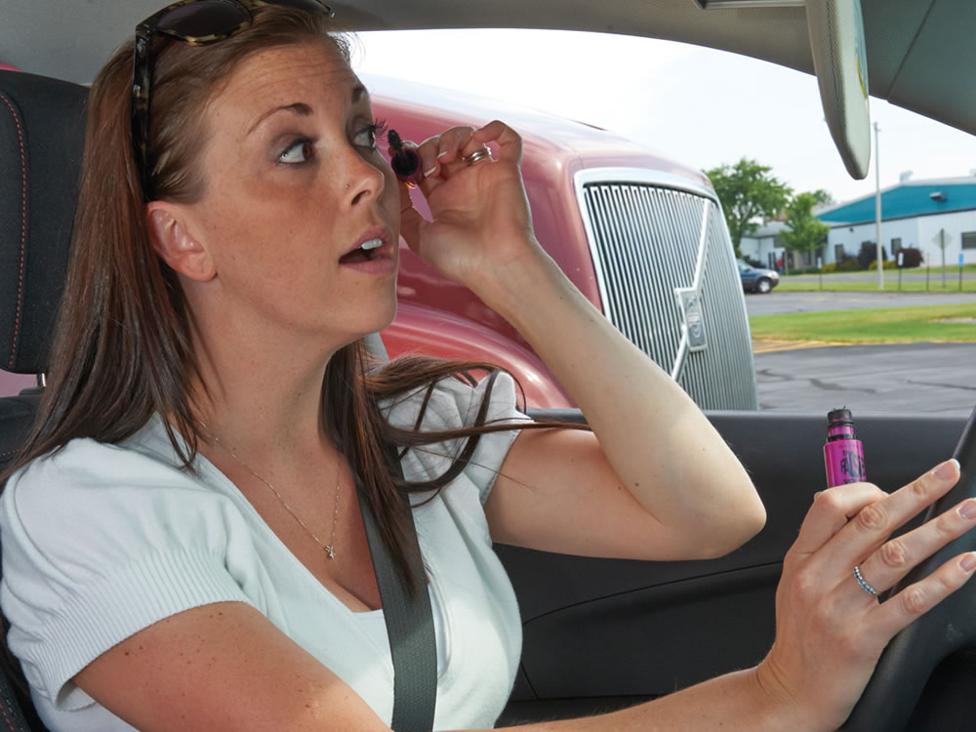
Distracted drivers make a conscious choice to distract themselves
from driving.
It important for you to be aware of the unfocused drivers around you.
Notes:
Distracted drivers make a conscious choice to distract themselves from driving whether it’s texting, looking at their GPS, or slowing down to look at an accident. This means not only is it important for you to be a focused driver, it’s equally as important for you to be aware of the unfocused drivers around you.

Slide 28
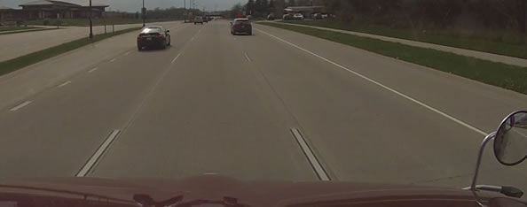
How to Spot a Distracted Driver
You can spot a distracted driver from a distance by the movement of their vehicle.
Notes:
Spotting a distracted driver is easy. They are usually participating in a distracting activity that takes them away from the task of driving. This includes not only talking on a cell phone, but also talking to passengers, changing the radio station, or drinking.
You can spot a distracted driver from a distance by the movement of their vehicle. Many distracted drivers are unable to stay within their lane or maintain a constant speed. They tailgate and may even disobey traffic rules, like stopping for a red light.

Slide 29
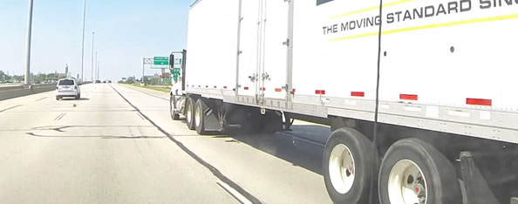
How to Respond to Distracted Drivers
If you spot a distracted driver behind you, move into the right lane to increase the likelihood they will pass you by without incident.
Notes:
Keep a safe distance behind the vehicle of a distracted driver in case you need to react quickly due to a sudden movement of their vehicle. If you spot a distracted driver behind you, move into the right lane to increase the likelihood they will pass you by without incident.
CALLOUT: You’ll want to increase the amount of space between you and any other driver you notice texting. A driver who is texting is six times more likely to be involved in a crash. The fact is, texting is one of the deadliest driving distractions. Studies have shown that texting while driving can impair a driver as much as driving with a blood alcohol level of .08 percent.

Slide 30
Objectives Review
You should now be able to:
Explain the importance of proper space management
Describe how to maintain an appropriate cushion of space
Discuss how to safely execute a right and left turn in a tractor-trailer
Recognize the signs of distracted drivers and identify how to manage them appropriately
Copyright 2019 J. J. Keller & Associates, Inc.
Notes:
You should now be able to:
Explain the importance of proper space management
Describe how to maintain an appropriate cushion of space
Discuss how to safely execute a right and left turn in a tractor-trailer
Recognize the signs of distracted drivers and identify how to manage them appropriately
CLASSROOM RECOMMENDATION
Before concluding your training session, have participants take the corresponding quiz (found on the Trainer Tools USB) to check their understanding of the material. You can customize any of the questions to fit your audience or workplace. The answer key can also be found on the Trainer Tools USB.
You may also choose to administer the quizzes before you begin your training session to help get participants thinking about the subject and/or to gauge their understanding of the topic ahead of time.
ROAD RECOMMENDATION
Managing Space
The purpose of this activity is to allow students to apply space management practices within the highway traffic environment.
In addition to the general procedures described earlier, the following procedures should be used:
Following distance illustration. At various points along the route, direct the driver to practice safe following distances to illustrate the ability to maintain adequate following distances without having large numbers of vehicles intrude upon the gap.
Clearances. Do not direct students along a route where overhead clearances are inadequate.
NOTE: To avoid hazardous situations, intervene whenever the student’s action presents a clear danger, including warning students if they are:
About to accept an inadequate gap
Entering a lane from which they are prohibited by law
In danger of cutting off another vehicle by a premature lane change
In danger of placing a vehicle where it will obstruct traffic
Continuing to follow closer than permitted by law
Both the students and instructor should observe and record errors in basic control, search, communication, and space management behavior. Space management errors include:
Following distance: Not allowing the proper number of seconds of following distance.
Lateral separation: Failure to maintain center lane position when passing parked vehicles or being passed by oncoming or overtaking vehicles.
Passing distance: Returning to the right lane too quickly after passing a vehicle.
Overhead clearance: Having to be stopped by the instructor to prevent collision with an overhead object.
Multi-lane roads: Failure to enter the lane most appropriate to the truck speed and intended maneuver.
Cross streets: Attempting to traverse or enter street when there is insufficient space to accommodate the tractor-trailer.
Right turn: Swinging left too far or too early and failing to close off the right side to overtaking traffic.
Left turn: Swinging right before starting turn or cutting diagonally across the intersection.
Multi-lane turns: Using inside lane where traffic turns in two lanes.
Barging: Causing a vehicle to alter speed or direction in order to avoid an accident during a merge attempt.
Stopping: Slowing or stopping when an earlier speed adjustment would have permitted a continuous merge.
Alignment: Not aligning the rig parallel to the highway for optimum rear vision.
Compromising: Passing two potential hazards simultaneously when a speed adjustment would have allowed them to be passed in sequence.
Adjacent operation: Unnecessarily prolonged operation alongside an adjacent vehicle or vehicles.

