Slide 1


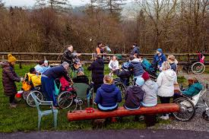
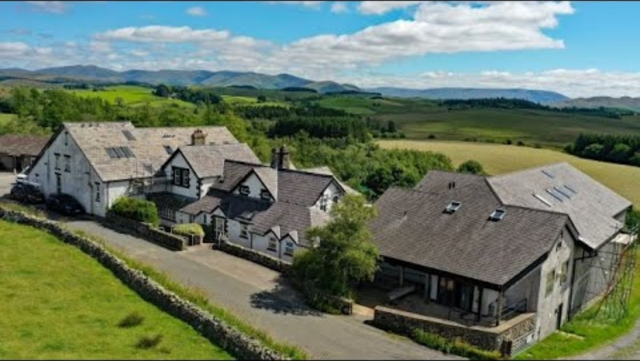
Bendrigg Roll Of Honour
1 Robin
2 Rick
3 Aboudi
4 Alicia
5 James C
6 George
7 Megan
8 Steve
9 Keira
10 Ben
11 Chelsea
12 Han
13 Hannah
14 Chris
15 James O
Nicola
Jodie
Dave
Neve
Dan
Sarah
Molly
Tess
Tracy

Slide 2
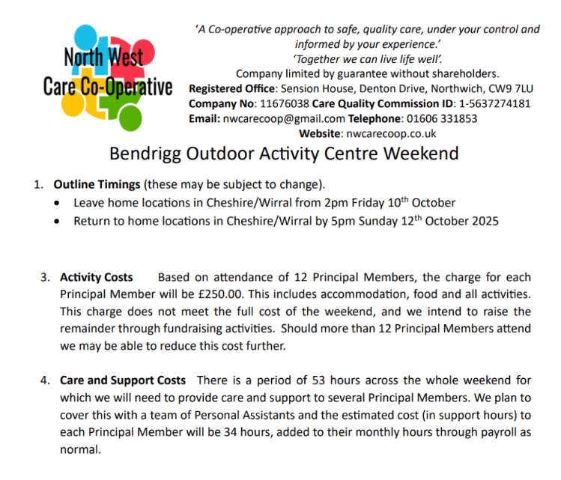

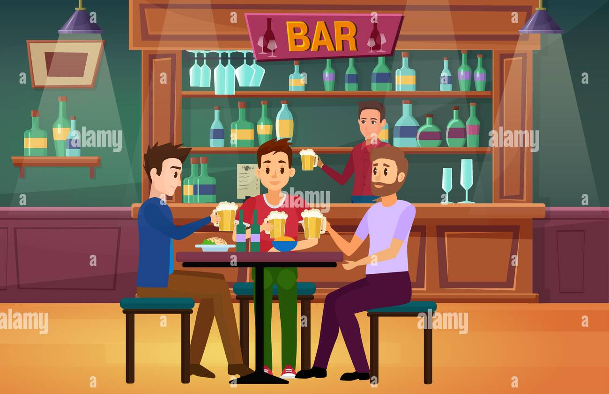
Transport:
Approx £30 per person
Optional visit to the local pub

Slide 3
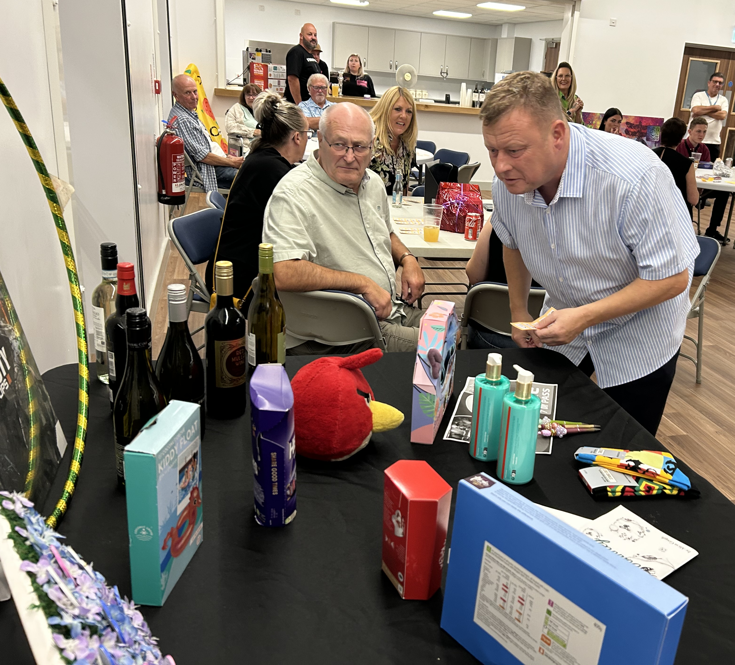

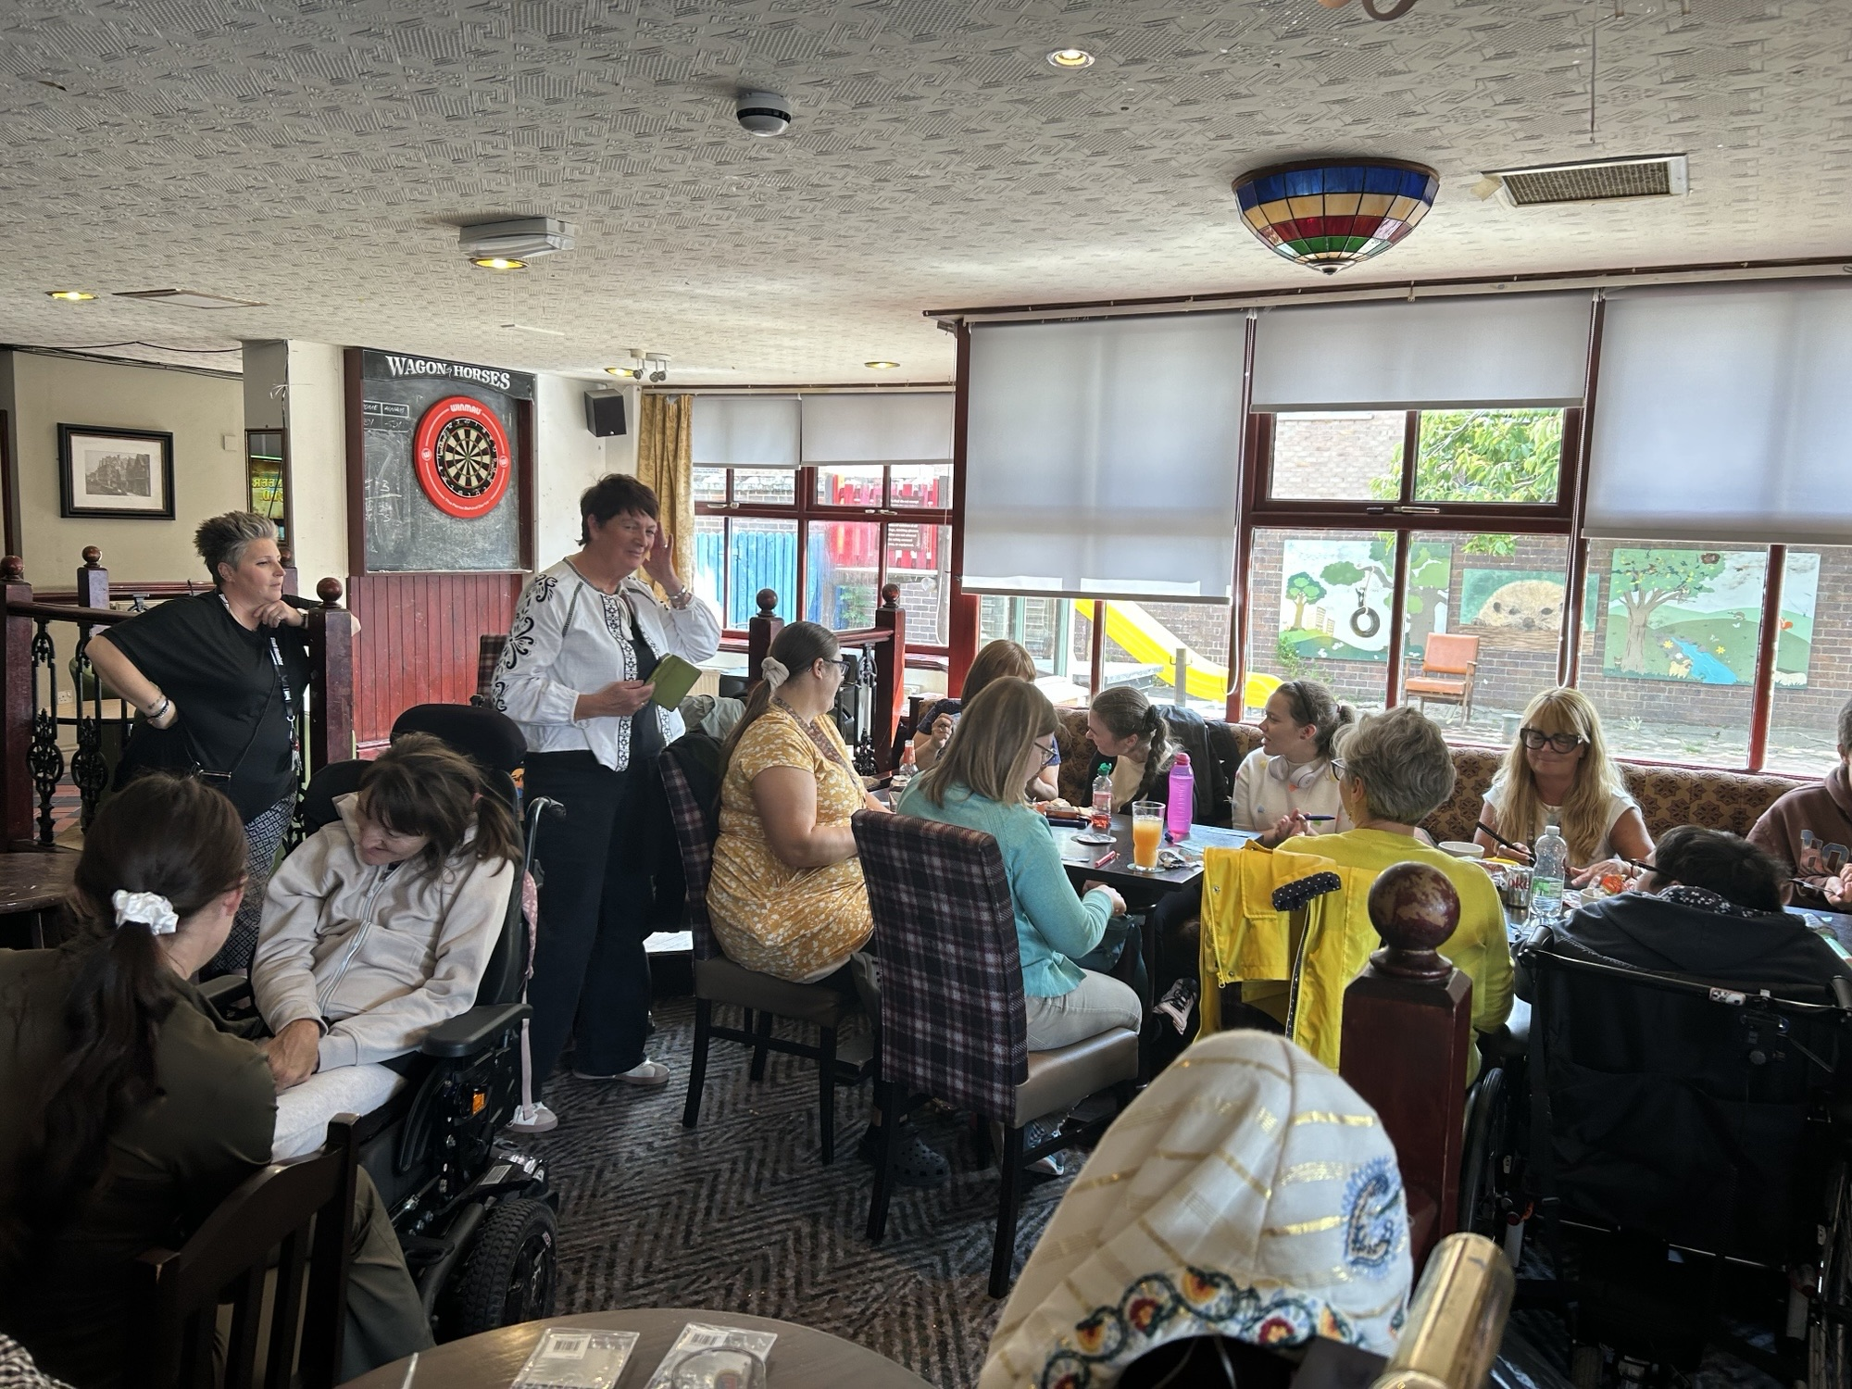
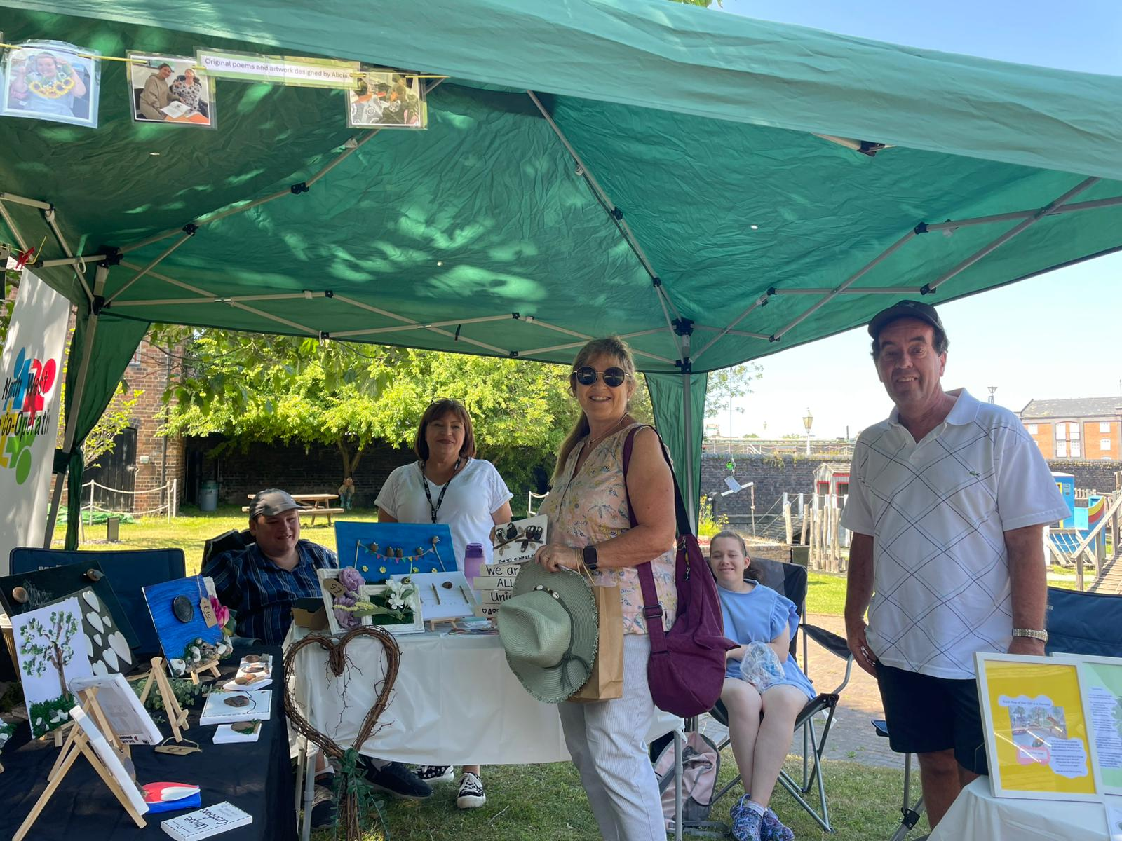
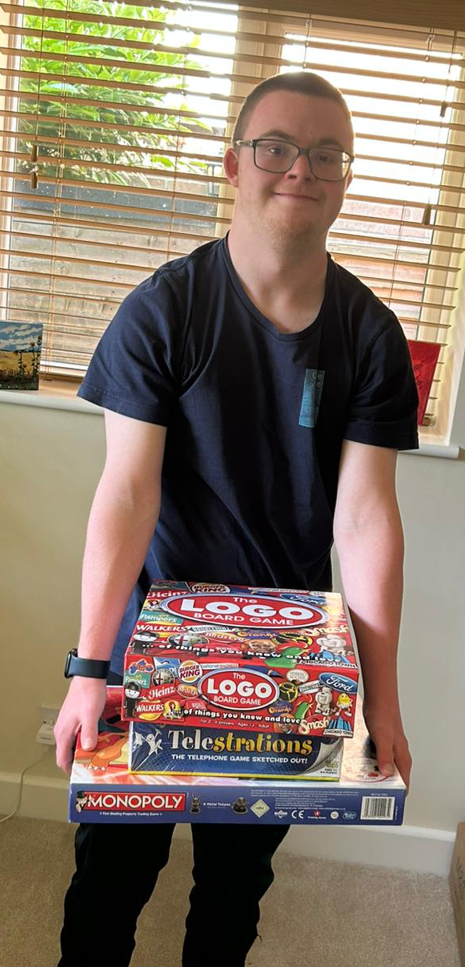
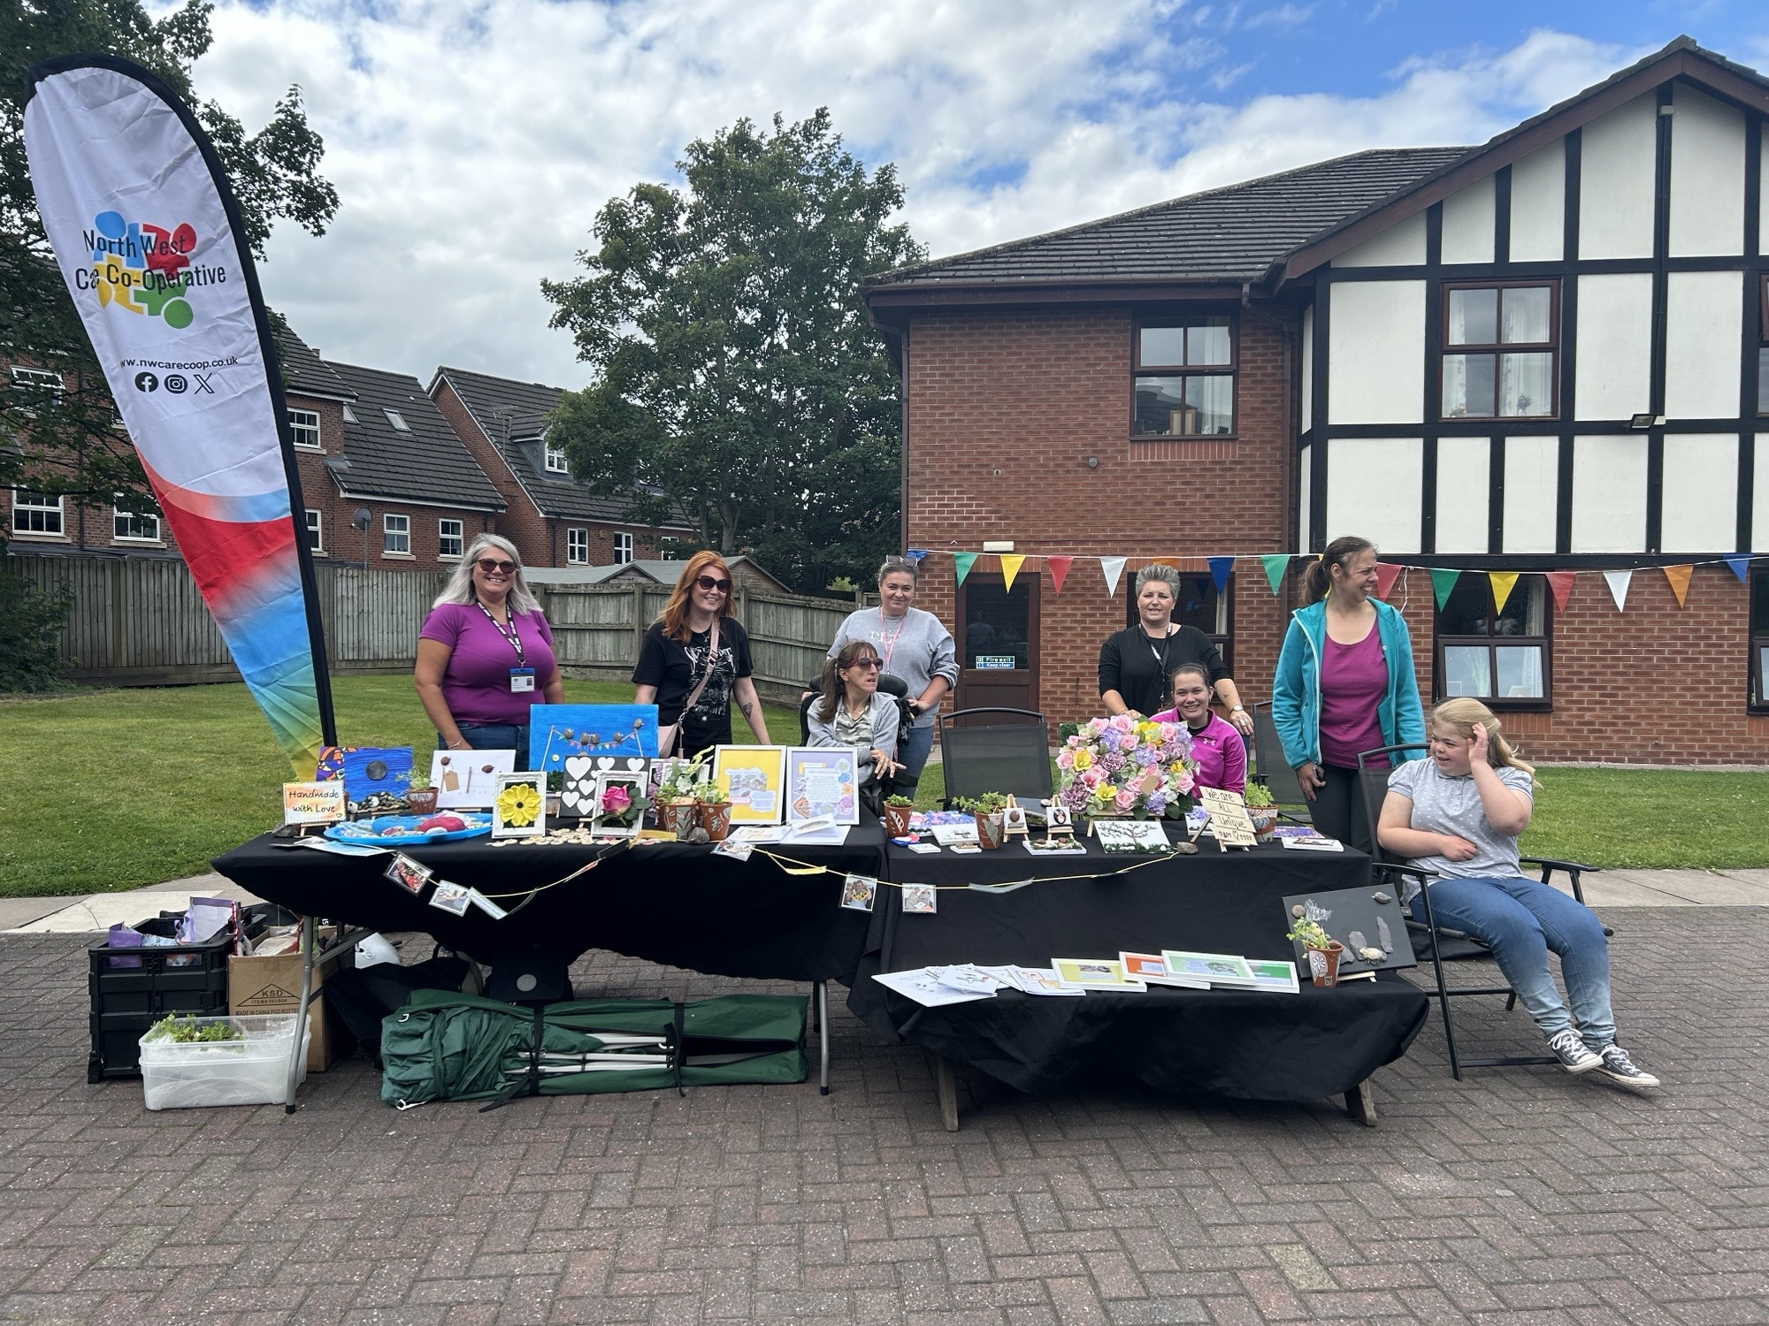
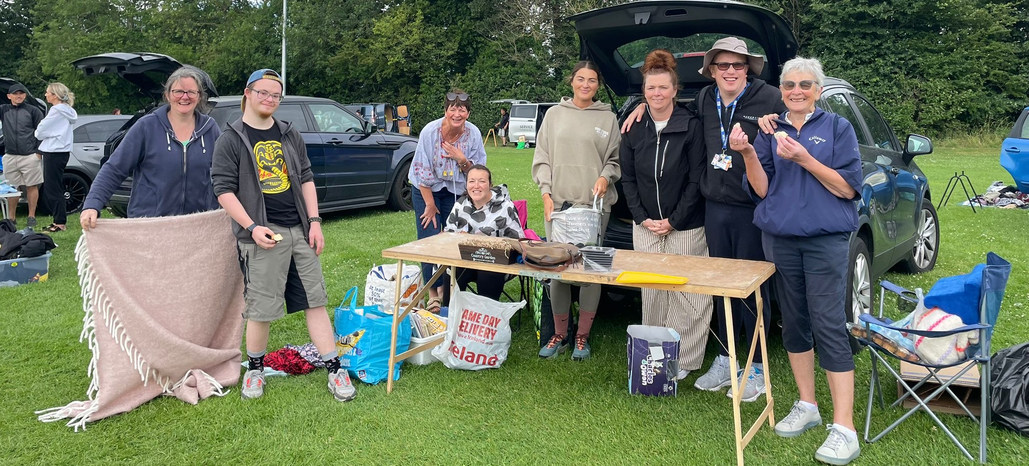
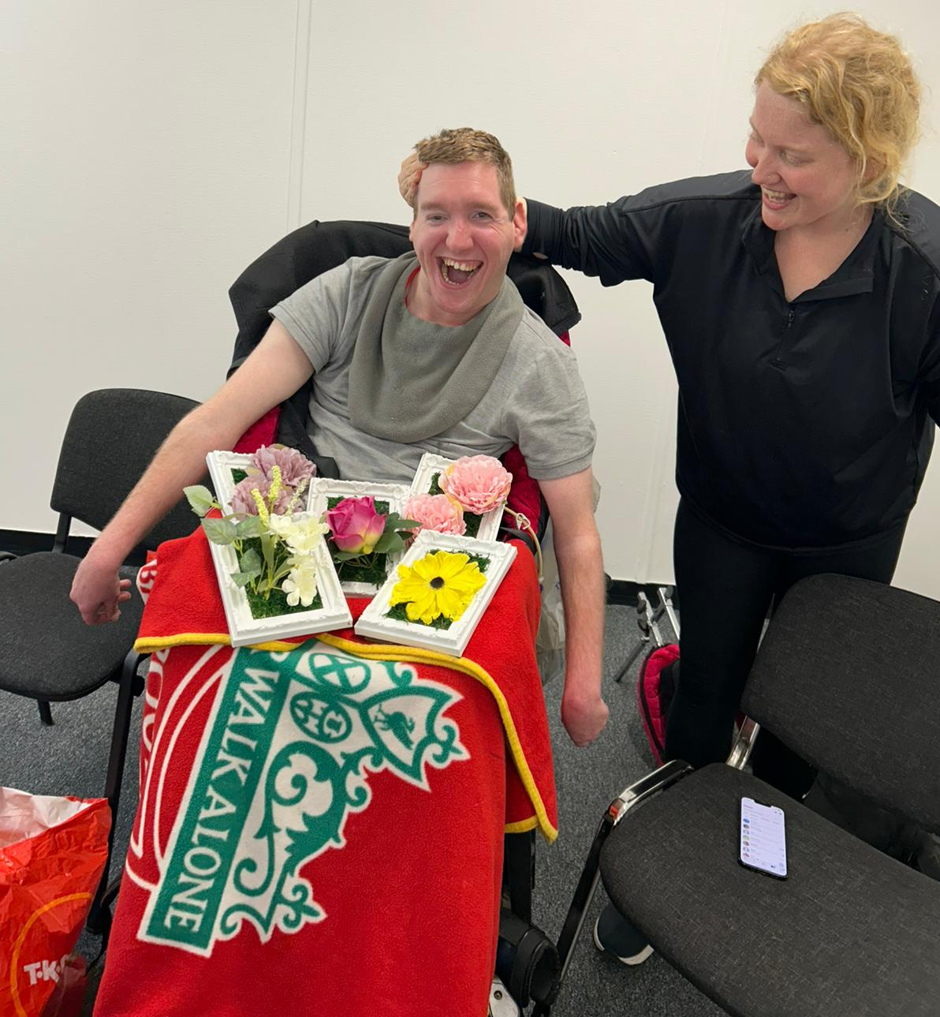
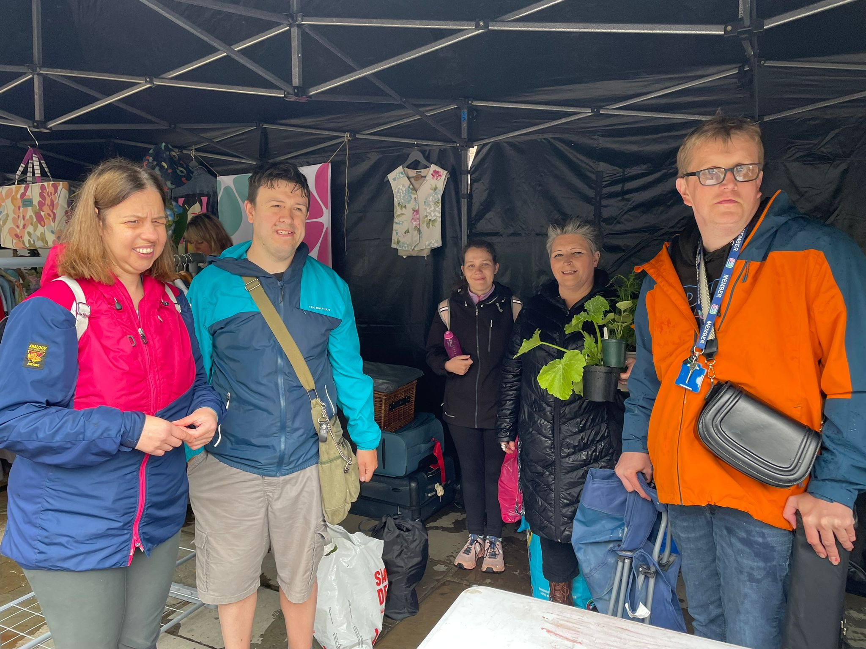
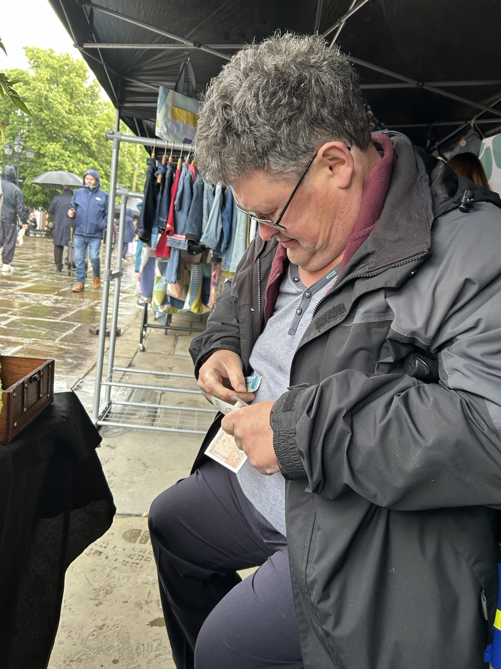
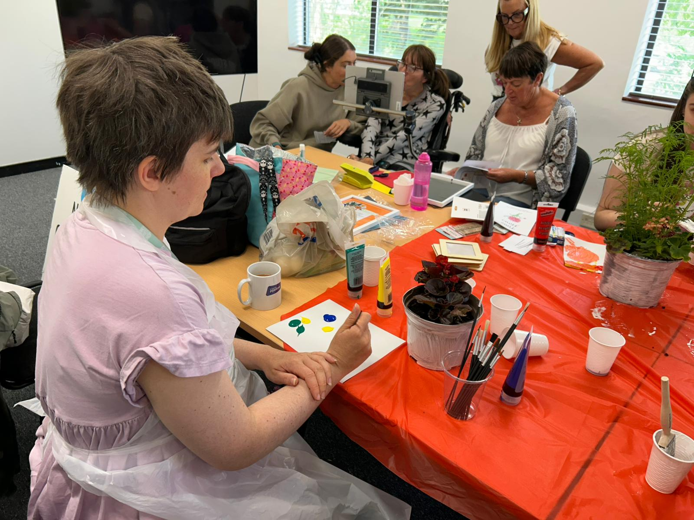
Bendrigg Fundraising
£1000
£500
£100

