Slide 1
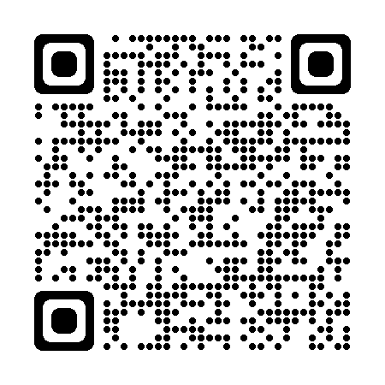
Boy Scouts of America Surveying Merit Badge
Scan the QR Code and you can follow along with the presentation and then get yourself signed up.

Slide 2
Boy Scouts of America Surveying Merit Badge
Become a counselor for the BSA Surveying Merit Badge
Share knowledge and inspire the next generation of land surveyors
Help Scouts explore the fascinating world of surveying
Make a difference in young people's lives today!

Slide 3
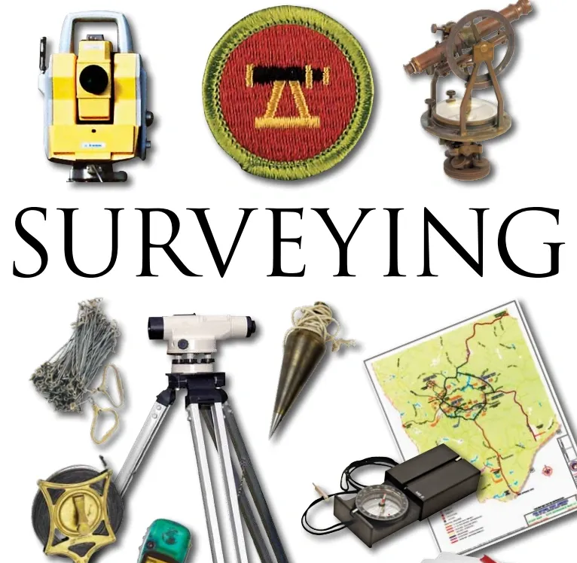
A Little History
Introduced in 1911 as one of the original 57 merit badges
Required scouts to learn about surveying principles and use of instruments
Was one of the most popular badges in the 1950s and 1960s
Declined in popularity due to technology like GPS and a focus on more technology-focused badges
Recent efforts to revitalize outdoor-oriented badges, including Surveying
Despite lower numbers of scouts earning the badge, it remains an important part of the organization's history and a valuable tool for teaching about surveying and land management.

Slide 4
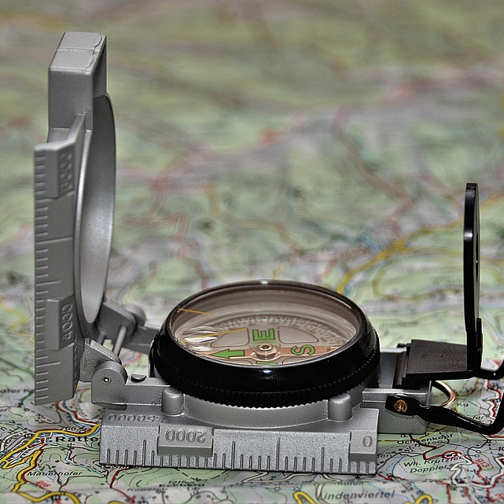
Get Your Bearings:
Requirements of the Merit Badge
Scouts must complete a range of challenging requirements that will put their mapping, measuring, and boundary identification skills to the test.
First aid and identifying poisonous plants and animals
Marking and measuring a five-sided lot
Drawing a map from field notes
Writing a metes and bounds description
Determining elevation using a level and rod
Obtaining a copy of a property deed
Understanding GPS technology
Discussing surveying as a career

Slide 5
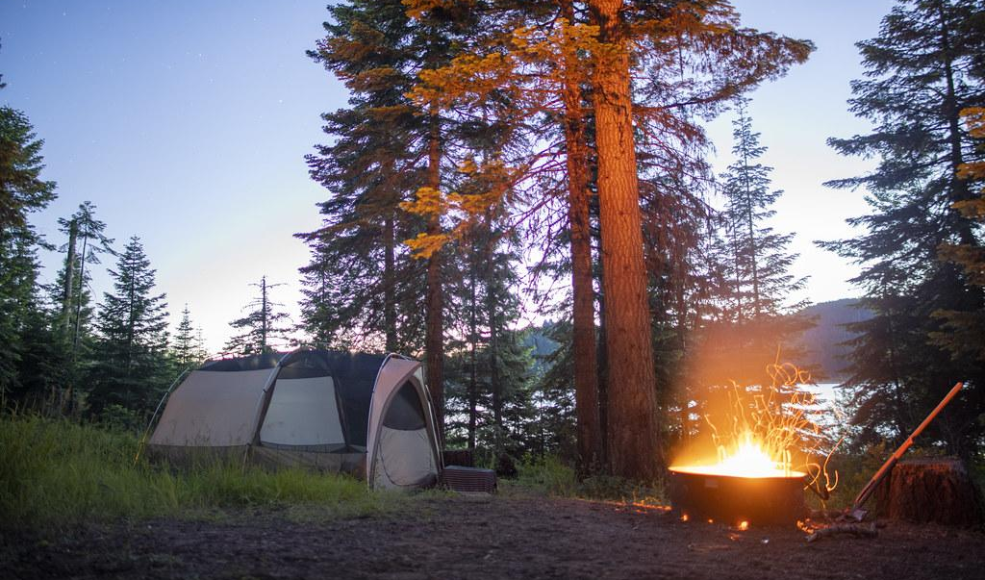
Engaging with Scouts
Events for Merit Badge Counselors
Merit badge counselors have a variety of events to engage with Scouts and help them achieve their goals, including
Merit badge workshops
Troop meetings
Summer camps
Field trips
Eagle Scout projects

Slide 6
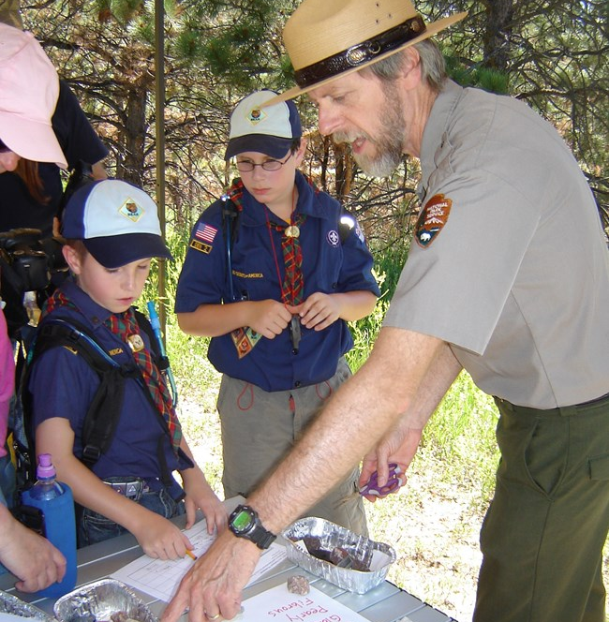
Leading The Way
A Guide to Becoming a Counselor
Embarking on the journey of becoming a Merit Badge Counselor is an exciting opportunity to share your knowledge and passion with Scouts, so let's take the first steps together!
Complete an Adult Application
Complete Youth Protection Training
Complete Merit Badge Counselor Training
Review the Merit Badge Requirements
Contact your local BSA Council
Complete any additional Council Requirements
Register as a Merit Badge Counselor

Slide 7
Follow the Link and Get Started!
Take the first step in sharing your passion for surveying and inspiring the next generation of scouts by completing the required training and registering as a Surveying Merit Badge Counselor today!

