Slide 1


Slide 2

INTRODUCTION
We live in troubling times
Sin is rampant
Religions are compromising
Christians in the First Century faced the very same problems
Paul addresses such concerns
False gospels and false hopes
Provided guidance for salvation

Slide 3
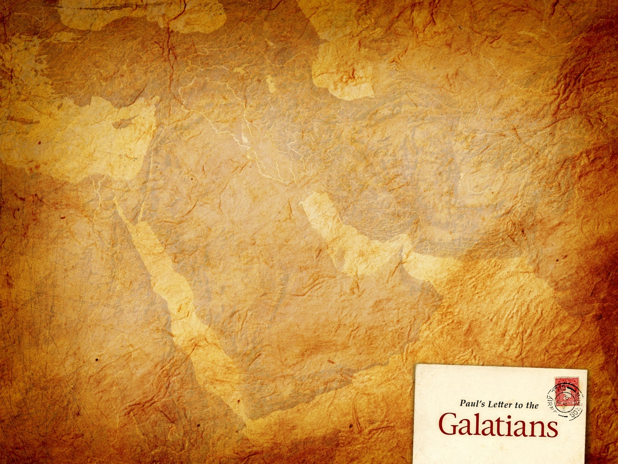
THE WRITER
God is the author of this book just as He is the author of the entire Bible
God used Paul to write the letter
Paul mentions himself by name twice in this letter (Gal. 1:1; 5:2)
Paul/Saul formerly persecuted the church (Acts 9:1-2)
Wrote over ½ of the N T

Slide 4
Paul, an Apostle
Apostle = “he that is sent”
Origin of his apostleship:
  Not of men
  But by Jesus Christ and God
  His apostleship had been questioned by some
  He dispels that notion very quickly at the beginning of this letter

Slide 5
Paul and Those with Him
These great saints are left nameless
How many great works have been done by nameless saints
The fact of the matter is that God is the One Who receives the glory (Mat. 5:16)
Some of Paul’s companions were: Luke, Timothy, Titus, etc…

Slide 6
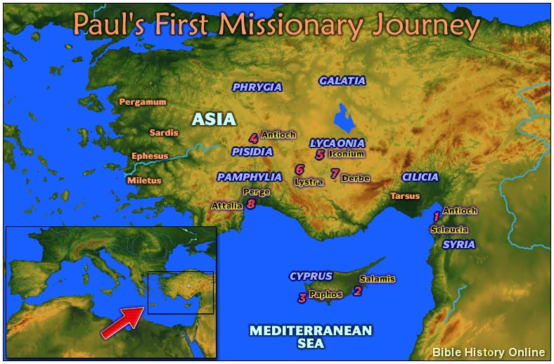
Recipients of the Letter

Slide 7
Recipients of the Letter
“Churches of Galatia”
Those congregations Paul established on his first missionary journey (Acts 13:14-14:23)
Paul revisited them on his second journey (Acts 16:1-5). Timothy is from here
He visited them again on his third journey (Acts 18:23)
Antioch, Lystra, Derbe, etc…

Slide 8
Purpose of the Letter
The church was being influenced by false teachers (Gal. 1:6-9)
Referred to as “Judaizing teachers” who taught Gentiles must keep the Law of Moses and be circumcised (Acts 15:1)
Paul recognized that this doctrine would jeopardize their souls (Gal. 5:4)
Those who were teaching false doctrine were undermining Paul’s apostleship
(Gal. 1:1)

Slide 9
Content of the Letter
Paul’s defense of his apostleship (chapters one and two)
Paul’s defense of justification by the faith (chapters three and four)
Paul’s call to stand fast in the liberty of the Gospel (chapters five and six)

