Slide 1
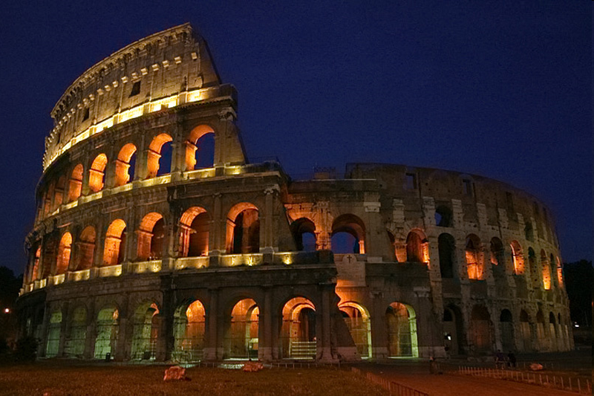
Romans

Slide 2
PAUL’S LETTER TO THE ROMANS
Romans 1:16

Slide 3
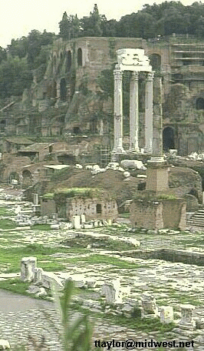
ROME
Rome was the capital city of the most powerful empire in the world. The book of Romans has much to say about the Christian’s relationship to their government.
Roman Forum

Slide 4
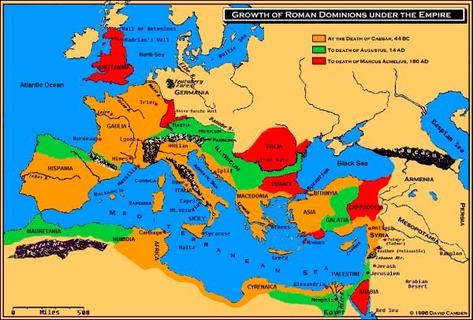
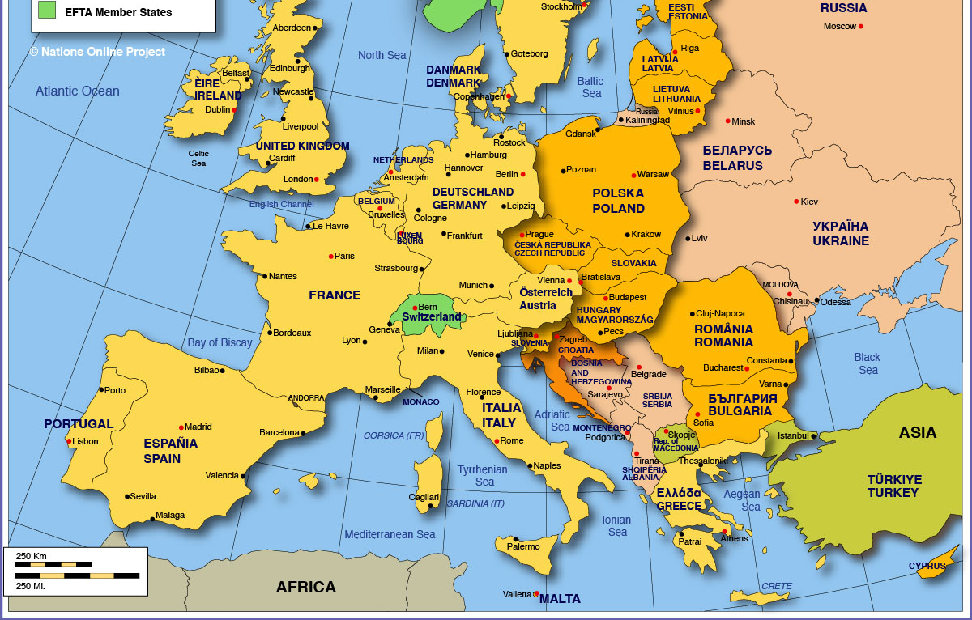

Slide 5
Author: The Holy Spirit
2 Peter 1:21

Slide 6
Writer: Paul
Romans 1:1

Slide 7
Time Written: 58 A.D.
During his third missionary journey from Corinth. Probably his sixth letter.

Slide 8
Chapter One
The Gentiles are lost and in need of the Gospel (Rom. 1:32)

Slide 9
Chapter Two
The Jews are lost and in need of the Gospel (Rom. 2:13)

Slide 10
Chapter Three
All are lost and in need of the Gospel (Rom. 3:23)

Slide 11
Chapter Four
Abraham and the Gospel (Rom. 4:1-3)

Slide 12
Chapter Five
Justification through faith, the Gospel plan of salvation (Rom. 5:1-5)

Slide 13
Chapter Six
The Gospel is the death, burial, and resurrection (Rom. 6:1-14)

Slide 14
Chapter Seven
The Gospel delivers us from the Law of Moses (Rom. 7:1-6)

Slide 15
Chapter Eight
The Gospel delivers us from the Law of Moses (Rom. 8:1-6)

Slide 16
Chapter Nine
Israel rejects the Gospel (Rom. 9:30-33)

Slide 17
Chapter Ten
Israel’s hope is the Gospel (Rom. 10:1-13)

Slide 18
Chapter Eleven
The Gospel and the Gentiles (Rom. 11:17-24)

Slide 19
Chapter Twelve
The Gospel and our service (Rom. 12:1-2)

Slide 20
Chapter Thirteen
The Gospel and our life (Rom. 13:8-14)

Slide 21
Chapter Fourteen
The Gospel and liberty (Rom. 14:1-7)

Slide 22
Chapter Fifteen
Paul preaching the Gospel (Rom. 15:20)

Slide 23
Chapter Sixteen
The power of the Gospel (Rom. 16:25)

Slide 24
Chapter One
Paul, servant, apostle
The promised Gospel
About Jesus the Christ
Declared the Son of God
Obedience to the faith
Called of Jesus Christ
Saints of Rome
Their faith

Slide 25
Chapter One
Serves God in the Gospel
Paul’s desire to visit Rome
To impart spiritual gifts
For Paul’s comfort
I often planned to come
Paul’s debts
I am ready to preach the Gospel in Rome

Slide 26
Chapter One
16 Not ashamed of the Gospel
Therein is the righteousness
Wrath of God is revealed
That which may be known
The invisible things testify
They did not glorify God
Professing wisdom, they became fools

Slide 27
Chapter One
Changed the glory of God
God gave them up
Changed truth into a lie
God gave them up
Men with men
They did not like to retain God in their knowledge

Slide 28
Chapter One
Filled with unrighteousness
Haters of God
Without understanding
Have pleasure in those who commit such sins

Slide 29
Chapter Two
The Jews are lost and in need of the Gospel (Rom. 2:13)

Slide 30
Chapter Two
Thou art inexcusable
God’s judgment is truth
If you do the same, you’ll be punished
Declared the Son of God
Treasuring up wrath
Who will render according to our work

Slide 31
Chapter Two
To those who good, glory
To those who do not, wrath
On every soul that does evil
Glory to every man who does good
There is no respect of persons with God
For as many as sinned

Slide 32
Chapter Two
Doers are the law are just
Gentiles did by nature
The law written on their heart
God shall judge by the Gospel
Thou art called a Jew
You knew His will
A guide for the blind

Slide 33
Chapter Two
An instructor of the foolish
Do you steal
Do you commit adultery, do you commit sacrilege
You boast in the law and break it
God is blasphemed because of you

Slide 34
Chapter Two
Circumcision profits, if you keep the law
UnCircumcision counted as circumcision
If they fulfill the law
Not a Jew outwardly
Jew is one inwardly

Slide 35
Chapter Three
All are lost and in need of the Gospel (Rom. 3:23)

Slide 36
Chapter Three
What advantage has the Jew
Much in every way
Does unbelief make the faith ineffectual
Let every man be a liar
Is God unrighteous
God forbid
Why am I judged a sinner

Slide 37
Chapter Three
Do evil, that good may come?
Jews and Gentiles are lost
There is none righteous
None understands
They are all gone out
With their tongues they have deceived

Slide 38
Chapter Three
Mouths full of cursing
Swift to shed blood
Destruction is their way
Don’t know peace
No fear of God
The world is guilty
No one is justified by the law

Slide 39
Chapter Three
Righteousness without the law
Righteousness by faith
All have sinned
Justified by grace
Jesus, our Propitiation
Justified by belief

Slide 40
Chapter Three
Where is the boasting
Justified by faith without the deeds of the law
God of both Jews and Gentiles
Both justified by faith
Does this void the law? No

Slide 41
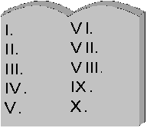
No Written Law
(Gentiles)
Matthew – John
Jesus is Here
H
E
A
V
E
N
Law of Christ:
Both Jew and Gentile
C
R
E
A
T
I
O
N
Law of Moses
(Jews)
1500 B. C.
In the early 60’s the Gospel was preached around the world
Genesis – Malachi
Jesus is Coming

Slide 42
Chapter Four
Abraham and the Gospel (Rom. 4:1-3)

Slide 43
Chapter Four
What about Abraham
Was Abraham justified by works of the law
What saith the Scripture
To him that worketh
To the one who believes
Blessed is the man

Slide 44
Chapter Four
Blessed are they who sins are forgiven
Blessed is the man to whom the Lord does not impute sin
Is this just for the Jew
Abraham was called in uncircumcision
Circumcision was a sign

Slide 45
Chapter Four
Walk in Abraham’s steps
The promise was of faith
Not by the law
The law works wrath
By faith, through grace
A father of many nations
Against hope believed

Slide 46
Chapter Four
Was not weak in faith
He staggered not
He was fully persuaded
It was imputed to him
Not for his sake alone
But to those who believe
He was raised

Slide 47
Chapter Five
Justification through faith, the Gospel plan of salvation (Rom. 5:1-5)

Slide 48
Chapter Five
Being justified by faith
We have access to grace by faith
Glory in tribulations
It brings patience
Hope makes us not ashamed
Christ died for the ungodly
For a good man some would die

Slide 49
Chapter Five
For a good man some would die
While we were sinners Christ died for us
We are justified by His blood
We were reconciled while we were still enemies
We received atonement

Slide 50
Chapter Five
By one man sin entered
Sin was in the world before the law
Death reigned from Adam to Moses
The free gift
Unto justification

Slide 51
Adam Christ
Created Creator
Creature of God Son of God
Slept unnatural Slept unnatural
Side was opened Side opened
Thus obtained bride Obtained bride
Law propagation Law propagation
Tempted by Satan Tempted by Satan
Was Overcome by sin Overcame sin
Defeated by Satan Defeated Satan

Slide 52
Chapter Five
Abundance of grace
The gift came upon all men
By one shall many be made righteous
The law entered
Eternal life by Jesus Christ

Slide 53
Chapter Six
The Gospel is the death, burial, and resurrection (Rom. 6:1-14)

Slide 54
Chapter Six
Shall we continue in sin that grace may abound
God forbid
Baptized into His death
Buried with Him by baptism
Planted together
Our old man is crucified
Freed from sin

Slide 55
Chapter Six
We are dead with Christ
Death has no hold on Christ
He lives unto God
We are dead to sin
Let not sin reign in your body
Use our bodies as instruments of righteousness
We are under grace

Slide 56
Chapter Six
Shall we sin?
We are servants of whom we obey
We obeyed from the heart
Being then made free from sin
Yield your members servants of righteousness

Slide 57
Chapter Six
When we served sin, we were void of righteousness
Our fruit now is not unto death
Now we are made free from sin
The wages of sin is death; the gift of God is everlasting life

Slide 58
Chapter Seven
The Gospel delivers us from the Law of Moses (Rom. 7:1-6)

Slide 59
Chapter Seven
Those under the Law have been delivered from it (1-6)
The Law was good (7-12)
It was not the Law, but sin, which produced spiritual death (13-24)
There must be some other means of deliverance (25)

Slide 60
Chapter Seven
The law has dominion over a man as long as it lives
The woman is bound to her husband while he is alive
If she marries another, she is an adulterer
We are dead to the law
When we were in the flesh

Slide 61
Chapter Seven
We are delivered from the law
Is the law sin?
No, but it heightened my desire to sin
I died
I found the commandment to be death

Slide 62
Chapter Seven
Sin deceived me
The law is holy, just, and good
Sin became exceedingly sinful
The law is spiritual
Those things I want to do; I don’t

Slide 63
Chapter Seven
I show the law to be good
Sin dwells in me
How to perform it is difficult
The that I don’t want to do, I do
It is sin dwelling in me

Slide 64
Chapter Seven
Evil is present in me
I delight in the law in the inward man
There is a war within me
O wretched man that I am
I thank God through Jesus Christ our Lord.

Slide 65
Chapter Eight
The Gospel delivers us from the Law of Moses (Rom. 8:1-6)

Slide 66
Chapter Eight
Flesh: σαρξ (sarx)
Simply means flesh. Used literally (Rom. 2:28)
Special use:
We were in the flesh (Rom. 7:5). Christians are not in the flesh (Rom. 8:9).

Slide 67
Chapter Eight
Spirit: πνυεμα (pneuma), From G4154; a current of air, that is, breath (blast) or a breeze; by analogy or figuratively a spirit, that is, (human) the rational soul, (by implication) vital principle, mental disposition, etc., or (superhuman) an angel, daemon, or (divine) God, Christ’s spirit, the Holy spirit: - ghost, life, spirit (-ual, -ually), mind.

Slide 68
Chapter Eight
There is now no condemna-tion for those in Christ
Free from the law of sin and death (Gal. 3:21)
What the Law of Moses could not do, Jesus did
The righteousness of the law is fulfilled in us (9:30-33)

Slide 69
Chapter Eight
Those in the flesh, mind the things of the flesh (9:32)
To be carnally minded is death
The carnal mind is the enemy of God
Those in the flesh cannot please God

Slide 70
THE SPIRIT
Witnesses (Rom. 8:16)
Instructs (Neh. 9:20)
Teaches (John 14:26)
Convicts (John 16:8)
Begets (2 Cor. 3:6)
Saves (Titus 3:5)
Sanctifies (1 Cor. 6:11)
Cleanses (1 Cor. 6:11)
Washes (1 Cor. 6:11)
Comforts (Acts 9:31)
Gives Love (Rom. 5:5)
Leads (Rom. 8:14)
Indwelling (Rom. 8:11)
Strengthens (Eph. 3:16)
Power (Rom. 15:13)
In Resurrection (Rom. 8:11)
Born of the Spirit (John 3:5,8)
THE WORD
Witnesses (John 5:39)
Instructs (2 Tim. 3:16)
Teaches (John 6:45)
Convicts (Titus 1:9)
Begets (James 1:18)
Saves (Acts 11:14)
Sanctifies (John 17:17)
Cleanses (John 15:3)
Washes (Eph. 5:26)
Comforts (1 Thess. 4:18)
Gives Love (1 John 2:5)
Leads (Psalms 119:105)
Indwells (Col. 3:16)
Strengthens (Acts 20:32)
Power (Hebrews 1:3)
In Resurrection (John 5:28-29)
Born of the Word (1 Peter 1:23)

Slide 71
Chapter Eight
But you (Christians) are not in the flesh
If you be in Christ
The Spirit of Him that raised up Jesus
We are debtors
If you live after the flesh, you shall die

Slide 72
Chapter Eight
As many as are led by the Spirit
We have not received the spirit of bondage
The Spirit (Holy) bears witness with our spirit
Joint-heirs with Christ

Slide 73
Chapter Eight
The sufferings of this present time (2 Cor. 11:17-33)
We wait for the manifestation of our body
The creature was made subject to vanity (2 Cor. 5:17)
Delivered from bondage

Slide 74
Chapter Eight
The whole creation, the church, (see Eph. 2:15)
The individual Christian groans within himself (Prov. 18:14)
We are saved by that hope
We patiently wait for the redemption of this body

Slide 75
Chapter Eight
The spirit helps with our infirmities
Most “scholars” contend that this is talking about the Holy Spirit
Some brethren have used the “most scholars” approach with this verse

Slide 76
Chapter Eight
The spirit helps with our infirmities
Consider this: most “scholars” teach that baptism is NOT required in the plan of salvation
Do we place our trust in “most scholars” or in an exhaustive study of the Word of God

Slide 77
Chapter Eight
The spirit helps with our infirmities
Could it be possible that Paul is speaking of our human spirit interceding for our weak bodies in this verse?
I believe that is exactly what Paul is talking about

Slide 78
Chapter Eight
The spirit helps with our infirmities
First, we must understand the human spirit
Our spirit comes from God (Ecc. 12:7)
When our spirit leaves our body, we die (James 2:26)

Slide 79
Chapter Eight
The spirit helps with our infirmities
Prov. 18:14
Prov. 16:2
Prov. 20:27
Prov. 15:13
Prov. 17:22
Prov. 25:28

Slide 80
Chapter Eight
He that searches our hearts makes intercession for us (This is Jesus, not the Holy Spirit, verse 34)
All things work together for good
We are conformed to His image

Slide 81
Chapter Eight
We will be glorified
Who can be against us?
He spared not His Own Son
God justifies
Christ makes intercession for us
Who shall separate us from the love of God?

Slide 82
Chapter Eight
For Thy sake we are killed all day long
We are more than conquerors through Him
I am persuaded
That nothing will be able to separate us from the love of God

Slide 83
Chapter Nine
Israel rejects the Gospel (Rom. 9:30-33)

Slide 84
Chapter Nine
Paul begins by stating his is not lying
His heart is heavy
For his brethren in the flesh
Israel (the nation)
Who brought Christ in the flesh

Slide 85
Chapter Nine
They are not all Israel which are of Israel
Not just because they descended physically from Abraham
Children of promise are counted for the seed

Slide 86
Chapter Nine
The promise was through Sarah
And then through Isaac and Rebecca
God’s purpose cannot be thwarted
The elder shall serve the younger

Slide 87
Chapter Nine
Jacob have I loved, but Esau have I hated (see Mal. 1:3)
This is talking about the posterity of Jacob and Esau
God recognized that Esau and his descendants were not suitable to bring the Christ into the world while Jacob and his were

Slide 88
Chapter Nine
Is God unrighteous? No!
I will have mercy (Ex. 33:19)
God is the One Who shows mercy
Even for this purpose God raised up Pharaoh
He will have mercy accord-ing to His will not man’s

Slide 89
Chapter Nine
Who can change God’s will
Who can reply against God
Can the clay tell the potter
God allowed those who were not doing His will to be used to accomplish His will
To make known His glory

Slide 90
Chapter Nine
Both Jew and Gentile (1:16-17)
As He said in Hosea
Ye that are not my people
A remnant will remain
He will finish His work
The Lord left a seed

Slide 91
Chapter Nine
The Gentiles attained righteousness
Israel did not
Why? They had the wrong motivation
They stumbled at the Christ

Slide 92
Chapter Ten
Israel’s hope is the Gospel (Rom. 10:1-13)

Slide 93
Chapter Ten
Paul’s desire was for Israel to be saved
They had a zeal for God
They sought their own righteousness
Christ is the end of the law
The man that doeth those things shall live

Slide 94
Chapter Ten
Say not, Who shall ascend to heaven
Or who shall descend into the deep
The word of faith
That if thou shalt confess and believe in thine heart
With the heart man believes

Slide 95
Chapter Ten
Whosoever believeth shall be saved
There is no difference between the Jew and the Greek
Whosoever calls on His Name
How shall they call

Slide 96
Chapter Ten
How shall they preach
But they have not all obeyed
Faith comes by hearing the Word of God
Have they not heard?
Did Israel not know?
I was found of them
To Israel, all day long

Slide 97
Chapter Eleven
The Gospel and the Gentiles (Rom. 11:17-24)

Slide 98
Chapter Eleven
Has God cast away His people?
God has not cast away His people
Elijah cried they have killed thy prophets and I am the only one left

Slide 99
Chapter Eleven
God responded there are 7,000 men who have not bowed to Baal
There is even now a remnant
Grace and works
What then?
God gave them a spirit of slumber

Slide 100
Chapter Eleven
Let their table be a snare
Let their eyes be darkened
Did the Jews intend to fall? God forbid
Their fall opened the way for the Gentiles
I speak to you Gentiles

Slide 101
Chapter Eleven
God desires now to use the Gentiles to bring the Jews back to Him
Life form the dead
The first fruits are holy
The wild olive grafted in
Boast not against the branches

Slide 102
Chapter Eleven
The branches were broken off
They were broken off because of unbelief
God did not spare the natural branches
Behold the goodness and severity of God

Slide 103
Chapter Eleven
God is able to graft them in again
How much more God is able to graft back in the natural branch
Do not be ignorant of this mystery

Slide 104
Chapter Eleven
In this manner or fashion (through the Gospel) all Israel shall be saved
For this is my covenant with them
Concerning the Gospel
Do not expect God to change His mind in the matter

Slide 105
Chapter Eleven
You (Gentiles) were disobedient and God gave you the opportunity to be saved
He will treat the Jews in the same fashion
God has concluded we all are disobedient

Slide 106
Chapter Eleven
The depth and the riches of the wisdom of God
Who has known His mind
Who moved first, God or man
All things are for His glory

Slide 107
Chapter Twelve
The Gospel and our service (Rom. 12:1-2)

Slide 108
Chapter Twelve
I plead with you brethren
Be not conformed to this world
Do not think more highly of himself
We have many members in one body
We are one body in Christ

Slide 109
Chapter Twelve
Having differing gifts
Ministry, teaching
Exhortation, he that ruleth
Let love be sincere
Be kindly affectionate one to another with brotherly love
Not slothful in business, fervent in spirit

Slide 110
Chapter Twelve
Rejoicing in hope
Given to hospitality
Bless them that persecute you
Rejoice with those that rejoice
Be of the same mind
Don’t return evil for evil

Slide 111
Chapter Twelve
As much as possible, live in peace
Avenge not yourselves
If your enemy is hungry, feed him
Overcome evil with good

Slide 112
Chapter Thirteen
The Gospel and our life (Rom. 13:8-14)

Slide 113
Chapter Thirteen
Let every soul be subject to the higher powers (government)
Whoever resists them, resists God
Rulers are not to be a terror against the good, but the bad
He is the minister of God

Slide 114
Chapter Thirteen
One must be in subjection
For for this cause you pay tribute (taxes)
Render all their dues
Owe no man anything
Love thy neighbor as thy self
Love works no ill to his neighbor

Slide 115
Chapter Thirteen
Wake up; our salvation is nearer
Put off the works of darkness
Walk honestly as in the day
Make no provisions for the flesh

Slide 116
Chapter Fourteen
The Gospel and liberty (Rom. 14:1-7)

Slide 117
Chapter Fourteen
The one that is weak in faith receive but not to fight over matters of opinion. The weak, it seems to me, is the one who is easily convinced to violate his conscience
One believes he can eat meat while another is a vegetarian

Slide 118
Chapter Fourteen
Do not despise each other
Who are you to judge another (John 8:24)
One man esteems one day over another
He that regards that day, regards it to the Lord
No one lives to himself

Slide 119
Chapter Fourteen
Whether we live or die, we are the Lord’s
Christ is Lord over all
Why judge your brother?
Every knee will bow before the Lord
We shall give account for ourselves to God

Slide 120
Chapter Fourteen
Do not put a stumbling block in your brother’s way
Nothing is unclean in itself
Do not destroy a fellow Christian
Let not your good be evil spoken of

Slide 121
Chapter Fourteen
The kingdom of God is not meat and drink
The one who serves Christ is acceptable to God
Follow things which make peace
For meat does not destroy the work of God

Slide 122
Chapter Fourteen
Do not do anything to make a brother stumble
Do not condemn yourself in what you allow
Whatsoever is not of faith is sin (faith is used here as personal conviction)

Slide 123
Chapter Fifteen
Paul preaching the Gospel (Rom. 15:20)

Slide 124
Chapter Fifteen
The strong ought to bear the weak
Please your neighbor not yourself
Christ pleased not himself
These things were written for our learning

Slide 125
Chapter Fifteen
Be likeminded according to Christ
With one mind and one mouth glorify God
Receive one another
Christ was a minister to the circumcision

Slide 126
Chapter Fifteen
The Gentiles might glorify God (Psa. 18:49)
Rejoice ye Gentiles (Deut. 32:43)
Praise the Lord, all ye Gentiles (Psa. 117:1)

Slide 127
Chapter Fifteen
The root of Jesse (Jesus) was promised to reign over the Gentiles, or nations (Isa. 11:1,10)
The God of hope fill you with joy and peace

Slide 128
Chapter Fifteen
Personal Matters
I am persuaded of you my brethren
I have written boldly
That I should be a minister to the Gentiles
I will glory through Christ

Slide 129
Chapter Fifteen
Personal Matters
I will work with the Gentiles
I fully preached the Gospel

Slide 130
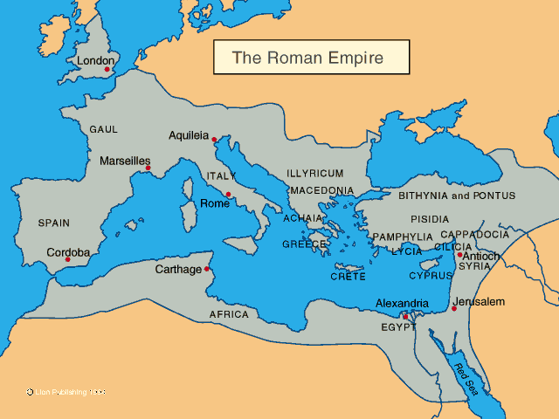

Slide 131
Chapter Fifteen
Personal Matters
I strived to preach where Christ was not named
They that have not heard shall understand (Isa. 52:15)
This is the cause for my delay in coming to you
Having not more place to go

Slide 132
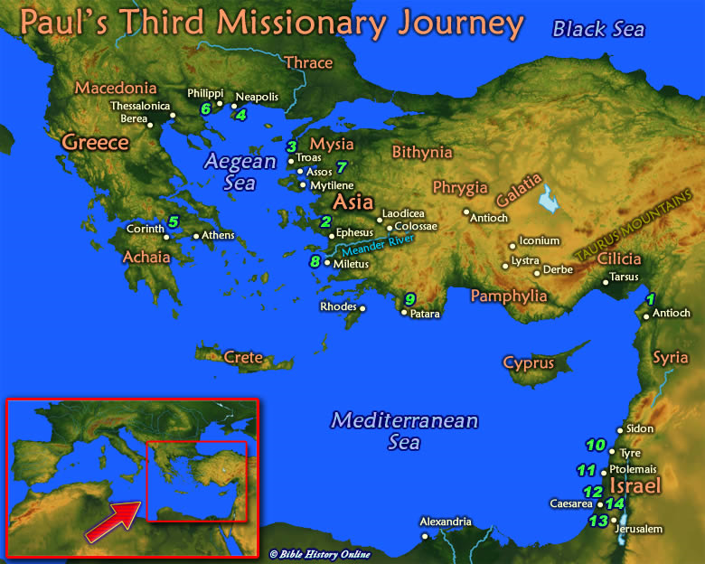

Slide 133
Chapter Fifteen
Personal Matters
When I go to Spain, I will come to you
But now I go to Jerusalem
It pleased those of Macedonia and Ahaia to give to the poor saints in Jerusalem

Slide 134
Chapter Fifteen
Personal Matters
If the Gentiles have partook of spiritual things, they should help with carnal things
I will come by here on my way to Spain

Slide 135
Chapter Fifteen
Personal Matters
I will come in the fulness of the Gospel
Pray to God for me
That I may be delivered
That I may come in joy
God be with you all

Slide 136
Chapter Sixteen
The power of the Gospel (Rom. 16:25)

Slide 137
Chapter Sixteen
I commend unto you Phebe
Receive her in the Lord
Greet Priscilla and Aquila
They laid down their own necks
Greet the church in their house

Slide 138
Chapter Sixteen
Greet Mary
Salute Andronicus
Greet Amplias
Salute Urbane
Salute Apelles
Salute Herodian

Slide 139
Chapter Sixteen
Salute Tryphena
Salute Rufus
Salute Asyncritus
Salute Philologus
Salute one another with a holy kiss

Slide 140
Chapter Sixteen
17. Mark those which cause division
18. They serve their own belly
19. Your obedience is know abroad
20. God shall bruise satan under your feet

Slide 141
Chapter Sixteen
Timothy sends greetings
Tertius greets you
Gaius greets you
Grace be with you all

Slide 142
Chapter Sixteen
To the One Who can make you strong
The mystery is now revealed
To God only wise, be glory through Jesus Christ

