Slide 1
kc

Slide 3
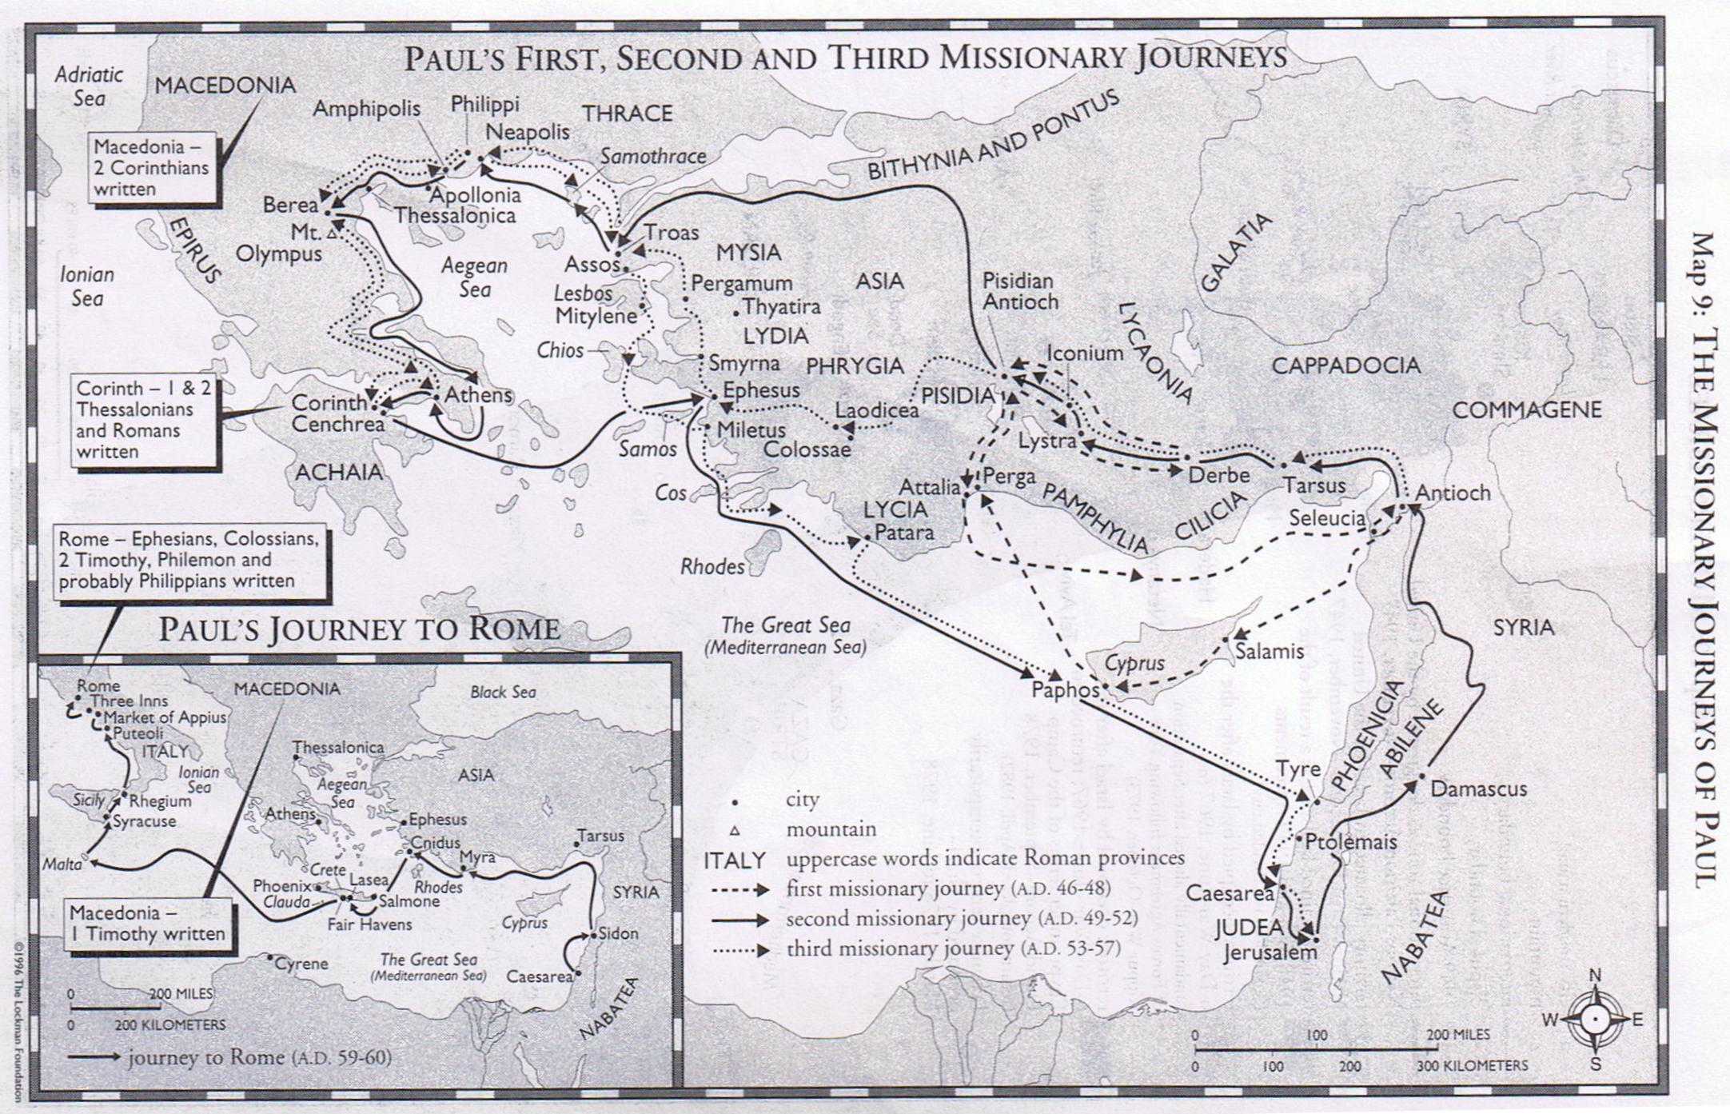

Slide 4
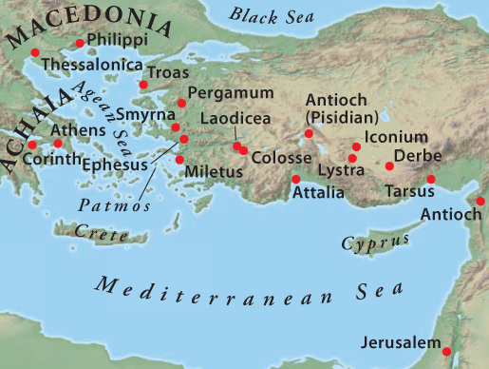

Slide 5
Colossians “Christ and the Church”

Slide 6
Colossians Theme of the Book: “…ye are complete in him…” (2:10)

Slide 7
Colossians Introduction
A prison epistle along with Ephesians, Philippians and Philemon
This letter was written around 62-63 AD
The congregation was not established by Paul (Col. 2:1)
Epaphras more than likely established the congregation (Col. 1:7)

Slide 8
Colossians Introduction
Reasons for writing the letter:
The Colossian Heresy
Gnosticism

Slide 9
Colossians Introduction
Reasons for writing the letter:
The Colossian Heresy
This doctrine is obscure. It apparently attacked, in some way, the supremacy of Jesus
Col. 1:15-19
Col. 2:9-10

Slide 10
Colossians Introduction
Reasons for writing the letter:
Gnosticism
This doctrine was still very young at this time. It came to maturity in the 2nd Century. It held that the spirit was good, but the flesh was inherently evil. Its aim was to release the spirit from the evil body (Col. 2:18)

Slide 12
Colossians Introduction
Outline:
Introductory Matters (1:1-12)
Doctrinal Matters (1:13-2:3)
Polemical Stance (2:4-3:4)
Practical Application (3:5-4:6)
Personal Notes (4:7-18)

Slide 13
Colossians
Chapter One:
Paul and Timothy
To the saints in Colosse
We thank God for you
Since we heard of your faith
The hope which you have in the Gospel

Slide 14
Colossians Theme of the Book: “…ye are complete in him…” (2:10)

Slide 15
Colossians
Chapter One:
Which has come to you and bears fruit
Ye learned from Epaphras
Who declared to us your love
We do not cease to pray for you
That you might walk worthy

Slide 16
Colossians
Chapter One:
Strengthened with all might, according to his glorious power
Giving thanks to the Father, who made us to be partakers of the inheritance
Who delivered us from the power of darkness
Redemption in the Son
Who is the image of the invisible God

Slide 17
Colossians
Chapter One:
For by him are all things created
He is before all things
He is the head of the body, the church
In him all fullness dwells
Peace through his blood

Slide 18
Colossians
Chapter One
Now hath he reconciled
To present you holy
Ground and settled
For his body sake
I am made a minister

Slide 19
Colossians
Chapter One
Even the mystery
God would make known the mystery
We preach Jesus
Whereunto I labor

Slide 20
Colossians Theme of the Book: “…ye are complete in him…” (2:10)

Slide 21
Colossians
Chapter Two
The great conflict Paul has
That their hearts might be comforted
Of Christ, in whom are hid all the treasure
Lest any man should beguile you
Beholding your order

Slide 22
Colossians
Chapter Two
Walk ye in the Lord
Rooted and built up in him
Beware lest any man spoil you through …the tradition of men
In Christ dwells all the fulness of the Godhead bodily
Ye are complete in him

Slide 23
Colossians
Chapter Two
Circumcised without hands
Buried with him in baptism
God has forgiven us our trespasses
Blotting out the handwriting of ordinances that was against us
Having spoiled principalities and powers

Slide 24
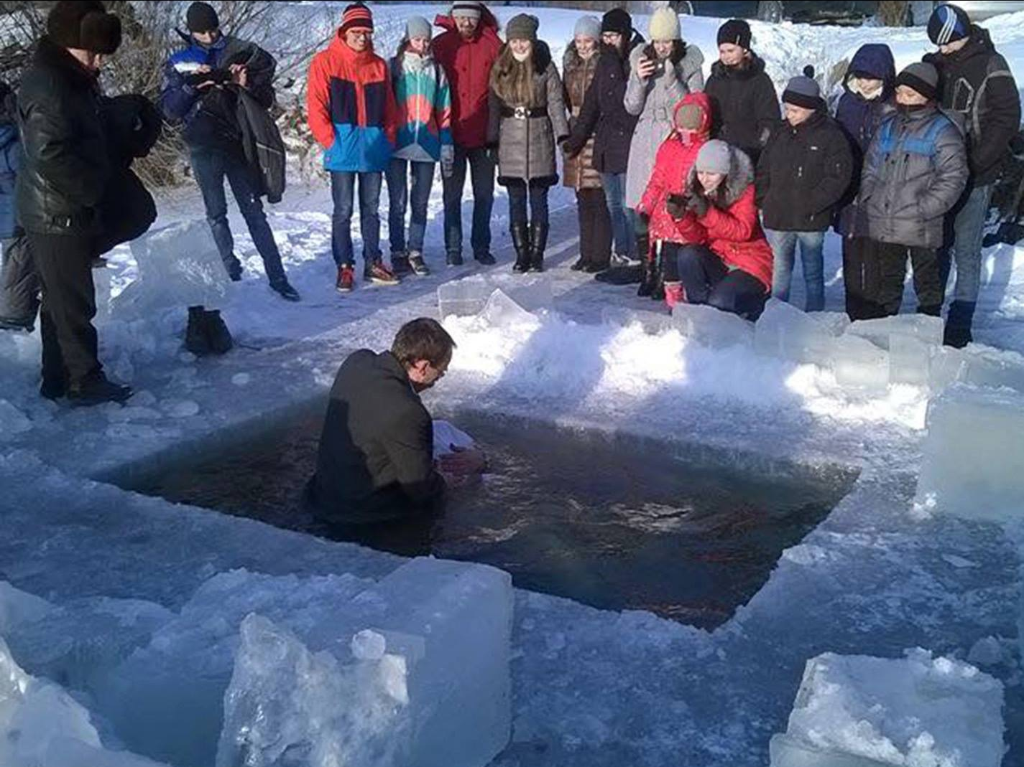

Slide 25
Colossians
Chapter Two
Let no man judge you in meat or drink, holyday, new moon (Num. 28:11), or sabbath (Ex. 20:8)
Which are a shadow of things to come
Let no man beguile you
And not holding the Head
We are dead from the rudiments of the world

Slide 26
Colossians
Chapter Two
2:18 “Let no man beguile you of your reward in a voluntary humility and worshipping of angels, intruding into those things which he hath not seen, vainly puffed up by his fleshly mind.” KJV

Slide 27
Colossians
Chapter Two
2:18 “Do not let anyone who delights in false humility and the worship of angels disqualify you for the prize. Such a person goes into great detail about what he has seen, and his unspiritual mind puffs him up with idle notions.” NIV

Slide 28
Colossians
Chapter Two
2:18 “Let no one disqualify you, insisting on asceticism and worship of angels, going on in detail about visions, puffed up without reason by his sensuous mind.” ESV

Slide 29
Colossians
Chapter Two
Touch not, taste not, handle not
Which perish with using
Which have a “show” of wisdom in will worship (self made religion ESV)

Slide 30
Colossians Chapter Three

Slide 31
Colossians
Chapter Three
Risen with Christ
Set your affection on things above
For ye are dead
Christ, who is our life
Mortify there your members which are upon the earth

Slide 32
Colossians
Chapter Three
For those things bring the wrath of God
In which you also walked
But now you put off those things
Lie not one to another
Put on the new man

Slide 33
Colossians
Chapter Three
Where there is neither Jew nor Greek
Put on therefore bowels of mercies
Forbearing and forgiving
Above all these put on love
Let the peace of God rule in your hearts

Slide 34
Colossians
Chapter Three
Let the Word of Christ dwell in you
Do all in the name of the Lord
Wives, submit to your own husbands
Husbands, love your wives
Children obey you parents

Slide 35
Colossians
Chapter Three
Fathers, do not provoke your children
Servants, obey your masters
Whatever you do, do it heartily
You will receive your reward
There is no respect of persons with God

Slide 36
Is Genesis History?
HOSTED BY DEL TACKETT
CREATOR OF "THE TRUTH PROJECT"
IN THEATERS FEBRUARY 23 ONLY

Slide 37
Colossians Chapter Four

Slide 38
Colossians
Chapter Four
Give your servants what is just and equal
Continue in prayer
Pray for us
That I may speak clearly
Walk in wisdom to those who are not Christians
Let your speech be seasoned

Slide 39
Colossians
Chapter Four: Final Greetings
Tychicus will tell you how I’m doing
He will also inform me of your affairs
Onesimus will also be there
Marcus will also be with him
Justus will also come with him

Slide 40
Colossians
Chapter Four: Final Greetings
Epaphras, whom you know, will come
He has a great zeal for you
Luke and Demas greet you
Greet the brethren in Laodicea
Send this letter on to Laodicea
Tell Archippus to keep his commitment
Written by my hand, Paul

