Slide 1
kc

Slide 2
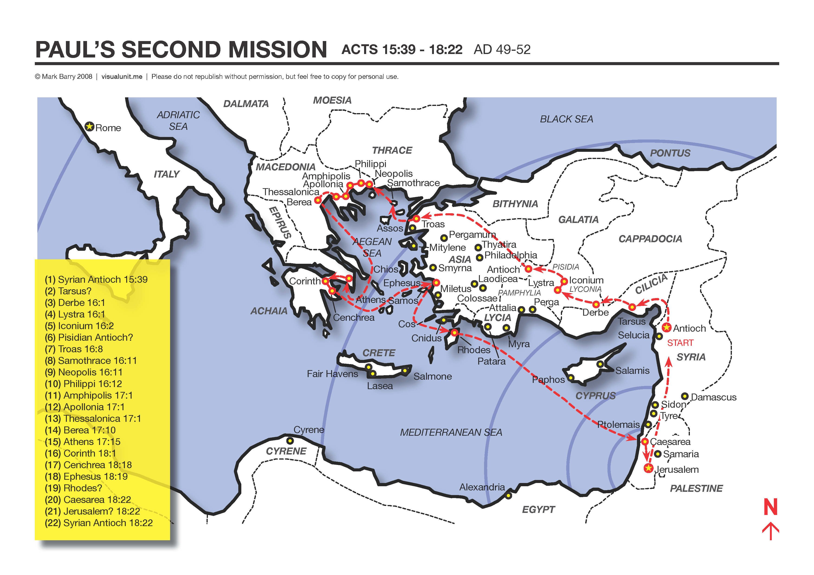

Slide 3
PHILIPPIANS
REJOICE!

Slide 4
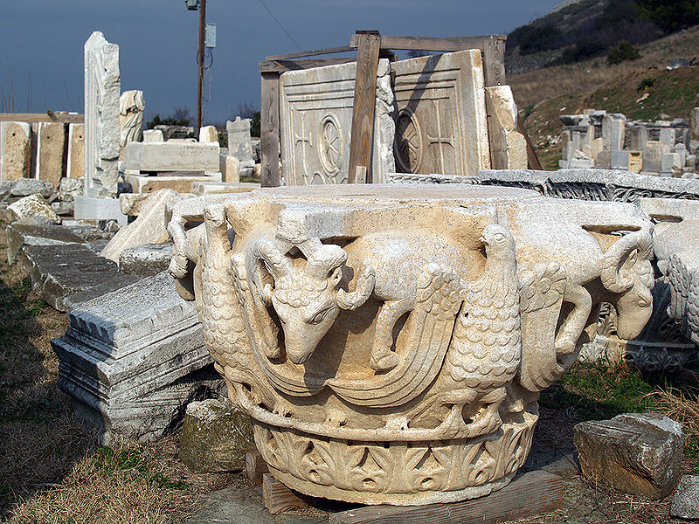
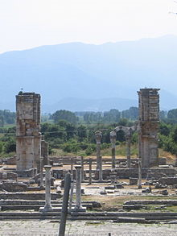
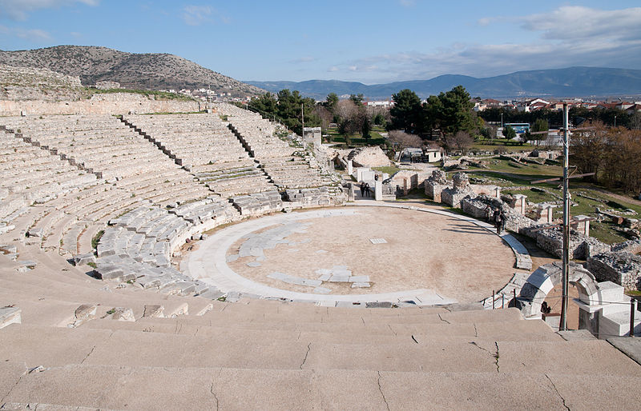

Slide 5
INTRODUCTION:
The city of Philippi was one of the major cities of Macedonia (Acts 16:12). It was located in Northern Greece near the seacoast, some 8 or 10 miles from the port of Neapolis. The location of the city was on the road from Europe to Asia and this made it a strategic location for preaching the gospel. Paul generally selected such sites for the beginning of his work.

Slide 6
INTRODUCTION:
Philip of Macedon, father of Alexander the Great, who assumed the throne in 360 B.C., conquered the town of Krenides, introduced colonists into the city and renamed it Philippi after himself. The province of Macedonia was later captured by the Romans and divided into four districts. The battle of Philippi in 42 B.C. was one of the decisive battles in history.

Slide 7
INTRODUCTION:
Here at Philippi, Mark Antony and Octavian defeated Brutus and Cassius and decided the future history of the Roman empire. After Philippi became a Roman colony Latin became the language of the people and Roman coins, laws and customs prevailed (Acts 16:20,21). The city flourished under Roman rule.

Slide 8
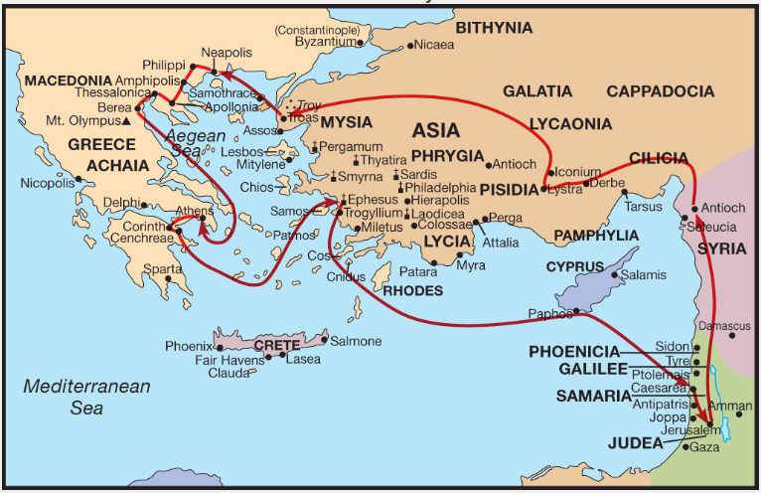

Slide 9
INTRODUCTION:
Only a few Jews lived in Philippi and there was no synagogue there (Acts 16:13). There was a school of medicine in the city. Luke the physician may have lived there. Only the ruins of the city remain today.
Paul first came to Philippi around 52 A.D. during his second missionary journey.

Slide 10
INTRODUCTION:
In 30 B. C., Octavian made the city a Roman colony where retired soldiers could live and enjoy the privileges of full Roman citizenship. Paul may have referenced this is in Chapter 3 and verse 20, “For our conversation (citizenship) is in heaven; from whence also we look for the Saviour, the Lord Jesus Christ.”

Slide 11
INTRODUCTION:
TIME OF WRITING:
This letter is one of four that Paul wrote while he was imprisoned in Rome. The other three letters written at this time were Colossians, Ephesians, and Philemon. That would place the time of writing around 62-63 A. D. and they would have been written in Rome.

Slide 12
INTRODUCTION:
Acts 16 relates the account of this visit. It was the first city in Europe where Paul preached
During his third missionary journey, Paul visited Philippi again, as well as other churches of Macedonia. This took place about five years after the first visit.

Slide 13
INTRODUCTION:
THEME OF THE BOOK:
The letters seems to be stressing the thought that Christians should be living a life of joy. The key word in the book seems to be joy. This word is used repeatedly to describe the life of a Christian. Paul encourages us that we can do all things through Christ, who strengthens us (Phil. 4:13).

Slide 14
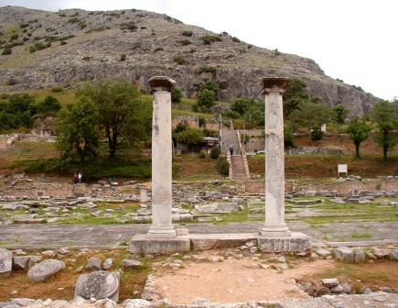
Philippians
Joy in the Journey

Slide 15
Philippians
INTRODUCTION (1-11)
1. SALUTATION (1-2)
1. From Paul and Timothy, servants of Jesus Christ (1)
2. To the saints in Christ Jesus who in Philippi, with the bishops and deacons (1)
3. Grace and peace from God and Jesus Christ (2)

Slide 16
Philippians
PAUL'S THANKSGIVING AND PRAYER (3-11)
  Paul thanks God for them (3-8)
  He always remembered them with joy (3-4)
  For their fellowship in the gospel from the beginning (5)

Slide 17
Philippians
4. He is confident that God will complete the work begun in them. He reminds them that he is set to defend the Gospel (6-7)
5. Paul longs for them as fellow saints (8)
6. He prays that their love may abound (9-11)

Slide 18
Paul’s bonds in Rome (12-26)
Those things that happened to Paul lead to and even greater spreading of the Gospel
Paul’s bonds are clear throughout the palace
This caused others to be even bolder
Some preach Christ out of even and strife; while some preach Christ because of their love for the Gospel

Slide 19
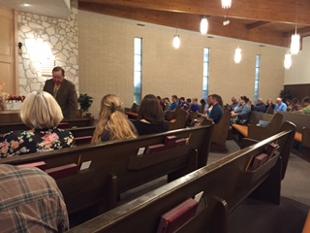

Slide 20
Paul’s bonds in Rome (12-26)
One preaches Christ out of contention and others hope to add to Paul’s afflictions
Some preach out of love knowing that Paul is ready to defend the Gospel
Paul rejoices whenever the TRUTH is preached even if for the wrong reasons
Their prayers help Paul in his quest for salvation

Slide 21
Paul’s bonds in Rome (12-26)
Everything Paul does is for the magnification of Jesus
For to me to live is Christ and to die is gain
If Paul lives, it will help the Philippians as well as others
His choice is difficult

Slide 22
Encouraged to stand (27-30)
Let your life style enhance the Gospel
Do not allow the adversary to intimidate us
We must suffer for Christ’s sake
They saw Paul’s suffering and know they that will suffer as well

Slide 23
Philippians
Joy in the Journey
Chapter Two

Slide 24
Chapter 2: the mind of Christ
If there is any consolation (encouragement) in Christ
Fulfil my joy by being likeminded
Let nothing be done through strife
Don’t look after just yourself, but on everyone else
Have the mind of Christ

Slide 25
Chapter 2: the mind of Christ
Who thought being equal with God was not worth clinging to
He came in the form of man, even the servant of men
He humbled Himself by dying on the cross
God has highly exalted Him
At the name of Jesus every knee will bend

Slide 26
Chapter 2: the mind of Christ
Every tongue will confess that Jesus is Lord
Continue to obey even in my absence
For God is working in you, so work out your own salvation
Do all things without murmuring
That you may be the sons of God

Slide 27
Chapter 2: the mind of Christ
Holding forth the word of Christ
If I be offered (poured out like a drink offering)
Rejoice with me
I plan to send Timothy to you
For he is like me in mind

Slide 28
Chapter 2: the mind of Christ
For all seek their own
He has served with me in the Gospel
As soon as I know my own state
I plan to come shortly as well
It was necessary to send Epaphroditus

Slide 29
Chapter 2: the mind of Christ
He wanted to be there, especially when you heard he was sick
In fact, he nearly died
I sent him eagerly
Receive him with gladness
Because of his work for the Lord, he almost died

Slide 30
Philippians
Joy in the Journey
Chapter Three
Righteousness through the faith

Slide 31
Chapter 3: Righteousness
I am writing the same thing to you, this is safe for you and no trouble for me
Beware of dogs, beware of evil workers, beware of the concision (to mutilate the flesh)
Christians are the true circumcision
Paul’s resume in the flesh
Circumcised on the eighth day

Slide 32
Chapter 3: Righteousness
Concerning the righteousness by the law: blameless
I counted all these lost for Christ’s sake
I count all things as nothing but dung
To win Christ and be found in Him
That I may know Him

Slide 33
Chapter 3: Righteousness
So that I might gain the resurrection of the dead
Not as though I had already attained
Forget those things that are behind
I press toward the mark for the prize
Let everyone be thus minded
Let us walk by the same rule

Slide 34
Chapter 3: Righteousness
Mark those who are thus walking
Some walk as enemies of Christ
Whose end is destruction
For our life is in heaven
Christ will change our vile body to be fashioned as His glorious body

Slide 35
Philippians
Joy in the Journey
Chapter Four
Rejoice in the Lord

Slide 36
Chapter 4: Rejoice!
My joy and my crown
I beg Euodias (fine travelling) and Syntyche (an accident) to be of the same mind
He entreats Epaphroditus and others to help these ladies
Rejoice in the Lord
Let your moderation (gentleness) be known

Slide 37
Chapter 4: Rejoice!
Be anxious in nothing
Let the peace of God guard you
Whatsoever things are true, etc
Those things you have seen in Paul
I know you wanted to help, but didn’t have the opportunity
I have learned to be content, no matter what state I’m in

Slide 38
Chapter 4: Rejoice!
I know how to be abased and to abound
I can do all things through Christ who strengthens me
You have done well
No one has helped like you have
Even while I was in Thessalonica you helped over and over
Not that I desire a gift, but fruit may abound to your account

Slide 39
Chapter 4: Rejoice!
Your gift was received and deep appreciated by both me and by God
God shall provide
Unto God be glory forever
Salute (to hug) every saint
All the saints (hug) you
The Lord’s grace be with you all. AMEN

